Slide 1
Future
Particle Colliders
CBB Symposium 2017
Cornell University
June 6, 2017
Ferdinand Willeke
BNL

Slide 2
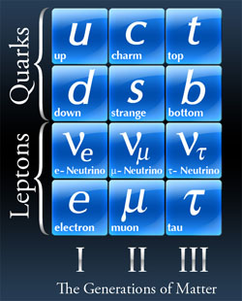
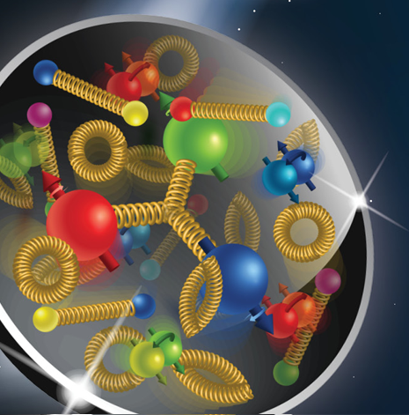

Outline
Energy frontier colliders
Luminosity frontier colliders
Lepton-hadron colliders
Key technologies
Electron-ion collider
JLEIC
eRHIC
WHY?

Slide 3
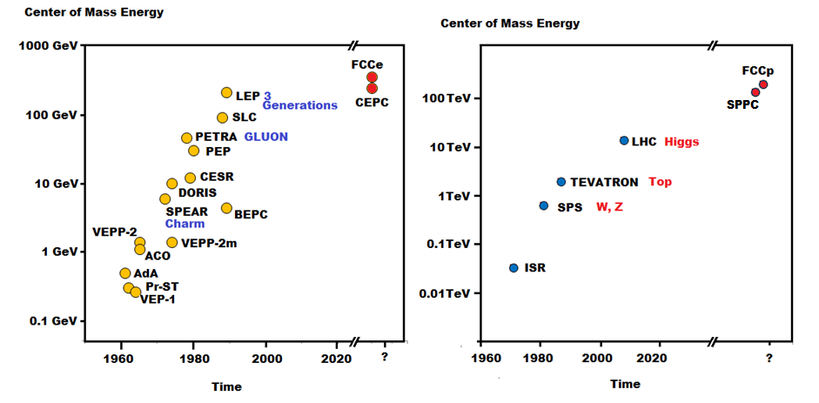
Colliders, engines of discovery
Time charts of energy frontier colliders

Slide 4
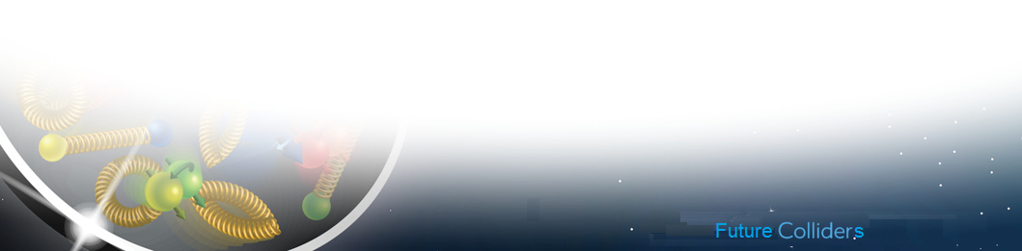
Energy Frontier Motivation
With discovery of the Higgs boson, the standard model is complete
but it does not to describe:
evidence for dark matter
prevalence of matter over antimatter
the neutrino masses
➔ New Physics required to move forward
Energy Frontier:
Answers via observation of new particles
➔ need factor ~ 10 in energy for discovery potential for new (supersymmetric?, new bosons?) particles up to a mass of 30 TeV
➔ Need ultra-high energy proton-proton collisions with E_{cm} = 100 TeV
for discovery of new particles need high luminosity, required L ~ E² if M ~ E_{cm}
Luminosity frontier
Energy Frontier
FCC

Slide 5
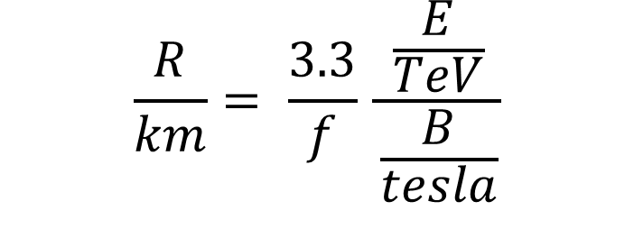
Technology Challenges
$$\frac{R}{km}= \frac{3.3}{f} \frac{\frac{E}{TeV}}{\frac{B}{tesla}}$$
f: fraction of the arc length occupied by the dipoles
© G. Sabbi, LBNL, Berkeley, IPAC2013
Very large accelerator circumference ~ up to 100 km
Very large magnetic field, B= 15-20 T, beyond the state of the art
Emphasis on Magnet Technology

Slide 6
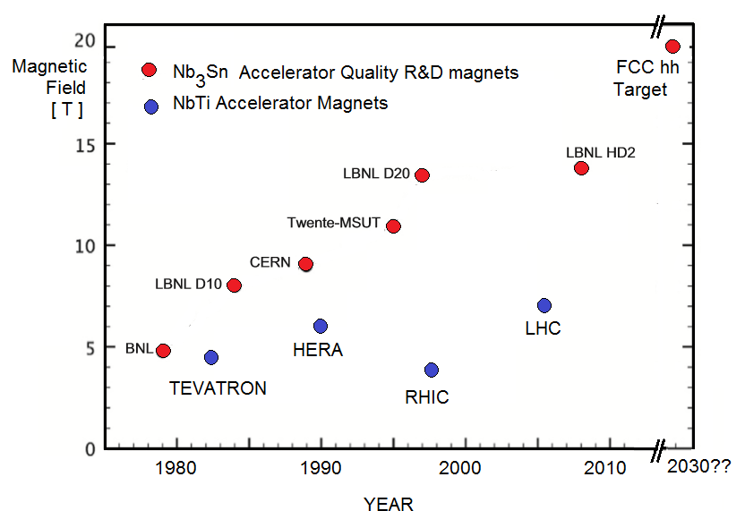
Progress in Nb₃Sn magnet technologies
2K

Slide 7
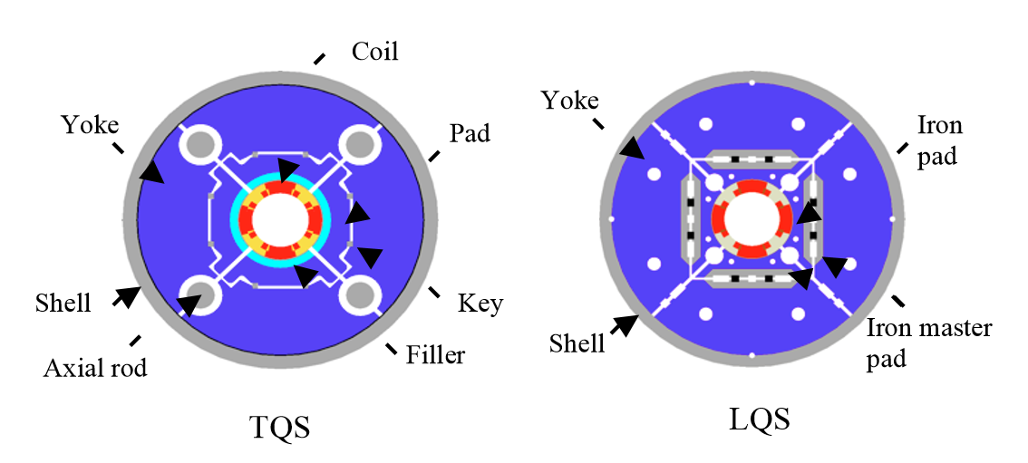
Low-β Nb₃Sn quadrupole magnets for LHC luminosity upgrade
Good progress made with Nb3Sn technology on with the LARP program on LHC luminosity upgrade.
Target Performance ranges up to 200 T/m at a rather large bore of 90 mm
Winding techniques have been developed to handle the subtle material (pre-cure – wind - activate) which led to good results
Required field quality, maximum field, quench behavior reasonable mechanical coil stability
close to maturity required for final production
LARP Nb3Sn quadrupole models: TQC (left), TQS (center), HQ (right)

Slide 8
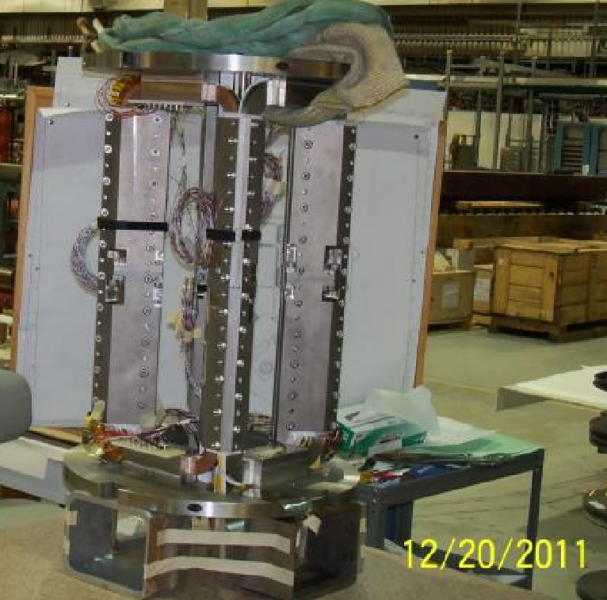
HTS Magnet Technology
Bi or Y componds
Bi2Sr₂CaCu₂O_{x} is a power, needs 900 C sintering
Critical Current density not sensitive to increasing magnetic field
and temperature
➔ very promising for very high field magnets
However
Material is anisotropic
Extremely difficult to handle and wind
Technology applied for conductors and coils with simple geometry (for example solenoids) so far
Technology not ready for high quality accelerator magnet coils
Simple Magnet with
Racetrack HTS coils, Magnet for FRIB (YBCO)

Slide 9
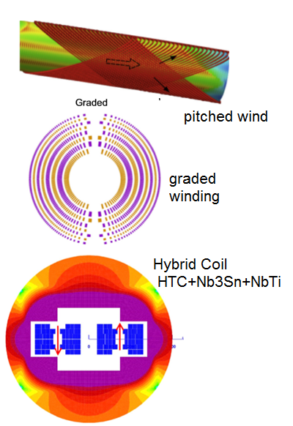
Novel Magnet Coil Concepts
Canted Coil winding
(cos(theta) like with simple conductor geometry)
Grading coil: increase current density
at outer layers since the field is lower
Hybrid coils made of (from inside to outside)
HTC, Nb₃Sn, Nb Ti exploiting the fortes of
Each material
Advanced Coil Stress management
by azimuthal conduct support
Stress <200 Mpa
Canted winding
© W. Barletta et al. / Nuclear Instruments and Methods in Physics Research A 764 (2014) 352–36

Slide 10
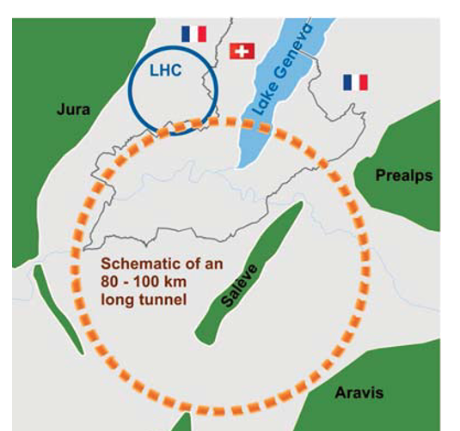
FCC
Large accelerator near Geneva CH
with
Circumference: 100 km
Superconducting dipoles ~15-20T
with advanced magnet technology
Developed at CERN
Similar project discussed to
be built in North-East China (CEPC)
Three stages:
e+-e- Collider FCC-ee
E_{cm} ≤ 350 GeV head-on L=2∙10³⁴cm⁻²s⁻¹, 50 MW synchrotron radiation power
Maximum luminosity @ 90GeV c.m. L=2.2∙10³⁶cm⁻²s⁻¹
Energy loss per turn up to 0.14%
Proton-proton collider FCC-hh
E_{cm} ≤ 100 TeV 74 μr cross angle L=5∙10³⁴cm⁻²s⁻¹, 2.4 MW synchrotron radiation
Electron Hadron Collider E_{cm} ~5 TeV

Slide 11
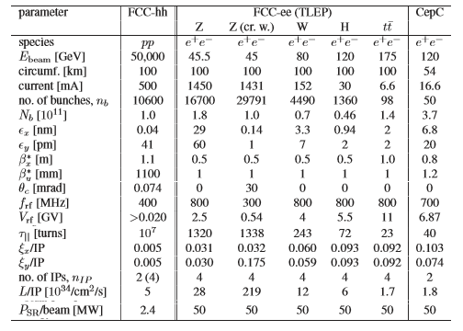
© Frank Zimmermann, IPAC 2014, Dresden

Slide 12
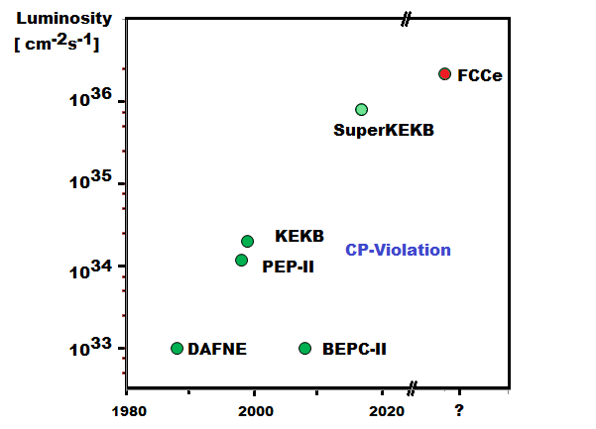
Luminosity Frontier Colliders

Slide 13
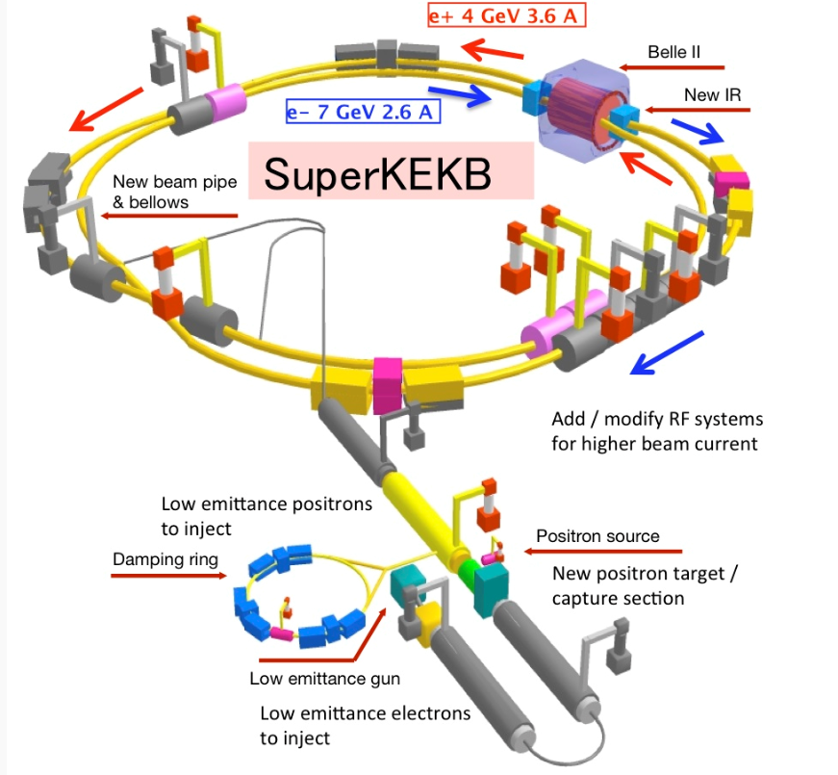
SuperKEKB
Successor and upgrade of very successful KEB asymmetric collider
Two rings in the TRISTAN tunnel LER (4GeV e+) and HER (7GeV e-)
Physics Motivation: High precision tests of Standard Model
Questions to be answered:
Why 3 generations?,
Does nature have multiple Higgs bosons?
Why is CKM so symmetric? unknown flavor symmetry?
Any glue to matter-antimatter asymmetry?
Are there new CP violating phases?
Are there right-handed currents from New Physics?
Are there quark flavor changing neutral currents?
➔ Study rare processes Ψ(1s)−Ψ(5s), Β_{s}∗ ⎝ Need very large Luminosity
Need ∫dtL = 10 ab⁻¹ ➔ Peak Luminosity L_{peak} = 8∙10³⁵ cm⁻²s⁻¹

Slide 14
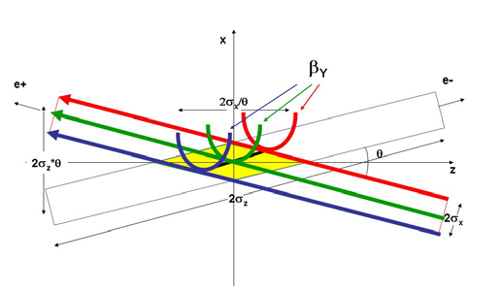
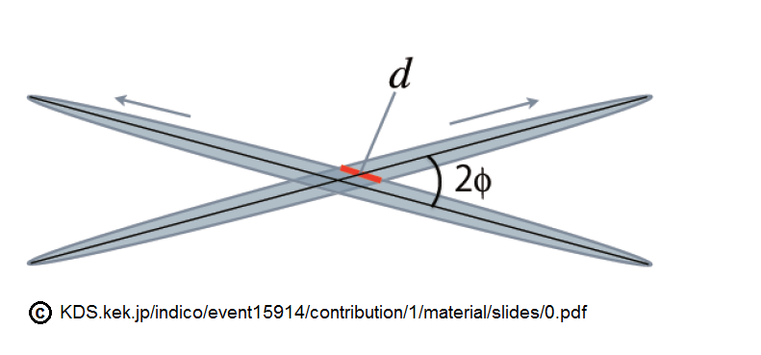
Extremely High Luminosity
Nanobunch Scheme (P. Raimundi, 2nd SuperB Workshop, Frascati, 2006)
Very flat beams by tiny vertical emittance (~10 pm) and vertical beta (0.3 mm)
Large crossing angle (83 mrad)
- Horizontal Crossing angle reduces luminosity, but more so beam-beam tune-shift
- Recovering max tune shift by large intensity, small beam size to ξ_{x,y,l,h} = 0.09
- largely overcompensates Luminosity reduction➔ large luminosity enhancement
- Usual vertical hourglass effect (@ β<σ) not relevant at large crossing angle
(short effective interaction length)
- modulation of bb effect by crossing angle compensated by crab-waist scheme
(shifting the vertical waist point as a function of x and s with sextupole magnets)
Lowβ quad: k∙y ➔ k ∙ y+ (m ∙ x) ∙ y

Slide 15
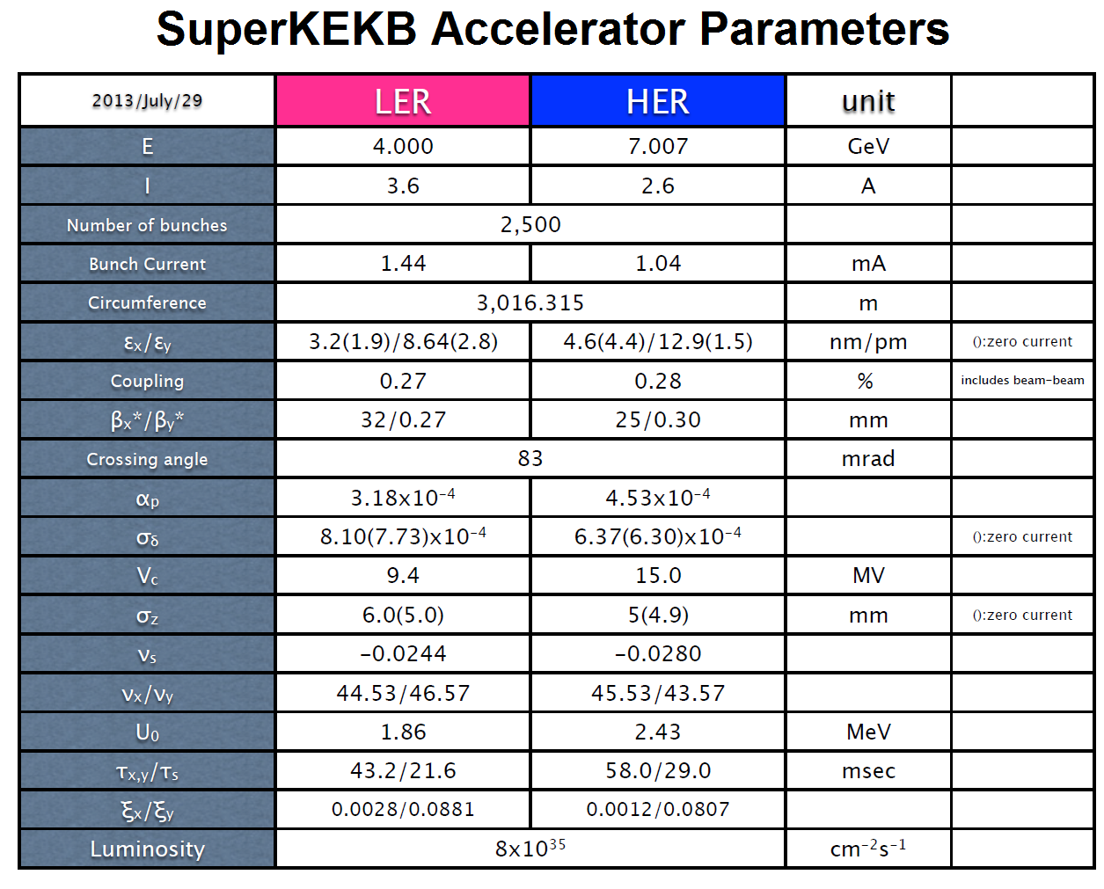

© http://www-superkekb.kek.jp/documents/MachineParameters150410.pdf

Slide 16
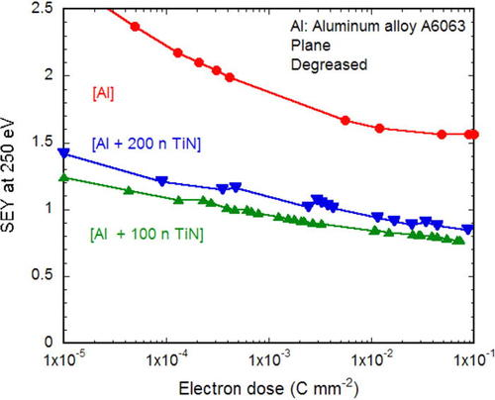
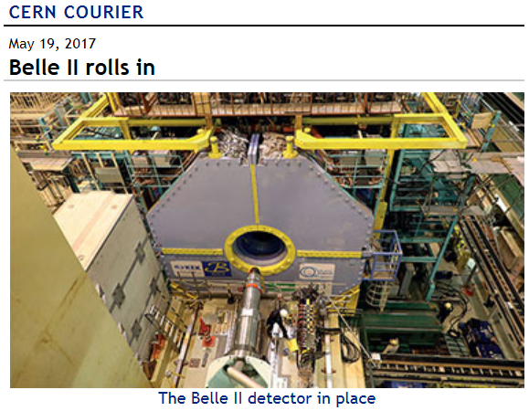
Status SuperKEKB
Three Phase Commissioning
Phase 1 Commissioning (without detector) was completed successfully.
High beam currents were achieved and vacuum system was conditioned
One of the largest issues encountered is the electron cloud effect I the positron ring (LER) for I_{B}>0.6mA which also has a strong impact on beam stability
Phase 2 With Belle 3 Detector (without central tracker) and implemented nano beam scheme
Detector in place, starting up soon
Phase 3 commissioning with full detector (to start 2018)
Slow conditioning of SEY with beam dose

Slide 17
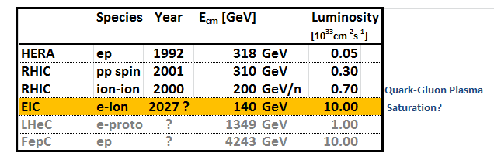
Electron-Hadron Colliders

Slide 18
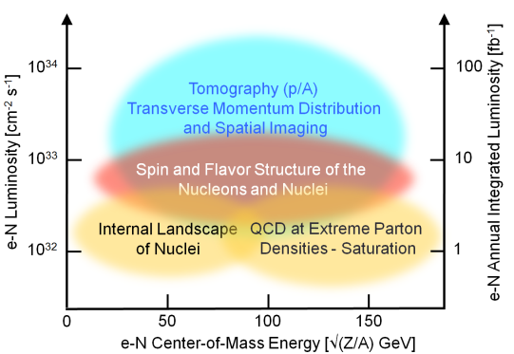

EIC Motivation and Requirements
How is the proton and neutron spin of ½ composed by its constituents?
How are the gluons spatially distributed in the nucleons?
How does the gluon density saturate? (Is this a fundamental phenomenon?)
EIC will provide enhanced access to measurement of nuclear structure (understanding of the “nucleon’s inner landscape”)
Large luminosity L= (10³³ - 10³⁴ ) s⁻¹ cm⁻²
Large center of mass energy, ($2\sqrt{E_{hadron}∙E_{electron}}$ ) (for studying saturation)
Electrons 5-18 GeV; protons 50 GeV to 275 GeV: E_{cm} 100-140 GeV
Large span of ions (from light to heavy)
The two beams must be longitudinally spin polarized in collisions
Large detector acceptance
Based on white paper worked out by NP community (2014/15)

Slide 19
EIC Concepts
e-h Collisions Parameters:
- Hadron collision parameters as in hh collision,
- e collision parameters as in e⁺e⁻ collisions (successful HERA concept)
Crossing Angle Geometry:
- Merge unequal species in IP without synchrotron radiation from electrons
- Large detector acceptance requirements
High Luminosity via small hadron emittance and bunch length
Strong, beyond state of the art hadron cooling required to balance IBS (for L > 10³⁴ cm⁻² s⁻¹)
Spin transparent beam transport, acceleration, storage
Determines choice of the injector, spin rotators, spin matching, possibly snakes or figure 8 geometry
Large to extremely high electron beam currents (up to SUPERKEKB level)
Efficient, low impedance and low HOM s.c. RF

Slide 20
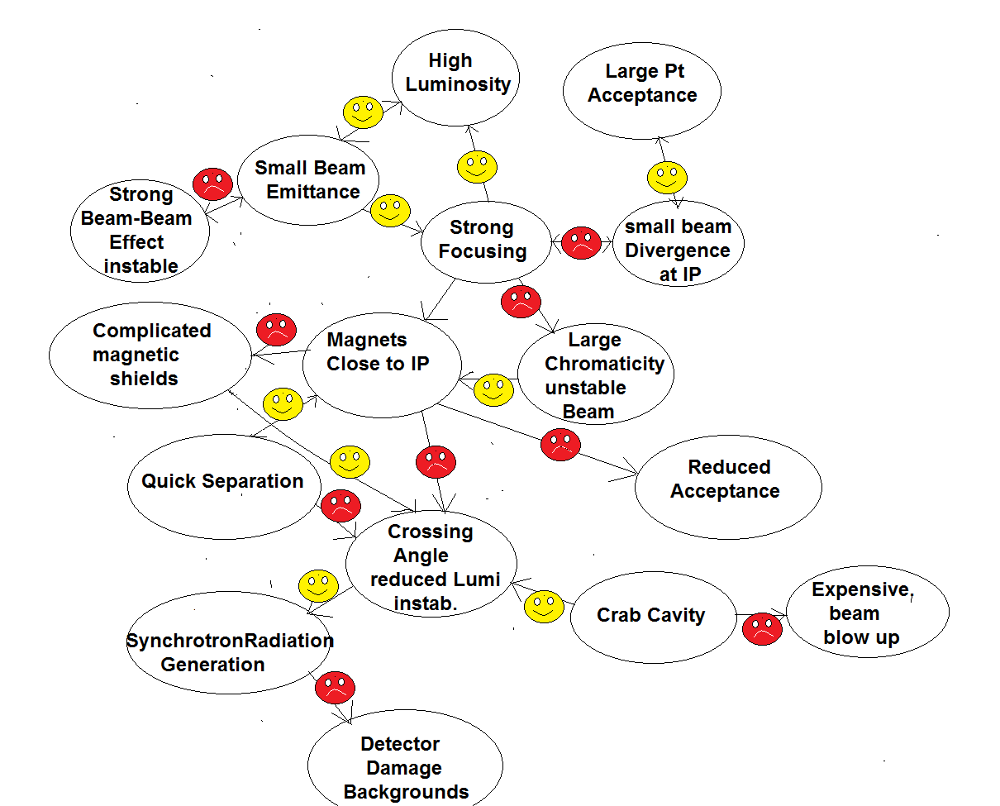
Highly Constraint Interaction Region Design compromising between high luminosity, beam stability, detector acceptance and minimum particle and SR backgrounds

Slide 21
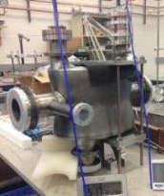
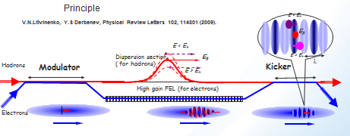
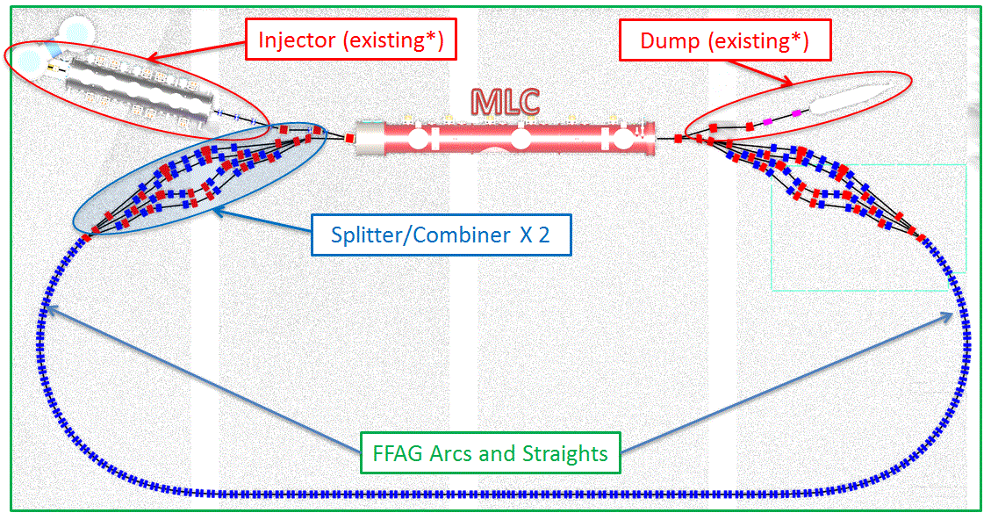
Key Techniques and Technologies
Magnets: Nb₃Sn IR quadrupoles
Superconducting RF: High power variable input/HOM couplers
Crossing angle geometry - crab cavities
Multiple layer beam pipe coating
Sub μm orbit stability
High current/charge polarized electron sources
Novel hadron cooling techniques
FFAG acceleration techniques (conditional, optional)
Polarized, high current/high charge electron sources
Shielded coil s.c. IR quadrupole
DQWL Crab cavity prototype

Slide 22


JLEIC design for an Electron Ion Collider on the JLAB site
8-100 GeV
3-10 GeV
8 GeV
Linac

Slide 23
JLEIC Parameters
CM energy | GeV | 21.9 (low) |  | 44.7 (medium) |  | 63.3 (high)
 |  | p | e | p | e | p | e
Beam energy | GeV | 40 | 3 | 100 | 5 | 100 | 10
Collision frequency | MHz | 476 |  | 476 |  | 476/4=119
Particles per bunch | 10¹⁰ | 0.98 | 3.7 | 0.98 | 3.7 | 3.9 | 3.7
Beam current | A | 0.75 | 2.8 | 0.75 | 2.8 | 0.75 | 0.71
Polarization | % | 80 | 80 | 80 | 80 | 80 | 75
Bunch length, RMS | cm | 3 | 1 | 1 | 1 | 2.2 | 1
Norm. emitt., hor./vert. | μm | 0.3/0.3 | 24/24 | 0.5/0.1 | 54/10.8 | 0.9/0.18 | 432/86.4
Horizontal & vertical β* | cm | 8/8 | 13.5/13.5 | 6/1.2 | 5.1/1 | 10.5/2.1 | 4/0.8
Vert. beam-beam param. |  | 0.015 | 0.092 | 0.015 | 0.068 | 0.008 | 0.034
Laslett tune-shift |  | 0.06 | 7x10⁻⁴ | 0.055 | 6x10⁻⁴ | 0.056 | 7x10⁻⁵
Detector space, up/down | m | 3.6/7 | 3.2/3 | 3.6/7 | 3.2/3 | 3.6/7 | 3.2/3
Hourglass(HG) reduction |  | 1 |  | 0.87 |  | 0.75
Luminosity/IP, w/HG, 10³³ | cm⁻²s⁻¹ | 2.5 |  | 21.4 |  | 5.9

Slide 24
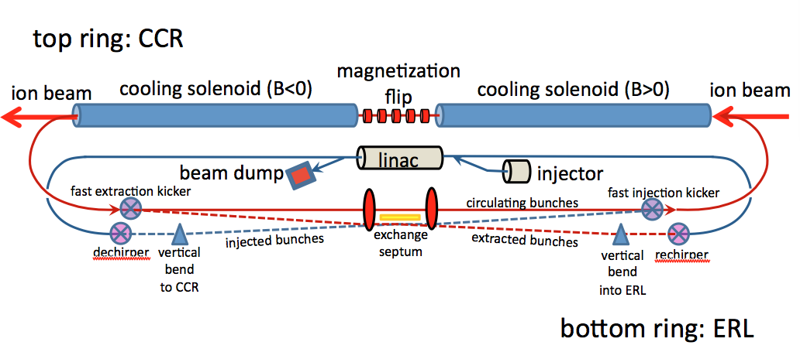
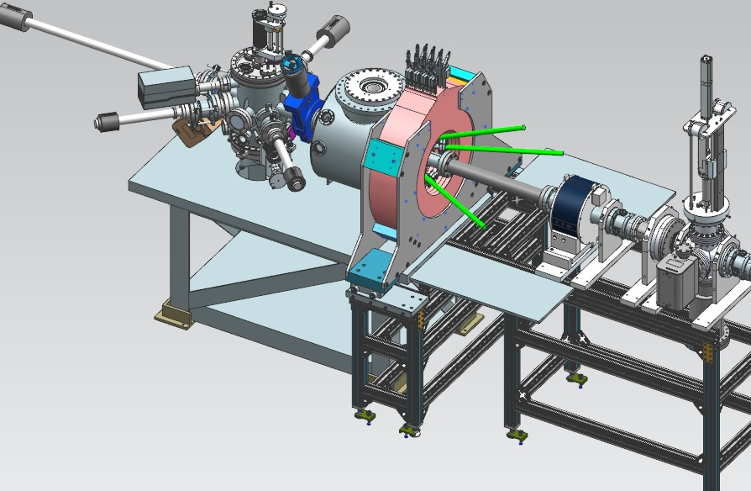
Magnetized cooling for up to 100 GeV hadrons
20 turn
cooler ring, 1.5A
Single turn ERL
75mA
Electron energy | MeV | up to 55
Bunch charge | nC | Up to 3.2
Turns in circulator ring | turn | Up to 20
Current in CCR/ERL | A | 1.5/0.075
Bunch repetition | MHz | 476
Cooling section length | m | 2x30
Cooling solenoid field | T | 1
Magnetized source

Slide 25
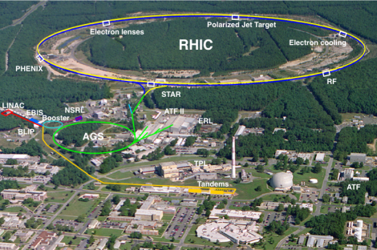
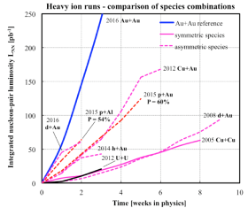
eRHIC uses the Relativistic Heavy Ion Collider RHIC
There will be only relatively small changes to the existing facility and its injector complex; basically same performance parameters are needed
Operating since 1999 with heavy ions and polarized protons
Improving machine luminosity in every run
Unique high energy polarized proton beam collider (60%)
Very successful physics program:
Discovery and detailed study of properties of quark-gluon perfect fluid matter, existing at very origin of the Big Bang
Study of proton spin composition, especially its gluon component
Present plan: to continue A-A and polarized p-p experiments till 2024
Circumference : 3.83 km
Max dipole field : 3.5 T
Energy : 255 GeV p; 100 GeV/n
Species : p to U (incl. asymmetric)
Experiments : STAR, PHENIX

Slide 26
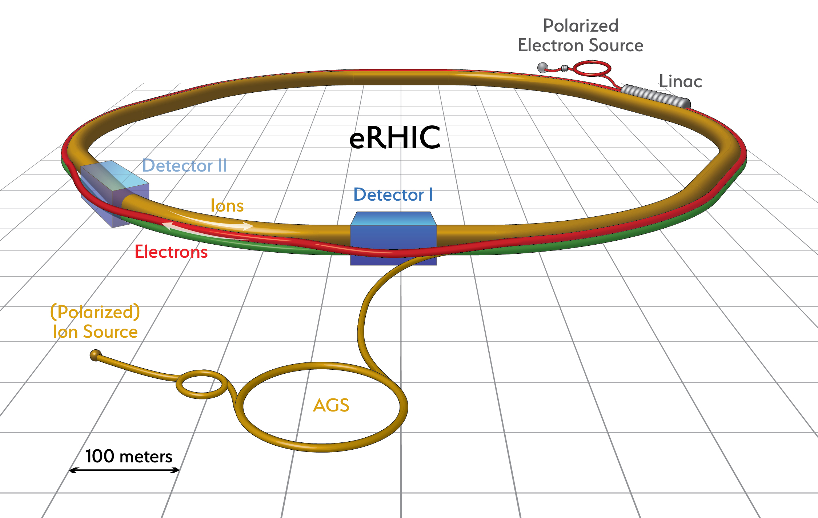
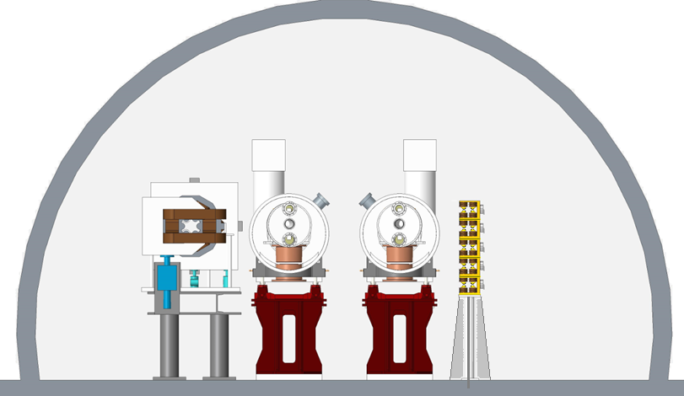
eRHIC: Electron Storage Ring and Electron Accelerator added to the RHIC complex
Designed for Peak Luminosity: $1.1×{10}^{34}{cm}^{−2}\sec^{−1}$

Slide 27
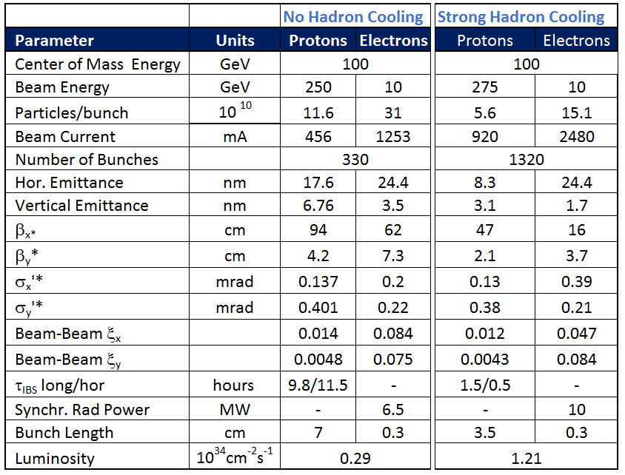
Main Parameters for Maximum Luminosity
E_{p} = 275 GeV, E_{e}= 10 GeV
27

Slide 28
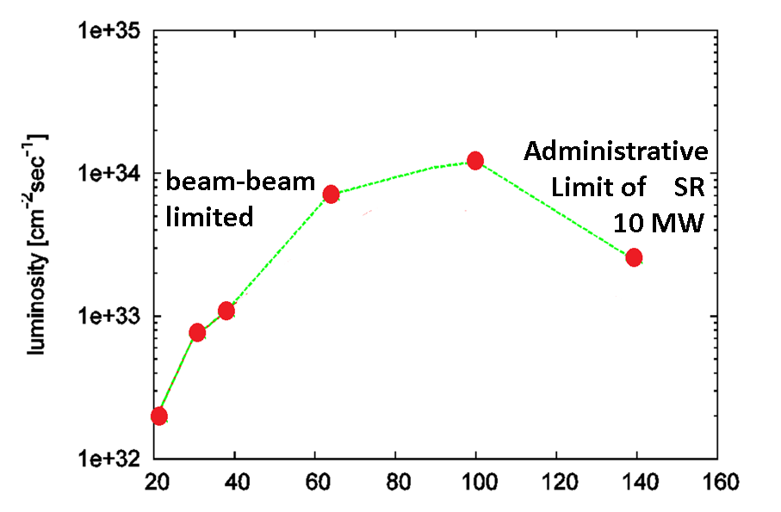
Luminosity vs. Center of Mass Energy
E_{cm} ➔

Slide 29
EIC Interaction Region Layout (note distorted scale)
Interleaved arrangement of electron and hadron quadrupoles
22mrad total crossing angle, using crab cavities
Beam size in crab cavity region independent of energy – crab cavity apertures can be rather small, thus allowing for higher frequency
Forward spectrometer (B0) and Roman Pots (R1-R4) for full acceptance

Slide 30
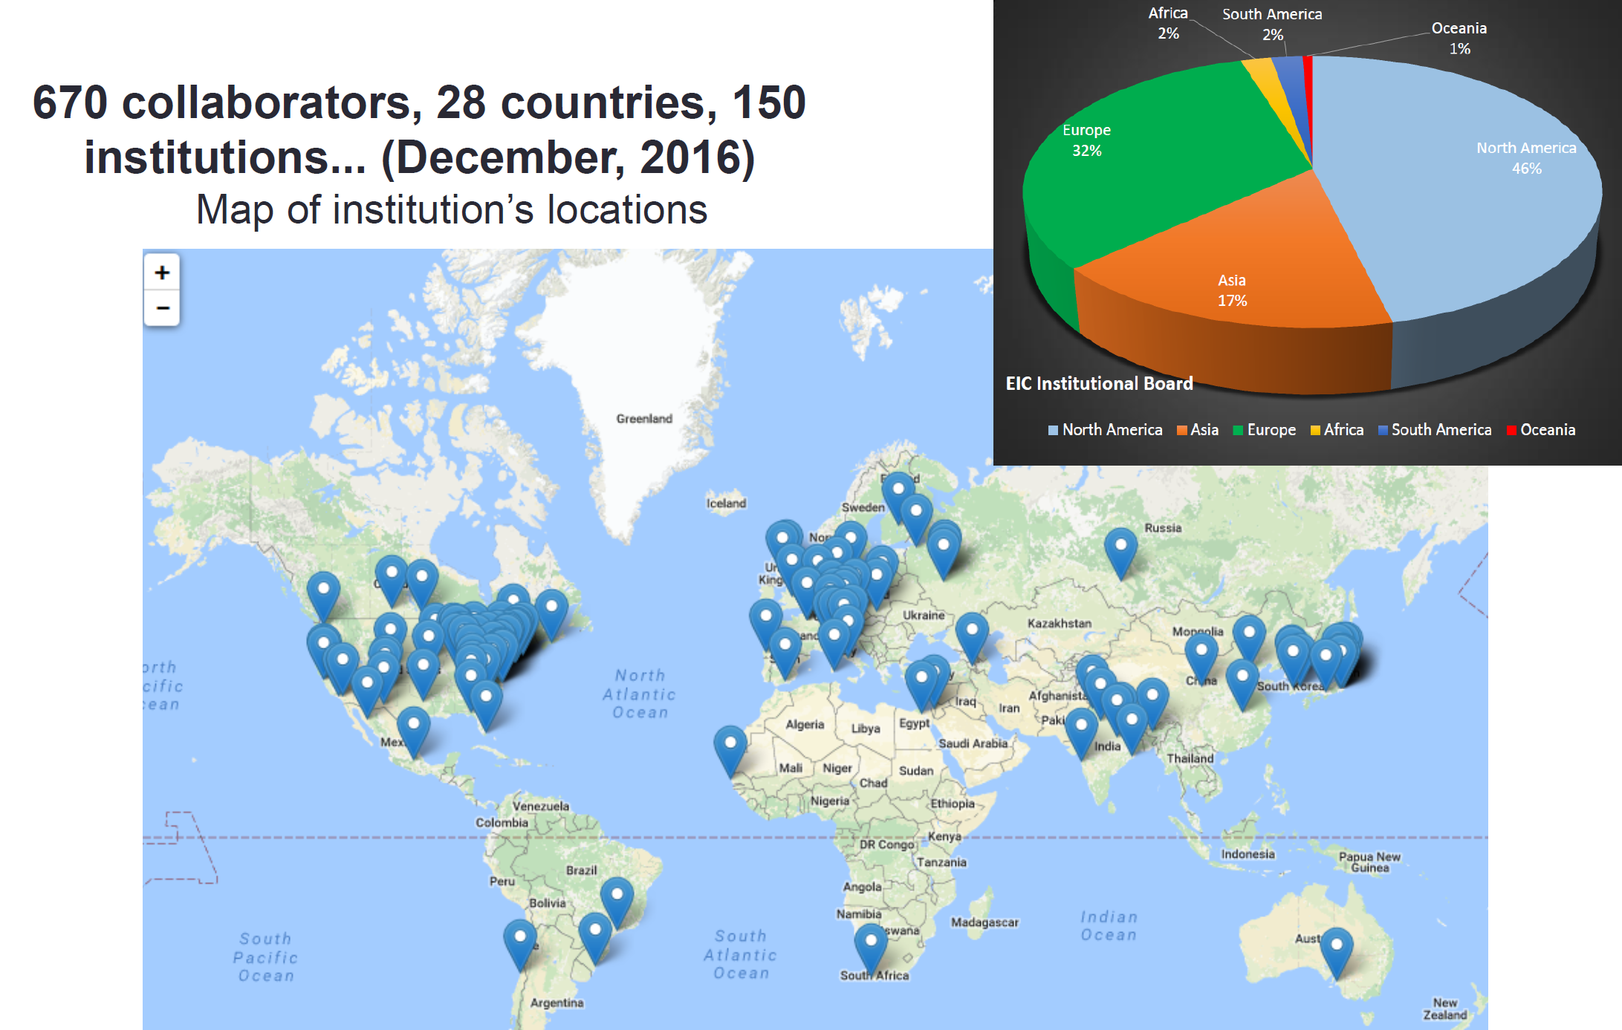
Conclusions
Long Range Plans to challenge the energy frontier
Luminosity frontiers: ongoing with SuperKEKB starting up soon
LeHC is still far future and so is FCCep
Electron Ion Collider is the most likely next large accelerator project in the US
Compelling Designs under development
Strong EIC Community support worldwide

Slide 31
eRHIC Injector Options
Nominal Solution: 6-pass recirculating 3GeV scRF LINAC with 5 x 4 km return loops in the RHIC tunnel: will work, is quite expensive
Low cost alternative: 18 GeV rapid cycling Synchrotron in the RHIC Tunnel, 20 Hz repetition rate, with high lattice symmetry for suppression of depolarizing spin resonances, seems to work but needs more effort to ensure
Low cost alternative: 18 GeV FFAG accelerator in the RHIC tunnel 102 turns, permanent combined function magnets, avoids all depolarizing resonances
needs more spin analysis, Need to wait for success of Cbeta before we can commit

Slide 32
Envisioned EIC Time Line
April 2017 Design Choice Validation Review
2017/18: Work out a pre-conceptual design report
2018: eRHIC Design Review
2019: Mission need acknowledged by DOE, critical decision zero (CD-0)
2019-2021: Conceptual design
incl Evaluation of alternates
2021: CD1: site decision
2021-2022: preliminary design project baseline in scope cost, and schedule scope
2022: CD2
2022-2023- Engineering design (final design)
2023: CD-3 Start Construction
2028 CD-4 Completion

Slide 33
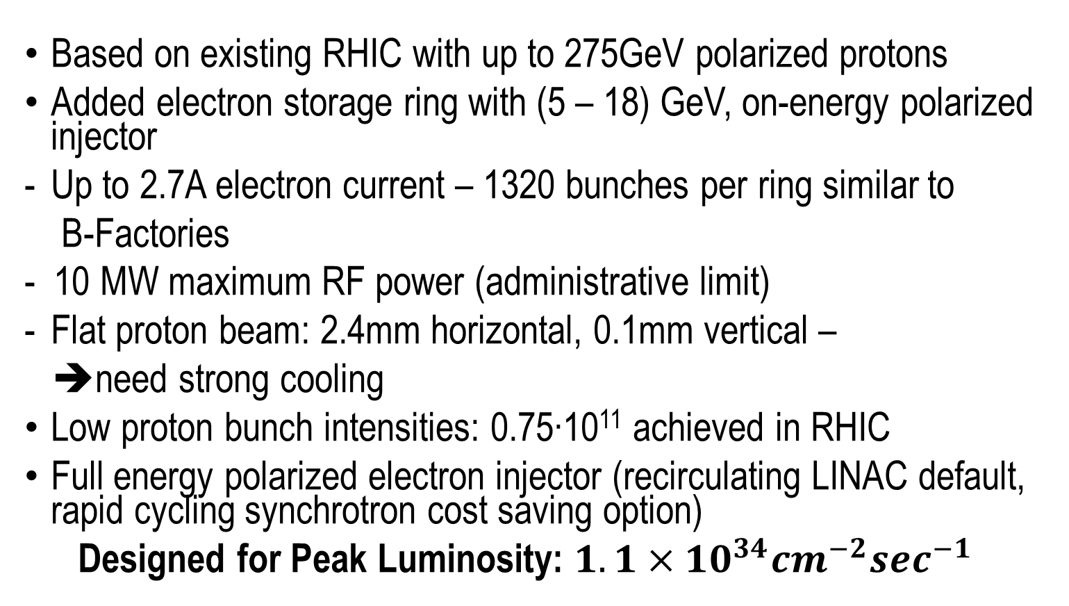
eRHIC Design Concept
Based on existing RHIC with up to 275GeV polarized protons
Added electron storage ring with (5 – 18) GeV, on-energy polarized injector
Up to 2.7A electron current – 1320 bunches per ring similar to
B-Factories
- 10 MW maximum RF power (administrative limit)
Flat proton beam: 2.4mm horizontal, 0.1mm vertical –
➔need strong cooling
Low proton bunch intensities: 0.75∙10¹¹ achieved in RHIC
Full energy polarized electron injector (recirculating LINAC default, rapid cycling synchrotron cost saving option)
Designed for Peak Luminosity: $1.1×{10}^{34}{cm}^{−2}\sec^{−1}$

