Slide 1
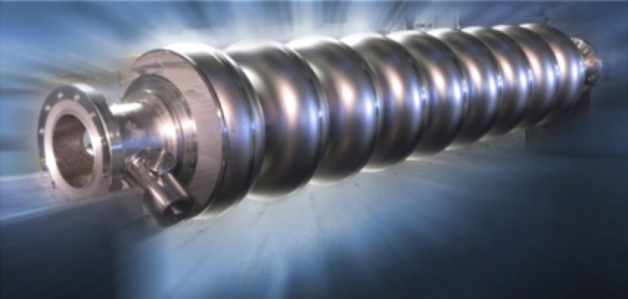


Year 1 Annual Meeting
Research Theme 2: Beam Acceleration
(Superconducting RF Cavities)
Coordinators: Matthias Liepe and Steve Sibener
Liepe
Cornell
Sibener
U Chicago
CBB Annual Meeting, June 6, Research Theme: Superconducting RF acceleration Slide 1

Slide 2
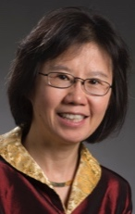
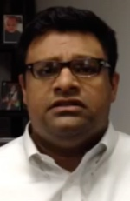

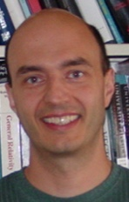
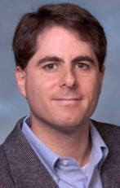



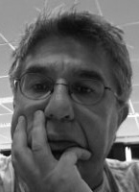
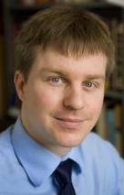
Beam Acceleration Research Team
U. Chicago
CABOT
FNAL
Cornell U.
Kim
HEP
Sibener
Chemist
Naman
Industry
Posen
Accel.
Arias
CM Theory
Hoffstätter
Accel.
Liepe
Accel.
TRIUMF
Muller
CM Exp.
Sethna
CM Theory
Shen
CM Exp.
Laxdal
Accel.
Clark Atlanta
Brigham Young U.
U. Florida
Wang
CM Theory
Japaridze
HEP
Transtrum
CM Theory
Hennig
Materials
CBB Annual Meeting, June 6, Research Theme: Superconducting RF acceleration Slide 2

Slide 3
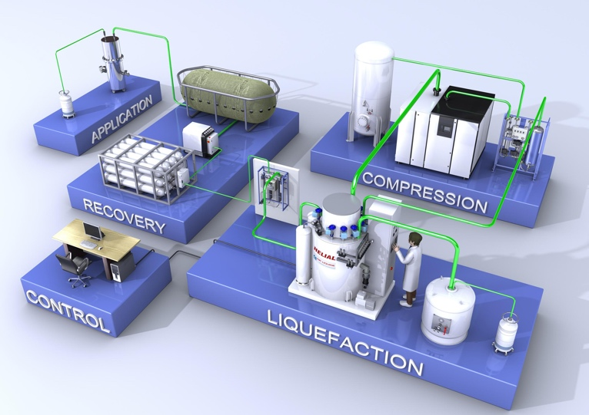

Research Theme Goals
Critical steps towards developing next generation of superconducting RF (SRF) cavities that outperform today’s cavities with:
Transformational impact:
  Factor of 5 to 10 reduced cryogenic cooling power
    Improved treatments of Nb; compound superconductors
  Factor of 2 higher accelerating field strength
    Compound superconductors
2K
4.2K
~$1M
~$50k
Map shown for scale only.
CBB Annual Meeting, June 6, Research Theme: Superconducting RF acceleration Slide 3

Slide 4
Current State of the Art
All SRF cavities currently in operation use Niobium as the superconducting material
Current generation of SRF cavities has been transformational for accelerator driven sciences, but high cost and complexity limit current use in science and prevent small-scale university and industrial applications
Progress in maximum accelerating field
Nb theoretical limit: 50 MV/m
2010: ~35 MV/m
1995: 20 MV/m
1990: 15 MV/m
1985: 6 MV/m
1975: 3 MV/m
CBB Annual Meeting, June 6, Research Theme: Superconducting RF acceleration Slide 4

Slide 5
Technical and Scientific Barriers
Quality factor/cryogenic efficiency:
  Typical: 2 to 3x10¹⁰ at 2K in 1.3 GHz Niobium SRF cavities at medium fields
  Barriers:
    Poor control of Niobium surface morphology, topology, and chemistry. What matters? Optimal surface?
    Poor control and understanding of synthesis processes for alternative high quality thin film compound superconductors
Accelerating field:
  Typical: ~35 MV/m (record ~50 MV/m) in Niobium SRF cavities
  Barriers:
    Fundamental flux-free field limit of niobium
    Poor control and understanding of synthesis processes for alternative high quality thin film compound superconductors
CBB Annual Meeting, June 6, Research Theme: Superconducting RF acceleration Slide 5

Slide 6
Path Forward
Liquid Helium
Niobium
B_{in}
3mm
λ(0) ~ 40 nm
B_{s}=B₀e^{iωt}
Nb₂O₅
1m
Vacuum with RF fields
B_{s}=B₀e^{iωt}
CBB’s will focus on 3 interconnected objectives:
  Advancing the theory of RF superconductivity of the RF penetration layer
  Developing optimized niobium surface layers and treatment protocols
  Developing new processes for fabricating cavities from game-changing superconductors such as Nb₃Sn and NbN, and MgB₂
…using an interdisciplinary, student-cented approach
…in synergistic connection with other two CBB themes for CBB’s overarching goal of increasing brightness of beams while decreasing cost of key accelerator technologies.
CBB Annual Meeting, June 6, Research Theme: Superconducting RF acceleration Slide 6

Slide 7
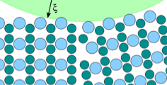
Objective 1
Advance the theory of RF superconductivity
Current Status
Theoretical max flux-free field calculated only in certain limits
  Accurate estimates for advanced materials theoretically challenging
Effects of vortex nucleation at defects not fully studied
Laminates proposed as way to stabilize surfaces against premature vortex entry, but not fully studied
Impact of dopants on superconductivity in Nb not fully understood
Goals
  Predict most promising surface for highest field cavities
    Material, crystal orientation and morphology…
    Bulk vs. laminate superconductors
    Vortex nucleation at defects and impact…
  Predict most promising surface for highest efficiency
    Field dependence of the surface resistance and dependence on impurity doping
    …
Importance
  Guidance for optimizing material properties for high Q at operating fields
  Guidance for exploring alternative superconductors for higher fields and higher efficiency
Arias, Hoffstaetter, Liepe, Sethna, Transtrum
CBB Annual Meeting, June 6, Research Theme: Superconducting RF acceleration Slide 7

Slide 8
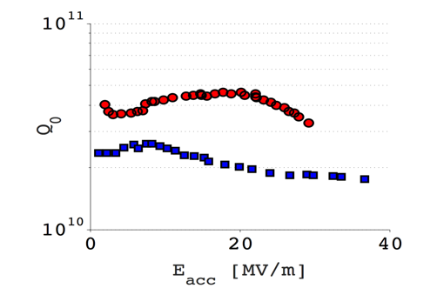
Objective 2
Develop more efficient niobium cavities
Current Status
N-doping shown to strongly reduce BCS resistance
  Optimal dopant, doping level, and underlying science mostly unknown
Large variation of residual surface resistance observed
Hydrogen likely key factor degrading cavity performance
Goals
  Investigate physics that underlies surface resistance, its observed strong field dependence, and impact of impurity doping in Nb
  Identify surface crystal morphology and topology that minimize surface resistance
  Find treatment protocols that yield optimal surfaces
  Work with vendors to commercialize high-efficiency treatment protocols
Importance
  Control of surface layer chemistry and oxide structure critical to reduce surface resistance for highest Q₀
  Significant further improvements possible
N-doping: Q doubles
x2
Arias, Kim, Liepe, Muller, Shen, Sibener
CBB Annual Meeting, June 6, Research Theme: Superconducting RF acceleration Slide 8

Slide 9
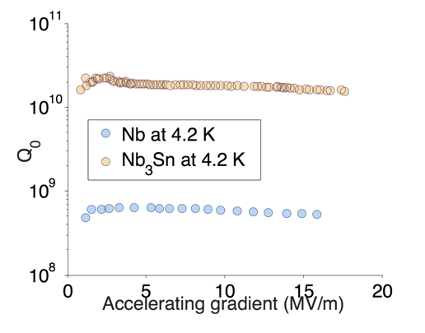
Objective 3
Develop new processes for fabricating cavities from compound superconductors
Current Status
First demonstration of very high efficiency potential of Nb₃Sn (T_{c}=18K) for SRF
Other candidates for SRF: NbN (T_{c}~16K), MgB₂ (T_{c}~40K), iron based superconductors (T_{c}~30 to 55K),…
  RF performance mostly unexplored
Goals
  Identify best synthesis processes that yield phase-pure and defect free materials
  Synthesize Nb₃Sn, NbN, MgB₂
  Analyze microstructures, measure critical temperatures, fields, and chemical concentration profiles
  Measure surface resistance and flux entry fields; localize limiting areas for post-mortem analysis
  Use information to further improve materials
Importance
  Compound superconductors promise very high efficiency, and up to 100 MV/m accelerating field if surfaces of sufficient quality can be produced.
    Higher operating temperature at very high Q₀
    Only way for >50 MV/m
Nb₃Sn
x30
Nb
Hennig, Laxdal, Liepe, Muller, Posen, Shen, Sibener
CBB Annual Meeting, June 6, Research Theme: Superconducting RF acceleration Slide 9

Slide 10
Beam Acceleration Team Connections
Synergy: Beam Storage & Transport
e.g. nonlinear continuum descriptions
Synergy: Beam Production
material synthesis
Predict
Electronic structure theorists, condensed matter theorists
Implement
Material scientist, accelerator scientists
Industry partner:
Cabot
Sethna Cornell
Arias
Cornell
Liepe
Cornell
Naman
Cabot
Hoffstätter
Cornell
Wang
Clark Atlanta
Transtrum
BYU
Hennig
U Florida
Test
Accelerator scientists
Characterize
Physical chemist, condensed matter experimentalists
Industry partner:
RI, AES
Liepe
Cornell
Laxdal
TRIUMF
Posen
FNAL
Shen
Cornell
Kim
U Chicago
Sibener
U Chicago
Muller
Cornell
Synergy: Beam Production and Beam Storage & Transport
accel. implementation
Synergy: Beam Production
material characterization
CBB Annual Meeting, June 6, Research Theme: Superconducting RF acceleration Slide 10

