Slide 1
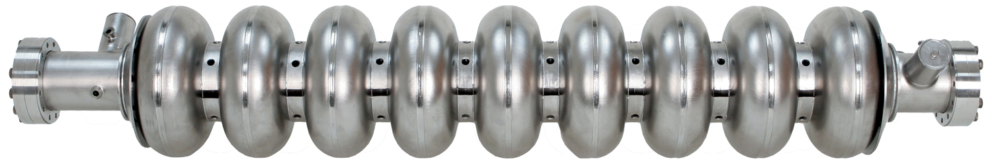
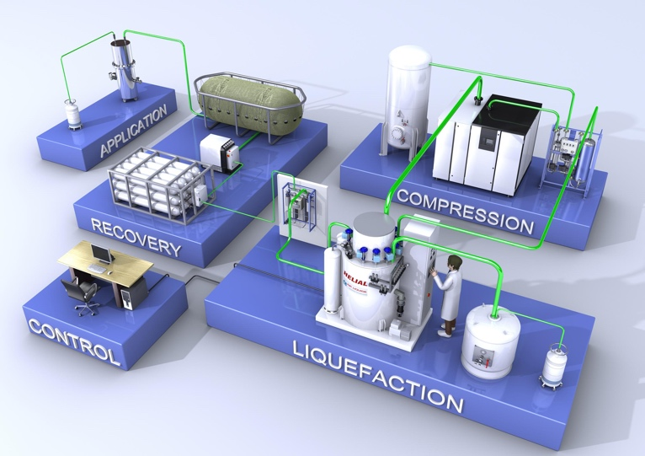
Superconducting RF
Continuous bright beams with low emittance
However, the cryogenics plant is costly to build and maintain
Notes:
SRF cavities made of niobium operating at 1.8 to 2.0 K provide continuous beams with a low emittance
A major cost driver is the price of the cryogenics facility

Slide 2
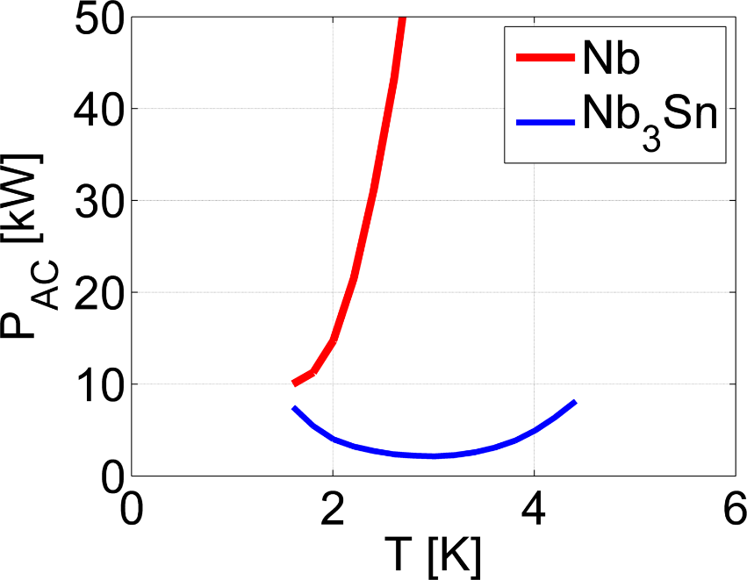
The case for Nb₃Sn
Higher critical temperature
→ Operation at 4.2 K
Higher superheating field
→ Double the limit of niobium
Green: tin
Red: niobium
Parameter | Niobium | Nb₃Sn
Transition temperature | 9.2 K | 18 K
Superheating field | 219 mT | 425 mT
Energy gap Δ/k_{b}T_{c} | 1.8 | 2.2
λ at T = 0 K | 50 nm | 111 nm
ξ at T = 0 K | 22 nm | 4.2 nm
GL parameter κ | 2.3 | 26
Notes:
Nb3Sn is an alternative to niobium
An A15 intermetallic alloy with a Tc of 18 K
With a higher Hsh, the ultimate gradient should be twice that of Nb

Slide 3
Operation at 4.2 K
Going to 4.2 K reduces cryogenic cost and complexity
2K
4.2K
~$1M
~$50k
Notes:
(COP – coefficient of performance)
The higher Tc of Nb3Sn means that the cryomodule power consumption at 4.2 K is low enough to operate there
Moving to 4.2 K liquid operation greatly simplifies things
We could even use a cryocooler, which would be very low maintenance

Slide 4
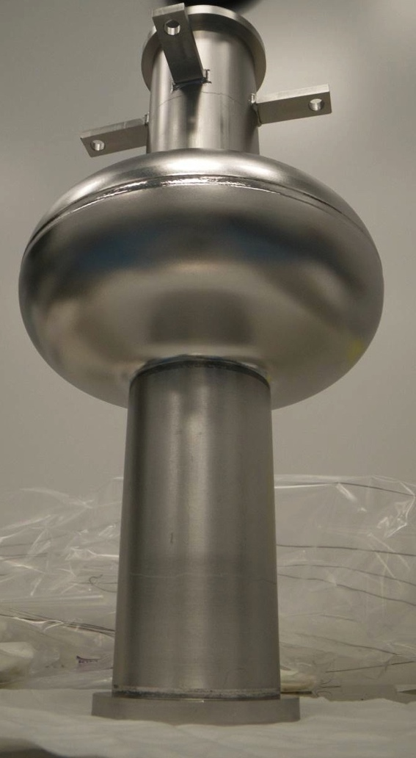
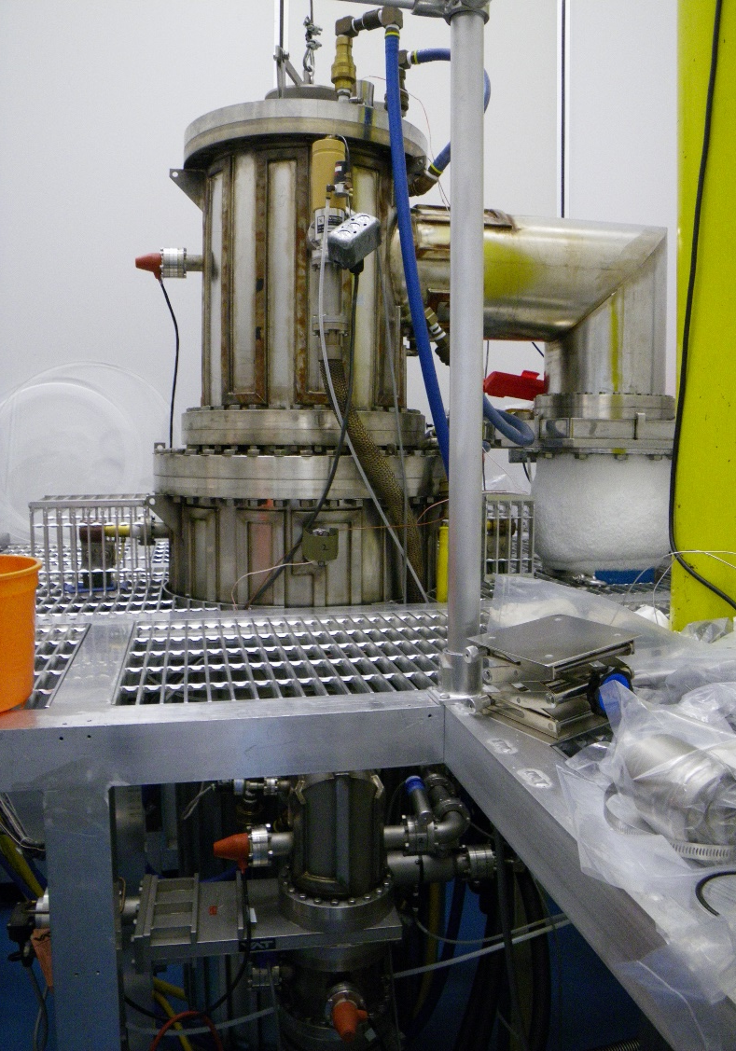
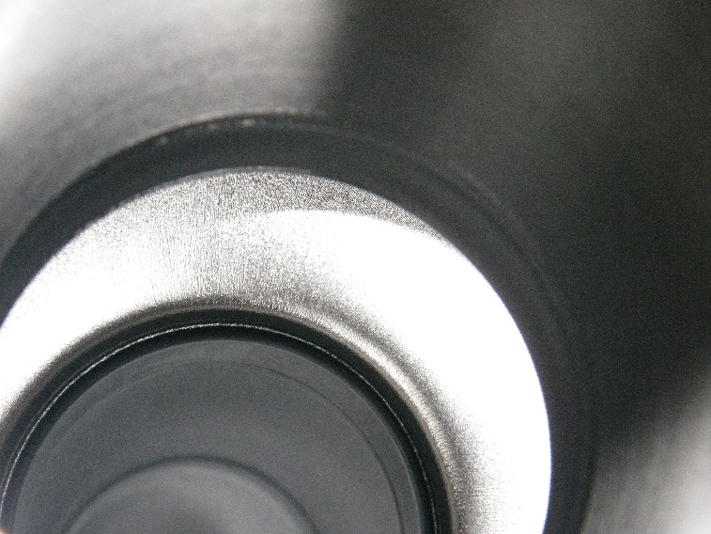
Fabricating an Nb₃Sn cavity
A 1.3 GHz single-cell is placed into the furnace
Notes:
Nb3Sn is brittle and cannot be shaped
We coat using the vapour diffusion method
We put a Nb structure into a UHV furnace

Slide 5
Coating method
Vacuum space
( < 10⁻⁵ Torr )
Cavity/sample
Coating chamber
( 1100 °C )
Nucleation agent ( SnCl₂ )
Primary heater
Secondary heater
Tin crucible
Tin source ( 1250 °C )
Notes:
A specially adapted UHV furnace with two hot zones, one contained within the other.
The cavity sits in the main hotzone
At the base lie a nucleation agent for coating prep and the source
The source is in the second hotzone

Slide 6
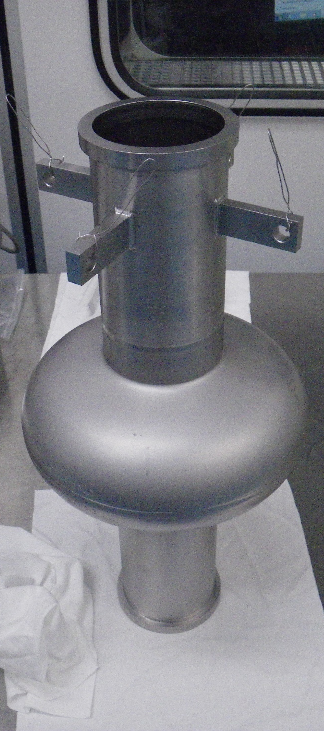
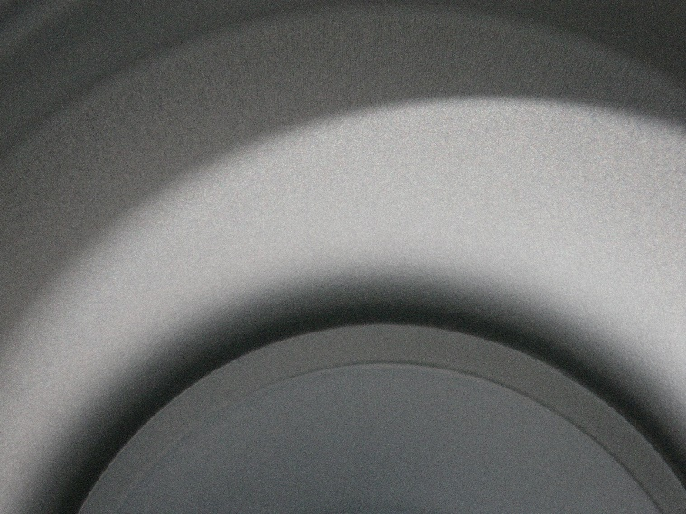
Post coating
A coated cavity doesn’t look very different
Notes:
- A coated cavity looks more matte, but otherwise not very different

Slide 7
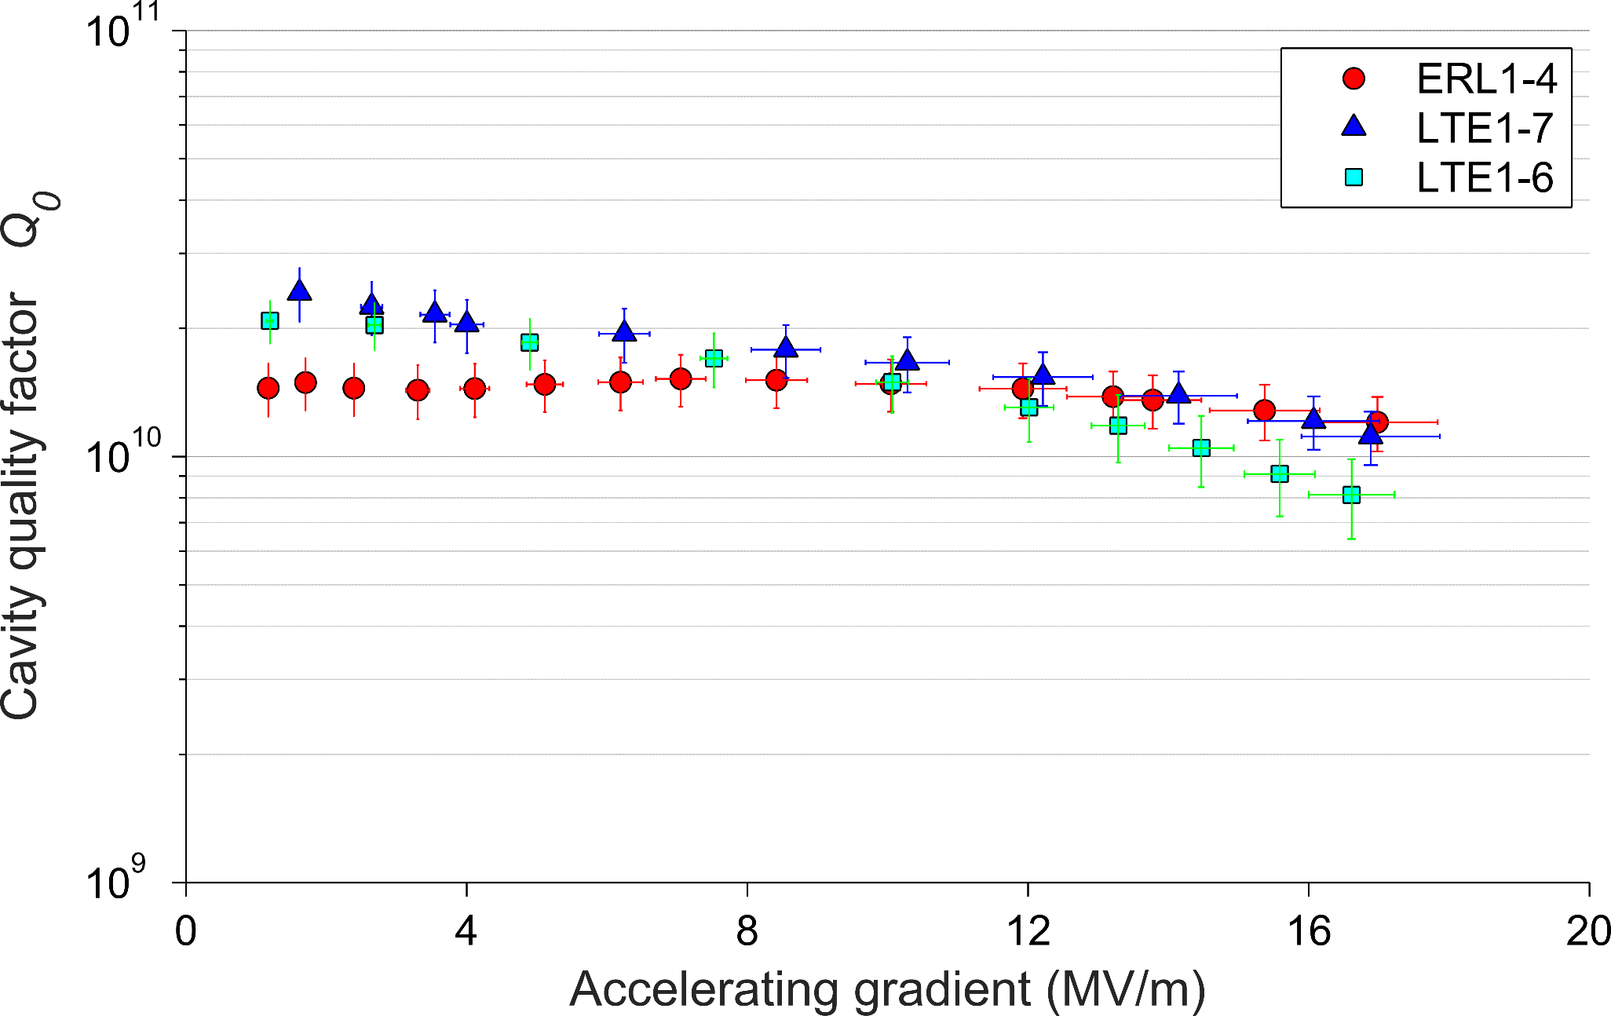
Exemplary cavities
But the difference in performance is significant
Bath temperature of 4.2 K
Notes:
These are some of our best performing cavities operating at 4.2 K
We have Qs approaching or exceeding 10^10 at useable gradients

Slide 8
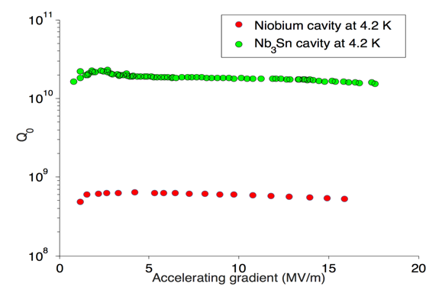
Comparison to niobium
30× more efficient than Nb at 4.2 K!
Notes:
This is 30 times more efficient than Nb at 4.2 K at useable gradients
This is the first time an “alternative” cavity has beaten niobium at useable gradients

Slide 9
Pushing performance further
Great performance! But theory predicts we can do even better
Pushing to the maximum achievable cavity efficiency
Understanding the limitations on accelerating gradient
How does the Centre for Bright Beams contribute to improving Nb₃Sn?
Notes:
This performance is already relevant to today’s machines
We want to push harder for the best efficiency
But we should be able to do better, particularly in terms of accelerating gradient
The centre for bright beams provides talent that has and can still make significant contributions to this research

Slide 10
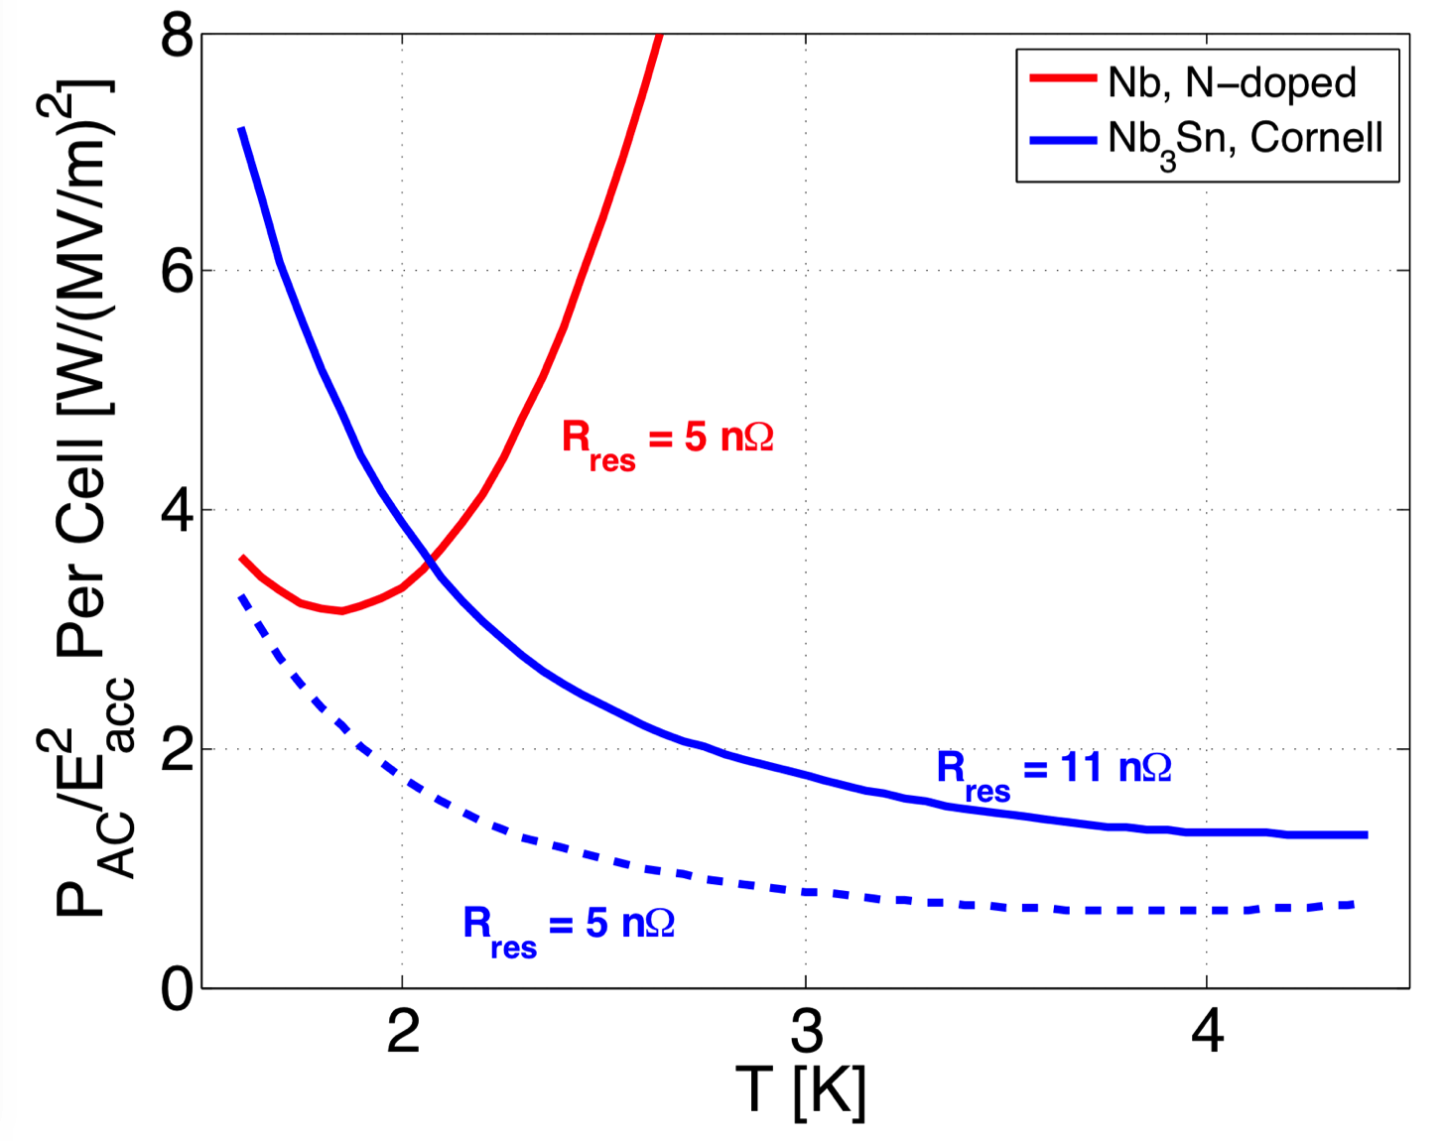
Maximising efficiency
Surface resistance = R_{BCS} + R_{Residual}
Low for Nb₃Sn at 4.2 K
Must be minimised!
Even 3-5 nΩ can make a big impact
Notes:
The surface resistance determines the efficiency
It has two components, one of which is fixed by the temperature and the material (BCS)
The other, the residual, must be minimised

Slide 11
Loss mechanisms
16 nΩ
Ambient fields
Trapped flux
Thin film regions
BCS Resistance
Thermal gradients
0 nΩ
Notes:
At 4.2 K, our non-BCS contribution comes from trapped flux and thin film regions (I will explain later)
Trapped flux are vortices trapped in the cavity during cooldown
They come from ambient fields and thermal gradients

Slide 12
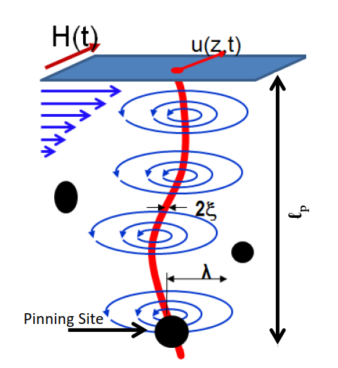
Generation of thermal currents
Thermal gradients → Thermal currents → Magnetic flux
Induced thermocurrent
HOT
Nb₃Sn
Nb
Generated
B field
COLD
Notes:
The bimetallic interface of Nb3Sn allows the generation of thermal currents in the presence of thermal gradients
This generates magnetic flux, which is trapped

Slide 13
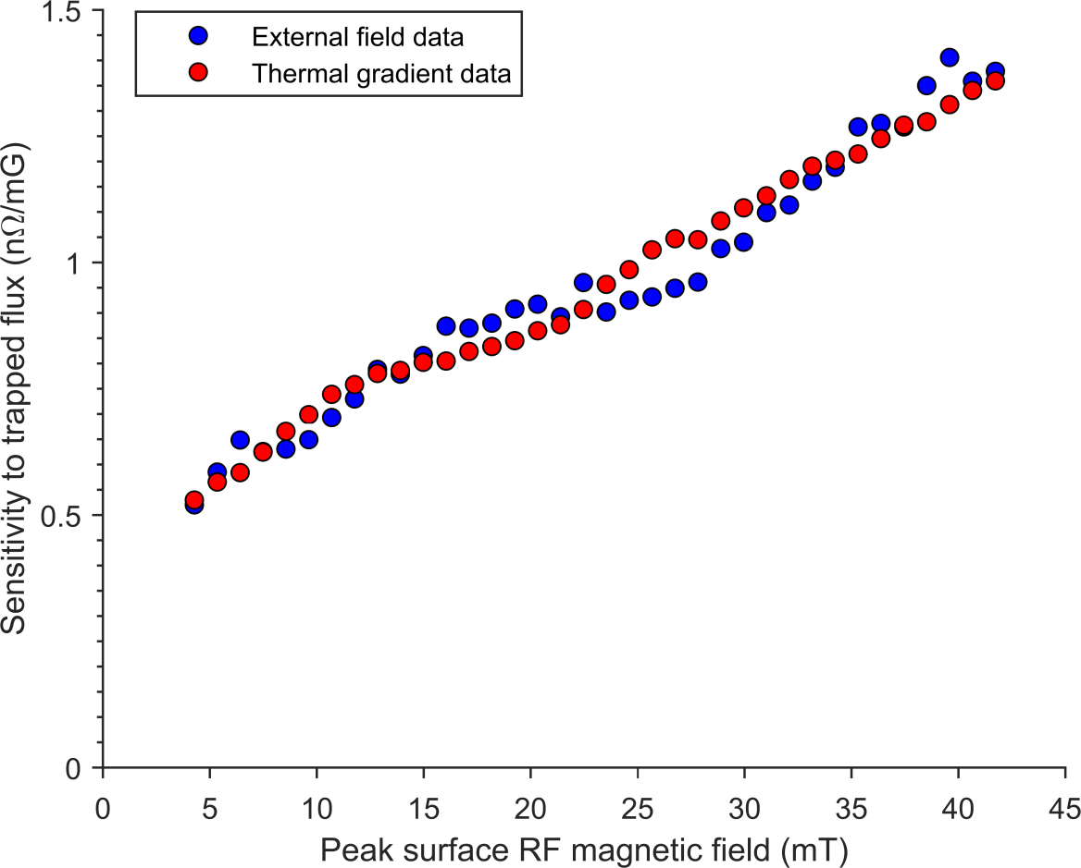
Field dependent sensitivity
Nb₃Sn is more sensitive to trapped flux at higher fields
Notes:
For each mG of magnetic flux trapped, you get a certain number of nano-ohms. In Nb3Sn, this value actually increases with accelerating field!

Slide 14
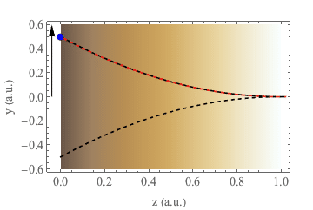
Weak collective pinning scenario
RF field increases
    Vortex amplitude increases
        Increased losses
Flux vortex oscillating
CBB Contribution by:
James P. Sethna and
Danilo B. Liarte
Notes:
The CBB collaboration has actually been vital in understanding why this happens. Sethna and Liarte have developed a “weak collective flux pinning” model that is able to describe this behaviour. Understanding the physics behind this behaviour is critical in trying to change it.

Slide 15
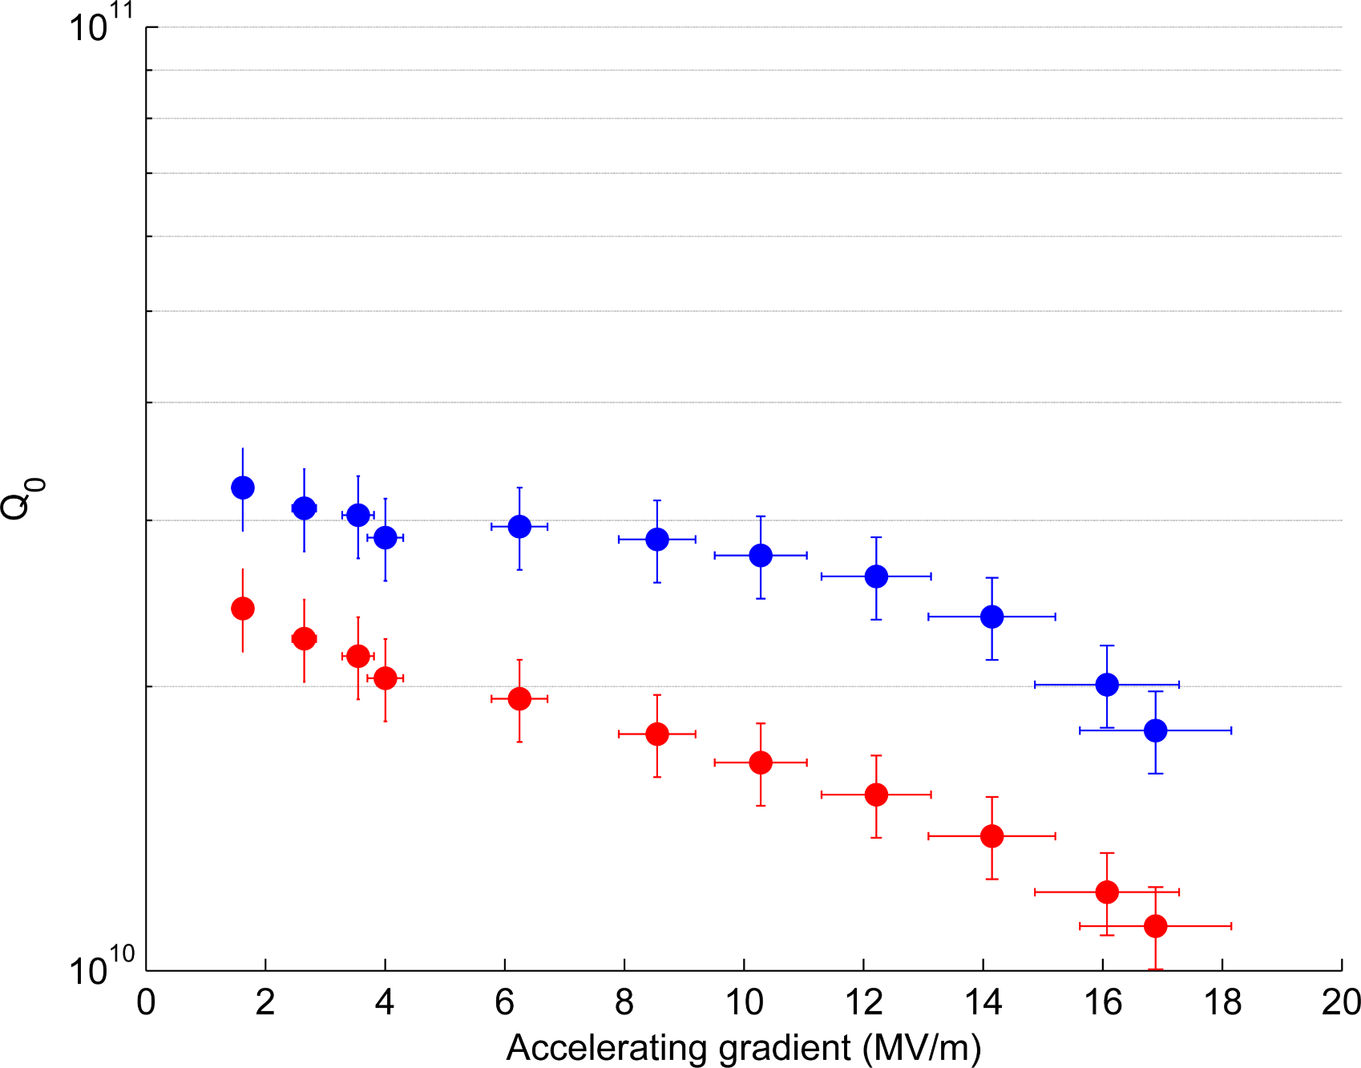
Improving cool-down
Optimising cool-down ensures great performance
Data: 200 mK/m, 5 mG ambient
Extrapolated: 100 mK/m, 1 mG ambient
Bath temperature of 4.2 K
Notes:
The knowledge we have gained on this phenomenon has allowed us to tailor the cooldown of a cavity to achieve exceptional performance.

Slide 16
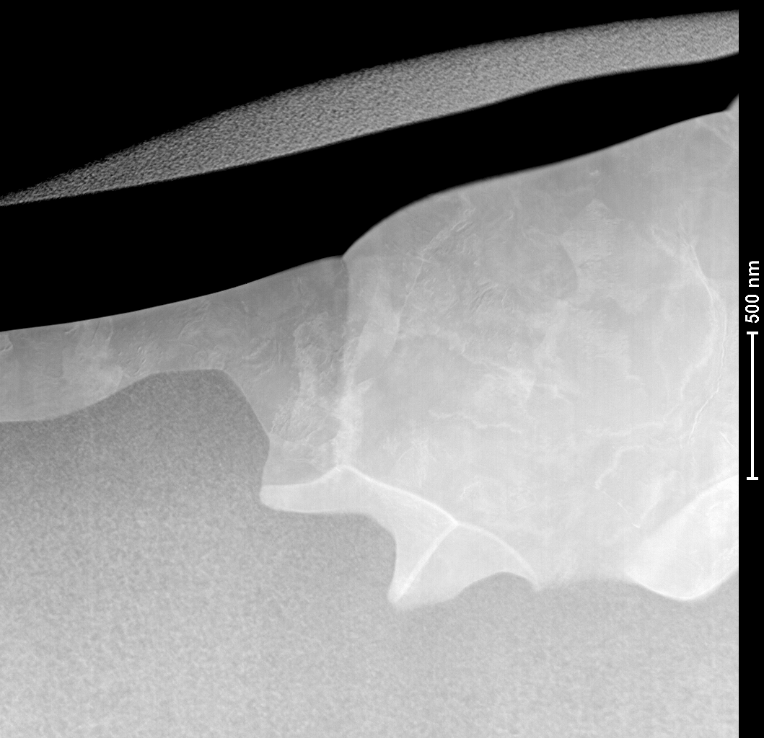
Thin film regions
400 nm
Nb₃Sn
Nb substrate
Too thin Sufficiently thick
CBB Contribution by: David A. Muller and Paul Cueva
Notes:
Another source of loss are thin film regions, where the film is too thin to screen the bulk from the RF field. The contributions from the Muller group have been instrumental in imaging such features using electron microscopy.

Slide 17
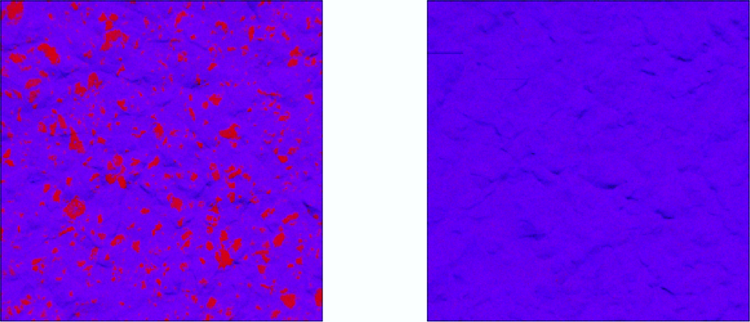
Suppressing thin film regions
Growing the substrate oxide prior to coating suppresses the formation of thin film regions
Not pre-anodised
Pre-anodised substrate
Red: too thin Blue: sufficiently thick
Notes:
Through the use of pre-anodisation we have succeeded in removing these regions, as can be seen in scanning electron microscopy.

Slide 18
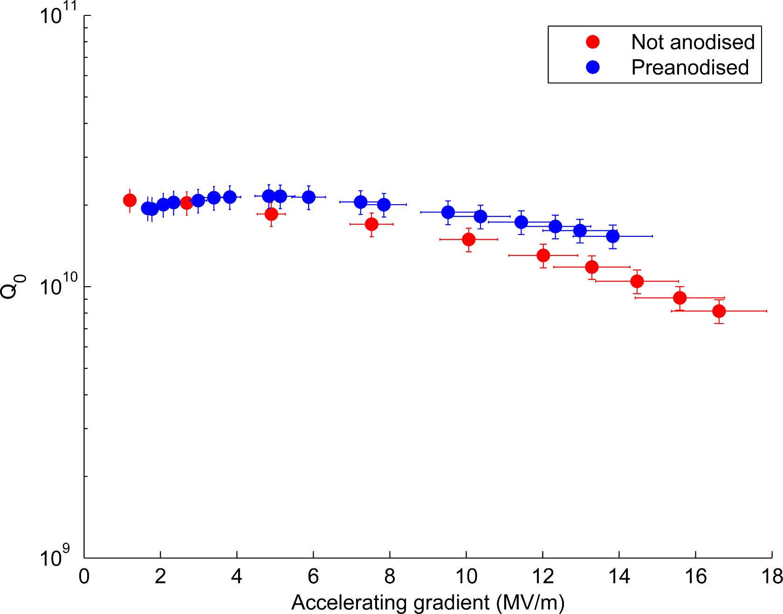
Performance improvement
Data taken at 4.2 K
Gain of ≈3 nΩ
Notes:
Indeed, we do see a difference when all other factors are held equal. A gain of 3 nO may seem small, but here is a big impact

Slide 19
Accelerating gradient
The ultimate gradient of a cavity is determined by the superheating field, at which flux enters and quenches superconductivity
In Nb₃Sn, this field is 400 mT, or 90 MV/m in an ILC cavity
We are currently limited to 14-17 MV/m
Notes:
The other frontier on which the CBB can make a big impact is understanding what the current limitation in our accelerating field is

Slide 20
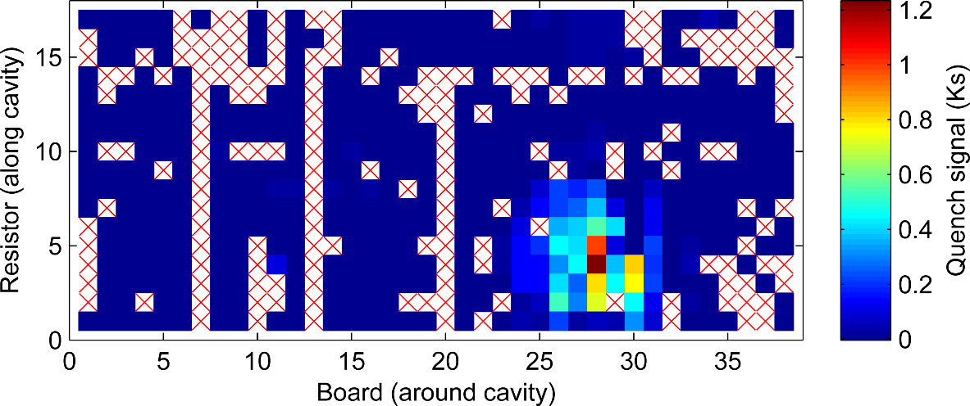
Investigating quench dynamics
Nb₃Sn cavities are limited by a quench at a defect
But what kind of defect, and why?
Notes:
By monitoring the temperature of the surface of a cavity during quench, we see that the quench is isolated to a defect

Slide 21
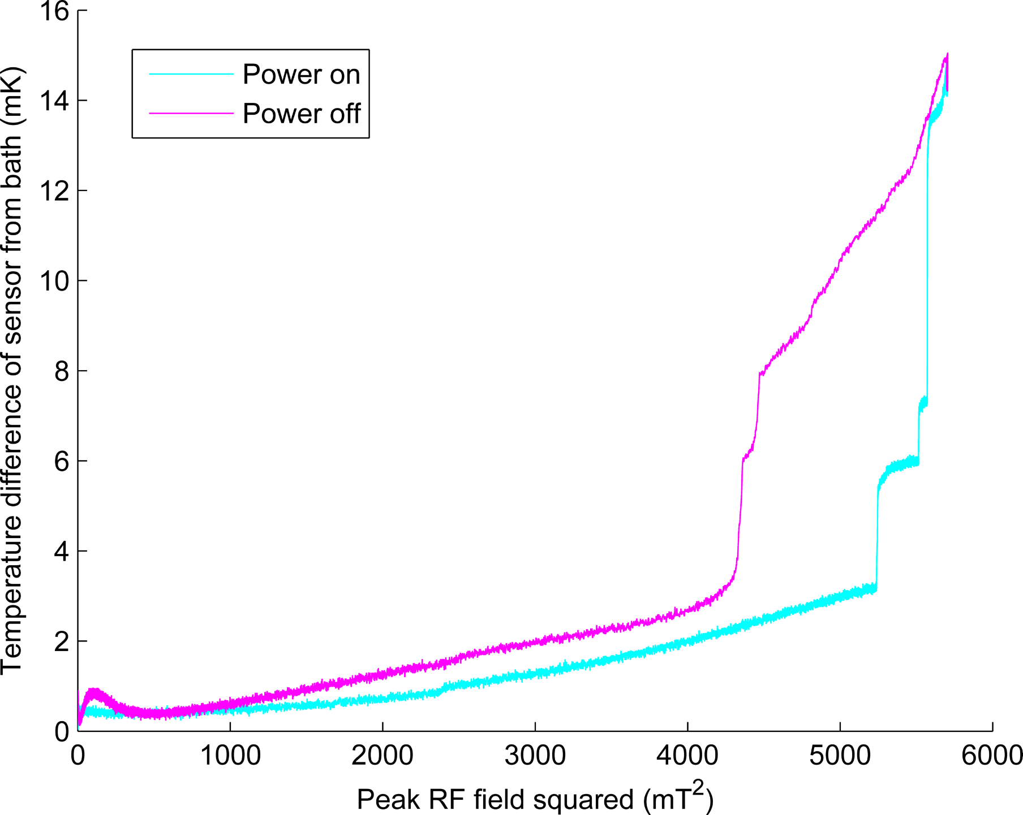
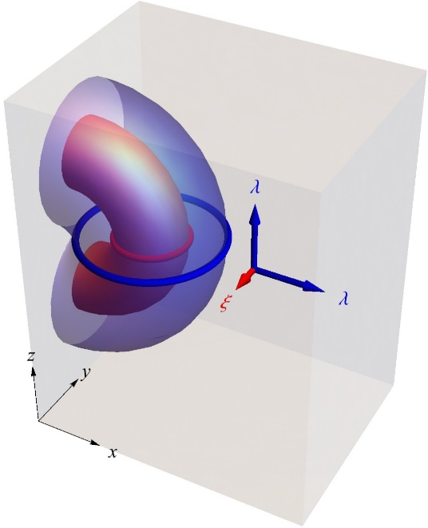
Temperature at quench origin
Data strongly suggests flux entry
Notes:
When we look at this region, we see sudden jumps in temperature near the quench field! This is very suggestive of early flux entry

Slide 22
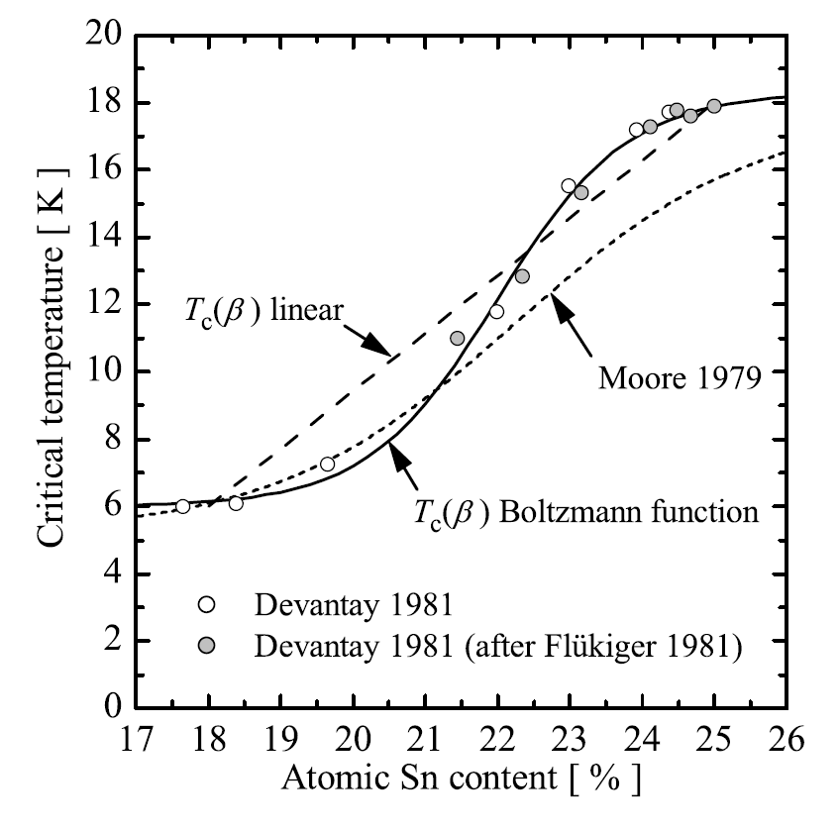
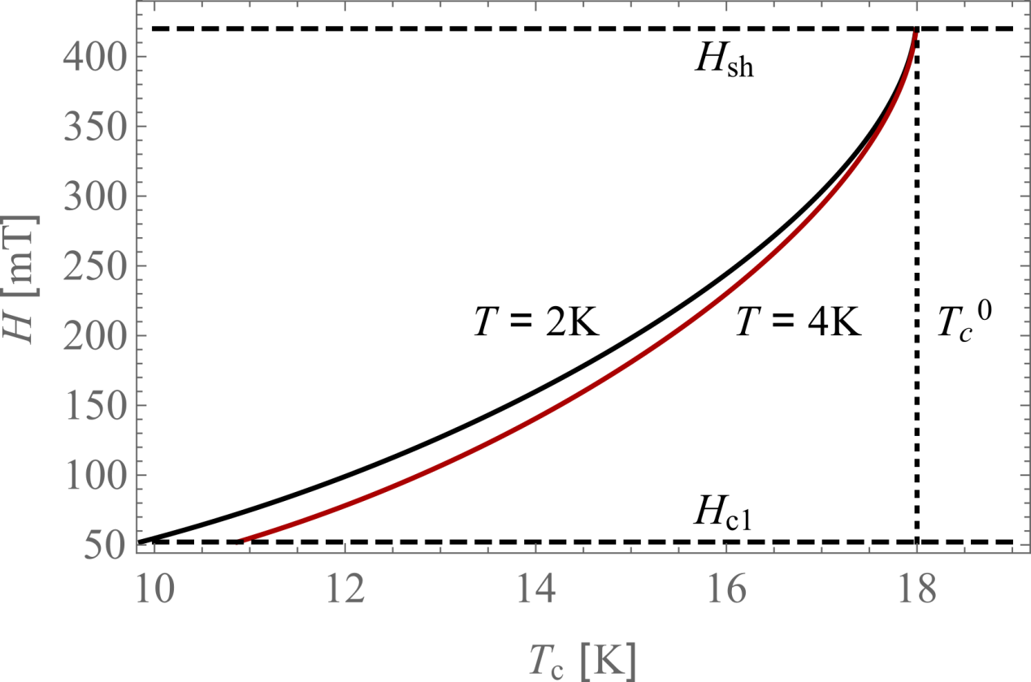
T_{c} suppresion
A depletion of only 3% reduces H_{sh} by 75%
Flux entry could occur at tin-depleted surface defects
CBB Contribution by: James P. Sethna and Danilo B. Liarte
Notes:
What could cause this? Tc suppression could. Sethna and Liarte are experts on flux entry into superconductors, and have looked into how suppression could reduce the superheating field

Slide 23
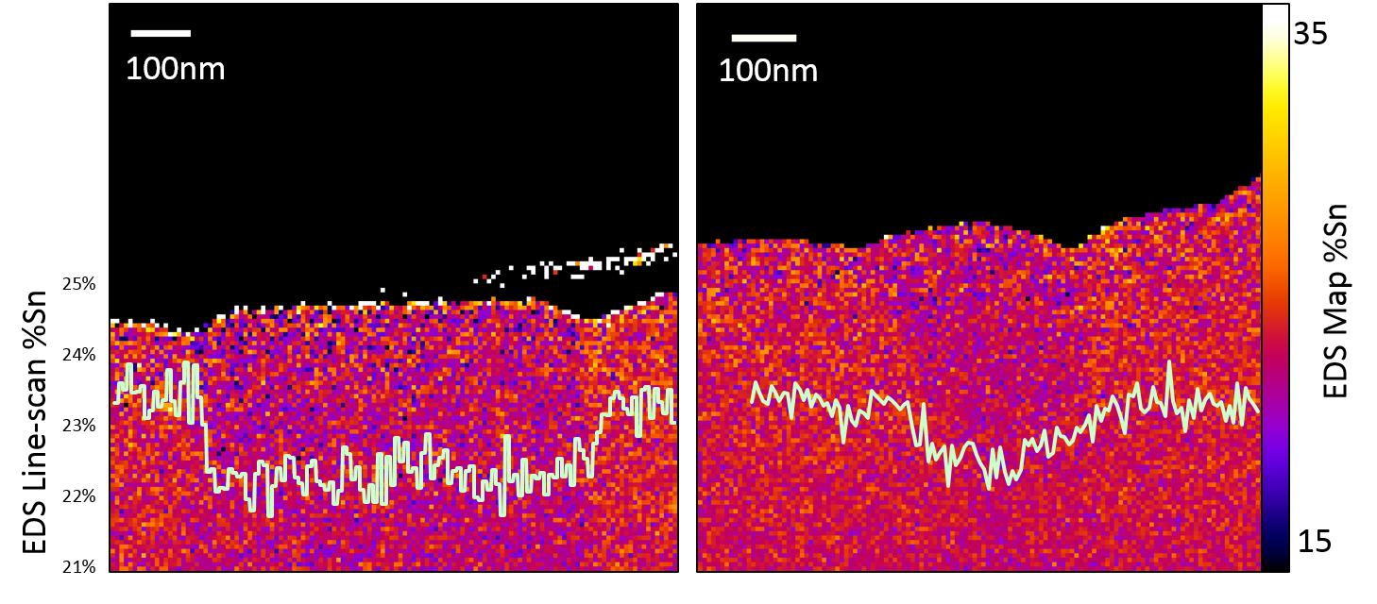
Tin-depletion in grains
Cross-section of the Nb₃Sn RF surface
Grain boundary
CBB Contribution by: David A. Muller and Paul Cueva
Notes:
In fact, in samples we have already seen depleted grains at the surface, as we can see in these images provided by the Muller group

Slide 24
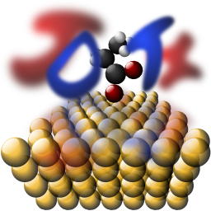
Understanding layer growth
Simulations use Joint Density Function Theory
Sn
CBB Contribution by:
Tomas Arias and
Nathan Sitaraman
Nb₃Sn
Nb
We compare growth simulations to features seen in coupons and correlate these with RF performance
Notes:
We need to be able to alter the prevalence of all these features to see how they affect the quench field. The contributions of the Arias group, with their DFT simulation code, are proving useful in understanding how the layer grows. As we combine these simulations with our sample measurements, it is becoming increasingly clear that it is the very early stages of the coating that seal its fate.

Slide 25
Outlook and conclusion
Nb₃Sn cavities have achieved the performance specifications demanded by modern machines
Cavity efficiency
  We routinely get quality factors of >10¹⁰ at 4.2 K and gradients of >14 MV/m
Accelerating gradient
  Cavities are limited by localised defects
  Surface features are being correlated to growth simulations to understand layer growth and guide the coating recipe
Notes:
To summarise – in cavity efficiency, we are doing very well, and can push it quite close to the limit. In accelerating gradient, we are isolating the defect that causes quench and trying to figure out what causes it to occur

Slide 26

Acknowledgements
with special thanks to
Prof. Matthias Liepe
Prof. Tomas Arias
Prof. David A. Muller
Prof. James P. Sethna
Danilo Liarte
Ryan Porter
Paul Cueva
Nathan Sitaraman
James Maniscalco
James Sears
Greg Kulina
John Kaufman
Holly Conklin
Terri Gruber
The Cornell Nb₃Sn program is primarily supported by the U.S. Department of Energy

