Slide 1
Single Crystal Photocathodes: A Route to Ultimate Beam Brightness and New Photoemission Physics
- Siddharth Karkare (Lawrence Berkeley Lab)
Notes:
Good morning everyone. Thanks to Ivan for the Introduction. Today I will be talking about how we plan to use single crystal photocathodes to obtain the ultimate beam brightness limited only by disorder induced heating and will also shed some light on the possibility of encountering new photoemission physics while doing so

Slide 2

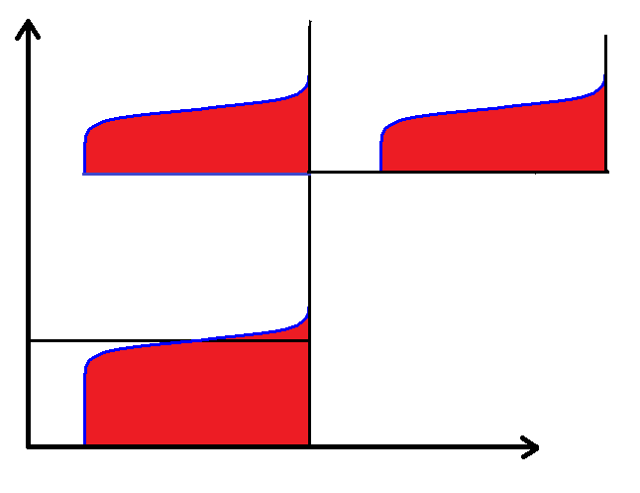
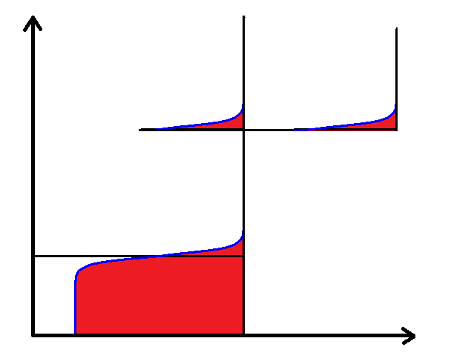
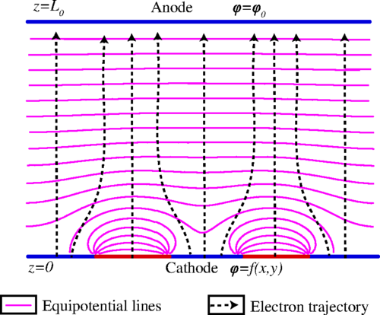
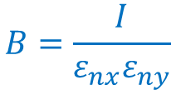

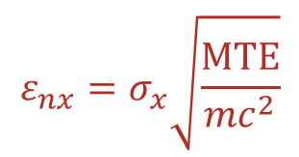

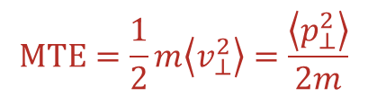

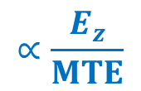

Brightness, Emittance and Disordered Cathodes
E_{z} (sets maximum electron density)
$$MTE=\frac{1}{2}m\left\langle v_{⊥}^{2}\right\rangle =\frac{\left\langle p_{⊥}^{2}\right\rangle }{2m}$$
Photocathode
electrons
$$B=\frac{I}{ε_{nx}ε_{ny}}$$
$$∝\frac{E_{z}}{MTE}$$
electron beam
$$ε_{nx}=σ_{x}\sqrt{\frac{MTE}{mc^{2}}}$$
Laser
All photoinjectors use cathodes with disordered surfaces
(eg. Alkali-antimonides, polycrystalline metals, NEA-GaAs)
$$MTE=\frac{E_{x}}{3}$$
$$=kT (E_{x}→0)$$
Vacuum Level
Energy
$$W$$
Fermi Level
$$ℏω$$
$E_{x}$→0
Surface roughness and work function variations eventually limit MTE
$$E_{x}$$
Feng et al. Appl. Phys. Lett. 107, 134101 (2015)
Karkare and Bazarov, Phys. Rev. Applied 4, 024015 (2015)
Feng et al. J. Appl. Phys. 121, 044904 (2017)
Notes:
References add name

Slide 3
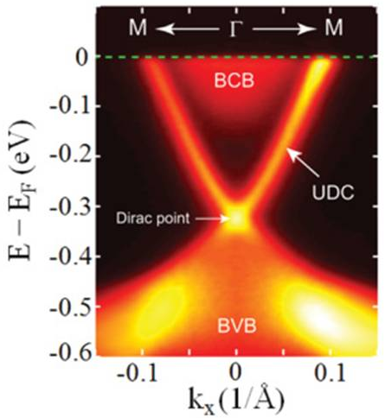
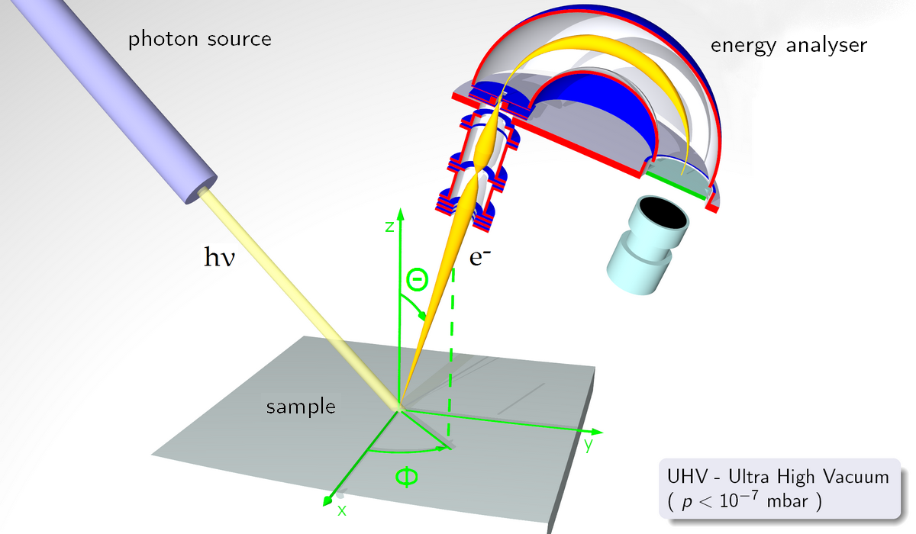
Photoemission from Single Crystals and ARPES
ARPES – Angle Resolved Photoemission Spectroscopy
Used for decades to ‘measure’ the band structure of single crystal solids with ordered surfaces
Conservation of Transverse Momentum
Conservation of Energy
*http://research.physics.berkeley.edu/lanzara/research/ti.html
Can we use/design materials with band structures that result in low MTE and high QE?

Slide 4
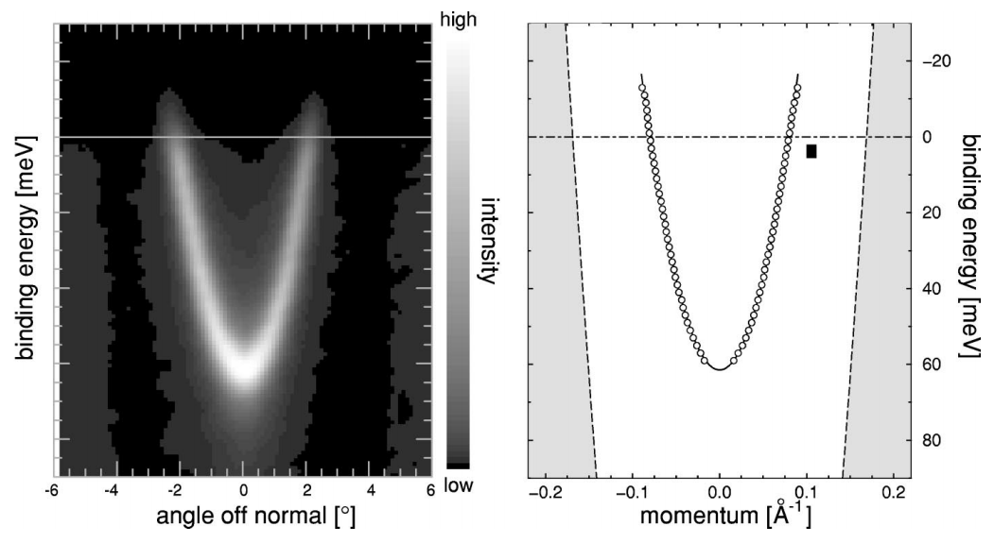
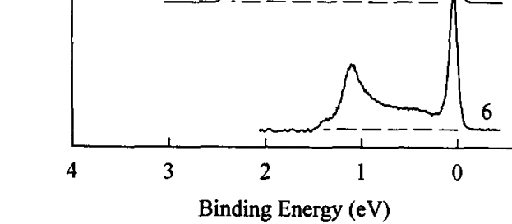
Ag(111) Surface-state – A test case
Easy to prepare – Simple ion bombardment and annealing to 450⁰C
  Gives excellent LEED pattern and clean Auger spectrum
Narrow momentum spread in ARPES – implies low MTE
Surface state peak
Intensity
Narrow Momentum Spread
F. Reinert et al., PRB, 63, 115415 (2001)
T. Miller et al., Surf. Sci. 376, 32 (1997)
Intense surface state peak in PES experiments – Could imply good QE

Slide 5
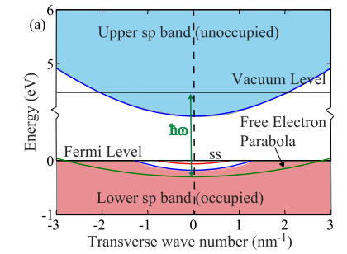
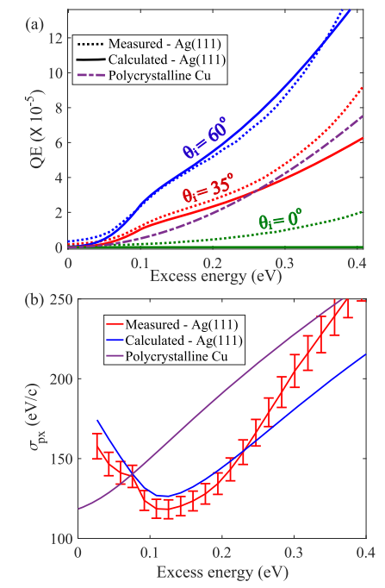
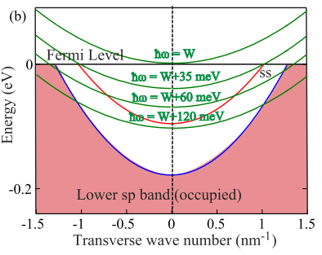
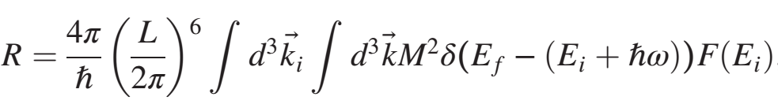
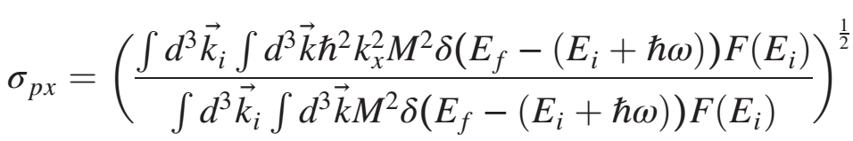
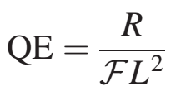



Ag(111) – QE and MTE
Projected band structure in direction transverse to surface
RMS Transverse
Momentum (eV/c)
25 meV
Excess energy (eV)
$$E=\frac{ℏ^{2}k_{r}^{2}}{2m_{e}}+W−ℏω$$
One step photoemission model
Conservation of energy
$$E_{vacuum}=E+ℏω−W$$
Conservation of transverse momentum
$$k_{ri}=k_{rf}$$
Karkare et al. Phys. Rev. B 95, 075439 (2017)
Karkare et al. Phys. Rev. Lett. 118, 164802 (2017)

Slide 6
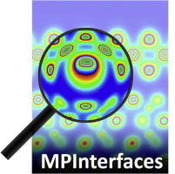
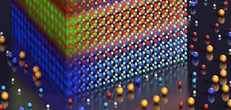
Route to Ultimate Beam Brightness
Photocathode
electrons
electron beam
Laser
High-throughput Materials Search
Materials growth
Photocathode with ultimate beam brightness
Expert: Richard Hennig
- See poster by Joshua T Paul
Expert: Kyle Shen

Slide 7
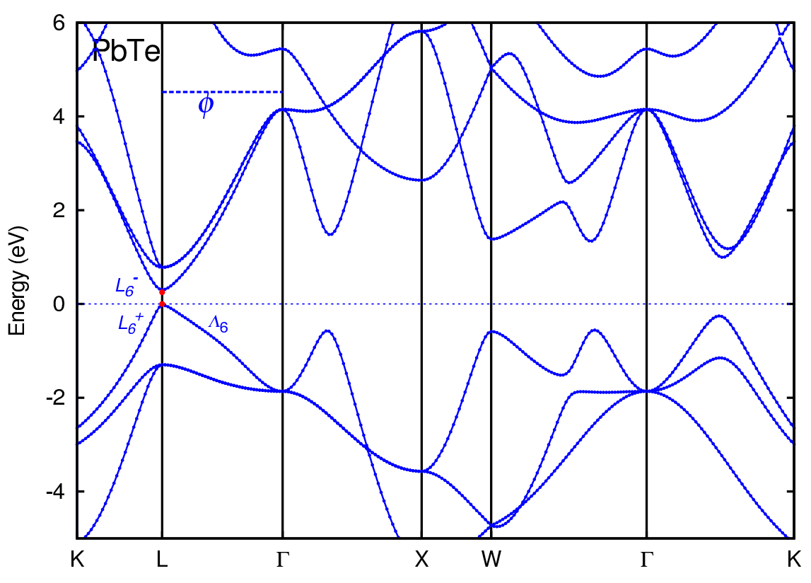
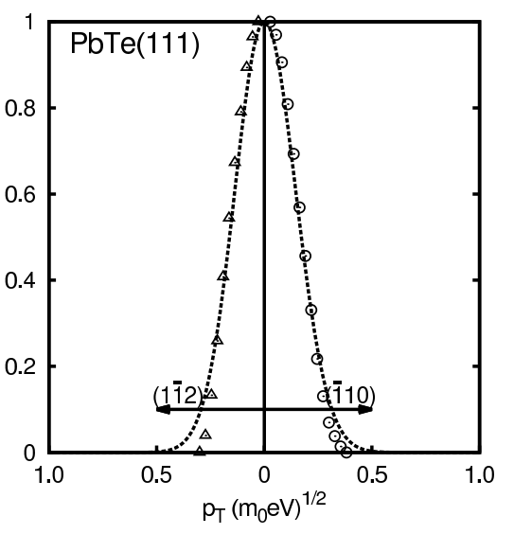
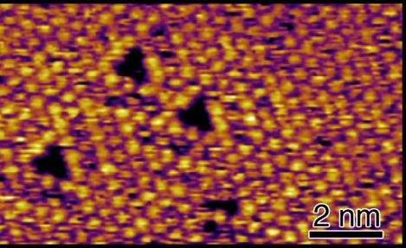
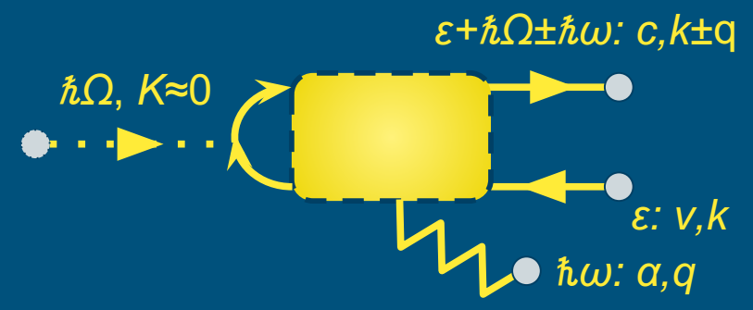
PbTe(111) – A Potential Cold Electron Source?
Conservation laws and band structure dictate that MTE should be < 5 meV
Theory
Measurement
Li and Schroeder https://arxiv.org/pdf/1704.00194.pdf
How good is our surface?
Flat terraces are mostly 1x1 terminated
Can many body scattering effects with phonons explain this behavior?
Can we obtain defect free p-doped surfaces?
Arias group is exploring this possibility
- See poster by Kevin Nangoi
STM image of PbTe(111) surface
- Hines group (Cornell) – See poster by Erik Skibinski, Will DeBenedetti

Slide 8

Low Energy Effects – New Physics
ARPES uses electrons above 1 eV kinetic energy
Our electrons are in the 10 meV range!!!
Long electron wavelengths
- Emitted electrons can see atomic defects
or steps at 10s of nm
Adiabatic limit?
Sudden approximation breakdown
- Emitted electrons interact with changes inside the surface
Sudden Approximation
$t_{λ}$- time required by an electron to move one DeBroglie wavelength

Slide 9
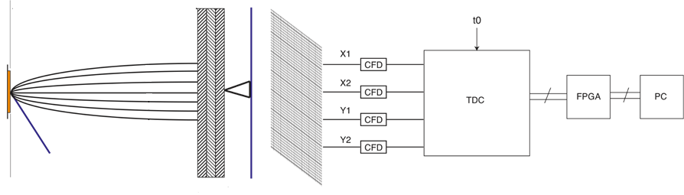
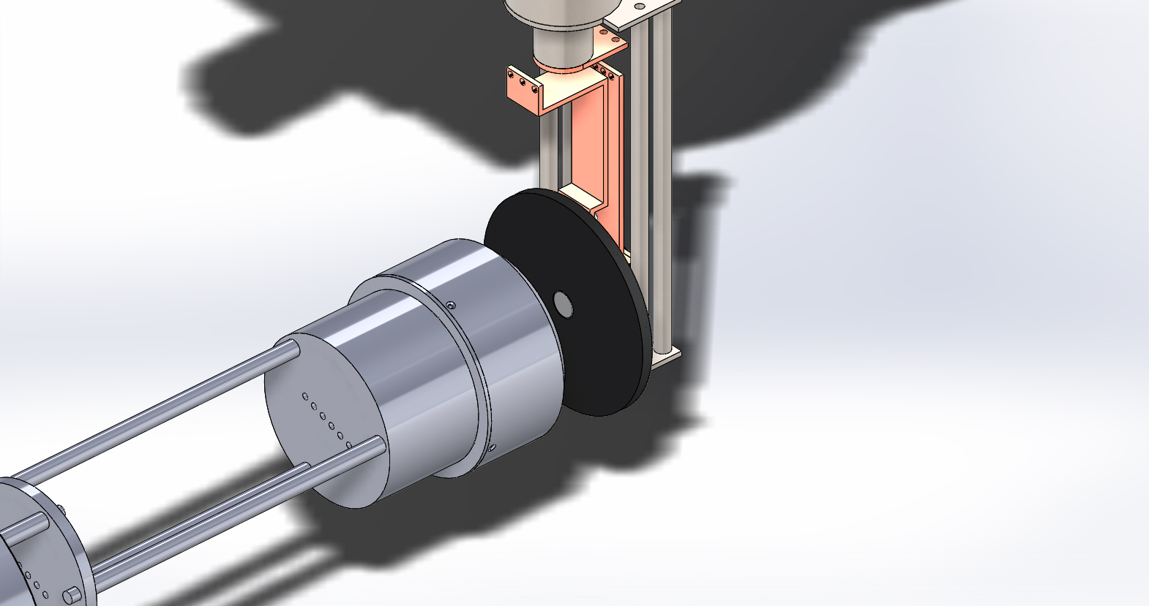
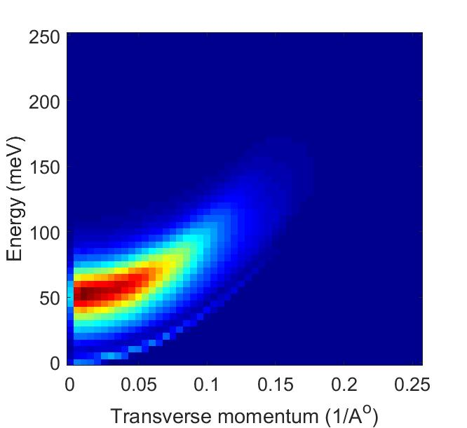
3-D Low Energy Electron Diagnostics
Electrons drift towards detector
Sample
(x,y,t) of electron hitting the MCP
Cryostat
Sample
Incident laser pulse (fs-ps)
X, Y Delay lines
Delay Line
Detector
MCP stack
Electrostatic shield
Enables complete characterization of energy-momentum distribution of photoemitted electrons to provide insight into photoemission process
<1 meV energy resolution expected
Will allow cooling of sample to ~20K

Slide 10
Route to Ultimate Beam Brightness
Photocathode with ultimate beam brightness
Bazarov, Padmore,
Shen, Musumeci
Photoemission Characterization
High-throughput Materials Search and growth
Physics of Low Energy Photoemission
Surface Characterization
Hines, Padmore, Muller
Hennig, Shen
Ab-initio Photoemission theory
Thanks to -
CBB Beam Generation team members
LBL – Jun Feng, Weishi Wan
UIUC – T. C. Chiang
NSF and DOE for $$$
Arias

Slide 11
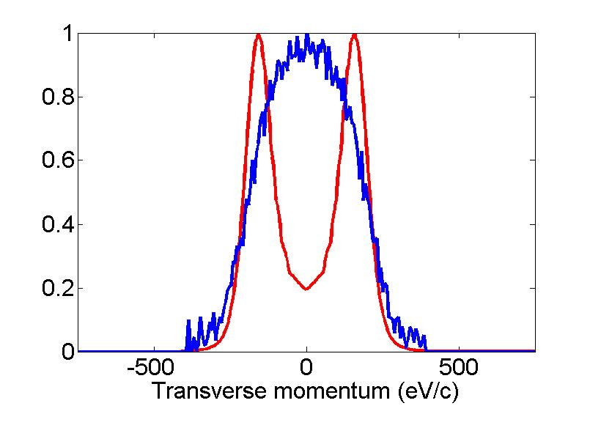
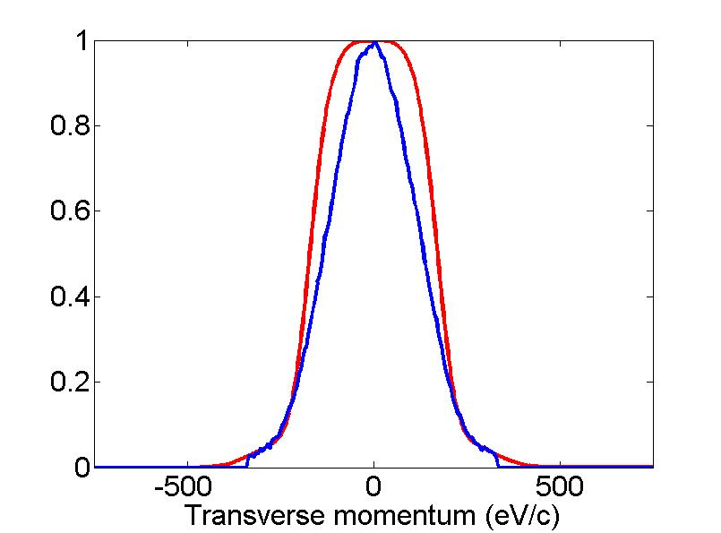
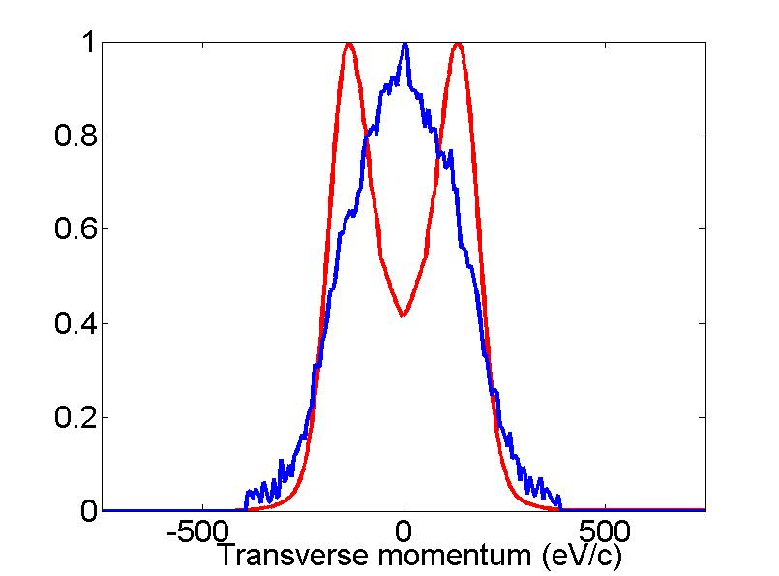
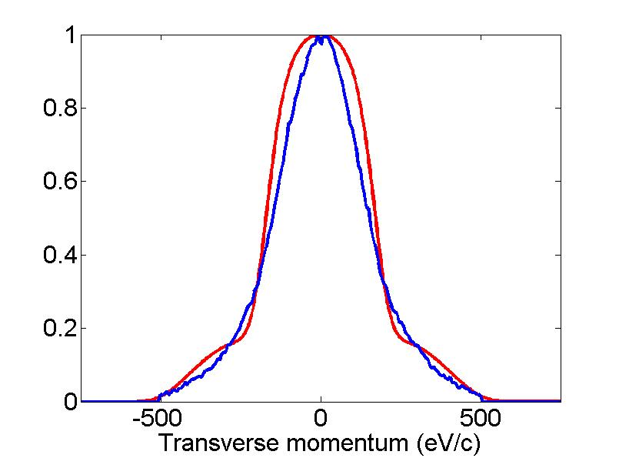
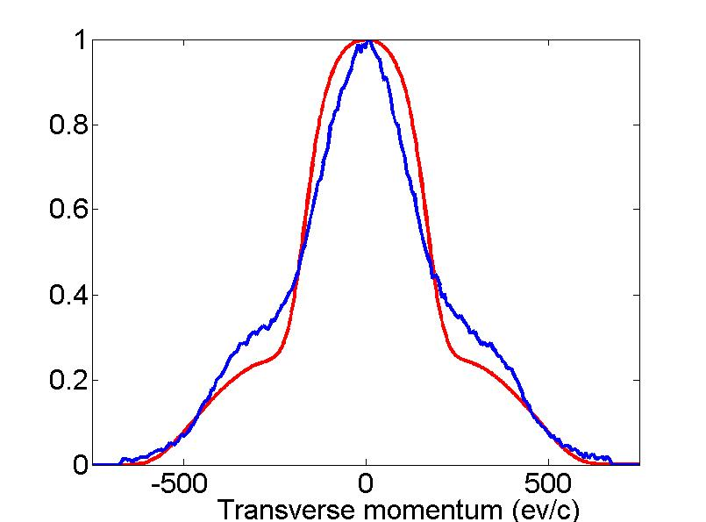
Ag(111) – Momentum distributions
Theory
Measurement

Slide 12
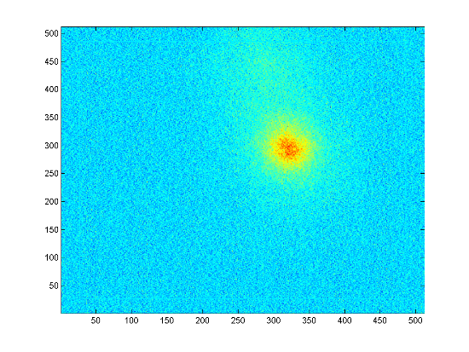
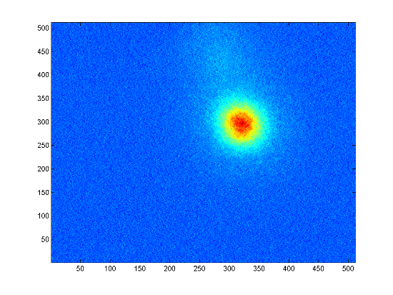
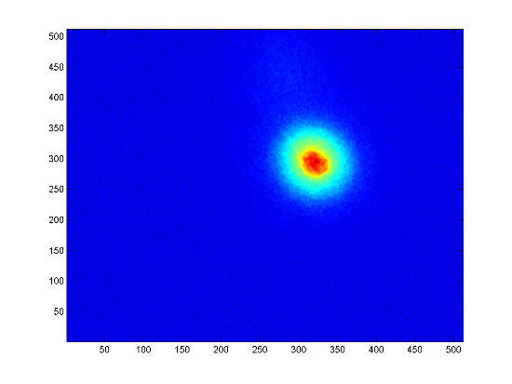
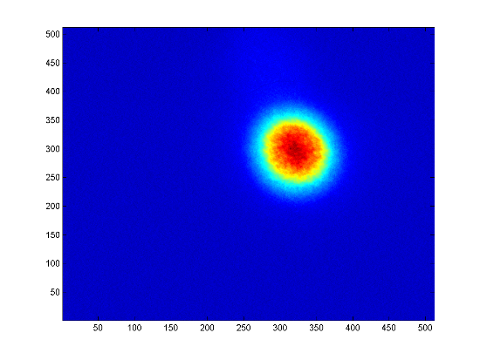
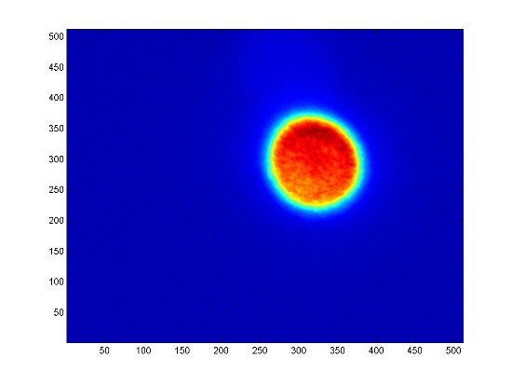
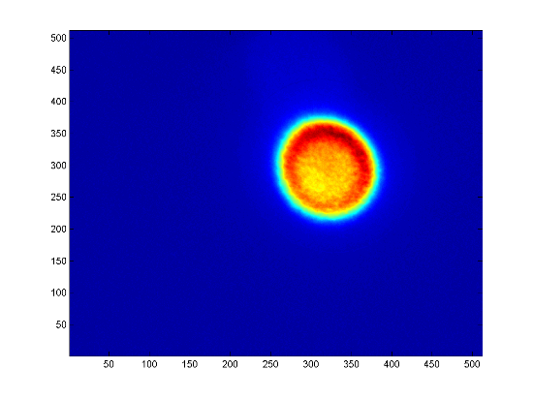
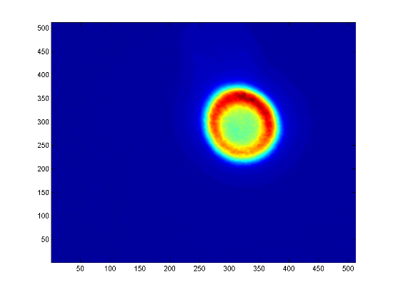

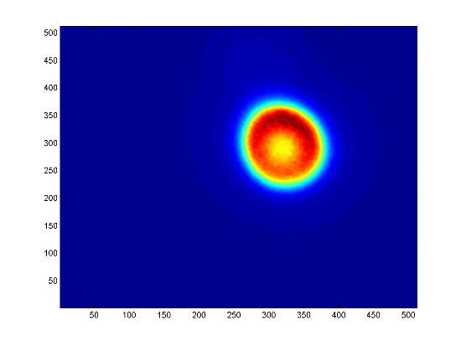
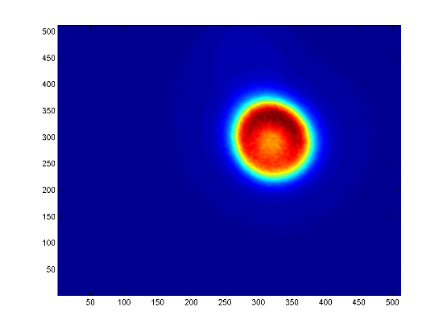
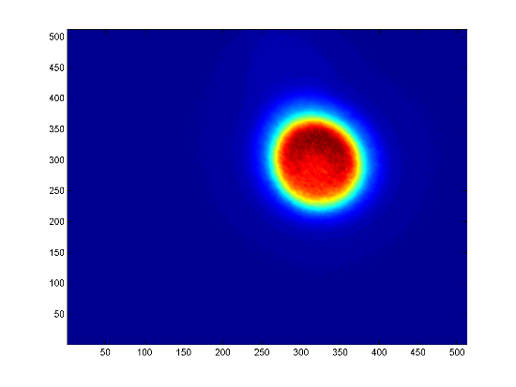
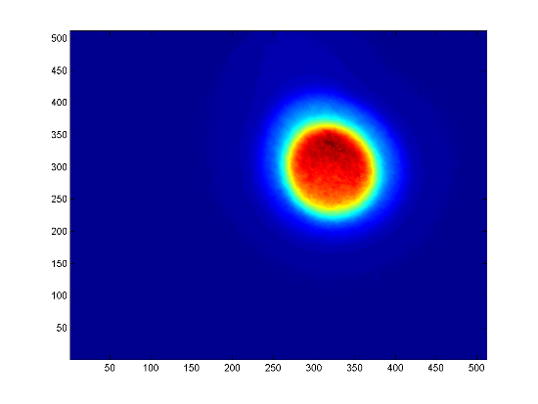
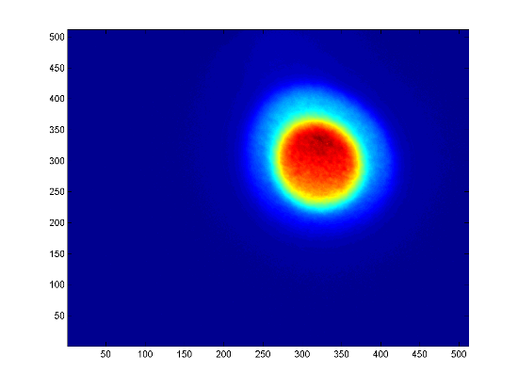
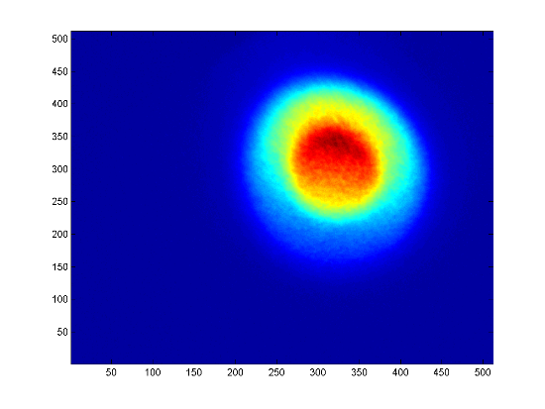
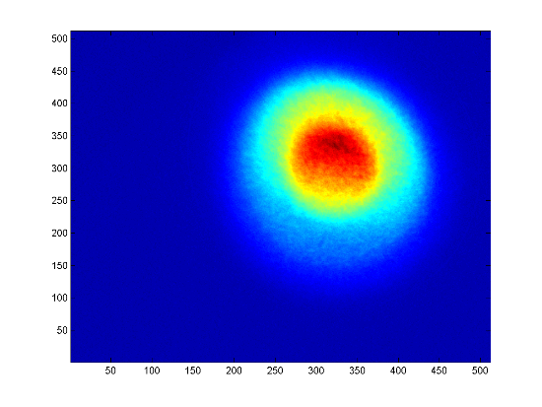
Momentotron images – Cu(111)
4.77 eV
4.82 eV
4.88 eV
4.94 eV
4.98 eV
5 eV
5.04 eV
5.10 eV
5.17 eV
5.19 eV
5.25 eV
5.32 eV
5.39 eV
5.77 eV
6.17 eV

Slide 13
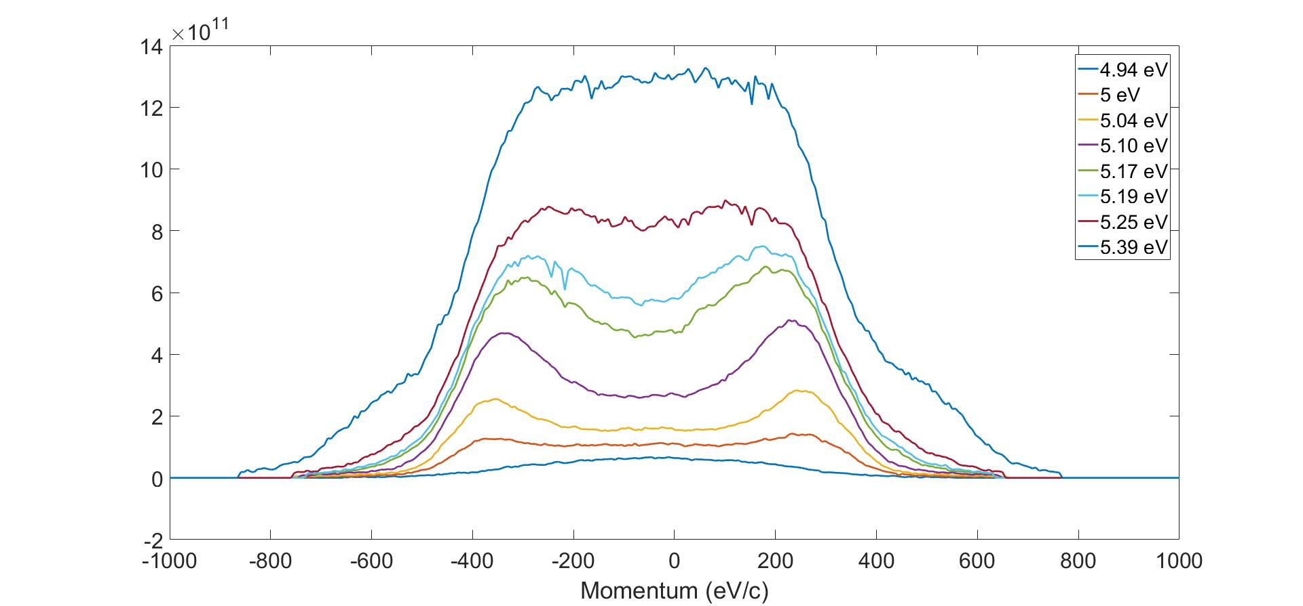
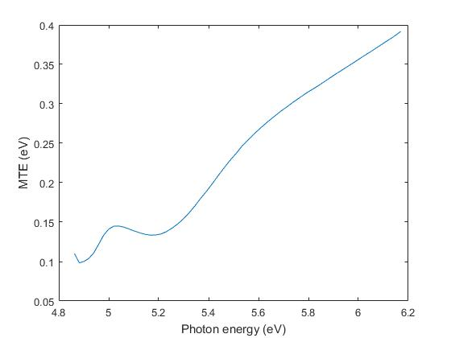
x cross-sections (normalized to incident power), MTE

Slide 14
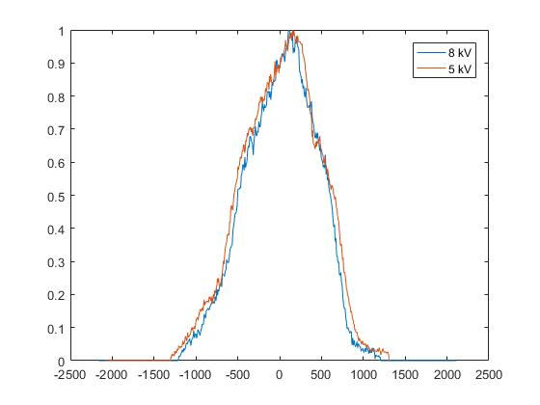
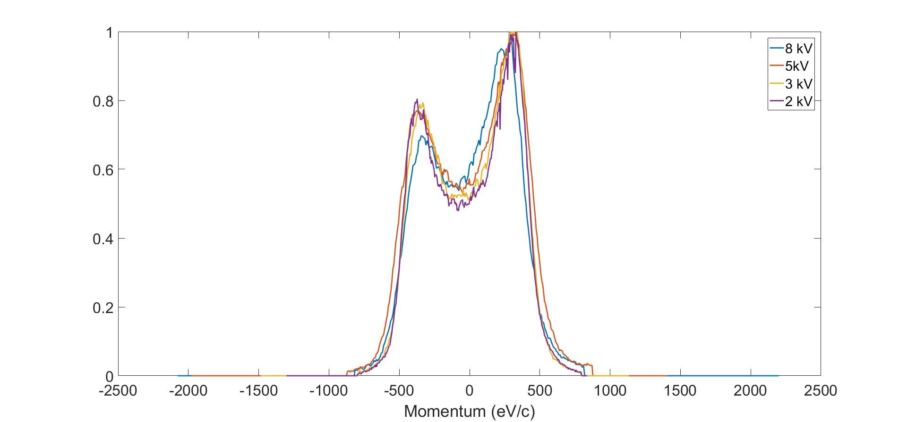

Y-cross section vs voltage
5.74 eV
5.14 eV
4.98 eV

Slide 15




Energy momentum distributions
4.67 eV
5.04 eV
4.76 eV
4.57 eV
4.53 eV
Preliminary first results

Slide 16

ARPES of n-doped PbTe(111)
Yan et al. PRL 112, 2014, 18601
Our sample is p-doped!!!

