Slide 2
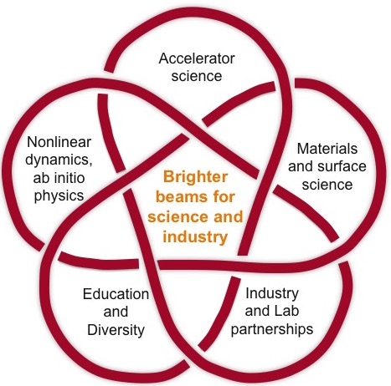
Symposium
Center for
Bright Beams
Future Accelerators: Overcoming the Challenges

