Slide 1

The Future of the Brightest X-ray Sources
Zhirong Huang
SLAC, Stanford University
June 6, 2017
Notes:
And I’m not talking about the ipad3. I am talking about R&D

Slide 2
Outline
Introduction
Status of XFELs
Future Development
Summary

Slide 3
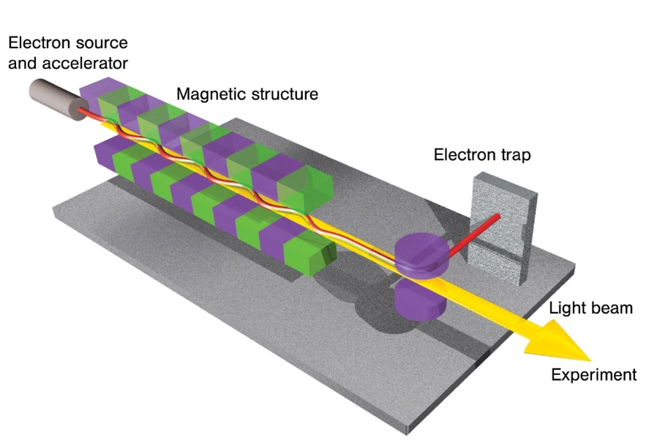
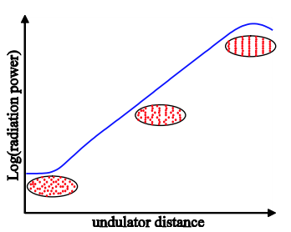
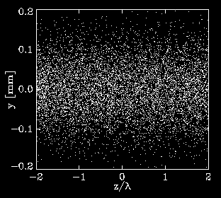
Free Electron Laser (FEL)
Resonant interaction of electrons
with EM radiation in an undulator^
Coherent radiation intensity ∝ N² due to beam microbunching
(N: # of e⁻ involved ~10⁶ to 10⁹)
At x-ray wavelengths, use Self-Amplified Spontaneous Emission* (a wonderful instability!) to reach high peak power
λ₁
S. Reiche
* Kondradenko, Saldin, Part. Accel., 1980
* Bonifacio, Pellegrini, Narducci, Opt. Com., 1984
^ J. Madey, J. Appl. Phys., 1971

Slide 4
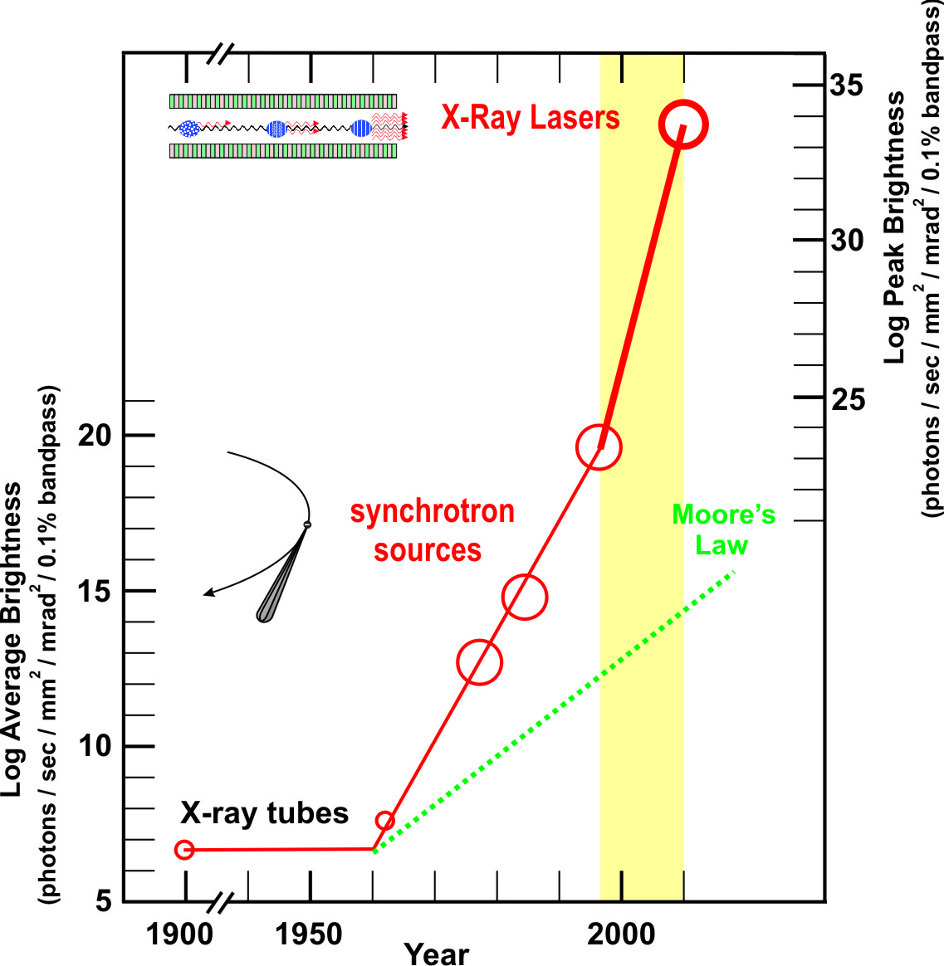
XFELs are Extremely Bright and Ultrafast
XFEL 10¹² photons
100 fs
Synchrotron 10⁶ photons
10 ps
time
High-rep. rate FEL has 100x or more average brightness than SR!

Slide 5
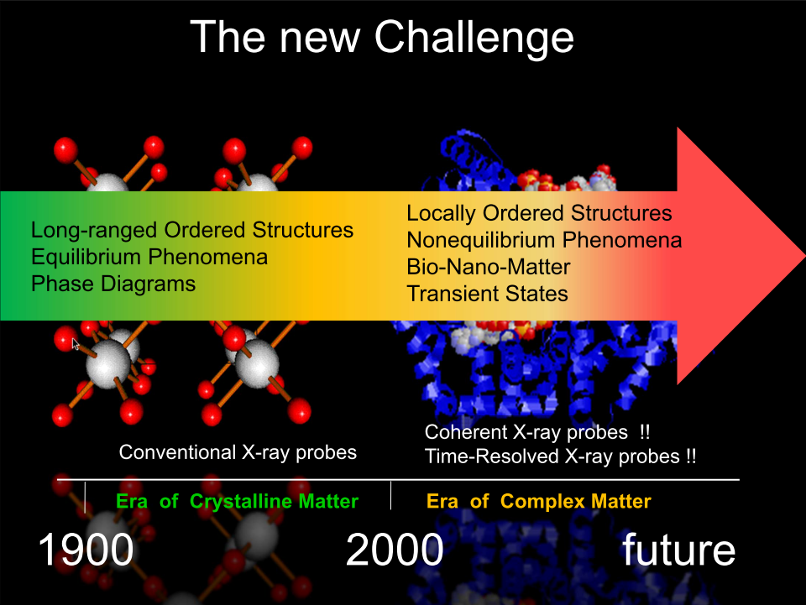
H. Dosch (DESY)
Notes:
晶体X射线衍
对非晶体的结构解析，给分子拍电影，以及对一些极端的物质状态（如高密度物质）进行研究

Slide 6
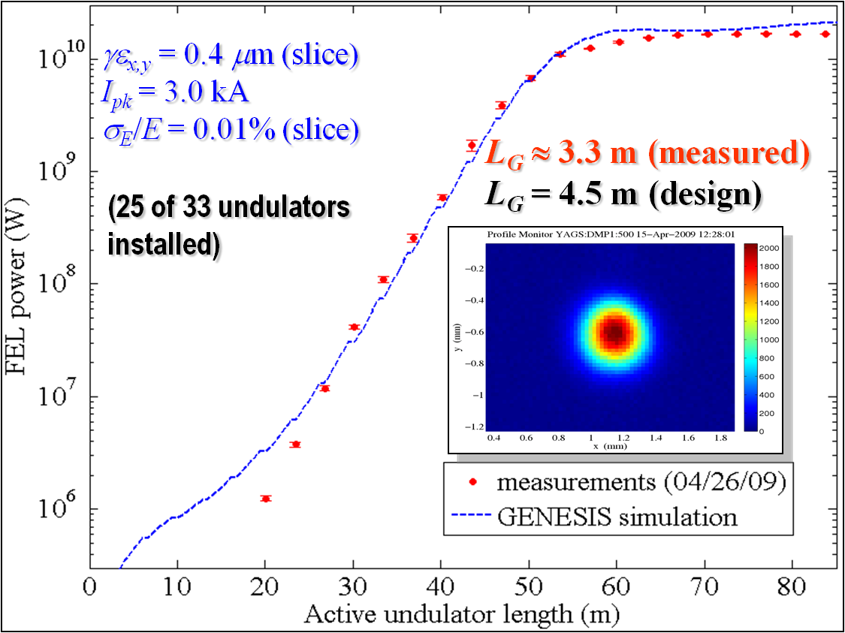
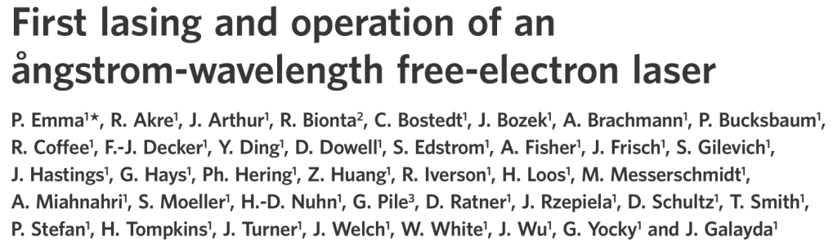
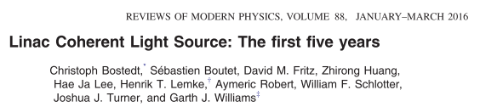
LCLS: the first hard X-ray laser
1.5 Å
PRP+IH+DD+PCS_block
SASE wavelength range: 40 – 1 Å
Photon energy range: 0.3 - 12 keV
Pulse length FWHM 5 – 100 fs
Pulse energy up to 5 mJ
Nat. Ph. 2010

Slide 7
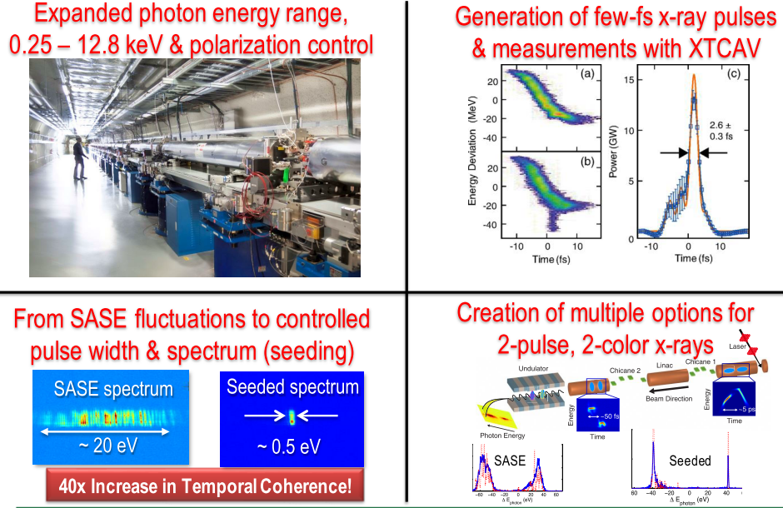
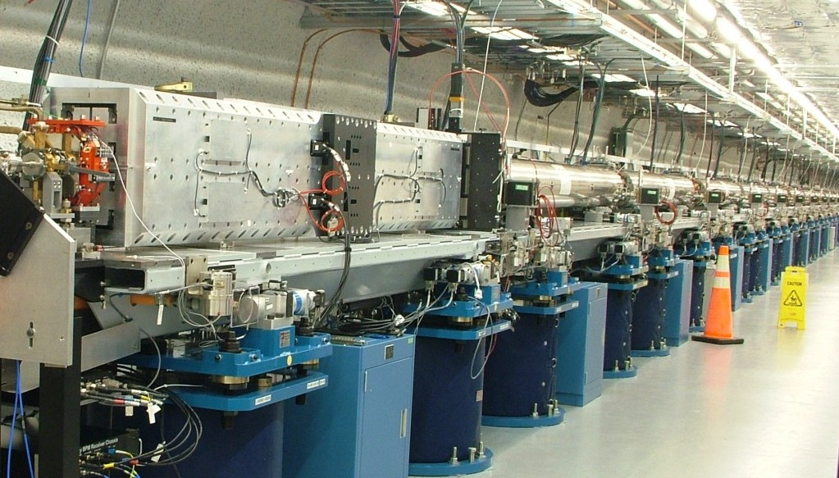
FEL R&D keep improving source properties
DELTA undulator
LCLS undulators

Slide 8







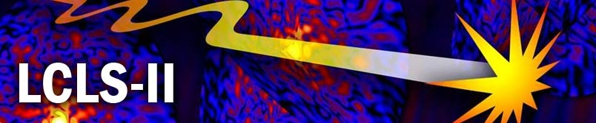


Planned/Existing X-ray FELs
FLASH at DESY, De (4.2-51 nm)
LCLS at SLAC, USA (0.11-4.4 nm)
Fermi in Trieste, Italy (4-80 nm)
SACLA at SPring-8, Japan (0.1-3.6 nm)
PAL-XFEL in Korea (0.1-10 nm)
Swiss-FEL at PSI, Ch (0.1-7 nm)
European X-FEL at DESY, De (0.05-6 nm)
LCLS-II at SLAC, USA (0.05-6 nm)
XFEL at Shanghai, China (0.05-3 nm)
(2001)
(2009)
(2010)
(2011)
(2016)
2017
2017
2020
2025

Slide 9
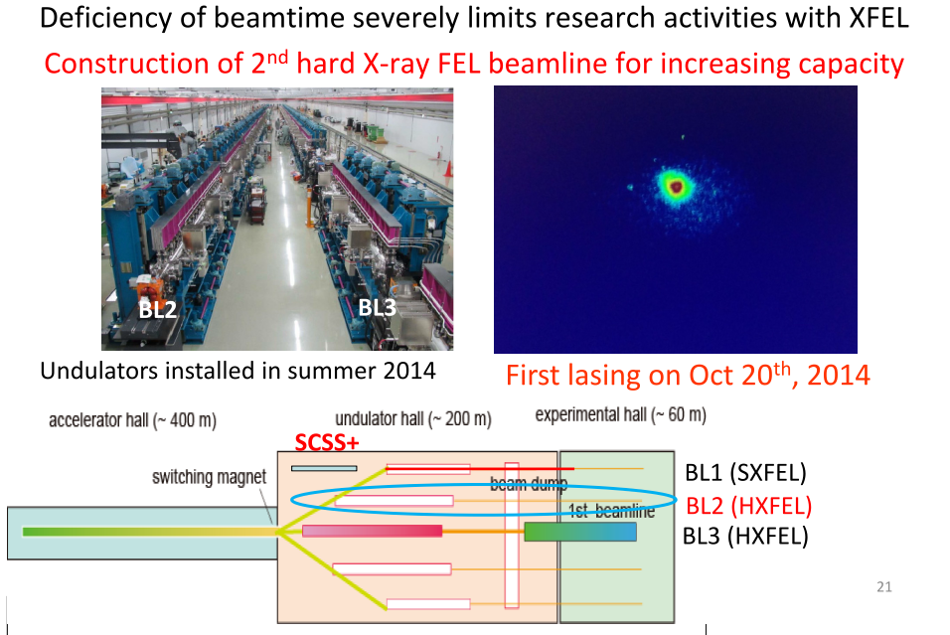
SACLA @Spring-8

Slide 10
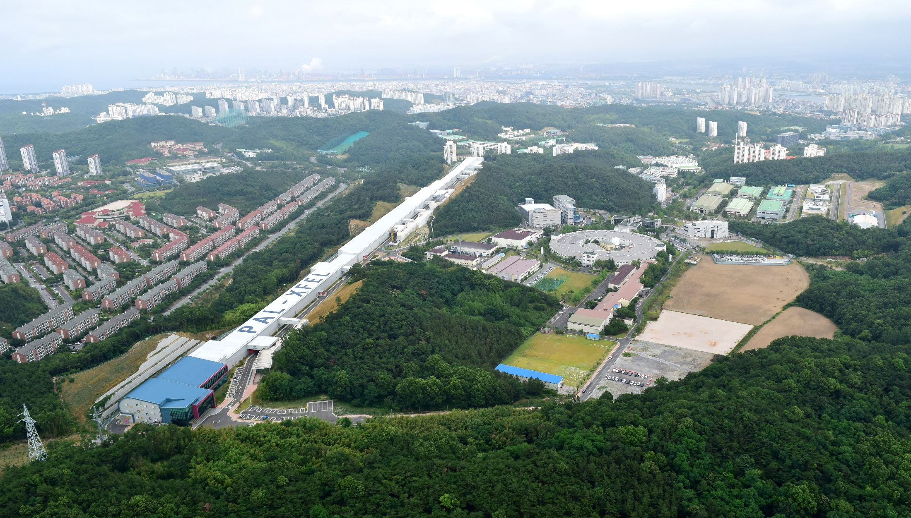
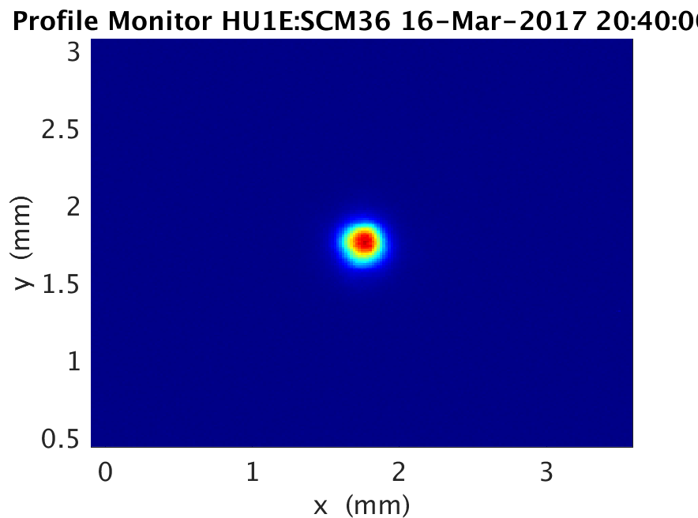
PAL-XFEL Commissioning
Heung-Sik Kang
Apr. 2011: PAL-XFEL project started
Jun. 2012: Ground-breaking
Dec. 2014: Building completed
Jan. 2016: Installation completed
Apr. 2016: Commissioning started
Jun. 2017: User-service will start
14 Jun. 2016 First SASE lasing at 0.5 nm
28 Oct. 2016 Lasing at 0.15 nm
27 Nov. 2016 Saturation of 0.15 nm
16 Mar. 2017 Saturation of 0.1 nm
0.1 nm

Slide 11
PAL-XFEL stability
M. Harmand et al. Achieving few-femtosecond time-sorting at hard X-ray free-electron lasers. Nature Photon. 7, 215-218 (2013).
- No timing jitter correction
- averaged by 50 trials of the time delay scan and normalized by GaSb(111) Bragg peak intensity
- Only slow time-drift correction
- Vibration Frequency : 2.7 THz
- Instrument Response: 137 fs (FWHM)
LCLS

Slide 12

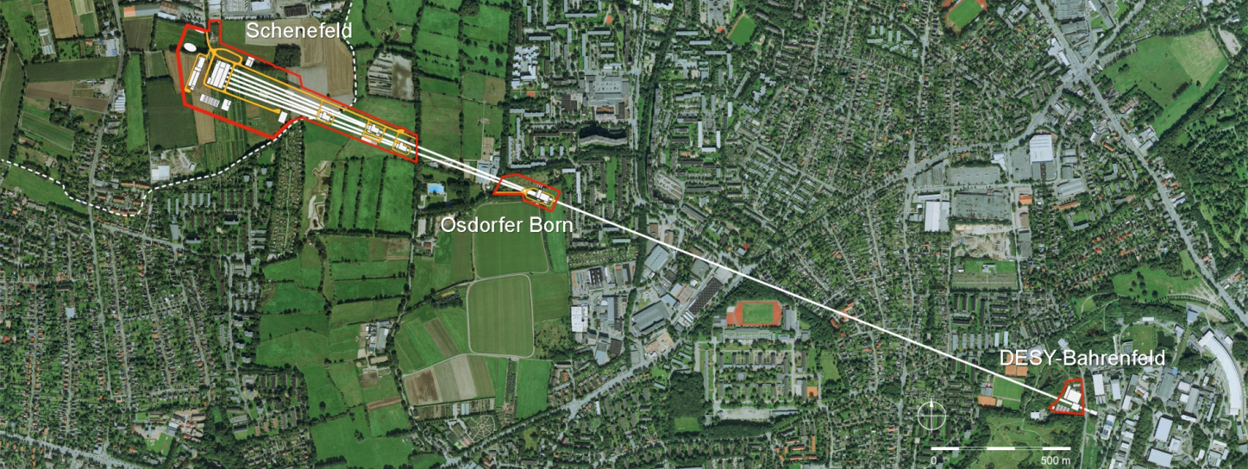

European XFEL at a Glance
International project realised in Hamburg area, Germany
17.5 GeV superconducting linac, 500 kW beam power
27000 pulses per second in 10 Hz burst mode
Three variable gap undulators for hard and soft X-rays
Initially 6 equipped experiments
All accelerator and beamlines in tunnels 6 -25 m below surface
Experimental Hall
Photon Beam Lines
Beam Dumps
Undulators
3.3 km
Electron Beam Distribution
Collimation
Linear Accelerator
Bunch
Compressors
Injector

Slide 13
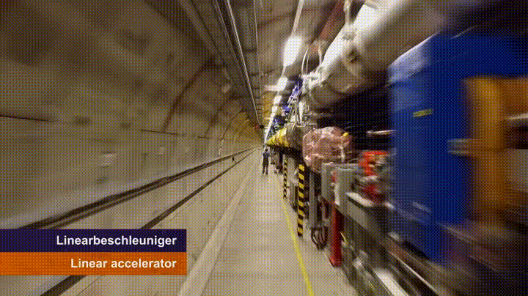

View along the 1km SRF linear accelerator
IPAC ‘17, 15.5.2017
Winni Decking, DESY

Slide 14
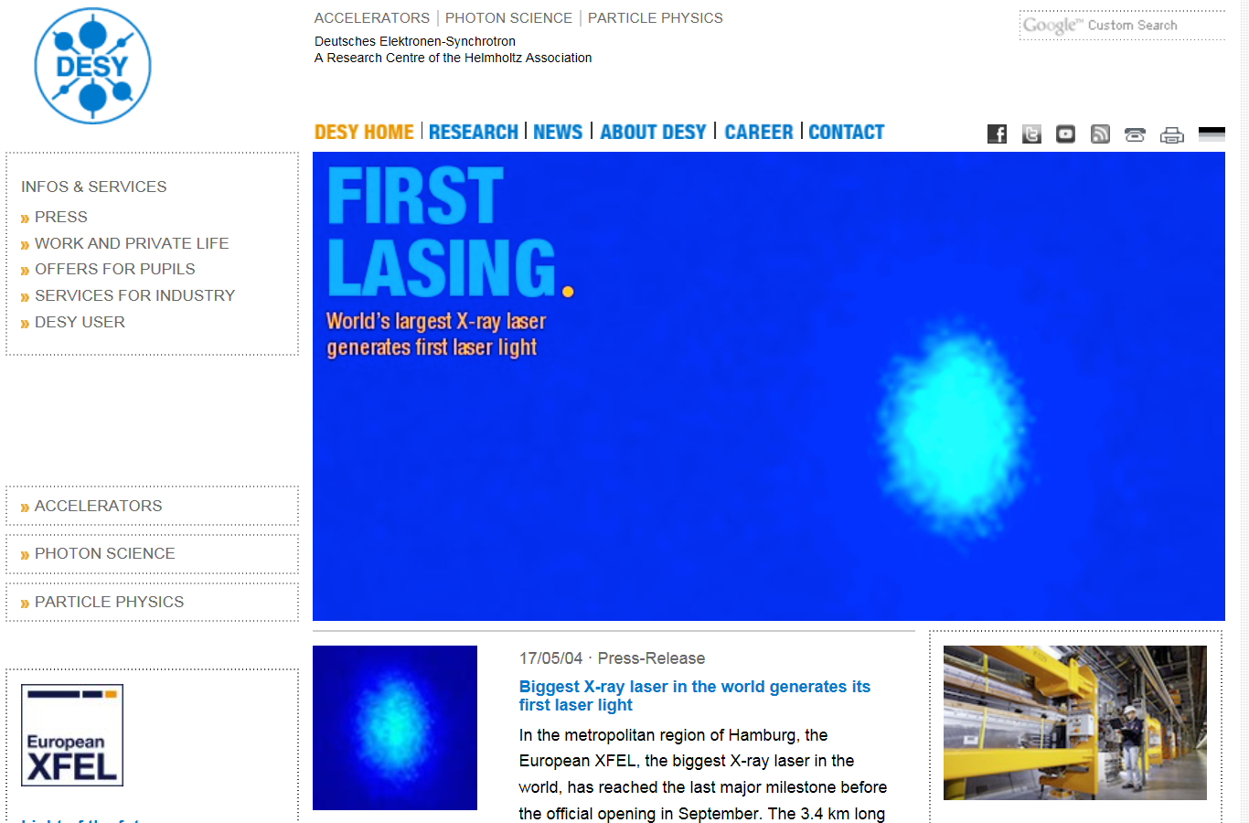

Slide 15

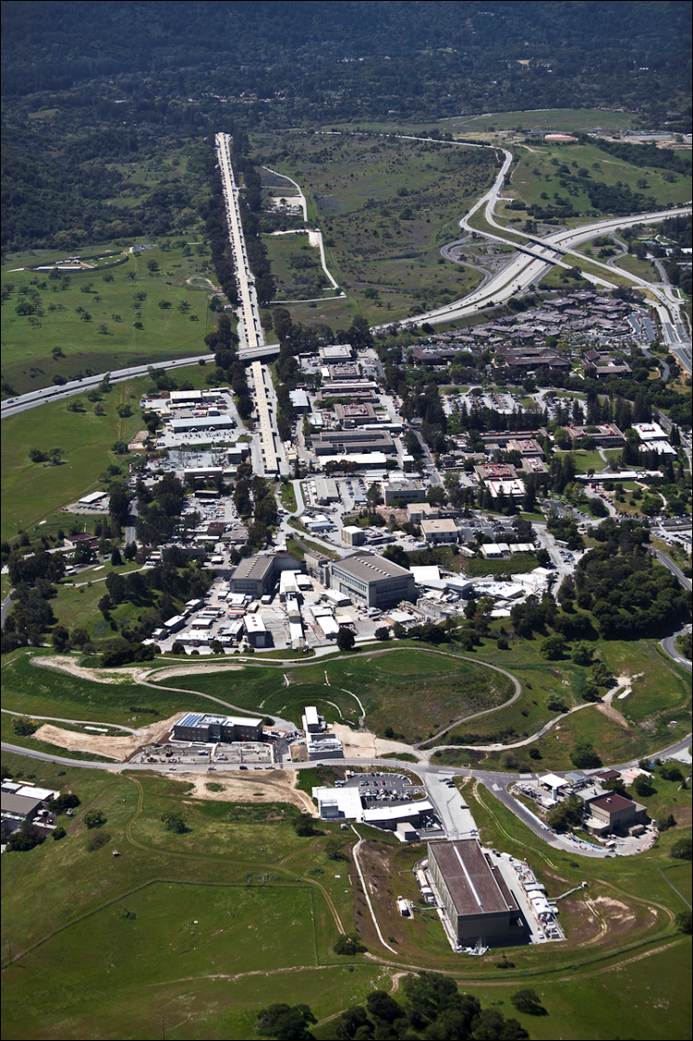


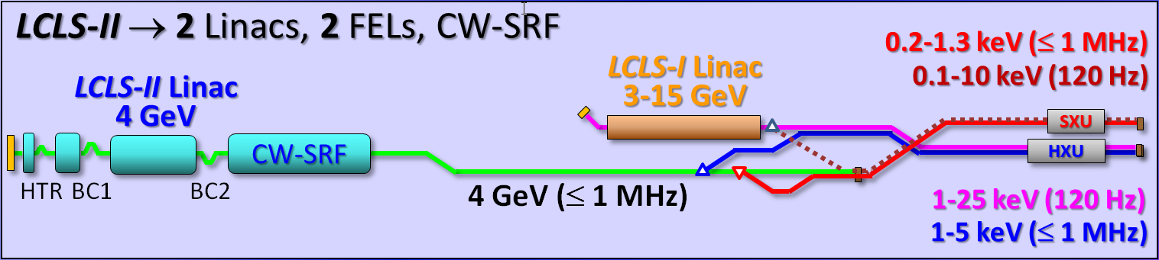
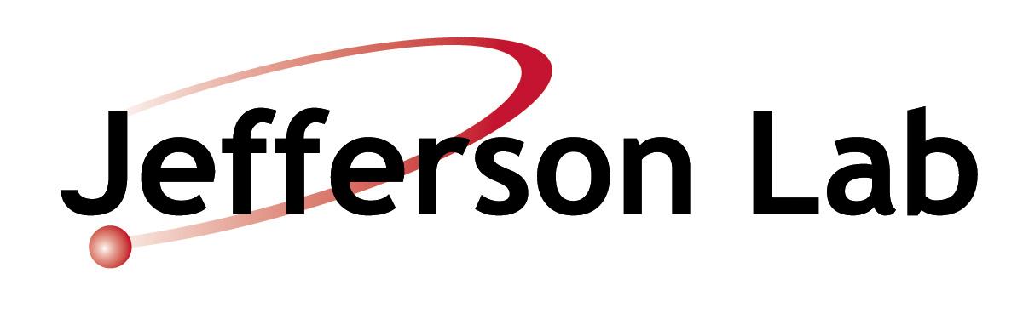

LCLS-II (2019)
Cu Linac and SRF Linac
LCLS-I (uses 1-km existing SLAC linac)
Repetition rate = 120 Hz
Electron energy = 3 - 15 GeV
Photon energy = 0.3 - 11 keV
X-ray pulse length = 5 - 500 fsec
Operations: 2009 - 2017
LCLS-II (2 FELs, 2 Linacs, CW-SRF)
Repetition rate = 1 MHz
Electron energy = 4 GeV & 3-15 GeV
Photon energy = 0.2 - 25 keV
X-ray pulse length = 5 - 200 fsec
Operations: 2019 - ?

Slide 16

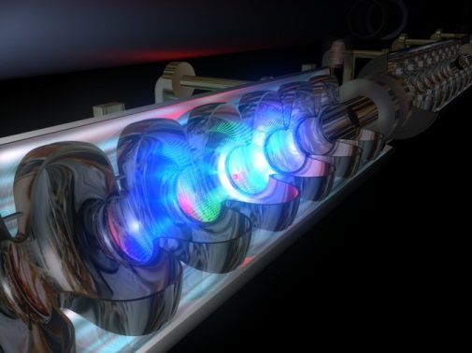
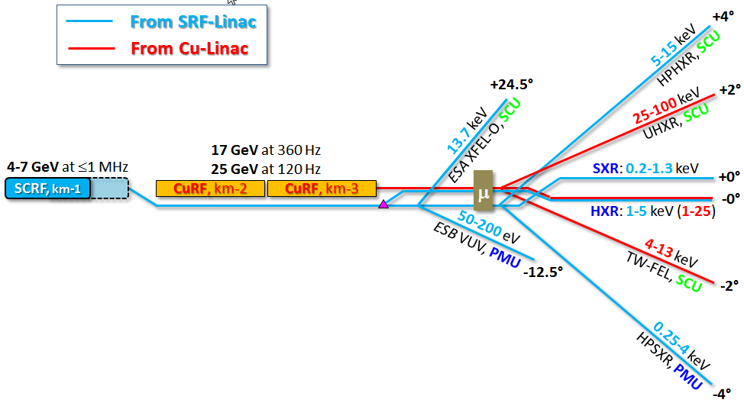
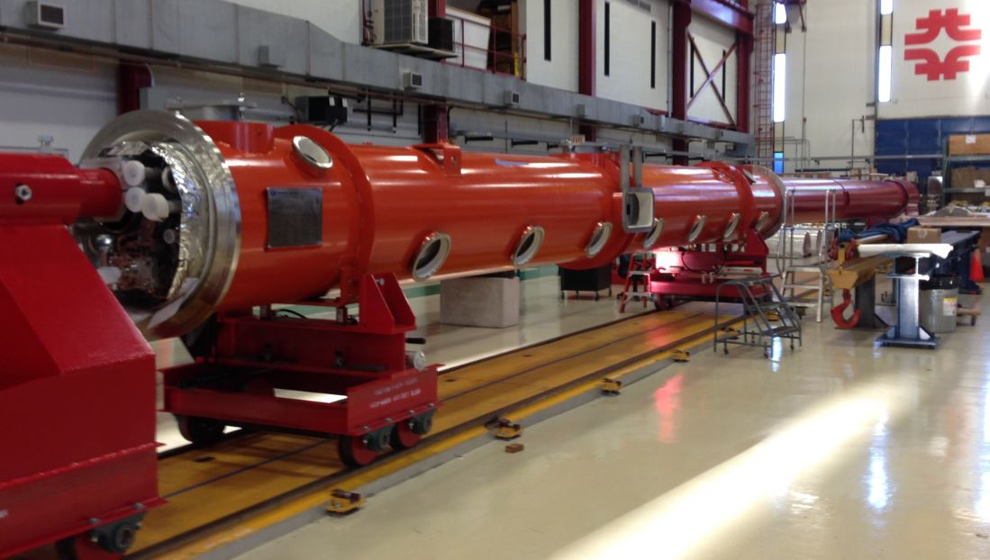
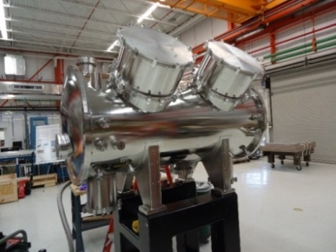
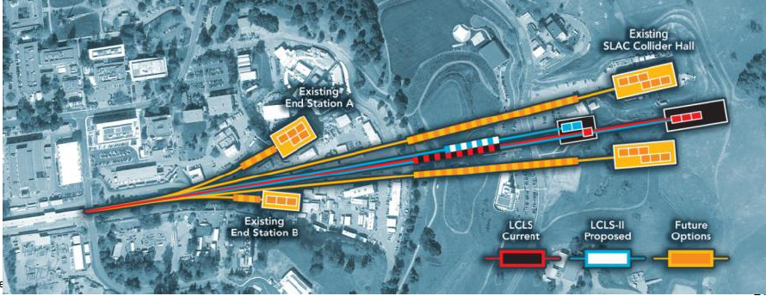

FEL Options Beyond LCLS-II
Add 20 Cryomodules for 8 GeV (19.5 MV/m)
Use 2-km SLAC linac → 25 GeV (100 keV photons)
Develop superconducting undulators
Build out ~6 more FELs (?)
From SRF-Linac
From Cu-Linac
8 GeV at
≤1 MHz
25 GeV at
120 Hz
8
20 more CM’s
(19.5 MV/m)
Speculative layout
P. Emma et al.,

Slide 17
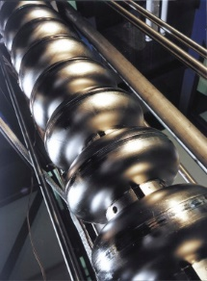
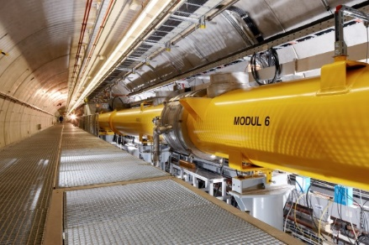
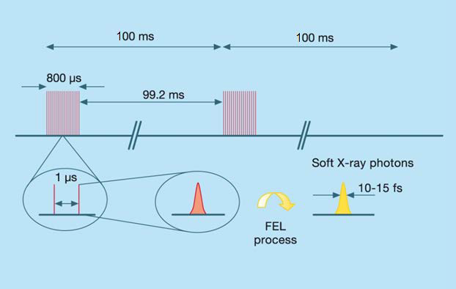
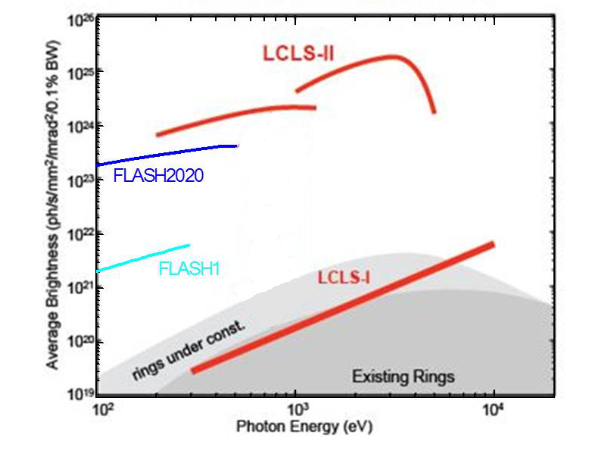

FLASH2020 – A High Rep. Rate XUV and Soft X-Ray FEL
FLASH
FLASH2020
Gain x 125
Key R&D for Eu-XFEL CW operation

Slide 18
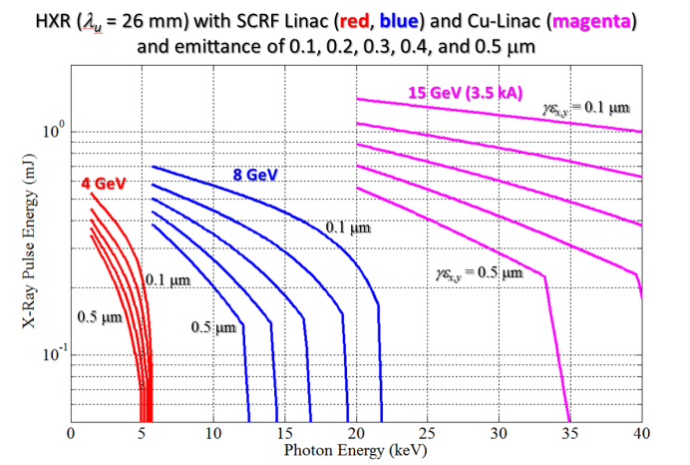
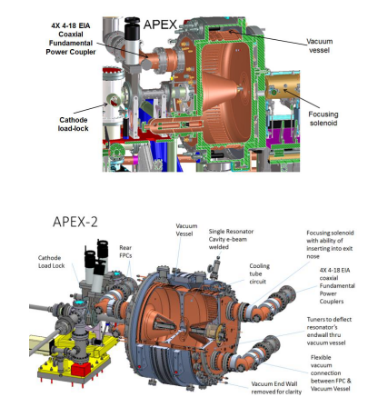
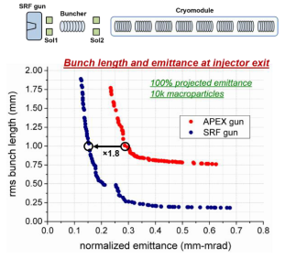
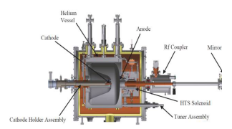
Brighter electron beams
Smaller emittance sources improve XFEL performance
Better cathodes and guns
SRF gun

Slide 19
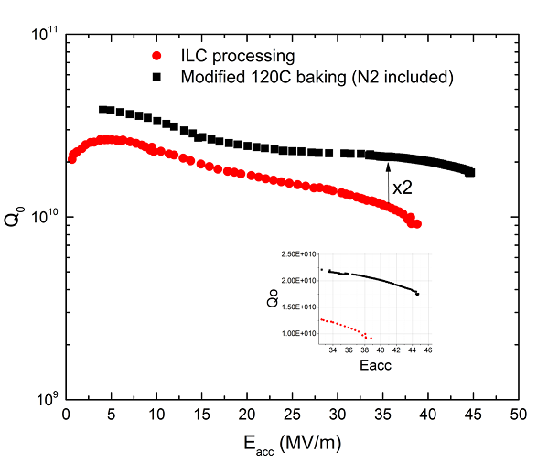
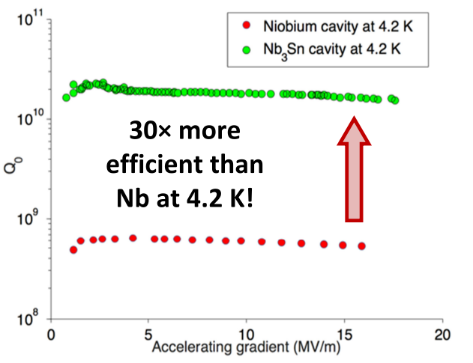
More efficient accelerators
SRF: high-current, high-energy beam
N doping double Q0 ➔ baseline of LCLS-II cavities
New development: N infusion: Increase in Q factor of two, increase in gradient ~20%
R&D: Nb3Sn at 4.2 K can further reduce cryogenic cost and complexity
A. Grassellino et al, arXiv:1701.06077
New breakthrough
N infusion: Increase in Q factor of two, increase in gradient ~20%
D. Halll, M. Liepe, IPAC17

Slide 20
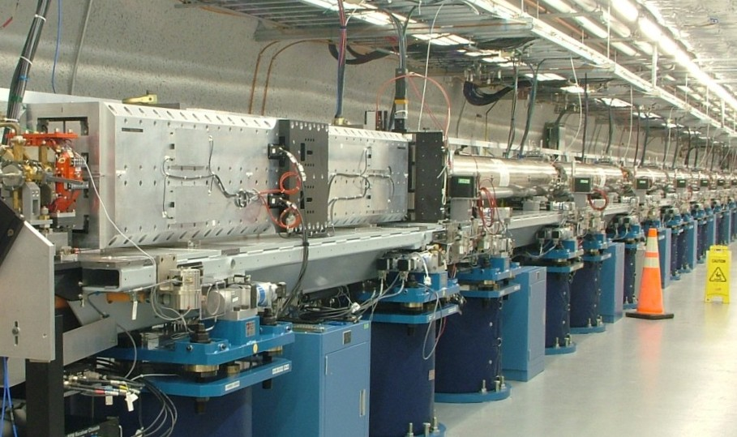
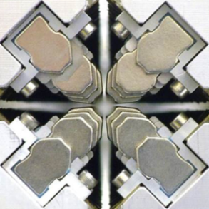

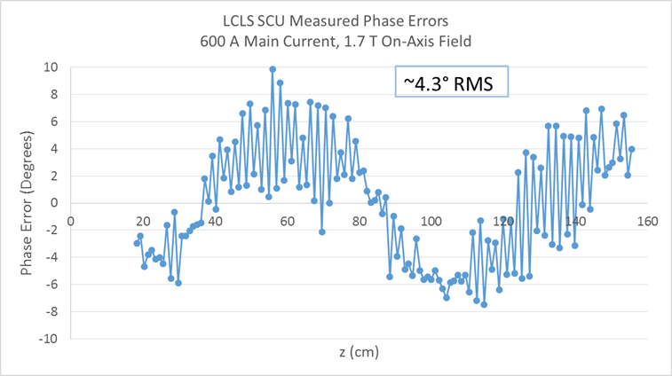
Novel Undulators
A new type of undulator (“Delta”) has been developed and commissioned at LCLS for polarization control. (H.-D. Nuhn et al., after A. Temnykh’s prototype)
Superconducting (helical) undulator improves FEL efficiency and extends spectral range for LCLS-II (P. Emma, E. Gluskin et al.)
Phase Error (deg)
z (m)
ANL prototype (NbTi) phase error controlled to < 5 deg rms

Slide 21
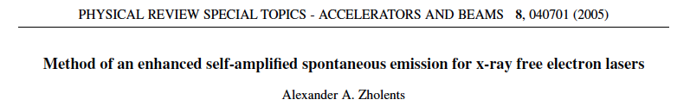
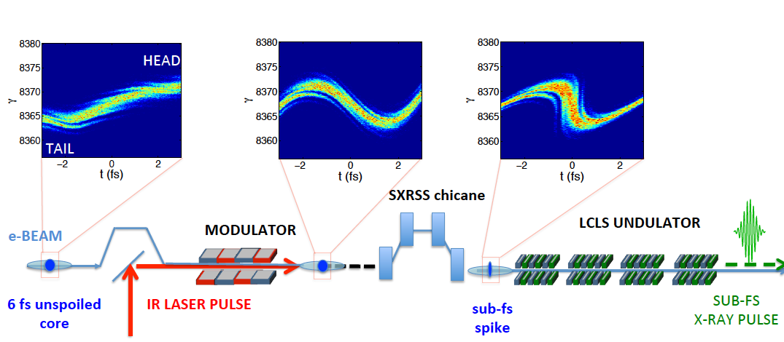
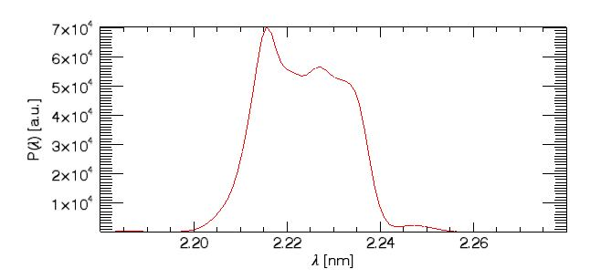
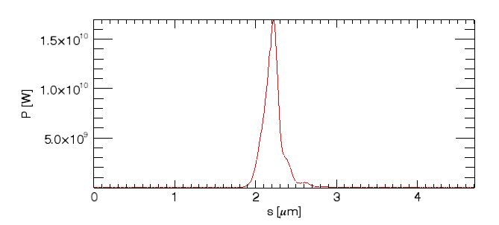
Shorter X-Rays – Attosecond pulses
1) <1 fs pulse duration.
2) Multi eV coherent bandwidth.
3) ~20 uJ pulse energy.
Two-color operation with sub-fs jitter for x-ray pump/x-ray probe experiments
0.6 fs FWHM
6 eV
A. Marinelli et al.
Notes:
Greatly decreases FEL Gain length!!!

Slide 22
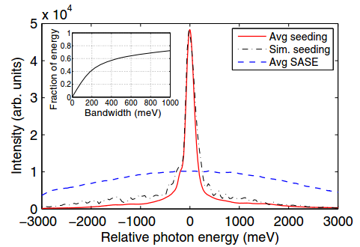
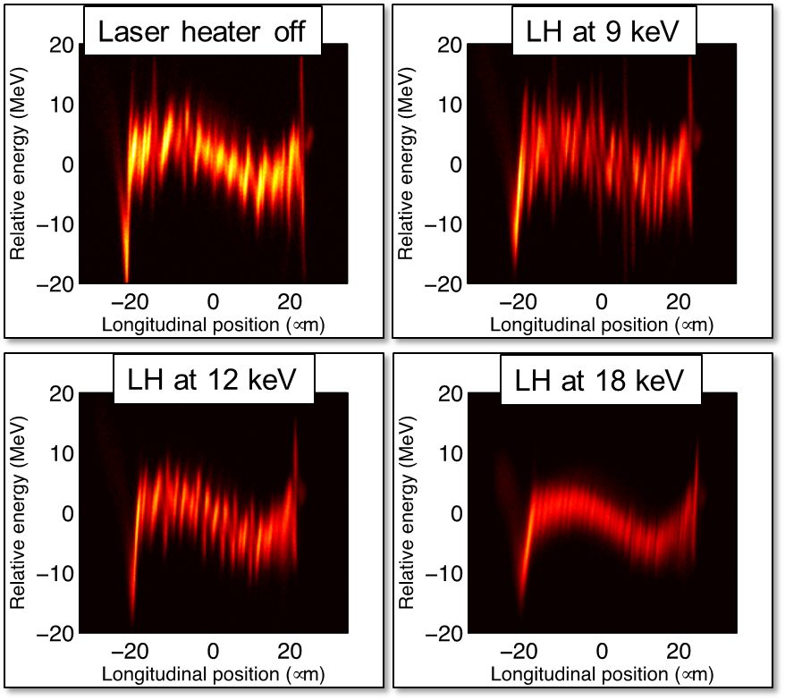


Better phase space ➔ Towards Fourier limit
chicane
Undulator 2-7
Undulator 10-18
e⁻
grating
M3
FEL
X-rays
slit
SASE FEL
Seeded FEL
M1
M2
930 eV
10000 shots
D. Ratner et al., PRL 114, 054801 (2015)
Soft X-ray spectral brightness ~5x higher than SASE
Observe spectral pedestals (from beam microbunching).
Various external laser seeding under-studies (FERMI, sFLASH, Shanghai)

Slide 23
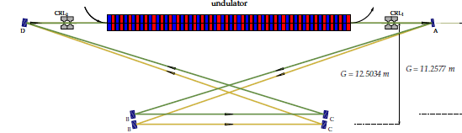
Narrower bandwidth: XFELO
XFELO was first proposed by R. Collela and A. Luccio at 1983 BNL workshop by using Bragg reflectors as high reflectivity normal incidence mirrors
  Taking into account of the advances in accelerator and x-ray optics, it was “resurrected” in 2008 by K.-J. Kim et al.
Tuning is possible with the four-crystal, zigzag cavity
  R. M.J. Cotterill (1968, ANL); KJK and Y. Shvyd’ko (2009)
Electron beam with a constant, ~ MHz rep rate will be ideal
Promise to provide narrow-bandwidth (~meV) and stable x-rays (cavity R&D)

Slide 24
Summary
XFEL is a breakthrough in light source development, enabling atomic-scale imaging at femtosecond time resolution.
SRF technology enables efficient CW operation and higher-average brightness XFEL.
Vigorous accelerator and FEL R&D can drastically improve FEL coherence and brightness, which in turn demands better control of electron beams and advanced undulator and X-ray optics development.

