Slide 1

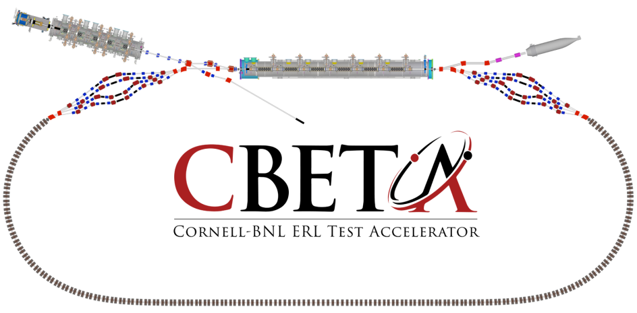
Page Headline
Splitters

Slide 2

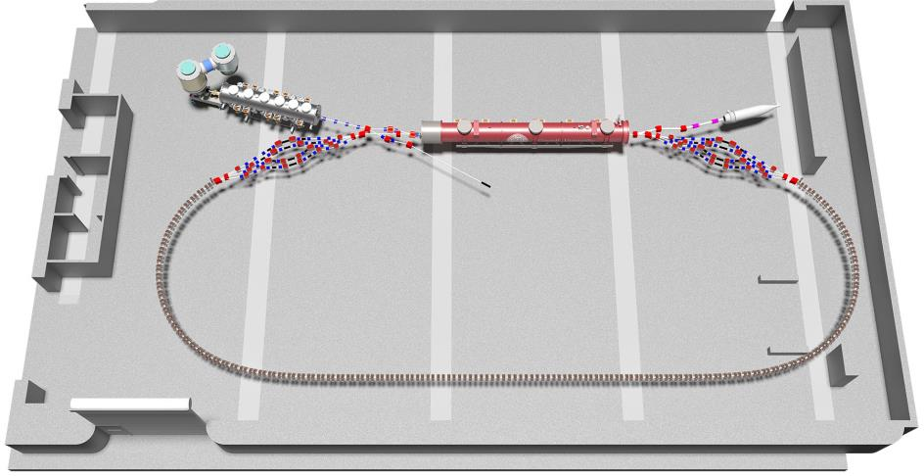

Slide 3
Outline
WBS dictionary
Basis of estimate
Overview of Cost estimate
Procurement Plan
Value Engineering
Major Risks

Slide 4
WBS Dictionary

Slide 5
WBS Dictionary

Slide 6
Basis of Estimate
Magnets
  Estimates via email. RFP in development – Due 3/1
  Quads range - $15k to $20.4K (estimates from suppliers)
  Dipole range - $15k to $23.5k (estimates from suppliers)
  Septa range - $15k to $20k (engineering judgement)
  Common range - $15k to $20k (engineering judgement)
  Labor – scientist to support magnet concepts, engineer for RFP and supplier engagement, engineer for septum and common magnets

Slide 7
Basis of Estimate
  Tables
  Catalog price. RFP in development
  Breadboard - $7k (4x) + NRE for custom size
  Labor – engineer for RFP and supplier management

Slide 8
Basis of Estimate
Magnet mounts (144x)
  Comparable designs at Cornell
  $$$ working on actual estimate if done in-house
  Labor – engineering/design, machinist (in-house)
  Translation Stages
  Catalog price. Looking at CU inventory for existing motor/hardware
  $2k catalog for high end linear translation stages
  Labor – engineer, designer, controls
  Table Hardware
  Technical low-risk designs
  Cables, cooling manifolds, bulkhead connectors, etc
  Labor – engineer, designer, electrical technician
  Table Assembly
  Supplies (tools, custom lifts/installation, hardware)
  Labor – engineer (project management), technicians

Slide 9
Cost Estimate Overview

Slide 10
Procurement Plan
RFP for outside magnet construction
Table 1.1 Magnet Type and Quantity
Type | Qty
Dipole H-Type 1 (21x27x20) | 24
Dipole H-Type 2 (21x27x30) | 12
Quadrupole (14x14x15) | 64
RFP for table/girders being developed
Newport (honeycomb breadboard)
ADC (table)
Table 1.2 Delivery Schedule
Due Date | Type | Qty
11/1/2017 | Dipole H-Type 1 (21x27x20) | 6
11/1/2017 | Dipole H-Type 2 (21x27x30) | 2
11/1/2017 | Quadrupole (14x14x15) | 10
5/1/2018 | Dipole H-Type 1 (21x27x20) | 19
5/1/2018 | Dipole H-Type 2 (21x27x30) | 10
5/1/2018 | Quadrupole (14x14x15) | 54

Slide 11
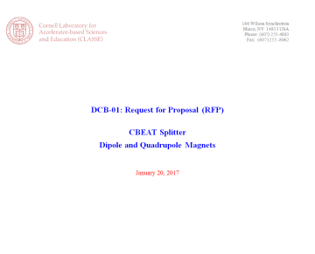
Procurement Plan

Slide 12
Major Risks

Slide 13
Value Engineering
  Splitter Magnets >> local manufacturers for iron and coils
  - Technical risk
  - Break even point? Engineer’s time and opportunity cost
  Correctors integrated into quads
  - savings of ~$5k * 32 = ~$160k
  Power supplies & magnets procured together as a total package
  Integrated mounting and adjustments in the magnets
  decision made after review of RFPs
  Potential savings of $55k

Slide 14
Backup Slides

Slide 15
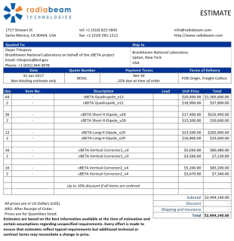
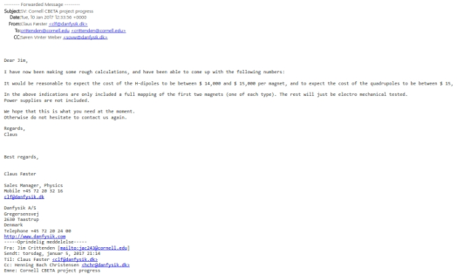
Basis of Estimate
Magnets
            Danfysik estimate - $15k for Quads (64x) and Dipoles (36x)
            RadiaBeam estimate - $20.4k for Quads, $17.4k for short Dipole, $23.5k for long Dipole, $5.1k for vertical correctors

Slide 16
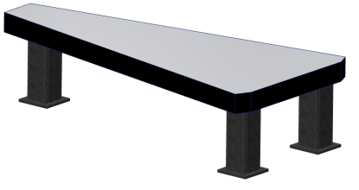
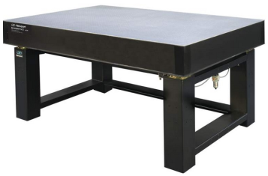
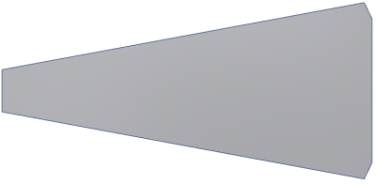
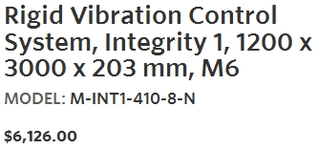
Basis of Estimate
Tables
            Newport Breadboard Optics Table - $7k + NRE
1650 mm
3500 mm

Slide 17
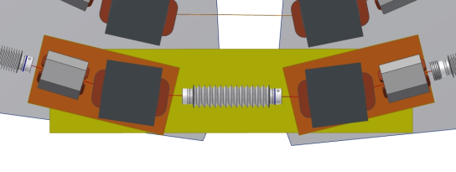
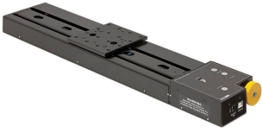
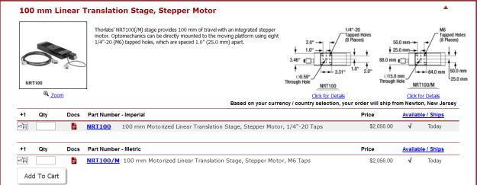
Basis of Estimate
Translation Stages (8x)
            Linear Stepper Slide and controllers

Slide 18

RFPs and Design Specs

Slide 19
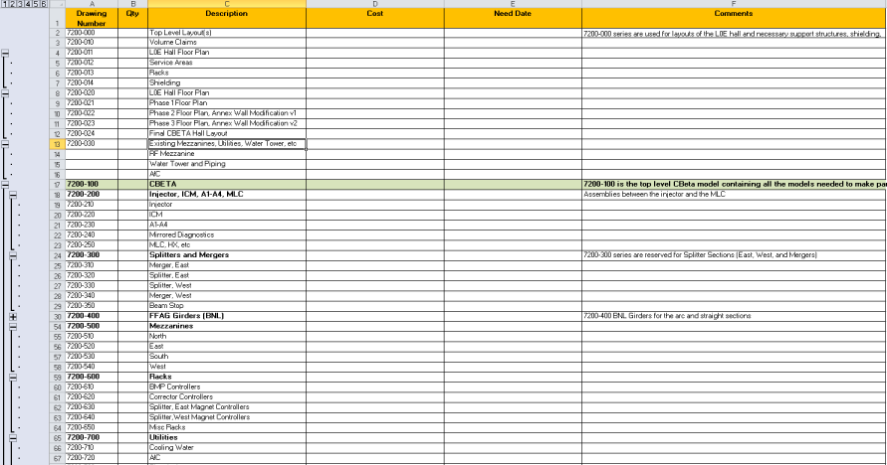
“ERP” & BoM

