Slide 1

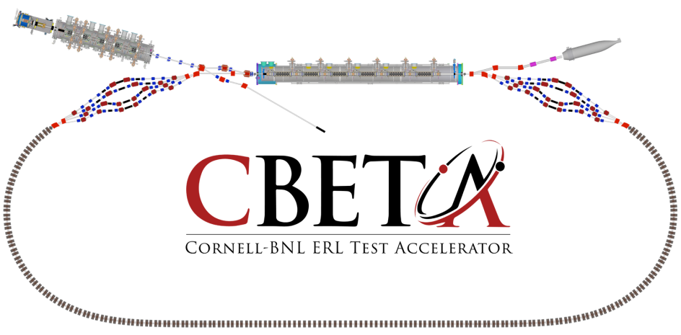
Page Headline
FFAG Magnet and Girders
J. Tuozzolo, Stephen Brooks, George Mahler, Steven Trabocchi,

Slide 2
Presentation Outline
WBS Dictionary (including brief specs & quantities)
Design
Labor & Materials
Basis of Estimate
Procurement & Production
Overview of cost estimate
Schedule Overview
Major Risks

Slide 3
WBS Dictionary
Scope: Design, Fabricate, and Test:
211 Consistent Halbach permanent magnets, (5 types)
211 Powered correctors for beam line, (2 types)
27 girder assemblies
Install and align magnets on “girder” assemblies with vacuum chamber from Cornell
Ship to Cornell for Installation

Slide 4
WBS Dictionary

Slide 5
WBS Dictionary

Slide 6
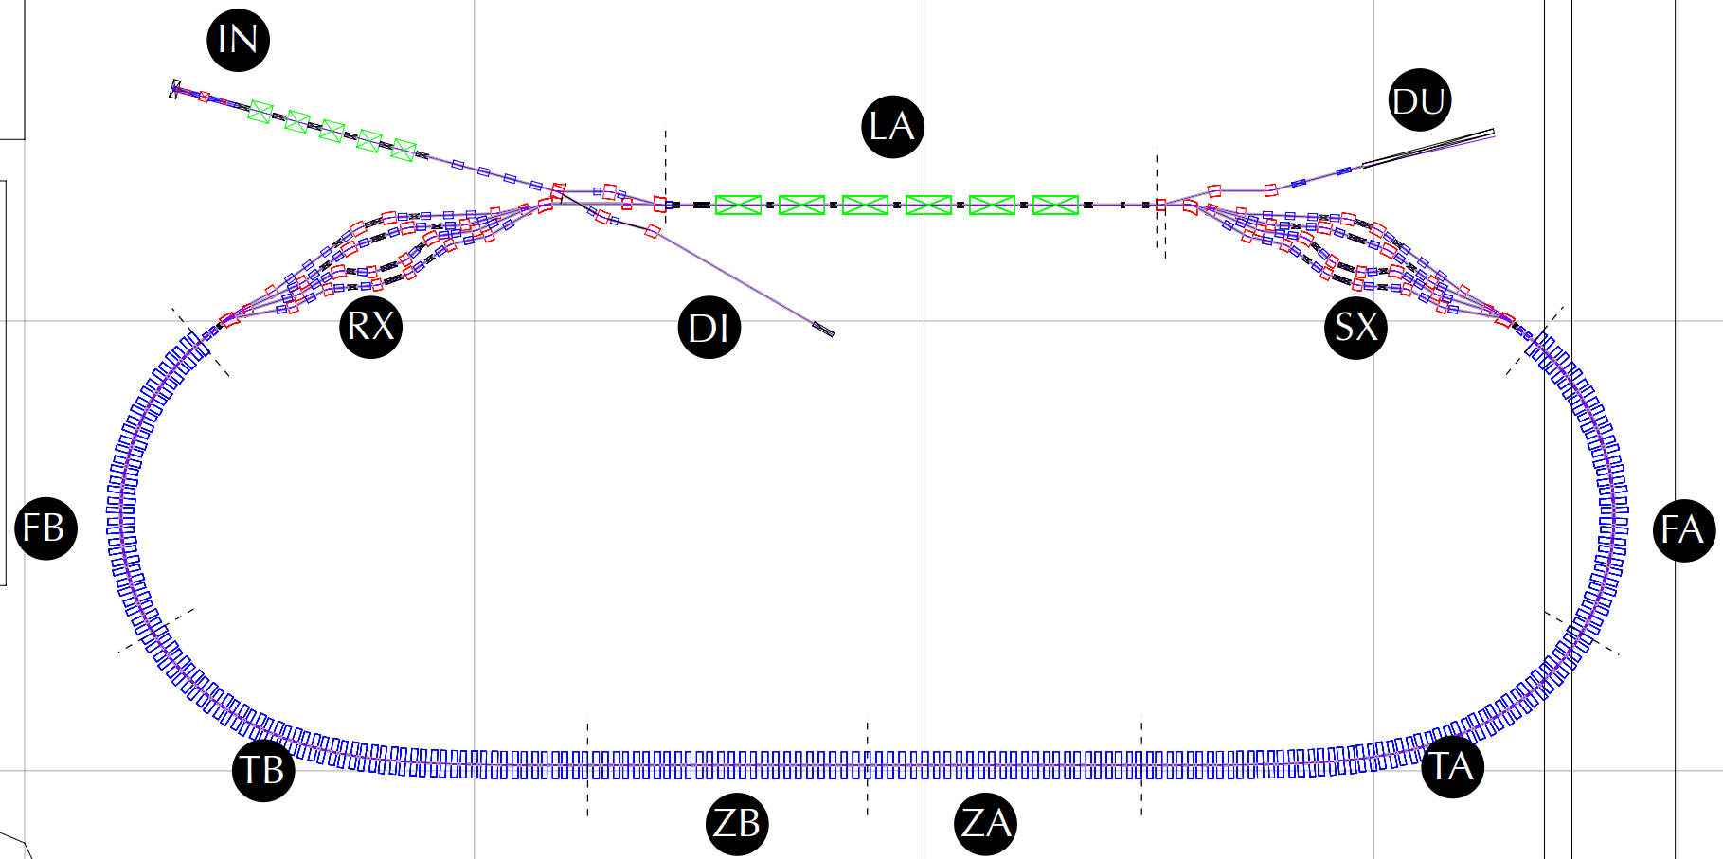
Girder Types and Positions
Gate Valves (11)
10 RF shielded
3 New to CBETA
NT
NexTorr Pump (28)
GV
CT
CapaciTorr Pump (34)
IP
Ion Pump (2)
GA
Ion and Pirani Gauges (8)
GV
GV
NT
GV
NT
GA
GA
IP
CT
CT
IP
NT
CT
GV
CT
NT
NT
NT
GV
NT X4
GV
GV
NT X4
CT X4
CT
GV
GA
GA
CT
CT X4
NT
CT
GA
CT
GA
(0,10m)
(10,10m)
NT
(20,10m)
GV
FB-GD04
CT
CT
FA-GD01
GV
FB-GD03
CT
NT
FA-GD02
NT
GA
CT
CT
GA
FB-GD02
FA-GD03
NT
FB-GD01
NT
CT
FA-GD04
CT
NT
TB-GD06
NT
ZB-GD02
ZB-GD01
ZA-GD03
ZA-GD02
CT
TA-GD01
CT
NT
CT
NT
CT
CT
NT
CT
CT
NT
CT
CT
NT
CT
CT
NT
TB-GD05
TA-GD02
(0,0)
TB-GD04
TA-GD03
TB-GD03
TB-GD02
TB-GD01
ZB-GD03
ZM-GD
ZA-GD01
TA-GD06
TA-GD05
TA-GD04

Slide 7
Girder Types and Positions
4 Cells per Girder, 2 Magnets per cell

Slide 8
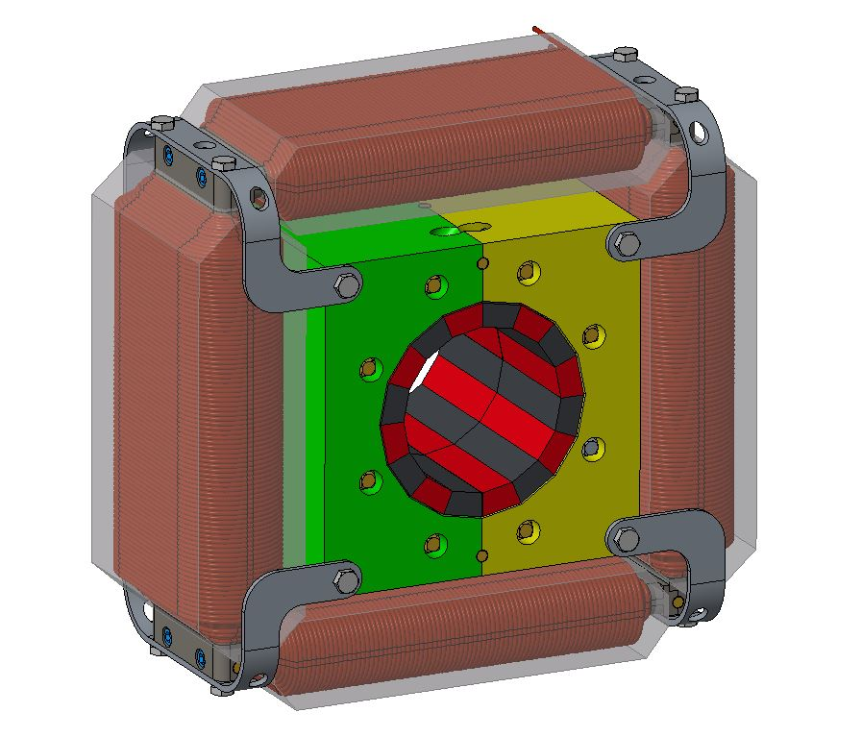
Halbach Magnet Frame Design
Final frame models/drawings with alignment pins
Quadrupole / Horizontal OR Vertical dipole correctors
Permanent Halbach wedges glued in place to defined shimmed location on an aluminum frame
Alignment pins for repeatable assembly of Halbach magnet
Corrector assembly disassembles to allow for vertical Halbach split
Alignment pins for repeatable assembly of Halbach magnet

Slide 9
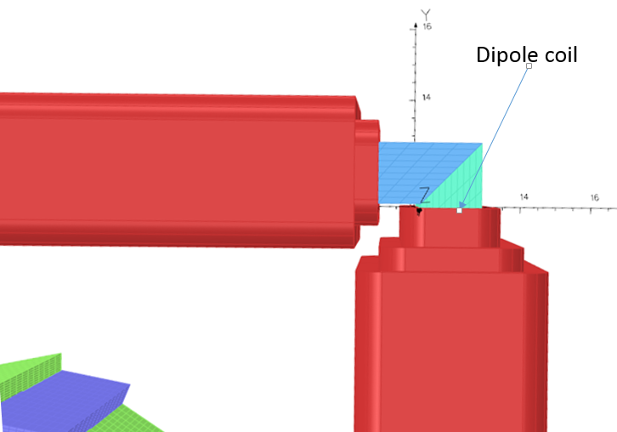
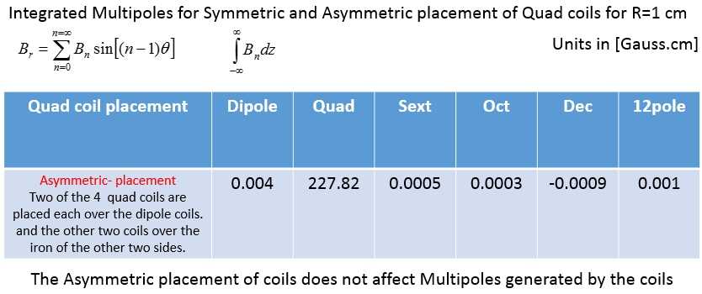
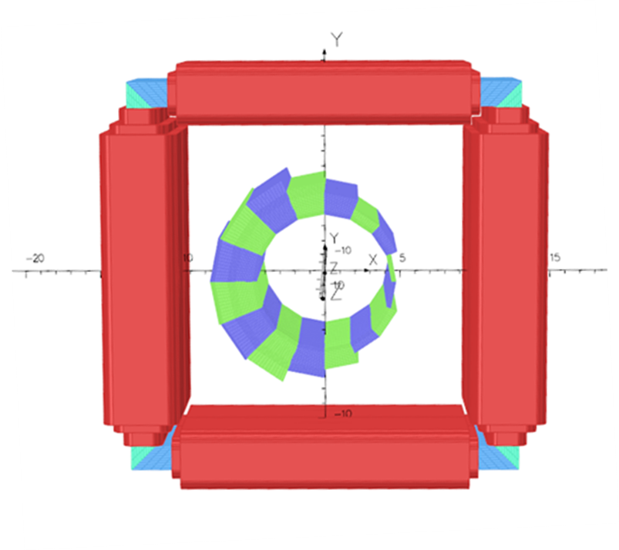
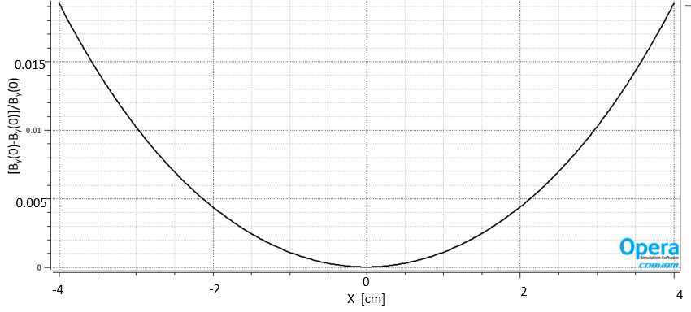
Halbach Corrector Magnets
Halbach Corrector Magnet details:
BD and QF correctors be the same configuration
Alternating horizontal & vertical dipole correction for orbit correction.
Dipole coils on steel core for efficient and best field quality
Asymmetric quadrupole correction coils for Halbach field strength correction, if needed. Good quality quadrupole field.
Dipole Field
Flatness

Slide 10
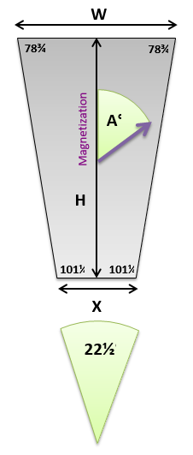
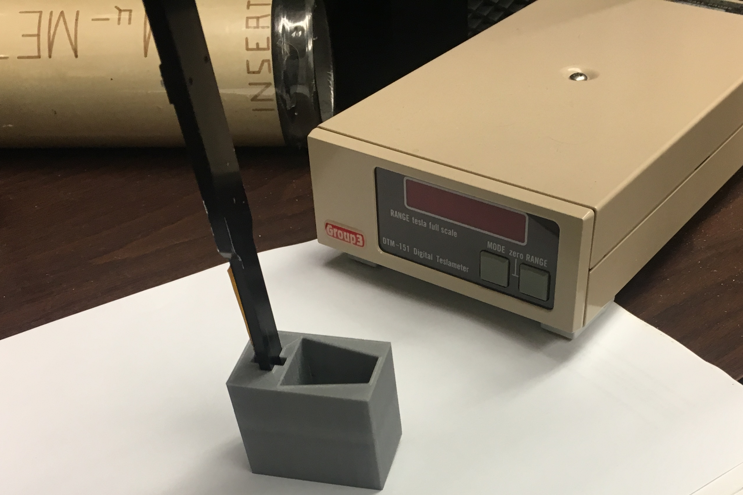

Shimming for Field Strength
Shimming design allowance 0.1mm to 0.8mm circumferentially between blocks.
Radial adjustment 0.2 mm to 2.2 mm.
PMM blocks of each type are measured for field strength and direction.
Measurement results are recorded and compared. Shim thickness specified.
Shims
Adhesive

Slide 11
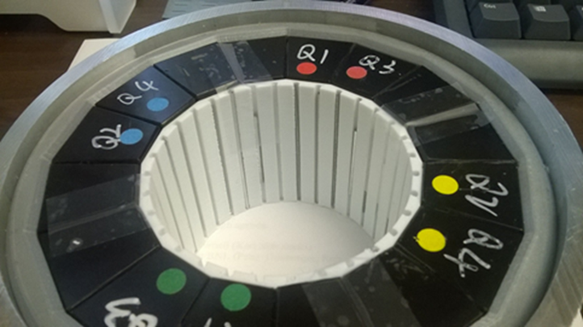
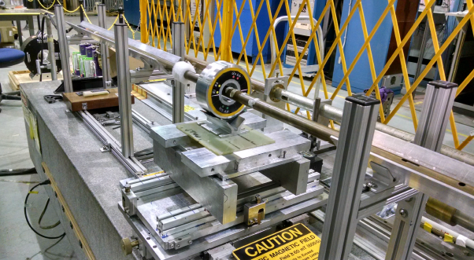
Magnetic Measurement – Multipole Reduction
To reduce multipole errors a plastic steel rod holder is installed in the aperture.
Steel wires of various diameters and lengths inserted into the magnet bore., shown in Fig. 3.1.8.
There are 32 wire holders evenly-spaced around the bore of the magnet
If necessary wire holders for 48 or 64 wires can be used to increase multipole reduction strength & accuracy.
Inner (white) holder for steel rods

Slide 12
Labor & Materials
Material
PMM: Vendor fabricates, magnetizes, machines, serializes.
PMM: Vendor (preferred) or BNL field vector measurement (BNL sample testing)
PMM: sorted & shimming specified by BNL.
Halbach Magnets: Vendor fabrication, shims PMM, fabricates frames, installs PMM, completes water lines.
Corrector Magnets: build to print.
Girders and Stands: build to print.
First article components, release for production with option to cancel.
PMM first lot for BDT2 (18 magnets, 600 blocks) with option to cancel

Slide 13
Labor & Materials
Labor (Halbach): BNL scientific, engineering, & technical
Scientific & Engineering: procurement specifications and vendor oversight. Request for Proposal
Scientific & Technical: PMM QA, measurement, & sorting
Scientific & Technical: Magnet measurement and analysis
Engineering & Technical: Multipole tuning rod installation
Scientific & Technical: Magnet measurement and analysis
Engineering & Technical: Girder inspection & assembly
Labor (Corrector): BNL scientific, engineering, & technical
Scientific & Engineering: procurement specifications, drawings, and vendor oversight. Build to print procurement.
Scientific & Technical: Magnet measurement (sampling only)

Slide 14
Basis of Estimate
Permanent Magnet Material (PMM) blocks cost estimate based on vendor estimates & recent procurements for proof of principle (pop) and preproduction magnets.
Halbach magnet component fabrication and assembly: magnet vendor estimates
Magnetic measurement and tuning hours: recent experience with pop magnets and magnets for CAD ERL, CeC project, and LEReC project.
Corrector magnets: Vendor estimates on preliminary drawings and procurement of similar magnets for CAD.
Girder: Small Rexroth assemblies built for CAD ERL, CeC project, and LEReC project.
Girder Assembly: assemblies built for CAD ERL, CeC project, and LEReC project.

Slide 15
Procurement & Production
PMM:
Request for Proposal, build to specification & print.
Vendor with accelerator PMM magnet experience (not hand drills).
BNL or PMM vendor inspection & field vector measurement.
If vendor does field measurement, BNL will sample test/verify.
These measurements are critical to successful magnet fabrication the first time. They also reduce BNL and Vendor Risk.
BNL labor for measuring and sorting PMM: 3.5 hours/magnet
Cost per magnet: $1400
Vendor quote for lower grade material $1005/magnet large quality
Latest order for 12 magnets $1900/magnet small quantity
Awaiting revised quotes from VacuumSchmelze and meeting this week with Shin-Etsu Magnetics

Slide 16
Procurement & Production
Halbach Magnets: Request for Proposal, build to print & specification.
Vendor with accelerator PMM magnet experience preferred.
BNL supplied PMM, PMM sorted & shimming specified by BNL.
Vendor fabricates frames, installs PMM, completes water lines.
BNL magnetic field measurement or vendor option to measure.
BNL reviews measurement, specifies wire rod multipole reduction.
Final measurement verification
First article magnets, then release for production, option to cancel.

Slide 17
Procurement & Production
Corrector Magnets: Request for Proposal, build to print.
Vendor with accelerator magnet experience
BNL option combined Halbach/corrector procurement
First article magnets, then release for production, (option to cancel).
BNL magnetic field testing of random magnets (sampling).
Field quality
Thermal stability (wet wind quality)

Slide 18
Procurement, Production
Cost per Magnet Assembly: $4000/assembly ($6000/1st article)
Danfysik cost estimate without PMM
BNL assumes risk as long as Danfysik follows BNL sorting guide.
BNL Labor:
Scientific: 2 hours/magnet + 115 hours
Engineering: 1 hours/magnet + 688 hours
Technician: 8 hours/magnet + 40 hours
Rigging: 7 hours/shipment – 4 shipments
Magnet measurement & Survey
Tuning for multipole reduction
Magnet measurement

Slide 19
Procurement & Production
Girders and Stands: request for bids, build to print.
Girder assembly (magnet supports) - Vendor
Inspection and pre-survey - BNL
Magnet install, vacuum chamber install, water manifold - BNL
Survey and alignment
Prepare for shipping, rigging
BNL Labor:
Engineering: 3 hours/girder + 320 hours
Technician: 32 hours/girder + 120 hours
Survey Technician: 8 hours/girder
Cost: $5400 Girder
w/water manifold, stands, & magnet mounts
Shipping $2550/shipment of 7 girders

Slide 20
Cost Estimate Overview

Slide 21
Schedule Overview
Project Milestones
Prototype Girder Assembled May 1, 2017
Magnet Production Approved June 30, 2017
First Arc Production Magnet Tested Jan 2, 2018
Fractional Arc Test: May 1, 2018
Beam through MLC and prototype girder
Girder Production Run Complete Dec 1, 2018

Slide 22
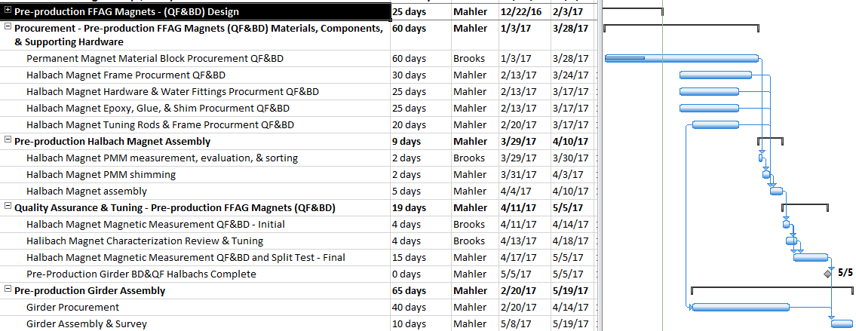
Schedule Overview
Project Milestones
Prototype Girder Assembled May 1, 2017
Pre-production magnets assembled and tested. May 5, 2017
Pre-production girder assembly & survey May 19,2017

Slide 23
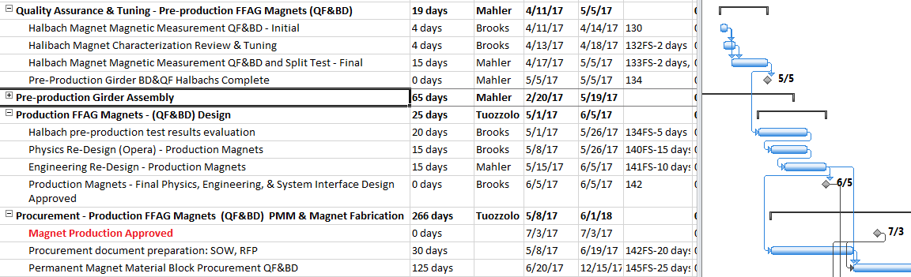
Schedule Overview
Project Milestones
Magnet Production Approved July 1, 2017
Predecessors: Pre-production magnet assembly and analysis of test results, redesign if needed, procurement plans and documents

Slide 24
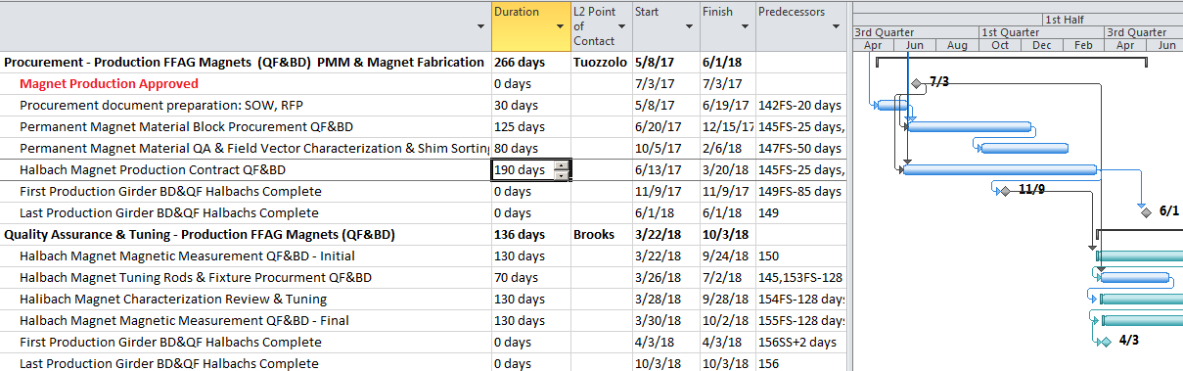
Schedule Overview
Project Milestones
First Arc Production Magnet Tested Jan 2, 2018 (Nov 11, 2017)
Girder Production Run Complete Dec 1, 2018 (Oct 31, 2018)

Slide 25
Risk List
WBS | ID | Risk Description | Potential Impact | L | I | L×I | S2 | S3 | Mitigation | Comment
1.5 | 1 | Computer simulations: resonant behaviour not calculated correctly | Lattice needs to be adjusted | 2 | 3 | 6 | 2.4 | 3.2 | Computer simulations without periodic boundary conditions
1.5 | 2 | Small change in material properties of NdFeB from radiation damage | Excessive beam losses cause drift in magnetic qualtiy field, still within range of correctors | 3 | 2 | 6 | 2.4 | 3.2 | Review machine loss control system. Re-run machine correction periodically
1.5 | 3 | Large change in material properties of NdFeB from radiation damage | Excessive beam losses make some magnets unusable | 2 | 4 | 8 | 2.8 | 4.2 | Review machine loss control system. Replace damaged magnets. | Should see this coming. Halbachs will take 4 to 5 months to fabricate & replace.
1.5 | 4 | Residual non-allowed multipoles in the Halbach magnets | Orbit differences, beam loss depending on magnitude | 2 | 4 | 8 | 2.8 | 4.2 | PMM field vector measurement/shimming. Multipole tuning rods. | Revisit magnet design/tolerances after pre-production and/or 1st article fabrication.
1.5 | 5 | Permanent magnet strength from batch sample does not reflect true average | Strength of magnet systematically wrong by a few percent | 1 | 3 | 3 | 1.7 | 3.0 | Measure field vector on all blocks, test pre-production and 1st article magnets | Use quad corrector coil as a last resort
1.5 | 6 | Temperature coefficient permanent magnets larger than expected | Temperature drift of gradient, resulting in orbit differences | 1 | 3 | 3 | 1.7 | 3.0 | Better water system stabilization | Use quad corrector coil as a last resort
1.5 | 7 | Temperature coefficient permanent magnets varies within batch | Strength variations aren't the same, small multipoles appear at off-nominal temperature | 1 | 2 | 2 | 1.4 | 2.0 | Temperature control during PMM field vector measurement | Better water system stabilization
1.5 | 8 | Geometric block tolerances larger than expected | Unwanted multipoles, gradient variation, leading to orbit differences | 1 | 4 | 4 | 2.0 | 4.0 | Drawing tolerances in agreement with vendor capabilities, vendor quality assurance control | Unlikely, good quality blocks were delivered for prototypes, active QA for production
1.5 | 9 | Mechanical properties of magnet holder inadequate | Magnet deformed, systematic multipoles appear | 1 | 3 | 3 | 1.7 | 3.0 | Vendor quality assurance control, pre-production measurement and testing | Unlikely, Aluminum frame is stiffer and has been analyzed for stress and deflection
1.5 | 10 | Corrector strength dipole insufficient | Lattice errors higher than expected | 3 | 3 | 9 | 3.0 | 3.8 | Lattice studies continue, increase power supply current, increase dipole coil turns | Corrector coils can be driven at higher currents; more turns added after pre-production tests
1.5 | 11 | Too much magnet-to-magnet gradient variation (>0.2%) | Poor optics performance |  |  |  |  |  | Power the quadrupole correctors
1.5 | 12 | Quadrupole corrector strength insufficient, need larger magnet to magnet correction | Halbach field strength variation larger than expected or lattice requires bigger variation | 2 | 3 | 6 | 2.4 | 3.2 | Lattice studies continue, increase power supply current, increase quadrupole coil turns | Corrector coils can be driven at higher currents; more turns added after pre-production tests
1.5 | 13 | Dipole correctors influence Halbach gradient quality negatively | Orbit differences, may limit ability to correct for fied errors | 1 | 3 | 3 | 1.7 | 3.0 | Re-design dipole corrector winding configuration to reduce multipoles | Unlikely, beam position is in small diameter central field region of a large corrector
1.5 | 14 | Magnet assembly takes longer than anticipated | Impact schedule and cost | 3 | 4 | 12 | 3.5 | 4.6 | Pre-production and 1st article magnet lessons learned & tight vendor control | Careful planning, well documented requests for proposal, communication with vendors, resource availability
1.5 | 15 | Shimming and multipole tuning of magnets takes longer than anticipated | Impact schedule and cost | 2 | 3 | 6 | 2.4 | 3.2 | Pre-production and 1st article magnet lessons learned & tight vendor control | Careful planning, resource availability
1.5 | 16 | Girder integration issues, magnet vendor quality, late delivery, excessive tuning time & protoype girder assembly schedule, production testing, and parts flow choreography. | Schedule impact leading to cost overruns. Vendor cost overruns. | 3 | 3 | 9 | 3.0 | 3.8 | Pre-production and 1st article girder lessons learned & tight vendor control | Careful planning, well documented requests for proposal, communication with vendors, resource availability

Slide 26
Major Risks
System Specifications (Lattice): (1, 10, 11, 12)
Lattice changes affect magnet specifications: greater number of Halbach variations, stronger dipole correction, power quad correctors.
Mitigation: Further Lattice refinement
PMM:
Material quality: large variation field strength/tolerances (5, 8)
Mitigation: Quality Assurance: thorough PMM inspection
Material quality: thermal response (6, 7)
Mitigation: thermal design, material, and assembly testing
Material quality: radiation damage from CBETA operations
Mitigation: careful commissioning planning

Slide 27
Major Risks
Halbach Manufacturing:
Magnet assembly: quality assurance delays, time required for PMM measurement, sorting, shim definition (14, 15, 16)
Mitigation: pre-production magnet QA PMM & field measurement, evaluation, and assembly methods.

Slide 28
Summary
BD & QF Halbach magnetic designs complete and reviewed.
Corrector magnets designs complete and reviewed.
Vendor cost estimates received for Halbach components and corrector magnets.
Halbach costs being updated to reflect latest design and manufacturing plan.
Corrector magnets are a common design used in CAD.
Other components similar to recently purchased equipment.
Risks identified and manageable.

Slide 29
Extra Slides

Slide 30
Pre-production Girder Assembly
Halbach magnets
Permanent Magnet Material Ordered for 6 (3 BD, 3 QF).
BNL PMM QA field vector measurement, dimension inspection, shim determination.
Aluminum frames designed, BNL machining.
BNL shim PMM, magnet assembly.
BNL field measurement, wire rod multipole reduction, field measurement.
Split magnets/realignment testing/field measurement.
Corrector magnets
Designed, in house machining.
BNL or vendor winding.
BNL field measurement.
Split magnets/realignment testing/field measurement.

Slide 31
Consistent Halbach Magnets
Proof-of-principle (PoP) magnets:
Demonstrated consistent field strength magnet to magnet.
Demonstrated the ability to reduce multipoles with interior steel rods.
Successfully reviewed by BNL committee: meets design specifications and “buildability”. https://www.classe.cornell.edu/CBETA_PM/161220_review_buildability
To be proven with pre-production magnets:
PoP magnets used a single batch of permanent magnet material blocks. Larger batches have larger variations in field strength. Magnets will be shimmed between PMM blocks (slide 10).
Mechanical tolerances: larger batches of PMM may have greater variation of dimensional tolerances. Shimming also adjusts for small variations in block dimensions.
PoP magnets used plastic frames and were not designed to be split for vacuum chamber installation. Production magnets will have aluminum frames with designed splits. (slides 7, 8, 9)

Slide 32
Consistent Halbach Magnets
Permanent Magnet Material (PMM) specifications with magnetic tolerances for field vector (strength and direction) and dimensional mechanical tolerances. (Brooks)
Specifications, method, and equipment for acceptance testing PMM field vector. (Brooks)
Solid PMM mounting frame design with minimum deflection and accurate alignment. (Mahler)
Method for shimming PMM for matching field strength. (Mahler)
Method for analyzing block field measurement results to define field strength shimming dimension. (Brooks)
Method for analyzing magnet measurement results for multipole correction. (Brooks)
Magnet mounting and alignment method and tolerances. (Mahler)

Slide 33
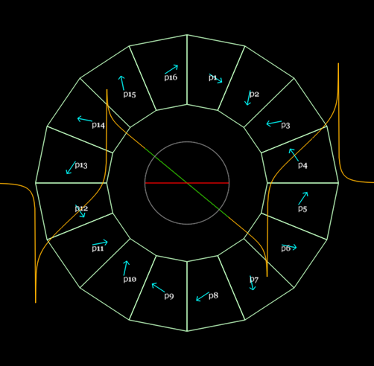
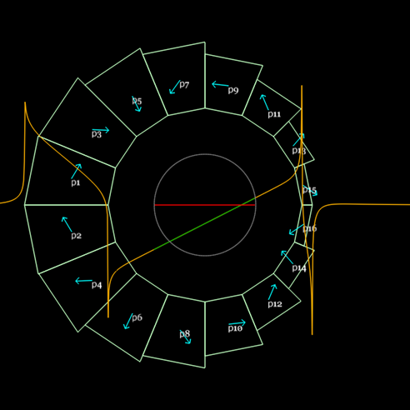
Permanent Magnet Block Dimensions

Slide 34
Production planning:
Complete preproduction development and testing
Develop a fabrication plan and procurement documents
Vendor interface, statement of works and specification for vendor proposals and bids
Bid and place orders
Acceptance testing and production oversight
BNL final assembly & ship to Cornell

Slide 35
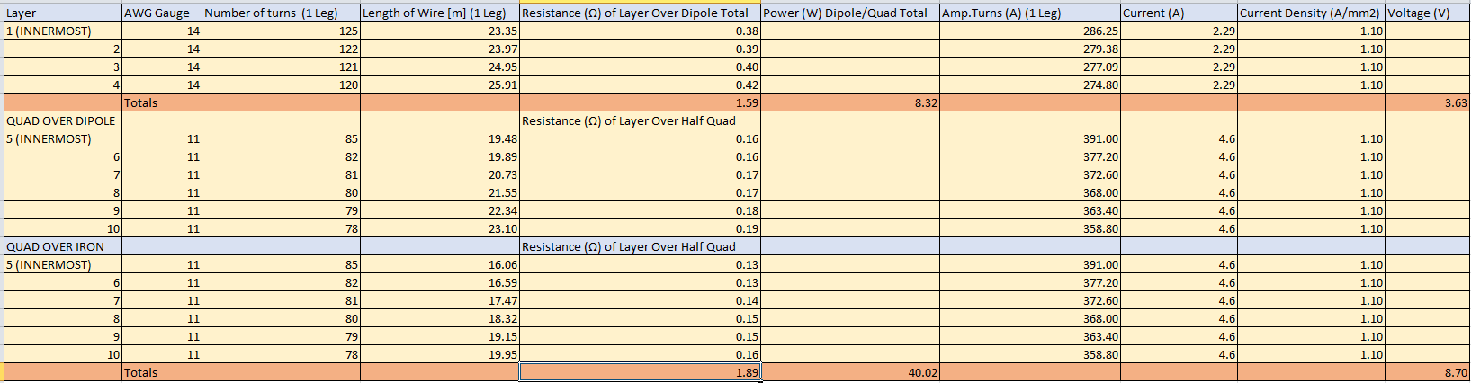
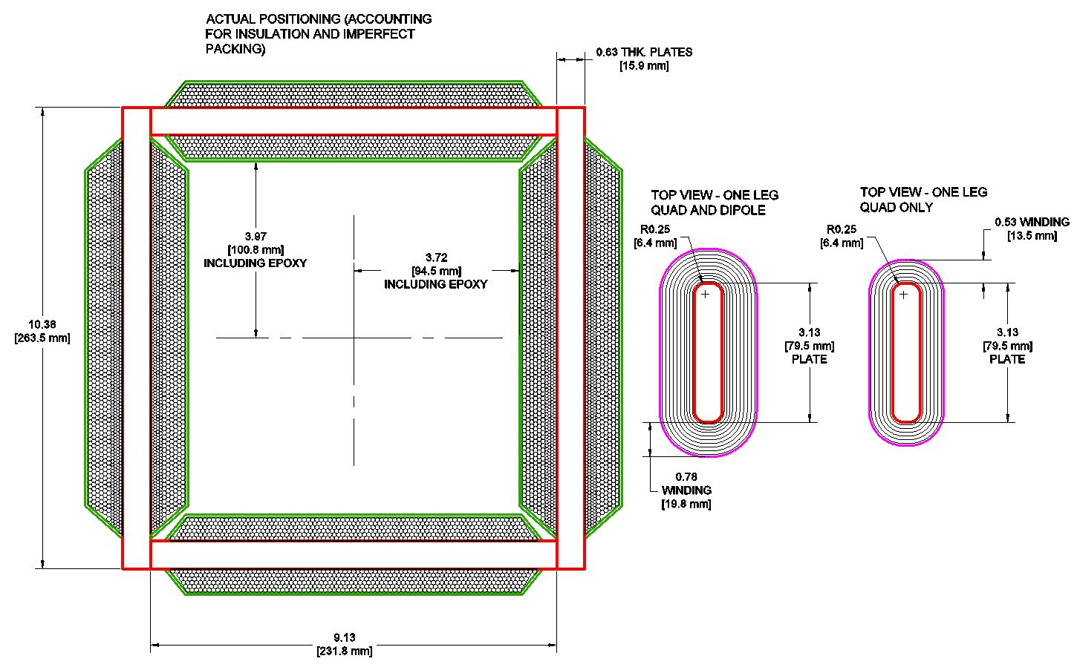
Halbach Corrector Magnets
Dipole and Quadrupole field strength interface.
PS specifications, Quadrupole corrector power supplies will not be procured until field measurements verify the need.

Slide 36
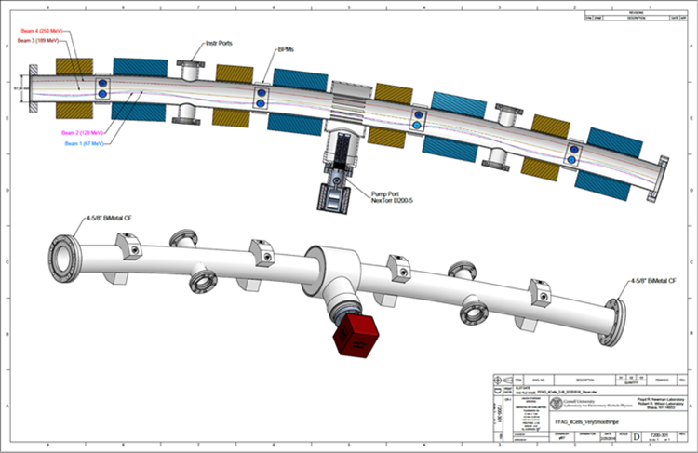
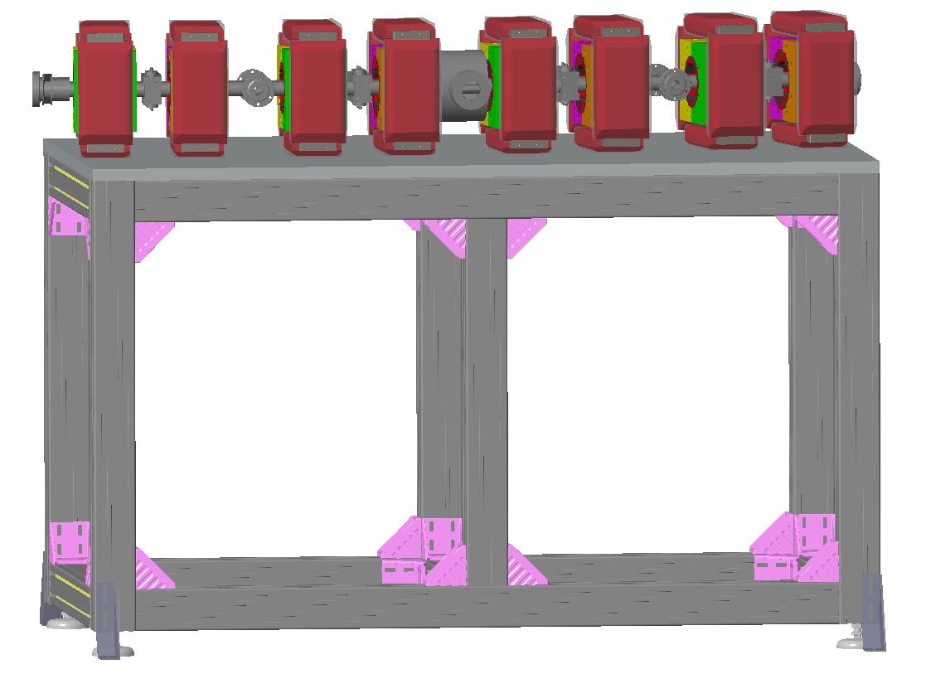
Girder Types and Positions
Alignment specifications:
+/- 0.2 mm (.008”) horizontal and vertical maximum allowance
+/- 0.1 mm (.004”) horizontal and vertical goal to provide design margin.
Allowance to resurvey and “retune” magnet positions after initial commissioning with beam (no shims or pins).
Magnet mounts – jacking screws for horizontal and vertical survey
Magnet mounts – integrated mounts for Halbach and Corrector
Vacuum chamber provided by Cornell
Crane lift points that do not cause deformation and misalignment, magnet assembly weight/girder assembly weight, deflection analysis

Slide 37
Interfaces
Cornell/BNL physics, Halbach magnet and corrector specifications
Cornell power supply group, corrector power supply specifications
Cornell vacuum group, vacuum chamber/pump support/BPM clearance and alignment
Cornell civil, magnet stabilization water supply
Cornell civil, space, cable tray, installation, & survey

