Slide 1
CBETA Project
ALD’s Cost and Schedule Review
February 6, 2017
Invoice Processing and Reporting
S. LaMontagne
NPP Business Operations Manager

Slide 2
CBETA Project
Objective and Schedule
The fundamental objective of this NYSERDA project is to build, test and evaluate a critical subsystem of the large scale EIC facility, before competitive bids are due to DoE, so that BNL is in the strongest position to win the award.
Our objective defines the timeline as DoE is expected to issue a competitive solicitation in April 2018 to determine an appropriate site and team to design, construct and operate an Electron-Ion Collider (EIC).

Slide 3
NYSERDA Contract with BNL
Contract Attributes
BNL Principal Investigator: Dejan Trbojevic
BNL Project Director: Stephen Peggs
BNL Project Manager: Rob Michnoff
Effective Date of Contract: October 31, 2016
Contract Value: $25.0M
Duration: 42 months, through April 30, 2020
Advance Payment:
  $2.0M received November 18, 2016

Slide 4
NYSERDA Contract with BNL
Technical Timeline showing Major Milestones
# | Technical milestone | Month | Comment
 | NYSERDA funding start date | 0 | Estimate: October 2016
1 | Engineering design documentation complete | 3
2 | Prototype girder assembled | 6
3 | Magnet production approved | 8 | Spreader, combiner & hybrid
4 | Beam through Main Linac Cryomodule | 10 | Go/no go 1
5 | First production hybrid magnet tested | 14
6 | Fractional Arc Test: Beam through MLC & prototype girder | 18 | Go/no go 2
7 | Girder production run complete | 25
8 | Final assembly and pre-beam commissioning complete | 28
9 | Single pass beam energy scan | 32
10 | Single pass beam with energy recovery | 36 | Key parameters achieved
11 | Four pass beam with energy recovery (low current) | 38
12 | Project complete | 42 | Estimate: April 2020

Slide 5
NYSERDA Contract with BNL
Financial Agreement / Cash Flow
Initial advance of $2.0M to fund commencement
Monthly invoices for incurred time/material costs
Monthly payments to maintain forward financing
2 “go/no go” milestones serve to mitigate NYSERDA’s financial risk
  Month 10 – Acceleration of Beam through Main Linac Cryomodule
  Month 18 – Fractional Arc Test which commissions as much CBETA equipment as practically possible before making a commitment to complete construction
A second advance of $2.0M timed to the 1st “go/no go” decision in month 10 (July 2017)

Slide 6
NYSERDA Contract with BNL
Financial Agreement / Cash Flow
Budget Profile, by quarter and year
With an advance payment of $2.0M and an obligation profile as shown above, it is critical that invoice payments are received within 30 days
Year | Q1 ($M) | Q2 ($M) | Q3 ($M) | Q4 ($M) | Sub-total ($M)
1 | 1.7 | 1.9 | 2.1 | 2.3 | 8
2 | 2.3 | 2.3 | 2.3 | 2 | 8.9
3 | 1.7 | 1.3 | 1.3 | 1.3 | 5.6
4 | 1.3 | 1.2 |  |  | 2.5
Total |  |  |  |  | 25

Slide 7
NYSERDA Contract with BNL
Financial Agreement / Cash Flow
Invoice payments received within 30 days enable BNL to maintain a positive cash flow
Month | Invoice | Cost / Obligation | Payment | Balance | Comments
0 | $2.0 |  | $2.0 | $2.0 | Initial advance received
1 |  | $0.4 |  | $1.6
2 | $0.4 | $0.5 | $0.4 | $1.5 | Payment for month 1 received
3 | $0.5 | $0.7 | $0.5 | $1.3 | Payment for month 2 received
Q1 | $2.9 | $1.7 | $2.9 | $1.3
4 | $0.7 | $0.5 | $0.7 | $1.5 | Payment for month 3 received
5 | $0.5 | $0.6 | $0.5 | $1.4 | Payment for month 4 received
6 | $0.6 | $0.8 | $0.6 | $1.2 | Payment for month 5 received
Q2 |  | $1.9 | $1.8 | $1.2

Slide 8
NYSERDA Contract with BNL
Financial Agreement / Cash Flow
Invoice payments received within 60 days may impact the ability to procure materials
Month | Invoice | Cost / Obligation | Payment | Balance | Comments
0 | $2.0 |  | $2.0 | $2.0 | Initial advance received
1 |  | $0.4 | $0.0 | $1.6
2 | $0.4 | $0.5 | $0.0 | $1.1
3 | $0.5 | $0.7 | $0.4 | $0.8 | Payment for month 1 received
Q1 | $2.9 | $1.6 | $2.4 | $0.8
4 | $0.7 | $0.5 | $0.5 | $0.8 | Payment for month 2 received
5 | $0.5 | $0.6 | $0.7 | $0.9 | Payment for month 3 received
6 | $0.6 | $0.8 | $0.5 | $0.6 | Payment for month 4 received
Q2 |  | $1.9 | $1.7 | $0.6

Slide 9
NYSERDA Contract with BNL
Financial Agreement / Cash Flow
Invoice payments received within 90 days will impact the ability to procure materials and maintain uninterrupted work progress
Month | Invoice | Cost / Obligation | Payment | Balance | Comments
0 | $2.0 |  | $2.0 | $2.0 | Initial advance received
1 |  | $0.4 | $0.0 | $1.6
2 | $0.4 | $0.5 | $0.0 | $1.1
3 | $0.5 | $0.7 | $0.0 | $0.4
Q1 | $2.9 | $1.6 | $2.0 | $0.4
4 | $0.7 | $0.5 | $0.4 | $0.3 | Payment for month 1 received
5 | $0.5 | $0.6 | $0.5 | $0.2 | Payment for month 2 received
6 | $0.6 | $0.8 | $0.7 | $0.1 | Payment for month 3 received
Q2 |  | $1.9 | $1.6 | $0.1

Slide 10
Monthly Invoice Process
Accounts Payable sends invoice to C-AD financial staff
Project Director drafts summary status in narrative form
C-AD financial staff prepare documentation of invoice details
Invoice along with narrative and detailed financial documentation returned to Accounts Payable
Accounts Payable forwards invoice along with detailed financial documentation to NYSERDA
Accounts Payable notifies C-AD financial staff upon receipt of payment
Payment included in monthly DoE contract modification

Slide 11
Cornell University Sub-Contract
Contract Attributes
Effective Date: December 14, 2016
Period of Performance: Nov 2016 through Apr 2020
Incrementally funded contract
  Ceiling Amount: $12.75m
  Initial Commitment: $1.0M
  Quarterly funding increments planned
Monthly invoices for incurred time/materials cost received in the first week of each month
Breakdown of invoice cost by WBS element along with bulleted list of activities performed in the prior month to be provided within 5 business days after the receipt of the invoice
Cornell invoices accrued by BNL upon receipt of WBS cost breakdown to ensure timely recording of cost for inclusion in BNL’s invoice to NYSERDA

Slide 12
BNL Invoice and Monthly Report
Contract provides guidance regarding content of the monthly report
Format developed by C-AD financial staff
  Narrative provided by Project Manager to include a description of activities at both BNL and Cornell
  Financial data downloaded from PeopleSoft and shown in both summary and detailed formats
First invoice sent to NYSERDA on Jan 20, 2017
Invoice format accepted and first payment received on Feb 2, 2017

Slide 13
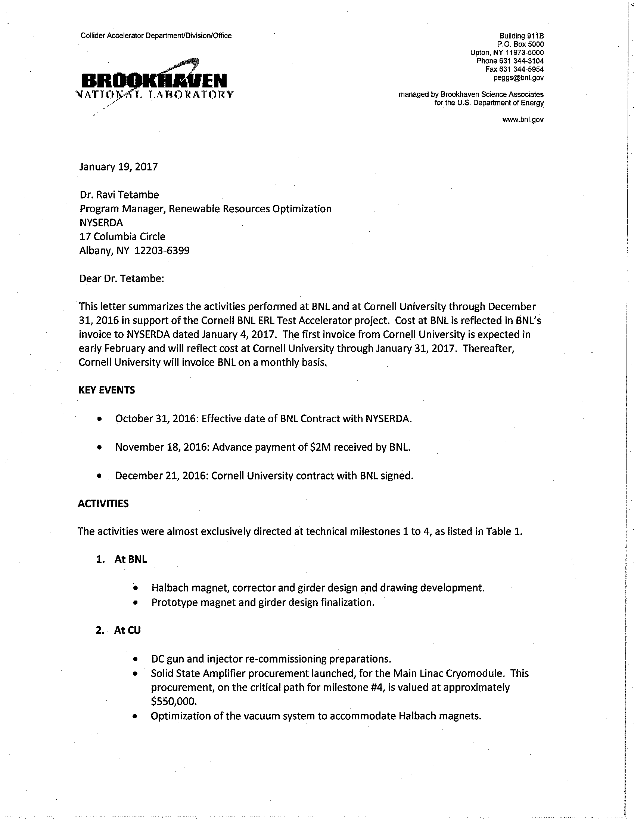
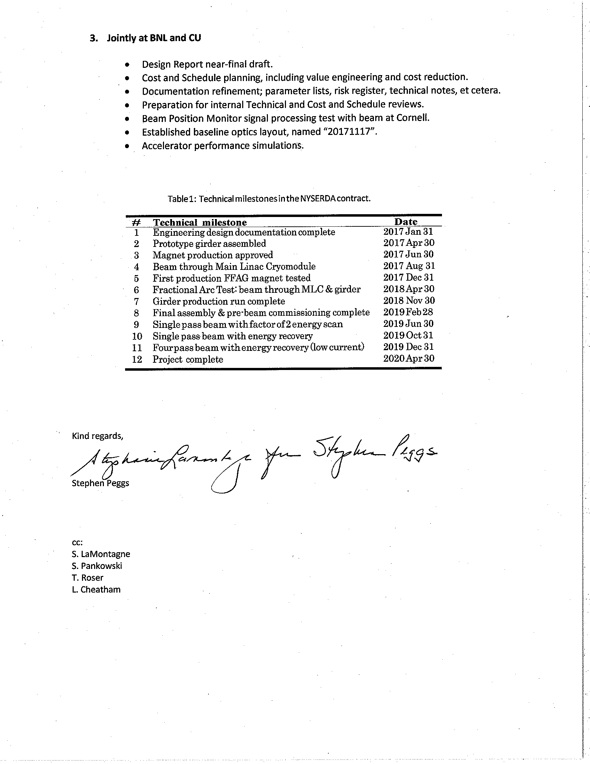
BNL Invoice and Monthly Report
Narrative

Slide 14
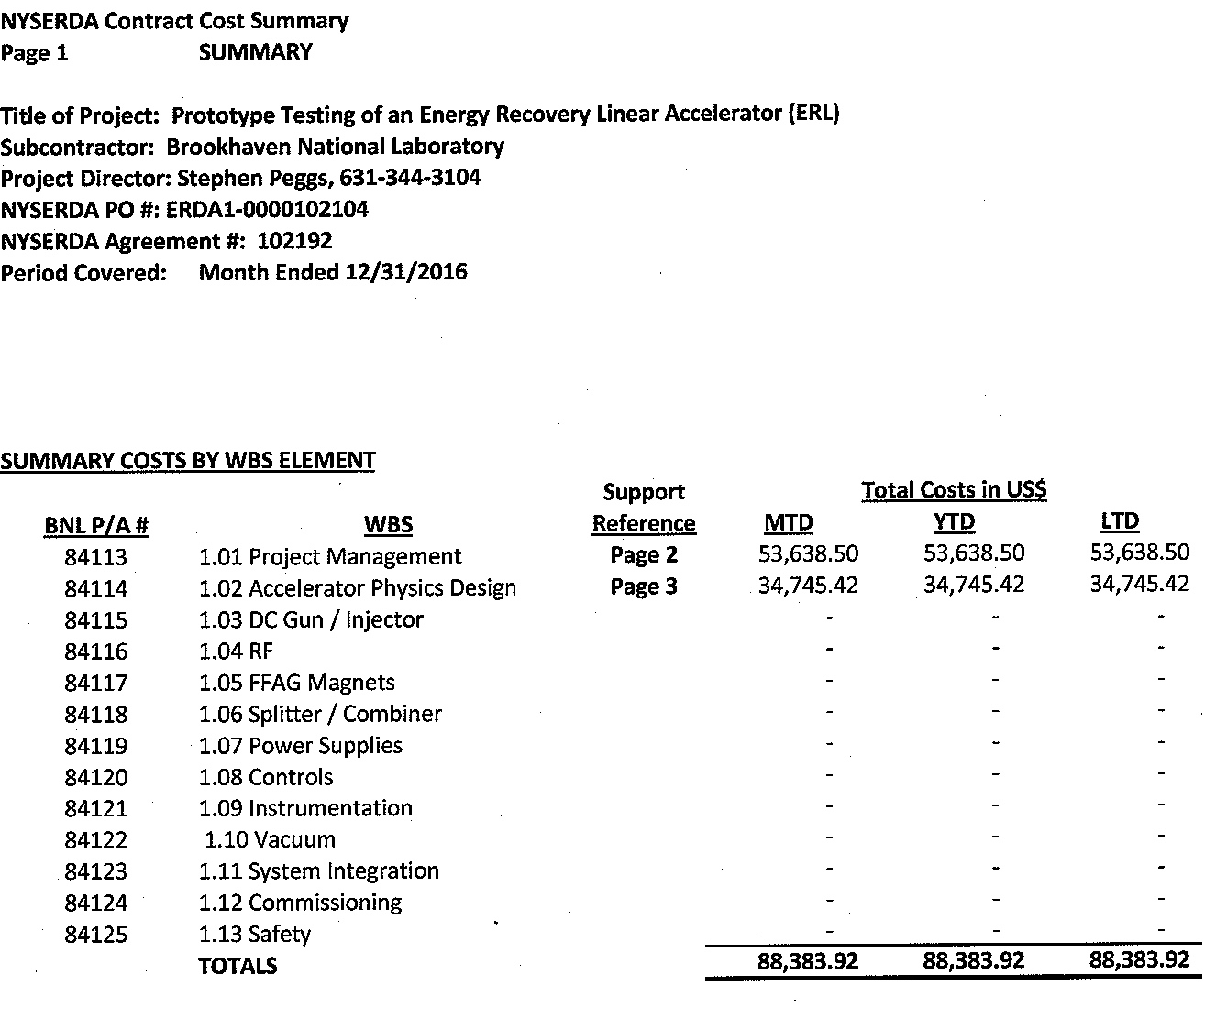
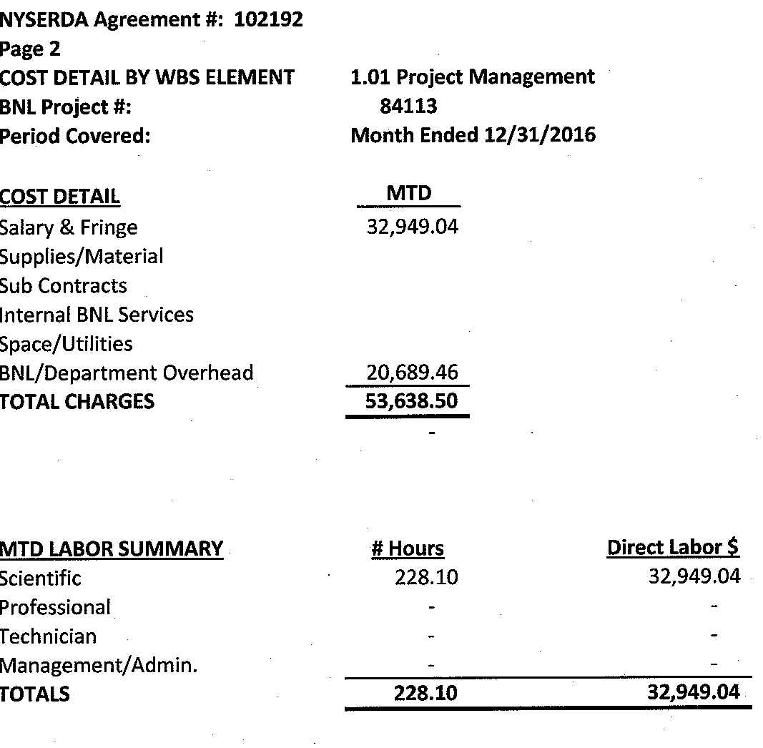
BNL Invoice and Monthly Report
Financial Details

Slide 15
Quarterly Reporting to NYSERDA
Prepared in letter format and submitted to NYSERDA’s Project Manager by the 15th of the month
Project Title
Agreement Number
Reporting Period
Progress
Identification of Issues
Planned Solutions
Ability to meet schedule, reasons for schedule slippage
Schedule - % complete
Analysis of actual cost incurred in relation to estimated cost
Deliverables completed during the reporting period
Detailed description of activities and planned procurements for the upcoming quarter

Slide 16
In Conclusion
My Take Away Message
Our objective defines the timeline; in order to ensure that BNL is in the strongest position to win the award for the EIC, the project must be completed on time.
Failure to maintain adequate forward financing may necessitate suspension of ongoing efforts, resulting in schedule delays. It is, therefore, critical that invoices be provided and payments received on a timely basis.

