Slide 1
Page Headline
Report from the
Independent Cost Review
Cost & Schedule Review
Rob Michnoff

Slide 2
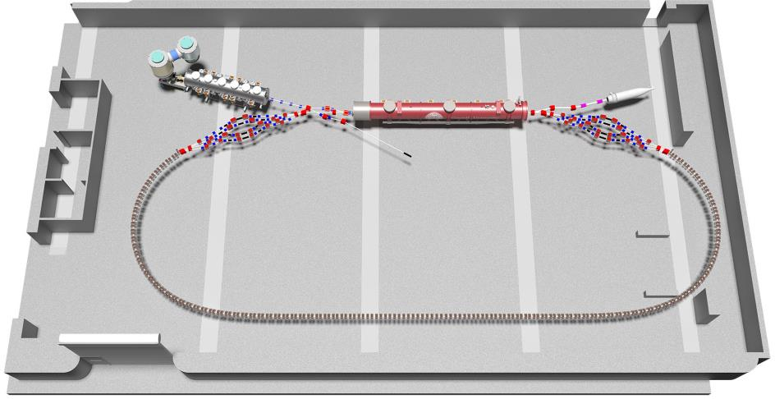

Slide 3
Outline
Purpose of the Independent Cost Reviews
WBS sections that were reviewed
Summary of findings
Cost savings
Additional potential cost savings
Summary

Slide 4
Purpose of the Independent Cost Reviews
Determine if the material and labor cost estimates accurately reflect the required work
Check for possible omissions in the estimate
Check for details that may result in higher costs than included in the estimate
Suggest potential cost savings
It is also important to note that in addition to these independent cost reviews, Cornell conducted an internal cost review on November 16, 2016. Notes from the Cornell review are included on the indico page.

Slide 5
WBS sections reviewed and participants
Each of the five reviews was conducted during a one-hour period of time and consisted mainly of questions and discussions prompted by the BNL system expert.

Slide 6
Highlights of findings
Found a few inconsistencies and missing components
For example, vacuum ports for the view screens were not included. Should be in the vacuum estimate
Some sections of estimate seem too low.
loss monitor system, machine protection system
These are 2 systems that have not been clearly defined yet, which makes accurate estimating difficult.

Slide 7
Highlights of findings
Some discrepancies in quantities have been found and corrected since the review.
For example, the number of BPM buttons and electronics were not consistent between the instrumentation estimate and the vacuum estimate
The total number of labor hours for the RF section is considerably higher than the other sections reviewed.

Slide 8
Highlights of findings
Cost estimate for the splitter magnets seems higher than expected. The hope is that the actual cost will be lower than the estimate.
Unfortunately a second vendor quotation was received after the review, and costs are in the same ballpark as the first vendor quotation.
Equipment rack space needs to be reviewed to confirm that sufficient floor space exists for all equipment.

Slide 9
Cost Savings
Significant cost saving measures have already been incorporated.
Only half of the BPM buttons in the FFAG will be populated with position measurement electronics.
Quadrupole corrector magnets in the FFAG will not be populated with power supplies.
Changed FFAG magnets from Hybrid (iron) to Halbach, resulting in a significant manufacturing cost decrease.

Slide 10
Additional Potential Cost Savings
Construct FFAG magnets without quadrupole corrector coils.
This presents risk, because if quadrupole correction is deemed necessary after completing the installation, modifying the magnets later will be more costly than doing it now.
Installing standard (expensive) beam current transformers may not be required.
A rougher measurement using the sum of 8 buttons may be adequate. Additional research is required.

Slide 11
Summary
The independent cost reviews proved to be very beneficial in helping to identify discrepancies and inconsistencies between the major hardware WBS sections
A list of issues and details to be addressed was created
Some have already been resolved
Some additional cost saving measures were discussed but very few significant concepts were identified
Searching for alternative design options will continue, with the goal of decreasing costs without sacrificing machine performance scope and without increasing risk
Review of costs will continue

