Slide 1

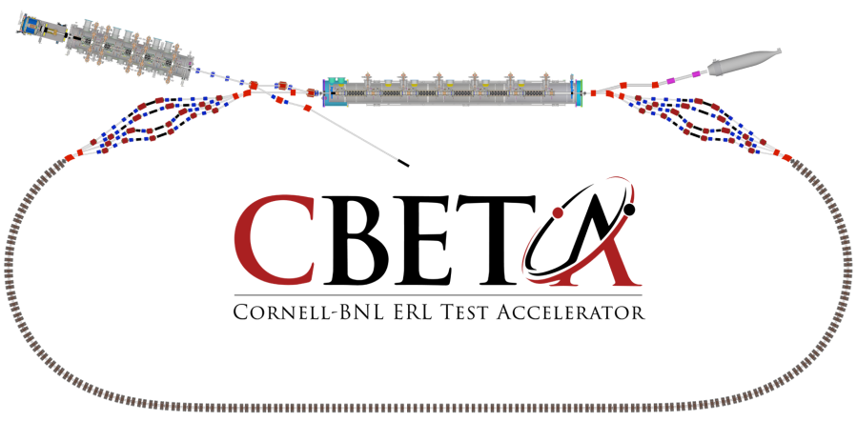
Page Headline
CBETA Splitter

Slide 2
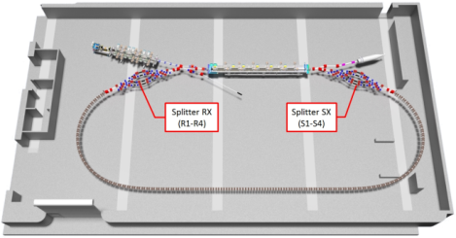
CBETA Splitter – WBS 1.6
Outline
Requirements/Parameters
Splitter SX Layout
Magnetic Design
Vacuum Design
Mechanical Design
Summary

Slide 3
Requirements & Parameters
Requirements:
4 different energy beams will be split into four separated beam pipes and then recombined into a single beam pipe for optic, timing and orbit requirements.
Provide beam path length adjustments for each of four energy electron beams.
Various reconfigurations are expected during staged commissioning (from 1-turn to 4-turn). Flexibility in the design is key.
Requirements
Splitter SX Layout
Magnetic Design
Vacuum Design
Mechanical Design
Summary
Parameter | Unit | Value
SYSTEM REQUIREMENTS
Alignment tolerance, girder to global accuracy | μm | 500
Alignment tolerance, girder to girder accuracy | μm | 200
Alignment tolerance, magnet on girder accuracy | μm | 50
Alignment tolerance, BPM on girder accuracy | μm | 80
Beam path length adjustment range | RF° | ±20°
Beam path length change *speed* | mm/s | 0.5
Parameter | Unit | Value
COMPONENT COUNTS
Quadrupole | count | 64
Dipole, H-type 1 | count | 24
Dipole, H-type 2 | count | 12
Common, type 1 | count | 4
Common, type 2 | count | TBD
Septum, type 1 | count | 8
Septum, type 2 | count | TBD
Septum, type 3 | count | TBD
Vertical correctors | count | 32
Girder | count | 4
Magnet mount (static) | count | 112
Magnet translation stage | count | 8
Motor (for stages) | count | 16
Motor controller | count | 8
Bulkhead connector plate | count | 20
Cable, Magnet | count | 144
Cable, BPM | count | 64
Cable, Instrumentation | count | 16
Cable, Vacuum | count | 16
Water manifold | count | 8

Slide 4
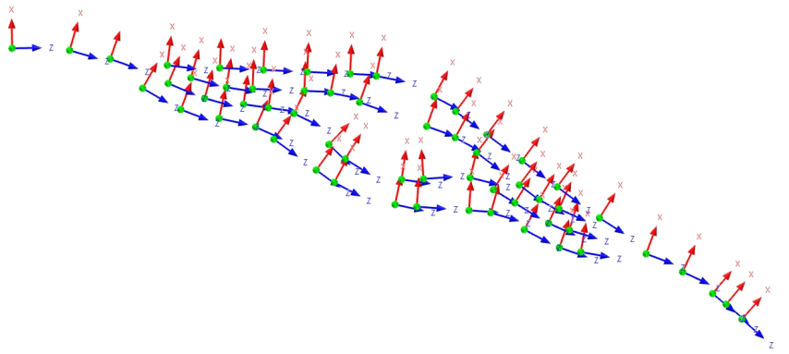
Splitter SX Layout
Lattice Controlled Layout drives the magnet locations
Bmad produced file generated by Chris Mayes
Each magnet location is represented by a coordinate system which matches the magnet centers
Updates to the Lattice will change the magnet location(s)
Provides the most flexibility during the conceptual phase
Requirements
Splitter SX Layout
Magnetic Design
Vacuum Design
Mechanical Design
Summary

Slide 5
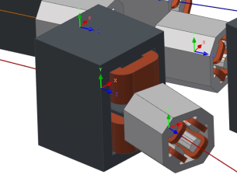
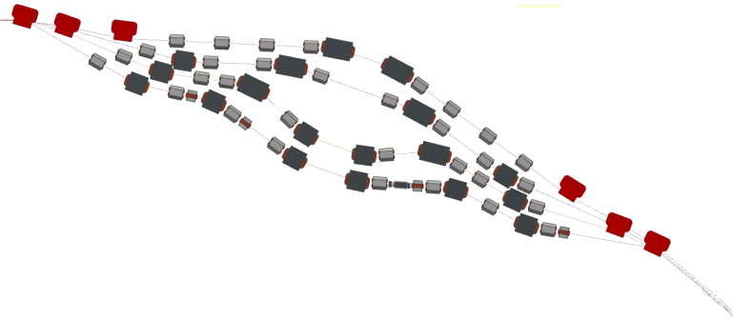
Splitter SX Layout
Magnets placed to allow for hardware design
Progress can be made despite future changes to the Lattice
Volume conflicts detected and resolved with updates to the lattice
Requirements
Splitter SX Layout
Magnetic Design
Vacuum Design
Mechanical Design
Summary

Slide 6
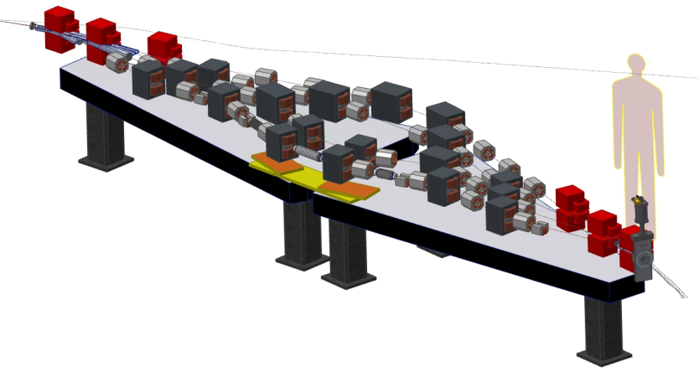
Splitter SX Layout
Hardware design in progress
Splitter RX Layout will use common components
Requirements
Splitter SX Layout
Magnetic Design
Vacuum Design
Mechanical Design
Summary
10 meters

Slide 7
Magnet Design
Bmad magnet identifiers from the lattice with magnet parameters from conceptual designs
Requirements
Splitter SX Layout
Magnetic Design
Vacuum Design
Mechanical Design
Summary
Partial Magnet Chart
Index | Identification | Magnet Type | S Position (m) | Length (m) | Momentum (MeV) | B field (T) | Bd Angle (degrees) | Bd Radius (m) | Sagitta (cm) | Gradient (T/m) | Inductance (mH) | Power Supply |  | Curr Density (A/mm^2)
 |  |  |  |  |  |  |  |  |  |  |  | (V) | (A)
1 | S1.BEN01 | Common | 23.154 | 0.3 | 41.997 | -0.265 | 32.487 | 0.529 | 2.228 | 0 | 0 | 0 | 0 | 0
2 | S1.QUA01 | Quad | 24.035 | 0.15 | 41.997 | 0 | 0 | 0 | 0 | -0.774 | 0.23 | -0.9 | -20.9 | -2.45
3 | S1.BEN02 | H-Dipole | 24.535 | 0.2 | 41.997 | 0.22 | -17.991 | -0.637 | -0.784 | 0 | 32.8 | 2.8 | 30.2 | 1.21
4 | S1.QUA02 | Quad | 24.985 | 0.15 | 41.997 | 0 | 0 | 0 | 0 | 1.8 | 0.23 | 2.1 | 48.6 | 5.68
5 | S1.BEN03 | H-Dipole | 25.415 | 0.2 | 41.997 | -0.293 | 24.007 | 0.477 | 1.043 | 0 | 32.8 | -3.7 | -40.3 | -1.61
6 | S1.QUA03 | Quad | 25.665 | 0.15 | 41.997 | 0 | 0 | 0 | 0 | -1.535 | 0.23 | -1.8 | -41.5 | -4.85
7 | S1.QUA04 | Quad | 26.264 | 0.15 | 41.997 | 0 | 0 | 0 | 0 | 0.682 | 0.23 | 0.8 | 18.4 | 2.15
8 | S1.BEN04 | H-Dipole | 26.514 | 0.2 | 41.997 | 0.196 | -15.986 | -0.716 | -0.697 | 0 | 32.8 | 2.5 | 26.9 | 1.08
9 | S1.BEN05 | H-Dipole | 27.253 | 0.2 | 41.997 | 0.196 | -15.986 | -0.716 | -0.697 | 0 | 32.8 | 2.5 | 26.9 | 1.08
10 | S1.QUA05 | Quad | 27.503 | 0.15 | 41.997 | 0 | 0 | 0 | 0 | 2.238 | 0.23 | 2.6 | 60.5 | 7.07
11 | S1.QUA06 | Quad | 28.102 | 0.15 | 41.997 | 0 | 0 | 0 | 0 | -0.875 | 0.23 | -1 | -23.6 | -2.76
12 | S1.BEN06 | H-Dipole | 28.352 | 0.2 | 41.997 | -0.293 | 24.007 | 0.477 | 1.043 | 0 | 32.8 | -3.7 | -40.3 | -1.61
13 | S1.QUA07 | Quad | 28.782 | 0.15 | 41.997 | 0 | 0 | 0 | 0 | -0.901 | 0.23 | -1.1 | -24.3 | -2.84
14 | S1.BEN07 | H-Dipole | 29.232 | 0.2 | 41.997 | 0.22 | -17.991 | -0.637 | -0.784 | 0 | 32.8 | 2.8 | 30.2 | 1.21
15 | S1.QUA08 | Quad | 29.482 | 0.15 | 41.997 | 0 | 0 | 0 | 0 | 0.932 | 0.23 | 1.1 | 25.2 | 2.94
16 | S1.BEN08 | Common | 30.726 | 0.3 | 41.997 | -0.244 | 30.023 | 0.573 | 2.044 | 0 | 0 | 0 | 0 | 0
. | . | . | . | . | . | . | . | . | . | . | . | . | . | .
. | . | . | . | . | . | . | . | . | . | . | . | . | . | .
. | . | . | . | . | . | . | . | . | . | . | . | . | . | .
99 | S4.QUA08 | Quad | 266.306 | 0.15 | 149.999 | 0 | 0 | 0 | 0 | 3.399 | 0.23 | 4 | 91.8 | 10.73
100 | S4.BEN04 | Septum | 266.906 | 0.2 | 149.999 | 0.368 | -8.422 | -1.358 | -0.368 | 0 | 0 | 0 | 0 | 0
101 | R4.BEN04 | Septum | 318.676 | 0.2 | 149.999 | 0.373 | -8.537 | -1.342 | -0.372 | 0 | 32.8 | 0 | 0 | 0
102 | R4.QUA08 | Quad | 319.176 | 0.15 | 149.999 | 0 | 0 | 0 | 0 | 4.215 | 0.23 | 5 | 113.8 | 13.31
103 | R4.QUA07 | Quad | 319.676 | 0.15 | 149.999 | 0 | 0 | 0 | 0 | -3.473 | 0.23 | -4.1 | -93.8 | -10.97
104 | R4.QUA06 | Quad | 320.176 | 0.15 | 149.999 | 0 | 0 | 0 | 0 | -2.585 | 0.23 | -3.1 | -69.8 | -8.16
105 | R4.QUA05 | Quad | 320.759 | 0.15 | 149.999 | 0 | 0 | 0 | 0 | 1.498 | 0.23 | 1.8 | 40.5 | 4.73
106 | R4.BEN03 | H-Dipole | 321.109 | 0.3 | 149.999 | -0.504 | 17.303 | 0.992 | 1.131 | 0 | 45.6 | -8.7 | -72.7 | -2.91
107 | R4.BEN02 | H-Dipole | 321.84 | 0.3 | 149.999 | -0.504 | 17.303 | 0.992 | 1.131 | 0 | 45.6 | -8.7 | -72.7 | -2.91
108 | R4.QUA04 | Quad | 322.09 | 0.15 | 149.999 | 0 | 0 | 0 | 0 | 0.254 | 0.23 | 0.3 | 6.9 | 0.8
109 | R4.QUA03 | Quad | 322.606 | 0.15 | 149.999 | 0 | 0 | 0 | 0 | 0.323 | 0.23 | 0.4 | 8.7 | 1.02
110 | R4.QUA02 | Quad | 323.106 | 0.15 | 149.999 | 0 | 0 | 0 | 0 | -3.808 | 0.23 | -4.5 | -102.8 | -12.03
111 | R4.QUA01 | Quad | 323.606 | 0.15 | 149.999 | 0 | 0 | 0 | 0 | 1.426 | 0.23 | 1.7 | 38.5 | 4.5
112 | R4.BEN01 | Septum | 324.156 | 0.2 | 149.999 | 0.437 | -10.027 | -1.145 | -0.436 | 0 | 32.8 | 0 | 0 | 0

Slide 8
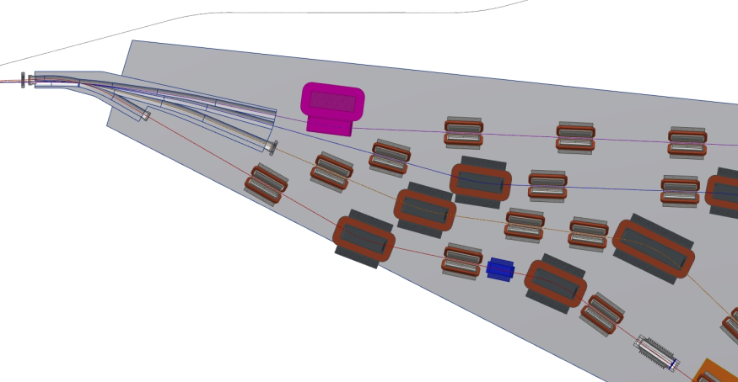
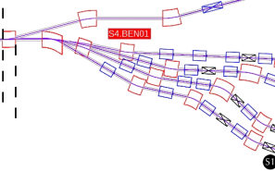
Magnet Design
Splitter SX partial layout with magnet identifiers
Requirements
Splitter SX Layout
Magnetic Design
Vacuum Design
Mechanical Design
Summary
Common Magnet
Septum #1
Septum #2
S1.BEN01
S2.BEN01
S4.BEN01
S4.QUA01
S4.QUA02
S4.QUA03
S2.QUA01
S3.QUA01
S1.QUA01
S3.BEN01
S3.QUA02
S2.BEN02
S3.QUA03
S1.BEN02
S2.QUA02
S2.QUA03
S2.BEN03
S1.QUA02
S1.BEN03
S1.QUA03
Bmad Lattice
Vertical Corrector

Slide 9
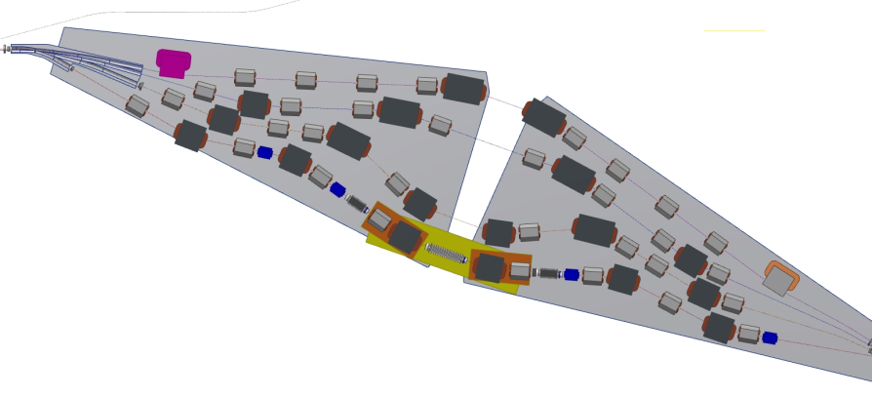
Magnet Design
32 Vertical Correctors (every other quad)
  Layout shows standalone correctors
  Work underway to integrate into quads
Requirements
Splitter SX Layout
Magnetic Design
Vacuum Design
Mechanical Design
Summary
Vertical Correctors

Slide 10
Magnet Design
Magnet Feasibility Studies and Design Concepts
Requirements
Splitter SX Layout
Magnetic Design
Vacuum Design
Mechanical Design
Summary
Magnet Parameter Table
Parameter | Dipole H-Type 1 (21x27x20) | Dipole H-Type 2 (21x27x30) | Quadrupole (14x14x15) | Common | Septum Type 1 | Septum Type 2 | V Corrector Type 1 | V Corrector Type 2
Model version number | 28 | 29 | 12 |  |  |  | 3 | 4
Number of magnets | 24 | 12 | 64 | 4 | 4 | 4 | 16 | 16
Gap or Bore (cm) | 3.6 | 3.6 | 4.5 |  |  | 3.2 | 4.4 | 4.4
Steel height (cm) | 27 | 27 | 14 |  |  | 7 | 7.5 | 7.5
Steel width (cm) | 21 | 21 | 14 |  |  | 31.4 | 12 | 12
Steel length (cm) | 20 | 30 | 15 |  |  | 20 | 10 | 5
Width including coil (cm) | 21 | 21 | 17.2 |  |  | 31.4 | 12 | 12
Length including coil (cm) | 26.6 | 36.6 | 17.2 |  |  |  | 12.4 | 7.4
Pole width (cm) | 7 | 7 | 3.36 |  |  | 3.5 | 3 | 3
Field (G)/Gradient (G/cm) | 1700-5400 | 2400-5400 | 10-490 |  |  | 4060 | 0-160 | 0-160
Field Integral (G-cm) at X = 0 (1) cm | 39400-125000 | 80000-179000 | 160-7700 |  |  |  | 0-2240 | 0-1500
Good Field Region (mm) | ± 15 | ± 15 | ± 15
Central Field Uniformity∗ (%) | ± 0.01 | ± 0.01 | ± 0.01
Field Integral Uniformity∗ | ± 0.01 | ± 0.01 | ± 0.01
NI (Amp-turns)∗∗ | 2437-7743 | 3442-7743 | 20-985 |  |  | 10345 | 0-625 | 0-625
Turns per coil | 6 x 15 | 6 x 15 | 4 + 3 |  |  | 4 | 210 | 210
Coil cross section (cm x cm)∗∗ | 3.3 x 8.3 | 3.3 x 8.3 | 0.55 x 1.65/2.20 |  |  | 5.3 x 3.2 | 1.2 x 5.1 | 1.2 x 5.1
Conductor cross section∗∗ | 0.5 cm square with 0.25-cm diameter hole |  |  |  |  |  | AWG 14 / Ø0.165
Conductor straight length (cm)∗∗ | 19 | 29 | 14 |  |  | 20 | 10 | 5
Coil inner corner radius (cm)∗∗ | 0.5 | 0.5 | 0.5 |  |  |  | 0.3 | 0.3
Conductor length per turn, avg (cm)∗∗ | 63.5 | 83.5 | 39.1 |  |  |  | 26 | 16
Rcoil (Ω)∗∗ | 0.0457 | 0.0601 | 0.00219 |  |  |  | 0.434 | 0.267
L (mH)∗∗ | 2 x 15.9 = 31.8 | 2 x 22.8 = 45.6 | 4 x 0.058 = 0.23 |  |  |  | 22.4 | 15.8
Power supply current (A)∗∗ | 27.1-86.0 | 38.2-86.0 | 5.0-140.7 |  |  | 2586 | 0-2.98 | 0-2.98
Current density (A/mm2 )∗∗ | 1.35-4.28 | 1.90-4.28 | 0.3-7.0 |  |  | ~ 90 | 0-1.0 | 0-1.0
Voltage drop for 1, 2 or 4 coils (V)∗∗ | 2.5-7.9 | 4.6-10.3 | 0.0-1.2 |  |  |  | 0-1.3 | 0-0.8
Power/magnet (W)∗∗ | 67-676 | 175-889 | 0.2-173 |  |  |  | 0-3.9 | 0-2.4
∗ Deﬁned as horizontal deviation from the ideal ﬁeld (BY − B^{idealY} )/B^{idealY}
∗∗ Conceptual model parameters for use as guidance only

Slide 11
Magnet Design
Magnet Status:
Requirements
Splitter SX Layout
Magnetic Design
Vacuum Design
Mechanical Design
Summary
Task | Status | Technical Risk | Comment
Quad Concepts | Finished | Low | RFP in final approval
Dipole Concepts | Finished | Medium | RFP in final approval. Current density appears too high. *Designed field gradient higher than needed
Vertical Corrector | Finished | Low | Continuing value-engineering underway to integrate correction into the quad
Septum Concepts | 75% | Medium | High current. *engineering work needed to reduce current requirements through coil design
Cross-talk | not started | Medium | Is modeling needed? Unknown risk

Slide 12
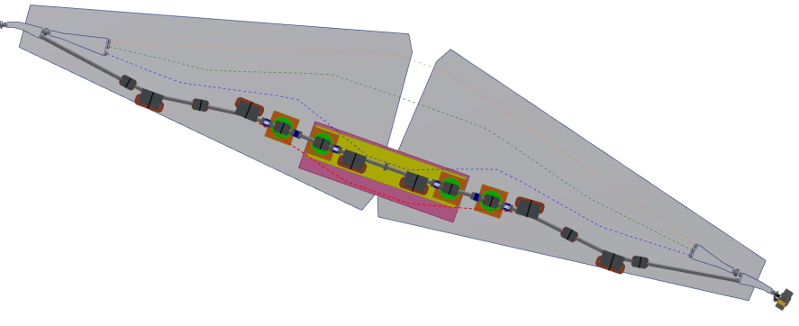
Vacuum Design
1 Pass ERL “flat pass”
Angle adjustment to achieve
+/- 10 mm change in length
Requirements
Splitter SX Layout
Magnetic Design
Vacuum Design
Mechanical Design
Summary

Slide 13
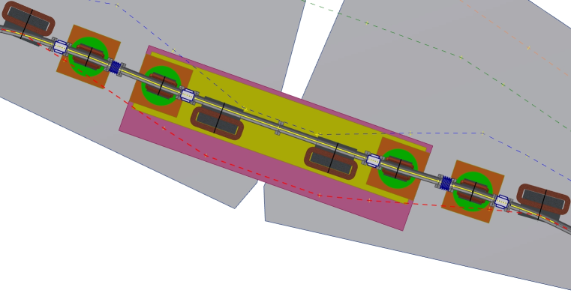
Vacuum Design
1 Pass ERL “flat pass”
Angle adjustment to achieve
+/- 10 mm change in length
Beam Path Length Adjustments
Requirements
Splitter SX Layout
Magnetic Design
Vacuum Design
Mechanical Design
Summary
Quad
Translation Stage
Rotation Stage
Quad
Translation Stage
Rotation Stage
Dipoles
Translation Stage
Quad
Translation Stage
Rotation Stage
Quad
Translation Stage
Rotation Stage
A
B
A to B = 8187.4 mm
0° Angle

Slide 14
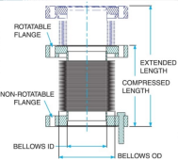
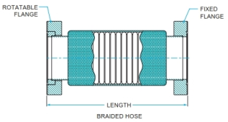
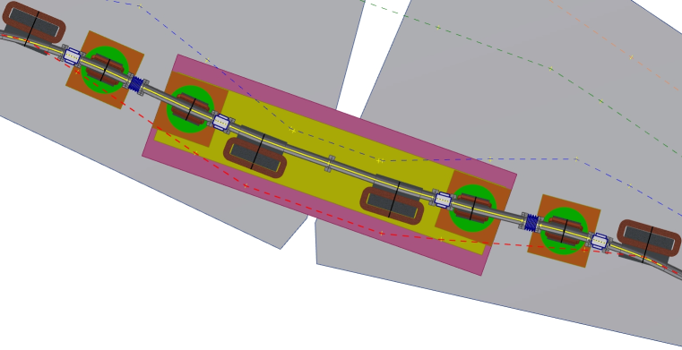
Vacuum Design
E
= Edge welded bellows to allow length change
F
= Formed bellows to allow angle change
Requirements
Splitter SX Layout
Magnetic Design
Vacuum Design
Mechanical Design
Summary
A
F
E
F
B
A to B = 8191.9 mm
3° Angle, 4.5 mm change
F
F
E

Slide 15
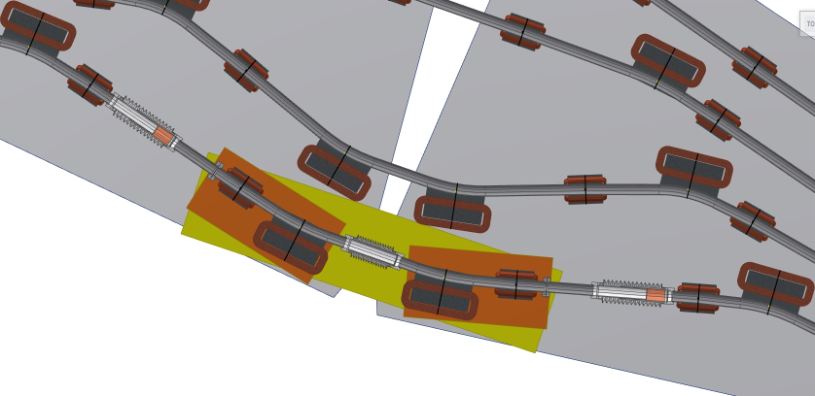
Vacuum Design
4 Pass ERL
Translation adjustment along the beam trajectories to achieve +/- 10mm change in length
Requirements
Splitter SX Layout
Magnetic Design
Vacuum Design
Mechanical Design
Summary
Beam Path Length Adjustments
Quads and Dipoles
Translation Stages
A
B
A to B = 2994.4 mm

Slide 16
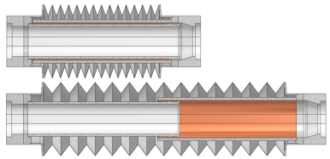
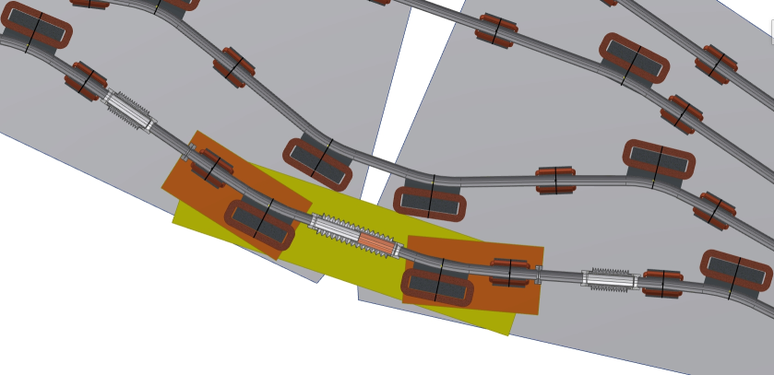
Vacuum Design
Beam Path Length Adjustments
Requirements
Splitter SX Layout
Magnetic Design
Vacuum Design
Mechanical Design
Summary
S
= Sliding Joint allows for length change
A
S
B
A to B = 2990.4 mm
S
S

Slide 17

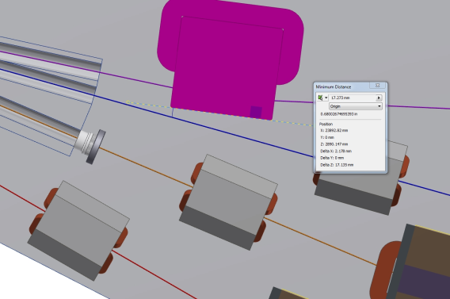
Vacuum Design
Requirements
Splitter SX Layout
Magnetic Design
Vacuum Design
Mechanical Design
Summary
Conceptual C-Dipole shown as a place holder until Septum model is available
70 mm Pole Width
200 mm Length
Septum clearance to S3 Beam Line = 17.3 mm

Slide 18
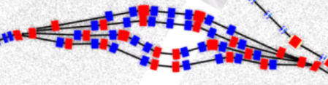
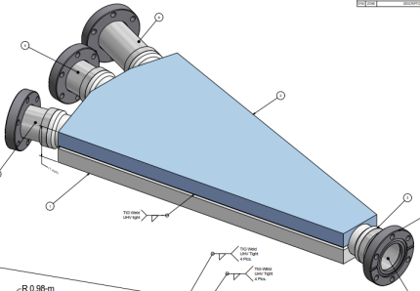
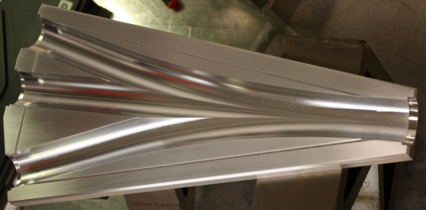
Splitter Chambers
To keep low beam impedance, the Splitter vacuum chambers where the beams merge/demerge may be made of aluminum alloy (6061-T6) with smooth beam path transitions, as used in the ERL Photo-Cathode Injector
Slide courtesy of Yulin Li

Slide 19
Vacuum Design
Vacuum Status:
Requirements
Splitter SX Layout
Magnetic Design
Vacuum Design
Mechanical Design
Summary
Task | Status | Technical Risk | Comment
Layout design | Finished | Medium | No volume conflicts. S4 Septum very close to S3 beam line
Vacuum Component Designs | not started | Low | Conventional Design, proven to work designs or methods to meet requirements

Slide 20
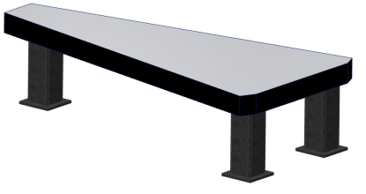
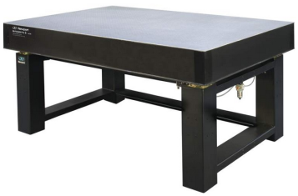
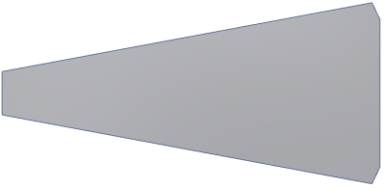
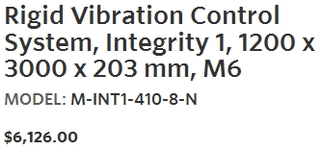
Mechanical Design
Table:
Requirement for vibrations needs to be finalized
Custom table based on standard tables could be advantageous
Requirements
Splitter SX Layout
Magnetic Design
Vacuum Design
Mechanical Design
Summary
1650 mm
3500 mm

Slide 21
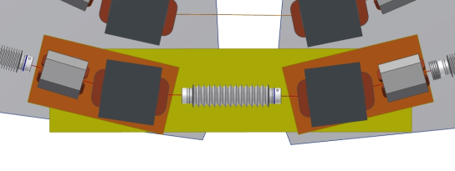
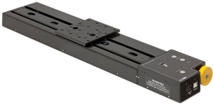
Mechanical Design
Translation Stages:
Stepper motors with linear slides will provide a relatively inexpensive, quick adjustment of path length
  Two motors work together to move the stages dependently (one controller drives both motors)
Requirements
Splitter SX Layout
Magnetic Design
Vacuum Design
Mechanical Design
Summary

Slide 22
Mechanical Design
Mechanical Status:
Requirements
Splitter SX Layout
Magnetic Design
Vacuum Design
Mechanical Design
Summary
Task | Status | Technical Risk | Comment
Beam Path Adjustment | 50% | Low | Conceptual design was for 10°RF, new requirement is 20°.
Magnet Mount and Table Designs | not started | Low | Conventional and known methods to mount magnets and table design

Slide 23
Summary
Physics Lattice and Design Layout (CAD) are in 100% agreement and are driving the mechanical design
Magnet design concepts are completed and meet the lattice requirements but more work is needed to adhere to best-practices of lower current-density
Vacuum and mechanical designs have low technical risks based on using conventional and known designs and methods
Requirements
Splitter SX Layout
Magnetic Design
Vacuum Design
Mechanical Design
Summary

Slide 24
Questions/Comments

Slide 26
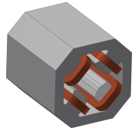
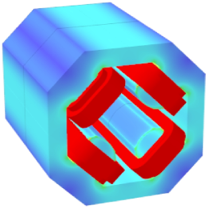
Magnet Design
Quadrupole Feasibility Study and Design Concept
Requirements
Splitter SX Layout
Magnetic Design
Vacuum Design
Mechanical Design
Summary
Parameter | Quadrupole (14x14x15)
Model version number | 12
Number of magnets | 64
Gap or Bore (cm) | 4.5
Steel height (cm) | 14
Steel width (cm) | 14
Steel length (cm) | 15
Width including coil (cm) | 17.2
Length including coil (cm) | 17.2
Pole width (cm) | 3.36
Good Field Region (mm) | ± 15
Central Field Uniformity∗ (%) | ± 0.01
Field Integral Uniformity∗ | ± 0.01
Field (G)/Gradient (G/cm) | 10-490
NI (Amp-turns)∗∗ | 20-985
Turns per coil | 4 + 3
Coil cross section (cm x cm)∗∗ | 0.55 x 1.65/2.20
Conductor cross section∗∗ | 0.5 cm square with 0.25-cm diameter hole
Conductor straight length (cm)∗∗ | 14
Coil inner corner radius (cm)∗∗ | 0.5
Conductor length per turn, avg (cm)∗∗ | 39.1
Rcoil (Ω)∗∗ | 0.00219
L (mH)∗∗ | 4 x 0.058 = 0.23
Power supply current (A)∗∗ | 5.0-140.7
Current density (A/mm2 )∗∗ | 0.3-7.0
Voltage drop for 1, 2 or 4 coils (V)∗∗ | 0.0-1.2
Power/magnet (W)∗∗ | 0.2-173
∗ Deﬁned as horizontal deviation from the ideal ﬁeld (BY − B^{idealY} )/B^{idealY}
∗∗ Conceptual model parameters for use as guidance only

Slide 27

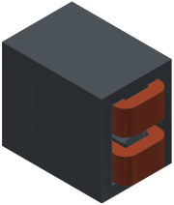
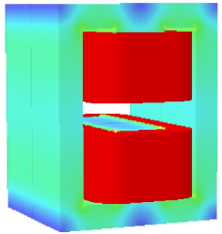
Magnet Design
Dipole Feasibility Study and Design Concept
Requirements
Splitter SX Layout
Magnetic Design
Vacuum Design
Mechanical Design
Summary
Parameter | Dipole H-Type 1 (21x27x20) | Dipole H-Type 2 (21x27x30)
Model version number | 28 | 29
Number of magnets | 24 | 12
Gap or Bore (cm) | 3.6 | 3.6
Steel height (cm) | 27 | 27
Steel width (cm) | 21 | 21
Steel length (cm) | 20 | 30
Width including coil (cm) | 21 | 21
Length including coil (cm) | 26.6 | 36.6
Pole width (cm) | 7 | 7
Good Field Region (mm) | ± 15 | ± 15
Central Field Uniformity∗ (%) | ± 0.01 | ± 0.01
Field Integral Uniformity∗ | ± 0.01 | ± 0.01
Field (G)/Gradient (G/cm) | 1700-5400 | 2400-5400
NI (Amp-turns)∗∗ | 2437-7743 | 3442-7743
Turns per coil | 6 x 15 | 6 x 15
Coil cross section (cm x cm)∗∗ | 3.3 x 8.3 | 3.3 x 8.3
Conductor cross section∗∗ | 0.5 cm square with 0.25-cm diameter hole
Conductor straight length (cm)∗∗ | 19 | 29
Coil inner corner radius (cm)∗∗ | 0.5 | 0.5
Conductor length per turn, avg (cm)∗∗ | 63.5 | 83.5
Rcoil (Ω)∗∗ | 0.0457 | 0.0601
L (mH)∗∗ | 2 x 15.9 = 31.8 | 2 x 22.8 = 45.6
Power supply current (A)∗∗ | 27.1-86.0 | 38.2-86.0
Current density (A/mm2 )∗∗ | 1.35-4.28 | 1.90-4.28
Voltage drop for 1, 2 or 4 coils (V)∗∗ | 2.5-7.9 | 4.6-10.3
Power/magnet (W)∗∗ | 67-676 | 175-889
∗ Deﬁned as horizontal deviation from the ideal ﬁeld (BY − B^{idealY} )/B^{idealY}
∗∗ Conceptual model parameters for use as guidance only

Slide 28
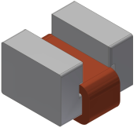
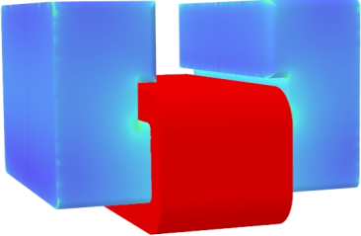
Magnet Design
Dipole Feasibility Study and Design Concept
Requirements
Splitter SX Layout
Magnetic Design
Vacuum Design
Mechanical Design
Summary
Parameter | V Corrector Type 1 (Standalone) | V Corrector Type 2 (Standalone) | Vertical Correction in Quadrupole
Model version number | 3 | 4
Number of magnets | 16 | 16
Gap or Bore (cm) | 4.4 | 4.4
Steel height (cm) | 7.5 | 7.5
Steel width (cm) | 12 | 12
Steel length (cm) | 10 | 5
Width including coil (cm) | 12 | 12
Length including coil (cm) | 12.4 | 7.4
Pole width (cm) | 3 | 3
Good Field Region (mm) |  |  | ± 15
Central Field Uniformity∗ (%) |  |  | ± 0.01
Field Integral Uniformity∗ |  |  | ± 0.01
Field (G)/Gradient (G/cm) | 0-160 | 0-160 | 0-160
NI (Amp-turns)∗∗ | 0-625 | 0-625 | 0-625
Turns per coil | 210 | 210 | 210
Coil cross section (cm x cm)∗∗ | 1.2 x 5.1 | 1.2 x 5.1 | 1.2 x 5.1
Conductor cross section∗∗ | AWG 14 / Ø0.165 |  | TBD
Conductor straight length (cm)∗∗ | 10 | 5 | 14
Coil inner corner radius (cm)∗∗ | 0.3 | 0.3 | 0.5
Conductor length per turn, avg (cm)∗∗ | 26 | 16 | 39.1
Rcoil (Ω)∗∗ | 0.434 | 0.267 | 0.434
L (mH)∗∗ | 22.4 | 15.8 | 22.4
Power supply current (A)∗∗ | 0-2.98 | 0-2.98 | 0-2.98
Current density (A/mm2 )∗∗ | 0-1.0 | 0-1.0 | 0-1.0
Voltage drop for 1, 2 or 4 coils (V)∗∗ | 0-1.3 | 0-0.8 | 0-1.3
Power/magnet (W)∗∗ | 0-3.9 | 0-2.4 | 0-3.9
∗ Deﬁned as horizontal deviation from the ideal ﬁeld (BY − B^{idealY} )/B^{idealY}
∗∗ Conceptual model parameters for use as guidance only

Slide 29
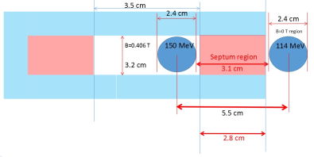
Magnet Design
Septum Feasibility Study and Design Concept
Requirements
Splitter SX Layout
Magnetic Design
Vacuum Design
Mechanical Design
Summary
Parameter | Septum Type 1 | Septum Type 2
Model version number
Number of magnets | 4 | 4
Gap or Bore (cm) |  | 3.2
Steel height (cm) |  | 7
Steel width (cm) |  | 31.4
Steel length (cm) |  | 20
Width including coil (cm) |  | 31.4
Length including coil (cm)
Pole width (cm) |  | 3.5
Good Field Region (mm)
Central Field Uniformity∗ (%)
Field Integral Uniformity∗
Field (G)/Gradient (G/cm) |  | 4060
NI (Amp-turns)∗∗ |  | 10345
Turns per coil |  | 4
Coil cross section (cm x cm)∗∗ |  | 5.3 x 3.2
Conductor cross section∗∗
Conductor straight length (cm)∗∗ |  | 20
Coil inner corner radius (cm)∗∗
Conductor length per turn, avg (cm)∗∗
Rcoil (Ω)∗∗
L (mH)∗∗
Power supply current (A)∗∗ |  | 2586
Current density (A/mm2 )∗∗ |  | ~ 90
Voltage drop for 1, 2 or 4 coils (V)∗∗
Power/magnet (W)∗∗
∗ Deﬁned as horizontal deviation from the ideal ﬁeld (BY − B^{idealY} )/B^{idealY}
∗∗ Conceptual model parameters for use as guidance only

Slide 30
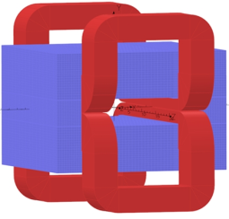
Magnet Design
Common Feasibility Study and Design Concept
Requirements
Splitter SX Layout
Magnetic Design
Vacuum Design
Mechanical Design
Summary
Parameter | Septum Type 1 | Septum Type 2
Model version number
Number of magnets | 4 | 4
Gap or Bore (cm) |  | 3.2
Steel height (cm) |  | 7
Steel width (cm) |  | 31.4
Steel length (cm) |  | 20
Width including coil (cm) |  | 31.4
Length including coil (cm)
Pole width (cm) |  | 3.5
Good Field Region (mm)
Central Field Uniformity∗ (%)
Field Integral Uniformity∗
Field (G)/Gradient (G/cm) |  | 4060
NI (Amp-turns)∗∗ |  | 10345
Turns per coil |  | 4
Coil cross section (cm x cm)∗∗ |  | 5.3 x 3.2
Conductor cross section∗∗
Conductor straight length (cm)∗∗ |  | 20
Coil inner corner radius (cm)∗∗
Conductor length per turn, avg (cm)∗∗
Rcoil (Ω)∗∗
L (mH)∗∗
Power supply current (A)∗∗ |  | 2586
Current density (A/mm2 )∗∗ |  | ~ 90
Voltage drop for 1, 2 or 4 coils (V)∗∗
Power/magnet (W)∗∗
Latest Picture not Available
∗ Deﬁned as horizontal deviation from the ideal ﬁeld (BY − B^{idealY} )/B^{idealY}
∗∗ Conceptual model parameters for use as guidance only

