Slide 1

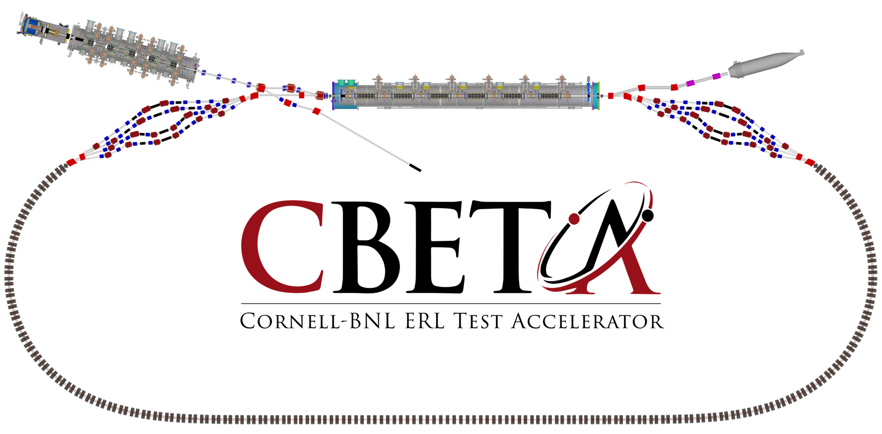
Page Headline
Baseline: Lattice & Studies

Slide 2

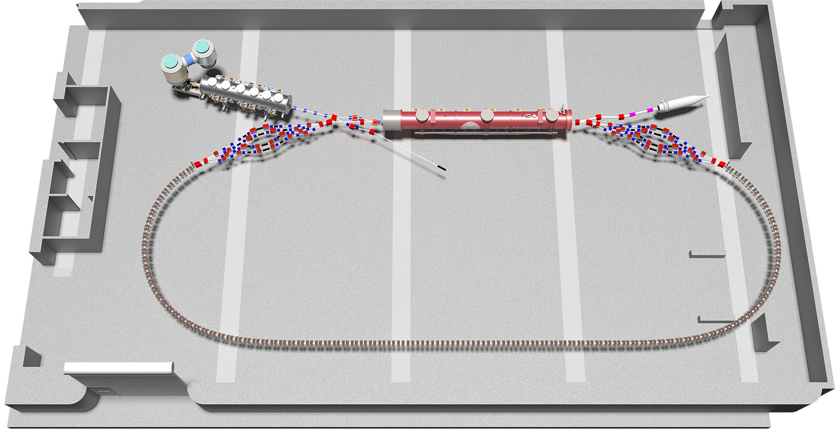

Slide 3
CBETA Layout in L0E
Page Headline

Slide 4
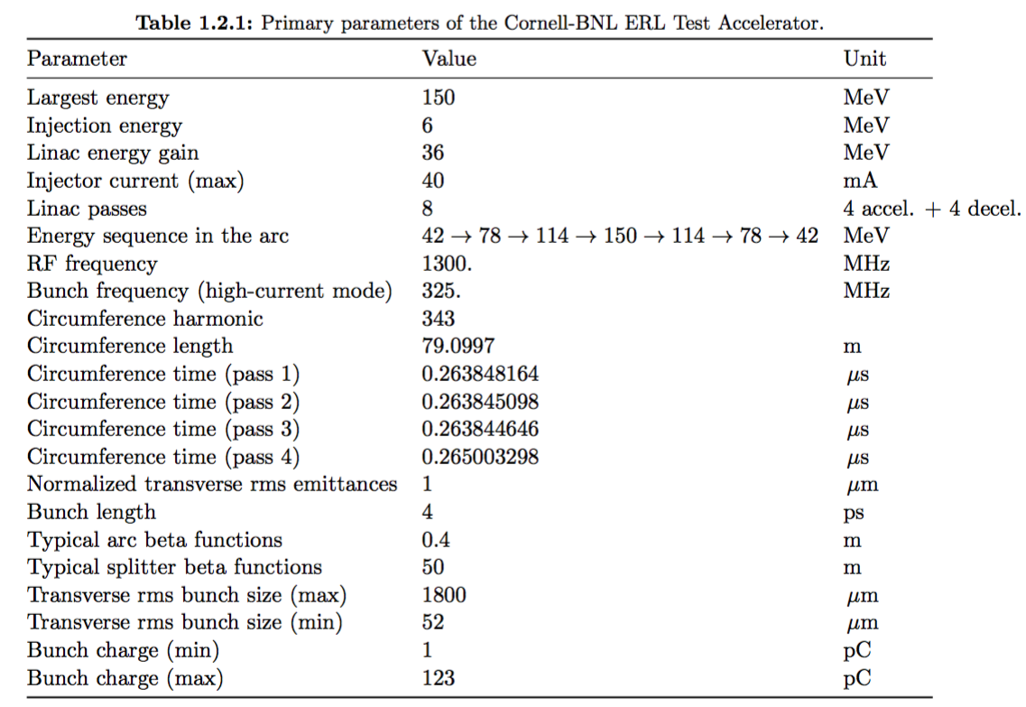
Basic Parameters
Page Headline

Slide 5
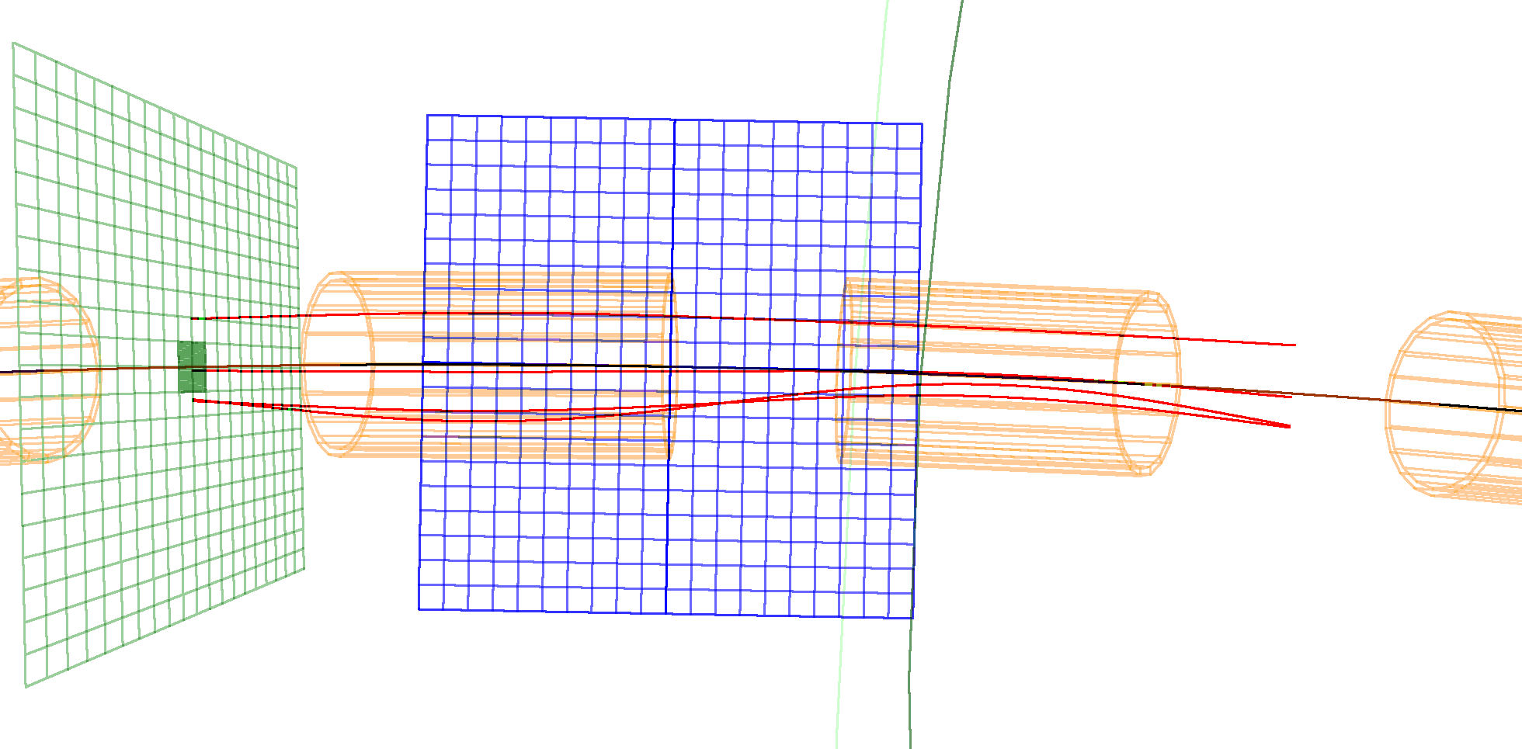
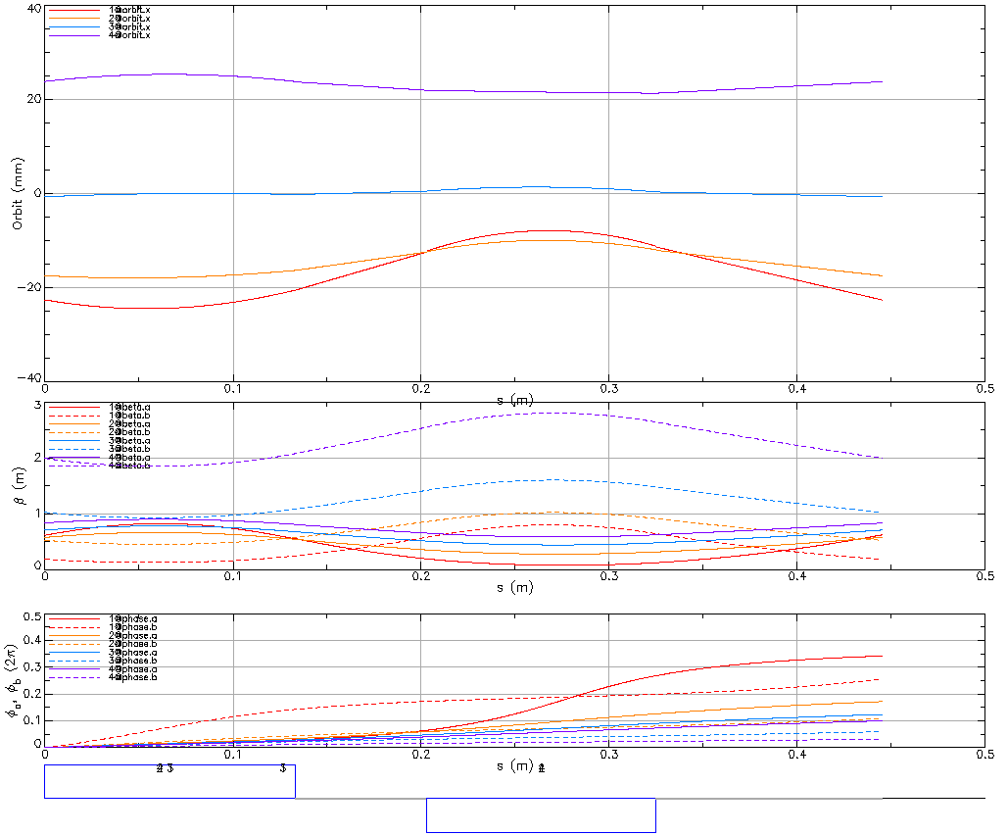
FFAG Arc Cell (5 deg)
150 MeV
114 MeV
QF
(focusing)
13.3 cm
-11.5 T/m
78 MeV
QD
(defocusing)
12.2 cm
11.0 T/m
-0.311 T in center
42 MeV
Short Drift
7 cm
BPM
Long Drift
12 cm
Pump or screen
QF
BPM
QD

Slide 6
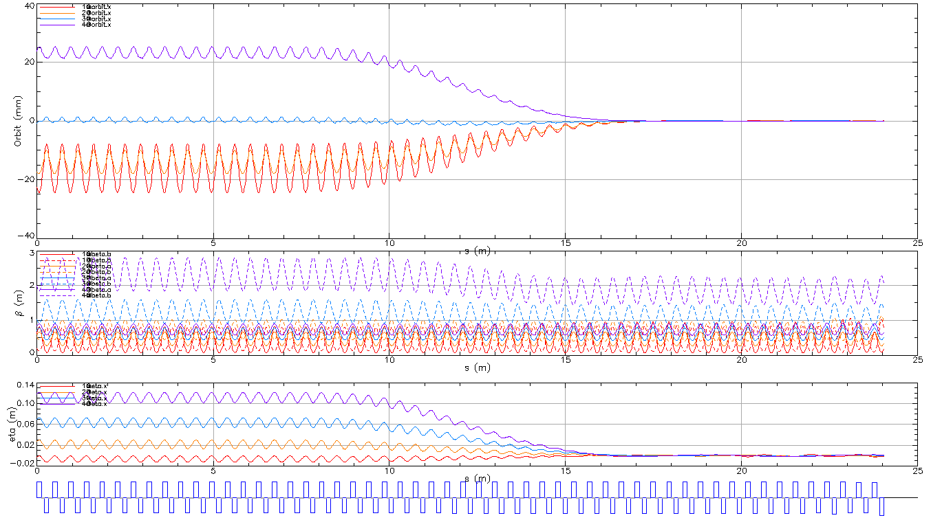
Designed FFAG Arc, transition, straight
Page Headline
Offsets, angles scaled by factor:
FA
TA
ZA

Slide 7
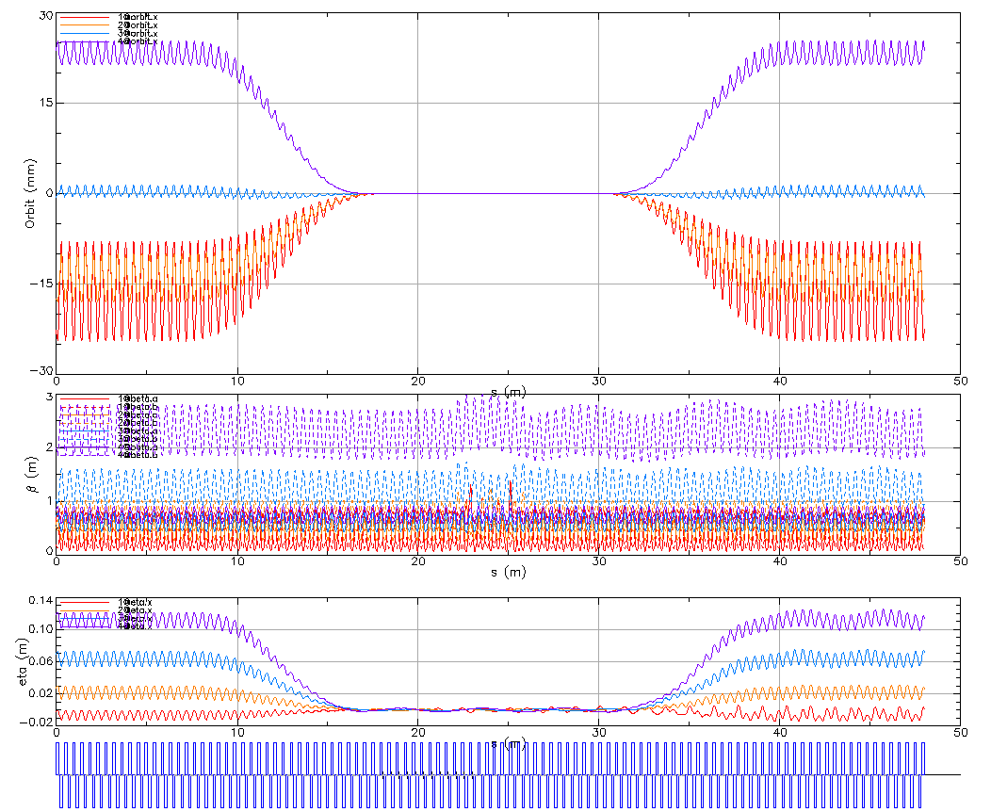
Full FFAG Arc

Slide 8
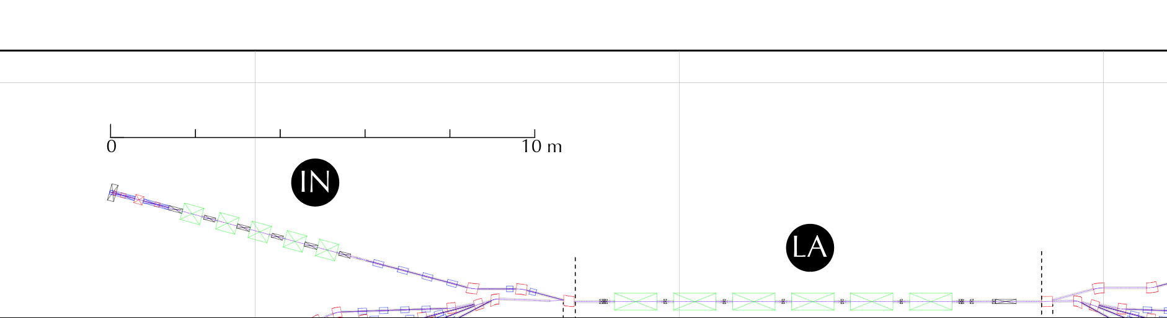
Space Charge optimization through LA
Page Headline
The beam is optimized with space charge using GPT to match specified beam sizes and divergence at the end of the first pass of the Linac.

Slide 9
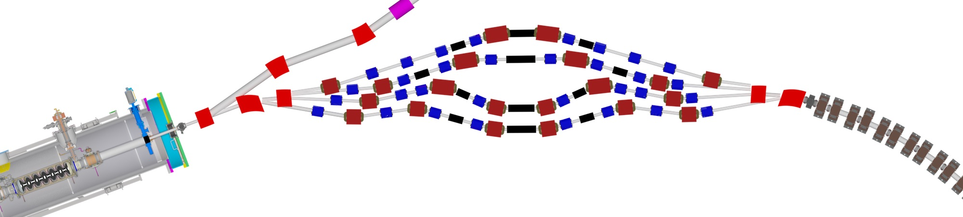
Splitters (SX, RX)
Page Headline
common
dipole
quad
dipole
sliding
joints
Receive beams on-axis from LA
Match each energy beam onto its stable orbit in FA
Match optics for each energy beam
Momentum compaction (r56) adjustment
Path lengths: (S1 + FA pass 1) = (S2 + FA pass 2) =(S3 + FA pass 3)
Allow path length adjustment by sliding joints
Dipole fields < 0.6 T
Quad fields < 4 T/m
Realistic transverse element sizes

Slide 10
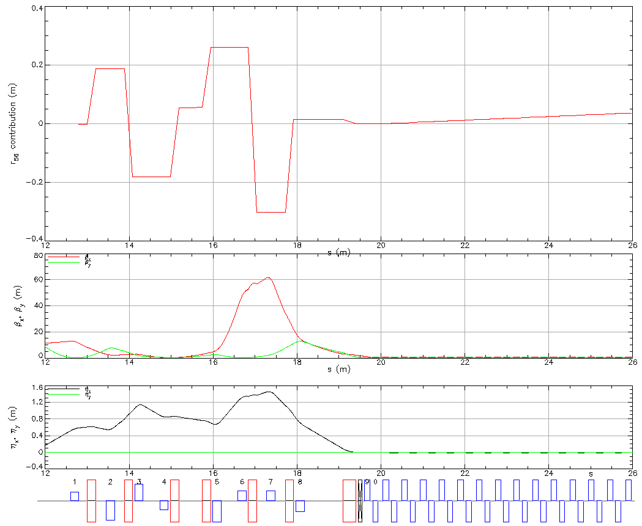
S1 optics (42 MeV)
Page Headline

Slide 11
Splitter optics for each pass
Page Headline

Slide 12
Path length: 1-pass ERL
Page Headline
Harmonic:

Slide 13
Path length: 2-pass ERL
Page Headline
Harmonics:

Slide 14
Path length: 3-pass ERL
Page Headline
Harmonics:

Slide 15
Path length: 4-pass ERL
Page Headline
Harmonics:

Slide 16
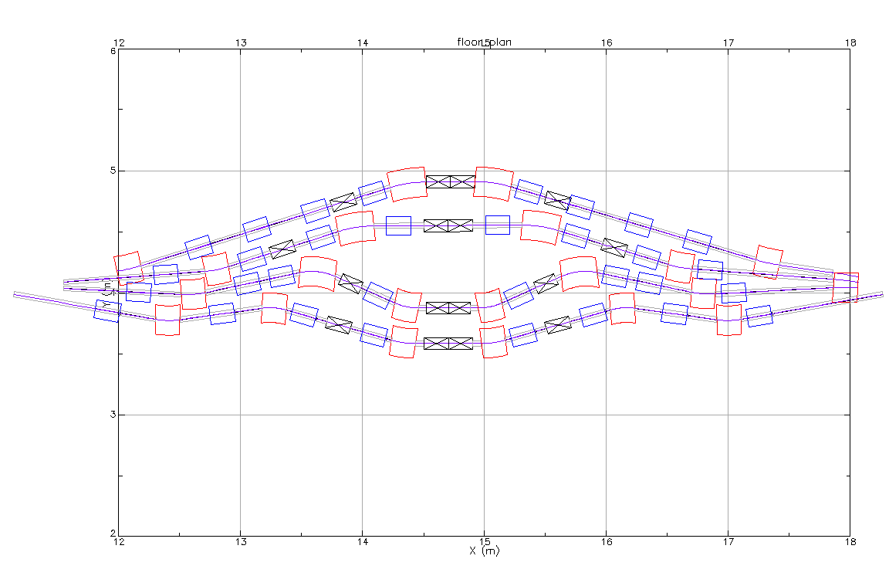
Path length tuning: pass 1
Page Headline
Harmonics:

Slide 17

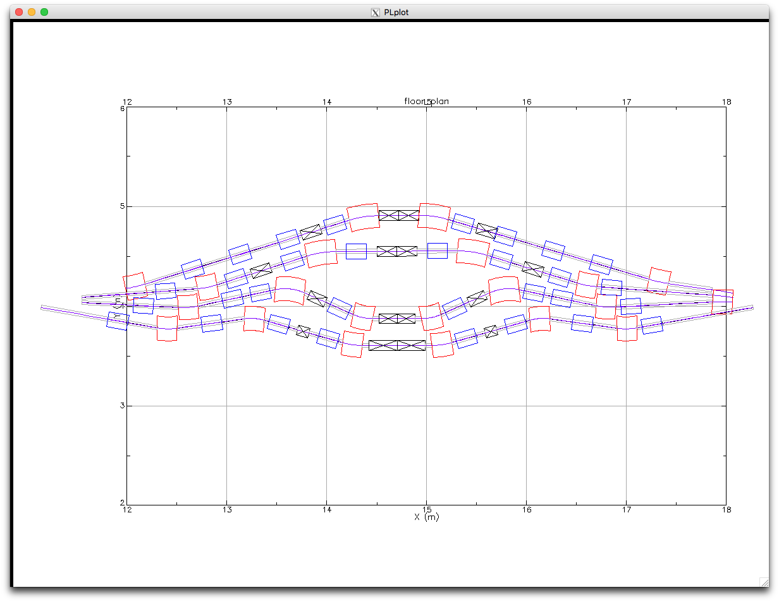
Path length tuning: pass 1
Page Headline
Harmonics:
+ 10/360 * rf wavelength

Slide 18
Path length tuning: pass 1
Page Headline
Harmonics:
- 10/360 * rf wavelength

Slide 19
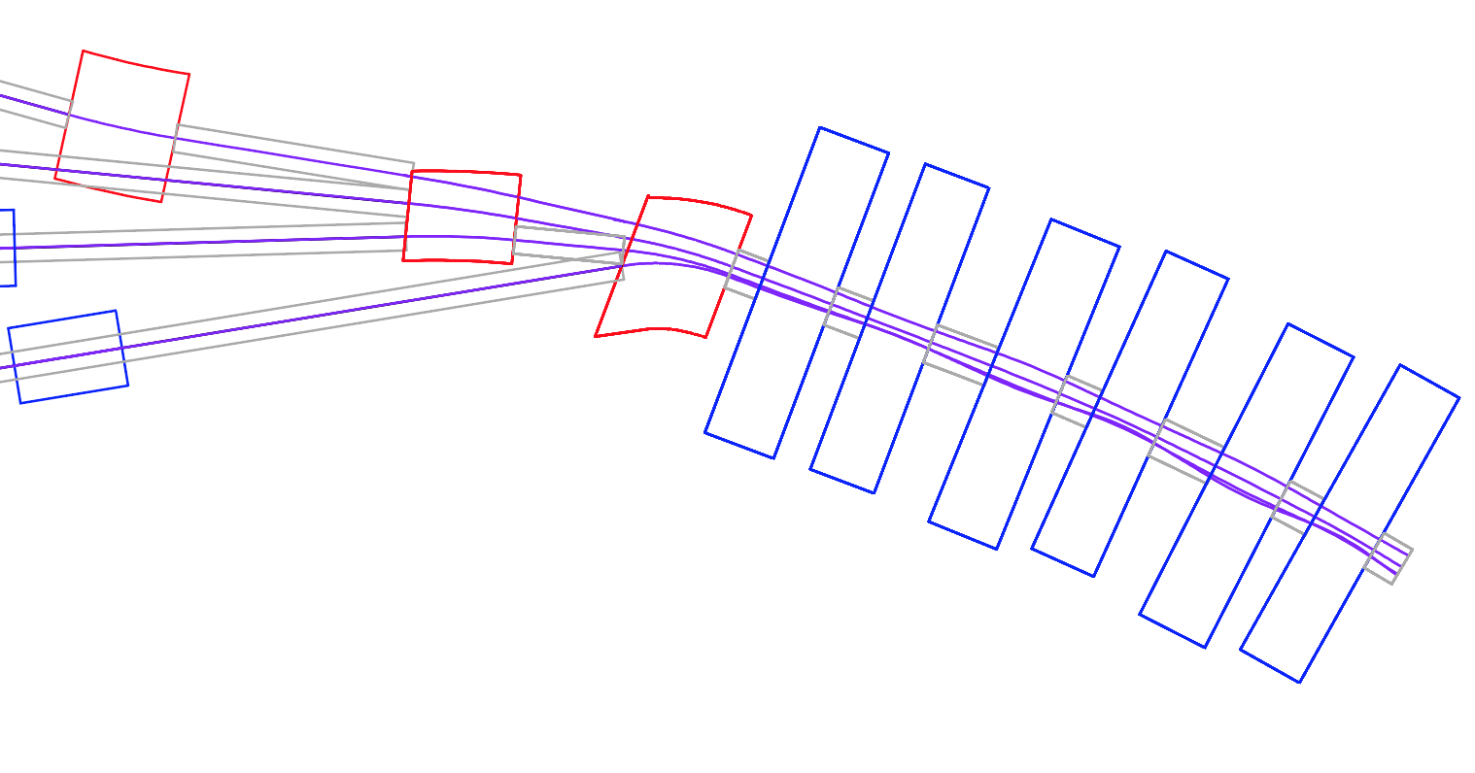
SX demerge and merge detail
S4: 150 MeV
S3: 114 MeV
S2: 78 MeV
S1: 42 MeV
S4
FA
S3
S2
S1

Slide 20
RX Merge and Mirror Merger detail
R4
R3
R2
R1

Slide 21
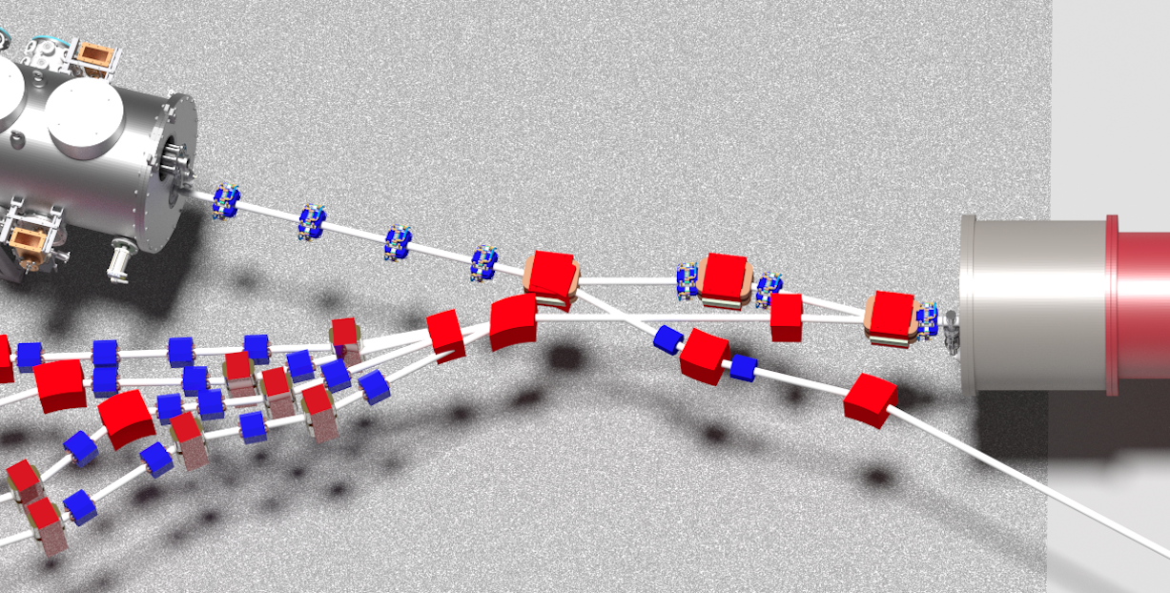
RX Merge and Mirror Merger

Slide 22
4-pass Optics Design
Page Headline
Design
Match into Energy 3 (114 MeV) line

Slide 23
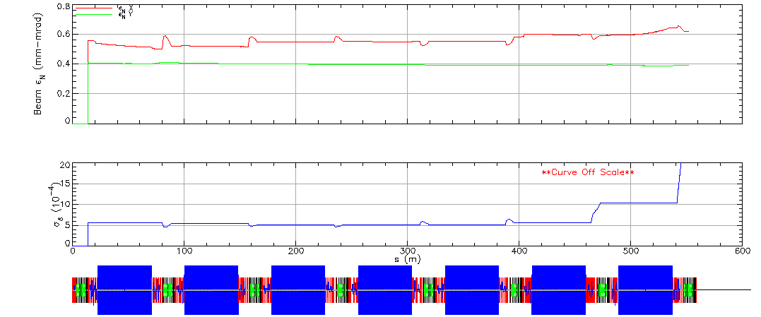
Start-to-End tracking
Page Headline

Slide 24
Orbit correction simulation
Page Headline
200 um offset errors in all quads
Simultaneously corrected: h corrector in QF, v corrector in QD

Slide 25
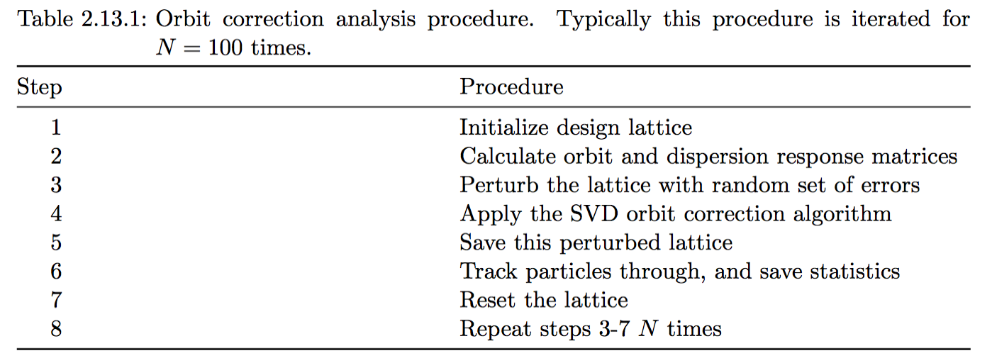
Corrector strength scaling for offsets
Page Headline

Slide 26
Accelerator Physics Topics
Injector + Linac space charge optimization
Complete 4-pass start-to-end lattice
Fieldmap tracking in FFAG cell (many codes)
Start-to-end tracking with no collective effects
CSR 1-pass tracking
Resistive wall and roughness wakefields
Orbit and optics correction
Tolerance & stability analysis
BBU
RGS
Touschek scattering
Longitudinal Tails
Dark current tracking & collimation
Ion trapping
Realistic Splitter magnet design
Online model
CSR 4-pass tracking, with longitudinal phasing/shaping
Halo from cathode
microbunching
Well under control
Straightforward but not done
Difficult
Caution

Slide 27
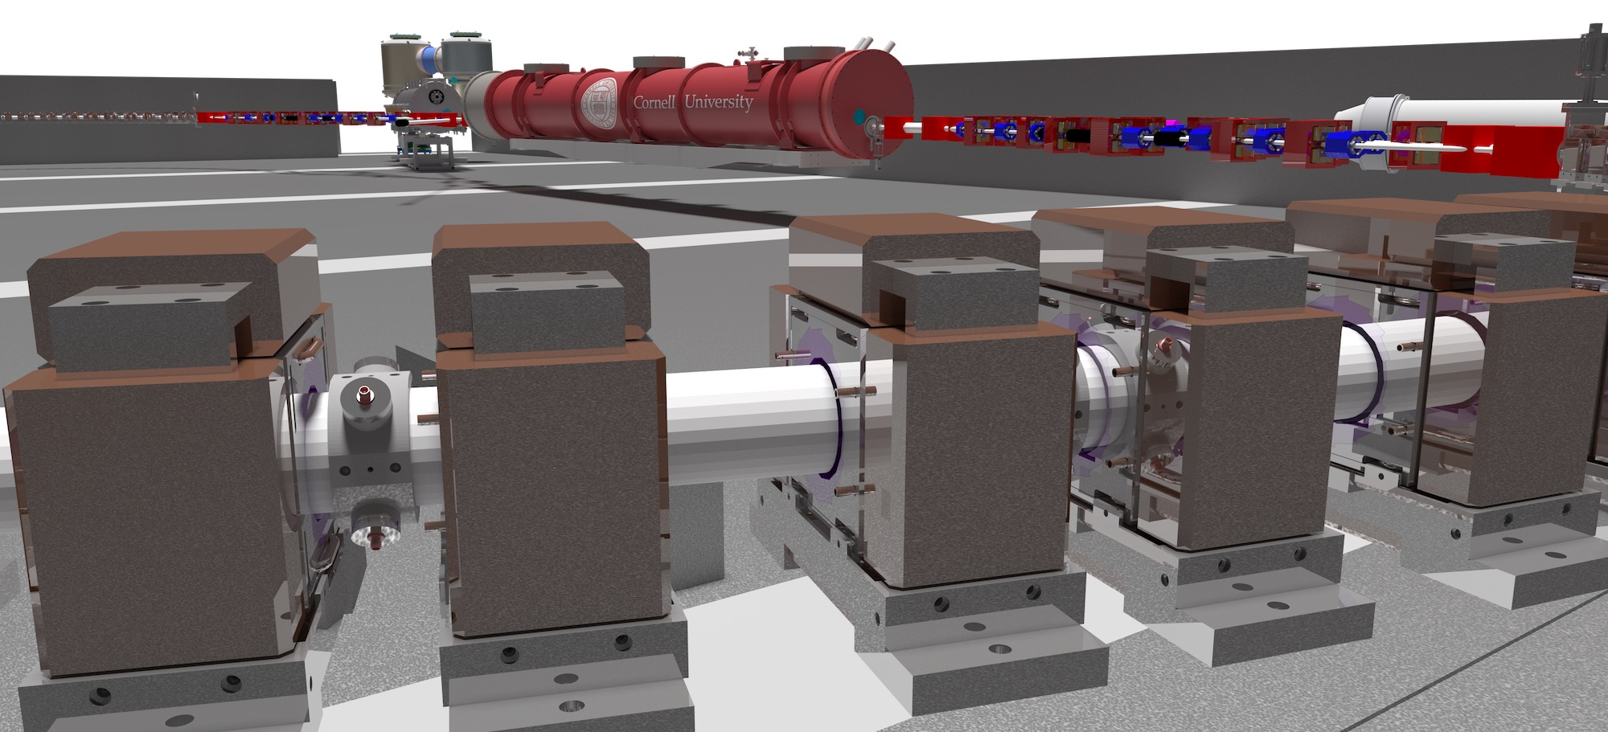
END
Page Headline

Slide 28
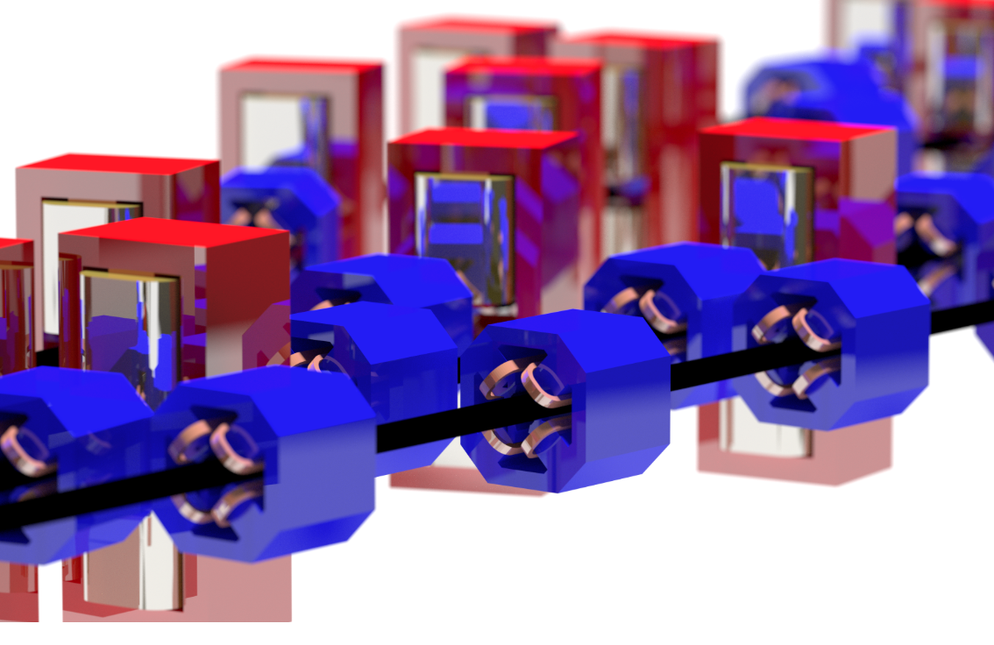
Splitter render
Page Headline

Slide 29
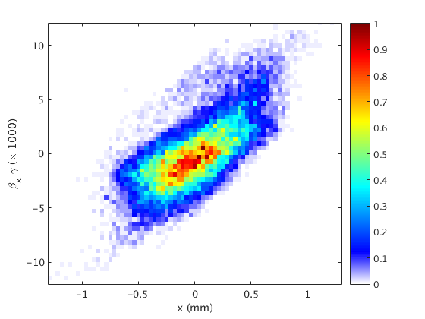
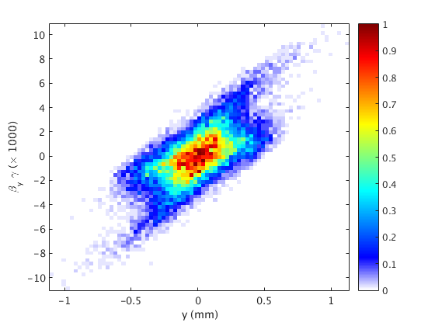
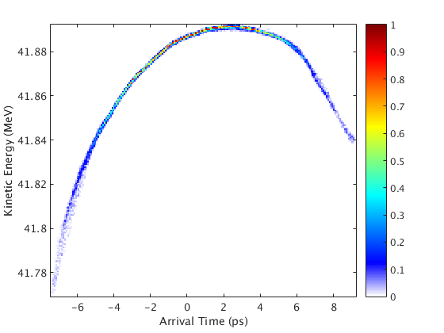
Start-to-End tracking
Page Headline
100 pC bunch calculated from GPT with space charge
…spliced into Bmad 4-pass model

