Slide 1

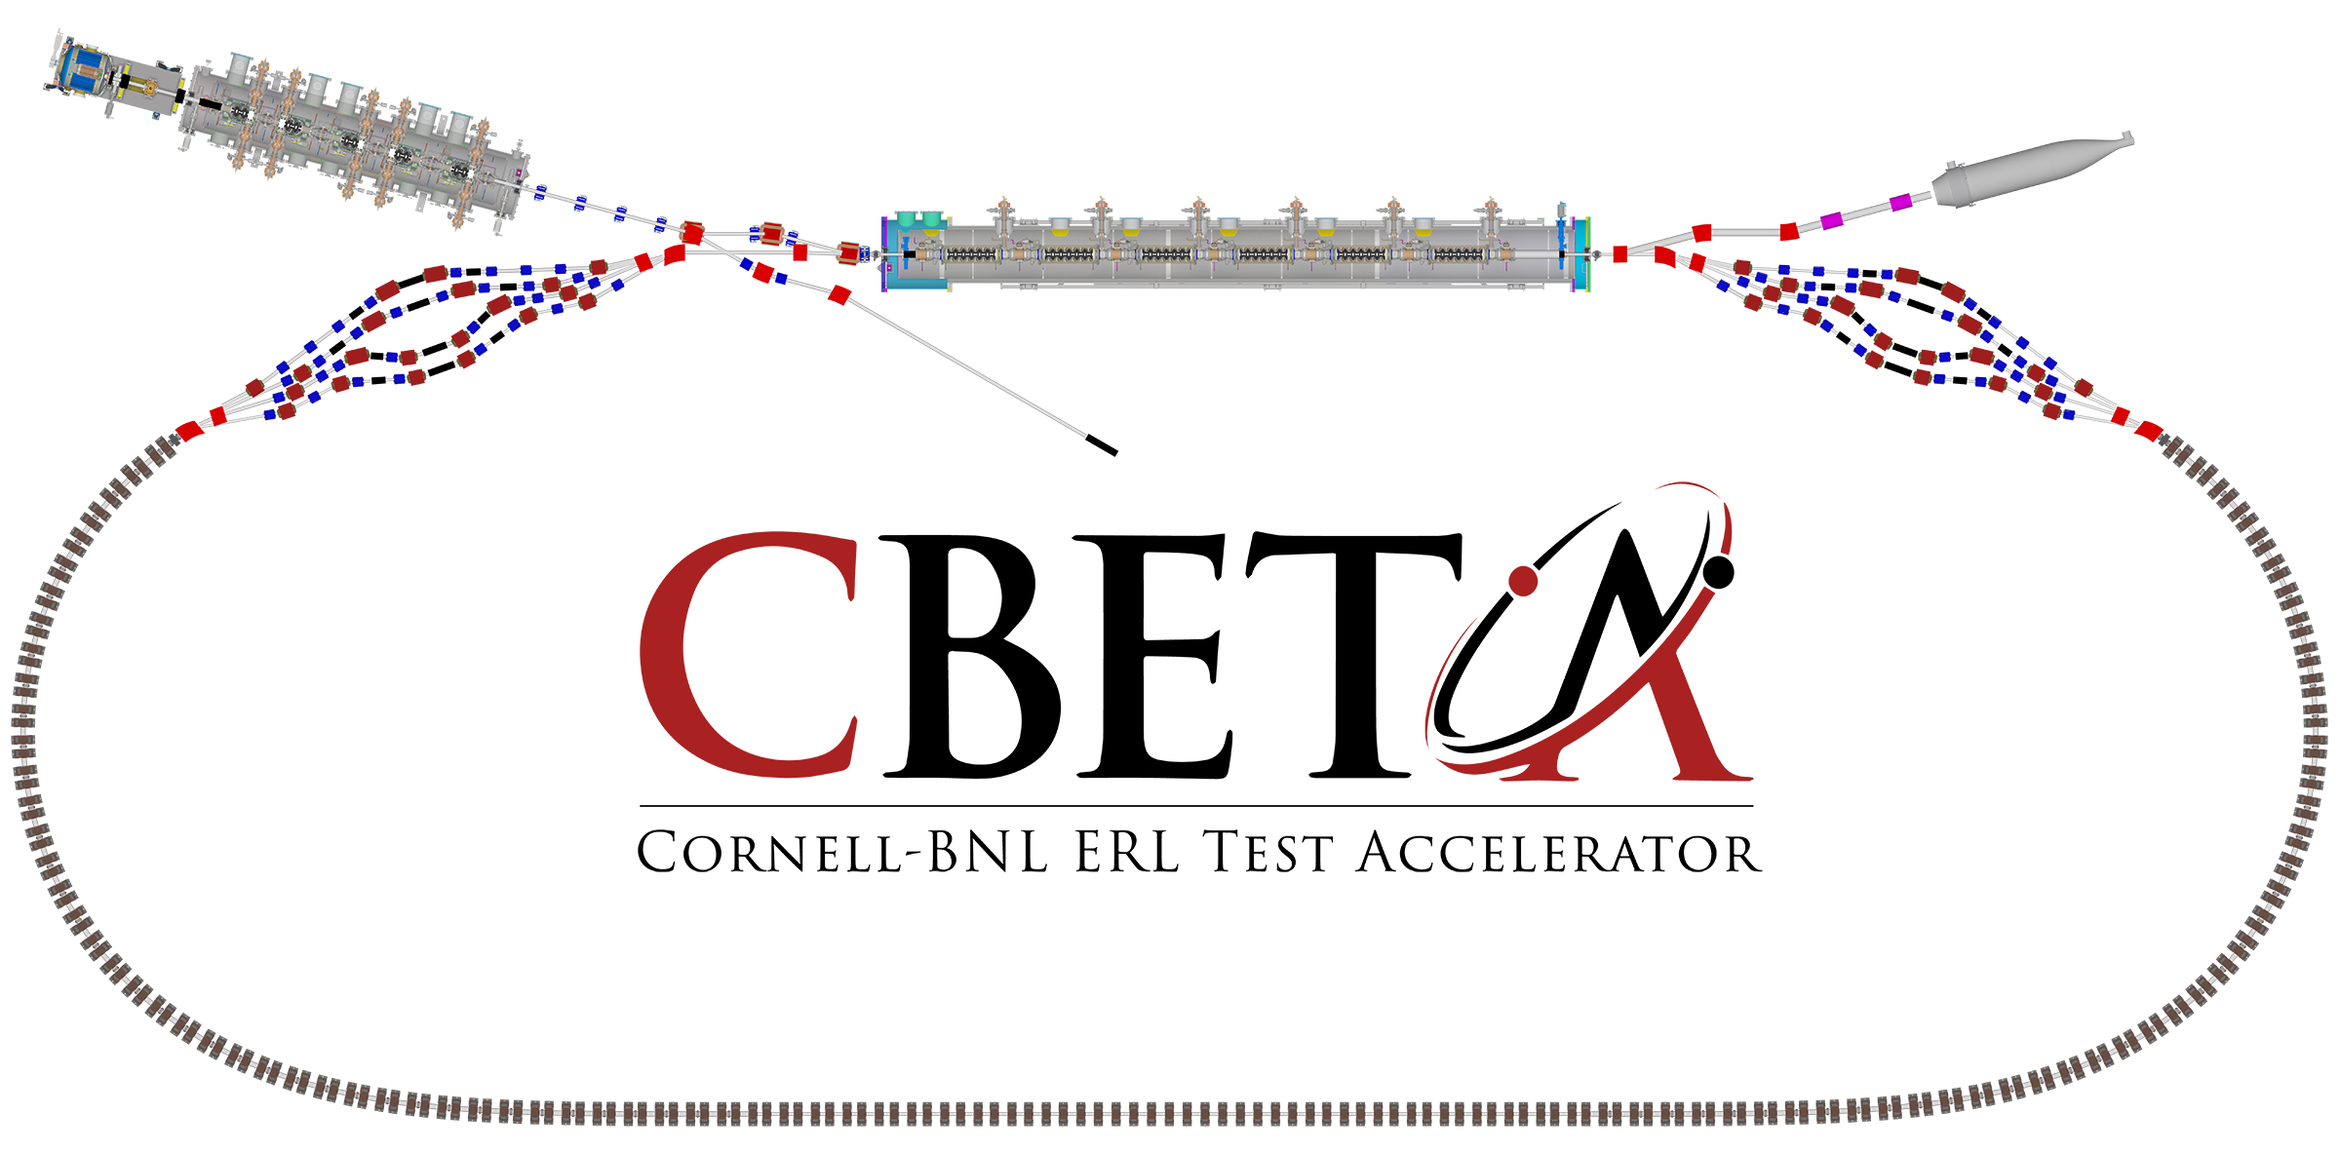




The Cornell/BNL FFAG-ERL Test Accelerator: CBETA
KPP and UPP strategy
Goals for the first 42 months
Georg Hoffstaetter (Cornell)

Slide 2
The test ERL in Cornell’s hall LOE
Cornell DC gun
100mA, 6MeV SRF injector (ICM)
600kW beam dump
100mA, 6-cavity SRF CW Linac (MLC)
Existing components at Cornell
6 MeV
6 MeV
+/- 36 MeV
Electron Current up to 320mA in the linac
Bunch charge Q of up to 2nC
Bunch repetition rate 1.3GHz/N
Beams of 100mA for 1 turn and 40mA for 4 turns
42, 78, 114, 150 MeV

Slide 3
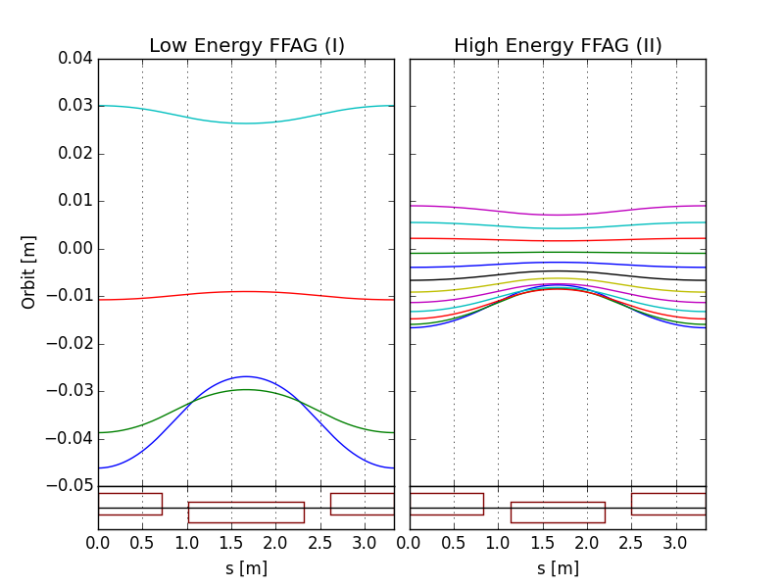
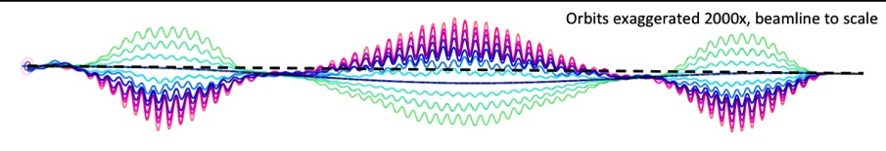
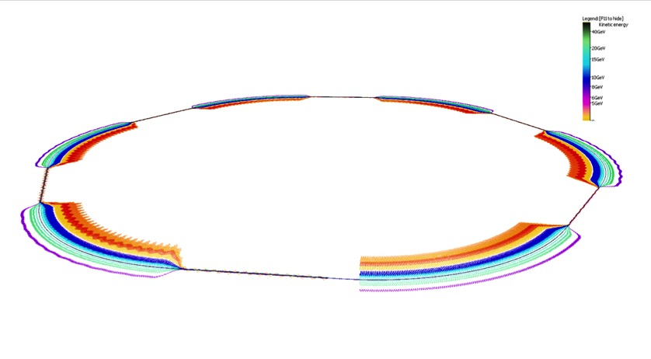
Topics of eRHIC to be studied in CBETA
eRHIC uses two FFAG beamlines to do multiple recirculations.
(FFAG-I: 1.7-5.0 GeV, FFAG-II: 6.7-18.3 GeV, 20 GeV)
All sections of a FFAG beamline is formed using a same FODO cell. Required bending in different sections is arranged by proper selection of the offsets between cell magnets (or, alternatively, with dipole field correctors).
Permanent magnets can be used for the FFAG beamline magnets (no need for power supplies/cables and cooling).
E=5.0 GeV
E=18.3 GeV
E=6.7 GeV
E=1.7 GeV
BD
QF
@S.Brooks, D.Trbojevic
Orbits in Detector bypass section
Quad offsets evolve adiabatically
Orbits in Transition section
Each of two eRHIC FFAGs contain 1066 FFAG cells

Slide 4
CBETA topics to support eRHIC
CBETA study topics important for eRHIC:
FFAG loops with a factor of 4 in momentum aperture.
  Precision, reproducibility, alignment during magnet and girder production.
  Stability of magnetic fields in a radiation environment.
  Matching and correction of multiple simultaneous orbits.
  Matching and correction of multiple simultaneous optics.
  Path length control for all orbits.
Multi-turn ERL operation with a large number of turns.
  HOM damping.
  BBU limits.
  LLRF control and microphonics.
  ERL startup from low-power beam.

Slide 5
Key Performance Parameters and
Ultimate Performance Parameters
Parameter | Unit | KPP | UPP (Stretch)
Electron beam energy | MeV |  | 150
Electron bunch charge | pC |  | 123
Gun current | mA | 1 | 40
Bunch repetition rate (gun) | MHz |  | 325
RF frequency | MHz | 1300 | 1300
Injector energy | MeV |  | 6
RF operation mode |  |  | CW
Number of ERL turns |  | 1 | 4
Energy aperture of arc |  | 2 | 4

Slide 6
Cost estimate after value engineering and concentration on KPPs
Staying in the financial frame requires concentration on the KPPs
Fund-limited decisions
The commissioning time is 10 months.
The quadrupole correctors for permanent magnets are not equipped with power supplied.
Every other cell is equipped with BPM electronics, as backed up by orbit-correction studies.

Slide 7
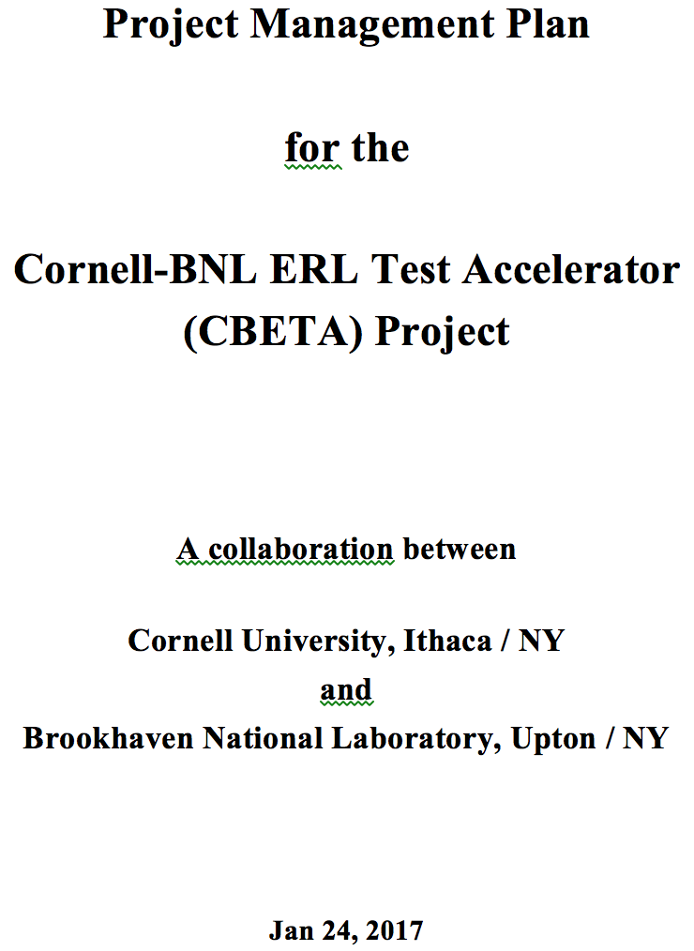
Congratulations: Path is free for CBETA
This plan spells out the KPPs and UPPs as well as the milestones for construction and commissioning of the project.
It includes
Commissioning to KPPs
Construction so that UPPs are not precluded by design decisions.
Pushing beyond KPPs as much as possible.
The first push will be commissioning 4-turns with low current.
a)

Slide 8
Congratulations: Path is free for CBETA
# | NYSERDA milestone (at the end of months) | Baseline | Actual
 | NYSERDA funding start date |  | Oct-16
1 | Engineering design documentation complete | Jan-17
2 | Prototype girder assembled | Apr-17
3 | Magnet production approved | Jun-17
4 | Beam through Main Linac Cryomodule | Aug-17
5 | First production hybrid magnet tested | Dec-17
6 | Fractional Arc Test: beam through MLC & girder | Apr-18
7 | Girder production run complete | Nov-18
8 | Final assembly & pre-beam commissioning complete | Feb-19
9 | Single pass beam with factor of 2 energy scan | Jun-18
10 | Single pass beam with energy recovery | Oct-19
11 | Four pass beam with energy recovery (low current) | Dec-19
12 | Project complete | Apr-20

Slide 9
Things to learn with KPP+ approach
CBETA study topics important for eRHIC:
FFAG loops with a factor of 4 in momentum aperture.
  Precision, reproducibility, alignment during magnet and girder production.
  Stability of magnetic fields in a radiation environment.
  Matching and correction of multiple simultaneous orbits.
  Matching and correction of multiple simultaneous optics.
  Path length control for all orbits.
Multi-turn ERL operation with a large number of turns.
  HOM damping.
  BBU limits.
  LLRF control and microphonics.
  ERL startup from low-power beam.

Slide 10
Questions to our goals
Questions?

