Slide 1
CBETA Technical Review
1.11 Systems Integration
January 31, 2017
Richard E. Gallagher

Slide 2
January 2017 Layout

Slide 3
2019 Layout

Slide 4
January 2017: 3 Major Move Actions

Slide 5
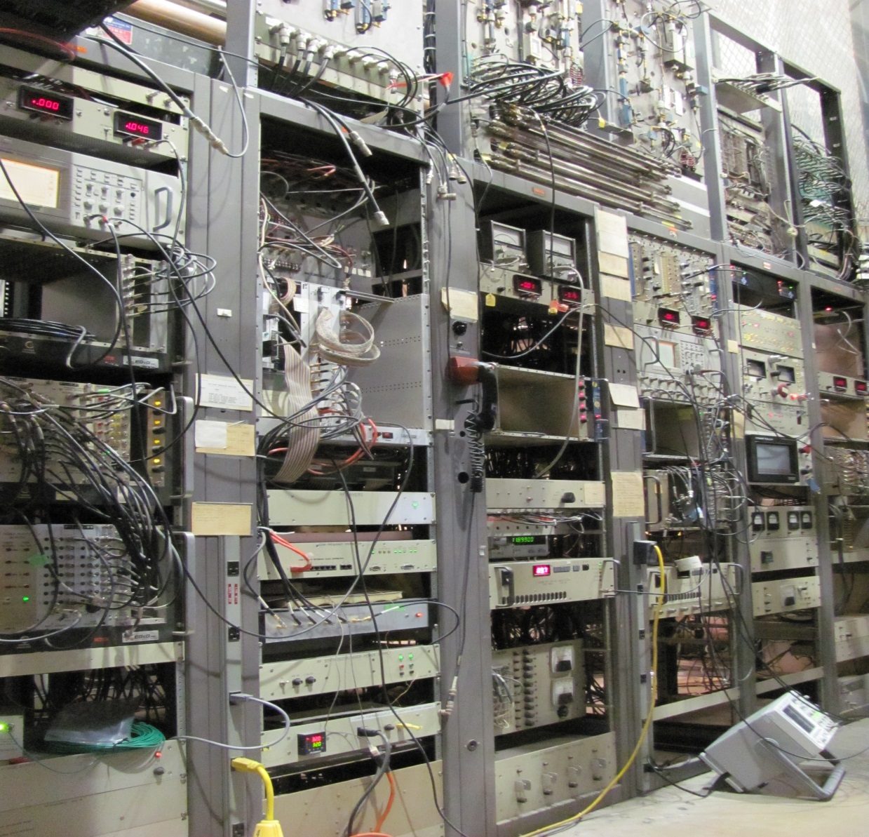
East-RF Power System CBETA Beam-Stop goes here

Slide 6
East-RF Power System Move
Since the system is essential to CESR-CHESS operations, a 2-part approach is necessary:
Re-route the RF waveguides to a new transmitter and modify controls
Re-create the East-RF system in the L0 Pit vacated by the CLEO Particle detector

Slide 7
East-RF powered by different transmitter

Slide 8
East RF move to L0 Pit

Slide 9
East RF Move Schedule
January 2017: Start installing waveguide, cable tray, cables and related modification
August 2017: Power east SRF cavities with different transmitter (commissioning while CESR-CHESS is off-line)
October 2017: East RF Pit Transmitter on-line
November 2017: Remove East RF components to permit wall modifications (maybe sooner)

Slide 10
Remove the Vacuum Lab Structure South beamline goes here

Slide 11
Relocate Gun Development Lab to make room for Vacuum Lab move

Slide 12
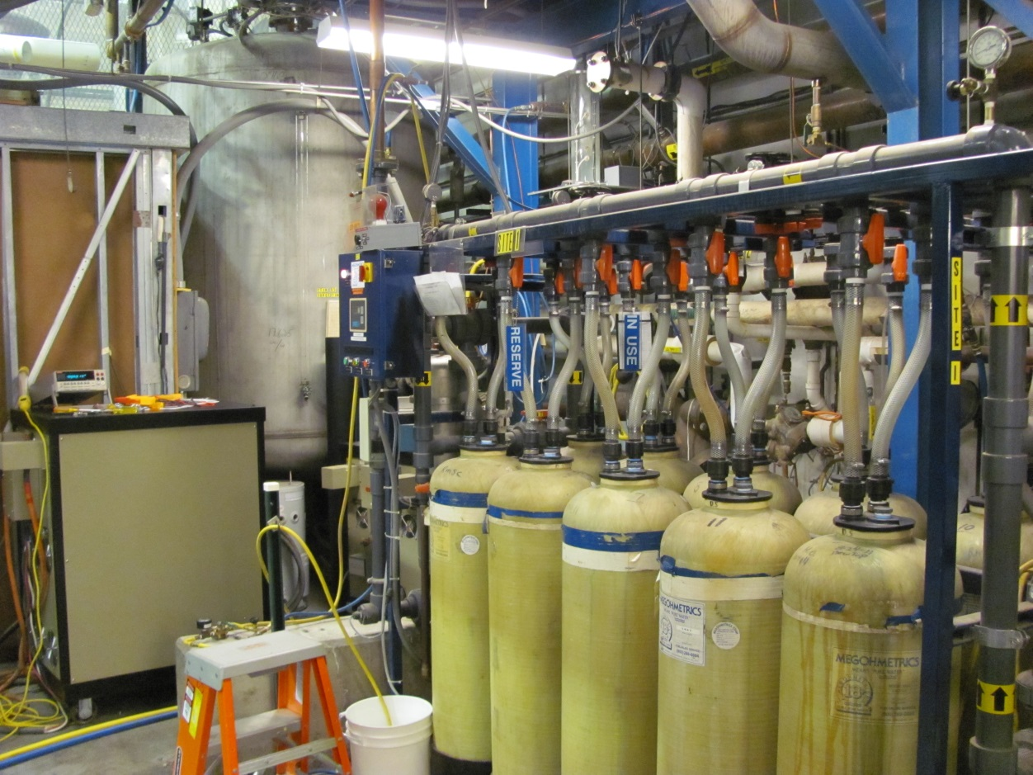
Reconfigure Cooling System: CESR-85F

Slide 13
Reconfigure Cooling System: CESR-85F

Slide 14
Schedule for CESR-85F modifications
June 2017: Install new platforms
July 2017: Move pumps and DI tanks
August 2017: Instrumentation and controls
September 2017: Fully operational

Slide 15
Other Cooling Requirements
Gun, ICM, klystrons, and existing beamline components are cooled by DI water systems.
Little capacity left on existing DI water systems
Dump cooling will require 75-gpm
Beamline Halbach and Splitter magnet requirements are not final
Plan is to install new closed loop heat exchangers
Campus Chilled Water will be extended to high bay area, but need flow-temp-DI requirements

Slide 16
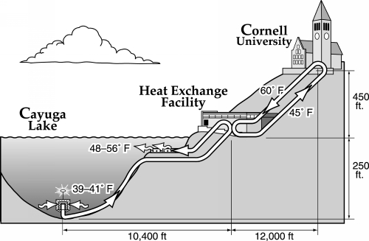
Campus Chilled Water (CCW)

Slide 17
Electrical Requirements

Slide 18
Electrical Requirements
Final design specifications for:
Magnet PS
Beamline components
Instrumentation and controls
MLC SSA and pump skids
Cable trays and wire routes
Lighting and convenience outlets
Vacuum chamber bake-out
Air cooling (fans) and local ventilation
Metering

Slide 19
HVAC: temperature stability, humidity, air-flow and control

Slide 20
Other Utilities and Services
IT hardware
Network capacities: wired and wireless
Compressed air
GN2
Survey and Reference system
Fire detection and alarm
Overhead crane access
Drainage
Potable water

Slide 21
East Wall Modification

Slide 22
East Wall Modifications

Slide 23
East Wall Modification Schedule
February 2017: Finalize location and sizes
March 2017: Engineering review of concept
June 2017: Engineering design
August 2017: Contract bids and award
December 2017: Construction
January 2018: Start installation for Partial Arc Test

Slide 24
Beamline System Integration Installation and Assembly

Slide 25
Beamline System Integration Installation and Assembly Sequence
Section 00-IN Gun and ICM are installed and operational
Section 01-LA is the MLC relocation, and is in progress
Section 02-SX Northeast merger in place February 2018
The subsequent installations after the CHESS-U CESR work (November 2018)

Slide 26
Beamline System Integration Installation and Assembly Sequence
Installation will be in a clock-wise sequence
Sections 03-FA to 09-RX will be generally duplicate efforts
Alignment
Vacuum connections
Magnet power,
Controls and instrumentation
Cooling
Electrical
Compressed air
GN2

Slide 27
Beamline System Integration Installation and Assembly Sequence
Section 10-BS Beam stop will be a more involved installation:
Alignment
Magnets
Beam pipes
Vacuum connections
Instrumentation
Electrical
Compressed air
GN2
Shielding

Slide 28
Project Management
Operating accelerator and X-ray programs
Requires detailed planning and scheduling for utility work and movement of components
Competition for shared resources
Resource loaded schedules
Common resource pool
Weekly reviews to identify potential issues
Space Use
Documented use with strict time limits

Slide 29
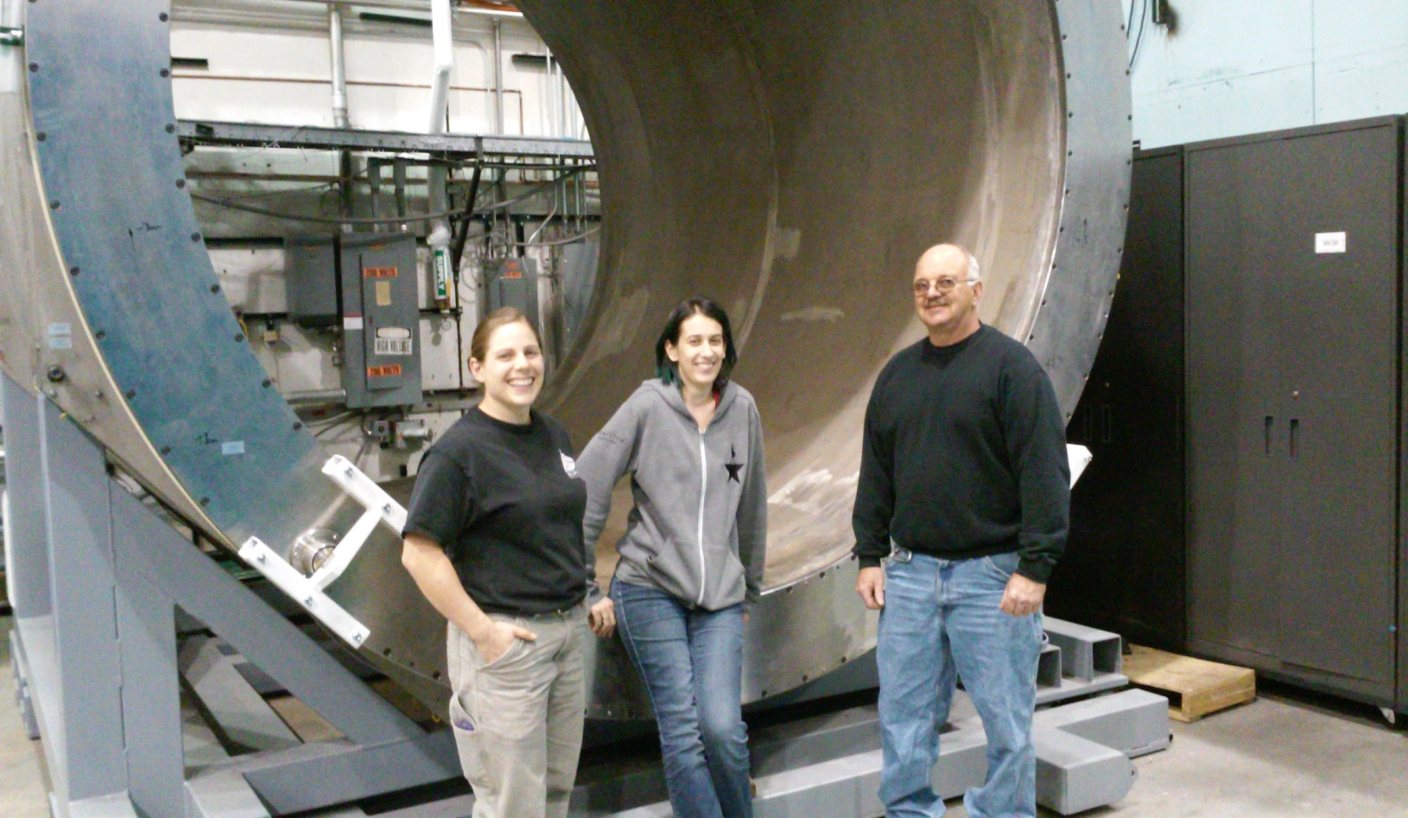
1.11 Systems Integration
The End

