Slide 1
CBETA Personnel Safety
Brian Heltsley, Senior Physicist & CLASSE Safety Director
Laboratory Safety Program
  Philosophy
  Administration & Tools
  Policies & Practices
  Resources
CBETA-specifics
  Personnel
  Electrical, magnet safety
  Radiation safety
    Stage Review approach
    Baseline shielding plan
    Simulations

Slide 2
Philosophy
Health & safety woven into fabric of laboratory operation
  Integrated approach found effective: Culture of Safety
Serve needs of a broad diversity of personnel
  Faculty, staff, & students
  Users, mostly transient
  Casual visitors here for tours & outreach
  Visiting scientists
Approach safety w/ 3 overlapping components
  Safe laboratory environment
  Foster a positive culture of safety
  Proactive management

Slide 3
Safety Administration
CLASSE Safety Committee
(CSC):
Lab Administrator
Safety Director (Chair)
CESR Tech Director
CESR Operations Director
CHESS Safety Officer
CHESS Beamline Scientist
Facility Engineer
Head CESR Operator
Radiation Safety Specialist
+ 4 others
Oversees Safety Program
Approves RPE Permit Applic’s
Vets new/modified policies
Approves new Safety Plans
Meets >= 6 times annually
CHESS User Safety Subcommittee (CUSS):
CHESS Safety Officer
MacCHESS DIrector
2 Staff Scientists
Chemical Safety Officer
CHESS Facility User Officer
Cornell EH&S
Provides resources, advice, & oversight
Vets proposals for safety issues

Slide 4
CLASSE Safety Accountability
CU Sr Vice Provost for Research
CLASSE Director
CU Radiation Safety Committee
CLASSE Safety Committee
CLASSE Safety Director
CU EHS
CLASSE Staff, Students, Visitors
4

Slide 5
Practices
Positive Safety Culture (see backup slides)
New personnel fill out online safety onboarding form
  Encourages discussion of training needs with supervisor
New projects or especially hazardous new activities or equipment get written Safety Plans
  Encourages thoughtful consideration of hazard mitigation
  E.g. A new lab is set up; tricky rigging jobs; a new device
Short term visitors fill out online safety form
Stop Work Rule
  Anyone can & should stop work if they have a safety concern
Two-person rule for proximate hazards

Slide 6
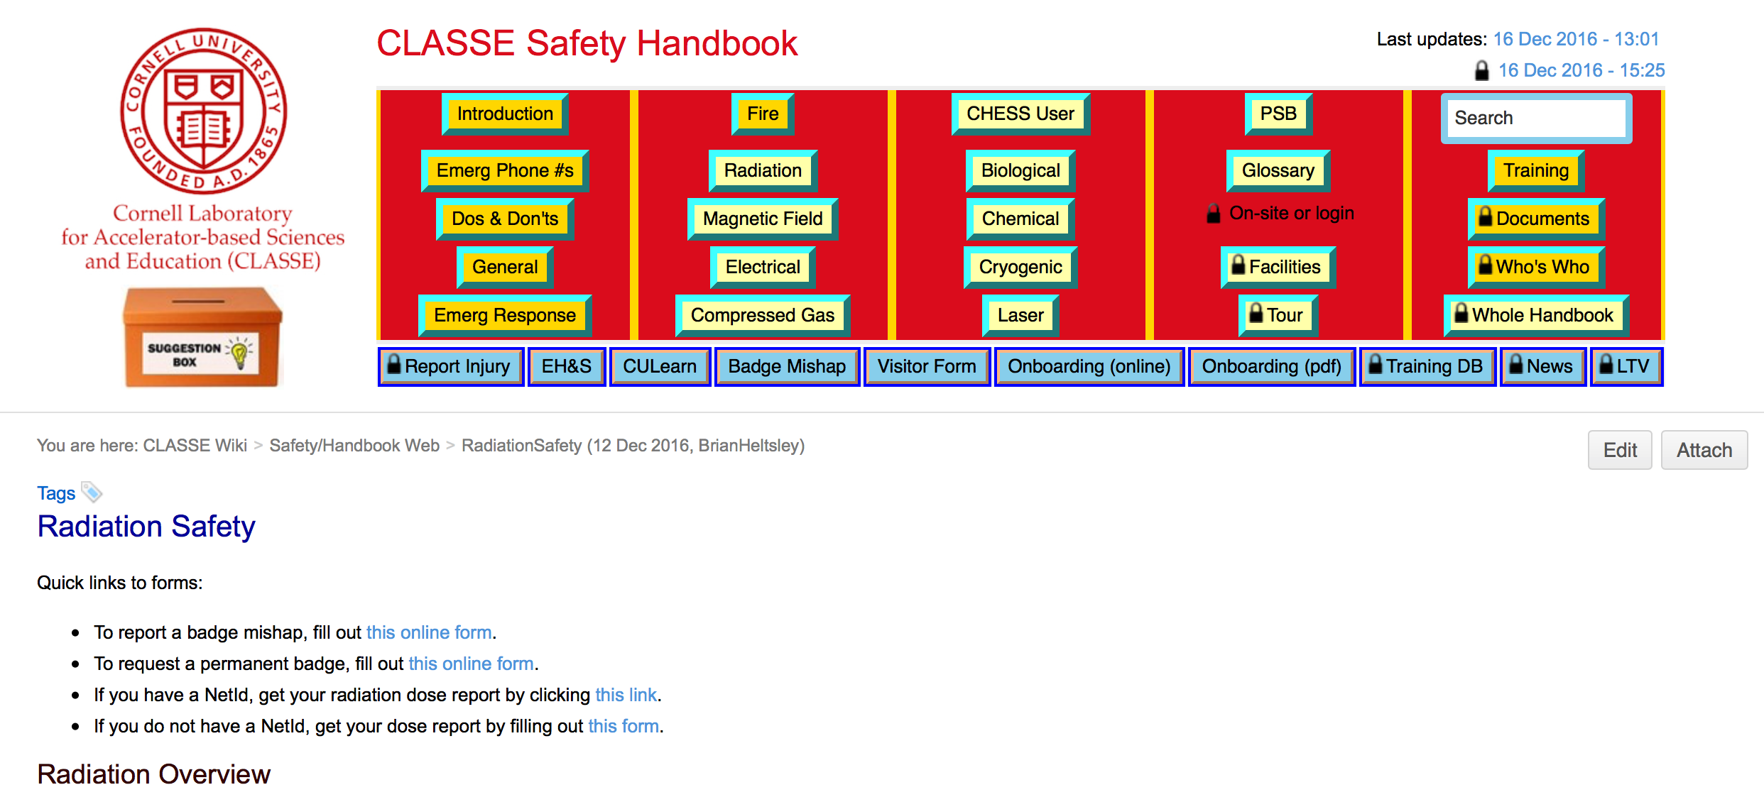
Online Safety Handbook

Slide 7
Electronic Document
Management System (EDMS)
CLASSE uses the Invenio product, developed at CERN
    Repository for institutional memory
Safety meeting minutes
Radiation permit documents
Safety plans
Safety procedures
Safety presentations
Incident reports
Other reports
Linked to from Safety Handbook

Slide 8
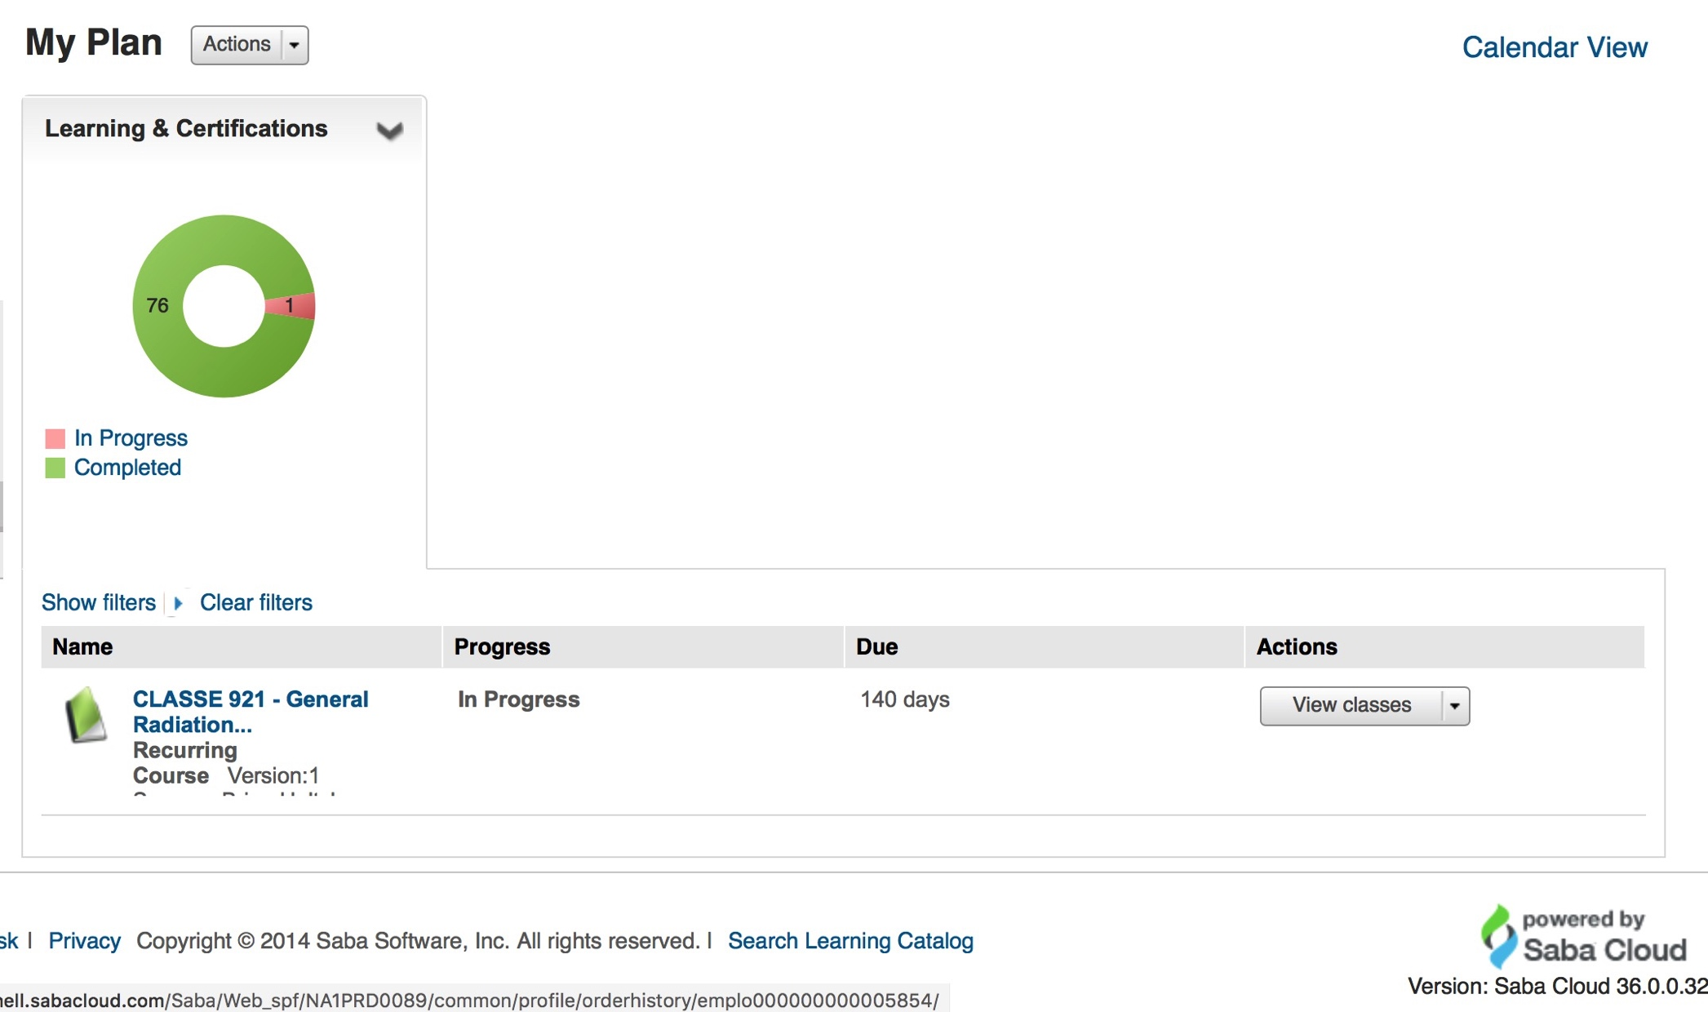
Safety Training
University LMS is “CULearn”, recently adopted
Cloud-based system from Saba, a world leader
Holds training catalog, transcripts, online content
Tracks training assignments & completions
Clear status for learners & managers
Holds 36 internal CLASSE trainings (9 online)
Holds hundreds of Cornell EHS trainings
CLASSE workers take (on avg) 8 recurring trainings

Slide 9
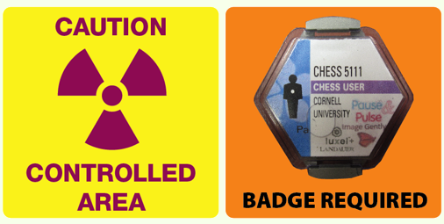
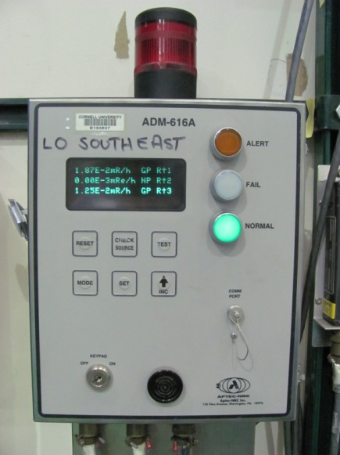
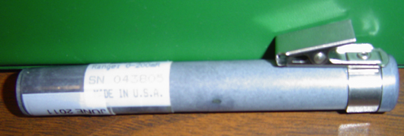
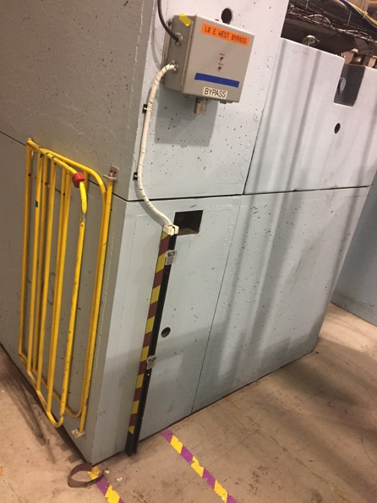
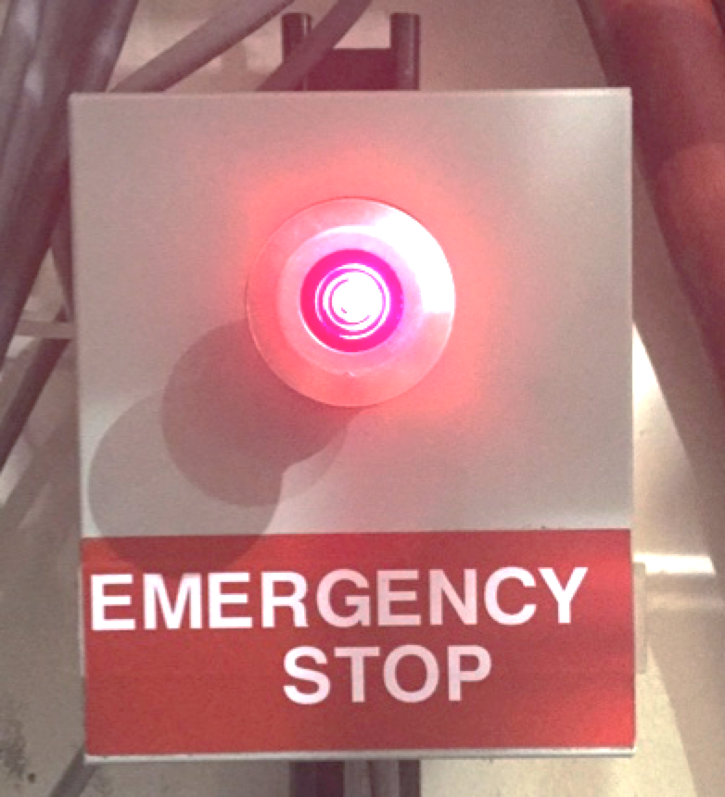
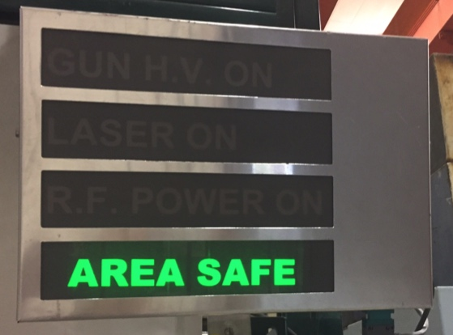
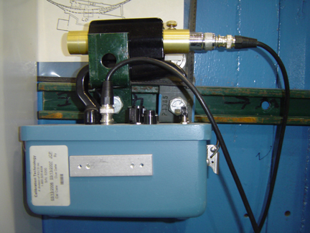
Radiation Safety
Multiple, redundant safety measures
Shielding appropriate to location & type of radiation
Access control via signs, gates, interlocked keys, interlocked light beams
Radiation monitors interlocked to beam power & visual/audible alarms
Crash buttons for emergency
Portable meters available for surveys
Dosimeters available for tours & special situations
Personal badge doses: keep below 100 mrem/year
  Badge reports monitored by CLASSE & Cornell EH&S
Area badges give integrated doses for controlled areas

Slide 10
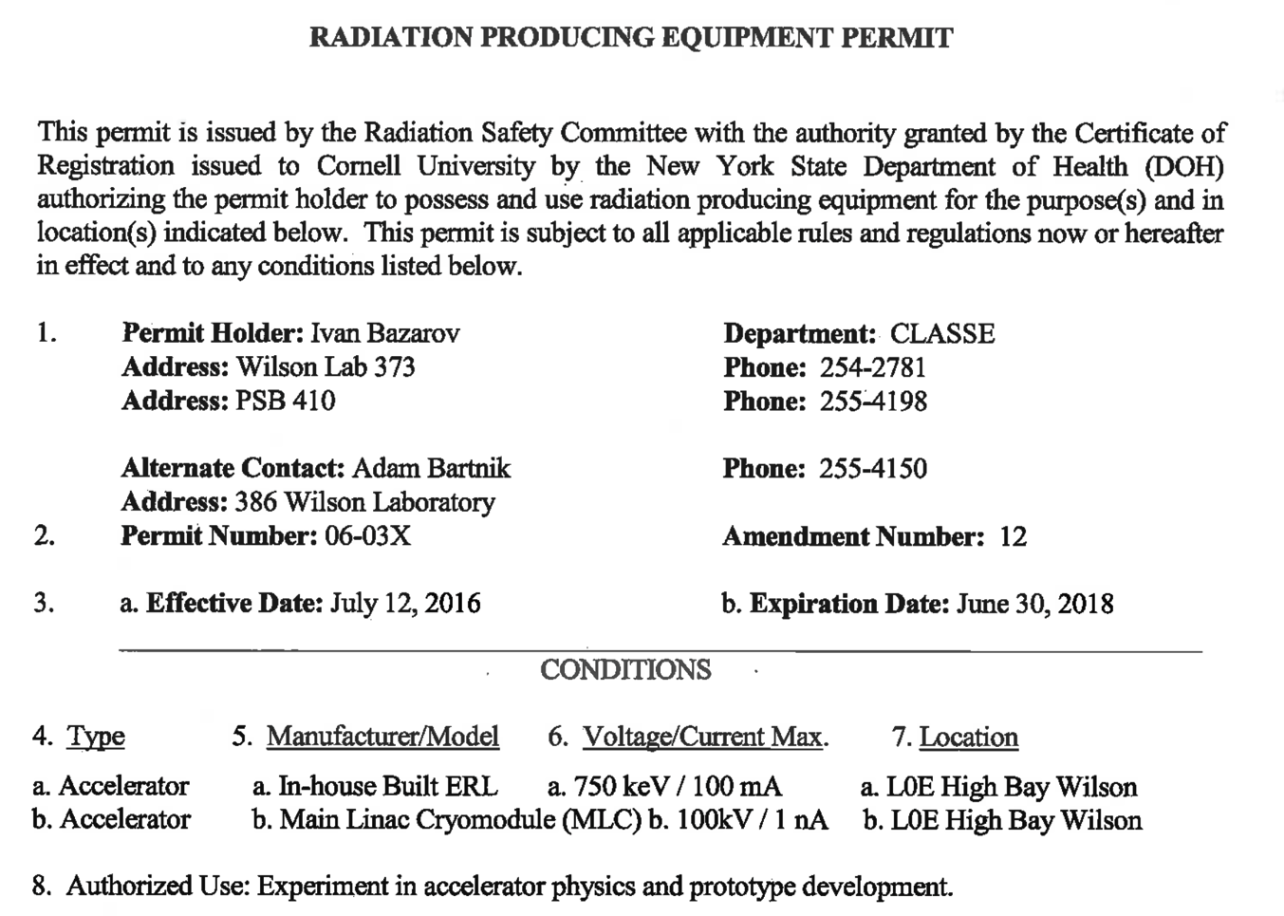

Radiation Permits
    NYS is an NRC Agreement State
    NYS DoH authorizes possession/use of radioactive materials & RPE at Cornell, requiring adherence to the NYS Sanitary Code & relevant ANSI standards
Via the Radiation Safety Committee (RSC), Cornell restricts possession of radioactive material & RPE to specific individuals & locations, & regulates their use with a system of permits & registrations
CESR Permit: 1 of 7 RPE Permits for CLASSE
Radiation Safety Officer (RSO)

Slide 11
CBETA-specific matters
Brookhaven collaborators
  Short termers: observe only, or accompanied by staff
  Long-termers, repeat visitors: Visiting Scientist Appmt
    Key card for building access
    NetId for access to safety training
    Training: identical to staff
Electrical safety
  Subject to CLASSE Lock / Tag / Verify program
Permanent Magnet Safety
  Need written Safety Plan: assembly, handling, etc.
  Restrictions on iron tools
  Need in-situ field map, 5 Gauss line, signage

Slide 12
Radiation Safety
Same processes & equipment as elsewhere
L0 & L0E are controlled areas (badge req’d)
Radiation monitors on perimeter will trip machine @ 2 mrem/h instantaneous
  Need to investigate exactly how long this takes!
Goal for shielding is to have average levels just outside shielding < 0.05 mrem/h
CBETA operation subject to Stage Review Process

Slide 13
Stage Review Process
Followed w/ERL development for many years
Committee approves operating envelope in stages
Members
  Safety Director
  Facility Engineer
  CHESS Safety Officer
  CESR Technical Director
  Radiation Safety Specialist
CBETA Permit Holder calls a meeting when needed for next stage

Slide 14
Stage Review (cont’d)
New conditions explored evenings/weekends
  L0E roped off. Restricted entry.
  Complete radiation survey of L0E conducted
New operating envelope is proposed/justified
Committee may decide to
  Require additional shielding & new surveys to be done
  Put administrative limits on operations
    Current limit, energy limit, hours or days allowed
  Require engineering limits on operations
  Approve request as is
Written record of request & decisions kept

Slide 15
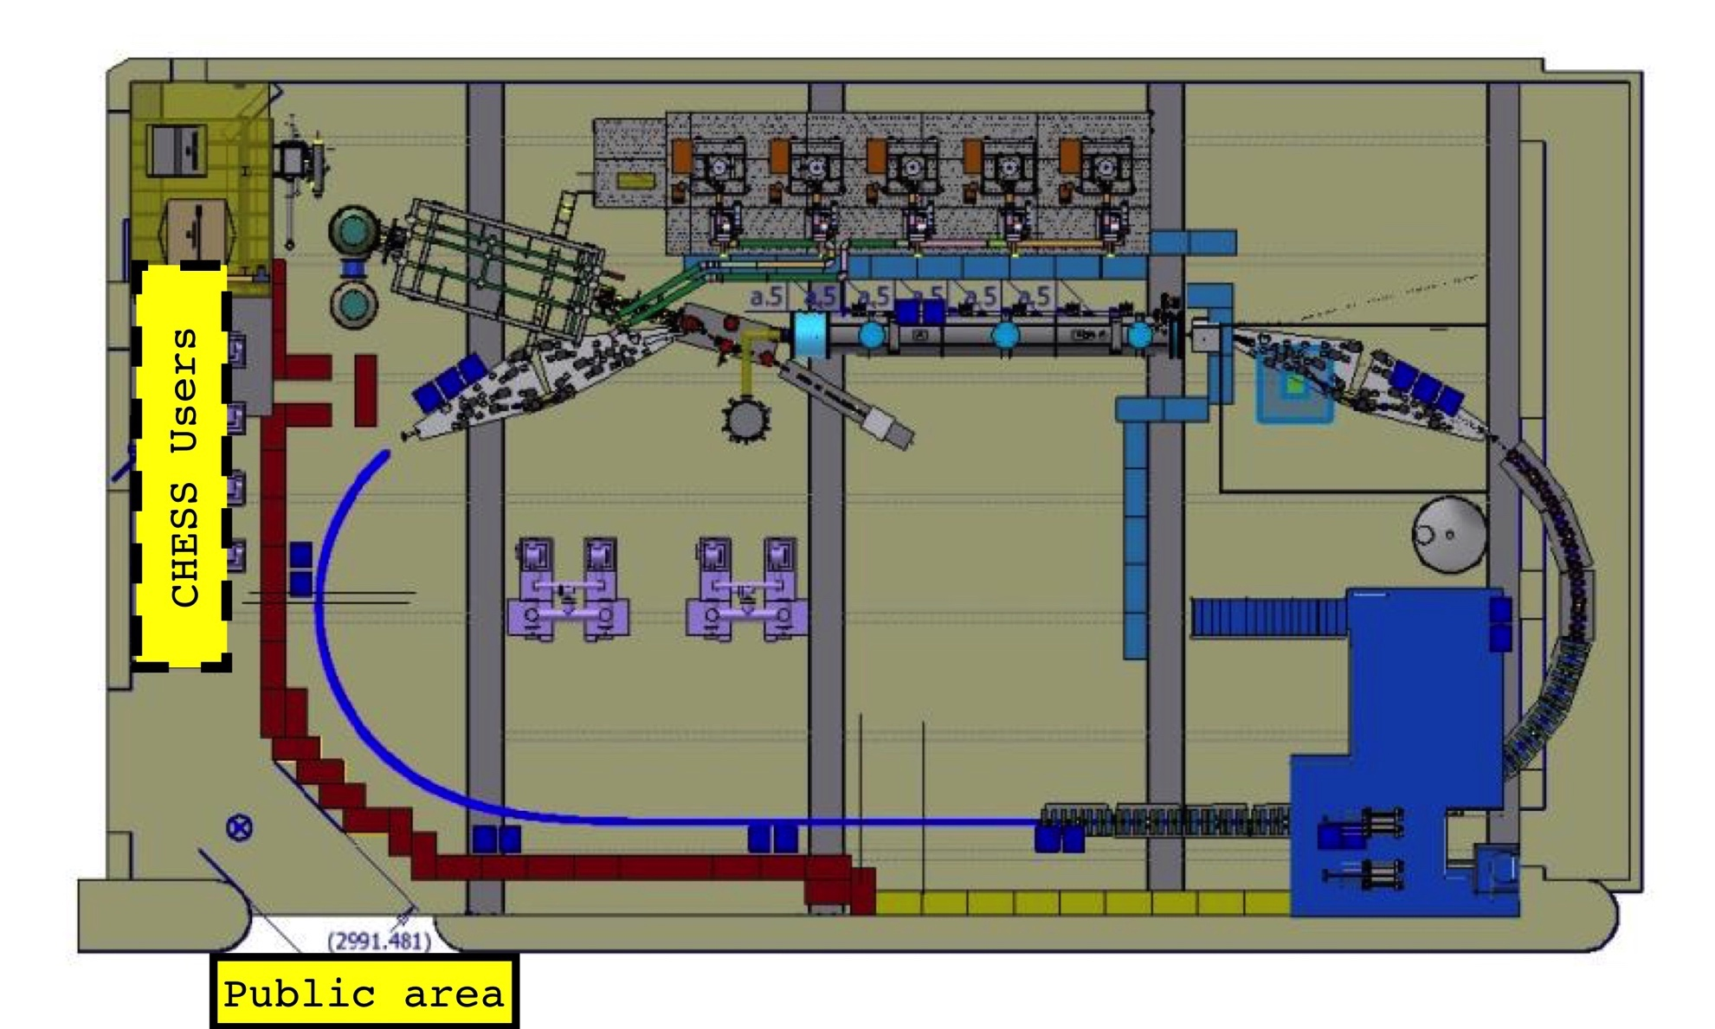
Baseline Shielding
First Try

Slide 16
Baseline Shielding
Wall: heavy concrete blocks 2’x4’x4’
  Space reserved just inside wall for supplementary Pb/Fe
May require roof over ring of steel+concrete
Biggest concern: SW corner + West wall
Preliminary conclusion from simulations
  Existing beam dump shielding ok for 6 MeV @ 40 mA
  Using observed JLab losses of 1W/m @ 150 MeV
    We expect 20 mW/m losses in the 42 MeV / 1 mA machine
      2’ heavy concrete safely shields such continuous losses
    We expect 5 W/m losses for the 150 W / 40 mA machine
      4’ heavy concrete safely shields such continuous losses
  Start with 2’ thick heavy concrete walls; allow for 4’

Slide 17
Simulations
MCNP6 is one of several standard tools
VK has crosschecked for several standardized configurations against other such tools
Simulations only as good as assumptions
  Magnets not used in geometry (so far)
  True magnitude of continuous or point losses as yet unknown for this machine
  Highlights crucial aspect of Stage Review Process
    Lowers dependence upon simulations

Slide 18
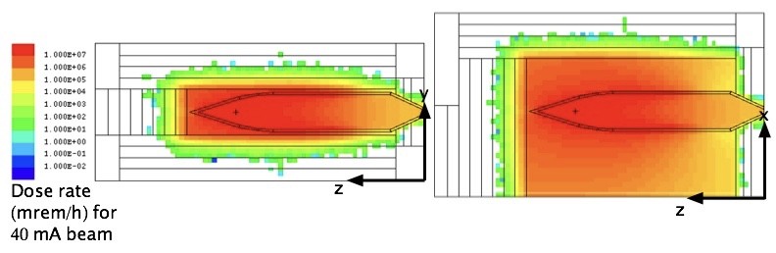
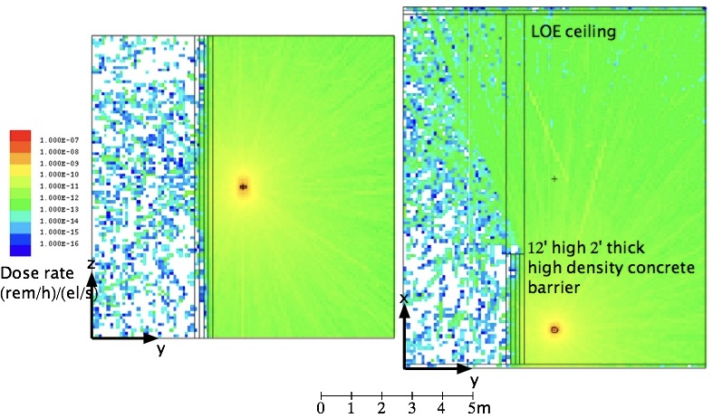
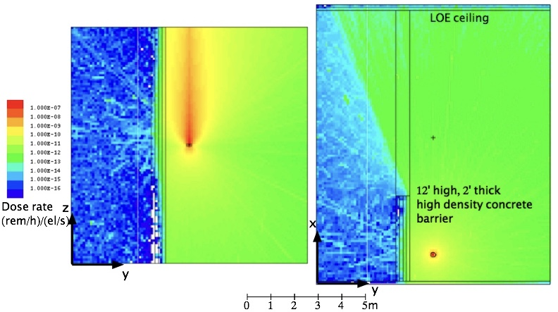
Shielding Simulations
Beam Dump, 6 MeV
UP
Top View
Side View
MCNP6 plots by
Val Kostroun
Shielding Wall, Point Loss, 150 MeV
Beam’s Eye
View
Beam’s Eye
View
Gammas
Neutrons
Top View
Top View
UP
UP

Slide 19
Conclusions
CLASSE Safety Program well established
Administration, procedures, practices in place
Past practices augmented to deal with CBETA
  CBETA collaborators must provide safety plans for review for delivered equipment (magnets)
Shielding studies need to mature. Appears that for SW corner and West wall shielding
  2’ heavy concrete will suffice for a 42 MeV machine with 20 mW/m continuous losses
  4’ of heavy concrete needed for a 150 MeV machine with 5 W/m continuous losses

Slide 20
Backup

Slide 21
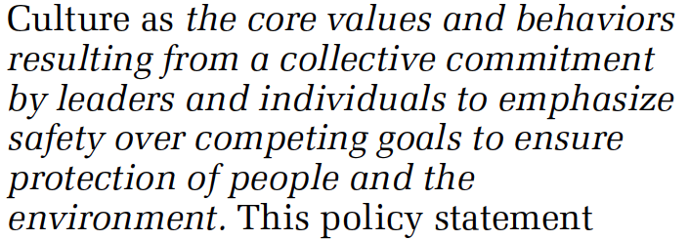
Positive Culture of Safety
Growing recognition in last decade how necessary it is, especially in academic research setting
Received attention a few years ago in Chemical Safety Board report on several serious / fatal accidents in University settings (UCLA, Texas Tech, Dartmouth)
Nuclear Regulartory Commission issued its own statement in 2010 on its importance, defining it as:

Slide 22
Positive Safety Culture
Each of us takes responsibility for our own safety and that of people we work with, supervise, or host
Safety is valued on par with (or above) scientific achievement and/or task completion
Safety concerns are always taken seriously and addressed
Safety challenges are approached with intellectual rigor
New activities are planned from the start with safety in mind
New participants receive relevant safety training immediately & are inculcated with the values of a positive safety culture
Each of us is held accountable for our safety-related responsibilities & behaviors
  Always striving for improvement

Slide 23
Written Policies/Procedures
Safety Committee (Charter)
Interlock wiring
Allowed radiation dose
Activated material
Working near stored energy (Lock/Tag/Verify)
Radiation Safety Signage
Non-radiation Safety Signage
Lead handling
Dozens of specific activity procedures
Many more …

Slide 24
Accident Statistics
TRC: # injuries per 100 workers that were OSHA Recordable (i.e. required treatment beyond First Aid &/or lost work time)
Cornell campus-wide 3-yr (all US university) average is ~2 (2.3)

