Slide 1
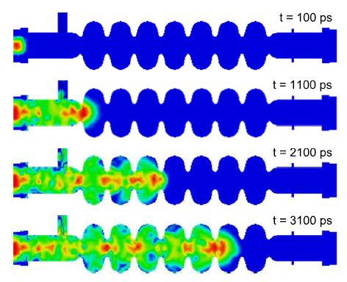
BBU simulation
William Lou
Supervisor: Prof. Georg Hoffstaetter

Slide 2
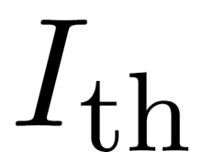
Outline
BBU overview
Design current of CBETA
Bmad simulation
2) 1-pass results
statistics
Results with additional phase-advances
Results with x-y coupling
4-pass results
(similar to 1-pass)

Slide 3
Beam breakup Instability (BBU)
Higher Order Modes (HOM) in the cavities give undesired kick.
Off-orbit bunch returns to the cavities and excite more HOMs…
BBU limits the maximum achievable current
in an ERL threshold current
decreases with # recirculation turns.

Slide 4
Design current of CBETA
Design current (mA) | KPP | UPP
1-pass | 1 | 40
4-pass | - | 40

Slide 5
BBU simulation on Bmad
Given a complete lattice with multi-pass cavities and HOMs assigned…
Starts with a test current…
tracks off-orbit bunches through lattice
computes bunch-HOM momentum exchanges
determines stability of all HOM voltages
Attempts different test currents to pin down

Slide 6
Simulated HOM data for one MLC cavity
Cavity construction error: ± 125 μm, 250 μm…
400 unique cavities provided per error case.
The “10 worst dipole HOMs” (large figure of merit) provided per cavity.

Slide 7
CBETA 1-pass
Cavity shape error: 125 μm
HOM assignment: random (10 dipole/cavity)
All results above KPP (1mA)
20 out of 500 below UPP (40mA)

Slide 8
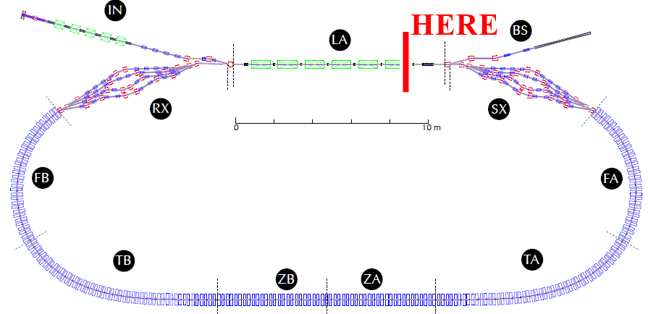
Vary the optics in Bmad
Two cases:
Introduce either T matrix
at the end of LINAC 1st pass

Slide 9
CBETA 1-pass
v.s additional phase advances (decoupled optics)
Min = 140 mA
Max = 611 mA
nominal = 342 mA
results can improve significantly
Notes:
The valley location depends on which cavity has the most dominant HOM

Slide 10
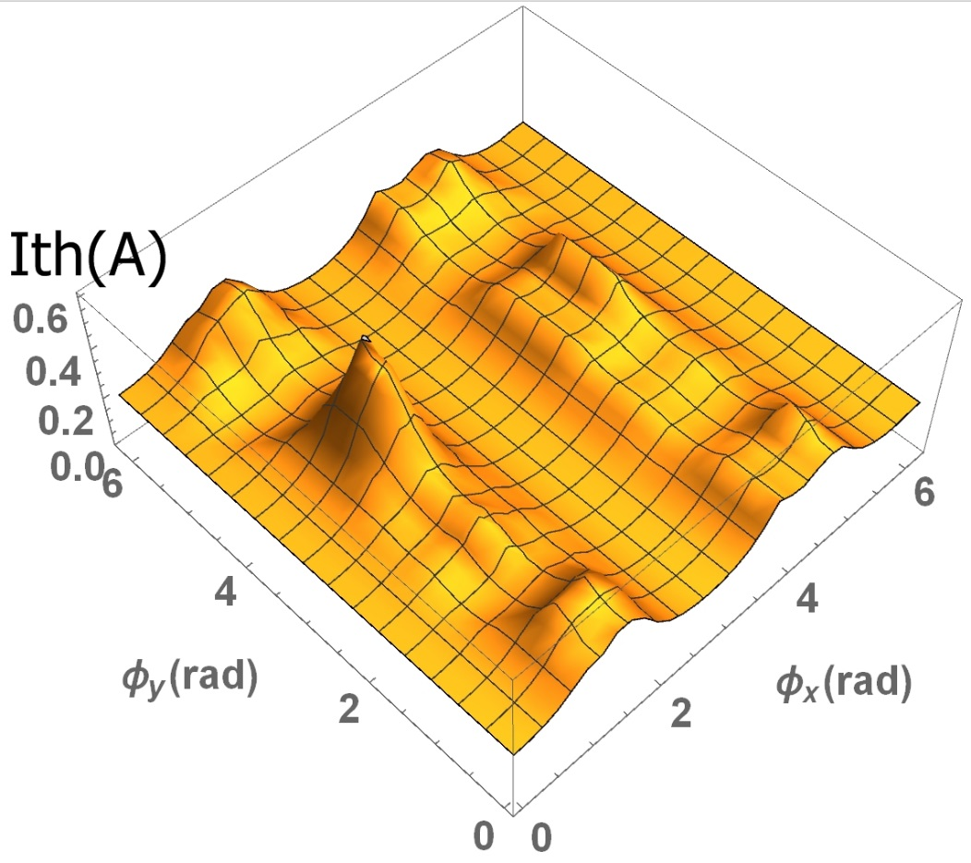
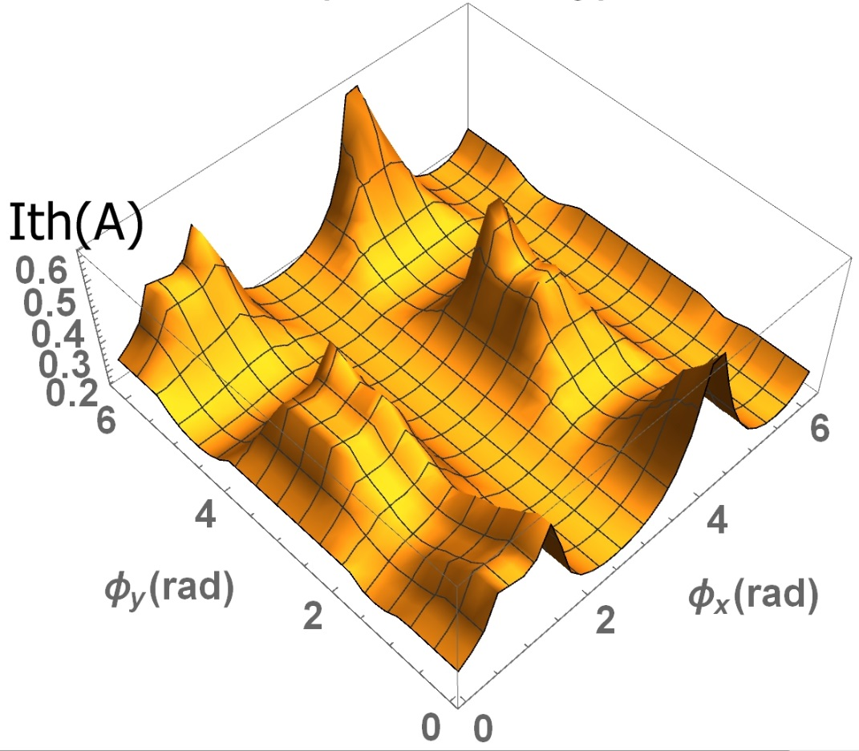
1-pass decoupled
with different HOM assignments…
Min = 175 mA
Max = 640 mA
Nominal = 218 mA
Min = 165 mA
Max = 595 mA
Nominal = 248 mA
Notes:
Valley location

Slide 11
CBETA 1-pass
with x-y coupling
Min = 140 mA
Max = 520 mA
nominal = 342 mA
results can improve significantly
Notes:
Nominal ( no coupling ) = 342mA
(0,0) at 277mA

Slide 12
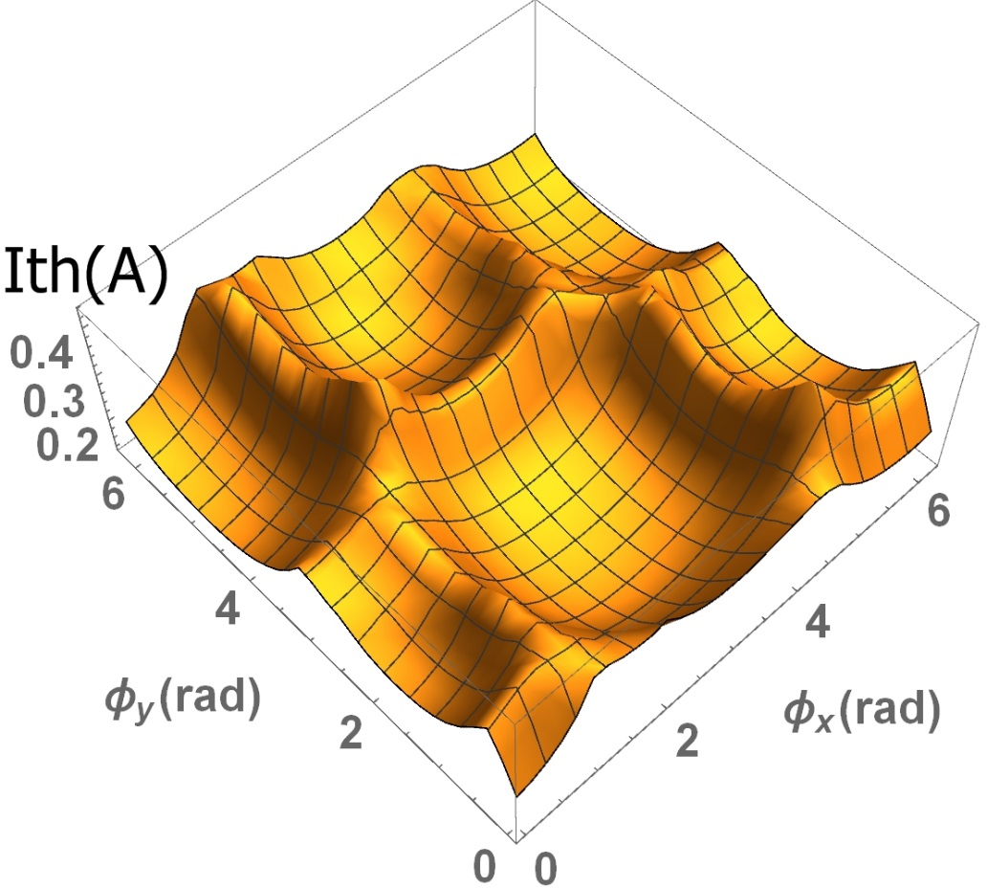
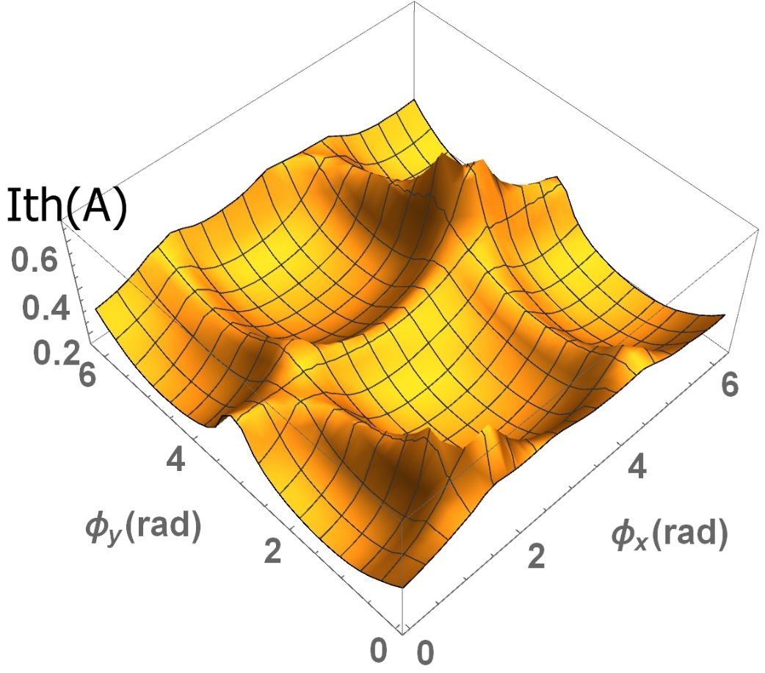
1-pass coupled
with different HOM assignments…
Min = 136 mA
Max = 436 mA
Nominal = 218 mA
Min = 166 mA
Max = 678 mA
Nominal = 248 mA

Slide 13
CBETA 4-pass
Cavity shape error: 125 μm
HOM assignment: random (10 dipole/cavity)
All results above 10 mA
32 out of 500 below UPP (40mA)
Notes:
Before: 70 out of 300

Slide 14
CBETA 4-pass
Cavity shape error: 250 μm
HOM assignment: random (10 dipole/cavity)
All results above 10mA
23 out of 500 below UPP (40mA)
Notes:
Before: 33 out of 300

Slide 15
CBETA 4-pass
v.s additional phase advances (decoupled optics)
Min = 61 mA
Max = 193 mA
Nominal = 69 mA
results can improve
Notes:
Location of the valley depends on which cavity has the most dominant HOM.

Slide 16
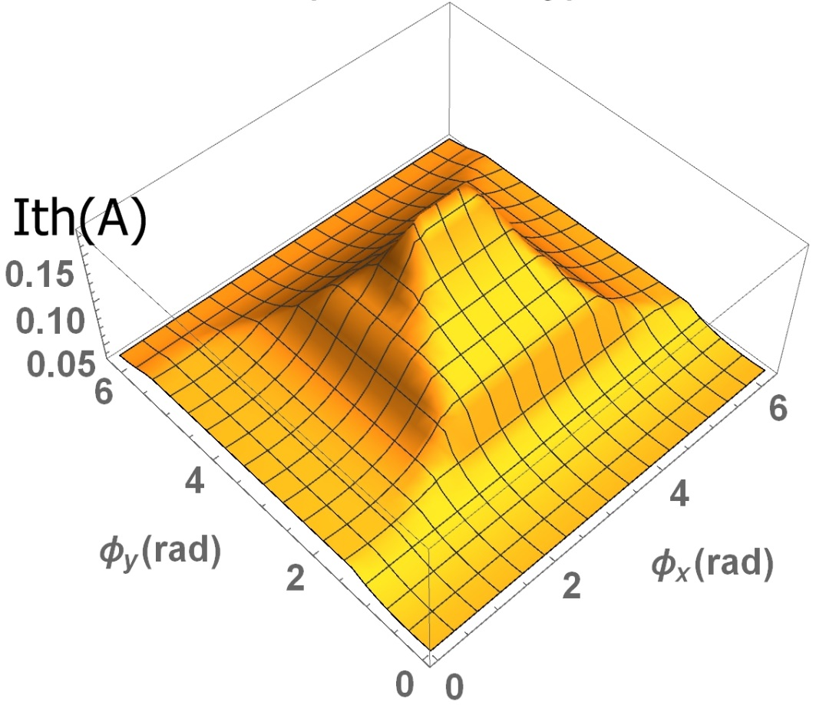
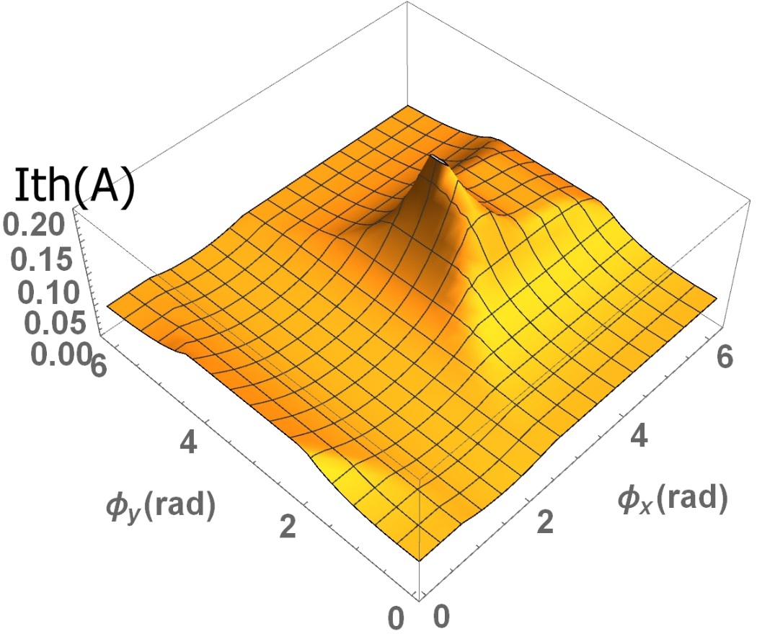
4-pass decoupled
with different HOM assignments…
Min = 37 mA
Max = 176 mA
Nominal = 38 mA
Min = 39 mA
Max = 205 mA
Nominal = 49 mA

Slide 17
CBETA 4-pass
with x-y coupling
Min = 89 mA
Max = 131 mA
Nominal = 69 mA
results can improve
Notes:
Nominal = 69mA
(0,0) = 99mA
Location of

Slide 18
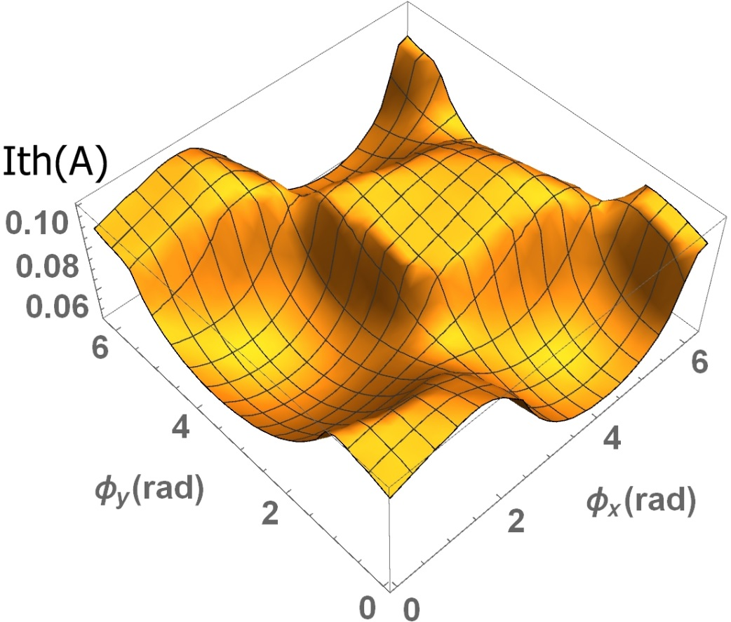
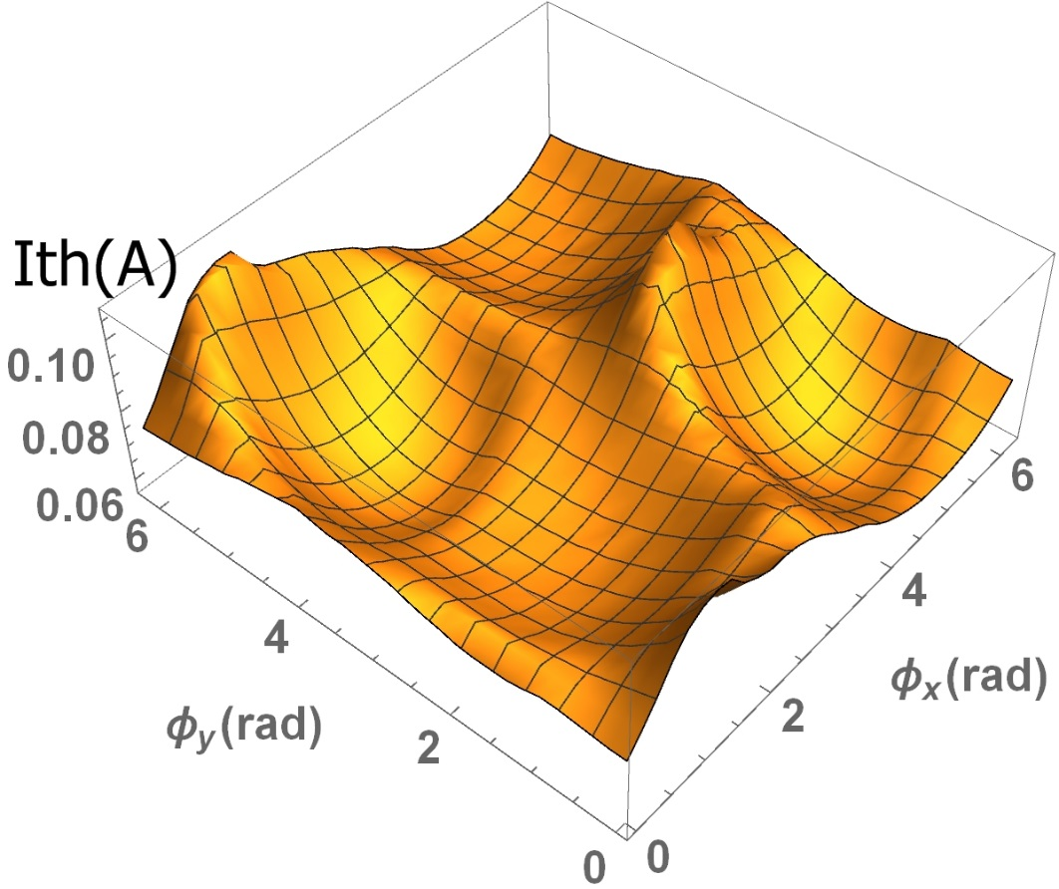
4-pass coupled
with different HOM assignments…
Min = 47 mA
Max = 100 mA
Nominal = 38 mA
Min = 57 mA
Max = 107 mA
Nominal = 49 mA

Slide 19
Potential improvement on Ith from the current design (mA) | Additional phase advances (decoupled optics) | x-y coupling
1-pass | ~ 200 mA to 400 mA | ~ 200 mA to 400 mA
4-pass | ~150 mA | ~ 60 mA

Slide 20
Summary
For 1-pass, all simulated are above the UPP (40mA)
For 4-pass, 93% simulated are above the UPP (40mA)
For 4-pass, introducing additional phase advances allows greater improvement in than x-y coupling

Slide 21
Acknowledgment
Special thanks to:
Prof. Georg Hoffstaetter
Christopher Mayes
Nick Valles
David Sagan
References
BBU papers by Georg and Ivan
Bmad manual
Nick Valles’s dissertation

Slide 22
THE END

Slide 24
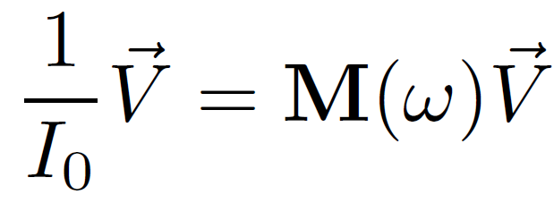
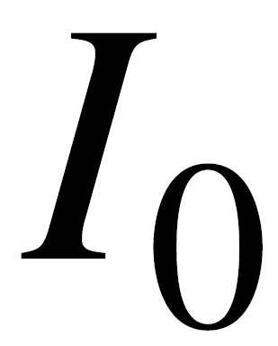
Find the critical which gives the maximum real eigenvalue of M
Helper Slide #1
General analytic formula for BBU
The corresponding is

Slide 25
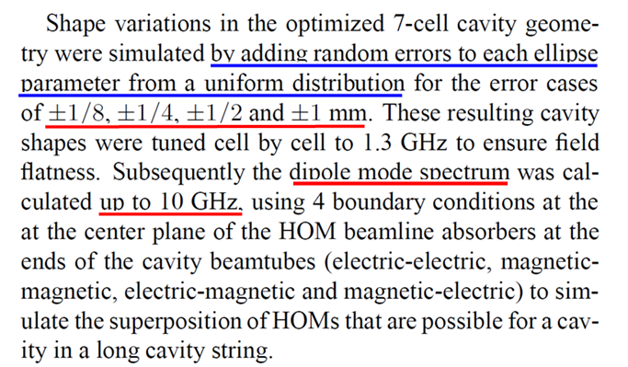
RFC cavity HOMs from Nick Valles
Helper Slide #2

Slide 26
Aim for better
Helper Slide #3
Potential ways to improve :
1) Change bunch frequency
2) Vary phase advance
3) x-y coupling of beam optics

Slide 27
Does vary with bunch frequency?
Helper Slide #4
fb / (1.3 GHz) | 4-pass (mA)
1 | 40.0
1/2 | 48.8
1/4 | 49.5
1/8 | 46.0
1/16 | 45.8

