Slide 1
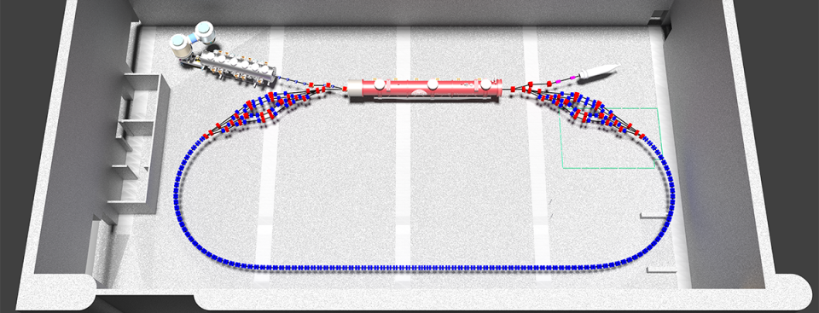
George Mahler

Slide 2
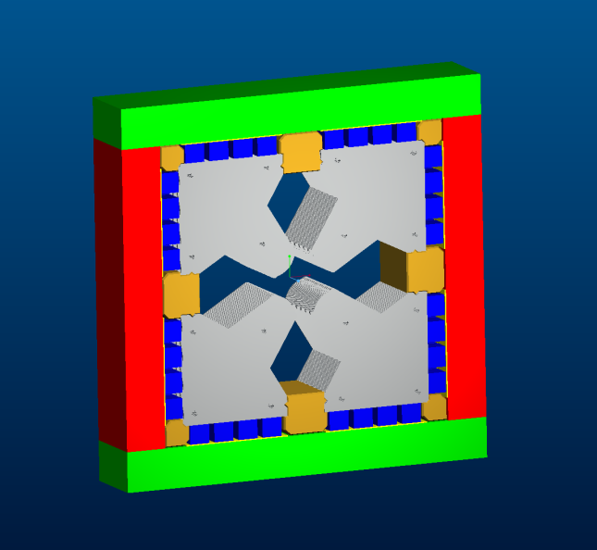
110 Dipoles
110 Quadrupoles

Slide 3
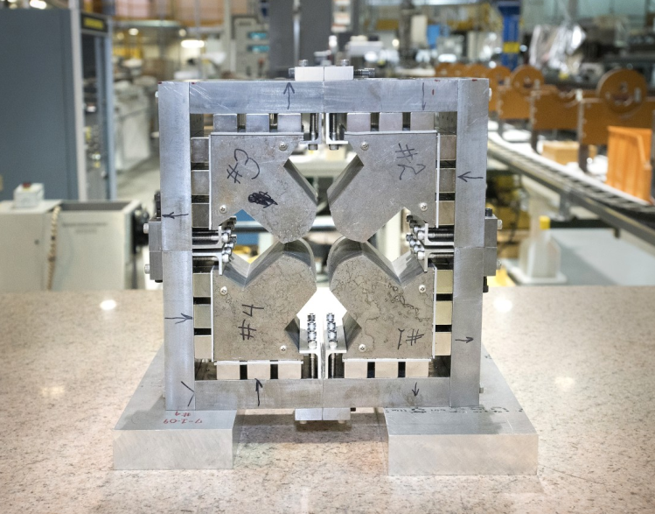
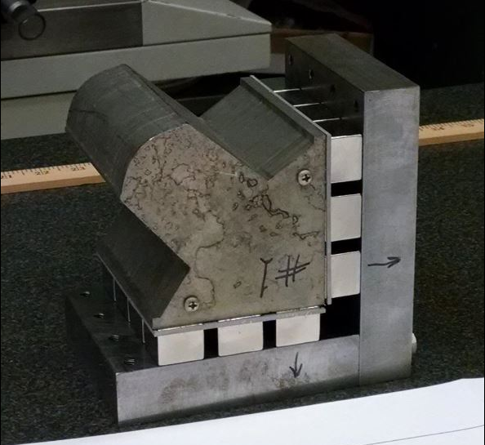
Higher Order Harmonics correction problematic
Difficult to assemble.

Slide 4
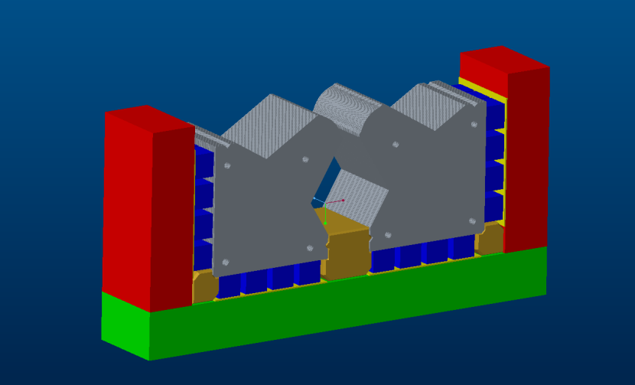

Slide 6
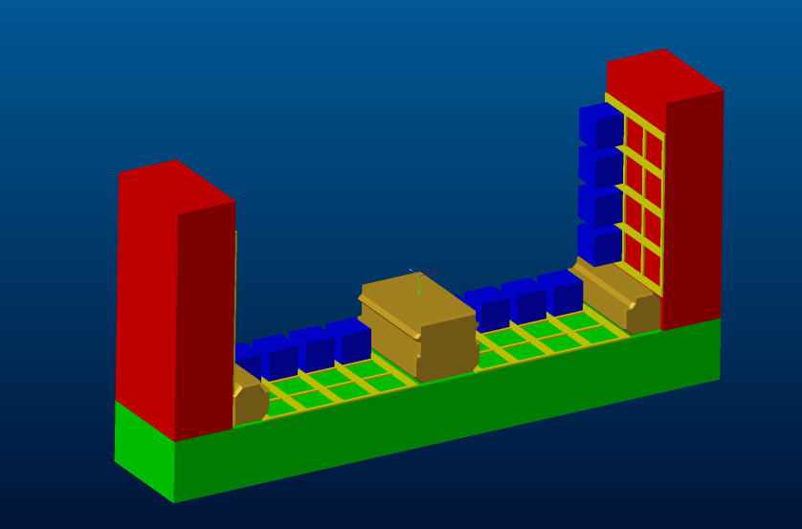

Slide 7
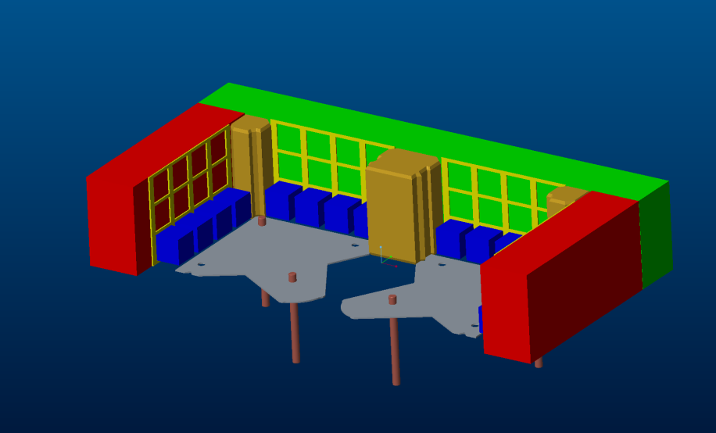

Slide 8
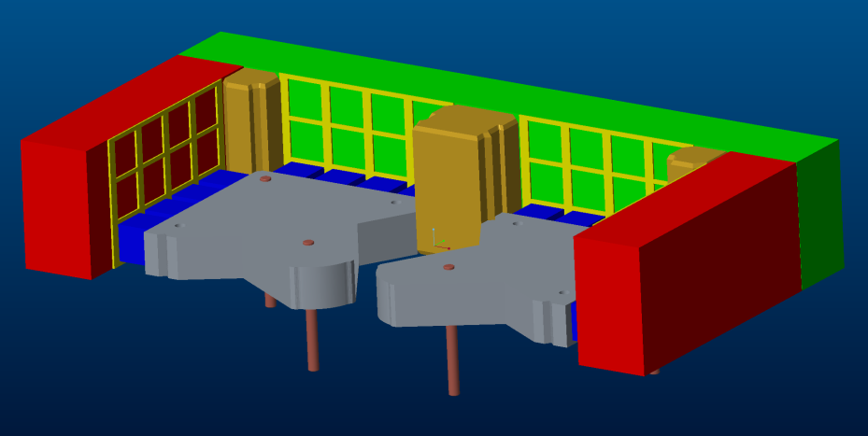

Slide 9
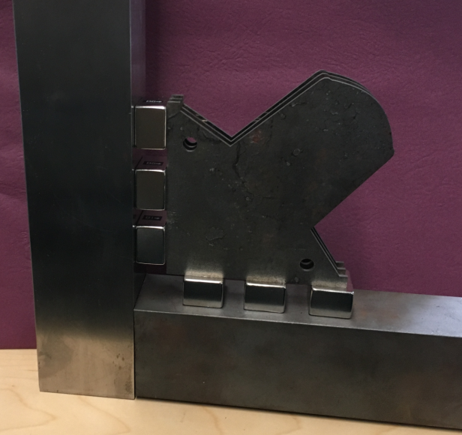
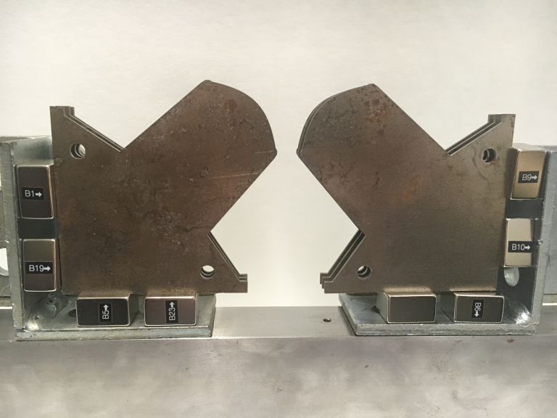

Slide 10
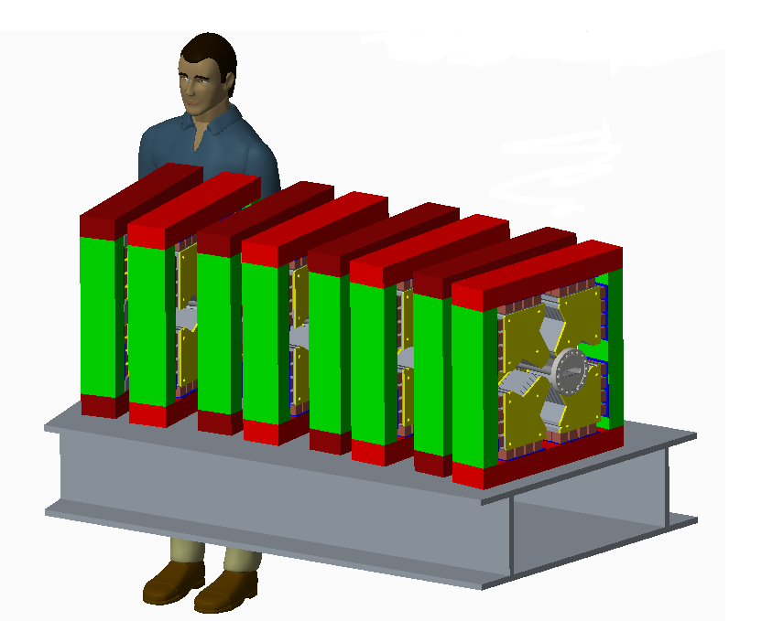
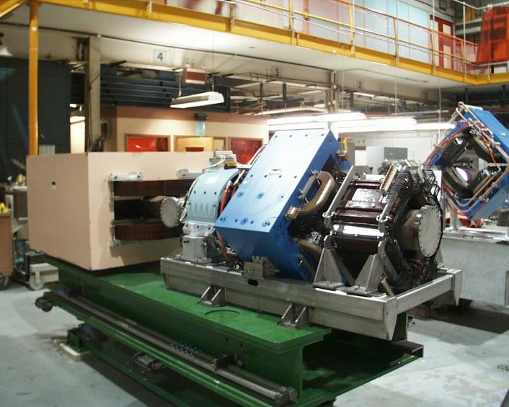
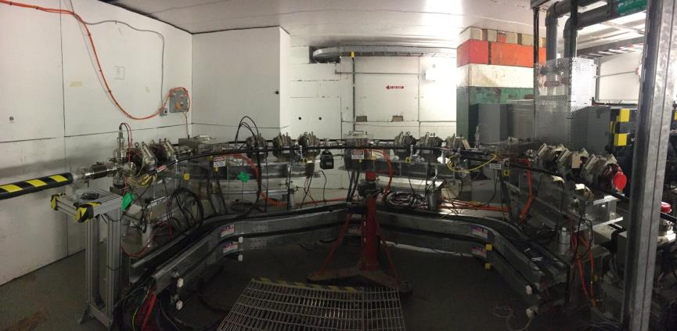

Slide 11
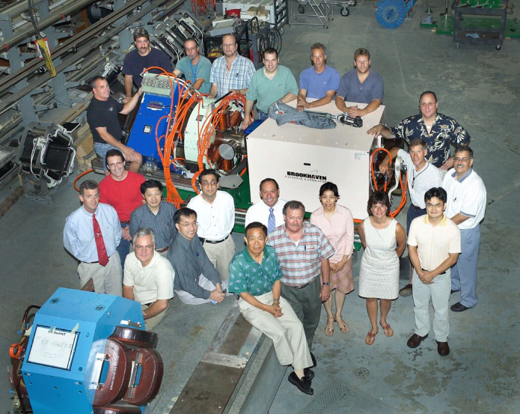
The conventional magnets are less of an issue, as we have designed and built a large number over the years.

Slide 12
Risk list:
First Article permanent magnet assembly doesn’t work
manpower limitations
conventional magnet vendor delays
current cost estimate inaccurate
procurement cycle delays

Slide 13
“To do” list:
Generate Cost Book
Develop Project Files
Engineering / Design work
Develop Drawing Files
Build Prototype Magnet
Procurement Package
Assembly / Testing / Installation
Commissioning
Initial demonstrator magnet build provides baseline cost estimates.
Historical data on many conventional type magnets and similar girder costs.
Engineering estimates on girder assembly costs.
Questions / Comments
Substantial experience from an assortment of DOE sponsored projects at Collider Accelerator
Ongoing....and in some cases will run in parallel with initial tasks
New hire in process to augment existing effort.
Thank you
Based on similar procurements. Not complicated but can be Time adder.

Slide 14
Title Headline Here

