Slide 1
CBETA Vacuum System
and Beam Stop
(Conceptual Design)
Yulin Li, CLASSE

Slide 2
Outline
Design Scope
Requirement and Considerations
Vacuum System Layout and Sections
Vacuum pumping and simulations
Vacuum system construction, installation and operation

Slide 3
Design Scope & Requirement
Provide vacuum beampipes for 4-turn ERL electron beams with sufficient aperture, while not interfere with beam transport magnets.
Through proper design, construction, installation and vacuum pumping, achieve adequate level of vacuum to minimize beam losses due to residual gas scattering.
Provide necessary flexibility to allow accelerator reconfiguration during CBETA commissioning and physics run.
Integrate required beam instrumentation and diagnostics, such as BPMs.

Slide 4
Design Considerations
Beampipe materials: Aluminum (6061) preferred for good electric and thermal properties, non-magnetic and no residual radioactivity.
Provide sufficient large beam apertures, while allowing magnets position adjustments.
For high beam current (40x7=280 mA in FFAG sections) operations, design efforts will be made to keep low beam impedance, including smooth beampipe inner profiles, RF shielded bellows and gate valves, gentle transitions between different beampipe cross sections, etc.
Draw experiences from CESR and ERL Photo-Cathode injector designs to minimize needs for vacuum R&D efforts.

Slide 5
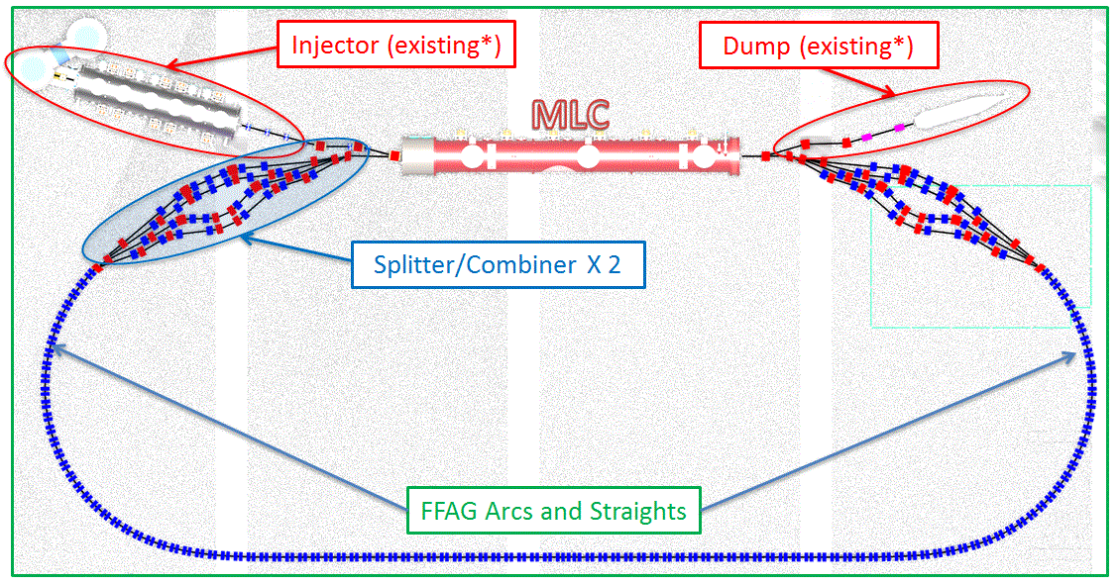
Layout and Sections
Gate Valve
Gate Valve
Photo-Injector and dump beamline to be re-used with minor modifications
MLC is a self-contained component, only need vacuum pumping through beamline when warm.

Slide 6
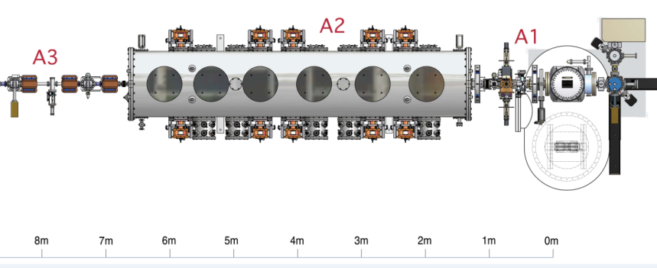
The Injector
ERL photo-injector (including the photo-cathode electron gun and the super-conducting cavity cryo-module, ICM) performed very well for the Cornell ERL prototype injector project.
The photo-injector has been relocated in the CBETA area (L0E) to serve as the CBETA injector.
Only minor modification (mainly the merger) is expected.
ICM
Laser Entrance, Buncher, etc.
Gun

Slide 7
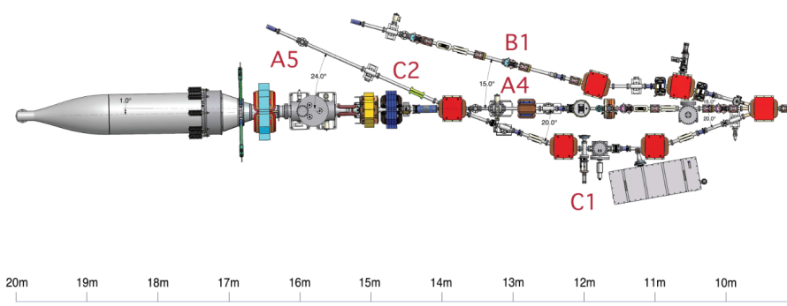
Electron Beam Stops
An aluminum 600-kW beam stop was constructed and performed very well for the Cornell ERL prototype injector project.
This main beam stop, together with its protection setup, has been relocated into the L0E area for CBETA project.
Many low power beam stops were also constructed and performed well, and can provide flexibility in staged commissioning of CBETA.
Low Power Beam Stops
(Faraday-Cup)
600-kW Aluminum Main Beam Stop

Slide 8
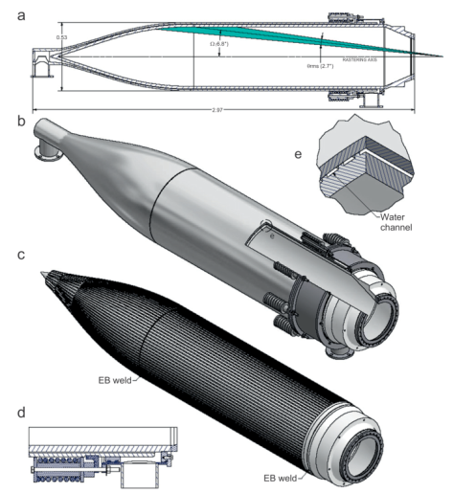
600-kW Beam Stop
Detail of the beam stop design is described in: X. Liu, et al, NIM A 709 (2013) 37-43.
Aluminum alloy was chosen for its good thermal and mechanical properties, and higher photo-neutron production threshold (13.1 MeV, comparing to 9.9 MeV for Cu)
Main body is made of two solid aluminum (6061-T6) ingots, jointed via E-beam welded. Machined fins and cooling jacket promote uniform and efficient cooling.
GEANT4 was used to simulate electron scattering and power deposition profile, and to optimized the beam stop geometry.
ANSYS calculations verified adequate safety margin for 600-kW operation.
The beam stop performed as expected up to 70 mA electron beam current.
(a) cross-section view of the beam dump; (b) cut-away view of the water channels; (c)the water channels and E-beam welds; (d)the ﬂexible joint; and (e)the water channel in the cylindrical section.

Slide 9
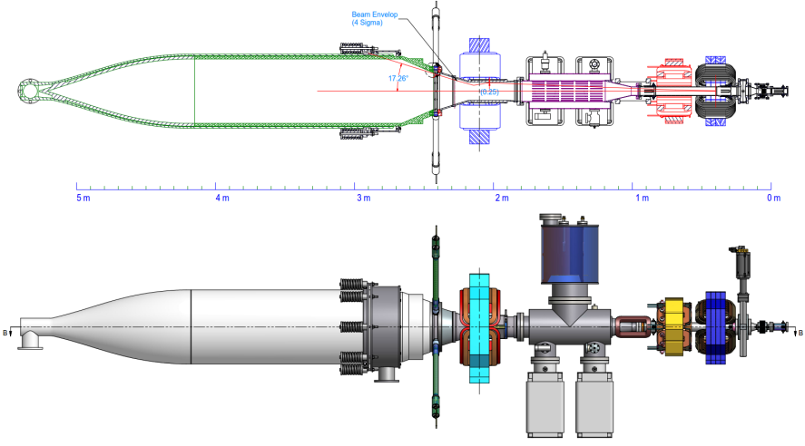
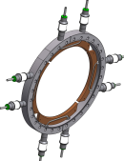
Main Beam Stop Beamline
BPMs
Quad 2
Quad 1
Quad Detector
80 TCs map beam stop body temperature
Raster
To dilute power density, a pair quads expand the electron beam, and a raster magnet orbits the expanded beam at 60 Hz.
A pair of BPMs and a quad-detector monitor beam trajectory and envelop.
Two large ion pumps and three TiSPs handle high gas load from electron-induced desorption.

Slide 10
FFAG Arcs and Straight
In the FFAG arcs and straight, permanent magnets are arranged in more or less periodic double-magnet cells, with relatively short drifts between magnets reserved as much as possible for vacuum pumping, beam instrumentation.
Single-bore beampipe is through permanent magnets used in the FFAG sections to contain electron beams at all planned energies. So the vacuum system here is to be designed as one-stage installation.
Consideration has been taken in the lattice and magnet design to allow ‘kink-free’ beampipe with uniform apertures, for low fabrication cost and low beam impedance.
it is efficient use of these drifts by constructing beampipe assembly through multiple FFAG magnet cells, reducing number of beampipe flanges.

Slide 11
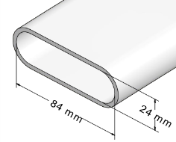
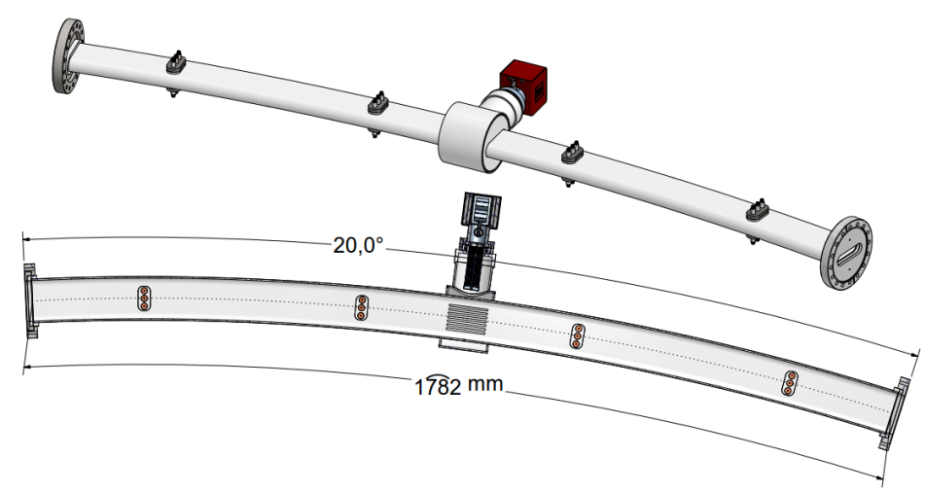
Conceptual 4-Cell FFAG Beampipe
Pump
Drifts for additional ports
(Beam diagnostics)
Beampipe made of extrusion w/ one smooth bend
→ 1.78-m in length
→ 5.09-m bending radius
→ 20° bending angle for 4-cell

Slide 12
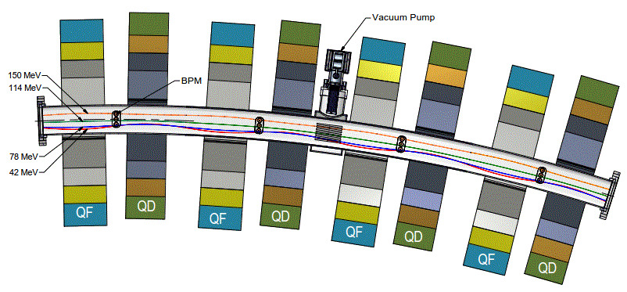
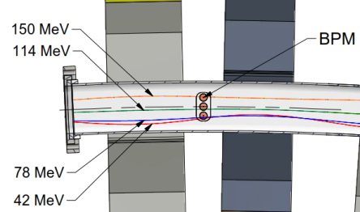
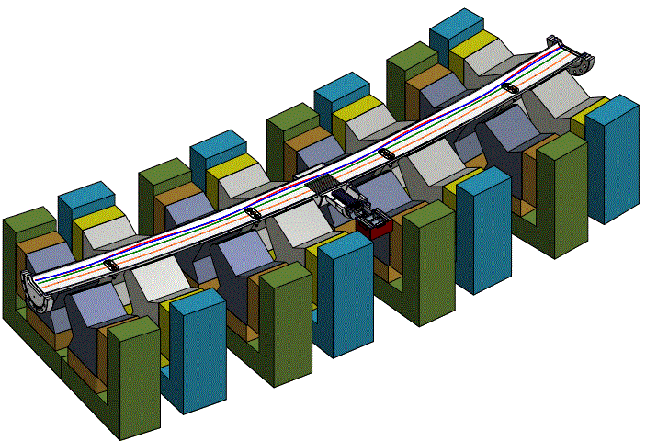
Conceptual 4-Cell FFAG Assembly
Closest beam approach ~ 12-mm
Clearance to magnet (QD) >2.0mm
Flat beampipe allows space for correctors

Slide 13
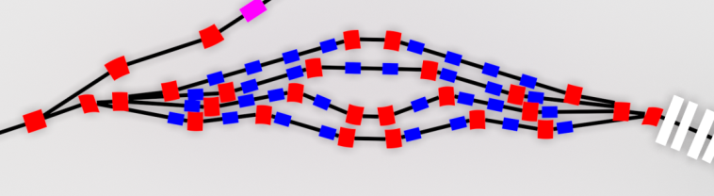
Splitter Section
4 different energies beams will be split into four separated beampipes and then recombined into a single beampipe for optics and timing reasons.
One of important features of this section is to provide beam path length adjustments for each of four energy electron beams.
Various reconfigurations are expected during staged commissioning (from 1-turn to 4-turn). Low cost, non-RF shield components will be used for the initial low beam current stages.
MLC
FFAG

Slide 14
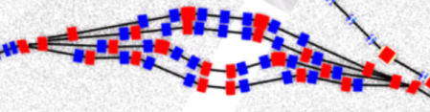
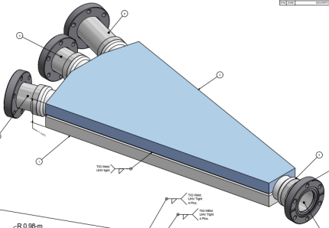
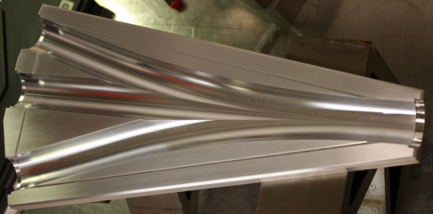
Splitter Chambers
To keep low beam impedance, the beam splitting and combining vacuum chambers may be made of aluminum alloy (6061-T6) with smooth beam path transitions, as used in the ERL Photo-Cathode Injector

Slide 15
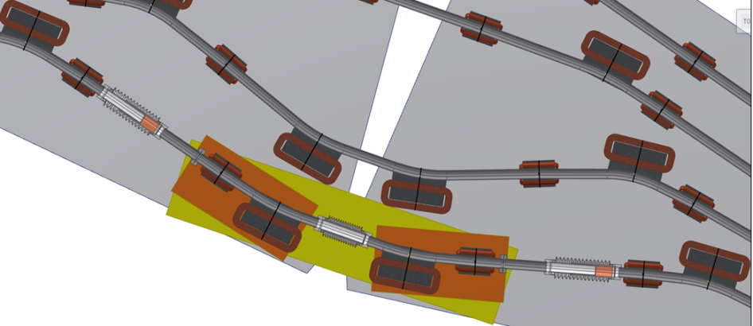
Beam Path Length Adjustments
Path Length Adjustment with 3 bellow sets.
→ Non-RF shielded for initial config. w/ large variation
→ RF-shielded for high beam current ops
Courtesy of David Burke (CLASSE)

Slide 16
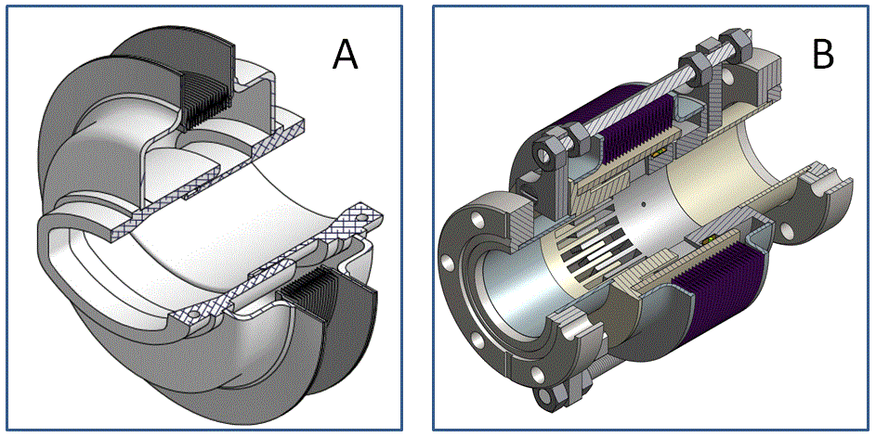
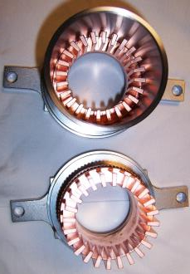
RF-Shielded Bellows
Bellows with RF shields are needed to provide adequate flexibility of the vacuum system in vacuum component installation and operations.
A – CESR-Style
B – KEKB-Style (Adapted at Injector)

Slide 17
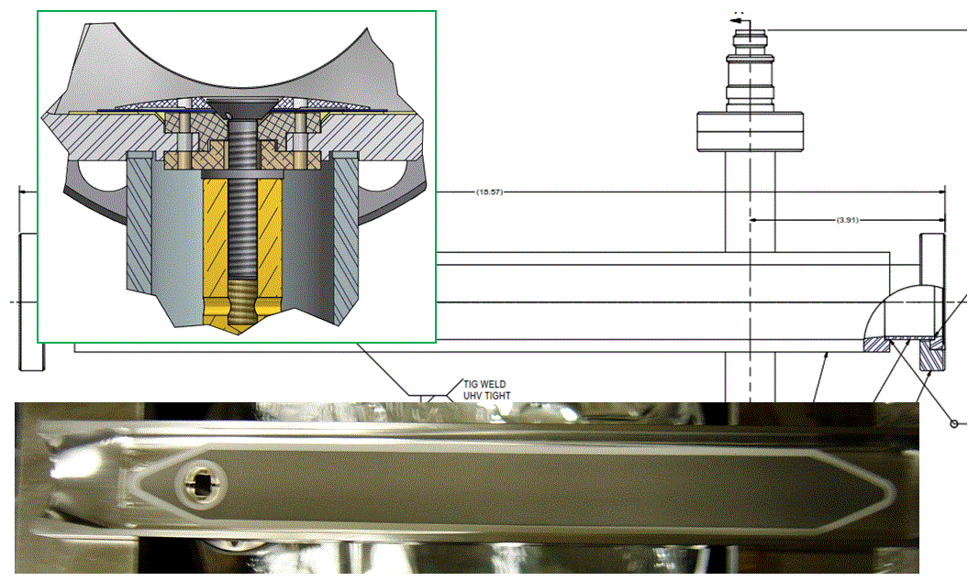
Ion Clearing Electrode
Ion trapping may not be avoidable without active clearing method, due to the nature of in the final CBETA CW beam operations.
Low impedance clearing electrodes may be deployed at various locations to reduce ill-effect from the ion trapping. Thermal-spray thin electrodes have been successfully implemented in Super KEKB, CesrTA and ERL Injector.

Slide 18
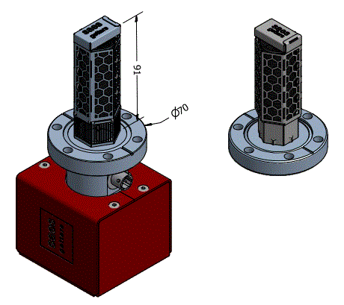
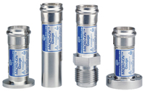
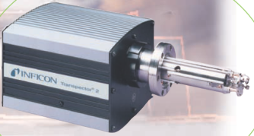
Pumping and Instrumentation
Compact NEG/SIP pumps will be used.
Additional ion gauges and RGAs for monitoring and control
Compact pumps fit in FFAG cells

Slide 19
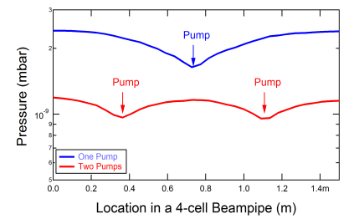
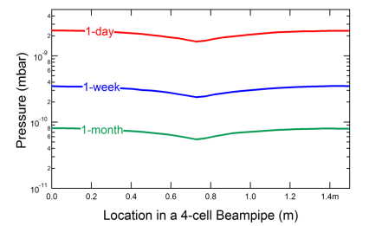
Vacuum Simulations
3D Test-Particle Monte-Carlo program, MolFlow+, will be used to optimize vacuum pumping and to simulate vacuum performances of CBETA vacuum system. For CBETA, only material thermal outgassing is considered.
Simulation showed that one pump per 4 FFAG cells is sufficient
Simulated pressure evolutions in FFAG arcs
Courtesy of Cara Zhao (Cornell Undergrad, Computer Science)

Slide 20
Fabrication & Integration
All vacuum beampipes will be fabricated following stringent ultra-high vacuum (UHV) procedure and practice.
All beampipe assemblies will be certified to be leak-free, and will be baked in vacuum up to 150°C.
Most of the beampipes will be delivered to BNL to be assembled onto the girder units.
Chemically filtered N₂ will be used for venting and purging, during integration to girders at BNL and installation at L0E, so that in situ bakeout can be avoided.
During initial staged low current operations, regular UHV gate valves will be used. Further cost/benefit analyses will determine the necessity of the RF-shielded valves.

Slide 21
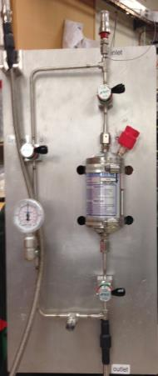

Example of Fast Pumpdown
CESR LINAC Gun Cathode Replacement
N₂
V₁
V₃
V₂
NANOCHEM® Filter
H₂O/THC ~ 0.1 ppb!
Self-Sealed Quick Connects

Slide 22
Conclusion
A conceptual vacuum design presented to meet the physics requirements of the CBETA project.
Vacuum designs will draw our experiences from the Cornell Prototype Photo-Cathode Injector project, as well from CESR operations.
A staged build up of CBETA vacuum system is expected.
Technical design of vacuum system can start as soon as the CBETA lattice and magnet design become mature (and checks written).

Slide 23
Thank you!

