Slide 1
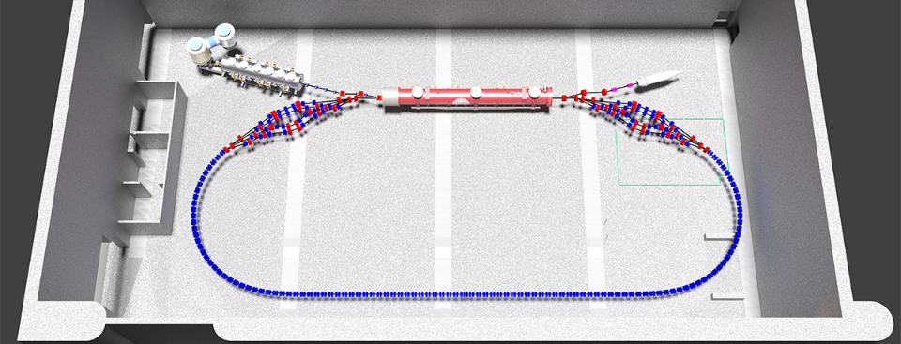
Physics Design of CBETA Quadrupoles
Holger Witte

Slide 2
Outline
Lattice and Magnet Requirements
General Concept
Physics Requirements on Design
Plans for Prototypes
Correctors

Slide 3
Lattice and Magnets
EMMA: the first non-scaling FFAG built
Magnet-to-magnet field variation contributed to
Significant closed orbit distortion, which
Ultimately limited the energy range at the low energy end
Correctors
Improved the situation
Never fully eliminated the orbit distortion

Slide 4
Cell
Qf/Qd: identical gradient / aperture (different length)
Beam excursion: +/- 31mm
Design: tracking with 3D field maps

Slide 5
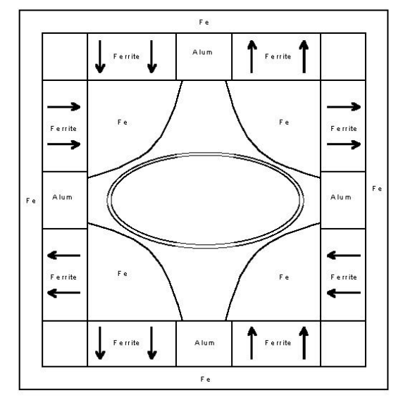
Magnet Concept
Based on permanent magnet design at Fermilab (recycler)
Advantages
(Largely) conventional approach
Field quality determined by pole
Laminations
Small magnet to magnet variation
Permanent magnet tolerances easier to handle
Magnetization 3%
Magnetization angle 3-5º
Scheme for temperature compensation
Adopted for CBETA
Material NdFeB (not ferrite)
Higher gradient (Fermilab: 2.6 T/m)
8.25’’

Slide 6
2D Geometry Qf/Qd
M
80% PM (N49M)
M
Size of magnets: driven by beam pipe requirements

Slide 7
Gradient quality
Requested: 1%
Hump: orbit compression
ΔG/G₀
Beam excursion: 31mm

Slide 8
Temperature Compensation
NdFeB: (∆B/B)/∆T≈-1.1x10⁻³/K
Compensation scheme: 30-32% Ni-Fe
Pioneered by Fermilab
Curie temperature of 60°C
B_{sat}=0.3-0.1 T (20-45°C)
Required Ni-Fe: about 20% of PM
Thermoflux TX65/100
NdFeB
NiFe
Top
Side

Slide 9
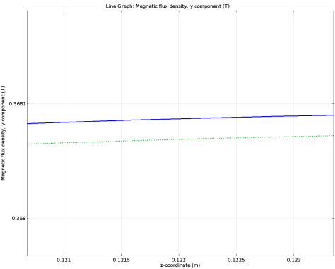
3D NiFe Temperature Compensation
Not shown: same for Qd / individual magnets
Qf, field at outermost aperture
NiFe
0.3681T
20ºC
30ºC
0.368T
z (m)
Margin: 9.2% (approx. 4mm gaps in long. direction)

Slide 10
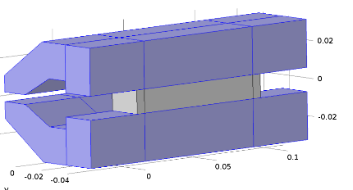
Bench Test
Material: VAC 745TP
Temperature coefficient (%/K)
uncompensated: -0.103
Compensated: <-0.003
NiFe

Slide 11
Manufacturing
Sources of error
Soft iron (spec this so that this is not an issue)
Geometry
PMs
Geometry: get it right from the beginning
Aim: after assembly no modification required
Poles are far out - possible to meet tolerances
PMs only source of error: imbalanced quadrants
Measure PMs
PMs can get damaged during assembly, …
Approach: correct with shunts

Slide 12
Geometry / Field Quality
Pole area
Pole shape
Distances / tilt
Identical to other quadrupoles
Distance pole to back yoke
NdFeB: μ_{r}≈1
Adds to air gap
Engineering: George’s talk

Slide 13
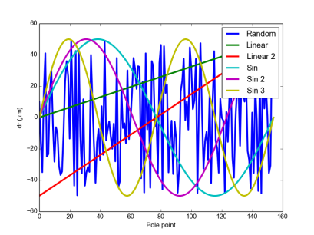
Pole Tolerance
Required pole accuracy?
Start with ideal pole and add error function
Amplitude +/-50um
(easily achievable with stamping)
Benchmarking
3D tracking
Look at orbit distortion
Result: no issue
Choose worst error function
Increase tolerance to 100 and 150 um
Orbit distortion < 0.3mm
Pole shape very robust

Slide 14
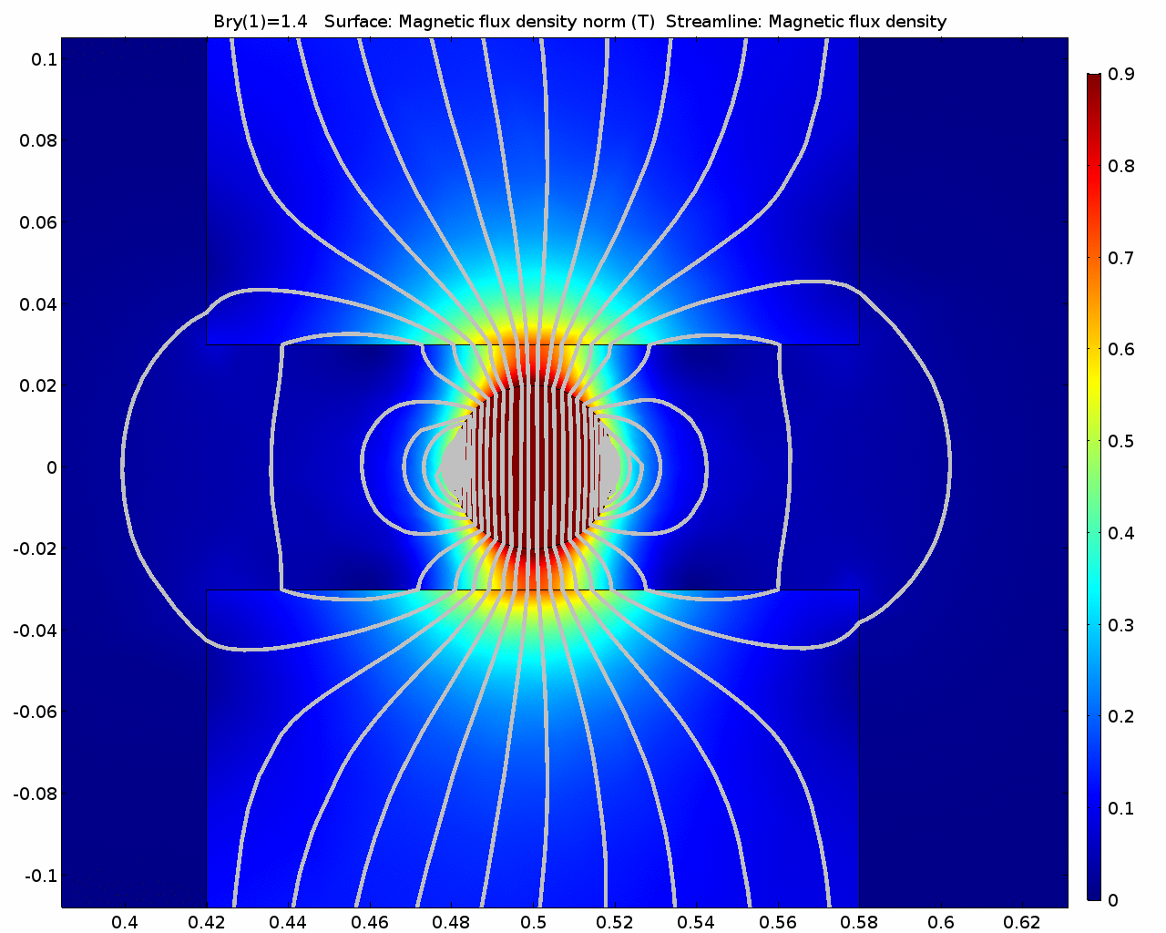
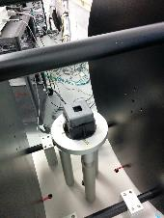
Permanent Magnets
B_{r,y}
Distance d needs to be identical for each pole
Permanent Magnets
Magnetization 3%
Magnetization angle 3-5º
Important for design
Flux through surface perpendicular to pole piece
Can be measured using Helmholtz Coil
Yoke
B_{r}
d
B_{r,x}
Pole

Slide 15
Block Measurements
Much smaller spread than expected
B_{r} smaller than expected (but within +/-5% spec)
Blue: Qf
Green: Qd
Qd: +/-0.5%
Qf: +/-1%
Matching (iterative): error < 1x10⁻⁵

Slide 16
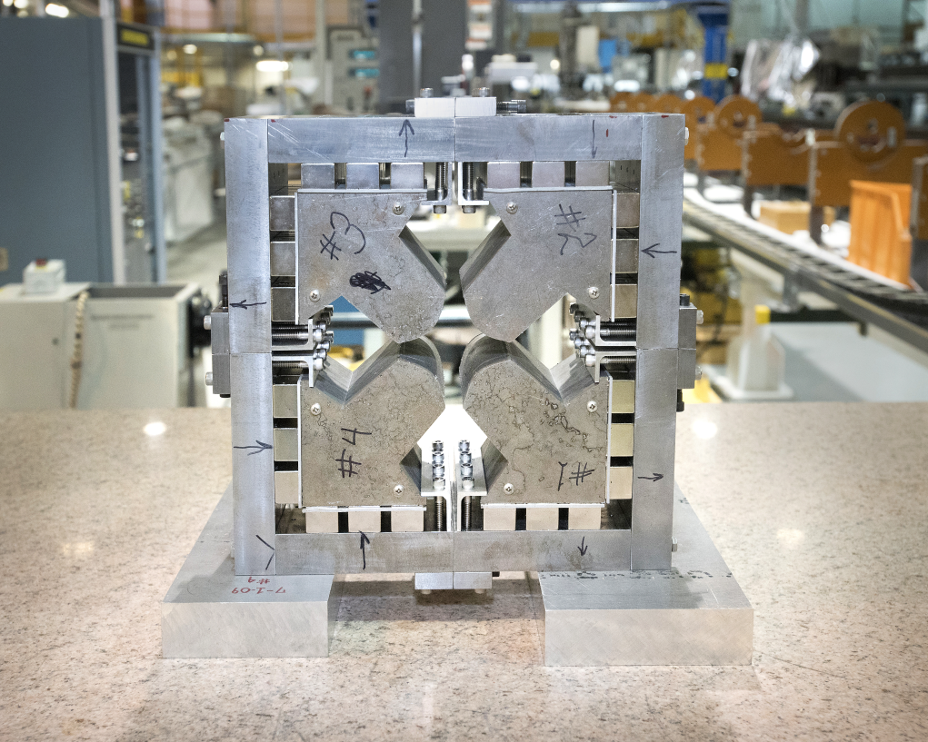
Demonstrator
Different lattice
Higher gradients (28 & 41T/m)
Smaller apertures (IR 16 & 22 mm)
Design freeze September 2015
Not all necessary simulation work carried out
‘Aggressive’ design
Sensitive to tolerances
Assembled without tooling
Harmonics measurement
12 units out (of 10000)
Qd
110 mm
80 mm
Qf

Slide 17
Prototype Magnet
Actual geometry + spacer
Use existing PMs
Come measured
Smaller than what we need (gradient lower)
Performance
Gradient about 5.8T/m
Harmonics identical
Upgrade to correct PMs later
Tests
Improved geometry
New pole shape
New assembly procedure
Splitting magnet
Time estimate: 1 month?
Spacer

Slide 18
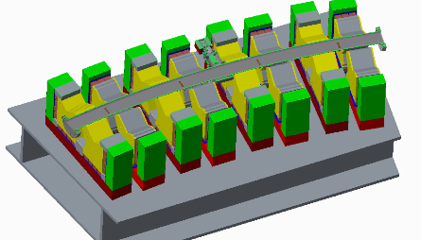
Prototype Girder
Assembly
Integration
Alignment
Test with beam
Cornell
40/80 MeV
Test of BPMs
First test of beam dynamics

Slide 19
Quad Corrector
Can be air-cooled
+/-4%
G/G_{0,nominal}
0.96
1.0
1.04
x (m)
Coil: 8x10mm²
J = 1A/mm²
Gradient quality unaffected by quad corrector

Slide 20
Skew Dipole Corrector
Skew dipole=590 Gcm
Four outermost conductors 4.5A/mm²
Increase area to lower current density
(otherwise 1A/mm²)
ΔB/B≤~8x10⁻³
Courtesy of N. Tsoupas

Slide 21
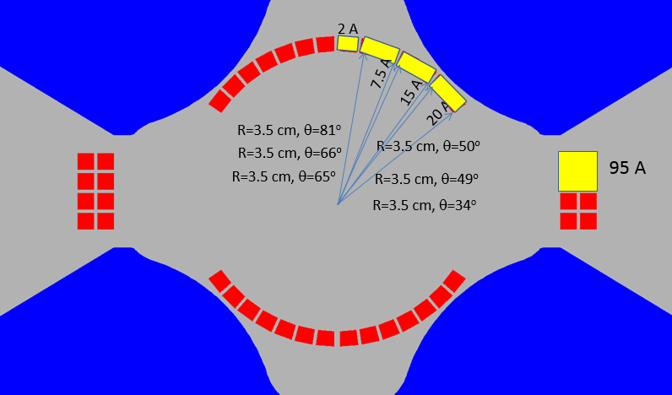
Dipole Corrector
Dipole 347.26 Gauss.cm
Current: cos(Θ) distribution (max J<1A/mm²)
with ΔB/B≤~5x10⁻³
Can be air-cooled
-38.4 Gauss
-38.5 Gauss
-38.6 Gauss
Courtesy of N. Tsoupas

Slide 22
Conclusion
Concept: iron dominated magnets
Factors affecting field quality understood
Large aperture magnets: pole and alignment tolerances not challenging
Laminations: small magnet-to-magnet variation
Temperature compensation
Concept shown to work at FNAL / CERN
Prototype magnet
Tests pole shape, improved assembly procedure
Prototype girder: assembly, integration
Test with beam: BPMs, beam dynamics
Concept for correctors

Slide 23
Additional Slides

Slide 24
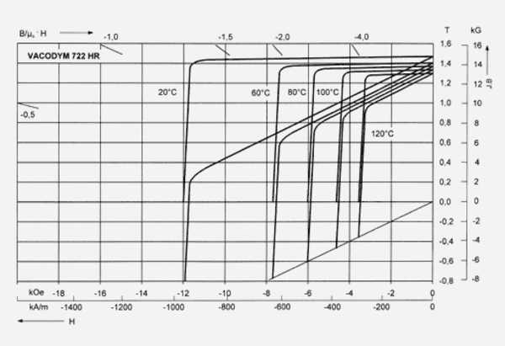
Materials
Iron
Low carbon steel
JFE-EFE: procured recently for large magnetic shiedling project
BH curves for as delivered, machined, machined+annealed
(SiFe no change in gradient or quality)
Permanent Magnet
Grade: N49

Slide 25
Magnetization
200 MeV
150 MeV
1.8T
1.4T
Less stringent requirements on iron

Slide 26
Gradient Quality
Gradient quality unaffected by quad corrector

Slide 27
Temperature Compensation
dB(T)
NiFe
w (m)
Required cross-sectional area of NiFe can be determined in 2D simulation
Result translates from 2D linear → 2D non-linear → 3D linear → 3D non-linear
Linear relationship between compensation performance and NiFe fraction

Slide 28
Angle of Magnetization
z
M
Angle of magnetization not important for this type of magnet
y
x
Qf
Qd
Angle: γ

Slide 29
Helmholtz Coil
Variation in permanent magnets: Match PMs to deliver same amount of flux to each pole
Thanks to Toshiya Tanabe & Chris Eng (BNL Insertion Devices Group)
Mike Anerella, Jesse, Ray + Mike

Slide 30
Shunting
Shunt
PM
Thin strip of soft iron – locally shunts fraction of magnetic flux
Shunted flux depends on width, length and material
Attractive, because this can be done while coil on measurement bench
Affects harmonics up to sextupole (skew and normal)

