Slide 1

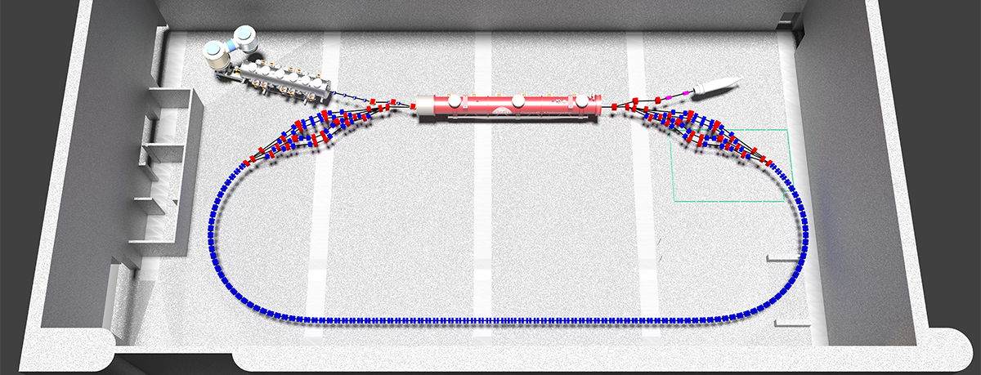
CBETA Project and
eRHIC Development
Dejan Trbojevic

Slide 2
C-Beta Project and eRHIC Development
EIC at RHIC
eRHIC ERL proposal and risks
What is Non-Scaling FFAG
NS-FFAG eRHIC Design
Estimated Cost of the Ultimate eRHIC
Expected Deliverables from CBETA

Slide 3
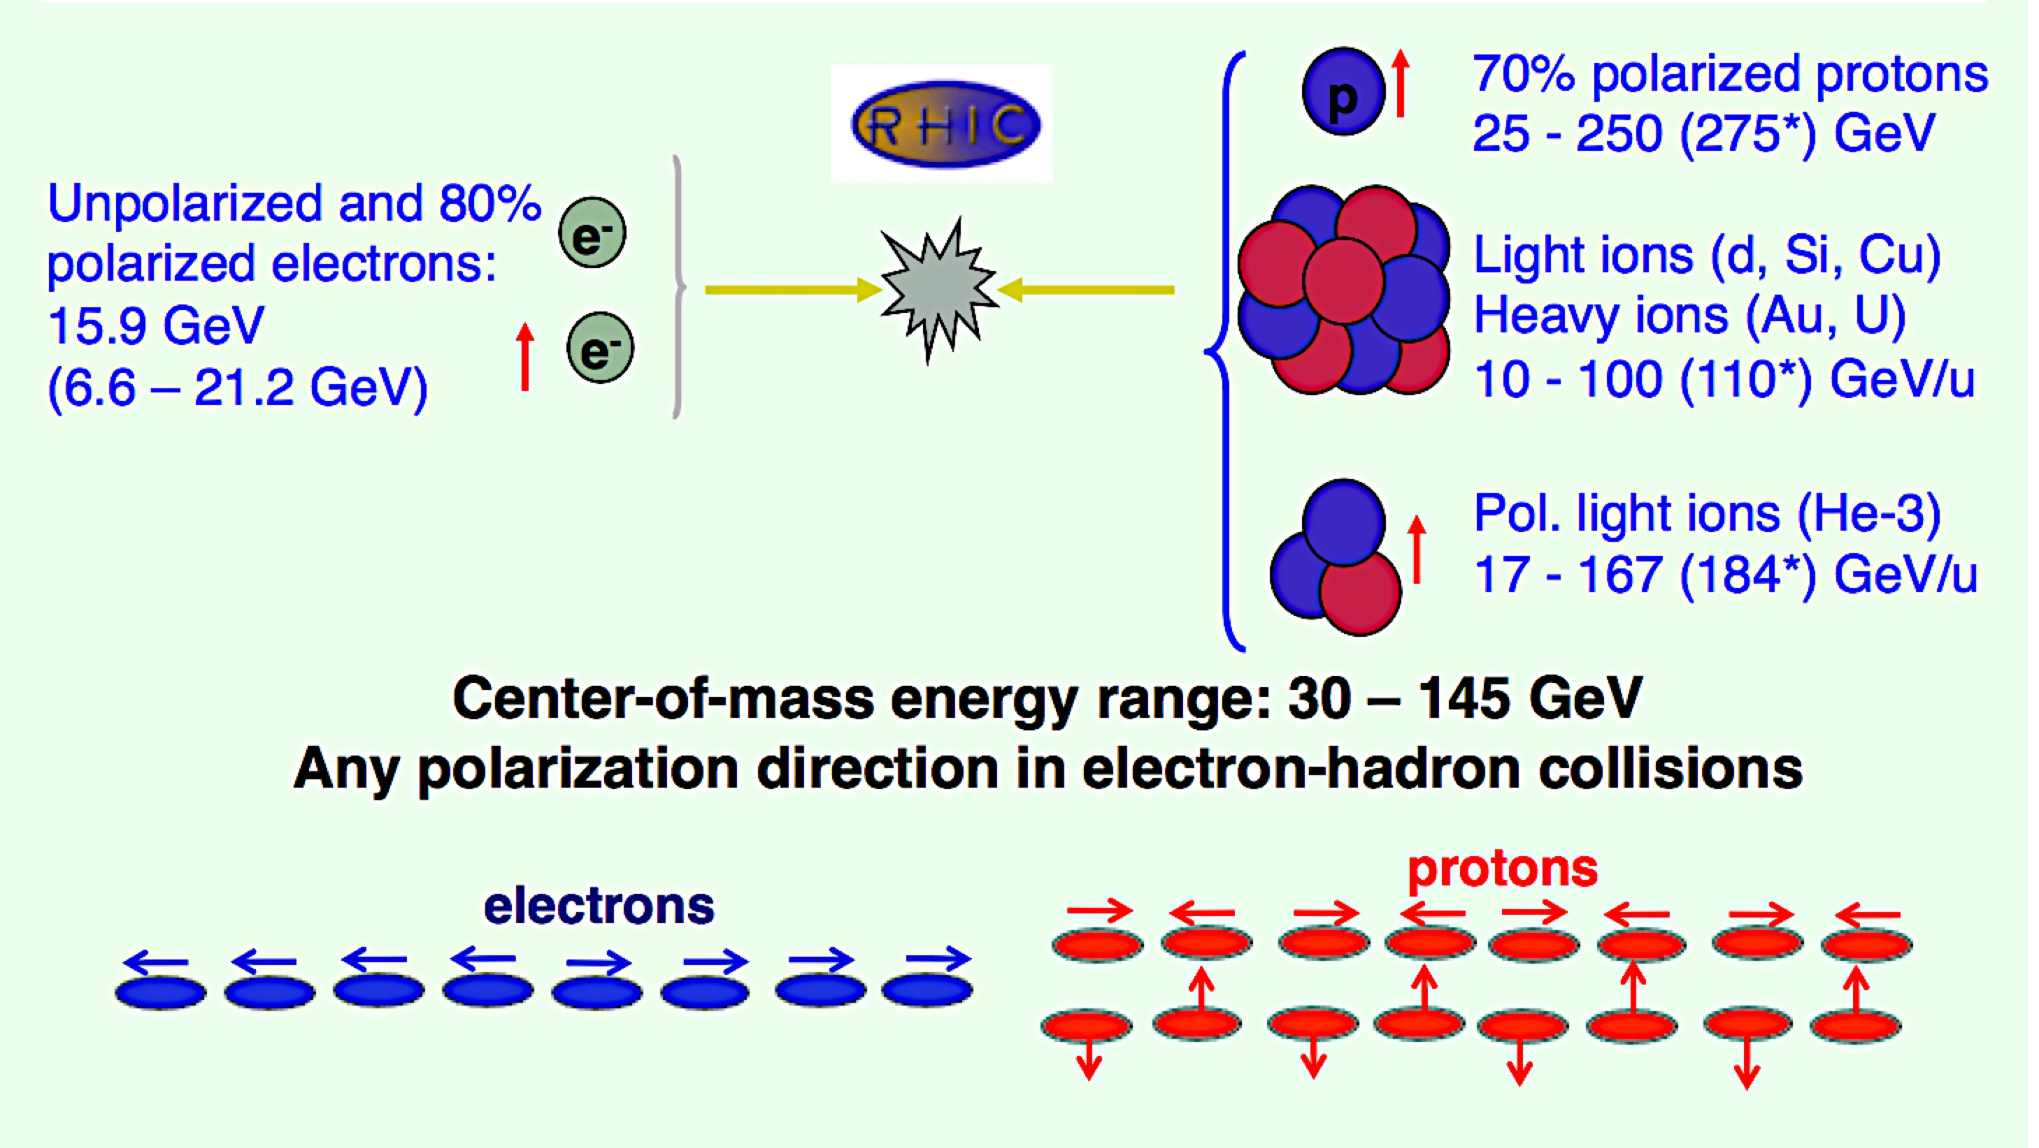
A Microscope for Gluons
AN ULTIMATE QCD LABORATORY
The study of the high density gluon field, which is at the center of it all, requires a high energy, high luminosity, polarized Electron Ion Collider
ELECTRON ION COLLIDER

Slide 4
eRHIC peak luminosity vs. CoM energy
Presented already in the
EIC WHITE PAPER
eRHIC peak luminosity
Falls down due to synchrotron radiation
10³⁴
100
Tomography (p/A)
Transverse Momentum Distribution
and Spatial Imaging
10³³
10
e-N Luminosity [cm⁻² s⁻¹]
Spin and Flavor Structure of the
Nucleons and Nuclei
e-N Integrated Luminosity [fb⁻¹/yr]
Internal Landscape
of Nuclei
QCD at Extreme Parton
Densities - Saturation
10³²
1
0
50
100
150
e-N Center-of-Mass Energy [√(Z/A) GeV]
eRHIC design covers whole Center-of-Mass energy range, including
“EIC White Paper Upgrade” region
Small beam emittances and IR design allows for full acceptance detector at full luminosity

Slide 5
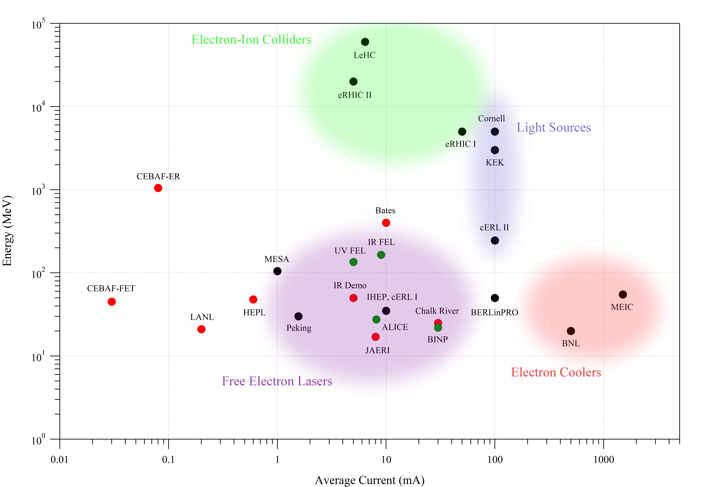
Risks of the eRHIC ultimate solution with ERL
Energy Recovery Linacs
Energy Recovery Linac
  ADVANTAGES:
    Accelerated electron bunch collides only ONCE with ions.
    Electron energy is recovered as the beam returns to the dump with its initial energy. This also saves energy as the operation is very close to 100% efficiency. In the storage rings the beam passes million times through the Radio Frequency (RF) storage cavities without significant problems. This is the case even in the operating Recirculating Linac Accelerators (RLA’s) at Jefferson Laboratory as the bunch currents are very small. The required very high luminosity of ~10³⁴ the Electron-Ion Collider (EIC) requires much higher charges per bunch.
  CONCERNS:
    Higher Order Modes HOM’s - Beam could excite higher order modes in the cavities which could make the electron beam unstable if the modes happen to resonate at specific frequencies
    Beam ion instability - electron induced desorption of molecule can create ions due to collisions with electrons and their accumulation at the end of the linac can make electron beam unstable.
    Wake fields – electron bunch passing through the cavity leaves the wake fields. The next bunches can add more wakes and this can affect the new arriving bunches.
    Energy recovery is affected by the synchrotron radiation loss. If not corrected this could induce energy spread during the recovery process and due to aperture limitations beam loss can occur.
Pre-project eRHIC R&D Plan (from Thomas Roser)
NS-FFAG ARCS with ERL
Advantages:
- Significantly Reduces a number of beam lines
- Permanent magnets reduce the operating cost
- Reduction of the linac energy from initial 6 GeV
- Reduction of overall cost
Disadvantages:
- At low energy transport high chromaticity induces emittance growth
- Only one example “EMMA” of NS-FFAG has been built
- No FFAG ERL has ever been built
 | Performance risk | Cost risk
Hadron cooling | peak L ~ 8 ∗ 10³² and average L < 5 ∗ 10³²
Polarized source |  | Multiple guns to achieve high current
FFAG recirculation lines | “unproven technology” | Individual beam lines
Multipass ERL | Energy reach | Very long linac
HOM power | Energy reach | Long linac
Crab-crossing | Reduced detector performance and the need for novel detector technologies. Reduced physics program.
Additional risks for Ultimate design include:
RHIC pipe copper coating | Reduced luminosity
Space charge compensation | Reduced luminosity at low CME
There are four high priority eRHIC R&D items to be completed before CD2. One of them is:
  High intensity, multi-pass test-ERL with single recirculation arc to be built using the Cornell high intensity electron injector and CW SRF Linac, led at BNL by Dejan Trbojevic and at Cornell by Georg Hoffstaetter
Plan to complete the BNL-Cornell FFAG-based test-ERL by with $25M from NYS Empire State Development Cooperation.
Red-past
Green-present
Black- designed or constructed
ERL@CEBAF
Low Risk eRHIC
4pass CBeta
2pass MESA
4pass BINP

Slide 6
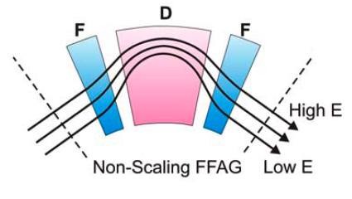
NON-SCALING FFAG
VERY STRONG FOCUSING
3 cm
To reduce the orbit offsets to ±4 cm range, for momentum range of
δp/p ~ ± 50 %
the dispersion function D_{x} has to be of the order of:
D_{x} ~ 4 cm / 0.5 = 8 cm
Δx = D_{x} ∗ δp/p

Slide 7
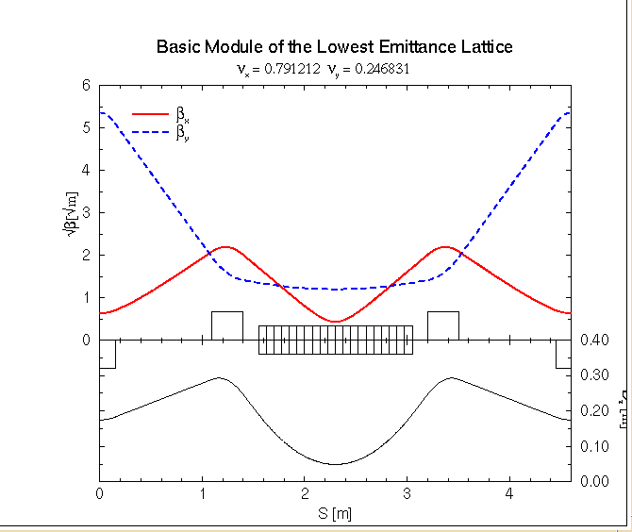
To minimize the dispersion function H the BENDING MAGNET (DEFOCUSING) should be in the centered in the cell with a minimum of β_{xmin}=L_{d}/2√15 and D_{xmin}=θ*L_{d}/24 @center
“FFAG Lattice Without Opposite Bends”
Dejan Trbojevic*, Ernest D. Courant* and Al Garren
Presented in September 1999
CP530, “Colliders and Collider Physics at the Highest Energies: HEMC'99 Workshop”, edited by B. J. King
β_{y}
β_{xmin}
0.3 m
Dispersion
D_{xmin}

Slide 8
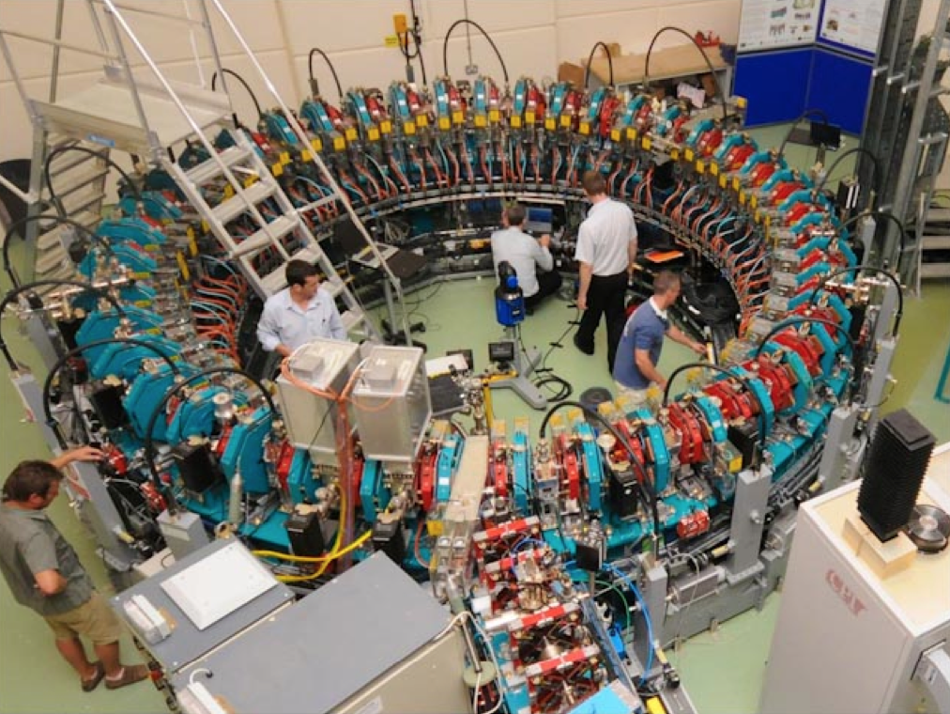

EMMA the first NS-FFAG
“Electron Model for Many Applications” built at Daresbury Laboratory
ELECTRON
ENERGY
RANGE
10-20 MeV

Slide 9
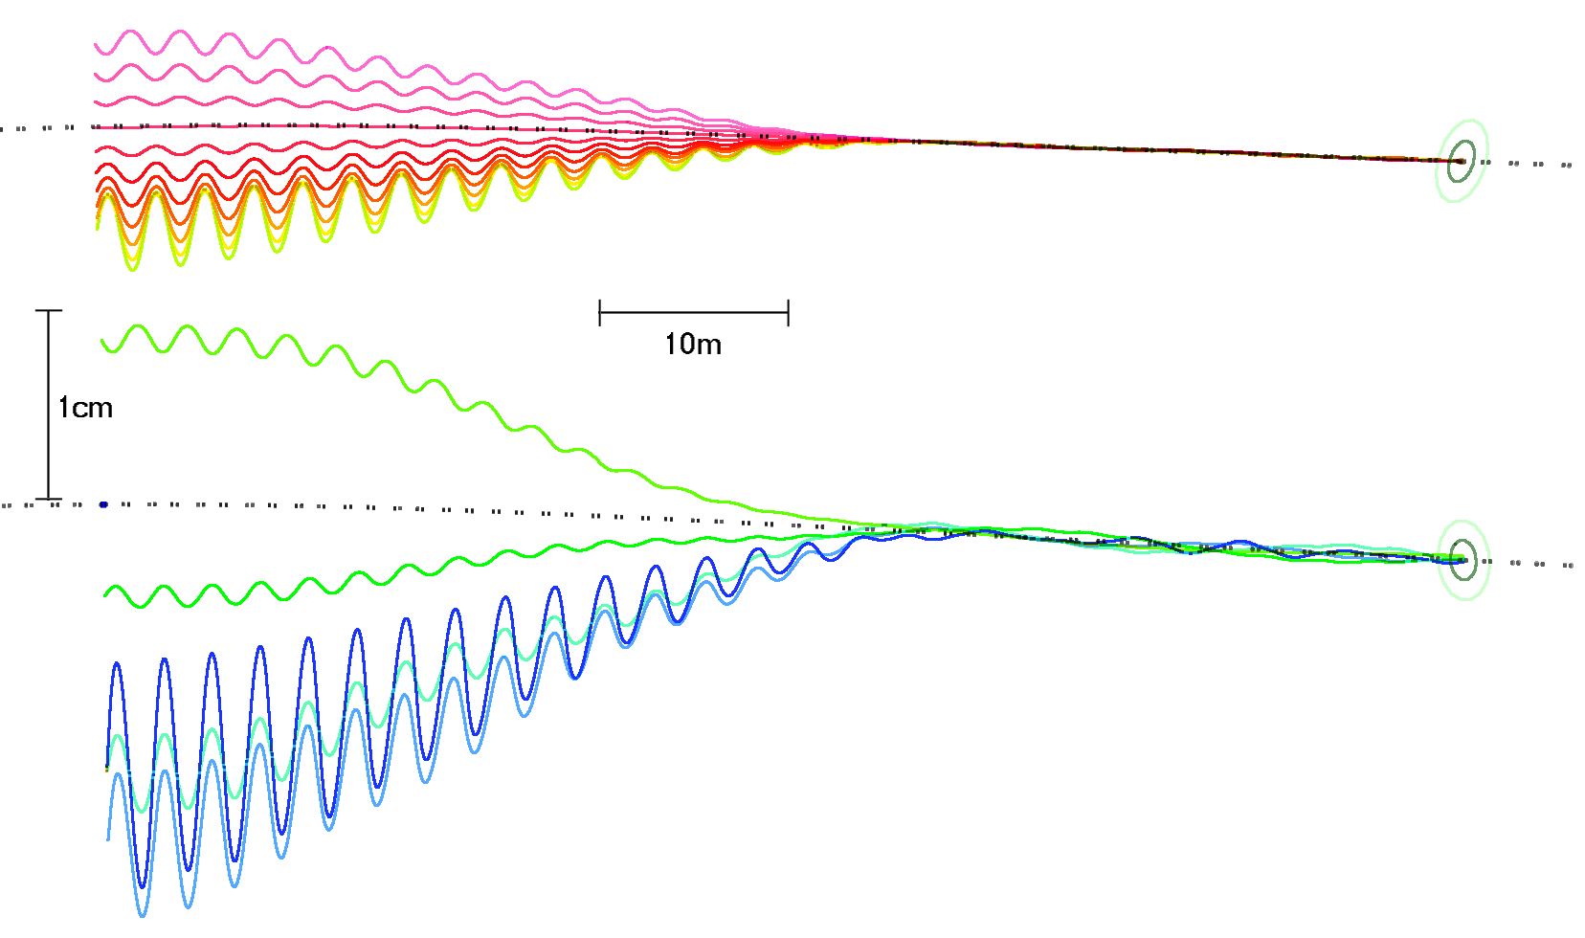
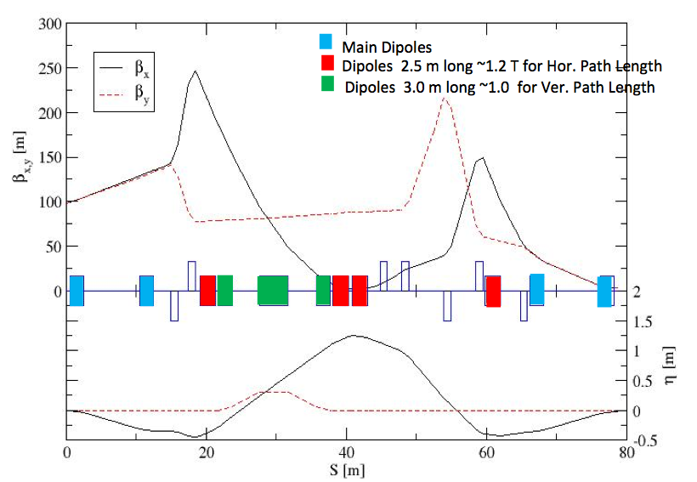
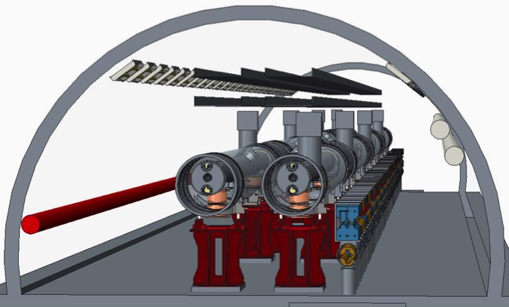
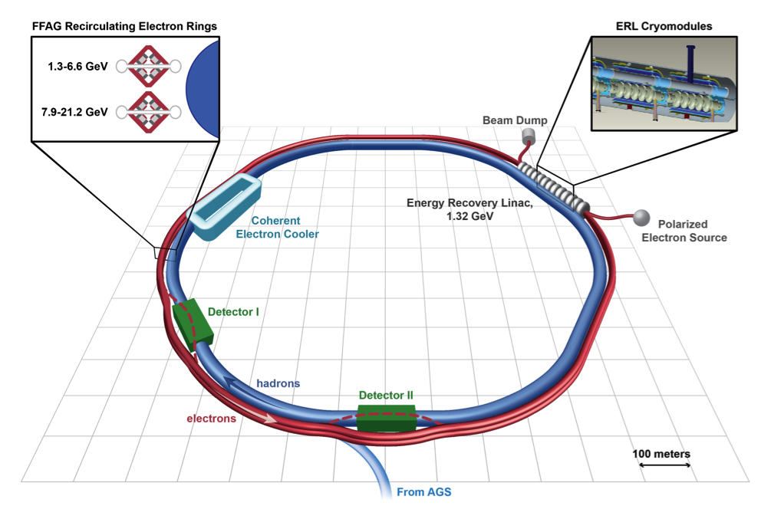
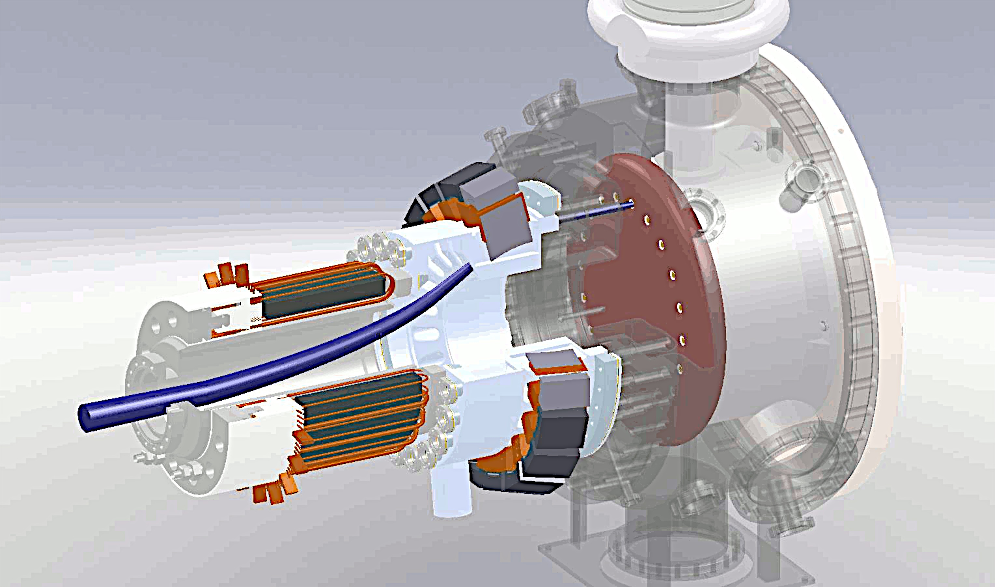
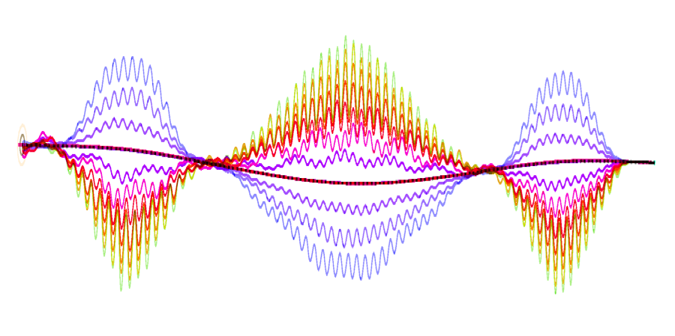
eRHIC Technical Overview
3
Major Technical Components:
3
3
2-6 GeV
5
Funneling Gun
8-20 GeV
5
ERL mergers
1
5
6
6
2
2
4
2
2
2
3
Superconducting Linac - ERL
6
6
7
4
4
2
3
2
1
2
6
3
2.0 GeV
4
4
Spreaders and Combiners
4
4
8
4
1
5
5
6
NS-FFAG arcs
9
7
7
Merging arcs to straight section
8
6
7
6
6
6
7
8
9
8
Straight section
5
5
5
5
Extracted high energy beam
© Stephen Brooks
8
9
Detector By Passes
The Non Scaling FFAG (NS-FFAG) lattice enables multiple passes of the electron beam with different energies in a single strong focusing recirculation beam line by using the superconducting RF (SRF) linac multiple times. The FFAG-ERL moves the cost optimized linac and recirculation lattice to a dramatically better optimum.
Proceedings of EPAC 2004, Lucerne, Switzerland
ELECTRON ACCELERATION FOR E-RHIC WITH NON-SCALING FFAG*
D. Trbojevic, M. Blaskiewicz, E. D. Courant, A. Ruggiero, J. Kewisch, T. Roser, and N. Tsoupas, BNL, Upton, N.Y. 11973, USA
© Stephen Brooks

Slide 10
eRHIC cost

Slide 11
Option #2
10 mA
Linac 1.67 GeV
#1 6.680 GeV
#2 8.345 GeV
#3 10.010 GeV
#4 11.675 GeV
#5 13.340 GeV
#6 15.005 GeV
#7 16.670 GeV
#8 18.335 GeV
#9 20.000 GeV
eRHIC Layout
50 mA
Linac 1.67 GeV
#1 6.680 GeV
#2 8.345 GeV
#3 10.010 GeV
#4 11.675 GeV
#5 13.340 GeV
#6 15.005 GeV
Energy
#1 1.685 GeV
#2 3.350 GeV
#3 5.015 GeV
6.685 – 15.005 GeV
x 2.976
Injector 20 MeV
Linac 1.665 GeV
1.665 GeV LINAC
Injector 20 MeV
12 passes through the Linac
x 2.99

Slide 12
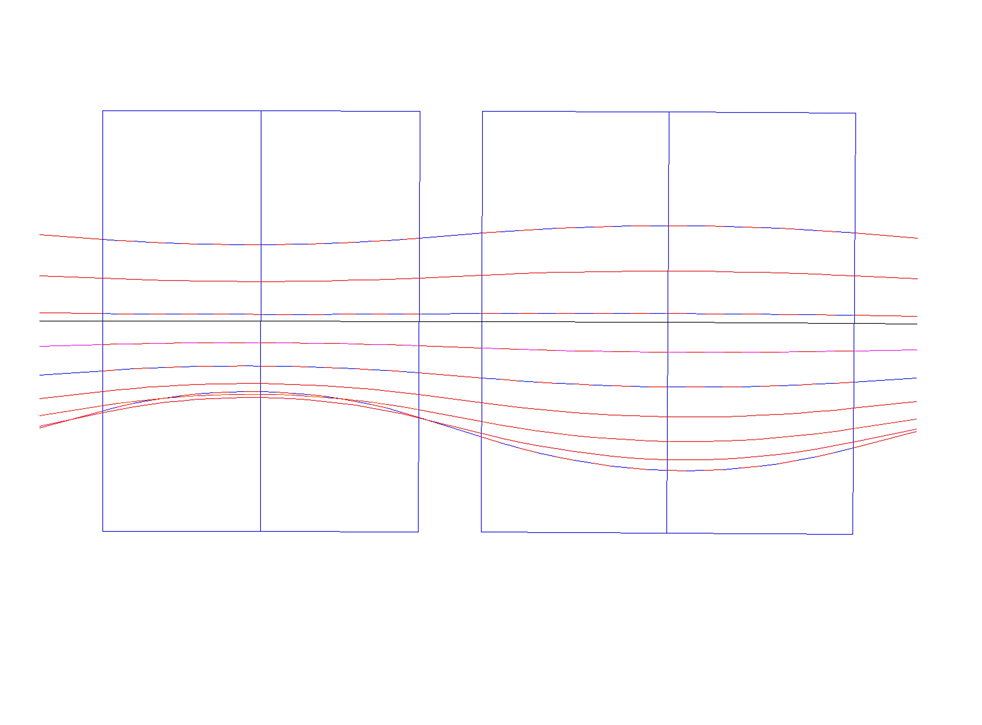
High Energy eRHIC NS-FFAG Cell
B_{Do} = 0.181 T,
G_{D} = -34.42 T/m
x_{Doffset}=+5.26 mm
B_{Fo}= 0.181 T,
G_{F}= 34.42T/m
x_{Foffset}= -5.26 mm
Synchrotron Radiation:
for 10 mA 20 GeV 3.32 MW
for 10 mA 15 GeV 1.62 MW
for 10 mA 16.67 GeV 1.95 MW
x(mm)
BD
B_{Fmax,min} =[0.446,-0.225] T
QF
x(mm)
10
B_{Dmax,min}=[0.443,0.046] T
20.00 GeV
1.3
D-Quad center
18.34 GeV
6.6
7.7
16.67 GeV
5.26
E_{CEN}=16.198 GeV
0
12.96
15.005 GeV
F-Quad center
-5.26
13.34 GeV
-7.6
11.68 GeV
10.01 GeV
-11.8
8.345 GeV
6.54
-10
6.68 GeV
B_{D}=B_{Do} + G_{D}•x
B_{F}=B_{Fo} + G_{F}•x
ρ_{D}=300.01 m
ρ_{F}= 302.3 m
20 cm
θ_{D}=3.366 mrad
20 cm
θ_{F}=3.927mrad
1.01 m
1.187m
20 cm
L = 2.797 m

Slide 13
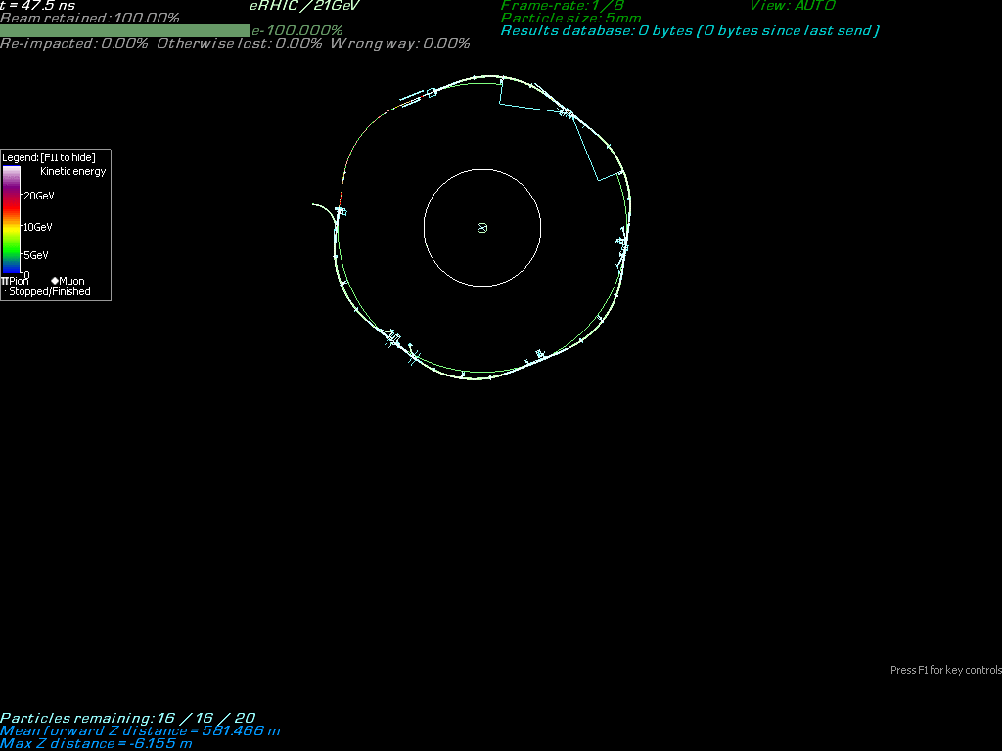

eRHIC Simulation

Slide 14
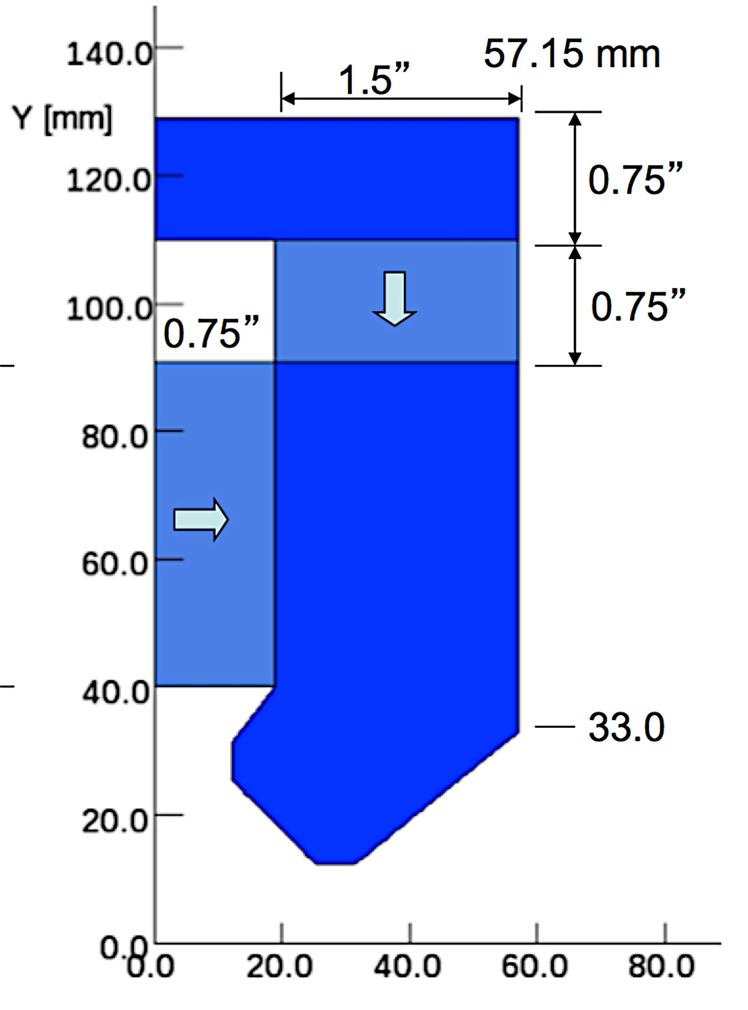
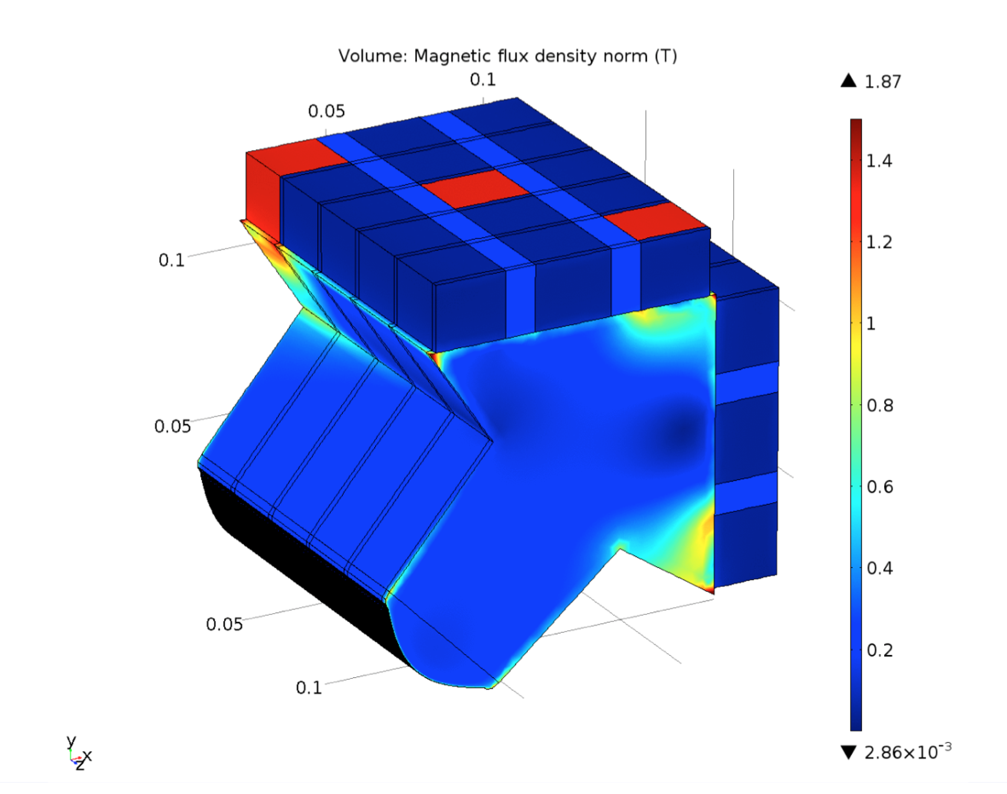
eRHIC Magnet Design

Slide 15
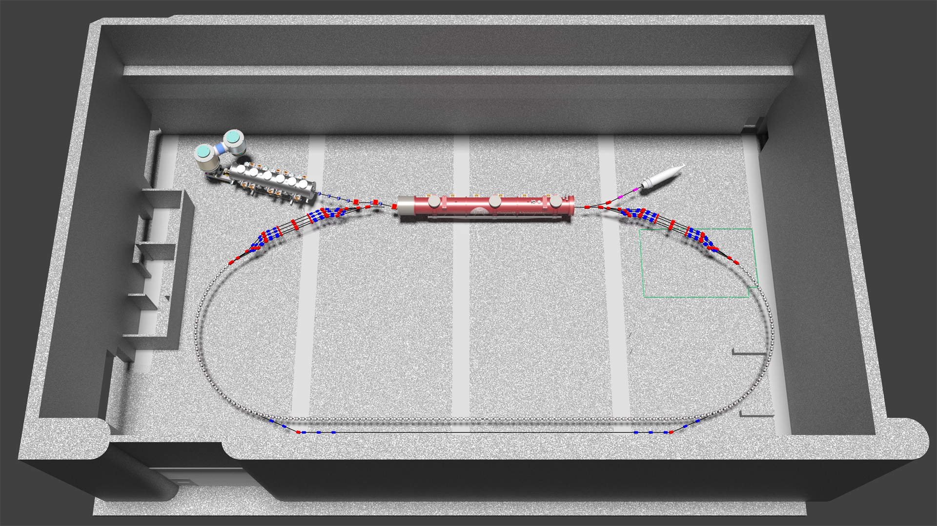
Technical Overview of eRHIC prototype CBETA
Major Technical Components:
Electron Gun with Linac
1
ERL mergers
2
2
Superconducting Linac - ERL
4
3
4
Spreaders and Combiners
5
5
NS-FFAG arcs
6
7
6
Merging arcs to straight section
8
Straight section
Extracted high energy beam
C-βeta will comprise the first ever Energy Recovery Linac (ERL) based on a Fixed Field Alternating Gradient (FFAG) lattice.

Slide 16
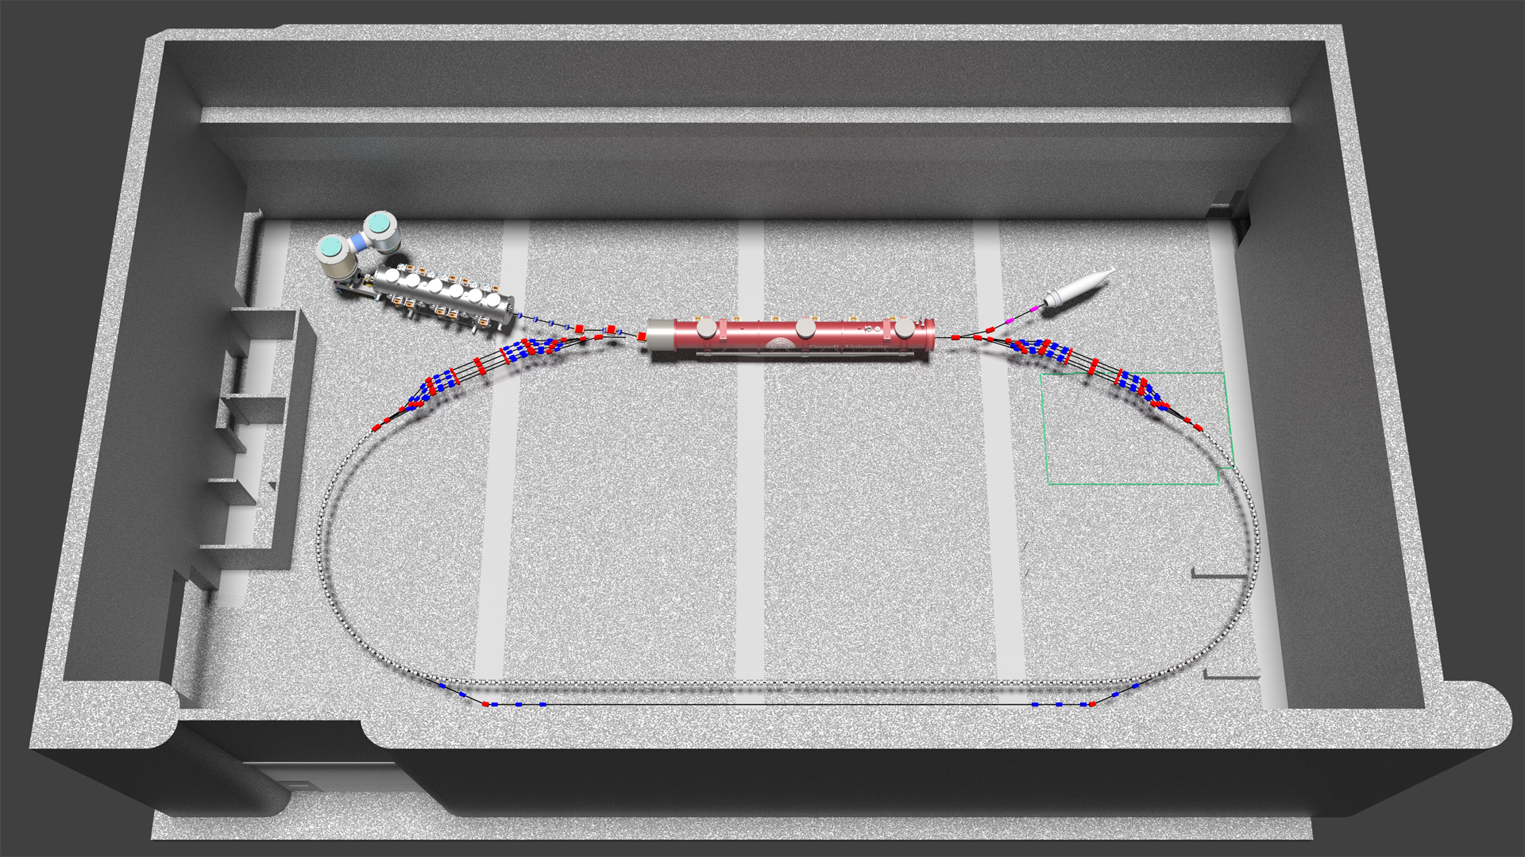
Prototype eRHIC ERL @ Cornell
NS-FFAG arcs, four passes (like first eRHIC loop)
Momentum aperture of x4, as for eRHIC (EMMA achieved x1.7, planned x2)
Uses Cornell DC gun, injector (ICM), dump, SRF CW Linac (MLC)
Prototyping of essential components of eRHIC design
6 MeV
6 MeV
+/- 36 MeV
42, 34, 48, 150 MeV

Slide 17
Unique capabilities of CBETA in eRHIC risk reduction
  Cβ will be the first accelerator in the world to include any of the following items required by the eRHIC design
  ERL using FFAG recirculating arcs
  Linear field FFAG with momentum range of 4x
  Adiabatic transition from curved to straight FFAG
  Permanent magnets (PMs) used in an FFAG
  NdFeB PMs used for main beam steering
  PMs used in ERL return arcs
  Multi-pass superconducting ERL

Slide 18
eRHIC prototype: Deliverables, Key and Ultimate Performance Parameters
Deliverables:
    Completed eRHIC prototype accelerator (Cornell University site location)
    Commission the ERL NS-FFAG eRHIC prototype.
    Perform eRHIC related experiments: accelerate 4 times in energy with the energy recovery for four energies, perform the orbit, gradient, time of flight correction, etc.
Key Performance Parameters (KPP):
    Demonstrate orbit corrections for all energies
    Demonstrate a factor of 4 momentum acceptance in the FFAG
    Demonstrate 4-pass recirculation with energy recovery at an average current of 1 mA
    Demonstrate extraction for the highest energy pass
Ultimate Performance Parameters (UPP):
    Demonstrate 4-pass recirculation with energy recovery at an average current of 40 mA, with extraction of the highest energy
    FFAG: large chromaticity-> emittance preservation simulations, lattice optimization can be experimentally studied in CBETA increasing Δp/p

Slide 19
RETIRING A LIST OF RISKS
Few most important risk items for eRHIC:
FFAG loops with a factor of 4 in momentum aperture.
  Precision, reproducibility, alignment during magnet and girder production.
  Stability of magnetic fields in a radiation environment.
  Matching and correction of multiple simultaneous orbits.
  Merging multiple orbits from arc to the straight and from straight to the arc
  Path length and M₅₆ control for all orbits.
  Control of the Emittance.
Multi-turn ERL operation with a large number of turns.
  HOM damping.
  BBU limits.
  LLRF control and microphonics.
  ERL startup from low-power beam.

Slide 20
Benefits to BNL and Cornell University
What BNL gets out of the collaboration: Risk reduction and prototyping.
R&D and prototyping of eRHIC systems, e.g. multi-beam feedback, timing and synchronization, high-current halo control, collimation, LLRF control, etc.
Proof of FFAG capabilities, e.g. momentum acceptance of x4, orbit and optics correction with real tolerances, reproducibility of magnet and girder construction, adiabatic FFAG transitions, resonant beam separation, etc.
Proof of multi-turn ERL operation, BBU studies for 4 turns, operational stability, multi-beam diagnostics possibly for pilot bunches, merger matching.
After replacing the MLC by an eRHIC cavity: Proof of eRHIC-cavity capabilities, e.g. current limits, RF stability, microphonics control, HOM heating, etc.
What Cornell gets out of the collaboration:
Forefront research in ERL physics.
Excellent opportunities to educate accelerator physics students (e.g. for eRHIC).
A high-brightness beam of moderate energy for physics experiment.

Slide 21
Future eRHIC studies
ADDITIONAL SLIDES:
Present Study: A lattice 6 times in energy with linac 2x1.5 GeV= total of 3 GeV using a single FFAG with sextupoles

Slide 22
eRHIC Layout
3 – 18 GeV
Linac 1.5 GeV
10 mA
Linac 3.0 GeV
#1 3 GeV
#2 6 GeV
#3 9 GeV
#4 12 GeV
#5 15 GeV
#6 18 GeV
Injector 20 MeV
Linac 1.5 GeV
3.0 GeV LINAC
6 passes through the Linacs
x 6 times
in energy

Slide 23
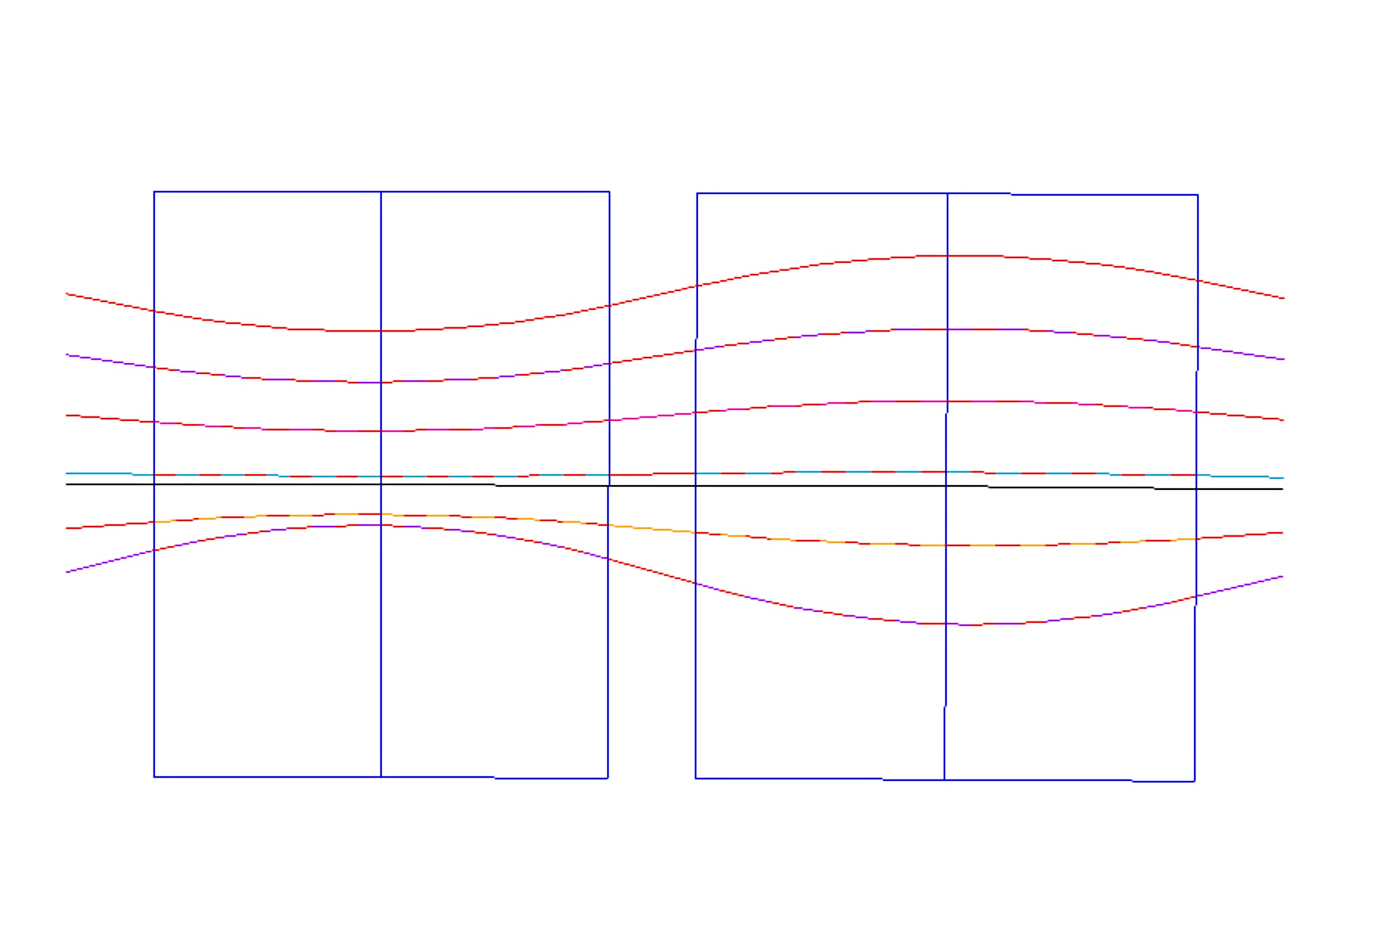
NS-FFAG Cell 2.5-15 GeV, 6 passes
B_{Do} = 0.07779 T,
G_{D} = -24.977 T/m
x_{Doffset}=+3.11 mm
B_{Fo}= 0.07779T,
G_{F} = 28.396T/m
x_{Foffset}= -2.74mm
KSF= 49.252
KSD=-91.923
x(mm)
B_{Dmax,min}=[0.263,-0.167] T
B_{Fmax,min} =[0.61,-0.15] T
B_{D}=B_{Do} + G_{D}•x + ½ B”•x²
B_{F}=B_{Fo} + G_{F}•x +1/2B”•x²
BD
QF
15 GeV
D-Quad center
10
12.5 GeV
13.1
10 GeV
9.8
6.7
15.84
F-Quad center
7.5 GeV
9.7
0
-7.4
E_{CEN}=7.0 GeV
5 GeV
-8.0
2.5 GeV
-5.26
-10
-17.0
ρ_{D}=300.15 m
ρ_{F}= 300.15 m
θ_{D}=3.49 mrad
θ_{F}=3.83mrad
20 cm
1.047 m
20 cm
1.15m
20 cm
L = 2.797 m

