Slide 1
RHIC and its EIC Future
Michiko Minty
Brookhaven National Laboratory

Slide 2

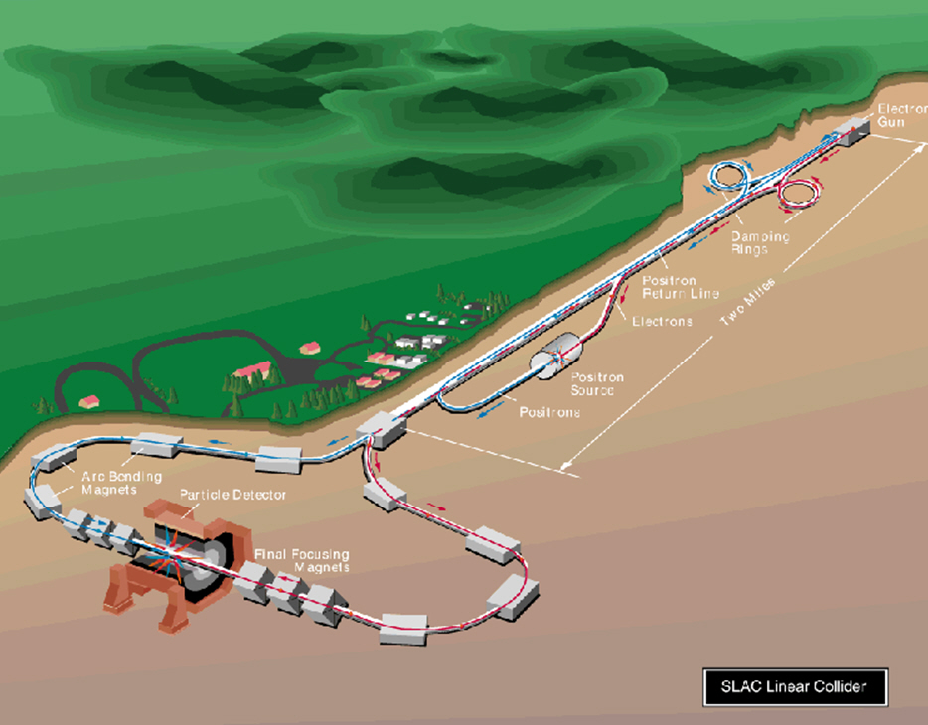
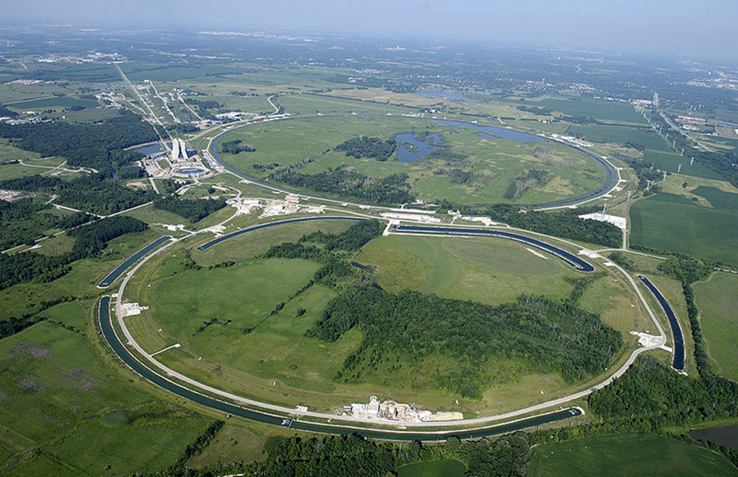
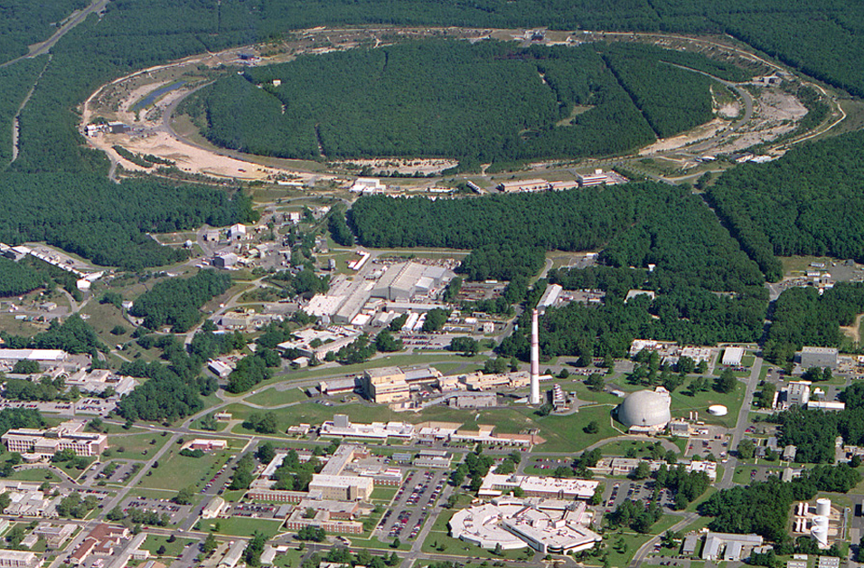
High Energy Colliders in the US
The Relativistic Heavy Ion Collider (RHIC)
is now the only high energy collider in the Americas
is the only high energy polarized proton collider in the world
Stanford Linear Collider (1989 – 1998)
2 miles
0.75 miles
1.2 miles
TeVatron (1987 – 2011)
RHIC (>2001)

Slide 3
RHIC and its EIC Future
Overview of RHIC facility
Electron Ion Collider
(Select)Technology Developments
Summary and Outlook

Slide 4
Timeline of RHIC
The 1983 NSAC (Nuclear Science Advisory Committee) Long Range Plan included a relativistic heavy ion collider as the highest priority new facility
In 1990 the idea of a polarized proton collider was first discussed at the 1990 Polarized Collider Workshop
RHIC construction started in 1991
First beam in RHIC tunnel (sextant test) in 1998
RHIC commissioning started in 1999
First gold-gold collisions on June 12, 2000
Reached RHIC gold-gold design luminosity in 2001
First polarized proton collisions in RHIC in 2001
RHIC running time is shared between heavy ion collisions and polarized proton collisions
RHIC 20th anniversary celebrated just last month!

Slide 5
The RHIC Accelerator Complex
Polarized Jet Target
Electron lenses
(PHOBOS)
RHIC
Electron cooling
(BRAHMS)
(s)PHENIX
RF
STAR
LINAC
EBIS
Booster
AGS
Tandems
Collider with two independently powered 3.8 km superconducting rings (~1750 SC magnets) that allows gold-gold, proton-gold, and proton-proton collisions at equal energies up to 100 GeV. Proton-proton collisions up to 250 GeV.
Six interaction regions and initially instrumented with four detectors: STAR, PHENIX, PHOBOS, BRAHMS.
Center for Bright Beams Symposium 2020

Slide 6
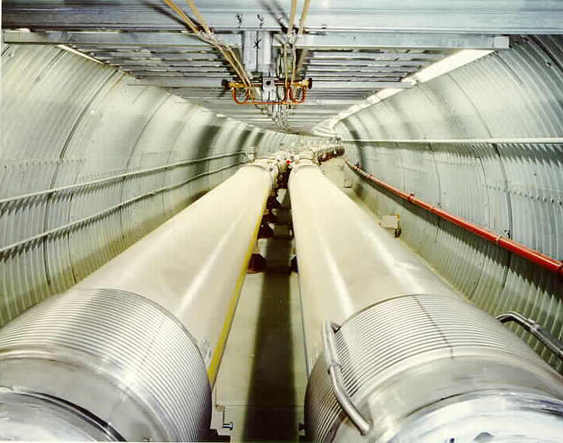
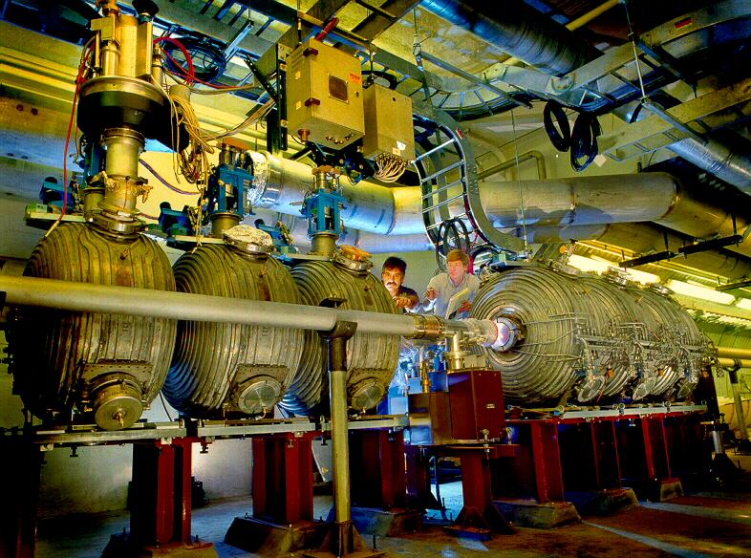
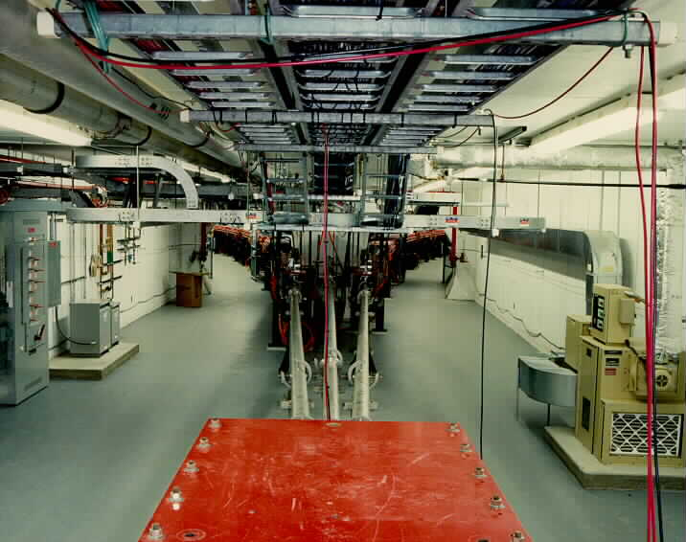
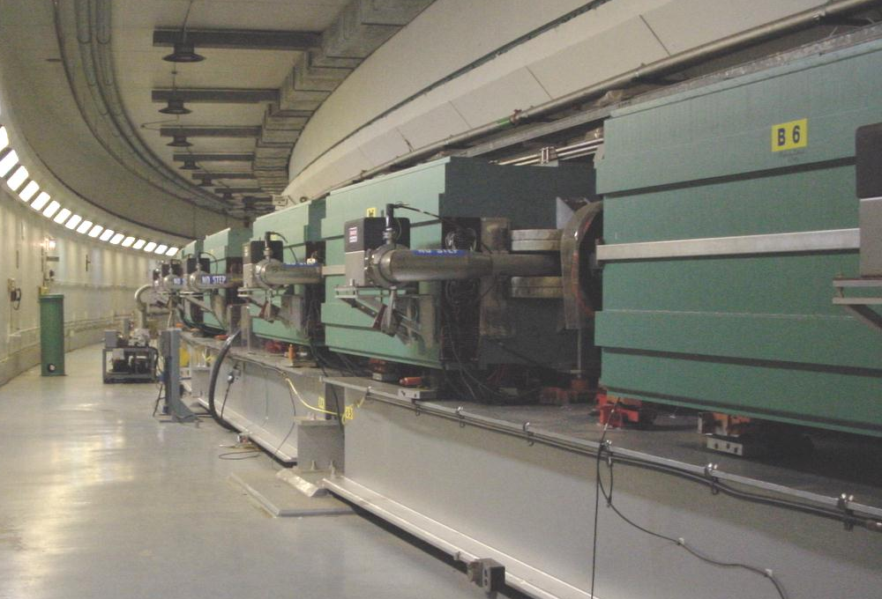
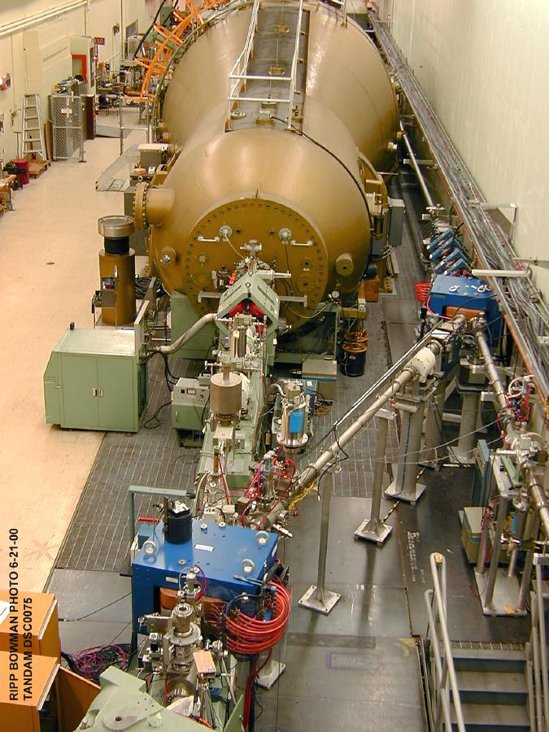
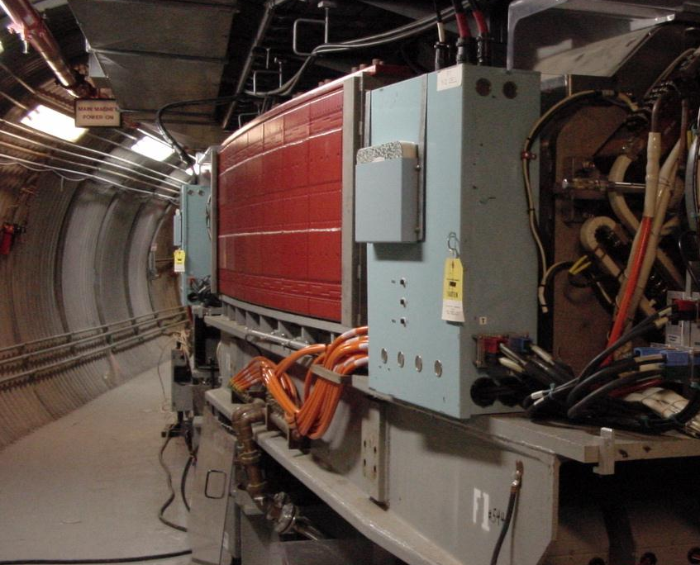
Gold Ion Collisions in RHIC
Beam Energy = 100 GeV/u
RHIC
9 GeV/u
Q = +79
BOOSTER
AGS
TANDEMS
1 MeV/u
Q = +32

Slide 7
RHIC – First Polarized Proton Collider
Two full Siberian snakes per ring preserve proton polarization to 255 GeV
Spin direction control at detectors with spin rotators
Minimally invasive polarimeters; also measure polarization profiles
Absolute polarimeter using an intense polarized H jet
Absolute Polarimeter (H↑ jet)
pC Polarimeters
Spin Flipper
Siberian Snakes
Siberian Snakes
PHENIX
STAR
Spin Rotators
(longitudinal polarization)
Spin Rotators (long. pol.)
LINAC
5.9% Helical Partial
Siberian Snake
BOOSTER
Pol. H⁻ Source
AGS
200 MeV Polarimeter
pC Polarimeter
10-25% Helical Partial Siberian Snake

Slide 8
RHIC history and future
Technology to be applied in EIC
RHIC commissioning era (2000 to 2002)
first full energy (100 GeV/n) heavy ion runs, first 100 GeV polarized proton run
RHIC-I era (2003 to 2013)
first full energy (250 GeV) polarized proton runs
new technology: stochastic cooling proof-of-principle (2007)
new technology: high intensity electron beam ion source, EBIS (>2010)
RHIC-II era (2014 to 2016)
new technology: 3D stochastic cooling (>2014)
new technology: high intensity polarized ion source, OPPIS (>2015)
new technology: electron lenses for head-on beam-beam compensation (>2015)
new technology: superconducting rf cavity used in operations (>2016)
RHIC today (2017+)
new technology: low energy electron cooling (2017-2021)
physics operations with detector upgrade, sPHENIX (>2022)
Future electron-ion collider, EIC

Slide 9
RHIC and its EIC Future
Overview of RHIC facility
Electron Ion Collider
development timeline
key parameters
how RHIC is transformed into an EIC (overview)
how RHIC is transformed into an EIC (detail)
(Select)Technology Developments
Summary and Outlook

Slide 10
Timeline of the EIC
EIC White Paper (The Next QCD Frontier – Understanding the Glue that Binds us All) released in 2012. Commissioned by BNL and JLab as a follow-up to the 2007 NSAC Long Range Plan.
Two approaches were pursued (JLEIC at JLab, eRHIC at BNL)
The 2015 NSAC Long Range Plan recommended a high-energy, high-luminosity polarized EIC as the highest priority for a new facility construction following the completion of FRIB.
Pre-Conceptual Design Reports (pCDR) drafted in 2018 and evaluated together with scope and cost reviews in 2019.
Critical Decision 0 (CD0, “mission need”) for an EIC approved by the DOE in Dec, 2019 (enables work to begin on R&D and on the CDR).
Site decision made by DOE in Jan, 2020 for hosting the EIC at BNL in strong partnership with JLab
Next milestone is release of Conceptual Design Report (CDR) and CD1 (to allow release of Project Engineering and Design funds)

Slide 11
Key parameters of the EIC
Highly polarized (70%) electron and light ion beams
Ion beams from deuteron to the heaviest nuclei (U, Pb)
Variable center of mass energies from 20 to 100 GeV upgradable to 140 GeV
High luminosity of 10³³-10³⁴ cm⁻²s⁻¹
More than one interaction region possible

Slide 12
Maximum Luminosity (10³⁴/cm²s) Parameters
Parameter | Units | Proton | Electron
Energy | GeV | 275 | 10
Beam Current | Amperes | 1.0 | 2.5
Particles per bunch | 10¹⁰ | 6.9 | 17.2
Number of bunches |  | 1160 | 1160
Horizontal emittance | nm | 11.3 | 20.0
Vertical emittance | nm | 1.0 | 1.3
Hor/Ver beta at IP | cm | 80/7.2 | 45/5.6
Hor/Ver beam size at IP | μm | 95/8.5 | 95/8.5
Hor/Ver angular spread at IP | μrad | 119/119 | 211/152
Bunch length (rms) | cm | 6 | 2
Hor/Ver beam-beam parameter |  | 0.012/0.012 | 0.072/0.100
IBS growth time (Long/Hor) | hours | 2.9/2.0 | [na]

Slide 13
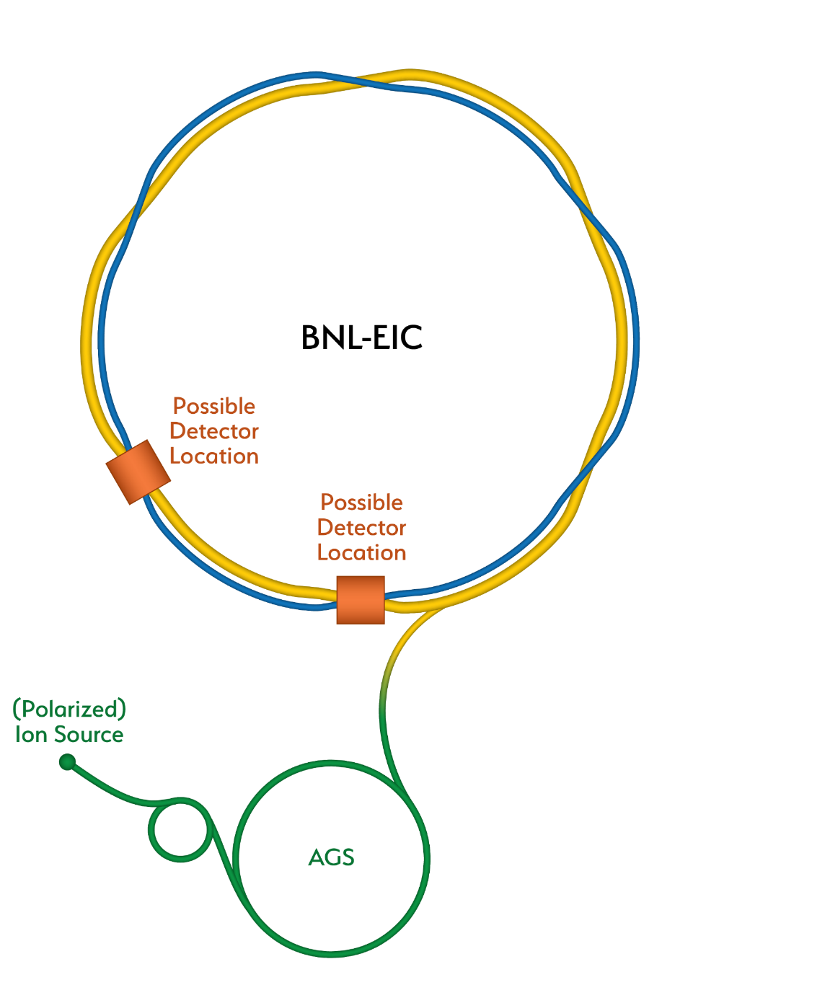
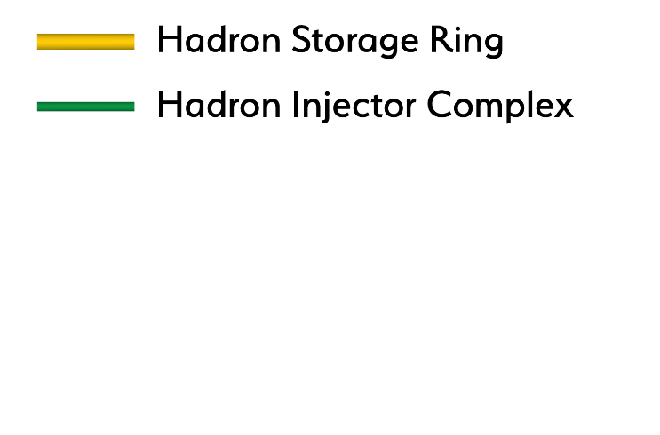
How RHIC is transformed into an EIC
Existing RHIC with blue and yellow rings

Slide 14
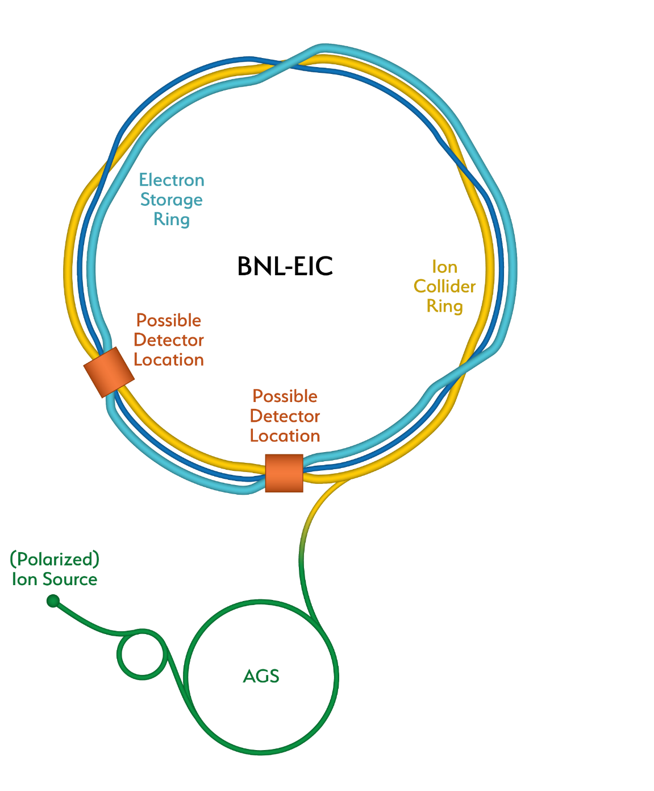
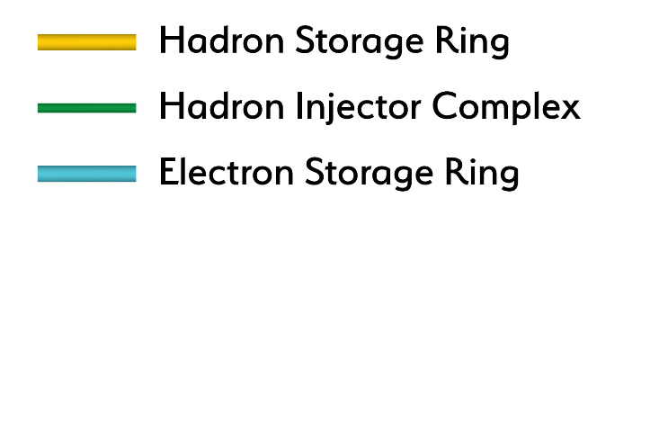
How RHIC is transformed into an EIC
Add electron storage ring

Slide 15
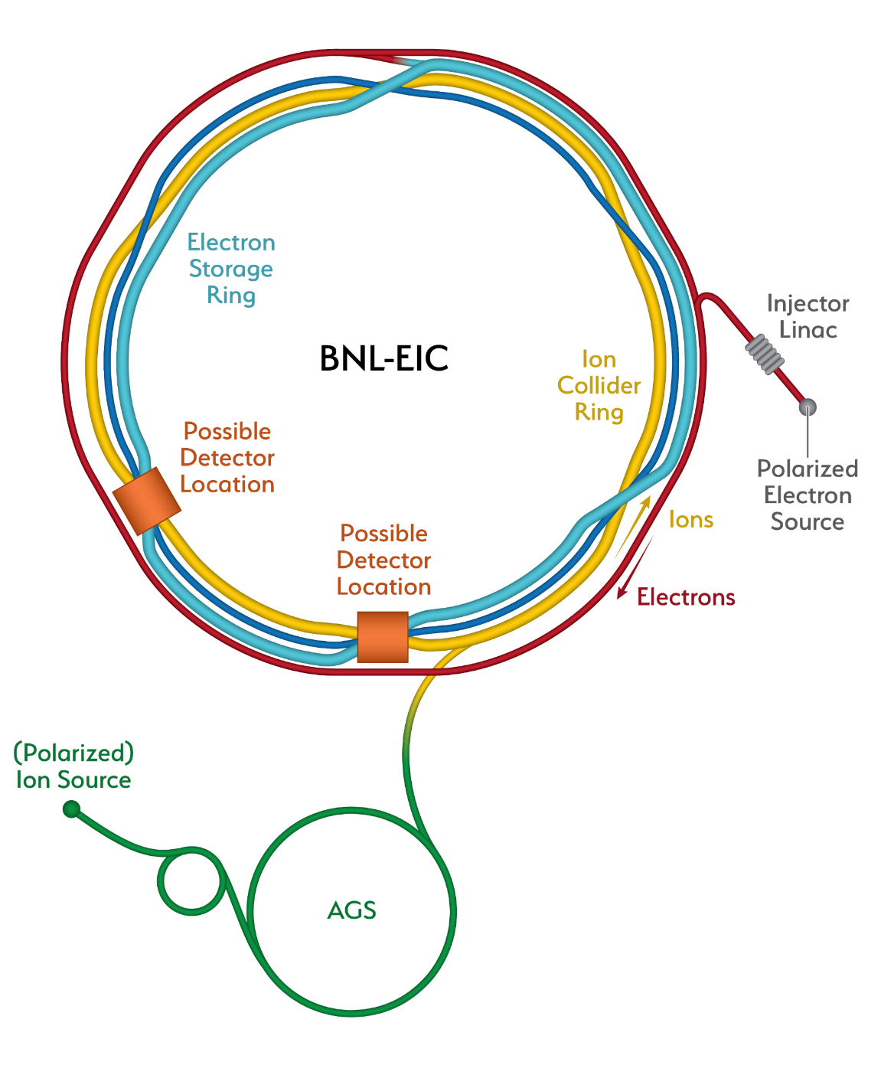
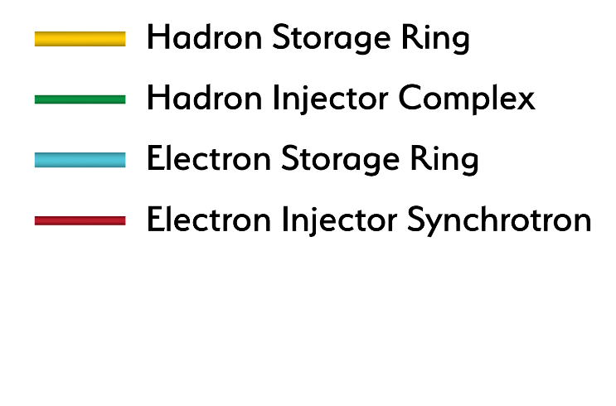
How RHIC is transformed into an EIC
Add an electron injector complex with Rapid Cycling Synchrotron

Slide 16
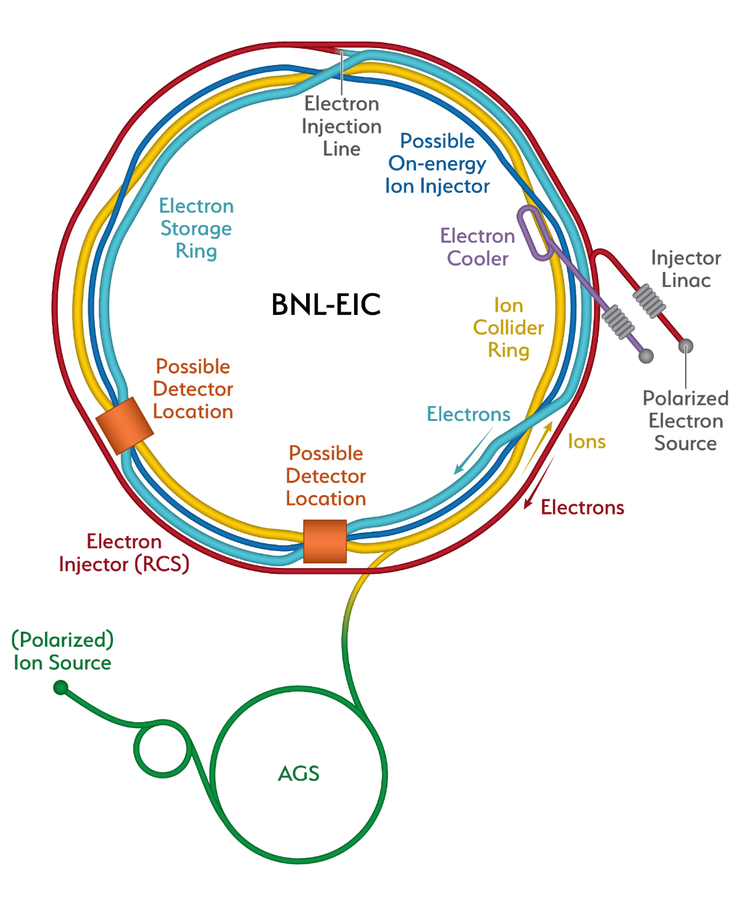
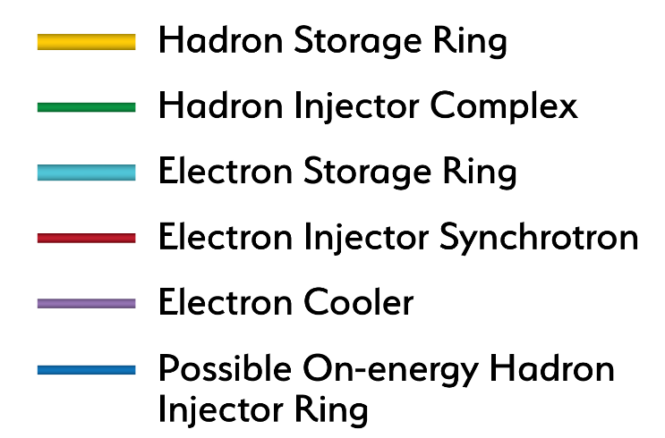
How RHIC is transformed into an EIC
Strong hadron cooling completes the facility
Alternate solution also shown using RHIC blue ring

Slide 17
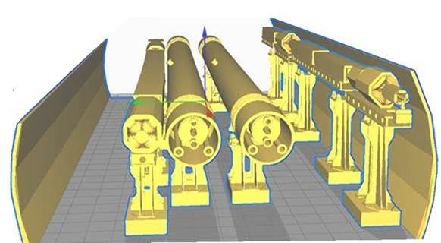
Cross-sectional view of the EIC tunnel
  Electron Storage Ring (eSR)
  Electron Injector Synchrotron (Rapid Cycling Synchrotron, RCS)
  Two detector halls available
eSR
RHIC
RCS
Existing
RHIC
tunnel
~ 5 m

Slide 18
Electron Storage Ring
Energy range, E = 2.5 – 18 GeV (beam injected at full energy)
11 superconducting 2-cell 591 MHz RF cavities
Design challenge: maintain electron beam emittance at all energies (~ 20 nm)
flexible design of magnetic lattice design comprising six FODO arcs with
adjustable proper phase advance:
90º /cell at E=18 GeV
60º /cell for E= 2.5-10 GeV plus radial shift and/or ‘super-bend’ lattice
Design challenge: 70% average polarization and fully flexible spin patterns
- polarized electron source and polarization-preserving pre-accelerators
- solenoid-based spin rotators
- bunch replacement at 1Hz (330 bunches in 5.5 minutes) to avoid stochastic
depolarization (Derbenev-Kondratenko)

Slide 19
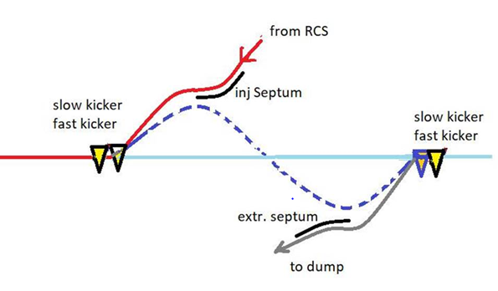
Bunch replacement
In the electron storage ring, single bunches will be replaced at a 1Hz rate
Replacing a 28 nC bunch requires accumulation of 7nC bunches in the RCS
Fast extraction kicker on top of slow bump to extract a single bunch

Slide 20
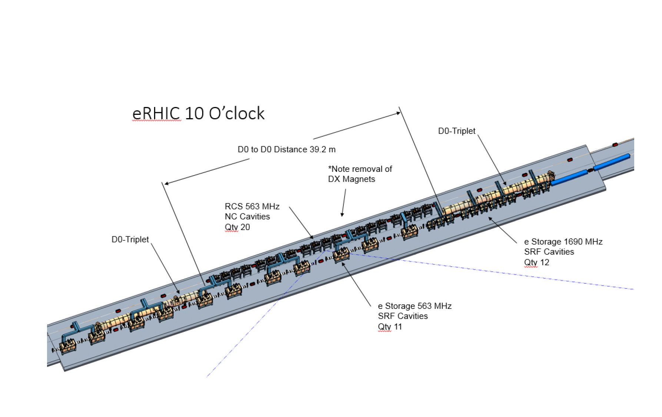
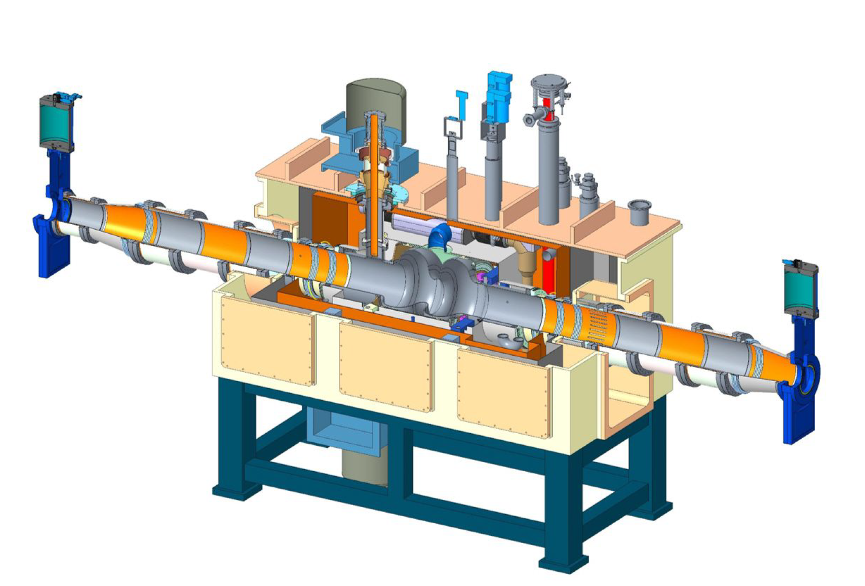
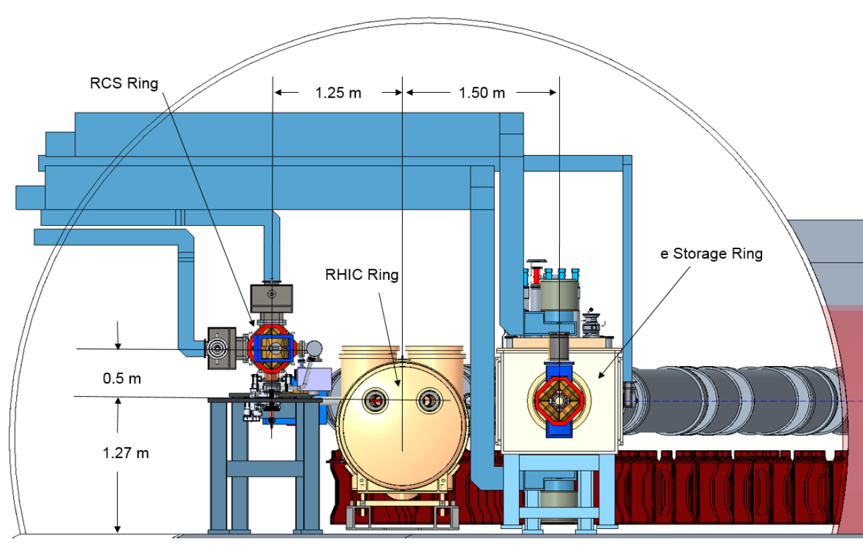
Superconducting RF cavities in the Electron Storage Ring

Slide 21
Electron Injector Synchrotron, RCS
Full energy injector for the electron storage ring
Energy range (at extraction), E = 2.5 – 18 GeV
Design challenge: preserve electron beam polarization during acceleration
spin-transparent, rapid-cycling synchrotron (RCS)

Slide 22
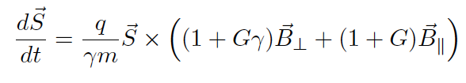
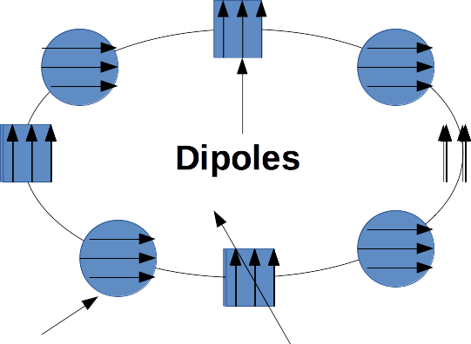
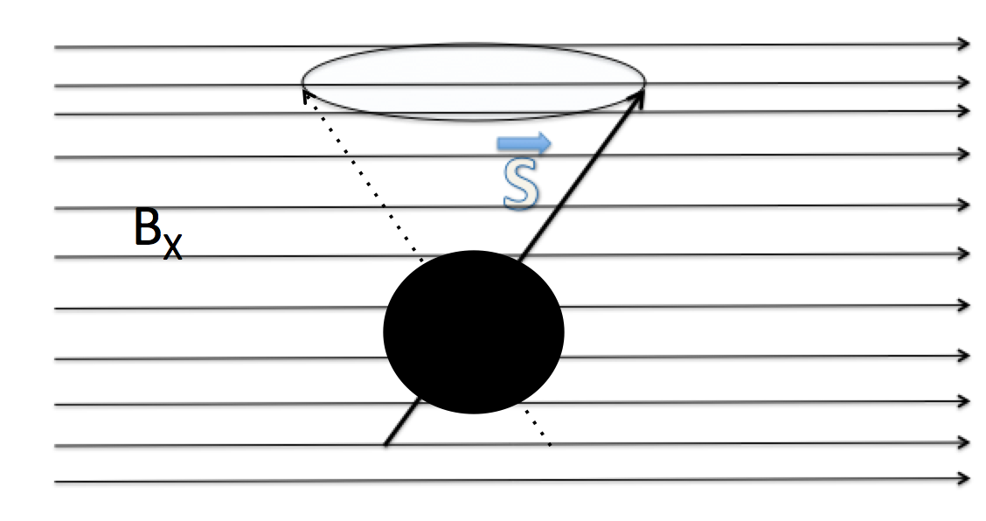
Spin Resonance Review
Thomas-BMT equation
S is the spin vector, G is the electron gyromagnetic anomaly
Quadrupole
Spin resonance conditions (n is an integer, P is lattice periodicity, Q is the betatron tune)
Imperfection resonances Gγ = nP due to dipole rotations, quadrupole misalignments
Intrinsic resonances Gγ = nP +/- Q due to (primarily) vertical betatron motion

Slide 23
RCS design: Spin Resonance Free Lattice
Imperfection resonances Gγ = nP
Intrinsic resonances Gγ = nP +/- Q
Acceleration from 400 MeV to 18 GeV (max): 0.9 < Gϒ < 41
By design of a lattice with periodicity P=96 and an integer betatron tune Q of ~50:
the strongest imperfection resonance occurs at Gγ = 96 – 50 = 46
the strongest intrinsic resonances occur at
Gγ = 50 +/- dQ (n=0)
Gγ = 96 +/- (Q+dQ) = 46 – dQ (n = 1)
dQ is the fractional betatron tune
With this lattice design, highest-order spin resonances are avoided.

Slide 24
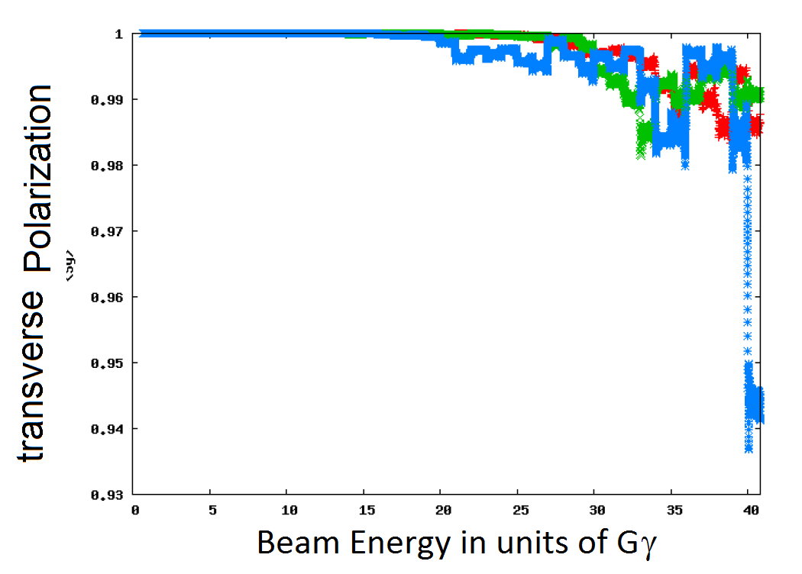
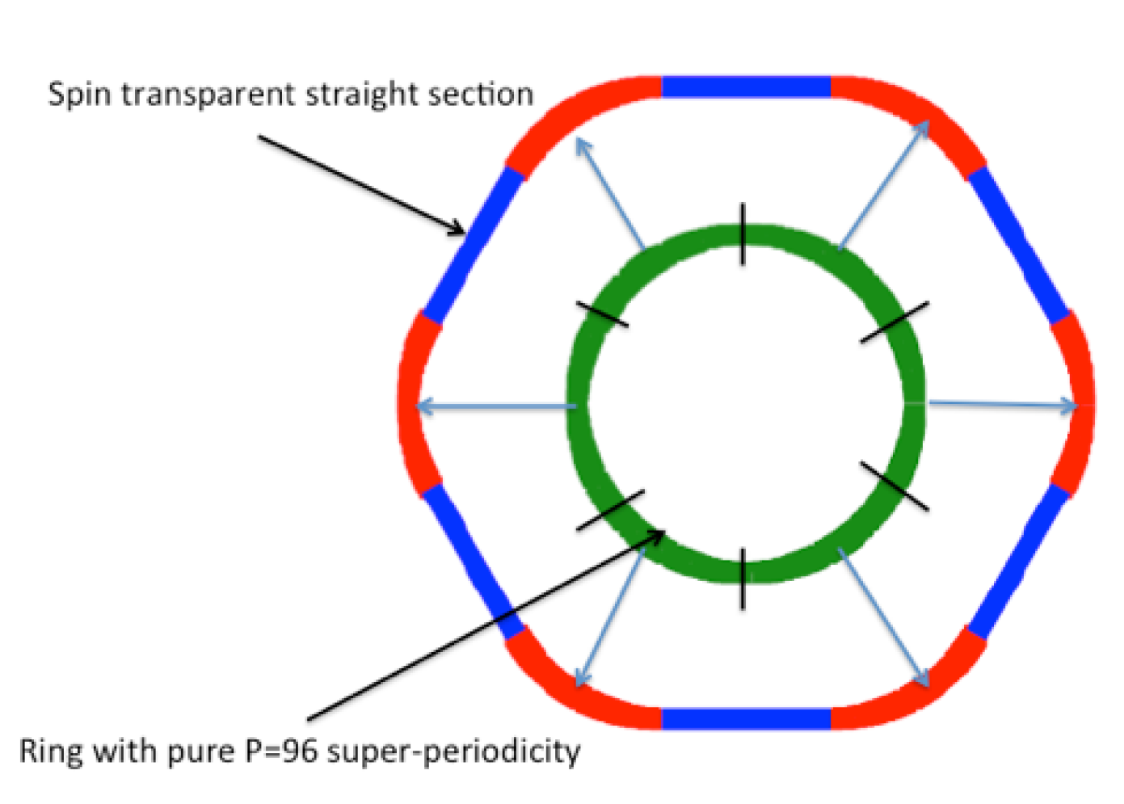
RCS Polarization
High Quasi-symmetry
➔ Good spin transparency properties
Simulated polarization transmission efficiency vs acceleration cycle duration (‘ramp’)
200 ms ramp

Slide 25
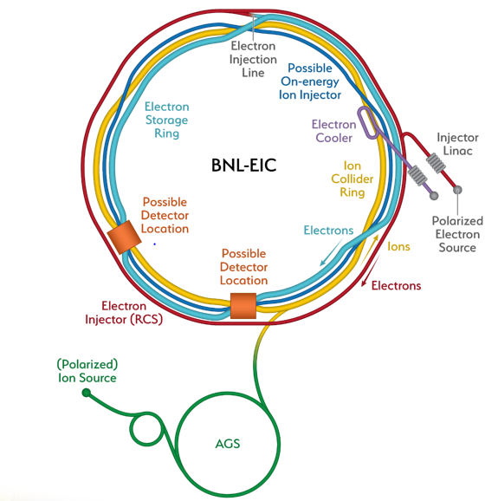
Strong Hadron Cooling
Two options
Coherent electron cooling with FEL amplifier or micro-bunching amplifier
Full on-energy injection with conventional electron cooling using the second (unused) RHIC storage ring

Slide 26
Coherent Cooling with FEL amplifier
E < E_{h}
E_{h}
E < E_{h}
Dispersion section
( for hadrons)
E > E_{h}
E_{h}
λ
Hadrons
Modulator
E > E_{h}
Kicker
High gain FEL (for electrons)
Electrons
cooling of high energy Hadron beams with high band-width, ~ 1THz
short cooling times to balance strong intra-beam scattering

Slide 27
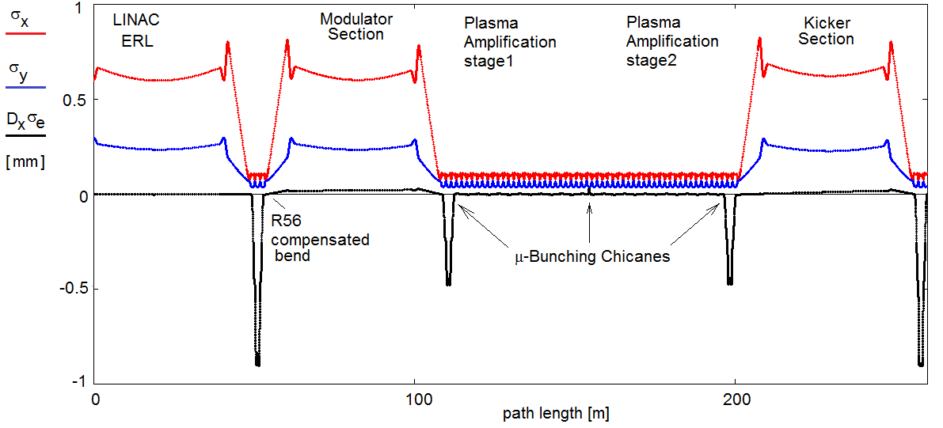
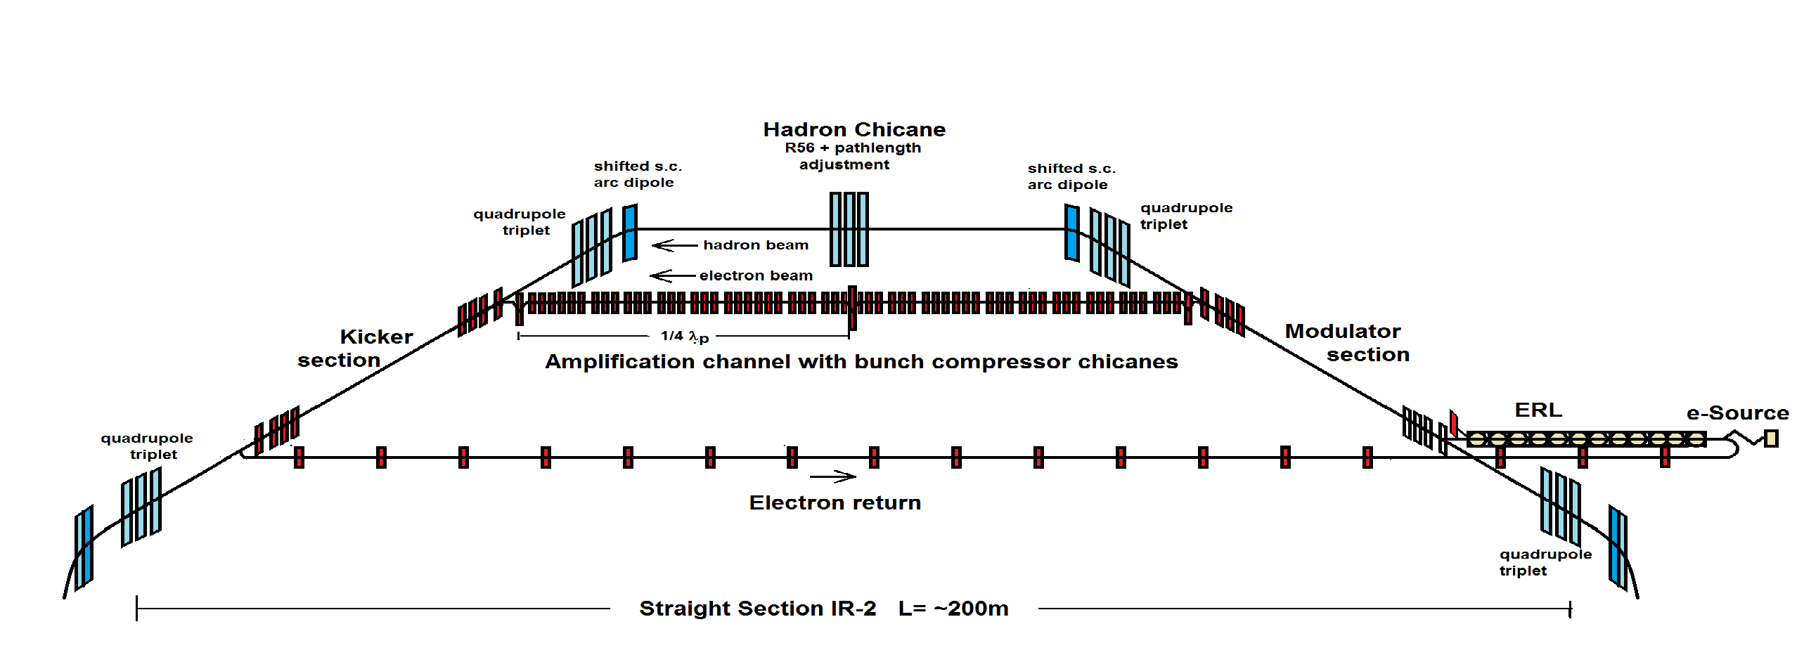
EIC Strong Hadron Cooling
Coherent Electron Cooling with μ-bunching amplification
Electron Beam Optics
Design Cooling Rate R_{cool}= 2h⁻¹
Electron beam current I_{e}=100 mA (1nC/bunch)
Relativistic factor γ = 293
ε_{xyN}= 2.5/0.5μm

Slide 28
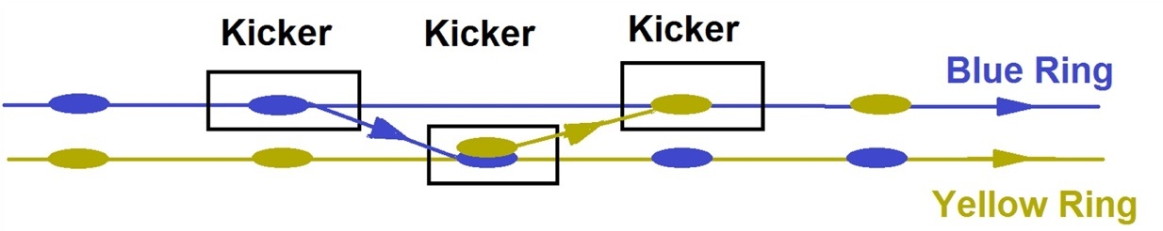
Frequent on-energy injection (FOEI)
Strong cooling as desirable but not necessary for high luminosity (especially high average luminosity) by using the existing second (Blue) ring, with conventional electron cooling, as a full-energy injector.
Bunch replenishment is accomplished using a series of kickers to simultaneously extract bunch(es) from the main (Yellow) hadron ring into the other (Blue) hadron ring while injecting bunches from the Blue ring into the Yellow ring.

Slide 29
RHIC and its EIC Future
Overview of RHIC facility
Electron Ion Collider
(Select) Technology Developments
bunched-beam stochastic cooling
coherent electron beam cooling
bunched beam electron cooling
polarized electron source
Summary and Outlook

Slide 30
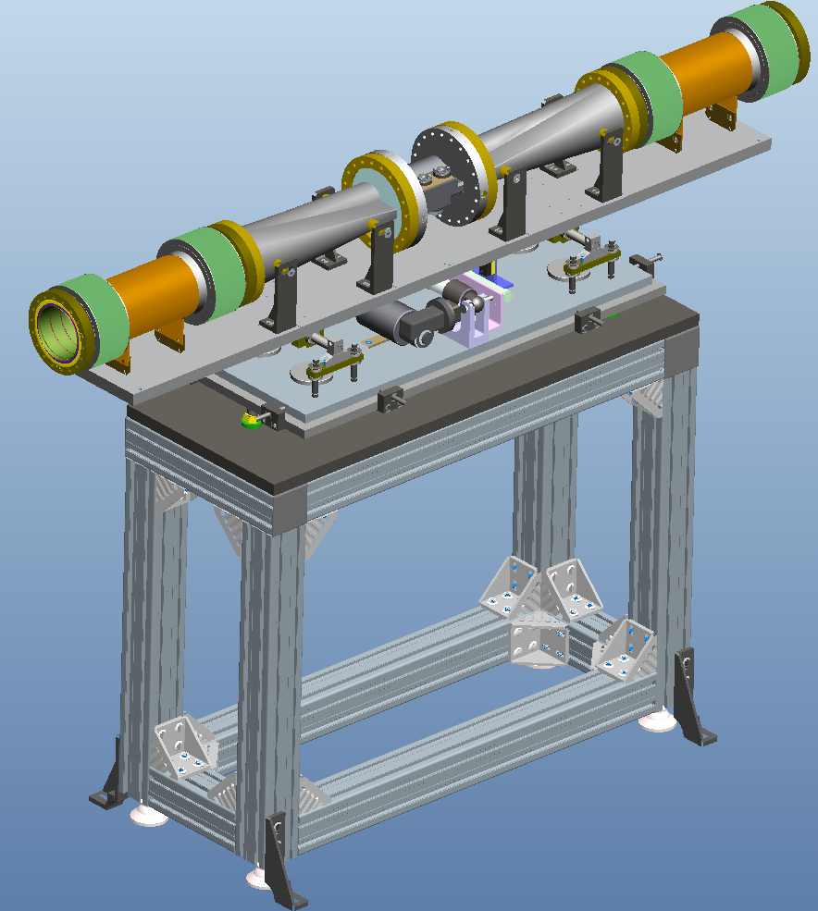
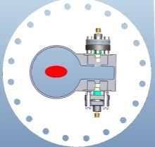
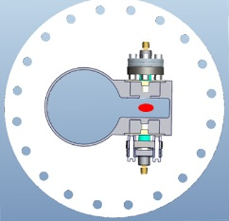
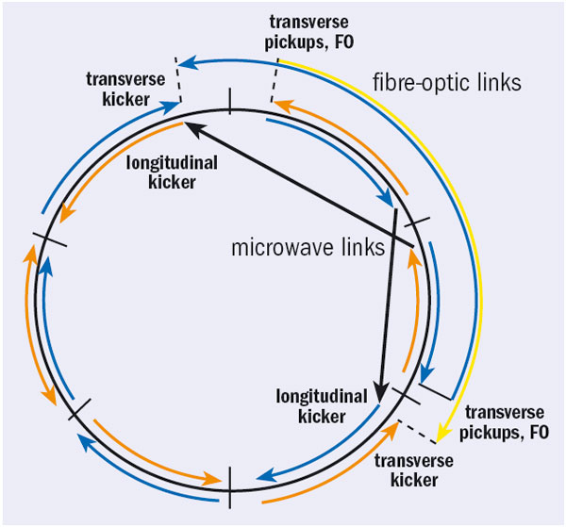
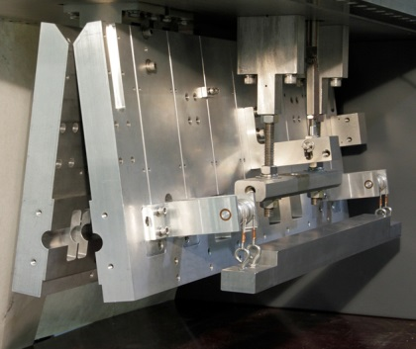
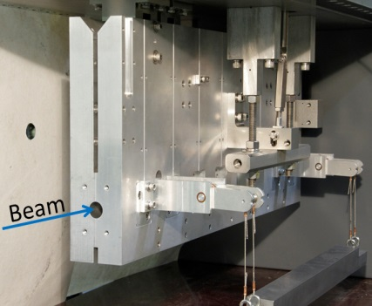
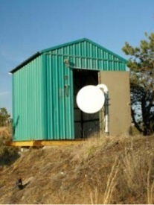
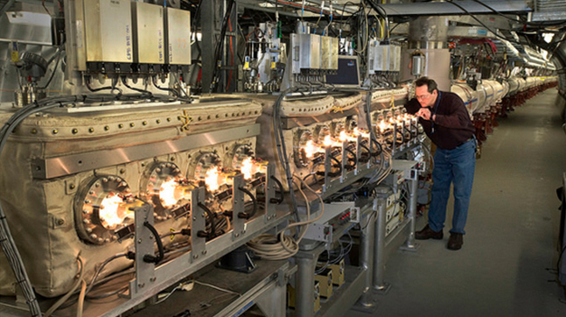
Accelerator Technology: 3D stochastic cooling for heavy ions
Motivation: counteract intrabeam scattering (IBS) and cool beam distributions for higher luminosity
pickups
kickers
3 GHz bandwidth, cooling times ~1 h
M. Blaskiewicz, J.M. Brennan and F. Severino, Operational stochastic cooling in the Relativistic Heavy Ion Collider, PRL 100, 174802 (2008)
M. Blaskiewicz, J.M. Brennan and K. Mernick, Three-Dimensional Stochastic Cooling in the Relativistic Heavy Ion Collider, PRL 105, 094801 (2010)

Slide 31
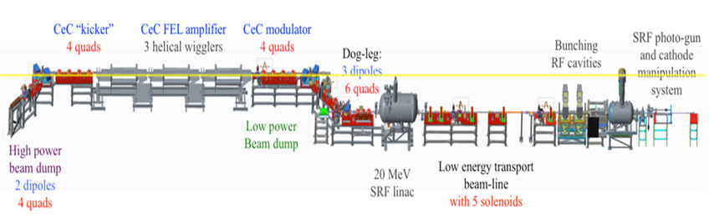
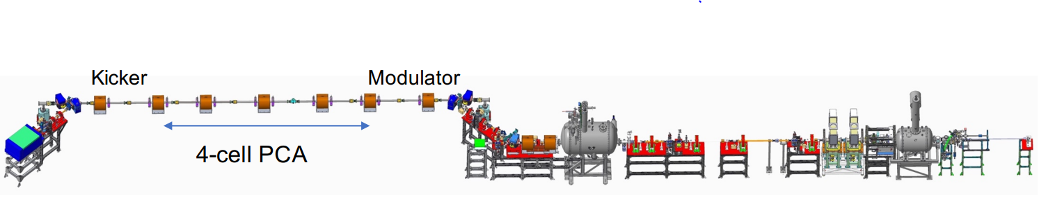
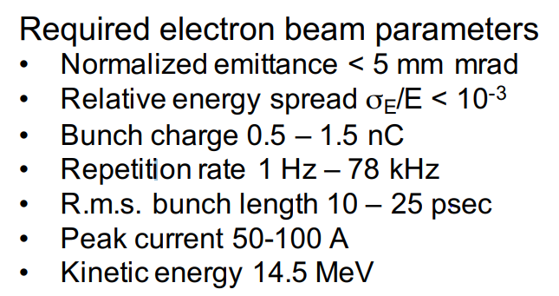
Technology: Coherent electron Cooling
< 2019, FEL-based cooling channel
Courtesy: V. Litvinenko and coworkers
2019+, PCA-based cooling channel
Electron beam parameters demonstrated 7/14/20
V. N. Litvinenko, Y.S. Derbenev, Coherent electron Cooling, PRL 102, 114801 (2009)

Slide 32
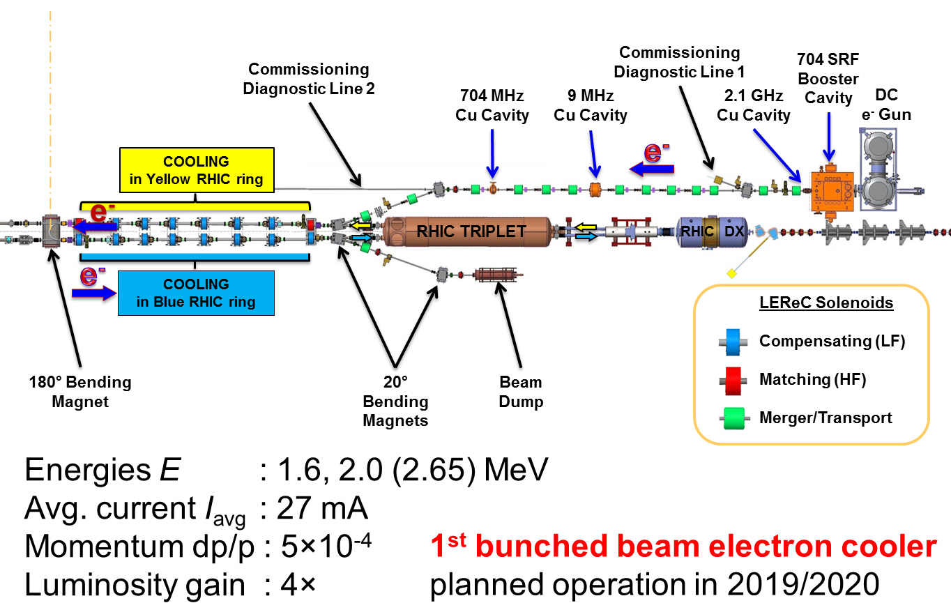
Technology: Bunched-Beam electron Cooling

Slide 33
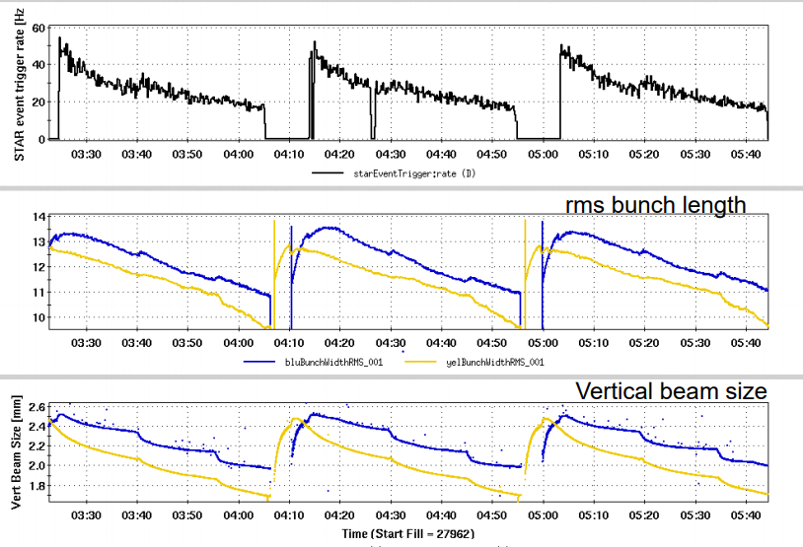
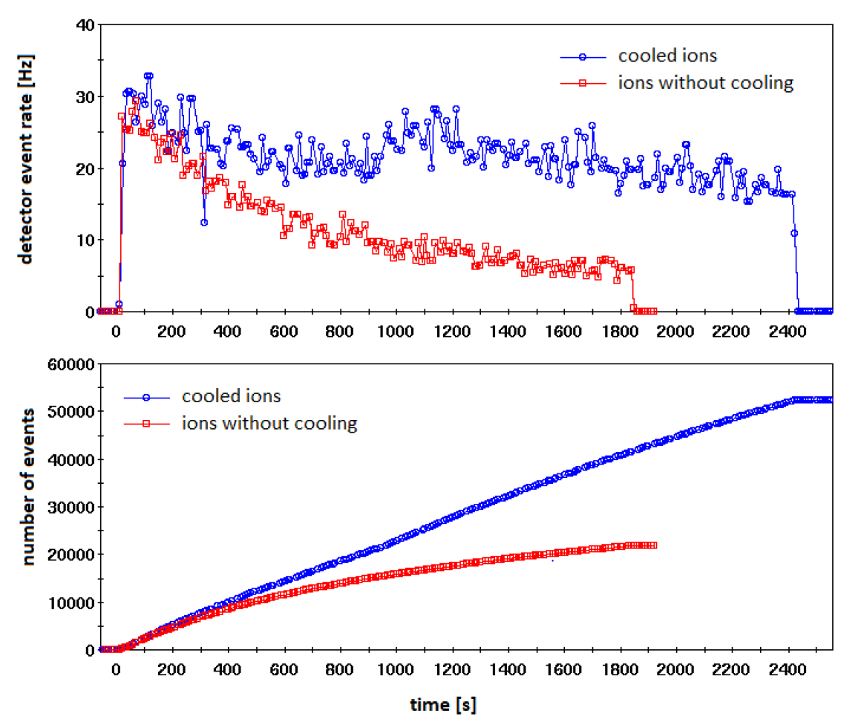
Bunched-Beam electron Cooling at RHIC
detector event rate
Bunched-beam electron cooling used now in routine operation at RHIC in support of the Basic Energy Sciences Program at BNL
After FY21 RHIC Run, facility will be converted for high-current injector studies for the EIC
A. Fedotov, Experimental demonstration of hadron beam cooling using radio-frequency accelerated electron bunches, PRL 124, 084801 (2020)

Slide 34
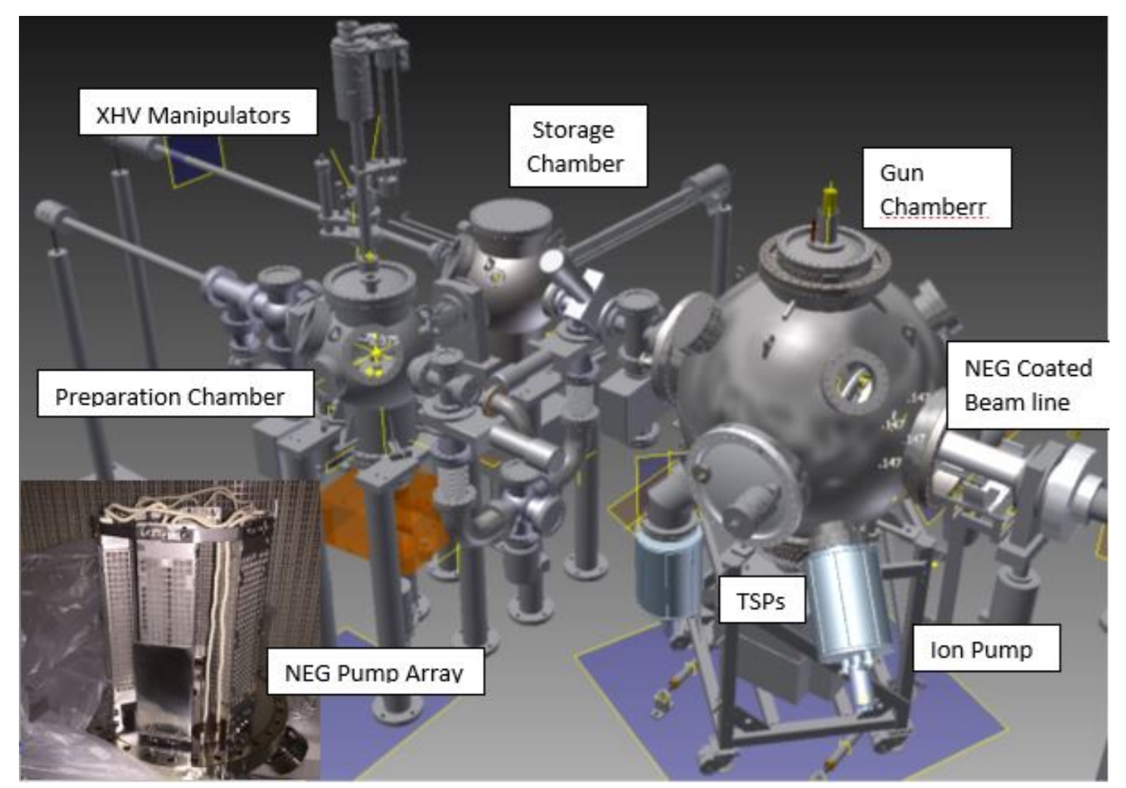
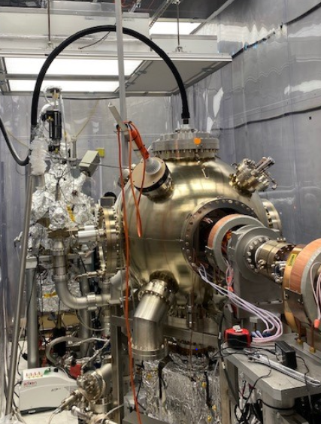
Technology: Polarized Electron Source
5-10 nC/bunch at 1-2 Hz repetition frequency
based on the JLAB inverted gun
XHV vacuum requirements (<10⁻¹² Torr)
In development at Stony Brook University
achieved mid-10⁻¹² Torr
first beams expected in August, 2020
planned R&D: cathode development and quantum efficiency lifetime

Slide 35
Overview of RHIC facility
Electron Ion Collider
development timeline
design concept and key parameters
how RHIC is transformed into an EIC (overview)
how RHIC is transformed into an EIC (detail)
(Select) Technology Developments
Summary and Outlook

Slide 36
Summary and Outlook
RHIC is the first heavy ion collider and also the first and only high energy polarized proton collide.
Over the last 20 years RHIC has been operated with unparalleled flexibility in collision energy and ion species from protons to Uranium.
The science case / mission need (CD-0) for an Electron-Ion Collider was approved by the DOE in Dec, 2019 with BNL chosen as host in Jan, 2020.
The next EIC milestone is completion of the CDR
Major technological advances in particle sources and beam cooling have been demonstrated and will be used at the EIC.

Slide 37
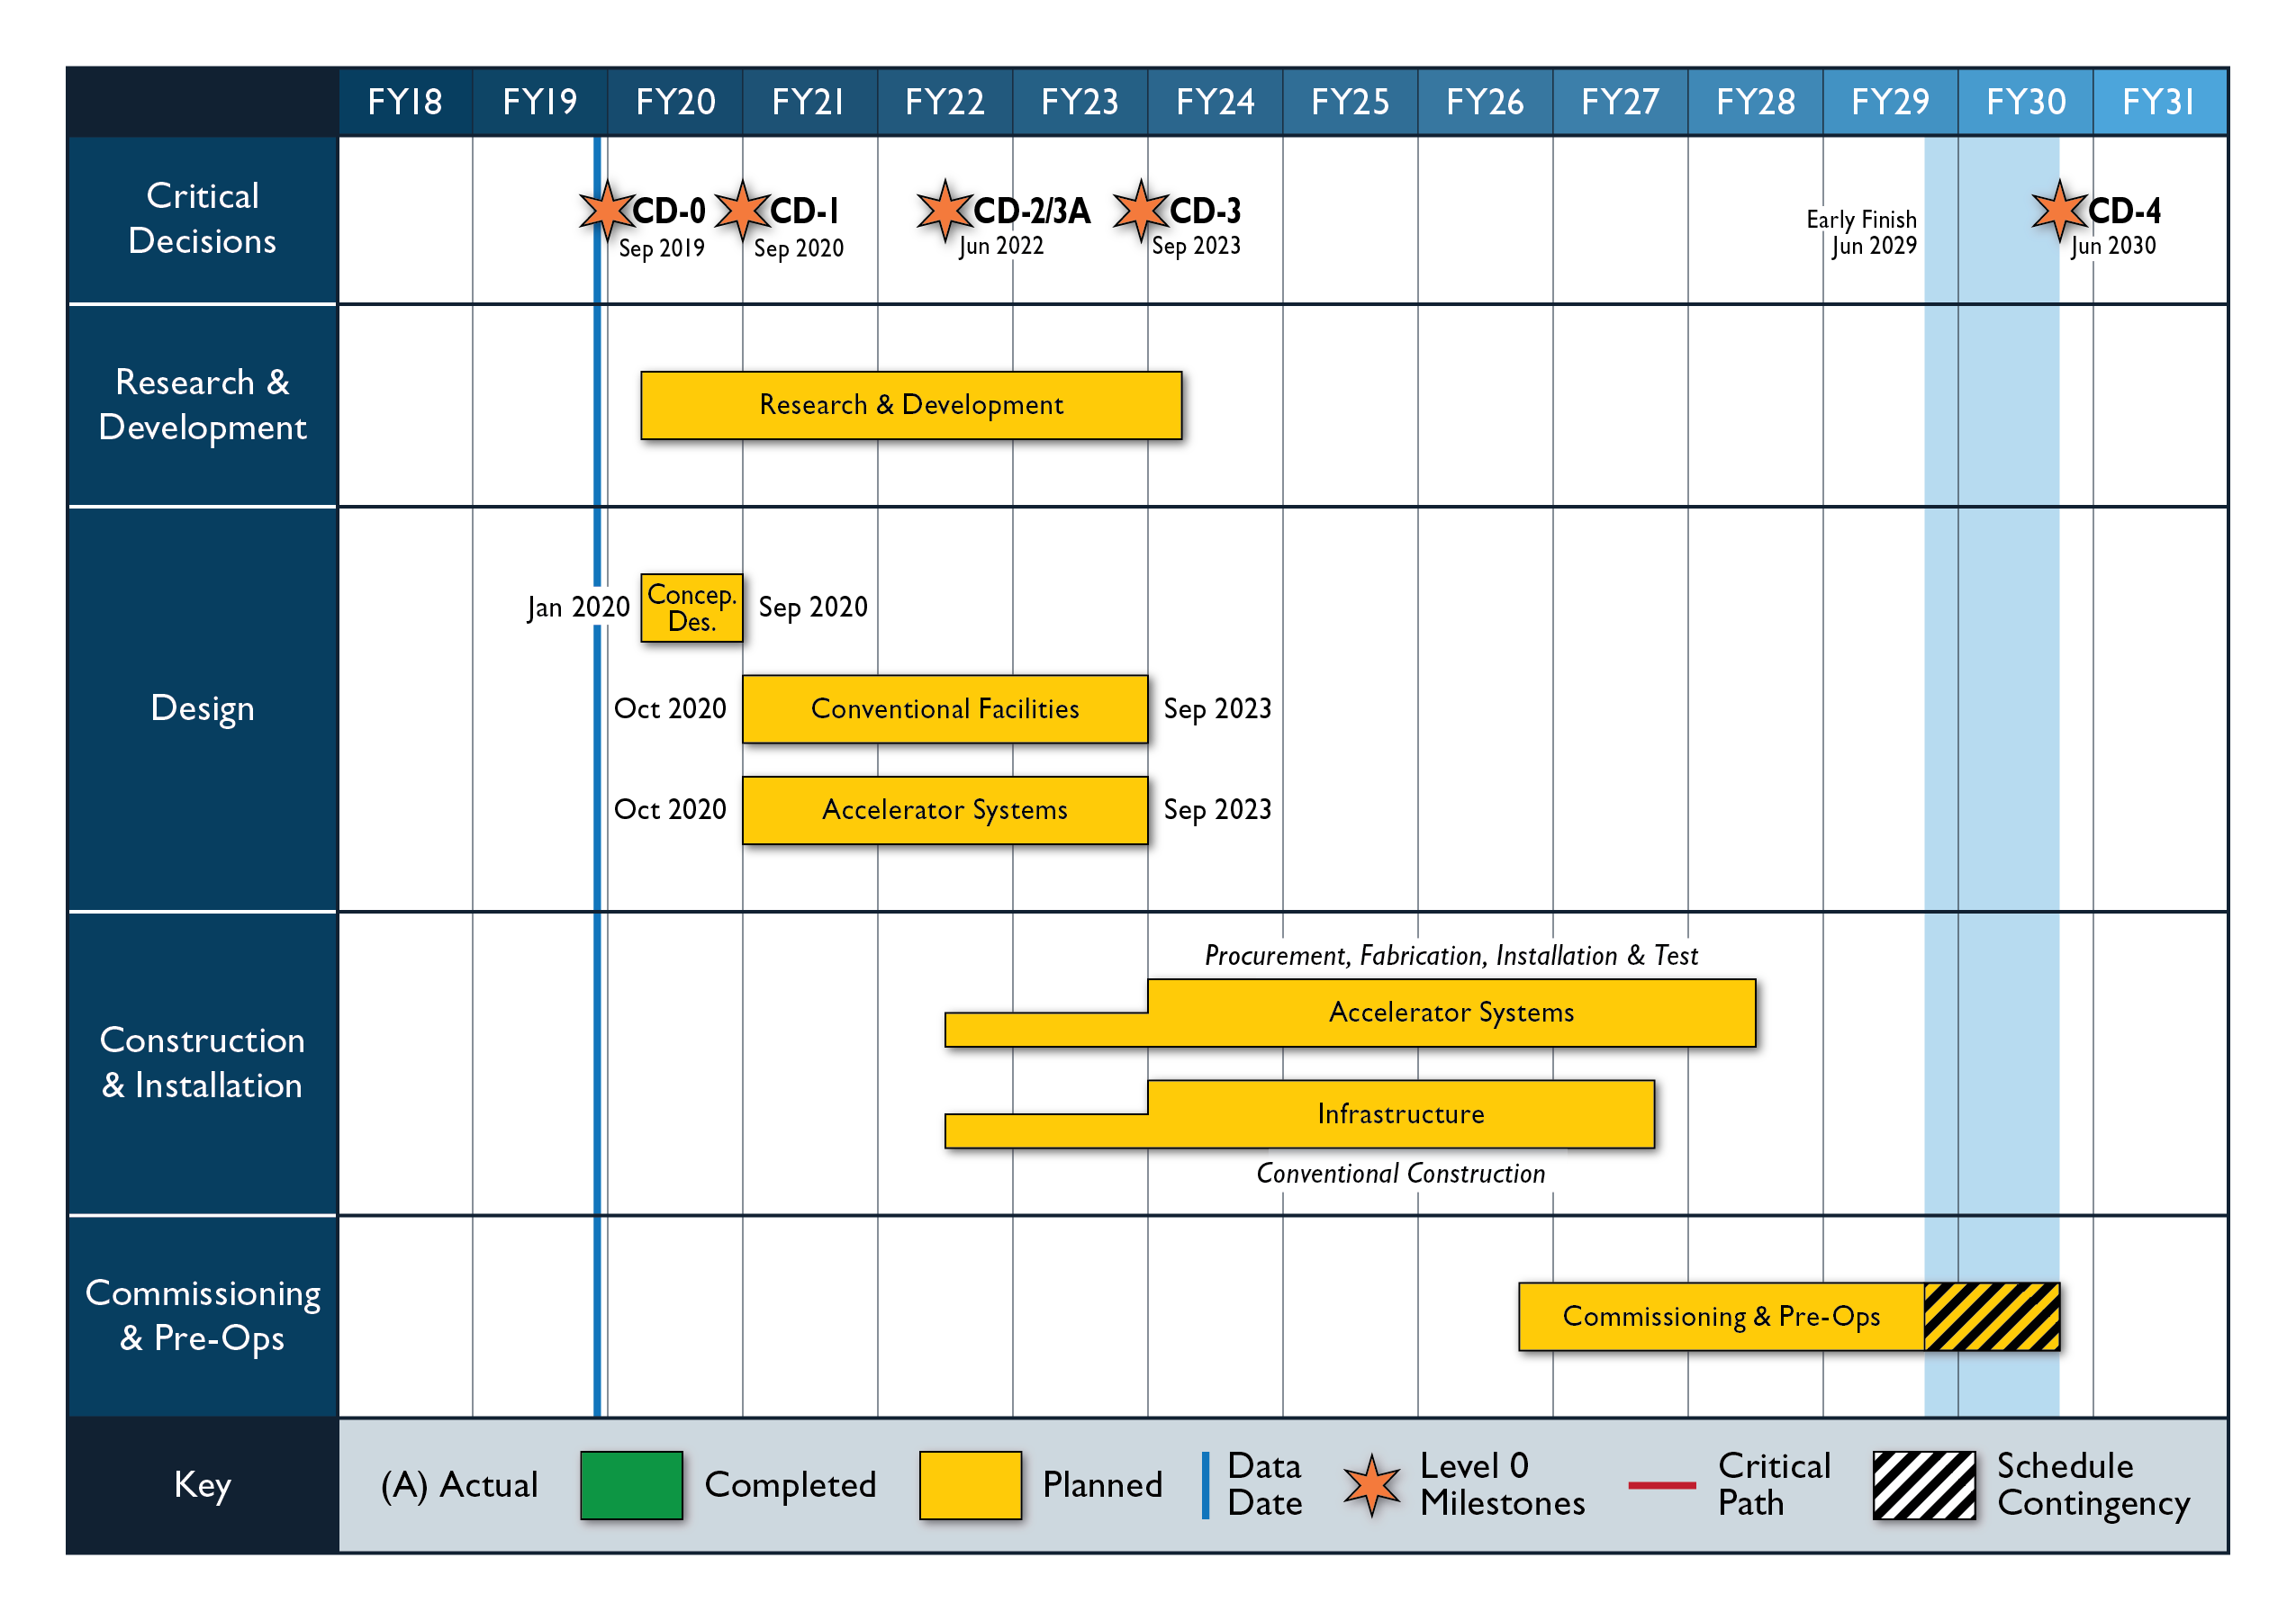
Schedule
RHIC
Beam Energy Scan
Commissioning and operations
sPHENIX
EIC schedule is technically driven
EIC
Operations
Access to RHIC tunnel
All work planned to early finish – June 2029
One year of float to CD-4

Slide 38

Acknowledgement and Thanks
Thank you to everyone in the C-AD department whose collective accomplishments are presented here!
Thank you to those who have supported our efforts through many external reviews!
And thank you to All for your attention!

Slide 39
3D stochastic cooling for heavy ions
Motivation: counteract intrabeam scattering (IBS) and cool beam distributions for higher luminosity
pickups
kickers
3 GHz bandwidth, cooling times ~1 h
M. Blaskiewicz, J.M. Brennan and F. Severino, Operational stochastic cooling in the Relativistic Heavy Ion Collider, PRL 100, 174802 (2008)
M. Blaskiewicz, J.M. Brennan and K. Mernick, Three-Dimensional Stochastic Cooling in the Relativistic Heavy Ion Collider, PRL 105, 094801 (2010)

