Slide 1
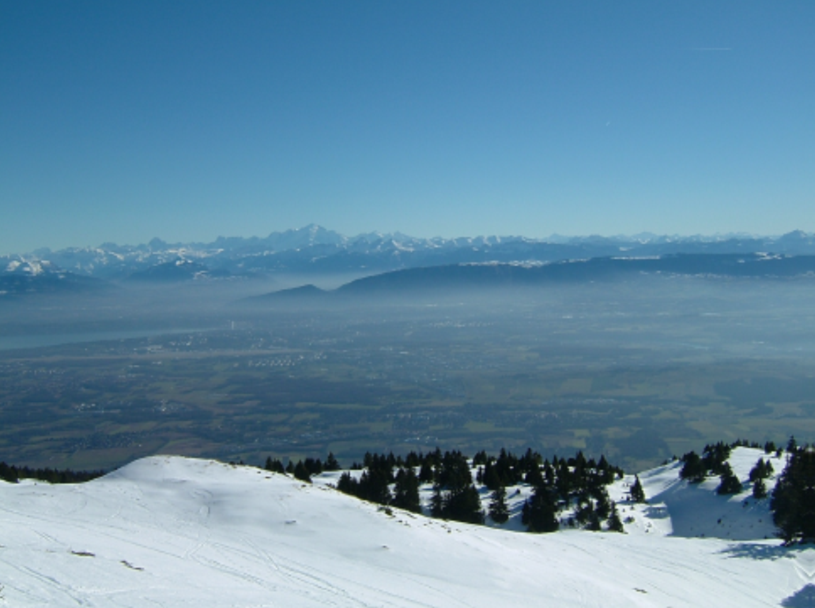
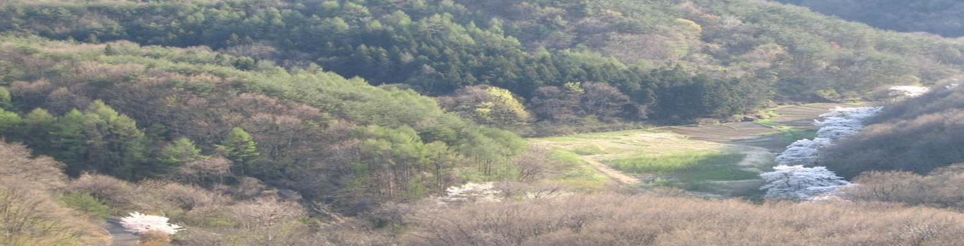


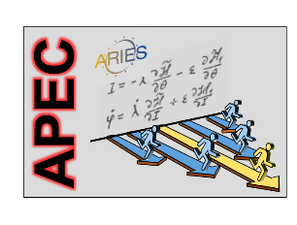

Overview of Future Colliders
Geneva site
Kitakami site
Frank Zimmermann, CERN
Annual and Virtual CBB Symposium, 23 July 2020
including slides from M. Benedikt, D. Contardo, D. Kaplan,
K. Oide, M. Palmer, D. Schulte, V. Shiltsev, et al.
Frank Zimmermann
CERN, BE Department
Helmholtz School CALC2018 Dubna
Qinhuangdao site
Work supported by the European Commission under Capacities 7th Framework Programme, Grant Agreement 312453

Slide 2
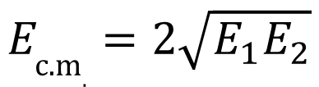
why colliders ? - energy
colliders were invented (1943) and patented (1953) by Rolf Wideröe
centre-of-mass energy:
beam hits
a “fixed target”
two equal
beams collide
colliding two beams against each other can provide
much higher centre-of-mass energies than fixed target!
$$E_{\text{c}\text{.}\text{m}.}=2\sqrt{E_{1}E_{2}}$$
for two high-energy beams
of unequal energy

Slide 3
colliders constructed and operated
Colliders with
superconducting RF system
Colliders with
superconducting arc magnet system
Colliders with
superconducting magnet & RF
advances by new technologies and new materials
Notes:
New slide from Davide.
Showing that conductor development is launched at international level, Russia, Japan, (Korea and Europe in preparation)
Underline importance of that development as main cost driver for the hadron collider machine.

Slide 4

colliders and discoveries
Standard Model
Particles and forces
powerful instruments for discovery and precision measurement
A. Ballarino
Notes:
New slide from Davide.
Showing that conductor development is launched at international level, Russia, Japan, (Korea and Europe in preparation)
Underline importance of that development as main cost driver for the hadron collider machine.

Slide 5
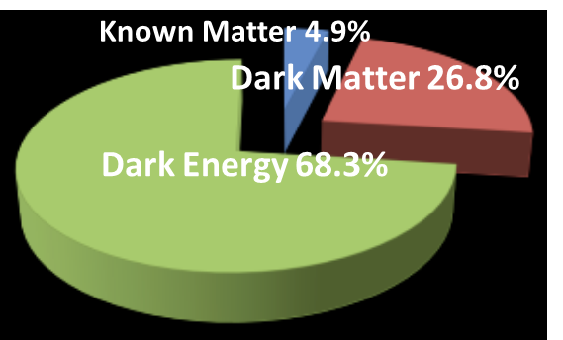
still many open questions
    Known matter is only 5% of universe!
    what is dark matter?
    what is dark energy?
    why more matter than antimatter?
    what about gravity?
also QCD,
quark-gluon plasma,
proton spin, etc.
Notes:
New slide from Davide.
Showing that conductor development is launched at international level, Russia, Japan, (Korea and Europe in preparation)
Underline importance of that development as main cost driver for the hadron collider machine.

Slide 6
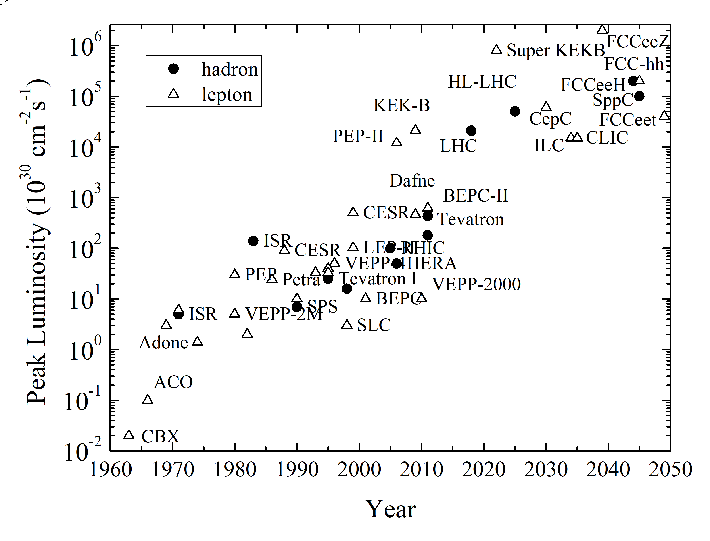
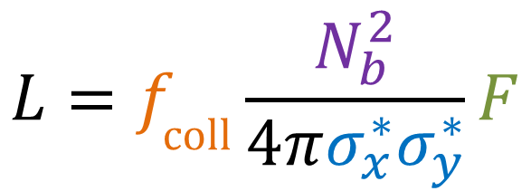
collider figure of merit: luminosity
R= σ L
tends to
decrease
as energy⁻²
luminosity
reaction rate
cross section
geometric factor
(crossing angle,
hour glass, pinch, …)
V. Shiltsev & F.Z., arXiv:2003.09084, submitted to RMP
bunch
population
$$L=f_{\text{coll}}\frac{N_{b}^{2}}{4πσ_{x}^{∗}σ_{y}^{∗}}F$$
bunch
collision
rate
horizontal & vertical
rms beam size
at collision point
peak luminosity increased by almost
7 orders of magnitude over 60 years

Slide 7
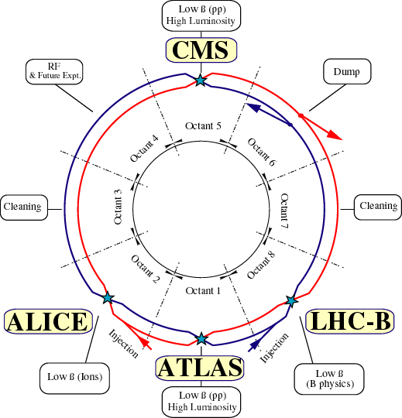
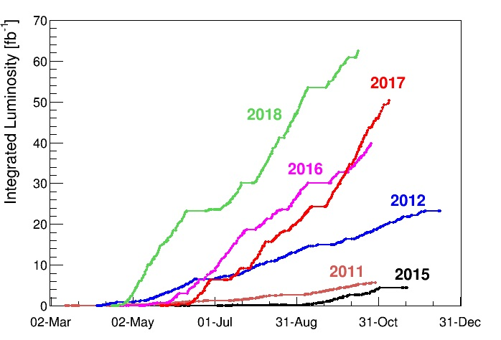
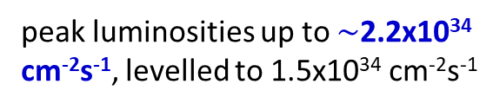

Large Hadron Collider (LHC)
circumference 27 km
world’s highest energy proton-proton collider at CERN/Geneva
peak luminosities up to $\sim$2.2x10³⁴ cm⁻²s⁻¹, levelled to 1.5x10³⁴ cm⁻²s⁻¹
total integrated
luminosity
so far $\sim$190 fb⁻¹
running extremely well

Slide 8
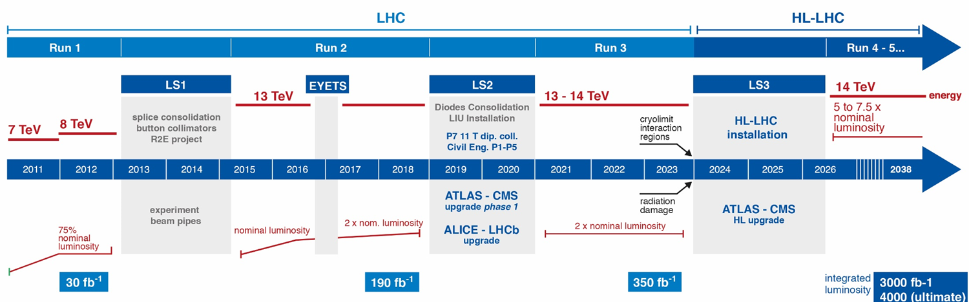
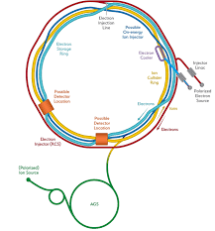
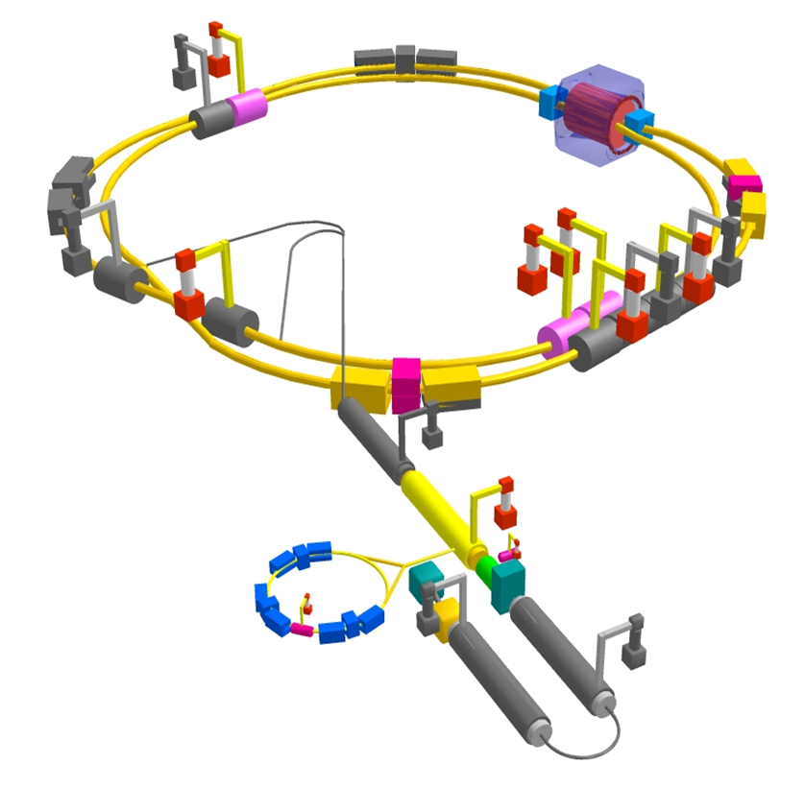
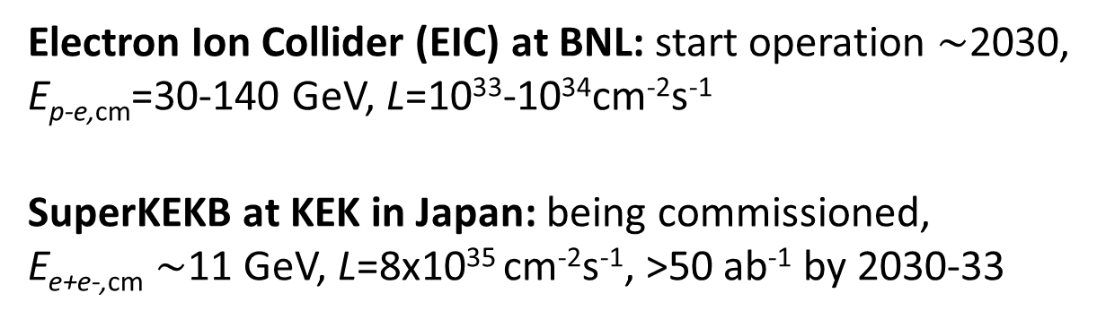

near-future colliders
High-Luminosity LHC at CERN: E_{p-p,cm}=14 TeV, L=5x10³⁴cm⁻²s⁻¹ levelled
goal: increase LHC integrated luminosity x10 to >3 ab⁻¹ around 2038
we are here
from $\sim$2027
Electron Ion Collider (EIC) at BNL: start operation $\sim$2030,
E_{p-e,cm}=30-140 GeV, L=10³³-10³⁴cm⁻²s⁻¹
SuperKEKB at KEK in Japan: being commissioned,
E_{e+e-,cm} $\sim$11 GeV, L=8x10³⁵ cm⁻²s⁻¹, >50 ab⁻¹ by 2030-33

Slide 9
basic types of accelerators
linear accelerator - LINAC
circular accelerators: synchrotrons, storage rings
recirculating energy-recovery linacs
rf cavities
particles are
accelerated
many times by
same rf cavity
rf cavity

Slide 10
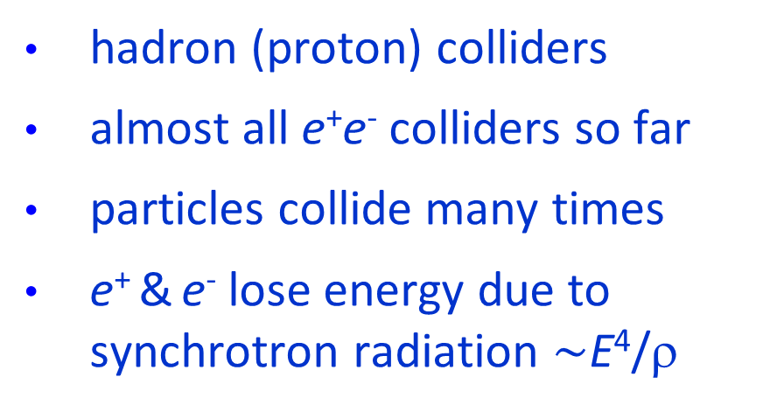
circular and linear colliders
hadron (proton) colliders
almost all e⁺e⁻ colliders so far
particles collide many times
e⁺ & e⁻ lose energy due to synchrotron radiation $\sim$E⁴/ρ
e⁻
e⁺
e⁻
e⁺
straight linacs for future e⁺e⁻ colliders?
negligible synchrotron radiation during acceleration
but only one collision per particle
requires a large accelerating system & small spot size → synchrotron radiation in collision (“beamstrahlung”)

Slide 11
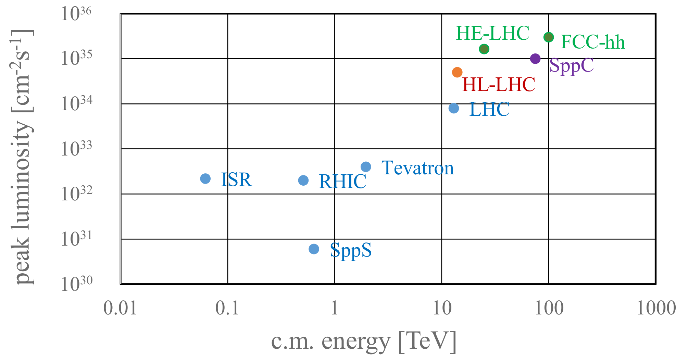
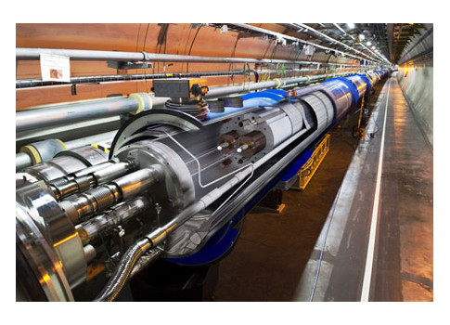
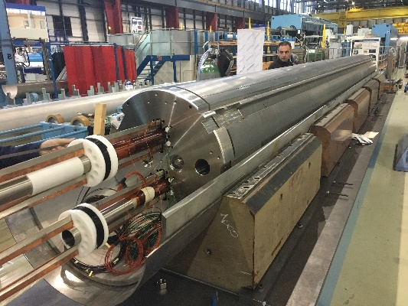
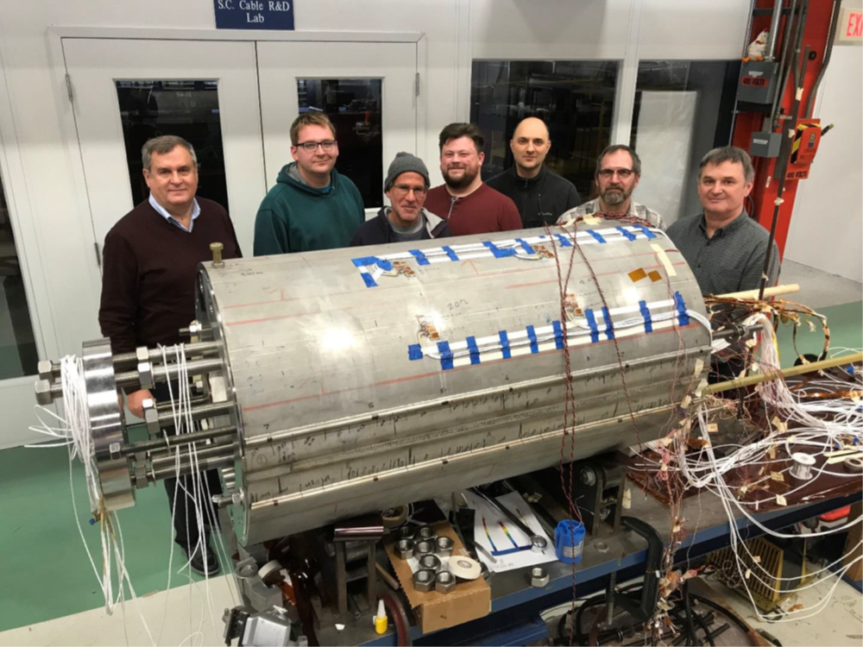

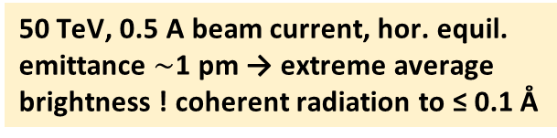
future 100km hadron colliders: FCC-hh & SppC
x10 increase in energy & luminosity
100 TeV cm energy (vs 14 TeV for LHC)
20 ab⁻¹ per experiment collected over 25 years of operation (vs 3 ab⁻¹ for LHC)
similar as step from Tevatron to LHC
key technology: high-field magnets
$$E∝ρB$$
50 TeV, 0.5 A beam current, hor. equil. emittance $\sim$1 pm → extreme average brightness ! coherent radiation to ≤ 0.1 Å
from
LHC technology
8.3 T NbTi
via
HL-LHC technology
11 T Nb₃Sn
FNAL demonstrator
14.5 T Nb₃Sn
14.5 T on
13 July 2020

Slide 12
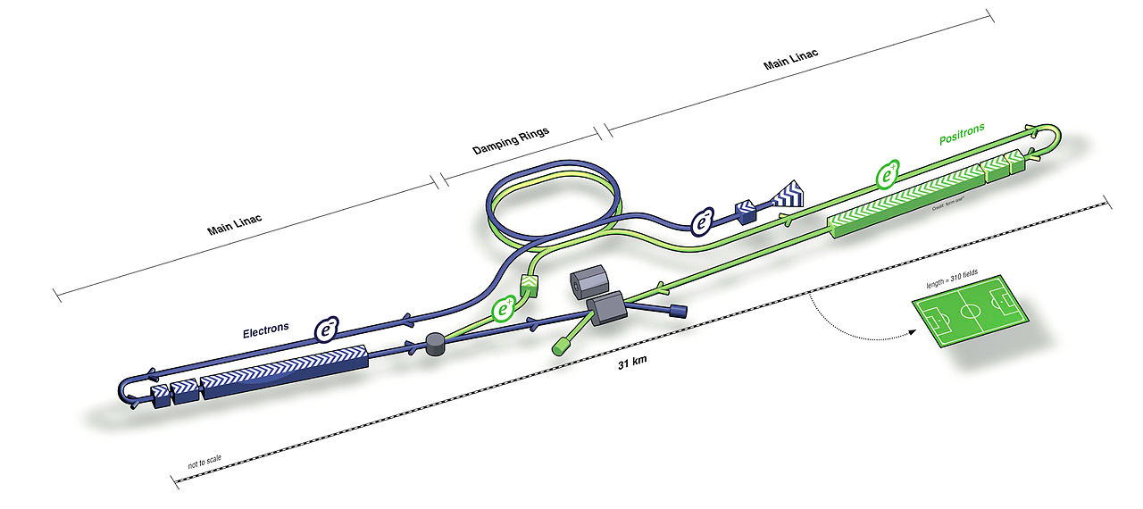
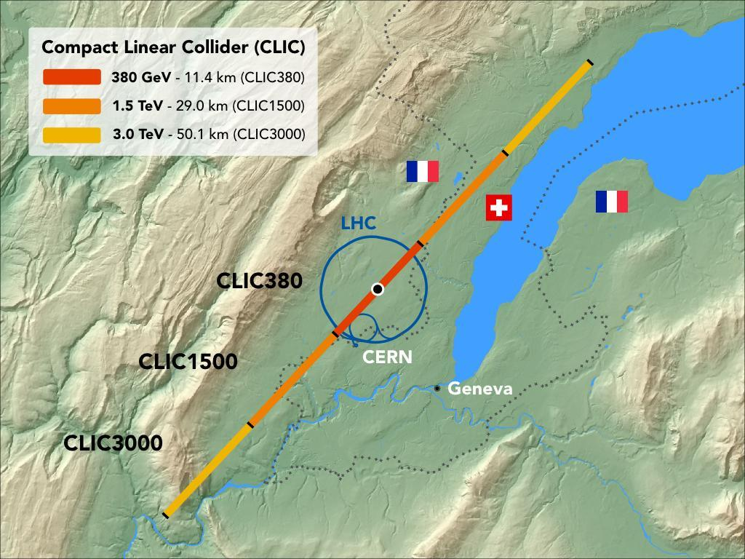
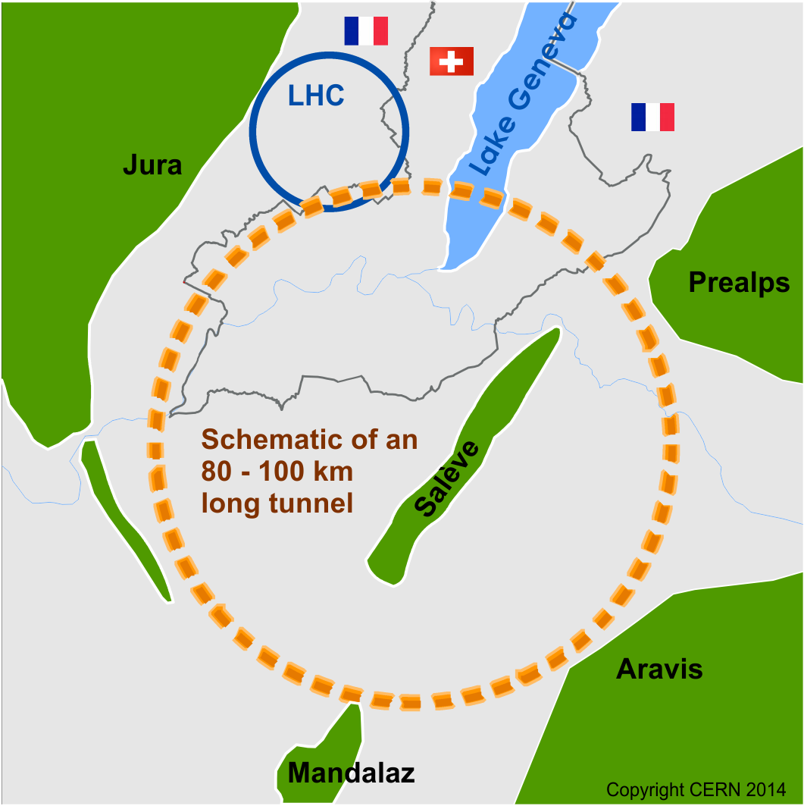
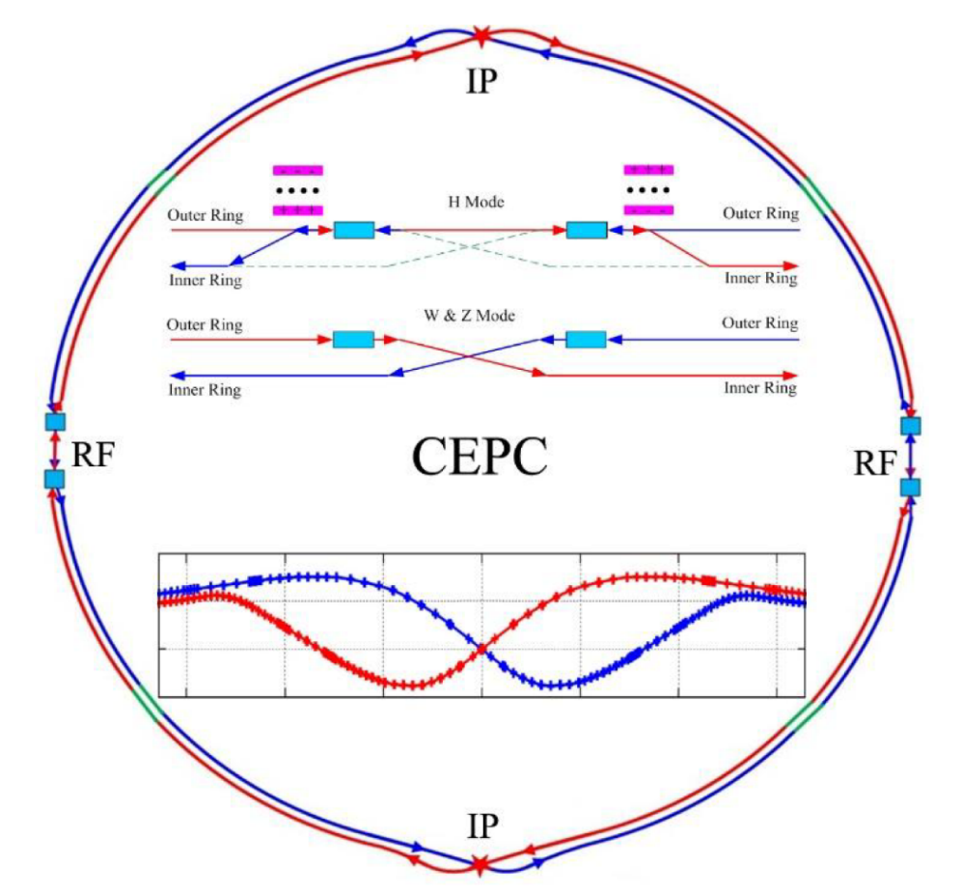
future e⁺e⁻ collider proposals
  20(30) km 250(500) GeV, 1.3 GHz SCRF cavities 30 MV/m
Linear Colliders
  11/29/50 km (0.38/1.5/3 TeV), 12 GHz, NCRF X-band 72/100 MV/m, e-drive beams
ILC (Japan)
CLIC (CERN)
Circular Colliders
  100 km, FCC-ee, 90-365 GeV, 0.4 & 0.8 GHz SCRF
CepC (China)
  100 km, CEPC(ee), 90-240 GeV, 0.65 GHz SCRF
FCC
(CERN)

Slide 13
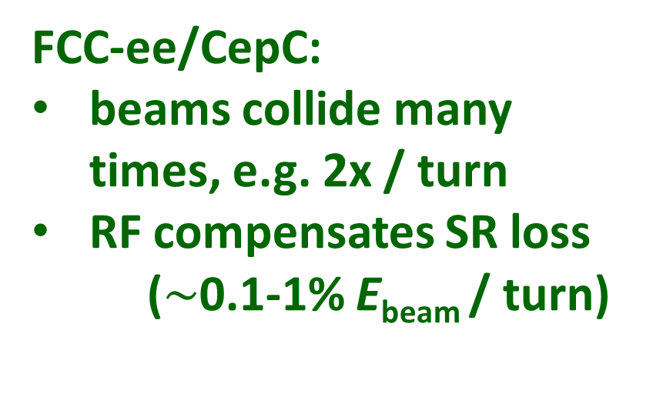
energy provided to e± beam per collision
LC: long RF sections w 2 x 125 (2 x 190 GV) voltage
e⁻
e⁺
both beams lost after single collision
RF must supply full beam energy for each collision
FCC-ee/CepC:
beams collide many times, e.g. 2x / turn
RF compensates SR loss
($\sim$0.1-1% E_{beam} / turn)
e⁻
e⁺
difference in #collisions / (beam energy) > 200x

Slide 14
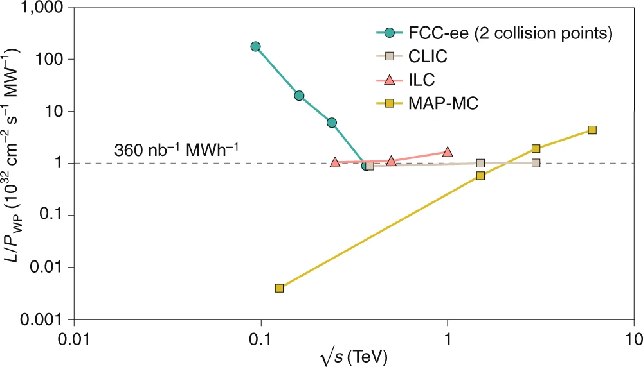

efficiency of lepton colliders
circular e+e-
linear e+e-
circular μ+μ-
Z
91 GeV
ZH
240 GeV
WW
160 GeV
$\text{t}\overline{\text{t}}$
350-365 GeV
Luminosity L per supplied electrical wall-plug power P_{WP} is shown as a function of centre-of-mass energy for several proposed future lepton colliders.
M. Benedikt, A. Blondel, P. Janot, et al., Nat. Phys. 16, 402-407 (2020), and
European Strategy for Particle Physics Preparatory Group, Physics Briefing Book (CERN, 2019)

Slide 15
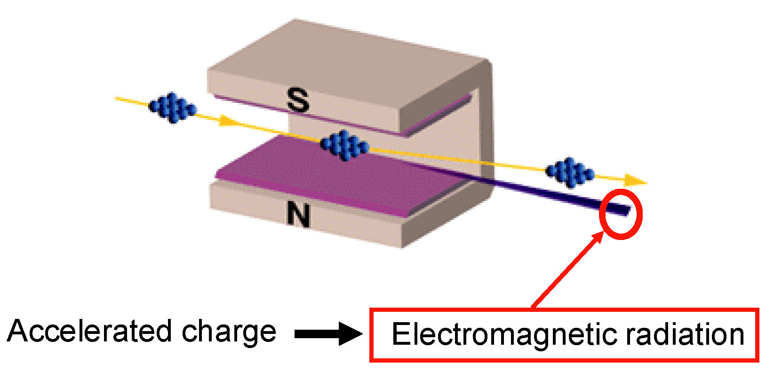
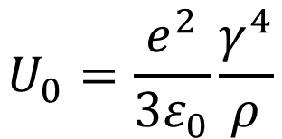
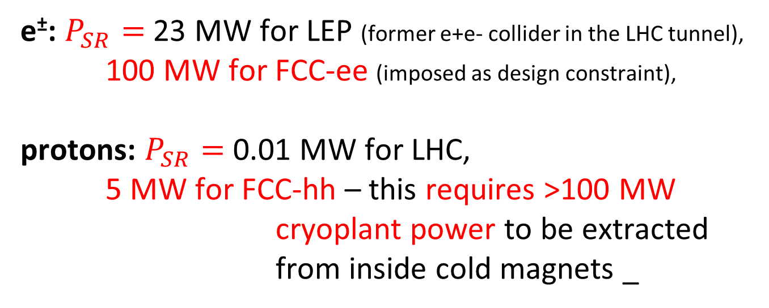
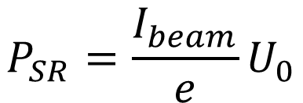
challenge: synchrotron radiation (SR)
circular colliders
energy loss per
particle per turn
$$U_{0}=\frac{e^{2}}{3ε_{0}}\frac{γ^{4}}{ρ}$$
SR power
$$P_{SR}=\frac{I_{beam}}{e}U_{0}$$
e±: $P_{SR}=$23 MW for LEP (former e+e- collider in the LHC tunnel),
100 MW for FCC-ee (imposed as design constraint),
protons: $P_{SR}=$0.01 MW for LHC,
5 MW for FCC-hh – this requires >100 MW cryoplant power to be extracted from inside cold magnets _

Slide 16
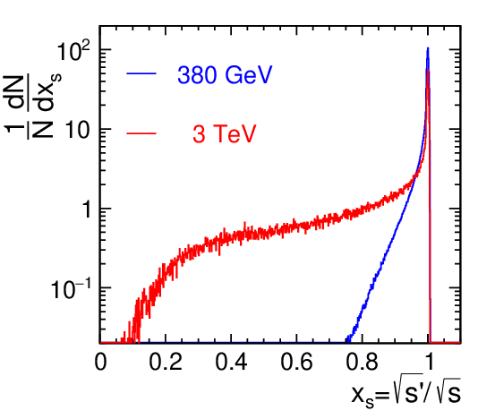
challenge: synchrotron radiation cnt’d
linear colliders
synchrotron radiation in the strong field of the opposing beam (=“beamstrahlung”) degrades the luminosity spectrum
CLIC at 380 GeV:
60% of total
luminosity
within 1% of
target energy
CLIC at 3 TeV:
only 33% of total
luminosity
within
1% of target
e⁺e⁻ collisions in
linear colliders lose
their distinct
energy precision
H. Abramowicz, H. et al
- arXiv:1807.02441

Slide 17
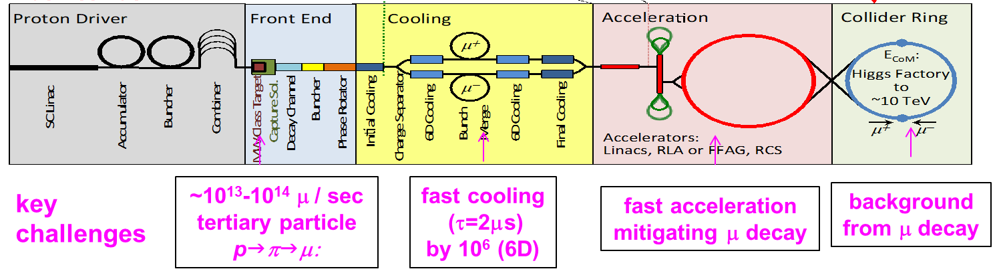
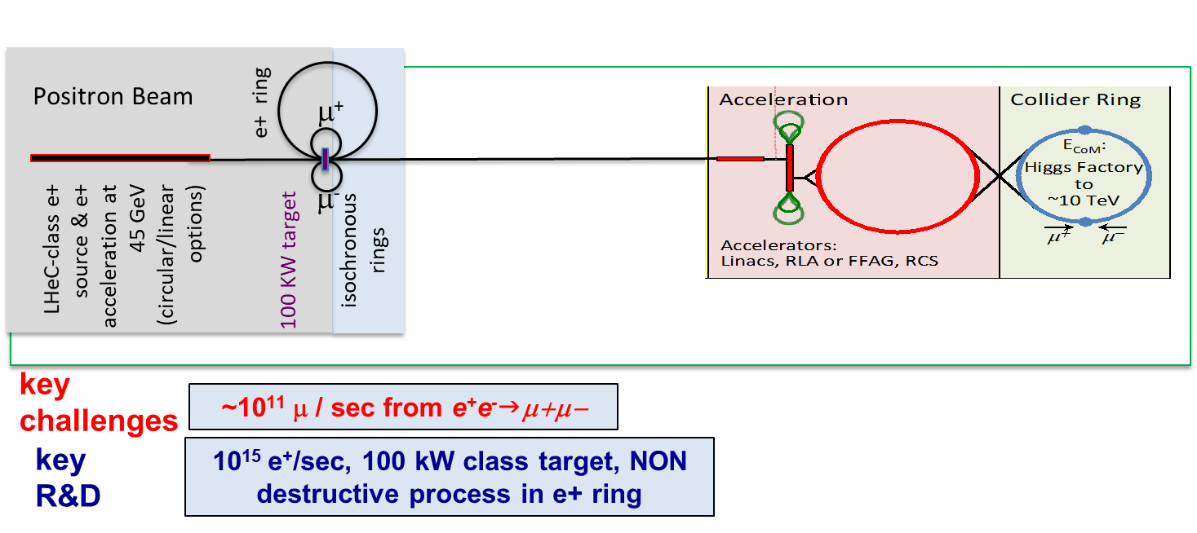
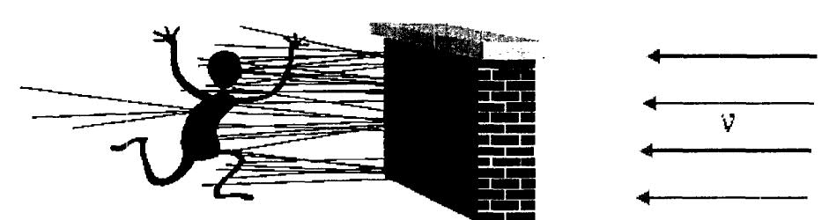
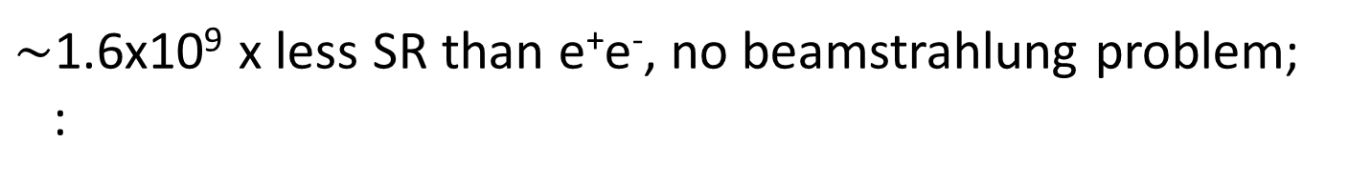

future muon collider ?
$\sim$1.6x10⁹ x less SR than e⁺e⁻, no beamstrahlung problem;
:
two production schemes proposed
US-MAP (2015) p-driven
Italian LEMMA (2017) e⁺-annihilation
μ‘s decay within
a few 100 - 1000 turns:
→ rapid acceleration
(perhaps plasma?)
→ ν radiation hazard
(limits maximum μ energy)
needs large 45 GeV e⁺ ring like FCC-ee,
possible upgrade path to FCC-μμ
Bruce King 1999
$$σ_{ν}∝E, flux ∝E^{2} (Lorentz boost)$$
solution beyond 10 TeV unclear

Slide 18
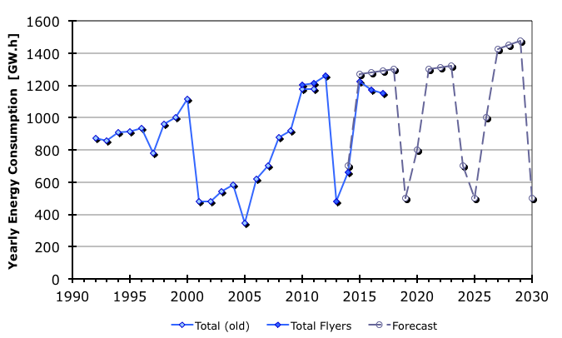
energy consumption – example CRN
Multi-years cycles for LHC
HL-LHC
LHC
LEP2
Cycles: 9m+3m
Cycles: 3 or 4 x (10m+2m) + 1.5yr
V. Mertens

Slide 19
how can we further boost collider energy efficiency ?`
more energy-efficient technologies
(RF, magnets,…)
multiple collision points
energy and particle recovery

Slide 20

SRF cavities over 30 years | high Q₀ & E_{acc} → less cryopower
Enabling future efficient High Energy Machines
bulk Nb, 1.3 GHz, 2K
similar progress for Nb/Cu cavities
5 MV/m
Thermal Breakdown
20 - 25 MV/m
High field
Q-SLOPE
Q > 5e10
At medium field !!
E_{acc} > 100 MV/m
Q > 3e10
3 – 4 MV/m
Multipacting
10 – 15 MV/m
Field Emission
35 – 40 MV/m
mid field Q-slope
Q > 2e10
At high field
?
Anna Grassellino - ICFA 2017
A. Grasselino, ICFA Seminar, Ottawa 2017

Slide 21
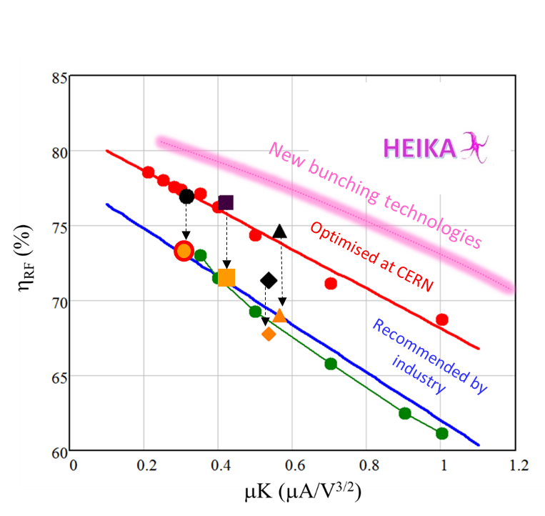
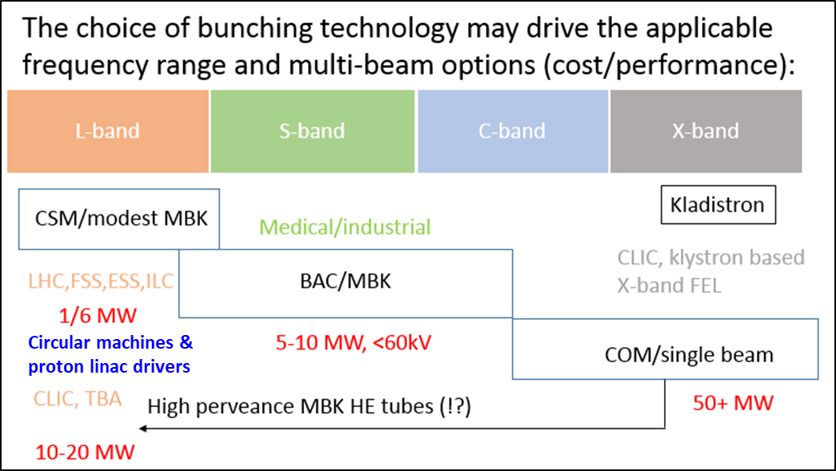
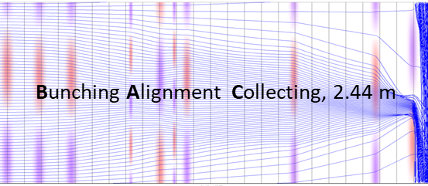
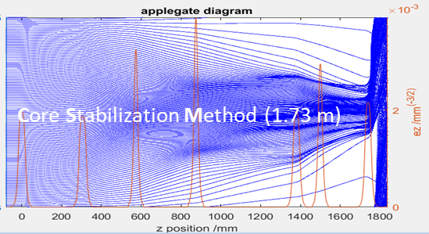
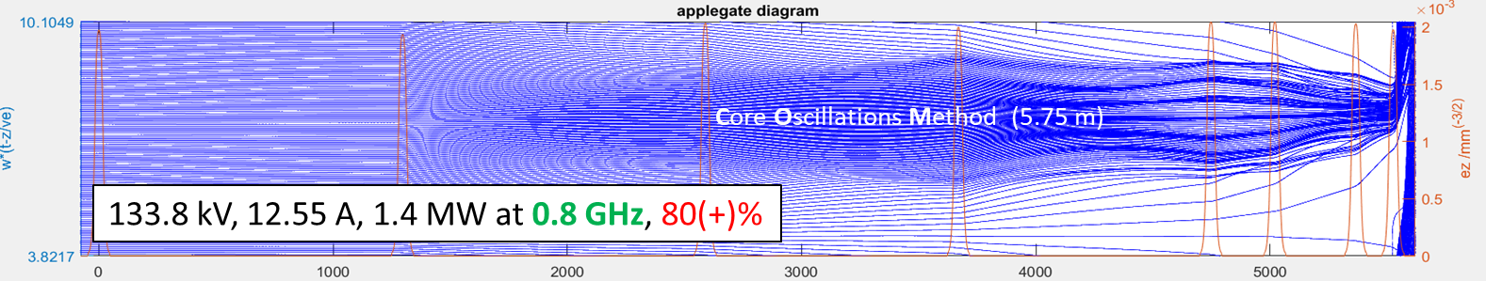
after 80 years a breakthrough in klystron technology
I. Syratchev
New bunching technologies.
Bunch saturation.

Slide 22
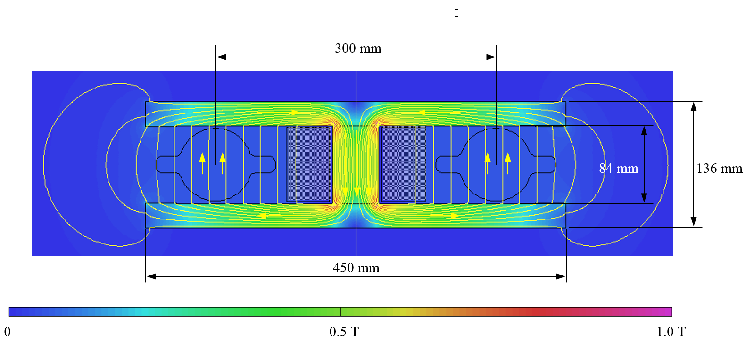
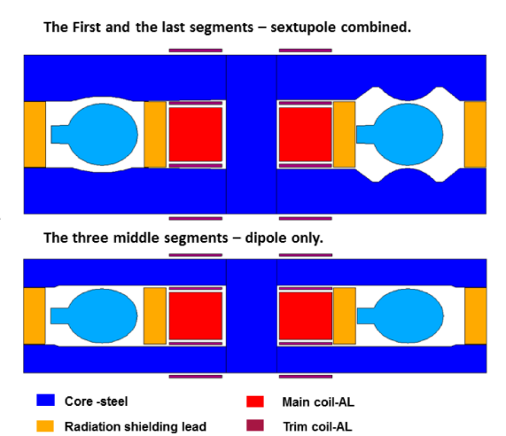
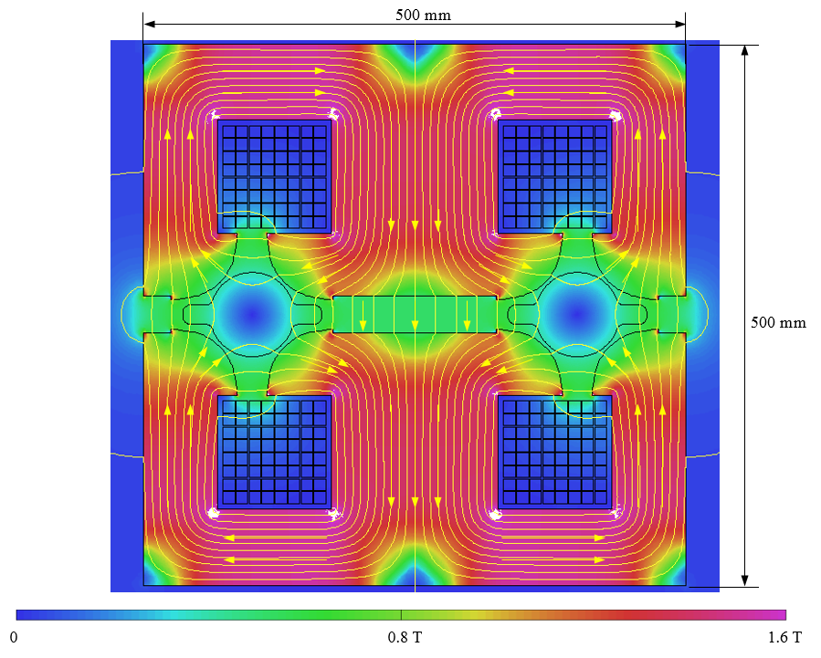
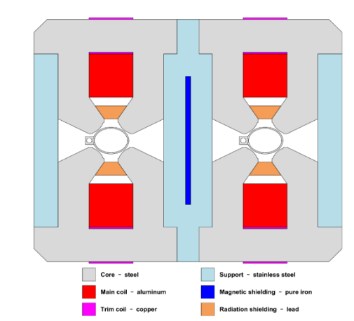
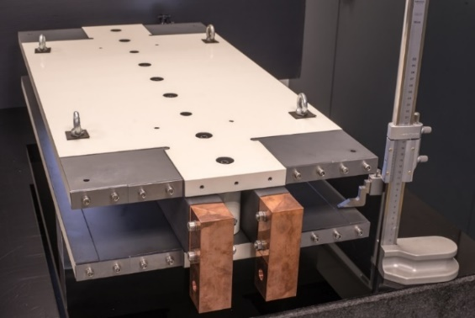
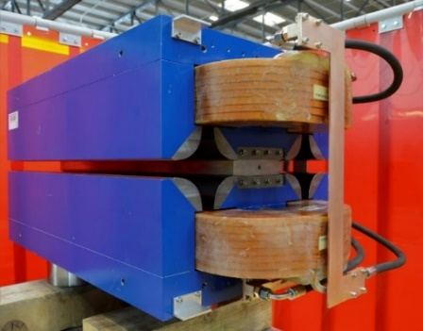

low-power arc magnets for FCC-ee & CEPC
FCC-ee
challenge of low-field magnets !
$\sim$500 G collider, $\sim$30 G booster
CEPC
Twin-dipole design with 2× power saving
16 MW at 175 GeV
Twin arc magnet combined function dipole with sextupole component
Twin F/D arc quad with 2× power saving
25 MW at 175 GeV
A. Milanese Phys. Rev. Accel. Beams 19, 112401 (2016)
dipole prototype
Twin F/D arc quad with 2× power saving
quadrupoleprototype
power reduction by factor 2 w.r.t. single-aperture magnets

Slide 23
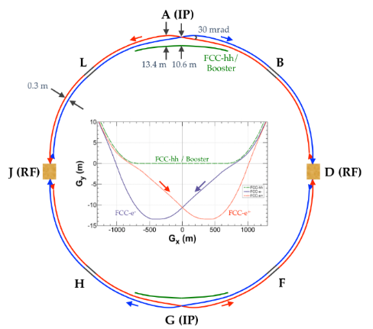
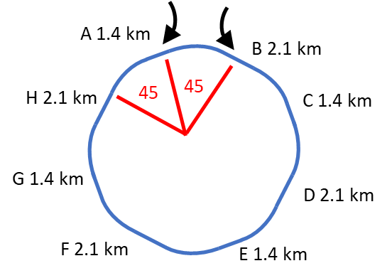

multiple collision points: circular colliders
FCC-ee baseline layout
with two CPs
alternative layouts with
four CPs under study
K. Oide
hadron injections
hadron injections
super-periodicity 4
super-periodicity 2
K. Oide et al., Phys. Rev. Accel. Beams 19, 111005 (2016)

Slide 24

multiple collision points: linear colliders?
VLEPP – only future Linear Collider ever approved, at Protvino
e⁺ production
based on polarized
Iight from helical
undulator (also later
adopted
for TESLA and ILC)
5 collision points
achromatic focusing
optics, based on
miniature quadrupoles
V.E. Balakin,
A.N. Skrinsky,
VLEPP Status
Report, HEACC’86
proposed
in 1978

Slide 25


energy recovery: linear colliders
1-6 GeV c.m.
Maury Tigner, “A Possible Apparatus for Clashing-Beam Experiments”, Nuovo Cimento 37, 1228 (1965)
these early proposal always
recovered the energy of the spent beam!
early linear-collider proposals
300 GeV c.m.
Ugo Amaldi, “A possible scheme to obtain e-e- and e+e- collisions at energies of hundreds of GeV”, Physics Letters B61, 313 (1976)

Slide 26




future cw LC’s with energy recovery ?
common linac with bypasses for XFEL
J. Sekutowicz et al., Proposed continuous wave energy recovery operation of an x-ray free electron laser, Phys. Rev. ST Accel. Beams 8, 010701 (2005)
dual axis linac for X-ray/THz production
R. Ainsworth et al., “Asymmetric dual axis energy recovery linac for ultrahigh flux sources of coherent x-ray and THz radiation: Investigations towards its ultimate performance,” Phys. Rev. Accel. Beams 19, 0803502 (2016) –

Slide 27



circular collider with energy recovery
FCC-ee-ERL upgrade
“a bent ILC”
V. Litvinenko, T. Roser, M. Chamizo Llatas, “High-energy high-luminosity e⁺e⁻ collider using energy-recovery linacs”, Physics Letters B 804 (2020) 135394

Slide 28

approximate technical timelines of future colliders
from V. Shiltsev & F.Z., “Present and Future Colliders”, submitted to RMP, arXiv:2003.09084

Slide 29

“We need men [and women] who can dream of things that never were.”
— John F. Kennedy
address to the Irish Parliament, Dublin, June 1963

Slide 30
a few references
M. Tigner, “A possible apparatus for electron clashing-beam experiments,” Nuovo Cimento 37, 1228–1231 (1965, doi:10.1007/BF02773204 [Open Access]
U. Amaldi, “A Possible Scheme to Obtain e- e- and e+ e- Collisions at Energies of Hundreds of GeV,” Phys.Lett.B 61 (1976) 313-315
B. Richter, “Very high energy electron–positron colliding beams for the study of weak interactions,” NIM, 136 (1976), p. 47.
M. Benedikt et al., “Future Circular Colliders succeeding the LHC ,” Nature Physics, vol. 16, pp 402–407 (2020) [Open Access]
V. Litvinenko, T. Roser, M. Chamizo Llatas, “High-energy high-luminosity e+e− collider using energy-recovery linacs”, Physics Letters B 804 (2020) 135394
V. Shiltsev and F. Zimmermann, “Modern and Future Colliders,’’ submitted to RMP, https://arxiv.org/abs/2003.09084

Slide 31
spare slide

Slide 32

FCC integral project technical schedule
1
2
3
4
5
6
7
8
9
10
11
12
13
14
15
16
17
18
15 years operation
34
35
36
37
38
39
40
41
42
43
~ 25 years operation
70
Project preparation &
administrative processes
Permis-sions
Update
Permissions
Funding strategy
Funding and
in-kind contribution agreements
Funding and
in-kind contribution agreements
Geological investigations, infrastructure detailed design and tendering preparation
Tunnel, site and technical infrastructure construction
FCC-ee dismantling, CE & infrastructure adaptations FCC-hh
FCC-ee accelerator R&D and technical design
FCC-ee accelerator construction, installation, commissioning
FCC-hh accelerator R&D and technical design
FCC-hh accelerator construction, installation, commissioning
Set up of international experiment collaborations, detector R&D and concept development
FCC-ee detector technical design
FCC-ee detector
construction, installation, commissioning
FCC-hh detector R&D,
technical design
FCC-hh detector
construction, installation, commissioning
Superconducting wire and magnet R&D, short models
Long model magnets, prototypes, preseries
16 T magnet industrialization and
series production
conductors & high-field magnet technology
optimized engineering design, energy efficiency, maintainability

