Slide 1
Summary of the target session
of the IEB Workshop
June 19, 2015 | Alexander Nass

Slide 2
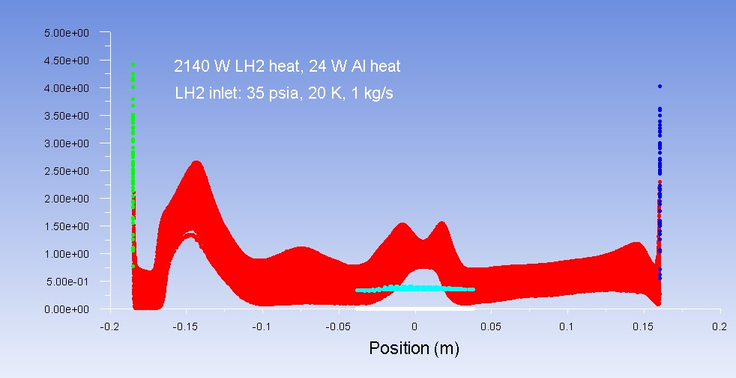
High Density Targets for External Beams Summary (S. Covrig)
High density (luminosity>10³⁸) and high power (hundreds to thousands of W) targets produce two systematic effects: luminosity loss and density fluctuations
Before Computational Fluid Dynamics (CFD) was possible high power and high density target design was an educated guess to minimize the target noise
The Qweak target (2500 W) was the 1st target at Jefferson Lab designed with CFD and it has been a great success for two years of running 2010-2012
The Qweak target achieved its goals:
  CFD predicted 0.8% LH2 density reduction and we measured 0.8% yield reduction
  LH2 density fluctuations were 3% of counting statistics, the goal was less than 5%
At 2.5 kW power and 50 ppm LH2 density fluctuations at 480 Hz the Qweak target is the highest power target in the world and with the smallest noise
CFD prediction for the Qweak target: LH2 relative density loss profile (%) in the beam volume of the target along the beam line , green and blue = LH2 relative density loss at the Al windows, red = LH2 relative density loss in the bulk, the black arrow shows the beam direction
Beam direction
Al window in
Al window out

Slide 3
High Density Targets for External Beams Summary
A CFD-Facility (CFDFAC) on HPC (high performance computing) has been set up and is running at Jefferson Lab to design future high power, high density targets with low noise
Transient CFD simulations are being developed at CFDFAC to predict the Qweak target LH2 density fluctuations on time scales from 960 Hz down to 15 Hz
The 5 kW LH2 target for the MØLLER experiment is designed by CFDFAC, the target design requires LH2 density fluctuations of less than 25 ppm at 2 kHz
A 20 cm IEB LH2 target hit by a 1 mA polarized electron beam would be rated at 7 kW. At 5% of counting statistics (assuming a particles rate of 20 GHz), the density fluctuations from such a target would be expected to be less than 30 ppm at a beam helicity frequency of 960 Hz, on par with the MØLLER target challenges. To build such a target from scratch would cost on the level of ~$1M, but, to serve its cryogenic needs, a 7-8 kW He cryo-plant would cost $7-10M.

Slide 4
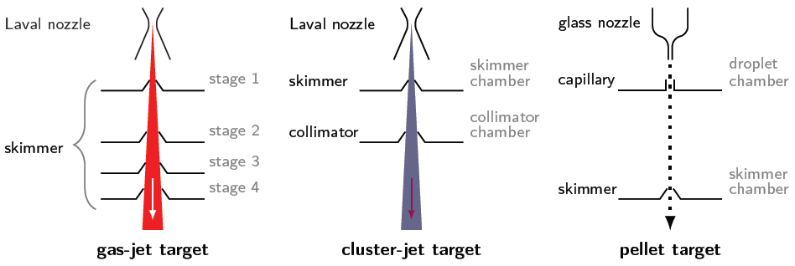
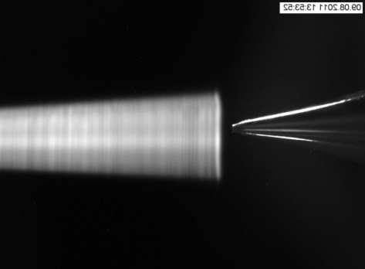
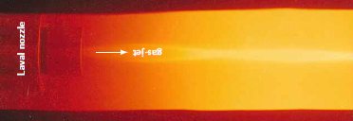
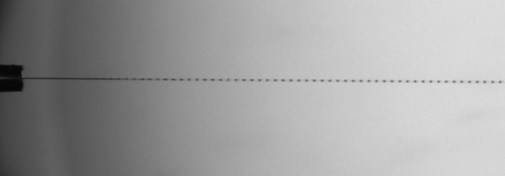
Gas, Cluster and Pellet Beams (A. Khoukaz)

Slide 5
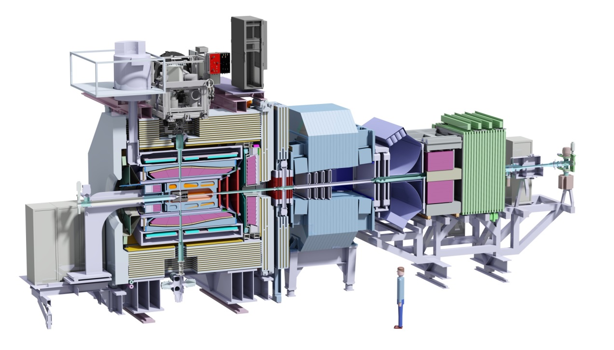
Common Advantages of Cluster and Pellet Targets
All types of gases can be used (H₂, D₂, N₂, Ne, Ar,..., Xe)
High target beam thickness at large distances from the nozzle (i.e. >10¹⁵ atoms/cm³ @ 2 m behind nozzle)
Well defined beam shape even at large distances
Pure and windowless target
Compatible with a 4π detector

Slide 6
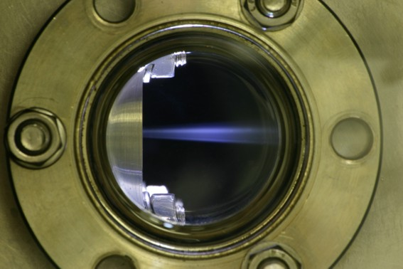
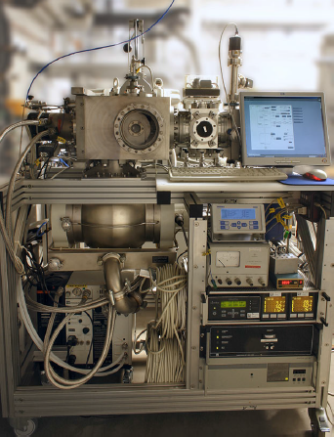
Special Features
Cluster jet beams:
  Target generator can work as gas and/or cluster source:
    Interaction point very close to nozzle or at larger distances
    Thickness O(10¹⁹) at./cm³ directly behind nozzle
    Thickness O(10¹⁵) at./cm³ at large distances (i.e. 2 m)
  Easy target beam shaping and lower gas load at the interaction point by use of specially shaped collimators
  Target beam with (nearly) no time structure
  Simple target thickness variation
  Compact target beam generator possible

Slide 7
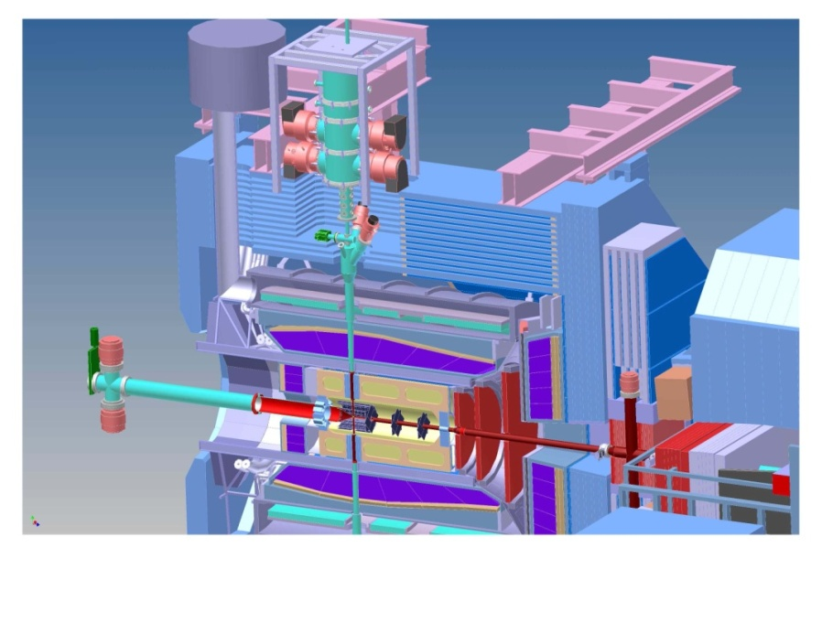
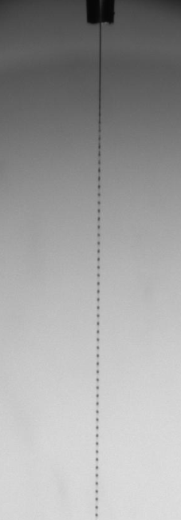
Special Features
Pellet beams:
  Pellets with uniform size/diameter
  Target beam with time structure
  Individual pellets have a mean thickness of O(10¹⁹) atoms/cm²
  Effective target beam thickness of O(10¹⁵) atoms/cm² at large distances from the nozzle, i.e. 2 m
  Target beam shaping and lower gas load at the interaction point by use of collimators
  Target thickness variation possible (time structure)
  More complex and larger target generator size

Slide 8
H-jet polarimeter and p-Carbon CNI polarimeters at RHIC (A.Zelenski)
Absolute H-jet
polarimeter
RHIC pC “CNI” polarimeters
RHIC
PHENIX
STAR
Siberian Snakes
Spin Rotators
Pol. H⁻ ion source
LINAC
AGS, 24GeV
AGS pC “CNI” polarimeter
200 MeV polarimeter
BOOSTER, 2.5 GeV
Notes:
8

Slide 9
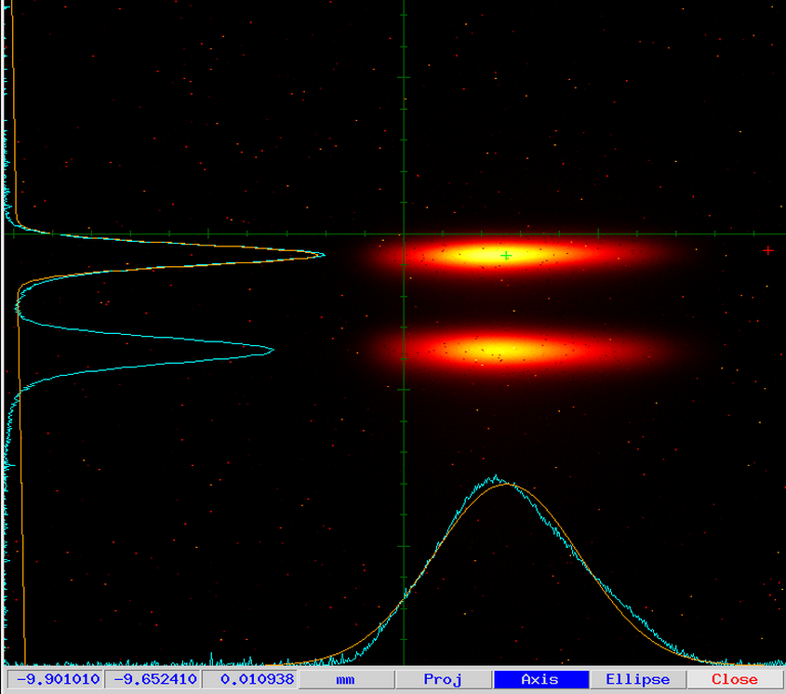
H-jet as a luminescence beam intensity profile monitor.

Slide 10
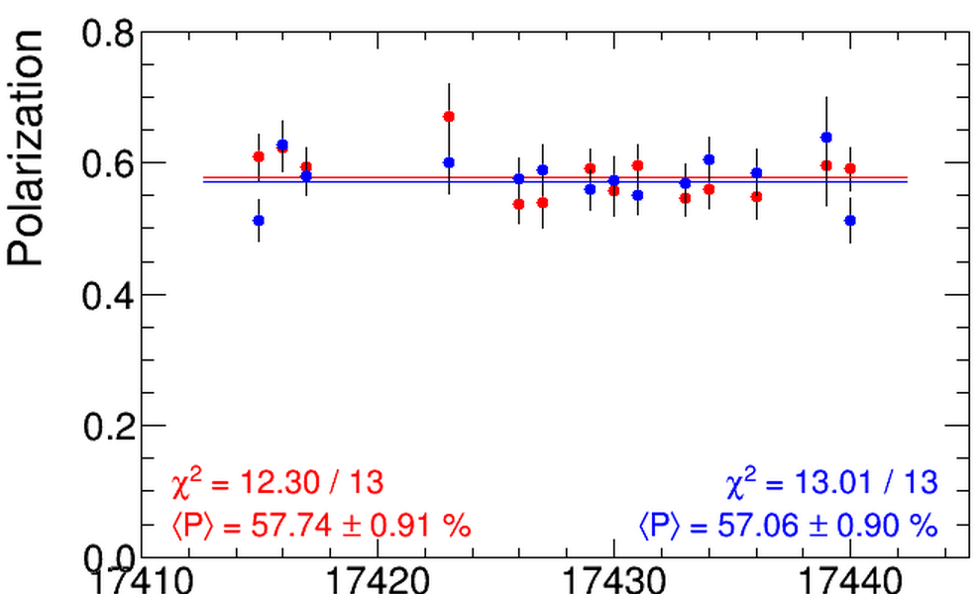
Polarization measurements at 255 GeV in H-jet polarimeter, Run-2013, April-25-30

Slide 11
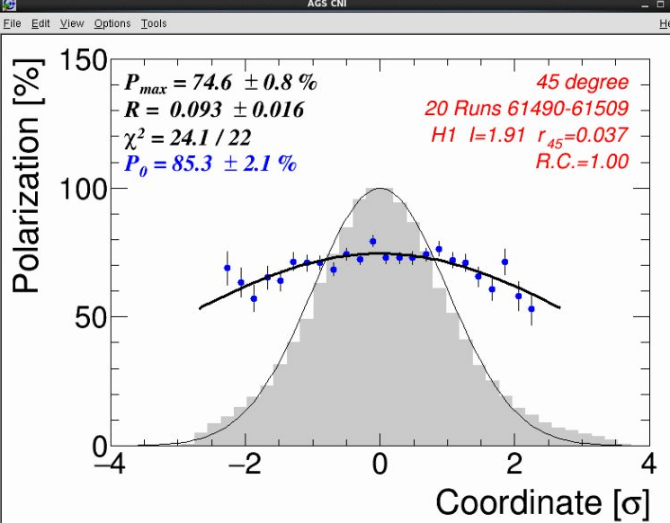
Polarization profiles in AGS, vertical

Slide 12
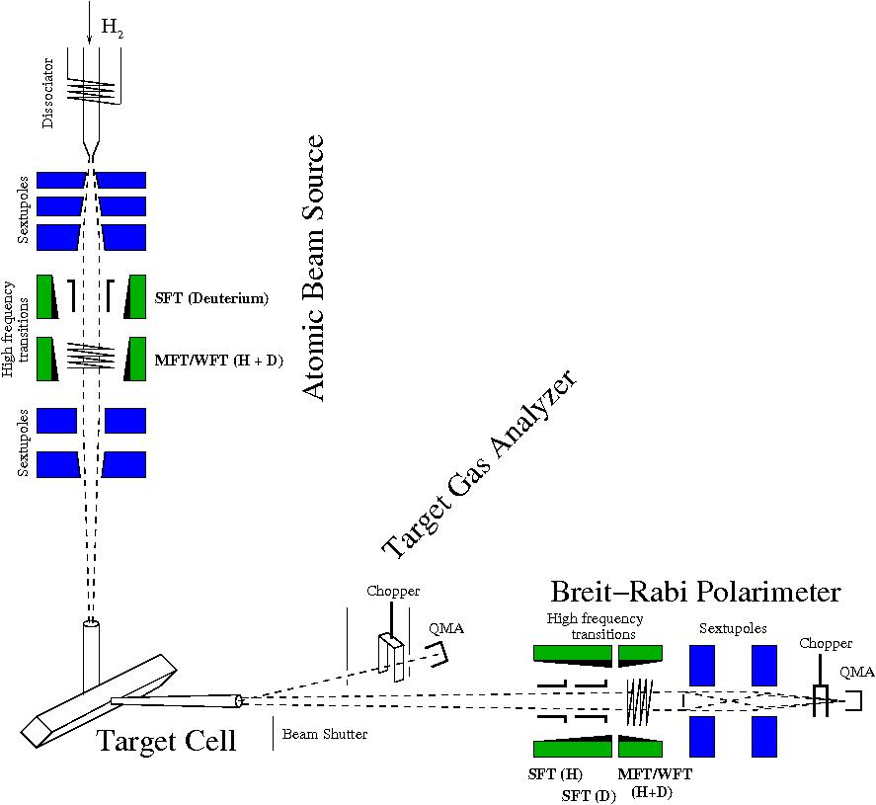
Polarized storage cell gas targets (A.Nass)
Production of a polarized atomic hydrogen beam by an Atomic Beam Source (ABS)
Increase of the target density by means of a storage cell
Analysis of target polarization by a Breit – Rabi Polarimeter (BRP) and Target Gas Analyzer (TGA)
Isotopically pure target
Rapid reversal of target spin
Low background (open cell)
No radiation damage (replenishment of gas)

Slide 13
Polarized molecules as target gas
Measurements on Fomblin oil (Perfluoropolyether PFPE)
T_{Cell} = 100 K
HFS 3
P_{a} = -0.87
High polarization
Higher densities possible (conductances, cell cooling)
Conditions:
- high magnetic field
- no water contamination
P_{m} = - 0.81 ± 0.02
n = 174 ± 19
c = 0.993 ± 0.005
p
+
P_{m} = - 0.84 ± 0.02
n = 277 ± 31
H
2
Courtesy of R.W.Engels

Slide 14
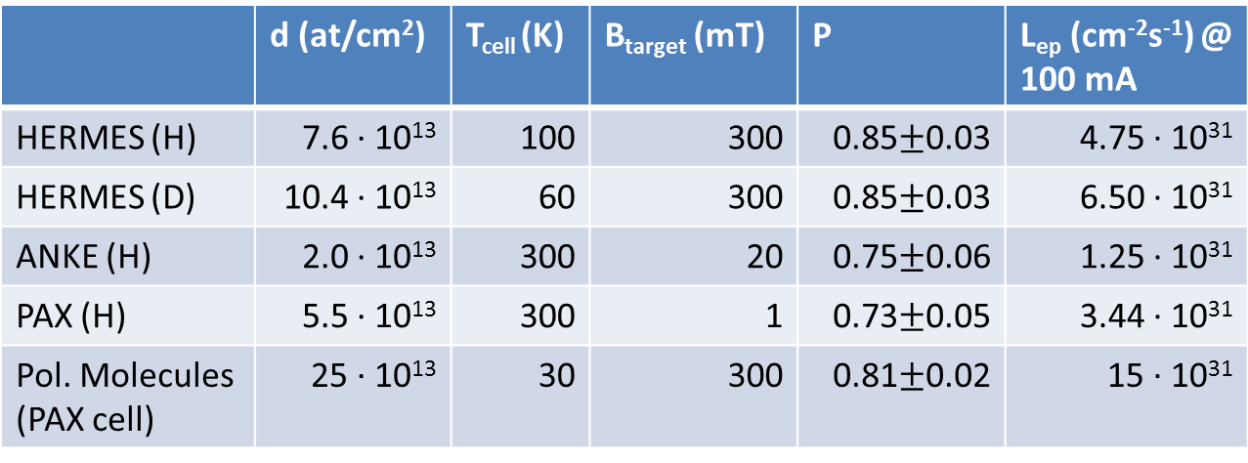
Summary & predicted luminosity for the proposed electron machine
 | d (at/cm²) | T_{cell} (K) | B_{target} (mT) | P | L_{ep} (cm⁻²s⁻¹) @ 100 mA
HERMES (H) | 7.6 · 10¹³ | 100 | 300 | 0.85$±$0.03 | 4.75 · 10³¹
HERMES (D) | 10.4 · 10¹³ | 60 | 300 | 0.85$±$0.03 | 6.50 · 10³¹
ANKE (H) | 2.0 · 10¹³ | 300 | 20 | 0.75$±$0.06 | 1.25 · 10³¹
PAX (H) | 5.5 · 10¹³ | 300 | 1 | 0.73$±$0.05 | 3.44 · 10³¹
Pol. Molecules (PAX cell) | 25 · 10¹³ | 30 | 300 | 0.81$±$0.02 | 15 · 10³¹
Areal densities d depend on cell size and temperature T_{cell} as well as injected number of states
(2 states at the HERMES in the high field target, 1 state at the ANKE & PAX low field target
and for the polarized molecules).

