Slide 1
BNL’s High-Current Program
Dmitry Kayran
Collider-Accelerator Department,
Brookhaven National Laboratory
INTENSE ELECTRON BEAMS WORKSHOP
Cornell University, June 17-19, 2015

Slide 2
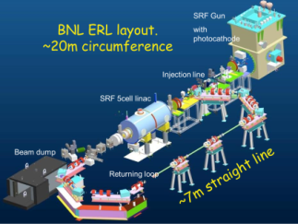
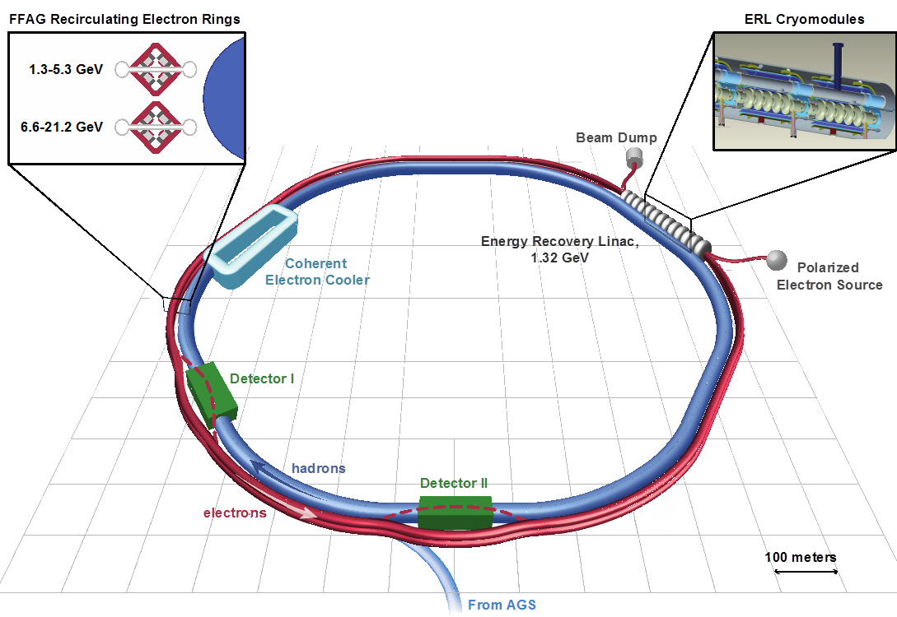
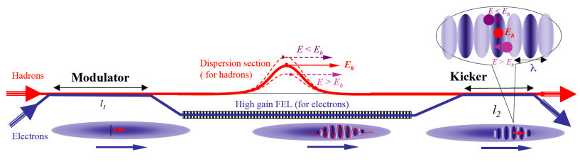
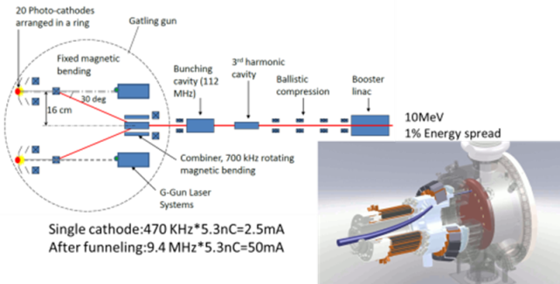
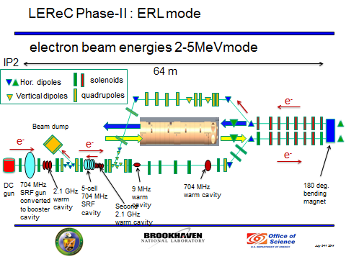
BNL high current program
High Average current R&D ERL
Polarized high current Gatling Gun
Low energy RHIC electron cooler (LEReC)
Coherent electron cooler for high energy ion/proton beams (proof of principal experiment)
Coherent electron cooling
Gatling Gun

Slide 3
R&D ERL

Slide 4
R&D ERL will serve as a test-bed for future RHIC projects
Test concepts relevant for electron-ion colliders and high-energy electron cooling (coherent and conventional)
  High average current
  SRF injector
  BBU
  e-dump
  Stability criteria for CW beam current
  Halo/losses control
Specifically for e-cooler
  High charge per bunch
  Low energy spread and emittances (3rd harmonic is needed)
  Conservation of beam parameter in merger at low energy (Z-bend test will give an answer)
  Ion bunch much longer then electron one (could use 703.75 MHz train of e-bunches, will split laser beam to 2, 4 or 8)
D. Kayran, IEBW’15 Cornell University

Slide 5
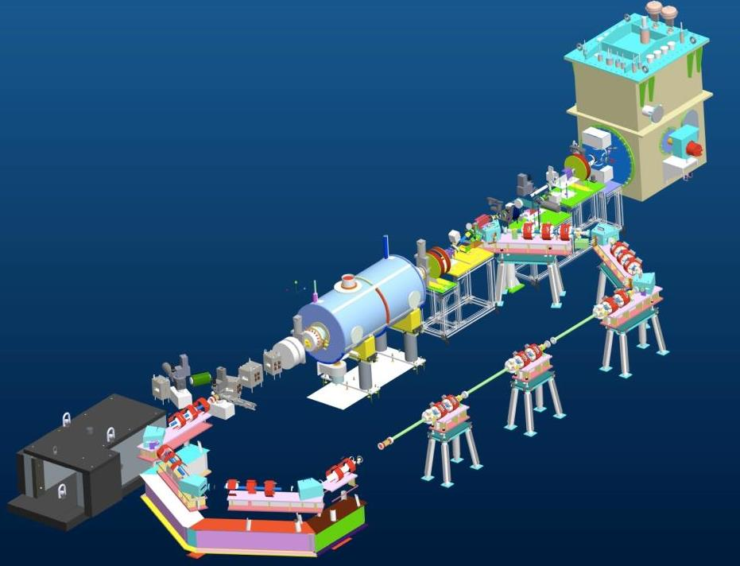
BNL ERL layout.
~20m circumference
SRF Gun
with photocathode
Injection line
SRF 5cell linac
Beam dump
Returning loop
~7m straight section

Slide 6
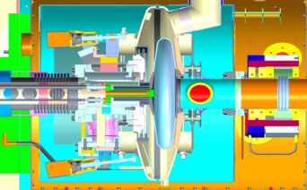
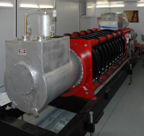
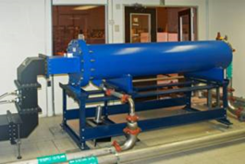
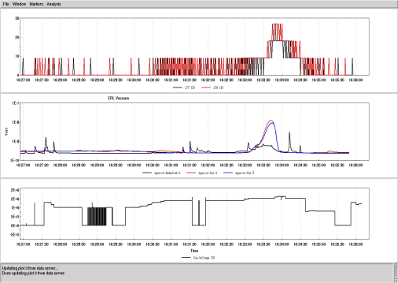
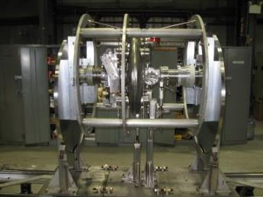
704 MHz SRF Gun: 2 MV CW operation
Dummy load
1MW CW Klystron
½ cell SRF gun
Radiation inside
Beam line vacuum
SRF gun before installation into the crymodule. March 2011
Gun voltage
1-2 MV CW operation of 704 MHZ SRF gun at BNL
D. Kayran, ERL2015

Slide 7
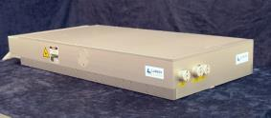
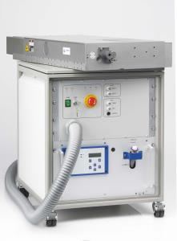
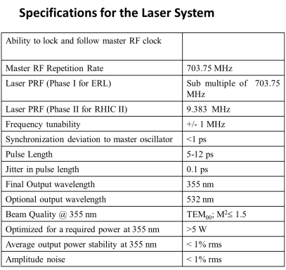
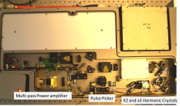
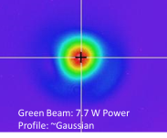
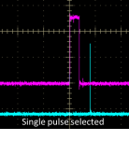
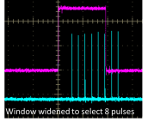
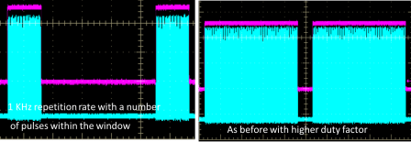
Laser system
Lumera Laser:
Pulse Selector Performance
Commissioned and operational since 2009
D. Kayran, IEBW’15 Cornell University

Slide 8
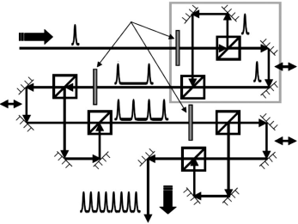
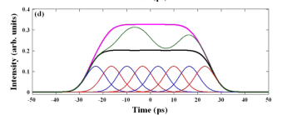
Laser pulses manipulation
Birefringent Method
Interferometric Method
Sharma et al PRSTAB 2009
Tomizawa et al Quant Elec 2007
No adjustable parameters
Crystal length and quality issues
Extremely sensitive to alignment
Stability
Used to increase pulse width by 4, 8 and pulse flat.
Used to increase to increase rep. rate by 4. (to 4*9.38MHz)
Tested with e-beam
Ready to test with e-beam
D. Kayran, IEBW’15 Cornell University
8

Slide 9
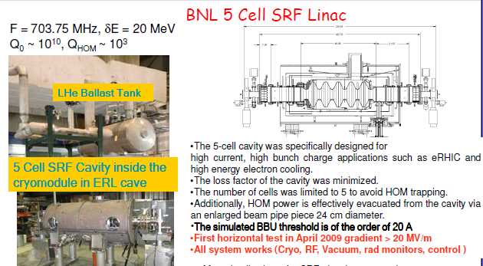
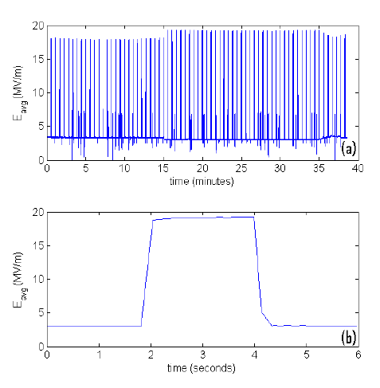
We find that by adopting a duty cycle of ~1:15 (on:off), we can safely turn the cavity up to an accelerating gradient of 18 MV/m. We demonstrated continuous running for 30 minutes with a pulse length of
2 seconds, and an off time of 30 seconds. During the “off” phase, the gradient is held at 3 MV/m. The longest pulse achieved before quenching was 5 seconds..
In cry module horizontal test results 2010.

Slide 10
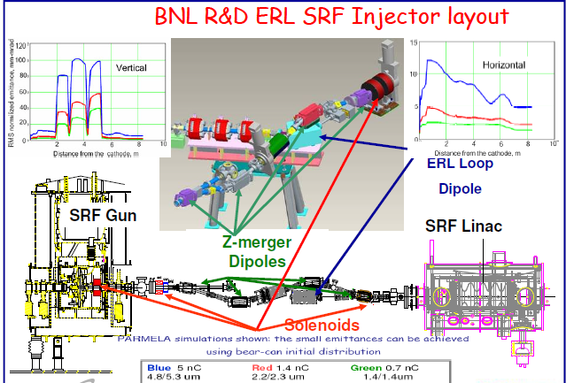

Slide 11
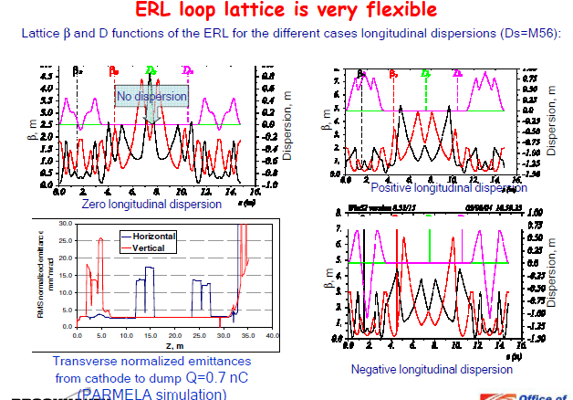

Slide 12
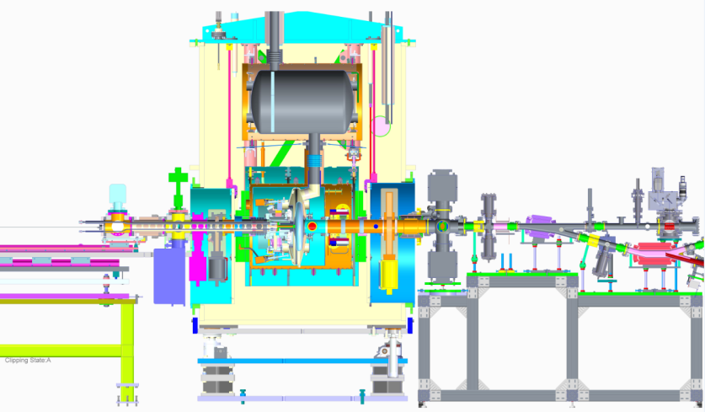
Gun to FC beam test setup
Slit mask
Cathode transport cart
Cavity
Profile monitor
ICT
Cathode
Solenoid
XY corrector
Faraday Cup
Inj. Dipole
Laser cross
BPM
Gate Valve
Halo monitors
Laser beam
D. Kayran, IEBW’15 Cornell University

Slide 13
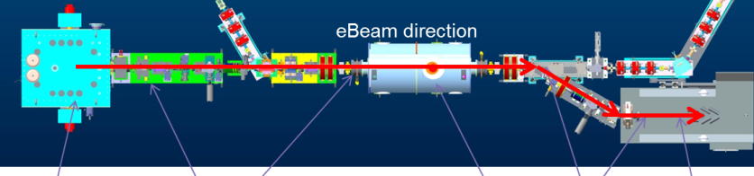
  Goals of Gun to Dump commissioning stages (ARR stage I)
  Injection line commissioning (low current)
      transport beam through the ERL injection line (ZigZag)
      calibrate beam loss monitors
      establish routine and fault dose rates external to the shielding
  Extraction and beam dump commissioning (low current)
      transport beam through 5cell cavity and the ERL extraction line to beam dump
      calibrate beam loss monitors and DCCTs
      establish close to 100% beam to dump transport line propagation
      carry out beam measurements
      establish routine and fault dose rates external to the shielding
  High Intensity Studies (final stage)
      demonstrate stable gun operation at minimum 30 mA average current
      conduct cathode life time studies
      beam dump commissioning
      establish routine dose rates external to the shielding
Learning the machine performance during previous commissioning phases allows proceeding with smooth transition to loop commissioning.
D. Kayran, ERL2015

Slide 14
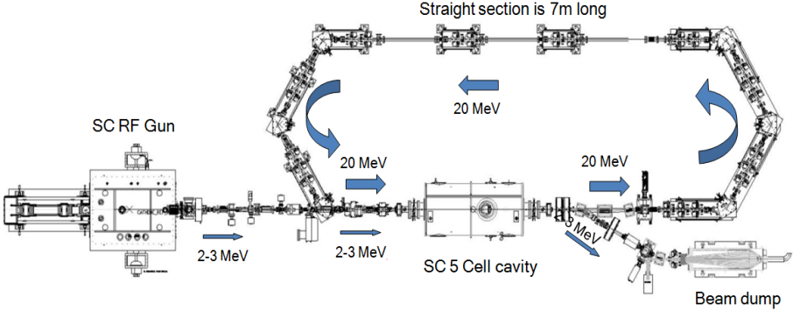
R&D ERL full commissioning ARR-II
Laser
1MW RF Amplifier (klystron)
60 kW RF Amplifier
Beam Parameters
Commissioning goal:
Injection energy: 2 MeV
Top energy: 20 MeV
Multi-Alkali photocathode : QE>3e-3
Laser repetition rate: 9.4 MHz (40 MHz)
Operating: single or/and train pulses
Charge per bunch: 1 nC
Average current : 30 mA
ASE limits (controlled by design)
Max SRF Gun Energy <3.5 MeV
Power source for SRF < 1.5 MW
Max loop electron energy <25 MeV
Maximum Reactive Power: < 10MW
Power source for 5cell cavity < 60 kW
Extraction Beam energy <3.5 MeV
Extraction beam power < 1.5 MW
D. Kayran, IEBW Cornell 2015

Slide 15
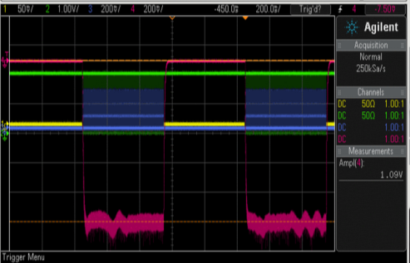
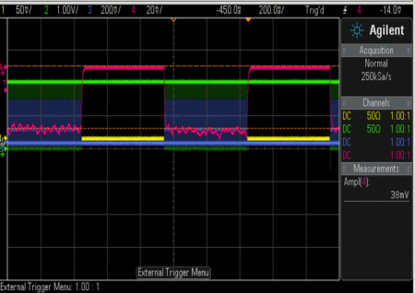
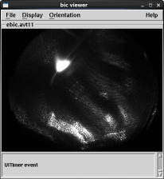
First beam, old cathode Nov 2014.
Laser shutter open
Laser shutter closed
Faraday cup signal (1MΩ termination)
Set up
Laser: 6.1 Watt, green,
Pulse structure 7 μsec, every 500 μsec; 9.38MHz rep rate.
RF: 1.2 MV, 500 ms;
Beam:
  bunch charge: 7.7 pC,
  Average per RF pulse
  photocurrent 1 μA, dark current 38 nA;
Photocathode cold QE=2.7e-5 Very low!!!
Beam image at YAG screen
D. Kayran, IEBW’15 Cornell University

Slide 16
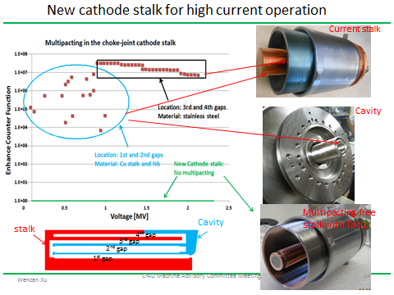
New cathode stalk with Ta tip
Courtesy Wencan Xu, more details on Tuesday, WG1+WG4 joint session.
D. Kayran, IEBW’15 Cornell University

Slide 17
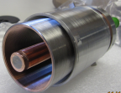
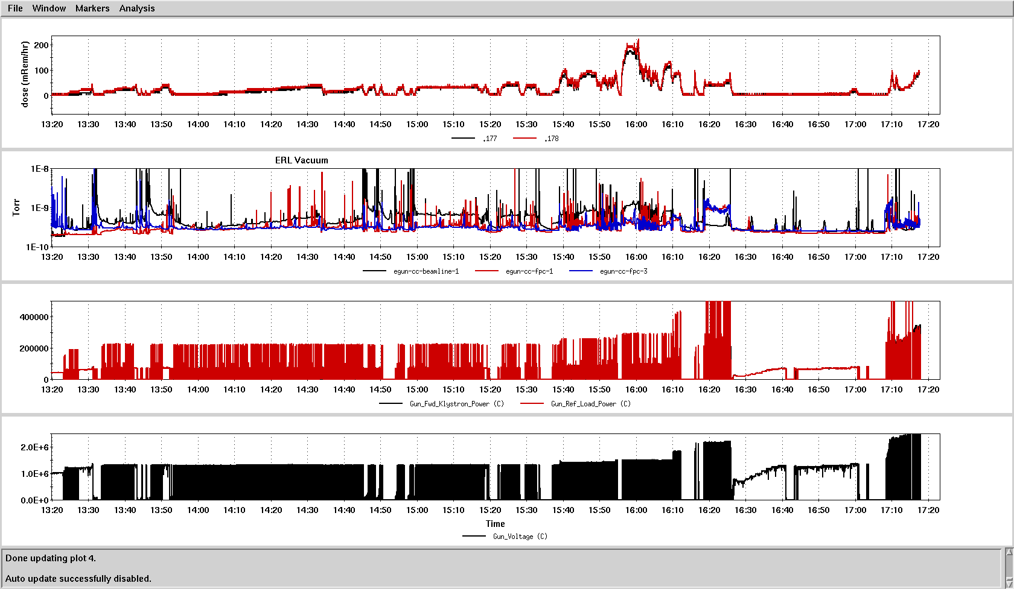
Conditioning Gun with new cathode stalk.
Radiation inside
Vacuum signal
Klystron power
Gun voltage
Conditioning~4 hours
1.25MV CW
Good vacuum,
No radiation
D. Kayran, IEBW’15 Cornell University

Slide 18
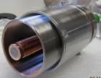
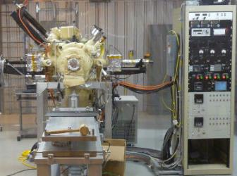
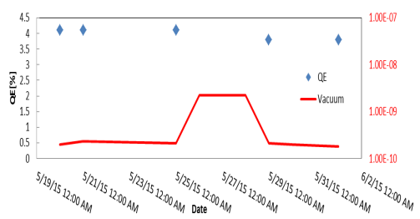
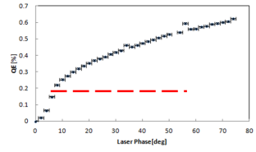
QE with new Ta cathode
~4% QE measured at room temperature
ERL Cathode deposition system at BLD912
We tested 3.8% QE K₂CsSb cathode in the 704MHz SRF gun.
The cathode survives well the gun and stalk RF conditioning.
The cathode QE inside the gun (cold) is 1%. We didn’t see any QE degradation after two days of high bunch charge operation. The vacuum at the gun exit is at 10⁻⁹ scale during gun operation.
After extracting the cathode out of the gun, the QE is still at 3.8%.
Dark current
Peak current 1.65A, Gradient 10 MV/m
Schottky effect
Courtesy Erdong Wang,
Photo current
D. Kayran, IEBW’15 Cornell University

Slide 19
Laser pulses matching RF pulse structure and ICT for startt up test
3-10 msec
1 sec
RF: adjustable pulse length
Bunch train
Raw signal
7 μsec
ICT window
charge measurement
500 μsec
Integrated signal
……….
Bunch car
100 nsec
Bunch:
Laser pulse
22 psec
…….
9.38 MHz
8.5 psec
D. Kayran, IEBW’15 Cornell University
Notes:
LUMERA: Nd: YVO4
Wavelength: 532nm
Power: up to 10 W
Pulse duration: ~ 8.5 ps

Slide 20
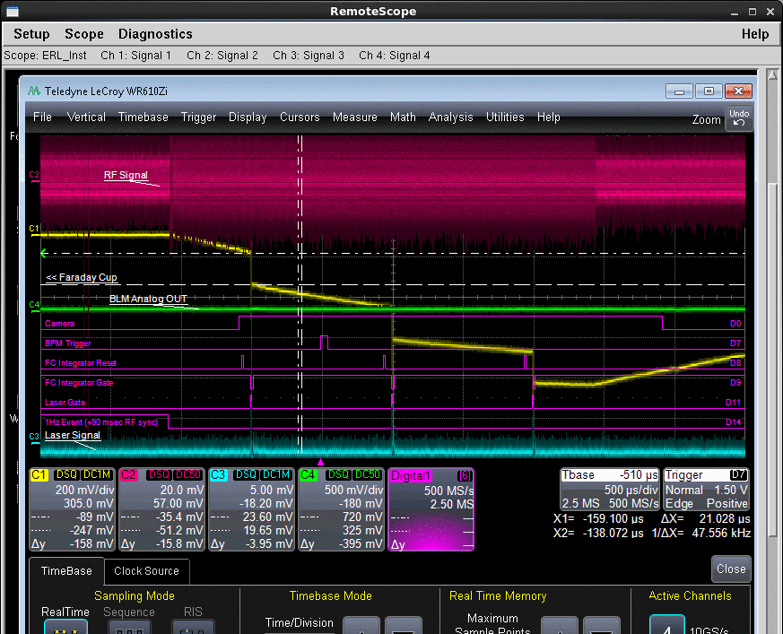
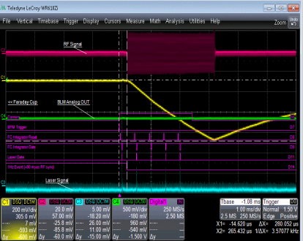
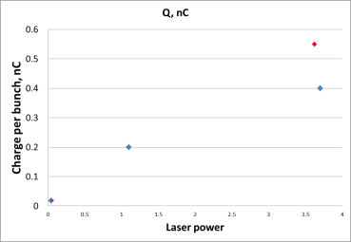
Beam commissioning with new cathode June 2015.
Laser shutter open
Laser shutter closed
Faraday cup signal (1MΩ termination)
Set up
Laser: 0.044 mWatt, green,
Pulse structure 5 μsec, every 500 μsec; 9.38MHz rep rate.
RF: 0.65 MV, 3 ms;
eBeam:
  charge per macro bunch 0.8nC/47bunches=17pC
  dark current 4 μ A;
Photocathode cold QE=1e-2 very Good!!!
Increase laser spot size
D. Kayran, IEBW’15 Cornell University

Slide 21
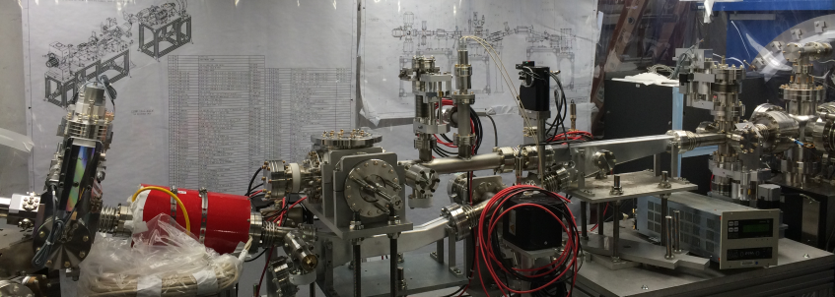
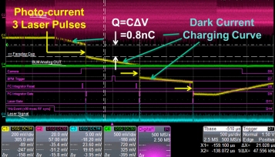
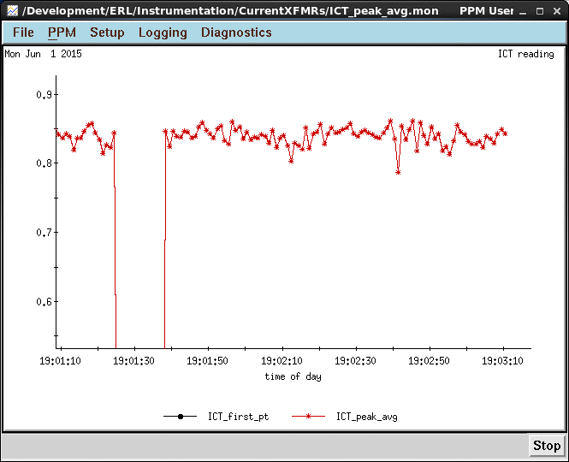
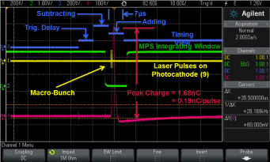
Beam charge measurements
GUN
Faraday Cup
ICT
Beam direction
YAG crystal
Pepper pot
DCCT
Faraday cup
Integrating Current Transformer
FC vs ICT. ICT signal 0.85 nC , FC signal 0.8 nC
D. Kayran, IEBW’15 Cornell University

Slide 22
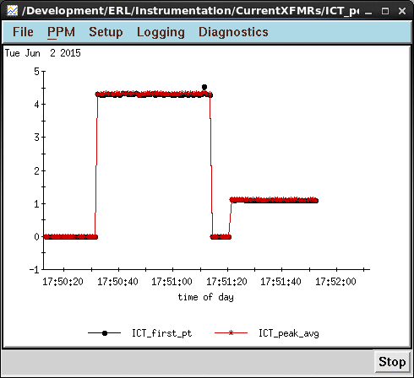
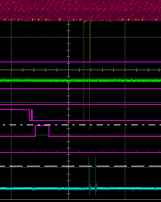
Charge per bunch 0.55nC
2 laser pulses, 0.39uJ each
2 e-bunches at FC observed
Iav_per_RF_pulse 4.5uA
9 bunches,
Q_ICT, nC
Iav_per laser_car=5.3mA
2 bunches
ICT signal for 9 pulses (4.4 nC> 4nC ICT saturation)
Reduce back to 2 laser pulses (1.1 nC) 0.55nC each.
Charge is enough to generate 386mA at 704MHz
D. Kayran, IEBW’15 Cornell University

Slide 23
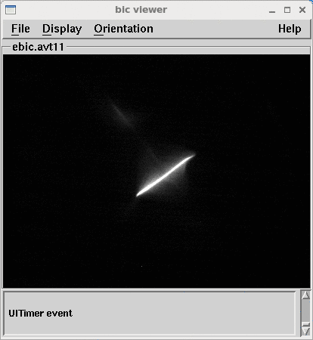
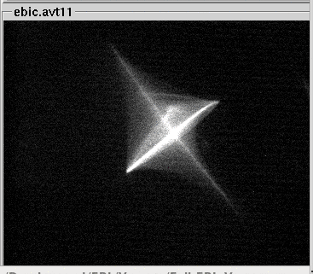
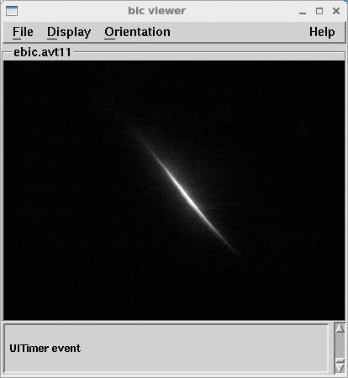

Solenoid scan to measure gun astigmatism (preliminary)
I_sol=6.7A
I_sol=7.24A
Ninja star shape
2 FPCs
Axial symmetric system or not?
Preliminary result focus length 64cm!!!. Required more investigation.
Courtesy V. Litvinenko
D. Kayran, IEBW’15 Cornell University

Slide 24





Dark current and photocurrent
Dark current and photocurrent respond similar to solenoid and corrector change.
Photocurrent 0.8 nC /2 laser pulses
Dark current @ .85MV 4uA per 3 msec
D. Kayran, IEBW’15 Cornell University

Slide 25









Try Solenoid scan, Q=133pC (preliminary)
 | Normalized emittance
full beam | 12 mm mrad
20% core | 0.25 mm mrad
Very Preliminary results
D. Kayran, IEBW’15 Cornell University
Notes:
Siga: 1.4 mm

Slide 26
BNL R&D ERL: designed parameters, progress
Parameter | Units | High current | High Charge | Measured
Energy max/inject | MeV | 20/2.5 | 20/3.0 | ?/1.2 (pulsed)
Charge per bunch | nC | 0.5 | 5 | 0.55
Average Current | mA | 350 | 50 | 0.004
RMS Bunch length | psec | 8-20 | 30 | 8.5; 22
Normalized emittance | 10⁻⁶ m | 1.4 | 5 | 20% core: 0.25 Full rms: 12
RMS energy spread, dE/E | 10⁻³ | 3.5 | 10 | ?
Repetition rate | MHz | 704 | 9.4
Beam dump power | kW | 875 | 150 | 1e-3
Only gun measured
Laser pulse
Very preliminary
Faraday Cup
D. Kayran, IEBW’15 Cornell University

Slide 27
R&D ERL: Installation and commissioning progress
Strategy: Start commission system by system of key components when systems and recourses are available.
Milestones : 
High power RF components installed and commissioned (2005-2007)
SRF 5‐cell installed and cold emission test completed (2009)
9.4MHz Laser system commissioned (2009)
Digital LLRF system commissioning (2012)
2 K LHe cryogenic system/refrigerator commissioned (2012)
SRF half‐cell gun cold emission test w/o cathode (2013)
Conditioning of the SRF gun with a copper cathode stalk (Jan 2014)
Beam instrumentation installed, commissioning continues.
D. Kayran, IEBW’15 Cornell University

Slide 28
Mile stones: commissioning with beam
First beam from the SRF gun with CsK2Sb photo cathode (Nov. 2014)
DOE Approved to beam commissioning Gun to dump (Jan 2015)
New cathode conditioned (Jan 2015)
All ERL components installed, ARR for full ERL commissioning (May 2015)
First good QE cathode (May 2015)
High charge per bunch from the gun (achieved June 2015)
Future plans
Gun into beam dump commissioning (Summer 2015)
ERL beam test low current (Fall 2015)
Laser system upgrade (Fall 2015)
Gun to dump then ERL gradually increase current (until Feb 2017).
Preparing for commissioning ERL components at RHIC IP2 for Low Energy RHIC electron cooler. (Feb 2017-March 2018)
D. Kayran, IEBW’15 Cornell University

Slide 29
R&D ERL summary
An ampere class 20 MeV superconducting Energy Recovery Linac (ERL) is presently under commissioning at BNL for testing of concepts relevant for high-energy electron cooling and electron-ion colliders.
There are two slightly different goals of ERL R&D:
  1. High charge ~1-5 nC per bunch
  2. Hundreds mA average current but moderate charge per bunch.
We may not be able to reach both simultaneously.
Our current laser system:
  without laser splitting can run 10 MHz
  with laser pulse splitting it can run 40MHz.
QE with Ta cathode tip: room temperature 4% , in gun cold 1%. No noticeable difference in QE before and after beam tests has been observed
During first new cathode stalk test.: charge .55 nC achieved, max average current per 3msec RF pulse 4.5uA .
Right now we are limited in charge per bunch because of space charge and low gradient at the cathode. (at 44mW Q=19pC at 4W 550pC).
We will increase voltage and make RF pulses longer by conditioning gun with stalk
Meanwhile our current plan will be study gun performance and try to resolve problems with unstable operation (laser, RF, timing etc).
Until we understand gun behavior it will be very difficult to run higher duty cycle.
D. Kayran, IEBW’15 Cornell University

Slide 30
LEReC

Slide 31


ERL for LeRHIC
Courtesy Jörg Kewisch
D. Kayran, IEBW’15 Cornell University

Slide 32
LEReC Requirements
Energy [MeV] | Gamma | Charge per bunch [pC] | Bunches per bunch train | Beam Current [mA]
1.58 | 4.10 | 100 | 30 | 30
2.04 | 5.00 | 100 | 30 | 30
2.65 | 6.18 | 150 | 24 | 33
3.48 | 7.80 | 200 | 21 | 40
4.85 | 10.50 | 300 | 18 | 50
 | Parameters need for ultimate cooling performance
Normalized rms emittance | < 2.5e-6 m
RMS energy spread | 5e-4

Slide 33
LEReC beam structure in cooling section
Example for γ= 4.1 (E_{ke}=1.6 MeV)
1.42 nsec
Electrons:
f_SRF=703.518MHz
Rms length=3 cm, I_peak=0.4 A
Q_e=100 pC
30 electron bunches
9 MHz RHIC RF
110 nsec,
f=9.1 MHz

Slide 34
LEReC timeline
SRF gun:
2015-2016: SRF gun commissioning w/beam with new cathode stalk.
High-current commissioning in CW mode (LEReC tests in 912).
DC gun:
May 2015 – mid 2016: DC gun construction by Cornell University.
2016: DC gun commissioning at Cornell.
Conversion of the SRF gun into the booster cavity
End of 2015: Start of cooling sections installation
2016: Start installation of electron beam transport and warm RF cavities
June 2017 – Feb.2018: Move and install SRF Gun, SRF cavity, beam dump, etc.
End of 2017-March 2018: Systems commissioning (RF, cryogenics, etc.)
April - Sept 2018: LEReC commissioning with e-beam in RHIC tunnel
October 2018: RHIC Run-19 BES-II physics program (commissioning of cooling with
Au ion beams). RHIC Run-20 BES-II program (LEReC Phase-II)
The new LEReC laser system will run 704MHz. As we demonstrate already .55 nC per laser pulse it should allow us to run 390mA as soon as it’ s available.

Slide 35
Gatling gun

Slide 36

Gatling Gun : Motivation
State-of-the-art
Polarized electron sources deliver either a high peak current, such as >5A achieved by the SLAC(High peak current, low average current)
Or a high average current, such as that up to 4mA reached by the Jlab. (Low peak current, high average current)
Current State-of-art single cathode charge lifetime: 1000C @ 2.5mA
Operation requirement: weekly cathode exchange.
=> Operation lifetime min 85 hours (half week)
Average current :50mA
Charge lifetime: 15,300C
What is needed?
High average current: 50mA; High Bunch charge:5.3nC; Long lifetime
Use set of 20 large area (6mm) cathodes => 50mA/20=2.5 mA
15300C/20=765C<1000C
Very important to demonstrate that the performance of an individual photocathode is not affected by the presence of other cathodes.
Courtesy Erdong Wang

Slide 37


Injector concept based on Gatling gun
10MeV
1% Energy spread
Combiner, 470kHz rotating magnetic bending
Single cathode:470 KHz*5.3nC=2.5mA
After funneling:9.4 MHz*5.3nC=50mA
Courtesy Erdong Wang

Slide 38








Beam Combiner
Bending the beam by dipole
Equalize the focusing by quadrupole
Parameters:
I(t)=I_{od}*cos(ωt+φ) where I_{od}=70.7A
I(t)=I_{oq}*cos2(ωt+φ) where I_{oq}=1.54A
B(0,0,0)=25.04G
Freq=470kHz
Bending angle=29 degrees
Courtesy Erdong Wang

Slide 39


Initial tests results
Cathode preparation
Good QE GaAs photocathodes have been activated
QE~7%
Two low current beams were combined
At a few hundreds nano-amper current level, the test indicates #1 beam will not affect #2cathode lifetime. No cathode cross talk observed.
Lifetime ~2000sec
Courtesy Erdong Wang

Slide 40
Gatling gun : future Plan
Conditioning the gun to 110kV
Reach 10⁻¹² scale vacuum in DC gun vessel
Generate 2.5mA current from super-lattice GaAs photocathode.
Combine four beams to get 10 mA current.
Funneling proof of principle test.
Study cathode charge lifetime, beam quality, beam halo and beam polarization.
Courtesy Erdong Wang

Slide 41
Coherent electron cooler

Slide 42
CEC Motivation
Traditional stochastic cooling does not have sufficient bandwidth to cool intense proton beams (~3×10¹¹ p/nsec) and can not provide two orders of density increase for heavy ion beams
Efficiency of traditional electron cooling falls as as high power of hadron’s energy
Synchrotron radiation is rather fable due to the heavy masses. For the same reason optical stochastic cooling is not suitable
Species | Energy, GeV/u | Stochastic cooling, hrs | Electron Cooling, hrs | CeC, hrs 1D/3D
Au | 130 | 1 | 1 | 0.015/0.3
p | 325 | 100 | > 30 | 0.3/1
Courtesy Igor Pinayev

Slide 43


COHERENT ELECTRON COOLING
The CeC is a novel technique to cool stored ion beam which combines features of stochastic cooling and plasma acceleration. This cooling, with a bandwidth of 10¹³ Hz, can be used to cool RHIC proton beams at full energy, and is essential for any version of the EIC.

Slide 44



eRHIC CEC requirements
Courtesy Igor Pinayev

Slide 45



CeC proof of principal experement
SRF gun – 113 MHz, 2 MV design
Two 500 MHz bunching cavities
Drift space with diagnostics: ICT, BPMs,
profile monitors, BPMs, slits for emittance measurement, Faraday cup

Slide 46
SUMMARY
Significant progress has been made at BNL during the last year in all high intensity beams frontiers.
First current has been observed from SRF gun and from polarized multi-cathodes Gatling gun.
ERL components installation completed
CEC POP SRF gun and other components installed conditioned beam test is scheduled for next week.
LEReC project has been approved
We are just at the beginning of a new adventure
To be continue…..

Slide 47
Acknowledgment for providing material
Ilan Ben-Zvi, Jörg Kewisch, Vladimir Litvinenko, Toby Allen Miller, Igor Pinayev, Vadim Ptitsyn, Thomas Seda, Brian Sheehy, Erdong Wang, Wencan Xu and R&D ERL team.
D. Kayran, IEBW’15 Cornell University

Slide 48
Thank you!

Slide 49
Back up

Slide 50



Gun at different stage of assembly

