Slide 1
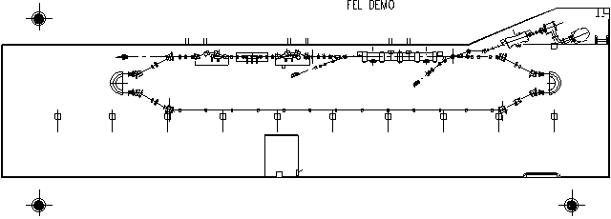
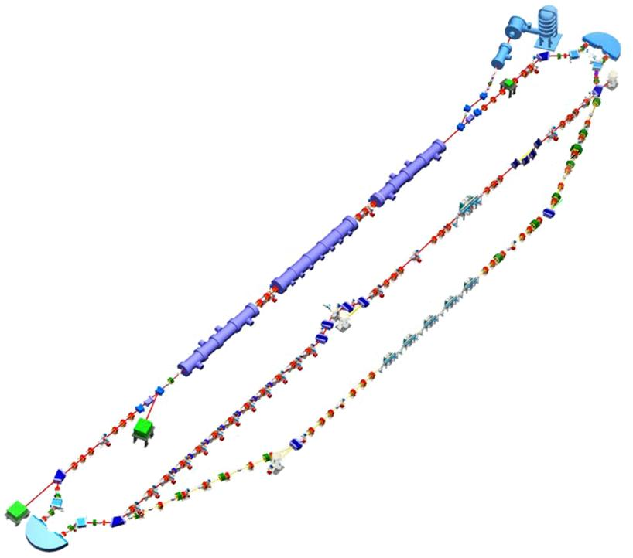
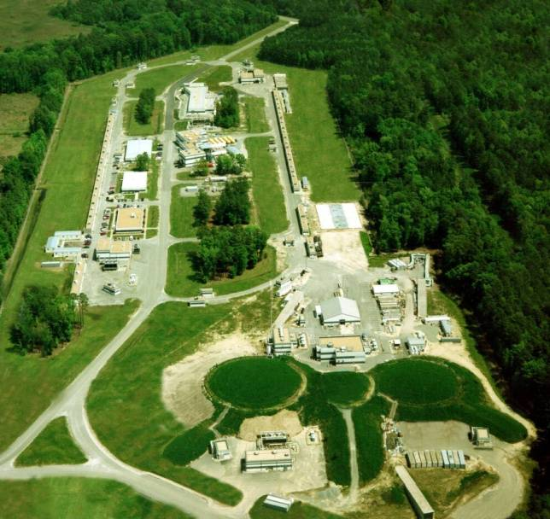
Operational Experience With CW SRF ERLs D. Douglas
Authored by Jefferson Science Associates, LLC under Contract No. DE-AC05-06OR23177 with the U.S. Department of Energy.

Slide 2
This Sermon’s 3 Points
Energy recovery is a robust cost control measure:
ERLs give bright beams at optimum cost
ERLs are really just fancy time of flight spectrometers
They exist to create specific time/energy correlations
Consequence*: system architecture driven by evolution of energy/phase dynamics (longitudinal match)
*(sermons are, after all, about consequences…)

Slide 3
ERLs are non-equilbrium systems
no natural emittance (cf. storage rings);
no closed orbit (really... there is no closed orbit…);
inherent betatron/synchrotron stability may be unnecessary;
beam and the lattice are different (sometimes deliberately…)
Consequence: an ERL is more similar to a storage ring injection chain than it is to the ring itself… (and recall, to our collective sorrow, that injection is when all the loss occurs… and notice that an ERL is a continuous, 100% duty cycle injector…!)

Slide 4
But first, a quick overview…

Slide 5
What are Energy Recovering Linacs? Compare to conventional accelerators…
Rings
Recycle each accelerated particle an infinite number of times – adding a bit of energy each time
High beam powers for modest input power: efficient acceleration
MW of RF + MW DC ⇒ GW beam power (e.g., 0.5 A @ 2 GeV)
Circulation of beam ⇒ radiation excitation ⇒ inherently limited beam quality
Linacs
Accelerate each particle rapidly in a multiple RF structures
Beam power inherently less than power required for acceleration (wall losses): inefficient acceleration
MW of RF + MW of DC ⇒ MW beam power (e.g., 50 μA @ 20 GeV)
BUT… Beam is not in machine long enough for quality to degrade: performance is source limited

Slide 6
Linac Cost/Performance Optimization: Recirculation and SRF
Linacs provide great beam quality, so its worthwhile to try to make them more cost effective
To control cost & improve performance, linac builders utilize certain “slight of hand” tricks
Recirculation : “reuse” accelerating structure, reducing linac size and hence cost
Transport beam from end of linac & reinject in phase with the RF fields for further acceleration
Superconducting RF : avoids wall losses
Allows high gradient CW operation
Dramatically reduces required RF power (enough to offset cost of cryogenic plant and additional RF system complexity)
Significantly improves beam quality
Notes:
Linacs give such good quality beam, it has been worthwhile to try to make them more cost effective…
You might argue that using SRF simply shifts cost of machine from installed RF power to cost of cryogenic plant and

Slide 7
Machine Topologies
RF Installation
Beam injector and dump
Beamline
Recirculating
Linac
Ring
Linac
Notes:
Multiple recirculations allows reuse of accelerating cavities – makes acceleration more efficient while requiring little additional bending, and imposing little additional constraint on beam quality…

Slide 8
Whence ERLs?
Use of recirculation reduces cost
Beamline inexpensive relative to RF
Proper system design avoids instabilities, beam quality degradation
RF power still a problem:
CEBAF: 200 μA x 4 GeV = 0.8 MW
manageable (affordable)
Light source 100 mA x 5 GeV = ½ GW
needs dedicated nuclear power plant...
and… what do you do with a GW of waste electrons?

Slide 9
The Next Step: Energy Recovery
So, “consider a circular linac”… or at least a recirculated linac
To accelerate turn-to-turn, beam bunches must be synchronous with RF. Pass-to-pass phase is important!
You might wonder what will happen if you reinject the beam out of phase with the accelerating field, rather than in phase…
Linac energy gain
time
Subsequent pass is decelerated – the beam power is deposited back into the RF system…
and can be used to accelerate later bunches – replacing significant amounts of RF power (and cost)!

Slide 10
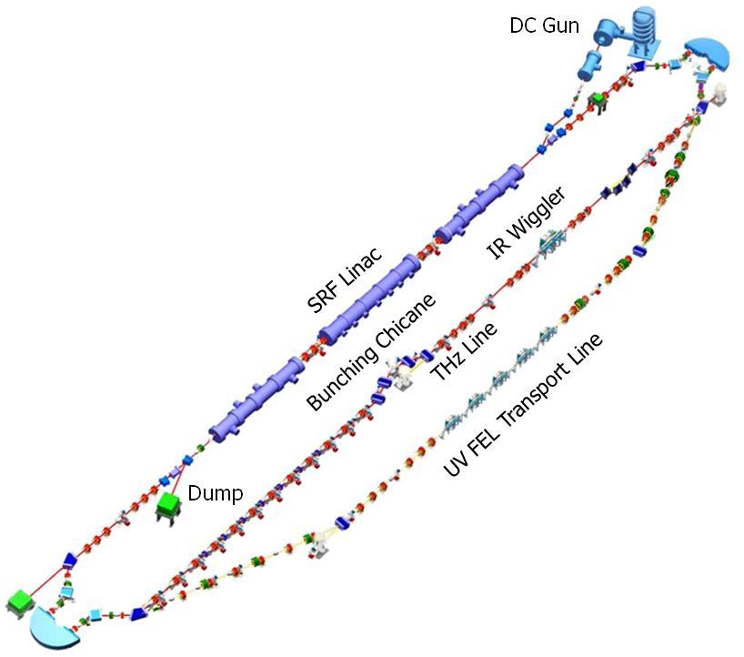
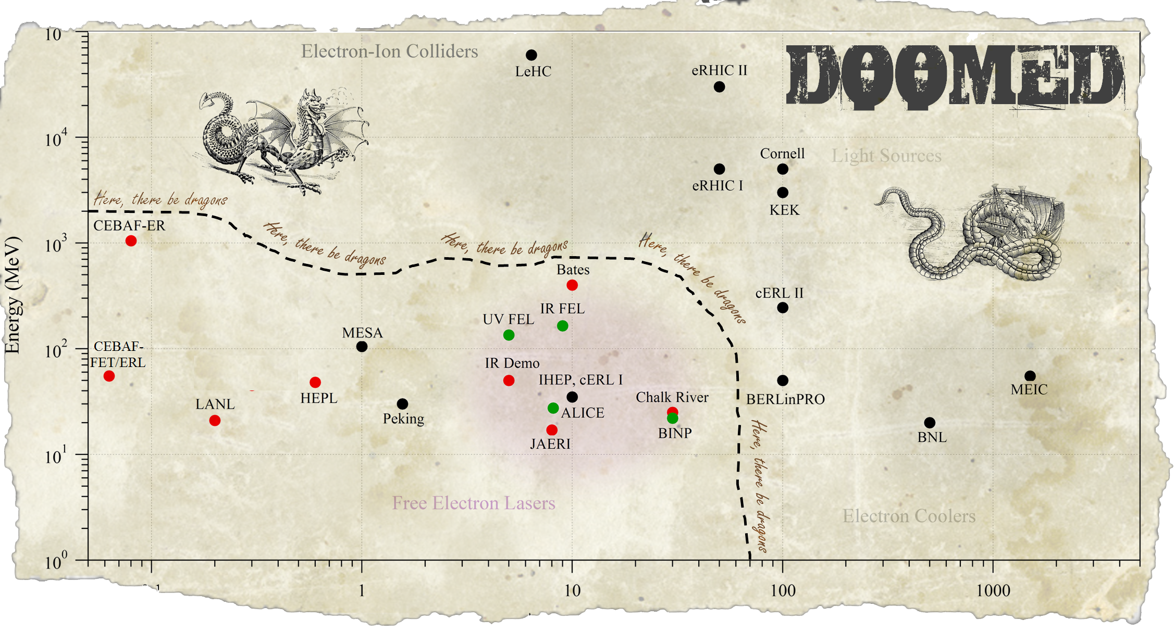
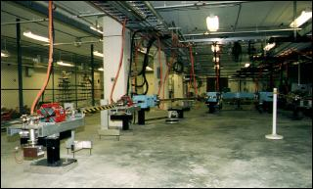
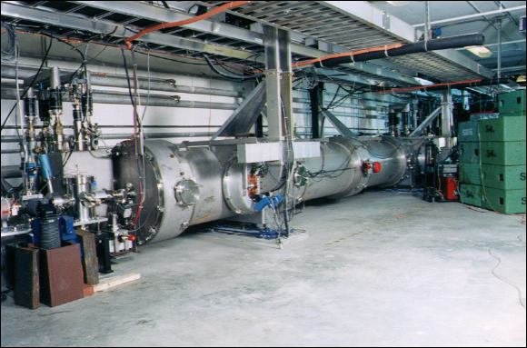
Historical Overview
Jlab has built and operated five of the world’s six CW SRF ERLs:
FET recirculation test – ca. 1991
BBU validation for CEBAF
IR Demo FEL Driver – 1997-2001
1 kW CW IR FEL demonstration (2.1 kW achieved)
CEBAF-ER – 2003
GeV-scale ERL test
IR Upgrade FEL Driver – 2003-present
10 kW IR FEL scale-up test (14.3 kW achieved)
UV Demo FEL Driver ERL – 2009-present
“high” power CW UV FEL wavelength scaling validation test (100+ W CW)
~15,000 hours beam time/20 CY operational experience
Current (mA)

Slide 11
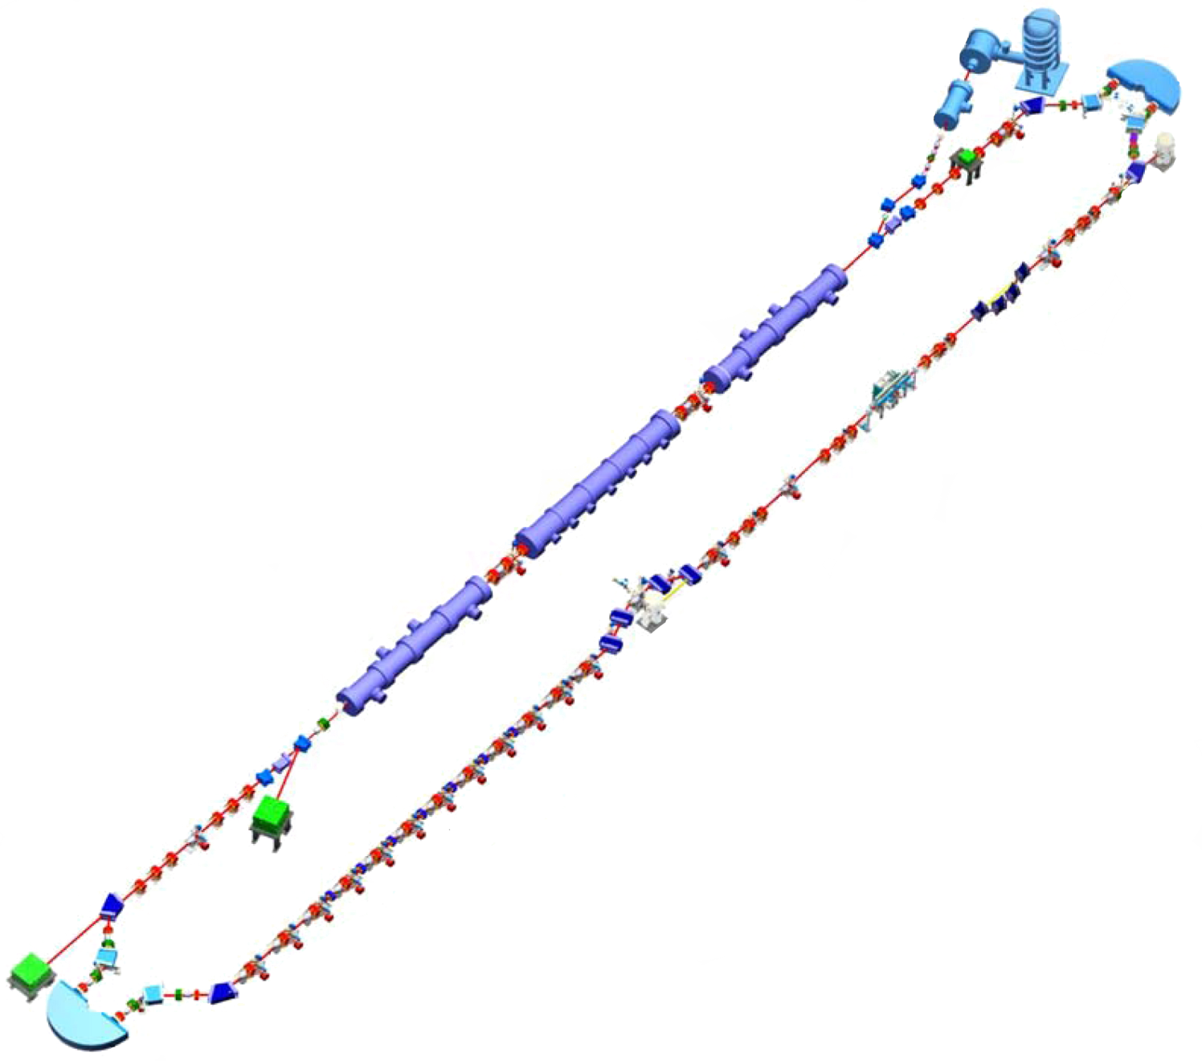
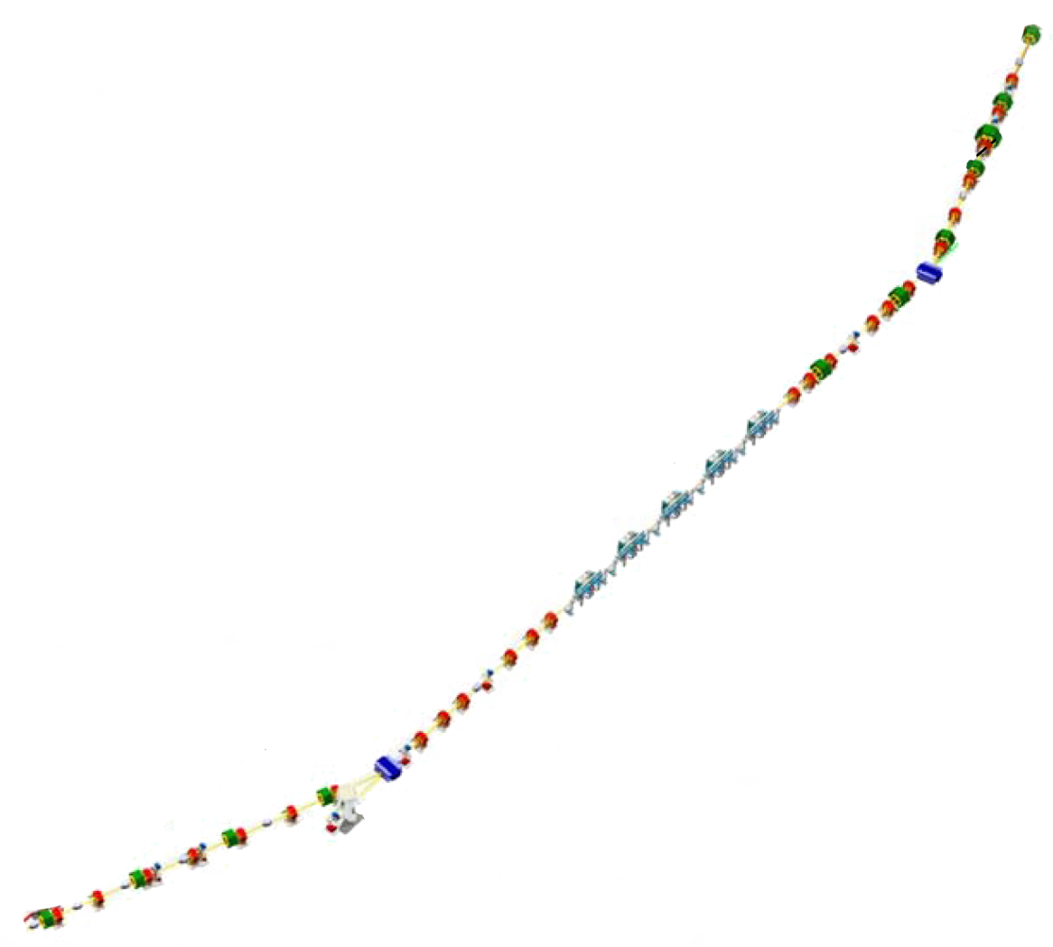
IR/UV ERL Architecture
DC photocathode gun (350 keV)
9 MeV booster
Penner bend merger
3 cryomodule linac
Bates bend arcs
compression in chicane for IR;
arc/bypass for UV (“chicaneless”)
nonlinear compaction management &
RF curvature compensation; energy compression during recovery
DC Gun
IR Wiggler
SRF Linac
Bunching Chicane
THz Line
UV FEL Transport Line
Issues
Drive laser
Gun
SRF performance/damage
Magnet field quality (time-of-flight
spectrometer);susceptibility to
small errors
DC power/field reproducibility
Dump

Slide 12
ERL Parameters (Achieved)
Parameter | IR | UV
Energy (MeV) | 88-165 | 135
I_{ave} (mA) | 9.1 | 2 (mirror limited)
Q_{bunch} (pC) | 135 (270) | 60
ε_{N} transverse/longitudinal (mm-mrad/keV-psec) | 8/75 | 5/50
σ_{δp/p,} σ_{l} (fsec) | 0.4%, 150 | 0.4%, 100
I_{peak} (A) | 400 | 250
FEL repetition rate (MHz) (cavity fundamental 4.6875) | 0.586-75 | 1.172-18.75
η_{FEL} | 2.5% | 0.8%
(ΔE/E) _{full} after FEL | ~15% | ~7%

Slide 13
Top 10 Lessons Learned
What has been is what will be, and what has been done is what will be done; there is nothing new under the sun.
Ecclesiastes 1:9 NRSV
Beam quality preservation: performance is source-limited – “as good as it gets…” (Liouville) => conservative design
“bad” things at high energy (power extraction, beam-beam, beam-target, SR, etc, etc…) adiabatically anti-damp to limit performance at back end
however…. “better is the enemy of good enough”: best injected emittance may not give best delivered emittance… (more rapid degradation in front end)
FET/Demo/CEBAF-ER=> longitudinal match constrains architecture
ERLs are time-of-flight spectrometers (create phase/energy correlations), not transport systems
nonequilbrium systems
no closed orbit; may not be betatron stable/have “matched” beam envelopes
beam and lattice are different (mismatch often advantageous)
spectrometer-grade components
aberration management critical: nonlinear modeling/control needed
e.g – octupoles in longitudinal match – need nonlinear control, but don’t need harmonic RF…
RF drive/transient management
high Q_{ext} can require more power than low Q_{ext} …

Slide 14
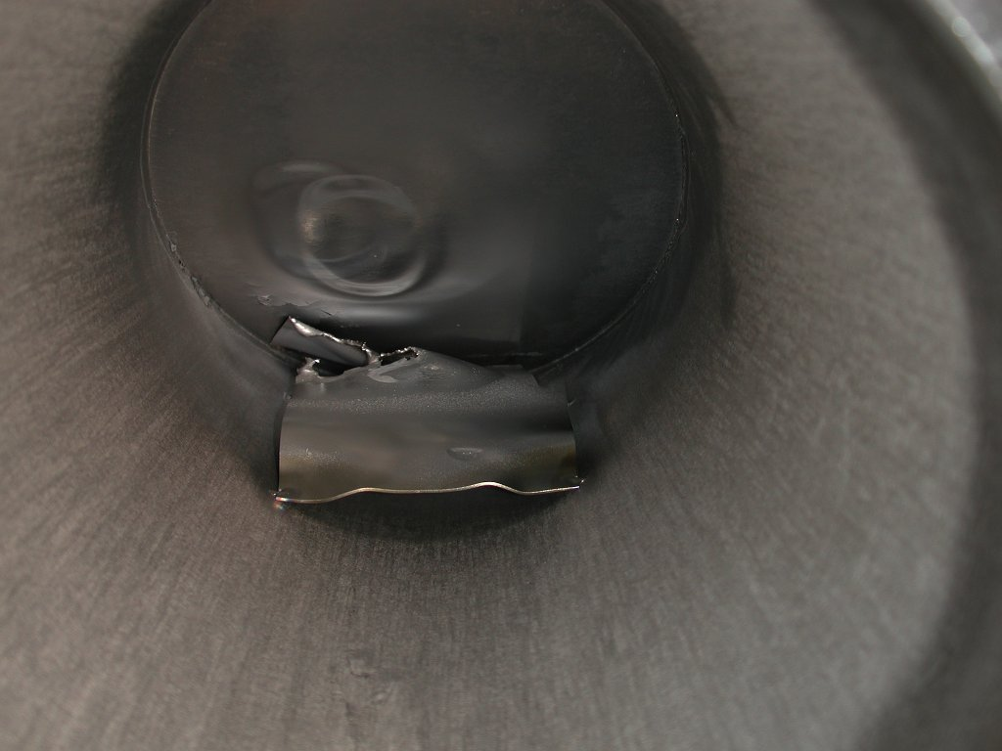
Hardware very robust, but… need to provide significant margin
flexible system design allows ops despite abuse (3 of 4 modules damaged)
performance can degrade over time
High power beam ⇒ power-flow management (i.e., “don’t lose beam or excite wakes”…)
high duty cycle/CW a game-changer; worse as bunch charge increases
CW operation equivalent to operating a ring injection chain with 99.999% efficiency
Halo & collective effects…
Design robustness (redundancy, reliability) and flexibility
needed major retrofits (THz chicane, phase space exchange)/had to run machine far from design operating point (lower energy) to achieve goals
encounter “new” effects (LSC, resistive wall, THz heating, RF heating…)
Beam loss in CW ERLs is not like that in storage rings, its equivalent to loss in a storage ring injector chain
high power ⇒ 99.999% capture efficiency – keep losses < 0.001%
halo – major operational impediment
Collective effects in an inherently high-brightness system
had to manage BBU (completely stabilized)
It’s always the drive laser…
subtleties of CW synchronization/control amongst various different types of RF systems (esp. vendor issues)
courtesy C. Tennant

Slide 15
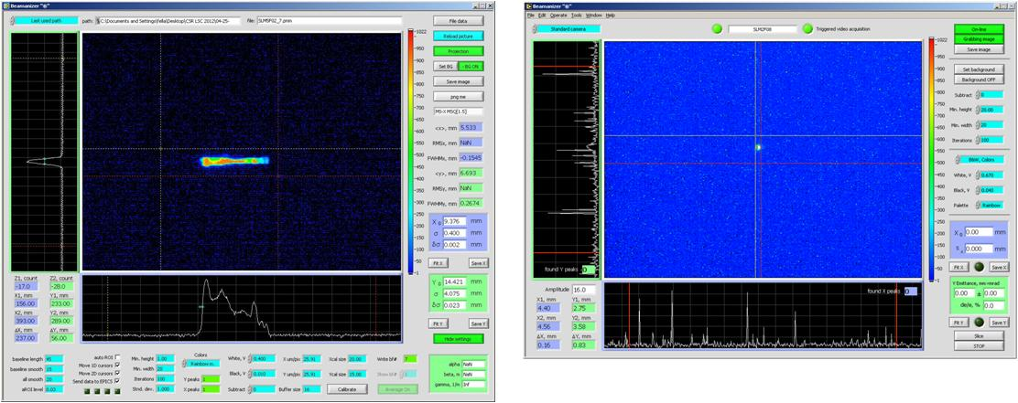
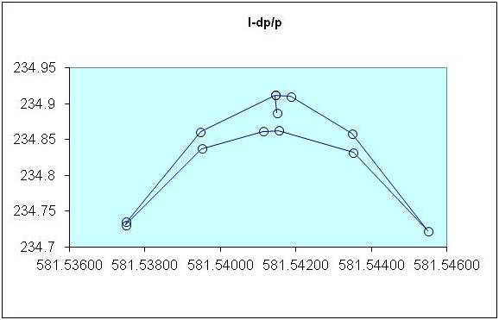
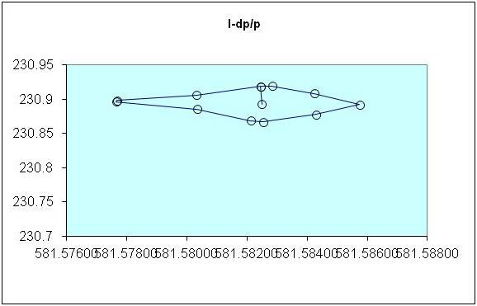
Influence of Longitudinal Match
ERL=time of flight spectrometer => performance sensitive to longitudinal dynamics
Can switch between quite different operational modes with only minor parametric changes
e.g. cross-phasing of linac modules: change single phase setpoint and go from short bunch to small dp/p
Allows management/control/improvement of beam quality (and degradation) in presence of collective effects, coherent phenomena, ...
Examples:
LSC management, bunch length compression during acceleration/transport; energy compression during energy recovery
UV bunch compression w/o chicane
RF curvature correction w/o harmonic RF
Bunch length compression with positive compaction (M₅₆>0)
Suppression of RF curvature effects ⬄ reduction in dp/p (cf. to on-crest/in trough operation)
Can run with longer bunch/mitigate LSC effects
Enhancement/suppression of LSC/CSR/μBI
E (MeV)
E (MeV)
t (nsec)
t (nsec)

Slide 16
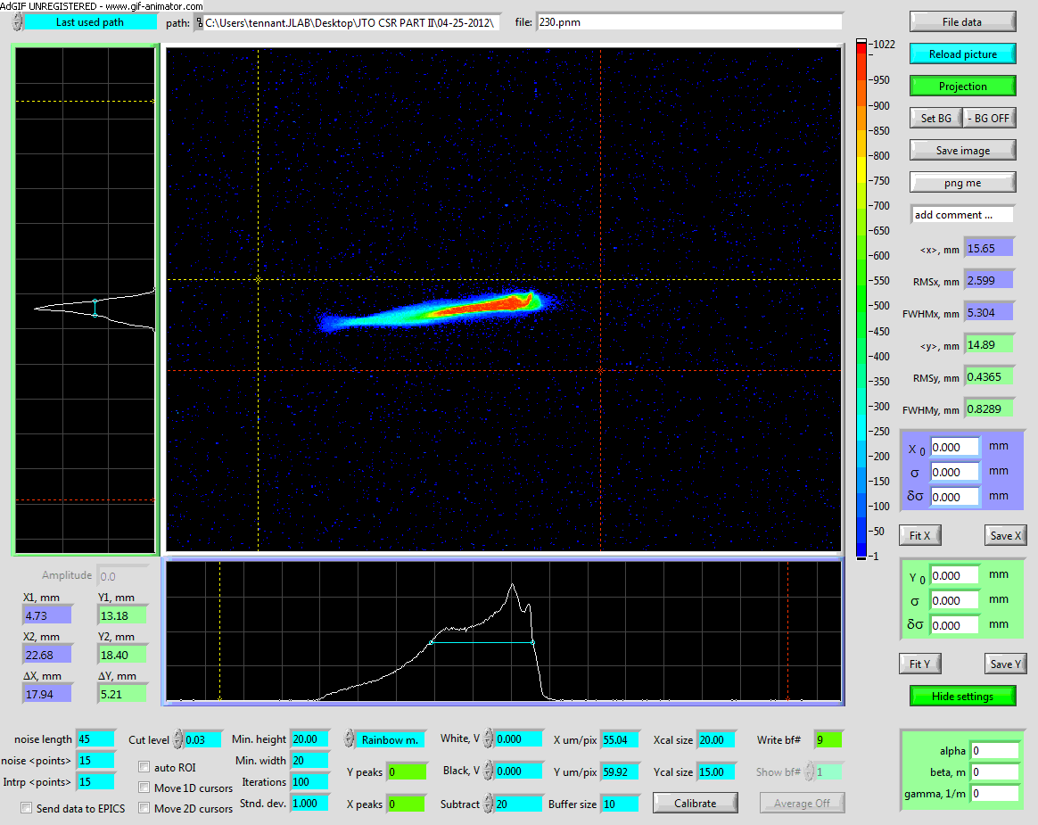
Courtesy C. Tennant

Slide 17
Longitudinal Matching Scenario
DC Gun
Requirements on phase space:
high peak current (short bunch) at FEL
bunch length compression at wiggler
using quads and sextupoles to adjust compactions
“small” energy spread at dump
energy compress while energy recovering
“short” RF wavelength/long bunch,
large exhaust δp/p (~10%)
get slope, curvature, and torsion right
(quads, sextupoles, octupoles – no
harmonic RF…)
E
φ
E
IR Wiggler
φ
SRF Linac
E
Bunching Chicane
E
φ
E
φ
Dump
E
φ
φ

Slide 18
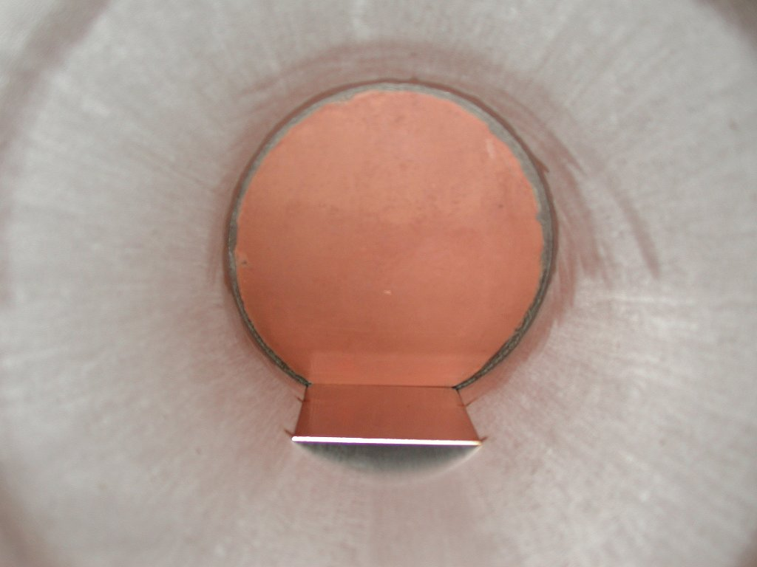
JLab IR Demo Dump
core of beam off center, even though BLMs showed
edges were centered
(high energy tail)

Slide 19
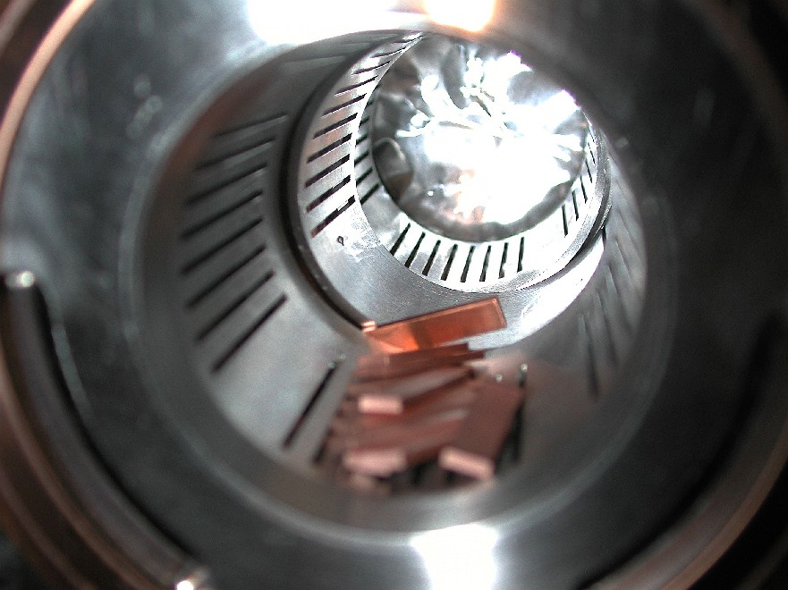
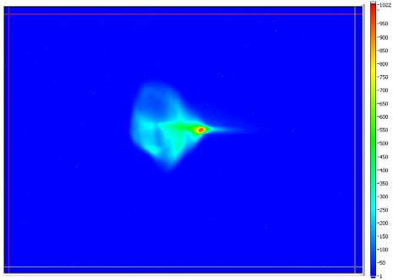
Halo – a dominant CW performance issue
Calibration: see losses from “10 mm-mrad” beam… at points with 5600 mm-mrad acceptance
“Real beams do not occur in distributions named after dead European mathematicians” (P. O’Shea).
typically multi-component (transversely and longitudinally)
Makes betatron matching tricky (match phase space volumes to phase space volumes, not beam spots to beam spots)
“Halo” = large emittance, low intensity component(s) of beam
6 mm
6σ
mismatched to core
sample large amplitudes
can be tightly focused (but with large divergence)
“stuff” that’s too dim to see with standard diagnostics (down by ~3+ orders of magnitude in density), but has enough power to burn things up
“Nσ” not a good measure of required aperture
50 mm
Notes:
Point out on this slide that ERLs are nonequilibrium systems – and thus much more like injection chains (and linacs) than rings – at least in terms of halo/scraping/activation. Compare fractional losses during injection (10s of % - due to low duty cycle) to what is tolerable in a high power ERL (0.001% or less)…

Slide 20
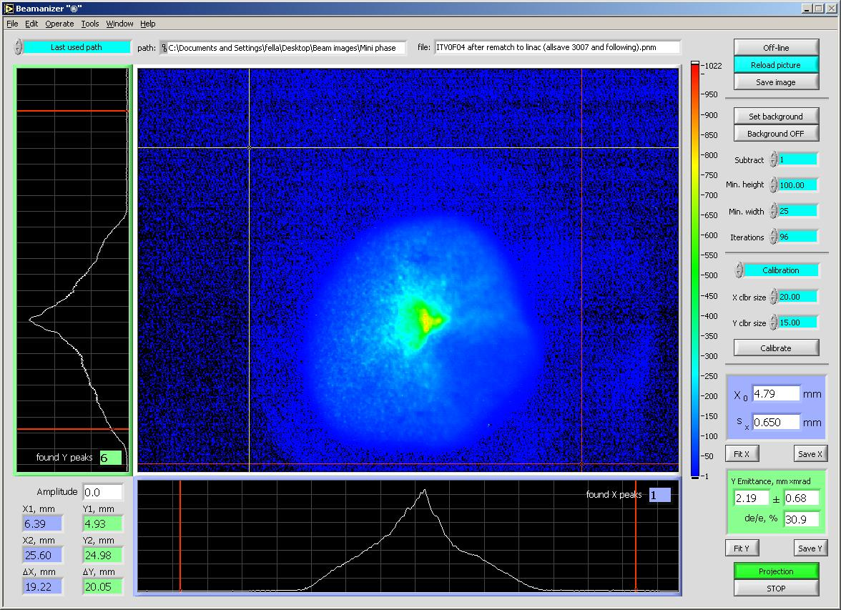
Halo Experience
Sources of halo:
stray light on cathode field emission
dynamics of bunch formation dark current (primary source
and evolution of background)
…
We’ve seen
Halo on beam in injector (measured/modeled – P. Evtushenko)
CW beamlets at ~40-50 MeV, 110 MeV, ... (drive laser shutter closed)
Loss at aperture constraints,
High radiation background around machine (RF on, beam off)
Can map out halo patterns:
Beam and lattice are different:
lattice defines what happens to beam
beam doesn’t a priori match lattice
Halo almost always mismatched
Assess where “big amplitude” stuff goes (e.g. by mapping out envelope of all correctors)
Results match surveys/observed loss pretty well
Courtesy P. Evtushenko

Slide 21
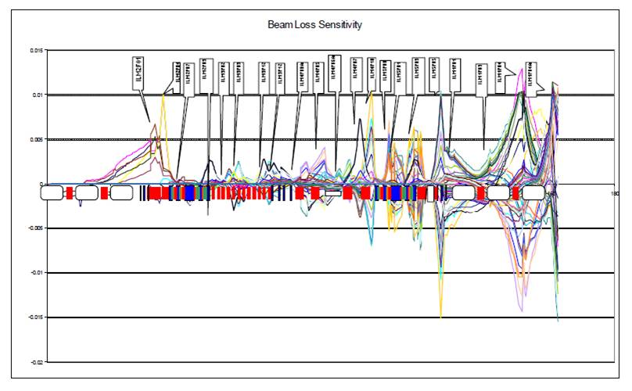
Halo
dark current
wiggler aperture
reinjection match
small bore module
beam dump

Slide 22
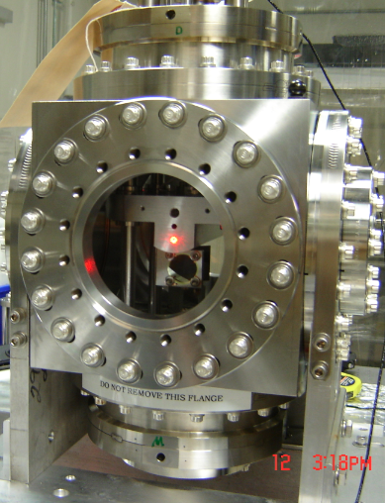
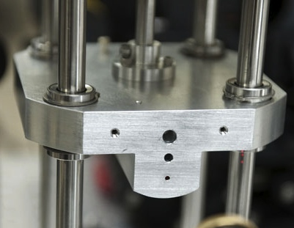
Halo Management
Can control halo – to some extent
Use mismatch to adjust halo envelopes at aperture constraints
Find quad where halo large, core beam small;
adjust “halo” knob, reduce halo size at aperture (vary phase advance);
use BLMs as diagnostic
Need to have flexible transport system design…
Controls loss at wigglers and during “DarkLight” test
Internal target validation run
450 kW (4.5 mA CW at 100 MeV) through 2 mm aperture for 8 hrs; 6 ppm loss
Method becomes problematic when aperture is constrained over significant phase advance… halo envelopes ring…
“Quantitative/deterministic” control – will need large (10⁶) dynamic range diagnostics, tomography, …
P. Evtushenko (10⁵ range achieved during DarkLight run)
“You can’t collimate electrons, you can only make ‘em mad…” (G. Neil)

Slide 23
Halo-Related Issues We Didn’t Have
Intrabeam/beam-gas scattering
No obvious evidence of beam-gas, IBS, Touschek, but…
Beam brightness is modest (5-10 mm-mrad x 50 keV-psec at 135 pC)
Ions
Estimates range from “no effect” to “fatal”
No obvious evidence of ion accumulation, however…
Beam current is modest (10 mA)

Slide 24
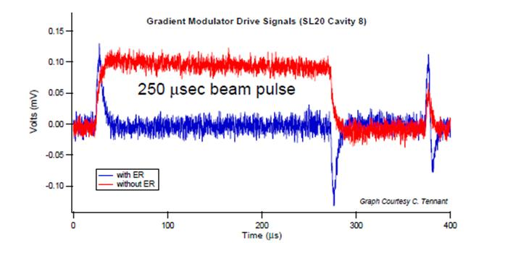
RF Transient Effects
Beam off/on
transient beam loading
cavities detune
FEL off/on
energy transients
reinjection phase transient
transient beam loading
cavities detune
Need adequate RF control & power to avoid tripping
Specs/methods depend on details of cavity design and operational modes
Details can be counterintuitive
Example – low Q_{ext} can sometimes require less power than high Q_{ext}

Slide 25
ERL Magnet Field Quality Requirements
ERLs: time-of-flight spectrometers ⇒ differential B errors a problem:
ΔB ⇒ δx’= ΔBl/Bρ = (ΔB/B) θ_{dipole}
δx’ ⇒ δl = M₅₂ δx’
δl ⇒ ΔE_{dump} = E_{linac} sin φ₀ (2π δl/λ_{RF})
= E_{linac} sin φ₀ (2π Μ₅₂(ΔB/B)θ_{dipole}/λ_{RF})
Tolerance ΔB/B needed for specific acceptance ΔE_{dump} tighter for higher E_{linac} , shorter λ_{RF} , larger dispersion (M₅₂ = M₂₂M₁₆ – M₁₂M₂₆)
JLab numbers: ΔE_{dump} ~ 3400 MeV * (ΔB/B)
(observed at JLab… ΔB/B ~ 10⁻⁴ ⇒ few 100s of keV at dump)
ΔB ⇒ δx’=ΔBl/Bρ∼ΔBl/(33.3564 kg-m/GeV * E_{linac}) ⇒ δl=M₅₂ δx’
δl ⇒ ΔE_{dump} = sin φ₀ (2π Μ₅₂(ΔBl/33.3564 kg-m)/λ_{RF})
Tolerable absolute “error integral” ΔBl is set by dump acceptance; is independent of linac length/energy gain; tolerable relative field error falls as energy (required field) goes up

Slide 26
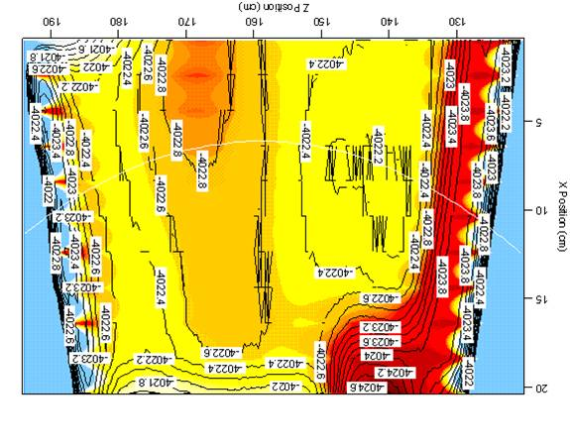
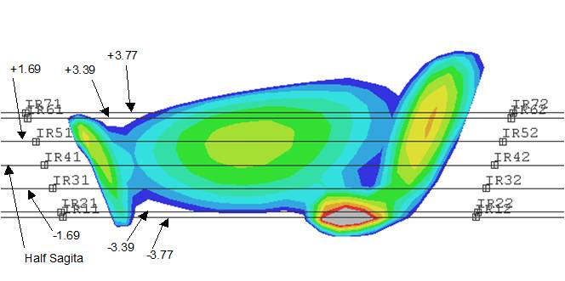
Dealing With Field Quality…
Palliative measures:
make better magnets
use lower energy linac
reduce M₅₂ (smaller dispersion, stronger focusing)
provide means of compensation (diagnostics & correction knobs)

Slide 27
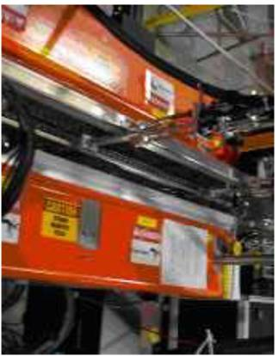
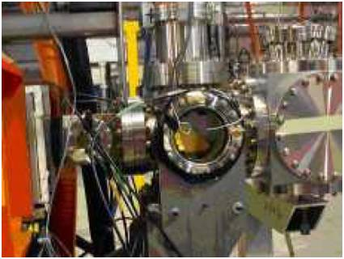
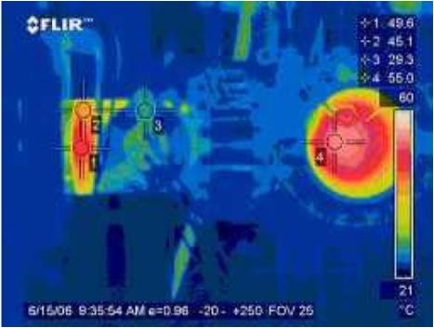
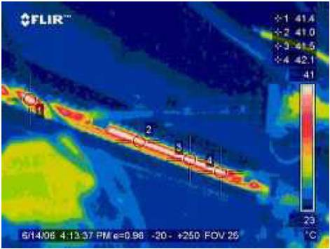
Collective Effects: Inherent in High-brightness Systems
Collective contributions to halo
dynamics of beam formation, Touschek/intrabeam scattering, …
[you can’t collimate electrons, you can only make ‘em mad…],
wakes, impedances, interaction of beam with itself &/or environment
BBU, CSR, LSC, μBI…
Space charge ->100+ MeV; “injector stretches from cathode to FEL”… and back to dump…
losses can be worse at lower charge than at higher (e.g. 30 pC worse at dump than 135 pc due to loss of space charge focusing)
dominates dynamics/performance down linac
THz, resistive wall, RF heating… all performance issues in IR Upgrade

Slide 28
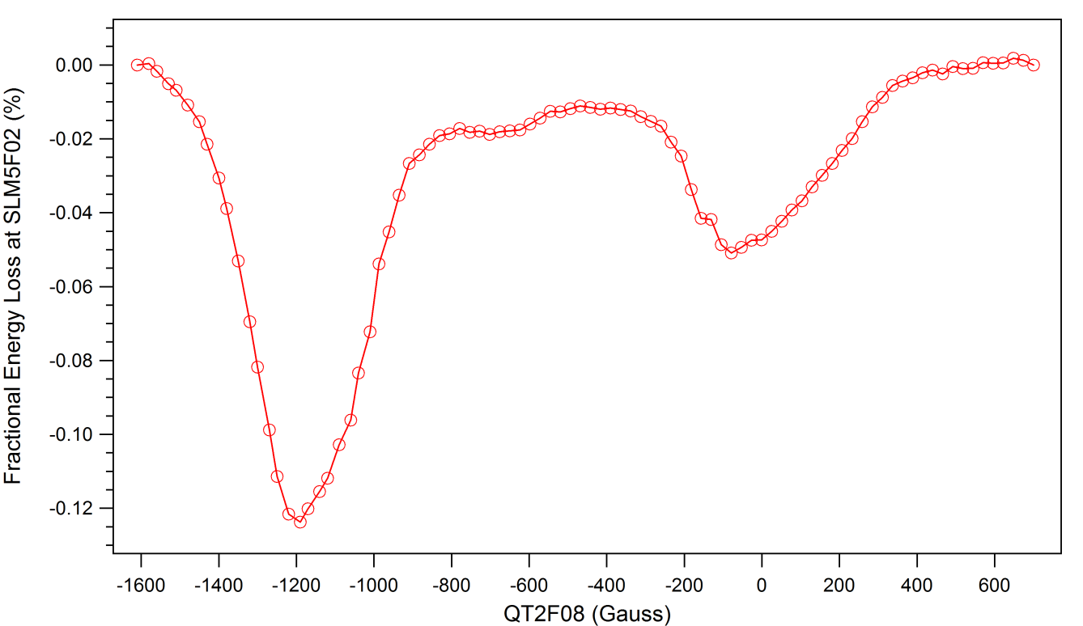
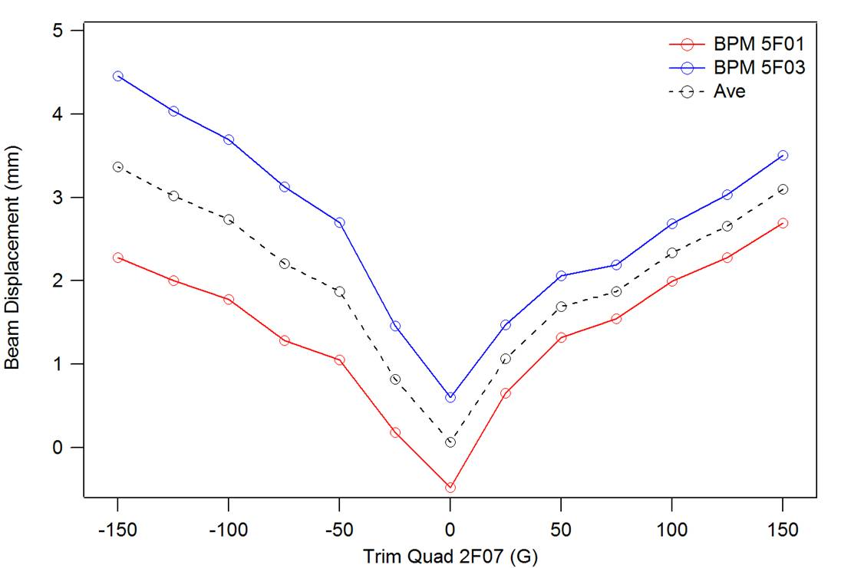
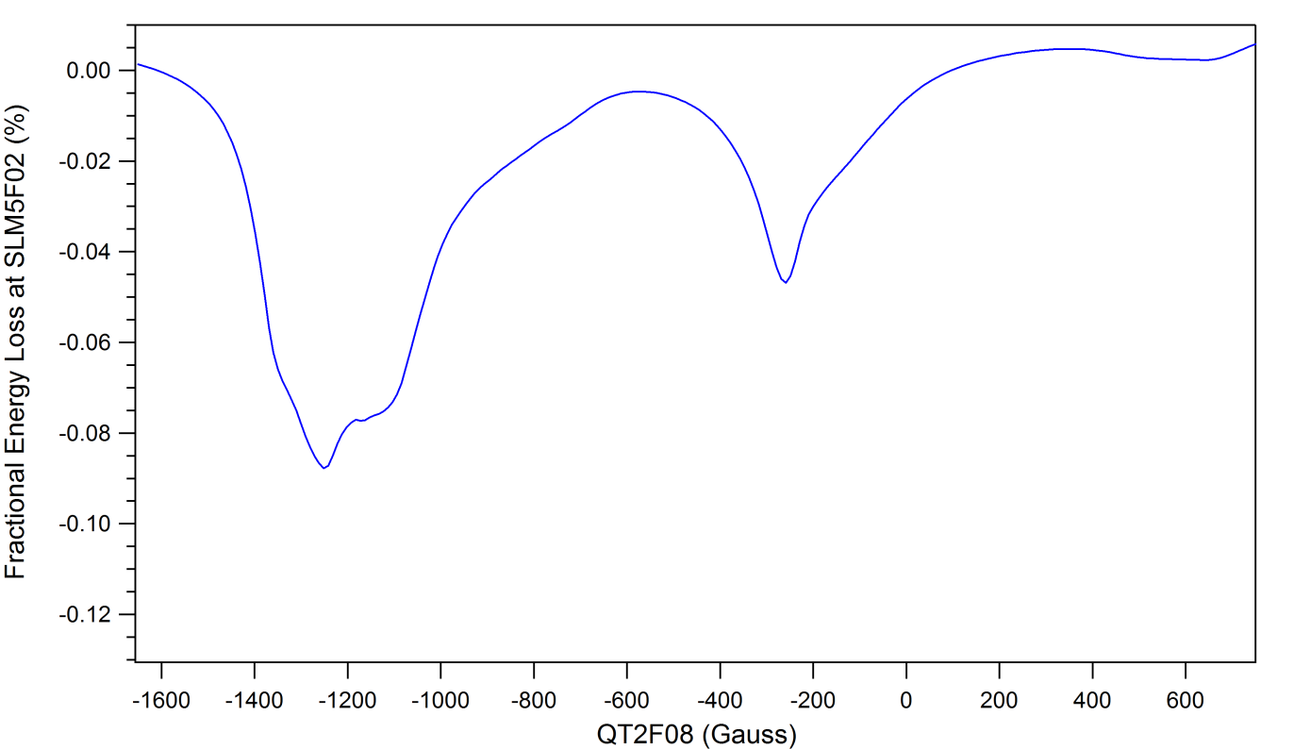
CSR Management During Recirculation & Compression
IR Upgrade generated high power THz (135 pC x 150 fsec)
Observed extraction efficiency ~0.2% => ~2+ kW at full current
Went unexpected places (e.g. FEL outcoupler…)
Must learn to control/optimize
Impact of CSR on beam quality a serious concern during both recirculation and compression
Impact of high power THz on hardware a serious concern for high brightness systems

Slide 29
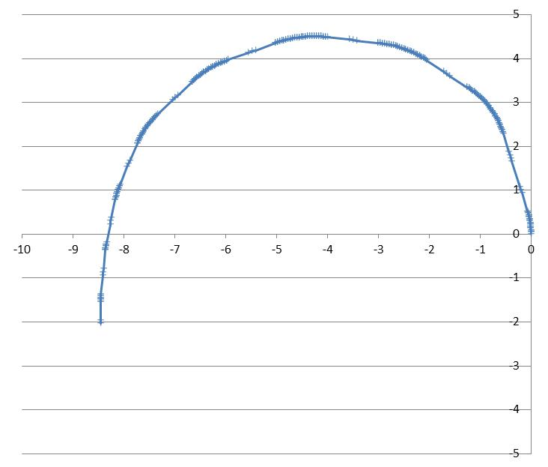
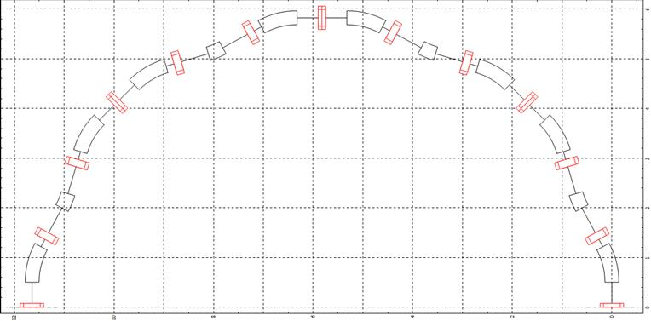
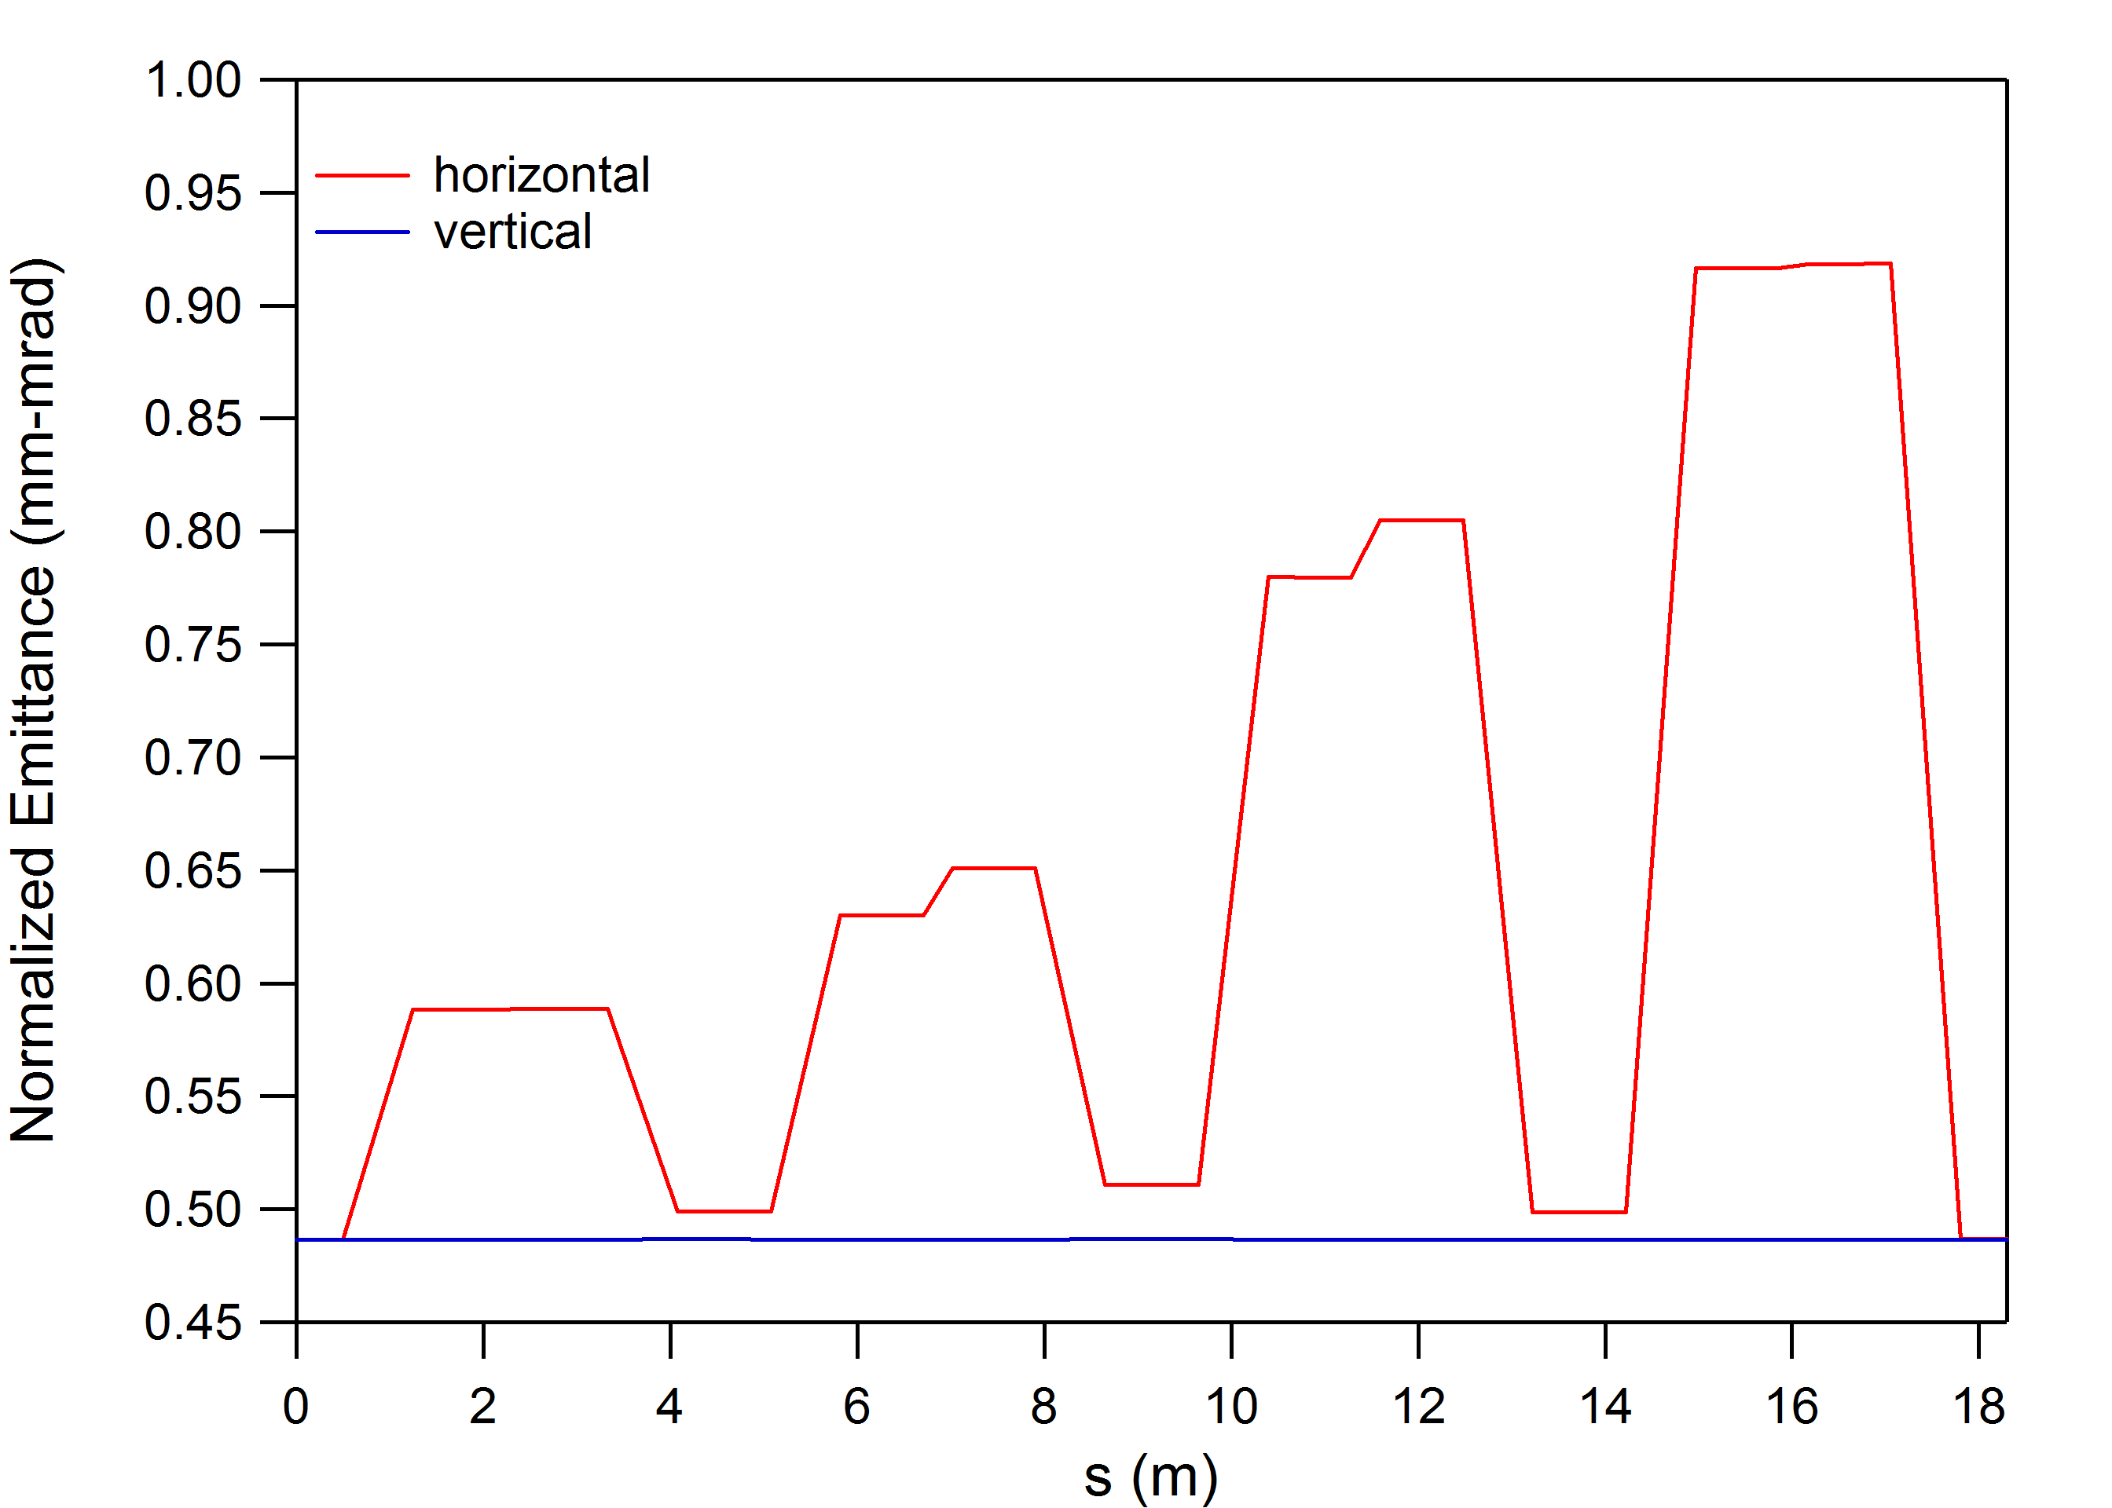
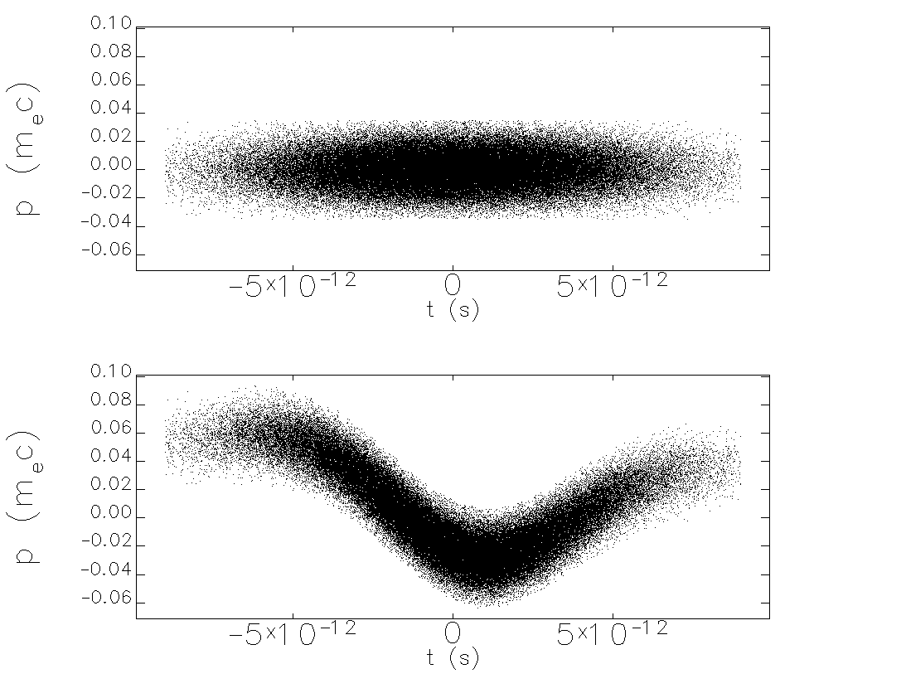
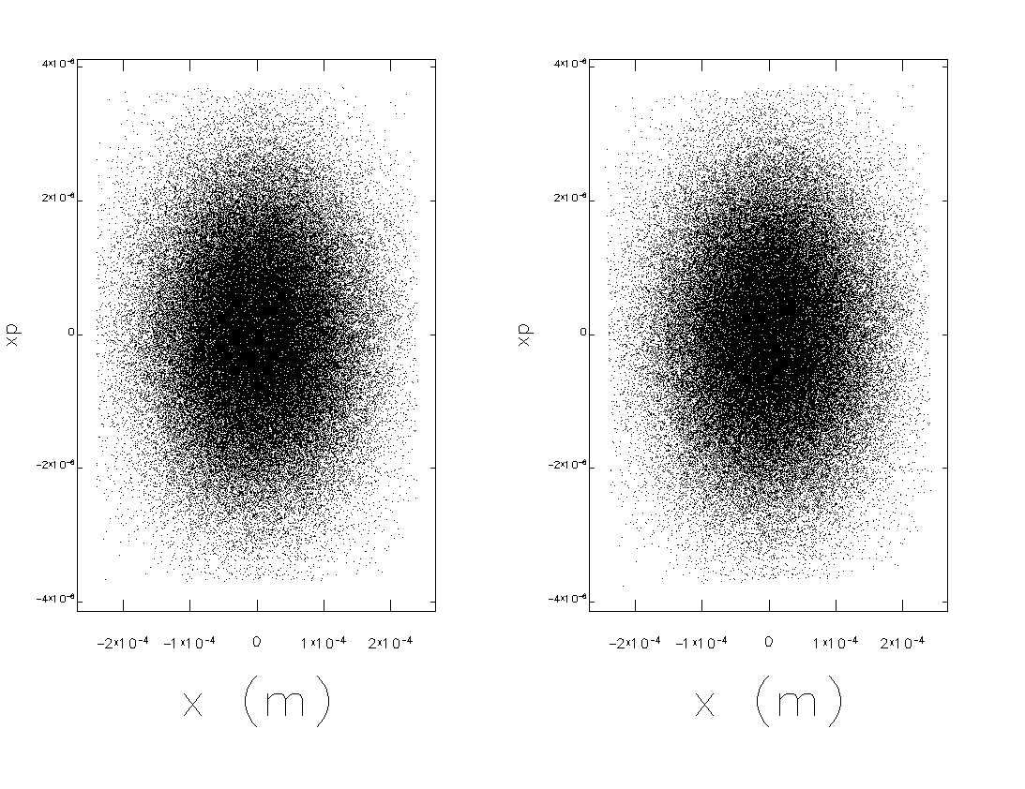
CSR Solutions
Recirculate with periodically isochronous 2nd order achromats
Emittance-compensates transverse effects up to fairly high charge/peak current
Leaves imprint of wake longitudinally
Suppresses microbunching
Compress with M₅₆>0
Avoids parasitic compressions; can suppress microbunching
Lases like gangbusters… (UV Demo, April 2012)
“Optics balanced” emittance compensated compressor

Slide 30
Implications for Diagnostics
What does this experience imply about diagnostic requirements (a topic for a very long discussion…)?
Need lots of longitudinal/time of flight/bunch length/energy diagnostics
longitudinal matching, correction of field errors
Must measure positions of multiple beams in common transport in an operationally noninvasive manner
beams out of phase: signals cancel in resonant structures like those used for some diagnostics
Must diagnose lattice and beam separately

Slide 31
Other Lessons, Fear, and Loathing
Internal target operation
Gas jet aperture validation (450 kW CW through 2 mm aperture with few ppm loss)
Small spot + halo control via choice of phase advance
Isotope production
Tricky: momentum spread not unlike FEL; transverse spray difficult to manage due to adiabatic antidamping during recovery
has implications for beam-beam if operating in the disruption regime
want large divergence => small spot; good for collider (NP, HEP) bad for solid target…
Costing: optimum may not lie in clone/copying
T. Powers/ILC cost workbook
ISR effects on longitudinal emittance (esp. at higher energy)
Bunch lengthening (M₅₆^{emission->reinjection} not zero everywhere) + σ_{dp/p} => entertainment (as with magnetic field quality)…
High power FELs from ‘80s on serve as cautionary tale: use caution during scale-up

Slide 32
and one more thing…
Common transport (two passes in one beam line) can be tricky (and risky).
Done at MIT/Bates (3 pass – one up, one coast, one down), IR Demo (same scheme), and CEBAF-ER
Limits flexibility and control; forces tighter specs (expensive); worse sensitivity
May be easier to use asymmetric gains in linacs & have separate transport of each pass on each end (GERBAL)
Better control of beam envelopes in multipass operation
“short” linac => “preaccelerator” to “long” linac
More “knobs”
Can deal with slight mismatches of energy pass-to-pass (reduced aperture requirements)
Relaxed energy gain matching on linacs (if S/R acceptance adequate)
Separates each pass for feedback stabilization

Slide 33
Acknowledgments
Many thanks to the organizers for the opportunity to participate in this discussion!
My JLab colleagues have all contributed to the work on which this talk is based; specific information, ideas, and/or slides were provided by
Pavel Evtushenko – George Neil
Chris Tennant – Steve Benson
Tom Powers – Jim Boyce
Bob Legg – Gwyn Williams
Carlos Hernandez-Garcia – Fay Hannon
Shukui Zhang
Notice: Authored by Jefferson Science Associates, LLC under U.S. DOE Contract No. DE-AC05-06OR23177 and by the Southeastern Universities Research Association, Inc. under U.S. DOE Contract No. DE-AC05-84ER40150. The U.S. Government retains a non-exclusive, paid-up, irrevocable, world-wide license to publish or reproduce this manuscript for U.S. Government purposes.

Slide 34
Backups

Slide 35
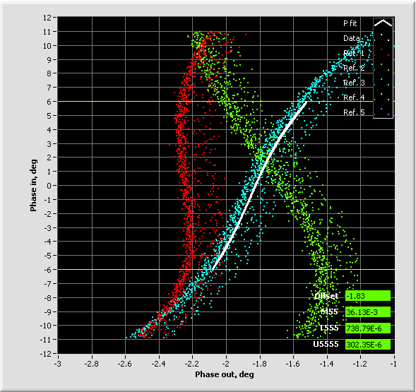
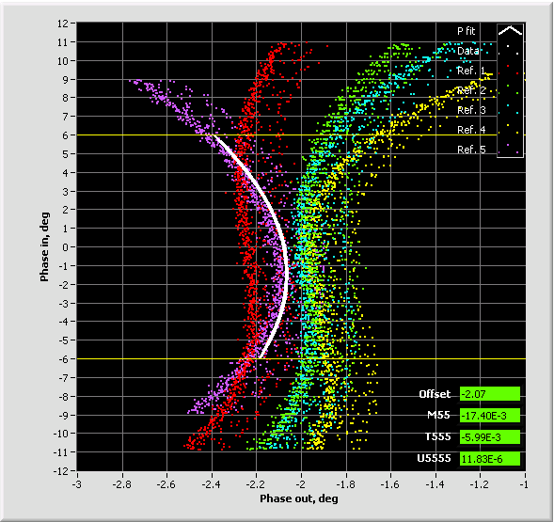
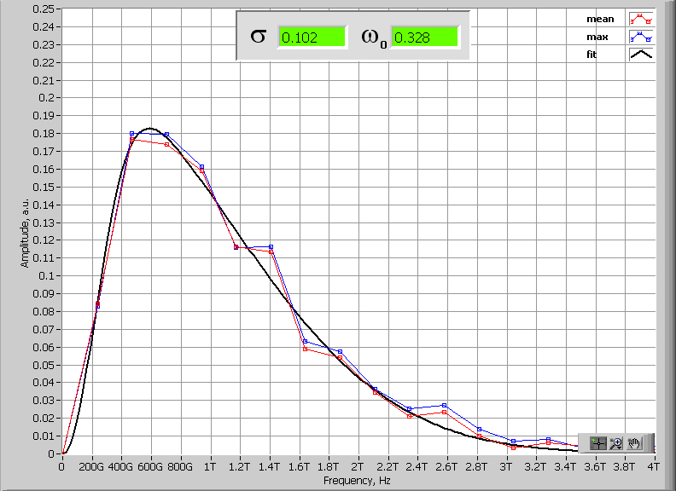
JLab FEL bunch compression and diagnostics
JLab IR/UV Upgrade FEL operates with bunch compression ratio of 90-135 (cathode to wiggler); 17-25 (LINAC entrance to wiggler).
To achieve this compression ratio nonlinear compression is used – compensating for LINAC RF curvature (up to 2nd order).
The RF curvature compensation is made with multipoles installed in dispersive locations of 180° Bates bend with separate function magnets - no harmonic RF
Operationally longitudinal match relies on:
a. Bunch length measurements at full compression (Martin-Puplett Interferometer)
b. Longitudinal transfer function measurements R₅₅, T₅₅₅, U₅₅₅₅
c. Energy spread measurements in injector and exit of the LINAC
Trim quads
(B’dL) 740 G
Sextupoles
(B’dL) 12730 G
Trim quads
(B’dL) 700 G
Sextupoles
(B’dL) 10730 G
Trim quads
(B’dL) 660 G
Sextupoles
(B’dL) 8730 G
Martin-Puplett Interferometer data
in frequency domain – give upper limit on the RMS bunch length
Courtesy Pavel Evtushenko

Slide 36
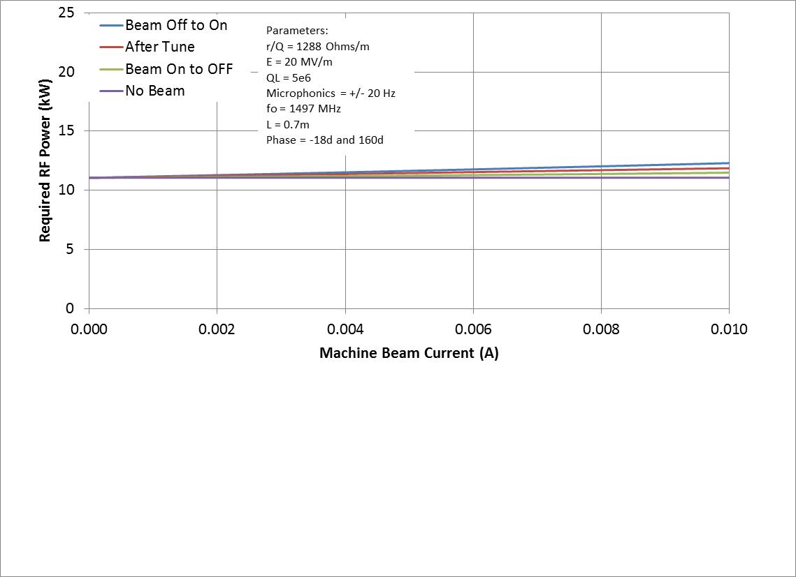
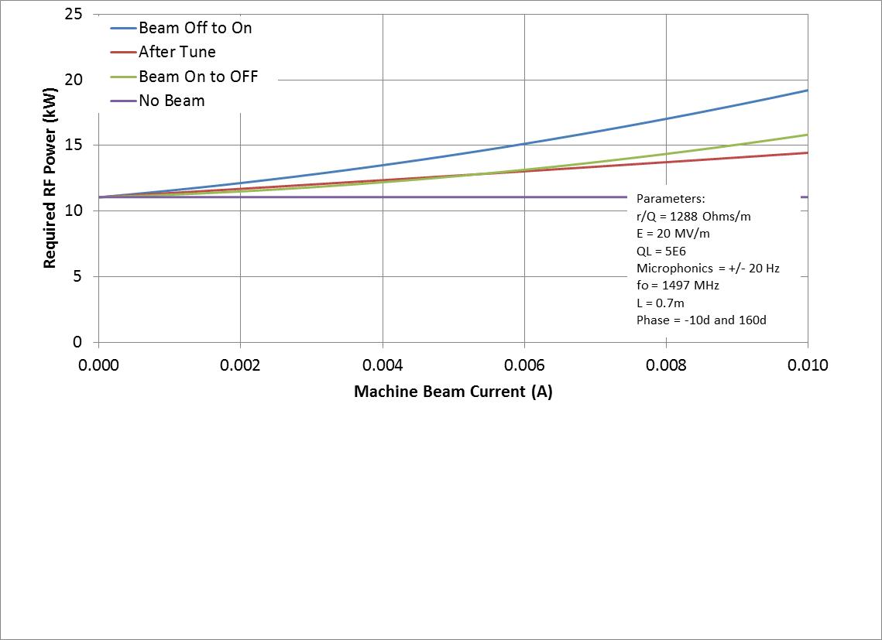
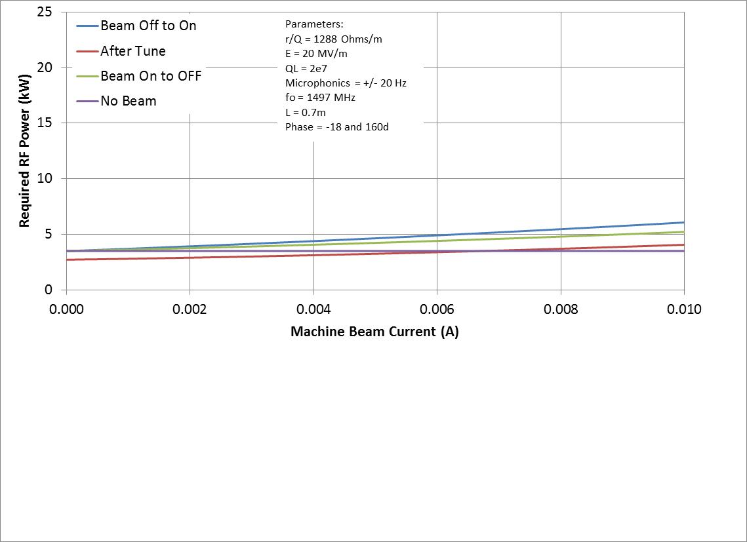
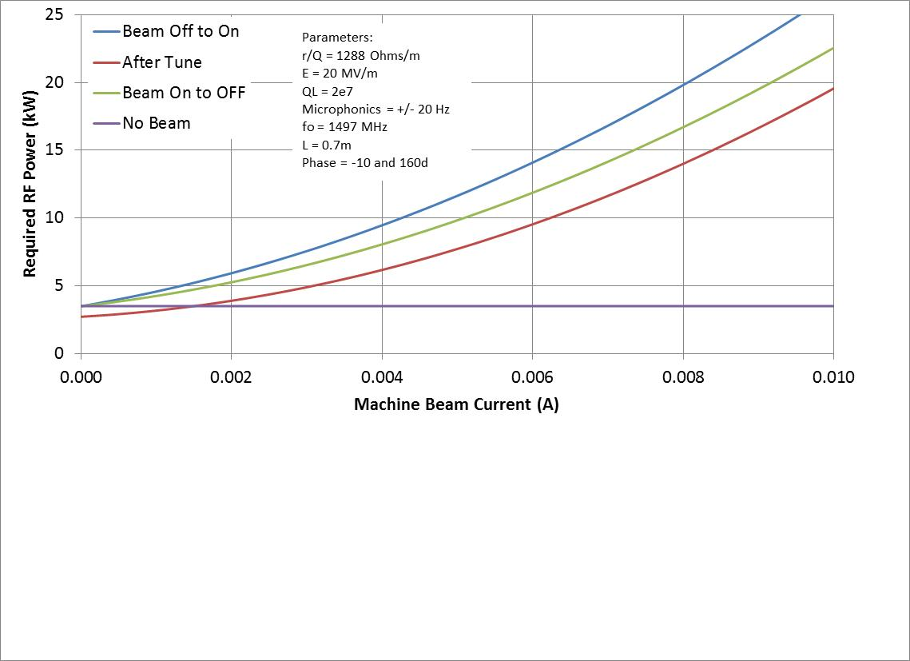

Slide 37
RF Transient Effects
Beam off/on
transient beam loading
cavities detune
FEL off/on
energy transients
reinjection phase transient
transient beam loading
cavities detune
Need adequate RF control & power to avoid tripping
Specs/methods depend on details of cavity design and operational modes

Slide 38
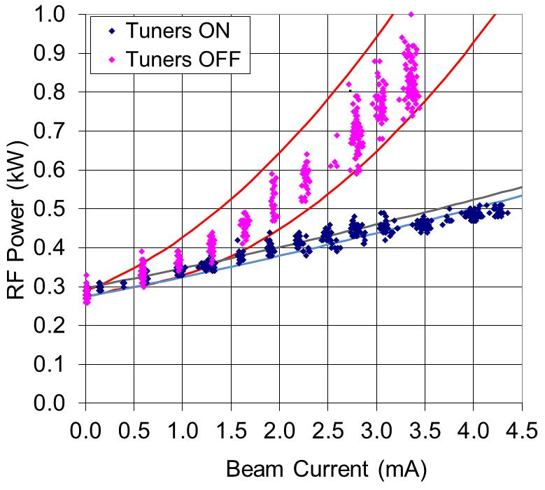
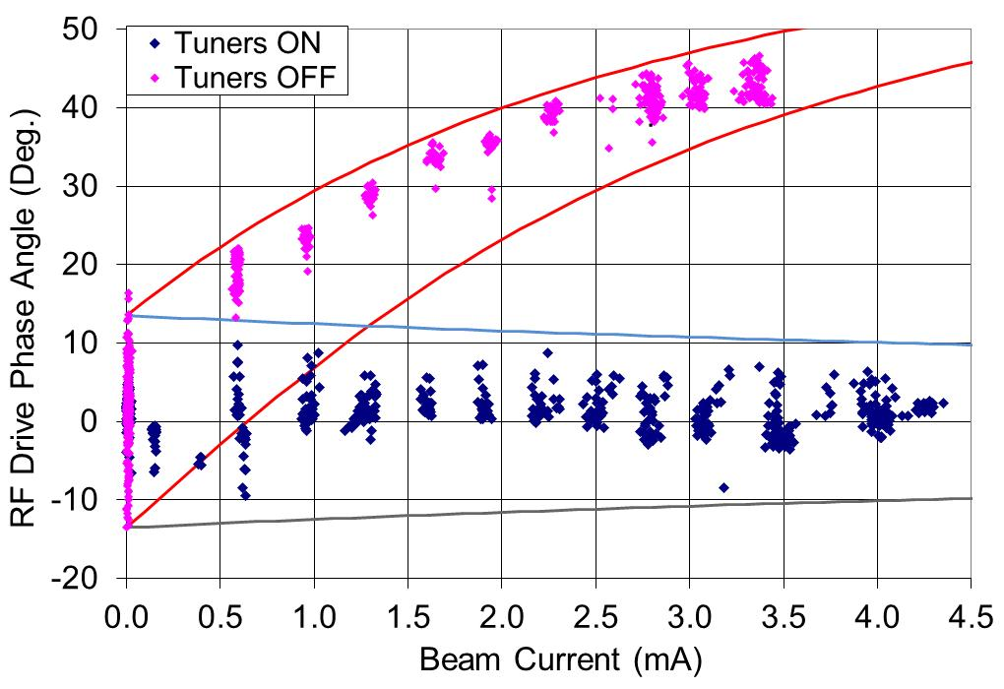
PREDICTED AND MEASURED FORWARD POWER/RF DRIVE PHASE IN AN ERL
The solid lines indicate the predicted values based on:
Q_{L} = 2 x 10⁷
E = 5.6 MV/m.
Δf = 10 Hz
Test Process:
Tune the cavity with no current.
Disable the mechanical tuners.
Ramp the current up and record the forward power and phase.
Repeat with Tuners enabled.

