Slide 1
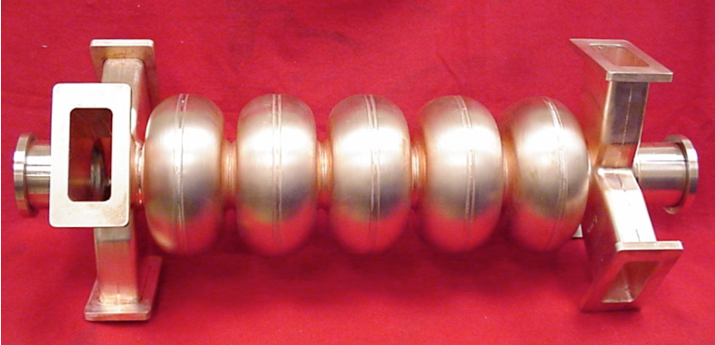
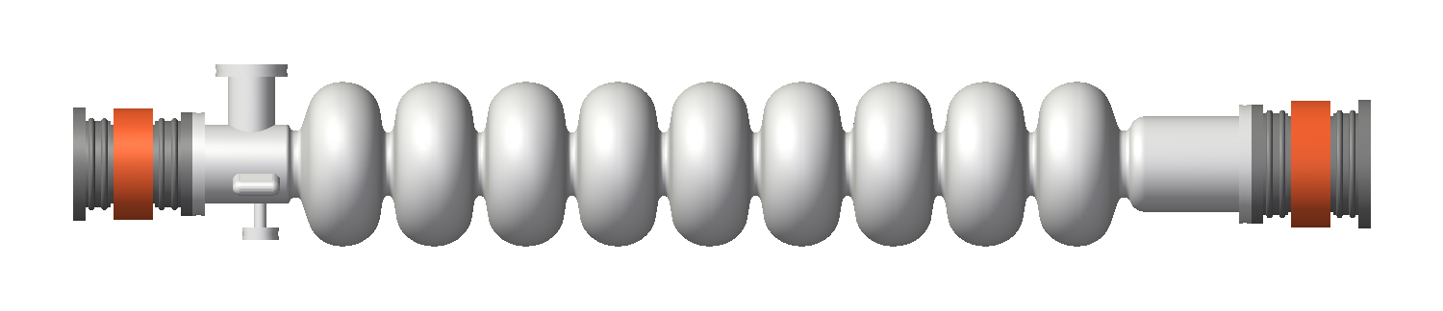
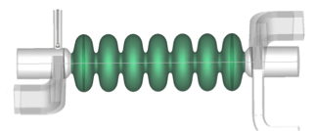
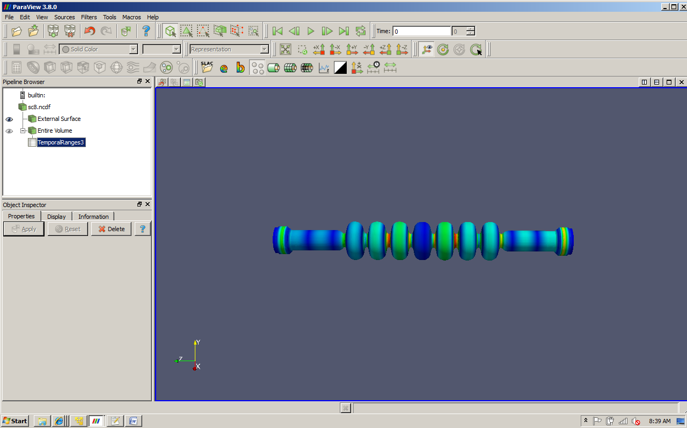
SRF Technology for High Current Application
Matthias Liepe
Associate Professor of Physics
Cornell University
M. Liepe June 18, 2015 Slide 1

Slide 2
Outline
Introduction
High Current Injector SRF
ERL High Current Main Linac SRF
Conclusions
M. Liepe June 18, 2015 Slide 2

Slide 3
Introduction
M. Liepe June 18, 2015 Slide 3

Slide 4
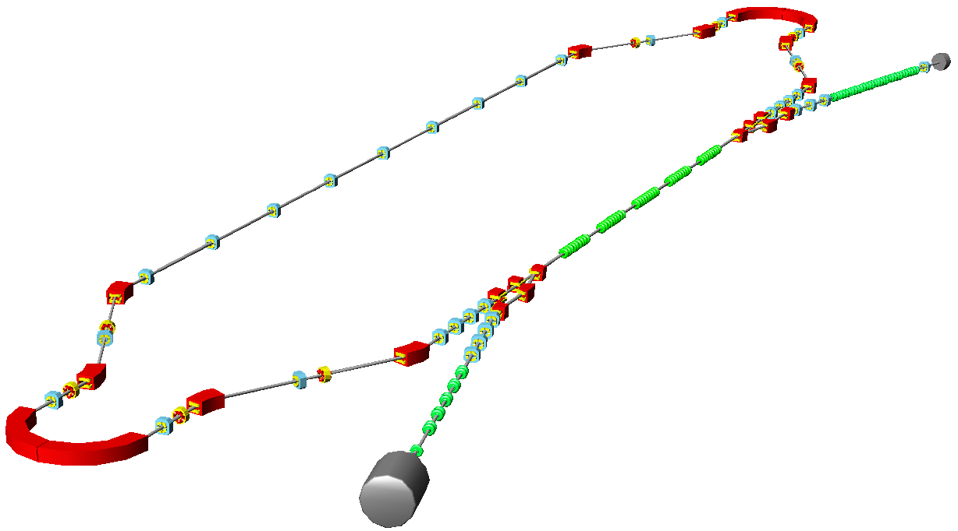
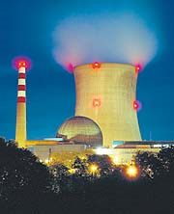
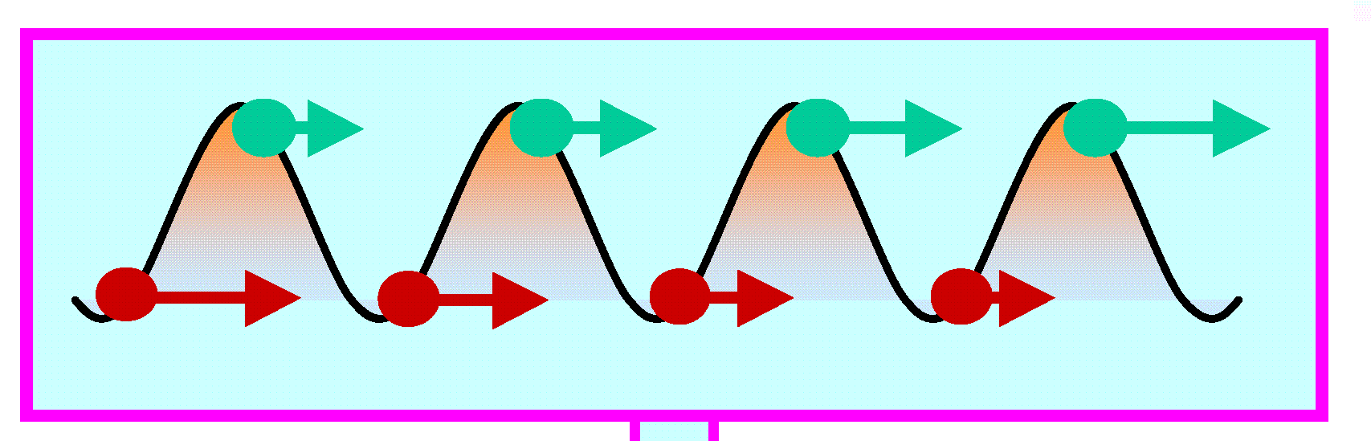
Energy-Recovery-Linacs
Linac Quality Beams with Storage Ring Beam Currents
3. Use beam for science, e.g. x-ray generation
Example: 5 GeV linac, 100 mA
S.C. without energy-recovery: >1 GW
S.C. with energy-recovery: <15 MW
6. dump beam:
low dump energy,
less radioactivity
2. acceleration
4. Recirculate beam
5. deceleration
to re-use energy
1. Injection
fresh beam
M. Liepe June 18, 2015 Slide 4

Slide 5
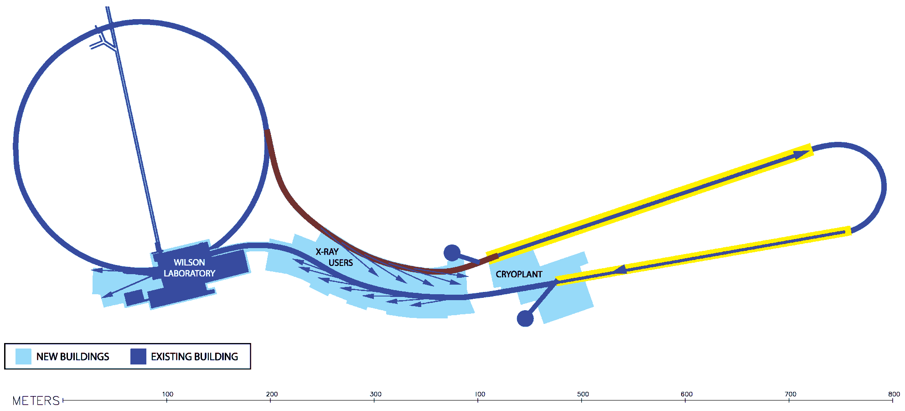
Example: The Cornell ERL X-Ray Light Source
ERL injector: 12 MeV SRF linac, 100 mA without energy recovery, >100 kW RF power per cavity
ERL main linac: 5 GeV SRF linac, 100 mA with energy recovery, 5 kW RF power per 7-cell cavity
Beam Parameter | Injector Linac | Main Linac
CW beam current [mA] | 100 | 2 x 100
Bunch charge [pC] | 77 | 77
Bunch length [ps] | 2 (600 µm) | 2 (600 µm)
Bunch repetition rate | 1.3 GHz | 2.6 GHz
Average HOM power / cavity [W] | 40 | 200
M. Liepe June 18, 2015 Slide 5

Slide 6
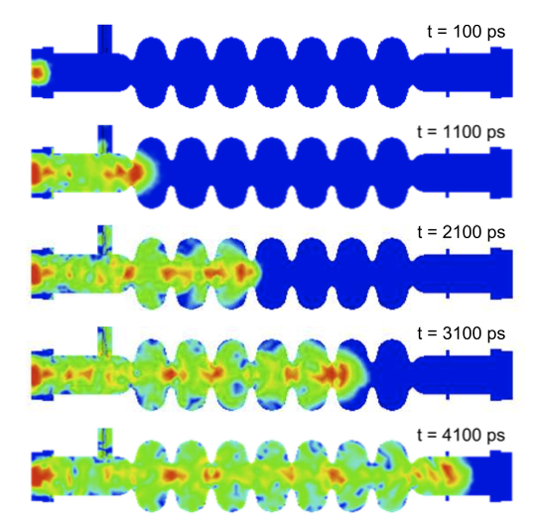
Example: Higher-Order Modes (HOMs) in the Cornell ERL
10
0
600
μ
m
bunch
10
-2
normalized integral of losses
10
-4
10
-6
0
50
100
150
200
250
frequency [GHz]
Bunch excites EM cavity eigenmodes (Higher-Order Modes)
The ERL beam will excite 1000s of HOMs up to f >100 GHz.
Average HOM power per ERL cavity = 200 W!
0
-10
Loss Factor:
wake potential W [V/pC]
-20
-30
-5
-4
-3
-2
-1
0
1
2
3
4
5
S [mm]
M. Liepe June 18, 2015 Slide 6

Slide 7


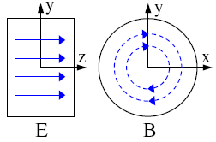
Higher-Order Modes: The Challenge
Resonant Monopole Mode Excitation if f_{HOM}=N⋅f_{bunch}
Need Q_{HOM}< 1000 for resonant modes in 100 mA ERL
Note: Q _{without damping} ~10¹⁰
Beam instability at high currents!
Need Q_{HOM}< 10³ to 10⁴ for dipole modes in 100 mA ERL
Cavity with dipole higher-order mode
M. Liepe June 18, 2015 Slide 7

Slide 8
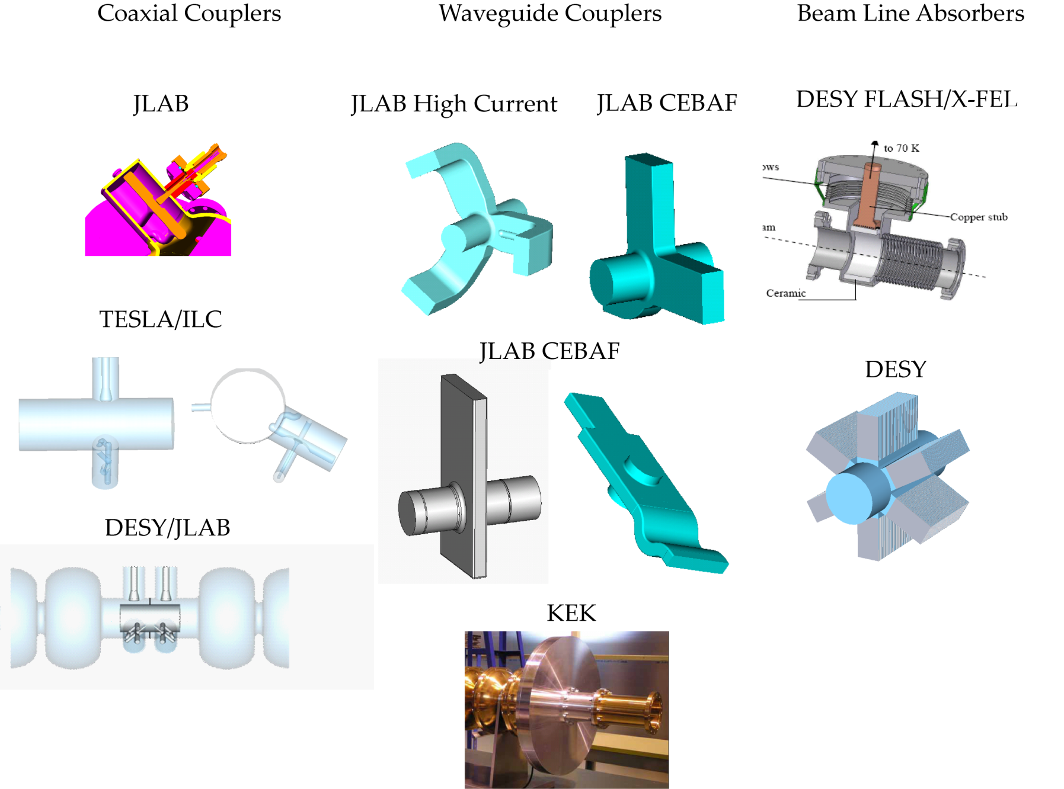
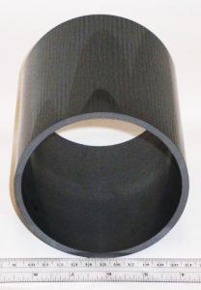
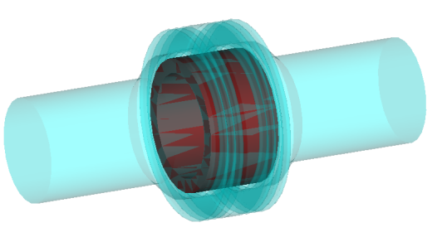
HOM Damping Schemes
Antenna / loop HOM couplers
Waveguide HOM dampers
RF absorbing materials
Beamline HOM loads
M. Liepe June 18, 2015 Slide 8

Slide 9
HOM Damping
Depending on the project, the HOM damping scheme must
  Efficiently handle high power up to several kW per cavity
  Provide very strong HOM suppression of monopole, dipole, quadrupole modes with Q=100 - 10,000
  Be broadband (up to >100 GHz)
  Be inexpensive / require little beam line length
Fortunately, usually not all of these are required at the same time
Different requirements ➔ different solutions
M. Liepe June 18, 2015 Slide 9

Slide 10
High Current Injector SRF
Main Challenge: High beam loading
M. Liepe June 18, 2015 Slide 10

Slide 11
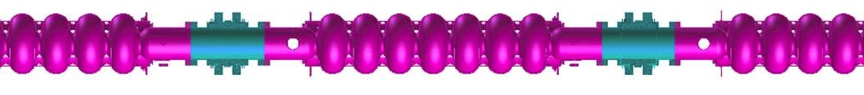
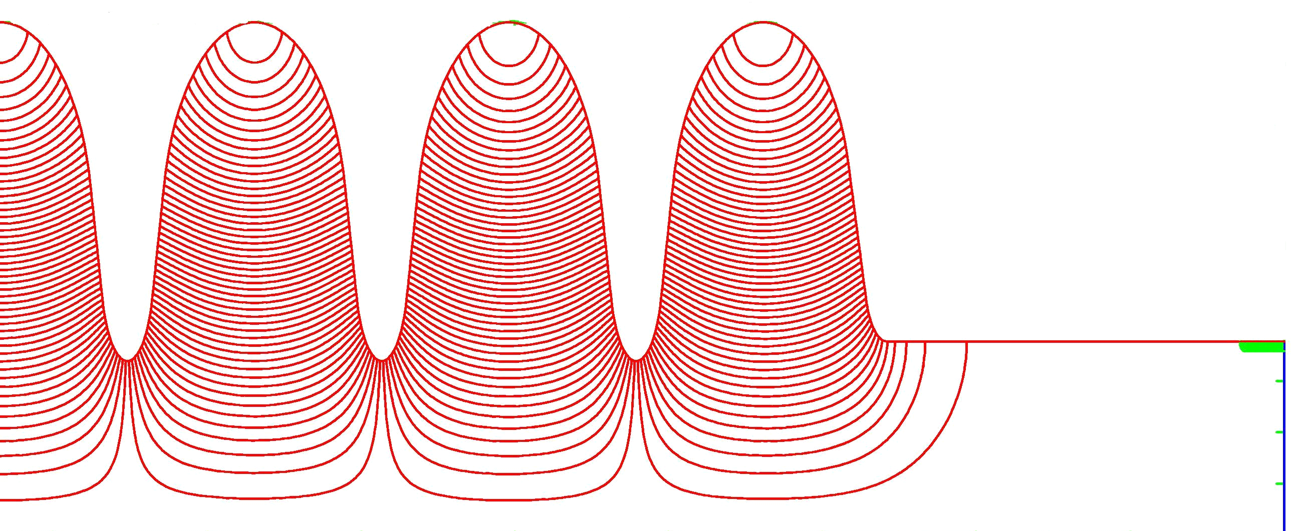
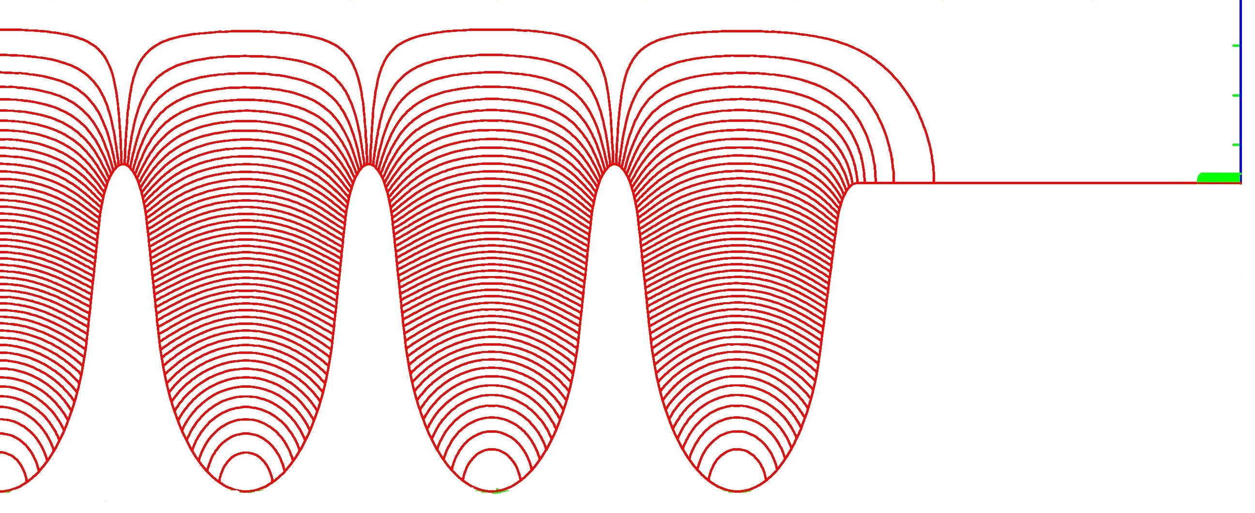
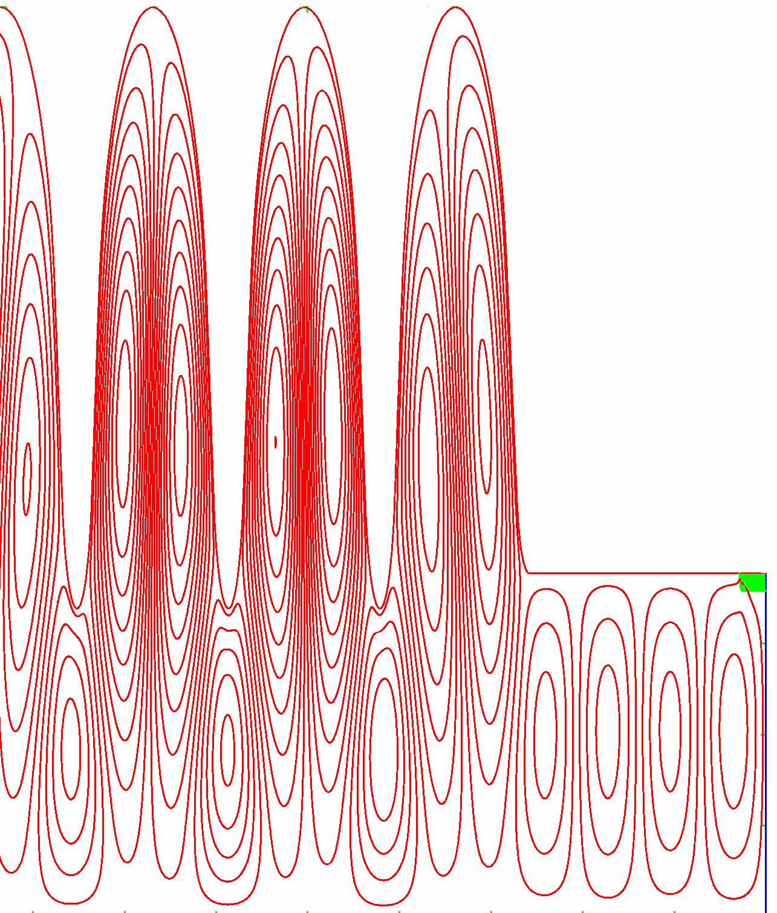
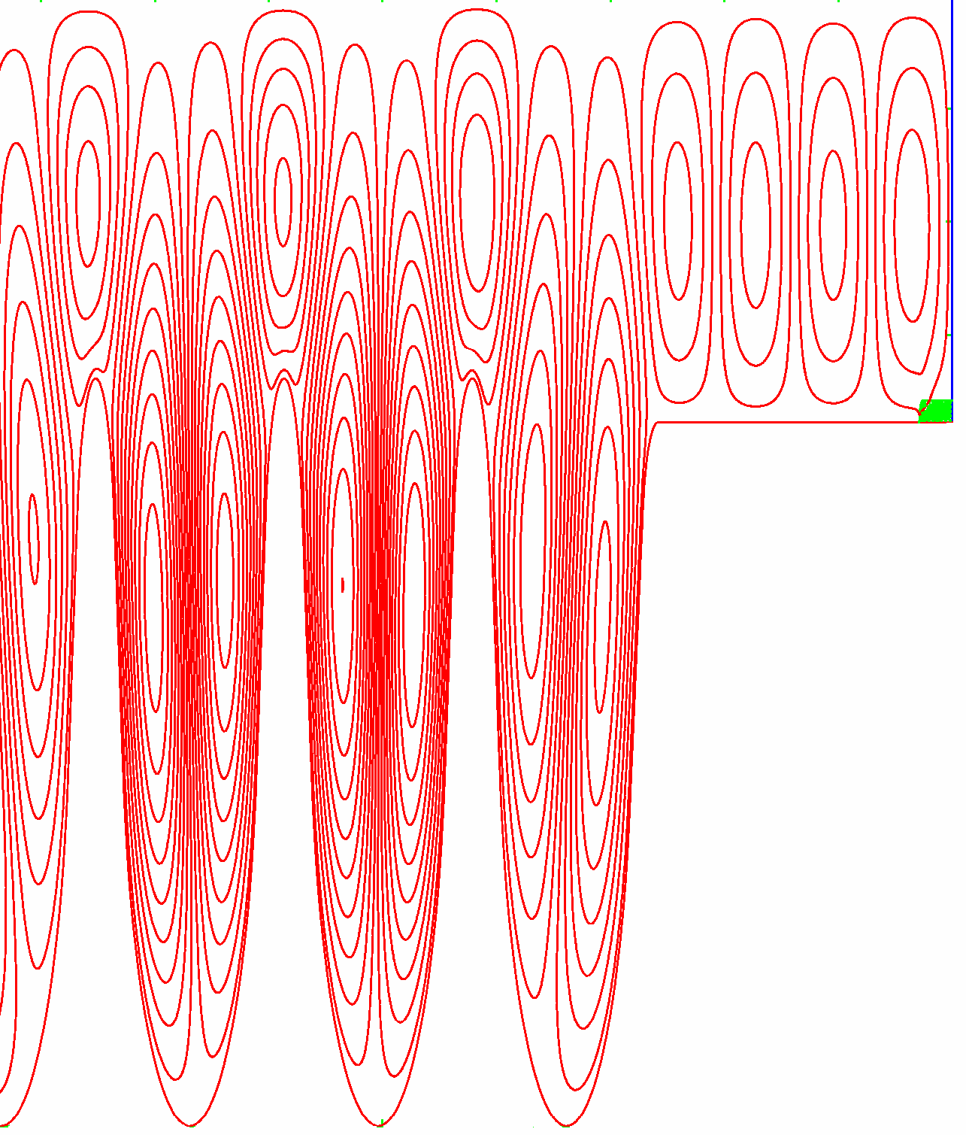
Cornell ERL HOM Damping Solution
80 K
Cavity at 1.8 K
80 K
HOM Power
Beam tube diameter optimized
  to trap accelerating mode in cavity and
  to propagate all monopole and dipole HOMs
RF absorbers in the beam pipes between the cavities
  Simple HOM damping design
  Broadband way of HOM damping
M. Liepe June 18, 2015 Slide 11

Slide 12
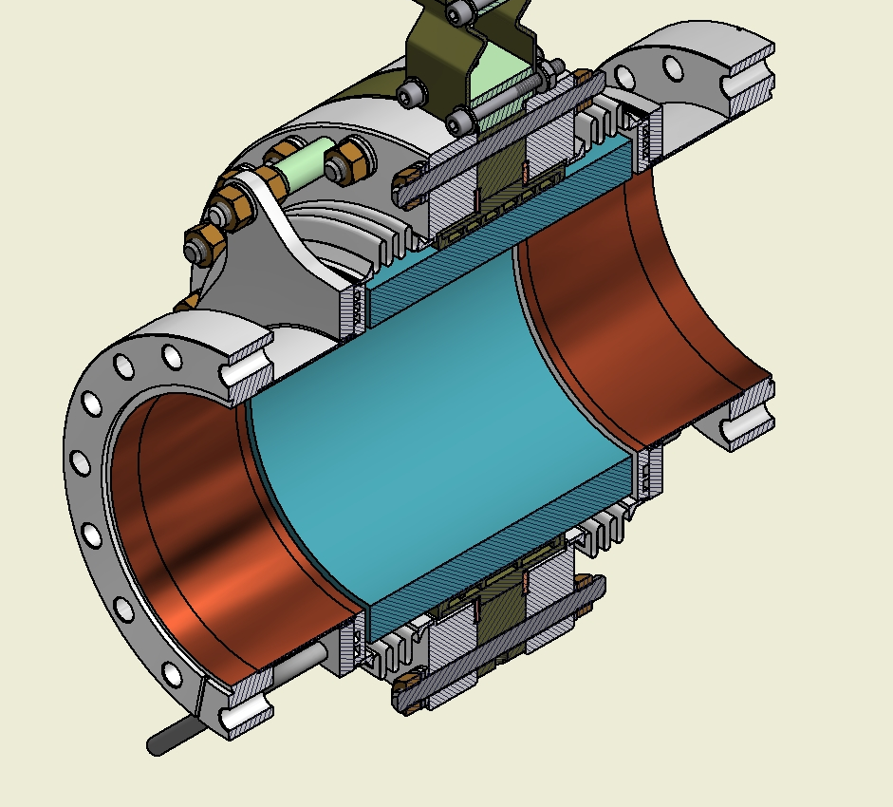
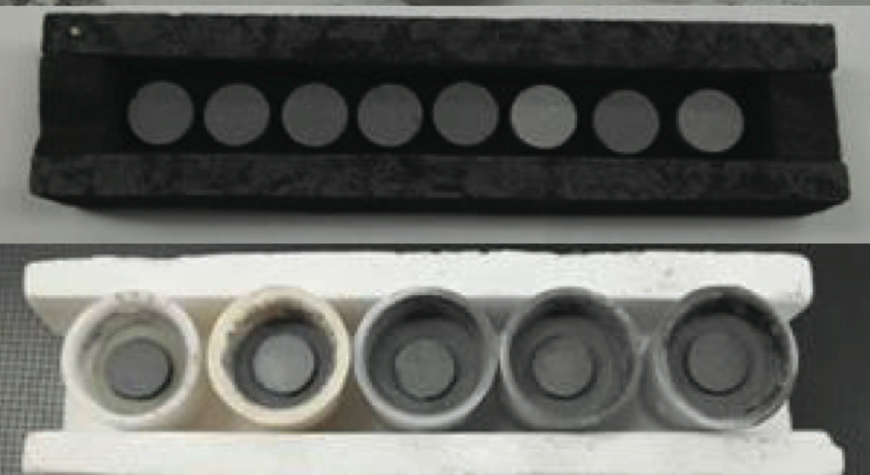
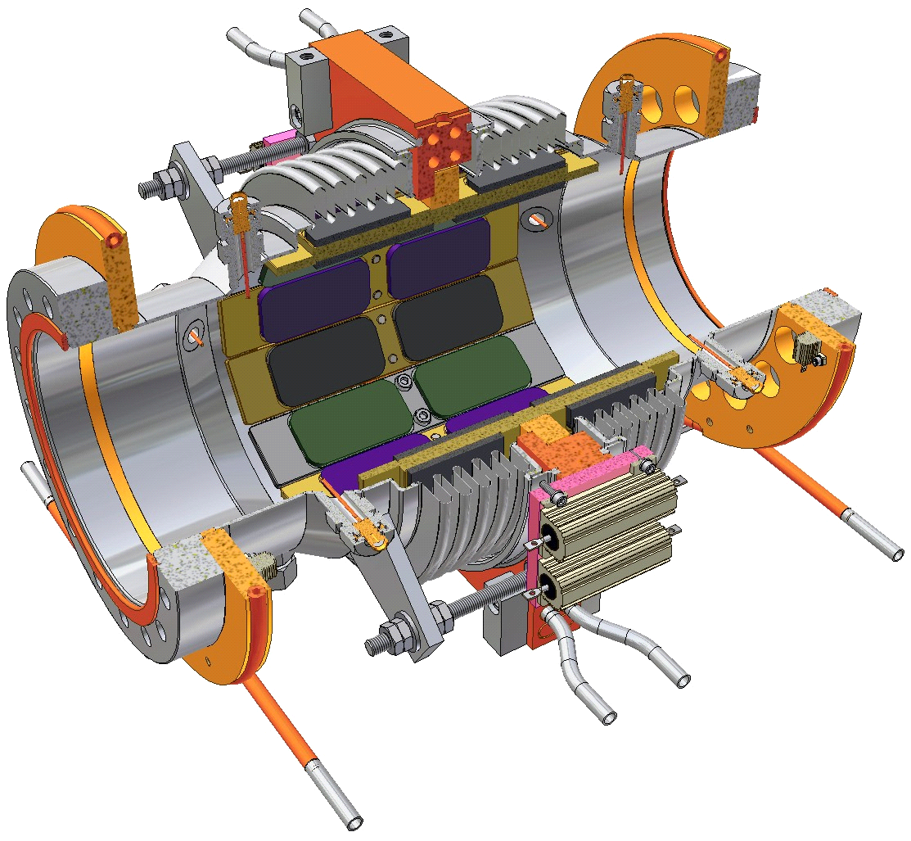
Cornell’s HOM Beamline Absorber (I)
Extensive research program to find absorber materials which
  are effective at 80 K,
  absorb over the required wide frequency range (1 GHz to >100 GHz),
  are vacuum compatible and radiation hard.
Ferrites, graphite loaded SiC, carbon-nanotube loaded ceramics…
Flange to cavity
80K cooling channel
RF absorbing tiles
Graphene-containing compositions
SiC absorber ring
M. Liepe June 18, 2015 Slide 12

Slide 13
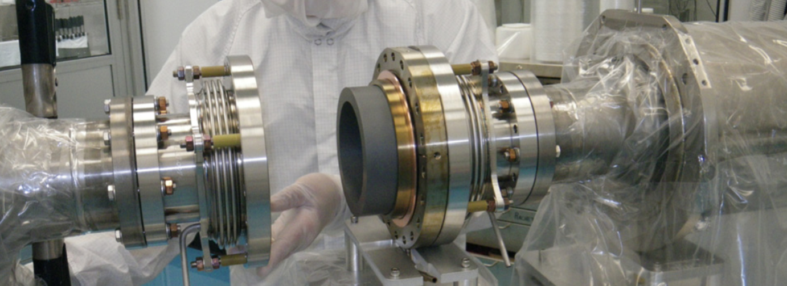
Cornell’s HOM Beamline Absorber (II)
Broadband (<1 GHz to >50 GHz) SiC absorber ring
Full-circumference heat sink to allow >500W dissipation @ 40K
Includes shielded bellow sections
Flanges allow easy cleaning
Zero-impedance beamline flanges
M. Liepe June 18, 2015 Slide 13

Slide 14
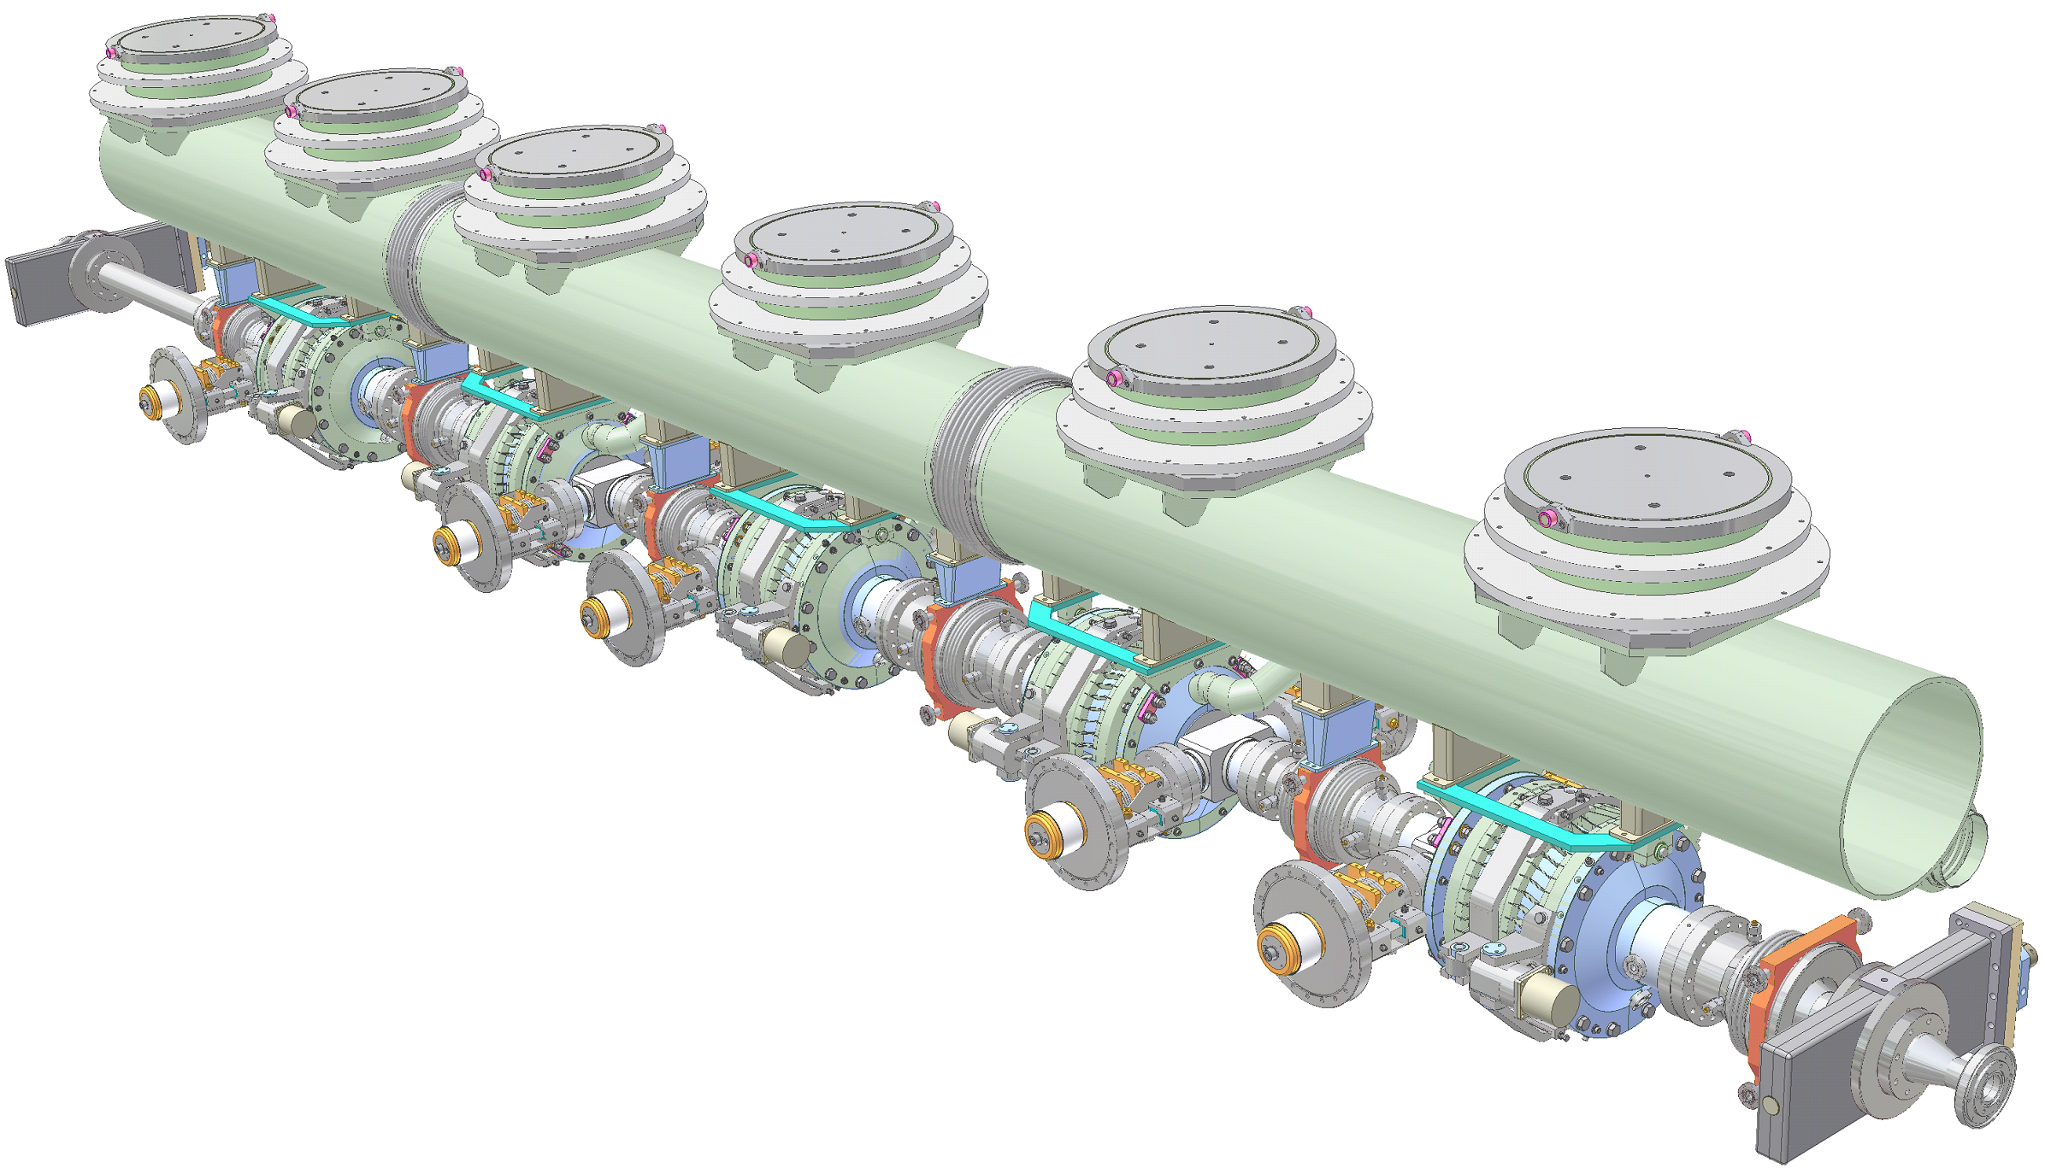
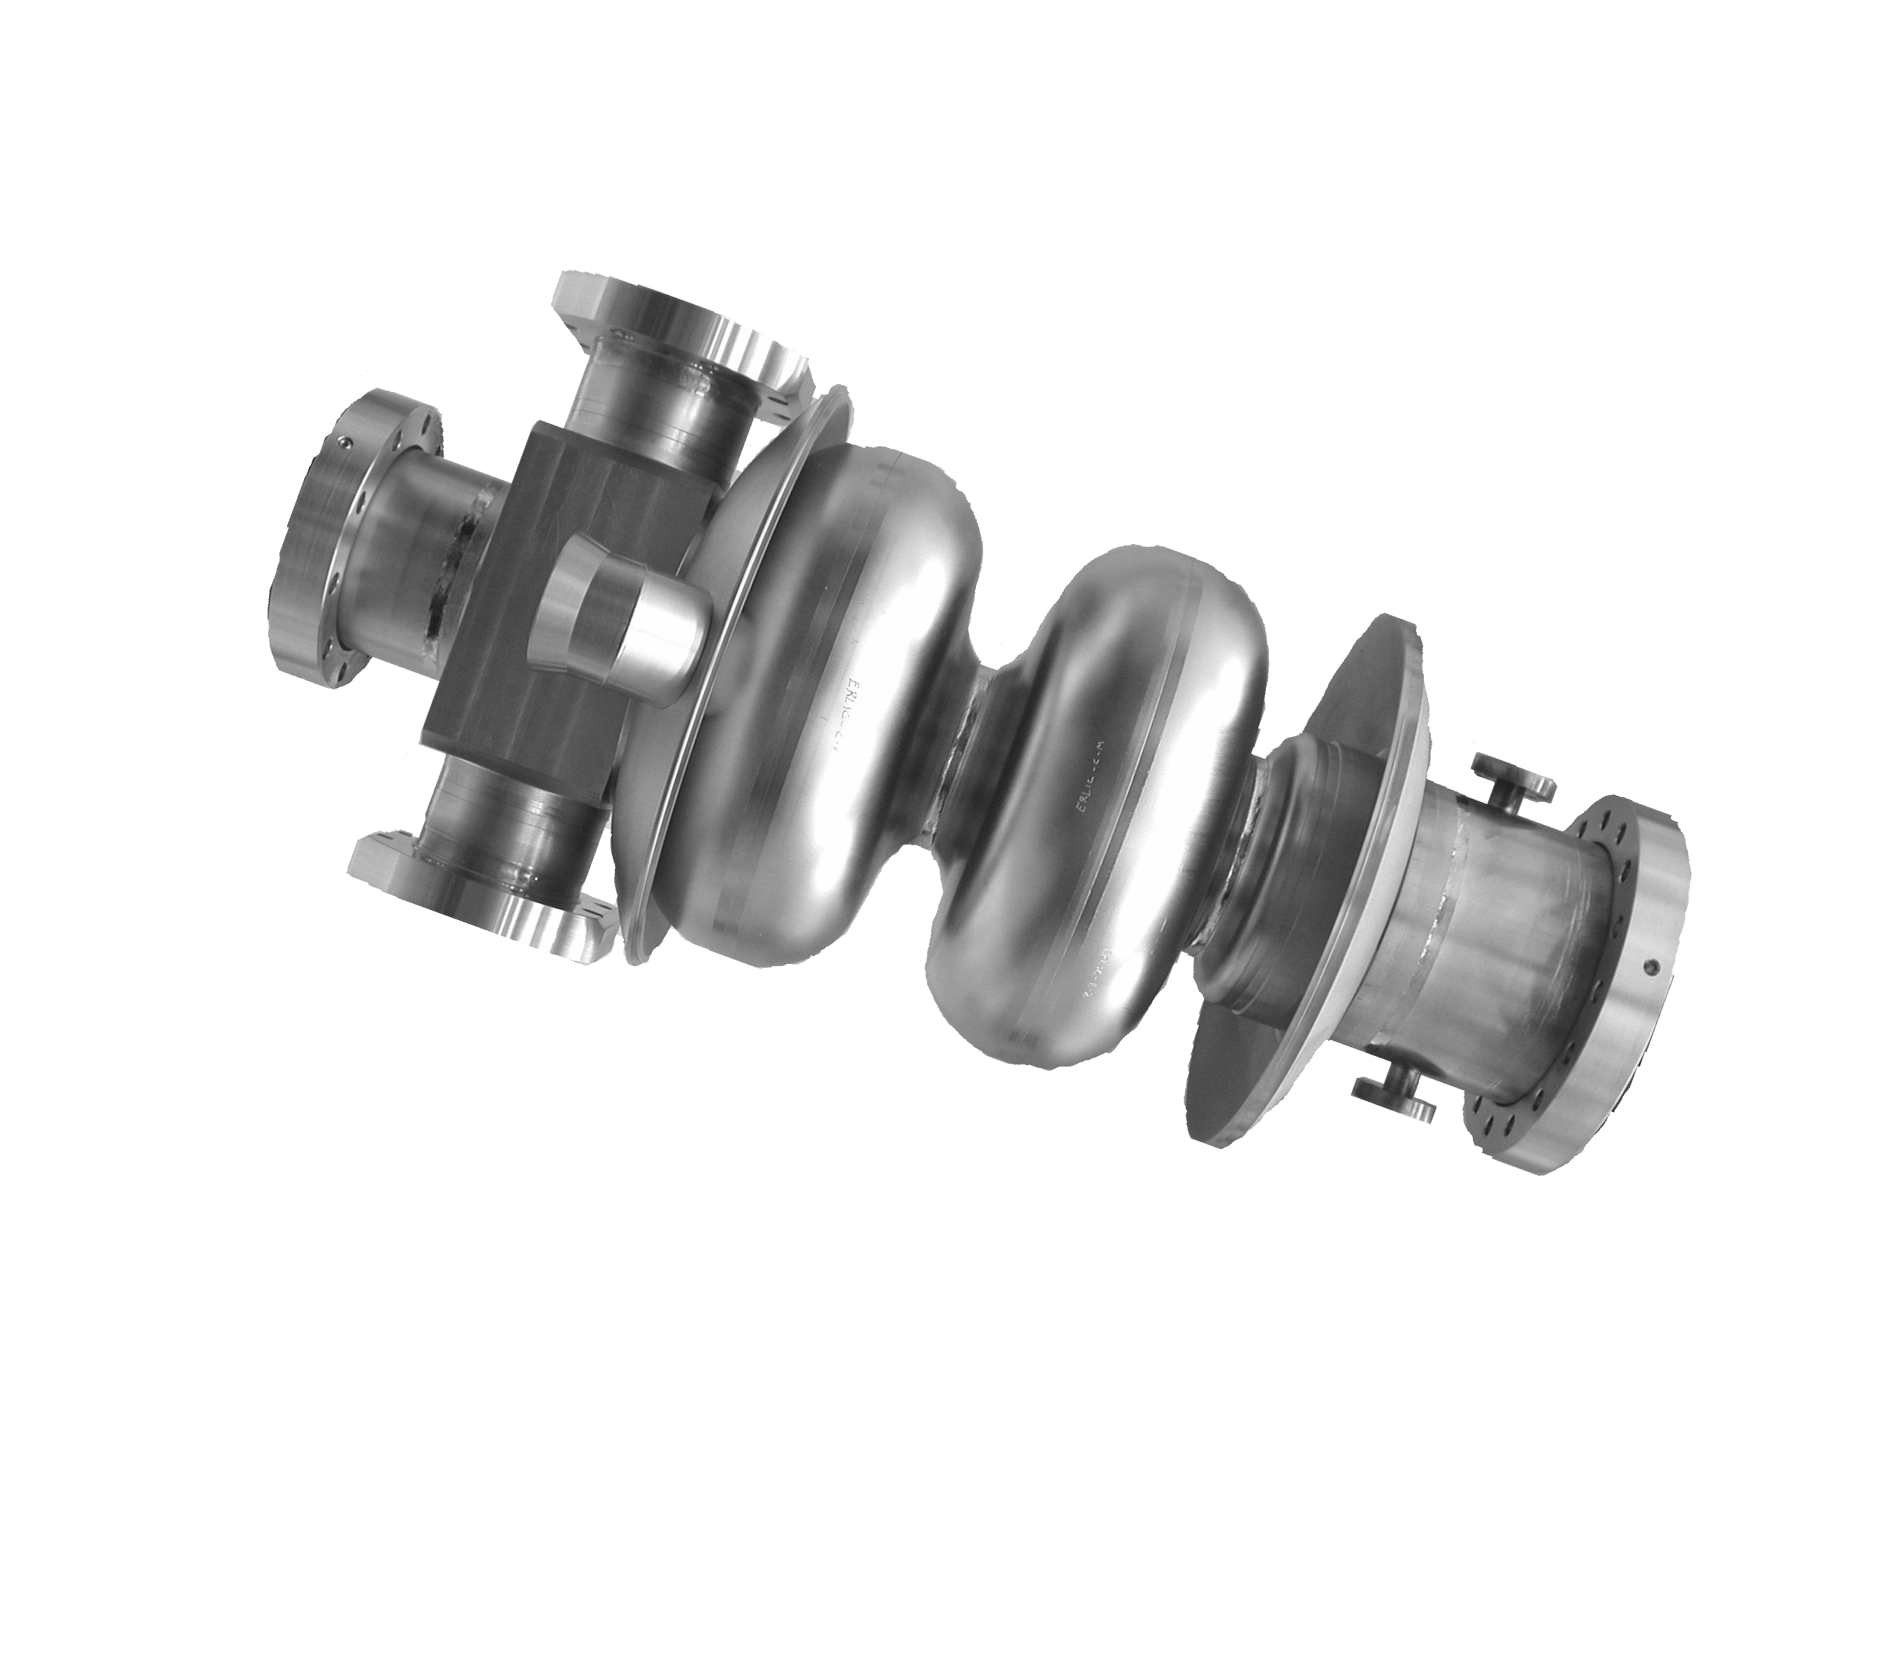
Cornell 100 mA ERL Injector Cryomodule
Cryogenic system
⇨ Bring cavity to 2K
~5 m
Frequency tuner
⇨ Adjust cavity frequency
HOM absorber
⇨ Damp unwanted Higher-Order Modes
Input Coupler
⇨ Couple RF power into cavity
RF cavity
Inside He vessel
M. Liepe June 18, 2015 Slide 14

Slide 15
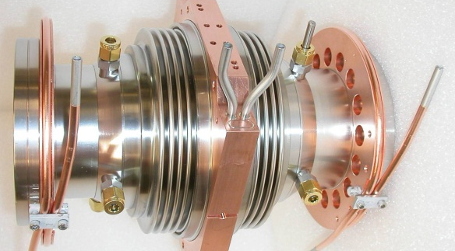
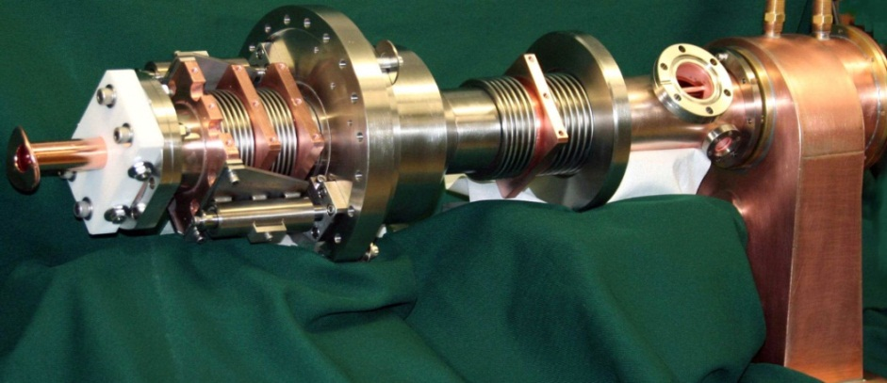
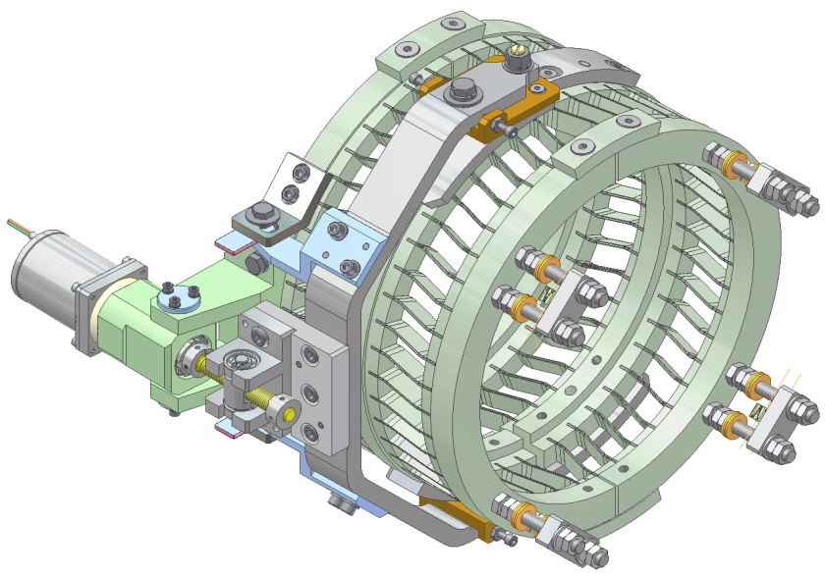
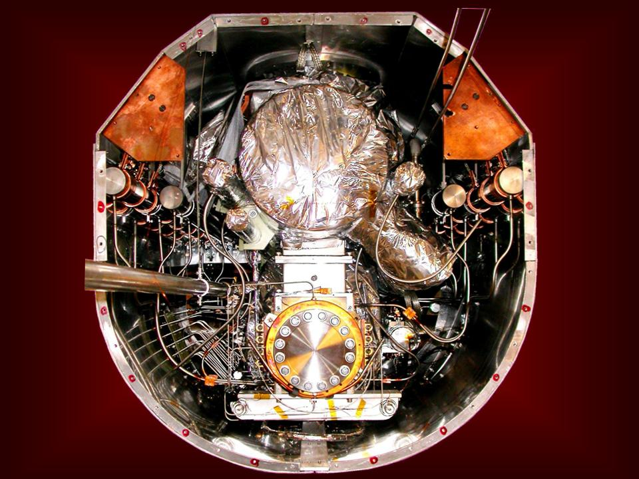
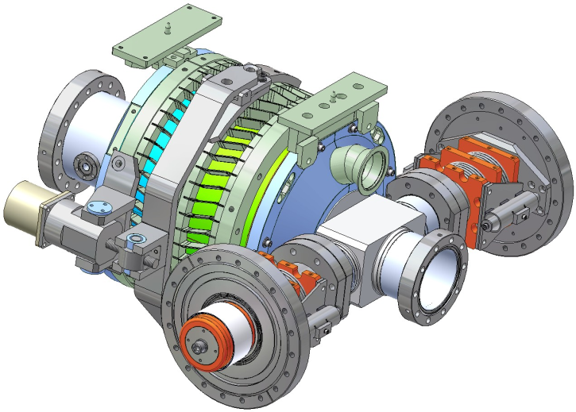
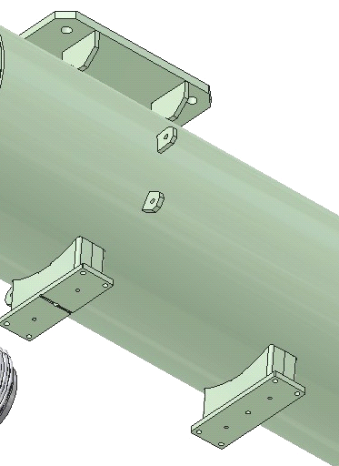
Pushing the Envelope in Many Ways
waveguide
Coax
-
2K
-
2K
80K
80K
300K
5K
300K
5K
transition
transition
SRF cavity: design for high beam current
RF input coupler: design for high power (50 kW)
HOM damper: design for strong HOM suppression
Frequency tuner: stabilize cavity length on nm scale
Module design: support high cryo loads and provide excellent alignment
piezo
M. Liepe June 18, 2015 Slide 15

Slide 16
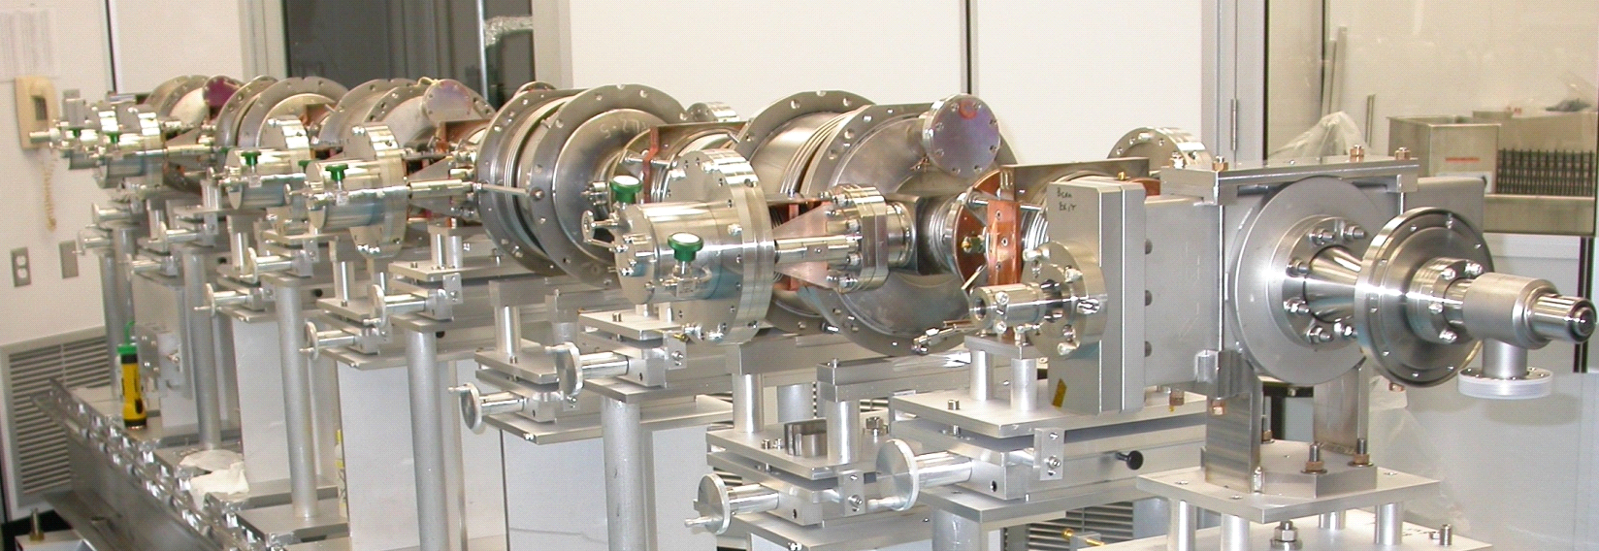
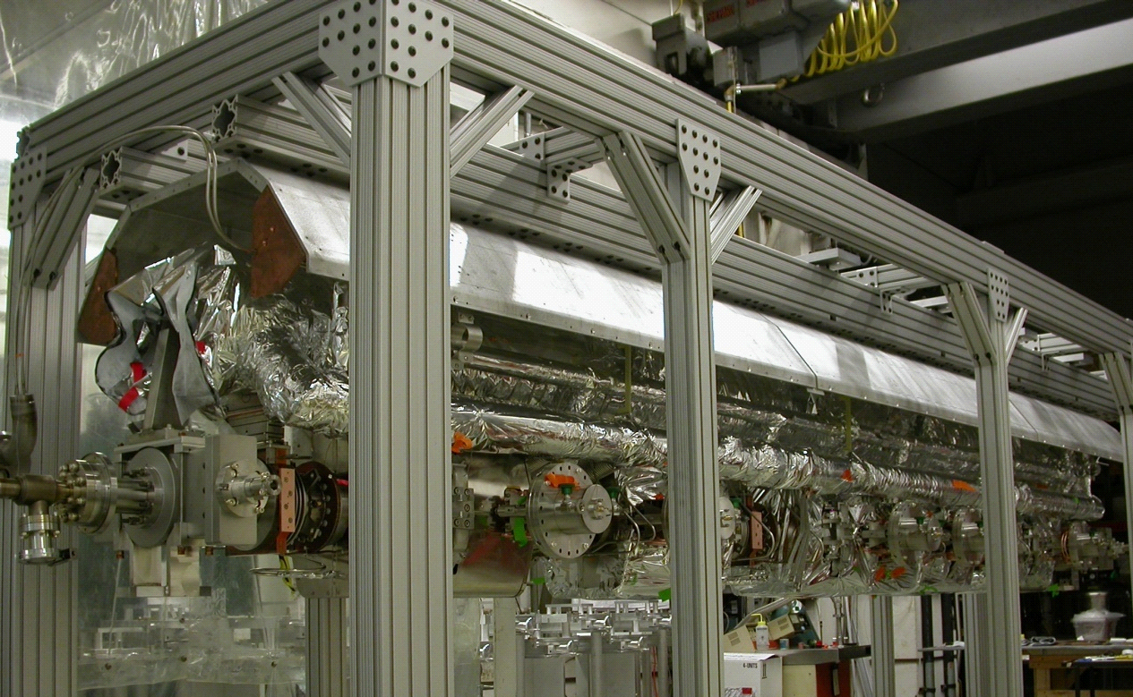
Module Assembly
Beam Line in Clean Room
1100 aluminum
Cold mass assembly
80K shield
5K manifold
2K 2
-
-
phase pipe
M. Liepe June 18, 2015 Slide 16

Slide 17
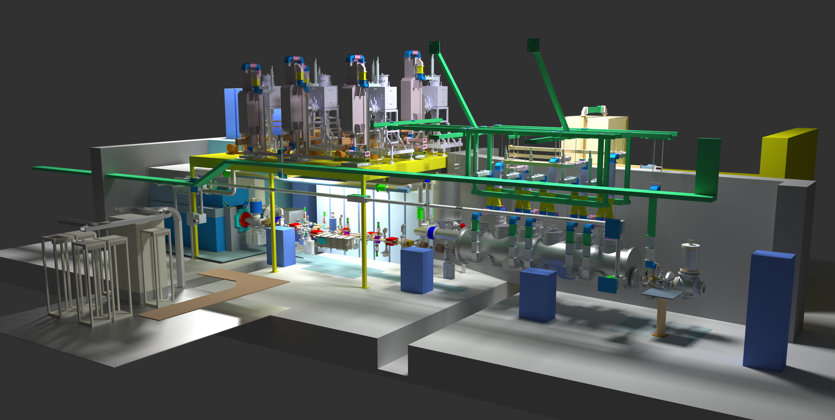
High Current ERL Injector Prototype
0.5 MW RF power
Diagnostic beam line
SRF cryomodule
Photocathode DC gun
M. Liepe June 18, 2015 Slide 17

Slide 18
Cornell ERL Injector Performance
photocathode
DC gun
deflector
cryomodule
beam dump
experimental beam lines
buncher
design parameters
Nominal bunch charge 77 pC
Bunch repetition rate 1.3 GHz
Beam power up to 550 kW
SC linac beam energy gain 5 to 15 MeV
Bunch length 0.6 mm (rms)
Beam current 100 mA at 5 MeV
33 mA at 15 MeV
Achieved so far
77 pC
50 MHz and 1.3 GHz
260 kW
5 to 15 MeV
0.6 mm
75 mA
World record for CW injector
M. Liepe June 18, 2015 Slide 18
Notes:
90% normalized transverse emittances for 19 (77) pC=bunch were 0.23 (0.51) um in the horizontal plane, and 0.14 (0.29) um in the vertical plane,

Slide 19
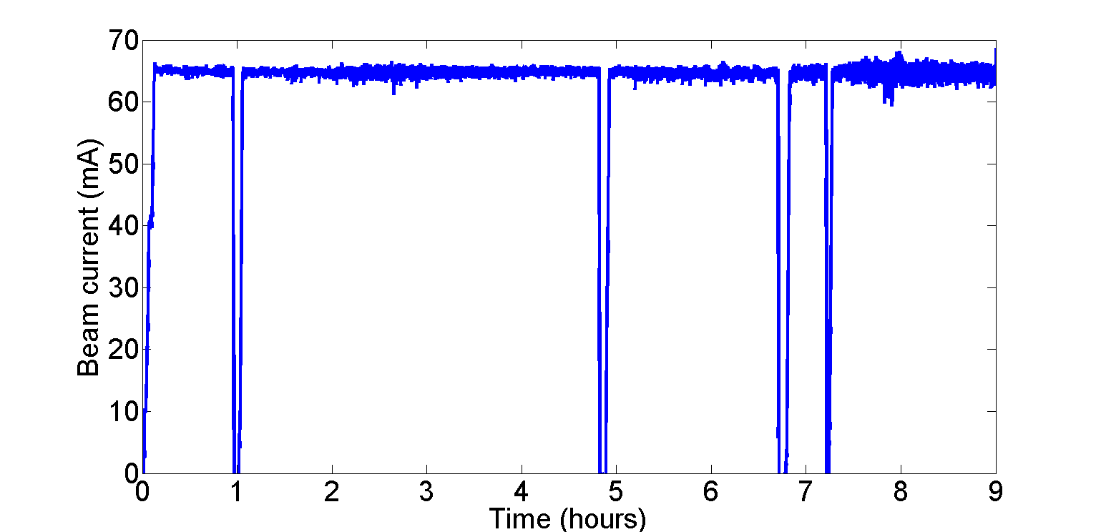
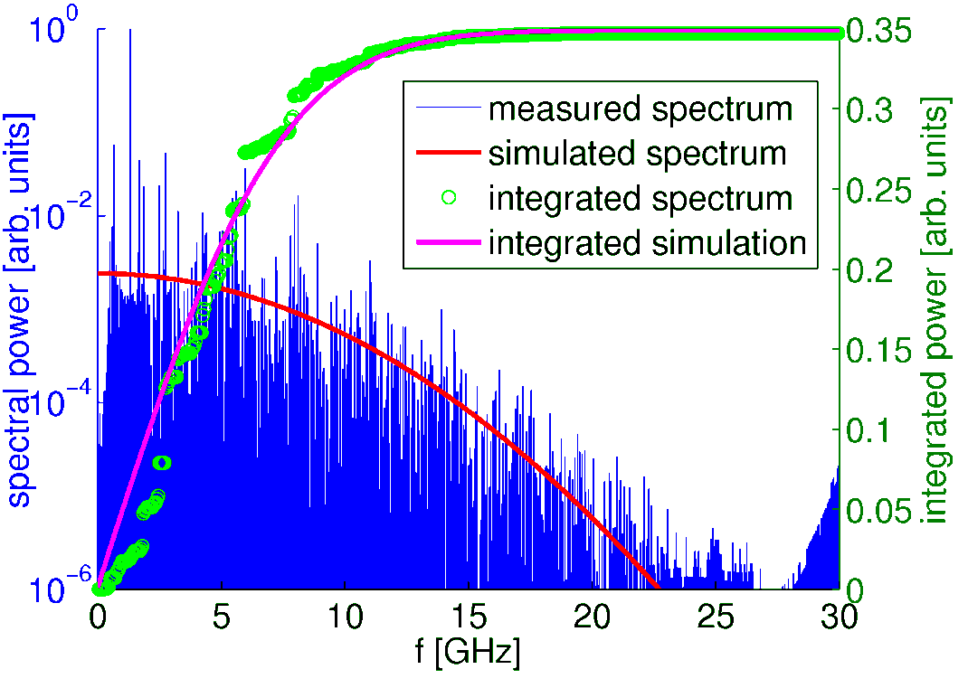
Does it work? Results from the Injector SRF Module
High beam current operation
HOM spectrum
Accelerated beam currents of up to 75 mA over many hours
No signs of beam instability or excessive heating by HOMs
Spectrum in good agreement with simulation results
Excellent damping with typical Qs of a few 1000
-60
S₂₁ [dB]
-80
-100
-120
HOM absorber performance
-140
1.5
2
2.5
3
3.5
4
Frequency [GHz]
M. Liepe June 18, 2015 Slide 19

Slide 20
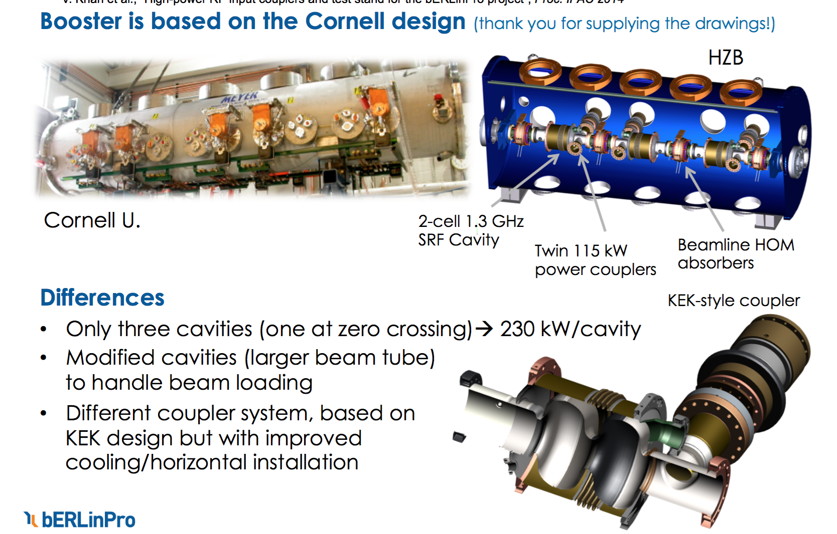
HZB 100 mA ERL Injector SRF (I)
Courtesy: J. Knobloch, ERL15
M. Liepe June 18, 2015 Slide 20

Slide 21
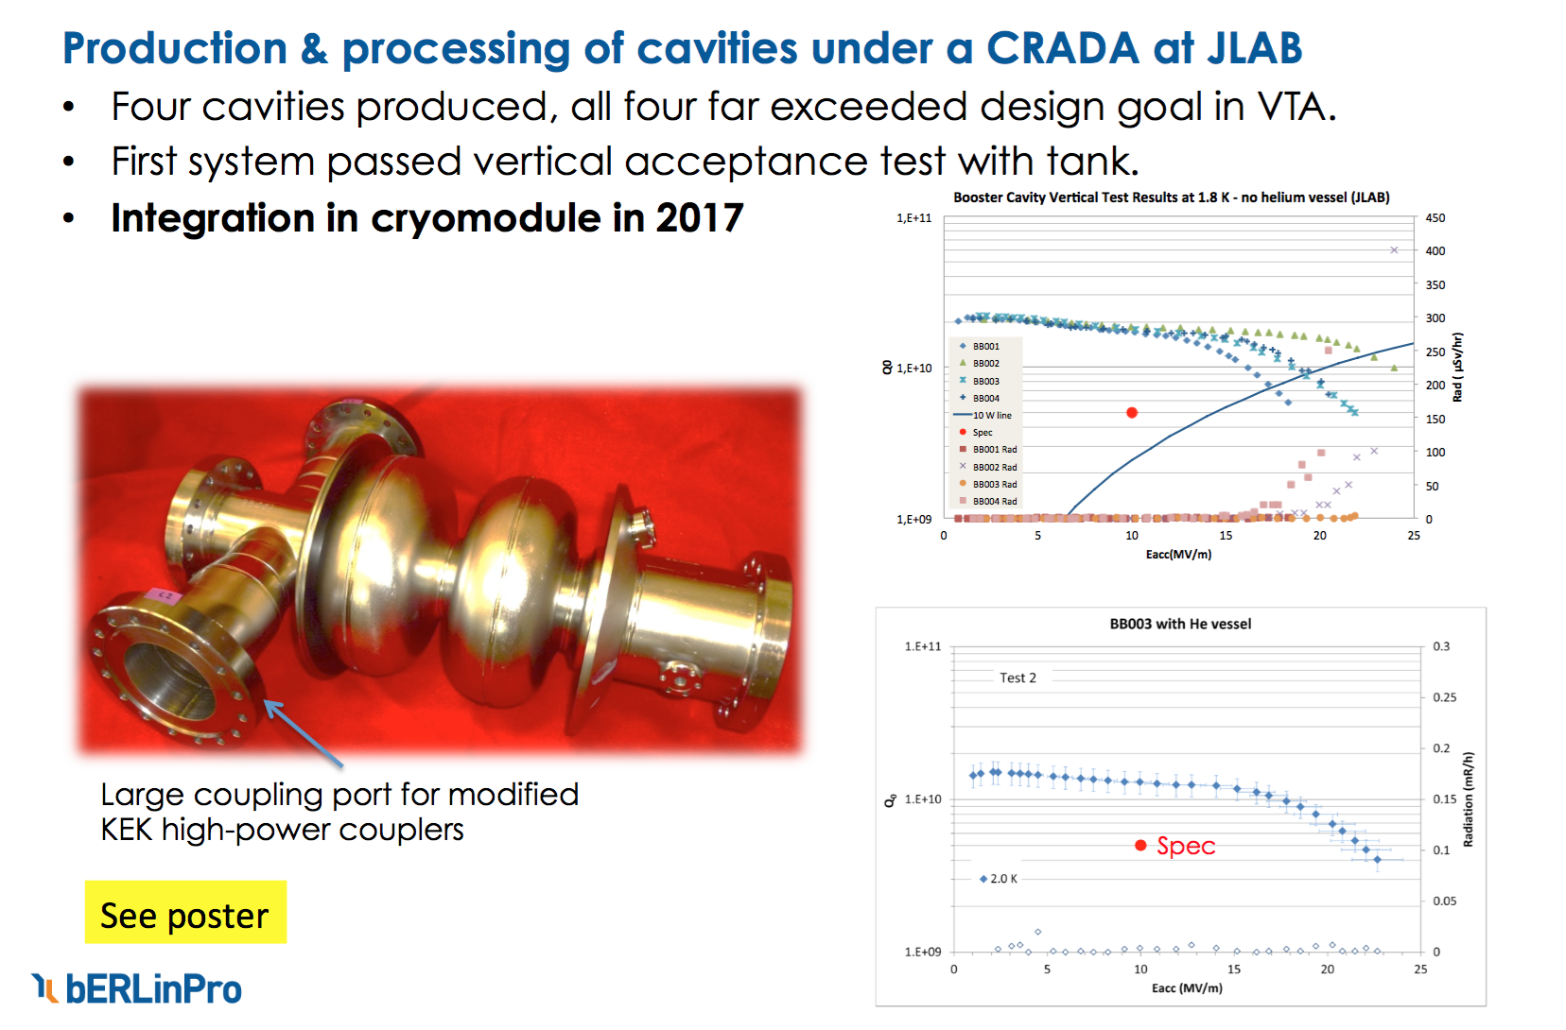
HZB 100 mA ERL Injector SRF (II)
Courtesy: J. Knobloch, ERL15
M. Liepe June 18, 2015 Slide 21

Slide 22
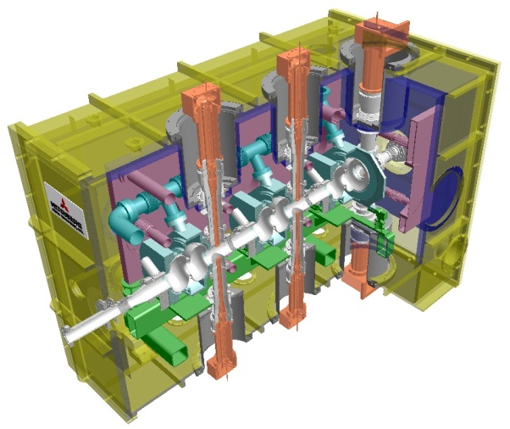
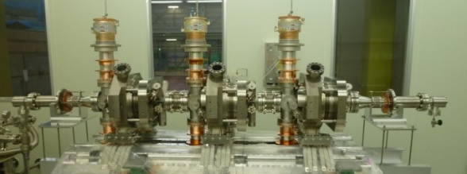
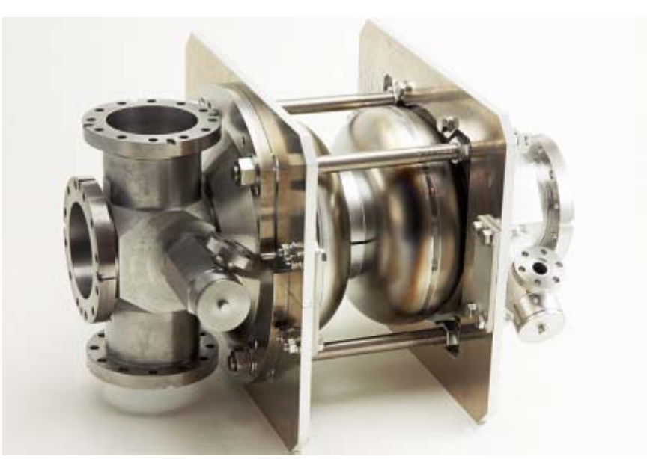
KEK 100 mA ERL Injector SRF
Three 2-cell cavities with HOM couplers
Conditioned up to E_{acc}=8 MV/m (CW); limited by heating-up of HOM couplers
So far, low current operation (<1mA)
2-cell Cavity
Cryostat
e-
Input Coupler
RF frequency: 1.3 GHz
Input power :
10kW/coupler (10mA, 5MeV)
180kW/coupler (100mA, 10MeV)
E_{acc}: 7.6MV/m（5MeV）
15MV/m (10MeV)
Unloaded-Q: Q₀ > 1×10¹⁰
HOM Coupler &
RF Feedthrough
Courtesy: Hiroshi Sakai, ERL15
M. Liepe June 18, 2015 Slide 22

Slide 23
ERL High Current Main Linac SRF
M. Liepe June 18, 2015 Slide 23

Slide 24
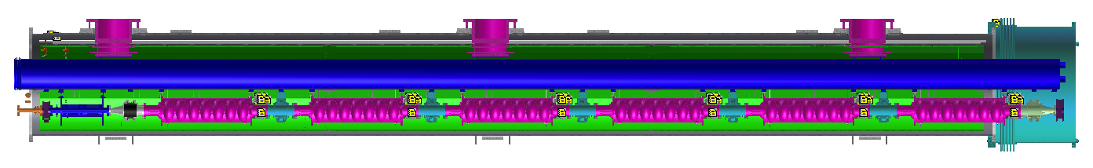
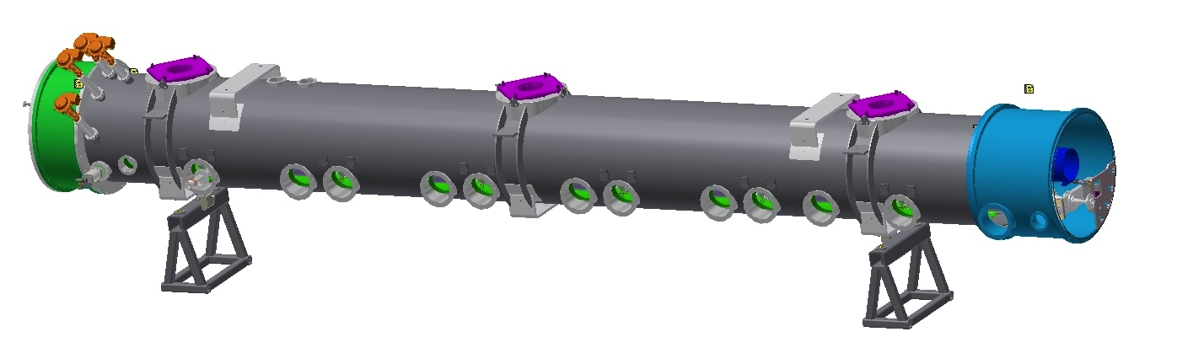
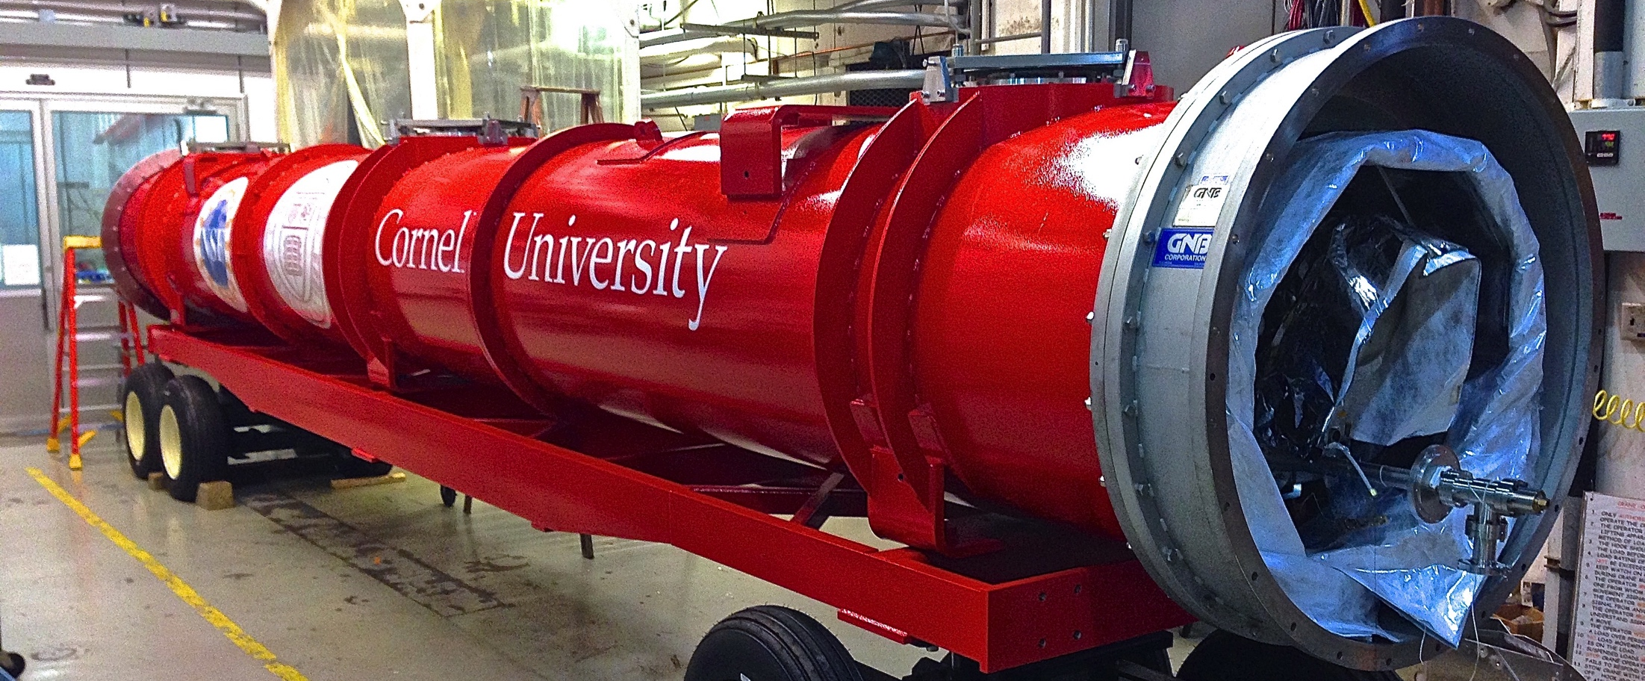
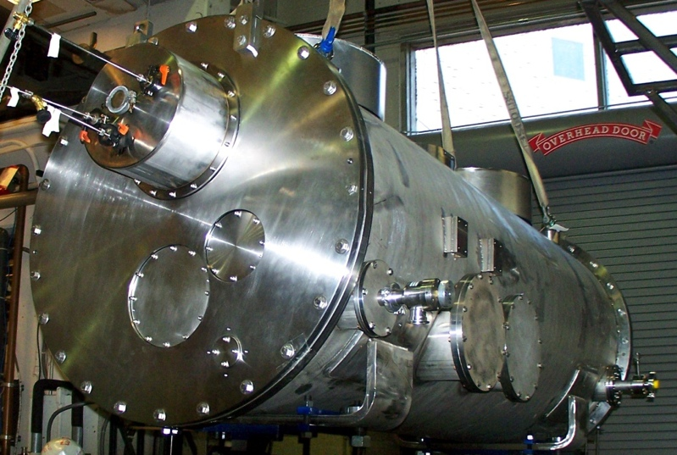
Cornell ERL Main Linac Cryomodule
~40K thermal shield
HGRP support post
Helium Gas Return Pipe
SC magnet
7-cell cavity
Beamline HOM absorber
~10 m
M. Liepe June 18, 2015 Slide 24

Slide 25
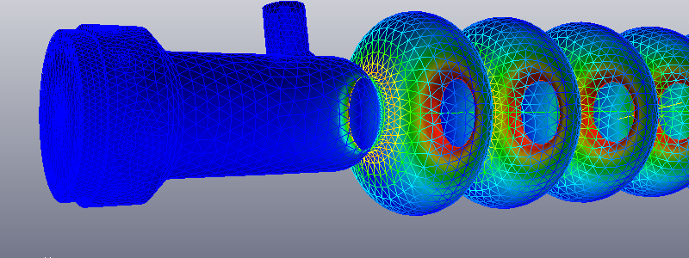
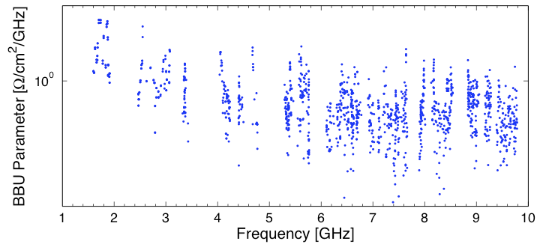
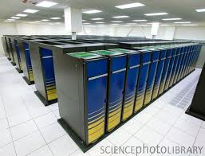
Main Linac Cavity Design for very high Beam Currents
Cell shape optimization
  ~20 free parameters
  1000’s of eigenmodes
  Impact of cell shape errors
    Supports beam current >400 mA (previous record: 10 mA)
Franklin Cray XT4
Dipole mode damping calculated up to 10 GHz with realistic RF absorbers
Worst mode limits beam current!
M. Liepe June 18, 2015 Slide 25

Slide 26
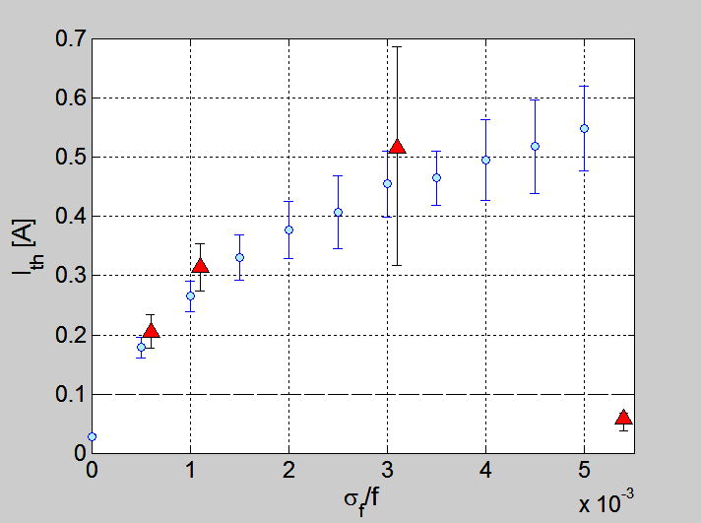
Main Linac Cavity Design: Beam Tracking Results
Maximum stable beam current (simulation) vs. cavity to cavity HOM frequency variation due to cavity shape errors
±0.125 mm
±0.250 mm
±1.000 mm
±0.500 mm
M. Liepe June 18, 2015 Slide 26

Slide 27
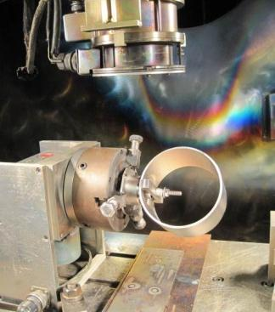
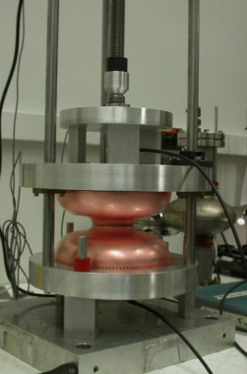




Prototype Cavity Fabrication
Electron Beam Welding
Quality control: CMM and frequency check
Finished main linac cavity with very tight (±0.25 mm) shape precision ⇒ important for supporting high currents (avoid risk of trapped HOMs!)
M. Liepe June 18, 2015 Slide 27

Slide 28



Full System Test of a 1-Cavity Main Linac Unit in a Cryomodule
80K shield
HGRP
First full main linac system test
  1st test: cavity and tuner only
  2nd test: add high power RF input coupler
  3rd test: add HOM beamline loads
HOM load
cavity
HOM load
Gate valve
Test cryomodule installed at Wilson Lab
M. Liepe June 18, 2015 Slide 28

Slide 29


Does it work? Results from the Main Linac 1-Cavity Prototype Module (I)
1.6K
1.8K
2K
Record Q₀ for cavity accelerating mode:
  Q(2.0 K) = 3.5 x 10¹⁰
  Q(1.8 K) = 6 x 10¹⁰ (3 x spec!)
  Q(1.6 K) = 1 x 10¹¹
Detailed HOM spectra measurements confirmed strong damping (Q_{HOM}<10⁴ for dipole modes)
Good agreement with 3D damping simulations
M. Liepe June 18, 2015 Slide 29

Slide 30


Does it work? Results from the Main Linac 1-Cavity Prototype Module (II)
Flange for disassembly
HTC-2: No HOM Absorbers
HTC-3: With HOM Absorbers
40 to 80K intercept
5K intercept
Flange to cavity
SiC absorber ring
Shielded bellow
Beamline HOM absorbers strongly damp dipole HOMs to under Q ~ 10⁴
M. Liepe June 18, 2015 Slide 30
Notes:
I lead Nb3Sn program !

Slide 31



Does it work? Results from the Main Linac 1-Cavity Prototype Module (III)
Beam operation:
  High currents >40 mA
  No significant heating from HOMs
  No sign of beam instability or weakly damped modes
Beam direction
BPM3
Charge-modulated beam
BPM2
BPM1
M. Liepe June 18, 2015 Slide 31

Slide 32

HZB 300 mA BESSY VSR SRF
Courtesy: J. Knobloch, ERL15
M. Liepe June 18, 2015 Slide 32
Notes:
I lead Nb3Sn program !

Slide 33

HZB 100 mA ERL Main Linac SRF
Courtesy: J. Knobloch, ERL15
M. Liepe June 18, 2015 Slide 33
Notes:
I lead Nb3Sn program !

Slide 34



KEK 100 mA ERL Main Linac SRF
Ferrite based beamline HOM damped (for 100mA operation)
So far only operated at low beam currents (<1mA)
Cryostat
Two 9-cell SC cavities
Fatal Q decrease potentially due to crack of Hom damper was observed
HOM absorber
Operation
voltage
Tuner
Decrease Q0
during operation
2012.Dec.
2014.Feb—Mar.
Input couplers
RF frequency: 1.3 GHz
Input power : 20kW CW (SW)
E_{acc}: 15 MV/m（design）
Unloaded-Q: Q₀ > 1×10¹⁰
Courtesy: Hiroshi Sakai, ERL15
M. Liepe June 18, 2015 Slide 34
Notes:
I lead Nb3Sn program !

Slide 35




BNL ERL Main Linac SRF (I)
704 MHz BNL1 cavity for R&D ERL
704 MHz BNL3 cavity for conventional lattice ERL eRHIC
High current ERL based (3.5 nC, 50 mA 6-pass ) => Heavy damped HOM
7.3 kW per average HOM power/cavity
Courtesy: Wencan Xu, ERL15
M. Liepe June 18, 2015 Slide 35
Notes:
I lead Nb3Sn program !

Slide 36


BNL ERL Main Linac SRF (II)
422 MHz BNL4 cavity for FFAG lattice ERL eRHIC (18 mA 16-pass ERL)
6 coaxial-line HOM couplers on the cavity for low frequency HOMs: ~ 5.6 kW
3 rectangular waveguide HOM dampers on the beamline taper for high frequency HOMs: ~2.2 kW
Courtesy: Wencan Xu, ERL15
M. Liepe June 18, 2015 Slide 36
Notes:
I lead Nb3Sn program !

Slide 37




JLAB High Current Cavity Work
748.5 MHz High Current Cavity
Courtesy: Bob Rimmer
M. Liepe June 18, 2015 Slide 37
Notes:
I lead Nb3Sn program !

Slide 38
Conclusions
M. Liepe June 18, 2015 Slide 38

Slide 39
Conclusions
Injector (non ERL) high current SRF:
  Several 100 mA+ designs (Cornell, HZB, KEK…)
  Cornell injector has reached >70 mA with no sign of limitation by SRF
  Future: need higher power CWRF couplers (especially at f >1 GHz) to reduce cost
ERL main linac high current SRF:
  Several 100 mA+ designs (BNL, Cornell, HZB, JLAB…)
  Cornell 7-cell cavity has been tested at ~40mA in 1-pass (non ERL) operation with no sign of beam instability or excessive HOM power
  Non of these cavities ever have been operated in high current (~100mA) ERL mode!!
    Test facilities: CBETA, HZB, KEK…
M. Liepe June 18, 2015 Slide 39
Notes:
I lead Nb3Sn program !

Slide 40
Thank you for your attention!

