Slide 1


FFAG Recirculation and Permanent Magnet Technology for ERL’s
N.Tsoupas, S. Brooks, A. Jain, G. Mahler, F. Meot, V. Ptitsyn, D. Trbojevic BNL
M. Severance SBU
1/17

Slide 2
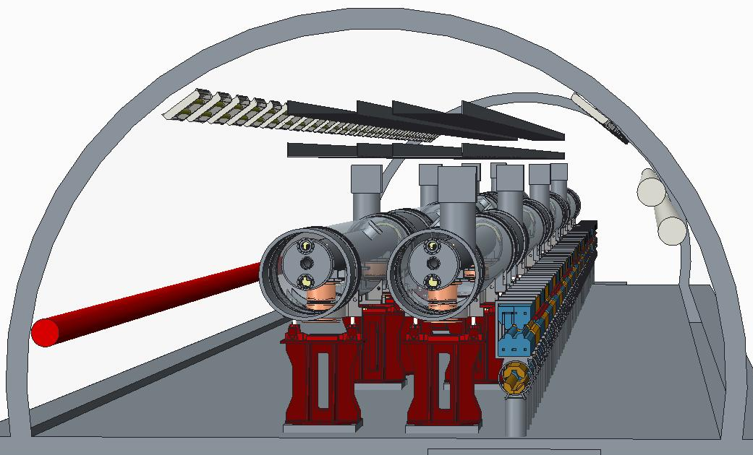
ERL & FFAG based eRHIC
arXiv:1409.1633
Novel FFAG lattice allows 16 beam re-circulations using only two beam transport loops
2/17

Slide 3
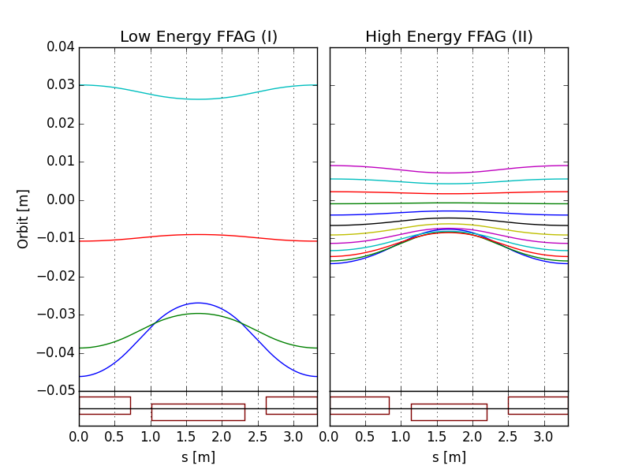
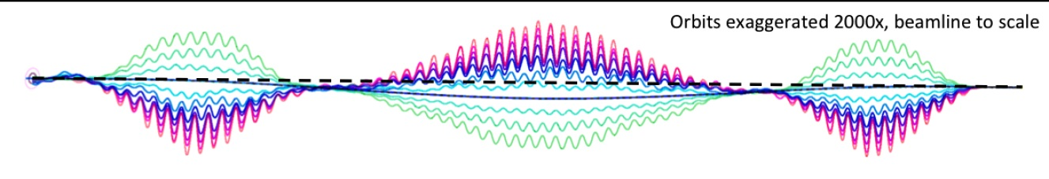
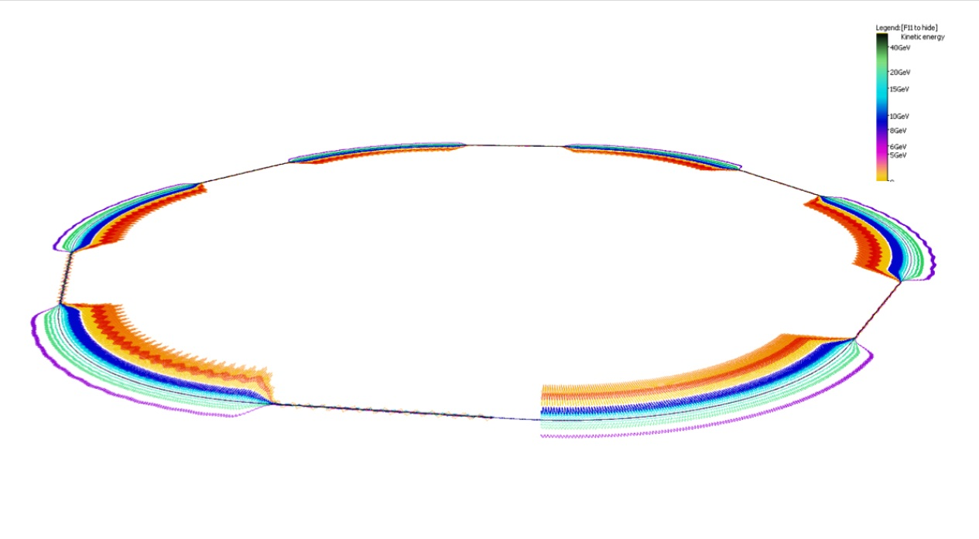
FFAG recirculation passes
eRHIC uses two FFAG beamlines to do multiple recirculations.
(FFAG-I: 1.3-5.4 GeV, FFAG-II: 6.6-21.2 GeV)
All sections of a FFAG beamline is formed using a same FODO cell. Required bending in different sections is arranged by proper selection of the offsets between cell magnets (or, alternatively, with dipole field correctors).
Permanent magnets can used for the FFAG beamline magnets (no need for power supplies/cables and cooling).
E=5.3 GeV
E=21.2 GeV
E=6.6 GeV
E=1.3 GeV
BD
QF
Orbits in Detector bypass section
@S.Brooks, D.Trbojevic
Quad offsets evolve adiabatically
Orbits in Transition section
Each of two eRHIC FFAGs contain 1066 FFAG cells
3/17

Slide 4
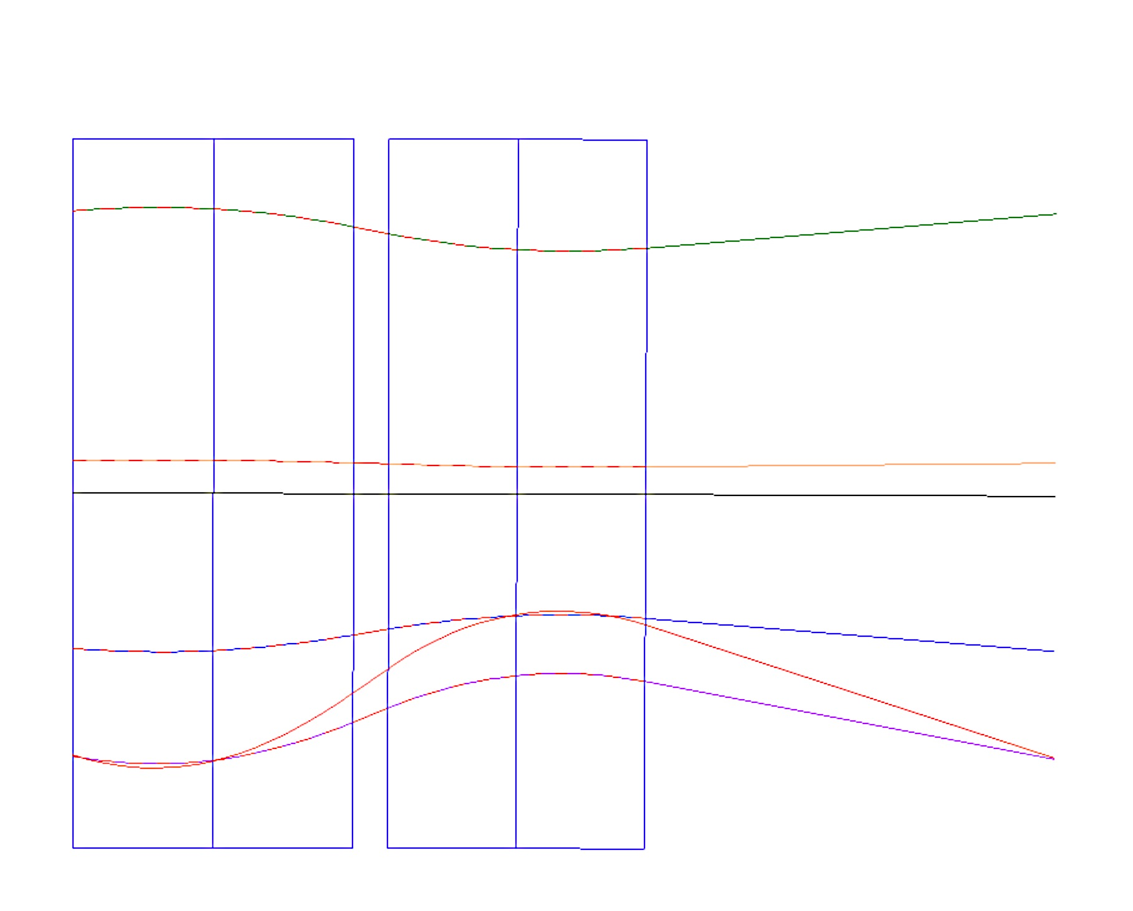
FFAG Cell of the eRHIC
B_{f}= 0.0813 T,
G_{f}= 30 T/m
x_{Foffset}= -2.7 mm
B_{D} = 0.0813 T,
G_{d} = -30 T/m
x_{Doffset}=+2.7 mm
x(mm)
N=212 cells per arc, 1.680 m
o
8.1 mm
θ=0.283º
6.622 GeV
2.7 mm
5.3 GeV
2.7 mm
3.978 GeV
1.334 GeV
-8.8 mm
6 cm
2.656 GeV
0.48 m
0.44 m
70 cm
4/17

Slide 5
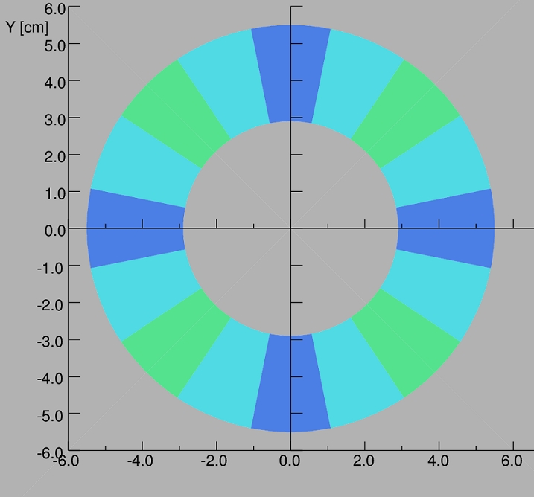
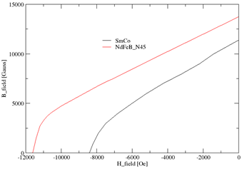
Perm. Magnet Material SmCO
Perm. Magnet Material NdFeB
2D Design establishes the magnet’s cross section
-The 12pole multipole=0 for R=1 cm
-NdFeB-N45 allows for larger inner radius
5/17

Slide 6
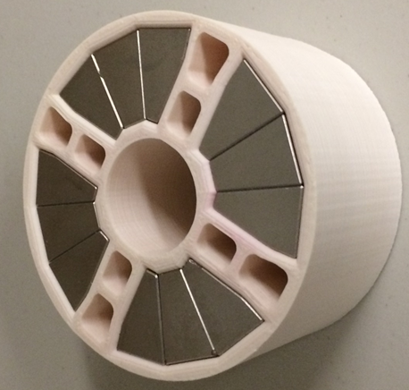
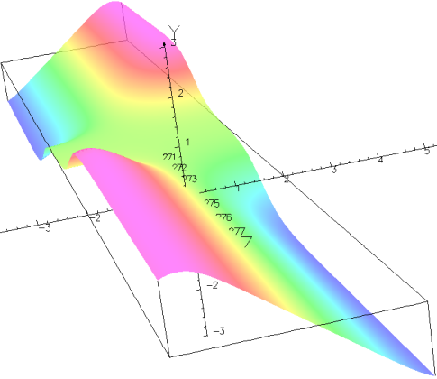
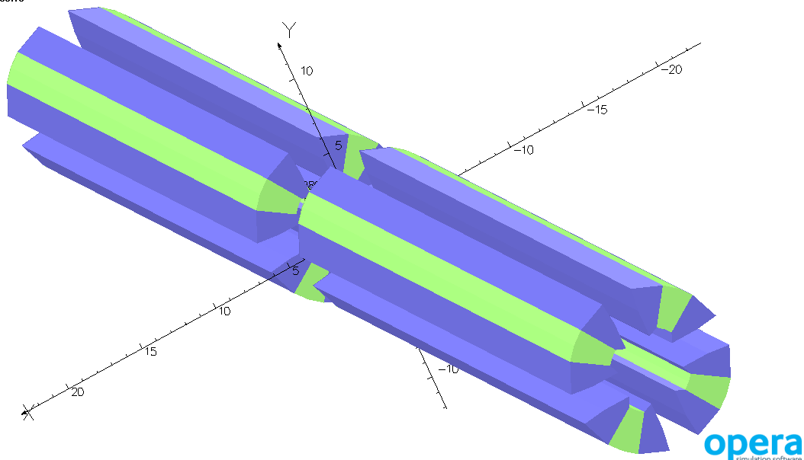
3D Magnetic field calculations for the FFAG cells
QF
QD
cell
θ=0.283º
3Dimensional Field map is
obtained over the volume of
a single cell where beam exists.
6/17

Slide 7
Long coil measurement of the magnetic multipoles at R=1 cm
 | [Gauss] | Q_Diff/Q_{meas} | [Gauss.cm⁻⁴] | 12p_diff/Q_{meas}
SmCo R26HS Temp.=20º Calculations | 18730.5 |  | 337.4
Magnet#1 Measurement | 18650.0 | 4.3x10⁻³ | 350.6 | 7x10⁻⁴
Magnet#2 Measurement | 19096.0 | 20x10⁻³ | 371.5 | 17x10⁻⁴
7/17

Slide 8
The Optics of the Low Energy FFAG cell*
3D Field Maps were obtained from the 3D EM Calculations
Calculate the closed orbits in the range 1.3 GeV to 6.6 GeV
Calculations of tunes Q_{x},Q_{y} and chromaticities ξ_{x}, ξ_{y} per cell.
Calculations of the maximum beam emittances ε_{x}, ε_{y} transported in the low energy arc for each of the five orbits.
Calculations on the dynamic aperture of the transport ring.
Calculation of the beta functions.
* The zgoubi computer code was used in the calculations.
8/17

Slide 9
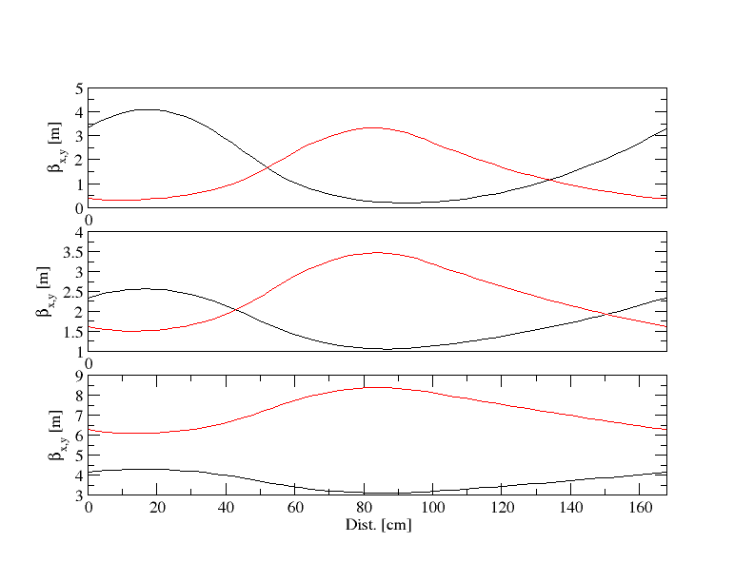
Beta functions of 3 different energies
QF
QD
β_{x}
1.3 GeV
β_{y}
2.6 GeV
6.6 GeV
9/17

Slide 10
Cornell-BNL FFAG-ERL Test Facility (Cβ)
NS-FFAG arcs, four passes (similar to first eRHIC loop)
Momentum aperture of x4, as for eRHIC
Uses Cornell DC gun, injector (ICM), dump, 70MeV SRF CW Linac
Prototyping of essential components of eRHIC design

Slide 11
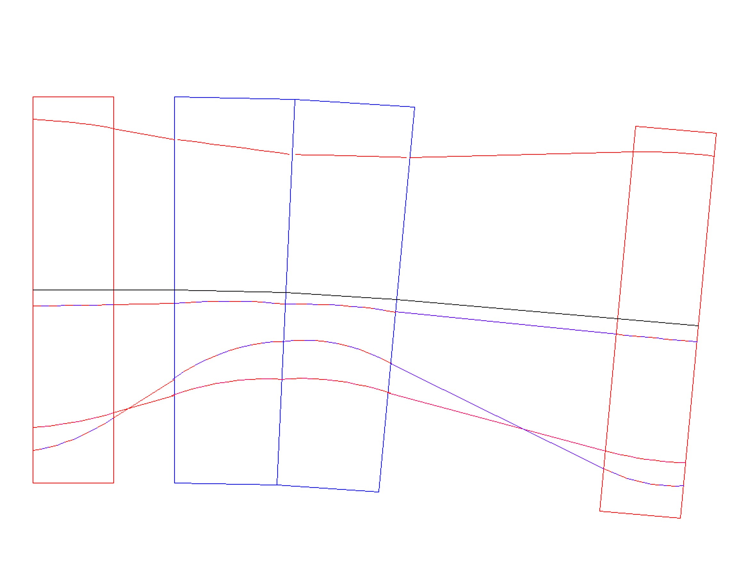
76 – 286 MeV NS-FFAG Cornell Lattice
100 cells : Orbits and magnets in the 10.5 m diameter
G_{F} = 42.54 T/m
B_{yF} =-0.104 T
x = 2.44 mm
G_{D} = -27.493 T/m
B_{yD} = 0.5044 T
x = + 18.331 mm
θ_{F/2}=-11.088/2 mrad
θ_{D}=73.93 mrad
x (mm)
BD
QF/2
286 MeV
11.2 mm
QF/2
11.9 mm
2.44
E_{CEN}=225 MeV
-8.98 mm
216MeV
15.8 mm
146 MeV
76 MeV
4.0 cm
3 cm
11 cm
10.99 cm
4.0 cm
32.99 cm

Slide 12
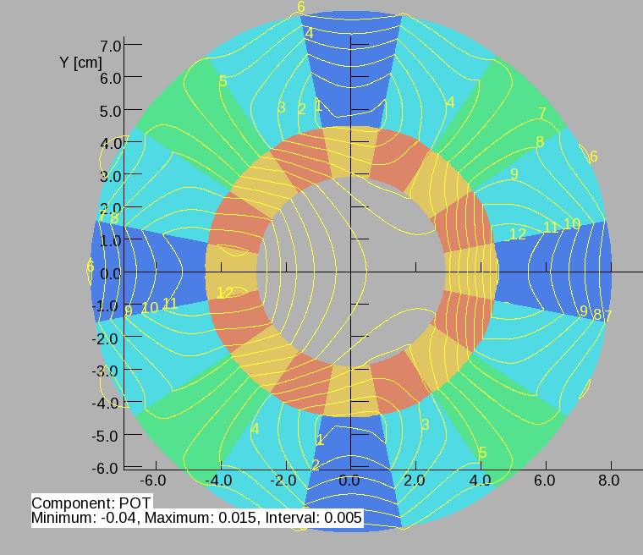
QF Quadrupole is displaced -2.44 mm with respect to the central Orbit (CO)
Material NdFeB-N45
Version # 1
Halbach Dipole=0.504 T
Gradient = 42.54 T/m
Halbach Quad=–27.493(T/m)
Inside a radius of 1.7 cm all multipoles including 12pole have strength <10⁻⁴
Inside a radius of 12 mm all multipoles including 12pole have strength <10⁻⁴

Slide 13
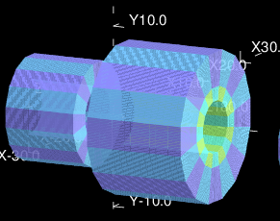
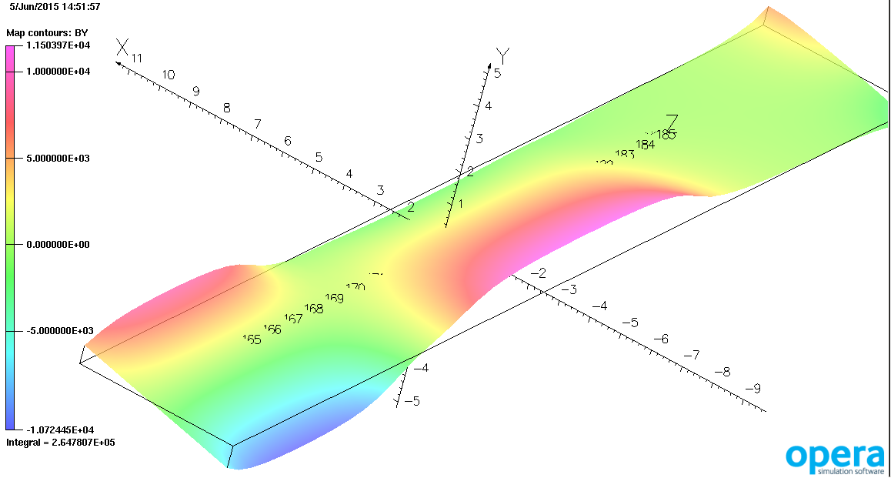
Z-axis of each cell

Slide 14
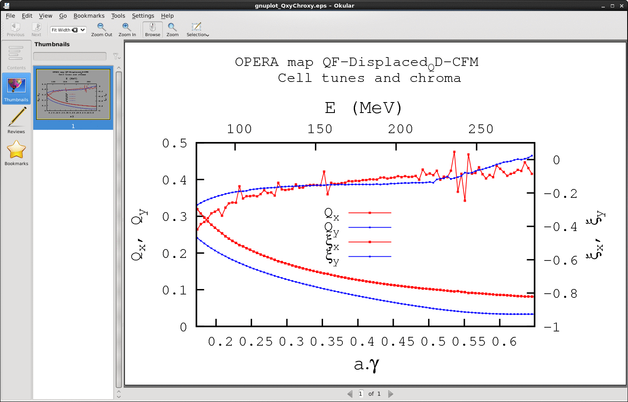

Slide 15
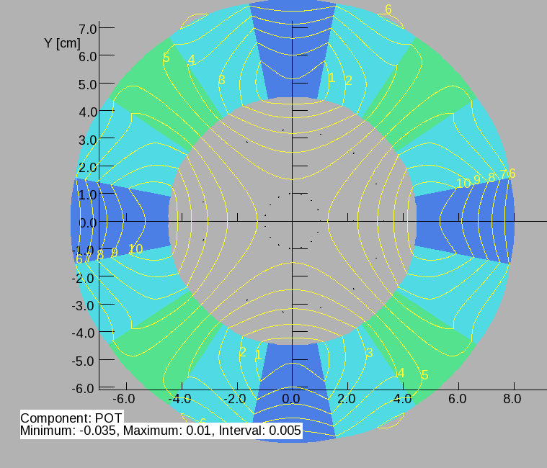
Version # 2
QF Quadrupole is displaced -2.44 mm with respect to the central Orbit (CO)
Material NdFeB-N45
Gradiend = +42.54 T/m
Gradiend = -27.5 T/m
Inside a radius of 1.7 cm all multipoles have zero strength
In a circle R=~12 mm with center (x=18.346 mm, 0)
Multipoles strength 10⁻⁵ or less

Slide 16
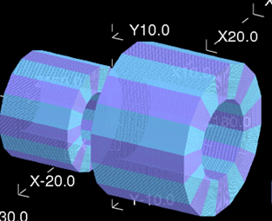
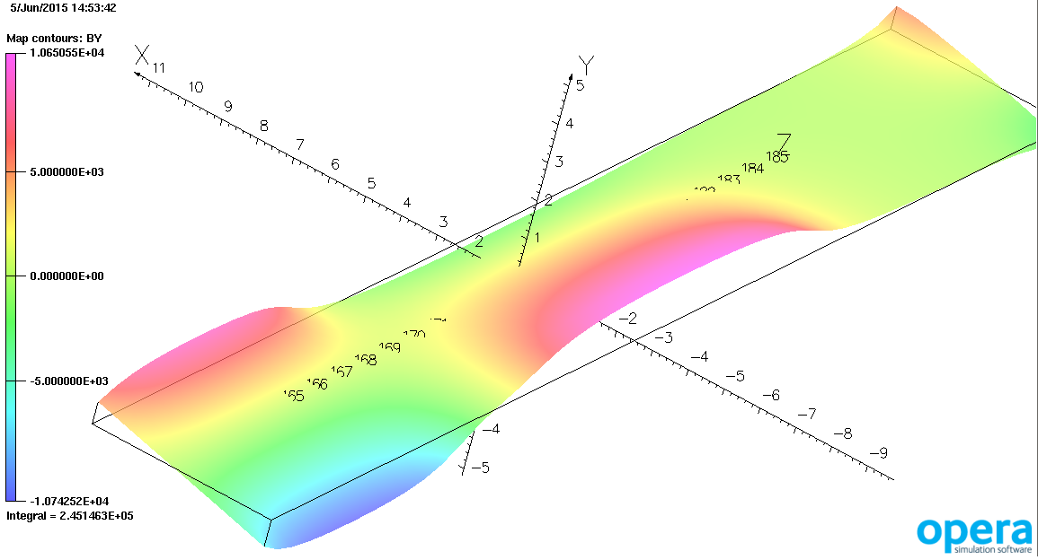

Slide 17
Thank you
for your attentions

