Slide 1

CASPEr: the Cosmic Axion Spin Precession Experiment
Derek F. Jackson Kimball

Slide 2

Collaboration

Slide 3
Collaboration

Slide 4



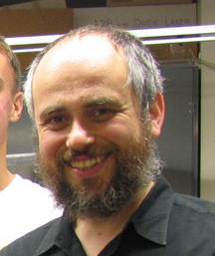
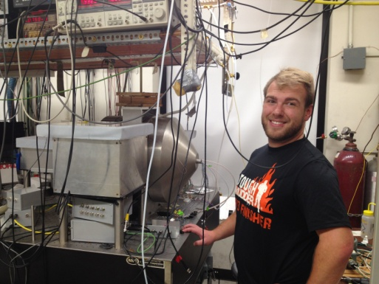





Collaboration
Dmitry Budker,
Arne Wickenbrock,
John Blanchard,
Samer Afach,
Nathan Leefer,
Lykourgas Bougas,
Dionysis Antypas (Mainz)

Slide 5
Collaboration

Slide 6
Collaboration

Slide 7



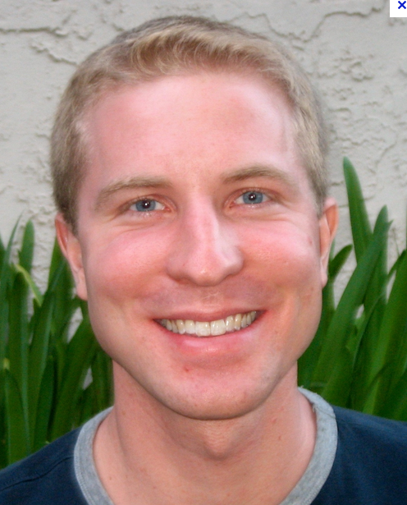


Collaboration
Surjeet Rajendran,
Dmitry Budker (UCB)
Peter Graham (Stanford)
Derek Kimball (CSUEB)

Slide 8
Collaboration

Slide 9
Collaboration

Slide 10


Collaboration
?
?
Alex Sushkov (Boston University)

Slide 11
Collaboration
?
Alex Sushkov (Boston University)

Slide 12
Collaboration

Slide 13
Cosmic Axion Spin Precession Experiment
(CASPEr)

Slide 14
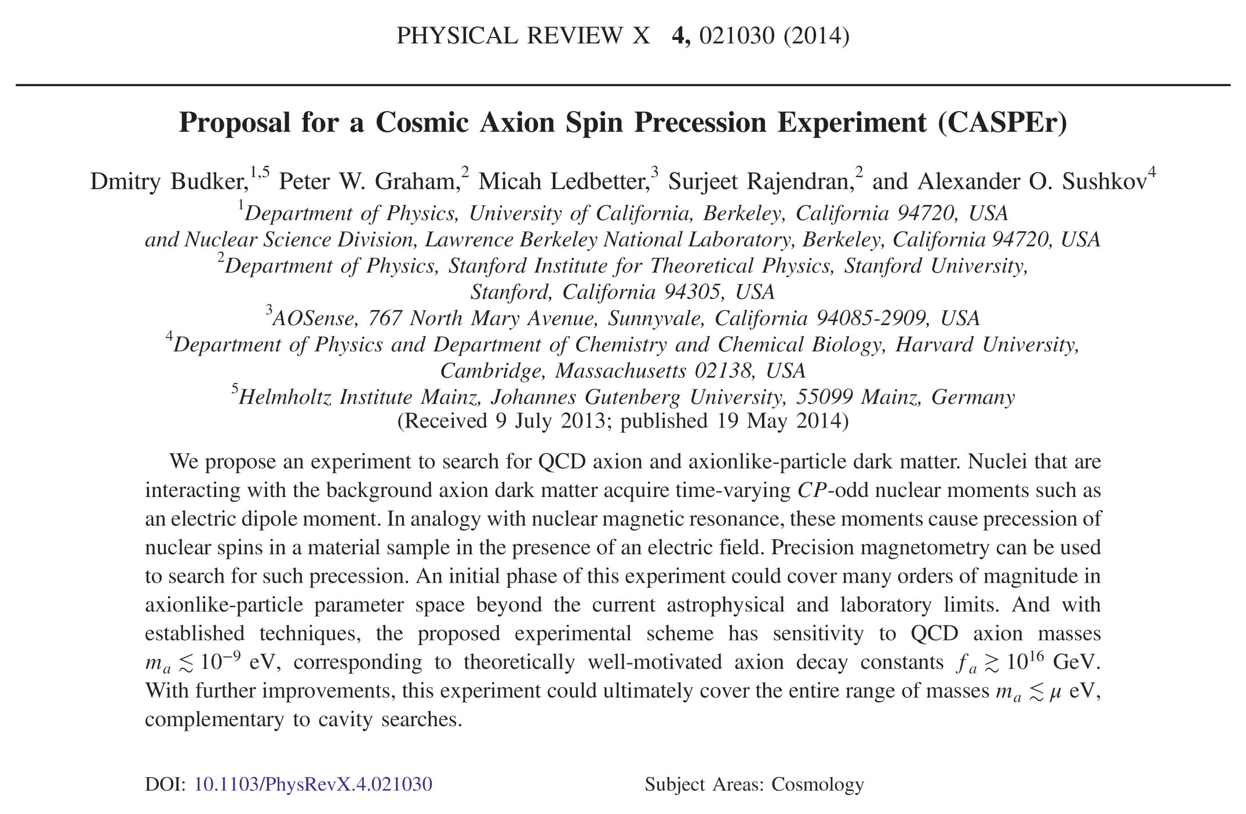
D. Budker et al., Phys. Rev. X 4, 021030 (2014).

Slide 15
Outline
Motivation and theory;
CASPEr Electric;
CASPEr Wind*;
Conclusions.
* Not enough time!

Slide 16
Motivation and theory

Slide 17
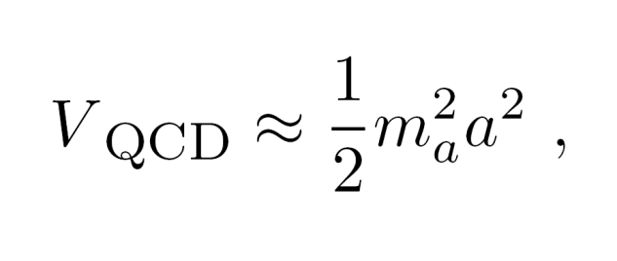
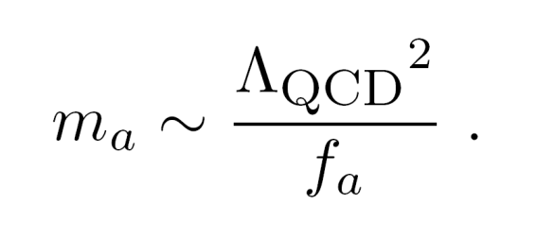
Axions
Axions and axion-like particles (ALPs) arise as the pseudo-Goldstone bosons of global symmetries broken at an energy scale f_{a}.
The strong interaction creates a potential for the QCD axion:
and the QCD axion mass is given by:
ALPs may have different
Λ and f.

Slide 18
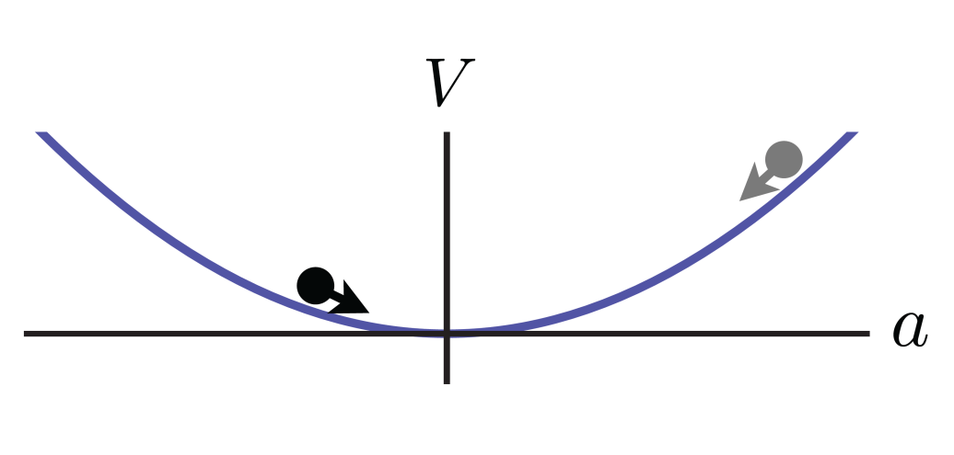
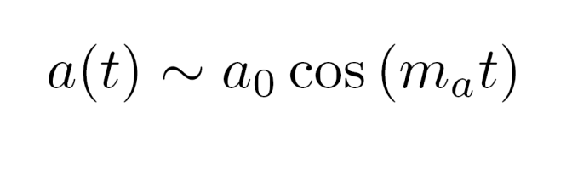
Axion oscillations
When axions are produced after the Big Bang, the field can generally take on any initial value, and thus axions appear as a classical coherent oscillating field.

Slide 19
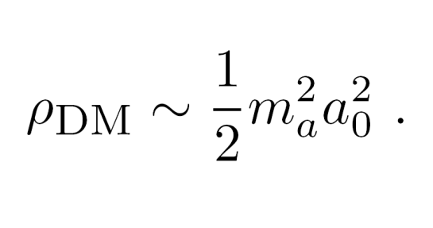
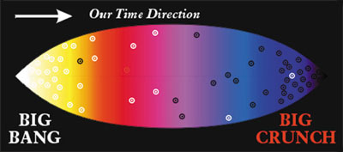
Axions as dark matter
Axion oscillations store energy that can be the dark matter:
In fact, if the energy density of the oscillating axion field is too large, it can overclose the universe!

Slide 20
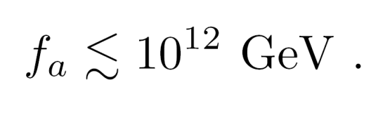
Inflation and axion cosmology
If θ_{QCD} ∼ 1 in the early universe, then for the QCD axion:
The “anthropic” window.
However, if the inflation scale is lower than f_{a} the universe before inflation can have an inhomogeneous distribution of a₀.
Any local patch can inflate into our visible universe with a uniform value of a₀, and of course our visible universe has a dark matter density small enough to avoid overclosure.

Slide 21
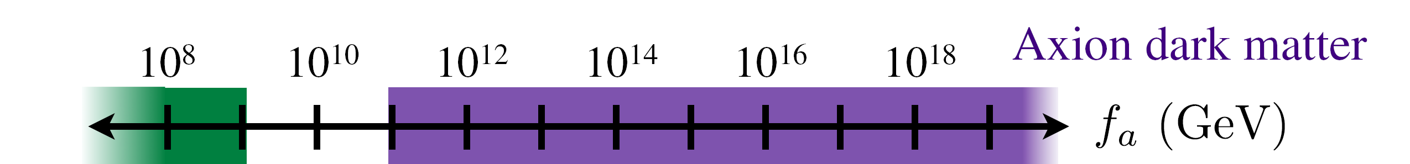
Inflation and axion cosmology
If θ_{QCD} ∼ 1 in the early universe, then for the QCD axion:
The “anthropic” window.
CASPEr
Astrophysical
constraints
ADMX
GUT scale
Planck scale

Slide 22
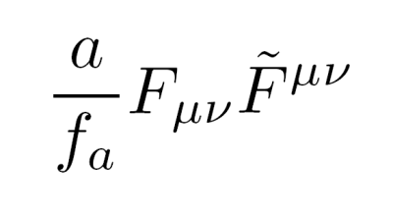
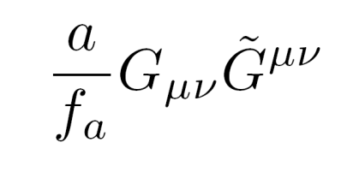
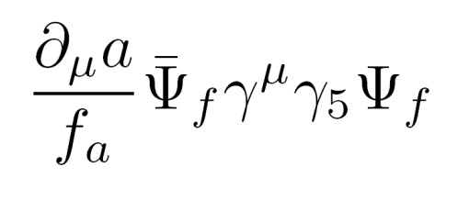
Axion couplings
Coupling to electromagnetic field
Coupling to gluon field
CASPEr Electric
Coupling to fermions
CASPEr Wind

Slide 23
CASPEr Electric

Slide 24
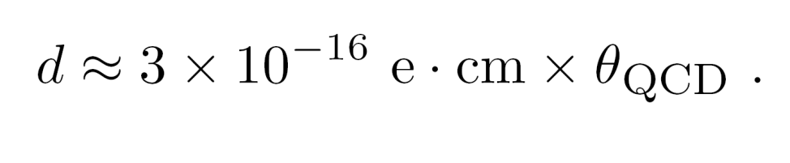
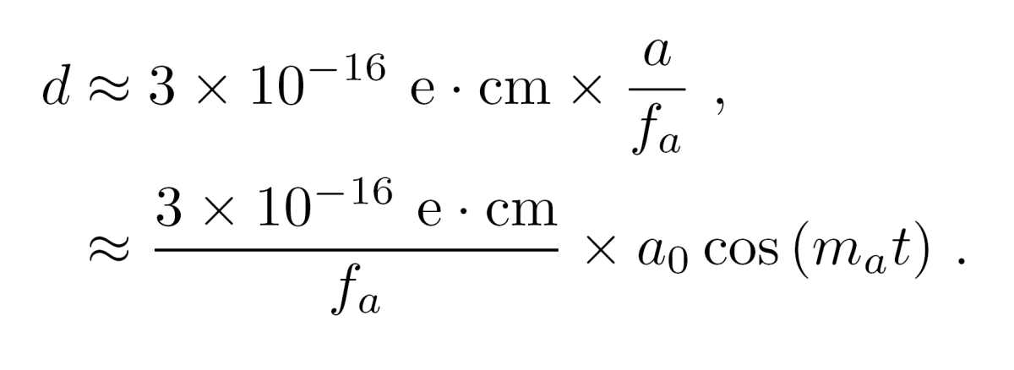
Axion-induced electric dipole moments (EDMs)
Nuclear EDM from the strong interaction (strong CP problem):
Nuclear EDM from axion field:

Slide 25
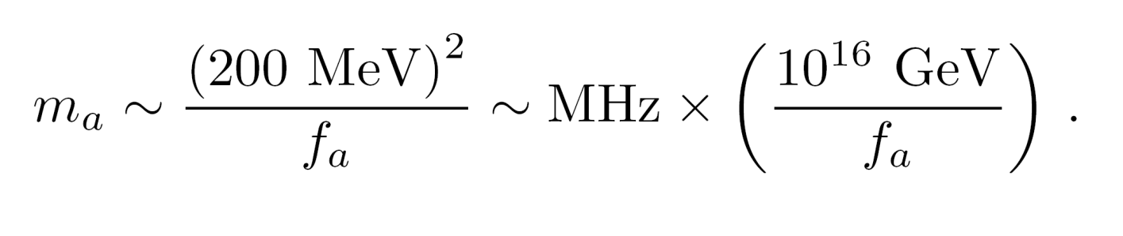
Axion oscillation frequency
Determined by the axion mass, related to the global symmetry breaking scale f_{a} :
f_{a} at GUT scale → MHz frequencies,
f_{a} at Planck scale → kHz frequencies.

Slide 26
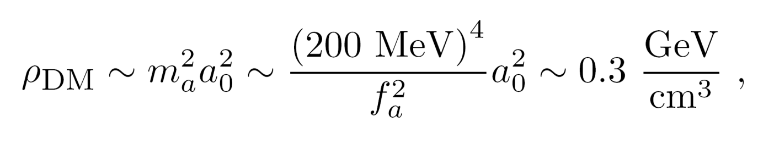
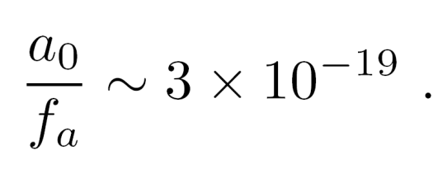
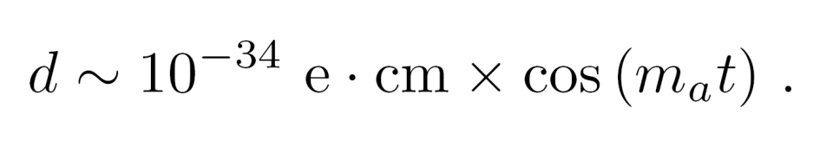
Axion-induced EDM coupling
Assuming axions are the dark matter, the dark matter density fixes the ratio a₀/f_{a}:
This generates an oscillating EDM:

Slide 27
Nuclear Magnetic Resonance (NMR)
NMR resonant spin flip when Larmor frequency

Slide 28
EDM coupling to axion plays role of oscillating transverse magnetic field
SQUID
pickup
loop
Larmor frequency = axion mass ➔ resonant enhancement.

Slide 29
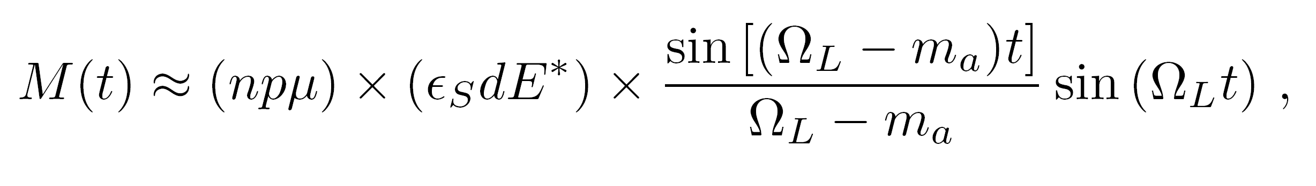
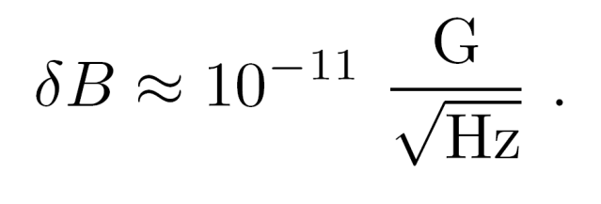
Signal estimate
n = atomic density;
p = nuclear polarization;
μ = magnetic moment;
E* = effective electric field;
ε_{S} = Schiff suppression;
Ω_{L} = Larmor frequency.
SQUID sensitivity:

Slide 30
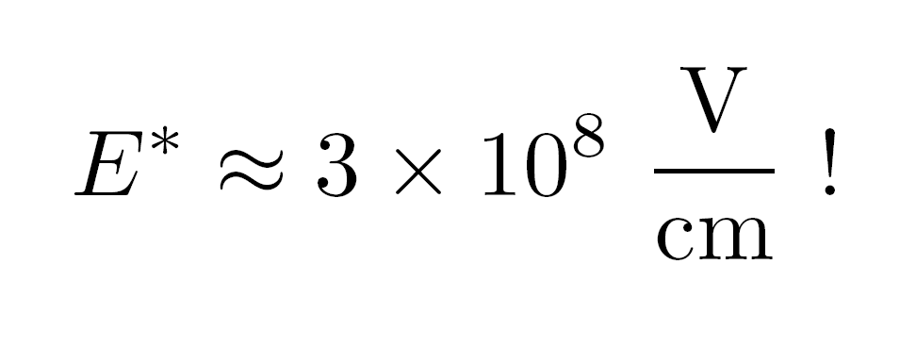
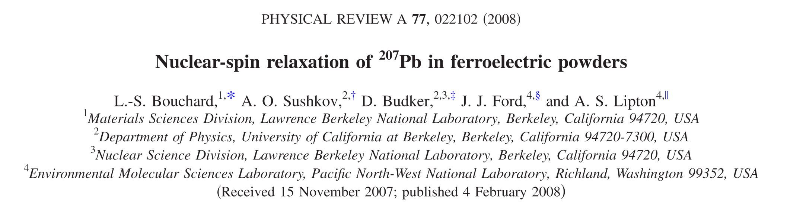
Sample choice
Need maximum n, p, E*, and ε_{S}, and (up to a point) long T₂.
For the first generation CASPEr-Electric experiment, we plan to use a ferroelectric crystal, PbTiO₃.

Slide 31
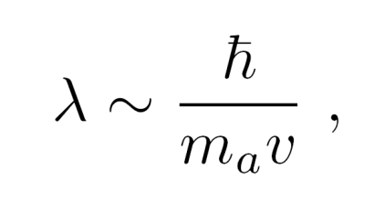
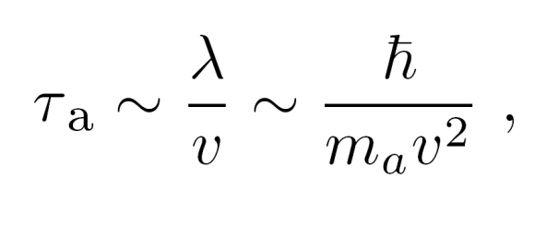
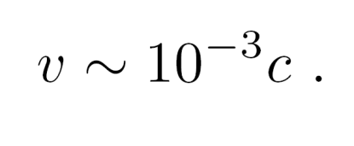
Coherence time
Coherence length of the axion field is given by its de Broglie wavelength:
which translates to a coherence time as the Earth moves through the axion field:
with virial velocity:

Slide 32
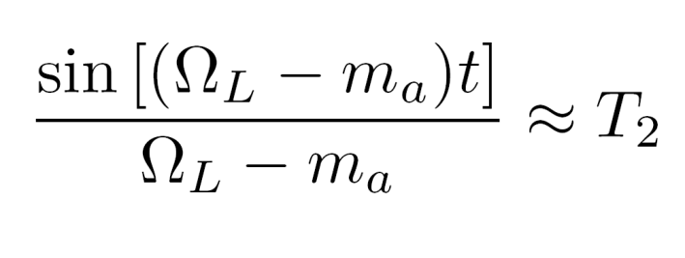
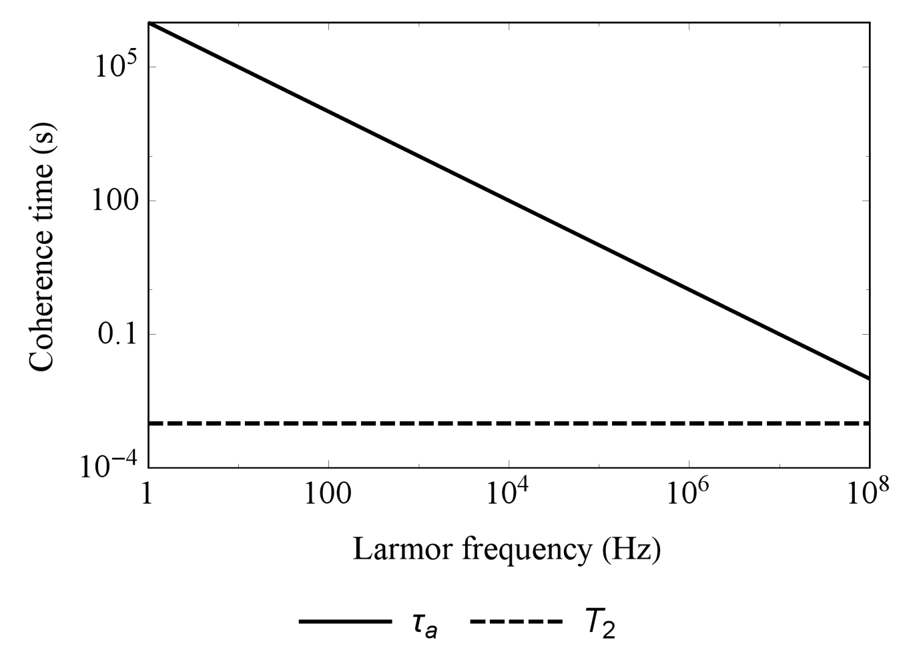
Coherence time
Measured coherence time in PbTiO₃ is T₂ ≈ 1 ms, at cryogenic temperatures T₁ ≈ 1000 s.

Slide 33
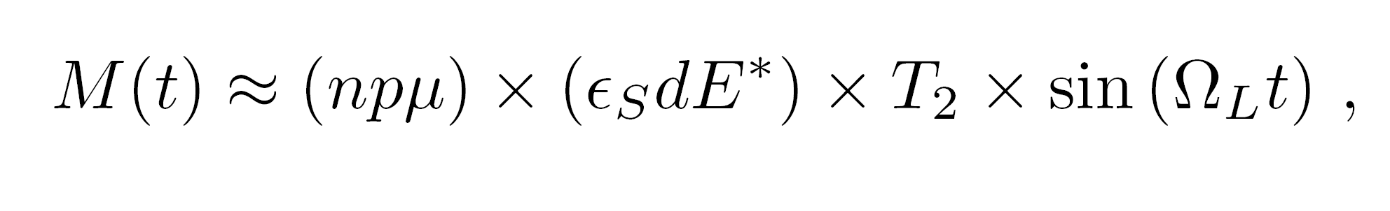
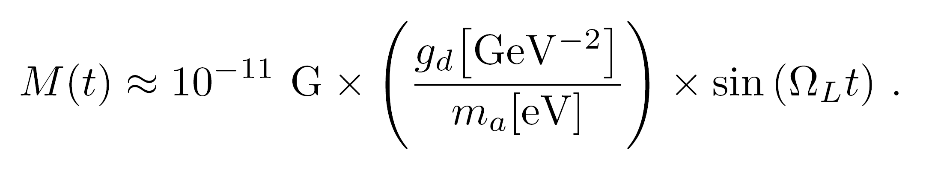
Signal estimate
Oscillating magnetization is given by:
For PbTiO₃ under our experimental conditions:

Slide 34
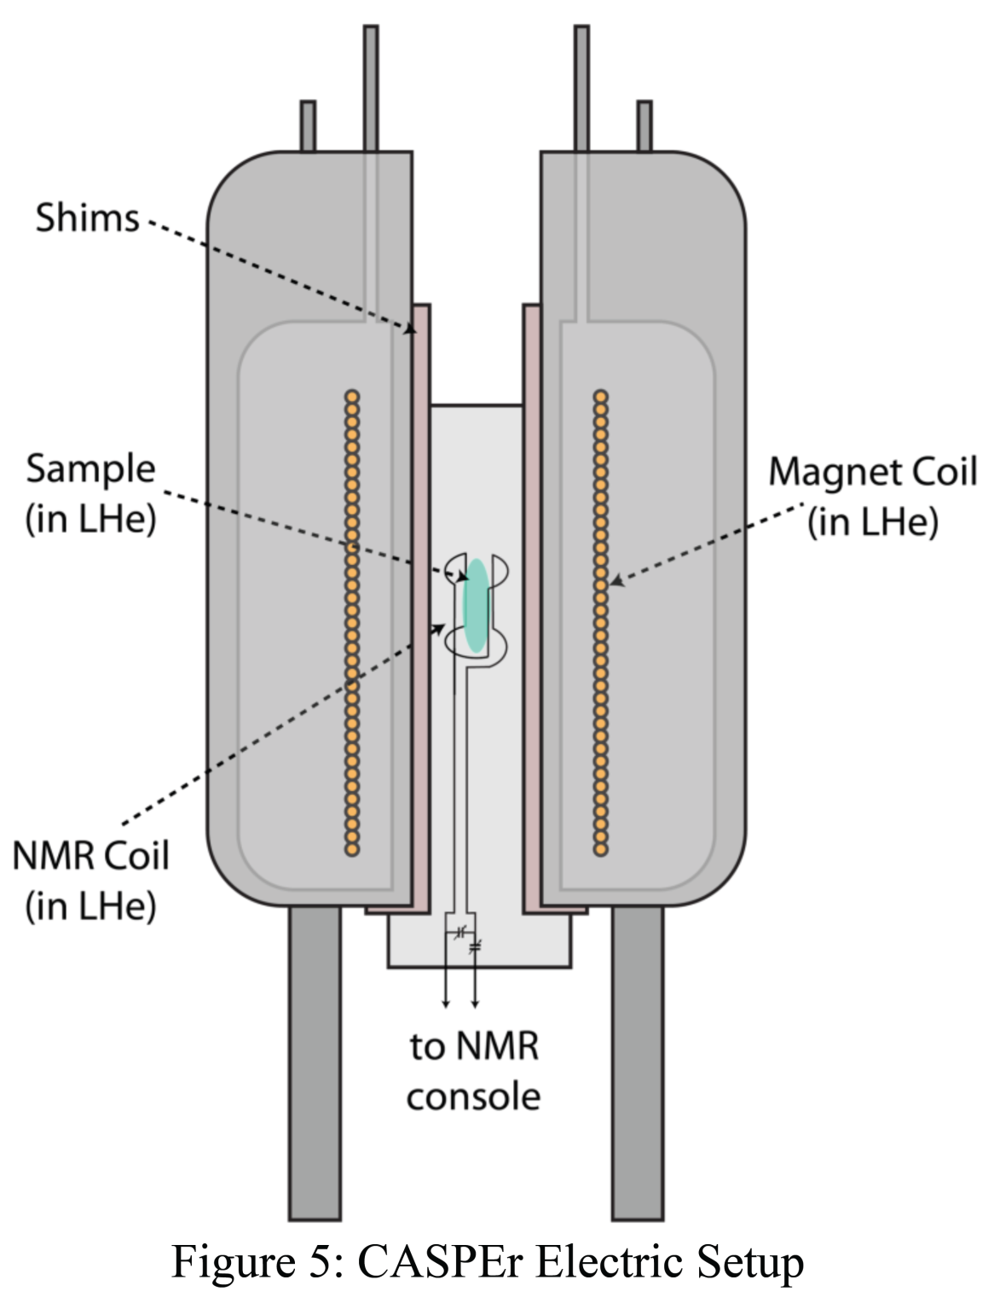
Experimental strategy
(1) Thermally polarize spins in a cryogenic environment at high magnetic field (10 T);
(2) Scan magnetic field from
10 T → 0 T; Larmor frequency decreases from 45 MHz;
(3) Integrate for about 20 ms at each frequency, a complete scan takes around 1000 s ≈ T₁ to complete.

Slide 35
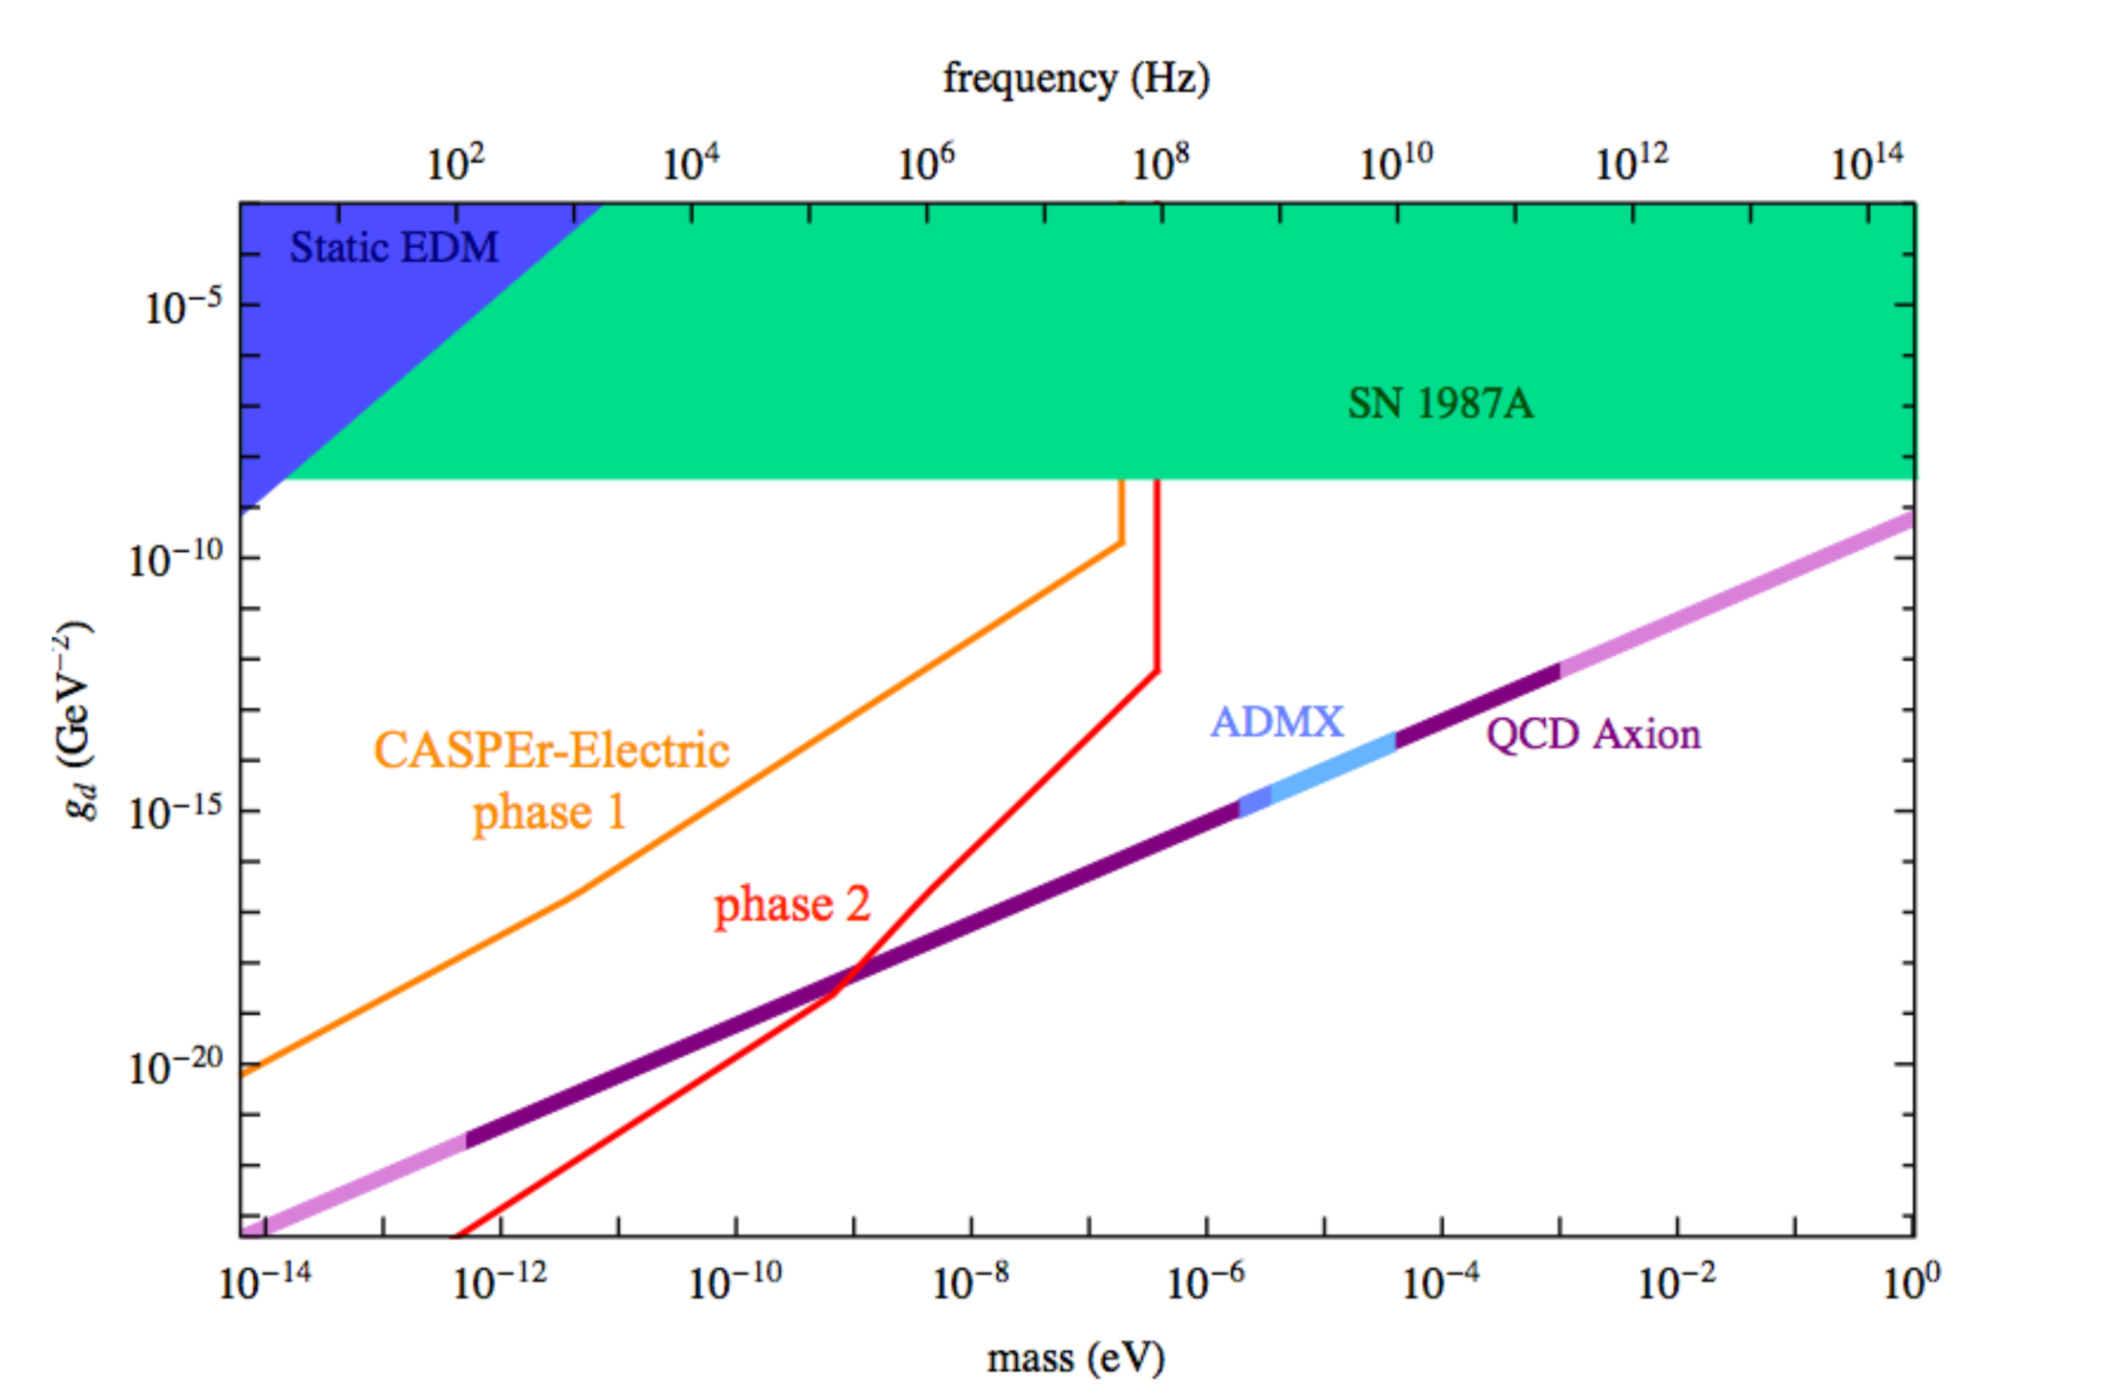
Experimental strategy
Experimental sensitivity

Slide 36
Phase 2 requirements
(1) Longer coherence time: T₂ ≈ 1 s.
(2) Hyperpolarization: p ≈ 1.
(3) Larger sample size: V ≈ 100-1000 cm³.
R&D required!

Slide 37
CASPEr Wind

Slide 38
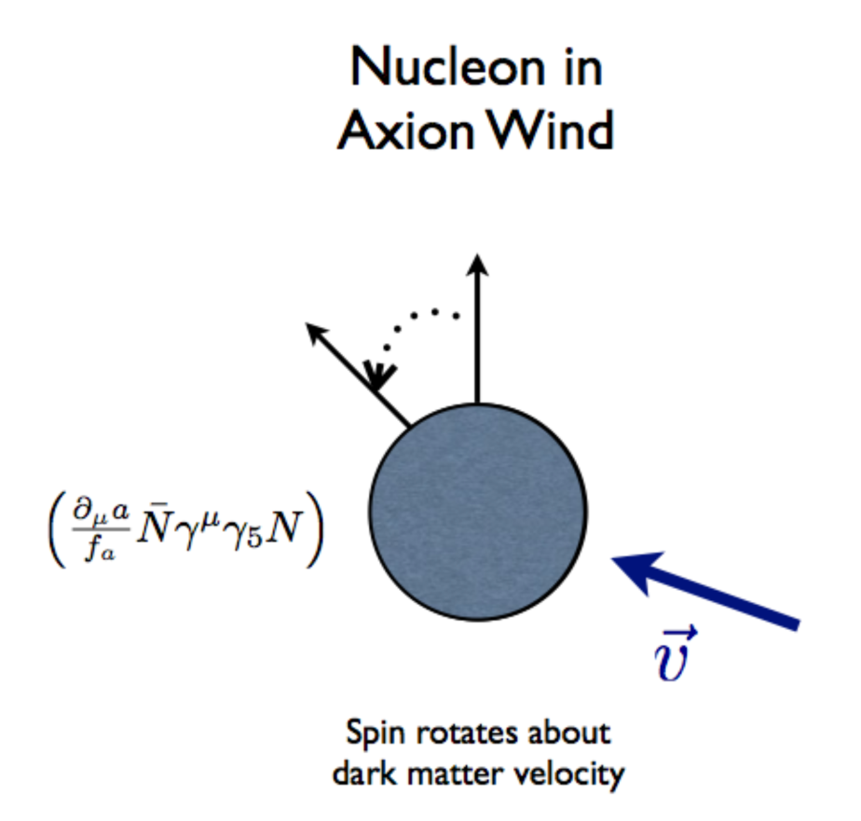
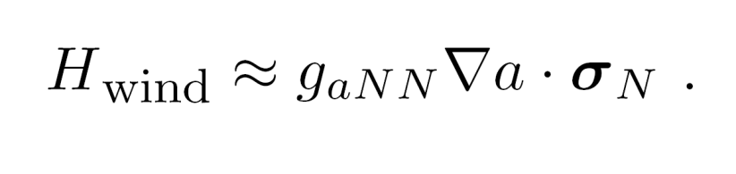
Axion/ALP-induced spin precession (axion wind)
Nonrelativistic limit of the axion-fermion coupling yields a Hamiltonian:

Slide 39
Axion wind detection
SQUID
pickup
loop
axion “wind”
Larmor frequency = axion mass ➔ resonant enhancement.

Slide 40
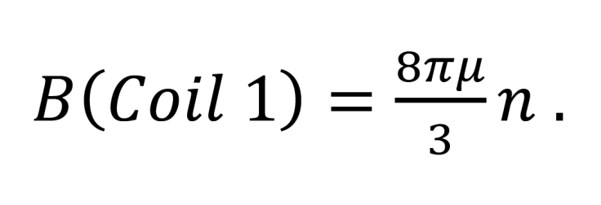
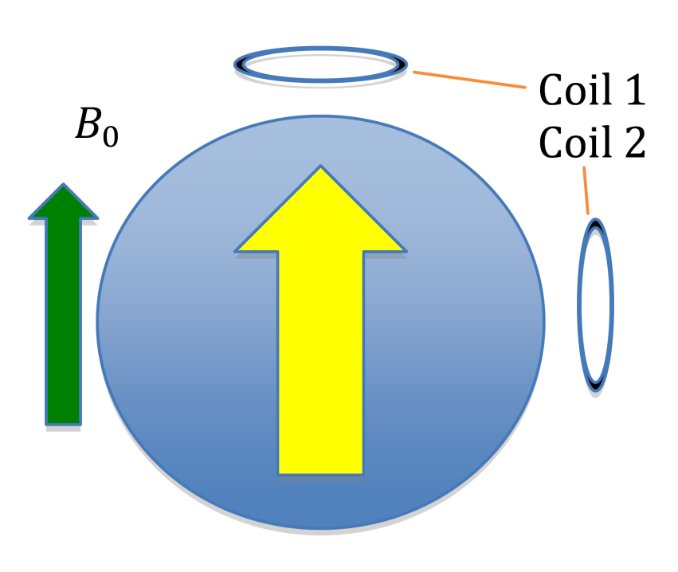
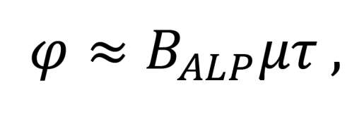
Signal amplification
During coherence time τ, polarized spins rotate by angle:

Slide 41
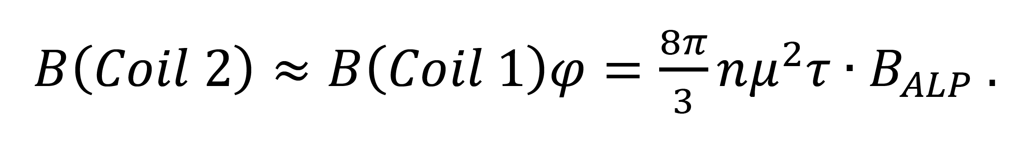
Signal amplification
Oscillating field detected by Coil 2 is given by:
Enhancement factor!

Slide 42
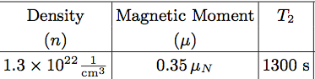
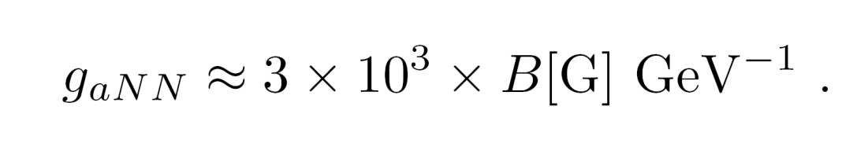
Sample choice: liquid Xenon
Relatively large sample can be hyperpolarized.
In this case, the enhancement factor can be on the order of 10⁶.
Coupling constant in magnetic field units is:

Slide 43
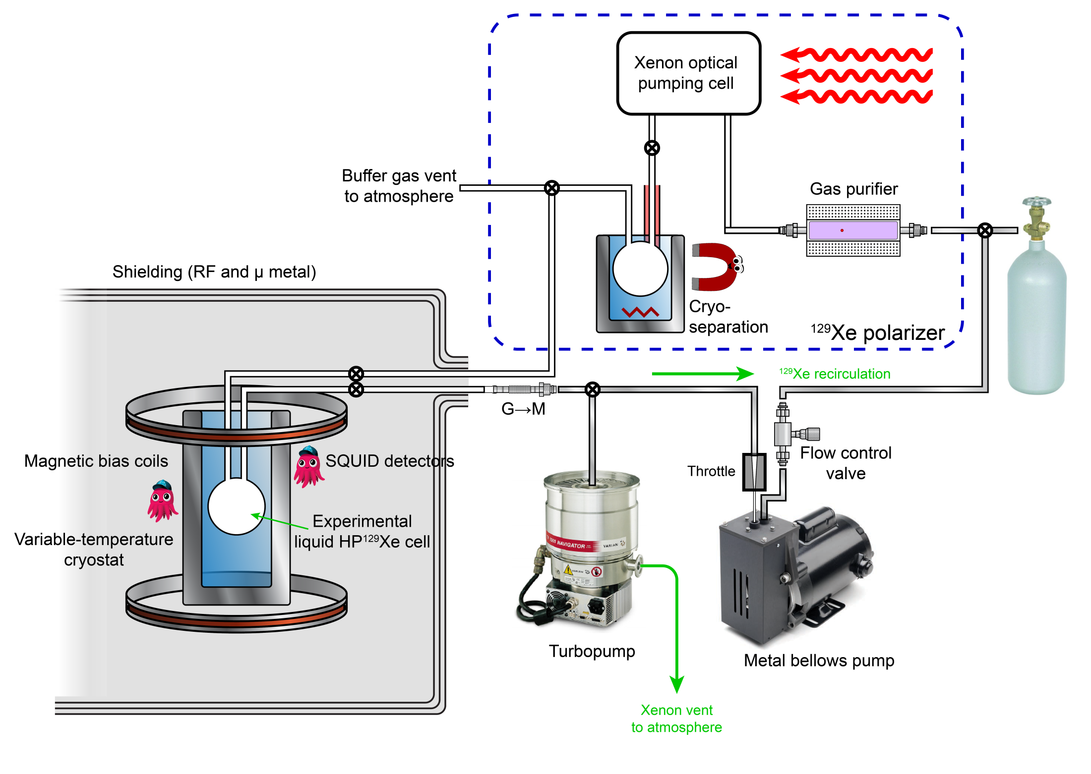
Experimental
setup

Slide 44
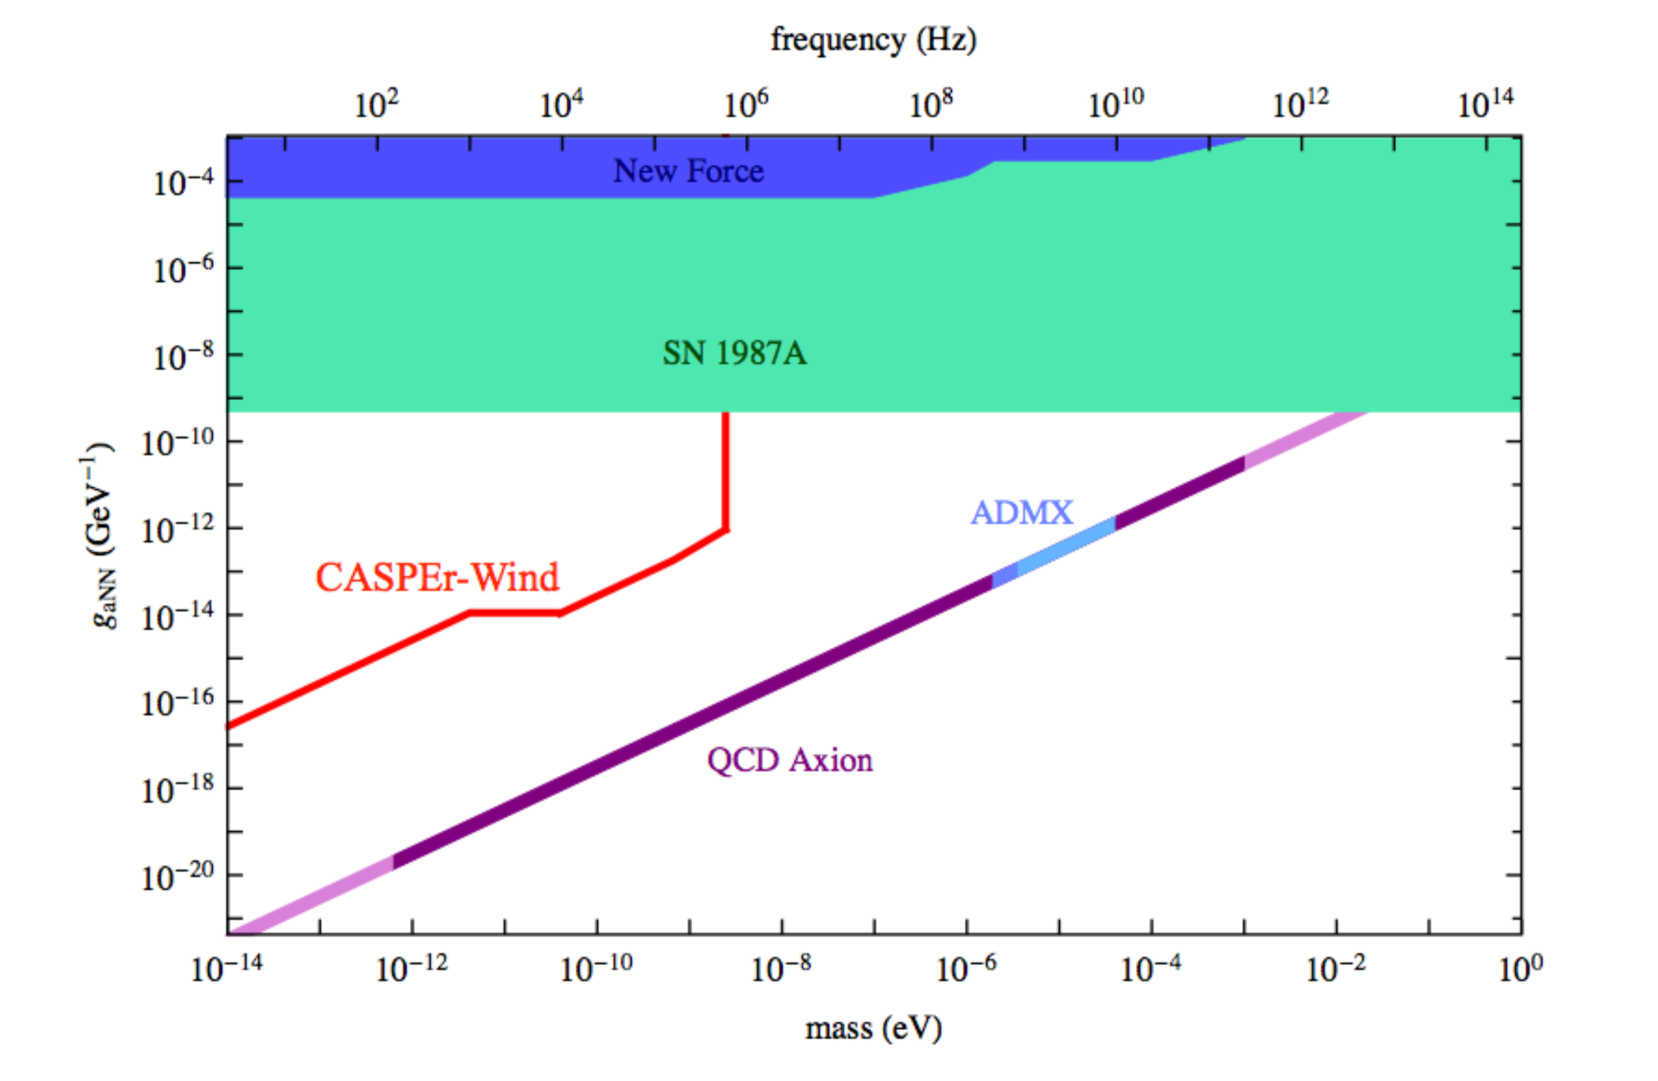
Experimental sensitivity

Slide 45
Conclusions
New searches for oscillating moments induced by coherent oscillations of the axion/ALP field offer the possibility to investigate a significant fraction of unexplored parameter space!
If research and development of new samples and new hyperpolarization techniques succeed, we may be able to search for the QCD axion with f_{a} near the GUT and Planck scale!

