Slide 1
Polarized storage cell gas targets
June 18, 2015 | Alexander Nass

Slide 2
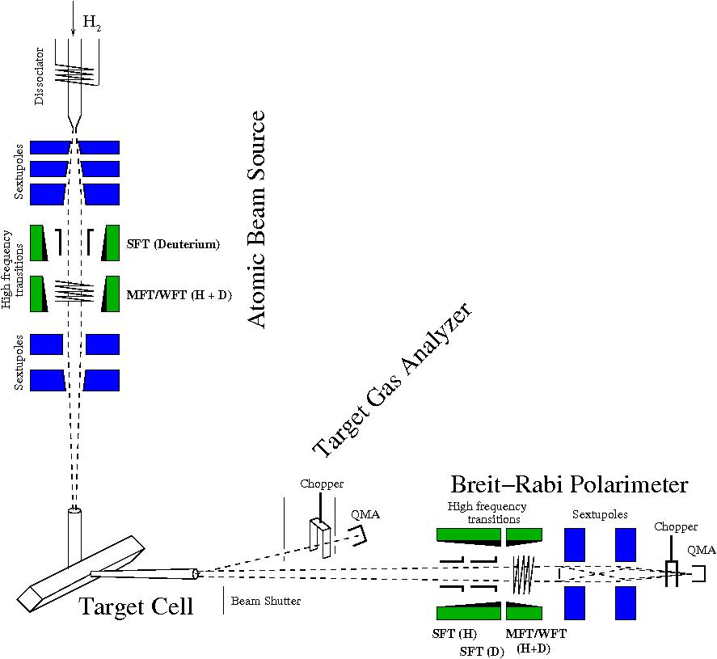
The polarized storage cell target
Production of a polarized atomic hydrogen beam by an Atomic Beam Source (ABS)
Increase of the target density by means of a storage cell
Analysis of target polarization by a Breit – Rabi Polarimeter (BRP) and Target Gas Analyzer (TGA)
Isotopically pure target
Rapid reversal of target spin
Low background (open cell)
No radiation damage (replenishment of gas)

Slide 3
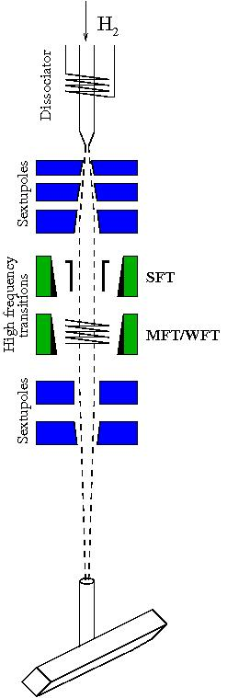




The atomic beam source
Dissociation of H₂ into atoms in the dissociator
Expansion of the gas into vacuum through nozzle, beam formation with skimmer and collimator
(Electron) spin separation and focussing of the atoms through sextupole magnets
Manipulation of the occupation numbers and polarization using high frequency transitions
Injection of the polarized beam into the storage cell
WFT 2-3

Slide 4
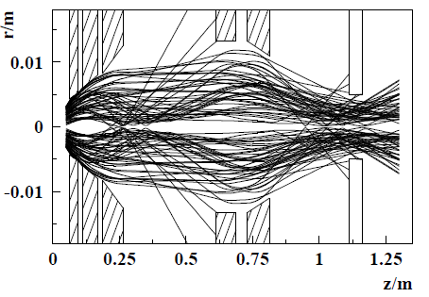
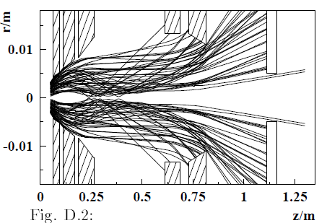
Spin selection with sextupole magnets
Hydrogen atoms of state |1 in the ABS
Cell entrance
State |1 → |3 in the ABS
Sextupol magnets

Slide 5
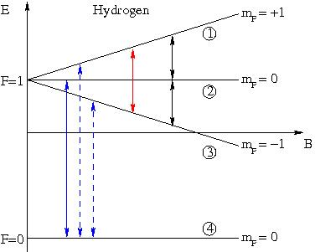
High frequency transitions (HFT)
Possibility of exchanging the occupation numbers of hyperfine levels
→ change polarization
In experiment: RF immersed into a static magnetic field and applied to atomic beam
If energy of RF and strength of magnetic field meet the criterias
→ exchange of occupation
numbers
MFT
WFT
SFT
WFT - weak field transition, MFT - medium field tr., SFT - strong field tr.

Slide 6
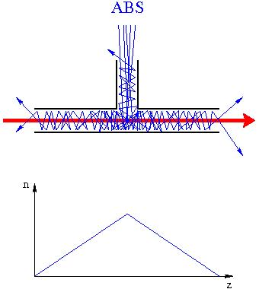
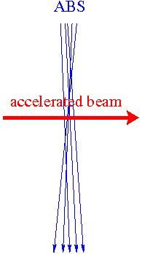
The storage cell principle
Simple Jet–target: Polarization as injected by the ABS
But: Low target density because each particle crosses the target region only once
Storage cell - Increase of target density due to multiple passing of the atoms through the target region
But: Suppression of recombination and depolarization on the cell walls necessary
→ use teflon foils or coating
Bunch field depolarization originating from RF fields of the electron beam possible
→ avoid resonance conditions

Slide 7
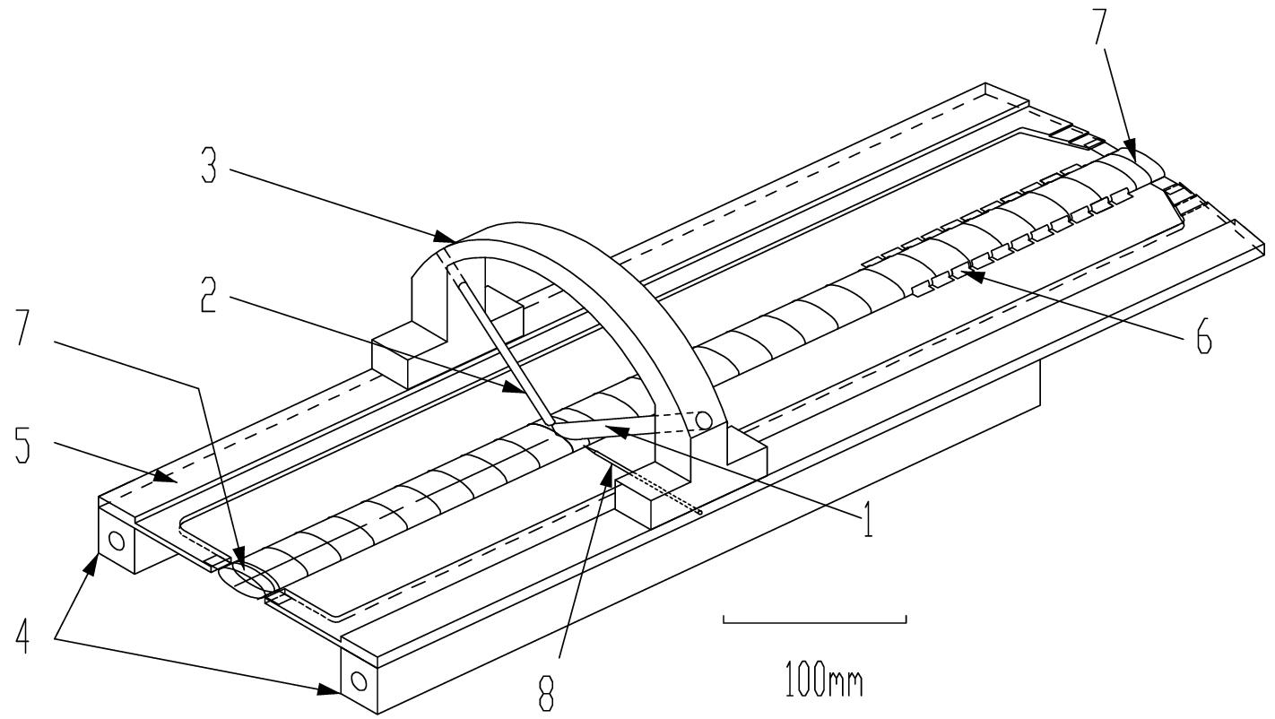
The HERMES storage cell
Material: Aluminum Drifilm coated
Temperature: 60 - 100 K
Dimensions: length: 400 mm
cross section 21 mm x 9 mm
1 – injection tube (ABS)
2 – sample tube (to BRP)
4 – support with cooling
7 – beam tube
8 – unpolarized gas feed

Slide 8
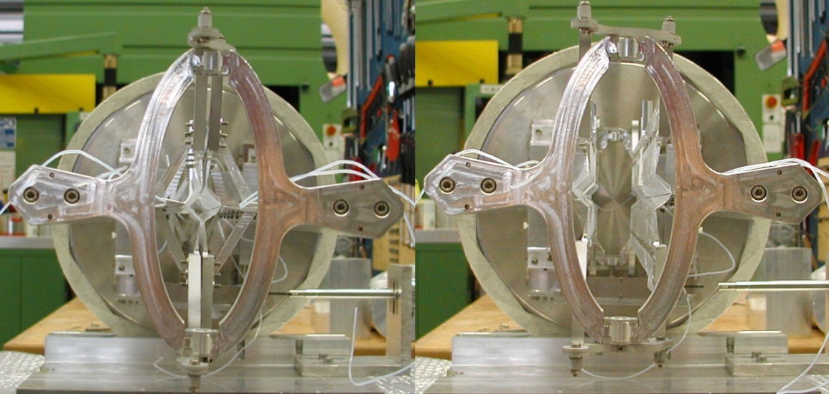
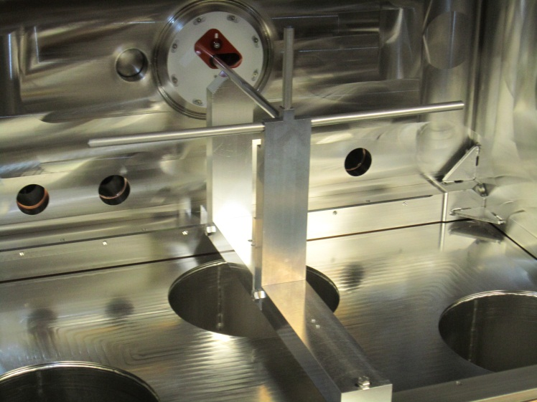
The PAX (openable) storage cells
Material: Teflon foil
Temperature: 300 K
Dimensions: length = 400mm
cross section = 10 mm x 10 mm
Possibility to construct openable storage cells
Material: Aluminum Teflon coated
Temperature: 300 K
Dimensions: length = 400mm
cross section = 10 mm diameter

Slide 9
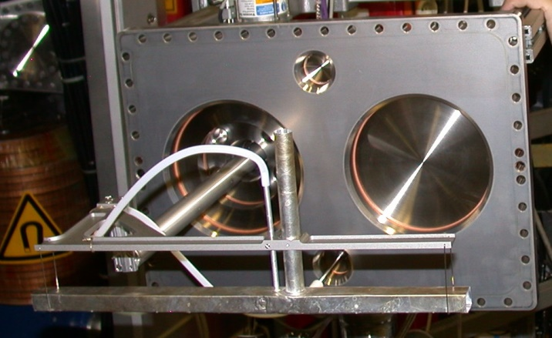
The ANKE storage cell
Material: Aluminum Teflon coated
Temperature: 300 K
Dimensions: length: 400 mm
cross section 20 mm x 15 mm

Slide 10
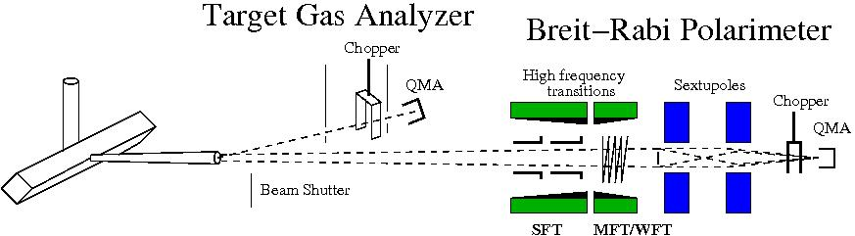
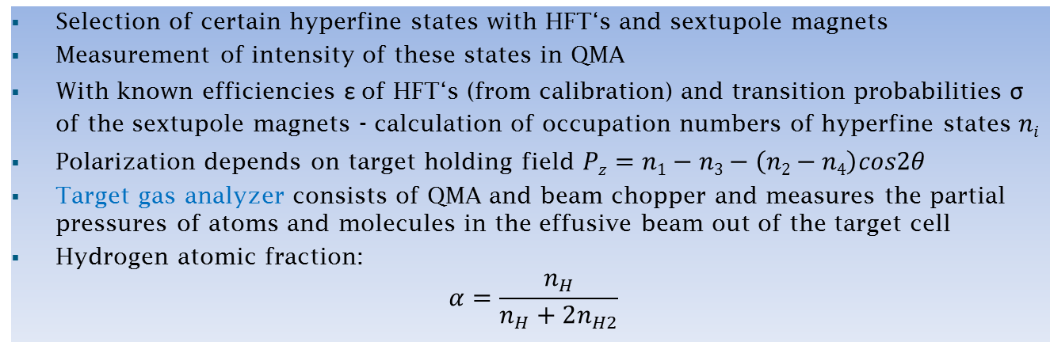
Principle of polarization measurement
Selection of certain hyperfine states with HFT‘s and sextupole magnets
Measurement of intensity of these states in QMA
With known efficiencies ε of HFT‘s (from calibration) and transition probabilities σ of the sextupole magnets - calculation of occupation numbers of hyperfine states $ni$
Polarization depends on target holding field $Pz=n1−n3−\left(n2−n4\right)cos2θ$
Target gas analyzer consists of QMA and beam chopper and measures the partial pressures of atoms and molecules in the effusive beam out of the target cell
Hydrogen atomic fraction:
$$α=\frac{n_{H}}{n_{H}+2n_{H2}}$$

Slide 11
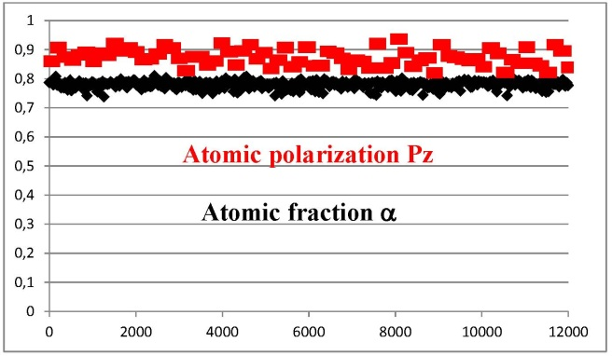
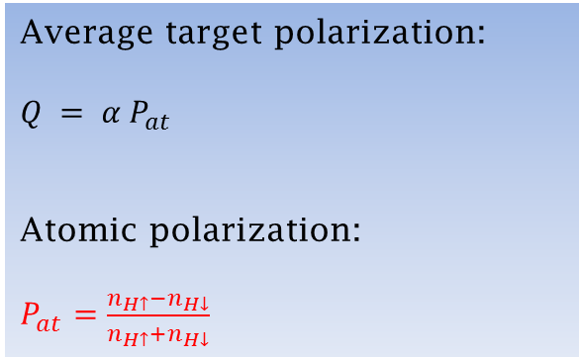
Polarization of the target gas in PAX
Average target polarization:
$Q = α P_{at}$
Atomic polarization:
$P_{at}=\frac{n_{H↑}−n_{H↓}}{n_{H↑}+n_{H↓}}$
Polarization injected into the storage cell: $Q^{inj}=α^{inj}P_{at}^{inj}=0.79±0.03$
Measured polarization in the BRP: $Q^{meas} = α^{TGA}P_{at}^{BRP} = 0.67±0.014$
Assuming the most probable, uniform distribution → $Q = 0.73±0.05$

Slide 12
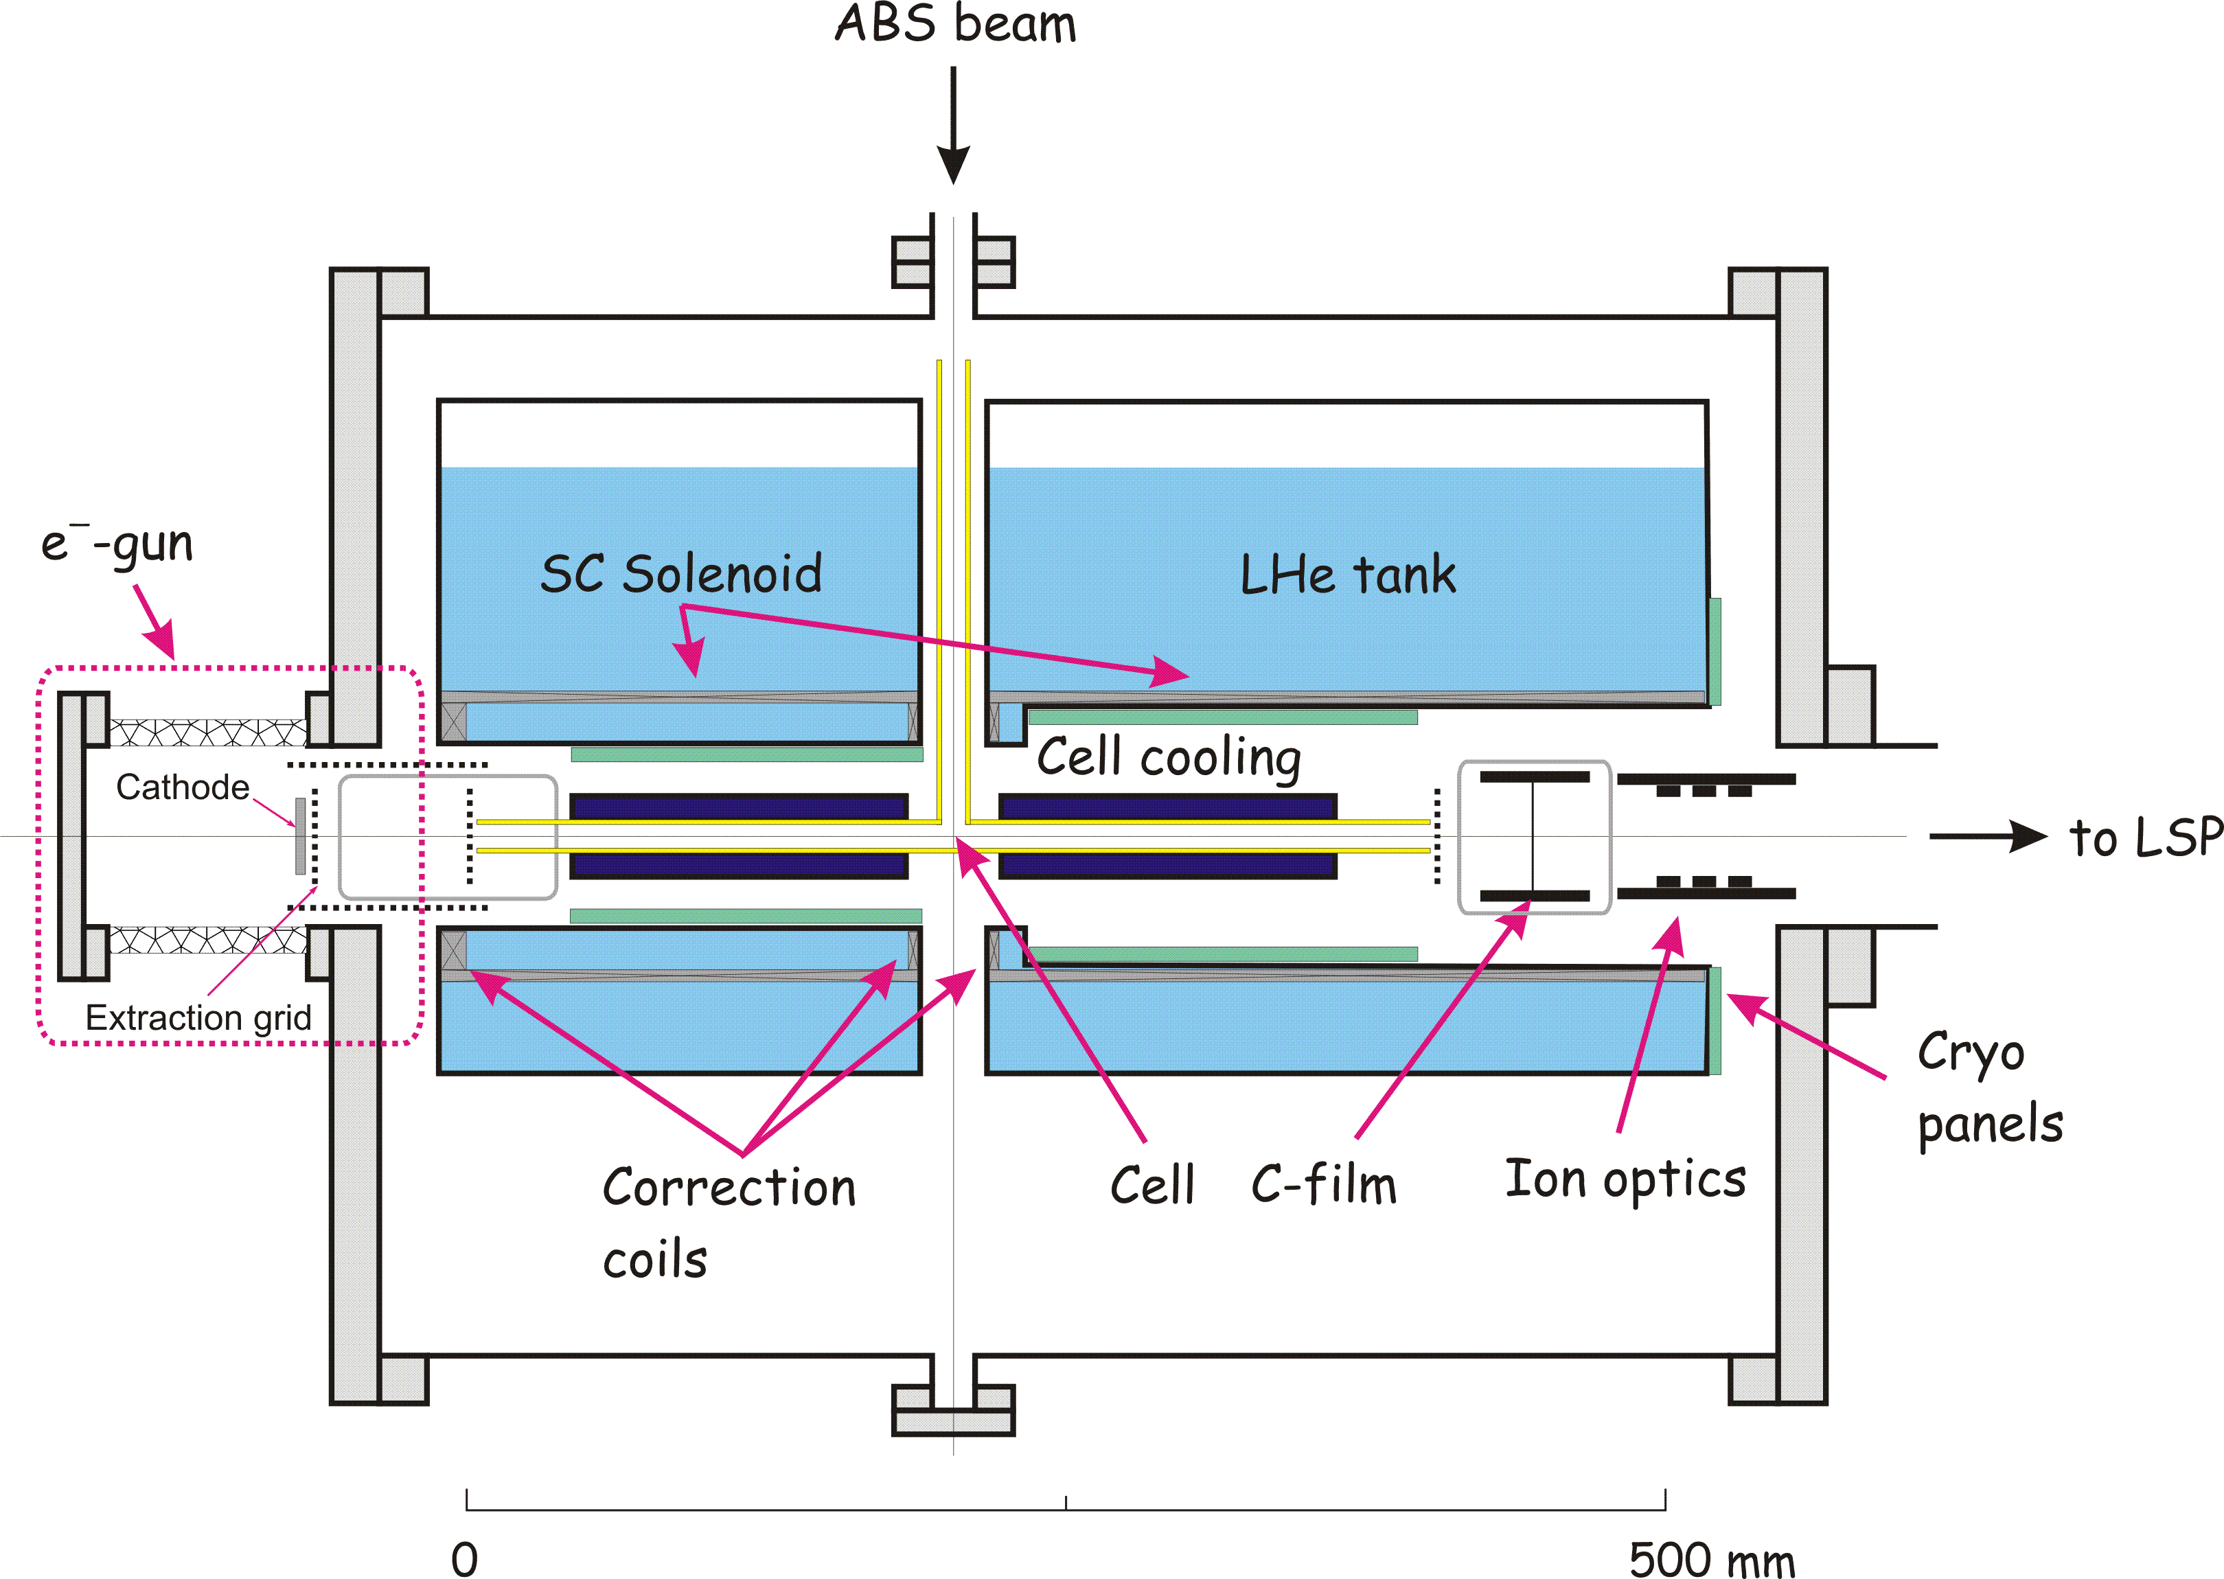
Polarized molecules as target gas
Experimental setup to measure the polarization of recombined molecules
ISTC Project # 1861 PNPI, FZJ, Uni. Cologne
DFG Project: 436 RUS 113/977/0-1
Courtesy of R.W.Engels

Slide 13
Polarized molecules as target gas
Measurements on Fomblin oil (Perfluoropolyether PFPE)
T_{Cell} = 100 K
HFS 3
P_{a} = -0.87
High polarization
Higher densities possible (conductances, cell cooling)
Conditions:
- high magnetic field
- no water contamination
P_{m} = - 0.81 ± 0.02
n = 174 ± 19
c = 0.993 ± 0.005
p
+
P_{m} = - 0.84 ± 0.02
n = 277 ± 31
H
2
Courtesy of R.W.Engels

Slide 14
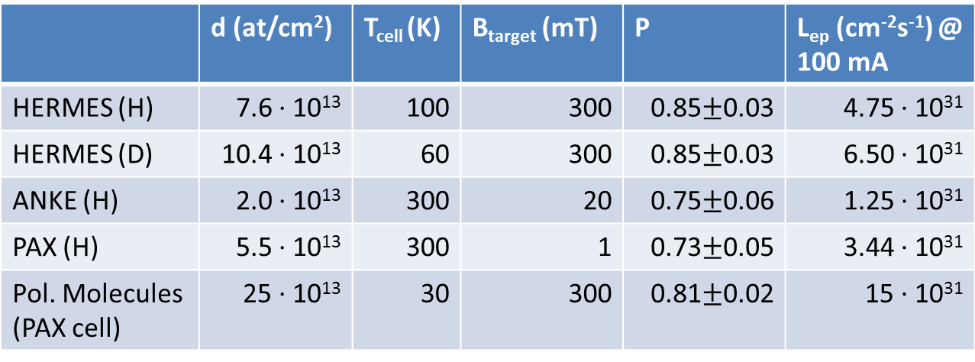
Summary & predicted luminosity for the proposed electron machine
 | d (at/cm²) | T_{cell} (K) | B_{target} (mT) | P | L_{ep} (cm⁻²s⁻¹) @ 100 mA
HERMES (H) | 7.6 · 10¹³ | 100 | 300 | 0.85$±$0.03 | 4.75 · 10³¹
HERMES (D) | 10.4 · 10¹³ | 60 | 300 | 0.85$±$0.03 | 6.50 · 10³¹
ANKE (H) | 2.0 · 10¹³ | 300 | 20 | 0.75$±$0.06 | 1.25 · 10³¹
PAX (H) | 5.5 · 10¹³ | 300 | 1 | 0.73$±$0.05 | 3.44 · 10³¹
Pol. Molecules (PAX cell) | 25 · 10¹³ | 30 | 300 | 0.81$±$0.02 | 15 · 10³¹
Areal densities d depend on cell size and temperature T_{cell} as well as injected number of states
(2 states at the HERMES in the high field target, 1 state at the ANKE & PAX low field target
and for the polarized molecules).

