Slide 1
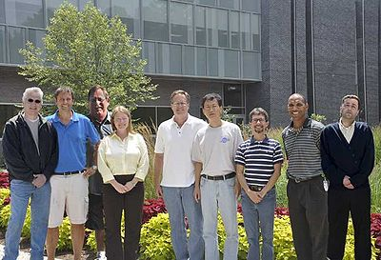
High Current Polarized Electron Source
Jefferson Lab NP Interest
Parity Violation Experiments
High current beams at JLab ERL, polarized and unpolarized
Photoguns for EIC
Polarized Positrons
P. Adderley, D. Bullard, E. Forman, J. Grames, J. Hansknecht, C. Hernandez-Garcia,
M. Poelker, M. Stutzman, R. Suleiman, J. Zhang, Graduate student: M. Mamun

Slide 2
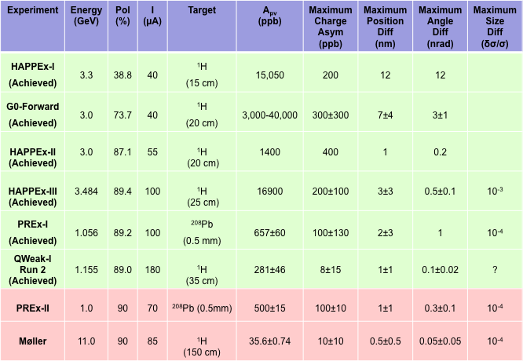
CEBAF Parity Violation Program
Precision PV experiments have motivated polarized source development for past 20 years.

Slide 3
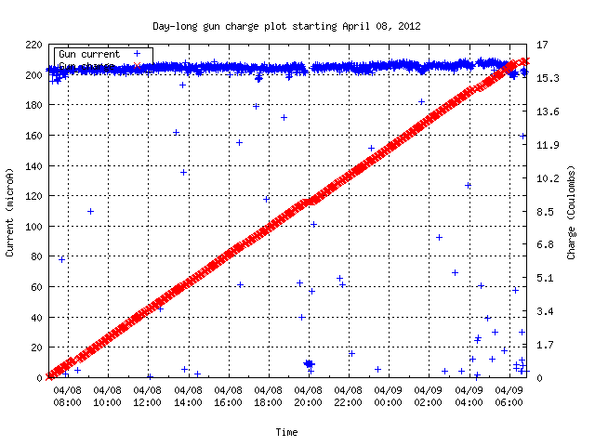
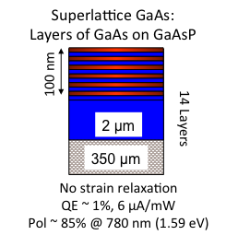
Daily Operation of CEBAF Photogun
200uA
17C
24 Hours
Delivering polarized beam to 3 Users simultaneously means providing average current > 200 μA
Delivering 20C/day for weeks without invasive interruption means achieving 1/e charge lifetimes that are > 200 C
Parity violation experiments benefit from a polarized source that remains constant over long periods of time.

Slide 4
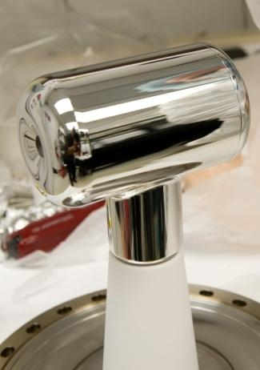
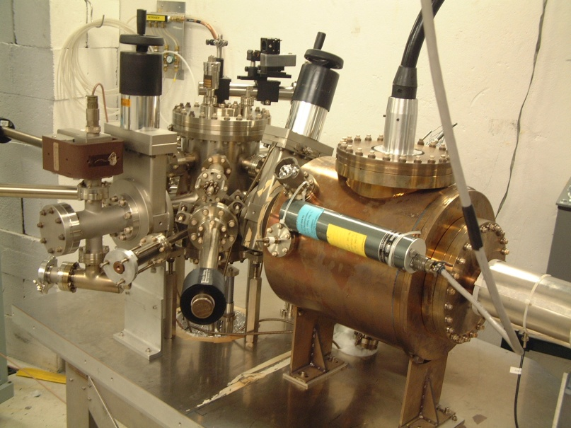
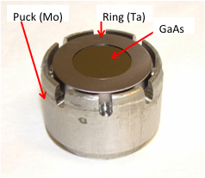
200 kV – ILC Load Lock Photogun
Best vacuum inside HV Chamber, which is never vented except to change electrodes
Photocathode Heat and Activation takes place inside Preparation Chamber
Use “Suitcase” to replace photocathodes through a Loading Chamber
Preparation Chamber
Activation Laser
Loading Chamber
Storage
Manipulators
HV Chamber
x-ray Detector

Slide 5
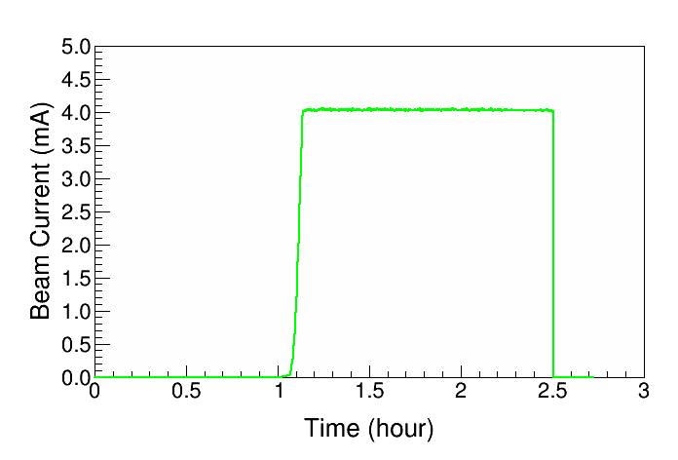
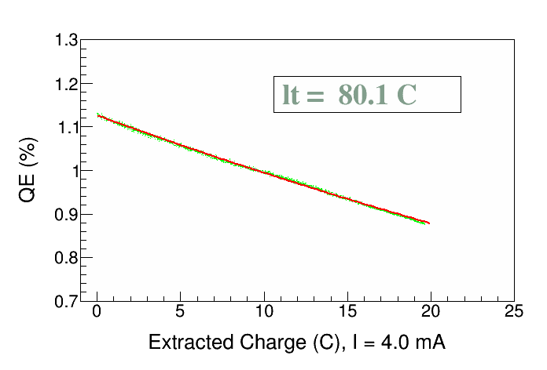
High Current and High Polarization Results
Parameter | Value | Value
Laser Rep Rate | 499 MHz | 1500 MHz
Laser Pulse Length | 30 ps | 50 ps
Laser Wavelength | 780 nm | 780 nm
Laser Spot Size | 0.45 mm | 0.35 mm
Photocathode | GaAs/GaAsP | GaAs/GaAsP
Gun Voltage | 100 kV | 200 kV
Beam Current | 1 mA | 4 mA
Run Duration | 8.25 hr | 1.4 hr
Extracted Charge | 30.3 C | 20 C
Charge Lifetime | 210 C | 80 C
Fluence Lifetime | 132 kC/cm² | 83 kC/cm²
Bunch Charge | 2.0 pC | 2.7 pC
Peak Current | 67 mA | 53 mA
Peak Current Density | 42 A/cm² | 55 A/cm²
We are proud of these results, but kC charge lifetimes are required before we can promise mA level polarized beam for months-long physics experiment
QE(q) = QE₀ e^{–(q / 80)}
J. Grames et al., PAC07, THPMS064
R. Suleiman et al., PAC11, WEODS3

Slide 6
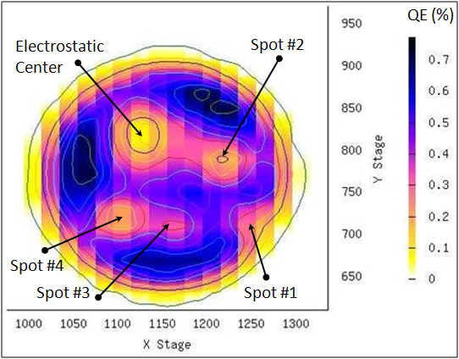
Imperfect Vacuum = Finite Charge Lifetime
Ion bombardment – with characteristic QE “trench” from laser spot to electrostatic center of photocathode – damages NEA of GaAs
High energy ions are focused to electrostatic center: create QE “hole” (We don’t run beam from electrostatic center)
QE can be restored, but takes about 8 hours to heat and reactivate
Residual
Gas
Laser
Photocathode “QE scan”
Active area = 5 mm
Laser size = 0.35 mm
Can run beam from 6 locations (spots) before heating and reactivating

Slide 7
Improve Vacuum = Improve Charge Lifetime
Q= gas load, q= outgassing rate, A = surface area, S = pump speed
Strategy: Reduce Gas Load, Increase the Pump Speed
Baked gun, baked beamline, no leaks
Perform vacuum “dirty work” inside the preparation chamber, i.e., heat and activate the photocathode
Degas all vacuum components at 400ºC to reduce outgassing rate
Minimize the surface area of your chamber
Lots of H₂ pumping - non-evaporable getter pumps. Plus a small ion pump for other gas (methane, argon, helium)

Slide 8
More Thoughts on Improving Charge Lifetime
Strategy Continued…
Do a much better job improving vacuum of adjoining beamline
Cryo pumping to replace ion pump that might suffer limitation at low pressure
Minimize ion bombardment using “tricks”…
Bias anode to limit ion dose
Use a large laser spot size to distribute ion damage over larger area
Operate at higher bias voltage, generate fewer ions
DBR photocathode (put less light into gun)
Mythical photocathode that provides polarized beam, but less sensitive to ion bombardment

Slide 9
Outlook at Jefferson Lab – Polarized Electrons
Known pathways toward kC charge lifetime
Improve static vacuum and minimize dynamic load
Increase laser size to “diffuse” ion bombardment
Optimize cathode/anode design for 100% beam transport
Increase gun voltage
Systematic study of charge lifetime vs. gun voltage
Post-mortem analysis of SSL damage
Minimize laser power
Higher QE (>1%): thicker superlattice absorber region and more efficient photon absorption

Slide 10
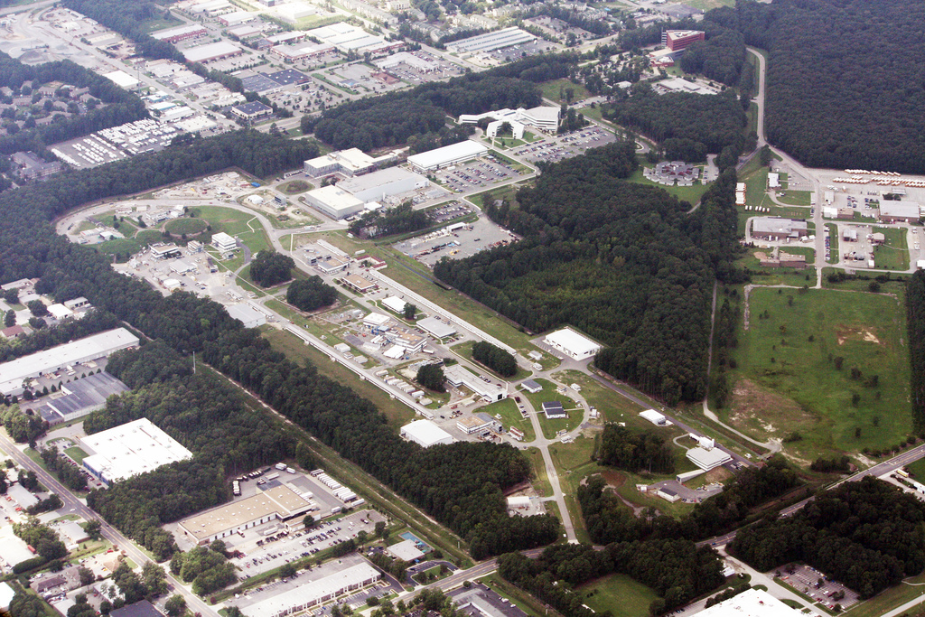
JLAB ERL: Low Energy Research Facility (LERF)
Vent/bake GaAs Photogun
Beam accelerated from 5 to 100 MeV and then decelerated back to 5 MeV, to recover the energy
Powerful light source
IR and UV FEL
THz light
Search for Dark Matter
Fixed Target Options

Slide 11
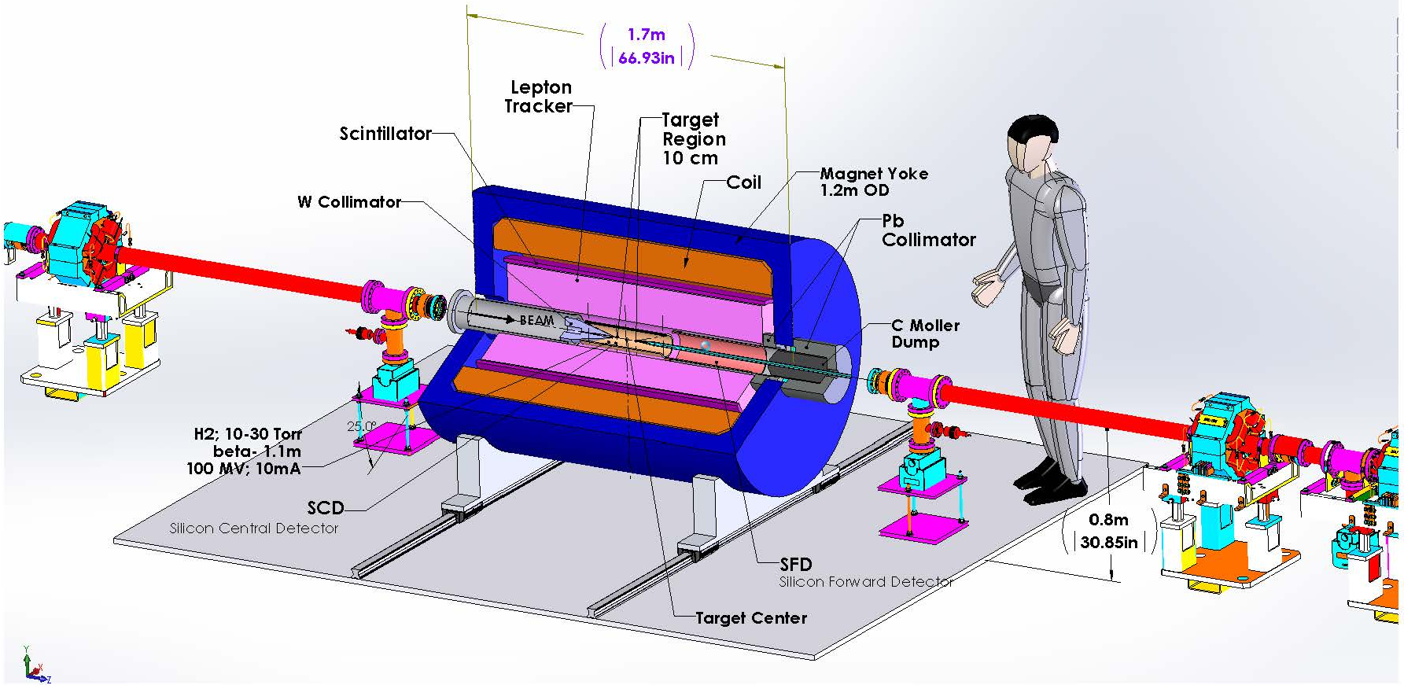
DarkLight Motivates High Current Operation
10 mA at 100 MeV : 1 MW beam power!!
ERL + internal target makes this experiment possible
But, not using GaAs…

Slide 12
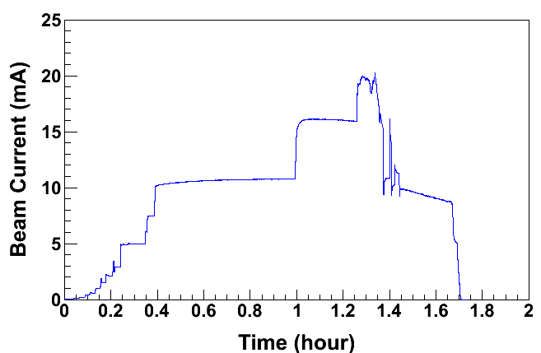
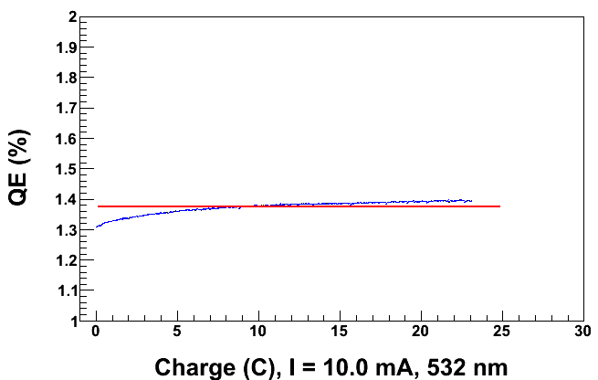
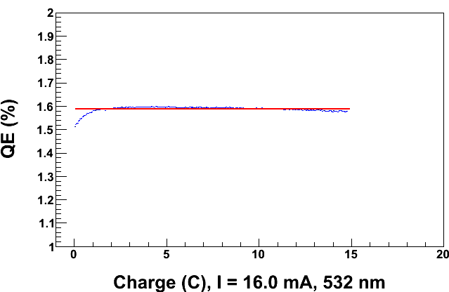
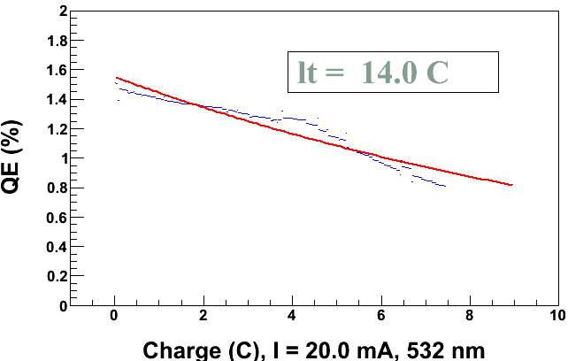
CsK₂Sb Photocathode in Load Lock Photogun
JLAB/BNL Collaboration
At 10mA, the QE of photocathode was increasing!!
Record current at JLab
Things were “normal” at 10mA
Then we see a slight QE decline at 16mA
Sharp QE decline at 20mA

Slide 13
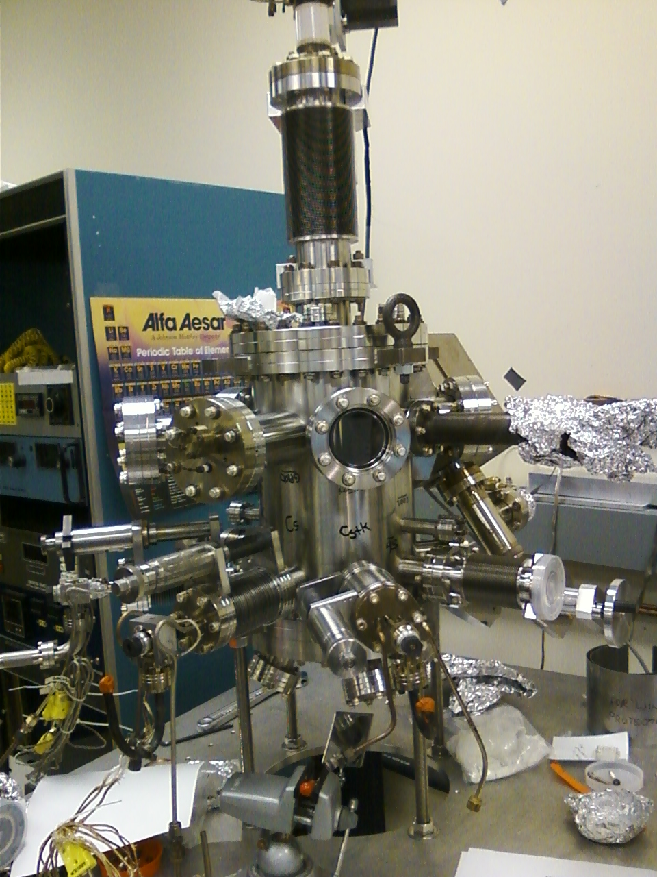
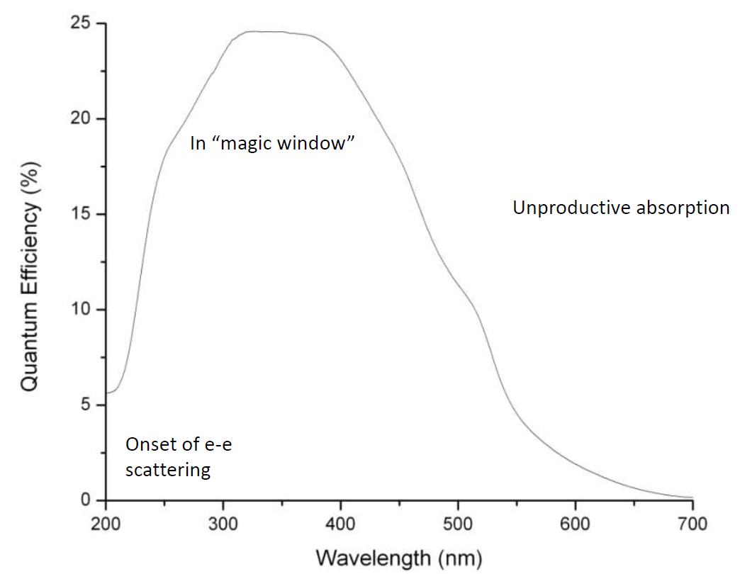
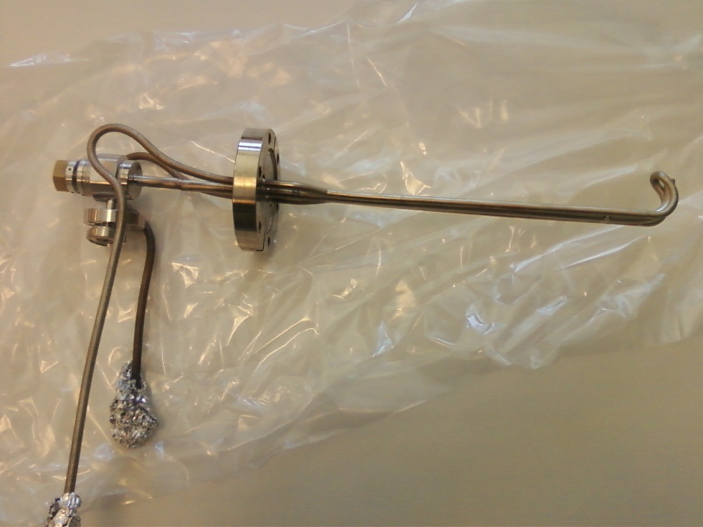
Making CsK₂Sb Photocathodes at JLAB
Add layer of Sb to a substrate, then co-deposit Cs and K
Now we make our own photocathodes
Ref: CHESS seminar 2013 Smedley
Cheap lasers at 532 nm
Work of M. Mamun, C. H Garcia

Slide 14
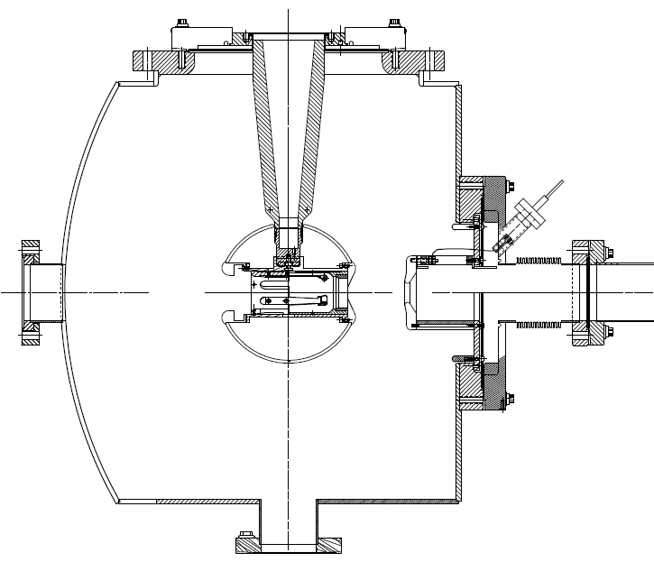
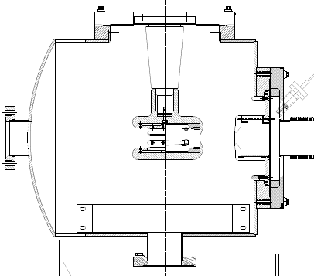
Physics at JLAB Requires a 350 kV Photogun
CEBAF Inverted 200 kV DC
Load Lock Inverted Photogun
Building two 350 kV DC
Load Lock Inverted Photoguns
Incorporates CsK₂Sb and GaAs/GaAsP SSL
Longer “R30” insulator
Spherical electrode
Thin NEG sheet moves ground further away
Maximum Field strength ~ 10 MV/m

Slide 15
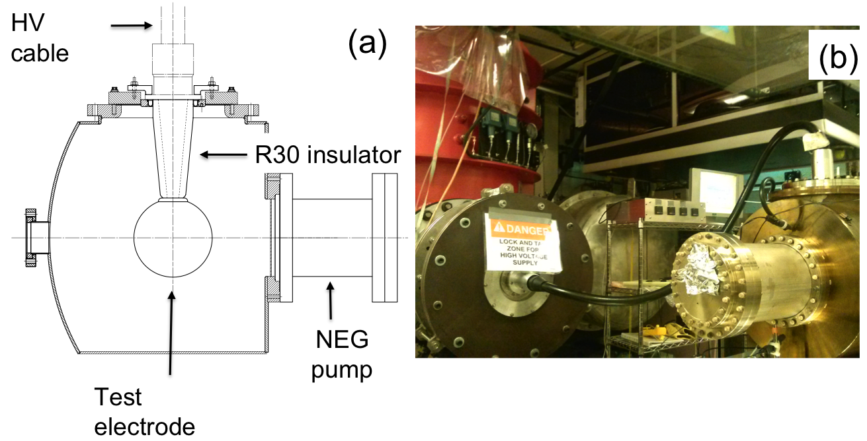
Building the 350 kV Gun
Start with “dummy” electrodes and test different insulators and cathode screening electrode

Slide 16
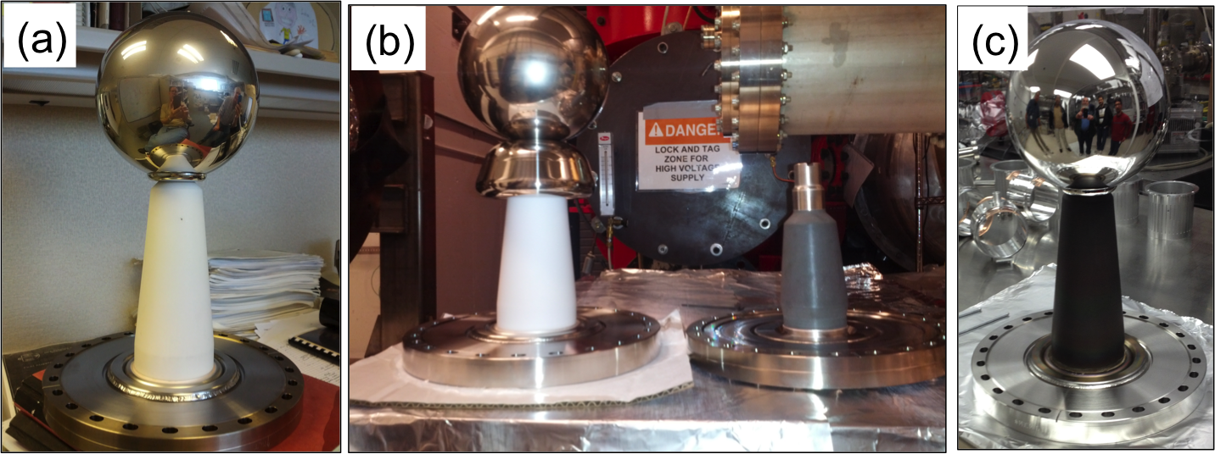
Testing Insulators and Screening Electrode
Longer R30 insulators, conventional alumina
Short R28 insulator, bulk resistivity, mildly conductive
ZrO-coated R30 insulator, also mildly conductive
dummy electrode and with a screening electrode

Slide 17
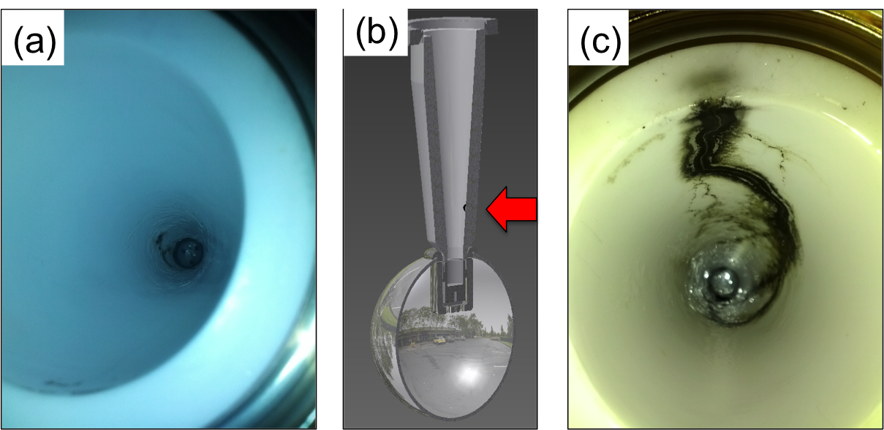
High Voltage Breakdown
Problems at the cable junction, atmosphere side

Slide 18
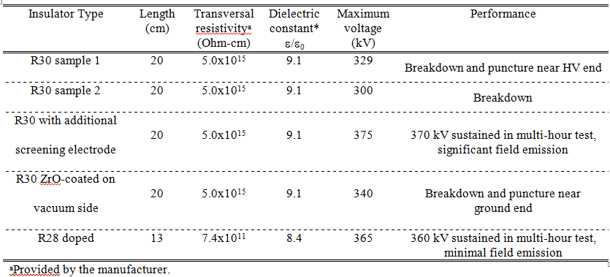
Summary of Insulator Tests
Two configurations reached our voltage goal

Slide 19
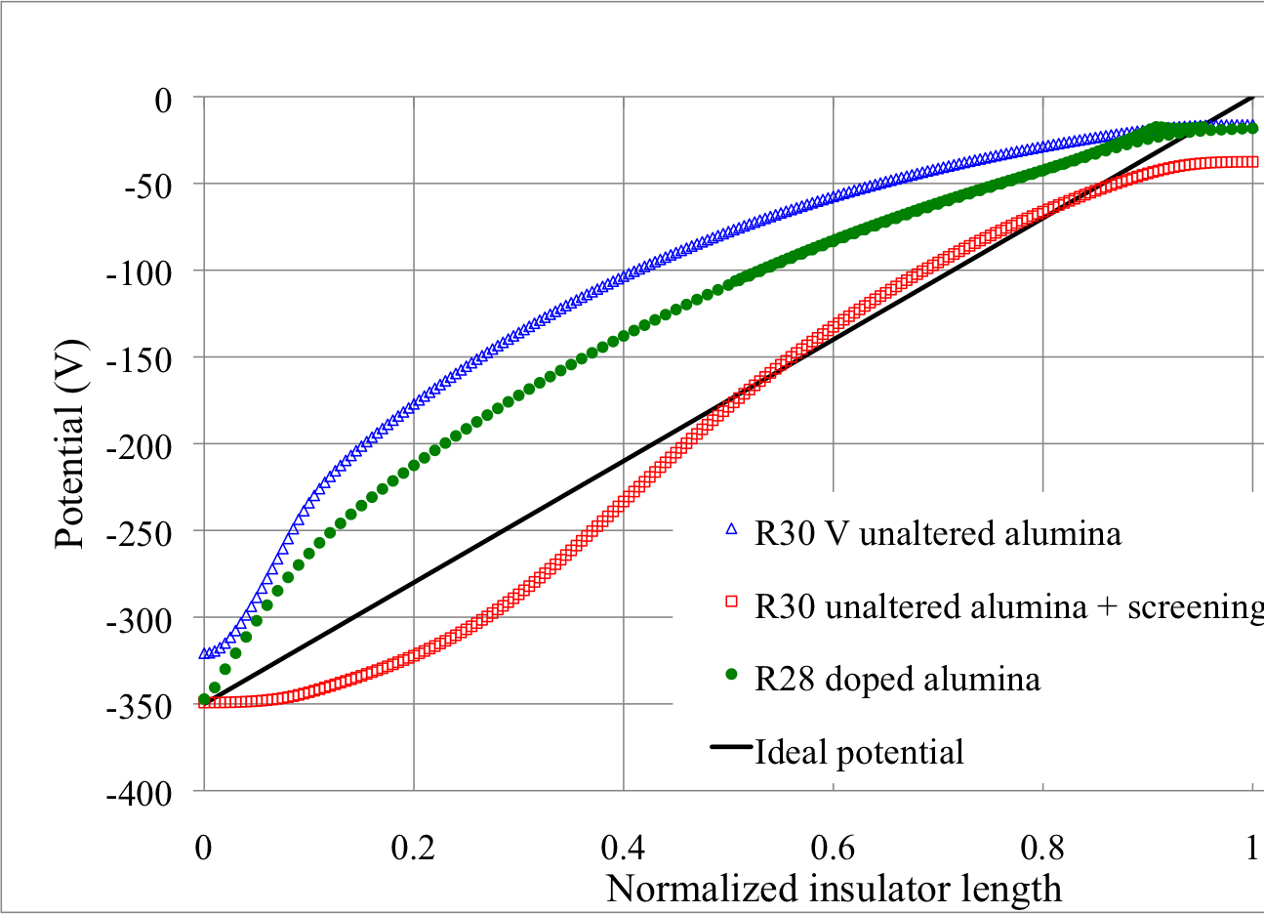
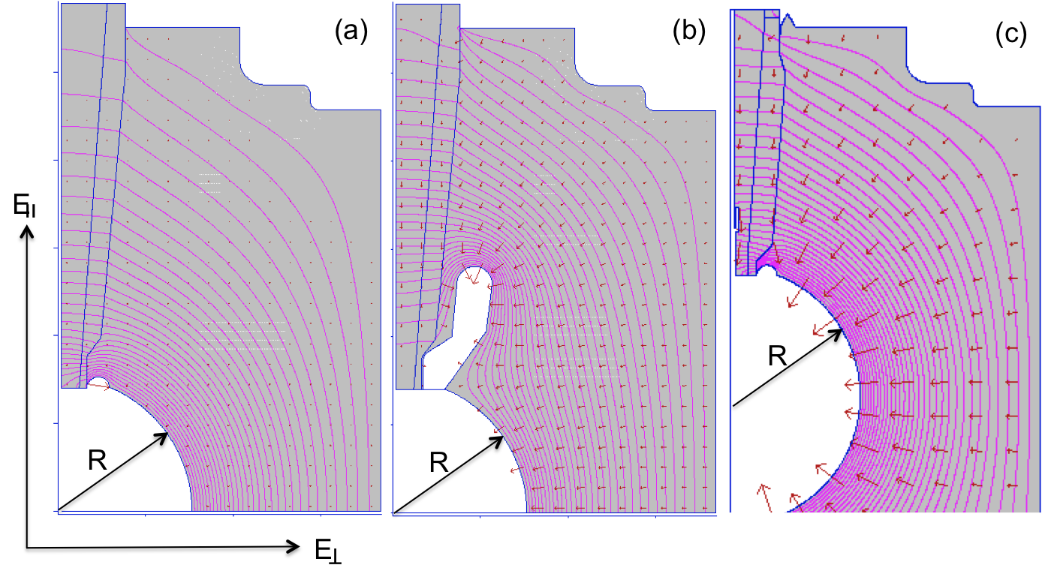
Insulator Potential Profile
Want a linear potential gradient along length of the insulator

Slide 20
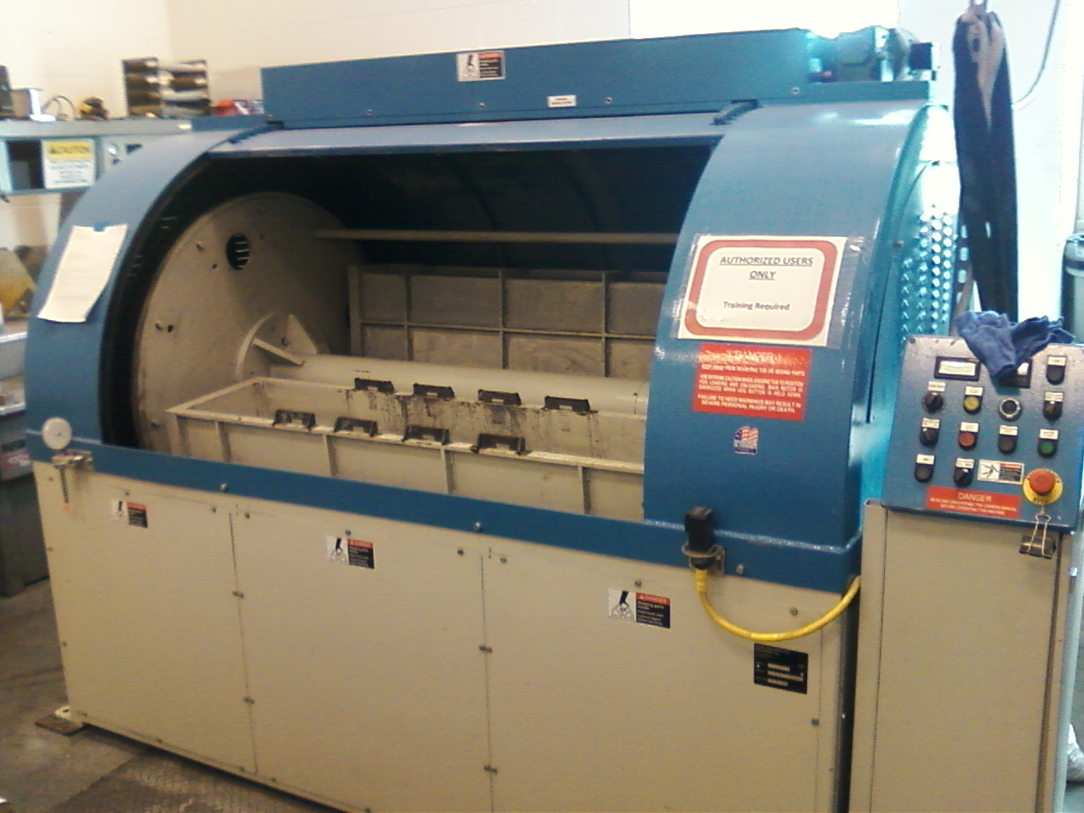
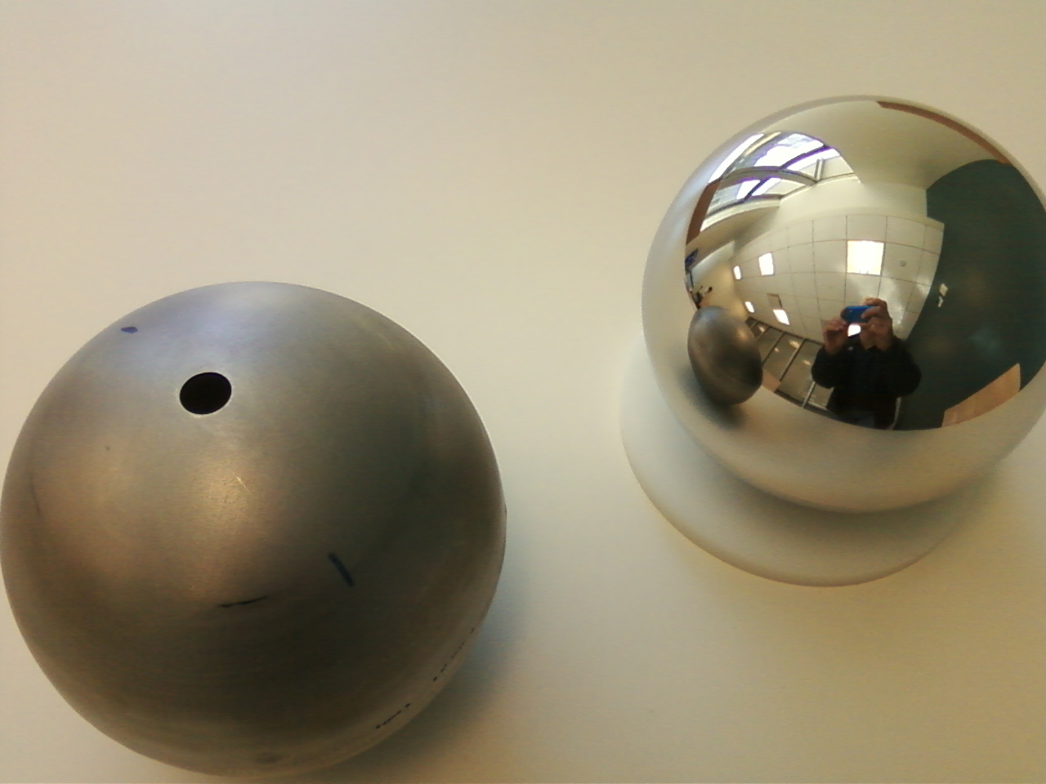
Barrel Polishing of Stainless Steel
On our to-do list for testing

Slide 21
Conclusions
As early as this summer resuscitate the Vent/Bake GaAs photogun at LERF to support Phase I of Dark Light
We would like to operate the future high current program with CsK₂Sb and have the capability to also use high-polarization GaAs/GaAsP
We’ve benefit from the CEBAF inverted load lock gun, so are now building two 350 kV load-lock inverted photoguns for LERF and UITF (Upgrade Injector Test Facility)
Preparing to test a new R30 inverted ceramic insulator in the upcoming weeks

Slide 22
BACKUP SLIDES

Slide 23
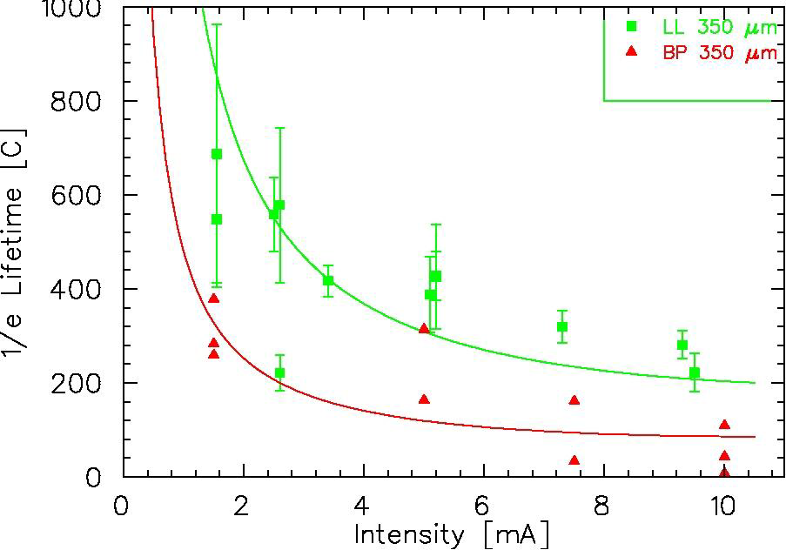
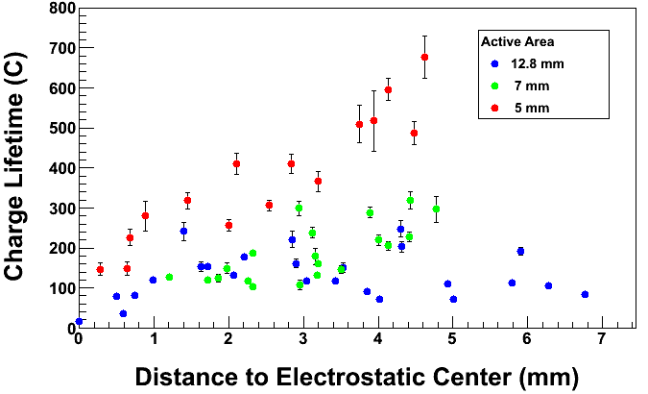
Lessons Learned: vacuum and managing laser
Bombardment of the photocathode by ionized gas limits photocathode lifetime
Primary beam
Poorly managed electrons
Field emission
Many lessons learned testing DC photoguns up to 10mA in DC using bulk GaAs
Improve vacuum!
Manage ALL of the beam
“Charge and fluence lifetime measurements of a DC high voltage GaAs photogun at high average current.,” J. Grames, R. Suleiman, et al., Phys. Rev. ST Accel. Beams 14, 043501 (2011)
I=2mA, φ=0.35mm
Improve Vacuum

Slide 24
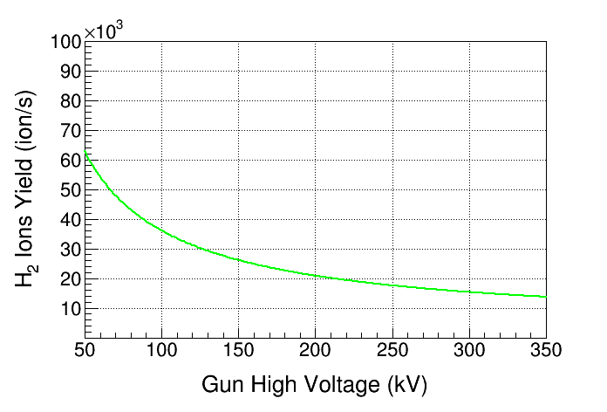
Increase Gun High Voltage
Higher Gun Voltage
Generate fewer ions
Decrease space-charge beam growth
Reduce Surface Charge Limit
anode (+)
electron beam
At 350kV, only <50% of ions are created compared to 130kV
H₂
I=2.0 mA, P=8.0 × 10⁻¹² Torr
cathode (-)
V_{o}
Ion energy
V_{o}
130 kV gun
350 kV gun

Slide 25
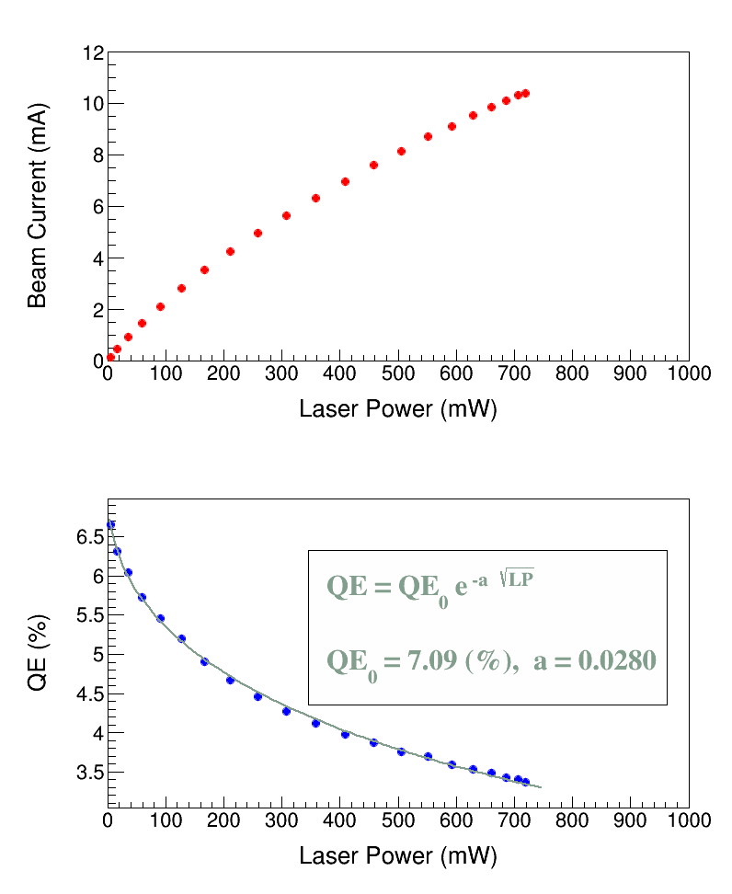
Surface Charge Limit
Surface Charge Limit, also known as Surface Photovoltage Effect, reduces NEA of GaAs: Photoelectrons trapped near GaAs surface produce opposing field that reduces NEA resulting in QE reduction at high laser power (LP),
Bulk GaAs, 532 nm, 100 kV
U(LP)
χ
E_{gap}
δU(E_{s})
Where U(LP) is up-shifting of potential barrier due to photovoltage.
For heavily Zn doped GaAs surface, U(LP) → 0 (doping introduces high internal electric field to facilitate charge transport, increase diffusion length, and reduce chance of depolarization in active layer)
Higher Gun HV suppresses photovoltage
Notes:
Bulk GaAs Doping: Zn at 8 e+18 atoms/cm³

Slide 26
How Long Can We Run at 4 mA?
Photocathode with 1% initial QE, 10 W laser at 780 nm and gun with 80 C charge lifetime. 4.0 mA operation, 14 C/hr, 346 C/day
Need initial laser power of about 1 W to produce 4 mA
Should be able to operate at 4 mA for 13 hours before running out of laser power
Spot Move (it takes 1 hr). With 6 spots, this provides 3 days of operation (since laser spot size is much smaller than active area) before heat and reactivate
Message: High current polarized electron sources need photoguns with kC lifetime

Slide 27
How to Prolong Charge Lifetime?
Larger Laser Size (also reduces space-charge emittance growth and suppresses surface charge limit)
Laser Position on Photocathode and Active Area
Higher Gun Voltage:
Less ions are created
Reduce space-charge emittance growth, maintain small transverse beam profile and short bunch-length; clean beam transport
Increase QE by lowering potential barrier (Schottky Effect)
Compact, less-complicated injector
Biggest Obstacle: Field emission and HV breakdown… which lead to bad vacuum and photocathode death
“Charge and fluence lifetime measurements of a DC high voltage GaAs photogun at high average current.,” J. Grames, R. Suleiman, et al., Phys. Rev. ST Accel. Beams 14, 043501 (2011)

Slide 28
Improve Lifetime with Larger Laser Size
Larger laser size
(same # electrons, same # ions)
Ionized gas
strikes photocathode
Ion damage distributed
over larger area

Slide 29
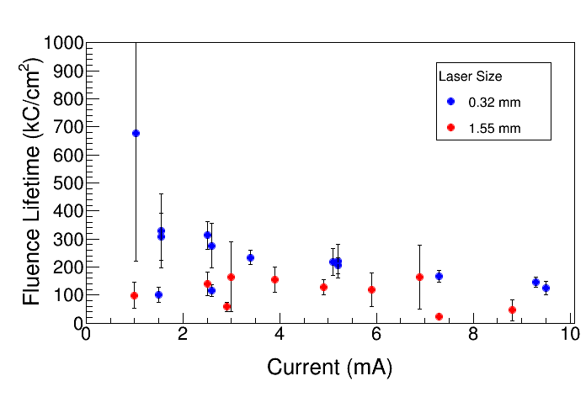
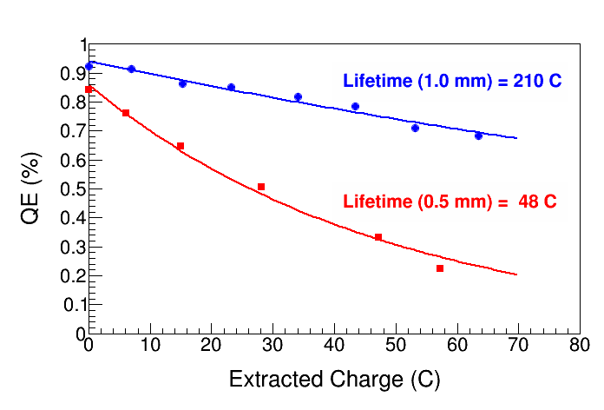
Fluence Lifetime
Fluence Lifetime: Charge Lifetime per Emission Area
Enhanced Charge Lifetime for QWeak: Increase laser size from 0.5 mm to 1.0 mm (diameter)
Bulk GaAs, 532 nm, 5 mm Active Area
Can we use cm size laser beams?
Not in today’s CEBAF photogun
Need a better cathode/anode beam transport optics

Slide 30
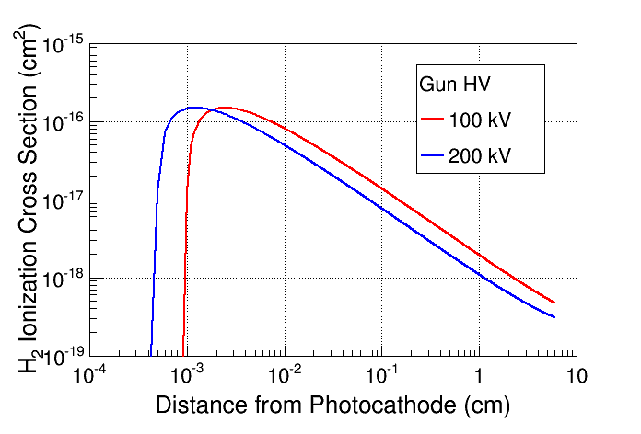
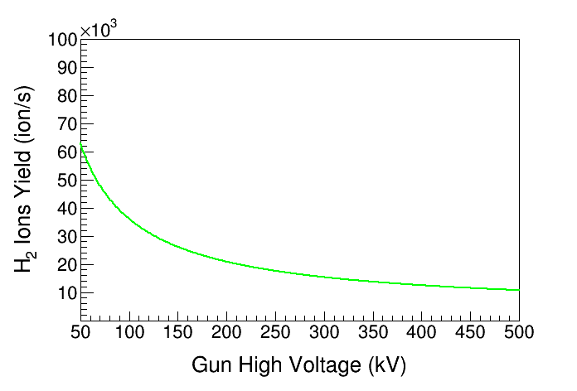
Will Higher HV Improve Lifetime?
anode (+)
electron beam
H₂
cathode (-)
Ion energy
At lower HV, cross section is larger over longer distance
Most ions created close to GaAs surface
100 kV gun
200 kV gun
At 200 kV, only 60% of ions are created compared to 100 kV
Beam Current: 2.0 mA
Vacuum:
8.0 × 10⁻¹² Torr
Awaits experimental verification

