Slide 1
High current SRF gun
Erdong Wang
Brookhaven National Laboratory

Slide 2
Outline
Overview SRF gun technology
Overview high current SRF gun projects
SRF guns
Photocathodes
Recent progress of BNL 704MHz SRF gun
Challenges and considerations
Summary

Slide 3
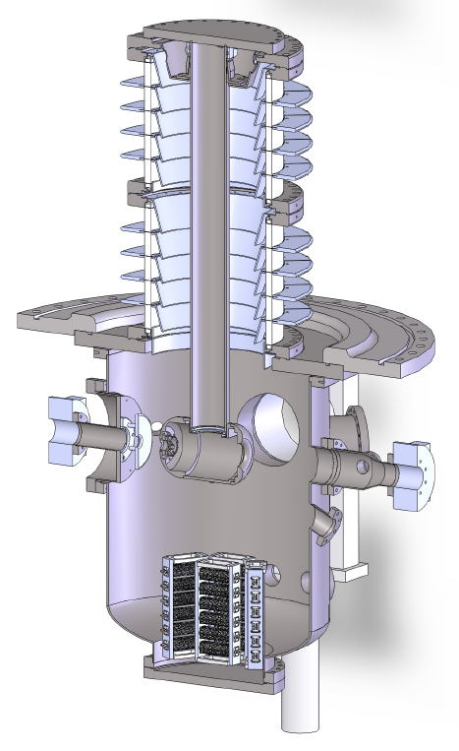
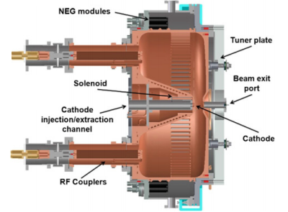
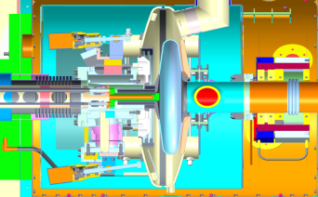
Why SRF photocathode gun?
To get high average current , the gun must operate in CW mode.
Candidate: DC gun, VHF NCRF gun, VHF~L band SCRF gun
DC gun:
Mature
Cathode gradient<7MV/m
Gun voltage:550kV
Cornell, Jlab, KEK, JAEA,IHEP
NCRF gun:
Commissioning
Cathode Gradient: 20MV/m
Gun voltage:1MV
LBNL, SLAC,SHLS
SCRF gun:
Commissioning
CW at high frequency
Cathode gradient:20~35MV/m
Gun voltage:2~9.4MV
BNL, HZD,HZB, NPS, WiFEL
High gradient :
High bunch charge
Small emittance
Large gap voltage:
Small emittance

Slide 4
Overview : SRF gun technology
Advantages:
CW mode of operation: High rate of acceleration; high average beam current; Very stable(phase, amplitude) system reduce time jitter.
High gradient on cathode: high bunch charge ; small emittance.
SRF cavity and operation have matured.
Elliptic cavity(low-β cell + 0~3 cell high-β) geometries based SRF gun has demonstrated and under developing for high current operation.
Quarter wave resonator SRF gun is under development and got beam on NPS gun.
The integration of a high QE semiconductor photocathode and the SRF gun is still a challenging topic.
Notes:
The superb stability of the SRF system comes from the CW operation, which allows very accurate control of both the amplitude (at 100 ppm or better) and phase (at 0.01 degree or better) of the accelerating field.

Slide 5
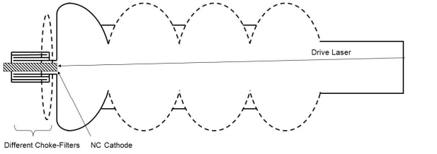
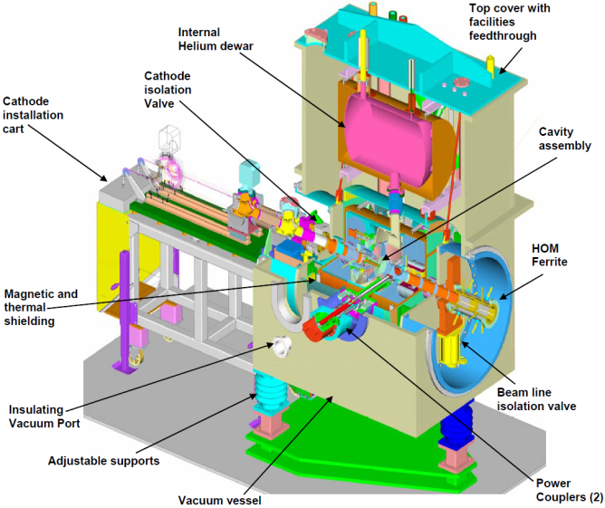
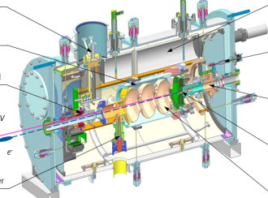
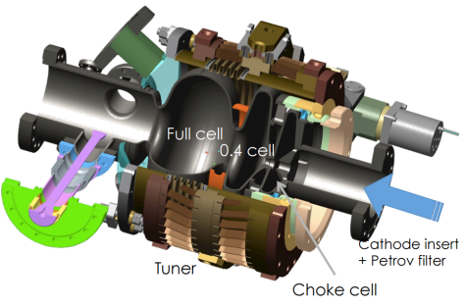
Overview SRF gun :Elliptic cavity+NC_cathode
Mature cavity shape; high kinetic energy; high average current
 | BNL /AES 704MHz | HZD 3.5 Cell | HZB Berlin Pro
Gun structure
Bunch charge(nC) | 5/1.4/0.7 | 1/0.077 | 0.077
Ave. Current(mA) | 50/300 | 0.5/1 | 4
Gun freq.(MHz) | 703.75 | 1300 | 1300
Peak gradient(MV/m) | 20 | 30/22 | <10
photocathode | CsK₂Sb | Cs₃Te,Mg | CsK₂Sb
N_Emittance(mm-mrad) | 5/2.3/1.4 | 2.5/1 | 1
Kinetic energy(MeV) | 2 | 9.4/4 | 3.5
Current status | Beam commissioning | Beam commissioning ,upgrade | Vertical tested

Slide 6
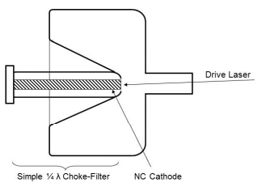
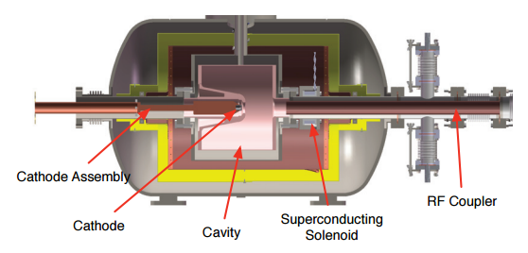
Overview SRF gun :QWR cavity+NC_cathode
4K operation; high gradient; long bunch; constant field(small energy spread)
 | BNL 112MHz(CeC) | NPS (FEL) | Wi FEL (FEL)
Gun structure
Bunch charge(nC) | 5 | 1 | 0.2
Ave. Current(mA) | 50 | 1 | 1
Gun freq.(MHz) | 112 | 500 | 200
Peak gradient(MV/m) | 19.7 | 25 | 45
photocathode | CsK₂Sb | CsK₂Sb | Cs₃Te, Cu
N_Emittance(mm-mrad) | 3 | 4 | 0.9
Kinetic energy(MeV) | 2 | 1.2 | 4.58
Current status | RF conditioning | Beam commissioning | Beam commissioning
Notes:
In keeping with the NPS Beam Physics Lab desire to be a test bed for linear accelerator and free electron laser (FEL) components, we desired to explore the use of a superconducting radiofrequency (SRF) gun as part of the injector for the future NPS FEL [1, 2]

Slide 7
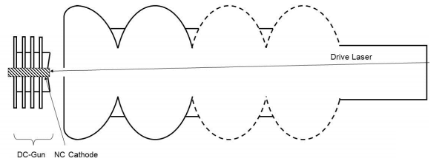
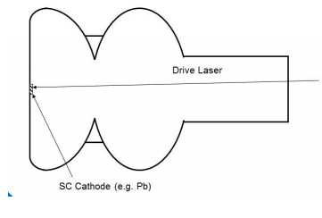
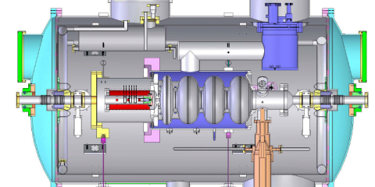
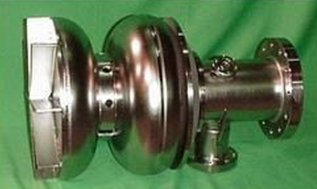
Overview SRF gun :Other type
Prevent cathode contamination;
Full superconducting
 | PKU DC-SC 3.5 cell | HZB HoBiCat
Gun structure
Bunch charge(nC) | 0.1 | 0.015
Ave. Current(mA) | 1~5 | 0.0045
Gun freq.(MHz) | 1300 | 1300
Peak gradient(MV/m) | 4.5 | 10
photocathode | Cs₃Te | Pb/Nb
N_Emittance(mm-mrad) | 1.2 | 1
Kinetic energy(MeV) | 5 | 3.5
Current status | Commissioning finished, upgrade | upgrade

Slide 8
Photocathode
To generate high average current beam, high QE(>1%) photocathode is required.
 | Wavelength(nm) | QE | Thermal emittance (mm-mrad/mm) | Lifetime
K₂Cs(Na)Sb | 532 | 10%~1% | 0.4 | Long
GaAs | 532/780 | ~10%/1% | 0.44 | Short
Cs₃Te | 266 | 16%~1% | 0.5 | Long
Diamond amplifier | Electron beam | Gain >200 times | ?/ Energy spread σ=0.12eV | Long
Diamond /Si field emitter | Field emitter | NA | ? | Very long
Plasmonic | 800 | nonlinear | 1.4 | Very long
Pb | 250 | 0.0001% | ? | Very long

Slide 9
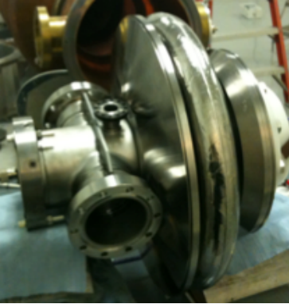
704MHz gun and beamline
RF: adjustable pulse length
Raw signal
7 μS
ICT window
Integrated signal
Laser pulse
(controlled by pockels cell)
SRF gun: Pulse to CW 2MV
Laser: LUMERA: Nd: YVO4, single pulse to 9.38 MHz, up to 6 W at the cathode surface.

Slide 10
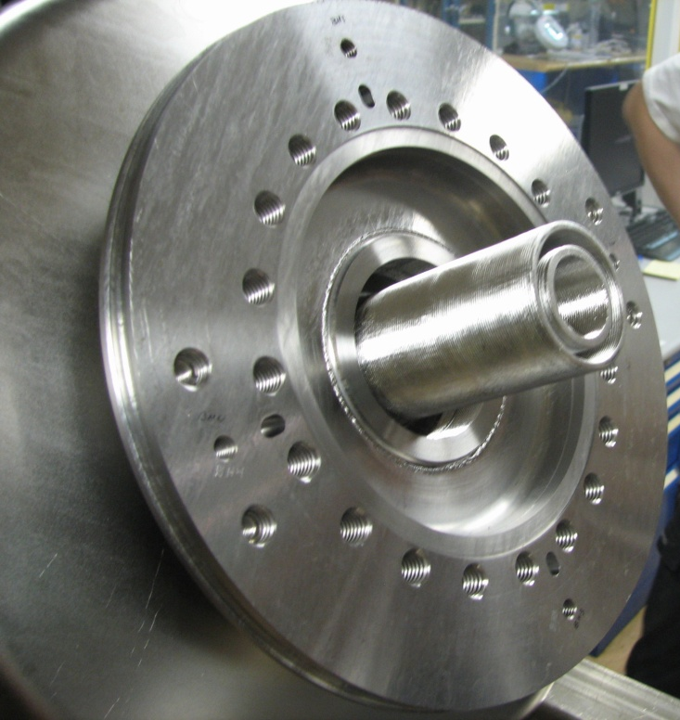
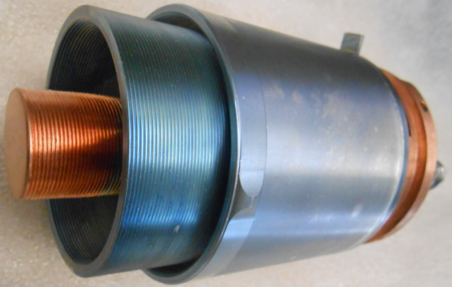
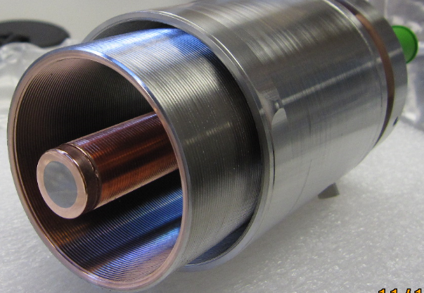
Choke joint cathode stalk upgrade
Re-designed choke structure to eliminate multipacting. Allow CW operation up to 2MV.
Change the cathode substrate to Ta to have better QE for high current, high bunch charge operation.
Better cooling design to dump the heat dissipation on the stalk.
Double choke with groove

Slide 11
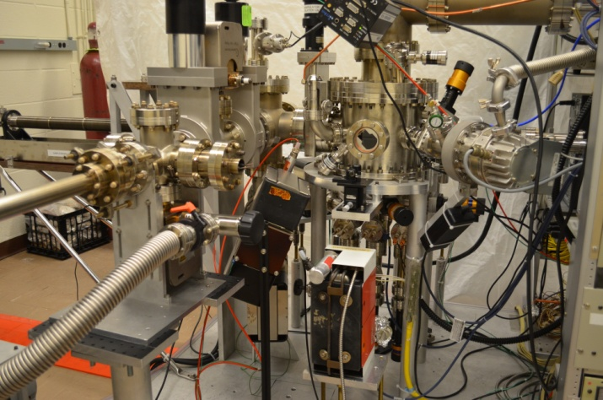
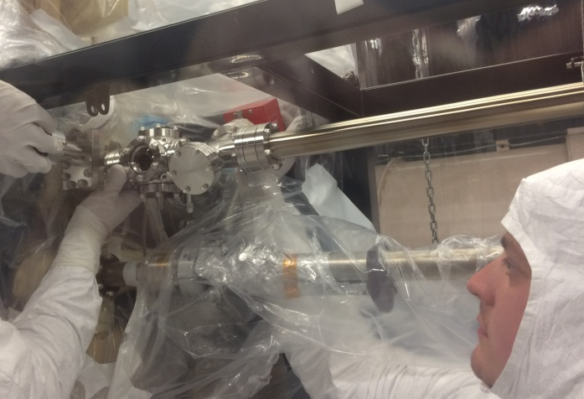
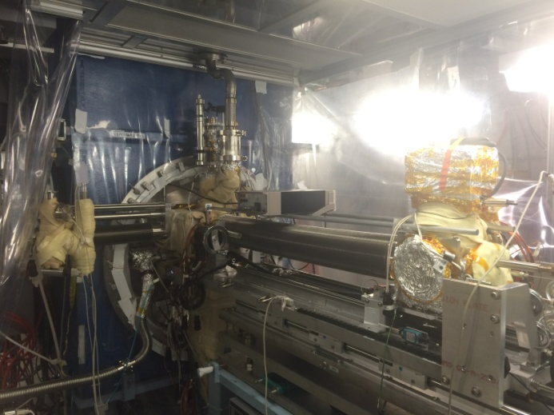
Photocathode for BNL SRF gun
CsK₂Sb @ 532nm ,10%

Slide 12
Photocathode preparation and transferring

Slide 13
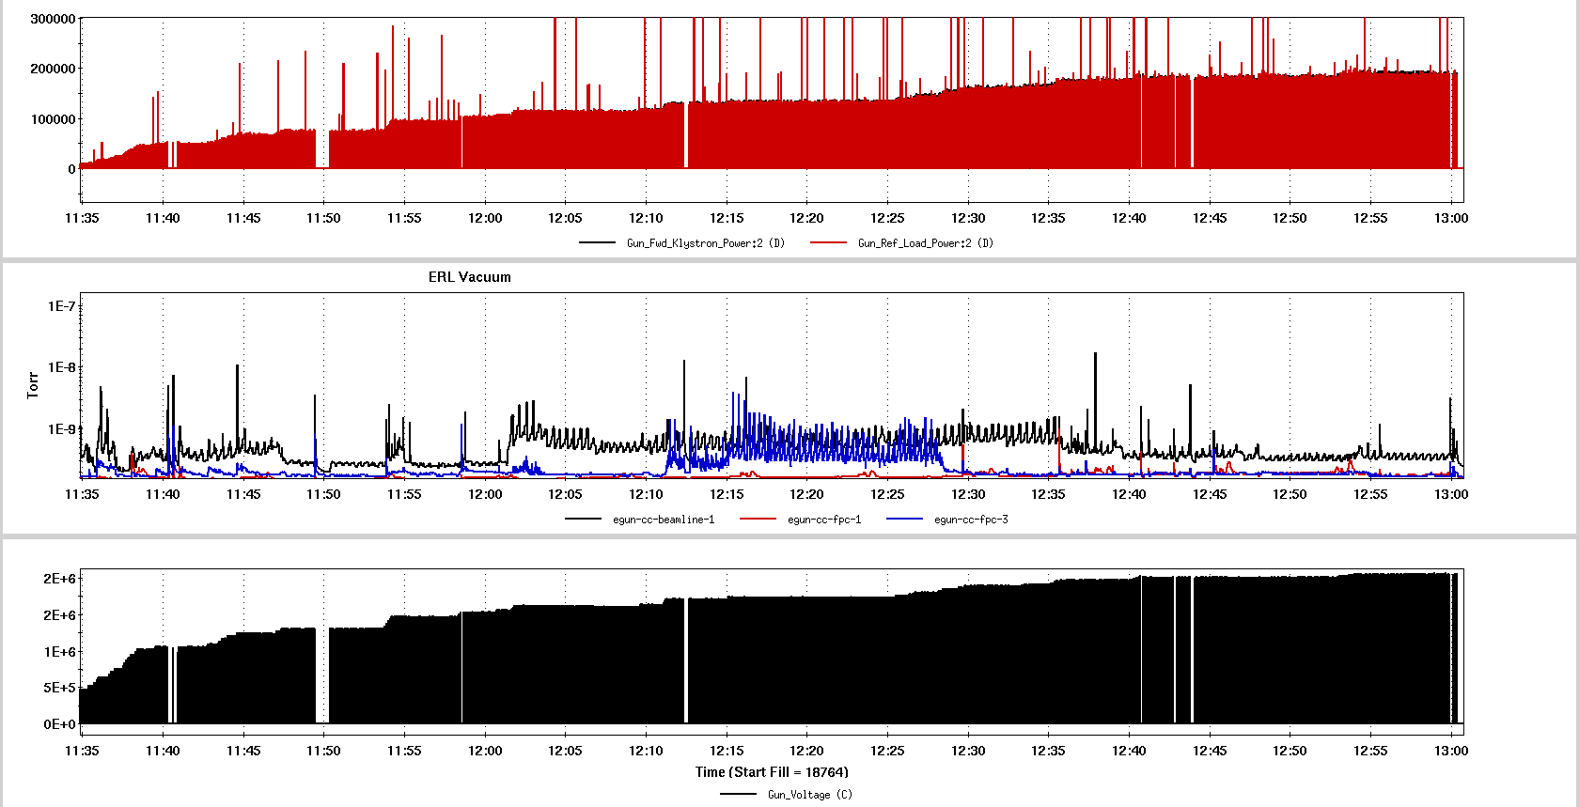
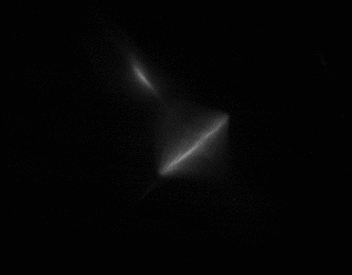
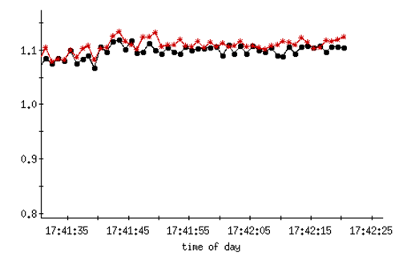
Conditioning result and beam commission
Dark current
Photo current
Courtesy by Wencan Xu
The QE of CsK₂Sb was 4.1% at initial prepared and 3.8% before inserting into the gun.
The gun was then conditioned and sent beam to a Faraday cup. Pulsed operations yielded bunches with up to 0.55nC per-bunch.
The gun was operated in pulsed mode at 0.85MV kinetic energy. The ICT and Faraday cup measurements confirmed QE=1% at low current.
After running for a couple of days including condition and high bunch charge test, there was no observed degradation of the QE.
550pC bunch charge

Slide 14
Challenges and considerations
SRF gun merging high QE photocathode, superconducting RF, high repetition rate laser, beam diagnostic. All complex.
Semiconductor cathode material contamination the gun/stalk induce the multipacting.
Bias the cathode
Shielding the RF field
Protect the multipacting zone in cathode preparation
High bunch charge and high average current operation with long lifetime cathode
Good vacuum in gun operation
High input power coupler
Beam halo control
Good beam quality
High peak gradient on the cathode
Uniform ,smooth and low thermal emittance photocathode
Laser shaping on both transverse and longitudinal
Laser and gun synchronization precisely.
CW mode Dark current eliminating
Kick the dark current
Reduce the field emitter area
Stable SRF operation
Cryogenic operation
Coupler kick and HOM damping

Slide 15
Summary
SRF photoinjectors are promising to provide high bunch charge, high average current and small emittance beam.
Significant progress on SRF gun researches in last a few years. For example: BNL 704MHz gun generated 550pC per bunch and no observed degradation of the QE in two days gun condition and operation.
ELBE SRF gun I generated beam for FEL operation and PKU DC-SC gun delivered beam for THz and UED test.
Demonstration of high average current operation and high bunch charge operation are under going.
Beginning of a new adventure, look forward to having more exciting results soon.

Slide 16
Acknowledgements
Thanks to BNL ERL and CeC project team.
I. Ben-Zvi; T. Rao; S. Belomestnykh; D. Kayran; B. Sheehy; H. Xie; T. Xin; W. Xu; L. Hammons; R. Kellerman; C. Liaw; V. Litvinenko; G. McIntyre; T. Miller; T. Seda; R. Than; D. Weiss; B. Xiao; J. Skaritka; I. Pinayev and many others.

Slide 17
Thanks for you attention!

Slide 18
Backup

Slide 19
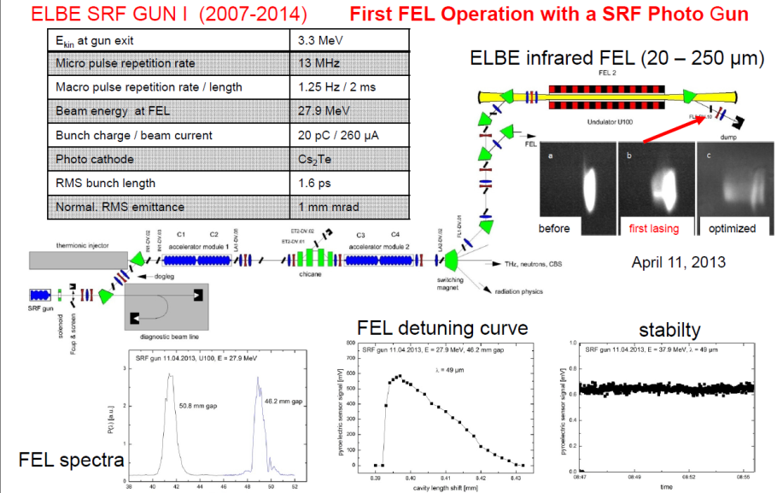
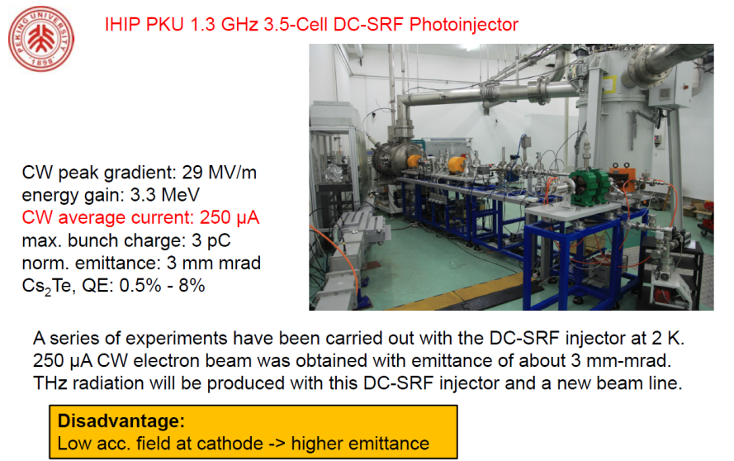
From J. Teichert IPAC 2014 slides

