Slide 1
The Cornell High Brightness Injector
Colwyn Gulliford, Adam Bartnik

Slide 2
Outline
Previous results
Introduction
Emittance ≤ 77 pC
High current ≤ 75 mA
High brightness at higher charge?
Good emittance with Q ≥ 100 pC?
Is high current still possible?

Slide 3
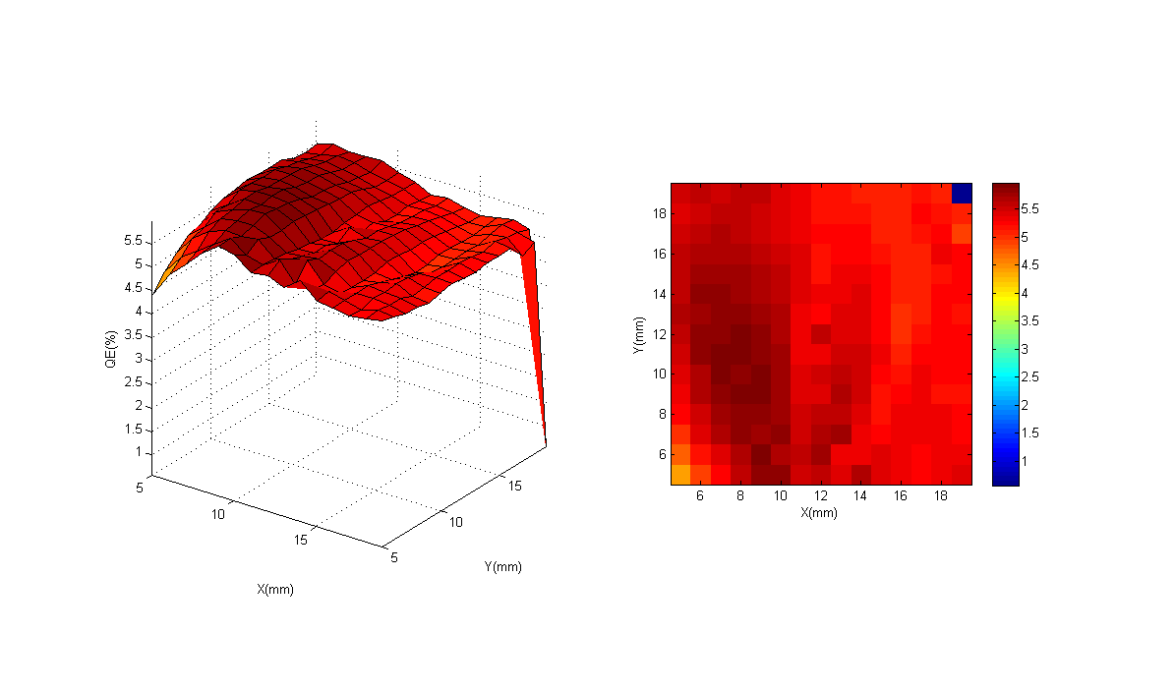
Injector Layout
6 Dimensional Phase Space Diagnostics + High Power Beam Dump + Chicane (Compton Scattering)
Short SRF Linac
5 – 15 MeV
400 kV DC Gun +
Bunching/Focusing
Emittance Measurement System
Superconducting
RF Cavities (niobium)
400 kV DC Gun
NaKSb: MTE = 140 meV, QE roughly 5%
2nd Scanner
Magnet Pair
1st Scanner
Magnet Pair
Faraday Cup
Faraday Cup
+ Viewscreen
50 MHz
520 nm
Viewscreen
Deflecting Cavity
2nd Slit
1st Slit

Slide 4
Laser Shaping
Transversely: clip Gaussian laser profile at a given intensity
fraction (typically 50%)
Longitudinally: Birefringent Crystals for pulse stacking:

Slide 5
Previous results
Emittance measurements¹ (merger section, 7 MeV)
350 kV Gun
Met requirements for ERL
Bunch charge | Bunch length | Horz Emit. (100%) | Vert Emit. (100%)
19 pC | 2.1 ps | 0.33 μm | 0.20 μm
77 pC | 3.0 ps | 0.69 μm | 0.40 μm
Asymmetry Due to the Merger?
High current operation^{2,3} (straight section, 4 MeV)
250 kV Gun
Up to 75 mA peak, reliable operation at 65 mA
> 60 hour cathode lifetime at 65 mA (NaKSb)
1. Gulliford el al., Phys. Rev. ST Accel. Beams 16, 073401 – 2013
2. Cultrera el al., Appl. Phys. Lett. 103, 103504 (2013)
3. Dunham el al., Appl. Phys. Lett. 102, 034105 (2013)

Slide 6
Low emittance at high charge

Slide 7
LCLS-II Injector Tests
CU Injector as possible injector for high rep. rate FEL (LCLS-II)
9.5 MeV
Straight linac - No ERL merger section!
Goal: measure emittance at specified charge / peak current:
Bunch charge | Peak current | Emittance (95%)
20 pC | 5 A | 0.25 μm
100 pC | 10 A | 0.4 μm
300 pC | 30 A | 0.6 μm

Slide 8
Expectations: Simple Scaling
Use previous results to get a rough estimate of what to expect:
Assume optimal emittance scales like
Previously:
(in merger)
Need around 0.8 μm (100%) emittance to get 0.6 μm (95%)
Requires removal of asymmetry (Merger? Couplers?)
Note: emittance may scale worse than
Bunch charge | ε_{n,x}(100%) | ε_{n,y}(100%)
19 pC | 0.33 μm | 0.20 μm
77 pC | 0.69 μm | 0.40 μm
300 pC | 1.36 μm | 0.79 μm
Note prior asymmetry in x , y

Slide 9
Expectations: Simple Scaling
Use previous results to get a rough estimate of what to expect:
Assume optimal emittance scales like
Previously:
(in merger)
Need around 0.8 μm (100%) emittance to get 0.6 μm (95%)
Requires removal of asymmetry (Merger? Couplers?)
Note: emittance may scale worse than
Bunch charge | ε_{n,x}(100%) | ε_{n,y}(100%)
19 pC | 0.33 μm | 0.20 μm
77 pC | 0.69 μm | 0.40 μm
300 pC | 1.36 μm | 0.79 μm

Slide 10
Initial trouble at 20 pC
Beam Based Alignment
Loaded optimized settings
Tuned machine (few weeks)
Bunch charge | Peak current | Emittance (95%)
20 pC | 5 A | 0.25 μm
100 pC | 10 A | 0.4 μm
300 pC | 30 A | 0.6 μm

Slide 11
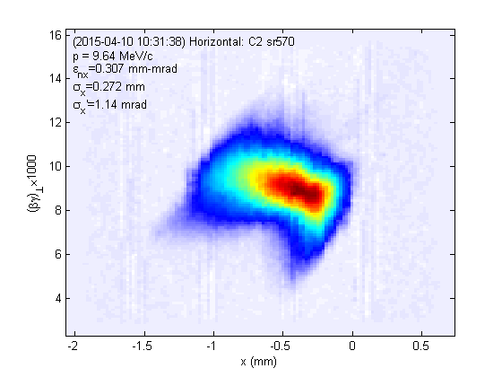
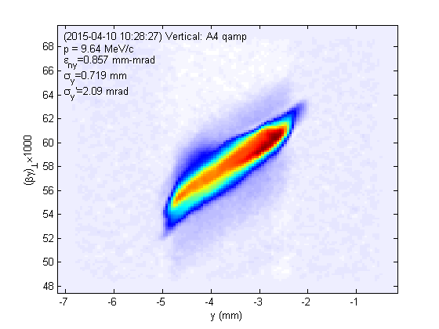
Initial trouble at 20 pC
Beam Based Alignment
Loaded optimized settings
Tuned machine (few weeks)
Bunch charge | Peak current | Emittance (95%)
20 pC | 5 A | 0.25 μm
100 pC | 10 A | 0.4 μm
300 pC | 30 A | 0.6 μm
Found emittance X/Y asymmetry that could not be removed!
H: 0.26 μm (95%)
V: 0.62 μm (95%)
Can’t be from the merger….

Slide 12
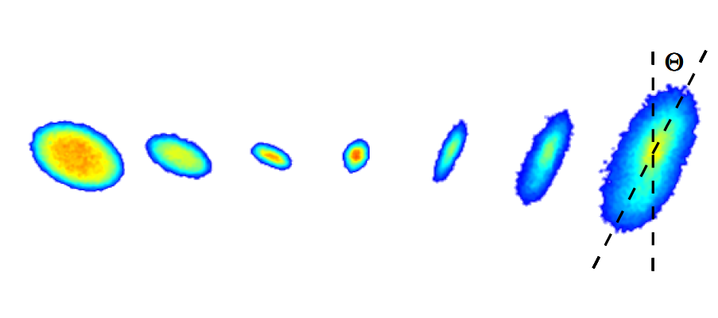
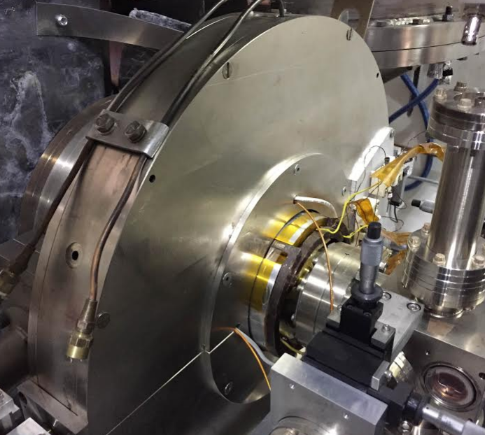
Origin of asymmetry
Found a beam asymmetry after (only) the first solenoid!
Tilt = half Larmor angle -> stray quad inside solenoid
Wired simple corrector quad through BPM feedthrus
-
R
20pC, before correction:
+
+
-
Increasing solenoid current
Quad wiring
20pC, after correction:
Increasing solenoid current

Slide 13
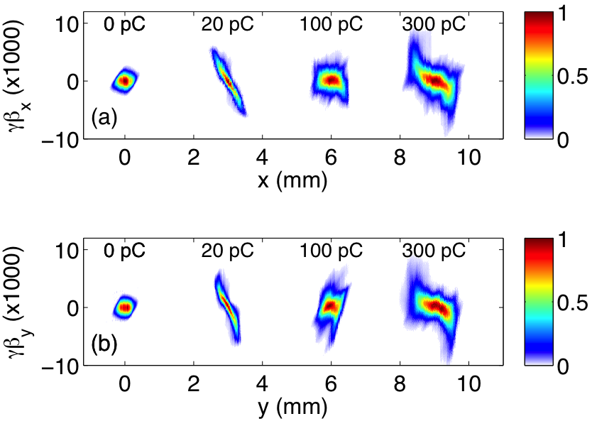
Results
After another month of work…
Emittance asymmetry is gone
Met spec at all charges
Same SRF settings for all charges
Q (pC) | I_{peak} Target (A) | I_{peak} (A) | ε_{n} Target (95%, μm) | ε_{n} (95%, μm) | ε_{n,th} /ε_{n}
20 | 5 | 5 | 0.25 | H: 0.18, V: 0.19 | 60%
100 | 10 | 11.5 | 0.40 | H: 0.32, V: 0.30 | 80%
300 | 30 | 32 | 0.60 | H: 0.62, V: 0.60 | 70%

Slide 14
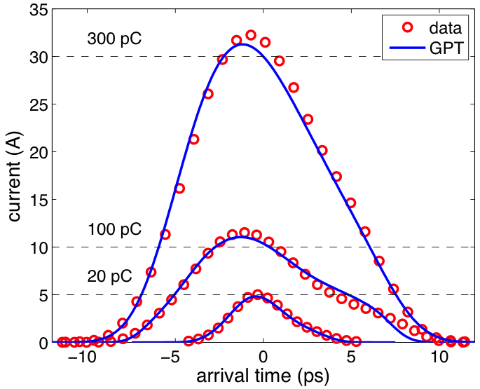
Agreement with Simulation
Current profile agrees well at all charges

Slide 15
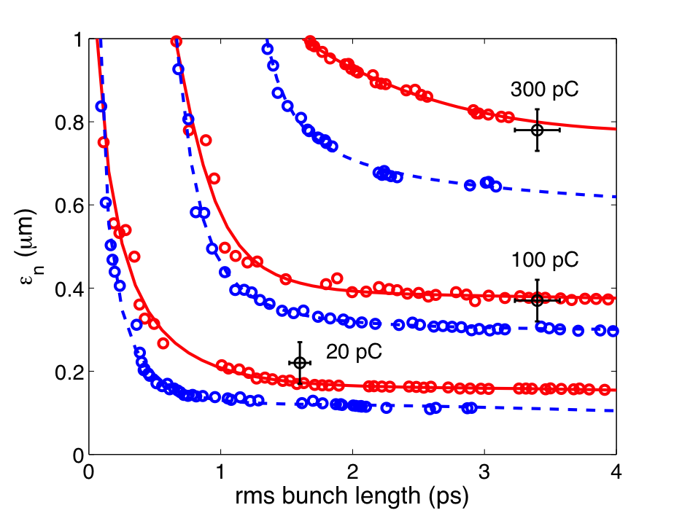
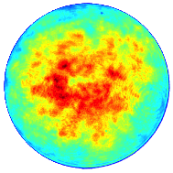
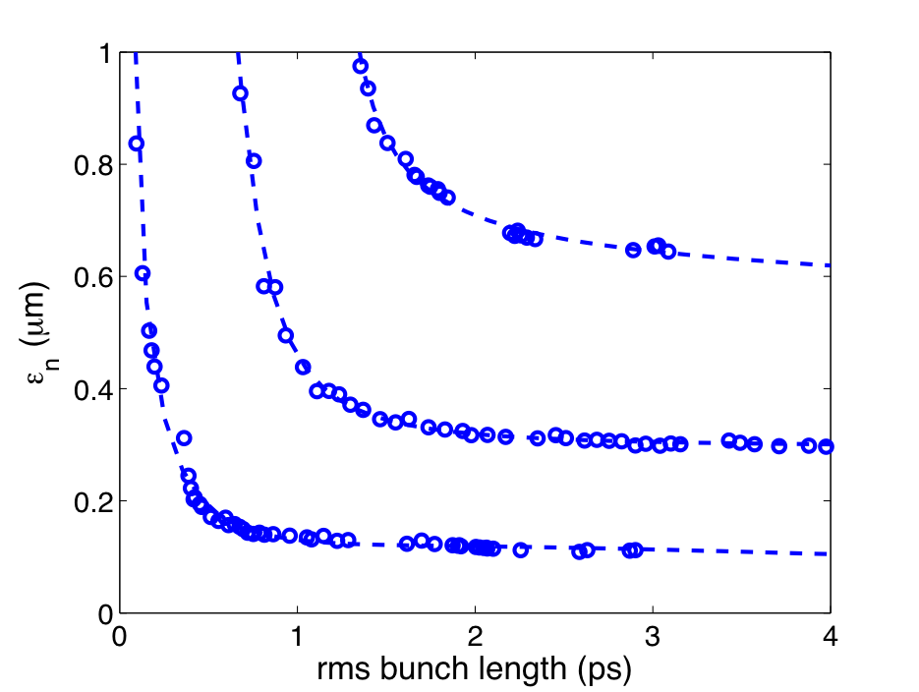
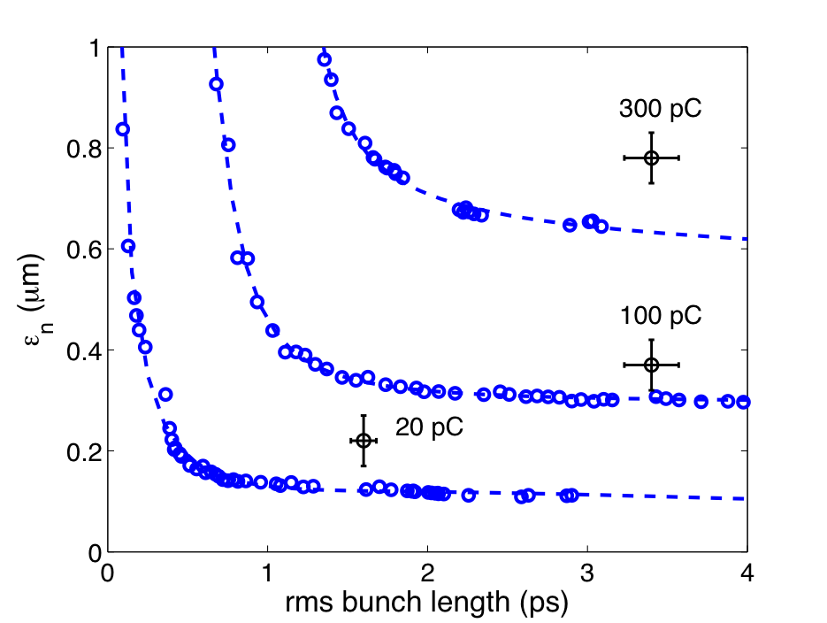
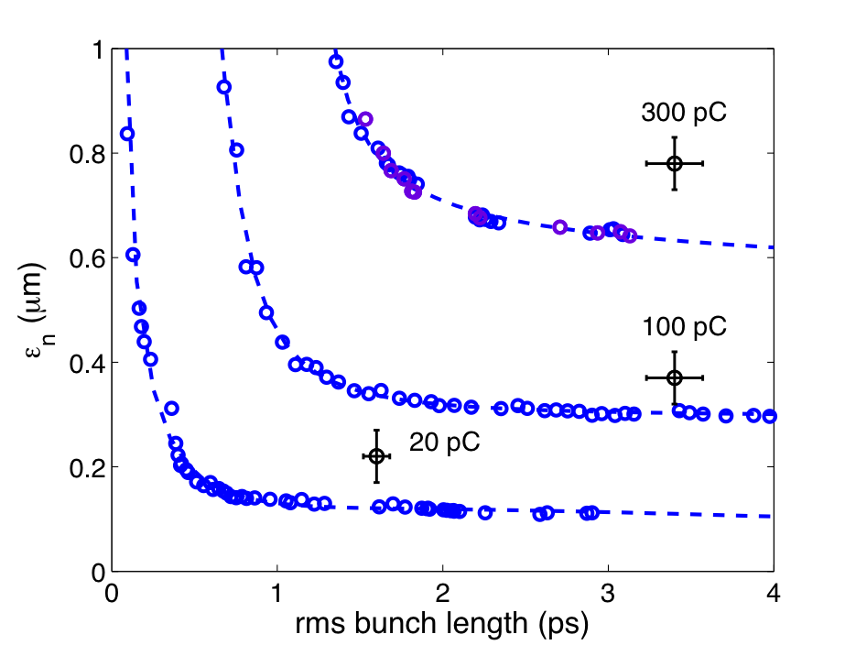
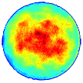
Effects of the Laser Shape
Ideal Shape
Measured Shape

Slide 16
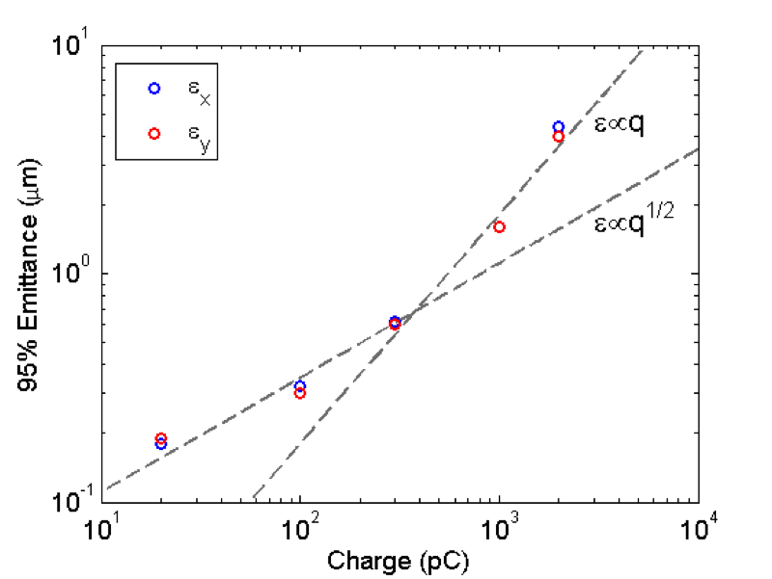
Even larger charge?
Primary result (omitting details): Emittance trend becomes more linear above 300 pC
Q (pC) | Peak current (A) | Emittance (95%, μm)
20 | 5 | H: 0.18 V: 0.19
100 | 11.5 | H: 0.32 V: 0.30
300 | 32 | H: 0.62 V: 0.60
1000 | 50 | H: 1.6 V: 1.6
2000 | 56 | H: 4.4 V: 4.0

Slide 17
High current with high charge

Slide 18
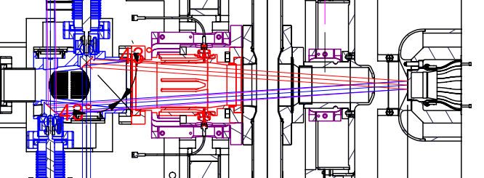
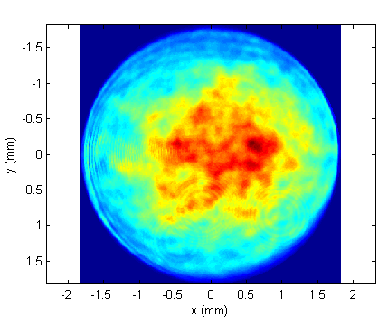
Off center cathode
High charge -> Large laser spot
Anode clips laser light more than 9 mm from cathode center
To avoid central 3 mm, laser size must be <6 mm
Sets a hard upper limit to charge
Practically, at the time of the experiment, we only had a 3 mm cathode
Simulation -> Hard limit to charge with 3 mm ~ 450 pC
Laser profile during high current
3 mm

Slide 19
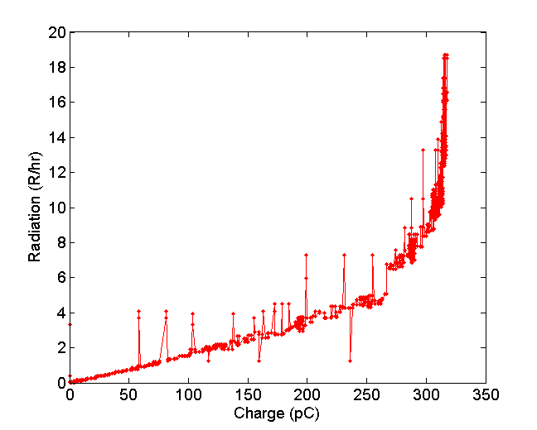
High current operation
High current machine settings (more conservative)
350 kV gun
5 MeV final energy
See dramatic increase in radiation around 320 pC
Changing machine settings did not help
Made laser size (slightly) bigger: same problem at 375 pC (~ 20 mA)
Even bigger would require larger cathode… future work!
Radiation while increasing charge
Space charge limit?

Slide 20
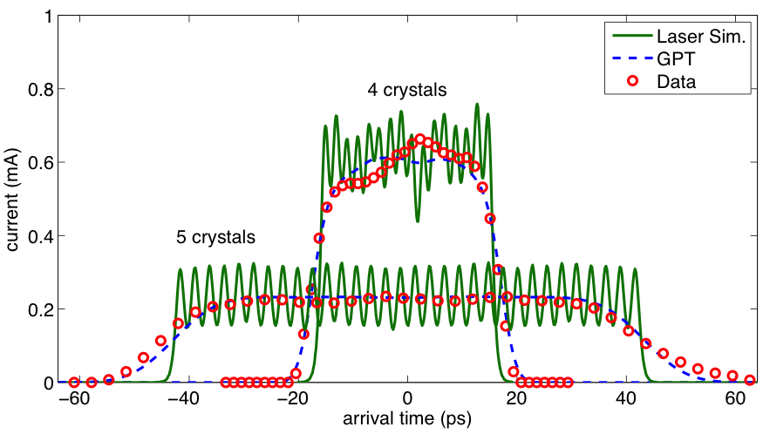
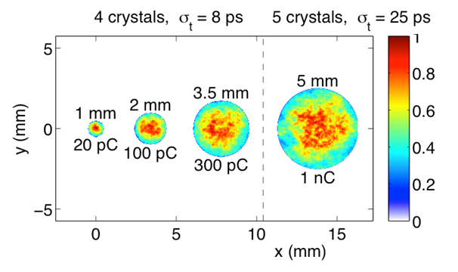
Laser Modifications
Laser size scales as
Problem:
1 nC, laser size > 6 mm
Solution:
Lengthen laser pulse:
4 crystals -> 5 crystals
8 ps -> 25 ps
1 nC, optimal D = 5 mm
Feasible!

Slide 21
Summary
The CU injector meets all LCLS – II requirements
Emittance growth well compensated up to 300 pC
(at 300 pC) ε_{th} = 0.41 μm, final at 9.5 MeV: ε_{n} = 0.6 μm
Emittance scales roughly as
At higher charge, compensation is worse
1nC: ε_{th} = 0.6 μm, ε_{n} = 1.6 μm
Emittance scales roughly as Q
Full (50 MHz) duty factor demonstrated up to 375 pC (20 mA)
Likely need a larger (off-center) cathode to go further
DOE Nuclear Physics awards
DE-SC0012493, DE-AC02-76SF00515

Slide 22
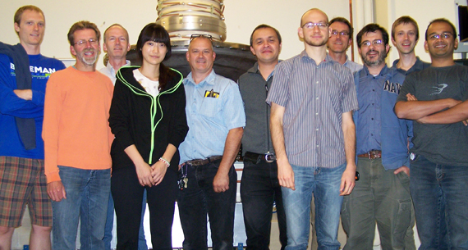
Acknowledgements
Thanks to the Cornell High-brightness Beam Group:

