Slide 1
Accelerator Technology Session
Convener: V.Ptitsyn
Thursday 15:30 - 16:30
Beam Instrumentation Challenges for Parity Violation Experiments 20'
Speaker: Dr. Emmanouil Kargiantoulakis (U. Virginia)
SRF Technology for High Current Application 20'
Speaker: Prof. Matthias Liepe (Cornell University)
FFAG Recirculation and Permanent Magnet Technology for ERL's 20'
Speaker: Dr. Nicholaos Tsoupas (Brookhaven National Lab)

Slide 3
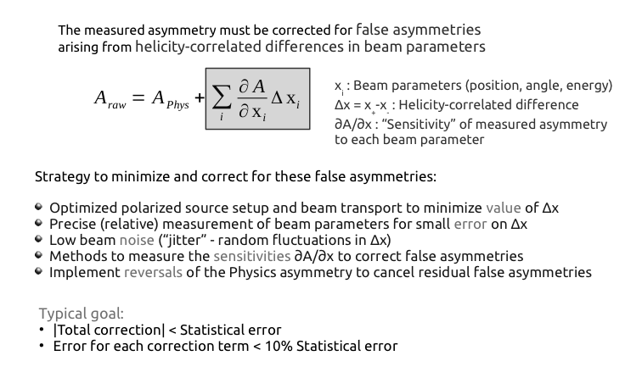
E. Kargiantoulakis, Beam Instrumentation Challenges for Parity Violation Experiments

Slide 4
E. Kargiantoulakis

Slide 5
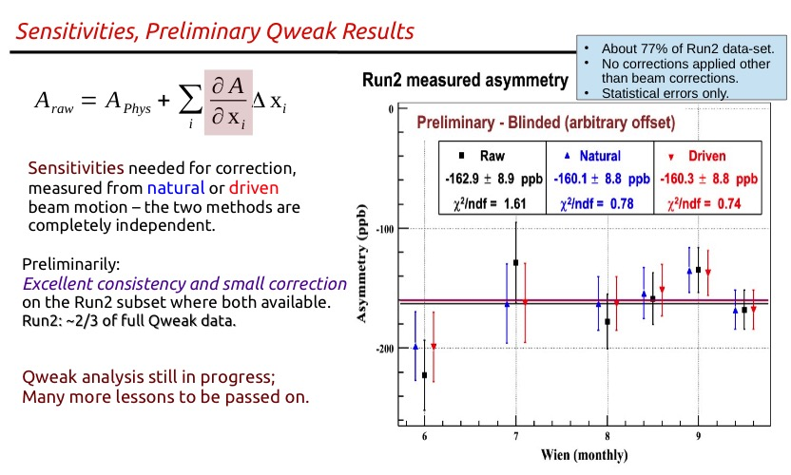
E. Kargiantoulakis

Slide 6
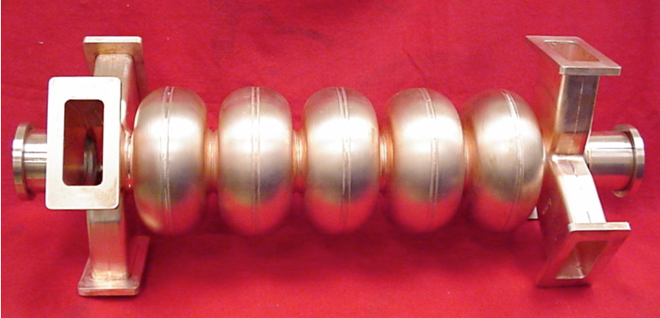
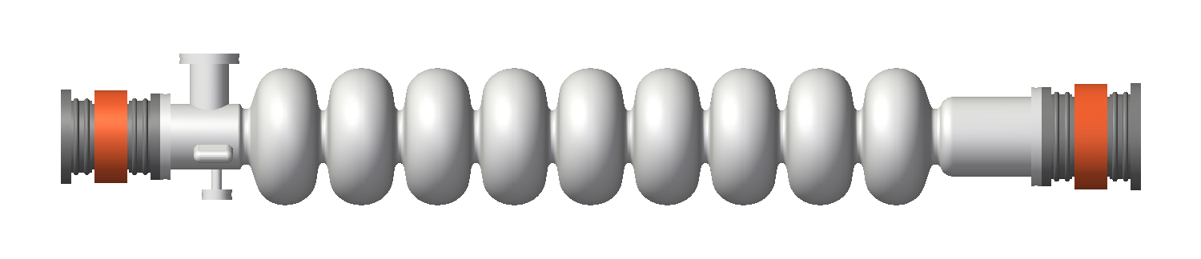
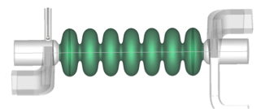
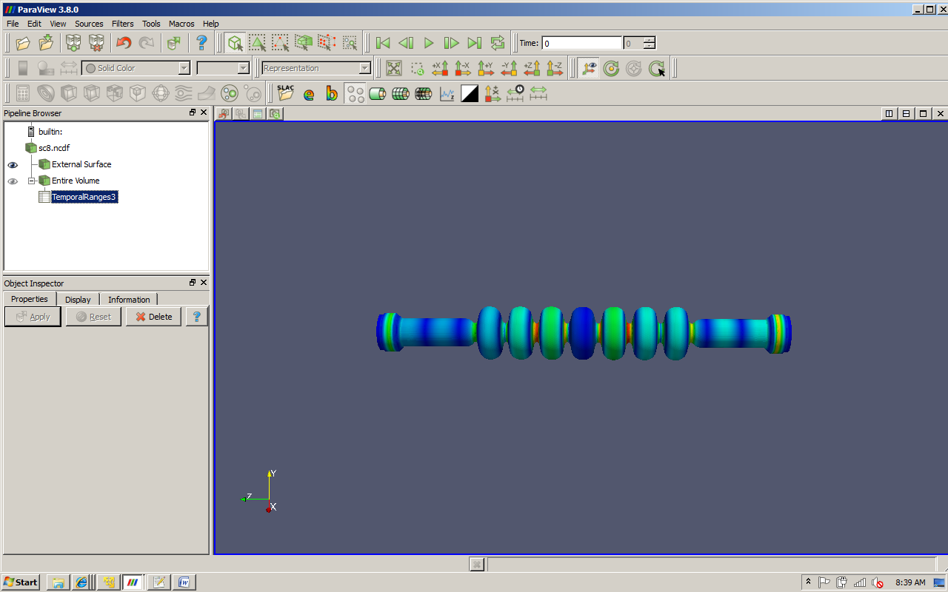
SRF Technology for High Current Application
Matthias Liepe
Associate Professor of Physics
Cornell University
M. Liepe June 18, 2015 Slide 6

Slide 7
Conclusions
Injector (non ERL) high current SRF:
  Several 100 mA+ designs (Cornell, HZB, KEK…)
  Cornell injector has reached >70 mA with no sign of limitation by SRF
  Future: need higher power CWRF couplers (especially at f >1 GHz) to reduce cost
ERL main linac high current SRF:
  Several 100 mA+ designs (BNL, Cornell, HZB, JLAB…)
  Cornell 7-cell cavity has been tested at ~40mA in 1-pass (non ERL) operation with no sign of beam instability or excessive HOM power
  Non of these cavities ever have been operated in high current (~100mA) ERL mode!!
    Test facilities: CBETA, HZB, KEK…
M. Liepe June 18, 2015 Slide 7
Notes:
I lead Nb3Sn program !

Slide 8
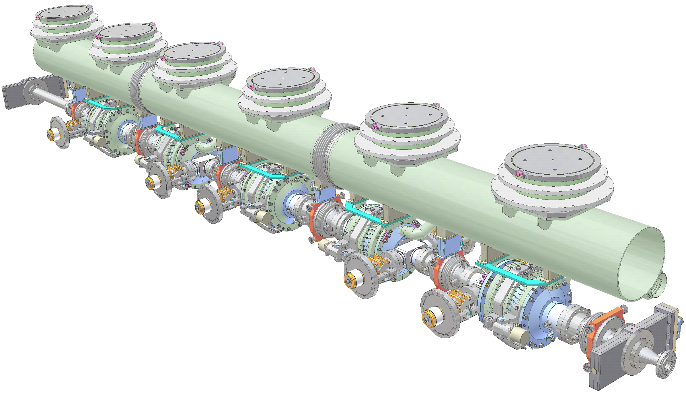
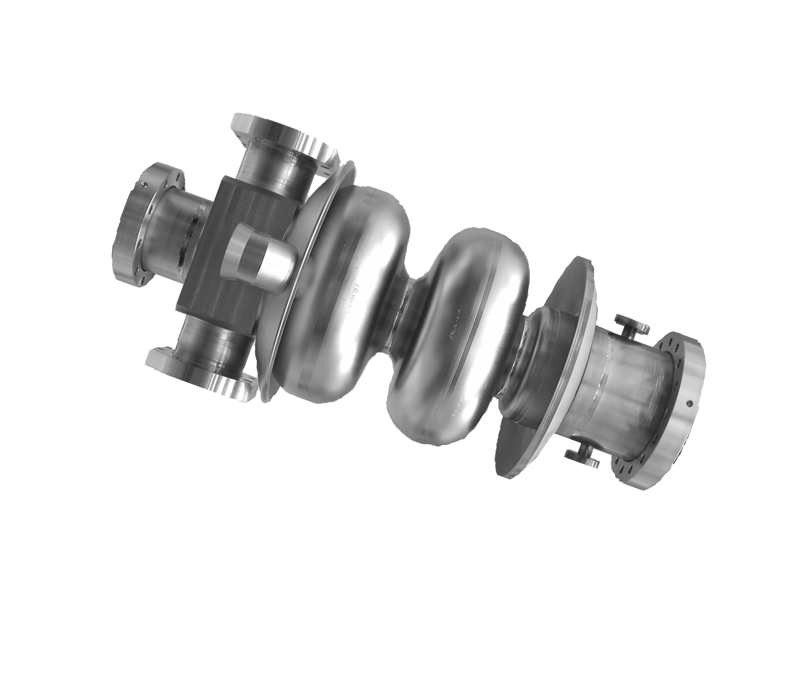
Cornell 100 mA ERL Injector Cryomodule
M .Liepe
Cryogenic system
⇨ Bring cavity to 2K
~5 m
Frequency tuner
⇨ Adjust cavity frequency
HOM absorber
⇨ Damp unwanted Higher-Order Modes
Input Coupler
⇨ Couple RF power into cavity
RF cavity
Inside He vessel
M. Liepe June 18, 2015 Slide 8

Slide 9
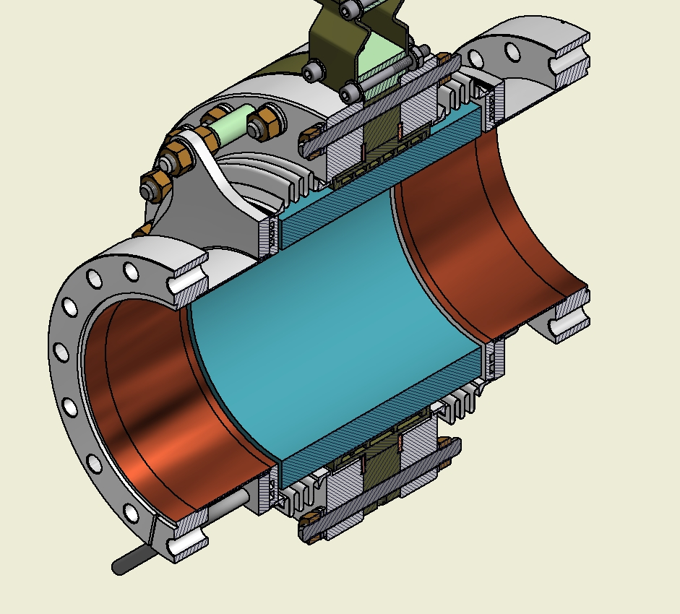
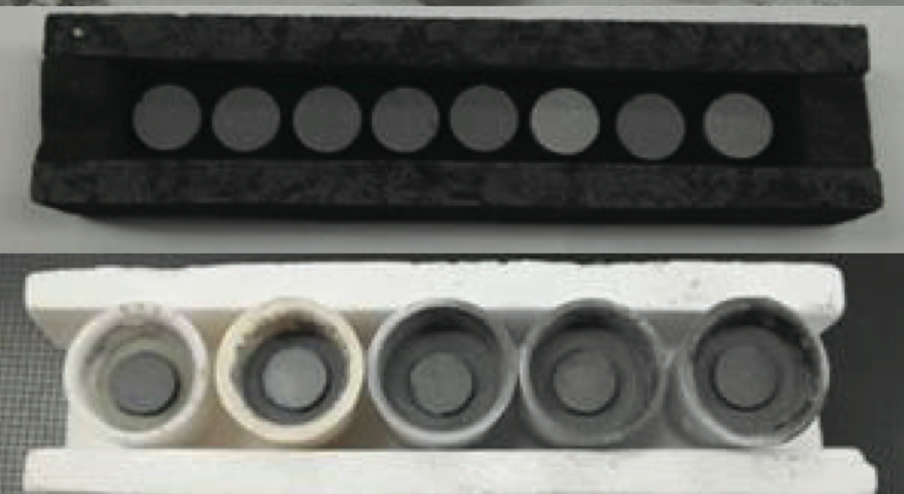
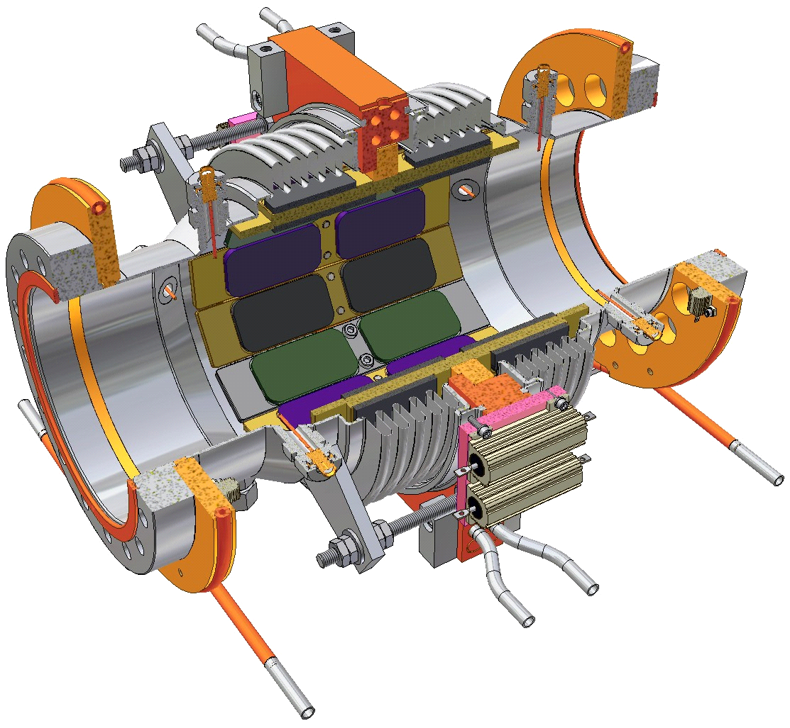
Cornell’s HOM Beamline Absorber (I)
M .Liepe
Extensive research program to find absorber materials which
  are effective at 80 K,
  absorb over the required wide frequency range (1 GHz to >100 GHz),
  are vacuum compatible and radiation hard.
Ferrites, graphite loaded SiC, carbon-nanotube loaded ceramics…
Flange to cavity
80K cooling channel
RF absorbing tiles
Graphene-containing compositions
SiC absorber ring
M. Liepe June 18, 2015 Slide 9

Slide 10
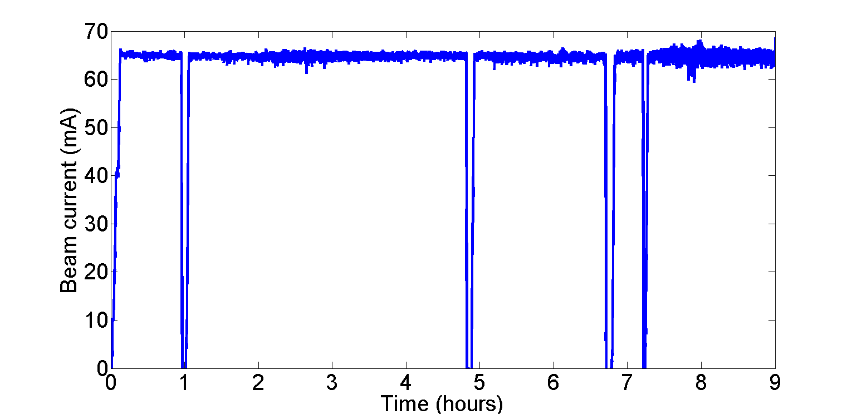
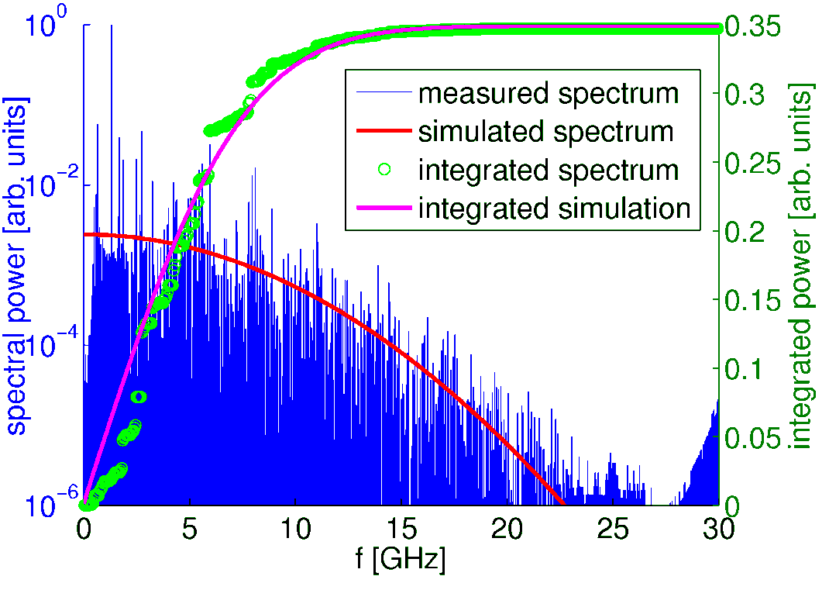
Does it work? Results from the Injector SRF Module
M .Liepe
High beam current operation
HOM spectrum
Accelerated beam currents of up to 75 mA over many hours
No signs of beam instability or excessive heating by HOMs
Spectrum in good agreement with simulation results
Excellent damping with typical Qs of a few 1000
-60
S₂₁ [dB]
-80
-100
-120
HOM absorber performance
-140
1.5
2
2.5
3
3.5
4
Frequency [GHz]
M. Liepe June 18, 2015 Slide 10

Slide 11


FFAG Recirculation and Permanent Magnet Technology for ERL’s
N.Tsoupas, S. Brooks, A. Jain, G. Mahler, F. Meot, V. Ptitsyn, D. Trbojevic BNL
M. Severance SBU
11/17

Slide 12
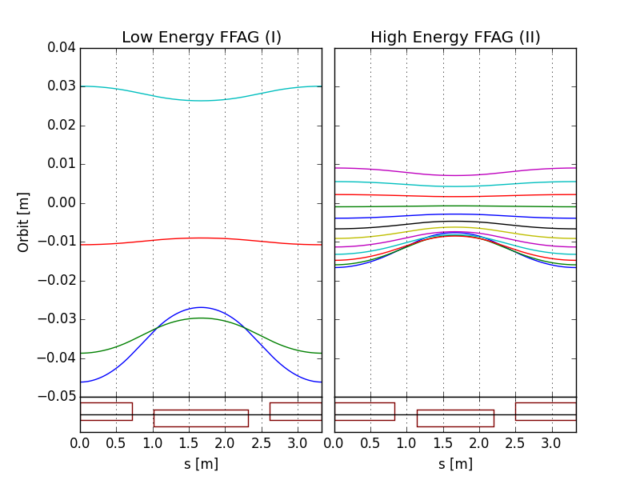
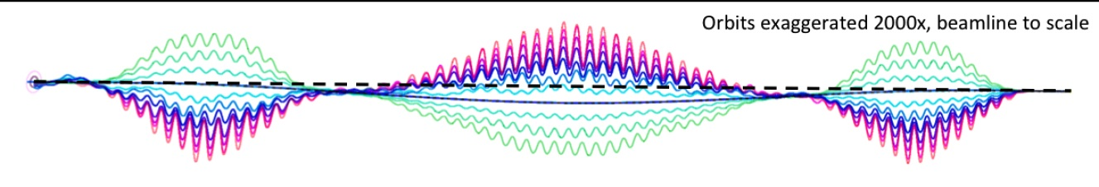
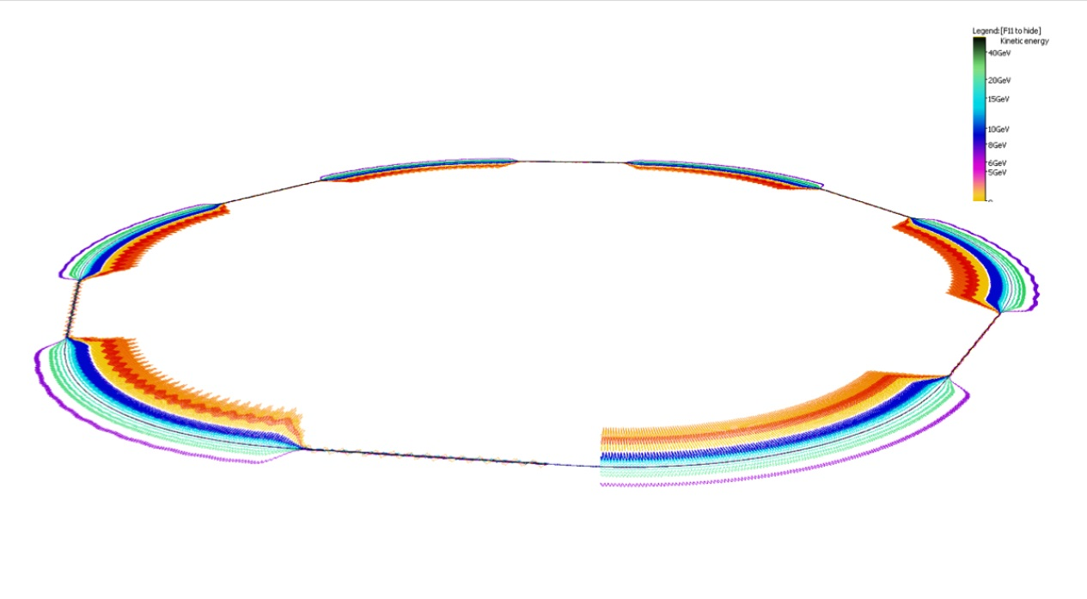
FFAG recirculation passes
N.Tsoupas
eRHIC uses two FFAG beamlines to do multiple recirculations.
(FFAG-I: 1.3-5.4 GeV, FFAG-II: 6.6-21.2 GeV)
All sections of a FFAG beamline is formed using a same FODO cell. Required bending in different sections is arranged by proper selection of the offsets between cell magnets (or, alternatively, with dipole field correctors).
Permanent magnets can used for the FFAG beamline magnets (no need for power supplies/cables and cooling).
E=5.3 GeV
E=21.2 GeV
E=6.6 GeV
E=1.3 GeV
BD
QF
Orbits in Detector bypass section
@S.Brooks, D.Trbojevic
Quad offsets evolve adiabatically
Orbits in Transition section
Each of two eRHIC FFAGs contain 1066 FFAG cells
12/17

Slide 13
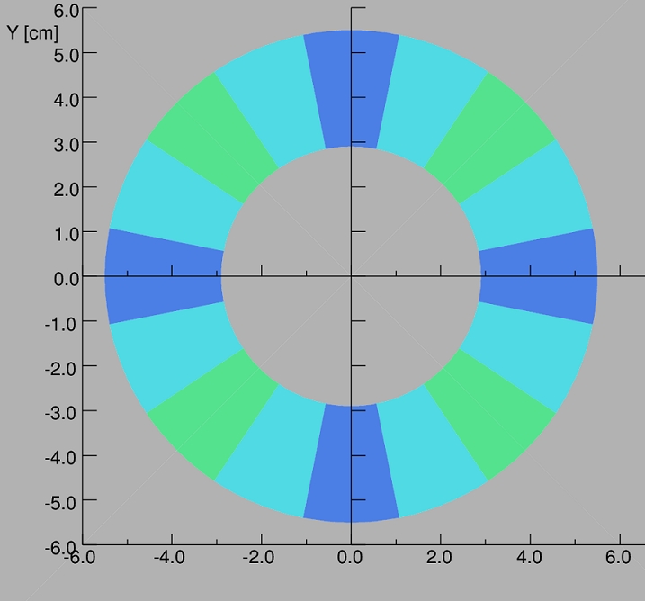
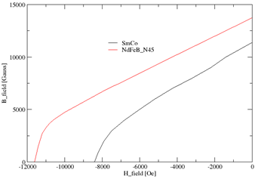
Perm. Magnet Material SmCO
Perm. Magnet Material NdFeB
2D Design establishes the magnet’s cross section
-The 12pole multipole=0 for R=1 cm
-NdFeB-N45 allows for larger inner radius
13/17

Slide 14
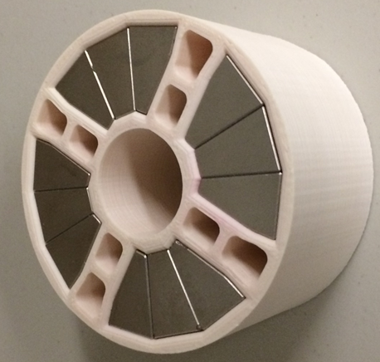
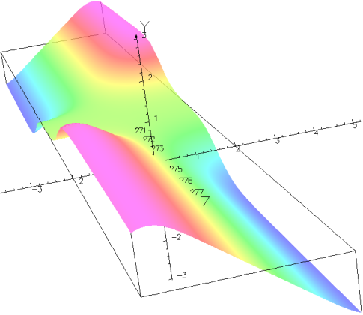
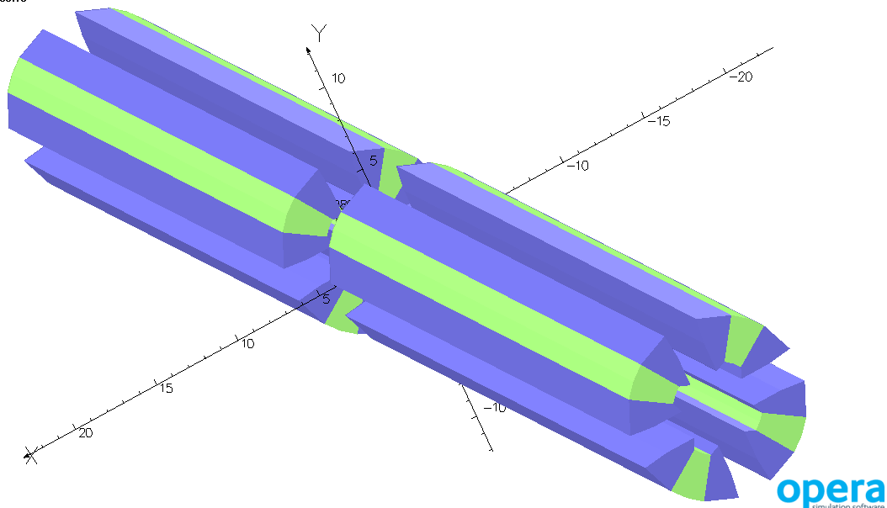
3D Magnetic field calculations for the FFAG cells
N.Tsoupas
QF
QD
cell
θ=0.283º
3Dimensional Field map is
obtained over the volume of
a single cell where beam exists.
14/17

Slide 15
Cornell marker is only first estimation! (Assumes E=300 MeV, I=40 mA)
Technology plane
Limits:
for external target experiments:
L1: Power on target ~5-8 kW
L2: Power limit: RF, Beam dump ~ few MW,
polarized source ~ few mA (R&D for 10-50 mA)
for internal target experiments:
L3: Beam disruption and beam power loss: <10 kW
L4: Beam current limit: ~tens mA (<100 mA)
(HOM power and MBBU;
Injector RF power;
beam dump power)
External targets
L1
P2, MESA
L~10⁴⁰ cm⁻² s⁻¹
L2
L3
+
Cornell
L~10³⁶ cm⁻² s⁻¹
L~10³⁸ cm⁻² s⁻¹
Dark Light, JLab
L~10³⁴ cm⁻² s⁻¹
L4
MAGIX, MESA
Accelerator technology tasks:
electron current: 10mA -> tens mA (-> 100mA)
disrupted beam transport:
  Beam loss control, collimation system
  Energy spread reducing technique(s)
Polarized targets:
Density: 10¹³-10¹⁴ cm⁻²
Luminosity ~10³¹ cm⁻² s⁻¹
Internal targets
(gas,foil,pellet)
ERL

