Slide 1
CyberInfrastructure Training and Education for Synchrotron X-Ray Science (X-CITE) Workshop
X-CITE Team
Anirban Mandal, Erik Scott (RENCI, UNC Chapel Hill)
Ewa Deelman, Karan Vahi, Mats Rynge (ISI, USC)
Matthew Miller, Werner Sun, Peter Ko, Kelly Nygren, Keara Soloway, Rolf Verberg, Valentin Kuznetsov (CHESS, Cornell)
Brandon Sorge (IU)
NSF OAC Award Numbers: 2320373, 2320375, 2320374
Notes:
I wanted to extend a warm welcome to everyone for coming to the second edition of the X-CITE workshop. X-CITE stands for Cyberinfrastructure training and education for synchrotron X-ray science. In short, this training program is geared toward CHESS users, you, to help you make better use of computing, data and systems - Cyberinfrastructure, to accelerate your scientific endeavors.
I am Anirban Mandal, the lead PI for X-CITE, and I serve as the Director for Network Research and Infrastructure at RENCI, UNC Chapel Hill.

Slide 2
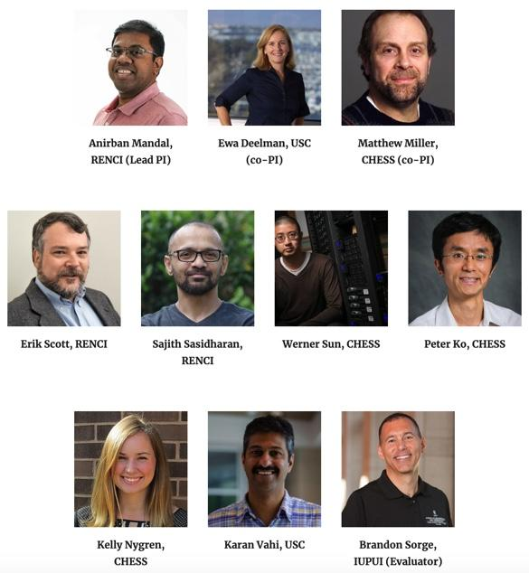
What is X-CITE and who are we ?
X-CITE is an NSF funded project with the goal of developing a training program targeted to CHESS users that
  reduces barriers to the use of CHESS Cyberinfrastructure (CI) - instruments, computing, data, and tools;
  democratizes access to NSF CI resources and services; and
  accelerates X-ray science for a broad user community.
We are a group with expertise in CI as well as X-ray and related domain sciences
Keara Soloway, Rolf Verberg, Valentin Kuznetsov

Slide 3
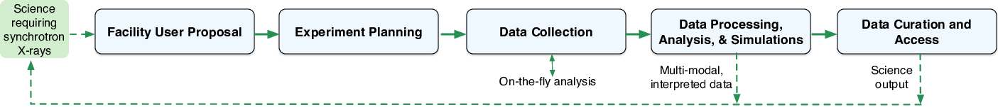
CI Training for CHESS: Motivation
Proposal and planning stage
  Proposal plans for processing and analyzing synchrotron X-ray data need some prior CI knowledge in all areas above.
Data collection stage
  Need for basic computer systems knowledge (command line) and (on-the-fly) data analysis; Best practices for collecting data
Data processing stage
  Processing data (reduction, analysis, simulation, interpretation), handling large data sets, leveraging existing software and CI.
Data curation stage
  Metadata management, Open Science/FAIR and data curation.

Slide 4
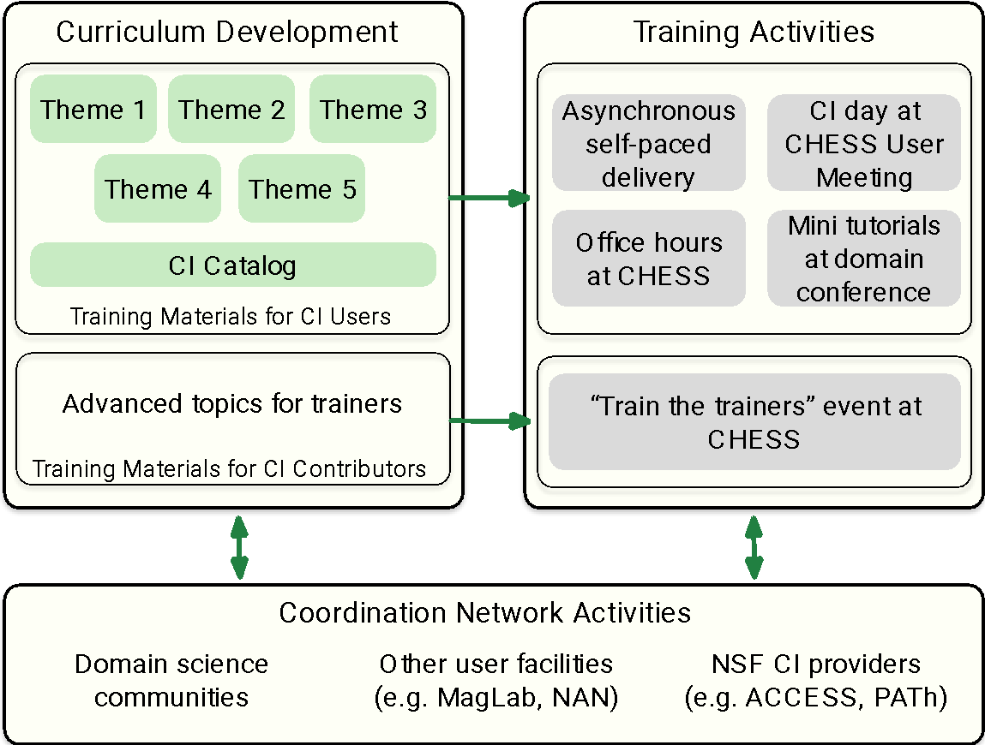
X-CITE Training Program Overview
Curriculum development
  Targeted to the Users
    Programming Essentials
    Systems fundamentals
    Distributed computing
    X-ray science software
    Data curation and FAIR
    CI Catalog
  Targeted to trainers
    Advanced CI uses and topics
Training activities
  Asynchronous materials
  Training events
    CHESS User meeting
    Tutorials at domain conferences
Coordination network activities
  Domain sciences, other facilities, NSF CI providers (ACCESS, etc.)

Slide 5
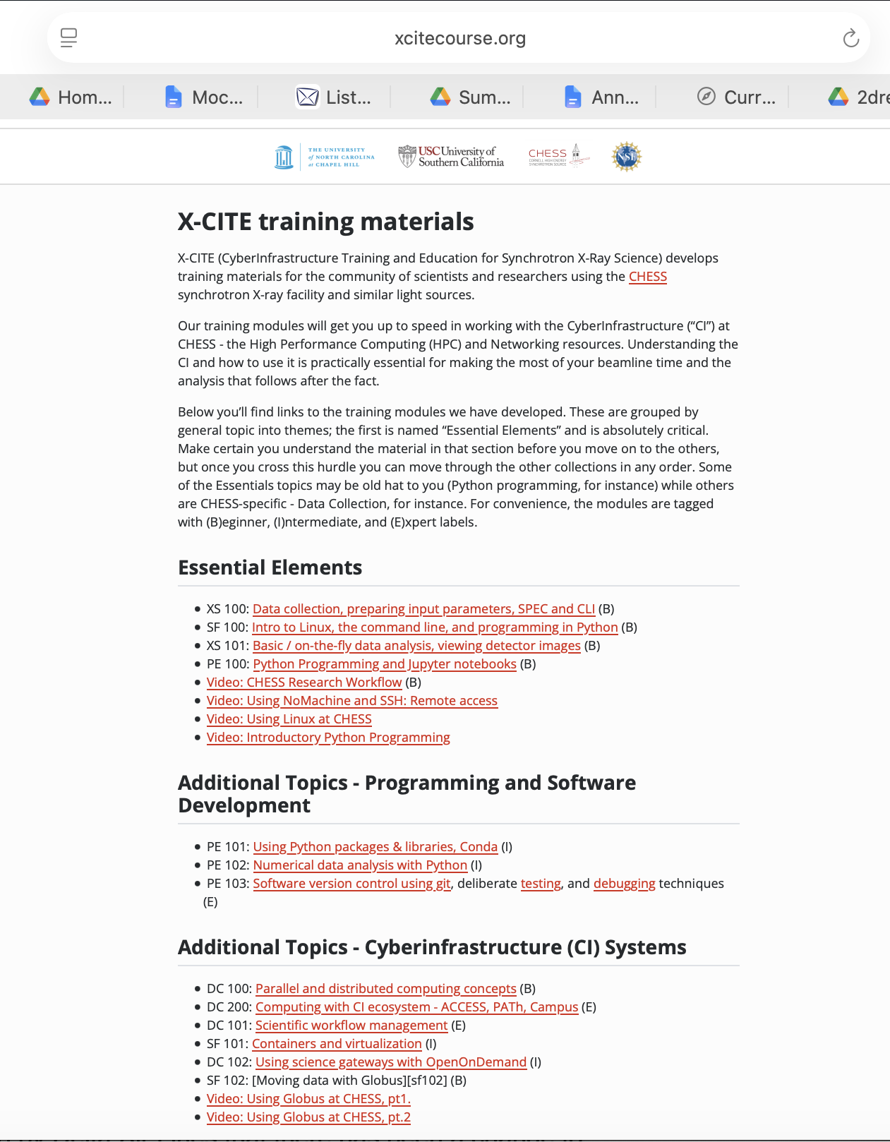
X-CITE Training Materials
https://xcitecourse.org

Slide 6
Workshop Agenda
Time | Content
8:30 – 9:00 | Breakfast and coffee (provided)
9:00 - 9:10 am | Introduction and Welcome to X-CITE Workshop
9:10 - 9:50 am | Overview of CHESS Research Workflow and CI (data collection software, data analysis software, compute farm, preparing for beamtime)
9:50 - 10:05 am | Coffee Break
10:05 - 11:05 am | FAIR Data Management and FOXDEN Demo
11:05 - 11:30 am | Science Gateways, Open OnDemand, and Scientific workflows
11:30 - 12:00 pm | AI Town Hall
12:00 - 12:10 pm | Group Photo
12:10 - 1:10 pm | Lunch (provided), Refresher of Systems Fundamentals and Programming [Optional]
1:10 - 3:40 pm | X-CITE Hands-on tutorial with complete end-to-end examples
3:40 - 3:55 pm | User Survey and Feedback
Notes:
Common plenary session followed by hands on sessions

Slide 7

Thanks and Acknowledgements
Local Organization and Help:
Mike Gilpin, Chris Mobley, Katerina Malysheva, Rick Ryan, Aia Ferreira Barboza, CLASSE-IT, CHESS User Office
Workshop attendees
X-CITE team members
X-CITE training materials: https://xcitecourse.org
NSF Cybertraining Award # 2320373

Slide 8
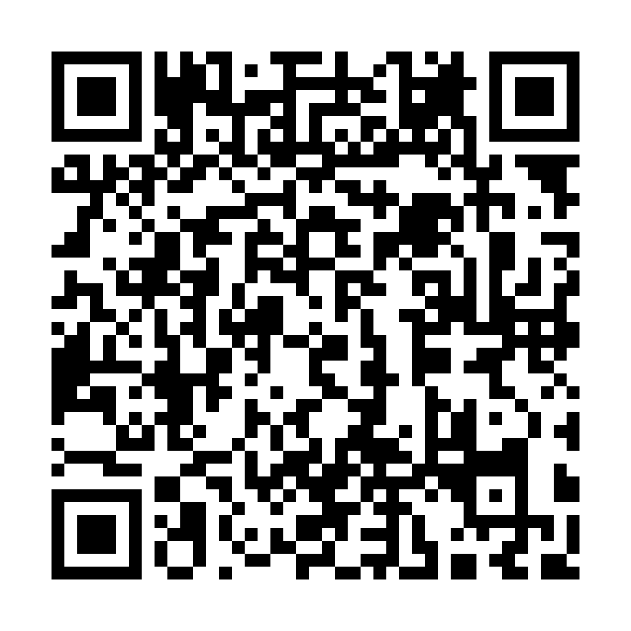
X-CITE Post Workshop Survey
Please take this
short survey to help us improve the X-CITE training program
https://iu.co1.qualtrics.com/jfe/form/SV_bjxlbrR1JrkkppQ
NSF Cybertraining Award # 2320373

