Slide 1
Reduction of Nb(100)-(3×1)O via Zr thin films
Robert Burnley, Margeret Hall, Joshua Wagner, and Steven Sibener
University of Chicago

Slide 2
SRF Cavities and progress with Zr
The performance of SRF cavities is highly sensitive to defects: oxides, impurities, surface roughness , etc.
Surface engineering aims to reduce these losses
Previous work within the Center for Bright Beams examined Zr-Nb surface alloys and found improvements over pure Nb
Sitaraman, N. S., et al. (2023). "Enhanced Surface Superconductivity of Niobium by Zirconium Doping." Physical Review Applied 20(1): 014064.

Slide 3
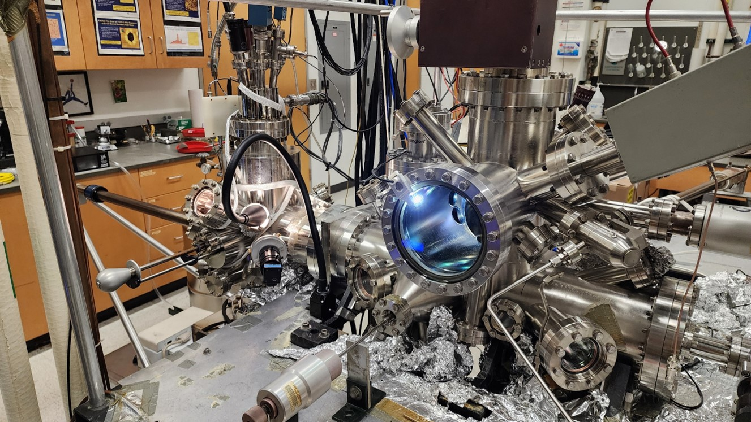
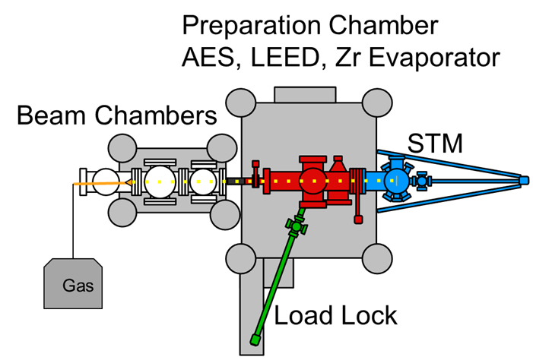
Surface Science in the Sibener Group
Model surfaces in UHV: single crystals isolate surface chemistry and reconstruction
Experimental methods:
XPS, AES, EDX → composition
STM, LEED, SEM → structure
STS → DOS/LDOS
Controlled preparation: deposition, annealing, and gas dosing reveal oxidation, reduction, alloying, and surface dynamics

Slide 4
Our work in the ZrNb system:
Thin film experiments examining growth mode
Vary coverage, temperature
Examination of surface reconstructions
Structure, electronic properties
Alloy formation and characterization
Activation, depth, uniformity
Van’s talk
The topic of this talk
In progress

Slide 5
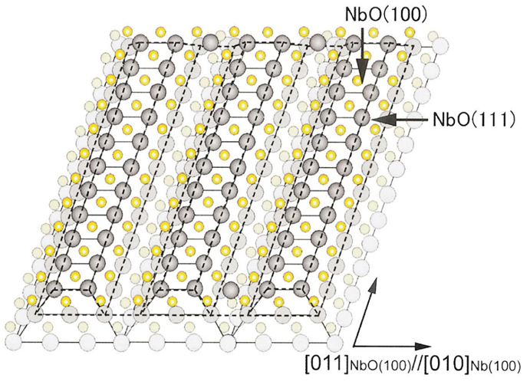
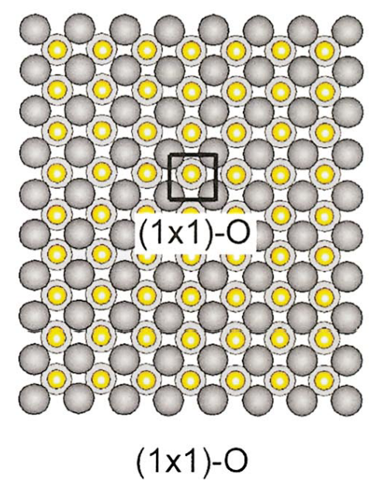
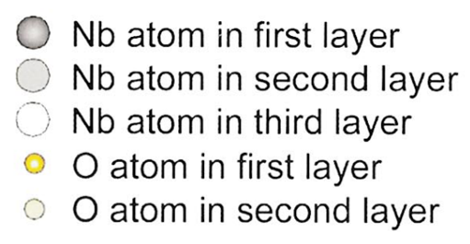
Model surface: Nb(100)-(3×1)O
The Nb(100)-(3×1)O is a well studied system with distinct topography
As the surface is reduced, the structure approaches the (100) termination
Nb(100)-(3×1)O
Nb(100)-(1×1)O
Reduction
An, B., et al. (2003). "Surface structures of clean and oxidized Nb(100) by LEED, AES, and STM." Physical Review B 68(11): 115423.

Slide 6
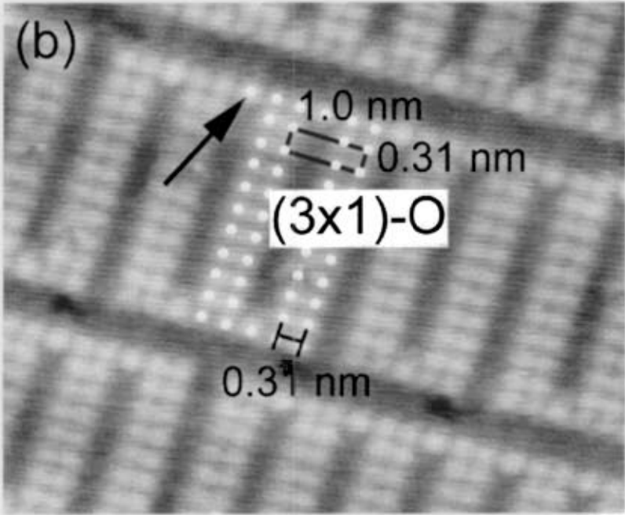
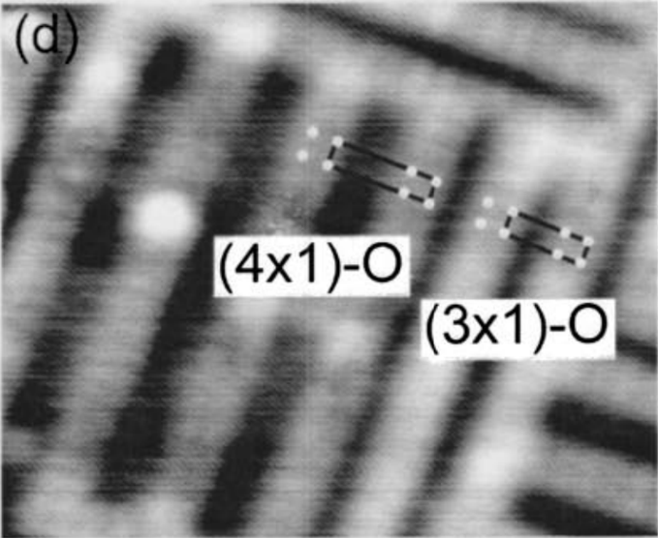
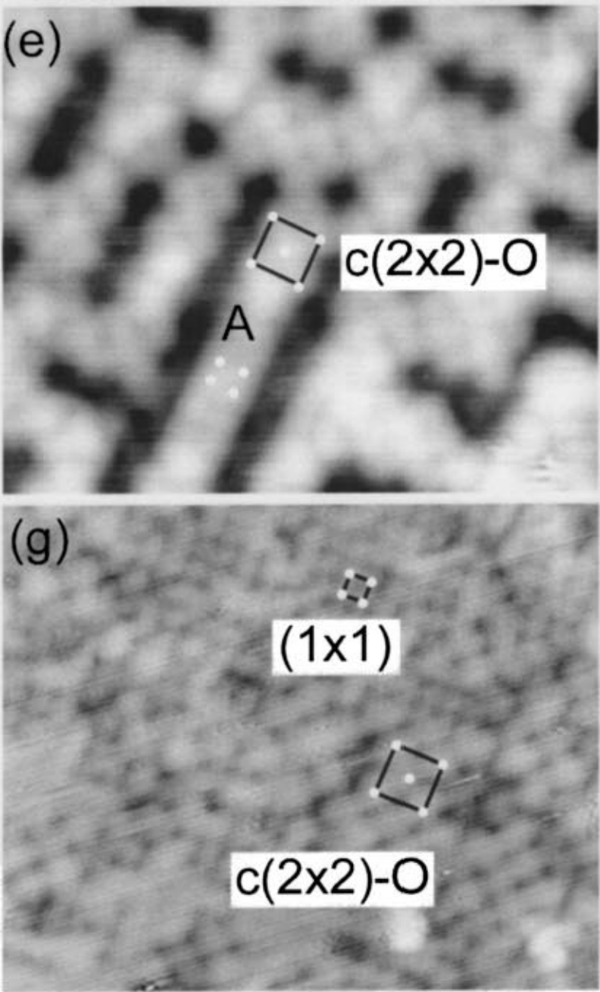
Model surface: Nb(100)-(3×1)O
The Nb(100)-(3×1)O is a well studied system with distinct topography
As the surface is reduced, the structure approaches the (100) termination
High O
Low O
1697 °C
1997 °C
2097 °C
2227 °C
An, B., et al. (2003). "Surface structures of clean and oxidized Nb(100) by LEED, AES, and STM." Physical Review B 68(11): 115423.

Slide 7
Model surface: Nb(100)-(3×1)O
The Nb(100)-(3×1)O is a well studied system with distinct topography
As the surface is reduced, the structure approaches the (100) termination
The surface topography of Nb(100) is related to the chemical state.
High O
Low O
1697 °C
1997 °C
2097 °C
2227 °C
An, B., et al. (2003). "Surface structures of clean and oxidized Nb(100) by LEED, AES, and STM." Physical Review B 68(11): 115423.

Slide 8
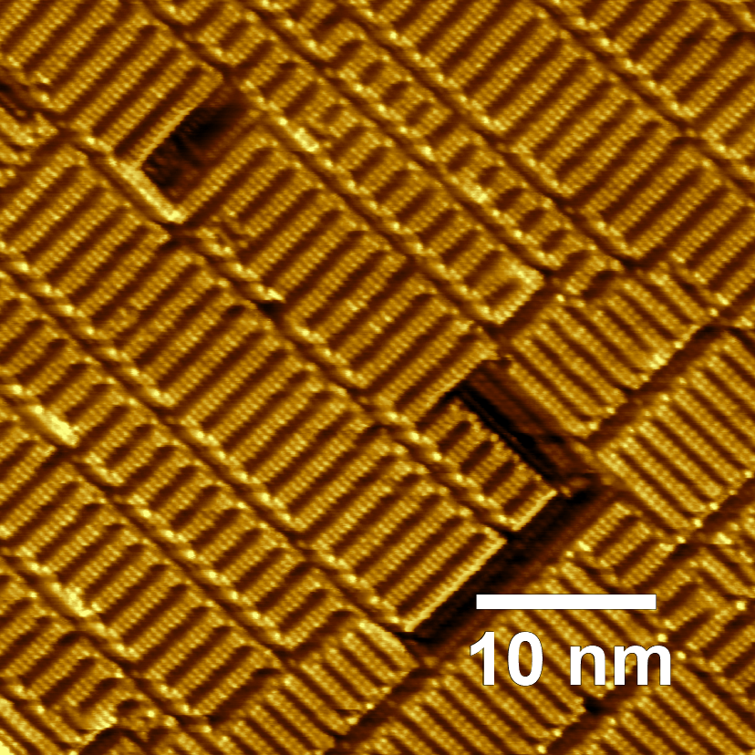
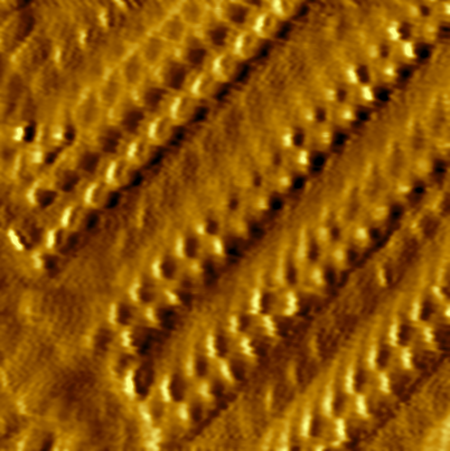
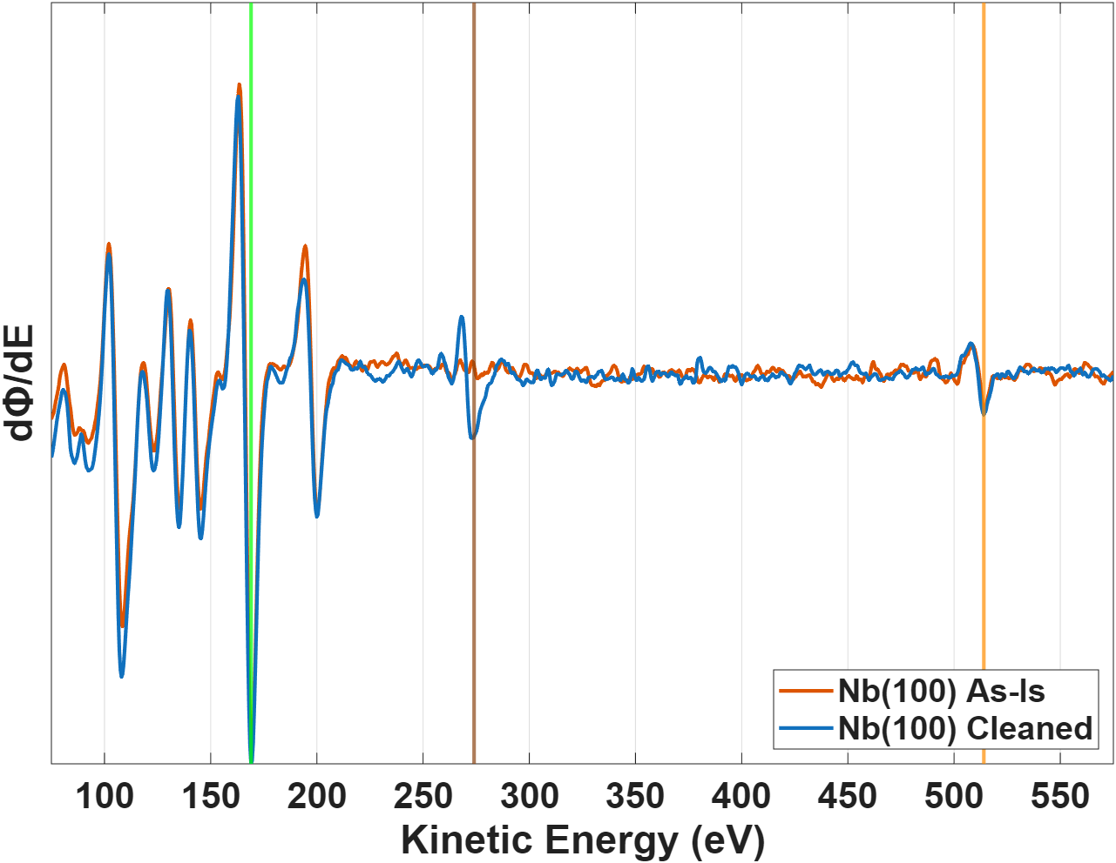
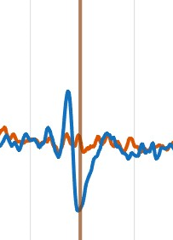
Surface preparation: Nb(100)-(3×1)O
Nb(100)-(3×1)O is created after many rounds of bombardment by 5 keV Ar⁺ and annealing at 1600 °C
AES was used to confirm surface cleanliness
(3×1)O
Nb
C
O
C
Imaged at:
10 mV, 30 pA,
room temperature

Slide 9
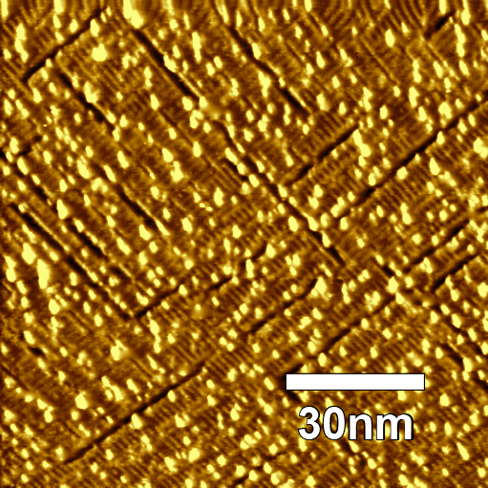
Zr deposition: e-beam evaporation
Zr was thermally evaporated in situ with an e-beam evaporator
Due to the low vapor pressure of Zr, deposition rates were <0.1 ML/min
The resulting films were composed of Zr nanoclusters ~ 2 atoms in height
Nb
Zr
Filament
High Voltage

Slide 10
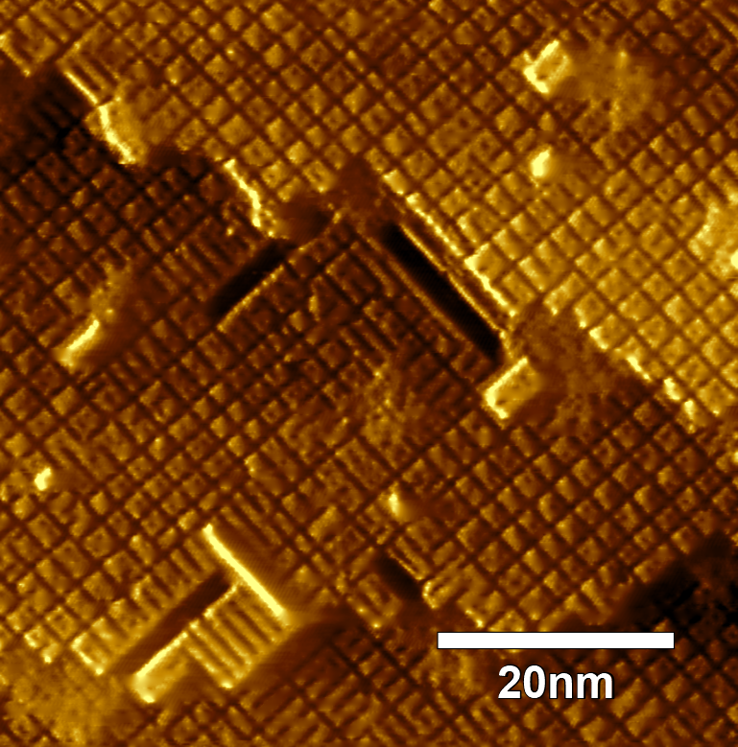
Reduction: Active in the 550-650 °C Range
Zr scavenges oxygen by forming stable ZrO_{x}
Annealing at 550-650 °C produces reduced Nb(100)-(n×m)O reconstructions
NbO
ZrO_{x}
Activated Zr scavenges oxygen from the NbO surface, forms monolayer ZrO_{x} islands, and facilitates the Nb(100)-(n×m)O reconstruction.

Slide 11
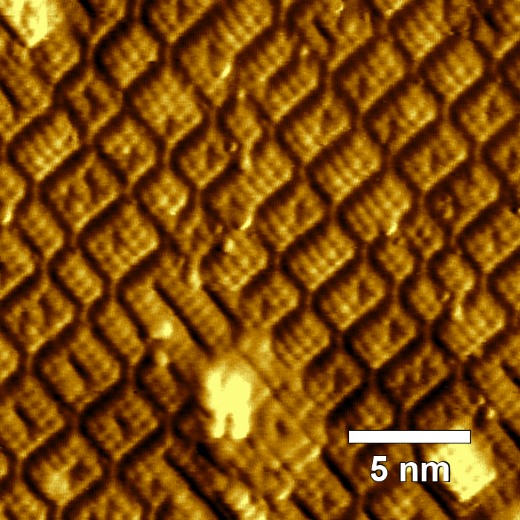
Reduction: Active in the 550-650 °C Range
Zr scavenges oxygen by forming stable ZrO_{x}
Annealing at 550-650 °C produces reduced Nb(100)-(n×m)O reconstructions
(4×5)O
Activated Zr scavenges oxygen from the NbO surface, forms monolayer ZrO_{x} islands, and facilitates the Nb(100)-(n×m)O reconstruction.
(3×5)O
(3×3)O

Slide 12
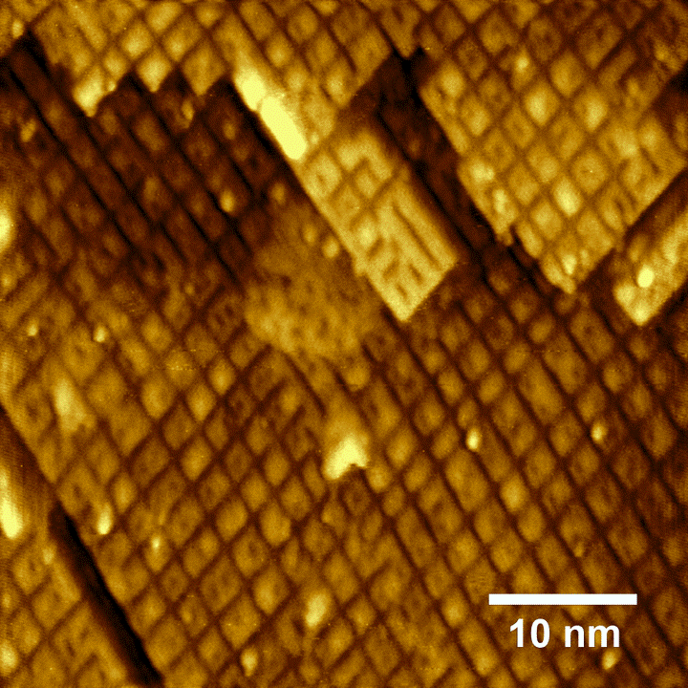
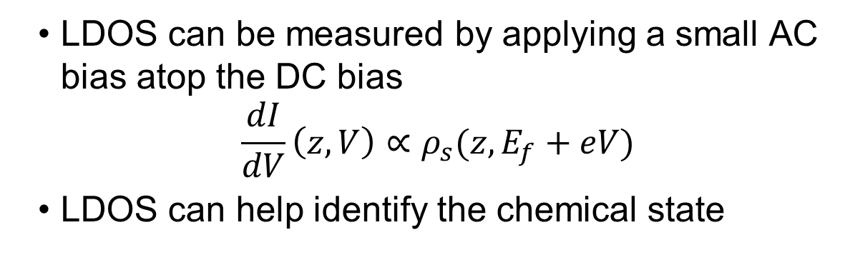
Local density of states mapping on (n×m)O
LDOS can be measured by applying a small AC bias atop the DC bias
$$\frac{dI}{dV}\left(z,V\right)∝ρ_{s}(z,E_{f}+eV)$$
LDOS can help identify the chemical state
(3×1)O
ZrO_{x}
(3×1)O
(n×m)O
Imaged at: constant height, 0.5 V, 200 mV oscillation, 40 pA

Slide 13

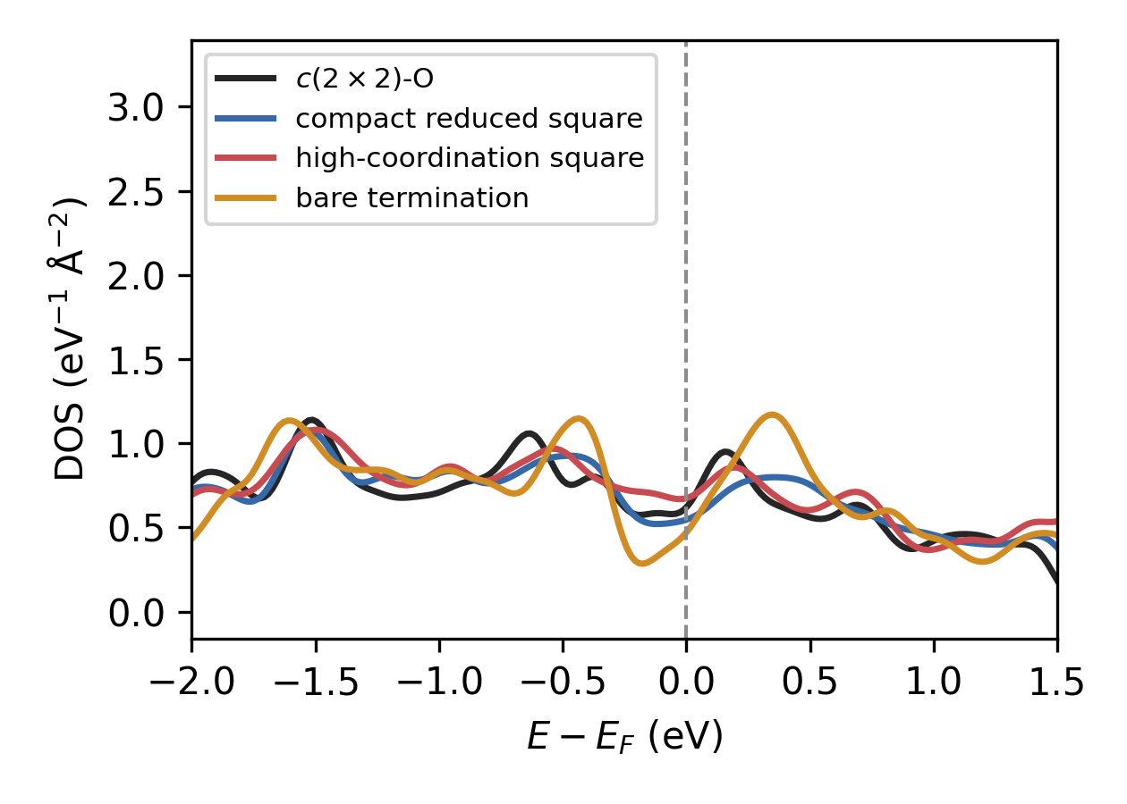
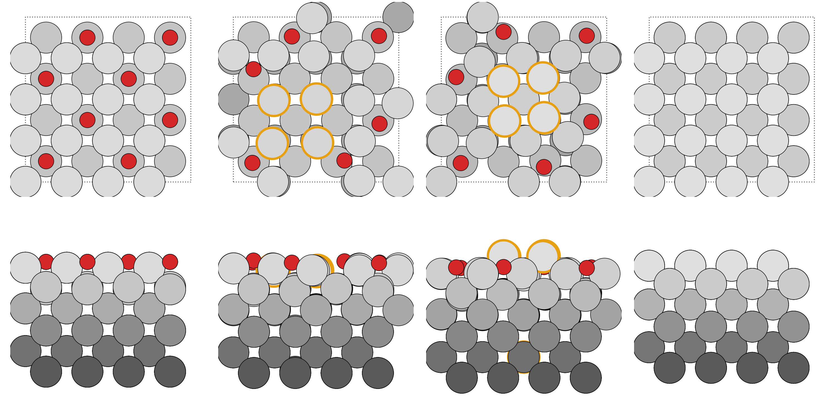
Simulated surface reconstructions
Various surface reconstructions were simulated using FairChem and validated using DFT
Simulated STM images were compared to observed surface reconstructions
Cristóbal Méndez
c(2×2)-O
(n×m)-O Compact, Reduced
(n×m)-O Highly
Coordinated
(100) Bare Termination
Top View
Side View
Nb (lighter=higher)
(n×m) motif
Oxygen

Slide 14
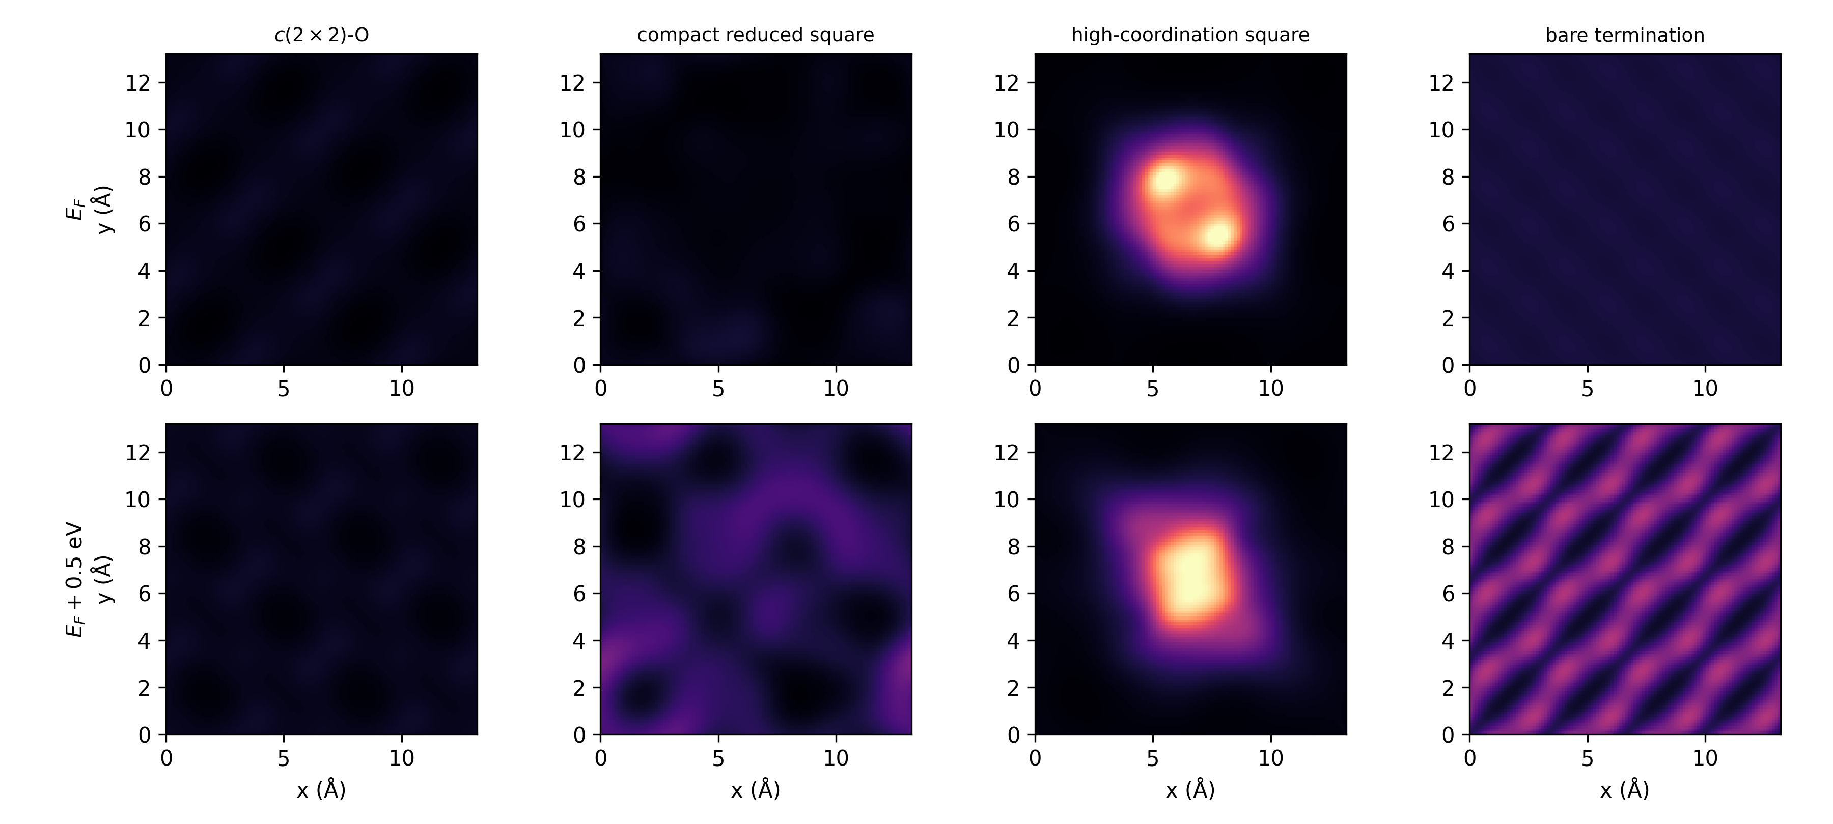
Simulated surface reconstructions
Constant-height LDOS 2 Å above the surface, ±50 meV windows
Highly coordinated (n×m)-O reconstructions are bright at both 0.5 V (used in experiments) and at the Fermi level
c(2×2)-O
(n×m)-O Compact, Reduced
(n×m)-O Highly
Coordinated
(100) Bare Termination
Cristóbal Méndez
Fermi level
0.5 V

Slide 15
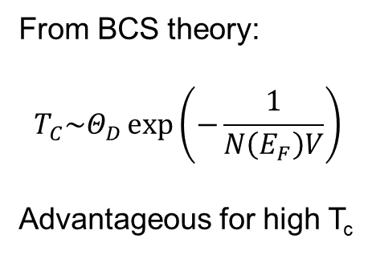
Simulated surface reconstructions
Both experiment and theory find higher LDOS in the reduced surface cells at 0.5 V
Theory shows a much high Fermi-level DOS for the reduced surface cells
Cristóbal Méndez
From BCS theory:
$$T_{C}\sim Θ_{D}\exp\left(−\frac{1}{N\left(E_{F}\right)V}\right)$$
Advantageous for high T_{c}
0.5 V
Fermi level

Slide 16
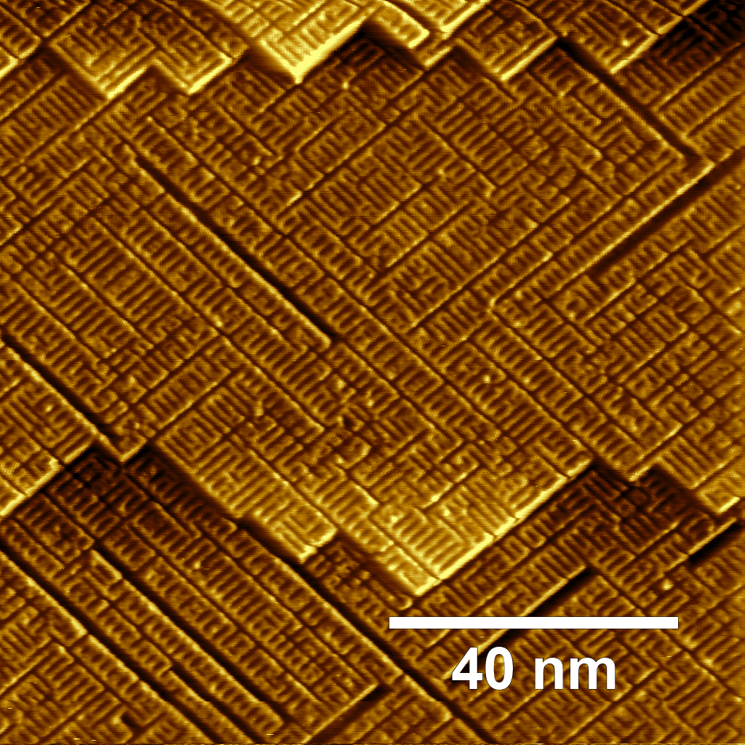
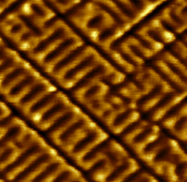
Reemergence of (3×1)O
The (n×m)O surface appears to be only metastable
At elevated temperatures, the (3×1)O surface returns
(3×1)O
Annealing at 1000 °C likely causes bulk oxygen to segregate to the surface, reversing the (n×m)O reconstruction.
(n×m)O

Slide 17
Summary
Alloy vs Surface Reconstruction: this work is not a direct comparison to early work on Zr-Nb surface alloys
What we do find: surface reduction is possible at low temperatures with Zr, but high-temperature annealing reverses it
A possible explanation:
Nb(100)-(3×1)O
Reduced
zone
Metallic Zr
ZrO_{x} formation
Oxygen segregation
A novel surface reconstruction exists in the vicinity of 600 °C, which may have important electronic properties.
ZrO_{x}

Slide 18

Acknowledgements
This work was supported by the U.S. National Science Foundation under Award PHY-1549132, the Center for Bright Beams
Thanks to our collaborators
Thanks to Steve and my groupmates
Thank you for your time!

