Slide 1
Learning Beam Dynamics
in Latent Space
Ningdong Wang · Ireanne Cao · Georg Hoffstaetter
Cornell University, Ithaca, NY
Notes:
[~0:30] Title. One sentence: a machine-learning surrogate for beam dynamics that, unlike previous surrogates, is NOT tied to one specific machine — it generalizes across lattice configurations. The punchline is real-time speed: a full trajectory in about 67 milliseconds. Introduce yourself and coauthors briefly, then move on.

Slide 2
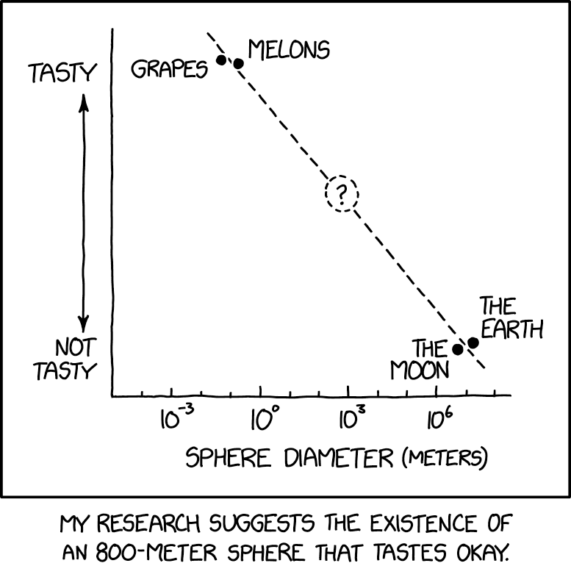
A surrogate model for speed and generality
Physics simulation codes
Existing ML surrogates
Accurate, trusted, general-purpose.
Computationally demanding. Too slow for real-time control and iterative optimization.
Large speedups over tracking, but fixed-machine.
Tied to one set of parameters; a new lattice means retraining from scratch.
The gap
No surrogate transfers across lattice configurations without retraining.
Models are learning about the machine, not generic beam dynamics.
Goal: one model that predicts through arbitrary element sequences.
Notes:
[~1:30] Frame the tradeoff. Simulation codes are accurate but slow — ruling them out for real-time control and optimization loops needing thousands of evaluations. Existing ML surrogates are fast but each is trained for ONE fixed machine. Nearest prior work — CLARM and the Latent Evolution Model — had the latent-space idea, but march along a single fixed linac. Our goal: a single model generalizing across arbitrary lattices without retraining.

Slide 3
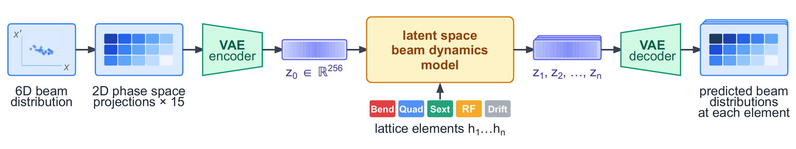
Beam dynamics as sequence-to-sequence
Encode the full 6D distribution into a compact latent vector z₀
Tokenize each lattice element as a discrete input.
Propagate z autoregressively with a causal transformer, then decode the beam at any element exit.
Notes:
[~1:30] The core diagram — spend time here. Left to right: (1) the incoming 6D beam is encoded by a VAE into a latent vector z0. (2) The lattice becomes a sequence of element tokens — the colored boxes. (3) A causal transformer rolls the latent forward, producing z1, z2, ... one per element. (4) The decoder turns any latent back into a beam. The key move vs prior work: elements are EXPLICIT TOKENS, so the same network works on any element type, order, or parameters — no retraining. And we bake in no physics equations.

Slide 4
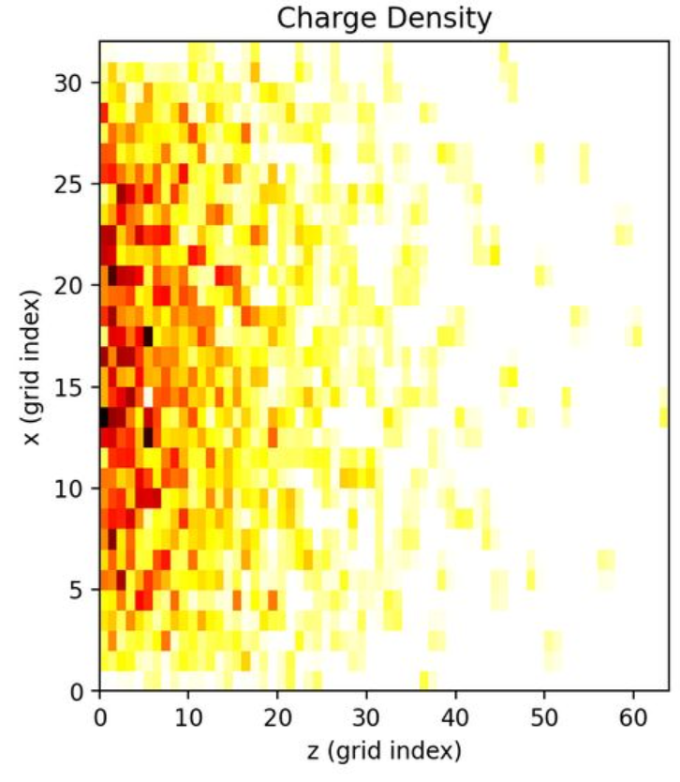
What is a beam?
A beam is N particles. Each has 6 coordinates: transverse position & angle (x, x′, y, y′) and longitudinal position & energy deviation (z, δ).
  Dimension: 6N
  Used by: particle tracking
A beam is a 6D grid of charge density. Diagnostics often projects into lower dimensions.
  Dimension: N^6
  Used by: particle-in-cell code
A beam is .
  Used by: theorists
Notes:
[~1:30] Ground the audience — most may not do beam dynamics daily. A beam is a swarm of particles; each lives in a 6-dimensional phase space. What we care about is the DISTRIBUTION over that space. A lattice is just an ordered list of magnets and cavities. The central task: given the incoming distribution, predict the outgoing distribution after each element. Point at the x–x′ blobs — one 2D slice of the 6D distribution, shearing and rotating down the line. That evolution is what we learn.

Slide 5
Encoding the beam distribution
Represent a beam by its 15 unique 2D projections of the 6D distribution. Input tensor: 15 × 64 × 64.
A convolutional variational autoencoder (VAE) encodes it to a 256-d latent vector z.
Anchor the latent with 12 physical quantities:
beam sizes σ and centroids ⟨x⟩ in all 6 coords.
Training objective
reconstruction
+ β · KL divergence (β = 1e−5)
+ γ · beam-size error
+ δ · centroid error (γ=δ=1e−4)
Notes:
[~1:30] Stage 1, the encoder. We can’t feed a raw 6D distribution to a transformer, so we compress it. Represent the beam by its 15 unique 2D projections (6-choose-2), carrying every pairwise correlation; each histogrammed to 64x64, giving a 15-channel image. A convolutional VAE squeezes that to a 256-d latent. Two choices matter: concatenate 12 physically meaningful numbers (beam sizes and centroids), and add auxiliary loss terms forcing the latent to predict them. That anchoring keeps the latent physically meaningful and smooth — which makes the downstream sequence model well-behaved. Note the tiny beta: reconstruction fidelity over a strongly Gaussian latent.

Slide 6
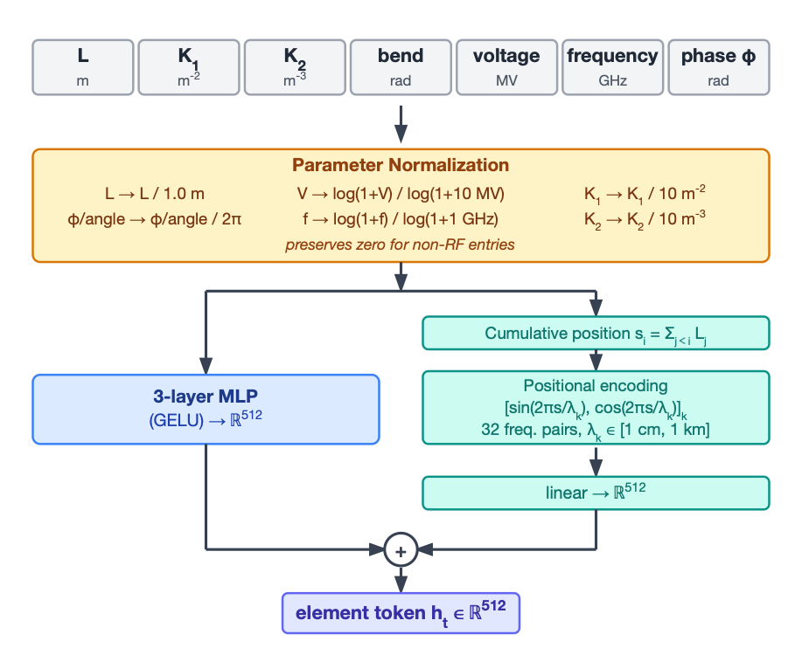
Tokenizing lattice elements
Parameters: length L, quad gradient K₁, sext gradient K₂, bend angle ϕ, and RF voltage / frequency / phase.
Normalize per parameter; RF voltage & frequency use a log(1+x) transform (huge dynamic range; zero stays zero for non-RF).
Project the vector to model width with a 3-layer MLP.
Encode position s = ΣL with a Fourier encoding from 1 cm to 1 km.
Notes:
[~1:15] Stage 2, turning a physical element into something the transformer can read. Every element — drift, quad, sext, dipole, RF — is the same 7-number vector; non-RF elements just have zeros in the RF slots. Normalize each; RF voltage/frequency span orders of magnitude so we use log(1+x), which also keeps zeros as zeros. An MLP maps to model dimension. Separately we encode WHERE the element sits — cumulative s-position — with a Fourier encoding from 1 cm to 1 km, resolving fine structure up to full machine length. The payoff: it’s open-ended — add dimensions for new element types, no architectural surgery.

Slide 7
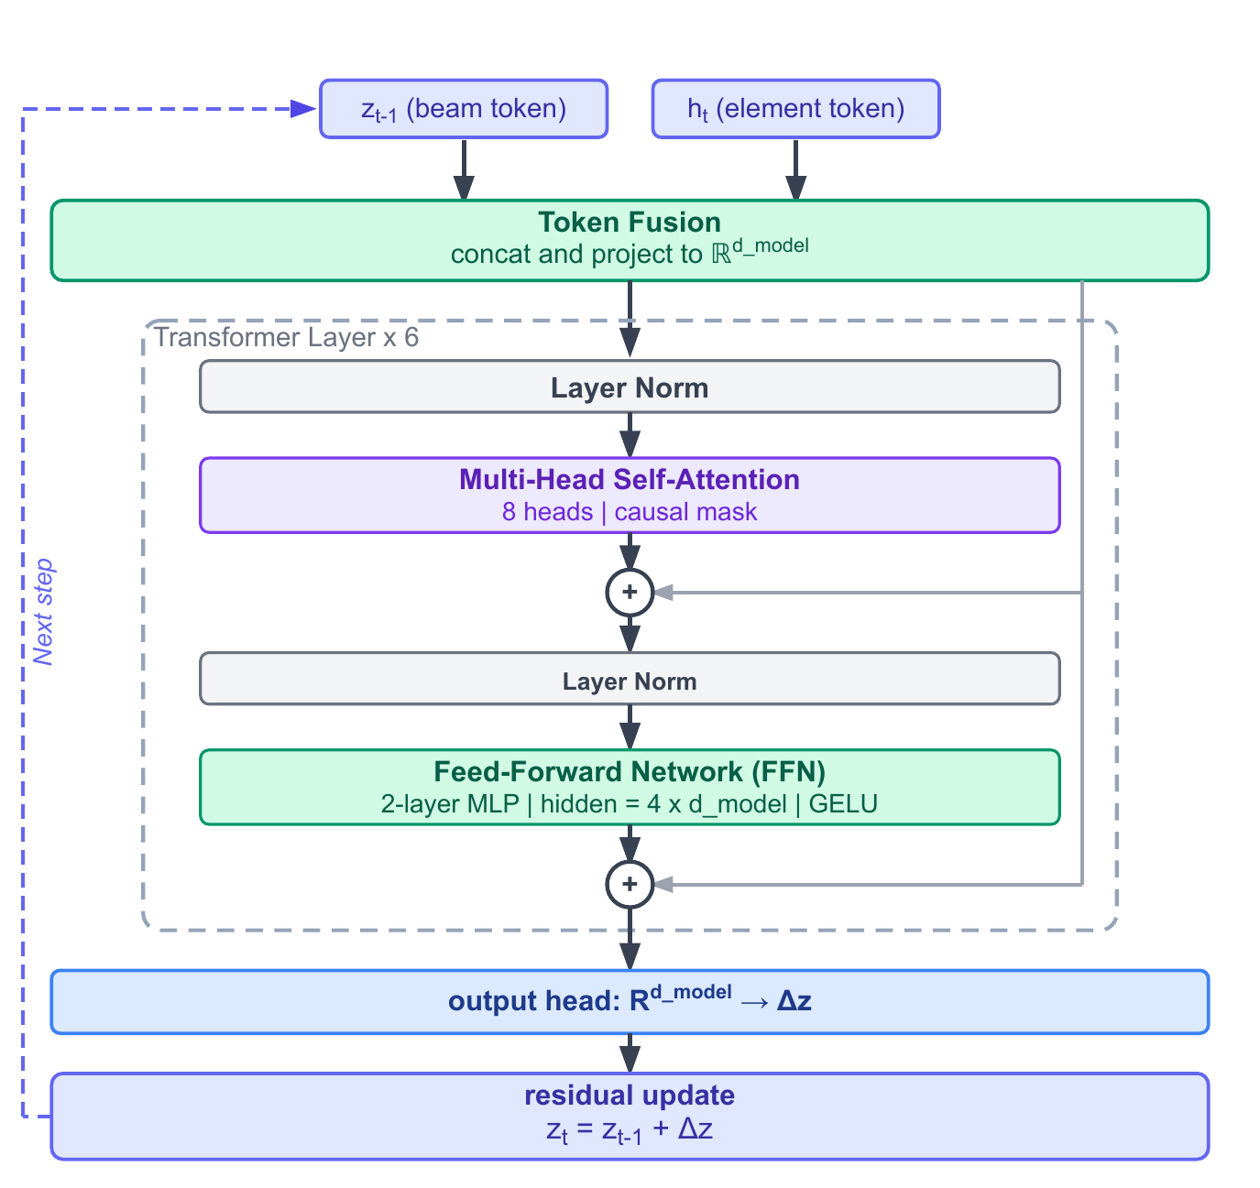
The latent dynamics model
GPT-style causal transformer: d_model = 512, 6 layers, 8 heads.
Each step: fuse the previous latent zₜ₋₁ with element token hₜ; attend causally over 0…t.
Residual update: zₜ = zₜ₋₁ + Δzₜ, a learned transfer map.
Two forward modes
Teacher-forcing (training): ground-truth zₜ₋₁ fed each step.
Autoregressive (inference): only z₀ given; all later states predicted.
Loss: MSE on the full latent trajectory z₁∶ₙ.
Notes:
[~1:30] Stage 3, the engine. A standard GPT-style causal transformer — 512 wide, 6 layers, 8 heads. At each position it fuses the previous beam latent with the current element token; a causal mask means step t sees only the past — exactly right for propagation down a beamline. Key detail: the output is a RESIDUAL update, delta-z, added to the previous latent — like a transfer map nudging the state through each element, easy to learn and numerically gentle. Two modes: teacher forcing during training (clean gradients); fully autoregressive at inference (give only z0, generate the whole trajectory). The gap between them is where error compounding lives.

Slide 8
Training data
Ground truth from tracking particles through FODO-style sectioned lattices with Bmad.
Each sample contains N = 32 elements: drifts, quadrupoles, dipoles, sextupoles, RF cavities with randomized parameters.
Random lattices are 99% of the time not stable! Imposed physical constraints to keep beams stable and beam size bounded.
Initial particles are random 6D Gaussian distributions.
This is the most difficult part.
Open question: How to efficiently generate realistic training data?
Notes:
[~0:45] Data. All ground truth comes from Bmad, a well-established tracking library — we’re distilling a trusted physics code, not inventing physics. Ten thousand lattices, each 32 elements, built from the five element types, randomized parameters for variety in strengths, orders, spacings. We impose physical stability constraints so beams don’t blow up. Be honest: this is a proof-of-concept FODO-style family, not yet a specific real machine — I’ll return to that in limitations.

Slide 9
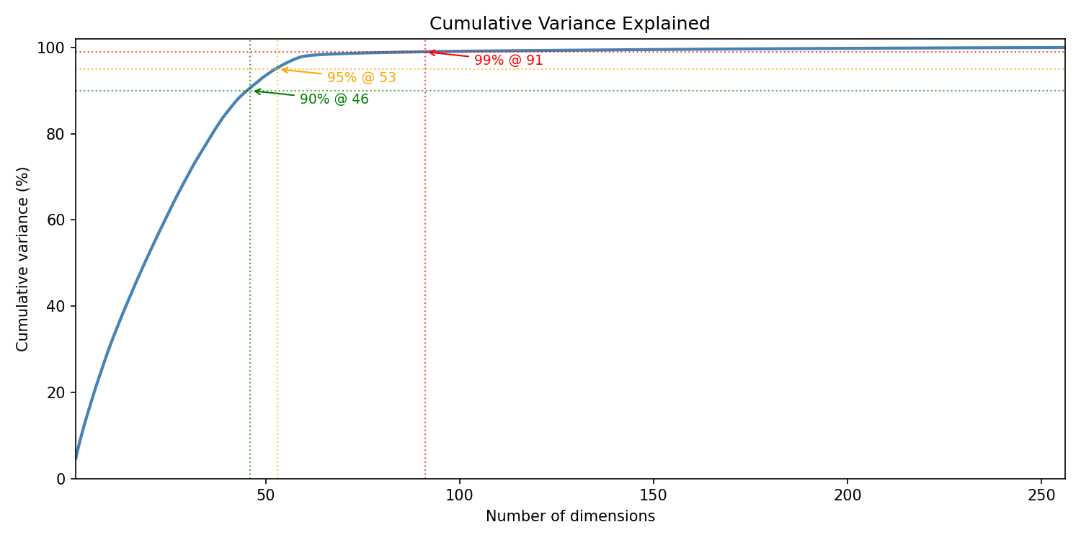
Result: The VAE encodes beams near-perfectly
The overall reconstruction loss is 2.99×10⁻⁹, and quality is consistent across projections.
Highly compressible: 46, 53, and 91 of 256 dimensions capture 90%, 95%, 99% of the posterior variance.
The beam dynamics in FODO-style lattices live on a low-dimensional manifold.
Notes:
[~1:00] First result: is the encoder any good? Emphatically yes. Physical quantities are recovered almost exactly: R-squared at least 0.9995 on all six beam sizes, essentially 1.0 on centroids, overall reconstruction MSE around 3e-9. Quality is uniform across projections — even the hardest, x–x′, with the richest transverse correlations. The striking number: although nominally 256-dimensional, only ~34 dimensions carry 90% of the variance, 41 carry 99%. So the dynamics genuinely live on a low-dimensional manifold — the reason the transformer can model the sequence efficiently.

Slide 10
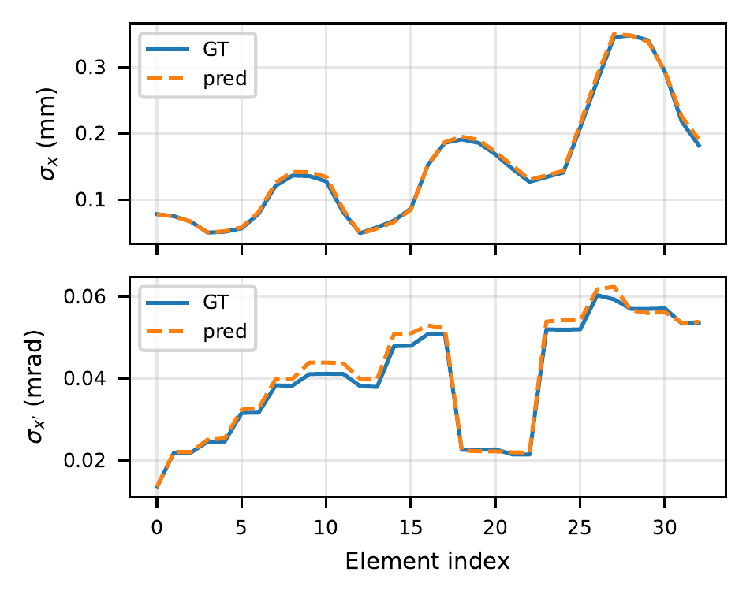
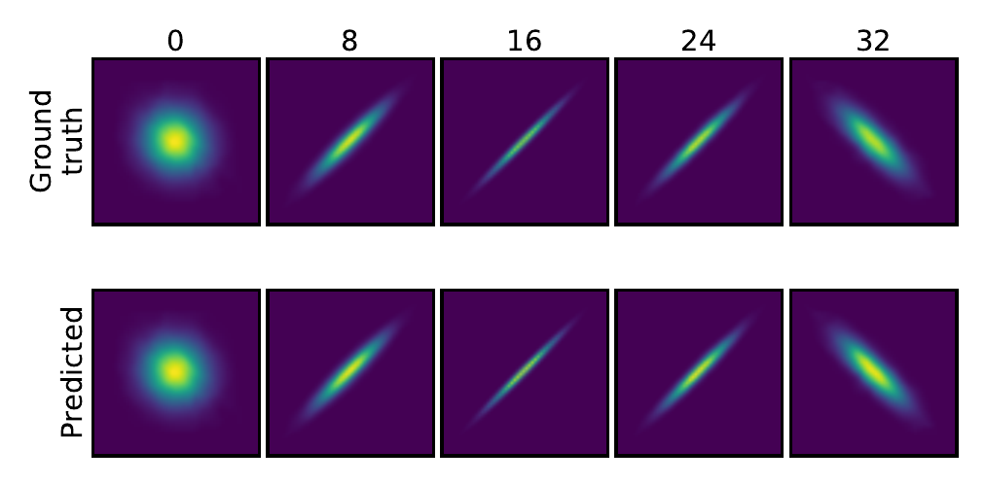
Predicting the full trajectory
Ground truth (top) vs. prediction (bottom):
x–x′ phase space at elements 0, 8, 16, 24, 32
σ_x, σ_x′ (dashed = prediction) track ground truth
Latent-space MSE
Predicted distributions are visually indistinguishable from ground truth across the lattice.
Fully autoregressive rollout from z₀ alone stays accurate over all 32 steps.
6.5e−4
4.5e−3
teacher-forcing MSE
autoregressive mean
Notes:
[~1:15] Headline result: does the whole pipeline predict trajectories? Left: a held-out lattice. Top row is Bmad ground truth, bottom row our prediction, at five points along the line — visually indistinguishable; the blob shears, thins, rotates and the model tracks it. Right: latent-space error. Teacher-forcing MSE ~6.5e-4. Fully autoregressive — the realistic setting, only the initial beam given — mean 4.5e-3. Both small. Stress the autoregressive number is the honest one: no ground truth injected mid-rollout.

Slide 11
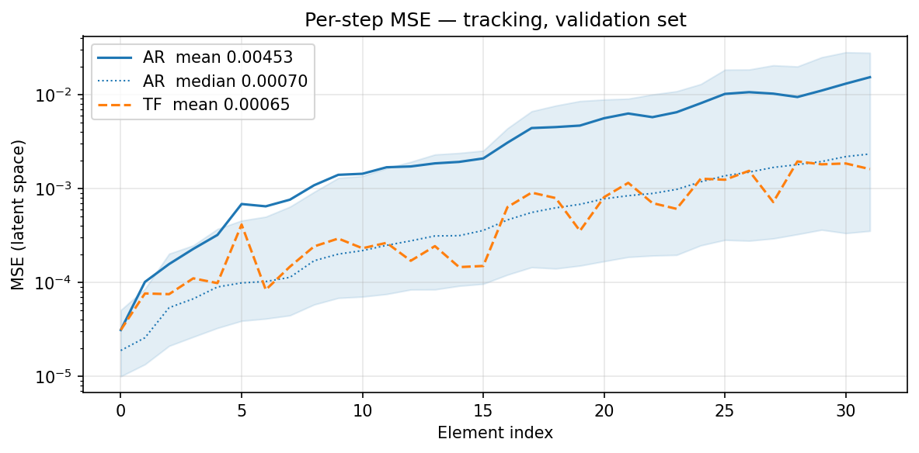
How error compounds
For typical lattices the AR median tracks the teacher-forced error closely.
The upward TF trend is a data-generation artifact. Distributions get more diverse and prediction gets harder.
The AR mean sits ~10× above the median, indicating a small tail of outliers with large errors. Mostly caused by RF.
Notes:
[~1:00] A closer look at error. Left: actual beam sizes sigma-x and sigma-x-prime — solid truth, dashed prediction — across all 32 elements, essentially on top of each other, including the focusing ups and downs. Right: per-element MSE, teacher-forced dashed vs autoregressive solid, with the 10th–90th percentile band. Two honest points: for typical lattices the AR MEDIAN hugs the teacher-forced curve — no systematic divergence; but the AR MEAN is ~10x the median — a small tail of hard trajectories where error compounds drags the average up. The gentle upward slope even in teacher forcing is a data-generation quirk. This tells us where to focus: taming the outlier tail.

Slide 12
Fast enough for real time
Component | Latency
VAE encode | 0.89 ms
VAE decode | 0.65 ms
Transformer, teacher-forced | 2.55 ms
Transformer, autoregressive (32 steps) | 66.3 ms
End-to-end | 67.8 ms
Real-time-capable regime for online control.
Bottleneck is the 32 sequential kernel launches of the AR loop, not per-step compute.
CUDA graph / KV-cache reuse would cut latency further, no architecture change.
A100-SXM4-40GB, float32, batch size 1
Notes:
[~1:00] Third result: speed — the whole point is real-time use. On one A100 the full pipeline — encode, 32-step autoregressive rollout, decode — runs in ~67 ms per trajectory. The table: encode and decode are well under a millisecond; almost all time is the autoregressive loop. Useful diagnostic: profiling shows the bottleneck is the 32 sequential KERNEL LAUNCHES, not the math per step — so standard fixes (CUDA graph capture, KV-cache reuse) would cut this further without touching the model. 67 ms already puts us in real-time territory for online control and previously-too-slow optimization loops.

Slide 13
Takeaways
Architecture: a VAE encodes the full 6D beam into a compact 256-d latent; a causal transformer propagates it through tokenized elements.
Lattice-agnostic by construction: element tokenization enables arbitrary element sequences — no retraining per machine.
Proof-of-concept on FODO lattices: near-perfect reconstruction, accurate 32-step rollout, ~67 ms end-to-end.
Model is data-limited, not capacity-limited. Room to learn collective effects!
Main limitation
Future work
Data scale & diversity: ~10k FODO-style lattices only. Generalization to different topologies and element types not yet demonstrated.
Scale training-data diversity.
Add collective effects: space charge, CSR.
Validate on a specific real machine.
Notes:
[~1:15] Wrap up. Three takeaways: the architecture (VAE latent + tokenized-element transformer); the key property (lattice-agnostic by construction, no retraining per machine); the evidence (near-perfect reconstruction, accurate 32-step AR rollout, 67-ms real-time inference on FODO lattices). Be upfront about the main limitation: proof of concept on ~10k FODO lattices; we have NOT shown generalization to qualitatively different machines or new element types. Future work: scale data diversity, fold in collective effects (space charge, CSR), and validate on a real machine.

Slide 14
Thank you
nw285@cornell.edu · Cornell University
Notes:
[~ closing] Thank the audience; put up your email and invite questions. Leave ~1–2 minutes for Q&A. Likely questions: why not just track (speed + differentiable surrogate for optimization); how does it extrapolate beyond FODO (open question — future work); the outlier tail on slide 11.

