Slide 1

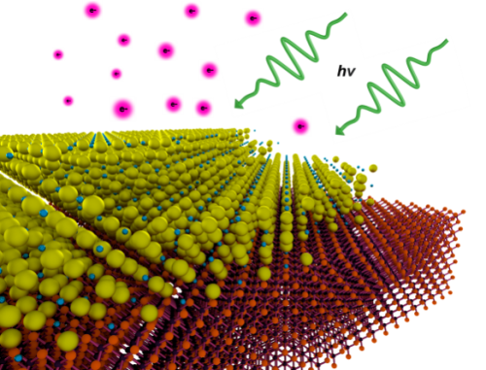
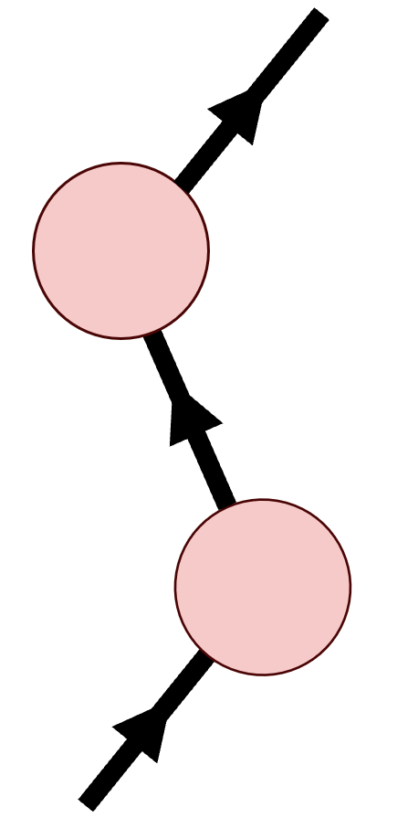
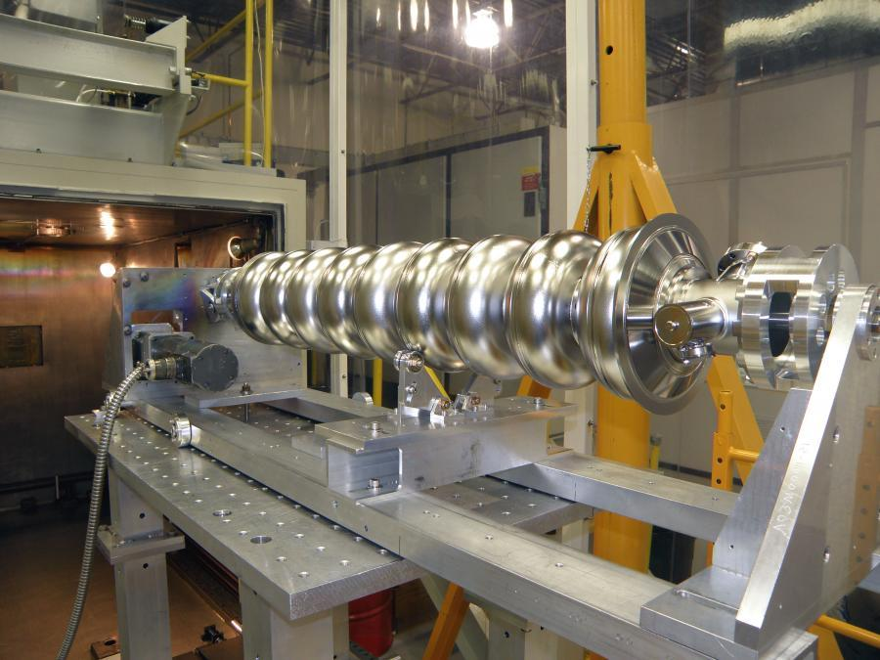
Exact Ab Initio Scattering for Photocathode and SRF Development
Tyler Wu¹, Cristóbal Méndez², J. K. Nangoi^{1,3}, Tomás Arias¹
¹Department of Physics, Cornell University, Ithaca, New York 14853, USA
²School of Applied and Engineering Physics, Cornell University, Ithaca, New York 14853, USA
³Materials Department, University of California, Santa Barbara, California 93106, USA
Notes:
Scattering theory is critical in all aspects of accelerator physics, which is why I’m very excited to go over our new work on ab initio theory for photocathodes and SRF cavities.

Slide 2
Talk Outline
Theme 1 Photocathodes: Ab initio one-step theory via time-reversed LEED states
Motivation
Theory
Ag 111 results
Theme 2 SRF Cavities: Exact helium atom scattering (HAS) states
HAS Motivation
Lippmann-Schwinger theory
Elastic and inelastic HAS results

Slide 3
Talk Outline
Theme 1 Photocathodes: Ab initio one-step theory via time-reversed LEED states
Motivation
Theory
Ag 111 results
Theme 2 SRF Cavities: Exact helium atom scattering (HAS) states
HAS Motivation
Lippmann-Schwinger theory
Elastic and inelastic HAS results

Slide 4
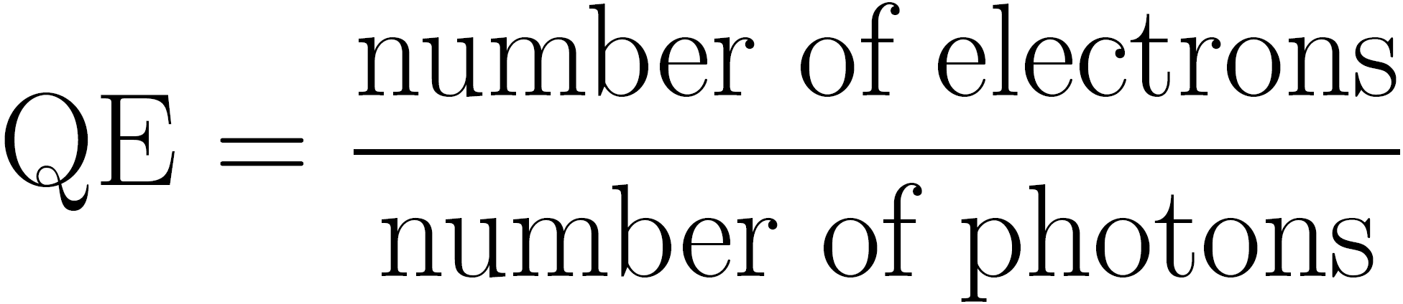

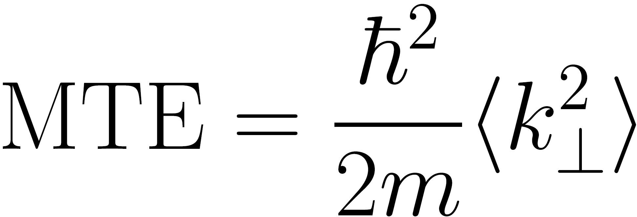
Motivation: Bright Electron Sources
Electron beams enable technologies like electron microscopy and accelerators
Performance is set by the brightness of the emitted beam
  Quantum efficiency (QE): electrons out/photons in
  Mean transverse energy (MTE): ~transverse spread
Key challenge: achieving high emission without degrading beam width
Quick materials screening enabled by first-principles calculations
Laser
Laser
High QE
Low MTE
Low QE
High MTE
Photocathode
Photocathode
Notes:
First-principles calculations enable quick screening for new materials search

Slide 5
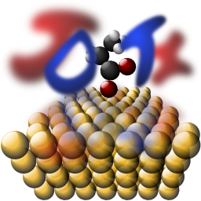
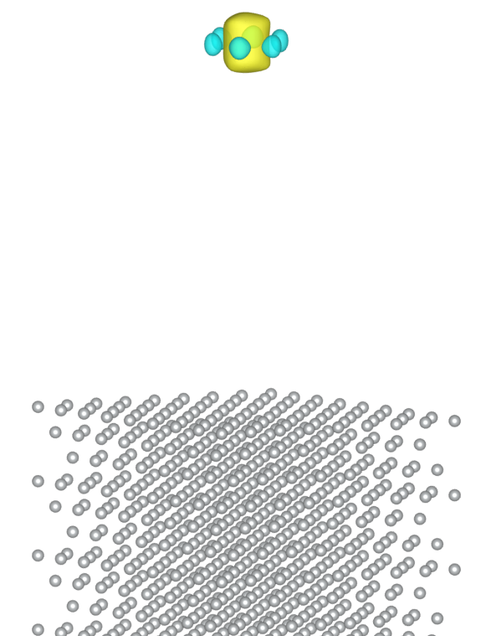
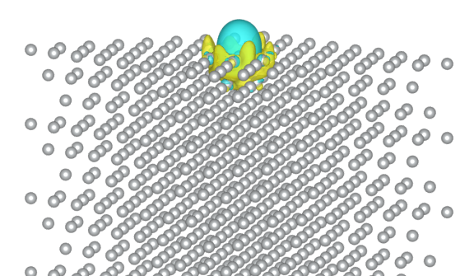

Theory ingredients
Ab initio calculation requires several key ingredients:
Plane wave DFT code
Wannier-based Green’s function scattering states
  Vacuum Wannier functions provide a localized first-principles basis for constructing scattering states at solid–vacuum interfaces (Wu and Arias, arXiv:2603.14105, 2026).
Inelastic electron scattering
vacuum
surface
Notes:
Mention efficiency in plane wave code due to convenience of FFTs!
Wannier based scattering states enabled by VWFs. Want credit!

Slide 6
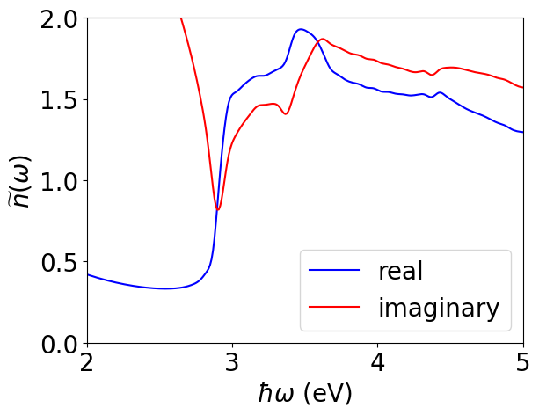

Transition matrix elements
Electrons in the material feel an attenuated field controlled by the refractive index
  Fresnel equations
  Ab initio refractive index
Light-matter interaction
Ag(111)
Typical term
Surface sensitive term
Notes:
Not discontinuous, but rapidly varying

Slide 7
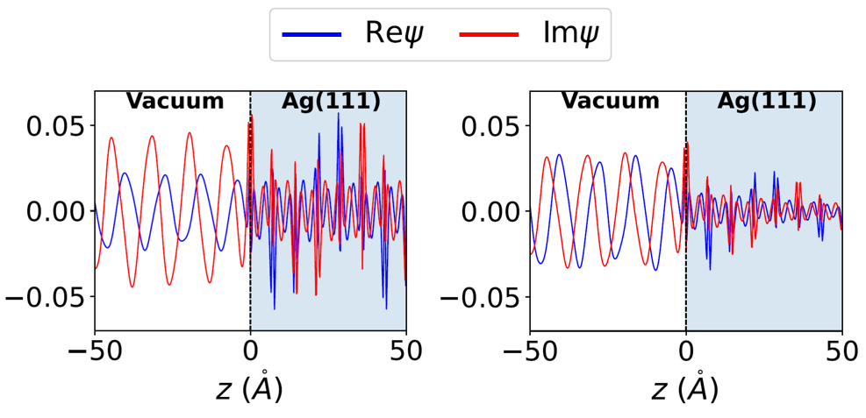
Ag(111) Inverse LEED states
Real-space representation
Imaginary self energy exponentially attenuates the inverse LEED states
Near-threshold inelastic mean free path (IMFP) is about 2.3 nm
Phonon self energy is 10x smaller than the e-e contribution
Notes:
Get rid of a and c

Slide 8

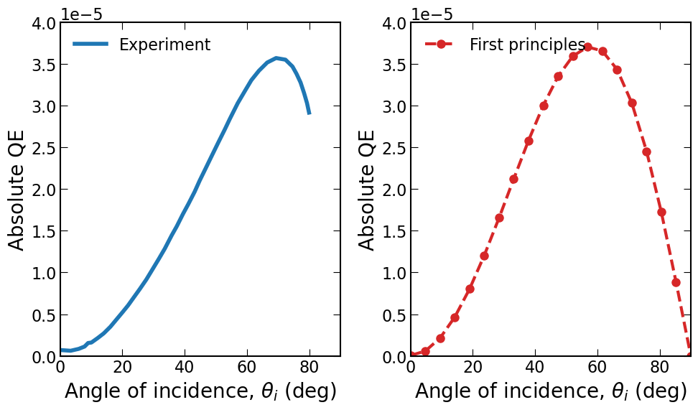
Ag(111) vectorial effect
Overall scale for absolute QE is very good
Peaks in correct locations
Ag(111)
Notes:
Change legend from This work to ab initio
Stress absolute

Slide 9
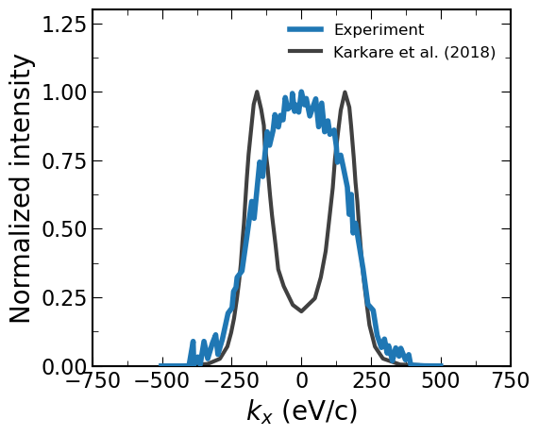
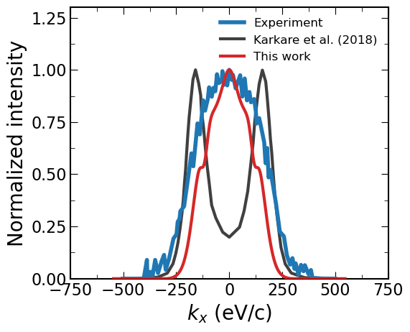
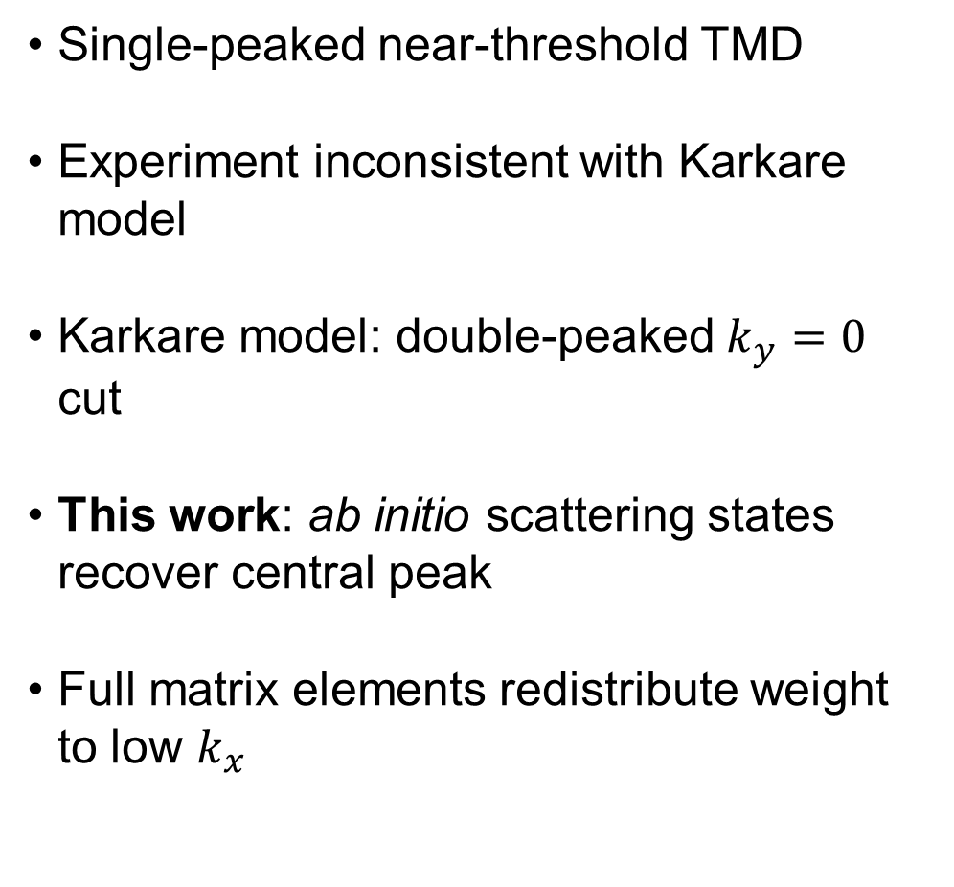
Ag(111) transverse momentum distributions
Single-peaked near-threshold TMD
Experiment inconsistent with Karkare model
Karkare model: double-peaked $k_{y}=0$ cut
This work: ab initio scattering states recover central peak
Full matrix elements redistribute weight to low $k_{x}$
Ag(111)
Notes:
Get rid of the zero points

Slide 10
Talk Outline
Theme 1 Photocathodes: Ab initio one-step theory via time-reversed LEED states
Motivation
Theory
Ag 111 results
Theme 2 SRF Cavities: Exact helium atom scattering (HAS) states
HAS Motivation
Lippmann-Schwinger theory
Elastic and inelastic HAS results

Slide 11
Talk Outline
Theme 1 Photocathodes: Ab initio one-step theory via time-reversed LEED states
Motivation
Theory
Ag 111 results
Theme 2 SRF Cavities: Exact helium atom scattering (HAS) states
HAS Motivation
Lippmann-Schwinger theory
Elastic and inelastic HAS results

Slide 12
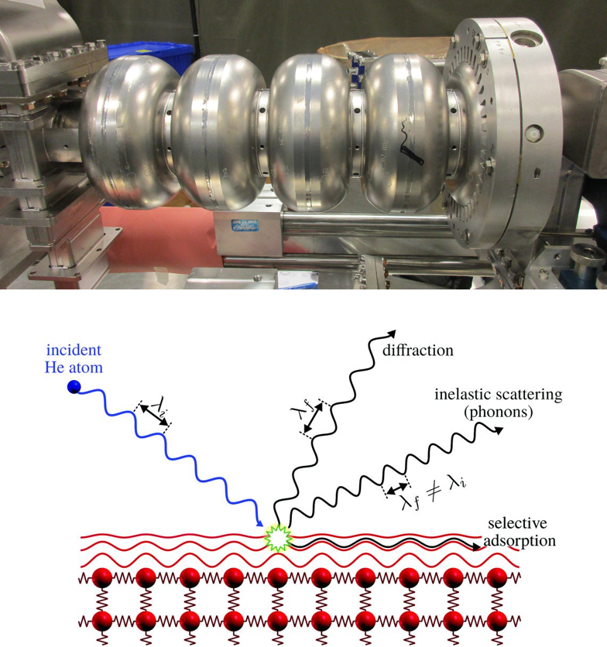
Motivation: Helium-atom scattering
SRF cavity performance limited by Nb surface quality
Surface oxides, adsorbates, defects, and reconstructions
HAS as a non-destructive probe of outermost surface structure and e-ph coupling
First-principles scattering theory for microscopic interpretation

Slide 13
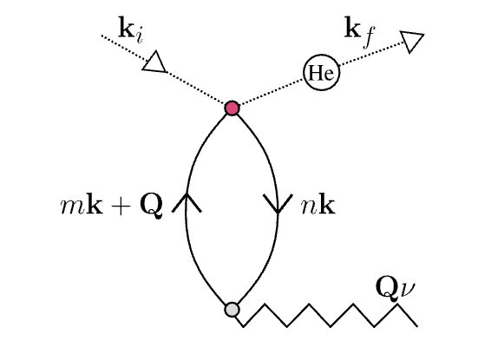
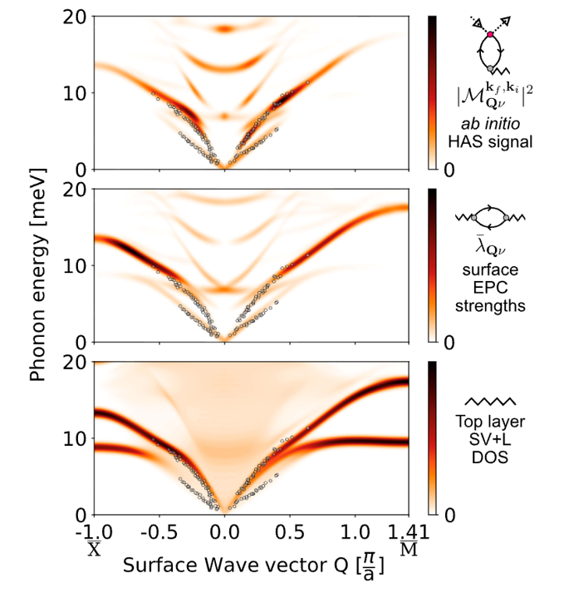
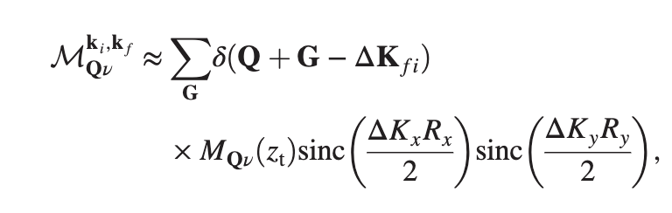
Current ab initio inelastic HAS theory
Inelastic HAS: one-phonon scattering from DFT He–electron vertex
Figure adapted from M. M. Kelley, R. Sundararaman, and T. A. Arias, Phys. Rev. Lett. 132, 016203 (2024).
Scattering state approximation
Notes:
Only keep top panel

Slide 14
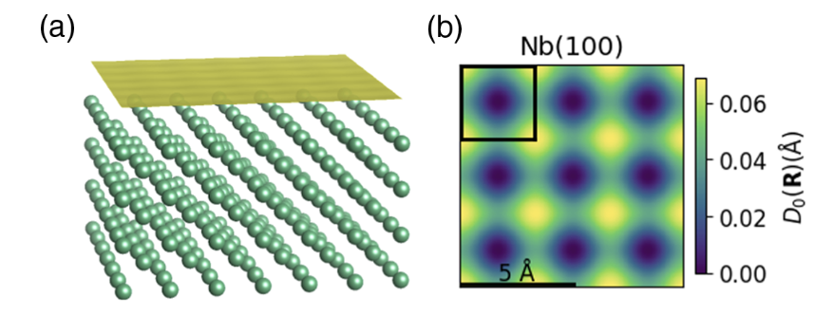
Current ab initio elastic HAS theory
Debye–Waller attenuation from surface phonons and hard-wall scattering
Shared approximation: simplified He scattering states
Missing ingredient: exact elastic wave functions and diffraction channels
Adapted from C. Méndez, C. J. Thompson, M. F. Van Duinen, S. J. Sibener, and T. A. Arias, Phys. Rev. Lett. 135, 196201 (2025).
Notes:
Old method uses electron density to define contour for hard wall scattering approximation
Delete plot

Slide 15


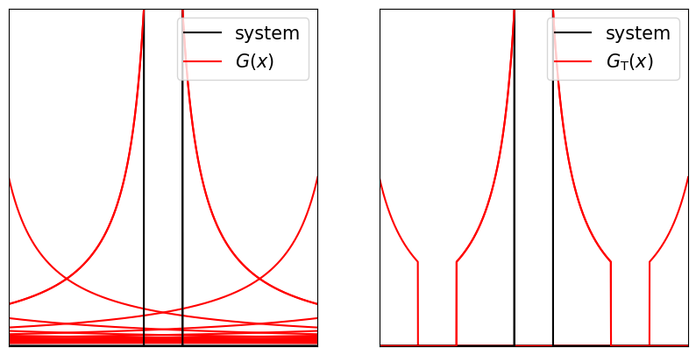
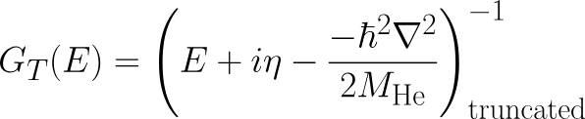

Missing piece: exact scattering state
Incident He plane wave as source
DFT He–surface potential as scatterer
Truncated Green’s function for open-boundary propagation
Krylov solve for exact elastic scattering state
Notes:
Artificial image effects from interactions with periodic copies

Slide 16
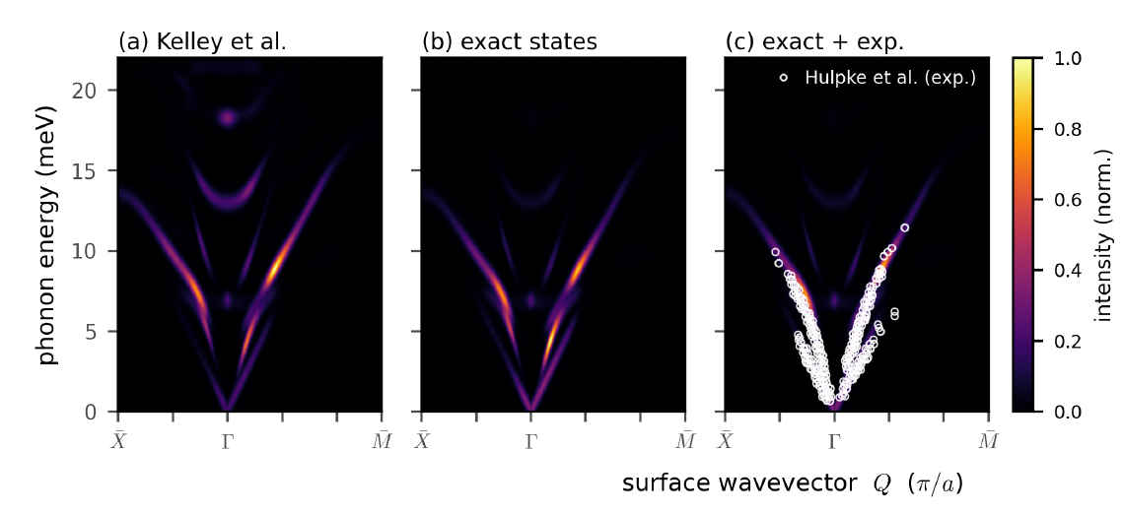
New inelastic intensities
Lowered intensities from optical phonon branches
Excellent agreement with experiment
Notes:
Reveal the figures one by one
Remove d

Slide 17
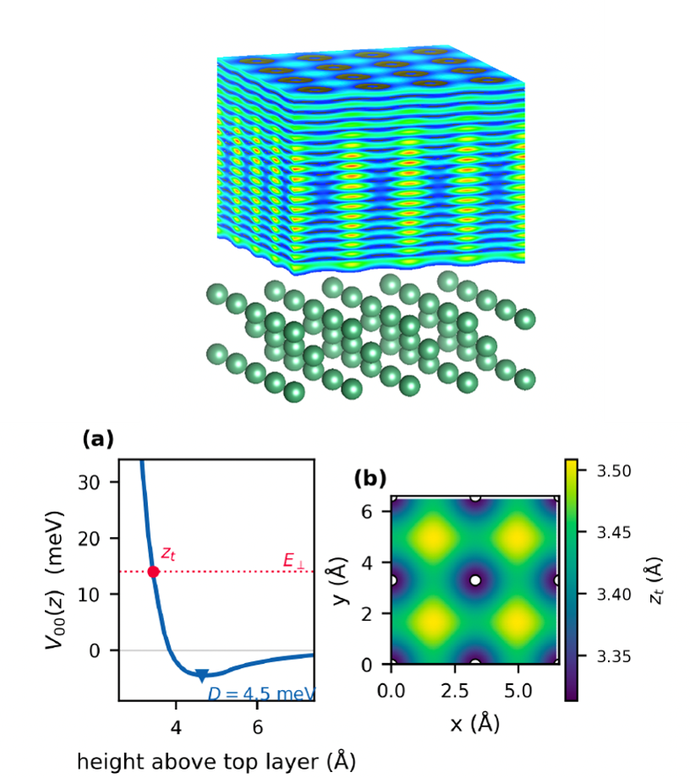
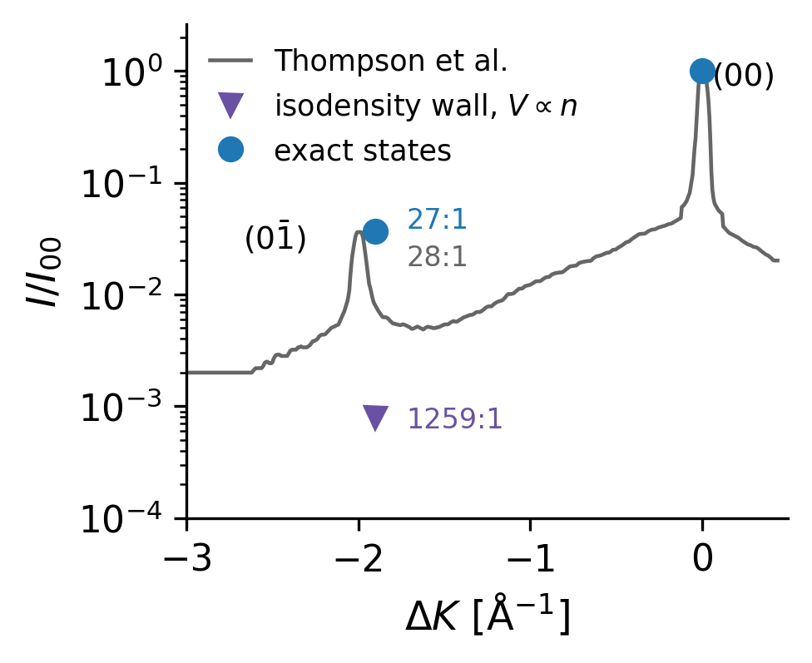
Exact elastic He scattering
DFT-constructed He–Nb(100) potential: SCAN + vdW corrections
Realistic surface physics: Beeby well depth and anti-corrugation
Exact elastically scattered He wave functions
New elastic observables: Bragg peaks beyond specular reflection
Notes:
DFT potential is also a new feature!
Specular means G=0
Old method incapable for Bragg peaks
Thompson is a former CBBer

Slide 18
References
T. Wu and T. A. Arias, “Vacuum Wannier Functions for First-Principles Scattering and Photoemission,” arXiv:2603.14105 [cond-mat.mtrl-sci] (2026). DOI: 10.48550/arXiv.2603.14105.
M. M. Kelley, R. Sundararaman, and T. A. Arias, “Fully Ab Initio Approach to Inelastic Atom-Surface Scattering,” Physical Review Letters 132, 016203 (2024). DOI: 10.1103/PhysRevLett.132.016203.
C. Méndez, C. J. Thompson, M. F. Van Duinen, S. J. Sibener, and T. A. Arias, “Ab Initio Electron-Phonon-Coupling Theory of Elastic Helium-Atom Scattering,” Physical Review Letters 135, 196201 (2025). DOI: 10.1103/mcgg-8hk8.

