Slide 1
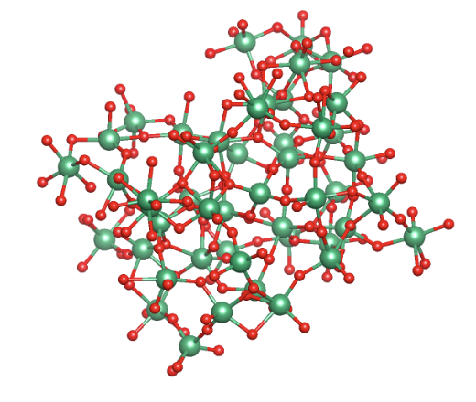
Ab initio modeling of two-level systems in amorphous niobium oxide
Cristóbal Méndez, Tomás Arias
PhD candidate, Cornell University
CBB annual meeting 2026

Slide 2
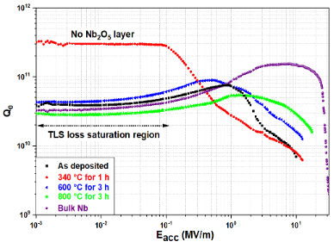
Why TLS in Nb for SRF?
Low-field region
High-field region
Without Nb2O5
With Nb2O5
If we want better SRF cavities, we need to understand and control material loss in Nb.

Slide 3
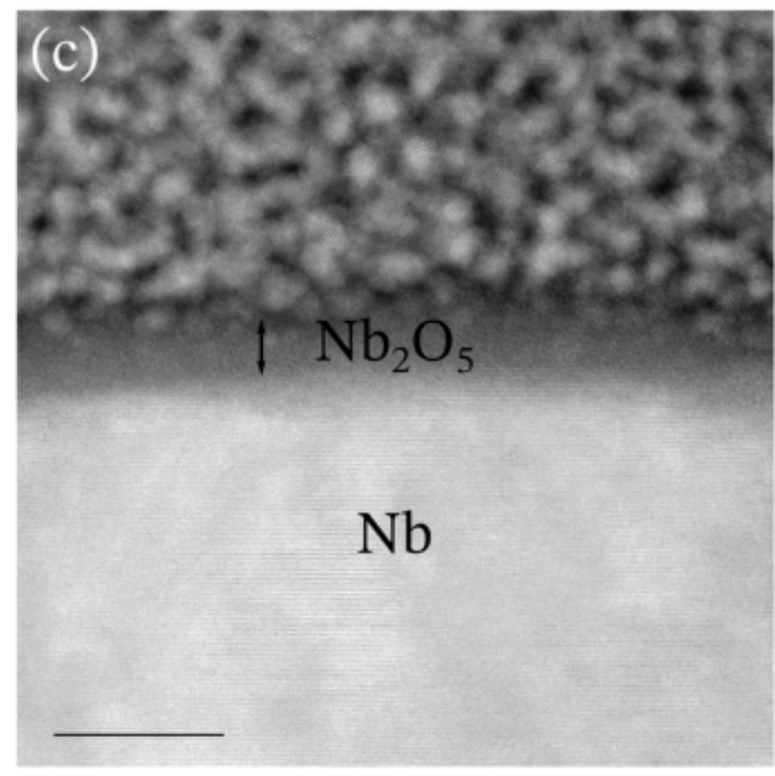
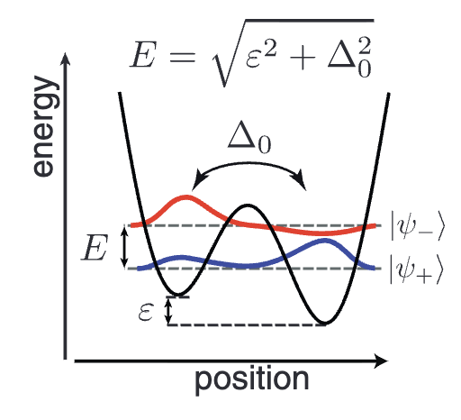
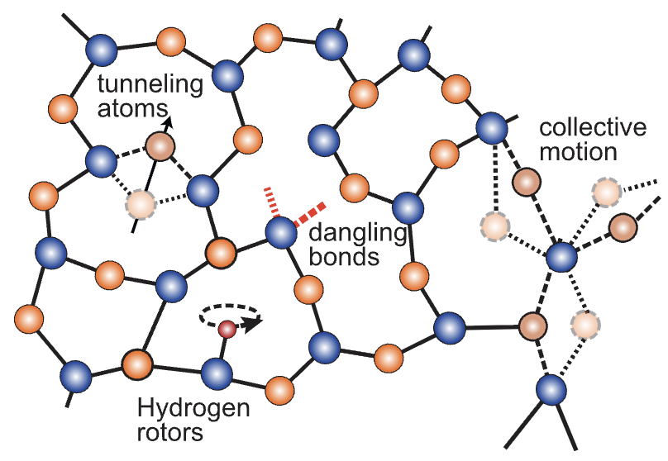
What are two-level systems (TLS)?
Atomic-scale defects in disordered oxides/interfaces
Two-level systems (TLS): Two nearly equivalent configurations
Quantum tunneling between the two states
Couple to microwave fields via their dipole moments

Slide 4

What is the microscopic origin of TLS loss in Nb oxide?
The microscopic origin of TLS loss is still unknown
Many mechanisms can produce similar signatures
In Nb and Ta oxides, experiments consistently show that TLS loss:
  increases with amorphous disorder — Oh et al., ACS Nano (2024)
  is strongest in the pentoxide — Ganesan et al., arXiv (2026)
  correlates with oxygen vacancies — Bafia et al., Phys. Rev. Applied (2024)
  is higher in Nb oxide than in Ta oxide — Goronzy et al., arXiv (2025)
Notes:
Say that I’m going to show a defect that does all 4 of these

Slide 5
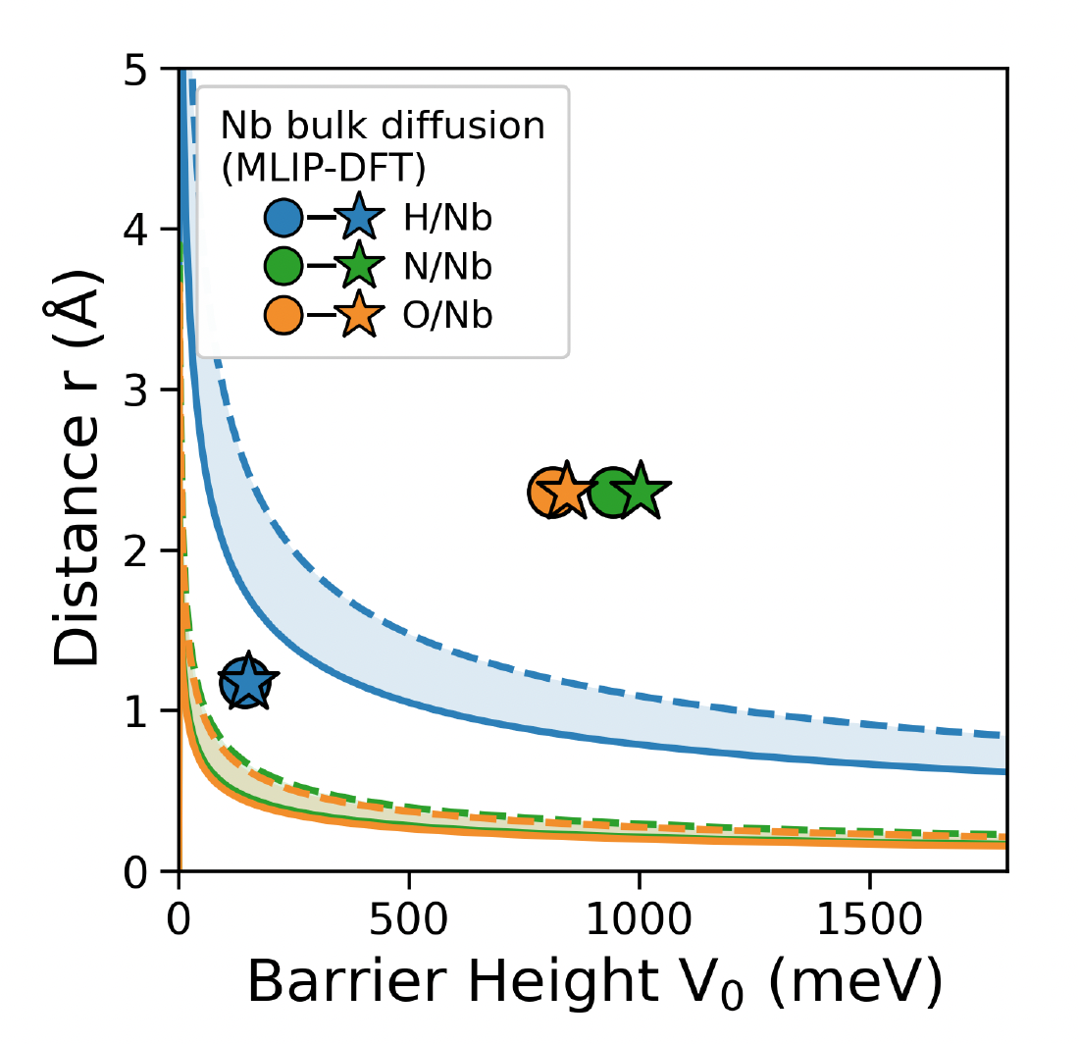
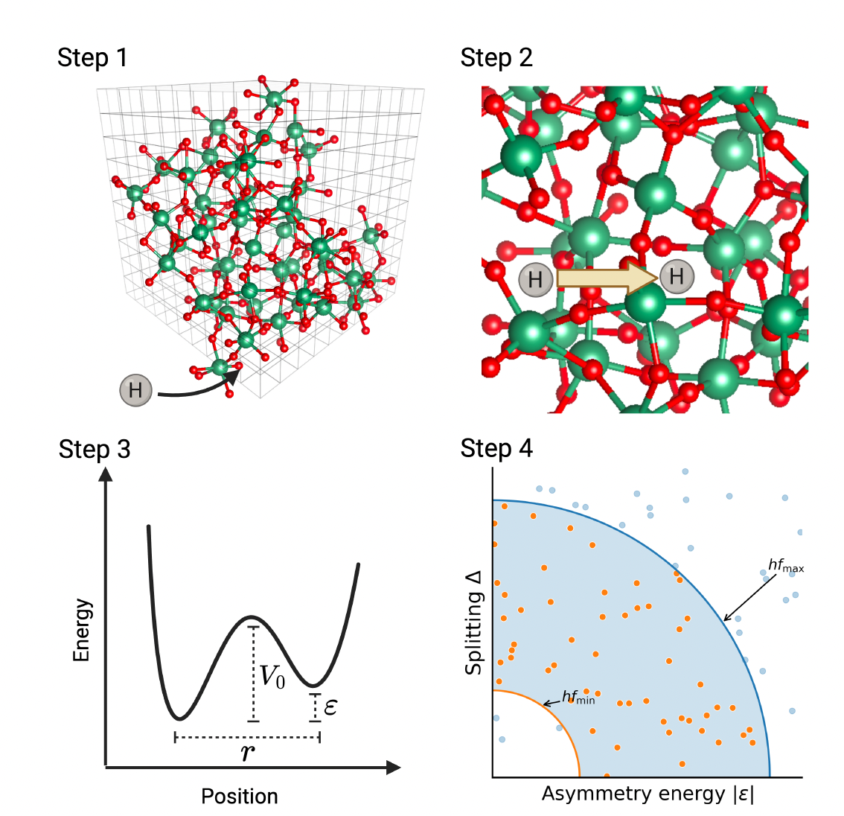
Potential tunneling species?
The usual suspects: H, N and O.
In Nb bulk:
GHz region

Slide 6
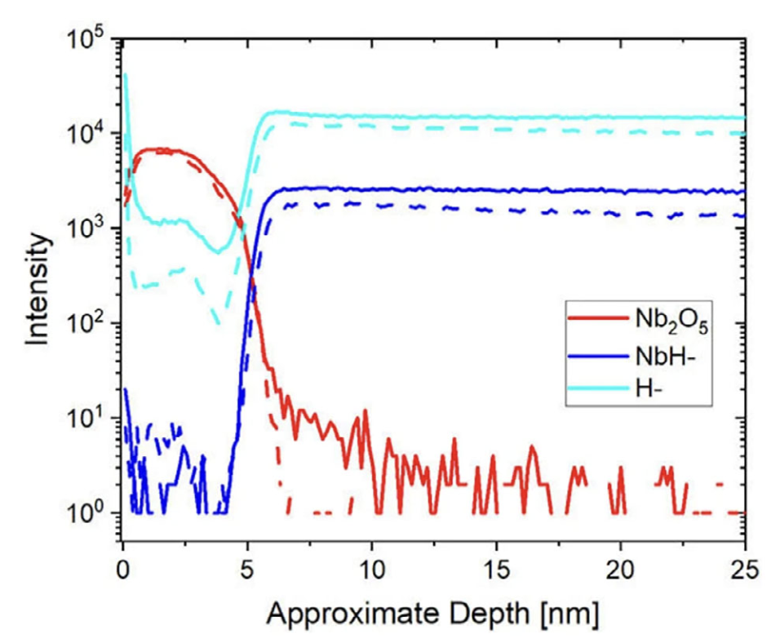
Hydrogen as a TLS candidate
Incorporates under ambient conditions
Interacts strongly with oxygen vacancies
Small mass ⇒ quantum tunneling
Depth profile from SIMS
H is a strong TLS candidate, but:
Really hard to see in STEM
We must ID an ensemble of defects
Notes:
Add a text saying the method of the plot

Slide 7
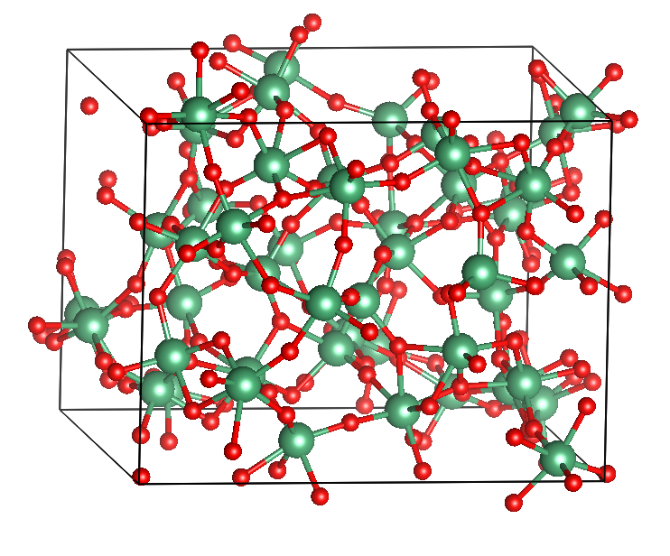
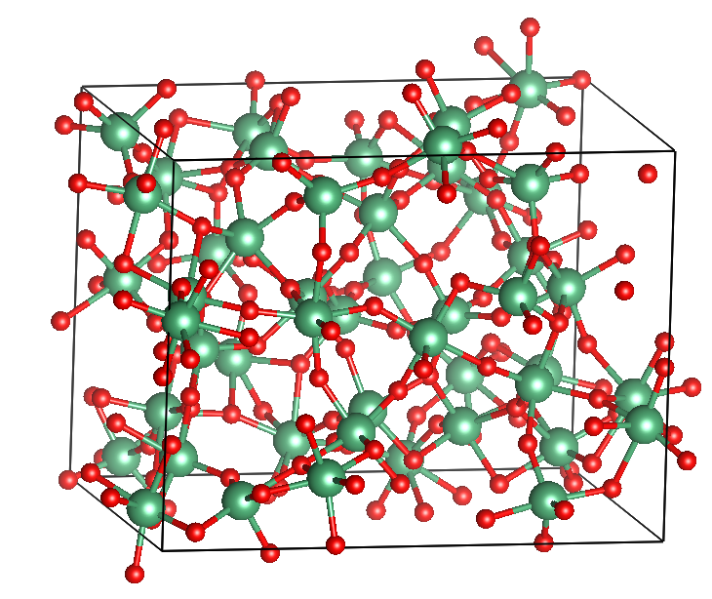
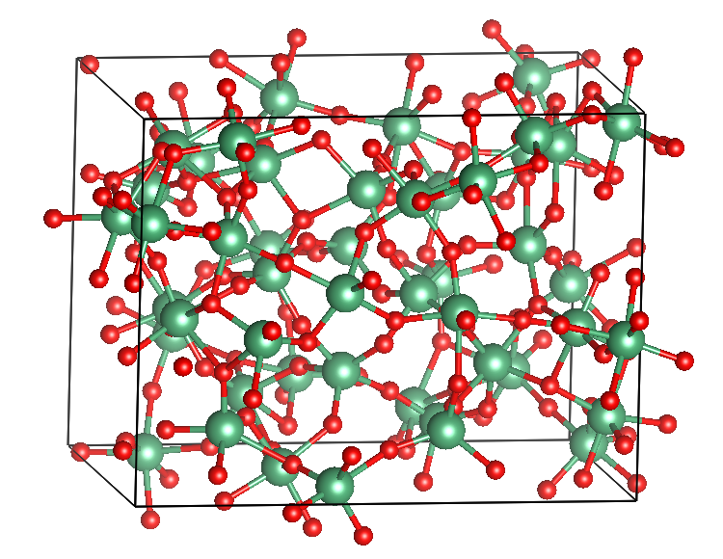
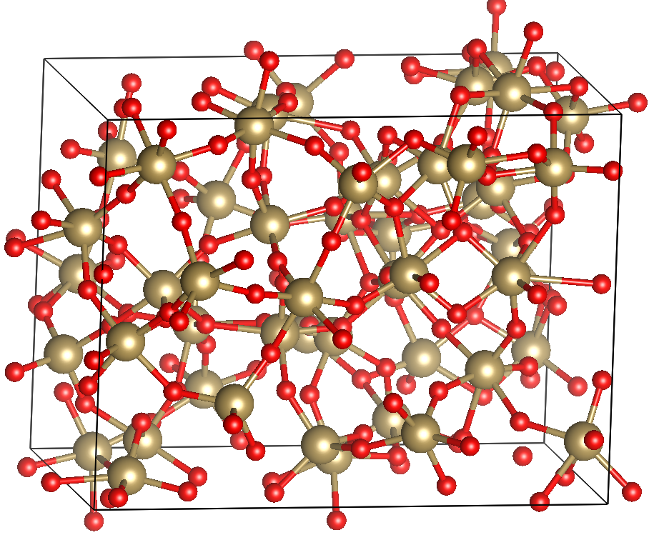
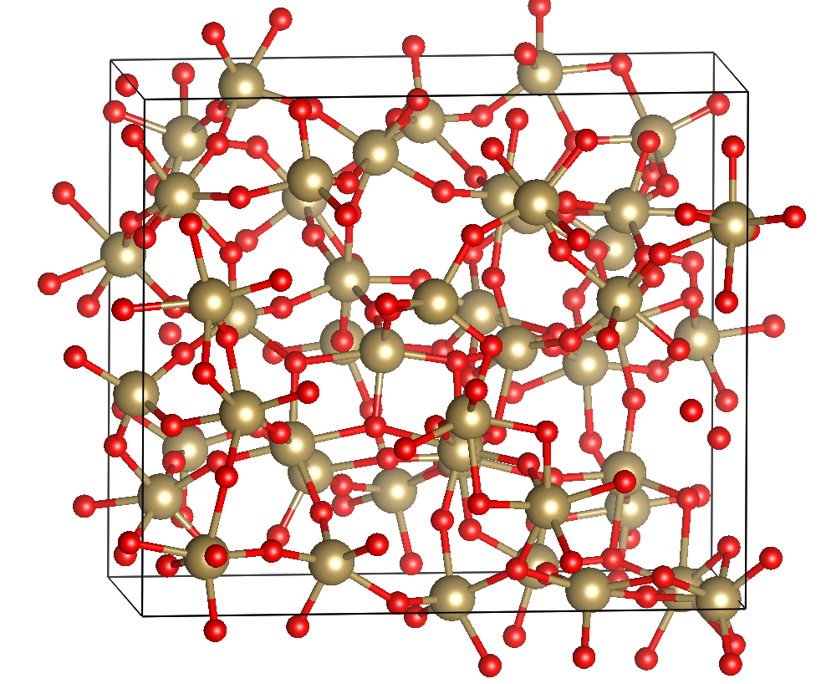
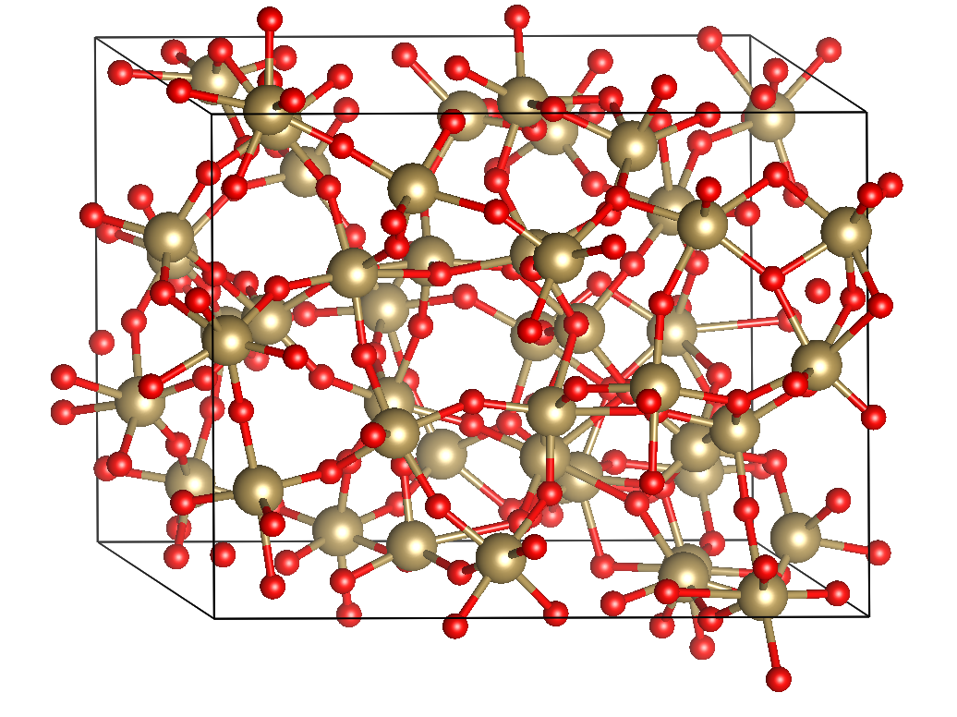
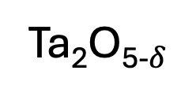
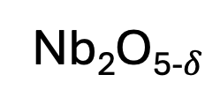
Our computational method
Start with 98 amorphous structures from Pritchard and Rondinelli (2025)
Use machine-learning interatomic potentials (MLIPs) for high-throughput screening of TLS candidates
(Done follow up DFT verification)
Nb₂O₅₋$δ$
…
Ta₂O₅₋$δ$
…
Notes:
Replace first bulletpoint with more pictures and … to 98

Slide 8
Our computational method
Fine-grid search for stable H locations
Locate neighboring pairs of minima
Compute tunneling profiles (Minimum energy path, NEB)
Statistical analysis on ensemble

Slide 9
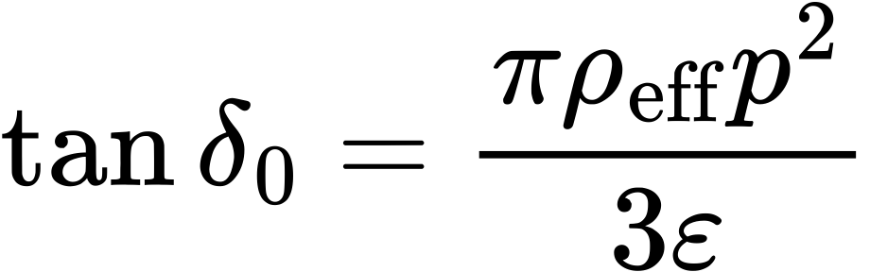
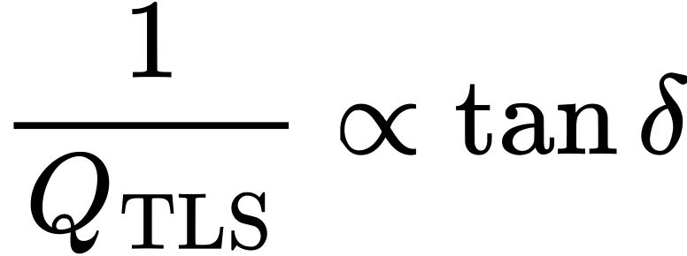
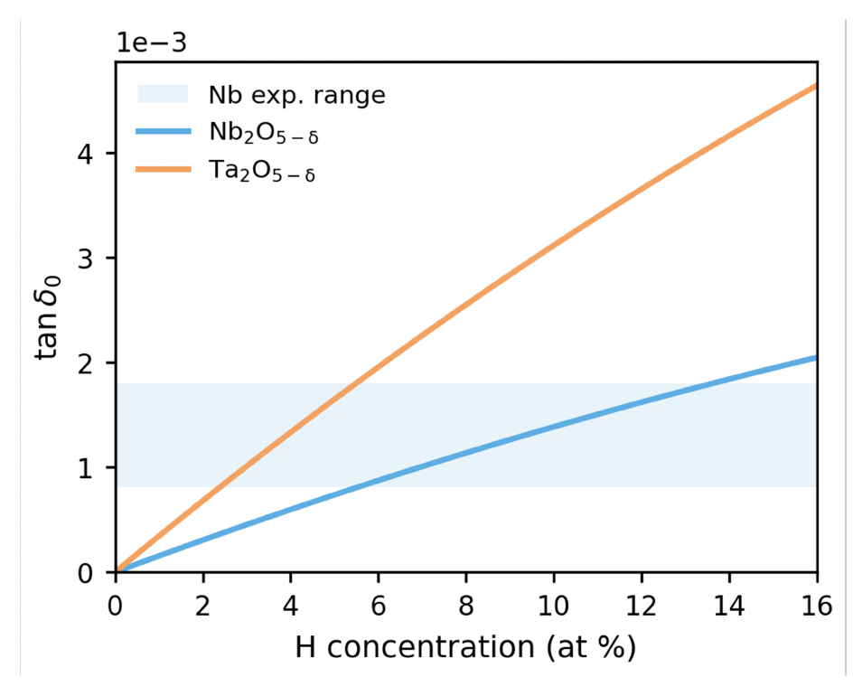
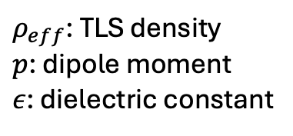
Results: Estimated loss
$ρ_{eff}$: TLS density
$p$: dipole moment
$ε$: dielectric constant
Native oxide layer
Oxide interface
Ta
Notes:
Mention loss tangent

Slide 10
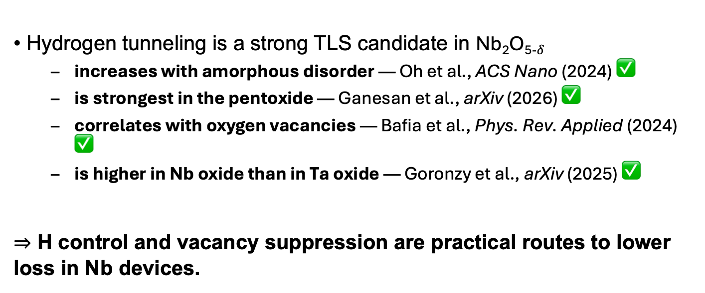
Conclusion
Hydrogen tunneling is a strong TLS candidate in Nb₂O₅₋$δ$
  increases with amorphous disorder — Oh et al., ACS Nano (2024) ✅
  is strongest in the pentoxide — Ganesan et al., arXiv (2026) ✅
  correlates with oxygen vacancies — Bafia et al., Phys. Rev. Applied (2024) ✅
  is higher in Nb oxide than in Ta oxide — Goronzy et al., arXiv (2025) ✅
⇒ H control and vacancy suppression are practical routes to lower loss in Nb devices.

Slide 11
Thank you!
Questions?
This work was supported by the US National Science Foundation under award PHY-1549132, the Center for Bright Beams.

Slide 13
Backup slides

Slide 14
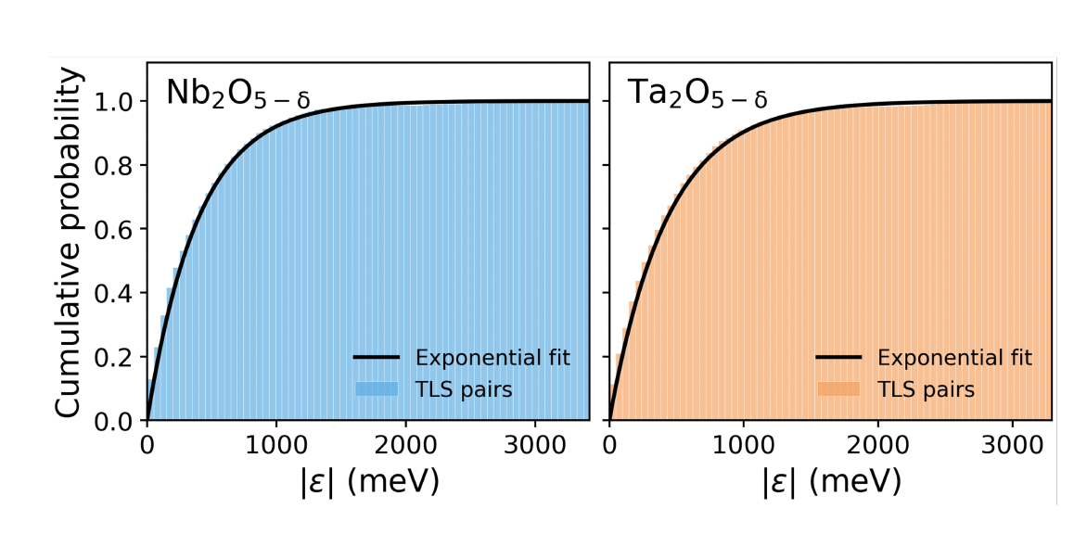
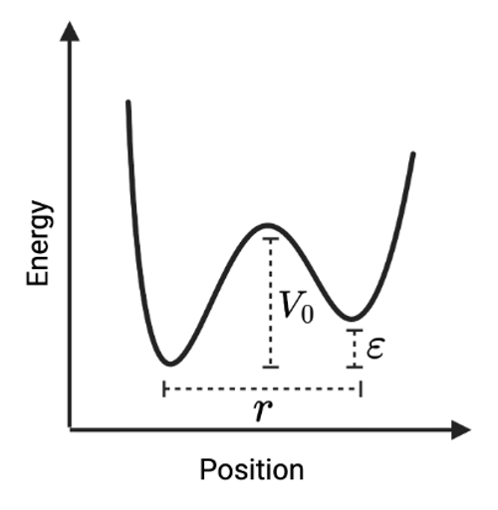
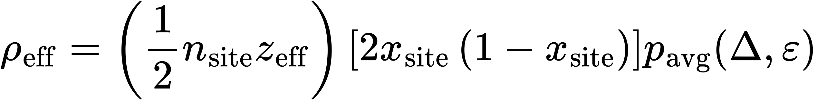

Results: Fits for the pentoxides
$$Δ(V_{0},r)$$
TLS density:
Number of potential pairs per site
Probability of TLS in the correct freq. range
Density of interstitial sites
H concentration

Slide 15
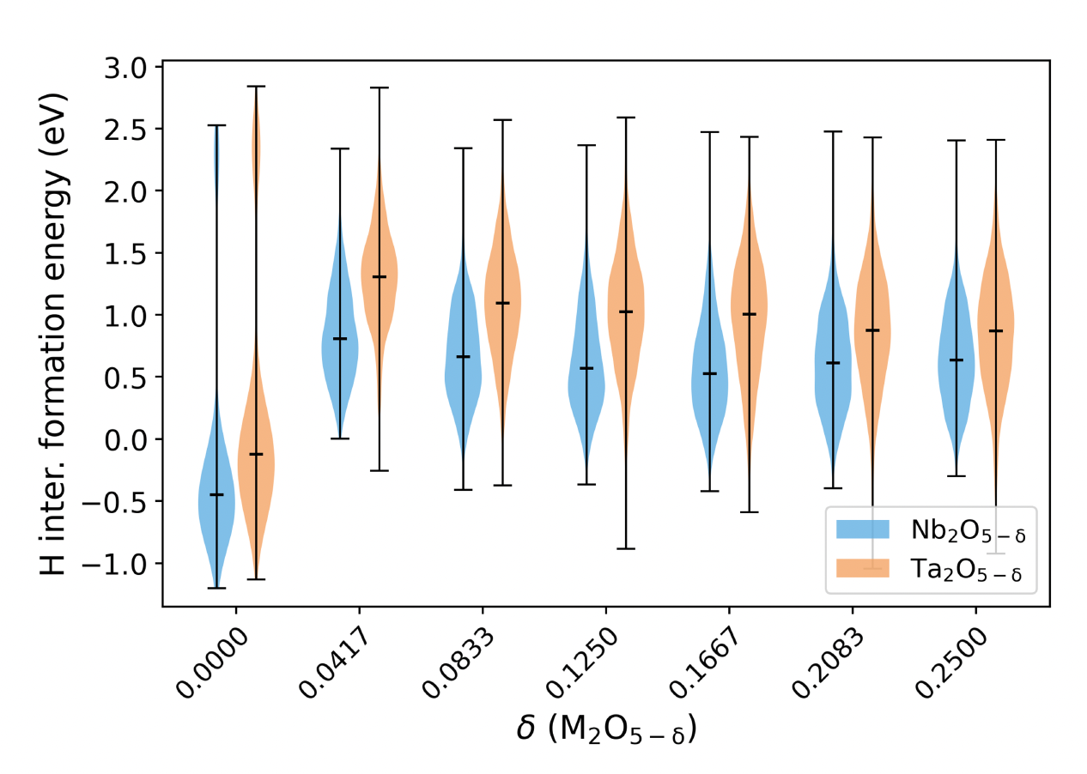
Results: H formation energy

Slide 16
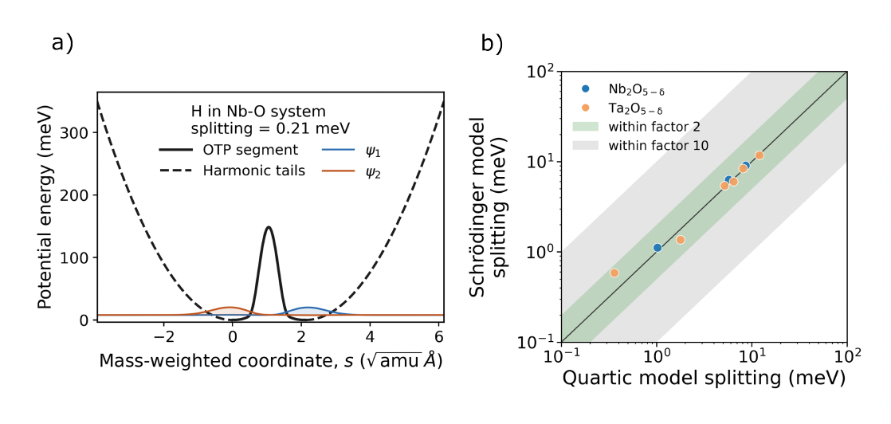
Quartic WKB vs tunneling

