Slide 1
Helium Atom Scattering: High Temperature Annealing Dynamics and Surface Recovery of (3x1)-O Nb(100) Elucidated by Helium Atom Scattering
Michael Van Duinen, Sibener Group, University of Chicago
July 9, 2026 CBB Annual Meeting

Slide 2
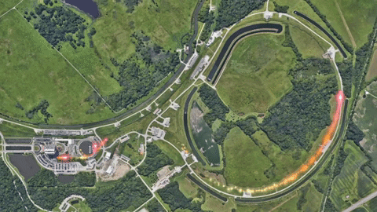
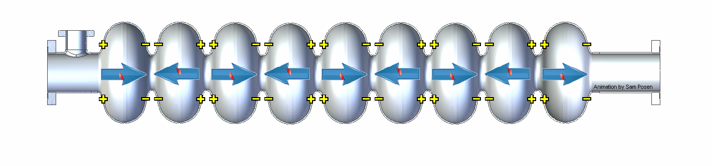
Niobium in SRF Cavities: Why? Why Not?
Superconducting Radio Frequency cavities accelerate particles in particle accelerators
  High-energy, AC field
  Superconductive materials prevent field losses
Niobium is state-of-the-art for SRF cavities
Nb has room for improvement
  Cryocooling is very costly at 2 K (helium boiling point ~ 4 K)
Nb can be improved with dopants and alloying
  A lot of existing Nb infrastructure – expensive to reinvent the wheel
  Only need ~1 µm to prevent field loss
@FermiLab on GIPHY
Current SRF cavity research is focused on developing new Nb-based materials at the Nb surface.

Slide 3
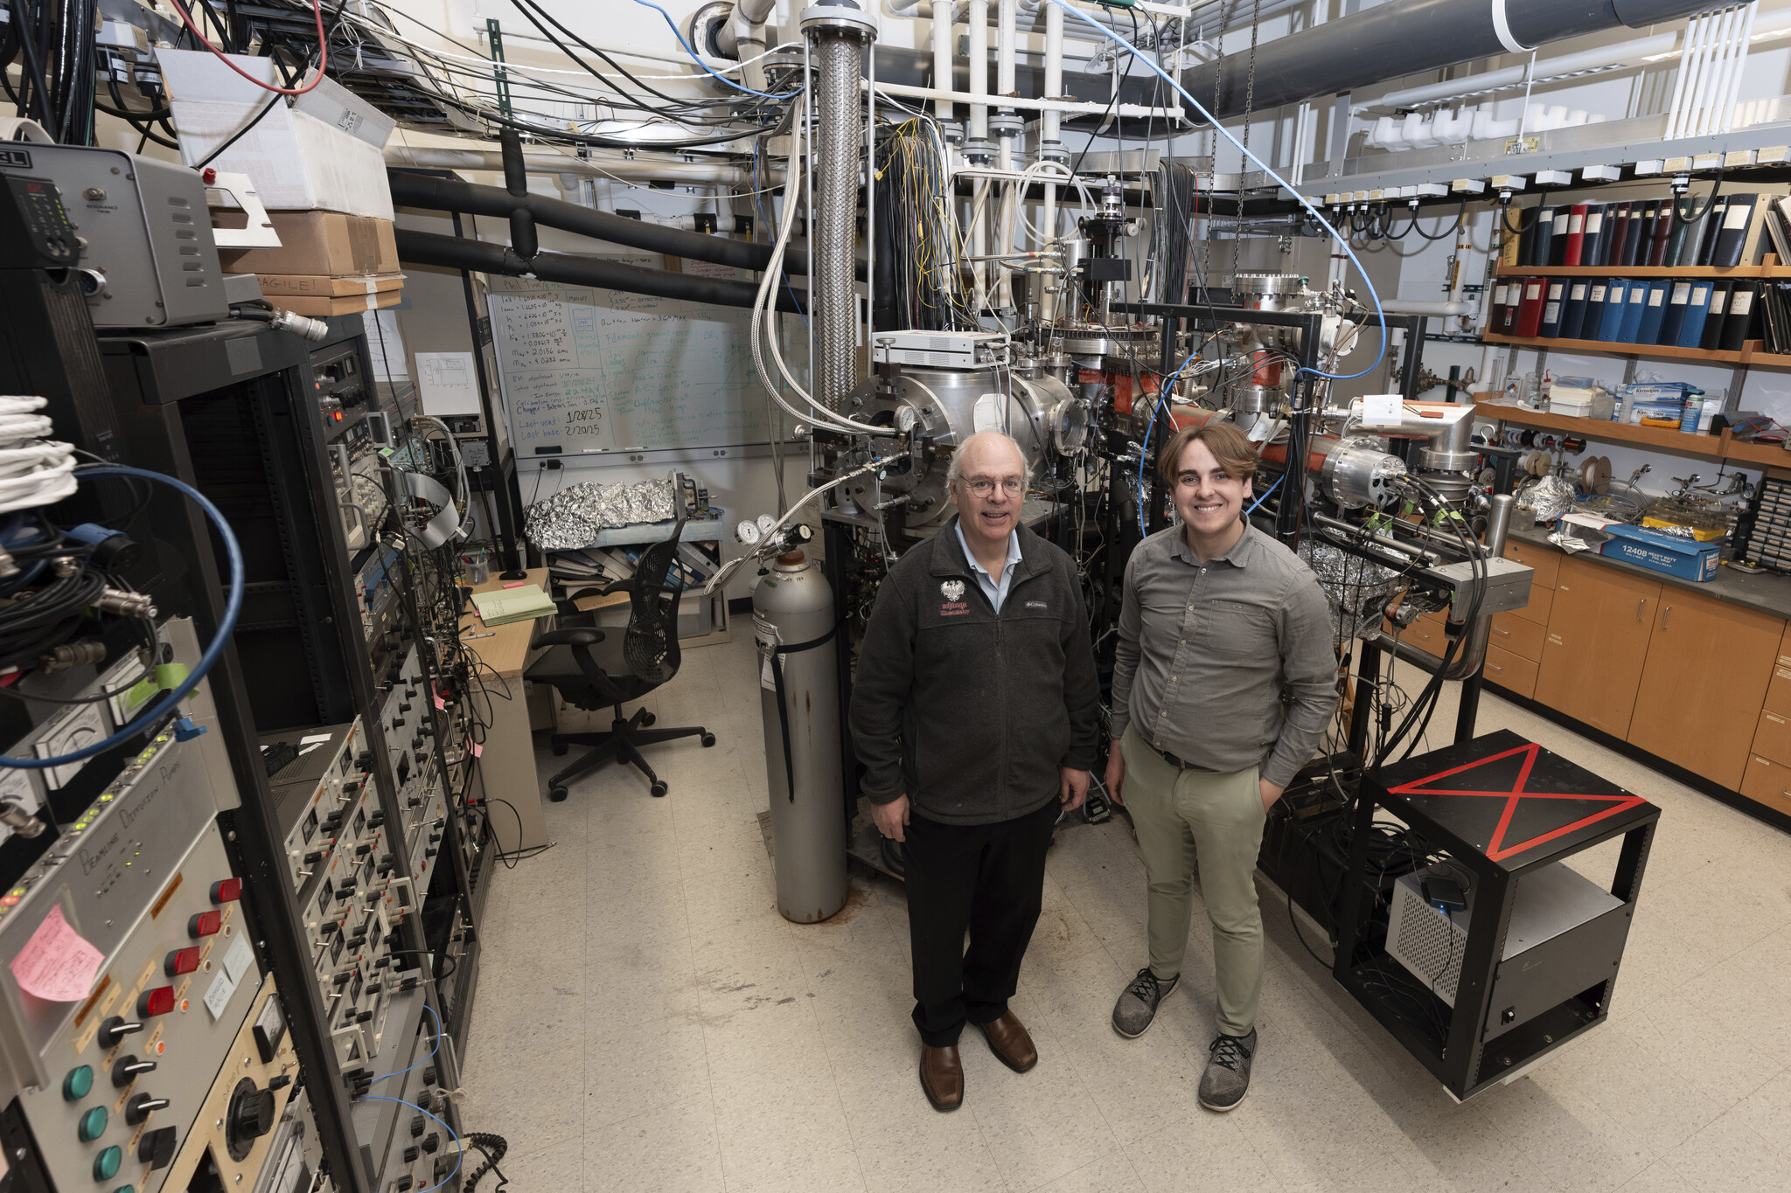

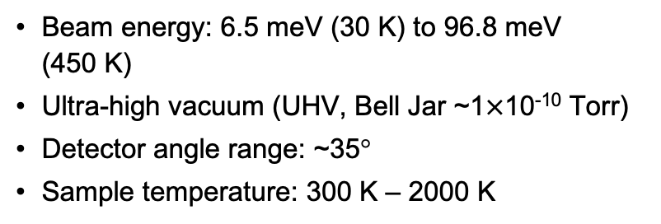
Helium Atom Scattering (HAS) Instrument
Bell Jar
Ion gun
Sample/Heater
Electron Energy Analyzer
LEED
AES
Beam QMS
Electron gun
Chopper wheel
Skimmer
Ionizer
Quadrupole Mass Spectrometer (QMS)
Beam energy: 6.5 meV (30 K) to 96.8 meV (450 K)
Ultra-high vacuum (UHV, Bell Jar ~1$×$10⁻¹⁰ Torr)
Detector angle range: ~35°
Sample temperature: 300 K – 2000 K
Nozzle
He
Beamline
Rotating Detector
Notes:
Be sure to brag; mention resolution

Slide 4
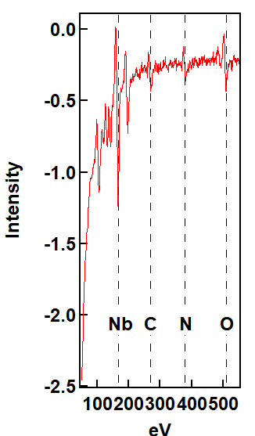
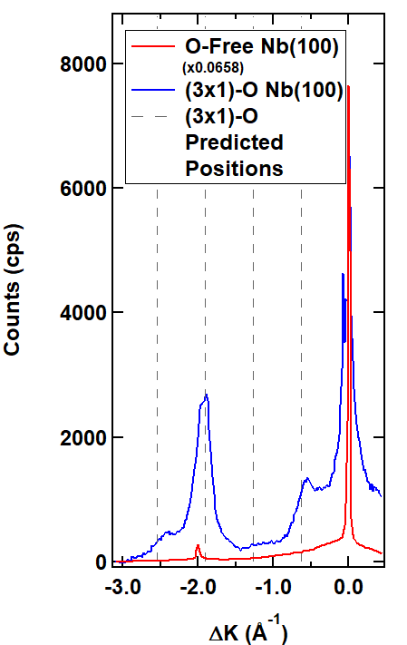
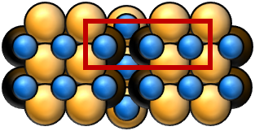
What Does the Data Look Like?
Diffraction
Ensemble atomic-scale surface structure
Wide range of accessible temperatures
Very sensitive to surface disorder
Auger
Ensemble atomic-scale elemental composition
Moderate range of accessible temperatures
Detects major surface contaminants of Nb(100) besides hydrogen
C. J. Thompson, M. F. Van Duinen, M. M. Kelley, T. A. Arias, S. J. Sibener. J. Phys. Chem. C 128 (14), 6149-6157 (2024).
C. J. Thompson, M. Van Duinen, C. Mendez, S. A. Willson, V. Do, T. A. Arias, S. J. Sibener. J. Phys. Chem. C 128 (25), 10714-10722 (2024).

Slide 5
HAS is a Surface-Sensitive, Inert, In Situ Probe
Measures surface atomic properties through electronic corrugation
  Good energy match with low-energy single phonons
  Can capture ensemble dynamical properties like mean-squared displacement and Debye temperature
Interacts with electron cloud ~3 Å above the surface
HAS uses the periodicity of surface electronic corrugation to capture ensemble surface atomic properties.
Notes:
Helium is chemically inert, and the beam is low energy
Reliably heat to 2400 K and measure up to 1750 K
Have a good Eliashberg response

Slide 6
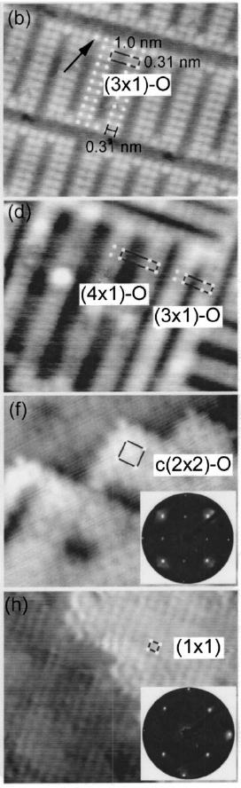

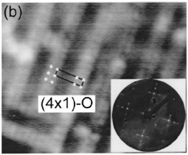
Overview of Nb(100) Oxide Temperature Treatment
Surface | T_{formation} (K) | STM Image
(3x1)-O | 1970
(4x1)-O | 2270
(2x2)-O | 2370
Metallic | 2500 (~2400 in our work)
These temperatures have been the standard in optimal oxide annealing temperatures for a long time
  Still definitely relevant for oxygen-free surface
Sibener lab has recently been able to obtain (3x1)-O at lower temperatures
4 nm
Ideal annealing temperatures and the dynamics of annealing for the (3x1)-O remain an open problem.
An, B., Fukuyama, S., Yokogawa, K. & Yoshimura, M. Phys. Rev. B 68, 115423 (2003).

Slide 7
Reproducibly Regenerating (3x1)-O
Annealing dynamics studies naturally must start from something that is not recognizable as the (3x1)-O
Venting to generate the pentoxide impractical
  No load lock – need to bake for ~1 week every time
  Exposure to atmosphere introduces carbon and nitrogen – adds undue cleaning burden
Metallic Nb(100) as an origin point also impractical
  Heating damage to mount over time
  Might have to dose oxygen
Sputtering a (3x1)-O surface ideal
  Relatively gentle compared to methods listed above
  No phase changes or reconstructions
  Can vary length and intensity of sputtering to fit needs
Sputtering is the preferred method for repetitively and controllably inducing disorder on the surface for seeing annealing recovery.

Slide 8
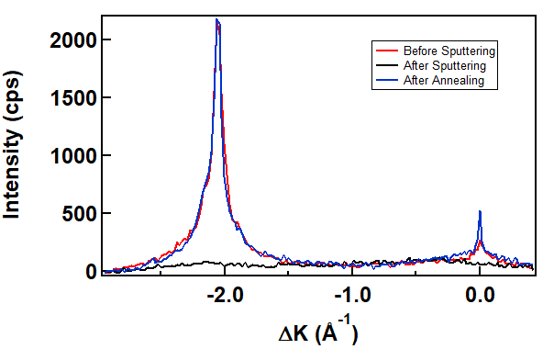
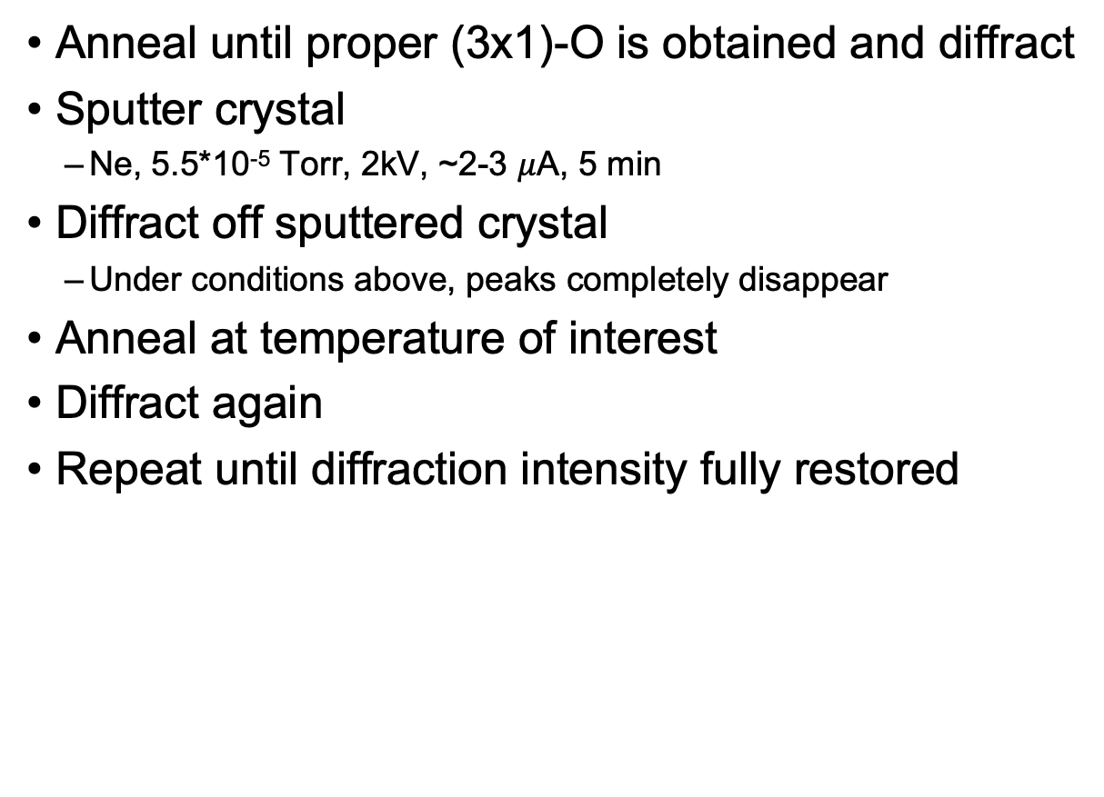
Original Sputter/Anneal Procedure
Anneal until proper (3x1)-O is obtained and diffract
Sputter crystal
  Ne, 5.5*10⁻⁵ Torr, 2kV, ~2-3 $μ$A, 5 min
Diffract off sputtered crystal
  Under conditions above, peaks completely disappear
Anneal at temperature of interest
Diffract again
Repeat until diffraction intensity fully restored
15 min, ~1000 K
Sputtering and annealing under the following procedure should allow me to see the kinetics of (3x1)-O recovery.
M. F. Van Duinen, C. Mendez, T. A. Arias, S. J. Sibener. In Progress

Slide 9
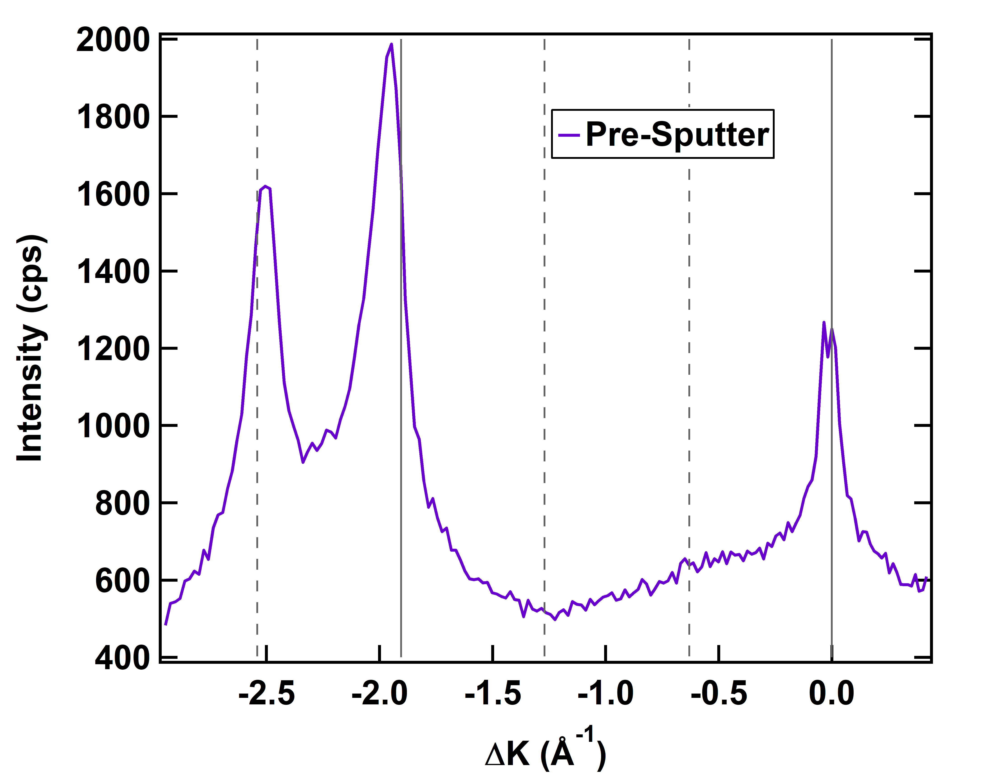
Peak Return is Relatively Instantaneous
Initial project plan was to watch the peaks slowly come back in as annealing progressed
Even reducing to 2.5 minutes brings diffraction to a plateau rather quickly
The return of diffraction intensity for a sputtered (3x1)-O surface is characterized by a sudden, singular event rather than a gradual annealing process.
M. F. Van Duinen, C. Mendez, T. A. Arias, S. J. Sibener. In Progress

Slide 10
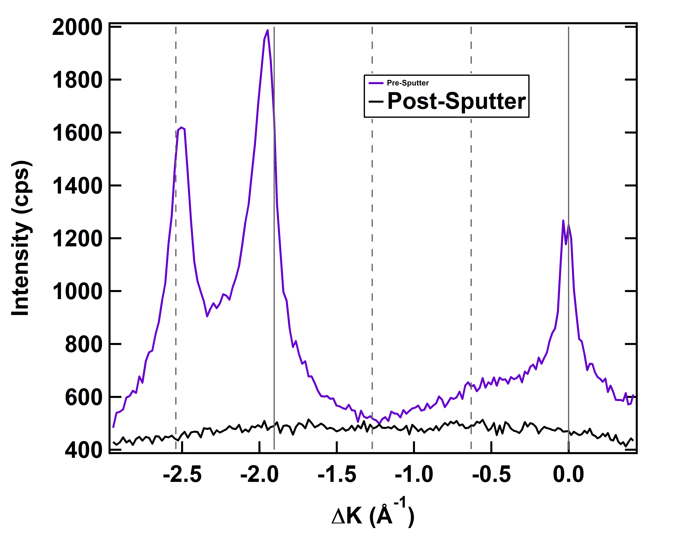
Peak Return is Relatively Instantaneous
Initial project plan was to watch the peaks slowly come back in as annealing progressed
Even reducing to 2.5 minutes brings diffraction to a plateau rather quickly
The return of diffraction intensity for a sputtered (3x1)-O surface is characterized by a sudden, singular event rather than a gradual annealing process.
M. F. Van Duinen, C. Mendez, T. A. Arias, S. J. Sibener. In Progress

Slide 11
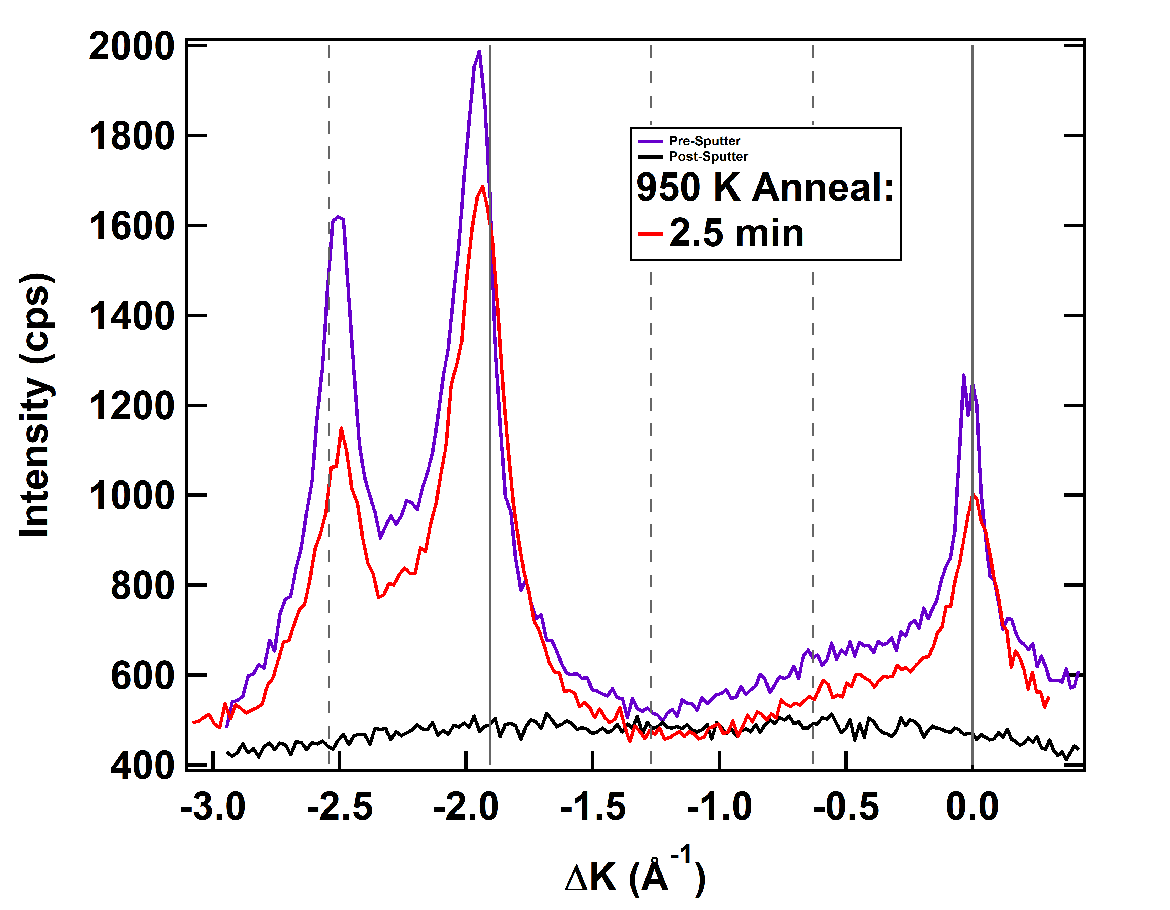
Peak Return is Relatively Instantaneous
Initial project plan was to watch the peaks slowly come back in as annealing progressed
Even reducing to 2.5 minutes brings diffraction to a plateau rather quickly
The return of diffraction intensity for a sputtered (3x1)-O surface is characterized by a sudden, singular event rather than a gradual annealing process.
M. F. Van Duinen, C. Mendez, T. A. Arias, S. J. Sibener. In Progress

Slide 12
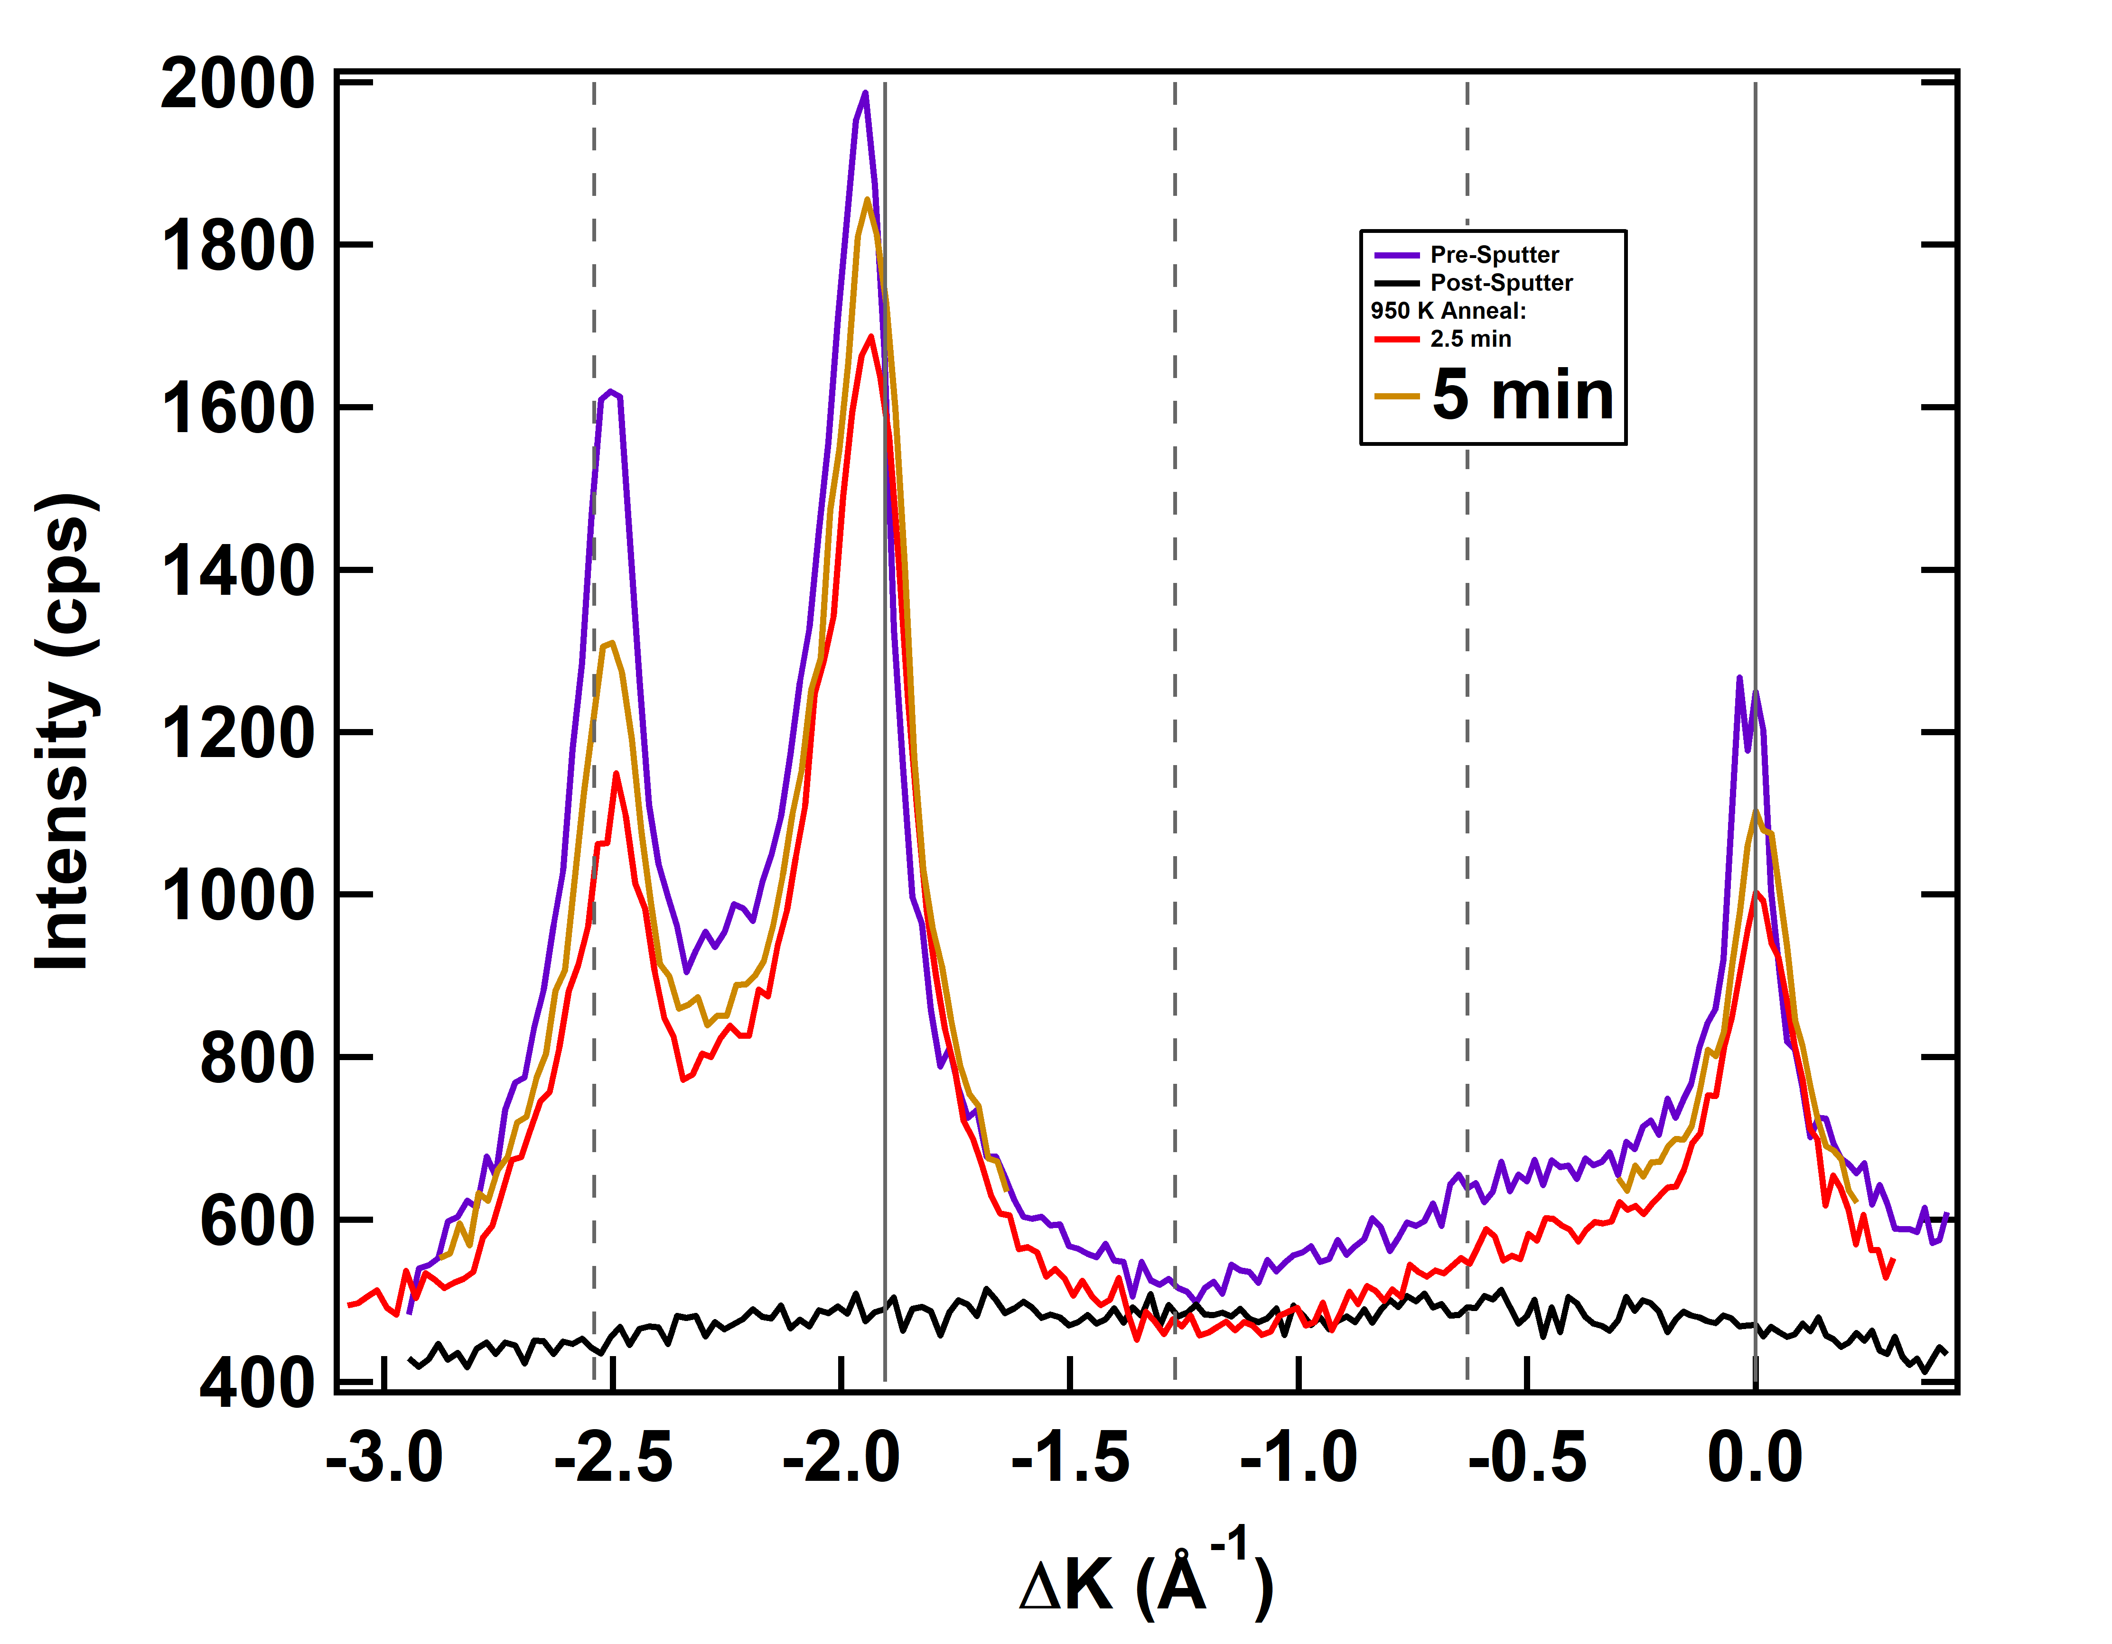
Peak Return is Relatively Instantaneous
Initial project plan was to watch the peaks slowly come back in as annealing progressed
Even reducing to 2.5 minutes brings diffraction to a plateau rather quickly
The return of diffraction intensity for a sputtered (3x1)-O surface is characterized by a sudden, singular event rather than a gradual annealing process.

Slide 13
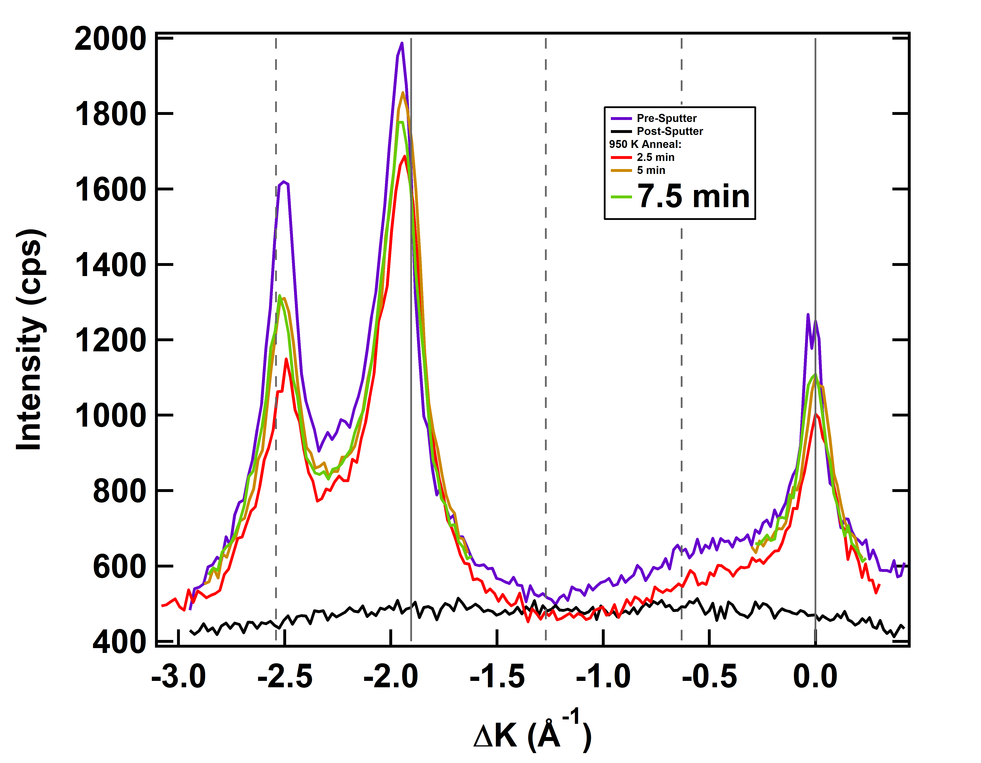
Peak Return is Relatively Instantaneous
Initial project plan was to watch the peaks slowly come back in as annealing progressed
Even reducing to 2.5 minutes brings diffraction to a plateau rather quickly
The return of diffraction intensity for a sputtered (3x1)-O surface is characterized by a sudden, singular event rather than a gradual annealing process.
M. F. Van Duinen, C. Mendez, T. A. Arias, S. J. Sibener. In Progress

Slide 14
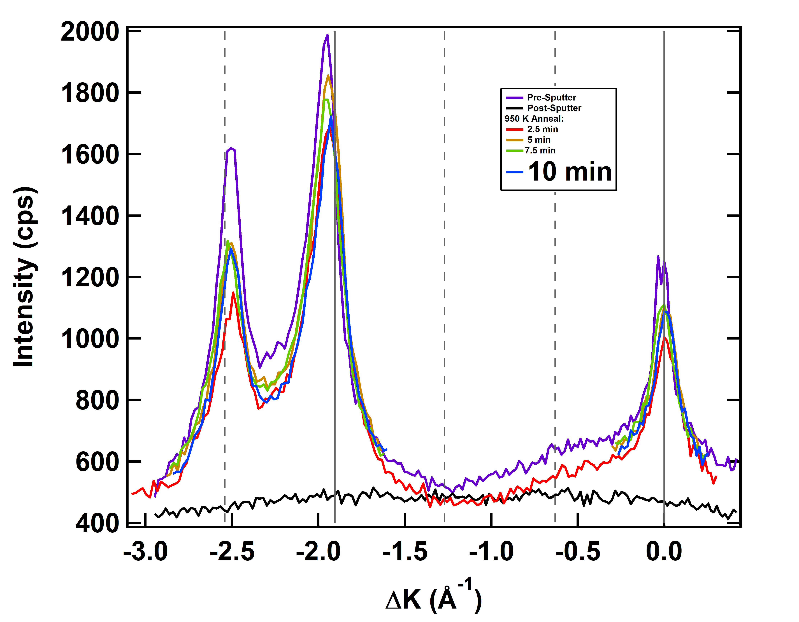
Peak Return is Relatively Instantaneous
Initial project plan was to watch the peaks slowly come back in as annealing progressed
Even reducing to 2.5 minutes brings diffraction to a plateau rather quickly
The return of diffraction intensity for a sputtered (3x1)-O surface is characterized by a sudden, singular event rather than a gradual annealing process.
M. F. Van Duinen, C. Mendez, T. A. Arias, S. J. Sibener. In Progress

Slide 15
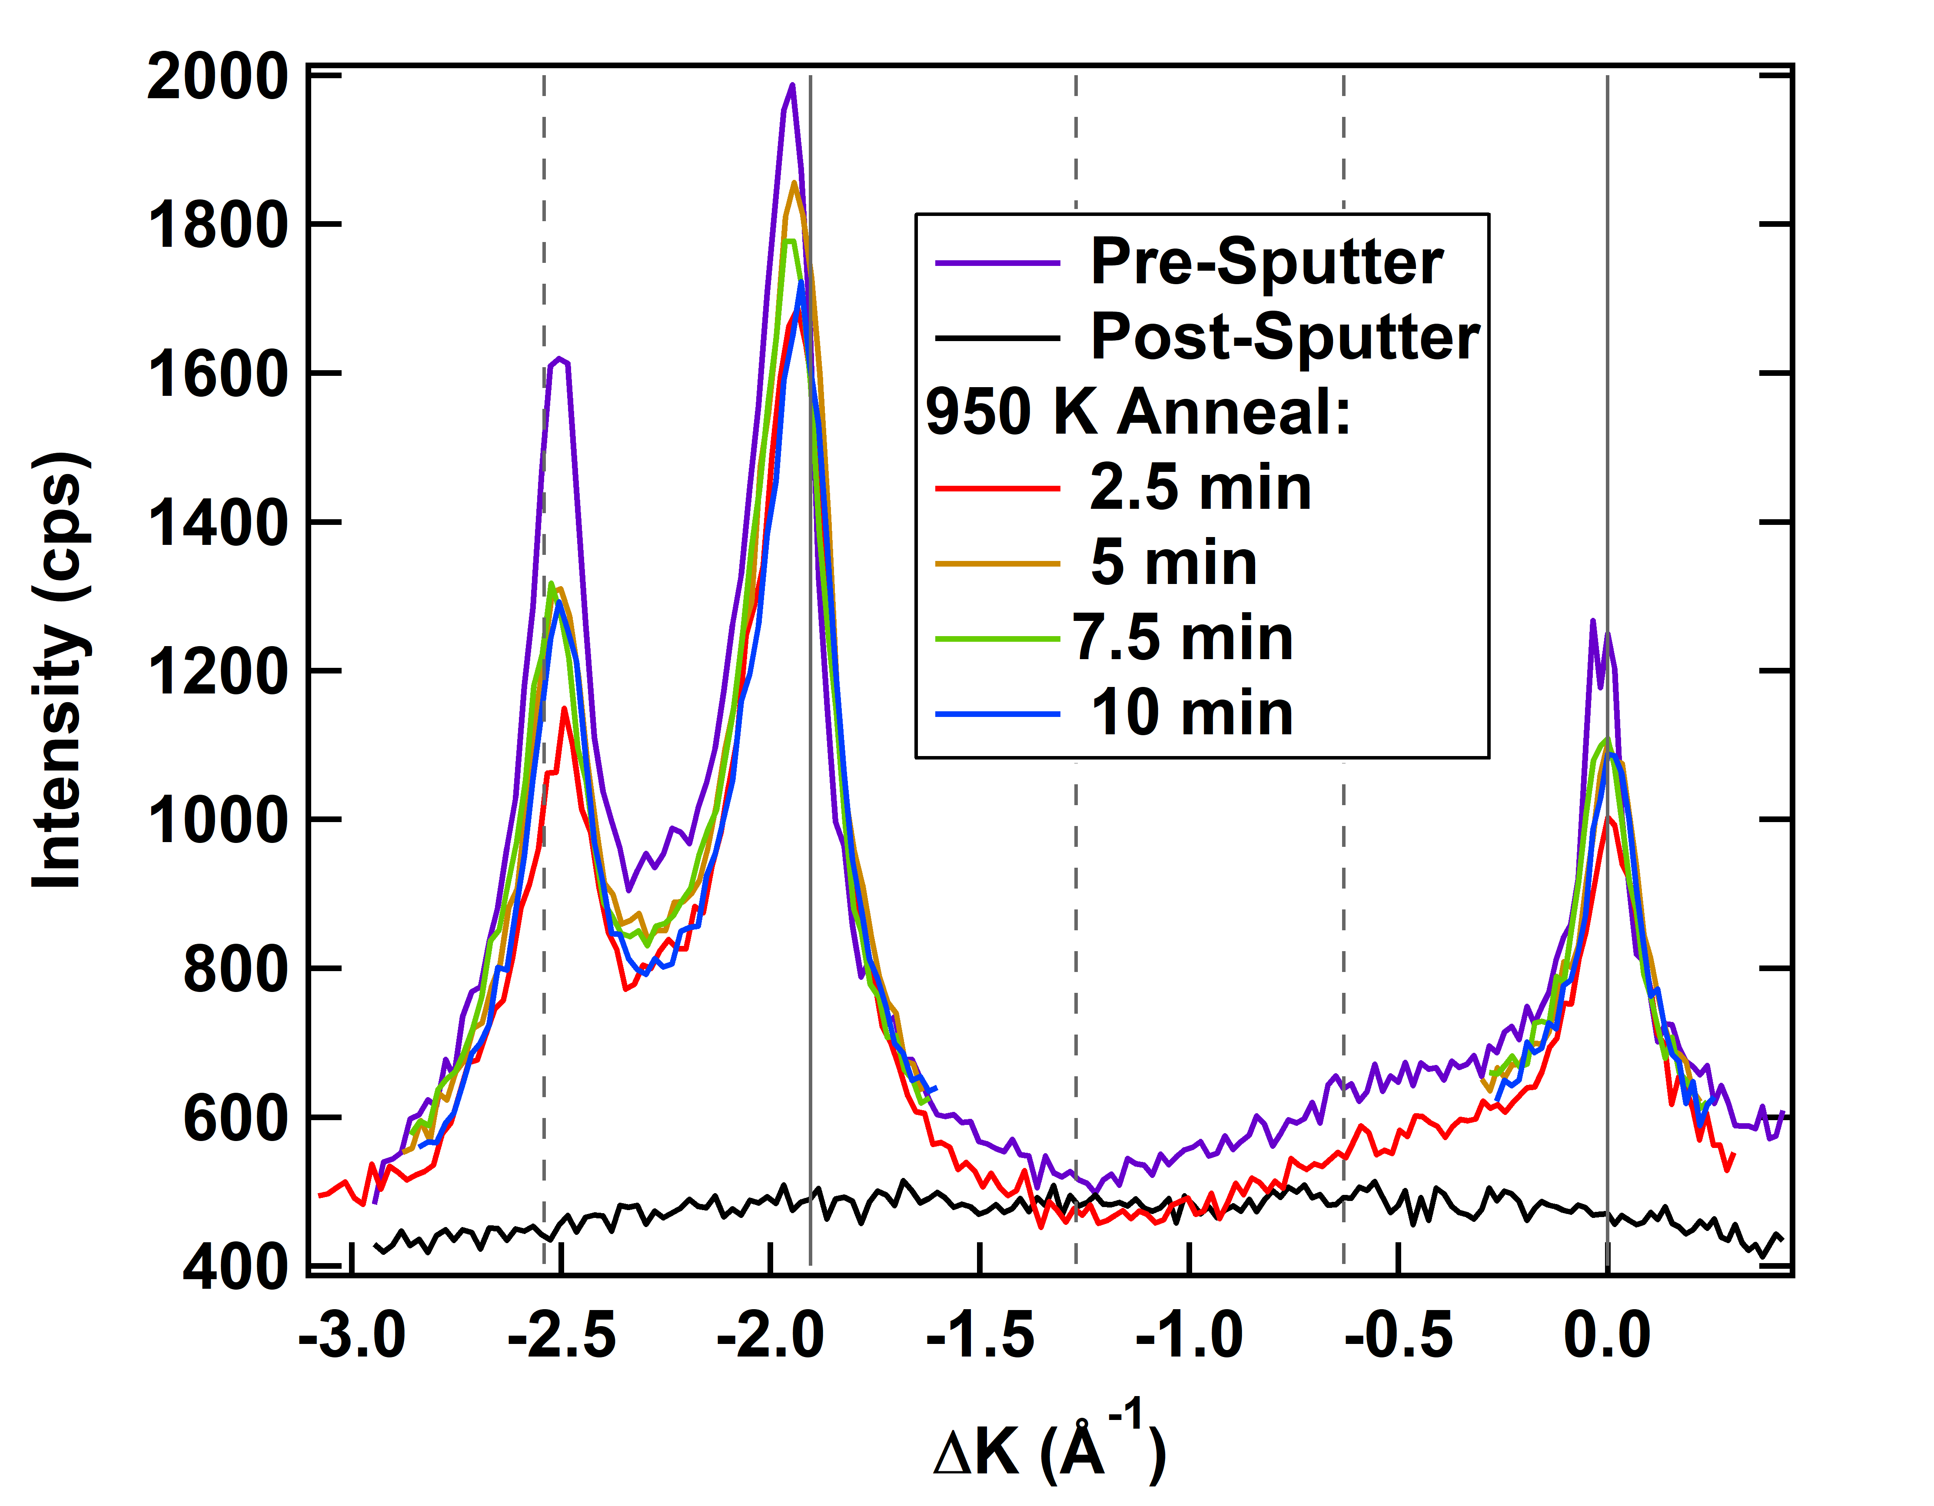
Peak Return is Relatively Instantaneous
Initial project plan was to watch the peaks slowly come back in as annealing progressed
Even reducing to 2.5 minutes brings diffraction to a plateau rather quickly
The return of diffraction intensity for a sputtered (3x1)-O surface is characterized by a sudden, singular event rather than a gradual annealing process.
M. F. Van Duinen, C. Mendez, T. A. Arias, S. J. Sibener. In Progress

Slide 16
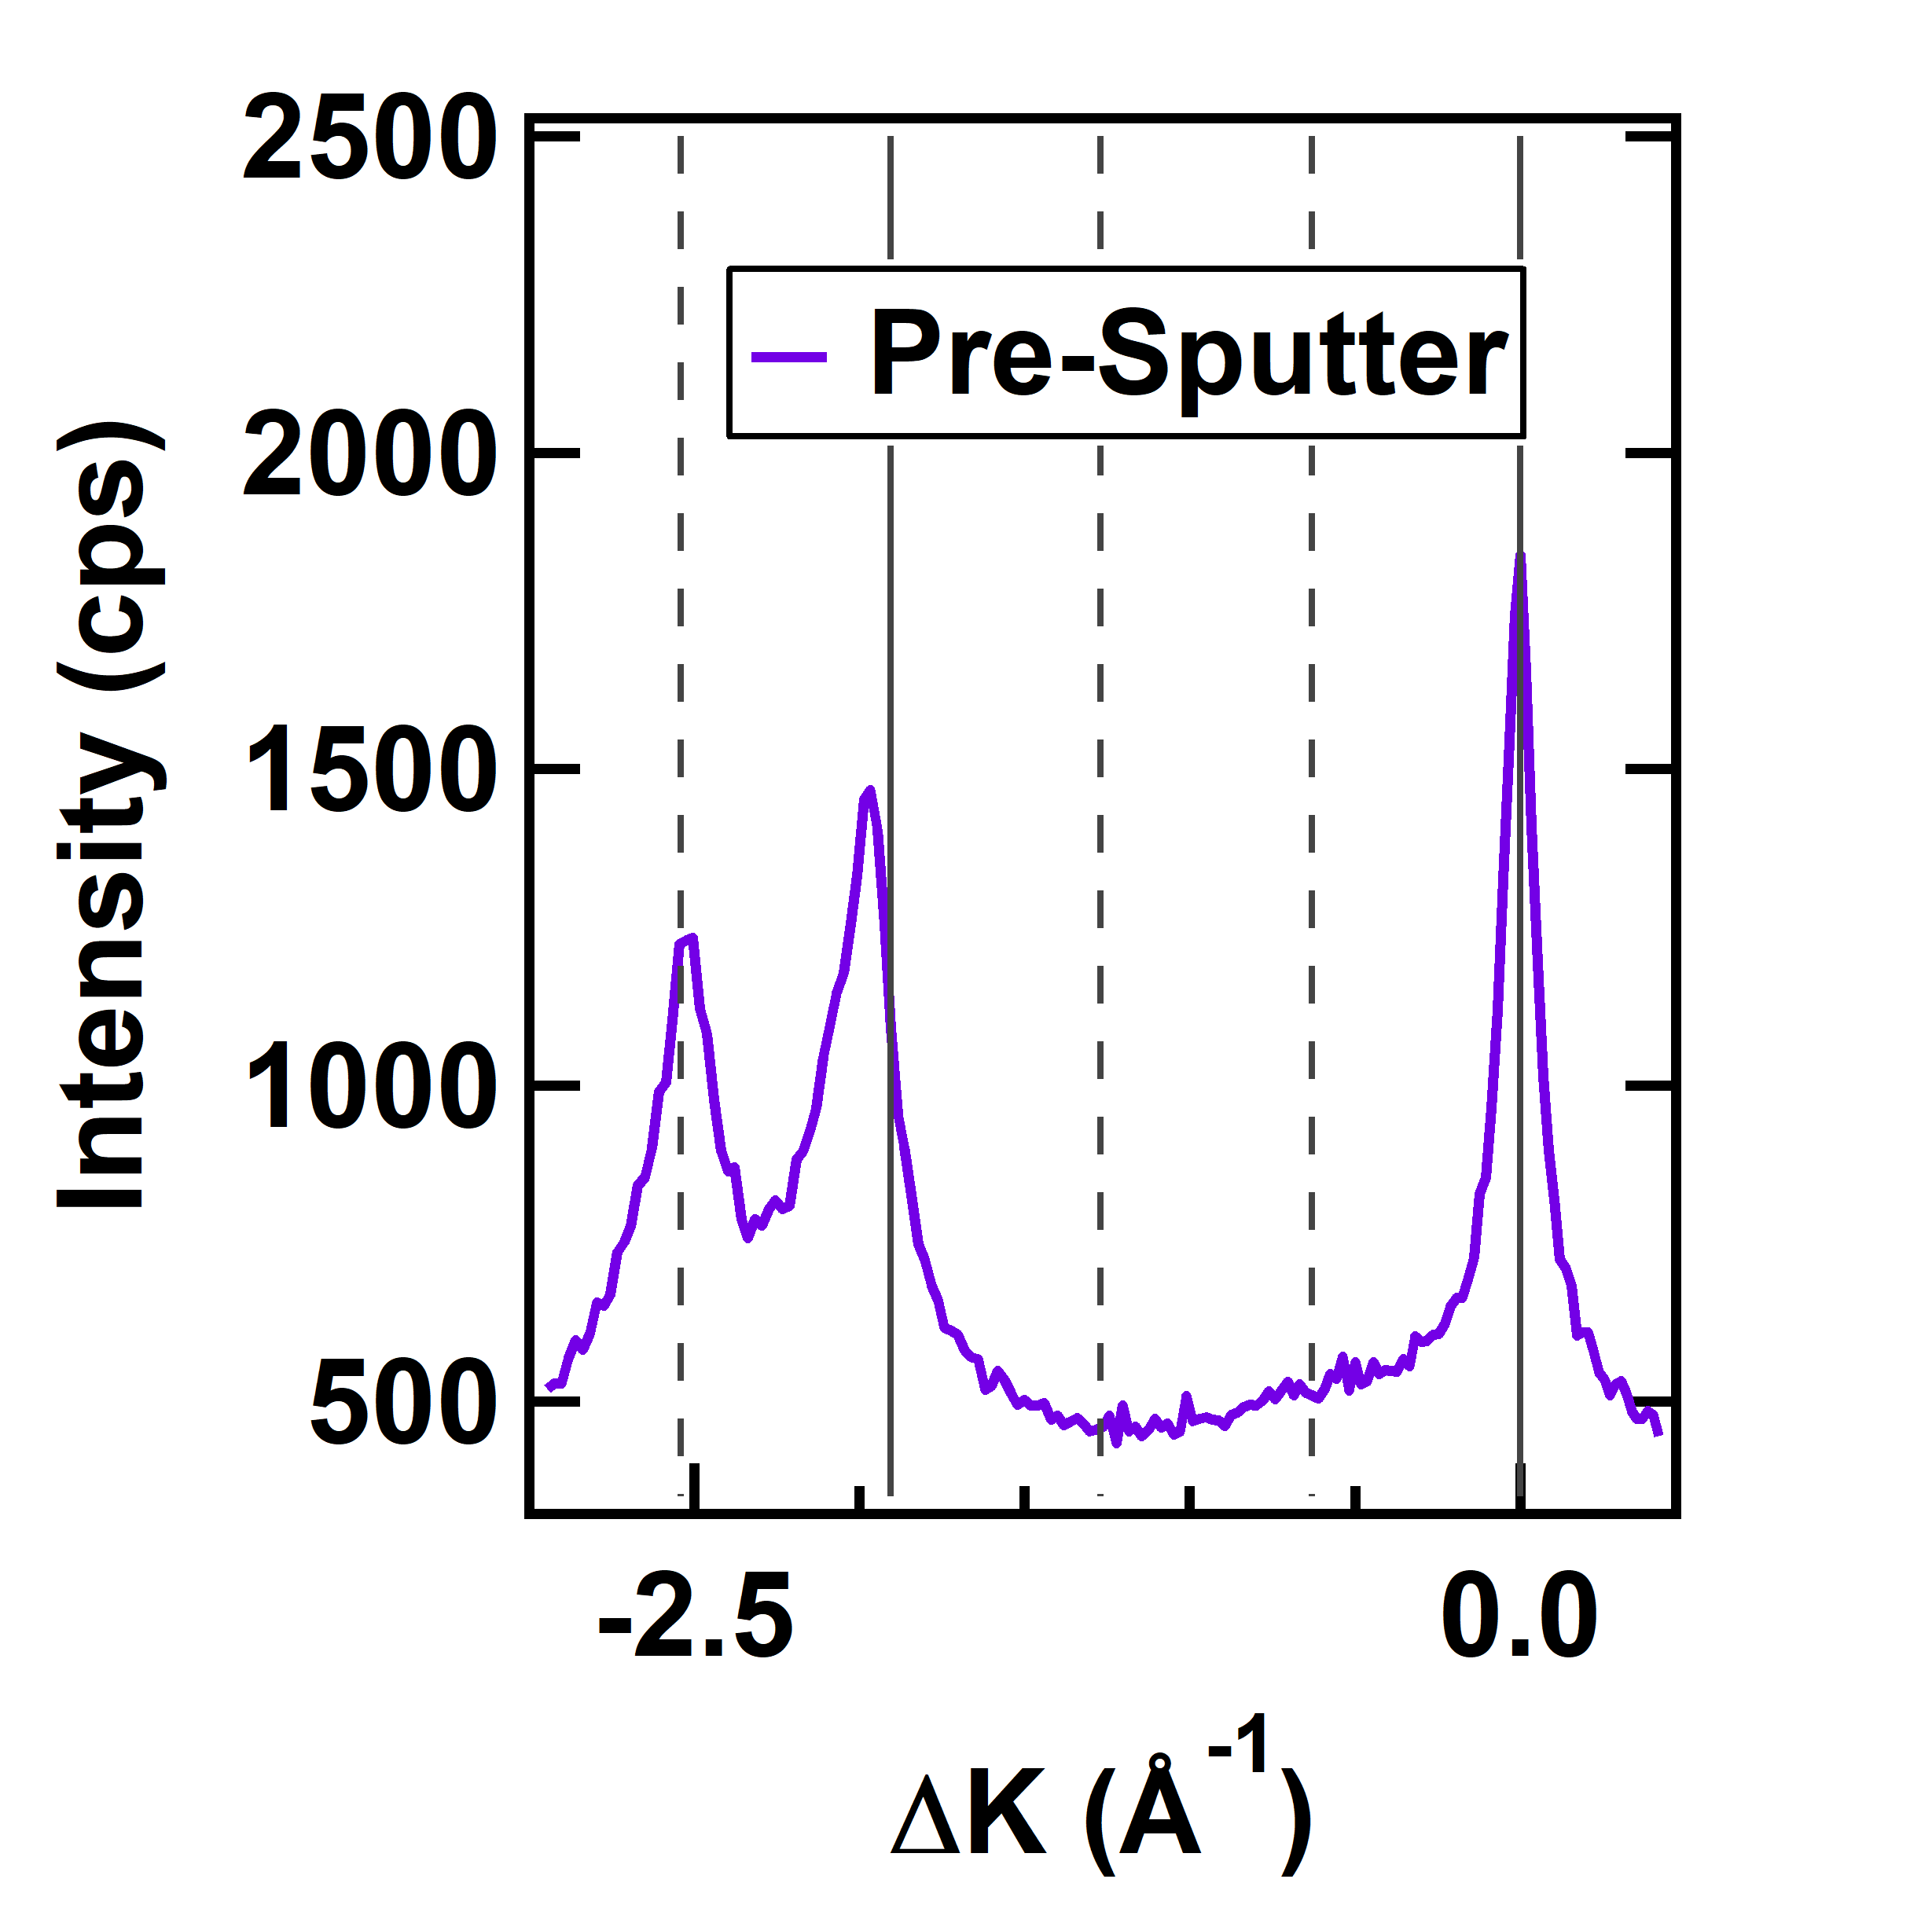
Can Pushing to Higher Temperatures Improve the Surface Order Further?
Surface order can be measured in terms of peak intensities or peak widths
Peak width corresponds to domain sizes at surface
Both intensities and widths tend to level off above 900 K
There does not seem to be a temperature significantly above 900 K at which a new level of crystalline order is obtained.
M. F. Van Duinen, C. Mendez, T. A. Arias, S. J. Sibener. In Progress

Slide 17
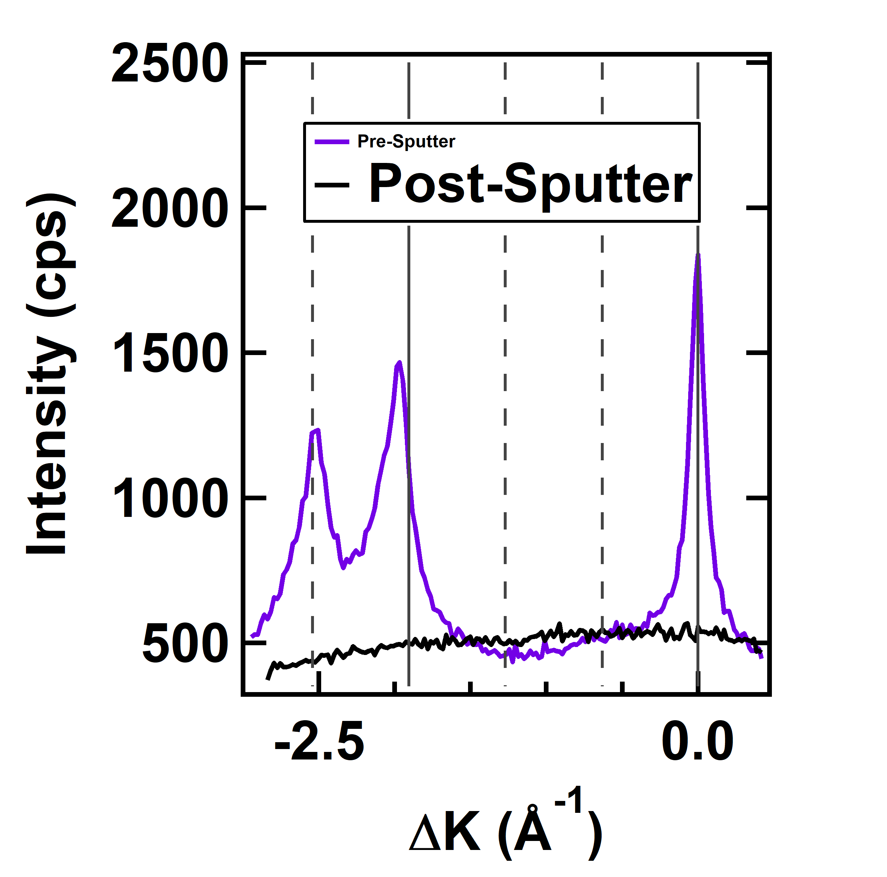
Can Pushing to Higher Temperatures Improve the Surface Order Further?
Surface order can be measured in terms of peak intensities or peak widths
Peak width corresponds to domain sizes at surface
Both intensities and widths tend to level off above 900 K
There does not seem to be a temperature significantly above 900 K at which a new level of crystalline order is obtained.
M. F. Van Duinen, C. Mendez, T. A. Arias, S. J. Sibener. In Progress

Slide 18
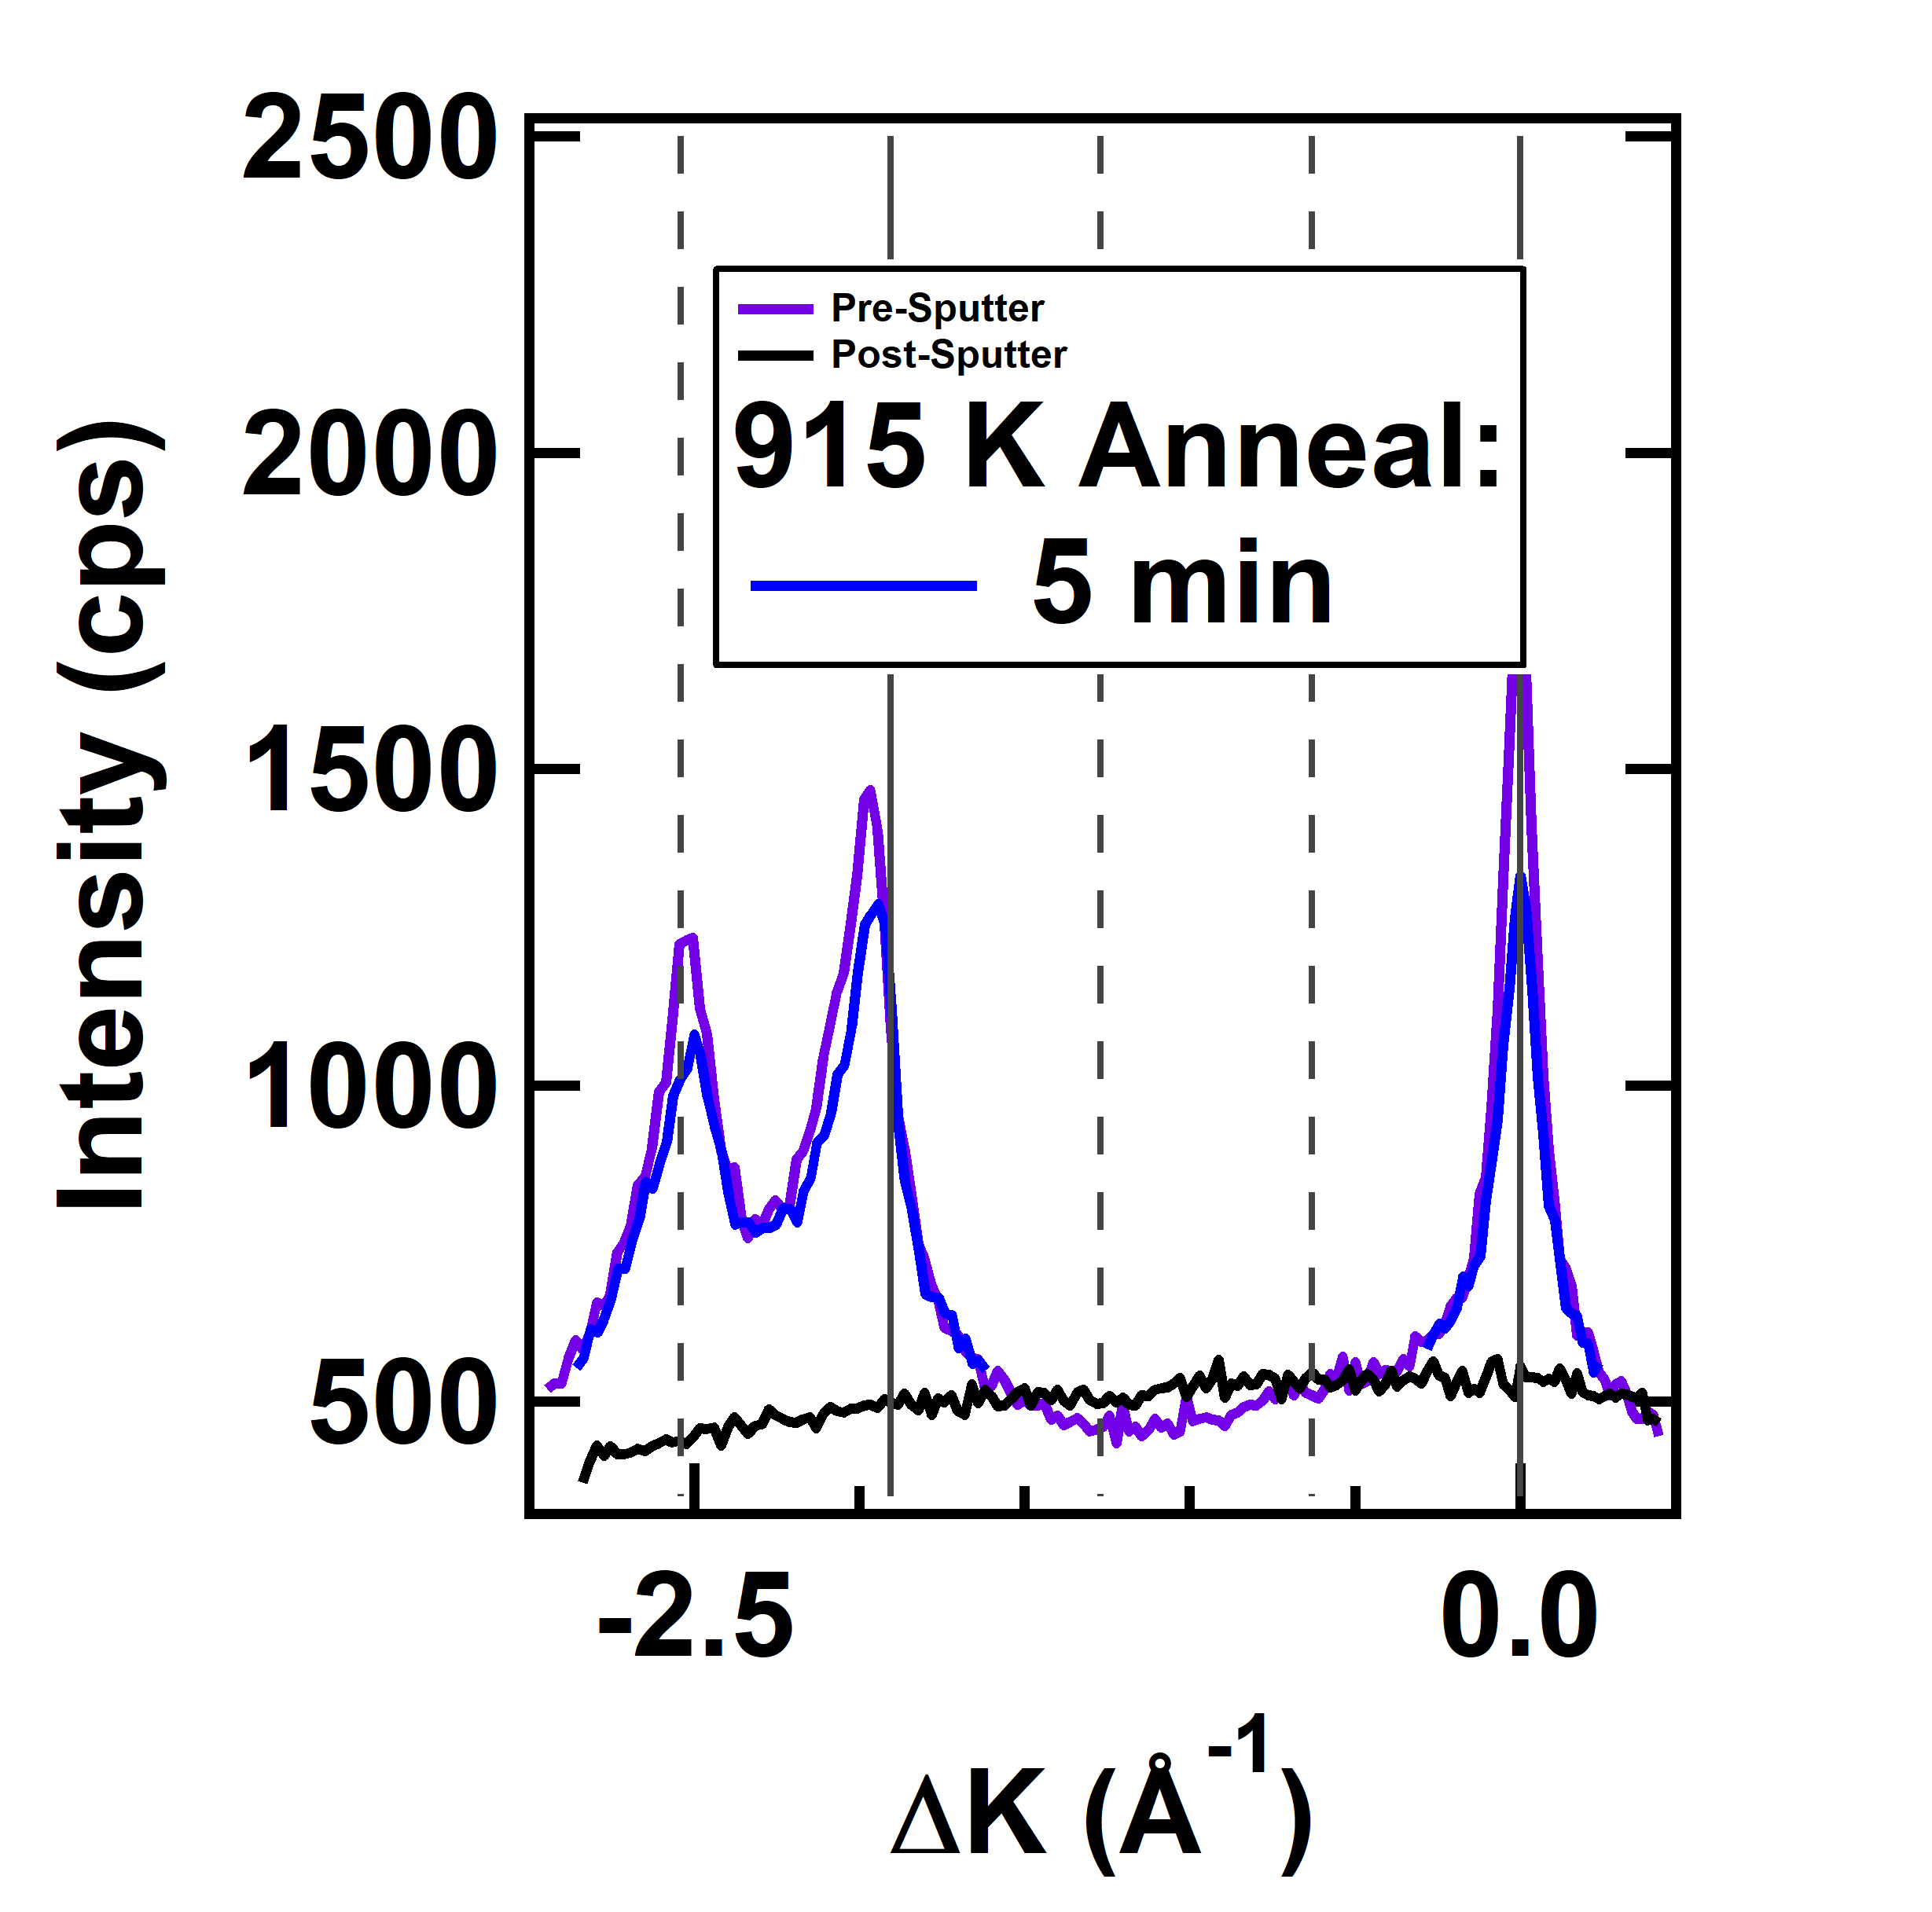
Can Pushing to Higher Temperatures Improve the Surface Order Further?
Surface order can be measured in terms of peak intensities or peak widths
Peak width corresponds to domain sizes at surface
Both intensities and widths tend to level off above 900 K
There does not seem to be a temperature significantly above 900 K at which a new level of crystalline order is obtained.
M. F. Van Duinen, C. Mendez, T. A. Arias, S. J. Sibener. In Progress

Slide 19
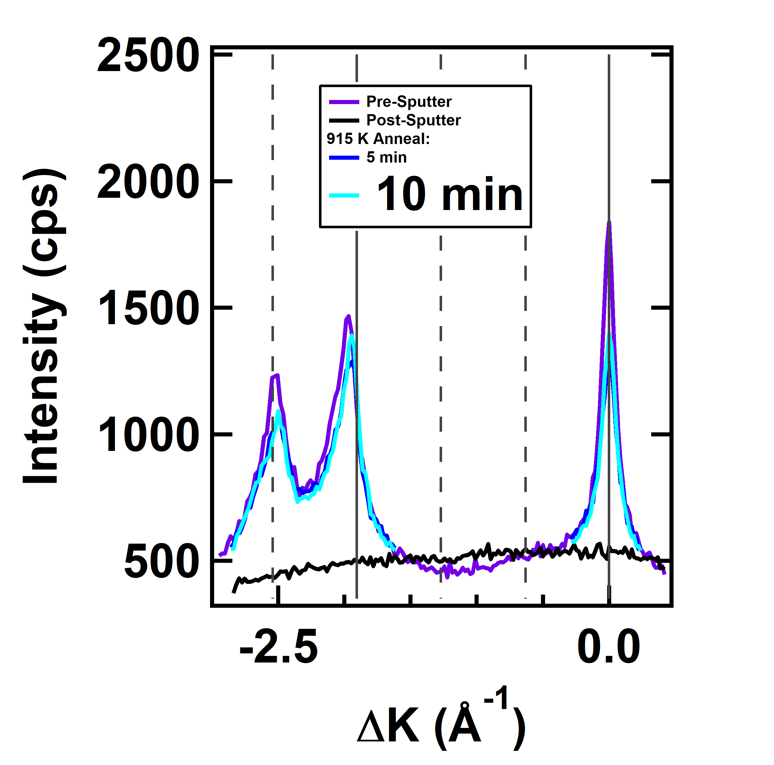
Can Pushing to Higher Temperatures Improve the Surface Order Further?
Surface order can be measured in terms of peak intensities or peak widths
Peak width corresponds to domain sizes at surface
Both intensities and widths tend to level off above 900 K
There does not seem to be a temperature significantly above 900 K at which a new level of crystalline order is obtained.
M. F. Van Duinen, C. Mendez, T. A. Arias, S. J. Sibener. In Progress

Slide 20
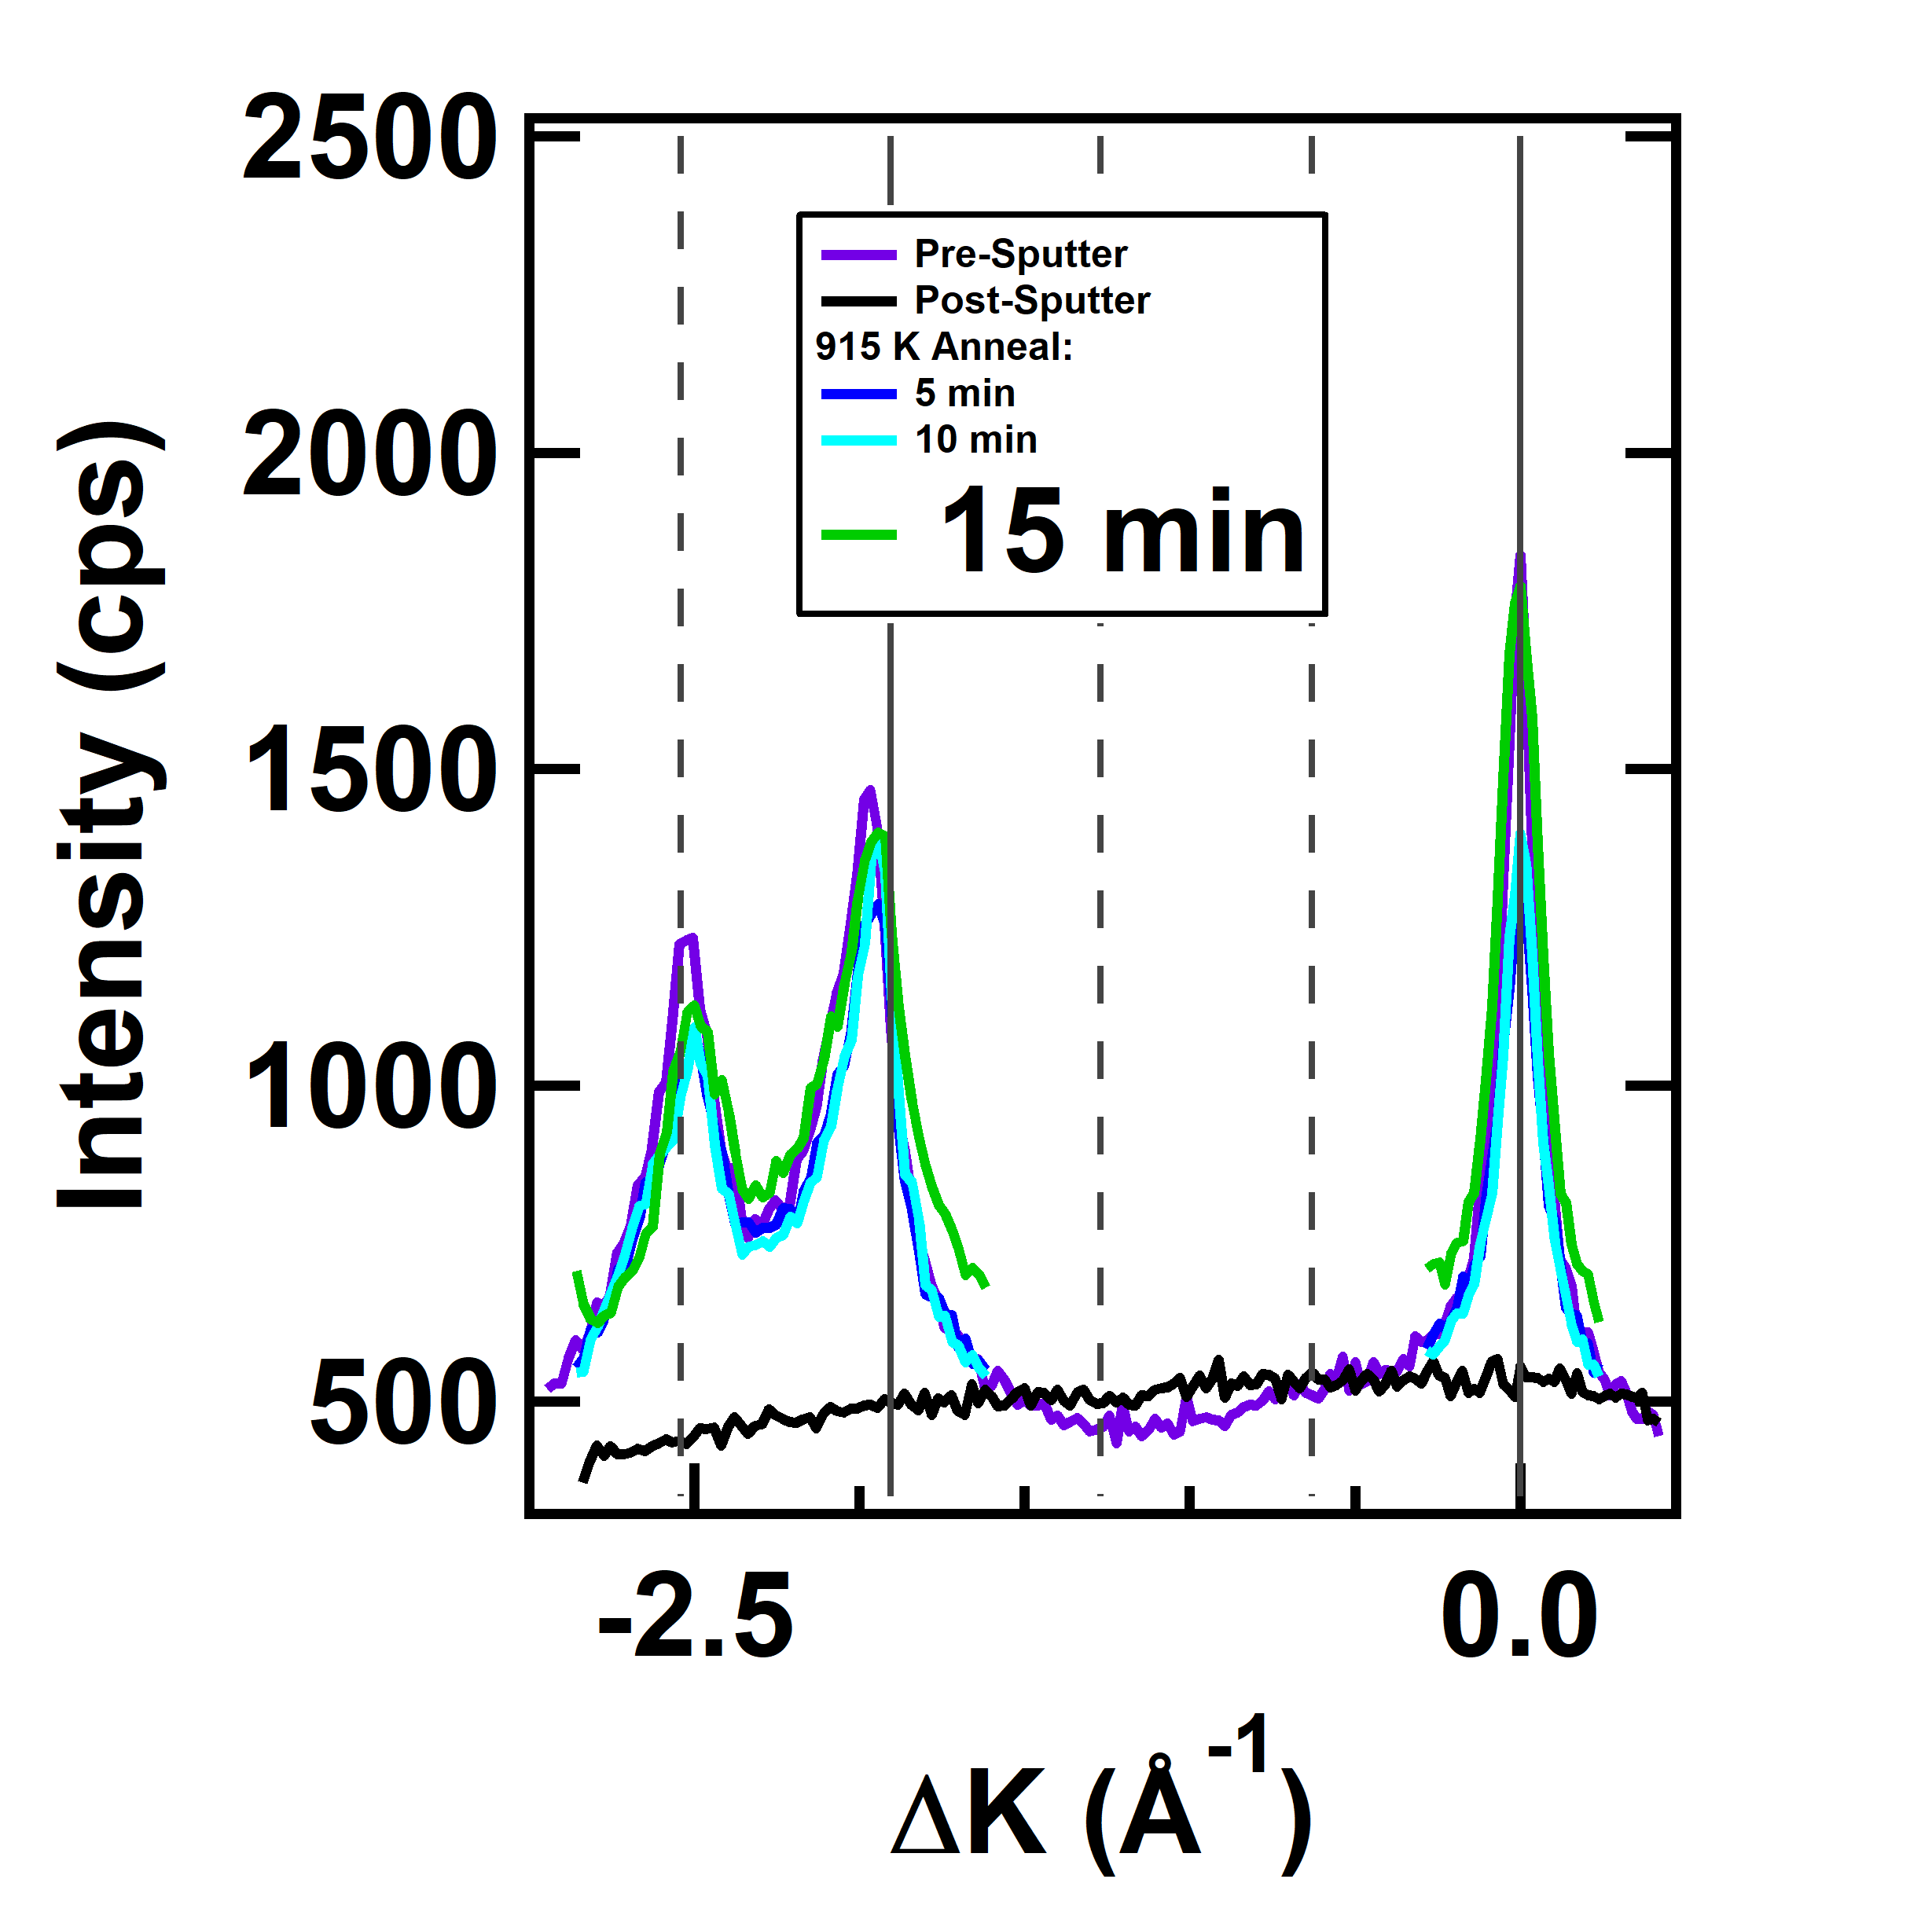
Can Pushing to Higher Temperatures Improve the Surface Order Further?
Surface order can be measured in terms of peak intensities or peak widths
Peak width corresponds to domain sizes at surface
Both intensities and widths tend to level off above 900 K
There does not seem to be a temperature significantly above 900 K at which a new level of crystalline order is obtained.
M. F. Van Duinen, C. Mendez, T. A. Arias, S. J. Sibener. In Progress

Slide 21
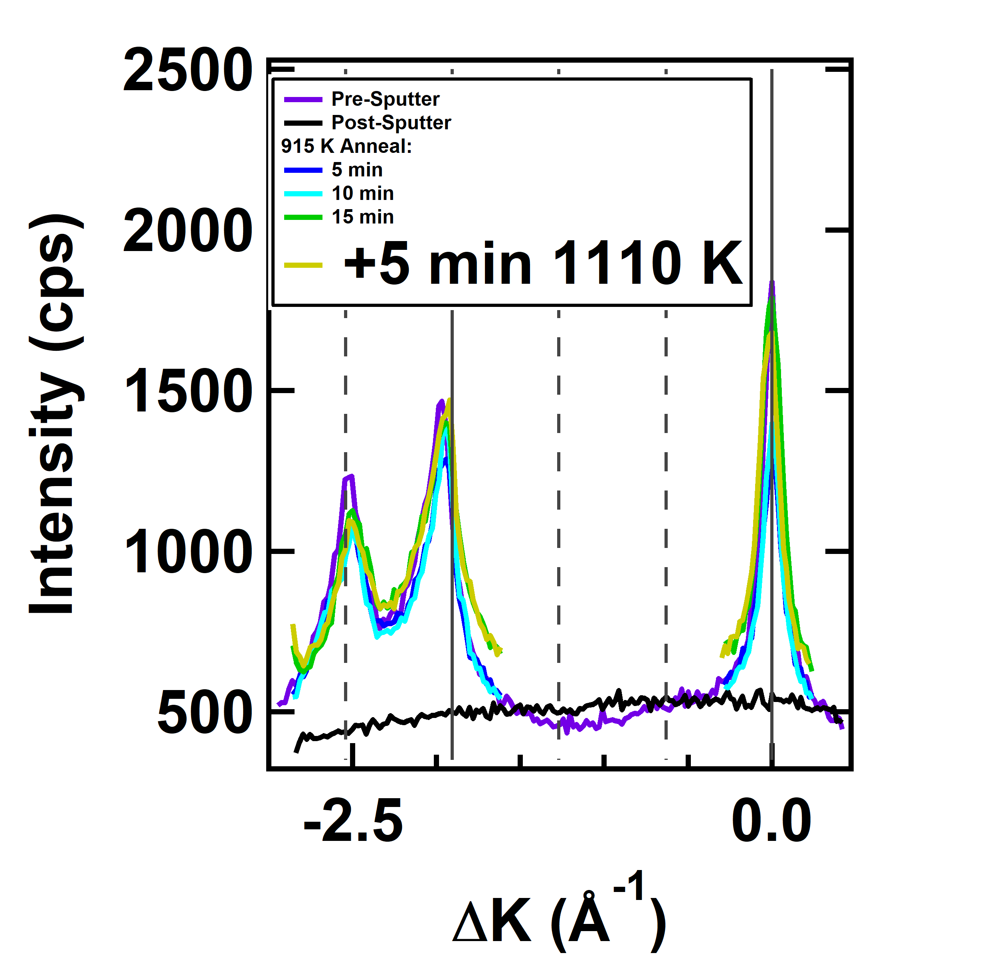
Can Pushing to Higher Temperatures Improve the Surface Order Further?
Surface order can be measured in terms of peak intensities or peak widths
Peak width corresponds to domain sizes at surface
Both intensities and widths tend to level off above 900 K
There does not seem to be a temperature significantly above 900 K at which a new level of crystalline order is obtained.
M. F. Van Duinen, C. Mendez, T. A. Arias, S. J. Sibener. In Progress

Slide 22
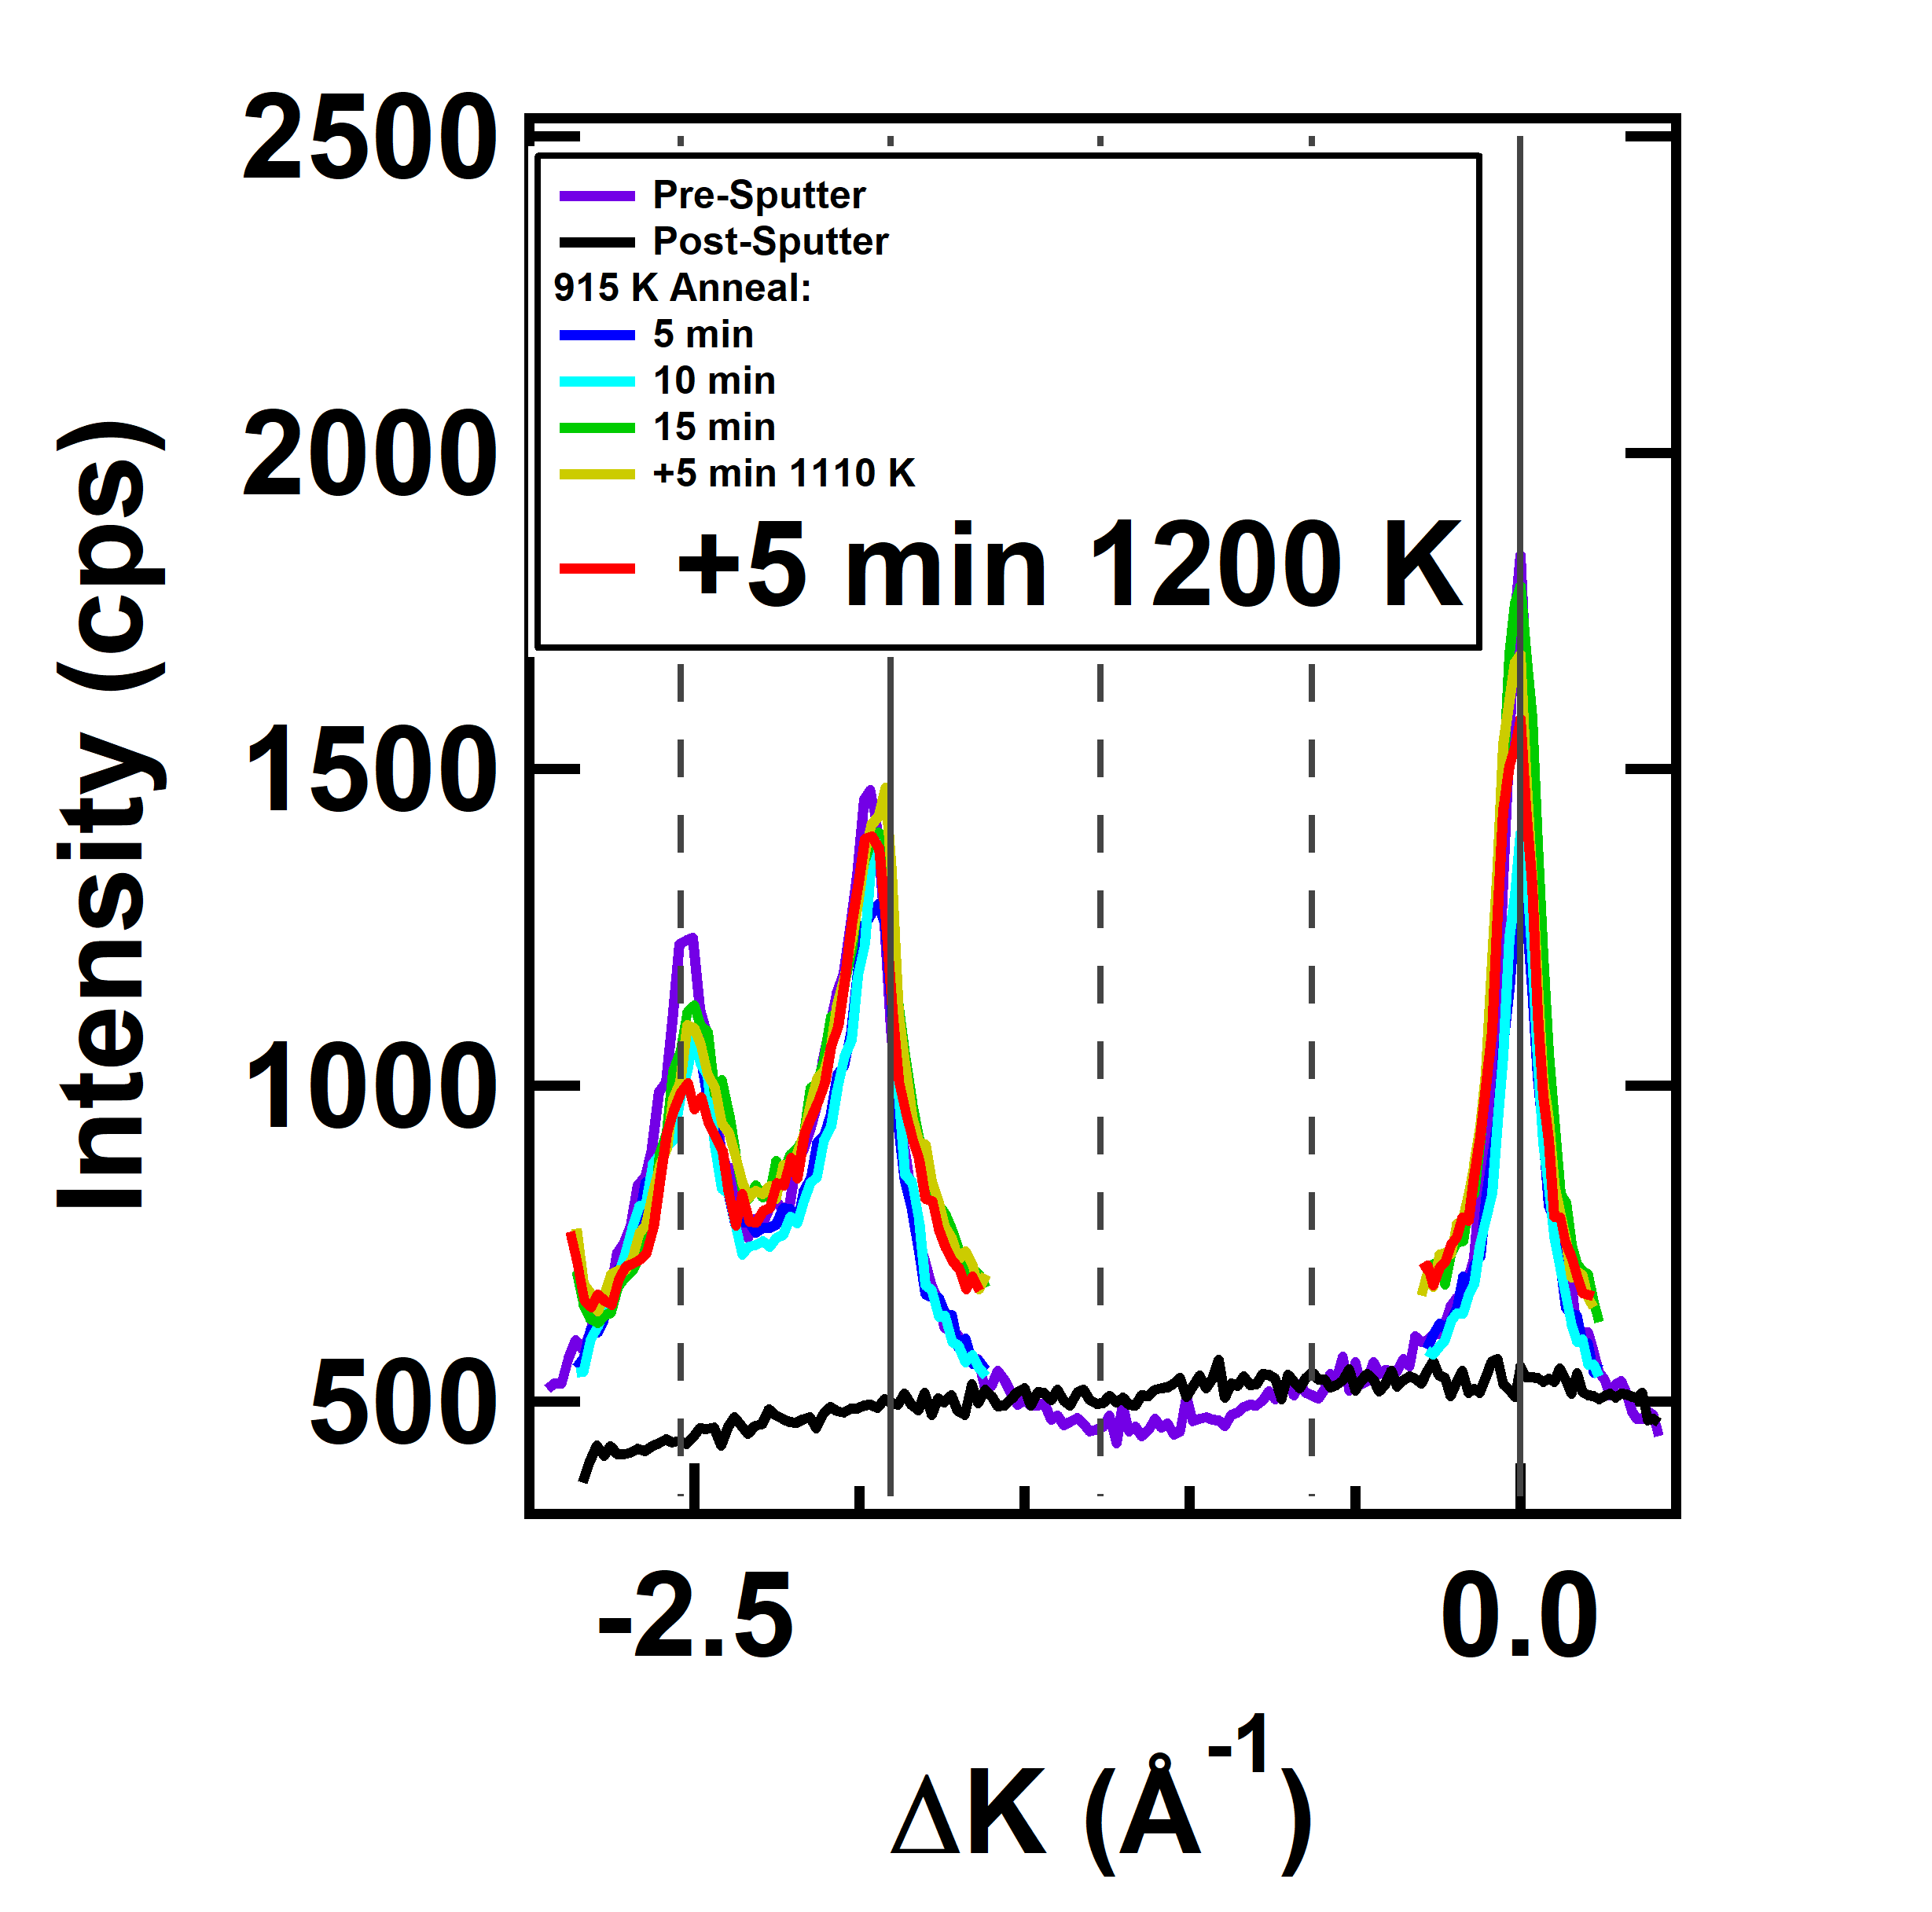
Can Pushing to Higher Temperatures Improve the Surface Order Further?
Surface order can be measured in terms of peak intensities or peak widths
Peak width corresponds to domain sizes at surface
Both intensities and widths tend to level off above 900 K
There does not seem to be a temperature significantly above 900 K at which a new level of crystalline order is obtained.
M. F. Van Duinen, C. Mendez, T. A. Arias, S. J. Sibener. In Progress

Slide 23
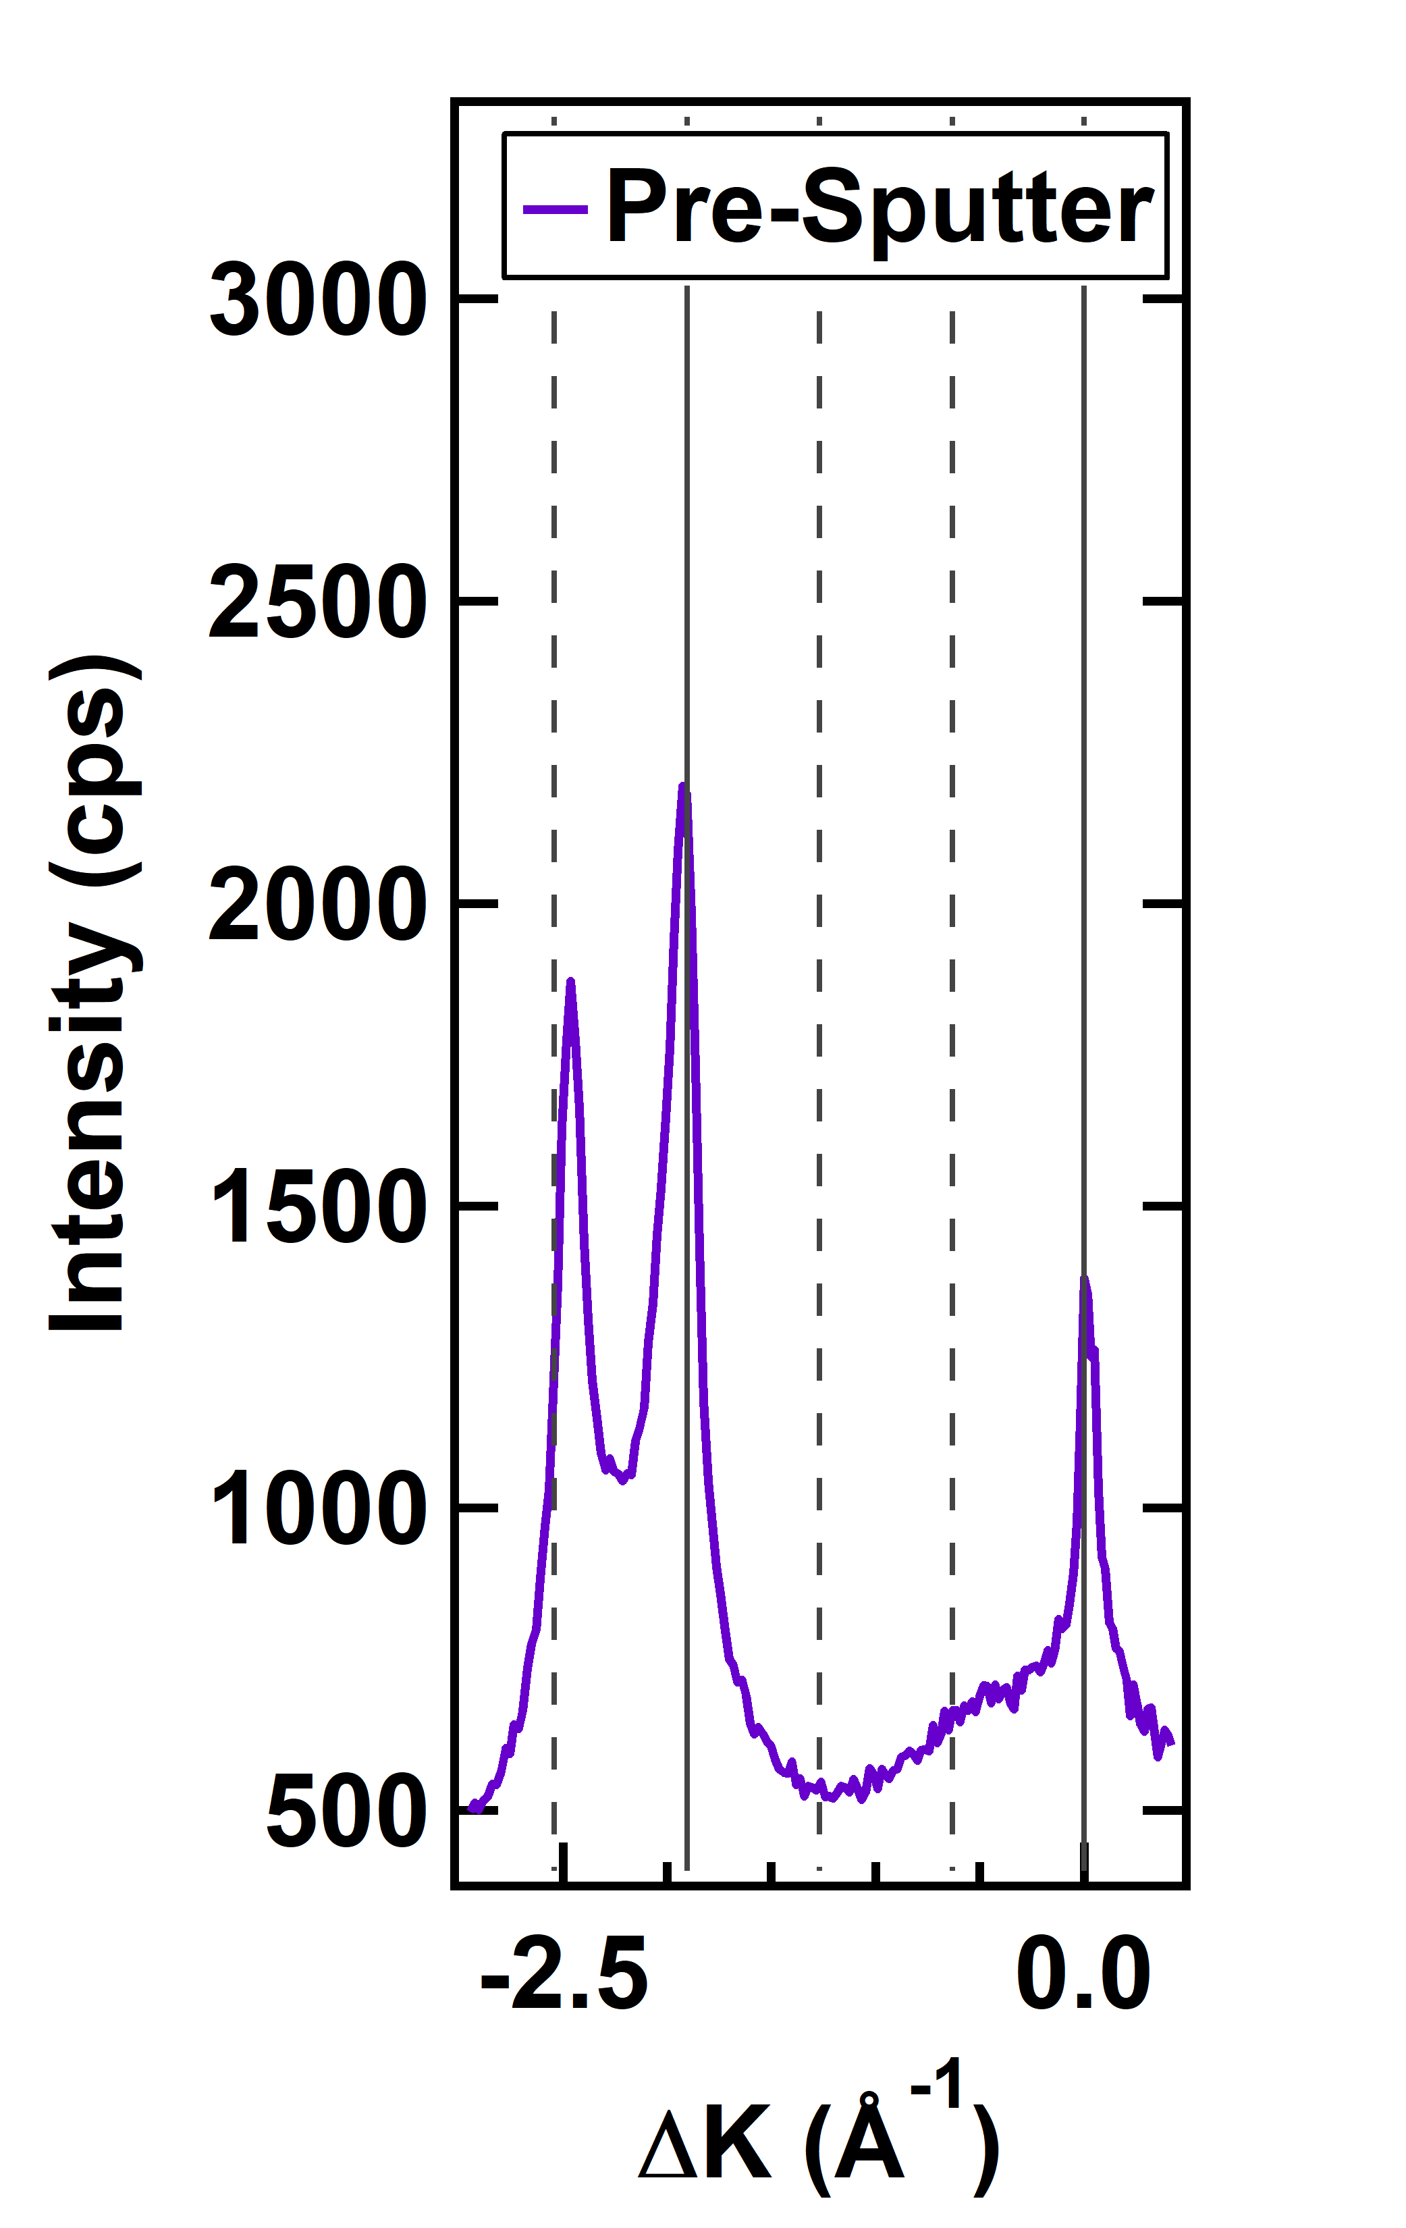
Restoring Order from Lower Temperatures
Ideally should be able to decrease temperature and watch peak slowly come in
At 800 K, some recovery happens, but complete recovery will never happen
At timescales of diffraction detection, peak recovery appears to be instantaneous
The restoration of surface order for the sputtered (3x1)-O surface appears to happen as a function of temperature, but not time in any meaningful, reproducible way.
M. F. Van Duinen, C. Mendez, T. A. Arias, S. J. Sibener. In Progress

Slide 24
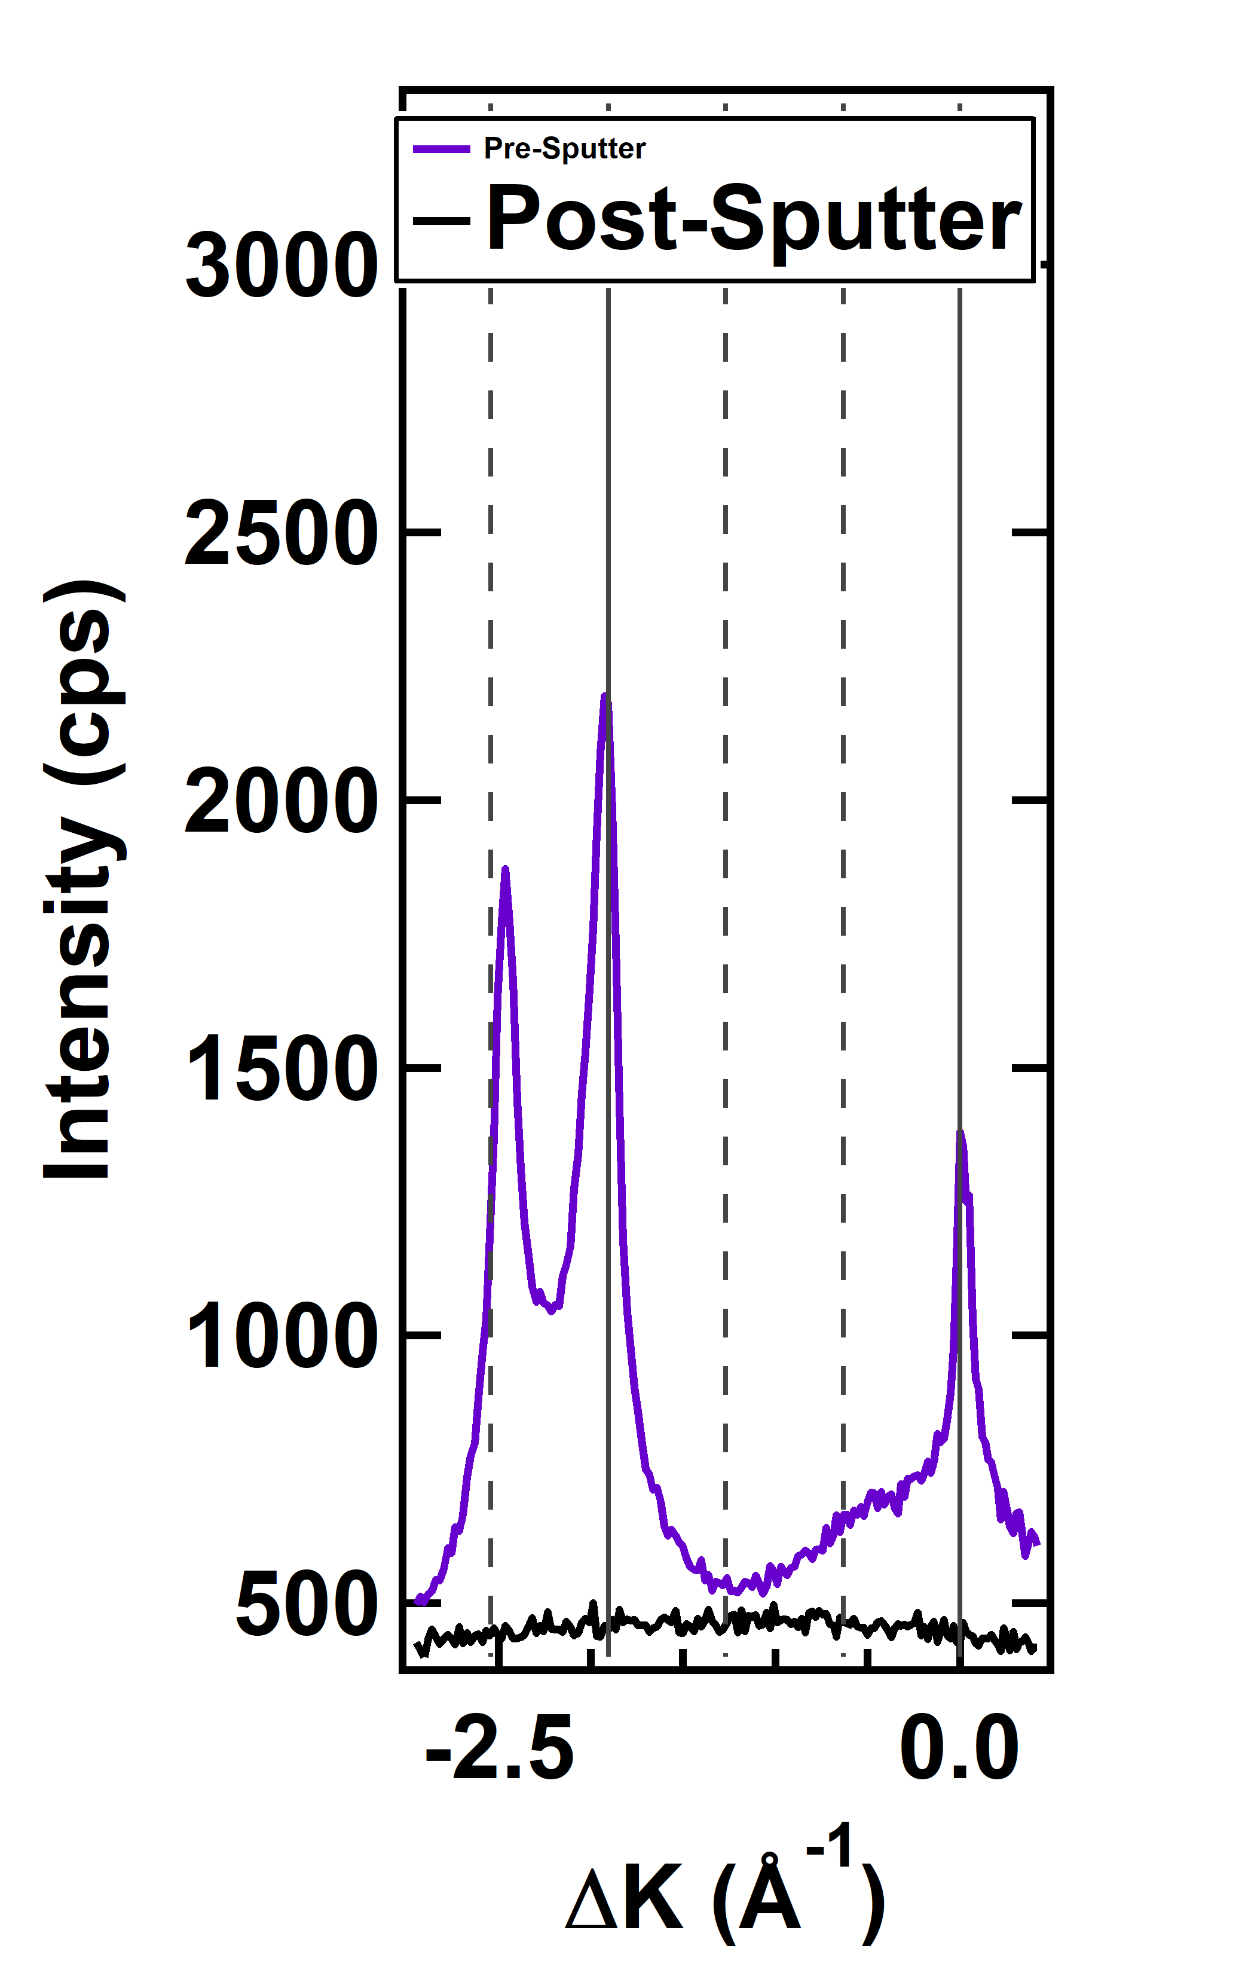
Restoring Order from Lower Temperatures
Ideally should be able to decrease temperature and watch peak slowly come in
At 800 K, some recovery happens, but complete recovery will never happen
At timescales of diffraction detection, peak recovery appears to be instantaneous
The restoration of surface order for the sputtered (3x1)-O surface appears to happen as a function of temperature, but not time in any meaningful, reproducible way.
M. F. Van Duinen, C. Mendez, T. A. Arias, S. J. Sibener. In Progress

Slide 25
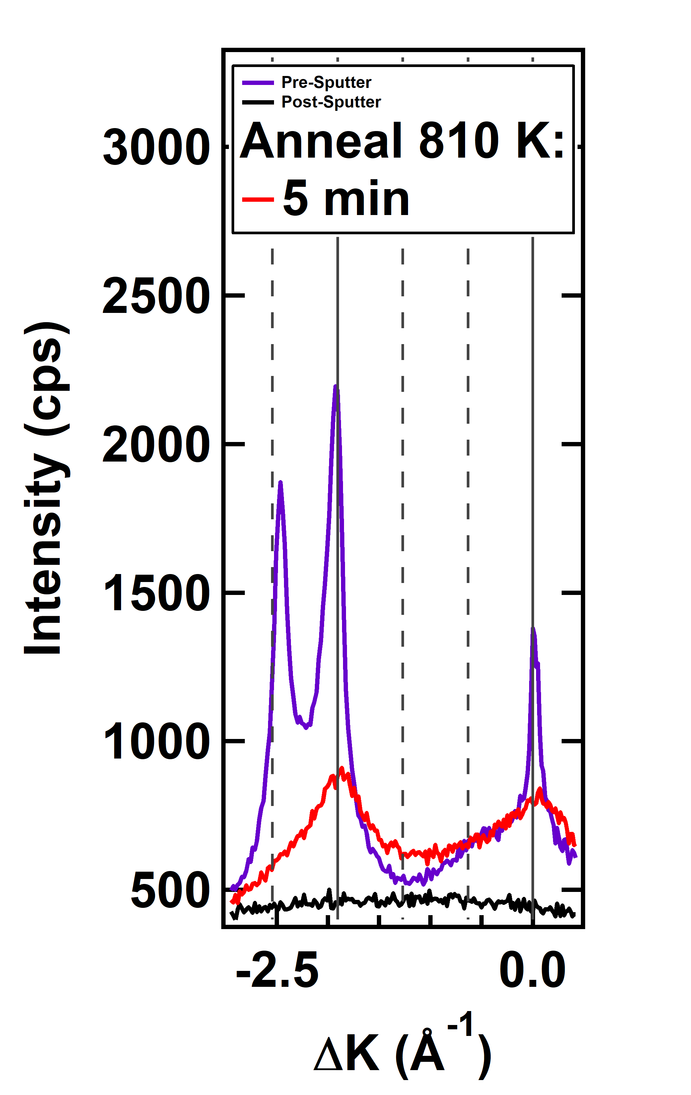
Restoring Order from Lower Temperatures
Ideally should be able to decrease temperature and watch peak slowly come in
At 800 K, some recovery happens, but complete recovery will never happen
At timescales of diffraction detection, peak recovery appears to be instantaneous
The restoration of surface order for the sputtered (3x1)-O surface appears to happen as a function of temperature, but not time in any meaningful, reproducible way.
M. F. Van Duinen, C. Mendez, T. A. Arias, S. J. Sibener. In Progress

Slide 26
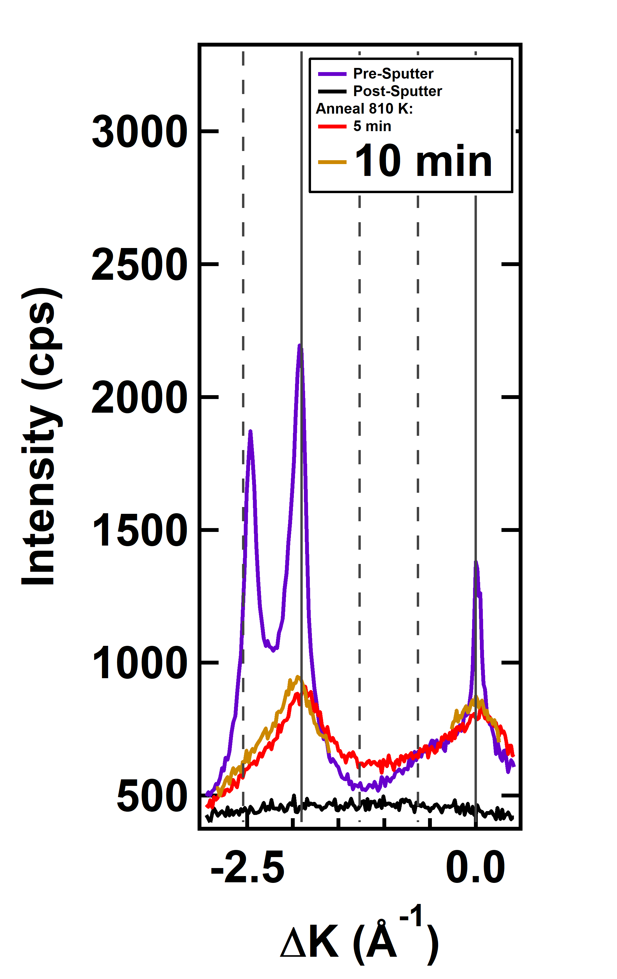
Restoring Order from Lower Temperatures
Ideally should be able to decrease temperature and watch peak slowly come in
At 800 K, some recovery happens, but complete recovery will never happen
At timescales of diffraction detection, peak recovery appears to be instantaneous
The restoration of surface order for the sputtered (3x1)-O surface appears to happen as a function of temperature, but not time in any meaningful, reproducible way.
M. F. Van Duinen, C. Mendez, T. A. Arias, S. J. Sibener. In Progress

Slide 27
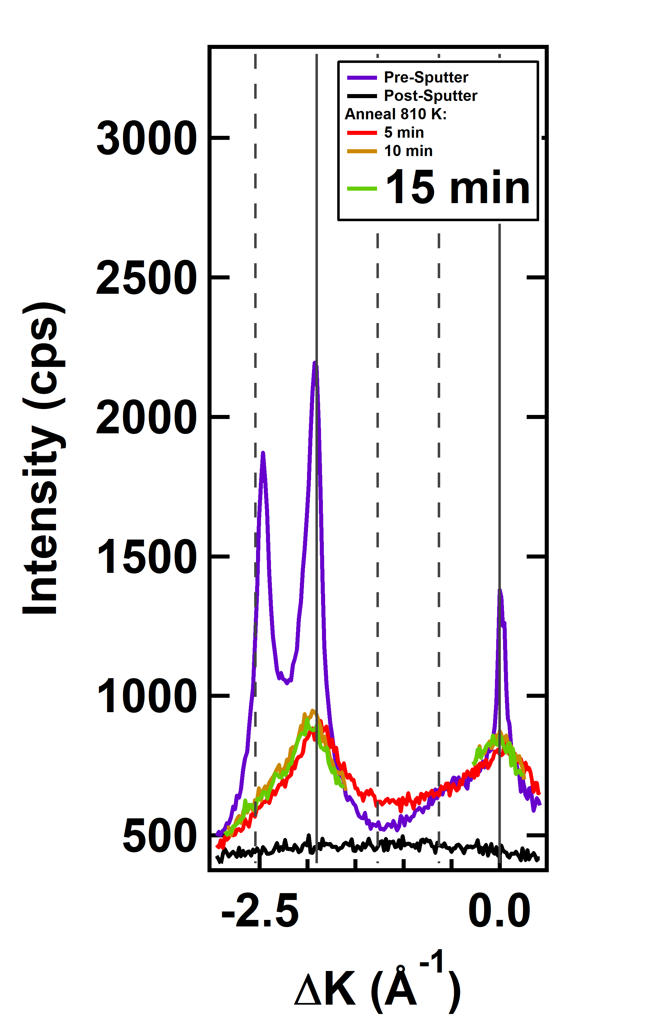
Restoring Order from Lower Temperatures
Ideally should be able to decrease temperature and watch peak slowly come in
At 800 K, some recovery happens, but complete recovery will never happen
At timescales of diffraction detection, peak recovery appears to be instantaneous
The restoration of surface order for the sputtered (3x1)-O surface appears to happen as a function of temperature, but not time in any meaningful, reproducible way.
M. F. Van Duinen, C. Mendez, T. A. Arias, S. J. Sibener. In Progress

Slide 28
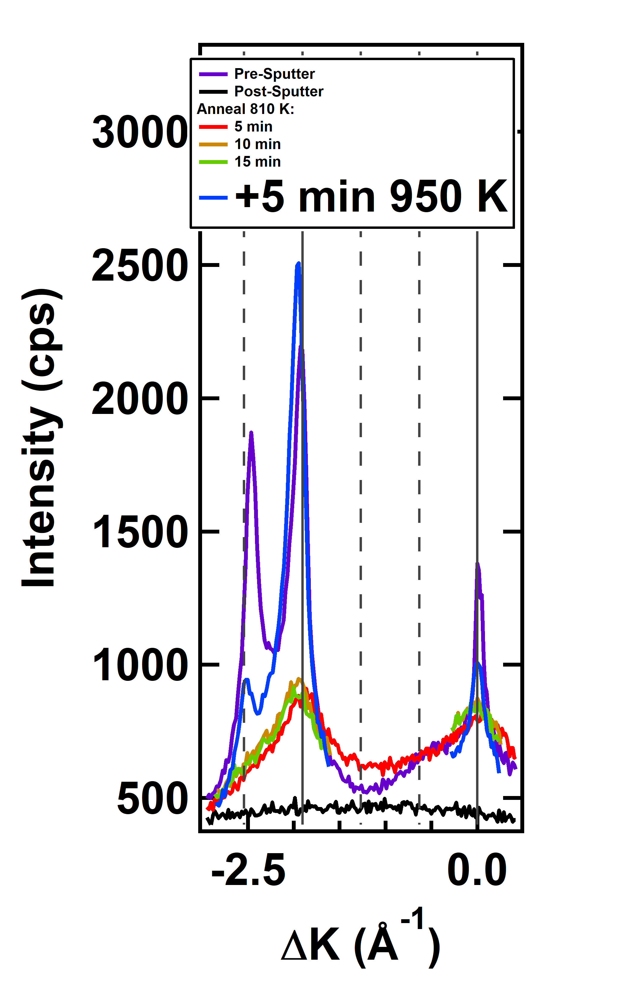
Restoring Order from Lower Temperatures
Ideally should be able to decrease temperature and watch peak slowly come in
At 800 K, some recovery happens, but complete recovery will never happen
At timescales of diffraction detection, peak recovery appears to be instantaneous
The restoration of surface order for the sputtered (3x1)-O surface appears to happen as a function of temperature, but not time in any meaningful, reproducible way.
M. F. Van Duinen, C. Mendez, T. A. Arias, S. J. Sibener. In Progress

Slide 29
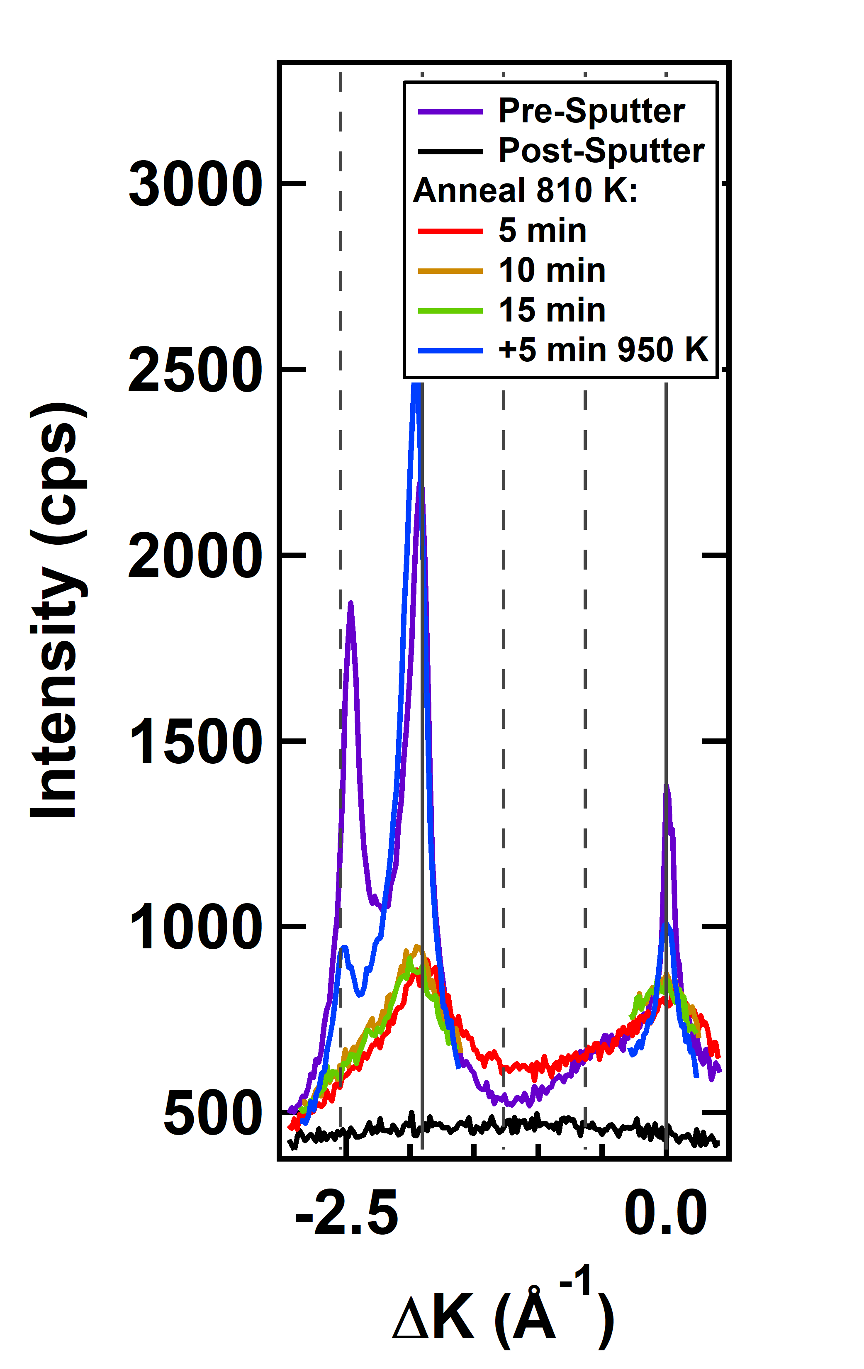
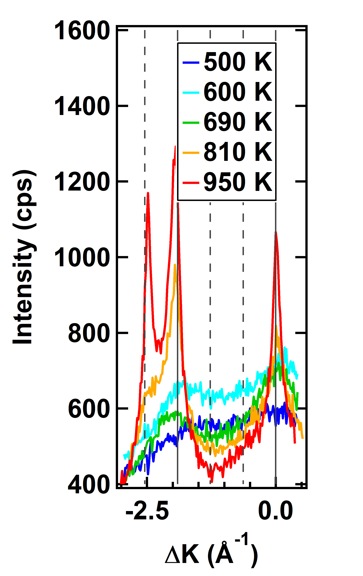
Restoring Order from Lower Temperatures
Ideally should be able to decrease temperature and watch peak slowly come in
At 800 K, some recovery happens, but complete recovery will never happen
At timescales of diffraction detection, peak recovery appears to be instantaneous
The restoration of surface order for the sputtered (3x1)-O surface appears to happen as a function of temperature, but not time in any meaningful, reproducible way.
M. F. Van Duinen, C. Mendez, T. A. Arias, S. J. Sibener. In Progress

Slide 30
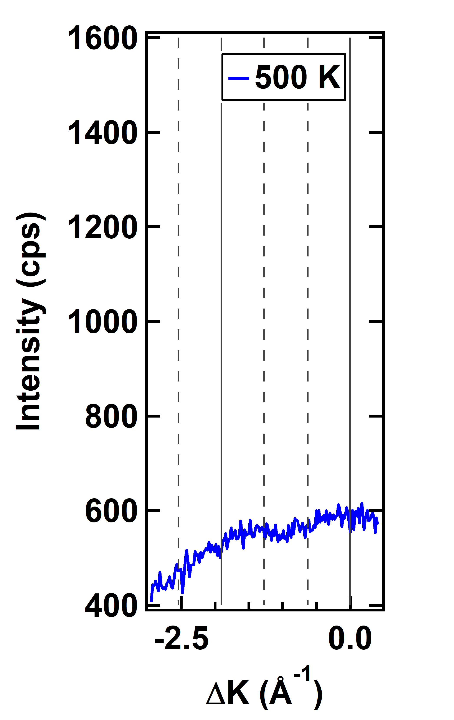
Restoring Order from Lower Temperatures
Ideally should be able to decrease temperature and watch peak slowly come in
At 800 K, some recovery happens, but complete recovery will never happen
At timescales of diffraction detection, peak recovery appears to be instantaneous
The restoration of surface order for the sputtered (3x1)-O surface appears to happen as a function of temperature, but not time in any meaningful, reproducible way.

Slide 31
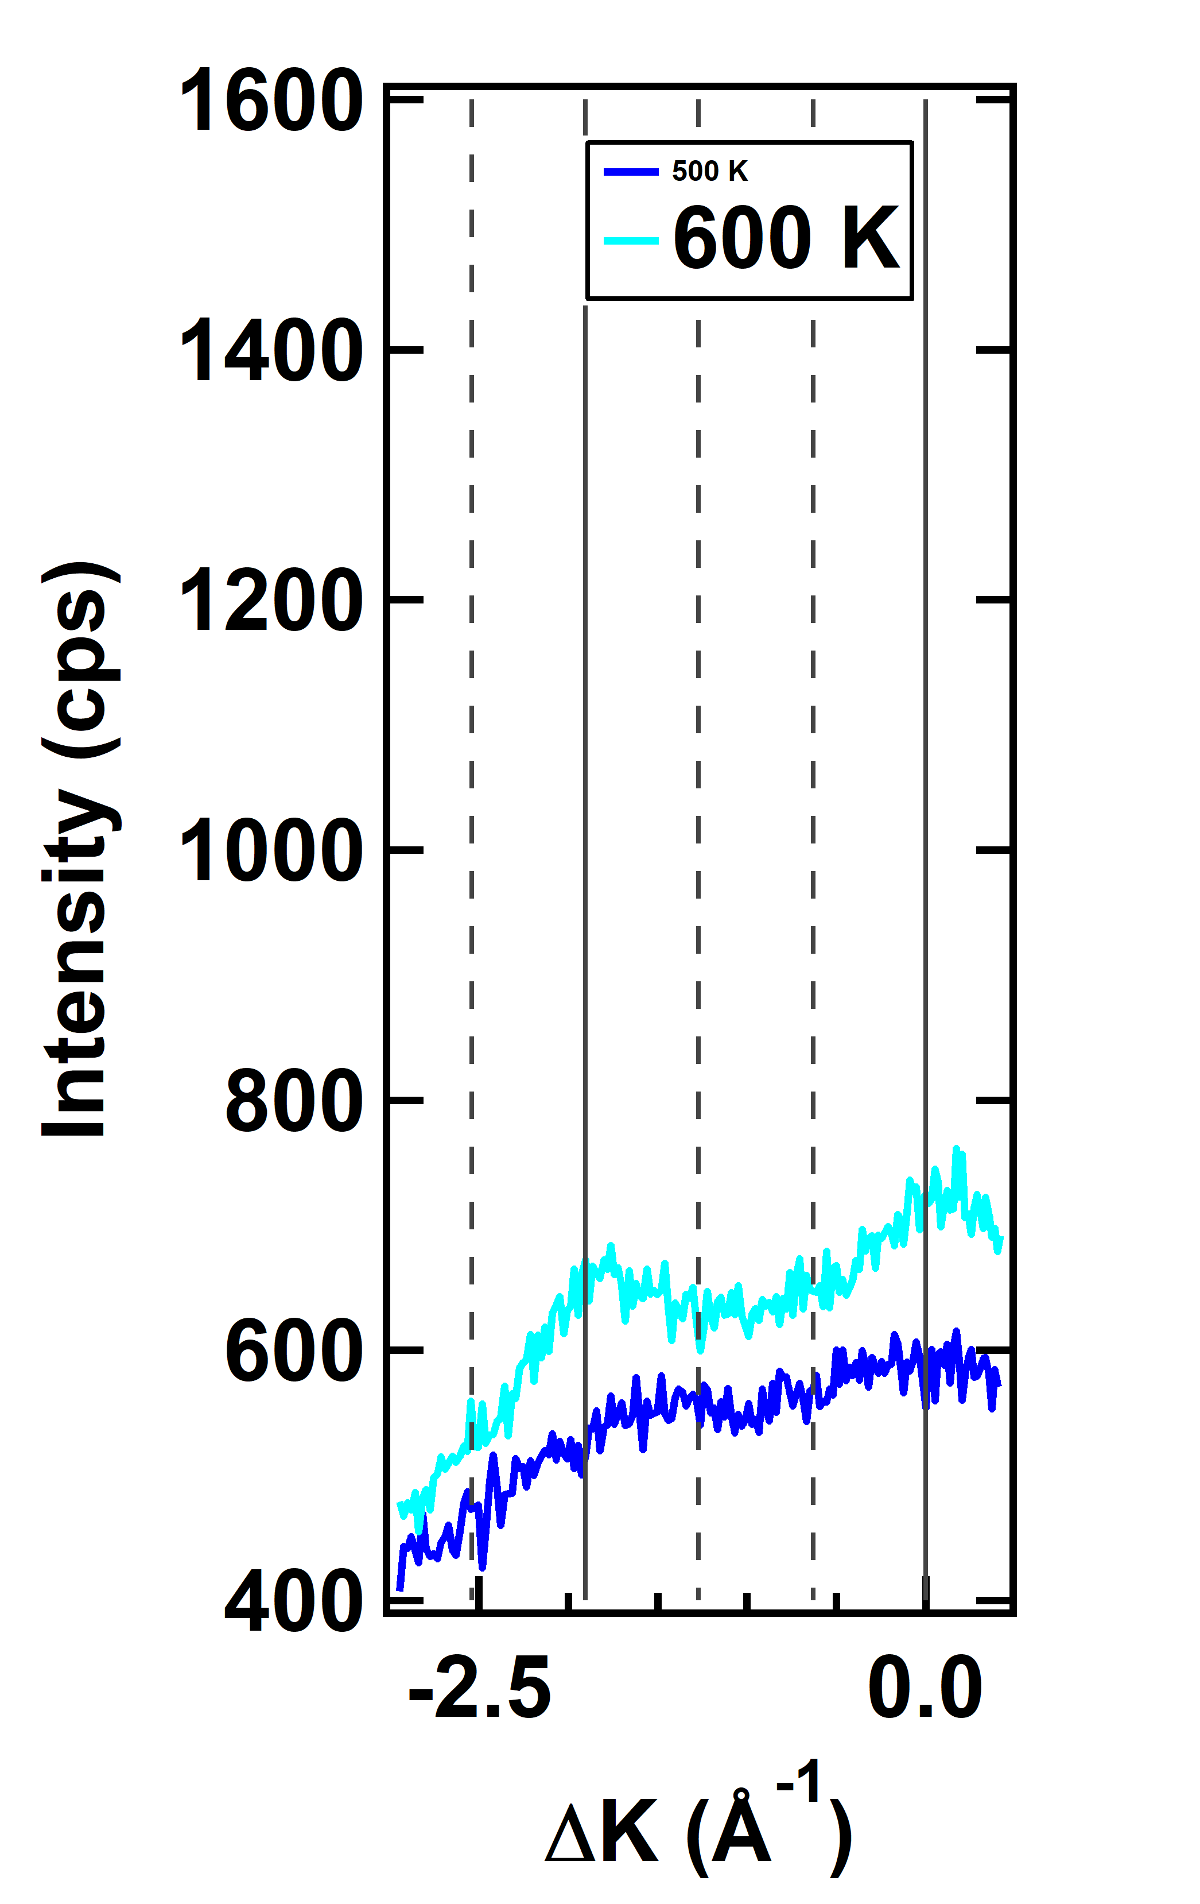
Restoring Order from Lower Temperatures
Ideally should be able to decrease temperature and watch peak slowly come in
At 800 K, some recovery happens, but complete recovery will never happen
At timescales of diffraction detection, peak recovery appears to be instantaneous
The restoration of surface order for the sputtered (3x1)-O surface appears to happen as a function of temperature, but not time in any meaningful, reproducible way.

Slide 32
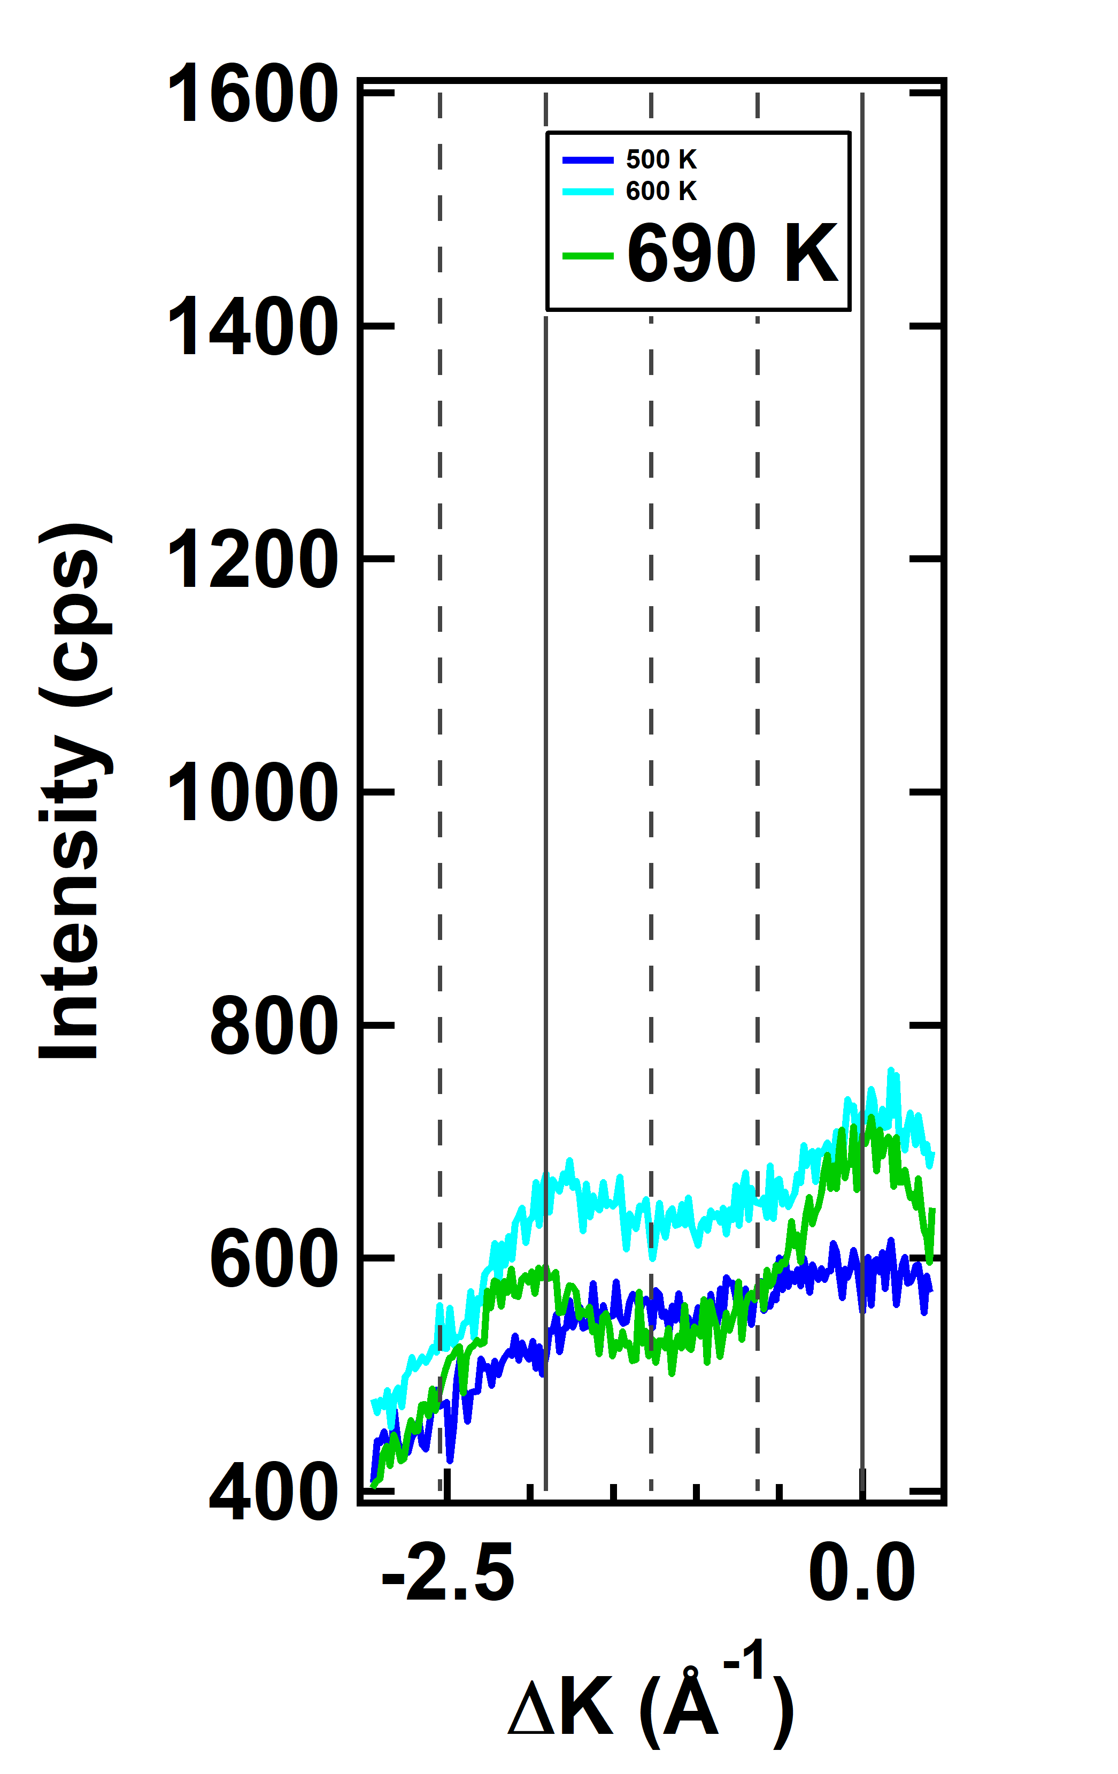
Restoring Order from Lower Temperatures
Ideally should be able to decrease temperature and watch peak slowly come in
At 800 K, some recovery happens, but complete recovery will never happen
At timescales of diffraction detection, peak recovery appears to be instantaneous
The restoration of surface order for the sputtered (3x1)-O surface appears to happen as a function of temperature, but not time in any meaningful, reproducible way.

Slide 33
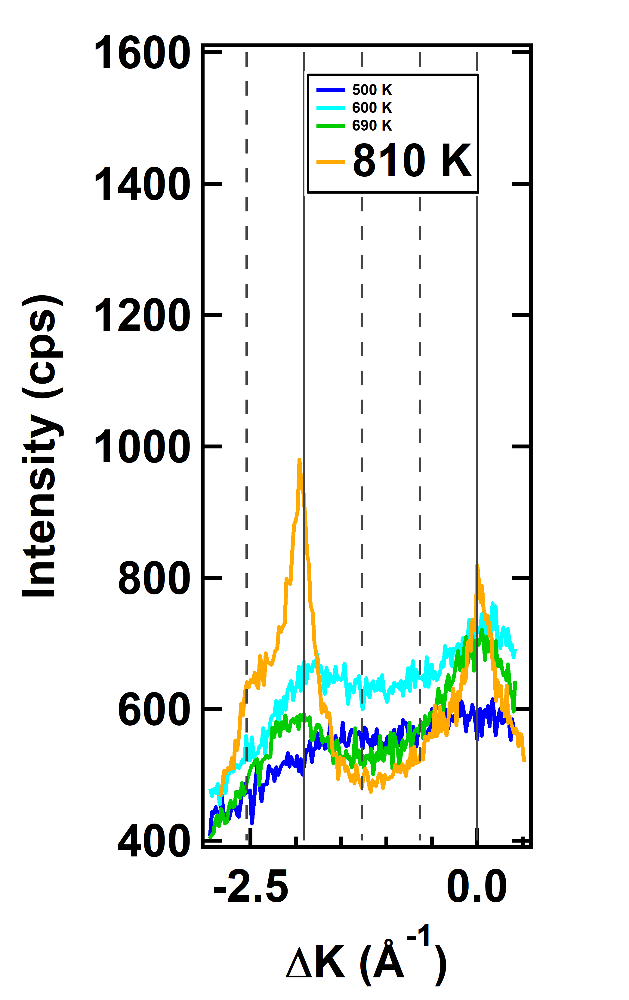
Restoring Order from Lower Temperatures
Ideally should be able to decrease temperature and watch peak slowly come in
At 800 K, some recovery happens, but complete recovery will never happen
At timescales of diffraction detection, peak recovery appears to be instantaneous
The restoration of surface order for the sputtered (3x1)-O surface appears to happen as a function of temperature, but not time in any meaningful, reproducible way.

Slide 34
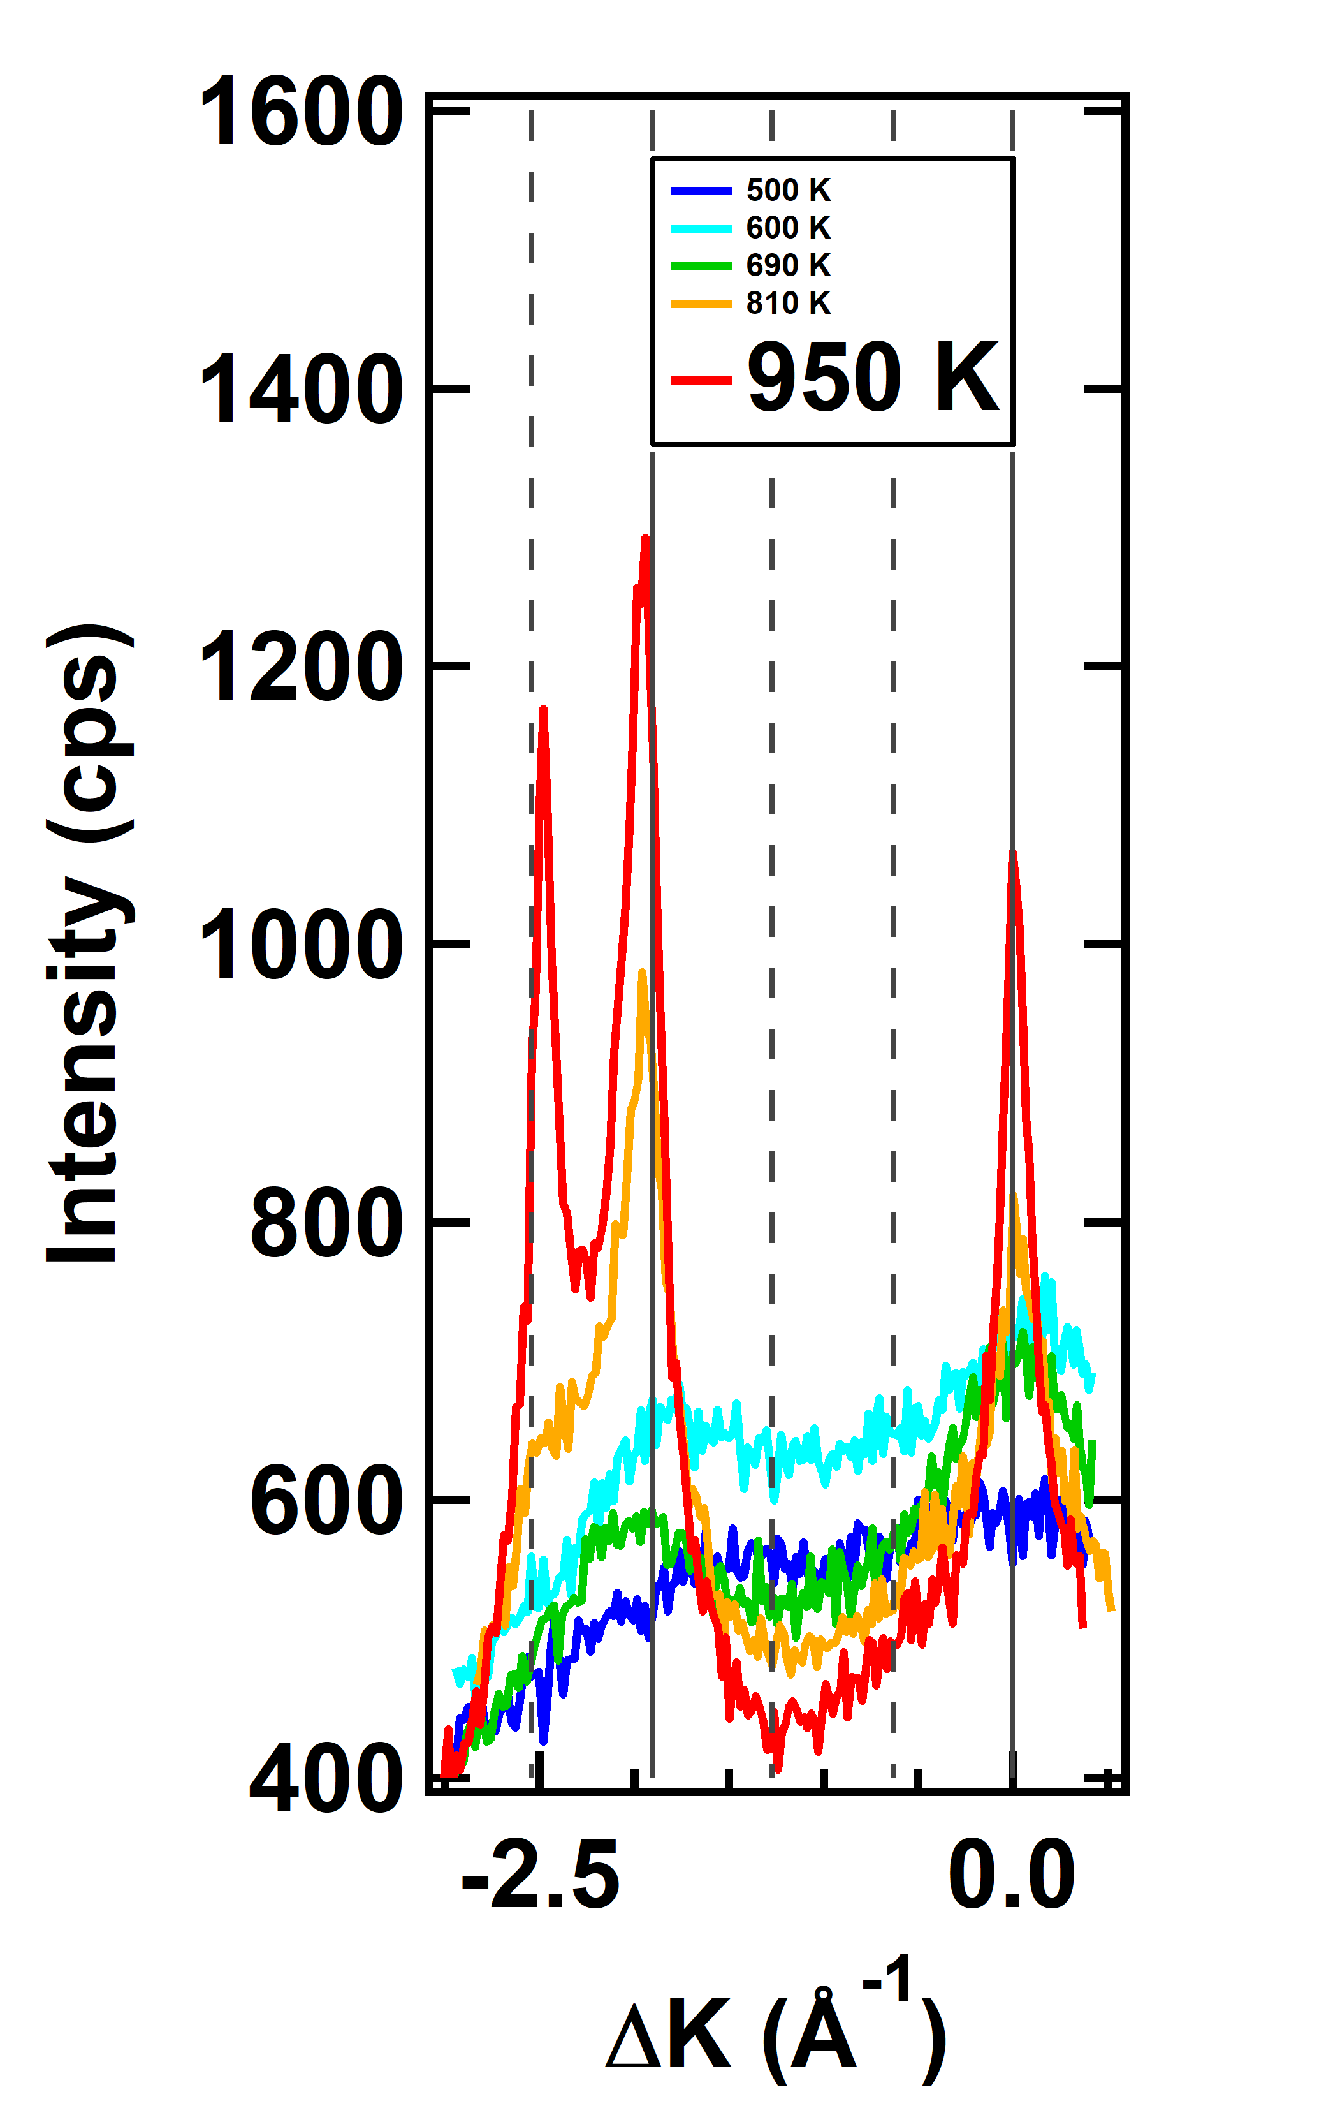
Restoring Order from Lower Temperatures
Ideally should be able to decrease temperature and watch peak slowly come in
At 800 K, some recovery happens, but complete recovery will never happen
At timescales of diffraction detection, peak recovery appears to be instantaneous
The restoration of surface order for the sputtered (3x1)-O surface appears to happen as a function of temperature, but not time in any meaningful, reproducible way.

Slide 35
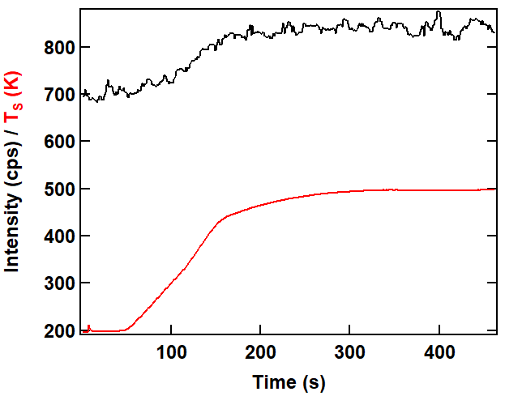
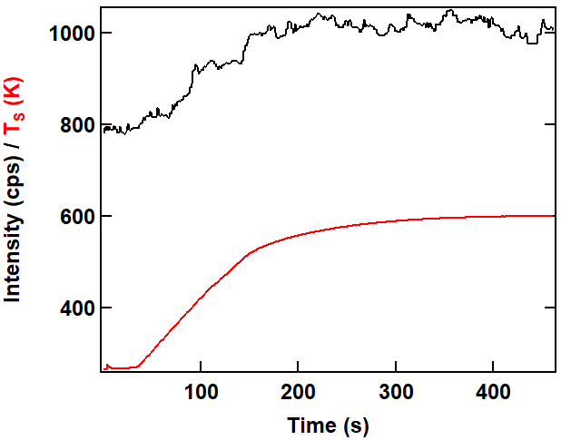
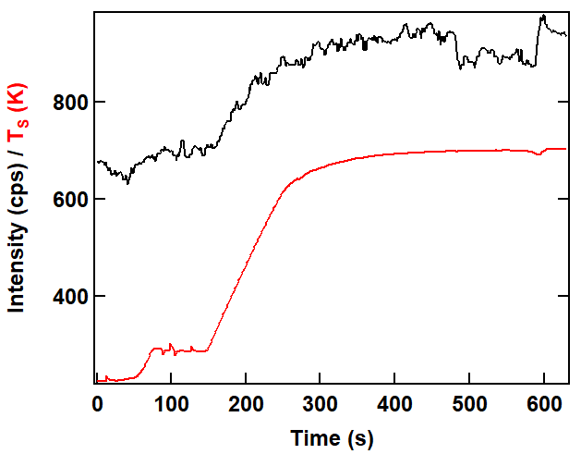
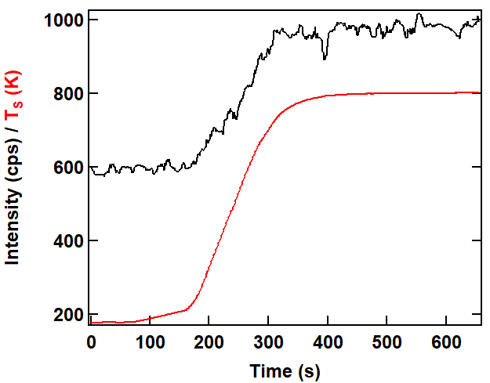
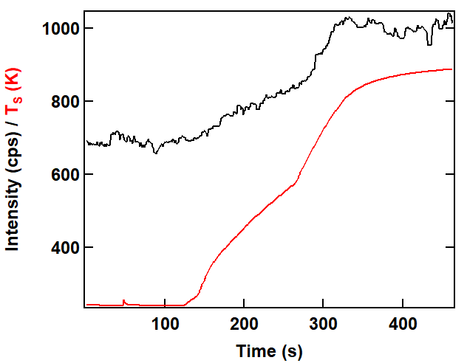
Intensity Scales with Temperature, Not Time
Recovery of diffraction is instantaneous, and it does not seem to be dependent on anneal times at least for the specular peak.

Slide 36
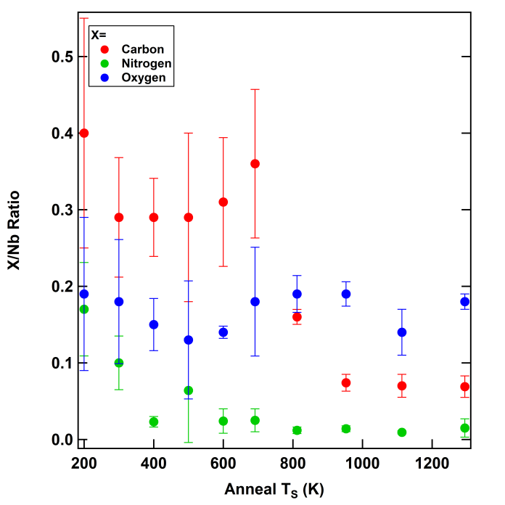
What is Changing Elementally at ~900 K?
Oxygen concentration is remarkably steady
Nitrogen falls off around 400 K
The temperatures at which diffraction returns are characterized by a dropoff in carbon concentration
The restoration of surface order for the sputtered (3x1)-O surface appears to be due to the departure of carbon.
M. F. Van Duinen, C. Mendez, T. A. Arias, S. J. Sibener. In Progress

Slide 37
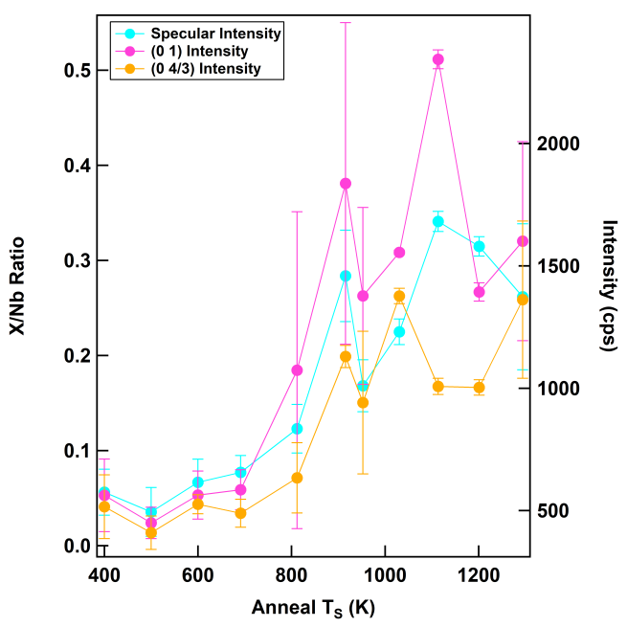
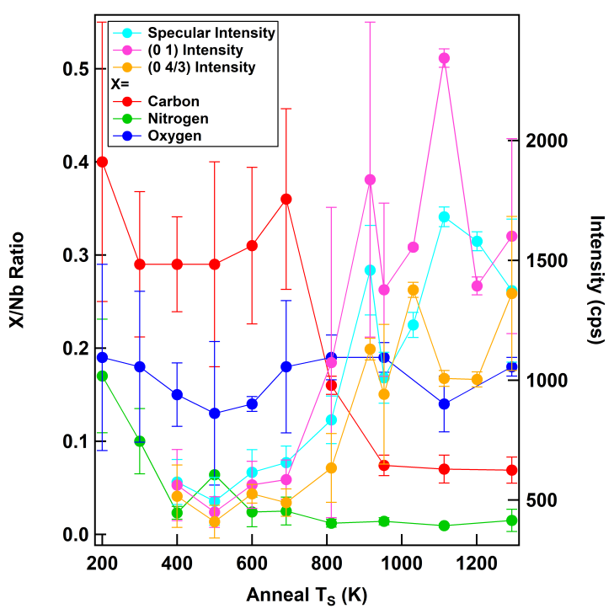
Averages of All Diffractions and Auger Scans
M. F. Van Duinen, C. Mendez, T. A. Arias, S. J. Sibener. In Progress

Slide 38
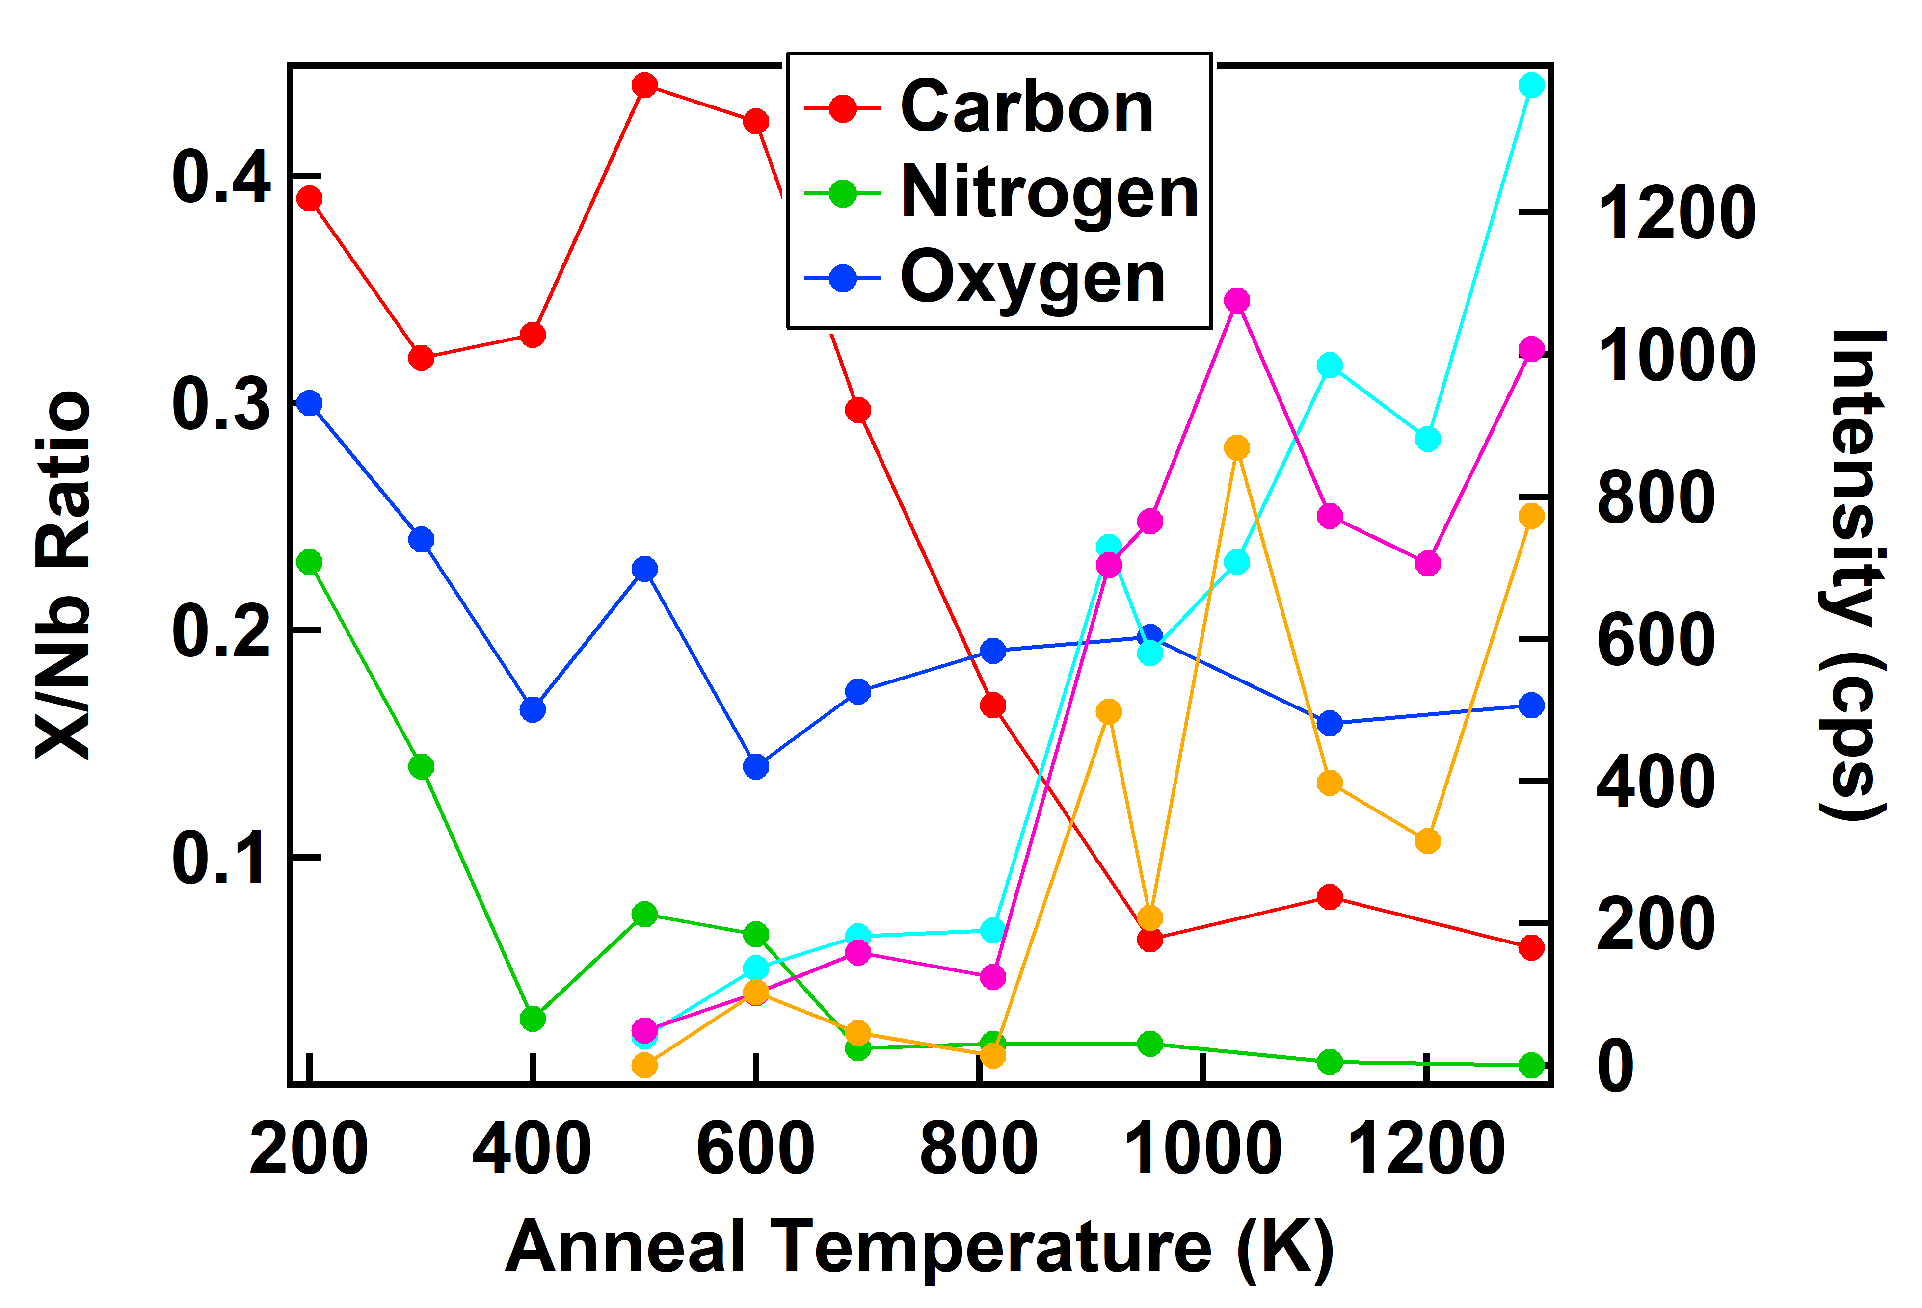
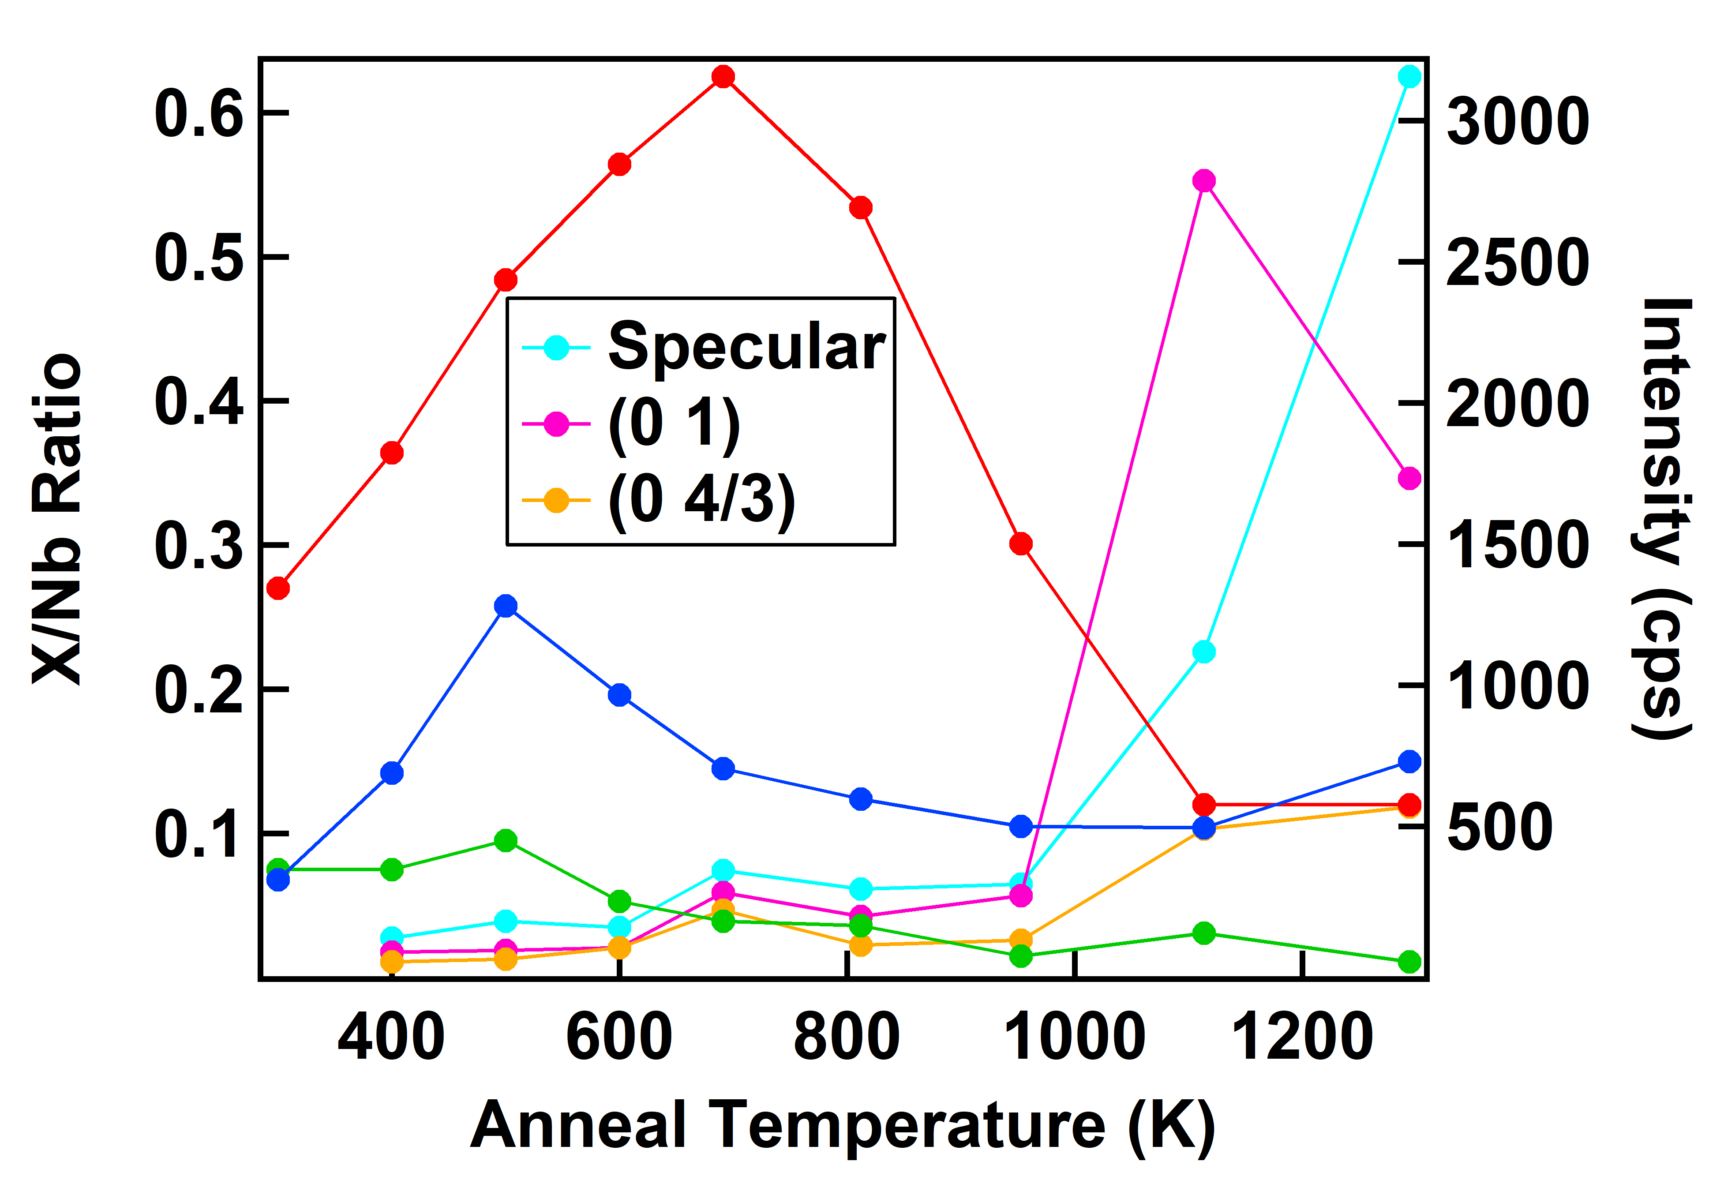
A Closer Look at Two Runs
The return of diffraction intensity can be described more accurately and completely by the departure of carbon than by any specific temperature.
M. F. Van Duinen, C. Mendez, T. A. Arias, S. J. Sibener. In Progress

Slide 39
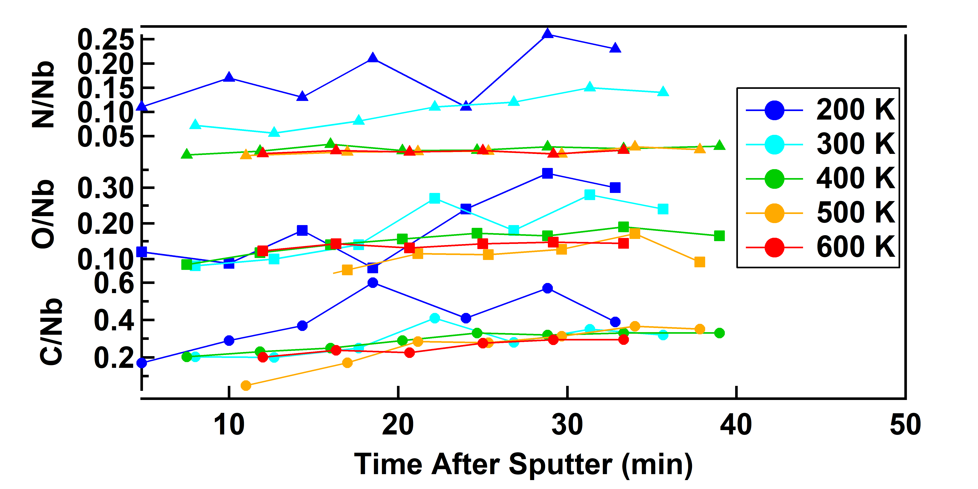
Time Dependence of Elemental Composition
Auger studies can help take a look at how elements are changing at the surface with temperature and time
Less surface order required as well
Nitrogen concentration drops off quickly around 400 K
Otherwise, mostly levels off more quickly at higher temperatures
Adsorption phenomena dominate the behavior of surface elemental composition at mild heating temperatures.
M. F. Van Duinen, C. Mendez, T. A. Arias, S. J. Sibener. In Progress

Slide 40
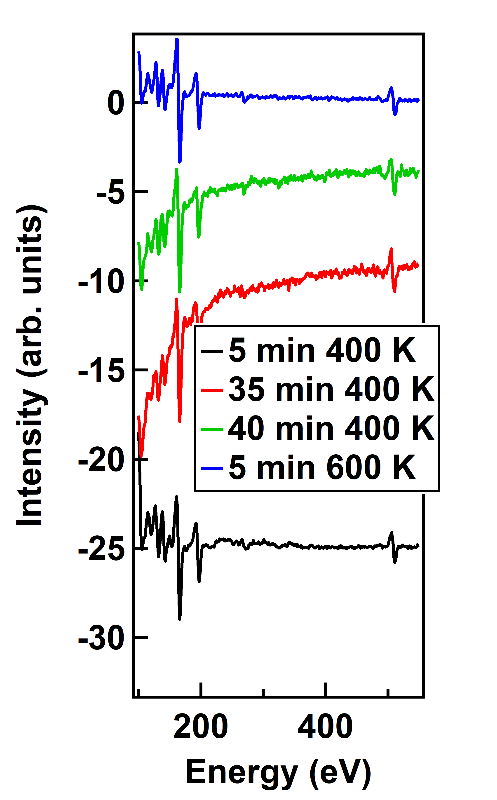
Diffusion or Desorption?
A diffusive phase transition should be reversible
Carbon concentrations do not increase after sitting at 400 K at timescales C would return to a sputtered surface
Trying to accelerate and/or force C back to the surface at 600 K also does not work
The departure of carbon seems to be due to an irreversible desorption of carbon rather than diffusion of carbon into the bulk.
M. F. Van Duinen, C. Mendez, T. A. Arias, S. J. Sibener. In Progress

Slide 41



Exploring Activation Energy

Slide 42


The Desorption of CO and Oxygen Diffusion
Carbon desorbs from the Nb(100) surface as CO, not carbon, as demonstrated in earlier, foundational studies
If CO is going away, why is oxygen concentration remarkably stable?
Oxygen diffuses both into and out of the bulk much more readily than C and N
The stability of oxygen surface concentration as CO desorbs can be rationalized by oxygen readily diffusing to the surface to take its place.

Slide 43

More to the Story: Theory and Adsorption
The adsorption affinity of the (3x1)-O surface greatly differs between ordered and disordered.
N does not adsorb particularly well to any site
O adsorbs better to the ordered oxide than the disordered oxide
C adsorbs significantly better to the disordered (3x1)-O than the ordered (3x1)-O
Cristobal Mendez
Species | Ordered Oxide | Lower O Vacancy | Top O Vacancy
C | +1.325 eV | +1.805 eV | -0.875 eV
N | +0.415 eV | +0.667 eV | +0.875 eV
O | -0.535 eV | -0.067 eV | +0.165 eV
Adsorption energies from theory further explain why carbon does not return after order is restored.
M. F. Van Duinen, C. Mendez, T. A. Arias, S. J. Sibener. In Progress

Slide 44
In Summary
Ordering of the sputtered (3x1)-O Nb(100) surface is a temperature-dependent phenomenon that happens instantaneously within the time scales accessible to HAS
Using AES, the ordering phenomenon is identified as the departure of carbon
  A more reliable indicator that the surface is properly ordered than any specific temperature
Using a combination of HAS, AES, and theory, the mechanism has been identified as the desorption of carbon.
Carbon desorption is not only an important phenomenon for removal of contaminants, but it is also an important phenomenon for ordering the surface.

Slide 45



Thanks!
Sibener Group, especially Van and Francisco
CBB, especially Cristobal

Slide 46


Slide 47
Overall Diagram of Heating Apparatus
Cooling Braid
Insulating Ceramics
Mounting Clips
Crystal
Filament
Filament Leads
Thermocouple
Bias

Slide 48



