Slide 1


Zone Plates in the Ultrafast Regime
Anagha Ullattuparambil
Advisor – Siddharth Karkare
Arizona State University
CBB Annual Meeting – 07/10/2026
aullattu@asu.edu

Slide 2
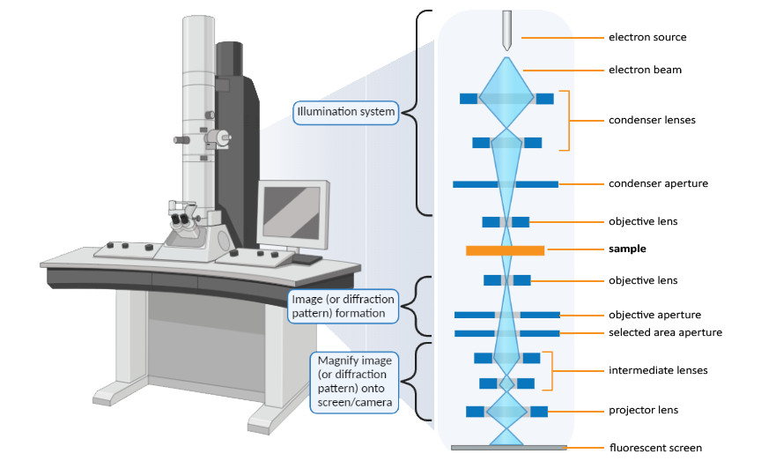
Zone plate
Final aim - Brightest electron source ever!
Electron microscopy applications
Ultrafast applications:
Ultrafast electron diffraction/microscopy
Free-electron lasers (FELs)
…
Pulsed electron beams are produced by shining ultrashort laser pulses onto a photocathode.
A tabletop TEM (Transmission Electron Microscope)
Can an integrated zone-plate photocathode be used for pulsed electron applications?
What are the effects of using ultrashort pulses on the focusing properties of a zone plate?

Slide 3
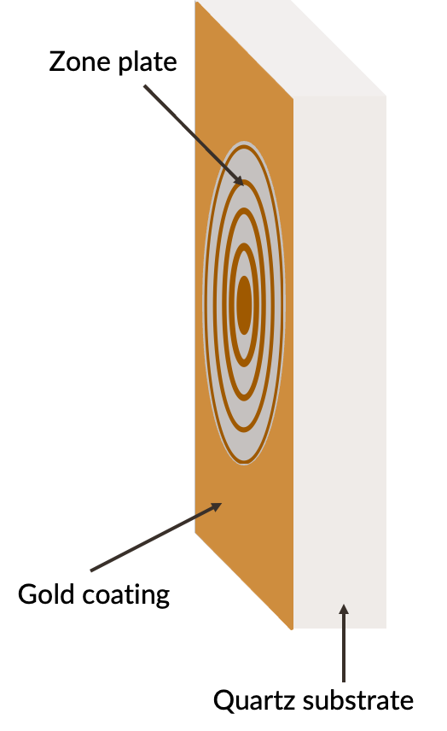

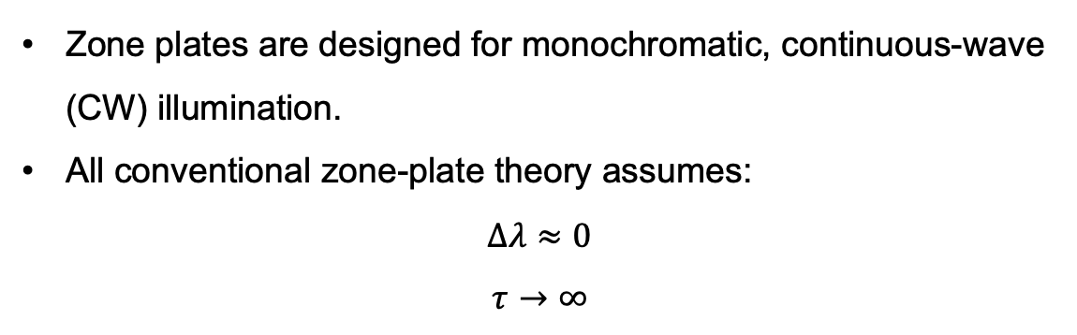
Zone plate beyond continuous wave optics
Photoemitting layer (Cs₃Sb/K₂CsSb)
Zone plates are designed for monochromatic, continuous-wave (CW) illumination.
All conventional zone-plate theory assumes:
$$Δλ≈0$$
$$τ→∞$$
Ultrafast laser illumination:
(1) Spectral bandwidth
(2) Temporal delay
When illumination becomes pulsed:
Is the focus still unchanged?
Does the electron emission spot size remain the same?
Does the electron pulse remain short?

Slide 4
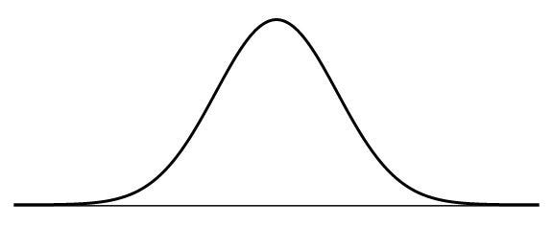
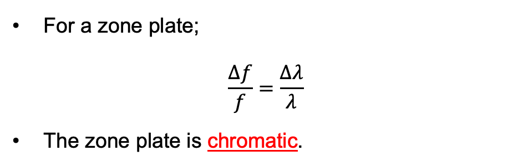
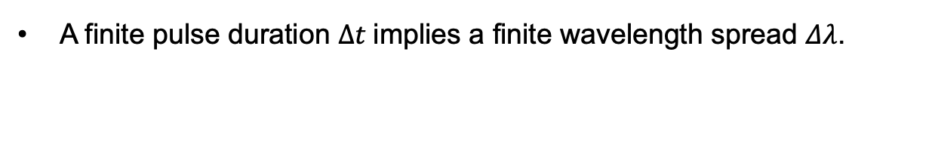
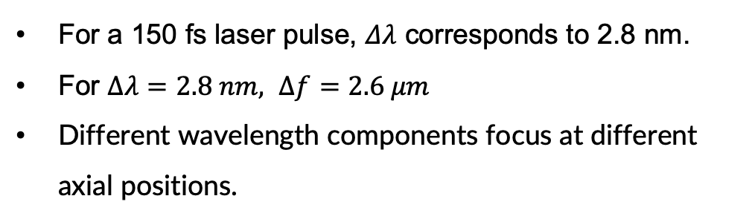

1. Spectral bandwidth
A finite pulse duration $Δt$implies a finite wavelength spread $Δλ$.
For $Δt=150 fs,$
$$Δλ=2.8 nm$$
For a zone plate;
$$\frac{Δf}{f}=\frac{Δλ}{λ}$$
The zone plate is chromatic.
531
532
533
Wavelength (nm)
For a 150 fs laser pulse, $Δλ$ corresponds to 2.8 nm.
For $Δλ=2.8 nm, Δf=2.6 μm$
Different wavelength components focus at different axial positions.
e⁻
e⁻
e⁻
e⁻
Incident light
Incident light

Slide 5
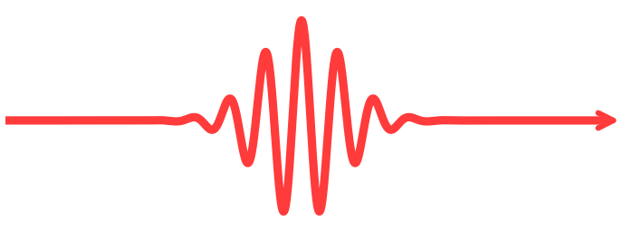
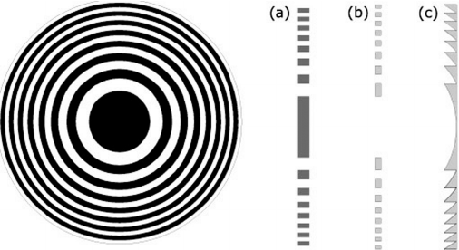
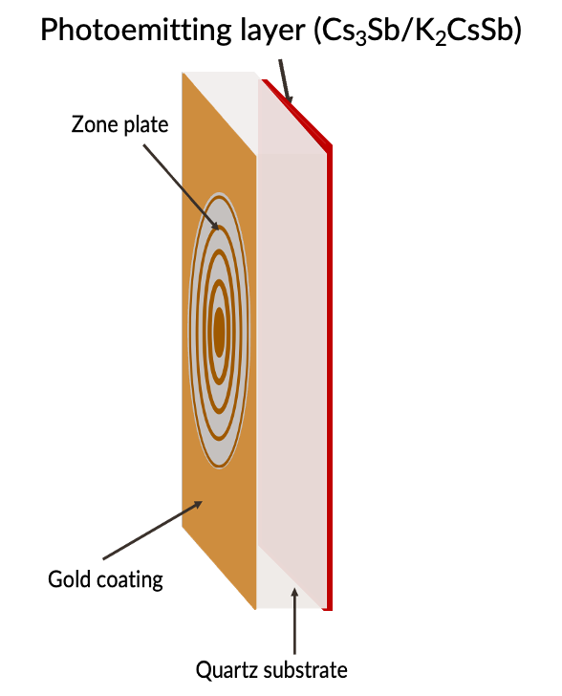
2. Temporal delay
The arrival time difference between wavefronts originating from the center versus the outermost edges of the zone plate.
b
a
f

Slide 6
2. Temporal delay
The arrival time difference between wavefronts originating from the center versus the outermost edges of the zone plate.
b
a

Slide 7


2. Temporal delay
The arrival time difference between wavefronts originating from the center versus the outermost edges of the zone plate
$$→$$
$$Δt_{delay }$$
b
a
Outer edge rays reach the focus only after the central pulse has departed.
Notes:
If the two rings arrive together,
T(r)-T(r')=0,
then
R_a(r,r')=1.
They interfere fully.
If they arrive separated by much more than the pulse duration,
|T(r)-T(r')|\gg \sigma_t,
then
R_a(r,r')\approx 0.
They no longer interfere with each other.

Slide 8
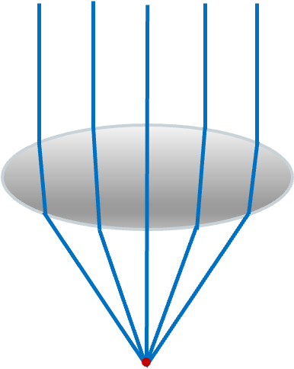
2. Temporal delay – why is it specific for zone plates?
Conventional lens
Zone plate
Light coming from the center and the edges reaches the focus at the same time
Light from the edges arrives late

Slide 9
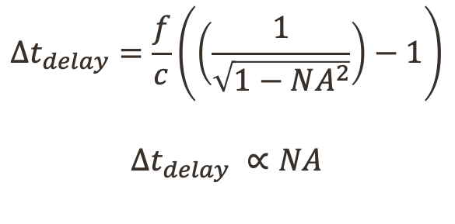
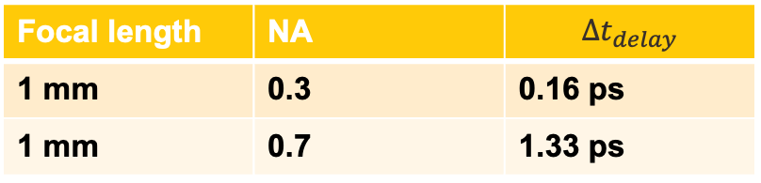
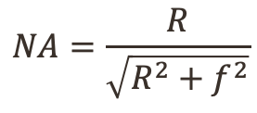
NA and Temporal delay
b
$$NA=\frac{R}{\sqrt{R^{2}+f^{2}}}$$
b
R
a
$$Δt_{delay}=\frac{f}{c}\left(\left(\frac{1}{\sqrt{1−NA^{2}}}\right)−1\right)$$
$$Δt_{delay} ∝NA$$
R
a
Larger the NA, larger is the path difference between the central and edge rays.
f
Focal length | NA | $$Δt_{delay}$$
1 mm | 0.3 | 0.16 ps
1 mm | 0.7 | 1.33 ps
f
Small NA
Large NA
If $Δt_{delay}$ > $τ_{pulse}$: mutual interference is strongly suppressed.

Slide 10
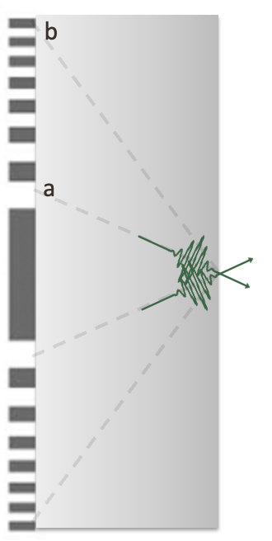
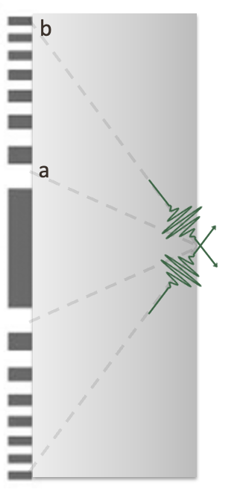
How can it affect the focus?
(1) First, the center zones create a low-resolution focus.
(2) Edge zones follow, building the high-resolution focus.
The focus is not formed instantaneously, but sequentially.
Notes:
So, how exactly does this geometric time delay affect the focus?
When we look at a time-resolved picture of the focus, we find that it doesn't just appear instantaneously. Because the light from different zones arrives at different times, the focus forms sequentially.
As you can see noted in image_26558a.png, the center zones create a low-resolution focus, which is then followed by the high-resolution focus by the edge zones.
Even though diffraction around any single ring is completely coherent, the arrival times of these individual foci are spread out. This causes an effectively incoherent addition of fields at the focal plane over time.
Next, let's see what our experimental data shows us when this time-dependent focus formation takes place

Slide 11
Zone plate in ultrafast regime
Finite spectral bandwidth
Temporal delay
Expect a larger spot size and a temporally elongated electron pulse.

Slide 12
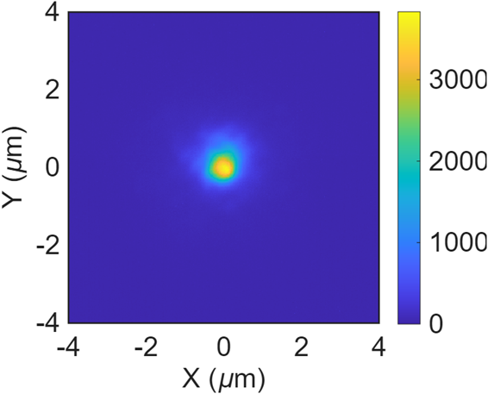
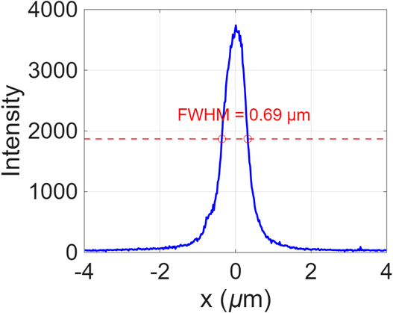
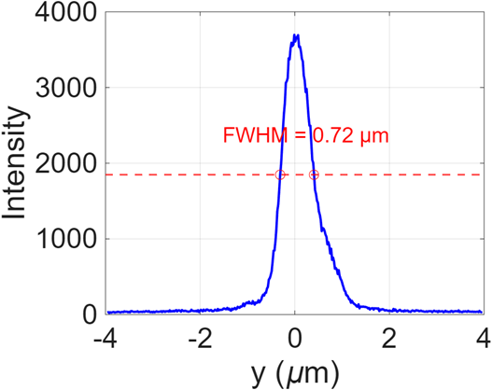

Experimental Results
532 nm pulsed laser
Pulse width = 150 fs
Repetition rate = 500kHz
$$FWHM_{cw}≈FWHM_{pulsed}$$

Slide 13
Why time delay is not affecting the spot size(FWHM)?
Diffraction is coherent around a given zone

Slide 14
Why time delay is not affecting the spot size(FWHM)?
Diffraction is coherent around a given zone
The addition of the individual foci arrives at different times and therefore does not interfere with one another.

Slide 15
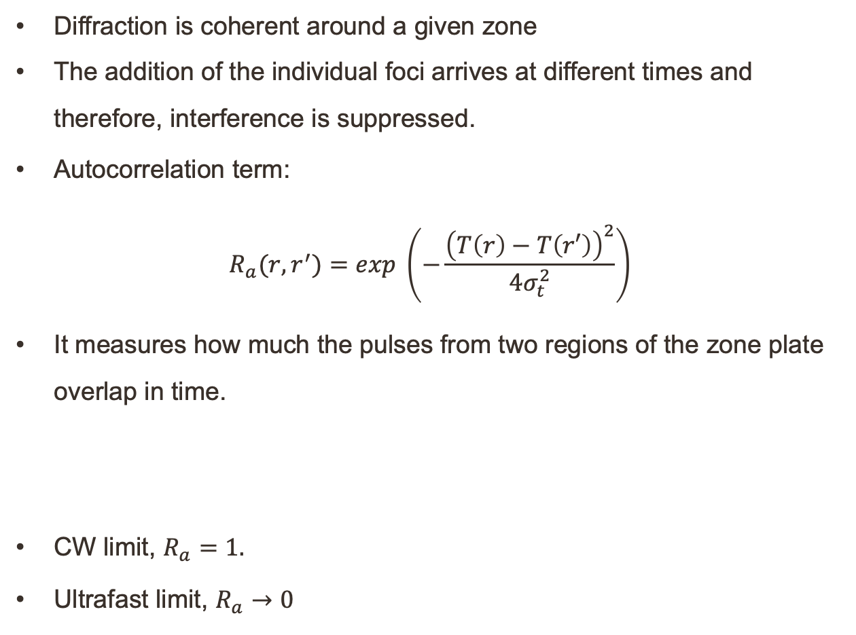
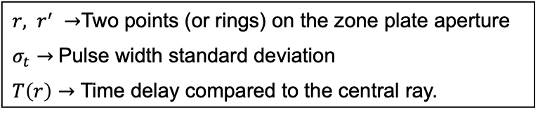


Why time delay is not affecting the spot size(FWHM)?
Diffraction is coherent around a given zone
The addition of the individual foci arrives at different times and therefore, interference is suppressed.
Autocorrelation term:
$R_{a}(r,r^{′})=exp \left(−\frac{{\left(T\left(r\right)−T\left(r′\right)\right)}^{2}}{4σ_{t}^{2}}\right)$
It measures how much the pulses from two regions of the zone plate overlap in time.
CW limit, $R_{a}=1.$
Ultrafast limit, $R_{a}→0$
$$r^{′}$$
$$r$$
f₀
${r, r}^{′} →$Two points (or rings) on the zone plate aperture
$σ_{t}→$Pulse width standard deviation
$T\left(r\right)→$ Time delay compared to the central ray.

Slide 16
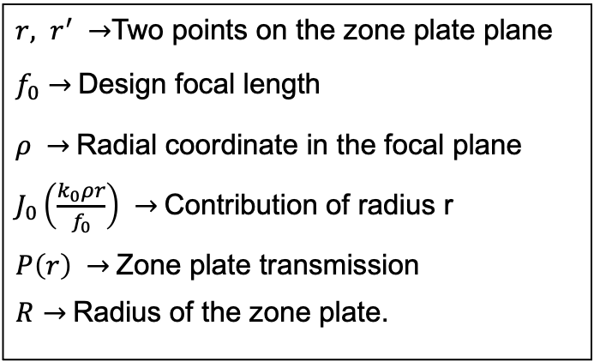




Why time delay is not affecting the spot size(FWHM)?
Autocorrelation term:
$R_{a}(r,r^{′})=exp \left(−\frac{{\left(T\left(r\right)−T\left(r′\right)\right)}^{2}}{4σ_{t}^{2}}\right)$
Temporally weighted focal intensity at radius $ρ$:
$$I_{temp}\left(ρ\right)=\int_{0}^{R}{\int_{0}^{R}{P\left(r\right)P^{∗}\left(r^{′}\right)J_{0}\left(\frac{k_{0}ρr}{f_{0}}\right)J_{0}\left(\frac{k_{0}ρr^{′}}{f_{0}}\right)R_{a}\left(r,r^{′}\right)rr^{′}dr dr′ }}$$
$$r^{′}$$
$$ρ$$
$$r$$
${r, r}^{′} →$Two points on the zone plate plane
$f_{0}→$Design focal length
$ρ →$Radial coordinate in the focal plane
$J_{0}\left(\frac{k_{0}ρr}{f_{0}}\right) →$Contribution of radius r
$P\left(r\right) →$Zone plate transmission
$R→$Radius of the zone plate.
Focal plane
f₀

Slide 17
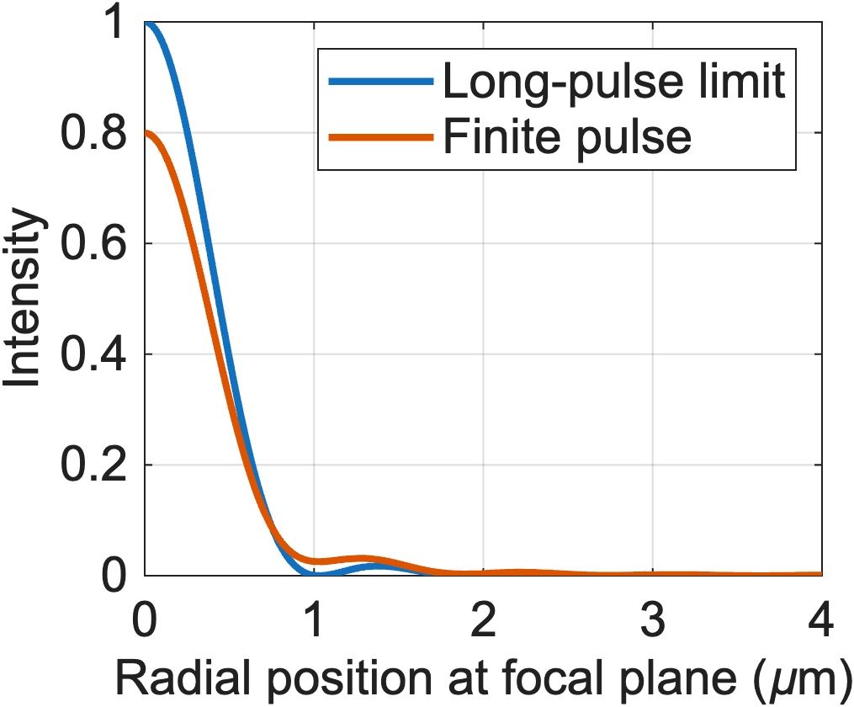
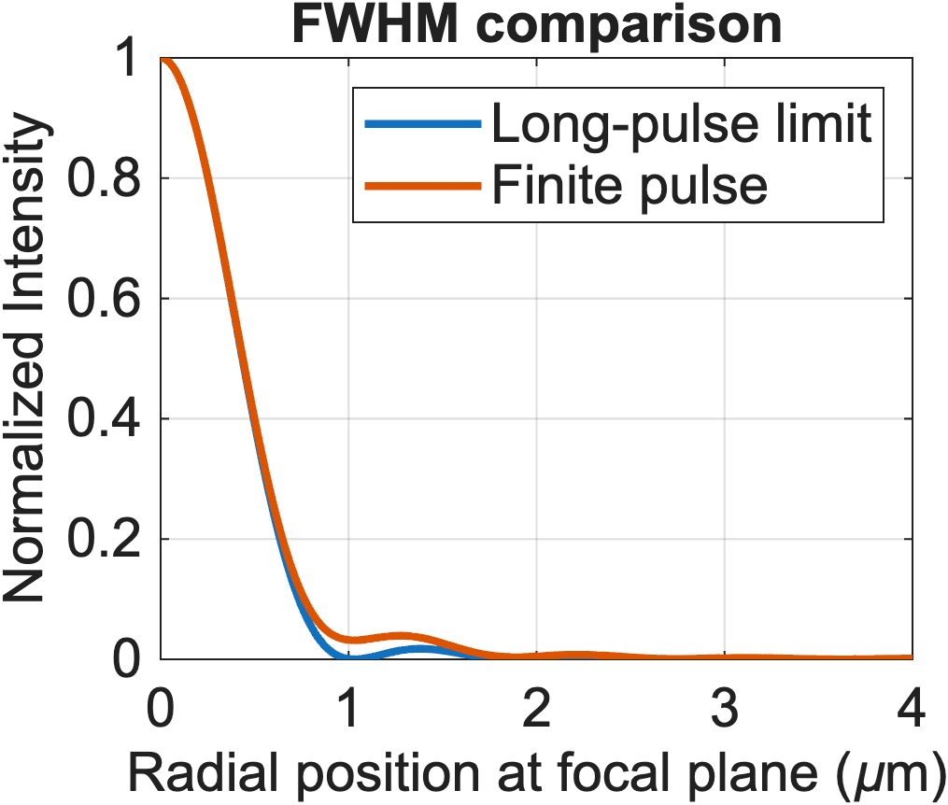
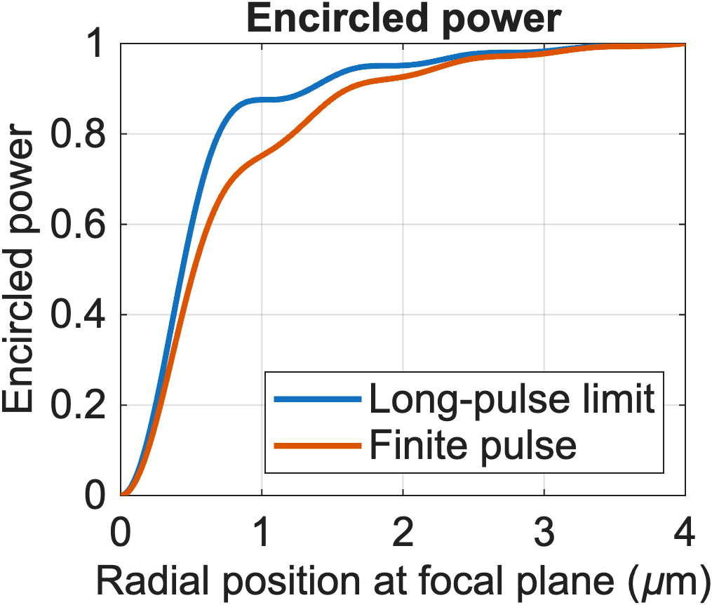
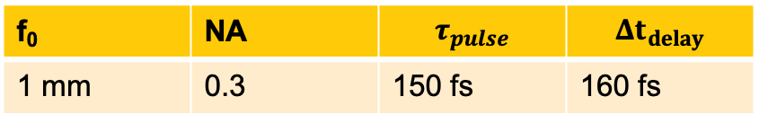
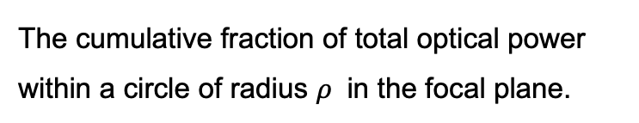
Results
Intensity in the focal plane
Encircled Power
The cumulative fraction of total optical power within a circle of radius $ρ$ in the focal plane.
f₀ | NA | $$τ_{pulse}$$ | $$Δt_{delay}$$
1 mm | 0.3 | 150 fs | 160 fs

Slide 18
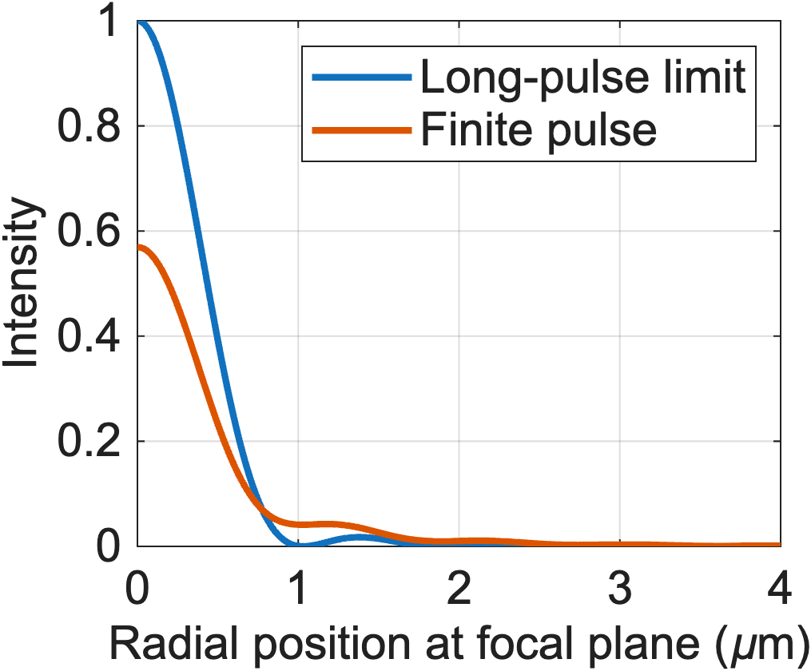
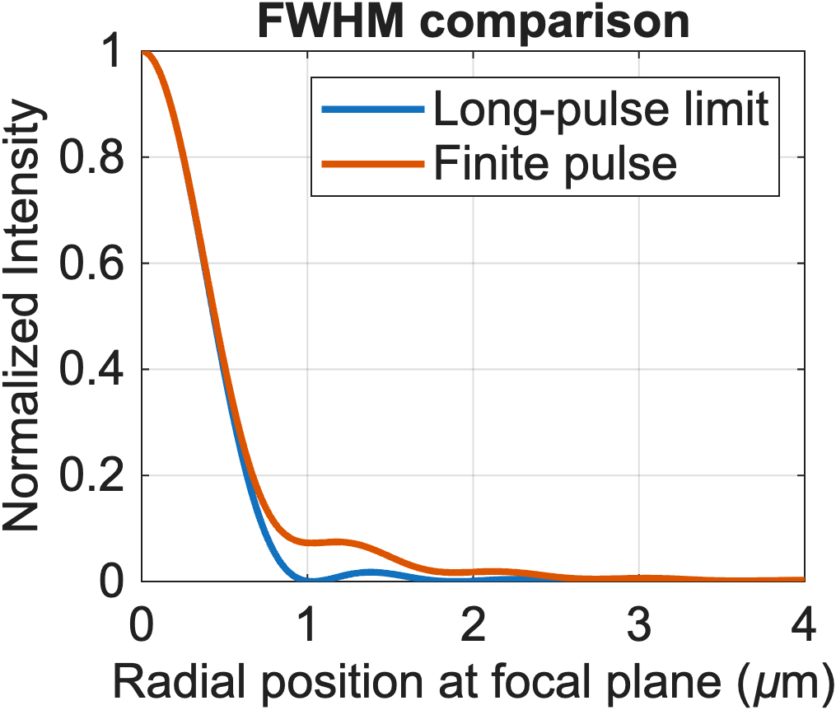
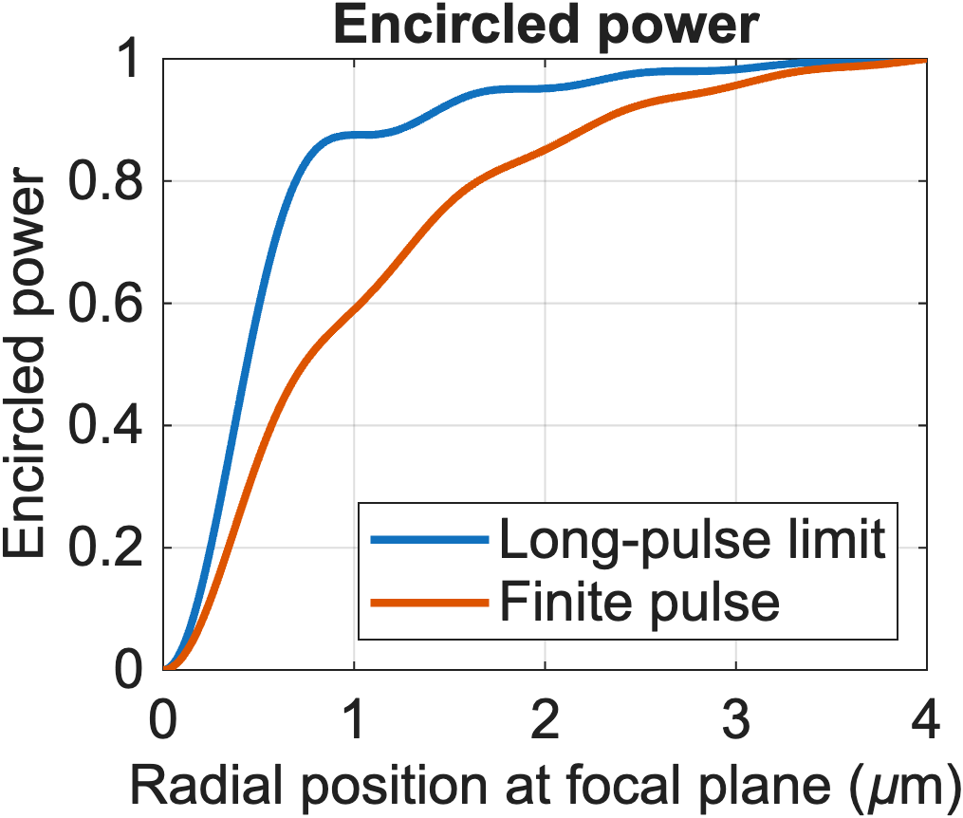
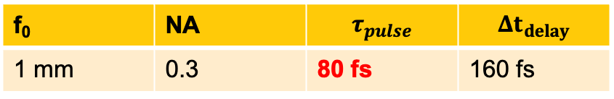
Results
Intensity in the focal plane
Encircled Power
f₀ | NA | $$τ_{pulse}$$ | $$Δt_{delay}$$
1 mm | 0.3 | 80 fs | 160 fs
The effects worsen as the pulse duration decreases.

Slide 19
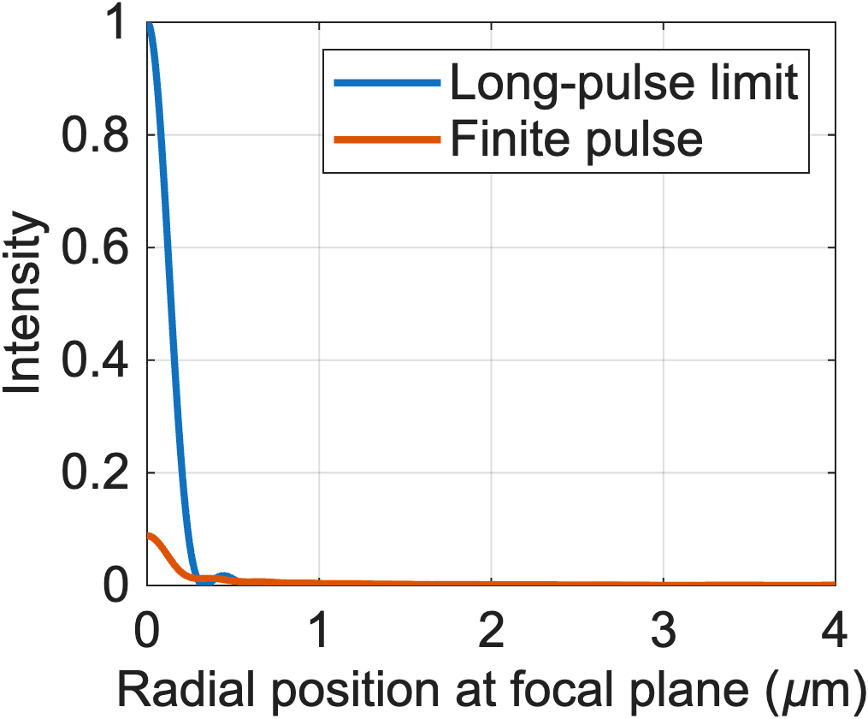
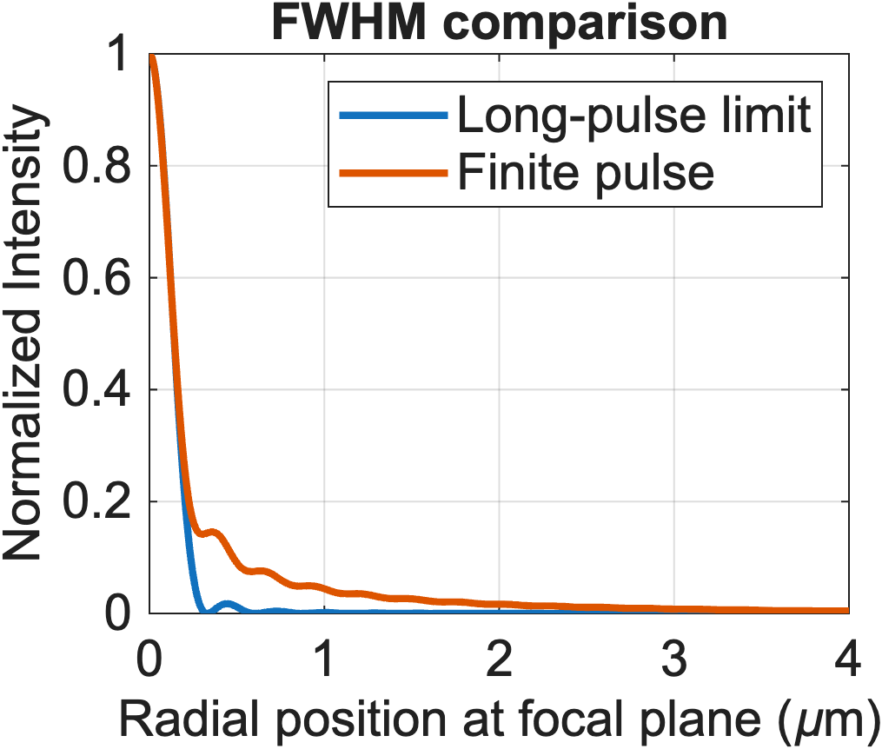
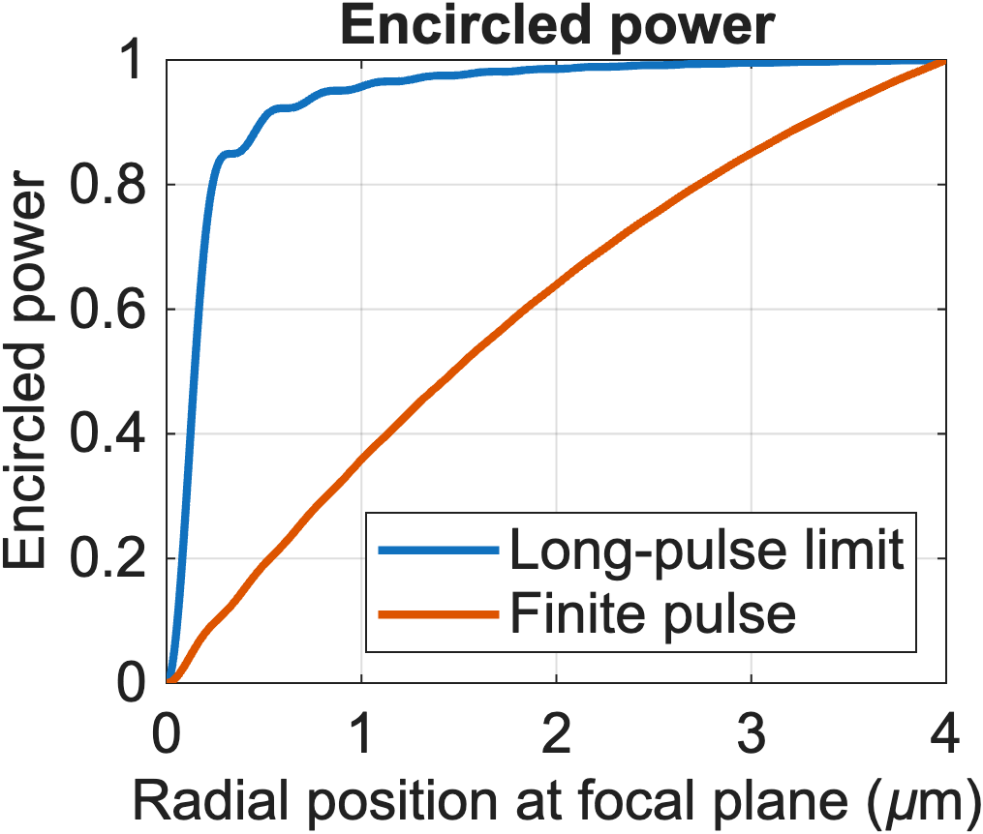
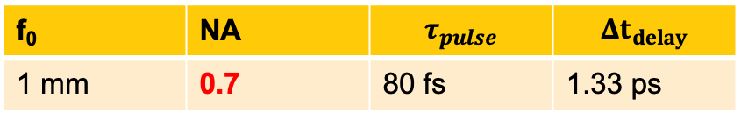
Results
Intensity in the focal plane
Encircled Power
f₀ | NA | $$τ_{pulse}$$ | $$Δt_{delay}$$
1 mm | 0.7 | 80 fs | 1.33 ps
The effects worsen as the NA increases.

Slide 20
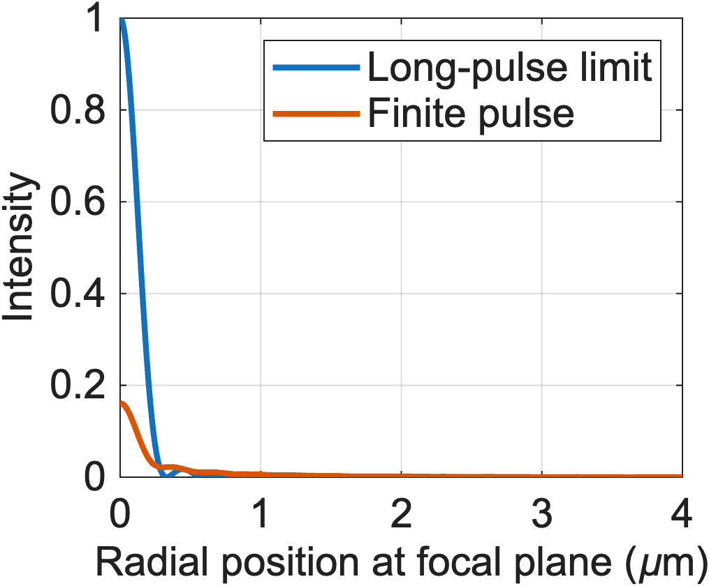
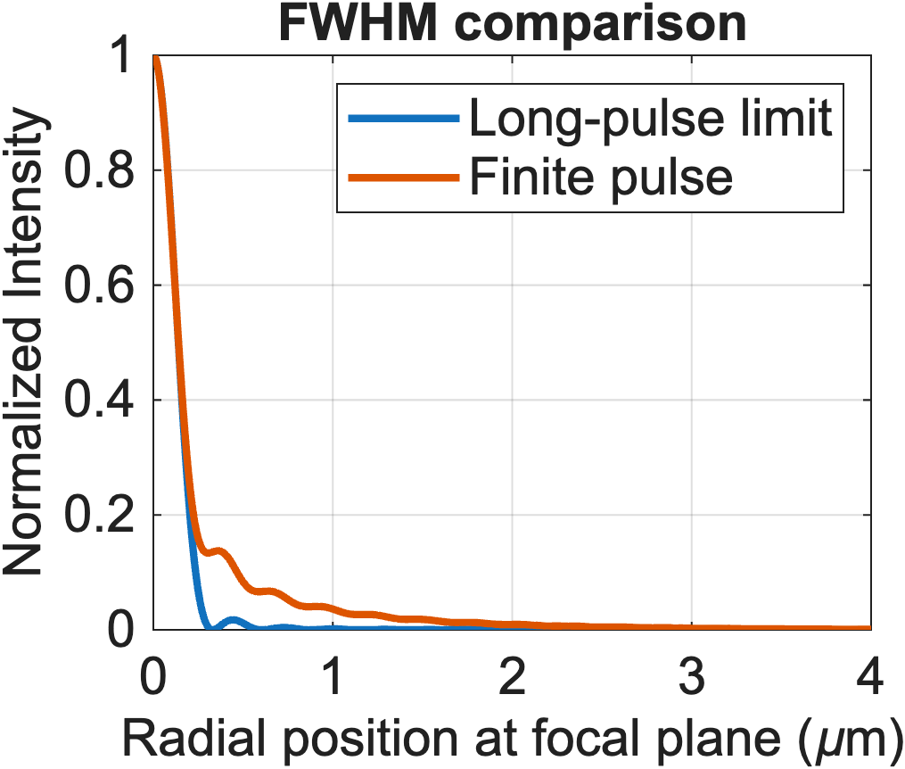
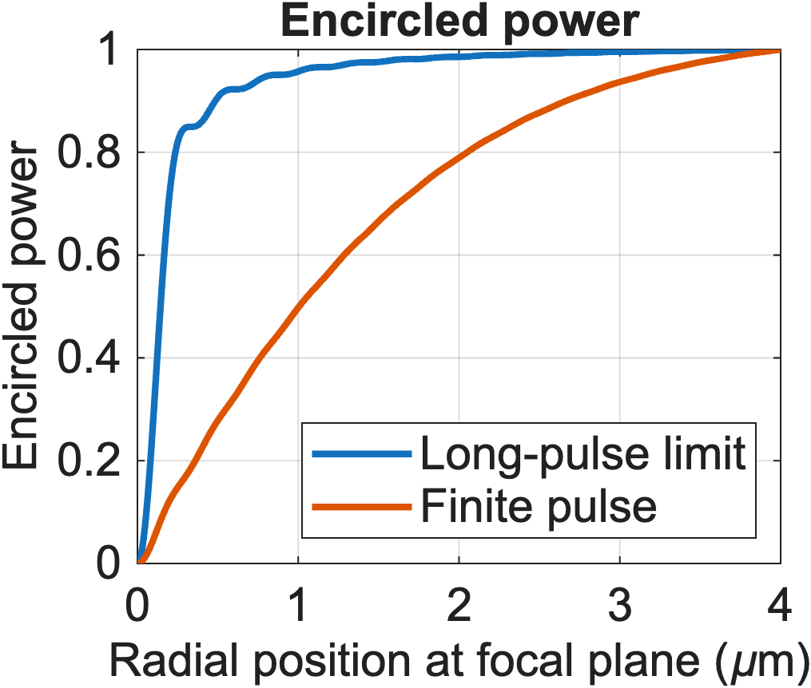
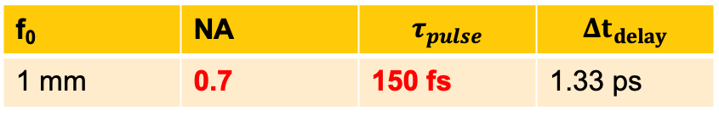
Results
Intensity in the focal plane
Encircled Power
f₀ | NA | $$τ_{pulse}$$ | $$Δt_{delay}$$
1 mm | 0.7 | 150 fs | 1.33 ps

Slide 21
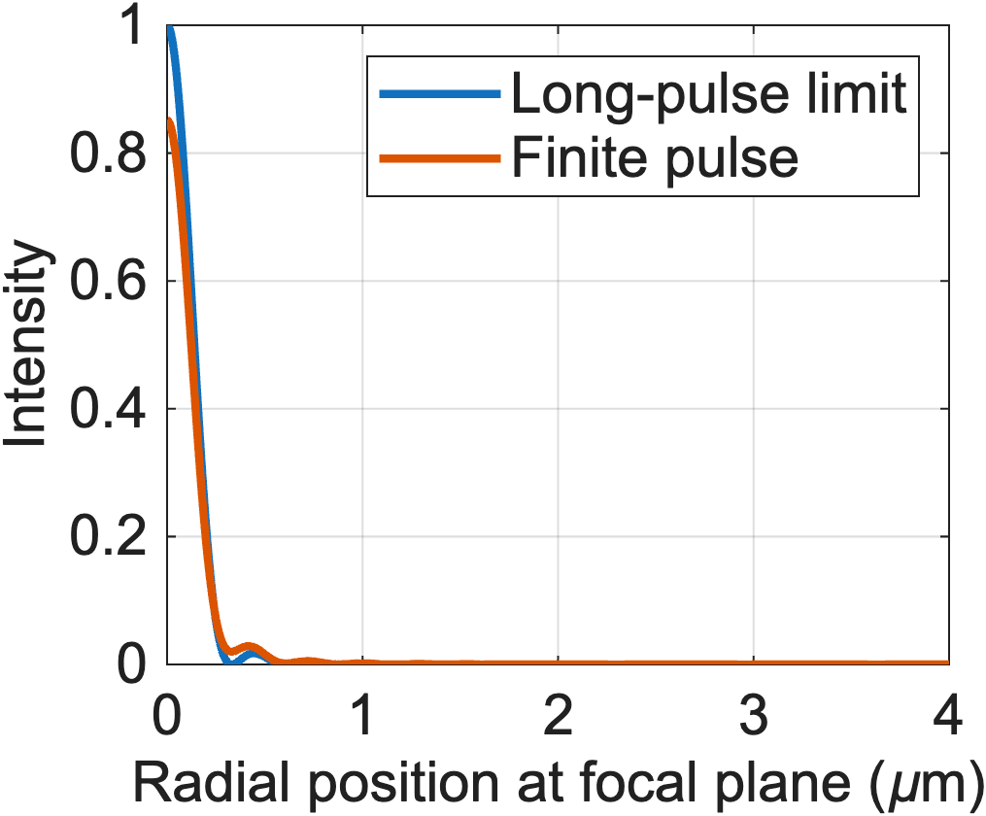
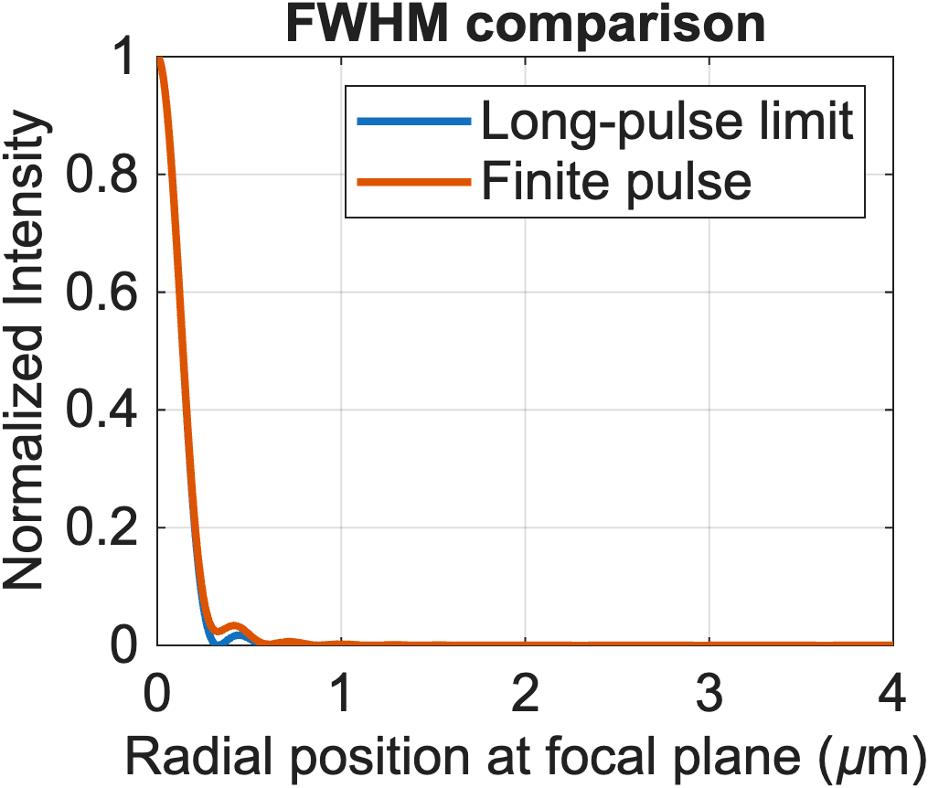
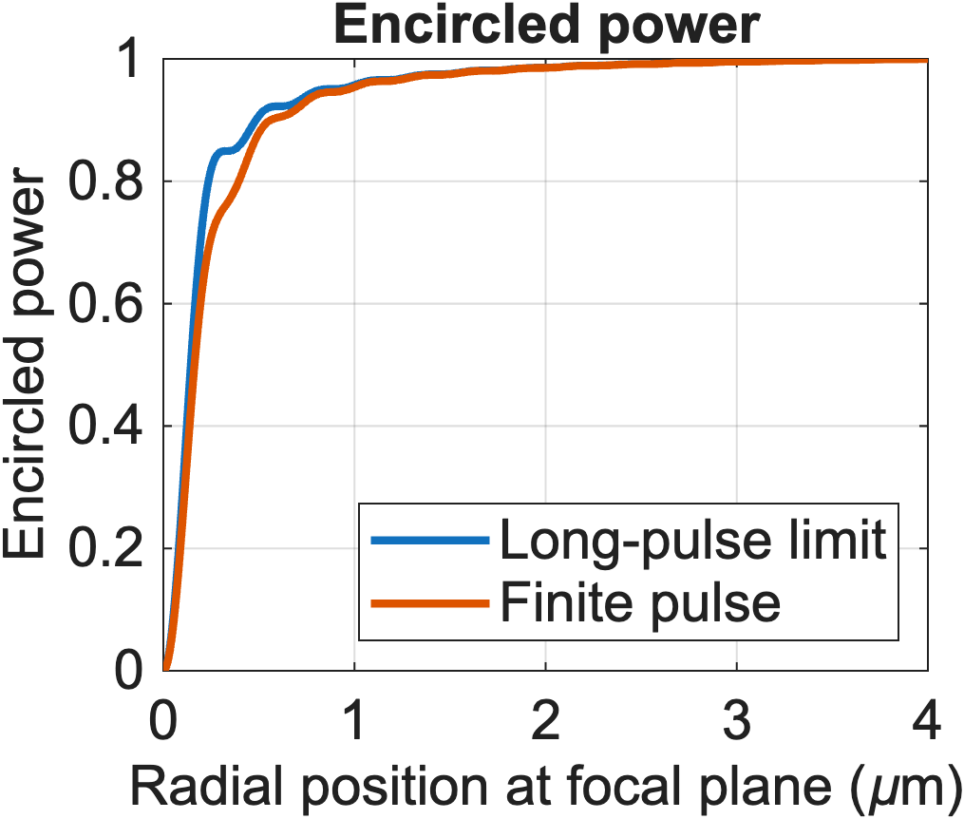
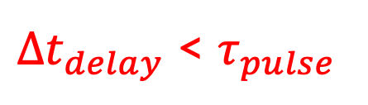
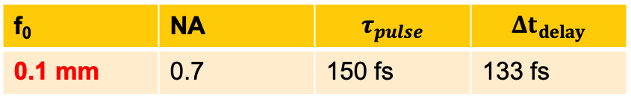
Results
Intensity in the focal plane
Encircled Power
f₀ | NA | $$τ_{pulse}$$ | $$Δt_{delay}$$
0.1 mm | 0.7 | 150 fs | 133 fs
$Δt_{delay}$ < $τ_{pulse}$
Shifting to an ultra-short focal length drastically reduces the pulsed-light effects.

Slide 22
2. Why is the spot size unaffected by spectral bandwidth?
Different wavelengths are focused at different points along the axial direction.
2.8 nm
531
532
533
Wavelength (nm)

Slide 23

2. Why is the spot size unaffected by spectral bandwidth?
Different wavelengths are focused at different points along the axial direction.
Design wavelength focuses at $z=f_{0}$
e⁻
e⁻
z = f₀
Incident light

Slide 24

2. Why is the spot size unaffected by spectral bandwidth?
Different wavelengths are focused at different points along the axial direction.
Design wavelength focuses at $z=f_{0}$
Longer wavelengths focus at $z<f_{0}$
e⁻
e⁻
z = f₀
Incident light

Slide 25

2. Why is the spot size unaffected by spectral bandwidth?
Different wavelengths are focused at different points along the axial direction.
Design wavelength focuses at $z=f_{0}$
Longer wavelengths focus at $z<f_{0}$
Shorter wavelengths focus at $z>f_{0}$
e⁻
e⁻
z = f₀
Incident light

Slide 26

2. Why is the spot size unaffected by spectral bandwidth?
Different wavelengths are focused at different points along the axial direction.
They produce a significantly larger spot at the focal plane, $z=f_{0}$.
Their power is distributed over a larger area.
e⁻
e⁻
z = f₀
Incident light

Slide 27


2. Why is the spot size unaffected by spectral bandwidth?
Different wavelengths are focused at different points along the axial direction.
They produce a significantly larger spot at the focal plane, $z=f_{0}$.
Their power is distributed over a larger area.
Adding the intensities from different wavelength components gives:
$I\left(ρ;λ_{1},z=f_{0}\right)→$Intensity contribution from wavelength $λ_{1}$at a radial distance $ρ$ from the axis at the focal plane $(z=f_{0})$
${a_{0},a}_{1},a_{2},..$spectral weight of that wavelength components.
e⁻
e⁻
z = f₀
$$I_{tot}\left(ρ;z=f_{0}\right)={a_{0}I\left(ρ;λ_{0},z=f_{0}\right)+a}_{1}I\left(ρ;λ_{1},z=f_{0}\right)+a_{2}I\left(ρ;λ_{2},z=f_{0}\right)+…$$
Incident light
The intensity contribution from the design wavelength ($λ_{0})$ dominates the final focus.
Notes:
After adding the intensities from different wavelength components, weighted by the spectral power distribution, the intensity contribution from the design wavelength ${(λ}_{1})$ dominates the final focus.

Slide 28
Summary
We are working on developing a similar model to explain the finite spectral bandwidth effects.
Pulsed sources can still produce a small focal spot, but with reduced efficiency and a longer temporal response.
When illumination becomes pulsed:
Is the focus still unchanged? No, temporally elongated
Does the electron emission spot size remain the same? Yes, the FWHM remains the same.
Does the electron pulse remain short? No, temporally elongated
The effects can be reduced by reducing the focal length of the zone plate ( by making $Δt_{delay}$ ≈ $τ_{pulse}$).
A high NA, small focal length zone plate integrated photocathode can be used as a high brightness pulsed electron source.

Slide 29

Acknowledgements
Howard Padmore
Mansoure Moeini Rizi
Peter Prah Owusu
Jo Mama
Siddharth Karkare
Thank you for listening

Slide 32




Results
Intensity in the focal plane
Encircled Power
f₀ | NA | $$τ_{pulse}$$ | $$Δt_{delay}$$
0.1 mm | 0.7 | 80 fs | 133 fs
Shifting to an ultra-short focal length drastically reduces the pulsed-light effects.

Slide 33
"What is the bandwidth of a zone plate?"
A zone plate is inherently chromatic
BUT,
If the incident ultrafast laser pulse has a component of the design wavelength, it may still produce a small spot, but with a huge tail.

