Slide 1
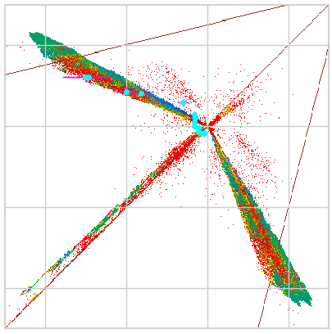
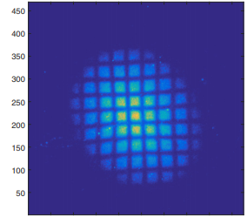
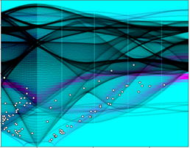
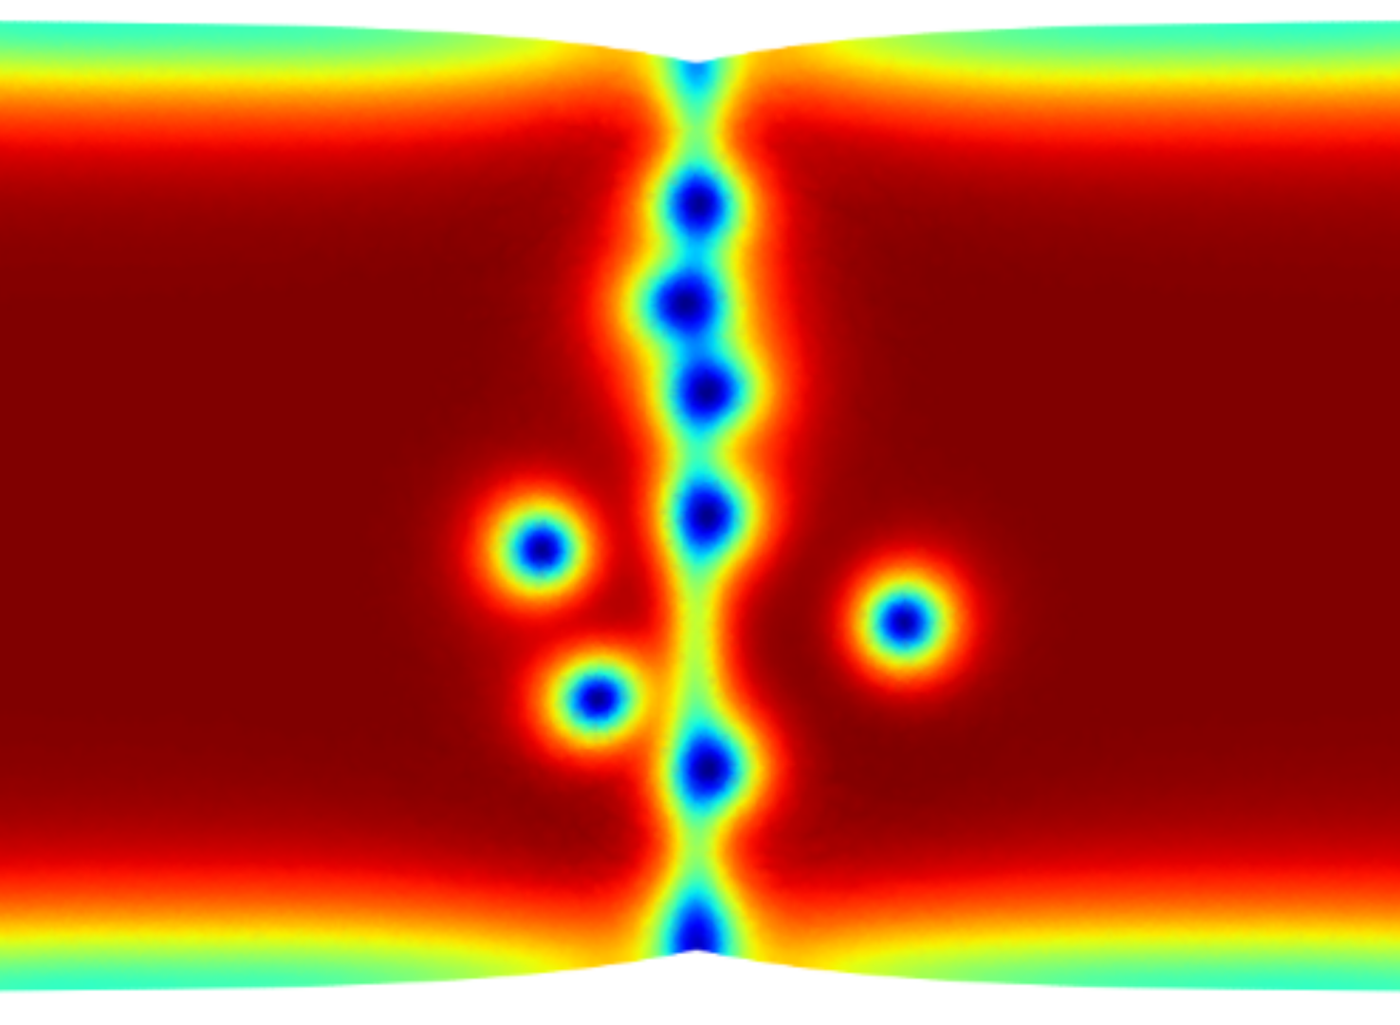
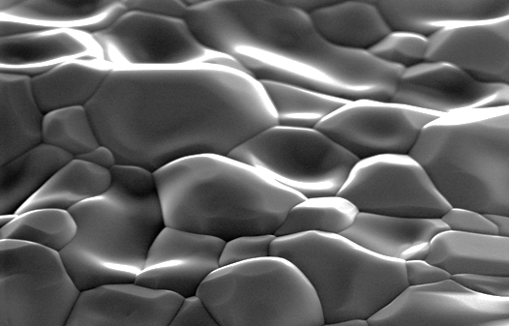
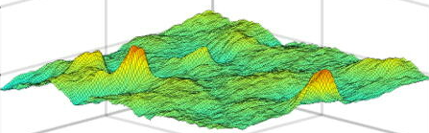
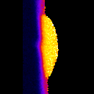
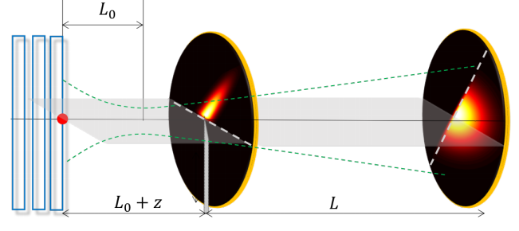
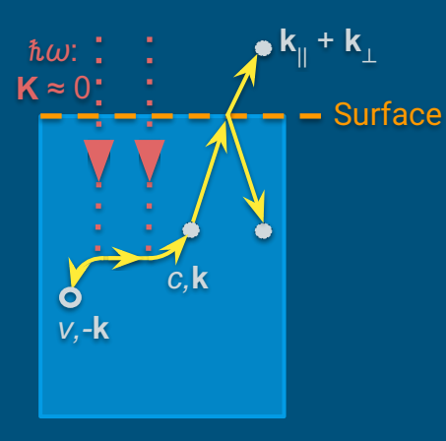
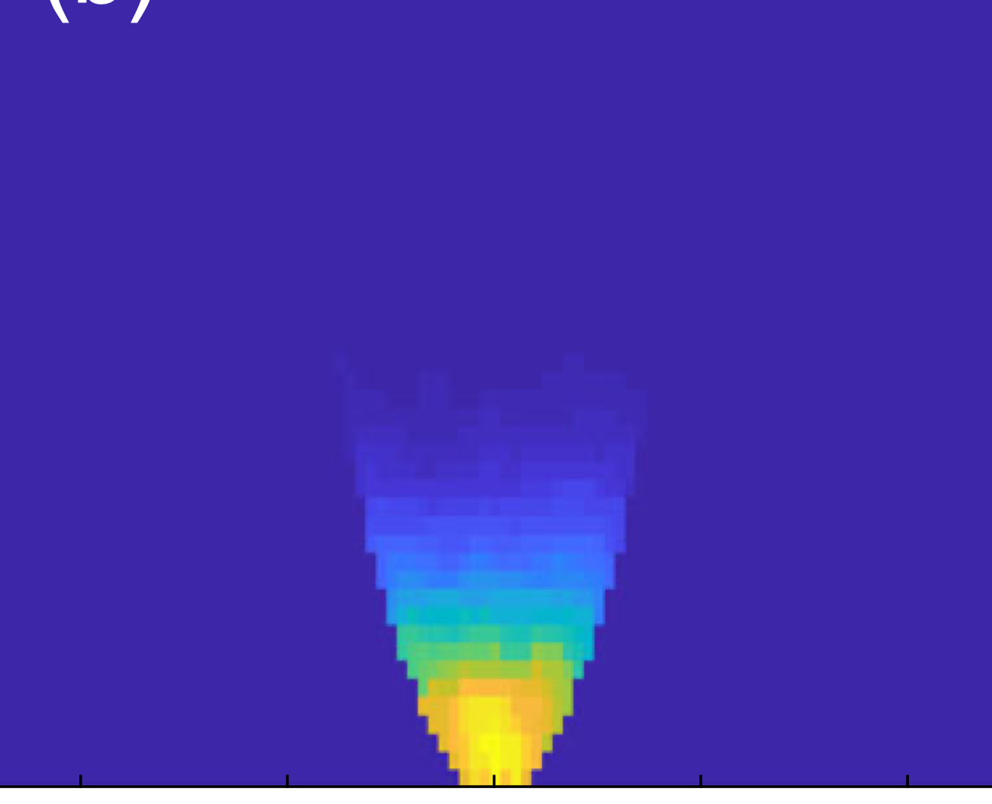
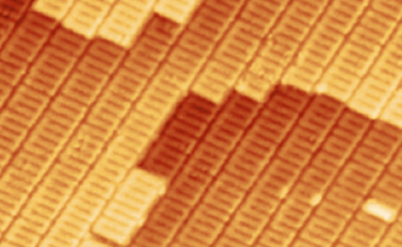
Welcome
CBB Meeting 2026
J. Ritchie Patterson
Center Director

Slide 2
Practical matters
Safety
Stairs are to the right of the elevators
Agenda
https://indico.classe.cornell.edu/event/2577/
Site visit
None!
but… we do need to prepare an annual report

Slide 3
Welcome to all
New students
Continuing students and postdocs
Earlier CBB collaborators

Slide 4
Code of Conduct
At CBB, we treat each other with respect at all times

Slide 5
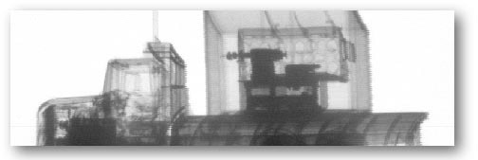
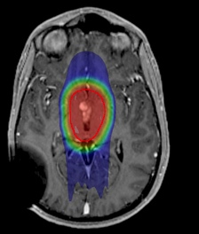
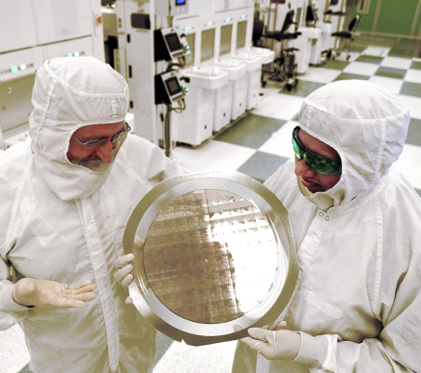
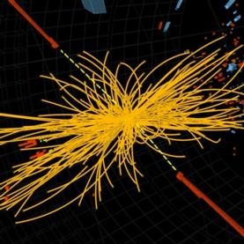
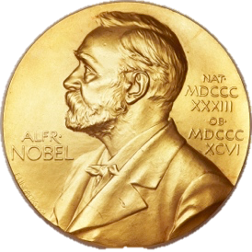
Why accelerators?
Industry
  Food & product safety
  Contraband detection
  Polymer cross-linking, eg tires
  Semiconductor fabrication
Medicine
  Medical isotope production
  Tumor treatment
Research
  Electron microscopes
  X ray sources and colliders for nuclear & particle physics
~40,000 industrial and medical accelerators are in use
Annual sales: $3.5 B
10% growth per year.
  Since 1943, a Nobel Prize in Physics has been awarded to research benefiting from accelerators every 3 years.
  Since 1997, the same has been true of Chemistry.

Slide 6
Center for Bright Beams - CBB
Center Vision:
Gain the fundamental understanding needed to transform the brightness of beams available to science, medicine and industry.
Center Mission:
What is brightness?
Beam dir.
Increase beam brightness
and reduce accelerator cost and size.
Transfer knowledge to the community and
key technologies to national labs and US industry.
Prepare a diverse group of students for leadership.
The annual demand for new Accelerator Science PhDs
is 2-4x the number produced by US universities.
HEPAP Subcommittee for Review of US Particle Accelerator School (2015).
Low brightness bunch
Beam dir.
High brightness bunch
Notes:
Report of the HEPAP Subcommittee for Review of USPAS (2015), p 13. In 2015, US produced only 40% of need at DOE labs, which is 40 new PhD accelerator scientists per year. US unifversties produce 15-20.

Slide 7
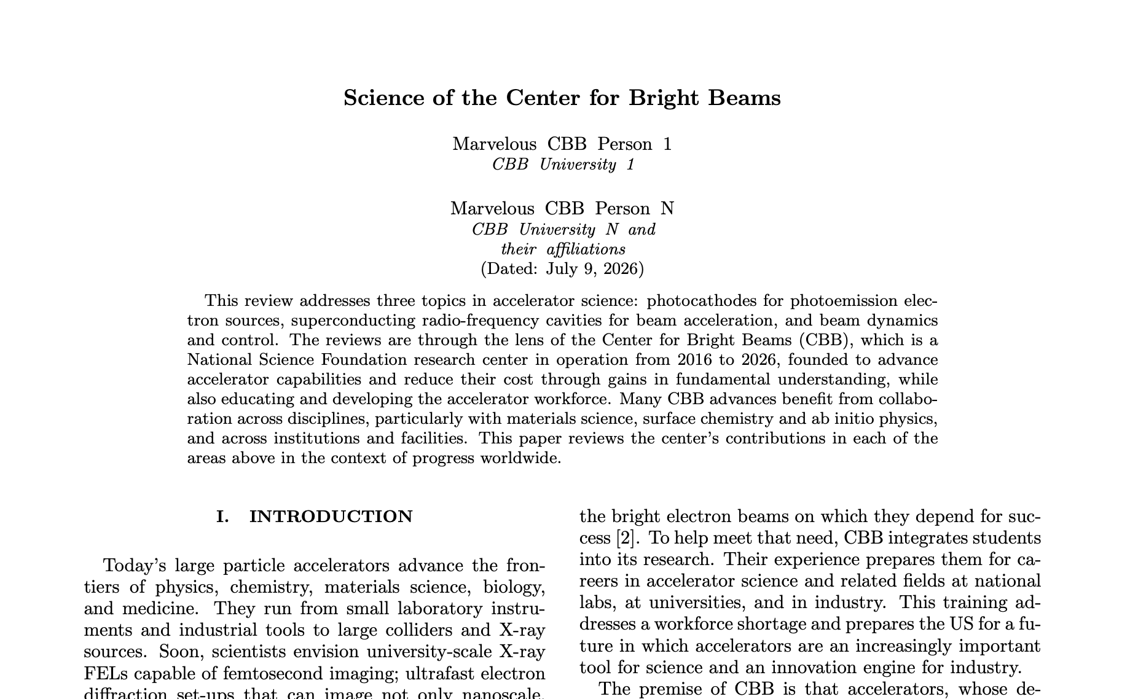
CBB Review article
Summarizes CBB science over its lifetime
Author list: All current or past CBB participants who (co-)authored a CBB pub.
Timeline: Draft is nearly complete
When ready, it will be circulated to
all authors for review & approval

Slide 8
Acknowledgement
Students and postdocs
You make it all happen

