Slide 1
Measuring Source 4D Phase Space with the PHOEBE Beamline
Charles Zhang (he/him)
Cornell University
Presented at the 2026 CBB Annual Meeting

Slide 2






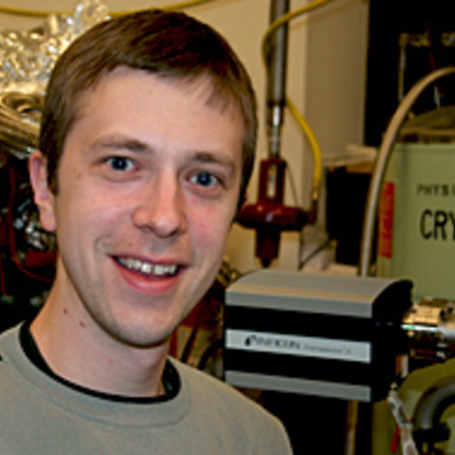


Acknowledgements
And many more!
Center for Bright Beams friends
Cornell technical staff
REU students
Elena Echeverria
Cornell
Alice Galdi
U. of Salerno
William Li
BNL
Chris Pierce
UChicago
Abigail Flint
Cornell
Chad Pennington
UCLA
Adam Bartnik
Cornell
Ivan Bazarov (PI)
Cornell
Jared Maxson (PI)
Cornell
Notes:
First I would like to thank all of the people who worked on this, especially the people shown here.

Slide 3
4D Phase Space
The 4D phase space is the distribution of particles in transverse position (x, y) and momentum (px, py)
y
x
z
Beam travels along z
Notes:
So what is the 4D phase space.
It is the distribution of particles in transverse position (x, y) and momentum (px, py),

Slide 4
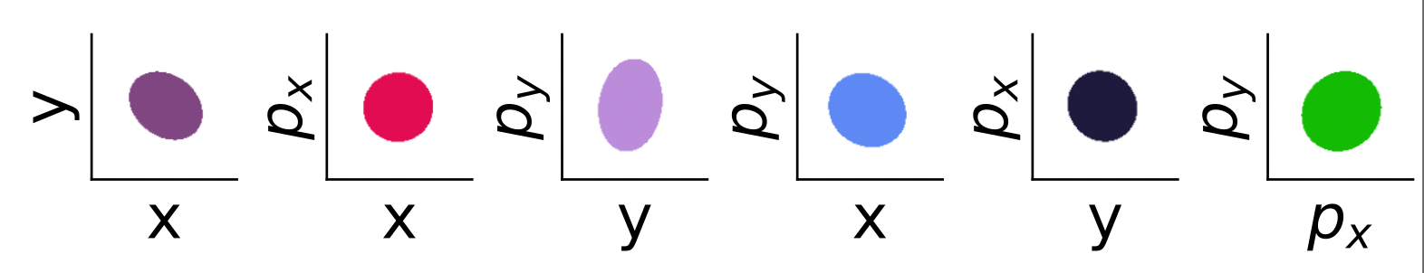
4D Phase Space
We typically visualize 4D phase spaces by 2D projections,
Notes:
To visualize 4D phase spaces, we will project it onto every pair of transverse coordinates, giving us 6 of these projections in total

Slide 5
4D Phase Space
Source 4D phase space is the distribution of particles in transverse space (x, px, y ,py) at the moment of emission.
z
e-
e-
e-
e-
e-
Source
Notes:
Read slide
But why would we want to measure the source phase space?

Slide 6
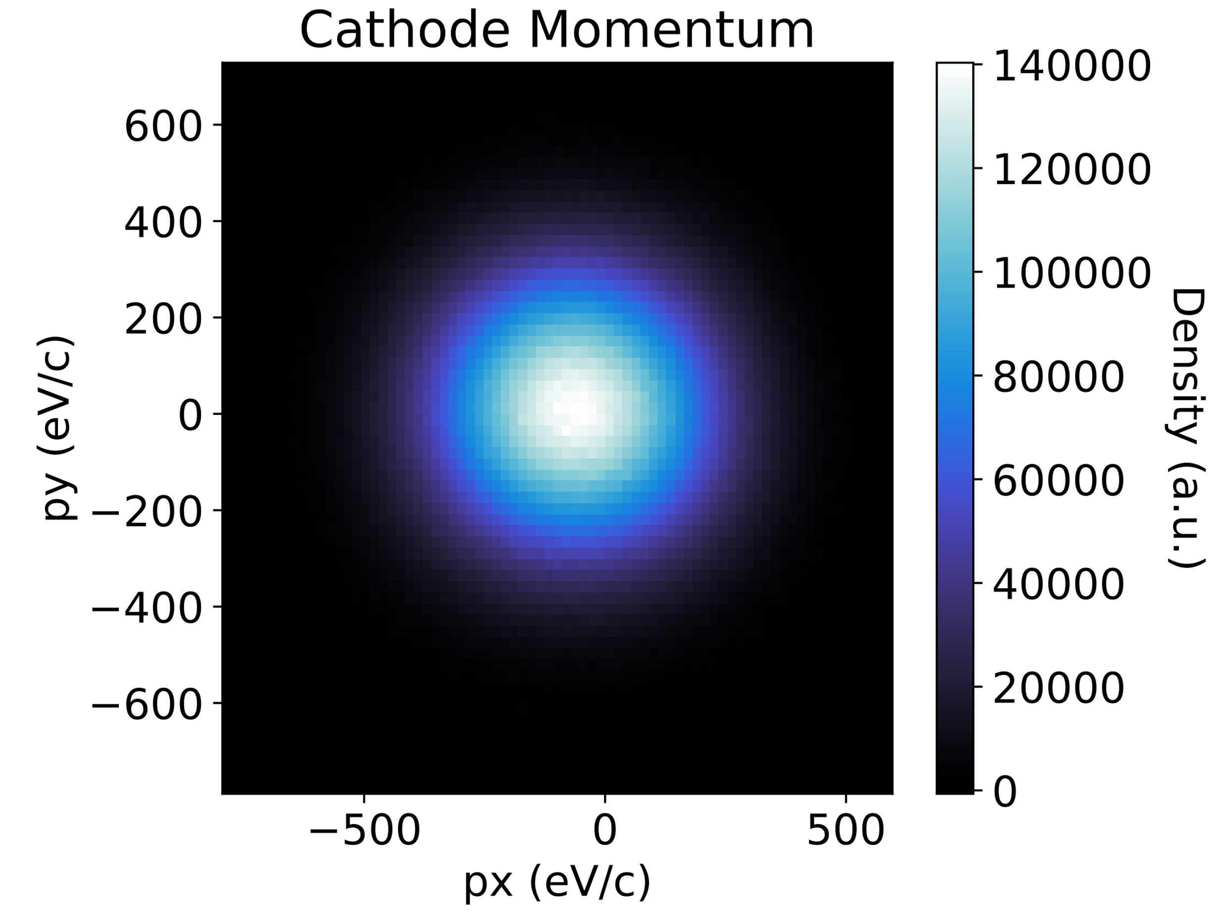
Source 4D Phase Spaces Reveals…
Complete picture of momentum that can be compared to photoemission models
Complete picture of momentum
We can image the entire momentum distribution of emitted electrons
Notes:
So why would we want to measure the 4D phase space of a beam at the source?
We can measure the entire transverse momentum distribution, which can be useful to compare with theoretical photoemission models. And with more exotic photocathodes, in the well-ordered single crystal limit, there may be interesting structure to see here.

Slide 7
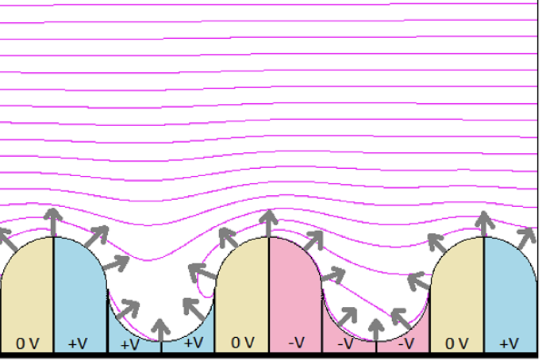
Source 4D Phase Spaces Reveals…
Physical and chemical features shape the momentum of photoemitted electrons.
Using the source 4D phase space, we can get the momentum distribution of electrons emitted at such features with high spatial resolution.
Equipotentials
Beam
e-
Source
Phys. Rev. Accel. Beams 21, 093401 (2018)
Notes:
Another reason the source phase space could be interesting is we can gain a better understanding of how physical or chemical disorder affects photoemission.
In this picture of emission from a source, the varying physical structure and chemical composition shapes the surface potentials, which affect the momentum of electrons emitted from this surface, shown by the gray arrows.
If we had the source phase space, we could continuously scan across the surface and see how the momentum distribution responds to these physical and chemical features.

Slide 8
Reconstructing Source 4D Phase Space
Given a 4D phase space measured downstream, we want to reconstruct the 4D phase space at the electron source
Source
Downstream
Diagnostic
Notes:
let’s define the problem here more specifically
If we used some diagnostic tool to measure the 4D phase space of a beam downstream in our beamline, how do we reconstruct the 4D phase space back at the source?

Slide 9

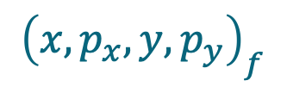
Reconstructing Source 4D Phase Space
Equivalently, given the measured downstream 4D coordinates of a single particle, we want to compute its source 4D coordinates,
$${\left(x, p_{x}, y, p_{y}\right)}_{i}$$
$${\left(x, p_{x}, y, p_{y}\right)}_{f}$$
Source
Downstream
Diagnostic
Notes:
Or equivalently, if we measured the position and momentum of a single particle downstream, what is its position and momentum at the source?

Slide 10


Reconstructing Source 4D Phase Space
The transfer matrix $\text{M}$defines the linear transformation of a particle’s position and momentum through a beamline
$${\left(x, p_{x}, y, p_{y}\right)}_{i}$$
$${\left(x, p_{x}, y, p_{y}\right)}_{f}$$
Source
Downstream
Diagnostic
Unknown Transfer Matrix
Notes:
In a beamline, we often use a transfer matrix to describes the evolution of a particle’s position and momentum

Slide 11
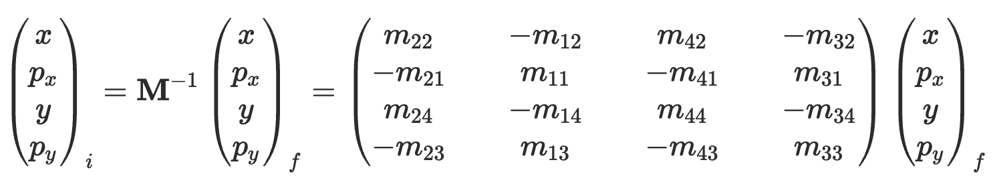
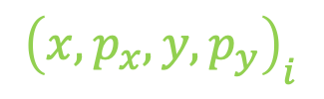
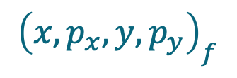
Reconstructing Source 4D Phase Space
$${\left(x, p_{x}, y, p_{y}\right)}_{i}$$
$${\left(x, p_{x}, y, p_{y}\right)}_{f}$$
Source
Downstream
Diagnostic
Unknown Transfer Matrix
Source
Downstream
Notes:
If we knew the transfer matrix and found its inverse, we can apply that to the measured particle coordinates and calculate the source coordinates
So we have to measure the transfer matrix first

Slide 12
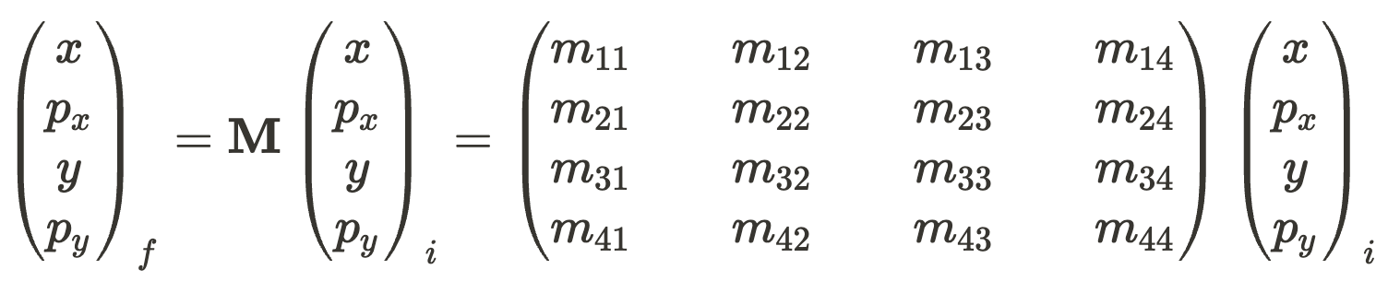
Measuring the Transfer Matrix
Downstream
Fit?
Source
Not so fast…
Notes:
Let’s flip the equation I just showed you
If we wanted to measure the transfer matrix, the natural thing to do would be to fit the downstream coordinates to the source coordinates
But this has its challenges

Slide 13
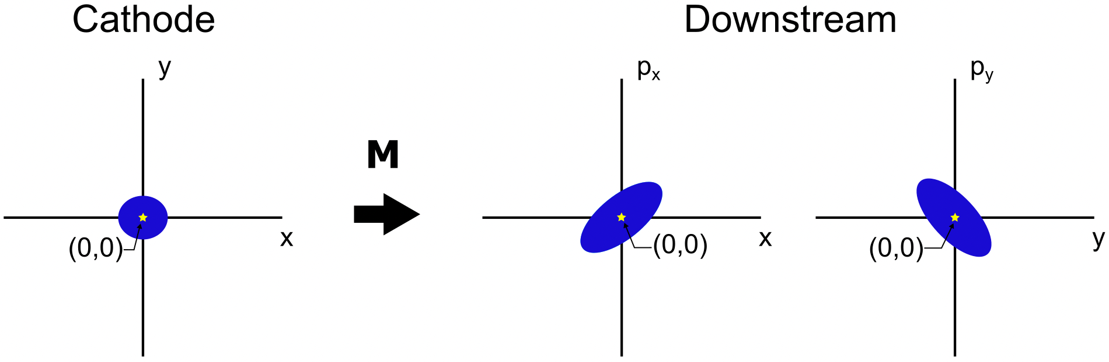
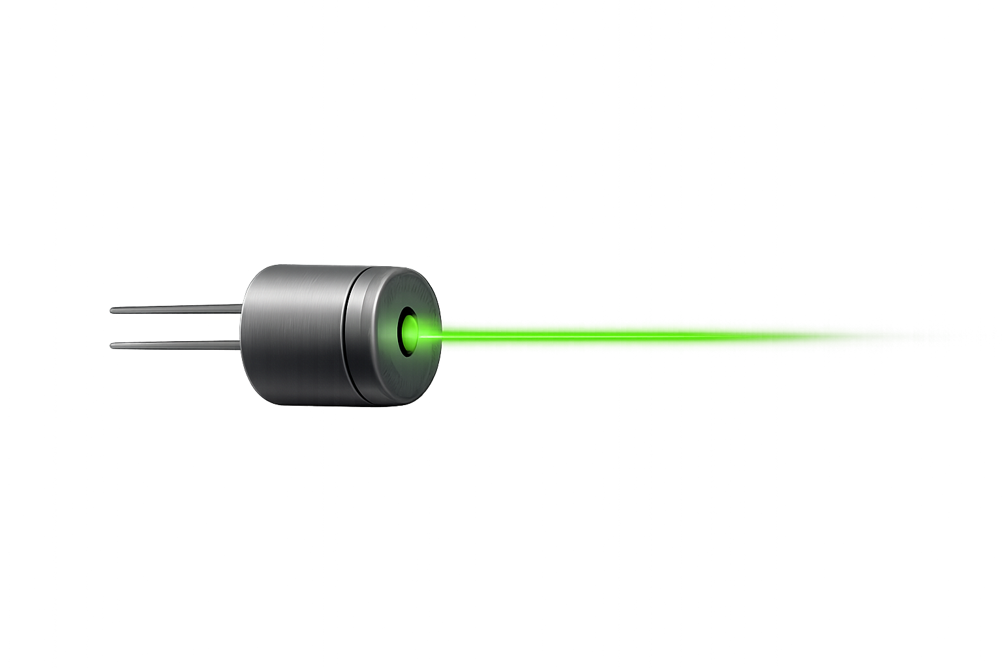
Measuring the Transfer Matrix
The beam centroid in 4D phase space effectively acts like a particle, which we can measure
Notes:
In practice, tracking the position and momentum of the same particle through the beamline is impossible
So we will instead work with the centroid of the beam in 4D phase space, which effectively acts like a particle

Slide 14
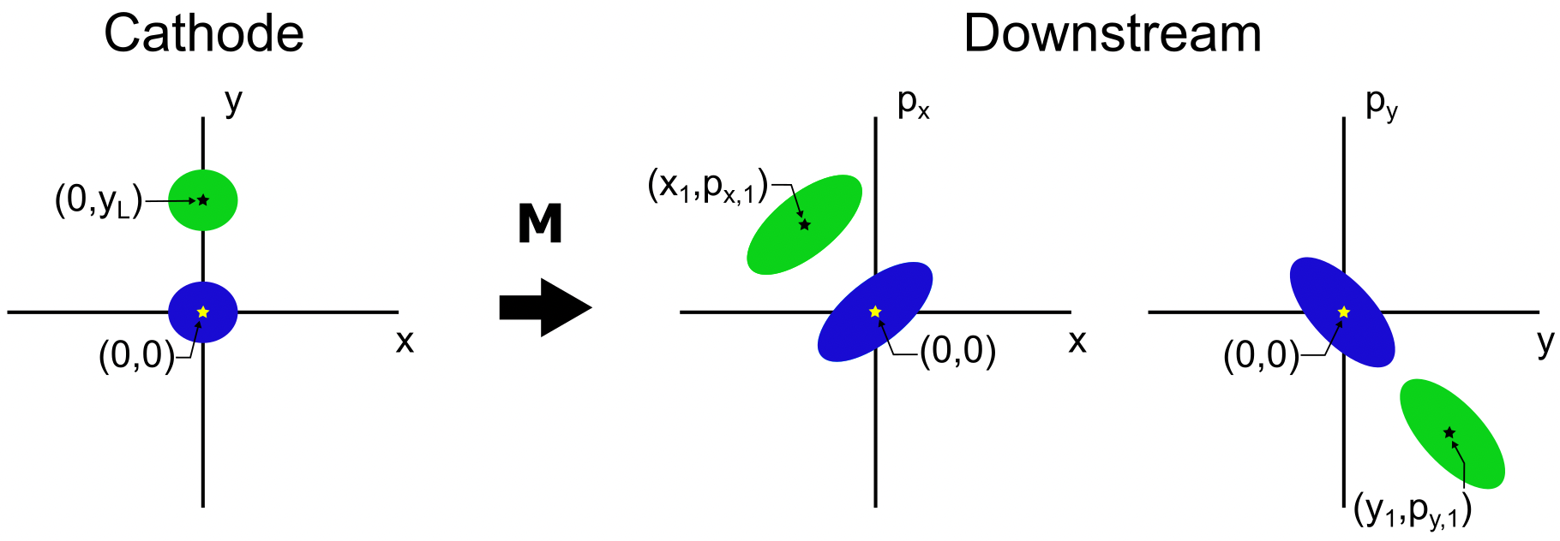
Measuring the Transfer Matrix
We move the beam a known displacement at the source by moving the driving laser and measuring its position centroid,
Notes:
Since we’re using a laser to drive the photoemission of beam, we can move the beam at the source by physically moving the laser around and we can infer the position of the beam from measurements of the laser position

Slide 15
Measuring the Transfer Matrix
At this new laser position, we measure the 4D phase space centroid
Notes:
So we move the beam at the cathode and measure another 4D phase space

Slide 16
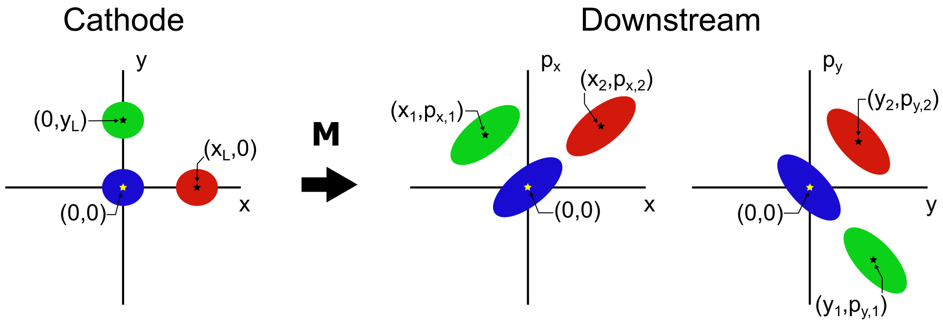
Measuring the Transfer Matrix
Repeat - measuring the 4D phase space centroid downstream as a function of initial beam position,
Notes:
We repeat this process, moving our laser and measuring the phase spaces, until we have enough points for a good linear fit.
For example, we typically measure 8 points

Slide 17
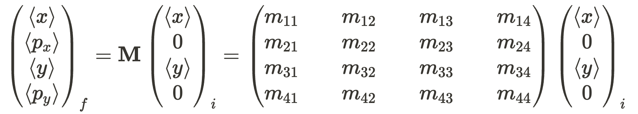
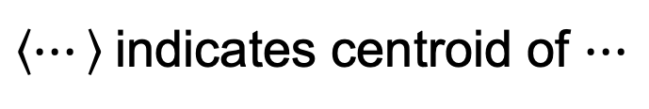
Measuring the Transfer Matrix
Source momentum centroids are assumed to be constant with respect to source position, we can then set them to zero
Downstream
Fit
Fit
Source
$\left\langle ⋯\right\rangle$indicates centroid of $⋯$
Notes:
Mathematically, all of that now looks like this.
There are now brackets around the phase space coordinates, which indicates that we're dealing with the beam centroid
And we also set the source momentum centroid to zero since we do not expect it to change when we move the beam around the source

Slide 18
Measuring the Transfer Matrix
Source position centroid is varied deterministically
Downstream
Fit
Fit
Source
$\left\langle ⋯\right\rangle$indicates centroid of $⋯$
Notes:
Read slide

Slide 19
Measuring the Transfer Matrix
Beam position and momentum centroid are measured downstream
Downstream
Fit
Fit
Source
$\left\langle ⋯\right\rangle$indicates centroid of $⋯$
Notes:
Read slide

Slide 20
Measuring the Transfer Matrix
Linearly fitting the downstream centroids and the source centroid gives part of the transfer matrix
Downstream
Fit
Fit
Source
$\left\langle ⋯\right\rangle$indicates centroid of $⋯$
Notes:
Linearly fitting these two quantities only gives us the highlighted columns of the transfer matrix since the source momentum centroids are constant

Slide 21
Measuring the Transfer Matrix
What about the rest of the transfer matrix?
Downstream
Fit
??
Fit
??
Source
$\left\langle ⋯\right\rangle$indicates centroid of $⋯$
Notes:
Now the problem is we can’t control the source momentum centroids, so how do we get the rest of the transfer matrix?

Slide 22
Solving for Full 4D Transfer Matrix
Higher-order (>1) statistical moments of the beam might give us more information
Notes:
So far we’ve only been looking at the centroid of the beam, but the beam has so much more to give! Maybe higher-order statistical moments like the beam covariance can give us more information.

Slide 23
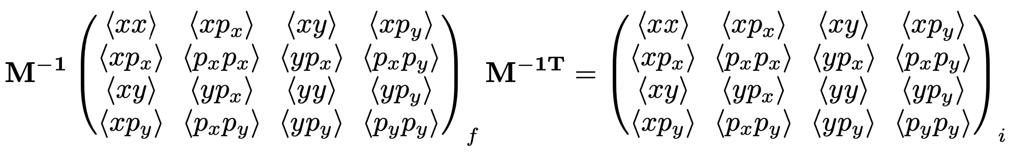
Solving for Full 4D Transfer Matrix
Higher-order (>1) statistical moments of the beam might give us more information
The covariances evolve in the beamline as such,
Downstream
Source
Notes:
The beam covariance at the source and downstream in the beamline can be represented by these matrices. And this is how they evolve with the transfer matrix

Slide 24
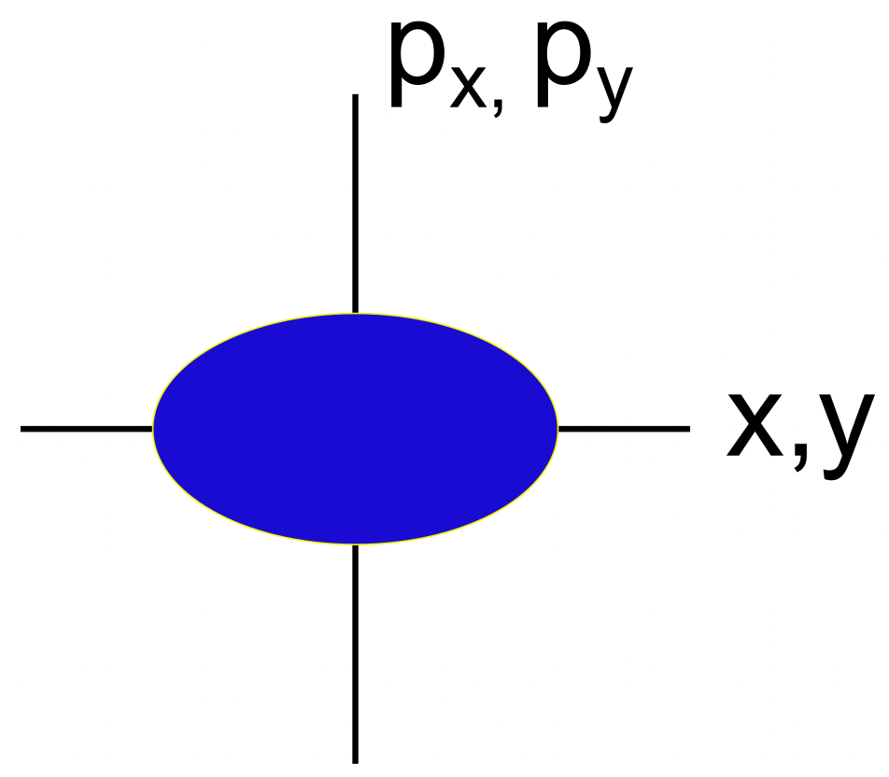
Solving for Full 4D Transfer Matrix
Assuming a polycrystalline cathode with a disordered surface, there’s no correlation between emission position and momentum
Notes:
Read slide

Slide 25
Solving for Full 4D Transfer Matrix
Assuming a polycrystalline cathode with a disordered surface, there’s no correlation between emission position and momentum
Downstream
Source
Notes:
Going back to this, we can now set these correlation elements in the source matrix to 0!

Slide 26
Solving for Full 4D Transfer Matrix
The correlation between emission position and momentum being zero adds constraints on the transfer matrix
Downstream
Source
0
0
0
0
0
0
0
0
Notes:
And that adds a bunch of new constrains on the transfer matrix

Slide 27

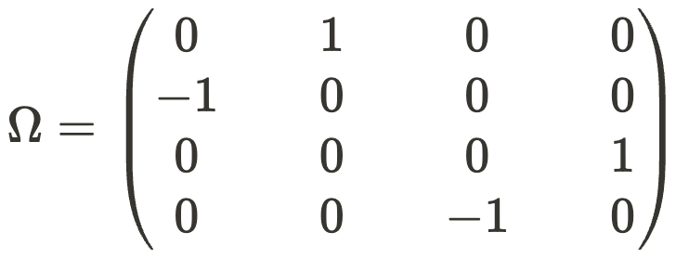
Solving for Full 4D Transfer Matrix
The last constraint on the transfer matrix is the symplectic condition, a fundamental tenet of Hamiltonian mechanics
Notes:
We have one last constraint and that is to enforce symplecticity which we get for simply obeying classical mechanics

Slide 28

Solving for Full 4D Transfer Matrix
Altogether, we solve this system of equations for the transfer matrix $\text{M}$,
Downstream
Source
0
0
0
0
0
0
0
0
Downstream
Source
Symplecticity
Notes:
So by only looking at the phase space moments like the centroid and covariances, we are able to solve for the full 4D transfer matrix

Slide 29
Testing the Source Reconstruction
Tests were performed at the PHOEBE beamline at Cornell
Beam
Notes:
Ok so to demonstrate this method in experiment we used the PHOEBE beamline at Cornell shown here

Slide 30
Testing the Source Reconstruction
Tests were performed at the PHOEBE beamline at Cornell
15 kV DC gun
Beam
Notes:
We have a 15 kV DC gun that accelerates the beam

Slide 31
Testing the Source Reconstruction
Tests were performed at the PHOEBE beamline at Cornell
Beam
Solenoid
Notes:
a solenoid magnet immediately after the gun exit focuses the beam onto the aperture scan diagnostic

Slide 32
Testing the Source Reconstruction
Tests were performed at the PHOEBE beamline at Cornell
Beam
Aperture Scan Diagnostic
Notes:
and this is where we measure the 4D phase space using an aperture scan, which I will also not talk about for time.

Slide 33
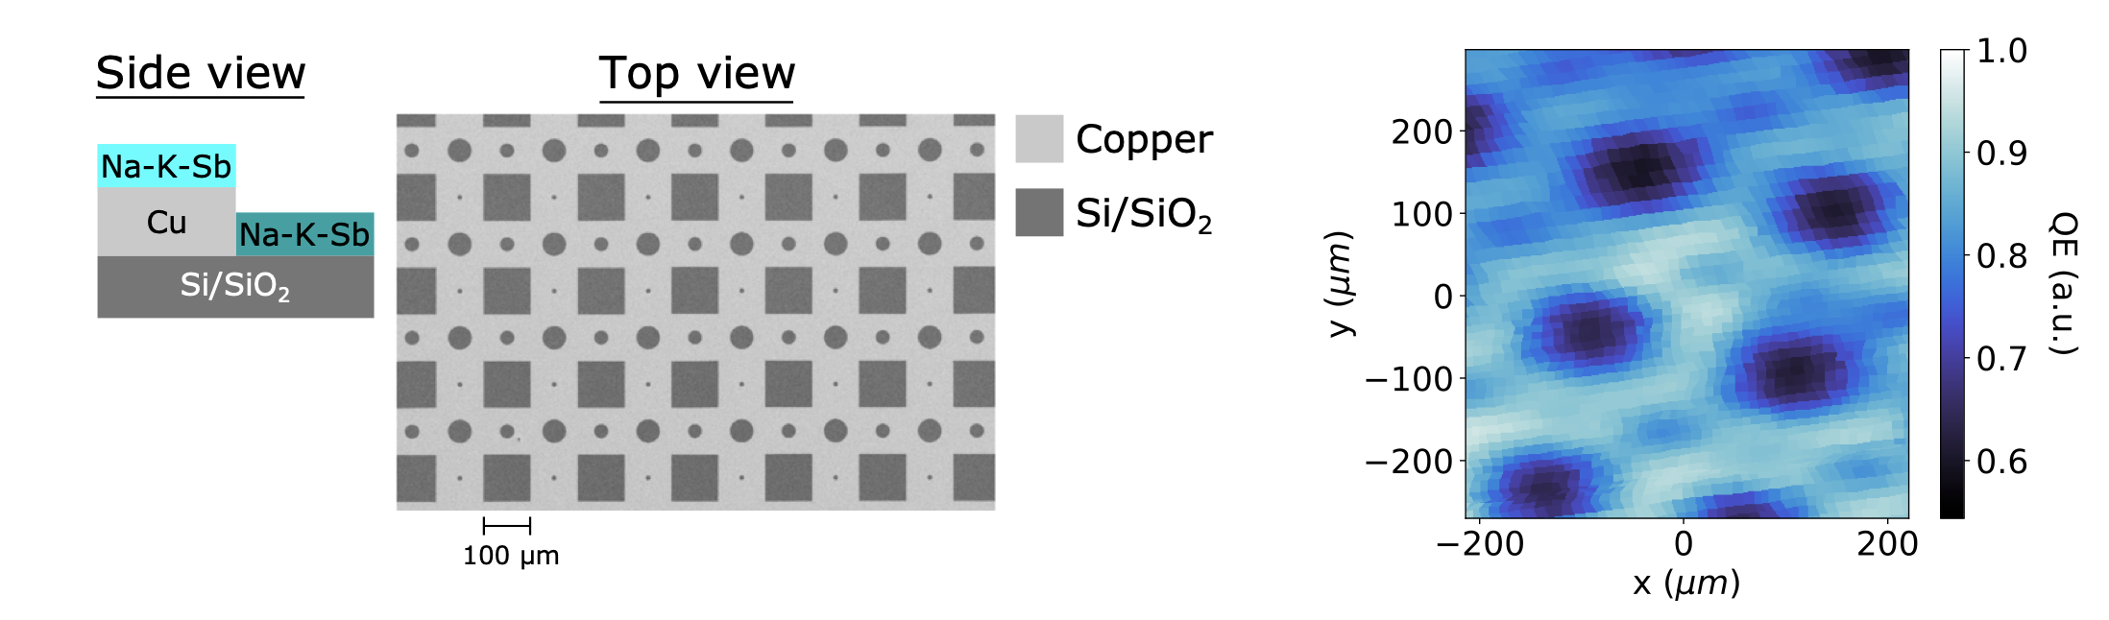
Testing the Source Reconstruction
We use a micro-patterned alkali-antimonide cathode that periodically modulates quantum efficiency
QE Map
Side View
Substrate SEM
arXiv:2510.04768 [physics.acc-ph]
Notes:
Here I’m showing the cathode we used

Slide 34
Testing the Source Reconstruction
We use a micro-patterned alkali-antimonide cathode that periodically modulates quantum efficiency
QE Map
Side View
Substrate SEM
arXiv:2510.04768 [physics.acc-ph]
Notes:
If you look all the way on the left, you can see that our cathode is an alkali antimonide, grown on top of a layer of copper deposited on Si.

Slide 35
Testing the Source Reconstruction
We use a micro-patterned alkali-antimonide cathode that periodically modulates quantum efficiency
QE Map
Side View
Substrate SEM
SEM
arXiv:2510.04768 [physics.acc-ph]
Notes:
Next to it, I’m showing an SEM image of the copper and silicon substrate, where we can see that the copper layer creates this periodic lattice of exposed silicon markers.

Slide 36
Testing the Source Reconstruction
We use a micro-patterned alkali-antimonide cathode that periodically modulates quantum efficiency
QE Map
Side View
Substrate SEM
arXiv:2510.04768 [physics.acc-ph]
Notes:
These markers periodically modulates the quantum efficiency of the cathode as shown in the QE map on the right, and this imprints the lattice pattern onto the beam itself!

Slide 37
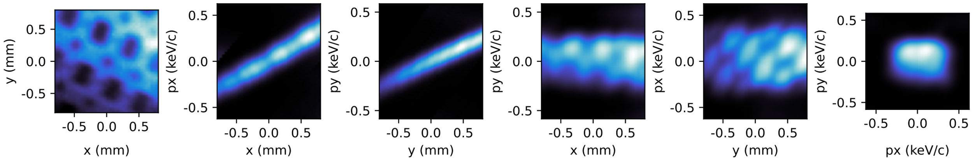
Testing the Source Reconstruction
Measured 4D Phase Space
arXiv:2510.04768 [physics.acc-ph]
Notes:
Andddd as promised, here is one of the 4D phase spaces that we measured,

Slide 38
Testing the Source Reconstruction
Measured 4D Phase Space
arXiv:2510.04768 [physics.acc-ph]
Notes:
you can see the QE modulations showing up in the spatial distribution in the upper leftmost plot.
Also note that we’re not measuring the full beam here, which is why some of the 2D phase spaces may look a bit strange

Slide 39
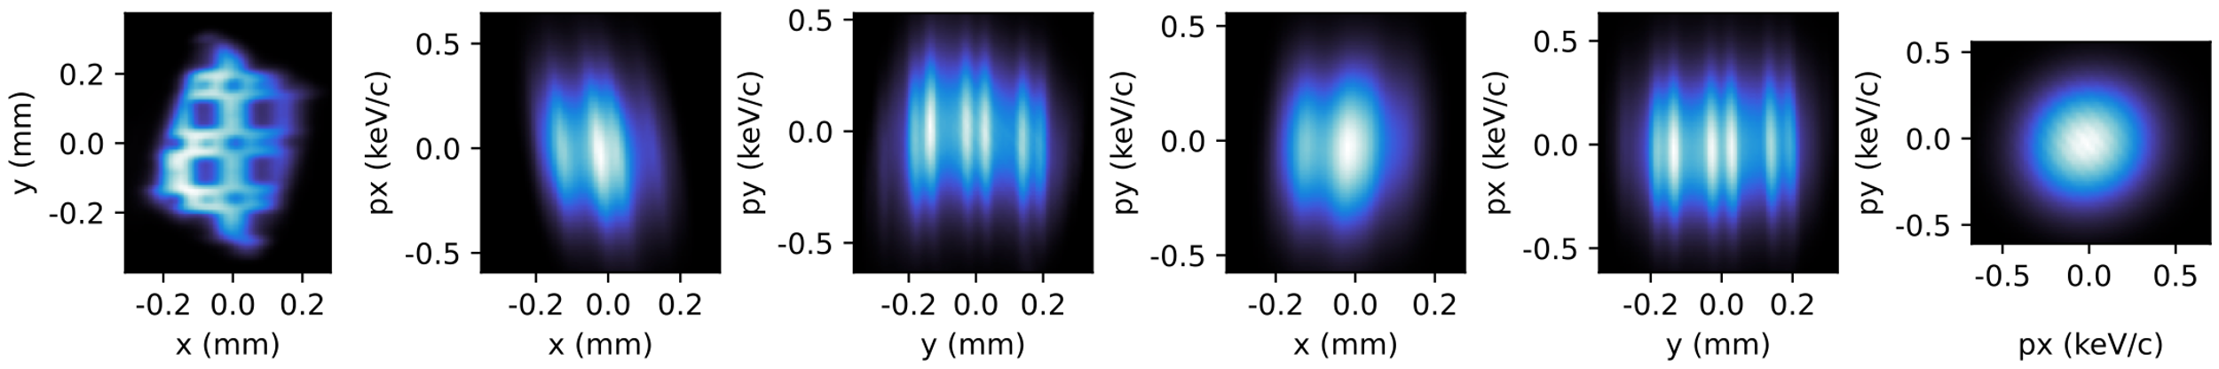
Testing the Source Reconstruction
Measured 4D Phase Space
Reconstructed Source 4D Phase Space
arXiv:2510.04768 [physics.acc-ph]
Notes:
We apply the reconstruction method to get the source phase space shown on the bottom row

Slide 40
Testing the Source Reconstruction
Measured 4D Phase Space
Reconstructed Source 4D Phase Space
arXiv:2510.04768 [physics.acc-ph]
Notes:
And right now we will only really look at the source spatial distribution and the momentum distribution

Slide 41
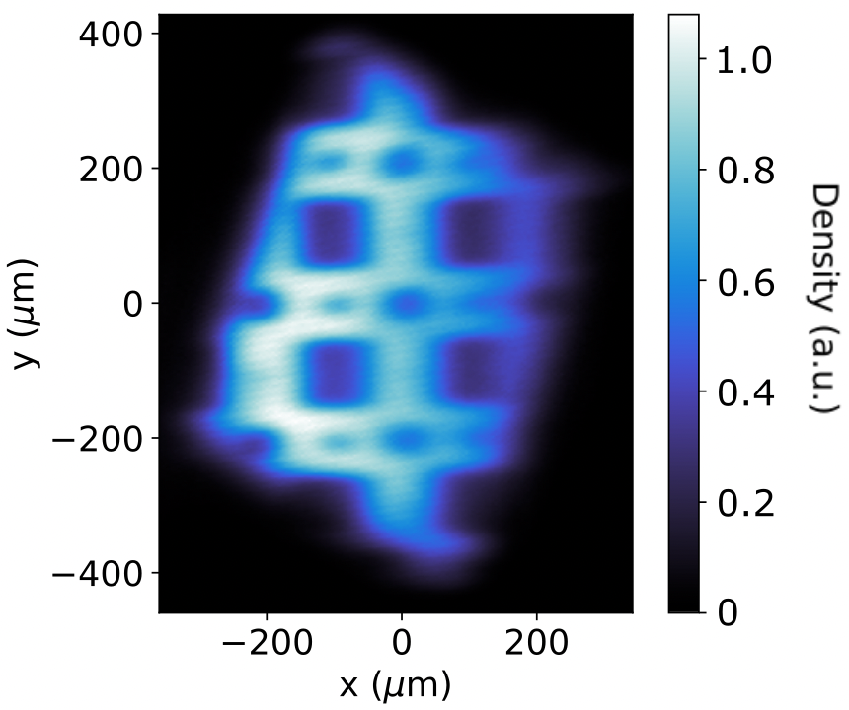
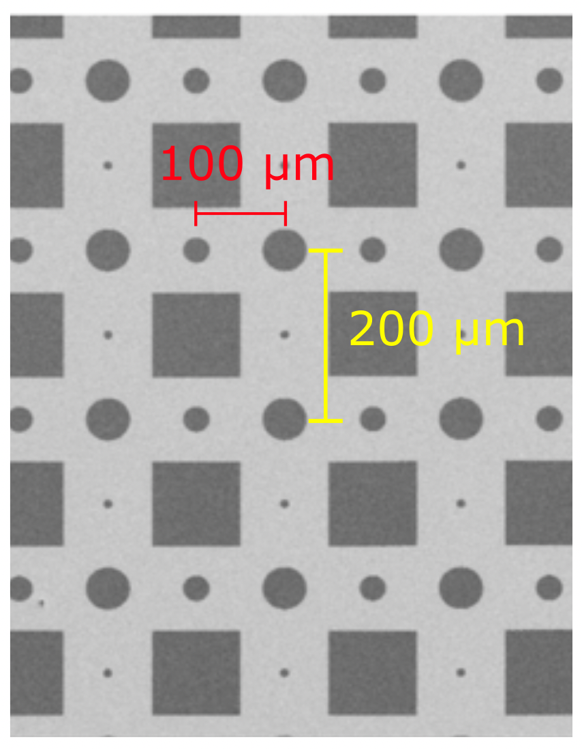




Checking Source Spatial Distribution
Average distances between patterned features on the cathode and in the beam agree,
Reconstructed
Substrate SEM
$$102±4 μ\text{m}$$
$$207±5 μ\text{m}$$
arXiv:2510.04768 [physics.acc-ph]
Notes:
We can analyze the source phase space further by seeing if we've reconstructed the cathode marker lattice in the beam!
So we compare the distances between markers in the reconstructed spatial distribution on the left and in the SEM image of the substrate on the right.
We see good agreement between the two images, so this at least confirms our reconstruction of the source positions

Slide 42
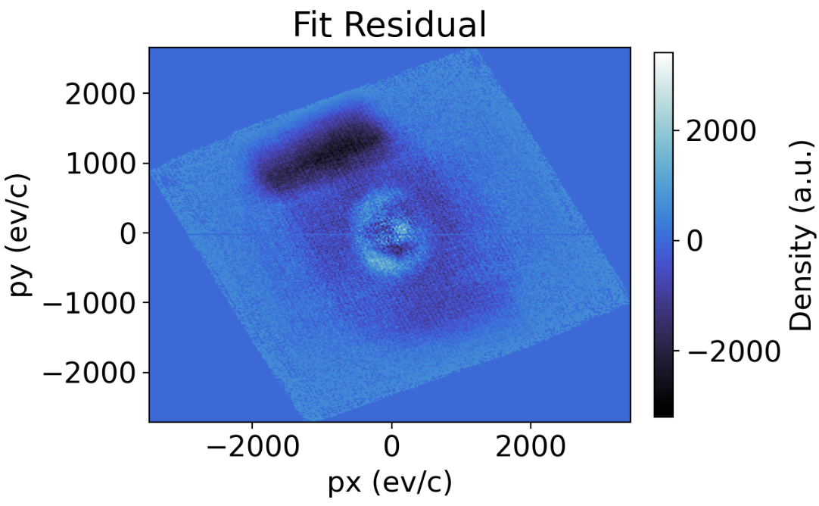
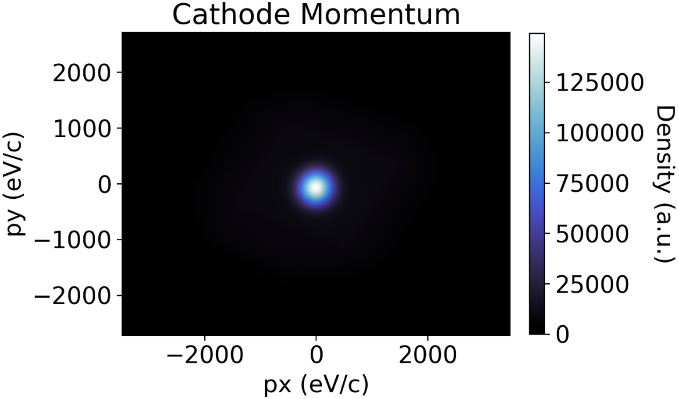


Checking MTE
We fit the source momentum distribution for the rms momentum, which gives an MTE of $73±2$ meV
MTE = $73±2$ meV
Notes:
We can also check the MTE, so we fitted the reconstructed source momentum distribution on the left with a 2D superguassian, which gave us an MTE of around 73 meV.
And for fun here's the fit residual on the right

Slide 43
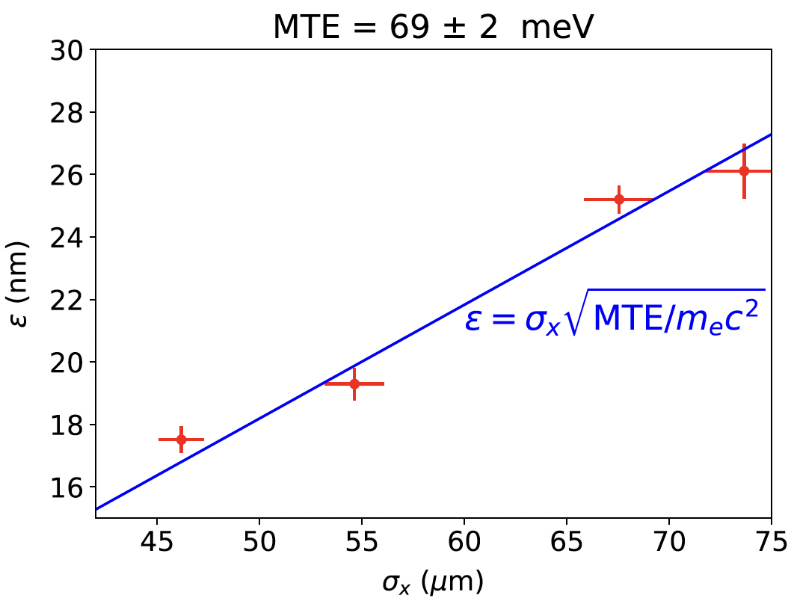
Checking MTE
An alternative measurement yields a comparable MTE of $69±2$ meV
Beam emittance
Beam size @ cathode
arXiv:2510.04768 [physics.acc-ph]
Notes:
Alternatively, we also measured beam emittance for varying initial beam sizes at the cathode
A linear fit of this gave us a comparable MTE of roughly 69 meV, which suggests that we’ve reconstructed the source momentums correctly.

Slide 44
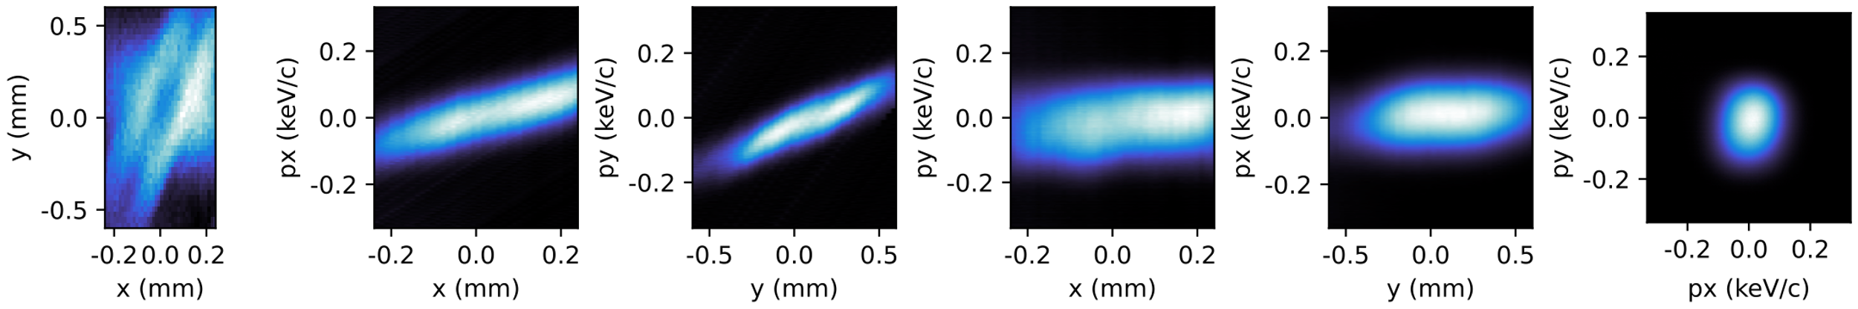
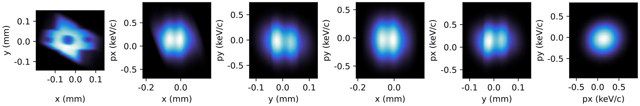
Testing the Source Reconstruction
Measured 4D Phase Space at Different Beamline Setting
Reconstructed Source 4D Phase Space
Notes:
To finish this off, we also had to see if this worked at different beamline optic settings.
So here we tried focusing the beam stronger with our solenoid

Slide 45
Testing the Source Reconstruction
Measured 4D Phase Space at Different Beamline Setting
Reconstructed Source 4D Phase Space
Notes:
Looking at the top row, the measured spatial distribution in the leftmost plot is significantly distorted now.

Slide 46
Testing the Source Reconstruction
Measured 4D Phase Space at Different Beamline Setting
Reconstructed Source 4D Phase Space
Notes:
However, if we look at the bottom row, we can see that the reconstructed spatial distribution in the leftmost plot still resembles the expected substrate pattern.

Slide 47

Takeaways
We obtain the 4D transfer matrix $\text{M}$ from phase space measurements,
Measure
Source
0
0
0
0
0
0
0
0
Measure
Vary
Symplecticity
Notes:
So our takeaways from this talk are -
We've developed a method to measure the 4D transfer matrix of a beamline from phase space measurements of centroid and covariances

Slide 48
Takeaways
We experimentally demonstrate and verify the fidelity of source 4D phase space reconstructed from downstream measurements,
Source Reconstruction
Notes:
say whats on slide

Slide 49
Stop here

Slide 50
Takeaways
Pros:
Requires no assumptions about the photoemission (multi-photon emission, accurate beam spot size, etc.)
Does not require EM fieldmaps of beamline elements
Does not require measuring the full beam to perform source phase space reconstruction
Cons:
Requires linear beam transport (i.e. negligible space charge, linear optics, etc.)
4D measurements does not account for correlations with energy or time (dispersion, etc.)
Notes:
shut up

Slide 51
Testing the Source Reconstruction
Measured 4D Phase Space
Reconstructed Source 4D Phase Space
arXiv:2510.04768 [physics.acc-ph]
Notes:
For example, the position-momentum phase spaces are flat, which indicates that the position and momentums are not correlated with each other.

Slide 52
Testing the Source Reconstruction
Measured 4D Phase Space
Reconstructed Source 4D Phase Space
arXiv:2510.04768 [physics.acc-ph]
Notes:
And the momentum distribution in the bottom rightmost plot has recovered its typical round profile.
This phase spaces are what we expect for most polycrystalline cathodes with disordered surfaces.

Slide 53

MTEs Agree
MTE = $73±2$ meV
arXiv:2510.04768 [physics.acc-ph]
Notes:
Comparing the MTEs measured both ways, we see that they agree and suggest that we’ve reconstructed the source momentums correctly.

Slide 54
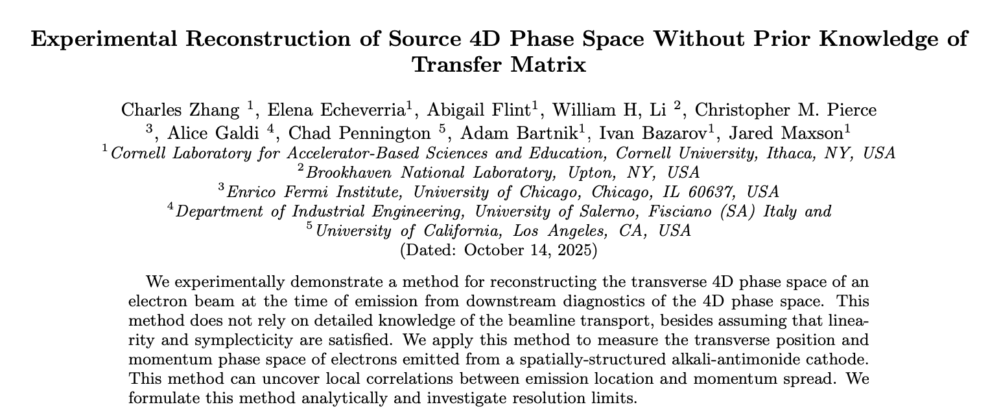
Takeaways
Check out our paper – now on ArXiv!
arXiv:2510.04768 [physics.acc-ph]

Slide 55

Testing the Source Reconstruction
1.5 m
Notes:
For a sense of scale, this beamline is about 1.5 meters long and could fit in the back of a camper van.

Slide 56
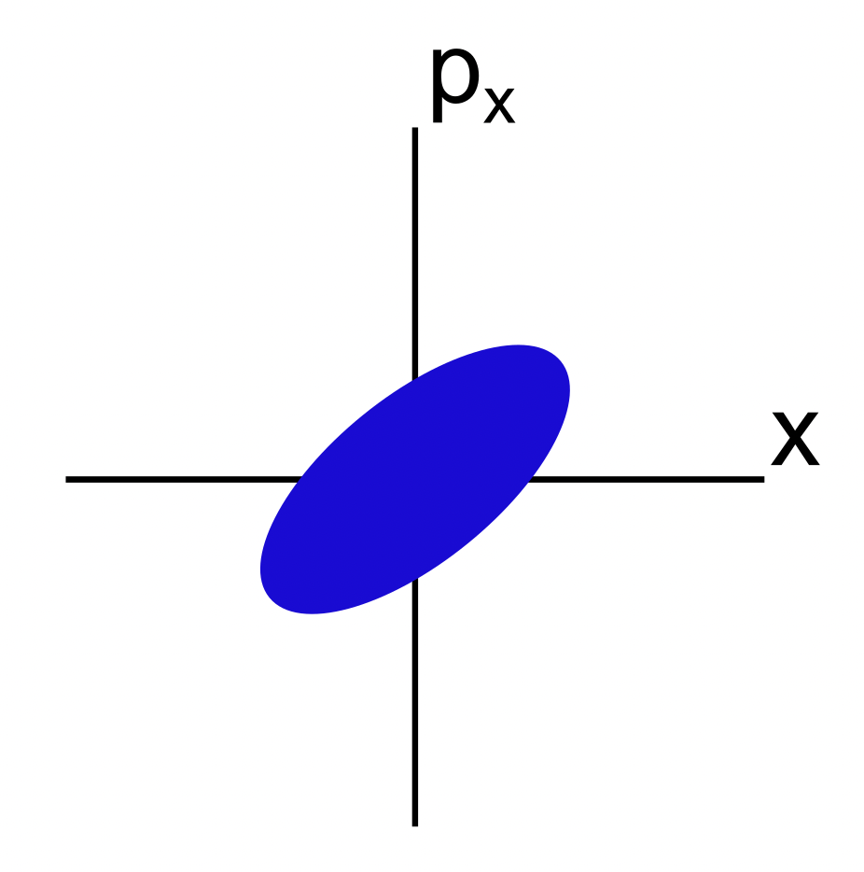
Phase Space
2D Phase Space

Slide 57
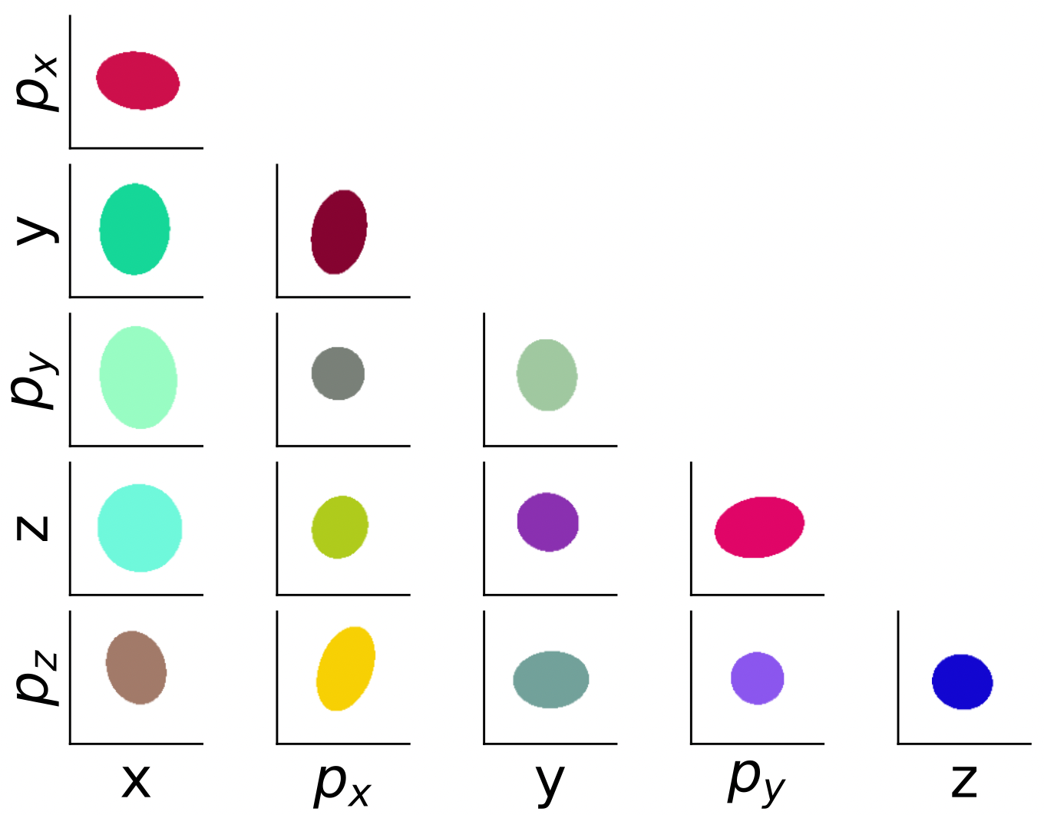
Phase Space
2D Phase Space
6D Phase Space

Slide 58
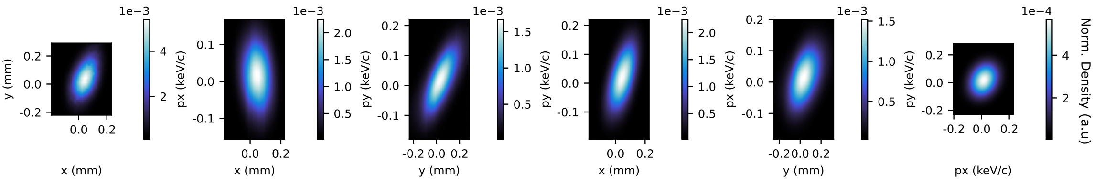
Phase Space
4D Phase Space

Slide 59
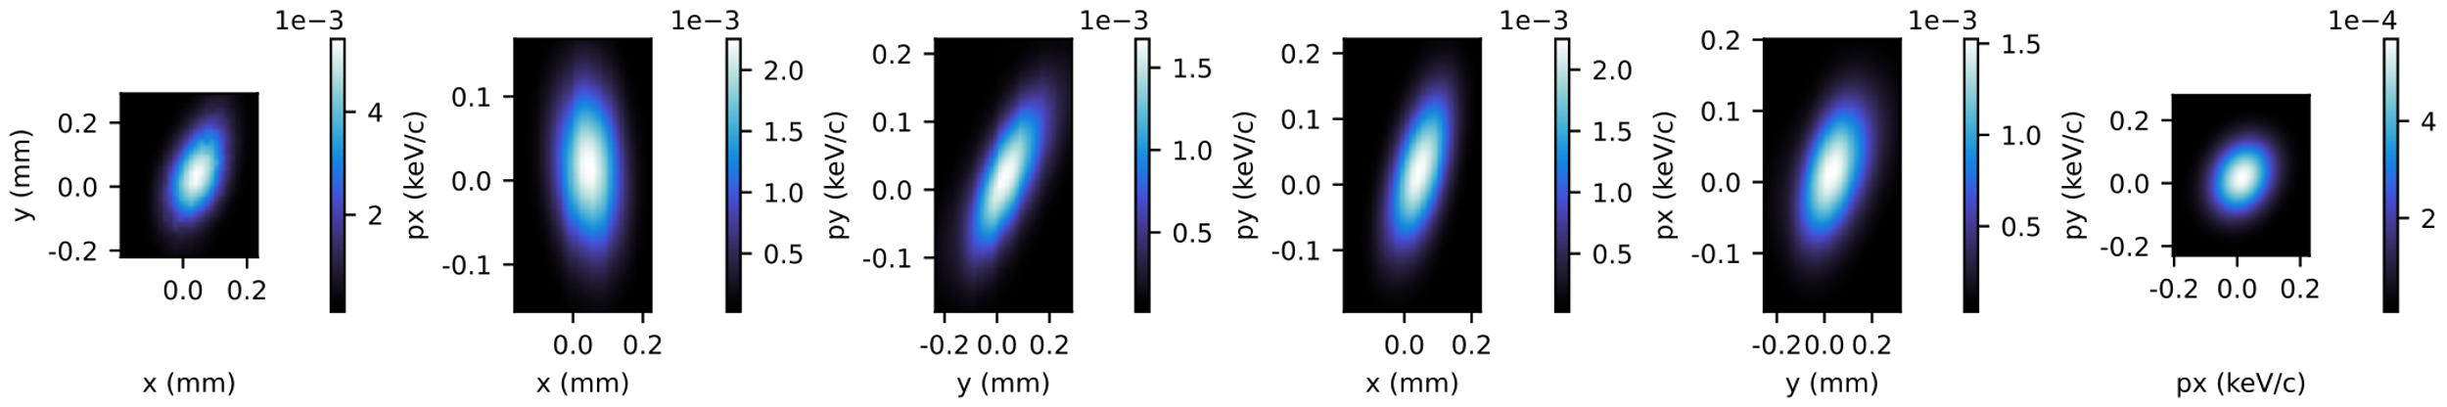

4D Phase Space
A more typical visualization

Slide 60
Solving for Full 4D Transfer Matrix
Higher-order (>1) statistical moments of the beam might give us more information
Measure
Source

Slide 61
Solving for Full 4D Transfer Matrix
Assuming a polycrystalline cathode with a disordered surface, there’s no correlation between emission position and momentum

Slide 62
Solving for Full 4D Transfer Matrix
Assuming a polycrystalline cathode with a disordered surface, there’s no correlation between emission position and momentum
Measure
Source

Slide 63
Solving for Full 4D Transfer Matrix
For a polycrystalline cathode with a disordered surface, there’s no correlation between emission position and momentum
Measure
Source
0
0
0
0

Slide 64

Solving for Full 4D Transfer Matrix
We solve this system of equations to solve for the transfer matrix $\text{M}$,
Measure
Vary
Measure
Source
0
0
0
0

Slide 65
Reconstructing Full Source 4D Phase Space
Measure
Fit
??
Fit
??
Vary

Slide 66
Solving for Full 4D Transfer Matrix
We measure beam covariances and assume zero source position-momentum correlations,
Measure
Source

Slide 67
Solving for Full 4D Transfer Matrix
We measure beam covariances and assume zero source position-momentum correlations,
Measure
Source

Slide 68
Solving for Full 4D Transfer Matrix
We measure beam covariances and assume zero source position-momentum correlations,
Measure
Source
0
0
0
0
0
0
0
0

Slide 69
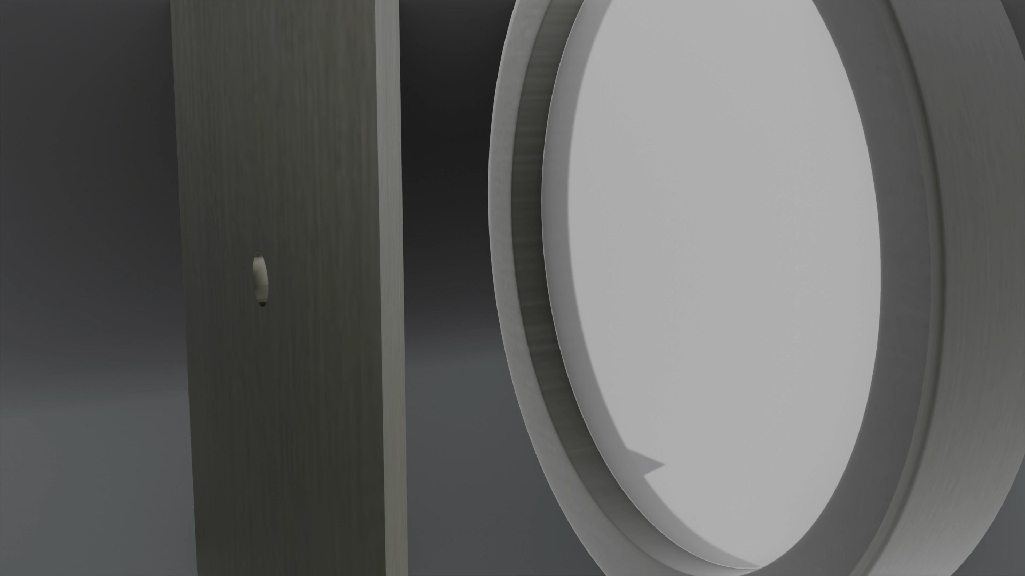
Testing the Source Reconstruction
We measure 4D phase space using an aperture scan

Slide 70
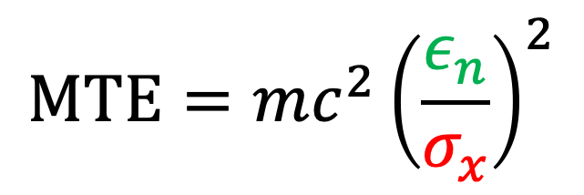
How do we measure MTE?
Beam emittance = phase space volume
$$MTE={mc^{2}\left(\frac{ε_{n}}{σ_{x}}\right)}^{2}$$
Beam size @ cathode

Slide 71
How do we measure MTE beam emittance $ε_{n}$?
Scanning beamline optics

Slide 72
How do we measure MTE beam emittance $ε_{n}$?
Phase space Imaging

Slide 73
How do we measure MTE beam size $σ_{x}$?

Slide 74
Solving for Full 4D Transfer Matrix
We solve this system of equations to solve for the transfer matrix $\text{M}$,
Measure
Source
0
0
0
0
0
0
0
0
Measure
Vary
Symplecticity

Slide 75
Reconstructing Source Momentum
The Symplectic Condition
Notes:
Even without the full transfer matrix we can do something pretty cool
But for that we need the symplectic condition.
Which is this equation here. This is a direct result of Hamiltonian mechanics and allows us to…

Slide 76
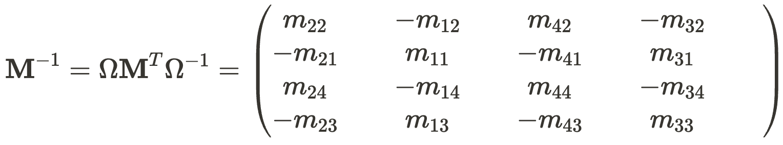
Reconstructing Source Momentum
Notes:
We can re-arrange the symplectic condition into the form here on the bottom

Slide 77
Reconstructing Source Momentum
Notes:
That allows us to derive this form for the inverse transfer matrix, which turns out to be a simple rearrangement of the original transfer matrix.

Slide 78
Reconstructing Source Momentum
Measure
Fit
Fit
Laser
Notes:
Remember, how we measured the first and third columns of the transfer matrix earlier.
Look at the highlighted rows here, they consist of those very same elements that we’ve measured in the original transfer matrix!

Slide 79
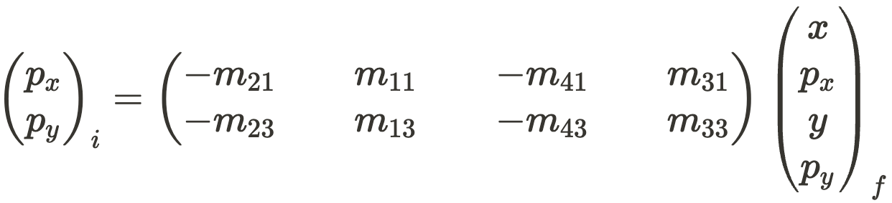
Reconstructing Source Momentum
Applying the inverse transfer matrix to the 4D particle coordinate measured downstream, we can calculate its source momentums,
Measure
Source
Previously Fitted
Notes:
If we then apply this inverse transfer matrix to the measured 4D coordinates, we can calculate the momentum of the particle at the source

Slide 80
Reconstructing Source Momentum
By measuring the 4D phase space dependence on initial position, we can determine the initial conjugate momentums
Measure
Source
Previously Fitted
Notes:
In summary, [READ FROM SLIDE]

Slide 81
Source Momentum Reconstructed
Complete picture of momentum beyond MTE
Notes:
This brings us back to the example I showed earlier of a full source momentum distribution, from which you can calculate the MTE
But we’ve still haven’t found the entire transfer matrix, which we need to reconstruct the entire 4D phase space

Slide 82
Solving for Full 4D Transfer Matrix
We also use the evolution of the beam covariance matrix in the beamline,
Measure
Source
0
0
0
0
0
0
0
0
Notes:
To do that, we also measure the beam covariance, which evolves in the beamline like this

Slide 83
Reconstructing 4D Source Phase Space
Applying the inverse transfer matrix to a measured 4D phase space yields the source 4D phase space,
Source
Solved Inverse Transfer Matrix
Measure
Notes:
Once we have that, it’s only a matter of applying the inverse transfer matrix to the measured phase space to reconstruct the source phase space

Slide 84
Testing the Source Reconstruction
Measured 4D Phase Space
arXiv:2510.04768 [physics.acc-ph]
Notes:
such as the momentum distribution in the rightmost plot.

