Slide 1
Nb3Sn Chemical Vapor Deposition and Nucleation Studies
G. Gaitan, L. Sphani, M. Liepe
This work was supported by the U.S. National Science Foundation under Award PHY-1549132, the Center for Bright Beams.

Slide 2
Outline
I. General Motivation
II. SnCl2 Nucleation study
III. Chemical Vapor Deposition using SnCl2 as a precursor
IV. Conclusions

Slide 3
Outline
I. General Motivation
II. SnCl2 Nucleation study
III. Chemical Vapor Deposition using SnCl2 as a precursor
IV. Conclusions

Slide 4
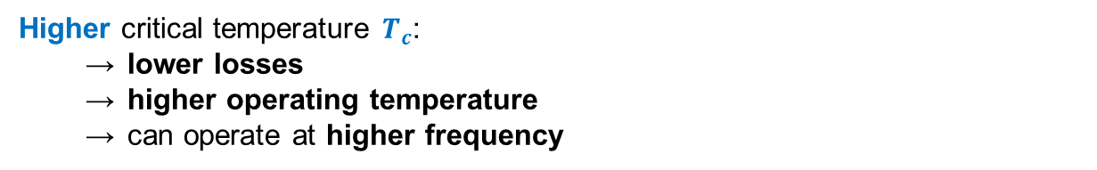

Exploring SRF Materials Beyond Nb
Material | λ [nm] | ξ [nm] | 𝜅 [nm] | Tc [K] | Bc1 [T] | Bc [T] | Bsh [T]
Nb | 40 | 27 | 1.5 | 9 | 0.13 | 0.21 | 0.25
Nb₃Sn | 111 | 4.2 | 26.4 | 18 | 0.042 | 0.5 | 0.42
NbN | 375 | 2.9 | 129.3 | 16 | 0.006 | 0.21 | 0.17
MgB2 | 40 | 6.9 | 5.8 | 40 | 0.051 | 0.34 | 0.33?
Notes:
We want to look at other materials beyond Nb. Such a material is Nb3Sn as it has a higher critical temperature compared to Nb and a higher maximum magnetic field it can tolerate. This is called the superheating field which is the field at which magnetic vortices enter the superconductor and heat it in AC operation. The superheating field was demonstrated in pulsed operation by a colleague In our group and it reached ~400mT as predicted by theory.
Main idea: Nb3Sn should be better than Nb.

Slide 5
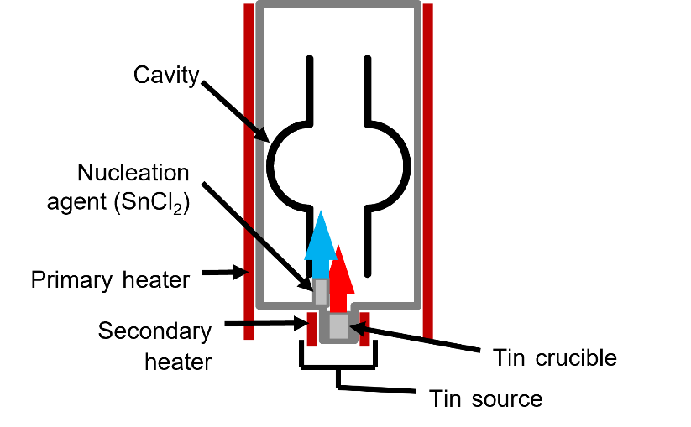
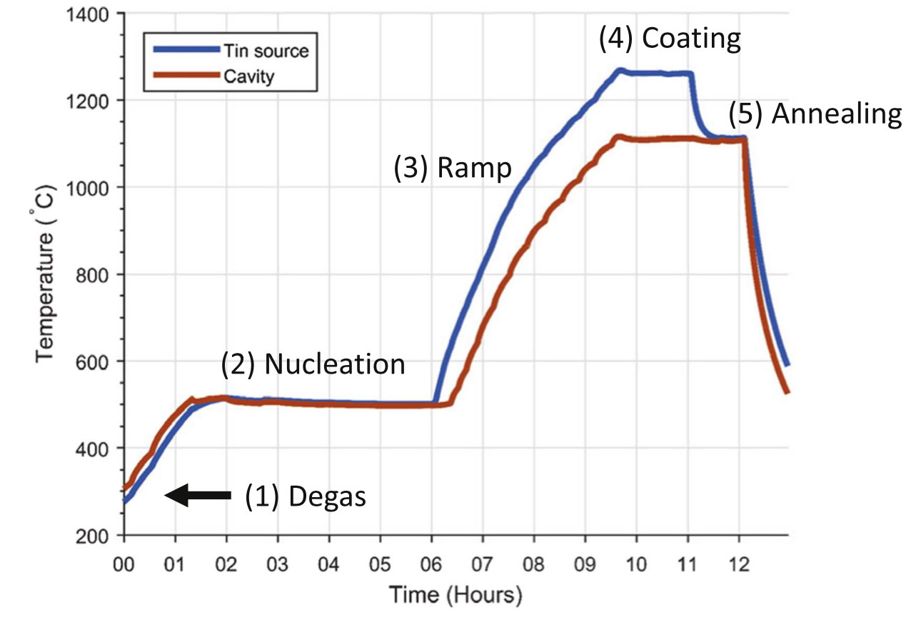

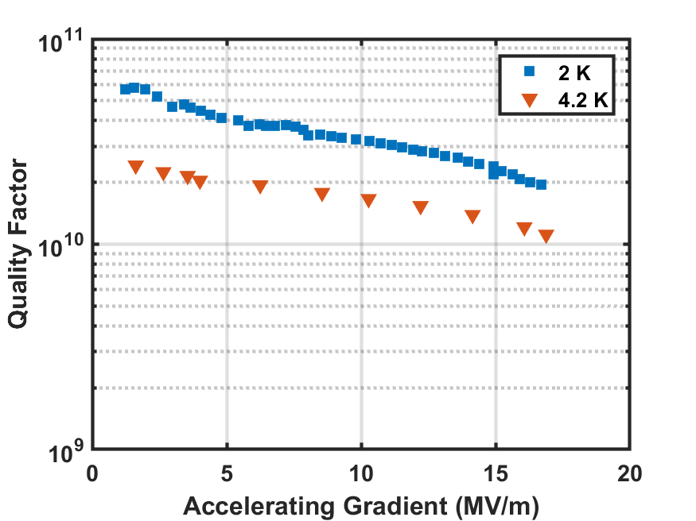
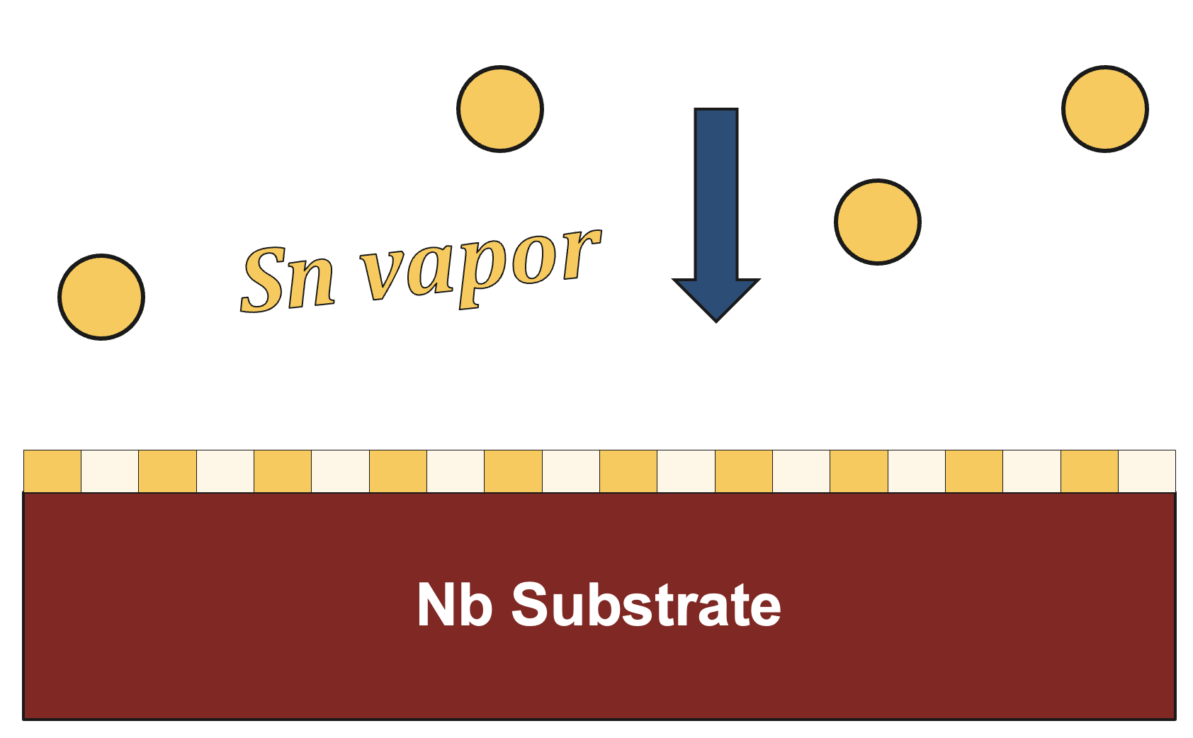
Nb₃Sn performance
→ Reproducible performance of ~4 K operation with Q₀ > 10¹⁰ at typical CW operating fields.
→ Current quench fields: 16–24 MV/m (FNAL holds world record)
Thermal Vapor Diffusion
S. Posen and M. Liepe, Phys. Rev. ST Accel. Beams 15, 112001 (2014).
SnCl2 vapor
Sn droplets Nucleating
Nb substrate
Previously thought to happen around 500C
We will show it happens around 200C
Notes:
The current process we use to deposit Nb3Sn now is using thermal vapor diffusion. It is a two-step process, first SnCl2 is evaporated at lower temperatures and nucleates Sn droplets on the Nb surface. Then at higher temperatures Sn is evaporated and deposits on the surface and forms the Nb3Sn film.
2. Main idea: On the first part of the talk, I will focus on our study on the nucleation stage where SnCl2 first arrives on the surface. A more uniform nucleation may lead to a more uniform Nb3Sn film which could improve RF performance.

Slide 6
Outline
I. General Motivation
II. SnCl2 Nucleation study
III. Chemical Vapor Deposition using SnCl2 as a precursor
IV. Conclusions

Slide 7
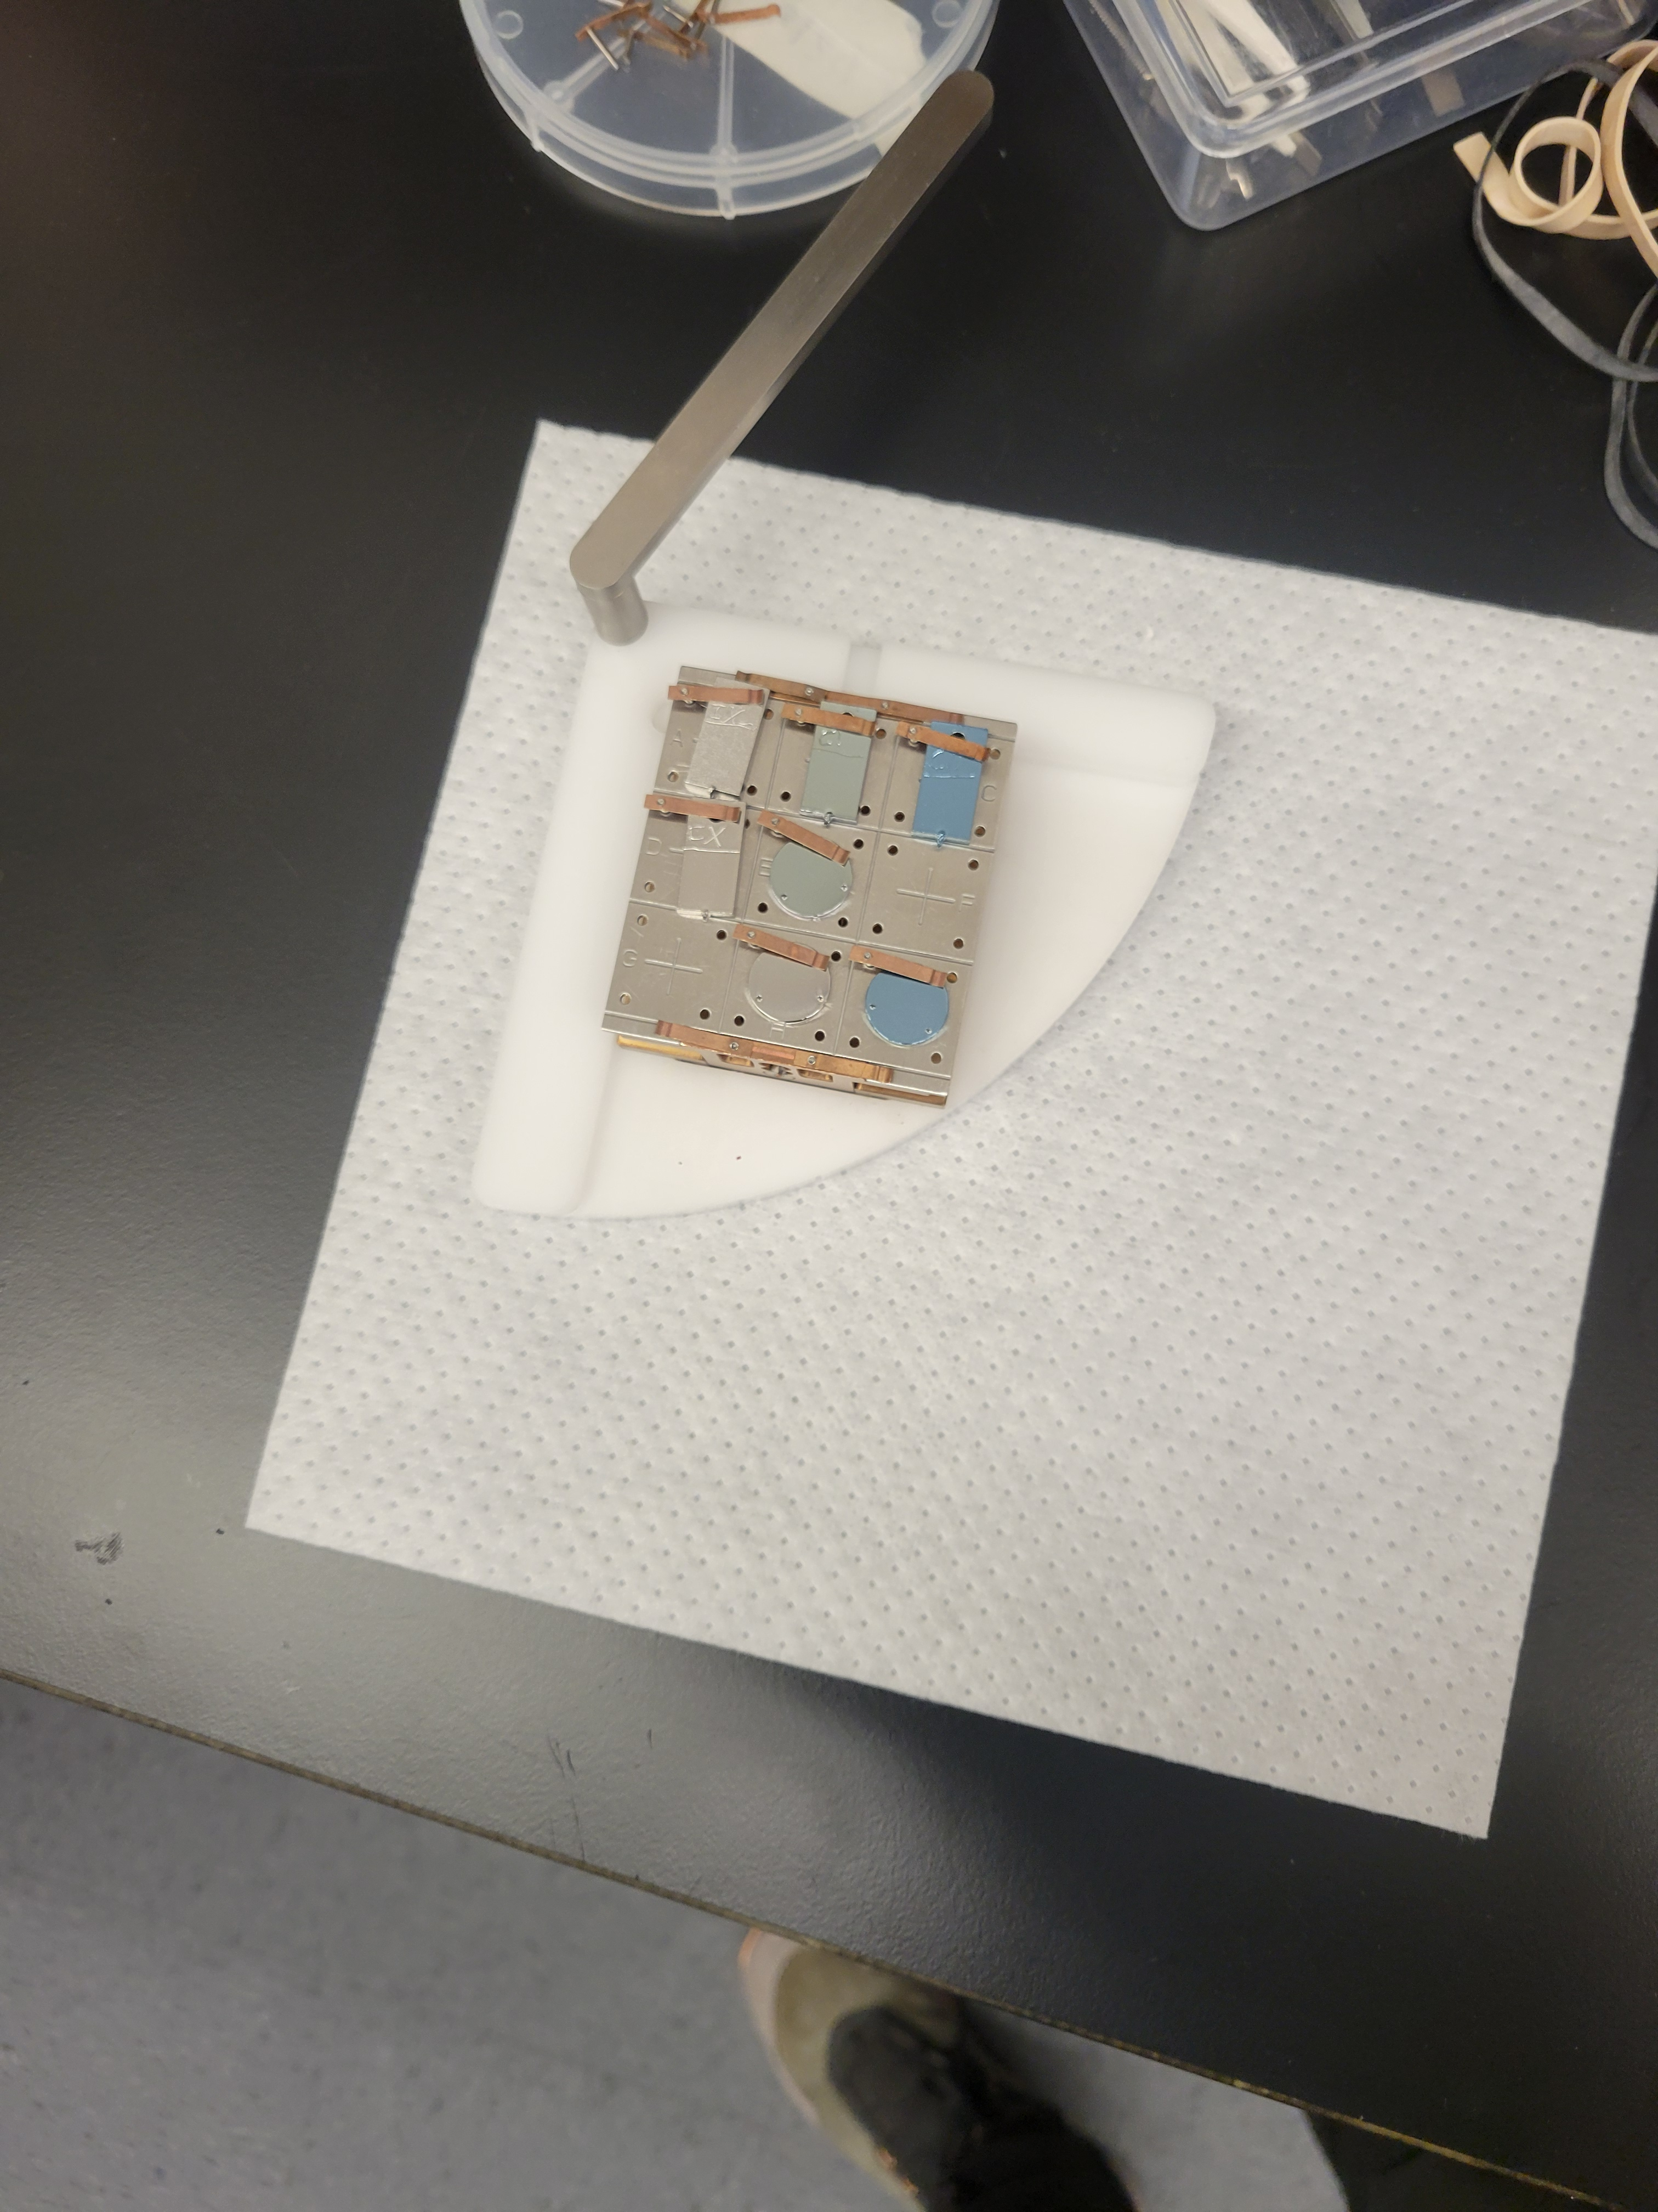
Nucleation study with SnCl2 and different oxides
NaOH anodization
Treatment | Roughness | Oxide
EP-ed (not anodized) | Smooth | Native(5 nm)
NaOH anodization | Rough | Thick (~250nm)
H2SO4 anodization | Smooth | Thick(~90nm)
Witness Cleanup bake
H2SO4 anodization
Not anodized
Round samples are Liana’s study
Liana Shpani, Van Do, Jasper Brown are studying the roughness of the oxides formed with anodization
SnCl2 vapor
Nb substrate
Sn droplets Nucleating
Notes:
Main idea: We are studying how different surface oxides influence the nucleation process to try to determine if the thickness of the oxide, the treatment, or the roughness of the oxide influence nucleation.

Slide 8
Setup SnCl2 tungsten crucible 200C
Non anodized 200C 2h
Smooth native oxide
Not anodized 200C - 5 h
Smooth native oxide
NO flow
NO flow
NaOH Anodized 200C - 5 hour (rough oxide)
0.828g
SnCl2
~5 g
SnCl2
SnCl2 crucible at 200C - 2h
NaOH Anodized 200C- 2h (rougher oxide)
SnCl2 larger crucible at 200C – 5 hour
H2SO4 Anodized 200C - 5 hour (smooth oxide)
Experiment 1
Experiment 2
Notes:
Main idea: Did some experiments to test if roughness or the oxide thickness influence nucleation
Two experiments with different amounts of SnCl2 evaporated. The first experiment compared a NaOH(sodium hydroxide) anodized sample with a rough oxide with
a smooth native Nb oxide and the second one compared added an anodized sample with sulfuric H2SO4 acid with a smooth but thicker oxide.

Slide 9
Results Non anodized sample at 200C
SnCl2 crucible at 200C, Non anodized sample XIII at 200C, 2 hours
Small droplets, likely condensed Sn? Not detectable on EDS
Sn on EDS
0.53% Sn/(Sn+Nb)
0.53% Sn/(Sn+Nb)
Notes:
Main idea: Droplets were dense and small, but not much Sn was deposited

Slide 10
Results Non anodized sample at 200C
SnCl2 crucible at 200C, Non anodized sample XIII at 200C, 2 hours
Small dense droplets
Big Sn accumulation
0.53% Sn/(Sn+Nb)
0.53% Sn/(Sn+Nb)
Notes:
Main idea: Dense droplets were everywhere, except for places where the plastic foil we keep the samples in scratched the Sn after deposition

Slide 11
Anodized NaOH 200C 2 hour run
XIV: anodized, 200 C 2 hr. Sn is detected on the surface even though no droplets are seen
1.2% Sn/(Sn+Nb)
1.2% Sn/(Sn+Nb)
Notes:
Main idea: NaOH has higher Sn content deposited on the surface, but no visible droplets.

Slide 12
EDS comparison with other samples
10keV voltage
Sample | %Sn/(%Sn+%Nb) in %
XIV: NaOH anodization, 200 C 2 hr | 1.20 ± 0.03
XIII: not anodized, 200 C 2 hr | 0.53 ± 0.15
XX: NaOH anodization, 500 C 30 min | 3.90 ± 0.13
III- not anodized 500C 30 min | 0%
Evaporated 0.828g
Evaporated 1.79g
As crucible was at 240C
500C was considered the temperature for nucleation for vapor diffusion, but as the 200C results show, nucleation starts much earlier
Notes:
Main idea: Very different behavior, between NaOH anodized(rough) and not anodized (Smooth) both in nucleation sites and Sn content.
Note: Higher temperature run not shown here in detail, but behavior persists.

Slide 13
Setup SnCl2 tungsten crucible 200C
Non anodized 200C 2h
Smooth native oxide
Not anodized 200C - 5 h
Smooth native oxide
NO flow
NO flow
NaOH Anodized 200C - 5 hour (rough oxide)
0.828g
SnCl2
~5 g
SnCl2
SnCl2 crucible at 200C - 2h
NaOH Anodized 200C- 2h (rougher oxide)
SnCl2 larger crucible at 200C – 5 hour
H2SO4 Anodized 200C - 5 hour (smooth oxide)
Experiment 1
Experiment 2
Notes:
Main idea: For the second experiment, we used a larger crucible and evaporated ~5g of SnCl2. We wanted to see the differences between the native oxide, the NaOH anodized oxide that was rough, and the H2SO4 oxide that was smoother.
Note: Also wanted to see what a longer run would do
Extra note: The precursor might have been degraded by humidity and that’s why we didn’t get as much evaporation as we should have. (only say if asked about it)

Slide 14
Comparison for XPS (5 hour run)
Largest Sn/Nb ratio NaOH
Notes:
Main idea: Sn/Nb ratio was highest on NaOH rougher oxide. Sulfuric and native had similar behaviour
These plots show a comparison between the amount of Sn detected on the sulfuric acid anodization vs the sodium hydroxide NaOH. We note that the native and sulfuric have smaller signal of Sn/Nb compared to the NaOH. This suggests that the roughness with/or the presence of Na are what allow Sn to bind more to the surface.

Slide 15
Comparison for SEM (5 hour run)
Similar, but Native oxide seems to have denser droplets
Sulfuric acid anodization
Native oxide (just Electropolished)
EDS: 0% Sn/(Sn+Nb)
EDS: 0% Sn/(Sn+Nb)
Notes:
Main idea: Native oxide may have denser droplets, but they look quite similar. On EDS scans both showed 0% Sn.

Slide 16
Comparison for SEM (5 hour run)
Sample with NaOH anodization 5 hour run looks the same as after the 2 hour run
Sulfuric acid anodization
NaOH anodization
EDS: 0% Sn/(Sn+Nb)
EDS: 1.65% Sn/(Sn+Nb)
Notes:
Main idea: Sample with NaOH anodization looks the same as after the 2 hour run with SnCl2. Oxide is still visible, no droplets visible. More Sn deposited than after 2 hours. Very different compared to the smooth surfaces both in Sn content and the lack of visible droplets.

Slide 17
EDS comparison (5 hour vs 2 hour)
The rougher oxide of NaOH allowed for more Sn to deposit even though droplets were not visible
Smoother native and H2SO4 oxides behaved similarly with droplets visible. No Sn was detected on EDS scans
Sample | %Sn/(%Sn+%Nb) in %
CI: NaOH anodization, 200 C 5 hr | 1.65 ± 0.205
XIV: NaOH anodization, 200 C 2 hr | 1.20 ± 0.03
CII: H2SO4 anodization, 200 C 5 hr | 0%
CX: Not anodized, 200C, 5h | 0%
XIII: Not anodized, 200 C 2 hr | 0.53 ± 0.15
Rough
10keV voltage
Smooth
In future studies we will bake the oxide before deposition (which keeps the roughness of the surface the same) to explore how the absence of an oxide affects nucleation and Nb3Sn growth
Notes:
Main idea: For nucleation it seems that the roughness plays a role, while the presence of oxygen doesn’t play such an important role.
Notes:
Future studies will look at baking the oxide before deposition while keeping the roughness to verify this
Oxygen may play a role in later stages of Nb3Sn growth, but that hasn’t been explored yet.

Slide 18
Outline
I. General Motivation
II. SnCl2 Nucleation study
III. Chemical Vapor Deposition using SnCl2 as a precursor
IV. Conclusions

Slide 19
Chemical Vapor Deposition (CVD)
H₂
Reactant Gas
Precursor Gas
Ar + SnCl₂ (g)
Intermediates and Byproducts
Sn²⁺(g) + HCl (g)
Exhaust
Desorption and carried off
Sn (s)
Product
Adsorption, nucleation, and growth
Notes:
Main idea: Chemical Vapor deposition in an alternative method to deposit various chemicals. Say we want to deposit Sn on a Nb surface, we can use this reaction: SnCl2+H2->Sn+2HCl
. We can deposit other materials too, like Nb, Al, Zr and recently some Zr contaminated my lines.
H₂ molecules readily donate electrons (reduce), while SCl2 accepts electrons (oxidizes), making this a typical redox reaction. the reaction occurs because SnCl2 is a strong oxidizer and hydrogen acts as a reducing agent, allowing the reduction of Sn

Slide 20
Recent CVD runs
Goal: Sn deposition on surface
Line 200C
Ar+SnCl2+H2
Argonne flow
200/500C non-anodized samples
SnCl2 bubbler 224C
Heat shield
Deposited Sn on two non-anodized native oxide samples at 200C and 500C
Notes:
Main idea: We performed some Sn deposition runs on not anodized samples at 200C and 500C

Slide 21
Results Recent CVD runs
Sn visible on XPS
EDS found a lot of Zirconium and no Sn
Likely from cross contamination from shared precursor delivery lines
Notes:
Main idea: Sn was visible was XPS, but Zr contamination prevented good studies

Slide 22
Changes to CVD System
Bypass line
Ar/H2 gas
Furnace door
MFC
MFC
S
NbCl₅
Bubbler
S
MFC
MFC
SnCl₂
S
Each precursor delivery line is separate, no more cross contamination
Bubbler
Bubbler
ZrCl₄
Notes:
Main idea: Separated the precursor delivery lines fully to avoid cross contamination

Slide 23
Outline
I. General Motivation
II. SnCl2 Nucleation study
III. Chemical Vapor Deposition using SnCl2 as a precursor
IV. Conclusions

Slide 24
Conclusions and Next steps
The rougher oxide formed by NaOH anodization resulted in more Sn deposited but no visible droplets at 200C. Sn droplets were visible at 500C in other runs.
The smooth native oxide and the thicker smooth oxide formed by H2SO4 anodization showed less Sn deposition in the nucleation stage. The roughness seemed to matter more than the oxide thickness.
SnCl2 Nucleation starts at 200C and likely earlier than the previous assumption that it happens around 500C. This should allow for optimizing the nucleation step.
Next, we will be annealing the Nb samples at 500C to eliminate the pentoxide and then bring the samples down to say 200C before Sn deposition using CVD `
Longer depositions followed by a ramp up to 1000C will tell us if these differences in nucleation lead to differences in Nb3Sn grain formation. (are the grains smaller if there are more initial nucleation sites?)
Notes:
Extra note: The non-anodized sample had dense droplets at 200C for 2 hours and had Sn detectable on EDS, but in another run that lasted for 5 hours these droplets were not as dense and Sn was not detectable on EDS. It is unclear if SnCl2 exposure to humidity was the cause of this, or something else. Some next tests will check the quality of SnCl2 and see if humidity degraded it.

Slide 25
Thank you
Questions?

