Slide 1
Nb surface oxide and anodization effects on tin nucleation for Nb₃Sn growth
Liana Shpani
In collaboration with: Van Do, Jasper Brown, and Gabriel Gaitan
Steven Sibener from University of Chicago, and Matthias Liepe from Cornell University
July 9th, 2026
Research funded by Center for Bright Beams, NSF award PHY-1549132

Slide 2
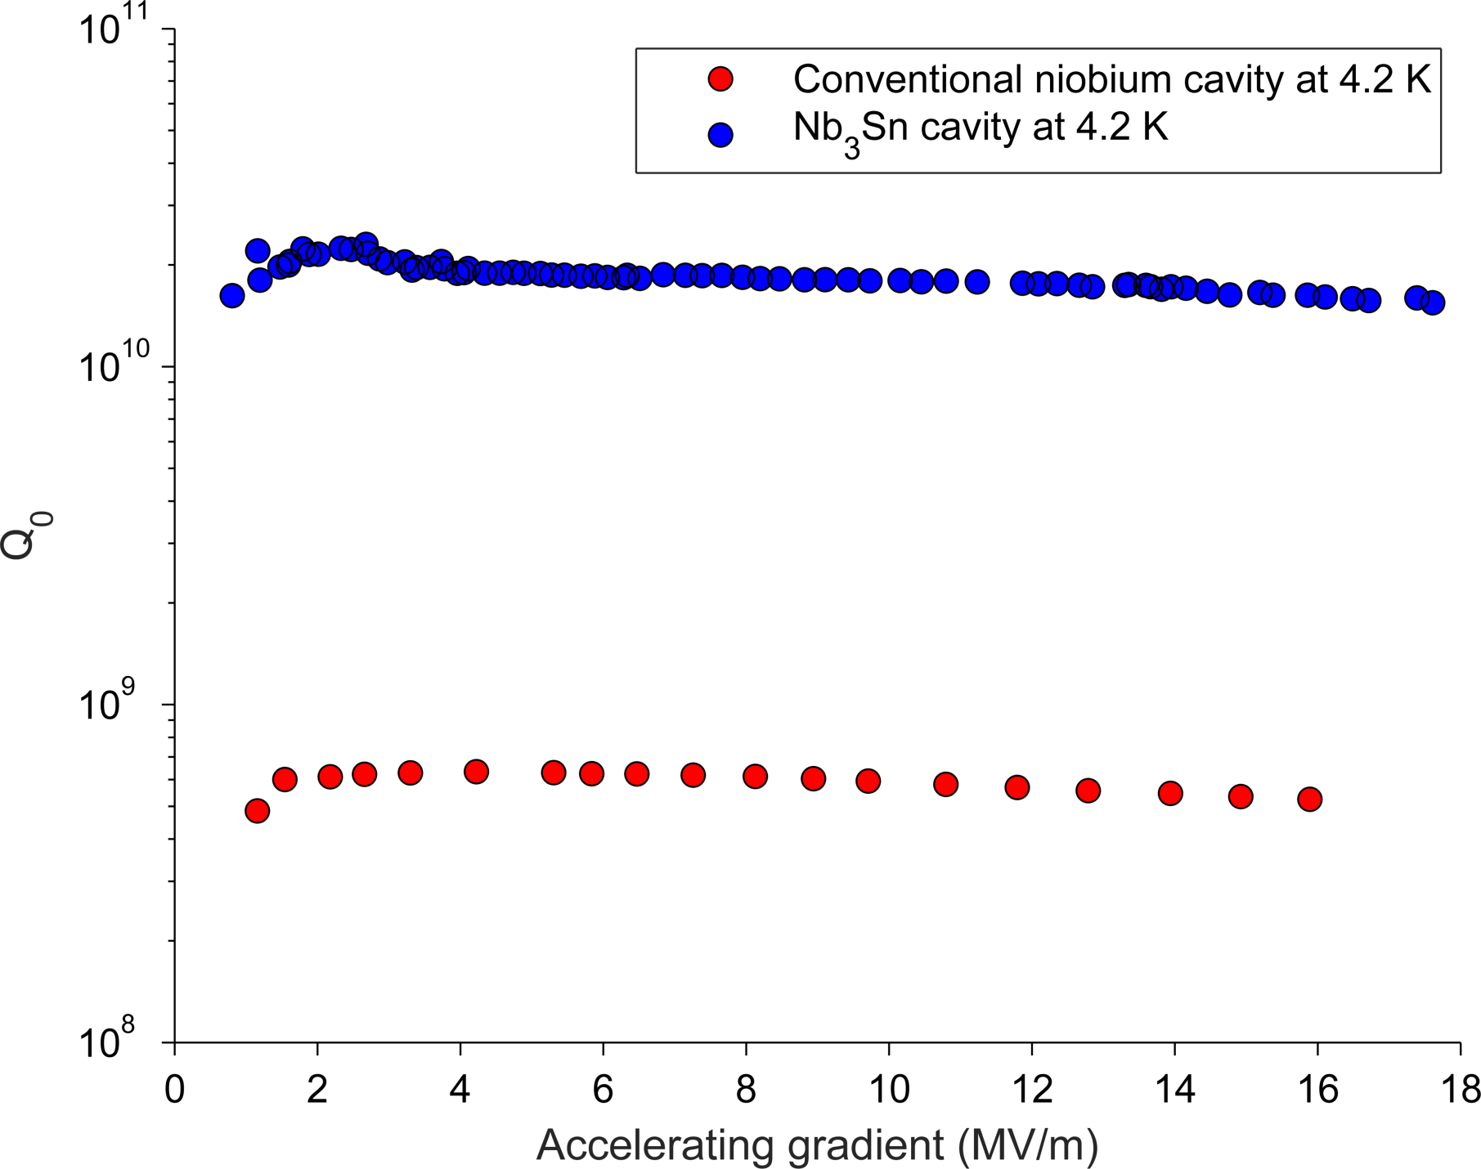
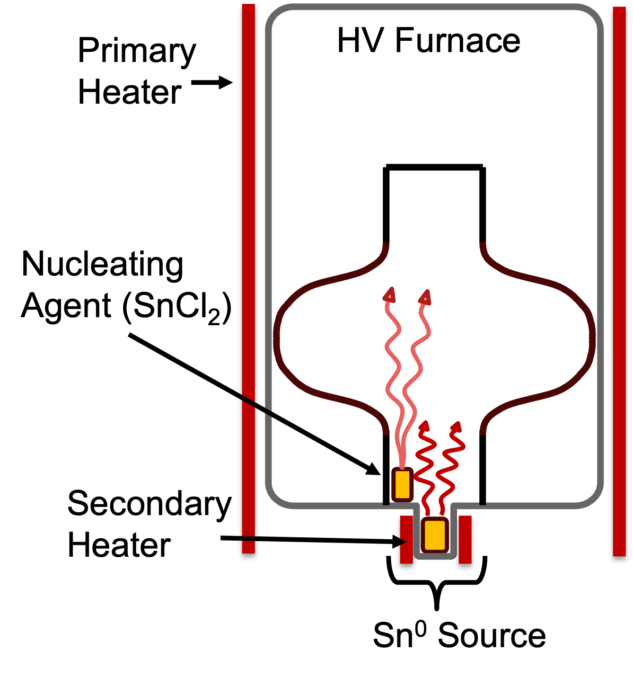
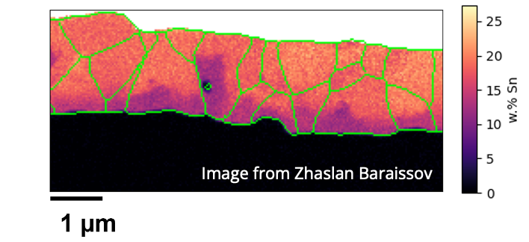
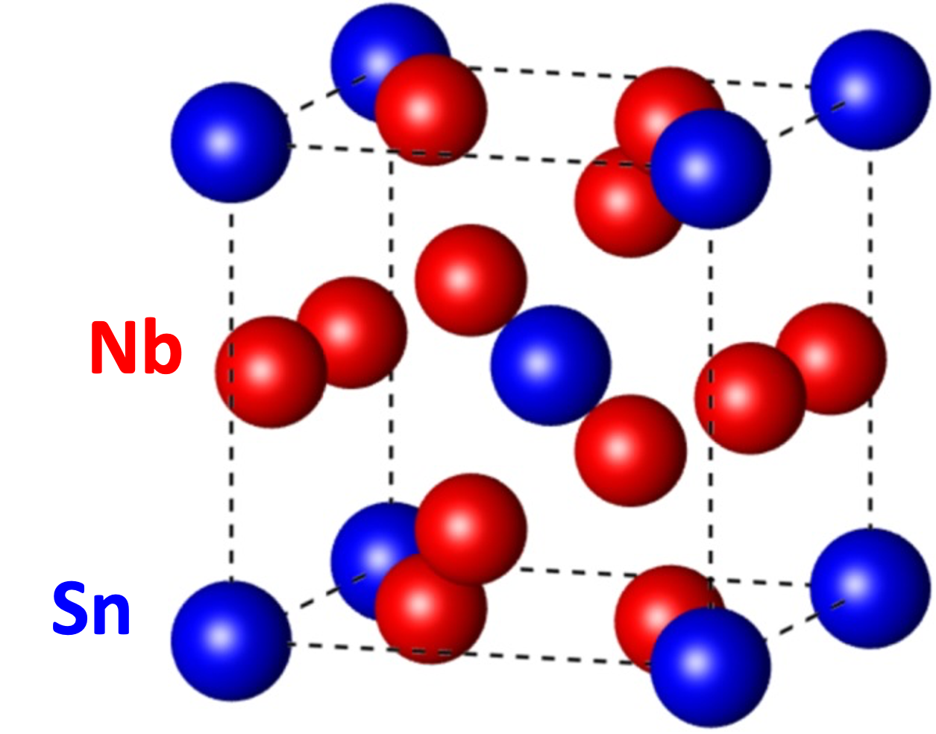
Nb₃Sn performance and nucleation challenge
Why Nb₃Sn?
Growth: thermal vapor diffusion
Higher Tc than Nb (18 K vs 9 K)
Nb₃Sn
Nb
Quality factor
20-30x more efficient than Nb at 4.2K
Non-stoichiometric regions degrade RF performance
Accelerating gradient (MV/m)
Lower cooling cost and complexity due to higher operating temperatures
Film quality is limited by non-uniform nucleation in early stages
Potential to reach higher accelerating gradients compared to Nb

Slide 3
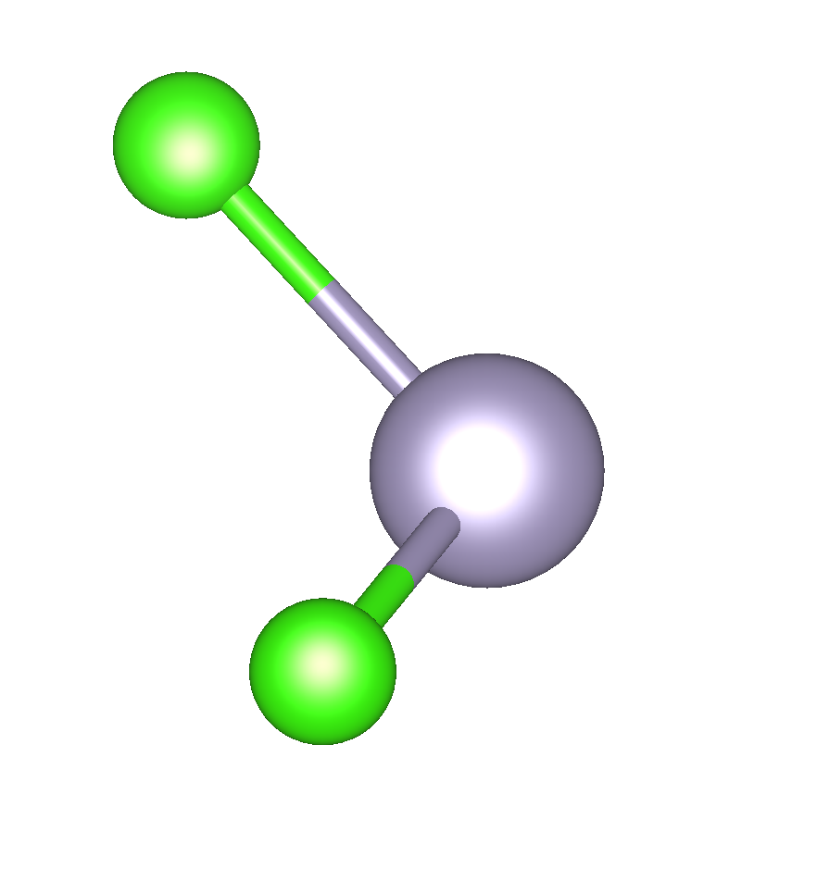
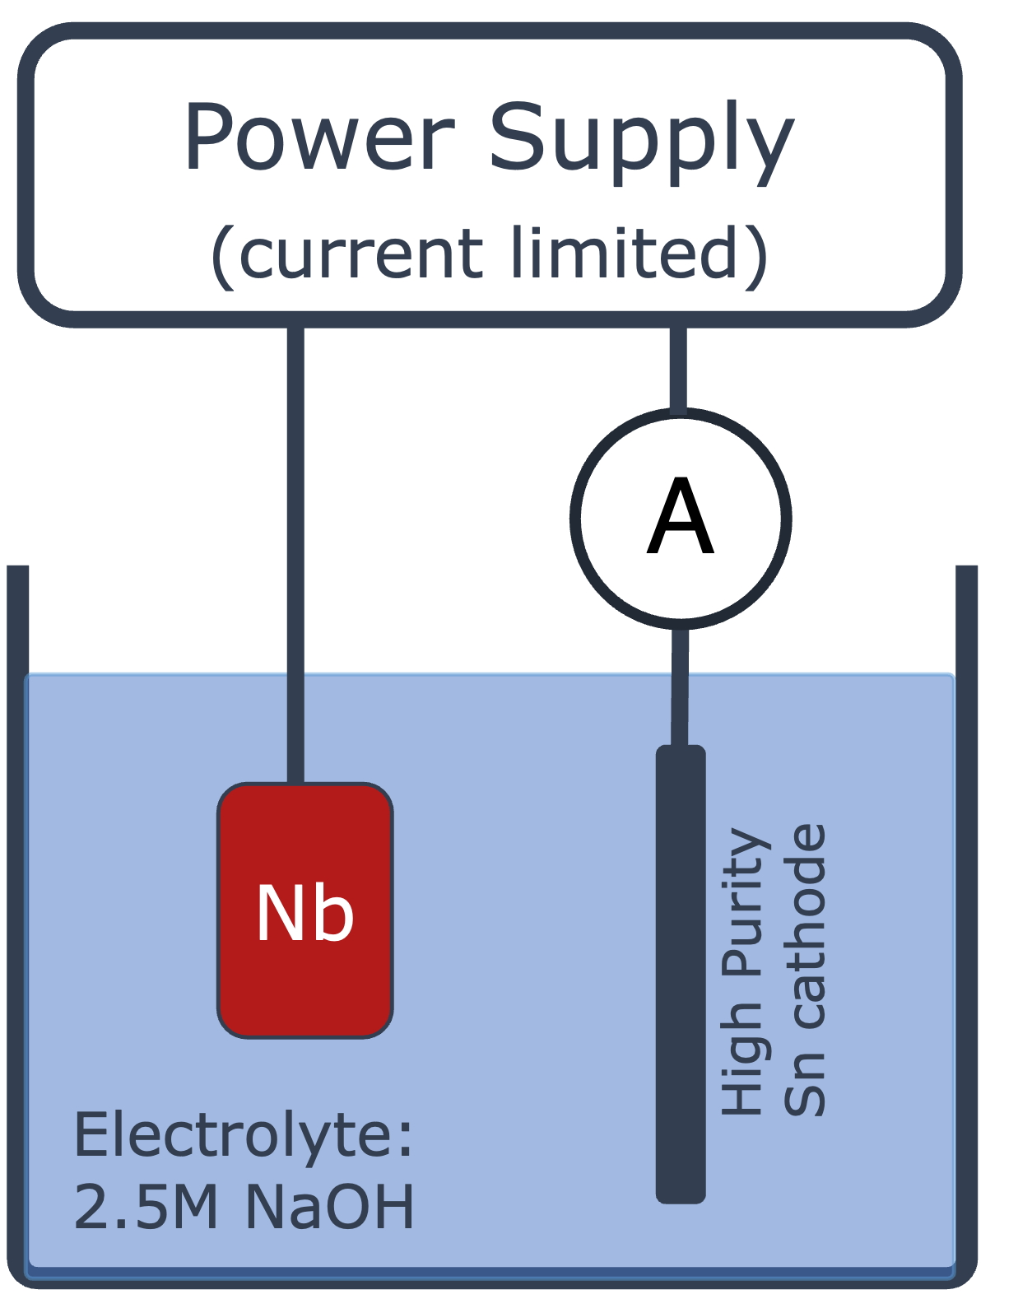
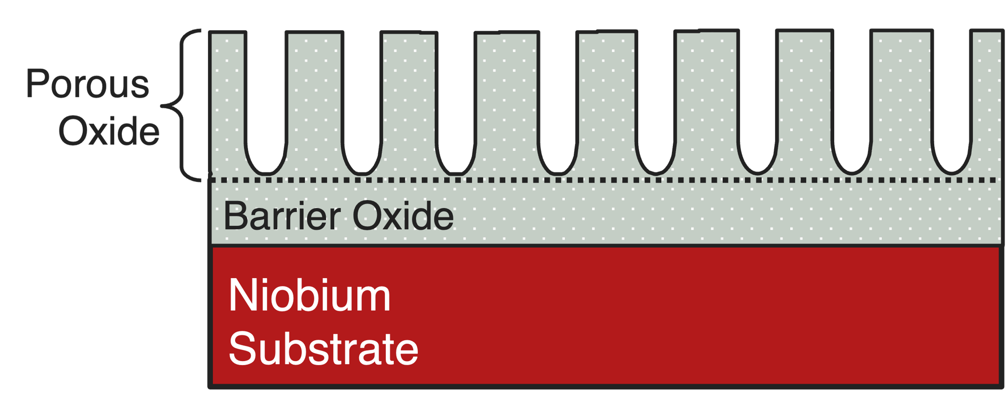
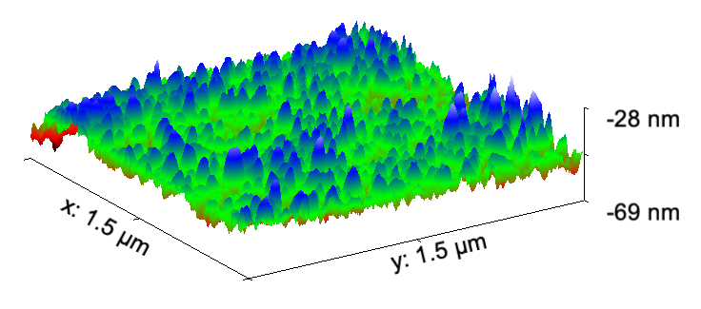
How can we improve tin nucleation?
Pre-anodization of the substrate
Add of SnCl₂ nucleating agent
Cl
= Electrochemically growing an oxide on the Nb substrate
Higher vapor pressure than metallic Sn at lower temperatures
Interacts with the substrate surface at earlier stages of coating
Sn
When the oxide is soluble in the electrolyte, you can grow a porous oxide
Cl
Does SnCl₂ bind preferentially to specific features?
Why does anodizing the surface help? Can we separate the physical vs chemical contributions?
This talk:
Study Nb oxide surface roughness and dissolution kinetics to understand early-stage SnCl₂ nucleation with the goal of optimizing substrate preparation and coating recipes

Slide 4
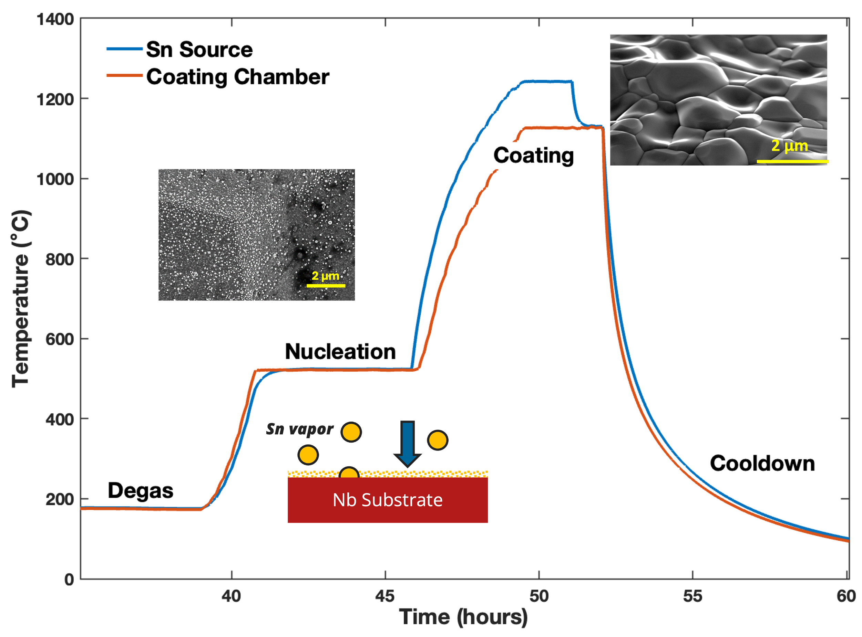


Niobium oxide study
High purity Nb samples cut from sheets used for SRF cavity fabrication were chemically polished (buffered chemical polish and electropolish)
Sample | Ramp rate
C1 (control) | 3 ℃/min
A1 (anodized, porous) | 3 ℃/min
A2 (anodized, porous) | 7 ℃/min
Samples were annealed following the vapor diffusion temperature profile ramp to nucleation temperatures
Sample | Ramp rate
C1 (control) | 3 C/min
A1 (anodized, porous) | 3 C/min
A2 (anodized, porous) | 7 C/min
Focus: pre-nucleation surface evolution
Characterization Methods
in-situ
ex-situ
X-ray photoelectron spectroscopy (XPS)
Atomic Force Microscopy (AFM)
Scanning Electron Microscopy (SEM) / Energy Dispersive Spectroscopy (EDS)
Oxidation state, throughout heating
Surface topography, before/after anneal
Imaging + elemental composition
Jasper Brown
Van Do

Slide 5
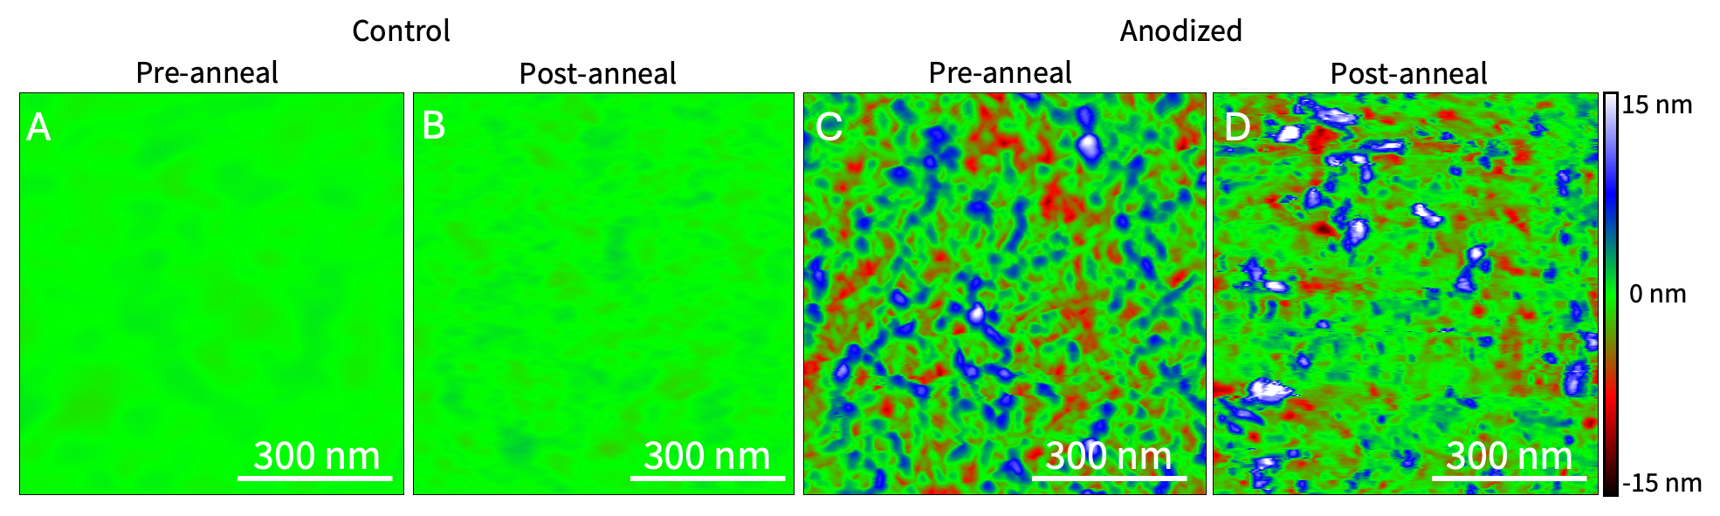
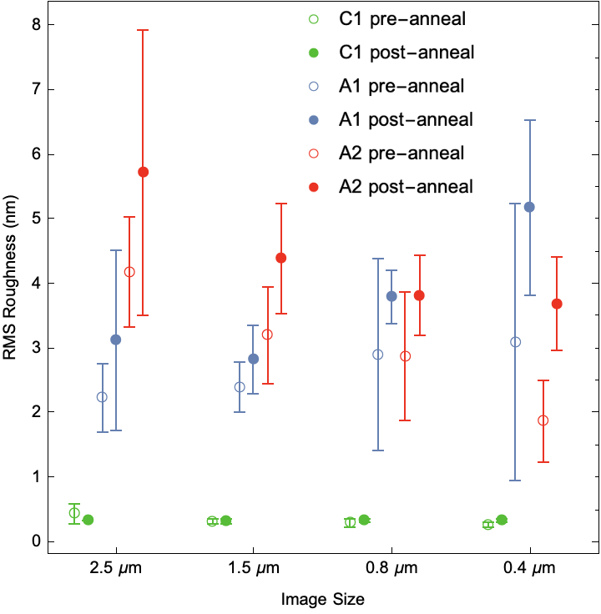
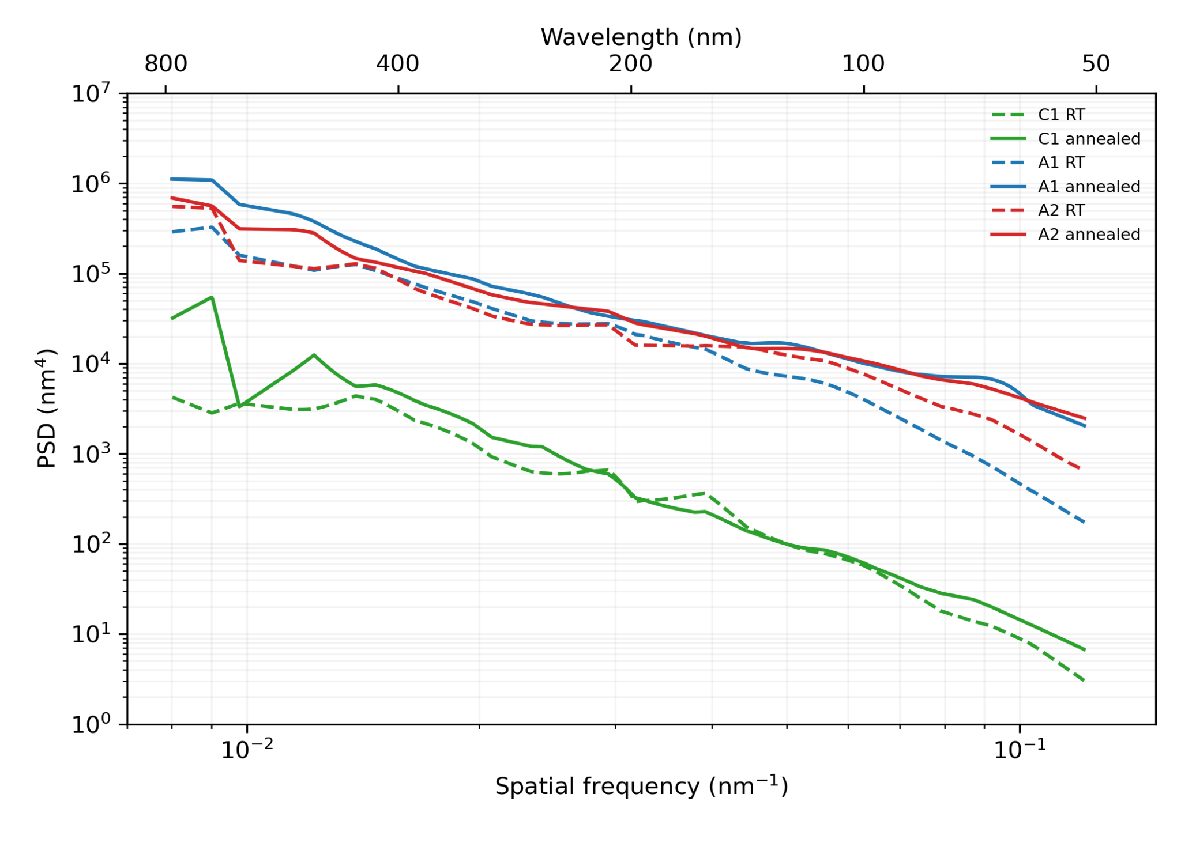
Surface topography and roughness
Anodized surface has a rough texture consisting of pores and intersecting bumps, which persist after annealing when all the Nb₂O₅ is gone.
Anodized
Mean values trend toward higher roughness post-anneal, but uncertainties overlap
Root Mean Squared (nm)
Power Spectral Density (nm⁴)
Rougher
Control
Anodization process impacts the metallic substrate and the resulting roughness is irreversible when Nb₂O₅ is reduced.
Spatial frequency (nm⁻¹)
Image Size

Slide 6
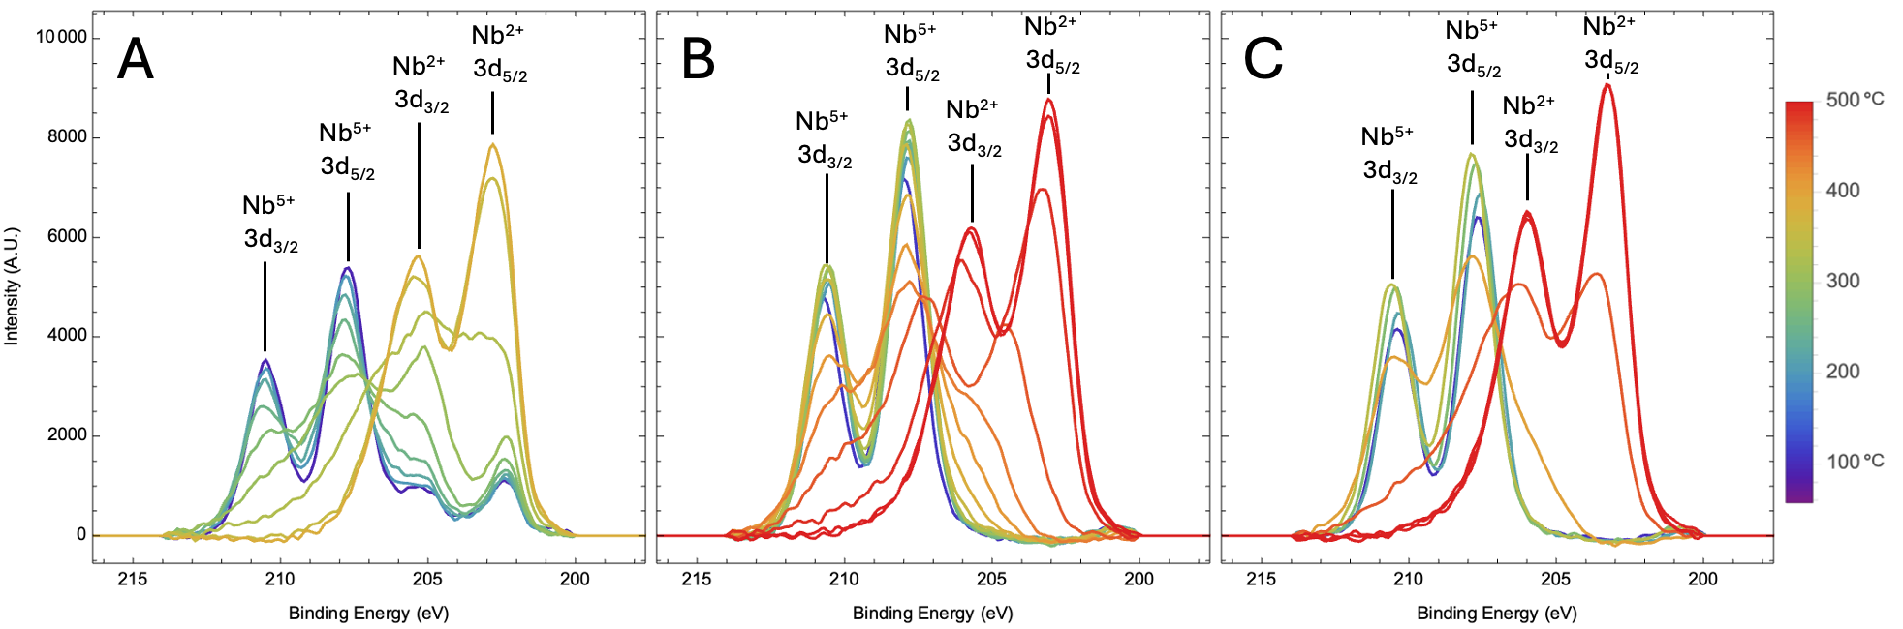
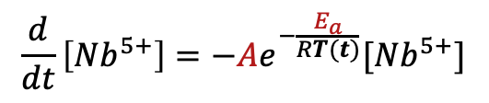
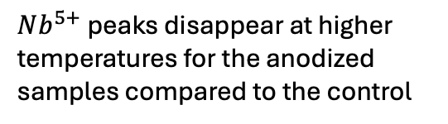
Oxide dissolution kinetics
Control (3℃ /min)
Anodized (3℃ /min)
Anodized (7℃ /min)
$Nb^{5+}$peaks disappear at higher temperatures for the anodized samples compared to the control
Assuming first-order kinetics, reduction rate follows Arrhenius form:
Activation energy
Use fitted parameters to model thickness of Nb₂O₅ as a function of the temperature profile in the furnace
$$\frac{d}{dt}\left[Nb^{5+}\right]=−Ae^{−\frac{E_{a}}{RT(t)}}[Nb^{5+}]$$
Frequency factor
Extracted from XPS data

Slide 7
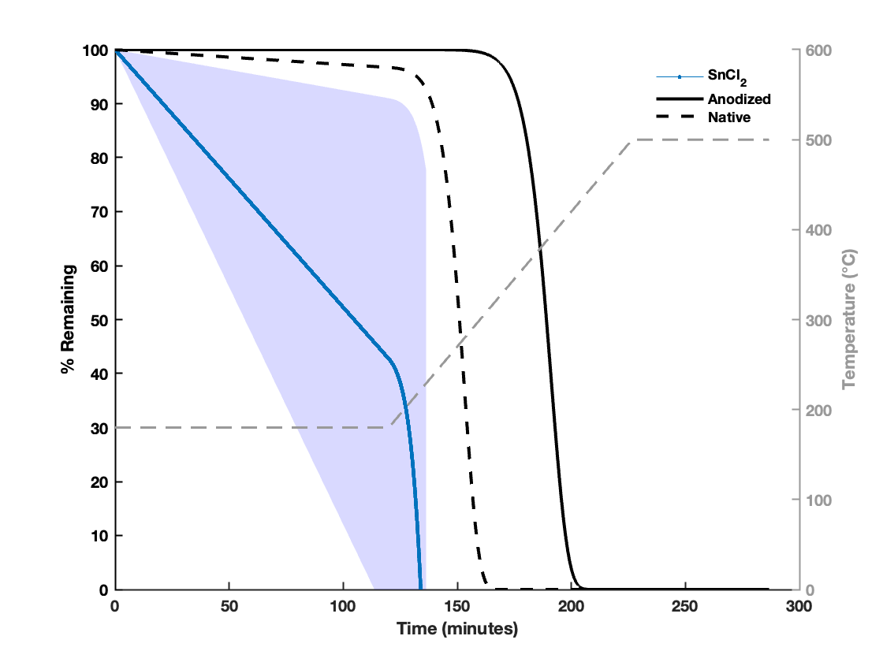
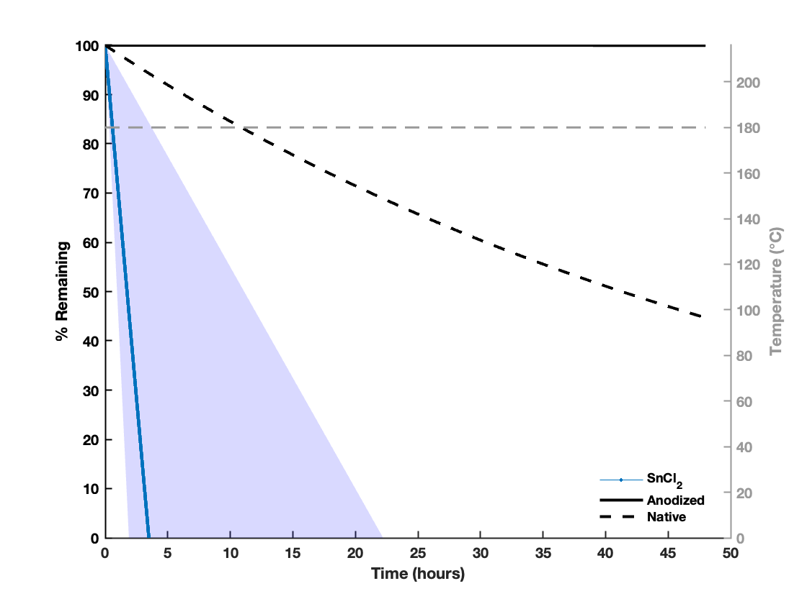
Modeling what’s happening in the furnace
We can use temperature profile as an input to predict when we run out of SnCl₂ in the crucible and % remaining of Nb₂O₅ layer:
Ramp to nucleation
Degas at 180℃
Anodized
SnCl₂
Native
Anodized
SnCl₂
Native
In this example, SnCl₂ vapor starts interacting with the Nb₂O₅ surfaces as early as 180℃ and is exhausted very early in the ramp process.
In this example, SnCl₂ vapor is exhausted early in the degas process.

Slide 8
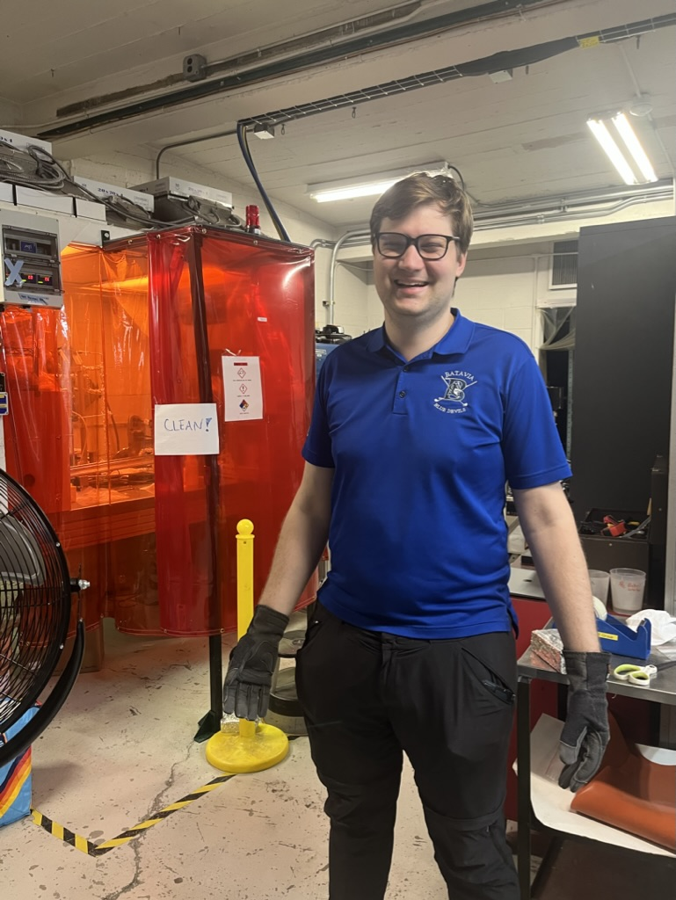
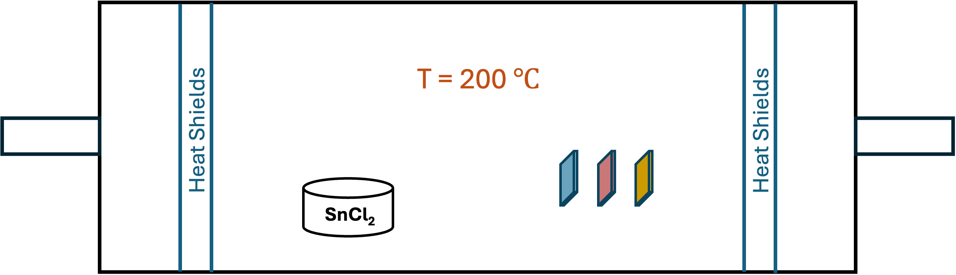
SnCl₂ evaporation study
Using Gabriel’s CVD furnace:
Experiment if any SnCl₂ deposition takes place at low temperatures (close to degas)
  SnCl₂ interacts with three different types of oxides:
No flow,
high vacuum
Native
oxide
Anodized
with H₂SO₄
Smoother oxide
Anodized
with NaOH
Gabriel Gaitan
Porous oxide
Want to compare how SnCl₂ binds to native vs anodized oxides, and compare two anodization electrolyte choices

Slide 9
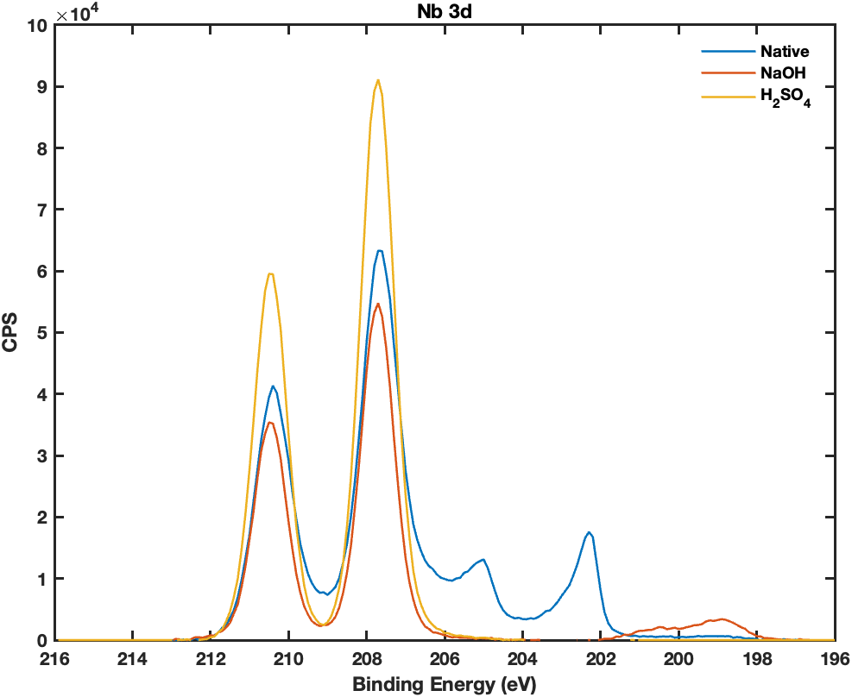
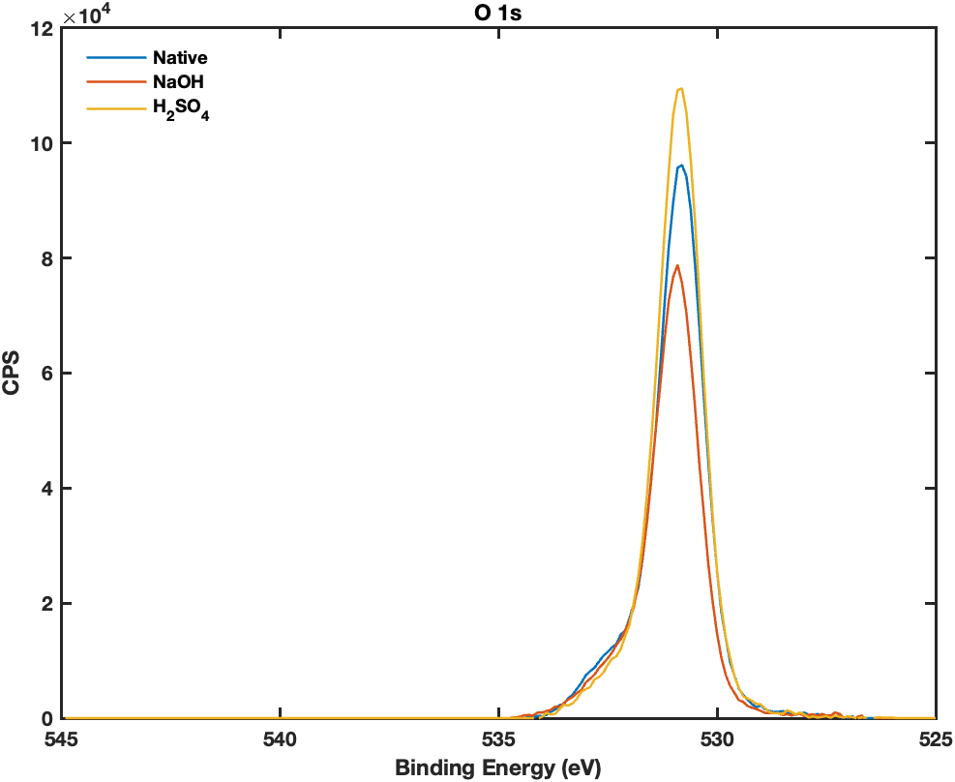
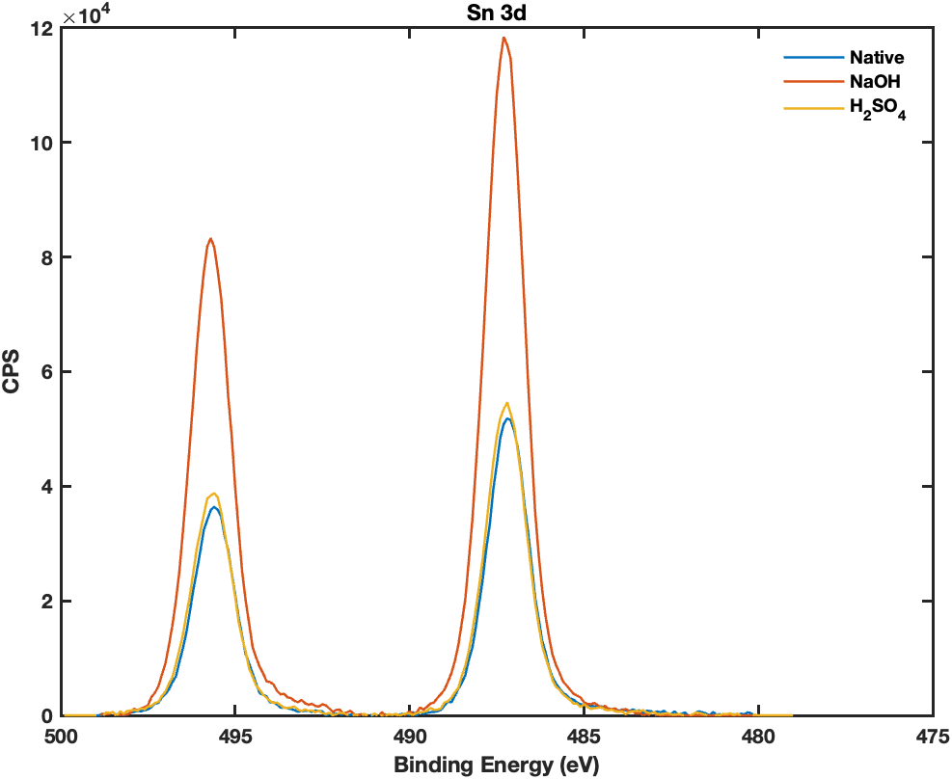
Post 200℃ bake with SnCl₂ results
Native
Porous
Smooth
No visible tin droplets
Most tin signal
Only sample with chlorine signal
400 nm
400 nm
400 nm
Nb⁵⁺
Oxidized Sn
Nb⁰ and Nb²⁺
Cl 2p

Slide 10
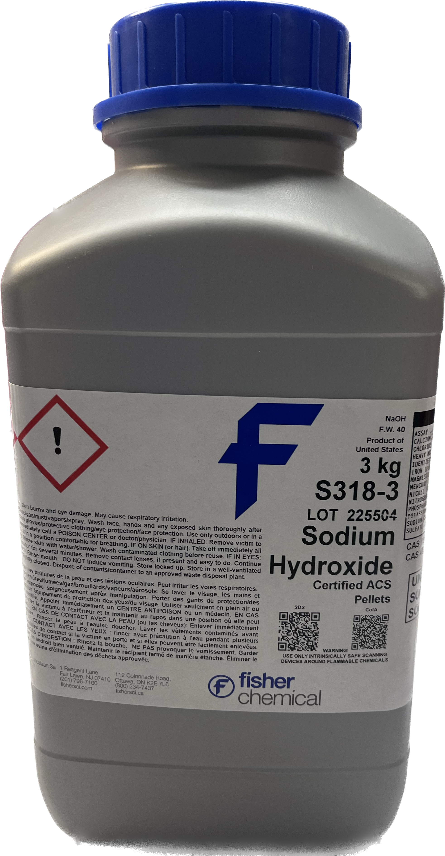
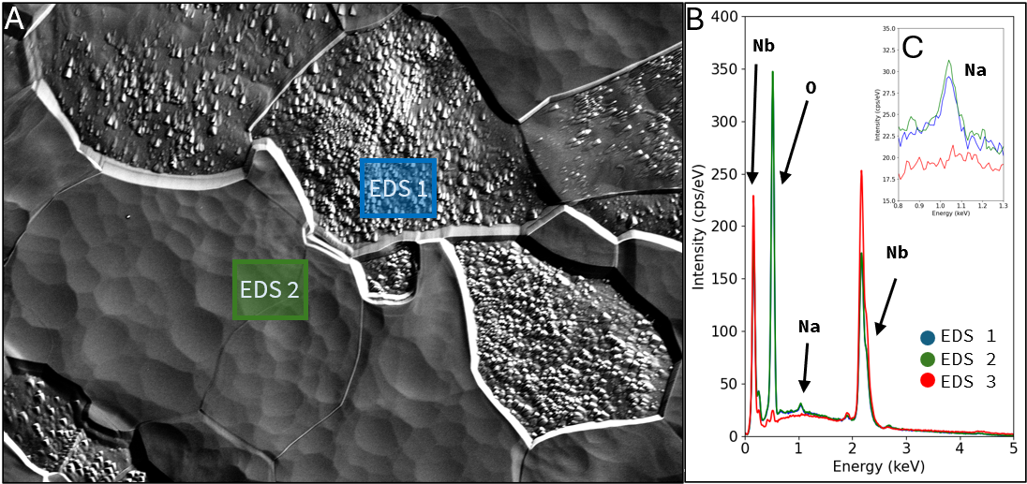
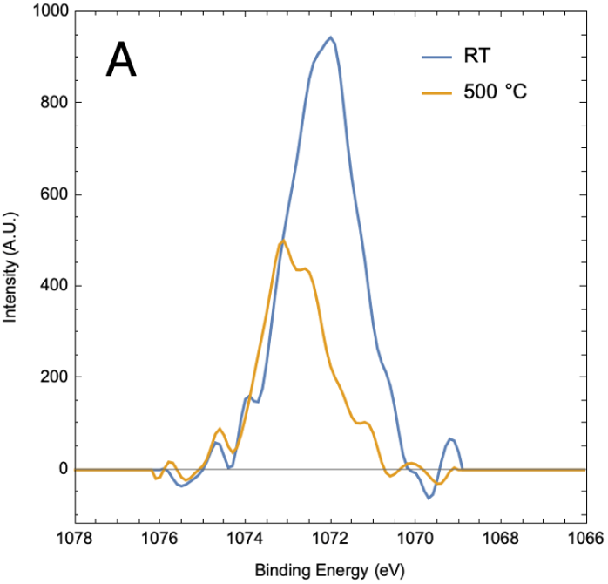
Surface chemistry reveals Na contamination
Samples anodized with NaOH had traces of Na at the surface
Electrolyte incorporation in the oxide during anodization
Control
Van Do
Na 1s
XPS showed that Na peak persisted after annealing in UHV
However, Na was not detected in any sample after being baked with SnCl₂ present in the chamber!
Jasper Brown

Slide 11
Takeaways and next steps
Surface roughness persists after oxide reduction through annealing: helpful to separate chemical vs roughness effects in future nucleation studies
SnCl₂ interacts with the Nb surface earlier than previously assumed (as early as degas): important for understanding what actually drives nucleation
Porous/rough oxides show potential for improved nucleation: no droplets but more tin
  promising direction for better final films
Thank you for your attention!
Next steps
Vapor diffusion furnace:
  Degas-only run: quantify SnCl₂ evaporation and deposition, anodized vs. not anodized
  Vary anodization recipe to test effect of oxide morphology on nucleation and film quality
CVD furnace:
  SnCl₂ deposition on anodized vs anodized + annealed samples: same roughness, but only one retains Nb₂O₅

