Slide 1
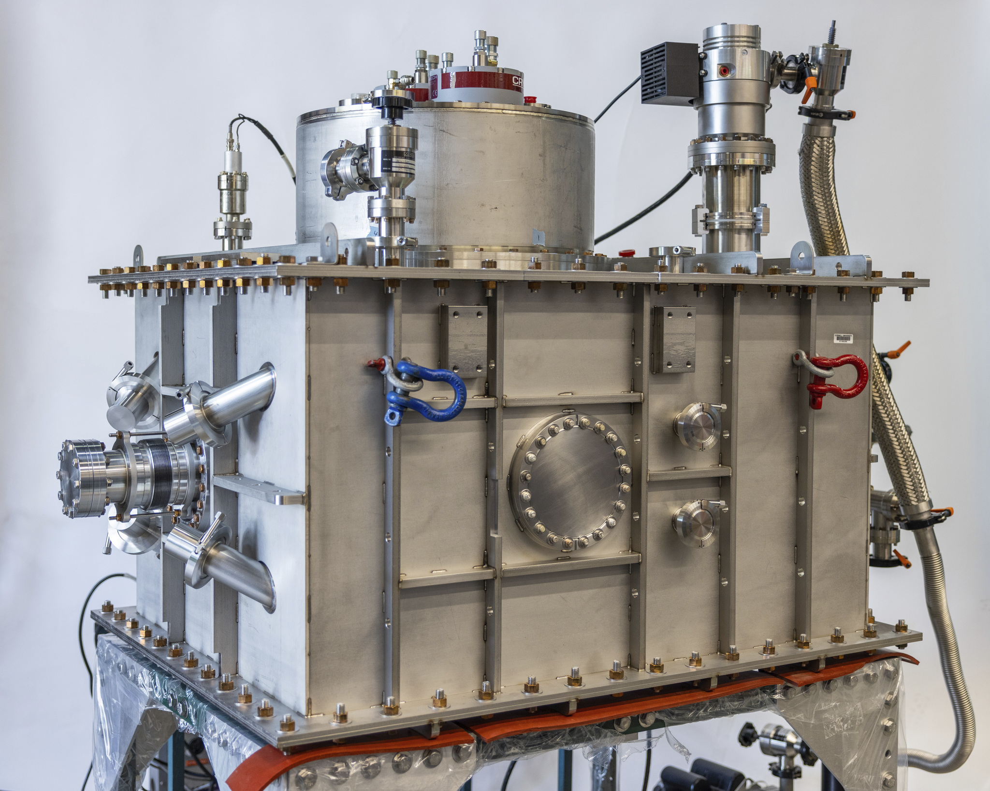
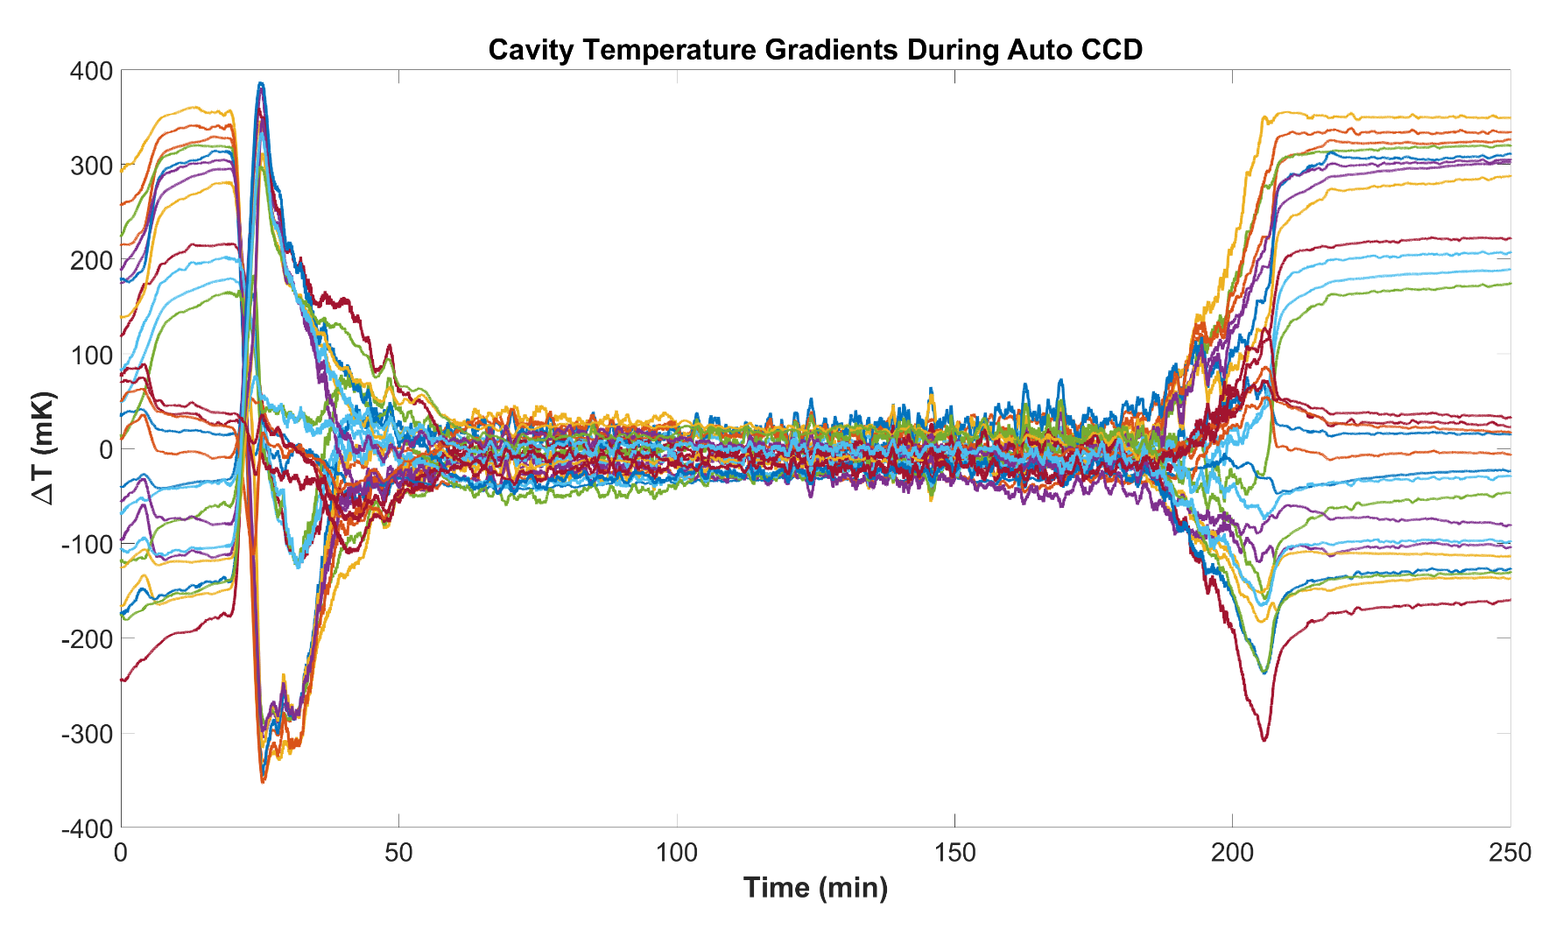


Low-Power Operation of the Cornell
Conduction-Cooled Nb₃Sn Cryomodule (C4M)
Jake Parsons* | jrp356@cornell.edu
Cornell Laboratory for Accelerator-based ScienceS & Education (CLASSE)
Center for Bright Beams (CBB)
*Tigner Traineeship for Accelerator Sciences

Slide 2
Outline
Motivation: Conduction-Cooled SRF Cavities
Design & Assembly: Cavity to Cryomodule
Low-Power Testing: Thermal and RF Performance
Summary & Future Work
Jake Parsons | Low-Power Operation of the Cornell Conduction-Cooled Nb₃Sn Cryomodule (C4M)

Slide 3
MOTIVATION
Conduction-Cooled SRF Cavities

Slide 4
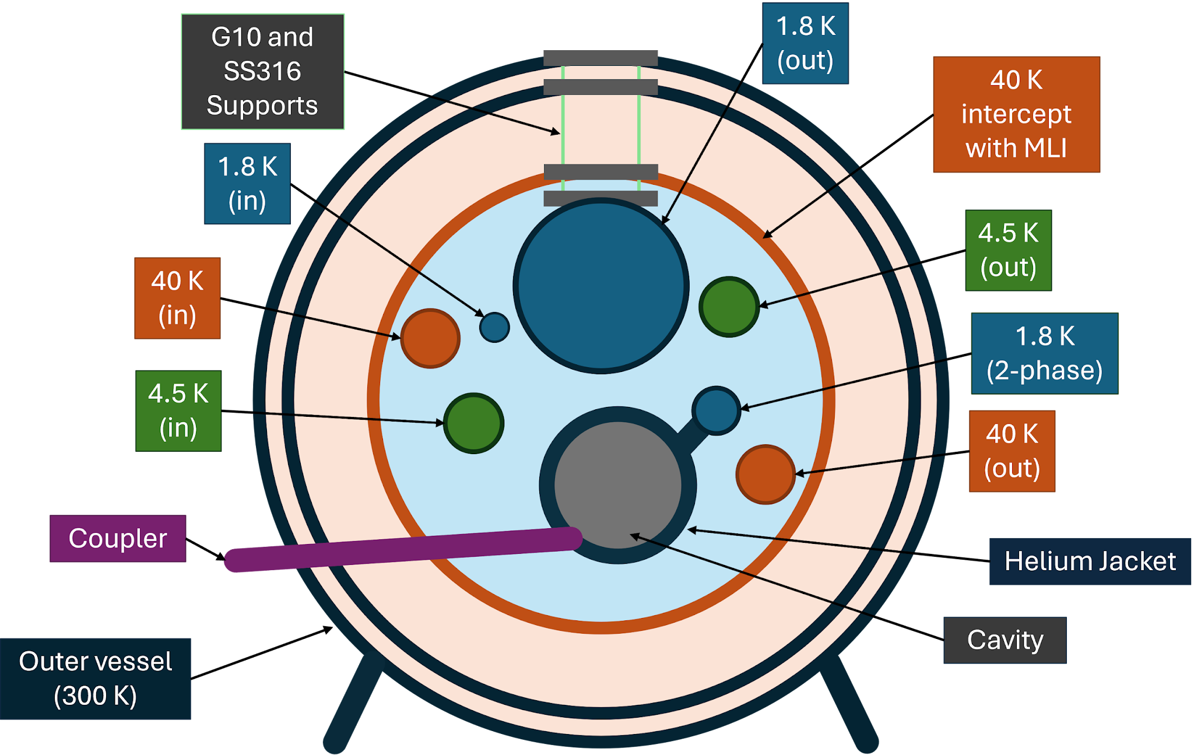
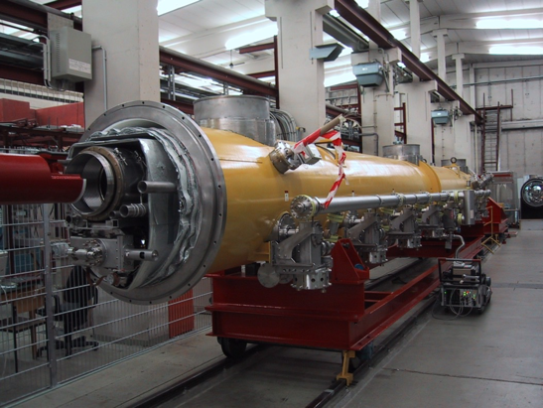
Modern Cryomodules
Vessel that maintains SRF cavities at cryogenic temperatures
  2 K for Nb, 4 K for Nb₃Sn
Complex system of pipes that deliver cryogenic liquids to appropriate sections
  Cryo liquids in accelerators: LN₂, LHe, He II
Above: Internal schematic of Nb cavity cryomodule
Left: TESLA-type cryomodule exterior
Jake Parsons | Low-Power Operation of the Cornell Conduction-Cooled Nb₃Sn Cryomodule (C4M)

Slide 5
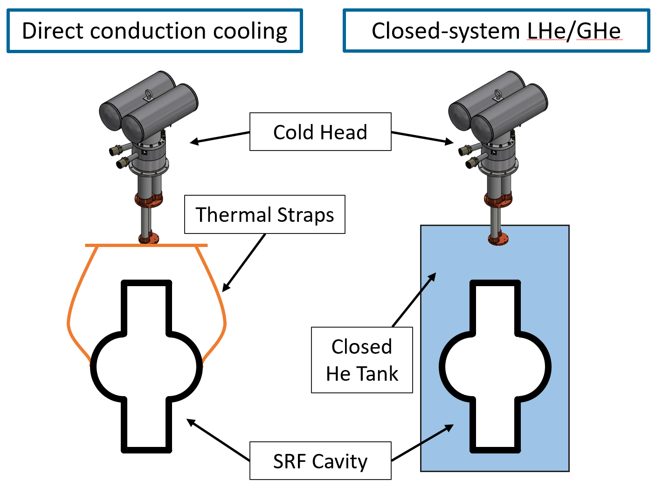
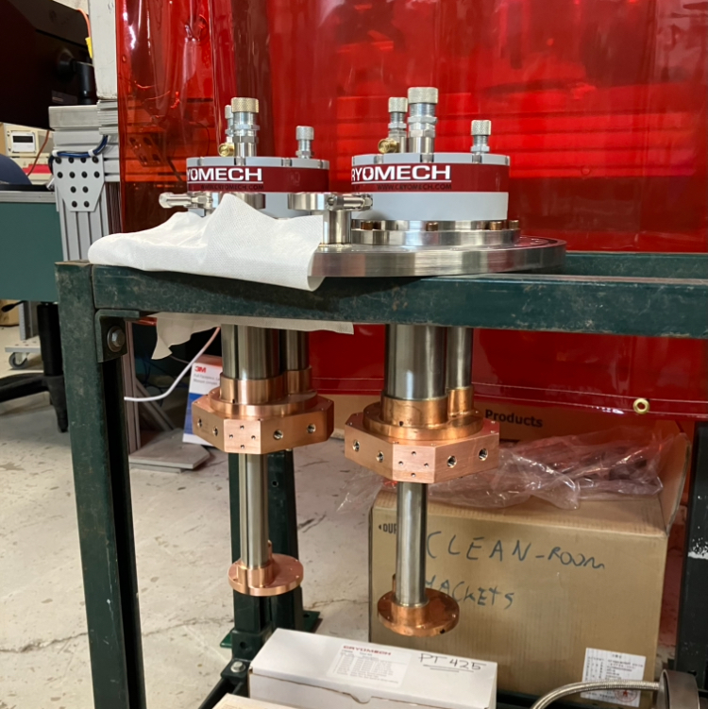
Conduction-Cooling
Cool cavity by direct contact to cooling power load
  Turnkey: no liquid cryogens or cryoplant necessary!
Cryocooler: closed refrigeration loop made of He gas, compressor, and cold head
1st stage: 55 W @ 45K
Left: PT420/425 cold heads used on C4M
Above: Most popular cold head cooling schemes in SRF applications
Left: PT420/425 cold heads used on C4M
2nd stage: 2 W @ 4K
Jake Parsons | Low-Power Operation of the Cornell Conduction-Cooled Nb₃Sn Cryomodule (C4M)

Slide 6
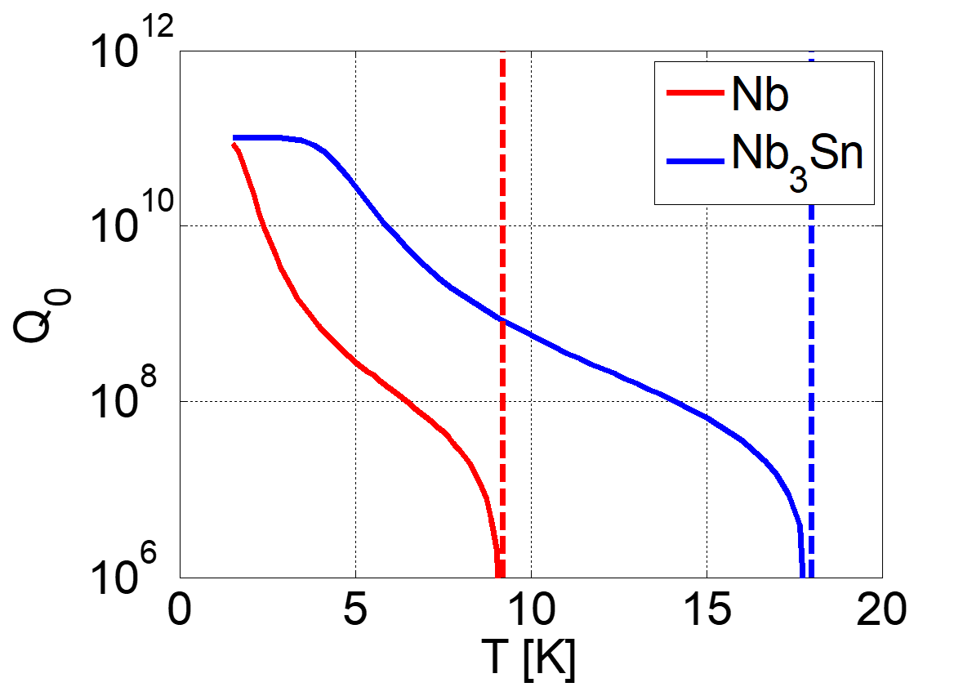
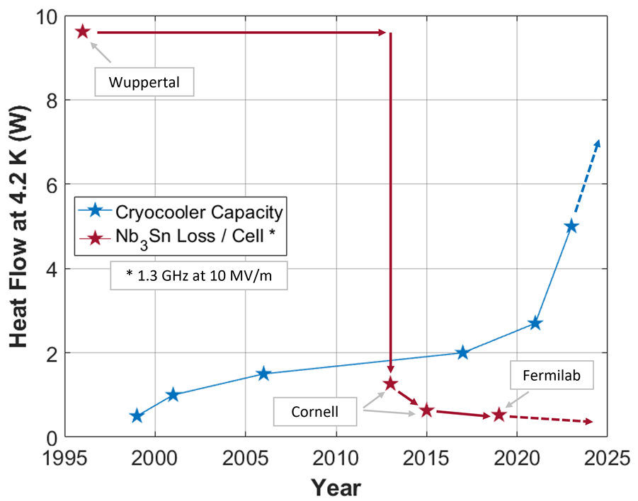
Nb₃Sn & Conduction-Cooling Feasibility
Nb vs Nb₃Sn Cavities
Cavity and Cryocooler Efficiency
C4M Cold Heads
Jake Parsons | Low-Power Operation of the Cornell Conduction-Cooled Nb₃Sn Cryomodule (C4M)

Slide 7
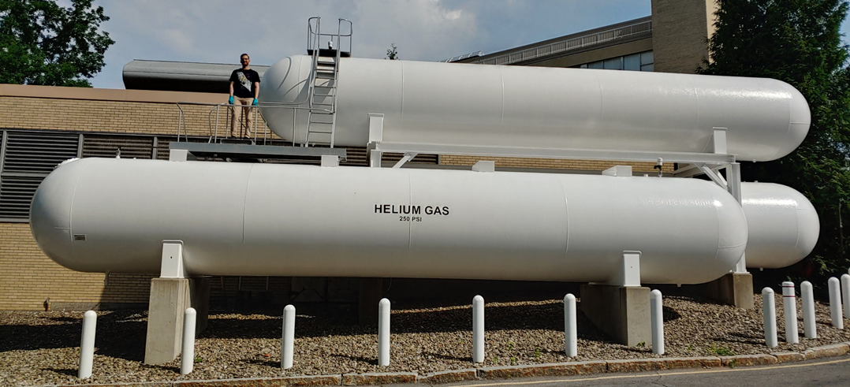
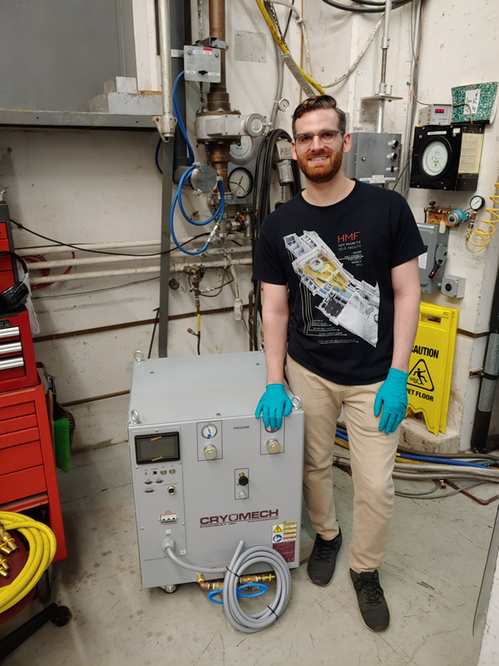
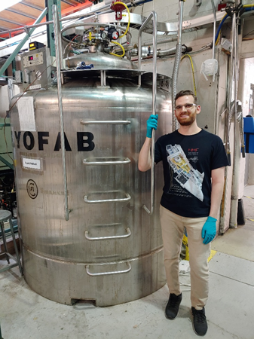
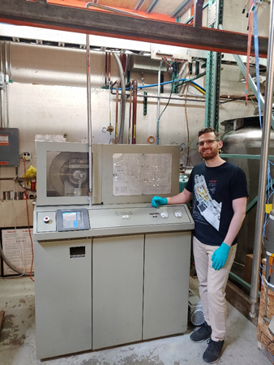
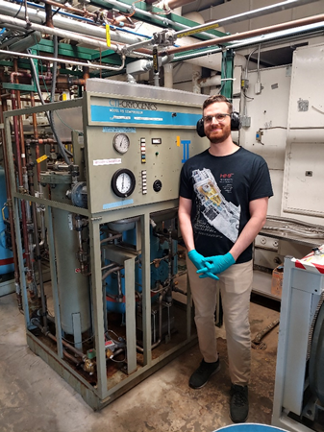
Why Conduction-Cooling?
~$10,000,000 LHe Processing Plant
(20 W at 4 K)
COP⁻¹ ~10²
~$70,000 x 10 Cryocoolers
(same cooling power)
Higher COP⁻¹ ~10³
Cryocoolers
Jake Parsons | Low-Power Operation of the Cornell Conduction-Cooled Nb₃Sn Cryomodule (C4M)

Slide 8
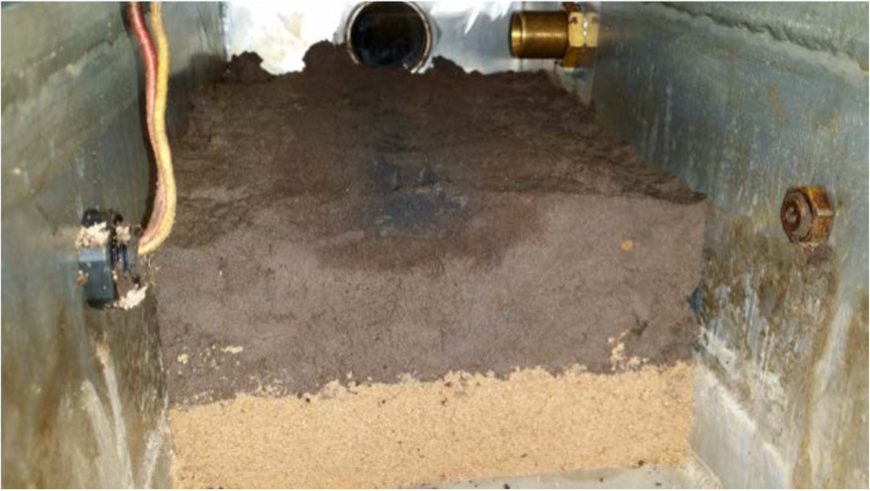
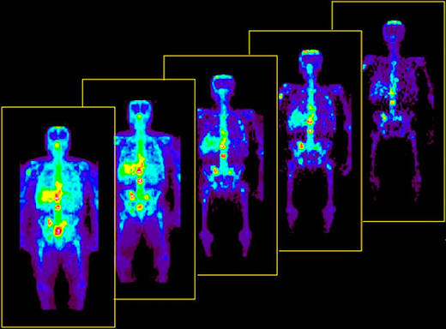
Small-Scale SRF Applications
Energy and environment
  Sterilizing waste water, sludge, medical waste
  Flue gas treatment
  Remediation of contaminated soil (top)
  Asphalt treatments
Medicine
  Radioisotope production (bottom)
Security & defense
  Cargo inspection
Industry
  Producing biofuel
  Curing carbon fiber composites
… and many more!
Typical beam parameters
Moderate Energy: 1 – 10 MeV
High Current: ≥ 100 mA
High Avg. Power: ≥ 1 MW
Jake Parsons | Low-Power Operation of the Cornell Conduction-Cooled Nb₃Sn Cryomodule (C4M)

Slide 9
DESIGN & ASSEMBLY
Cavity to Cryomodule

Slide 10
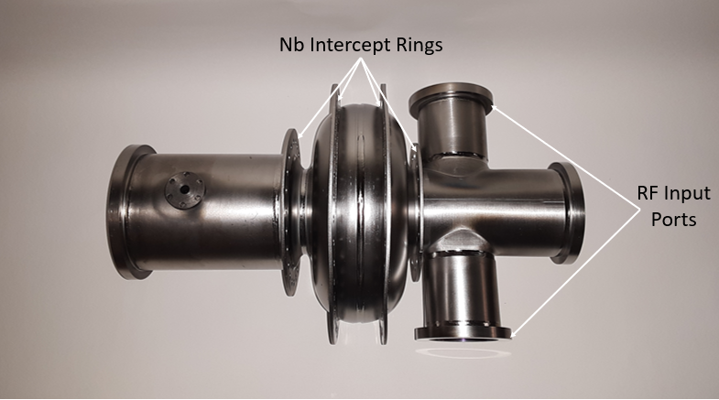
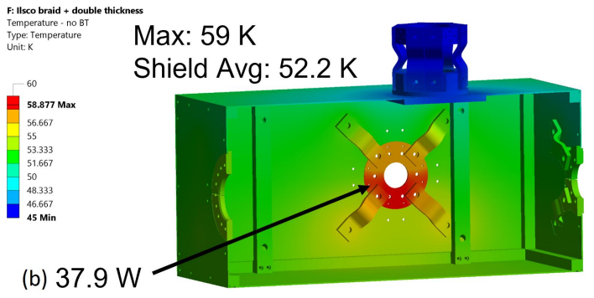
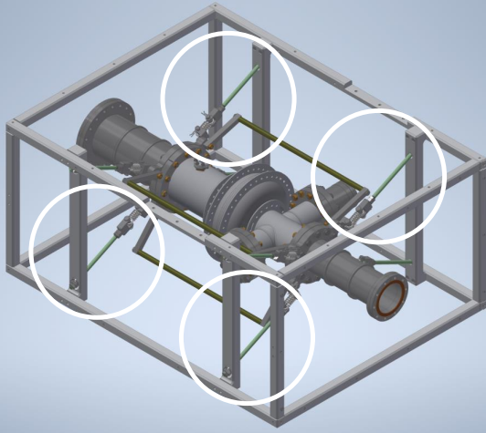
Conduction-Cooled Cavity
1.3 GHz Nb₃Sn cavity: want Q₀ = 10¹⁰, E_{acc} = 10 MV/m
Nb rings along equator (2) and beam tube transitions (2)
4.15 W of cooling power available at 4 K stage
Cavity suspended in Al frame using G10 rods
45 K stage Al thermal shield
1.3 GHz Nb₃Sn cavity: want Q₀ = 10¹⁰, E_{acc} = 10 MV/m
Nb rings along equator (2) and beam tube transitions (2)
4.15 W of cooling power available at 4 K stage
Jake Parsons | Low-Power Operation of the Cornell Conduction-Cooled Nb₃Sn Cryomodule (C4M)

Slide 11
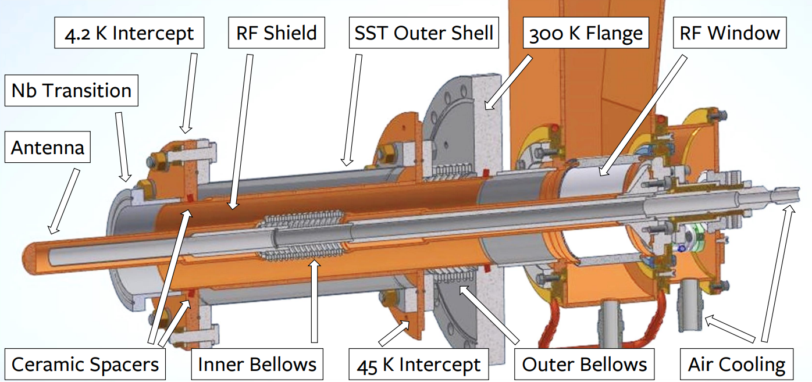
Forward Power Coupler
Optimized to deliver 100 kW of forward power while dissipating 1.1 W as heat at 4 K
  Factor of 10⁵ difference
Conductively coupled to cavity coupler port and 45 K thermal shield
Installation scheduled for October 2026
Jake Parsons | Low-Power Operation of the Cornell Conduction-Cooled Nb₃Sn Cryomodule (C4M)

Slide 12
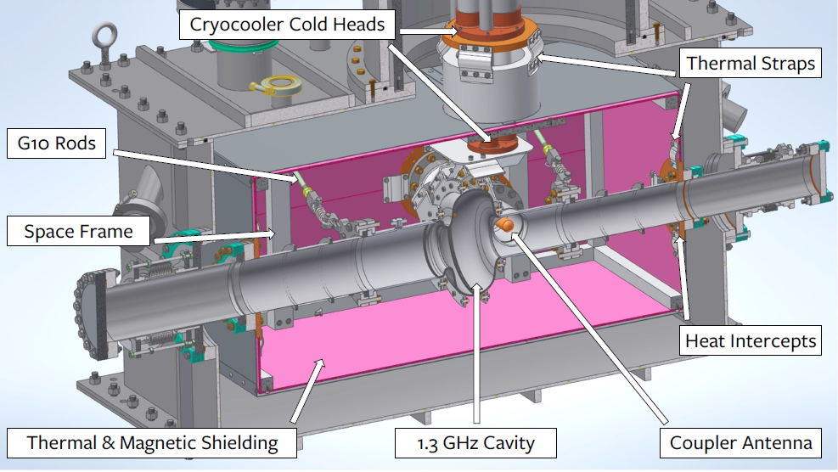
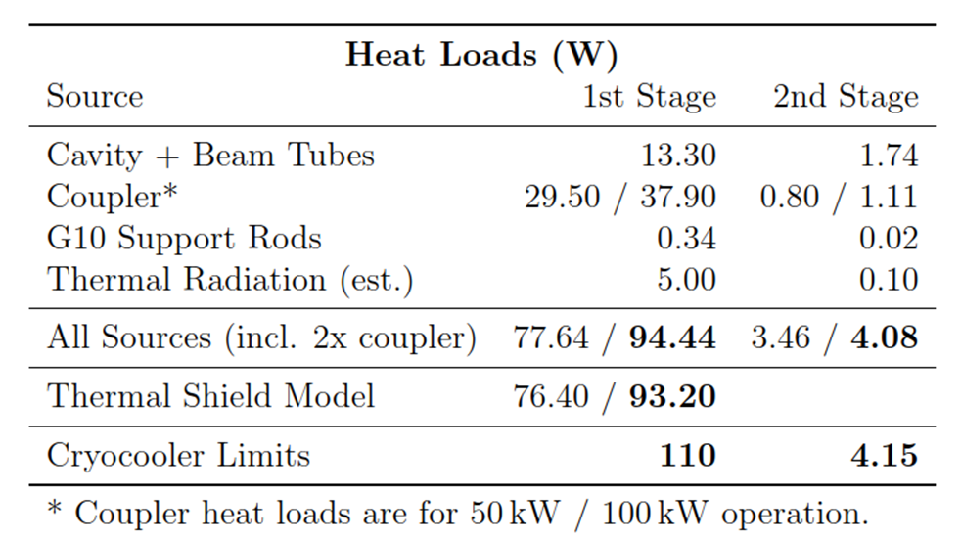
Cryomodule Overview
C4M meets the tight cooling power requirements for high-power, high-current operation!!
Jake Parsons | Low-Power Operation of the Cornell Conduction-Cooled Nb₃Sn Cryomodule (C4M)

Slide 13
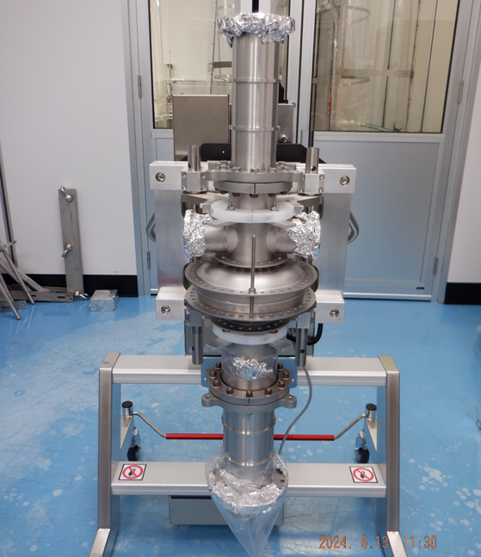
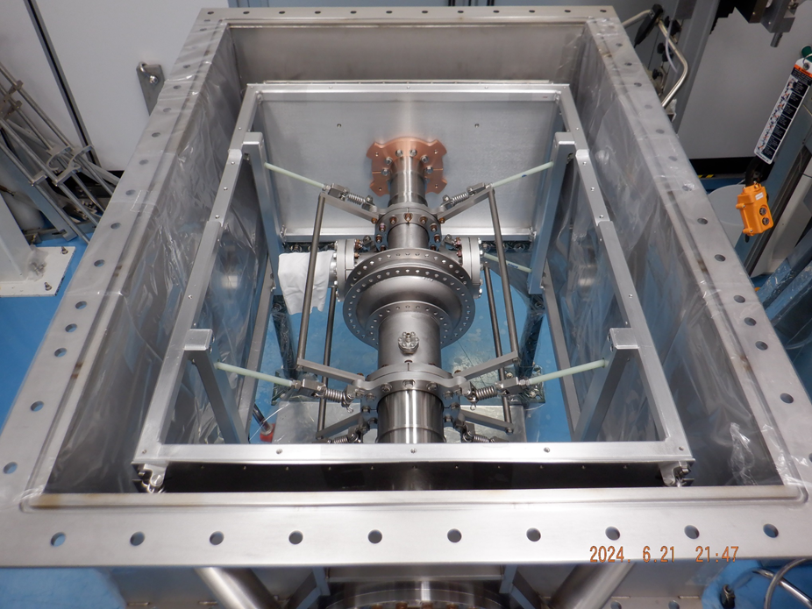
Clean Room Assembly
Cavity + SST Beam Tubes
G10 Rods and Space Frame
Jake Parsons | Low-Power Operation of the Cornell Conduction-Cooled Nb₃Sn Cryomodule (C4M)

Slide 14
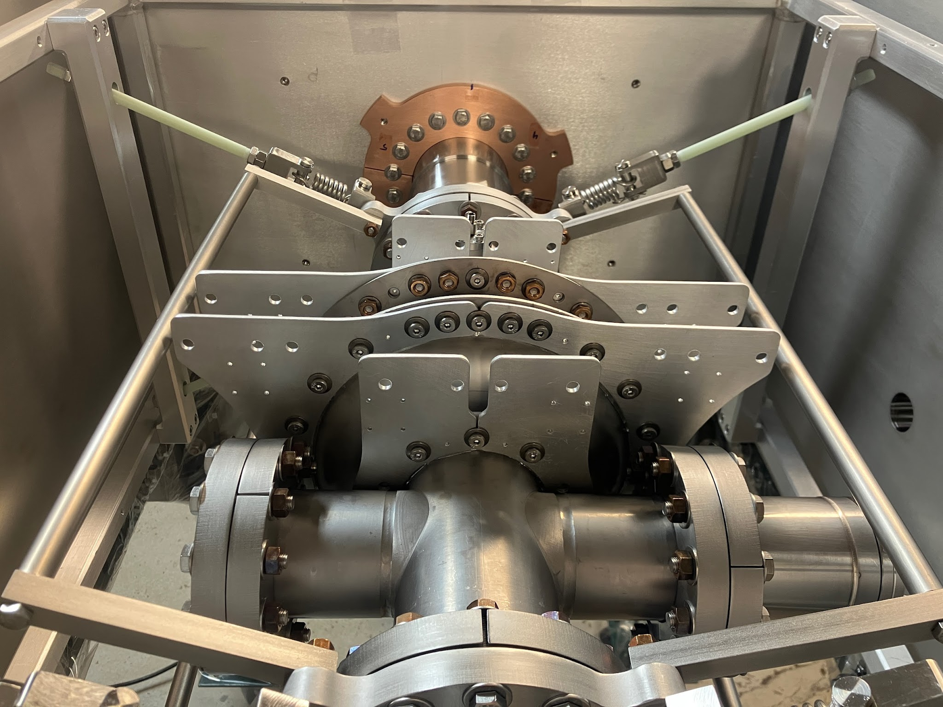
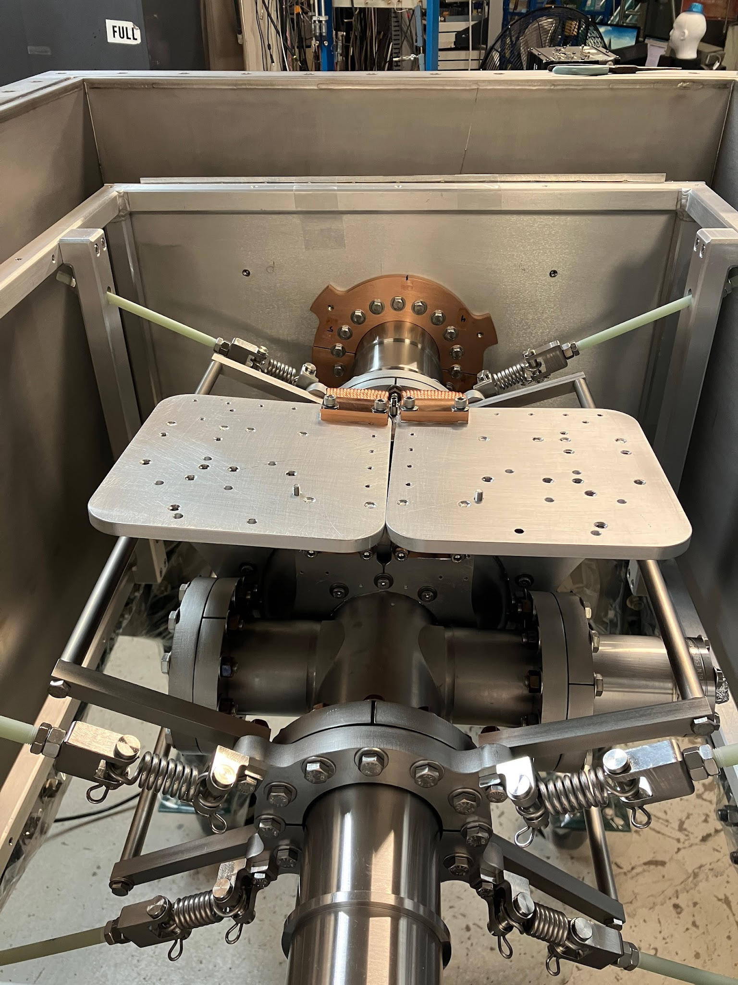
4 K Stage Assembly
5N Al Split Rings
Thermal Straps & 5N Al Plates
Jake Parsons | Low-Power Operation of the Cornell Conduction-Cooled Nb₃Sn Cryomodule (C4M)

Slide 15
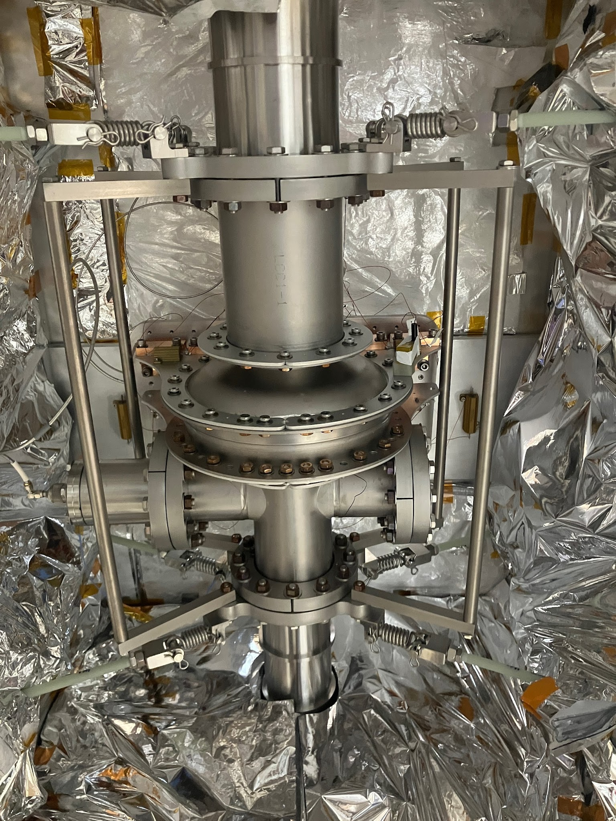
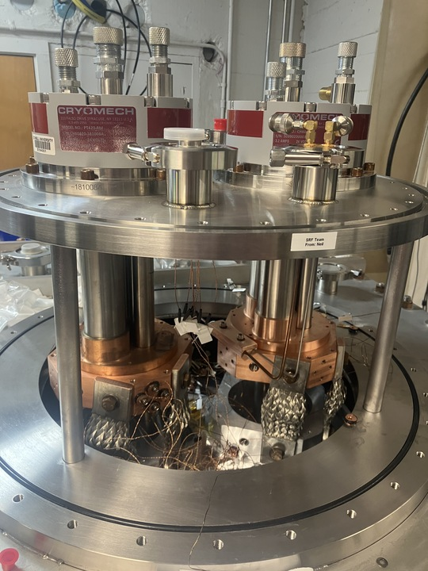
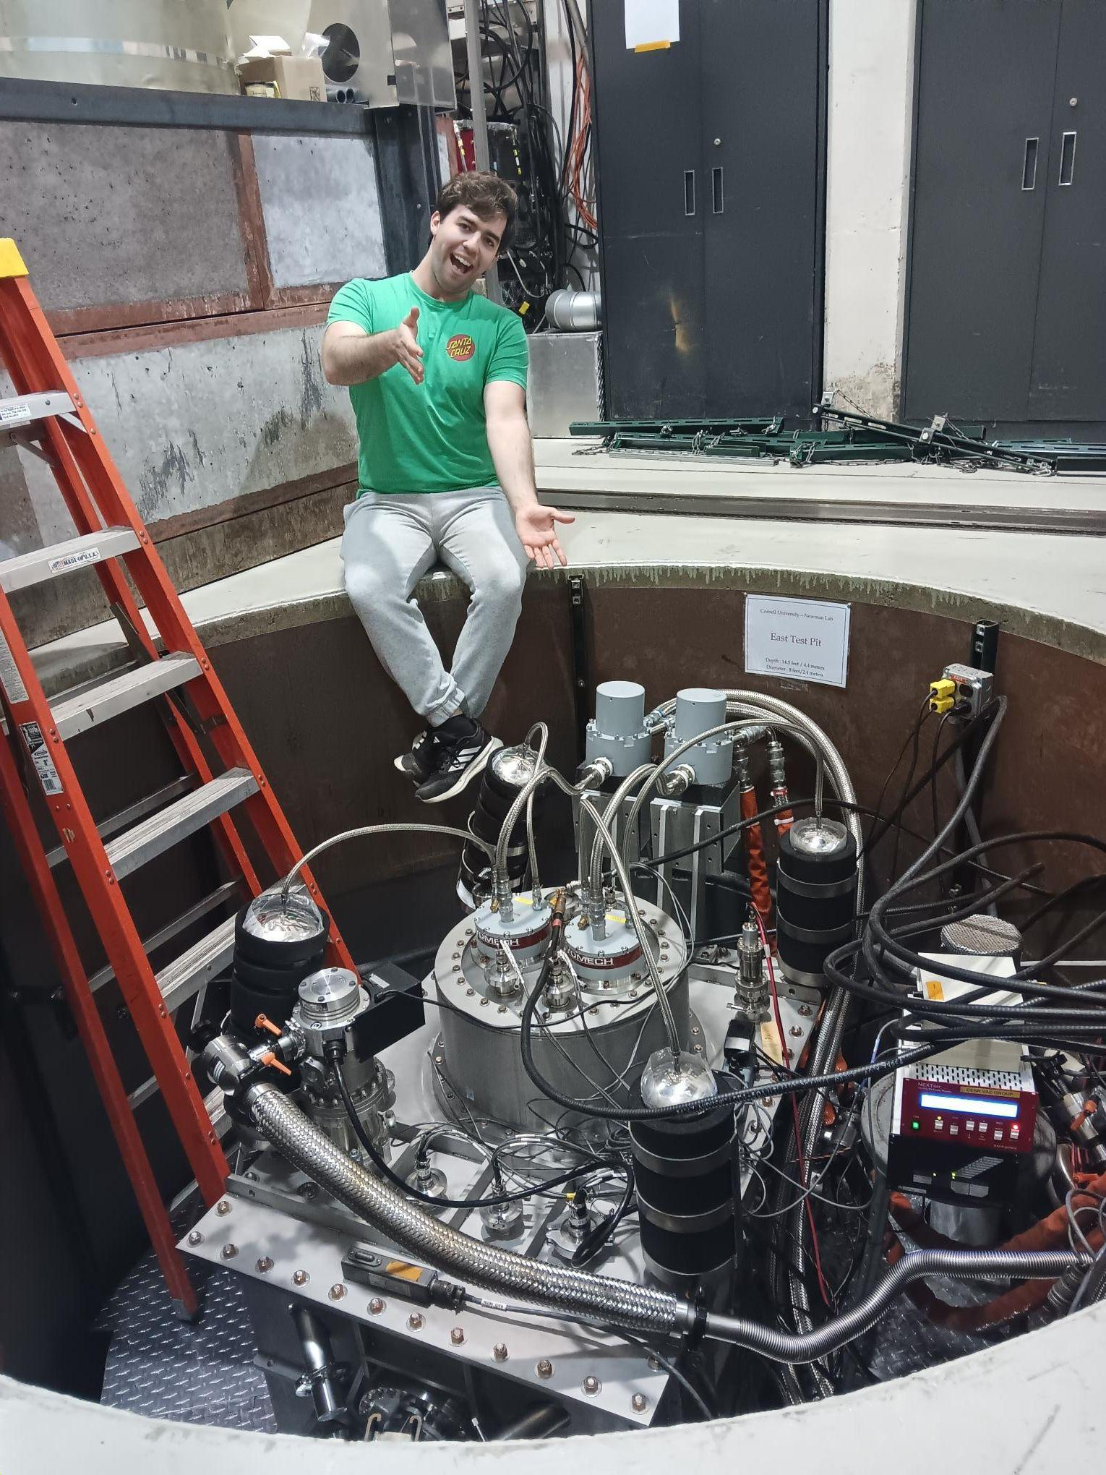
45 K Stage Assembly
Shielding
Cold Head Connections
Finished!!
Jake Parsons | Low-Power Operation of the Cornell Conduction-Cooled Nb₃Sn Cryomodule (C4M)

Slide 16
LOW-POWER TESTING
Thermal and RF Performance

Slide 17
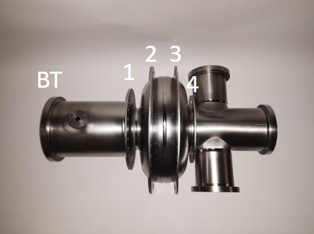
Static Heat Load Estimation
Sub-4K cavity baseline temperatures on first cooldown (see table)
2 methods for estimating static heat load:
  Cryocooler capacity curve
  Fourier’s Law of Conduction: P = -k_{eff}ΔT
 | SR 1 | SR 2 | SR 3 | SR 4 | BT | Coldheads
Baseline | 3.80 K | 3.47 K | 3.48 K | 3.60 K | 5.02 K | 3.40 K
Static heat load: < 2 W!!
Jake Parsons | Low-Power Operation of the Cornell Conduction-Cooled Nb₃Sn Cryomodule (C4M)

Slide 18
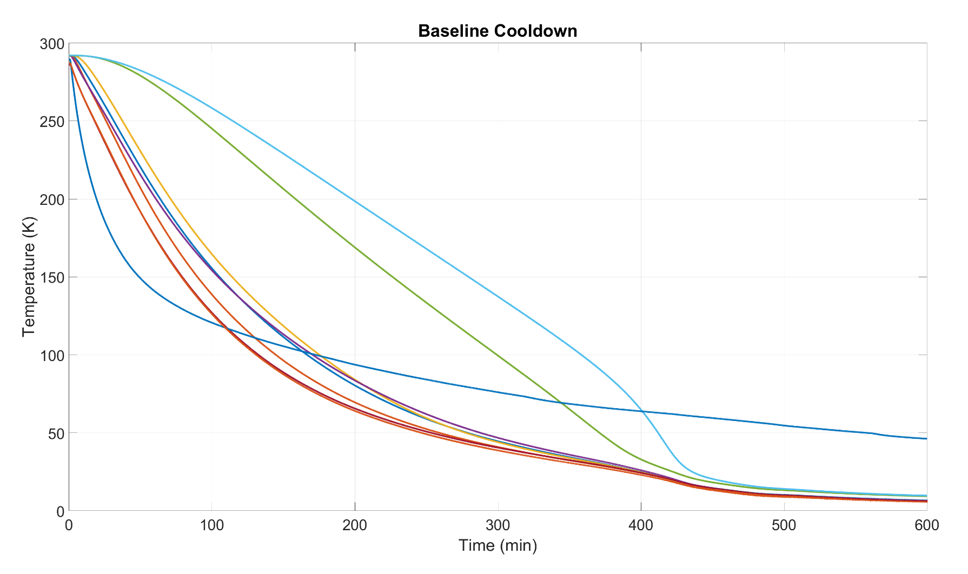
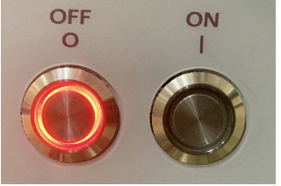
Controlled Cooldowns
Temperature gradient cooling through T_{c}: ΔT < 900 mK, want to reduce ΔT < 50 mK (Seeback)
Time to 4 K:
20 hrs
Crossing T_{c}:
ΔT < 900 mK
Jake Parsons | Low-Power Operation of the Cornell Conduction-Cooled Nb₃Sn Cryomodule (C4M)

Slide 19
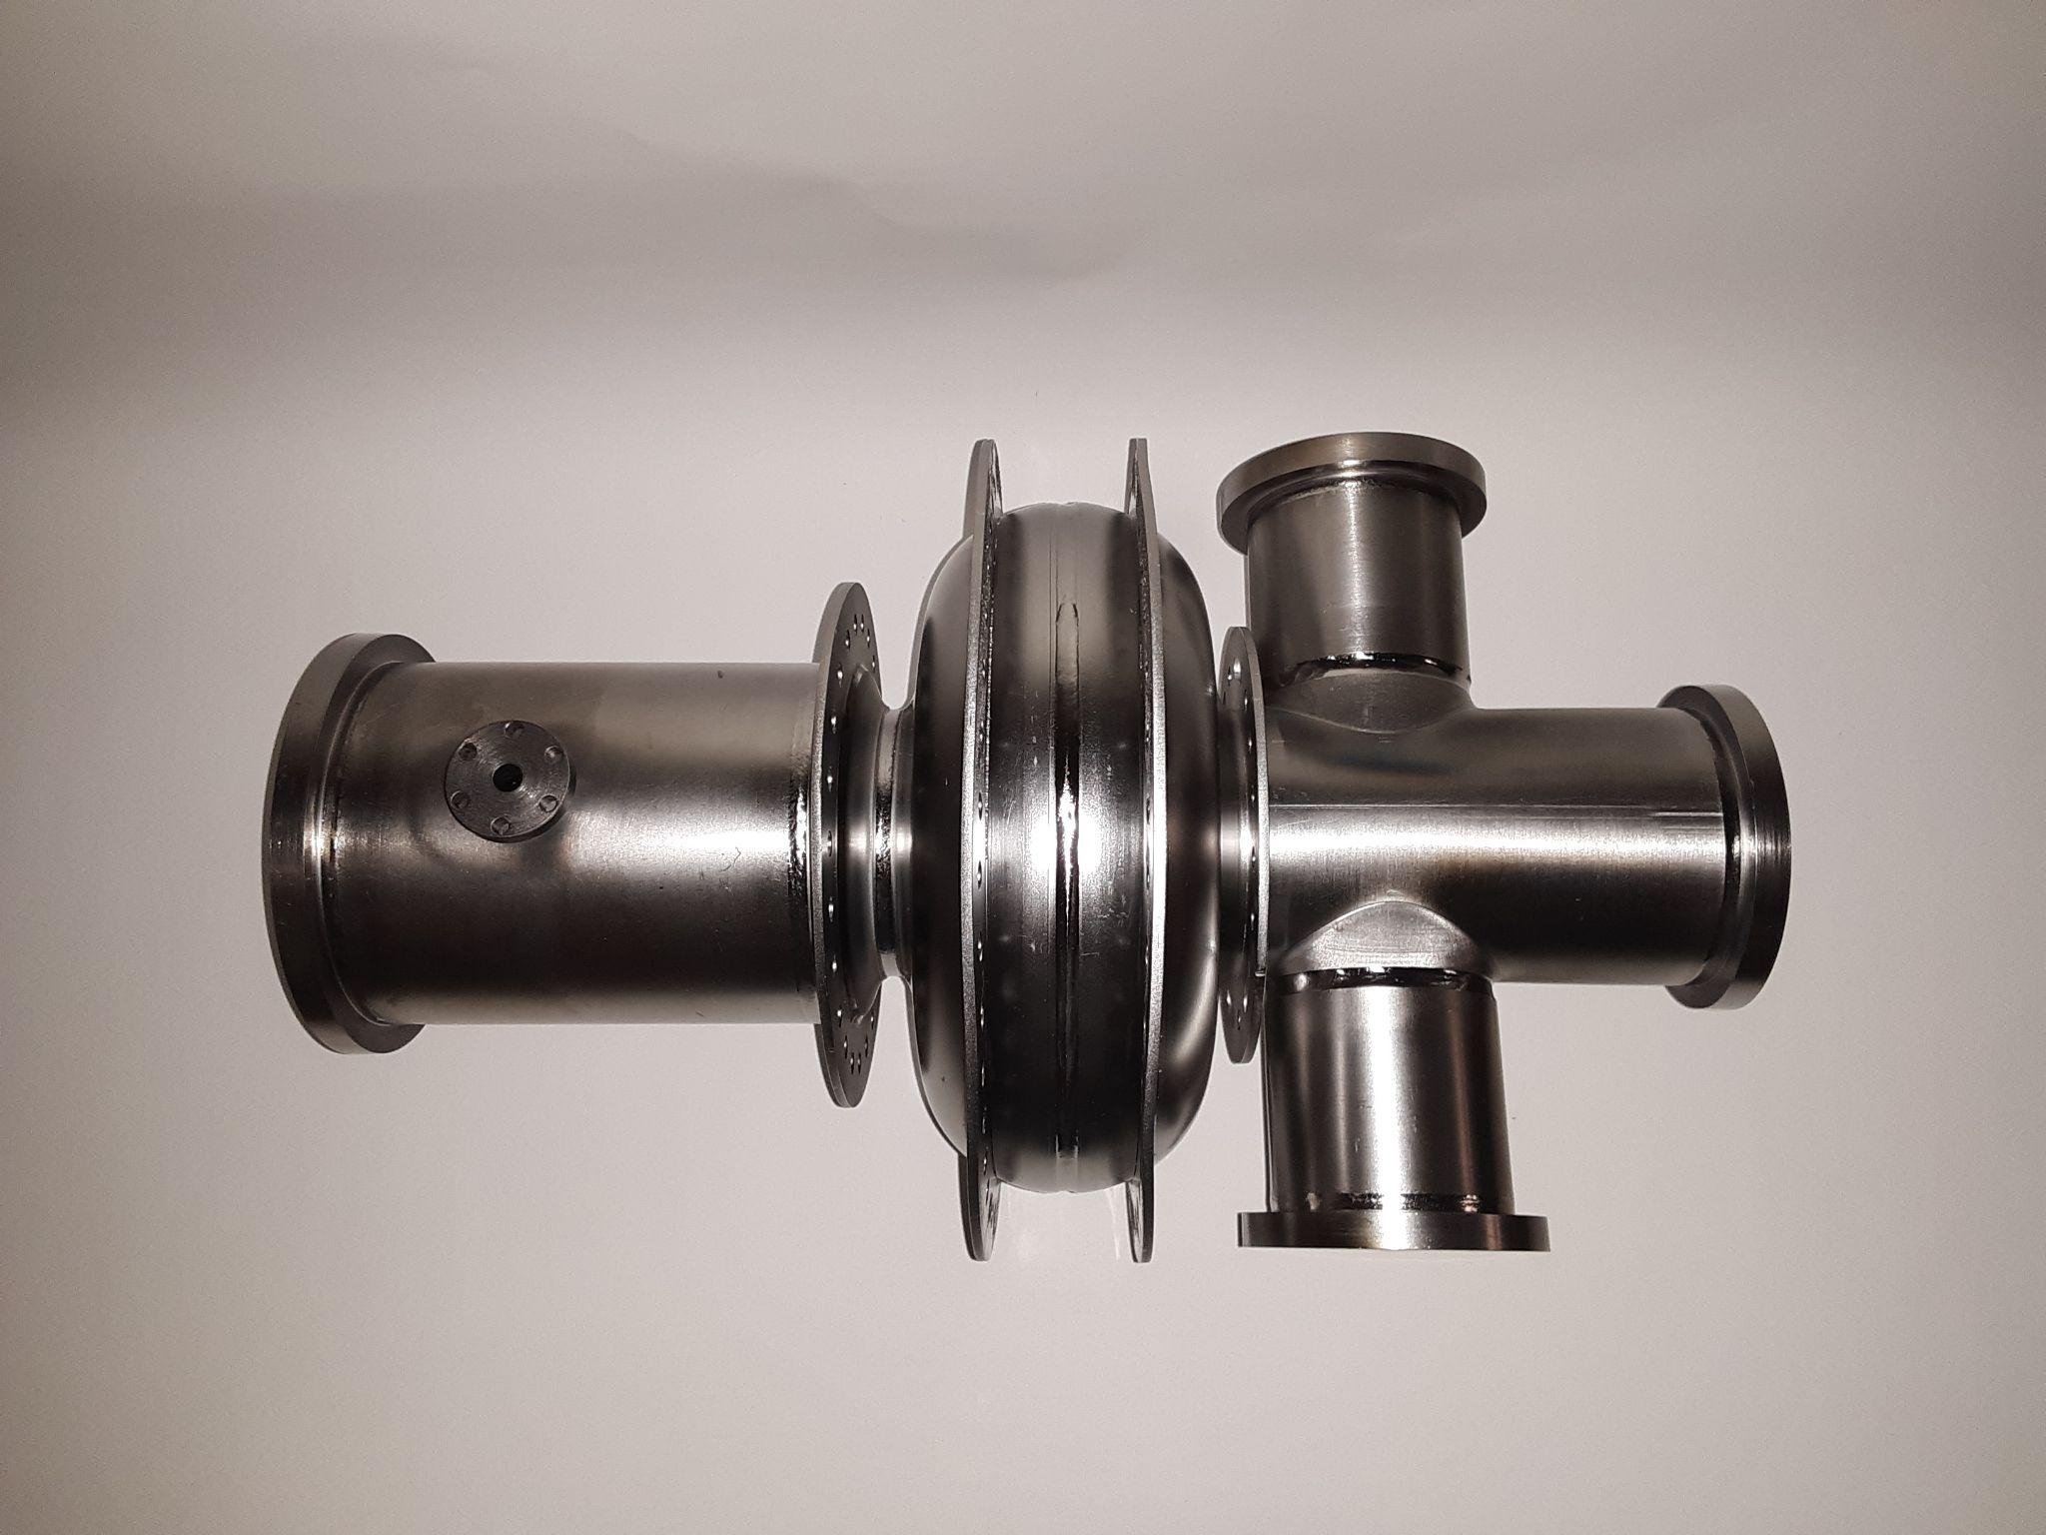
Controlled Cooldowns
Temperature gradient cooling through T_{c}: ΔT < 900 mK, want to reduce ΔT < 50 mK (Seeback)
Heaters: split rings (longitudinal) & coldhead staging plates (transverse)
Split Ring Heaters
PT420
PT425
2
3
1
4
Jake Parsons | Low-Power Operation of the Cornell Conduction-Cooled Nb₃Sn Cryomodule (C4M)

Slide 20
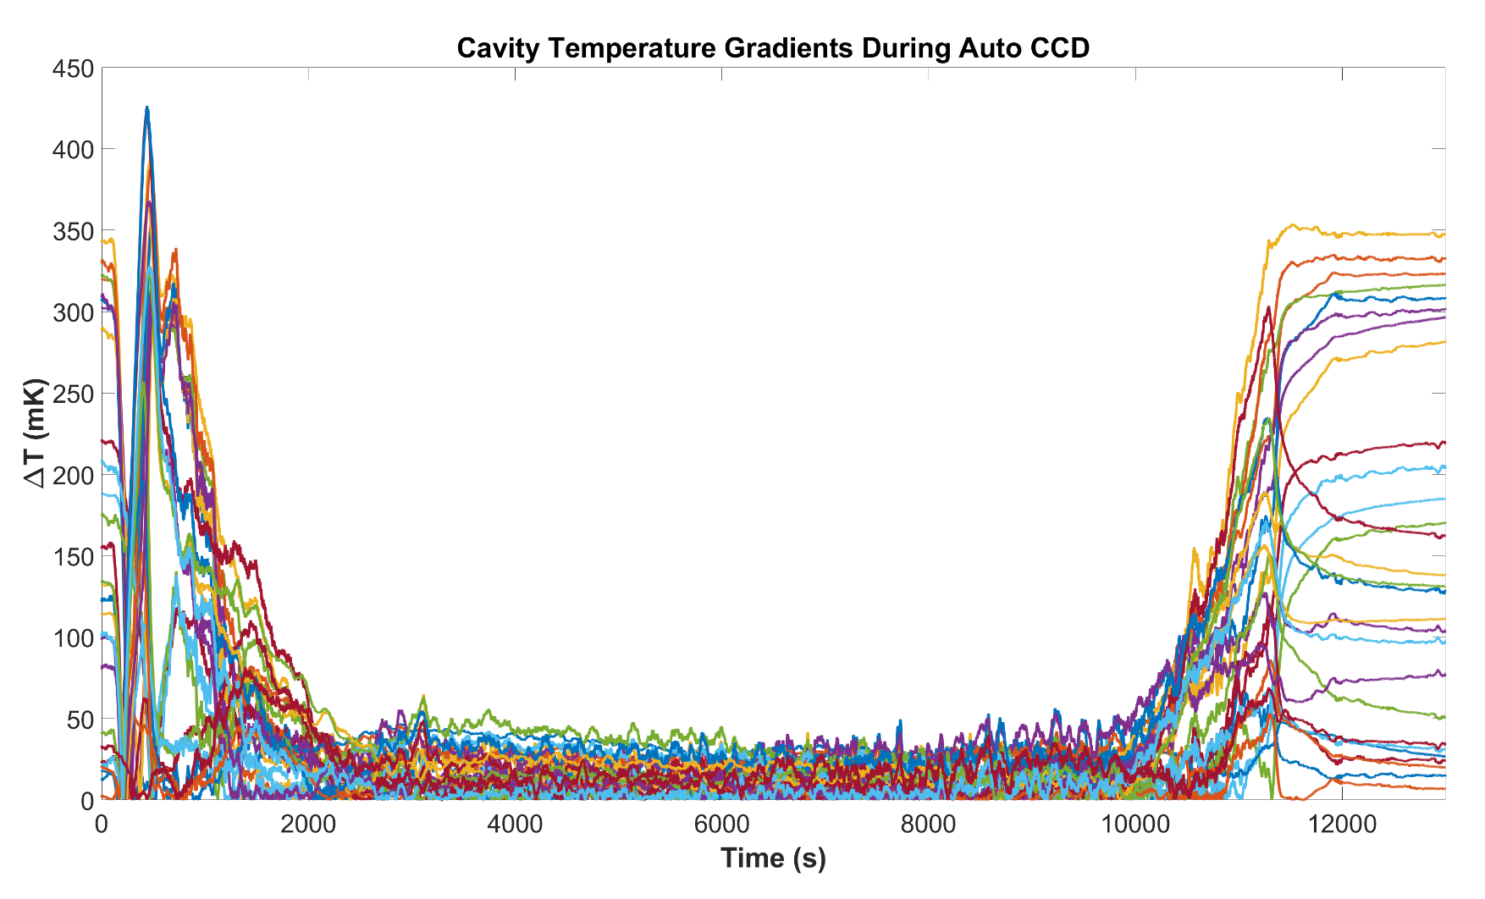
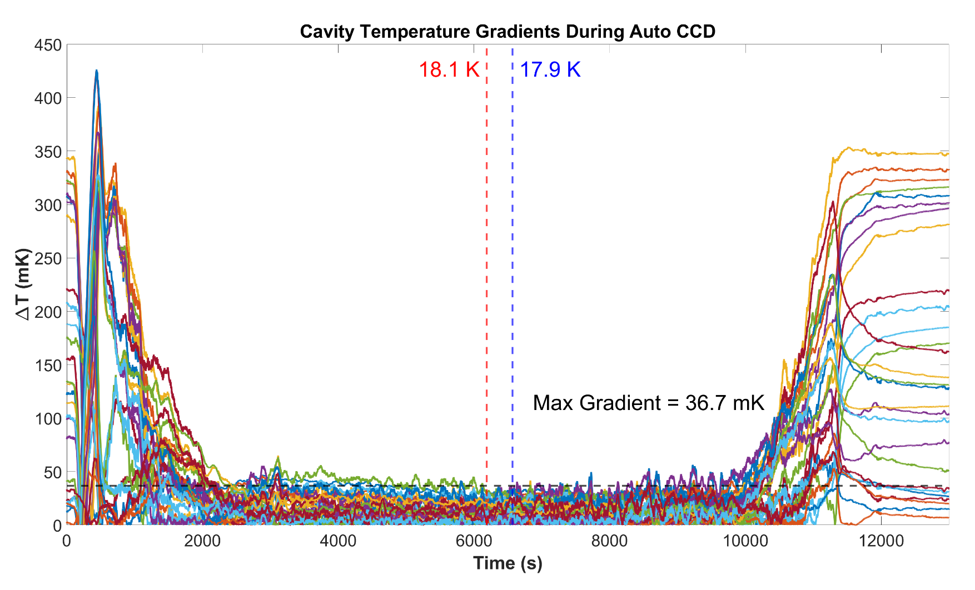
Slow & Autonomous CCD
Slow cool consistently produces < 60 mK gradients when crossing through T_{c} = 18 K
Automated with PID loop
Split Ring Heaters
Jake Parsons | Low-Power Operation of the Cornell Conduction-Cooled Nb₃Sn Cryomodule (C4M)

Slide 21
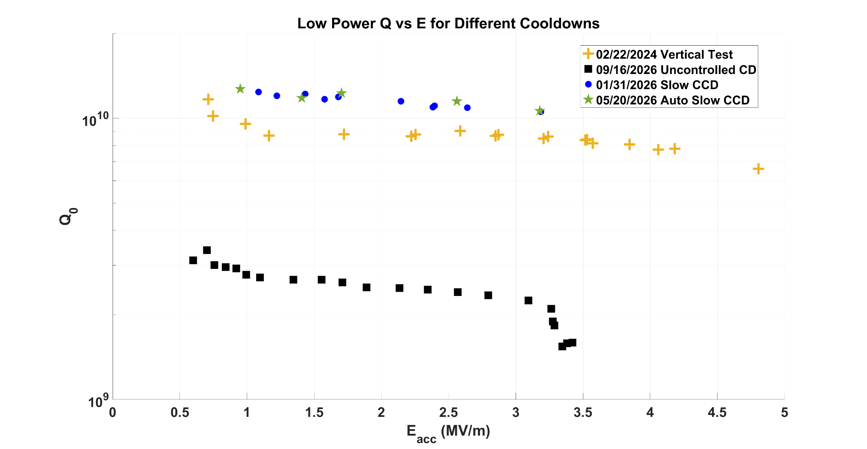
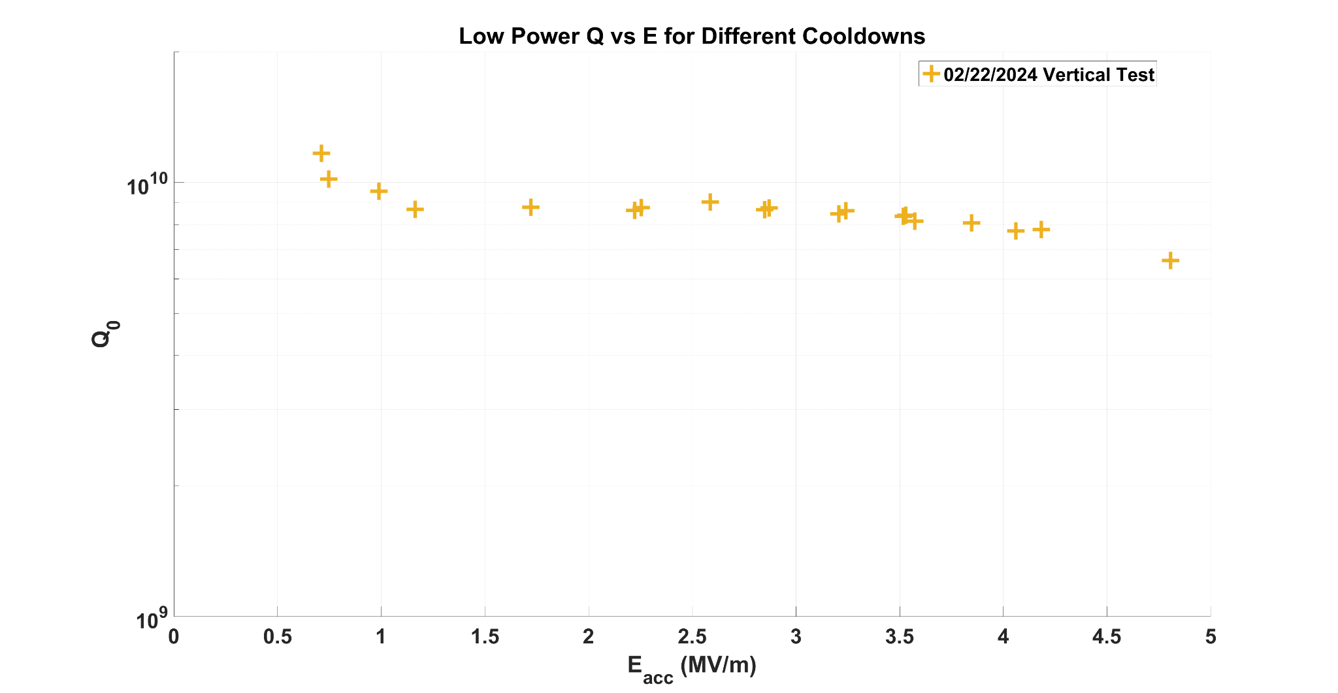
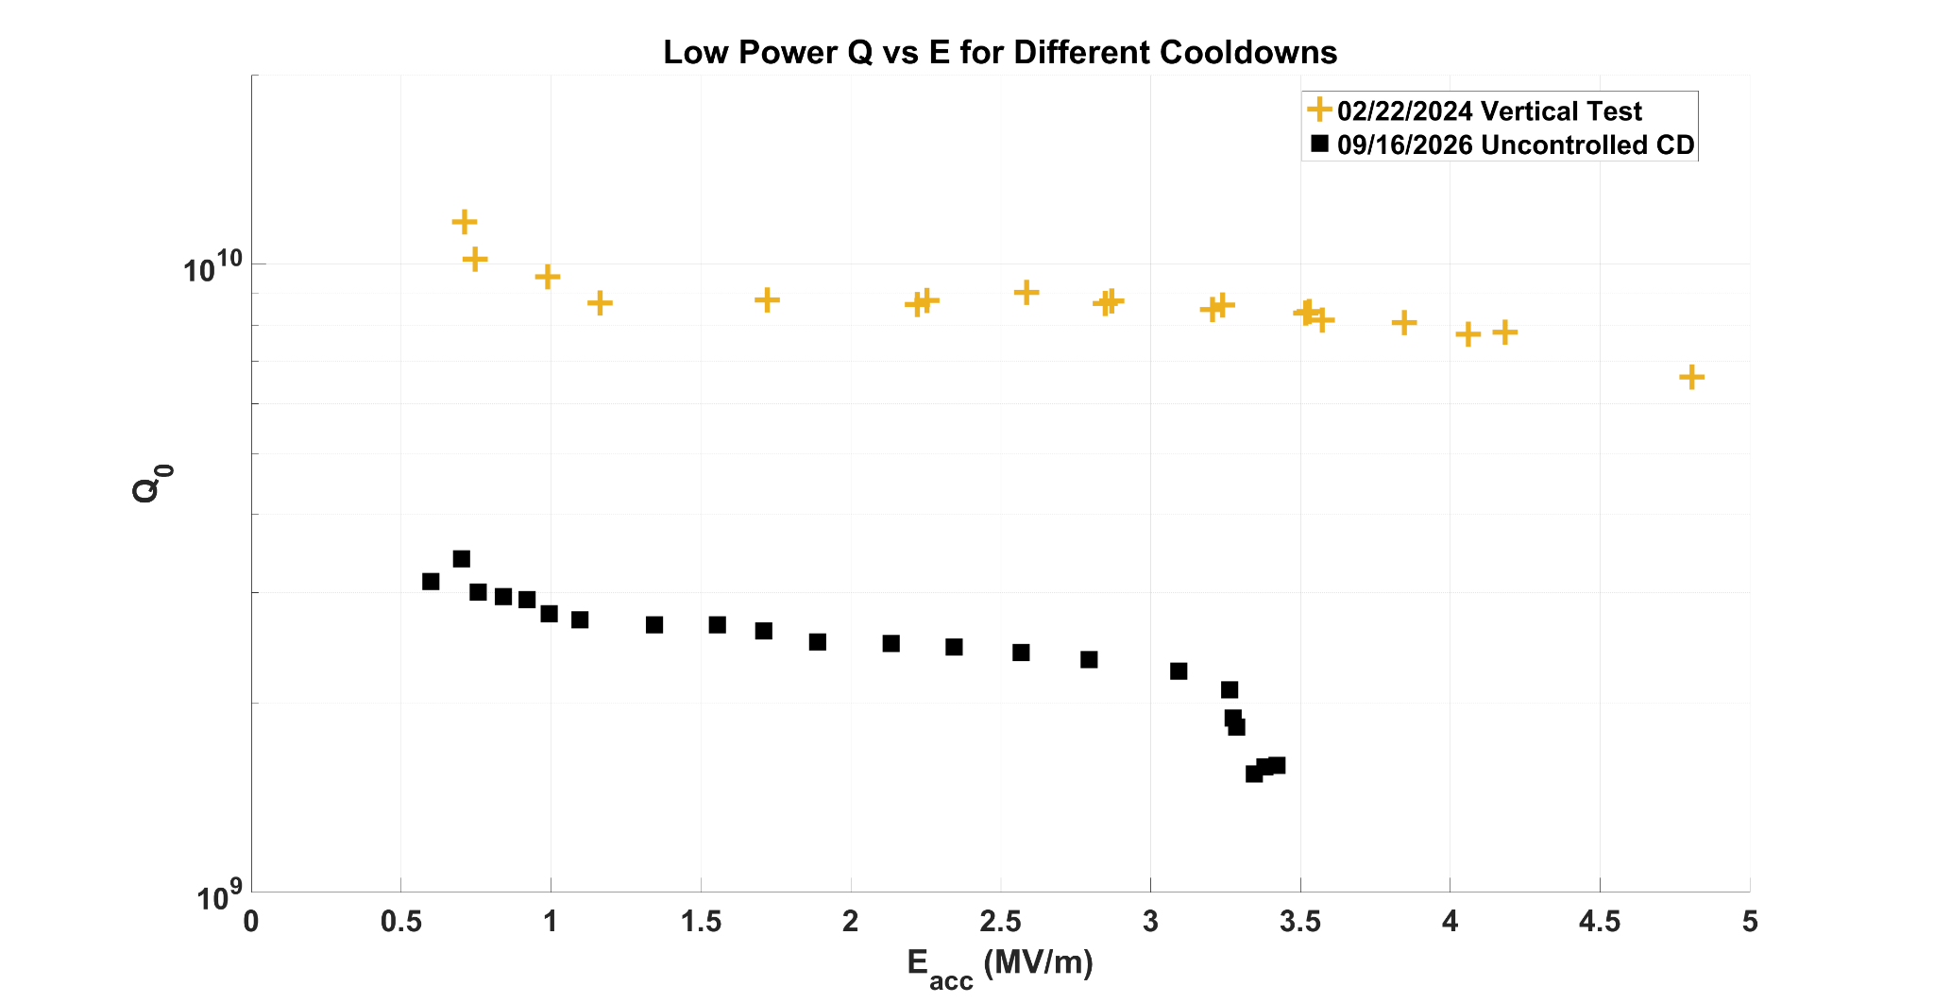
RF Test Results
Using low-power RF cable for tests, high-power coupler fabrication happening now!
Multipacting band at 4 MV/m prevents current setup from reaching quench
Using low-power RF cable for tests, high-power coupler fabrication happening now!
Multipacting band at 4 MV/m prevents current setup from reaching quench
Slow CCD generates highest Q₀ for currently testable E_{acc}
Using low-power RF cable for tests, high-power coupler fabrication happening now!
C4M RF performance
surpasses vertical test!!
Jake Parsons | Low-Power Operation of the Cornell Conduction-Cooled Nb₃Sn Cryomodule (C4M)

Slide 22
SUMMARY & FUTURE WORK
What did I (and will I) accomplish?

Slide 23
My Contributions
Completed first assembly of C4M without RF couplers
Cooled to target temperature on first cooldown with good static heat loads
Achieved small thermal gradients with autonomous controlled cooldown
Cavity performance better than vertical RF test
Jake Parsons | Low-Power Operation of the Cornell Conduction-Cooled Nb₃Sn Cryomodule (C4M)

Slide 24
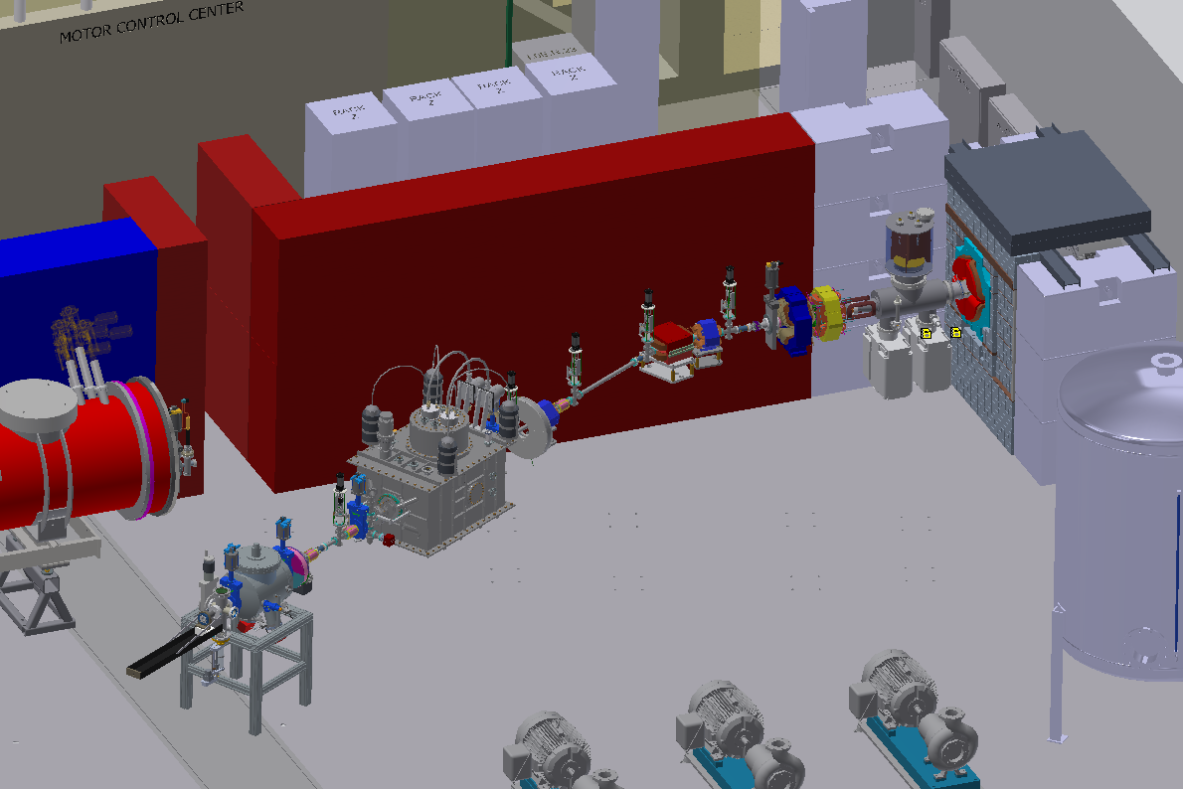
Imminent Future Work
High-Current Beam Test Coming in 2027!
C4M
Diagnostics
Electron Gun
Jake Parsons | Low-Power Operation of the Cornell Conduction-Cooled Nb₃Sn Cryomodule (C4M)

Slide 25
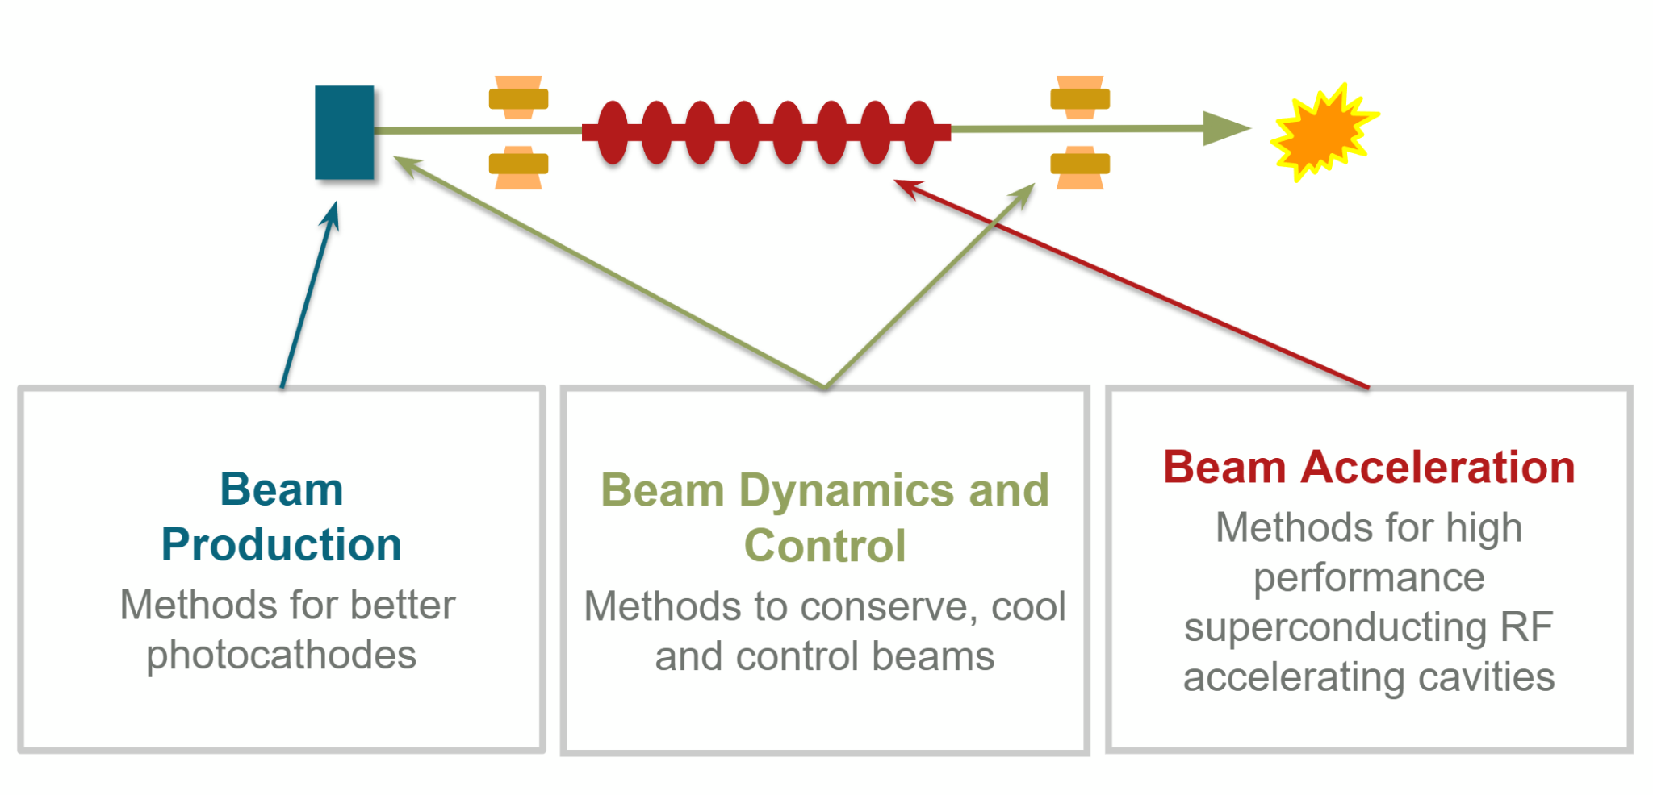
Imminent Future Work
High-Current Beam Test Coming in 2027!
C4M
Diagnostics
Electron Gun
Jake Parsons | Low-Power Operation of the Cornell Conduction-Cooled Nb₃Sn Cryomodule (C4M)

Slide 26

The CBB Prophecy is Being Fulfilled!
C4M
Diagnostics
Electron Gun
Jake Parsons | Low-Power Operation of the Cornell Conduction-Cooled Nb₃Sn Cryomodule (C4M)

Slide 27
Acknowledgements
Thank you to the following people for their significant contributions:
C4M Team: Neil Stilin, Matthias Liepe, Adam Holic, Tim O’Connell, Peter Quigley, James Sears, Valery Shemelin, Jessica Turco
Technician support: Holly Conklin, Terri Gruber-Hine, Greg Kulina
Cornell SRF Group: Gabriel Gaitan, Thomas Oseroff, Sadie Seddon-Stettler, Liana Shpani, Nathan Sitaraman, Nicole Verboncouer
Beamline Team: Jared Maxson, Matt Andorf, Adam Bartnik, Dave Burke, Ben Dickensheets
This work was funded by
U.S. DOE award DE-SC0021038 “Next Steps in the Development of Turn-Key SRF Technology”
DOE Tigner Traineeship in Accelerator Sciences
Jake Parsons | Low-Power Operation of the Cornell Conduction-Cooled Nb₃Sn Cryomodule (C4M)

