Slide 1
Characterization of Cs-Te in a High Gradient Gun
David Garcia
CBB Annual Meeting 2026
2026/07/09
Notes:
Good morning, my name is Daivd Garcia I’m a graduate student working in the Particle Beam Physics Lab at UCLA. Today I will share some recent results on our work towards a 6D characterization of a Cs-Te photocathode in the Pegasus high gradient RF gun

Slide 2
Outline
Motivation
Intro to photoemission
Photocathodes transported to UCLA
Pegasus RF gun, drive laser & photocathode exchange system
Characterization of Cs-Te
  Qunatum efficiency (QE) & mean transverse energy (MTE)
  Mean longitudinal energy (MLE)
  Time response
Conclusion & outlook
Notes:
I will first give some background and a brief overview of photoemission, then you will learn about the photocathodes transported to our experimental facilities at UCLA. Then I will describe characterization techniques used to measure the familiar QE and MTE as well as two new measurements in the longitudinal dimension of the MLE and time response.

Slide 3
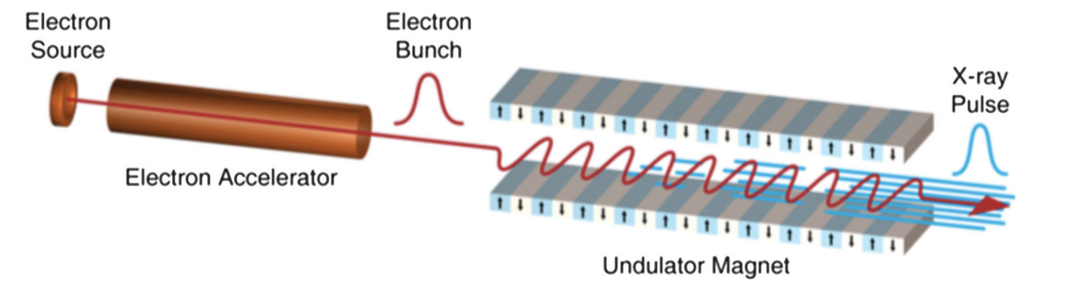
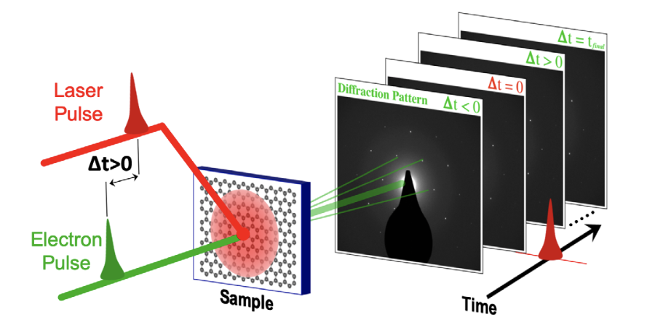
Motivation
Performance of accelerator applications benefit from increased beam brightness
  FEL: Low transverse emittance permits lasing at harder x-rays
  UED/UEM: Increased temporal & spatial and resolution from short & low emittance bunches
State of the art FEL facilities use Cs₂Te photocathodes because they:
  Emit many electrons when illuminated with UV light (high QE)
  Survive operation in an RF photoinjector
Notes:
State of the art user facilities around the world benefit from an increase in beam brightness. Free electron lasers can lase at shorter x ray wavelengths with a lower emittance beam & Ultrafast electron diffraction and microscopy schemes see increased temporal and spatial resolution from a shorter bunch with lower emittance.
Although many of the alkali antimonide photocathodes you will hear about this week display excellent beam quality, user facilities cannot risk sacrificing beam time upgrading to an underdeveloped & technology. Meanwhile the Cs-Te photocathodes has become widely adopted after many years of research. This cathode has a high QE but lackluster transverse emittance in the UV, meaning no change has to be made to the drive laser architecture already present at every facility to drive metallic photocathodes. Even more importantly, Cs-Te is extremely robust compared to the alkali antimonide family of cathode, meaning it can survive the harsh environment of the high gradient RF gun.

Slide 4
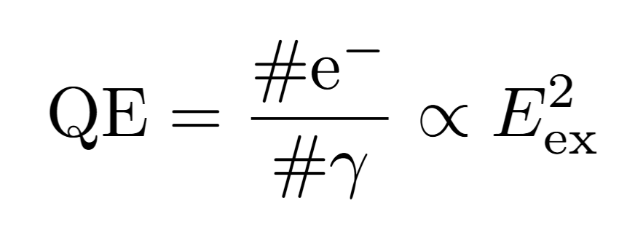
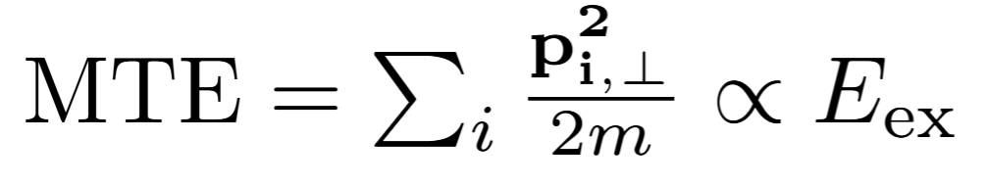
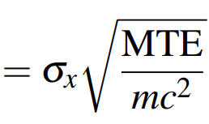

Photoemission
3 step photoemission model:
  Electron inside the material absorbs 1 or more photon
  Electron is transported to the surface of the material
  Electron escapes into vacuum
Schottky Effect: Applied RF accelerating field lowers the potential barrier
e⁻
e⁻
e⁻
$$B_{4D}=\frac{Q_{\text{bunch}}}{ε_{n,x}ε_{n,y}}$$
e⁻
e⁻
Notes:
- The 3 step photoemission model gives a high level understanding of scaling laws we will use throughout this talk. This figure shows the energy distribution of electrons inside the photocathode material on the left and the potential landscape outside the photocathode on the right
First electrons inside the cathode are excited by the photons incident from the drive laser. If the photon energy is close or below the work function then the electron will likely absorb multiple photons
The electron then transports towards the surface of the material. Many processes can occur during this step such as scattering events off of other electrons or off of the crystal lattice
The electron will escape over the potential barrier into vacuum if it has enough energy. This step is very sensitive to the surface of the cathode, a polycrystalline might have many grains with slightly different work functions and/or mountains and valleys on the surface known as chemical and physical roughness respectively which perturb the electron after emission.
Notice in the cartoon that the purple photon does not give the electron enough energy to escape the material work function, yet I claim it does. The applied accelerating field will lower the potential barrier, leading to an effective potential known as the Schottky effect. With 10’s of MV/m the work function can be lowered by 100s of meV. This will increase the excess energy defined as the difference between the photon energy and effective work function.
Now we can define some quantities and their scaling. The Quantum efficiency is the number of electrons out of the cathode vs the number of photons incident on the cathode, which will scale with the square of the excess energy. The mean transverse energy is a measure of exactly what it sounds like it is, it gives a sense of how fast the beam will spread apart and become less beamlike. The transverse emittance is the phase space area of the beam, in 2D you can think of this just like a length x width where you ask how long is the beam in the x dimension and how wide is the momentum space in the x dimension. There are many ways to define this but however you choose you multiply them to get an emittance. Lastly the brighness, which also has may definitions, can be though of in 4D as the total change in the electron bunch divided by emittance in both dimenisons

Slide 5
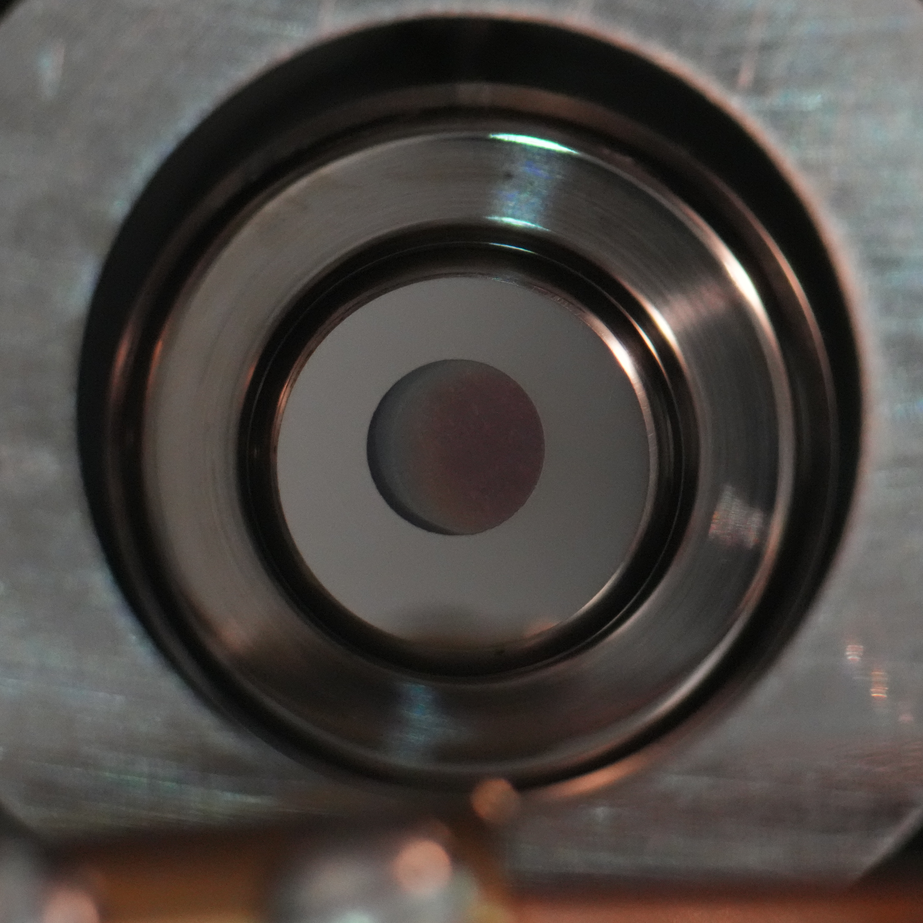
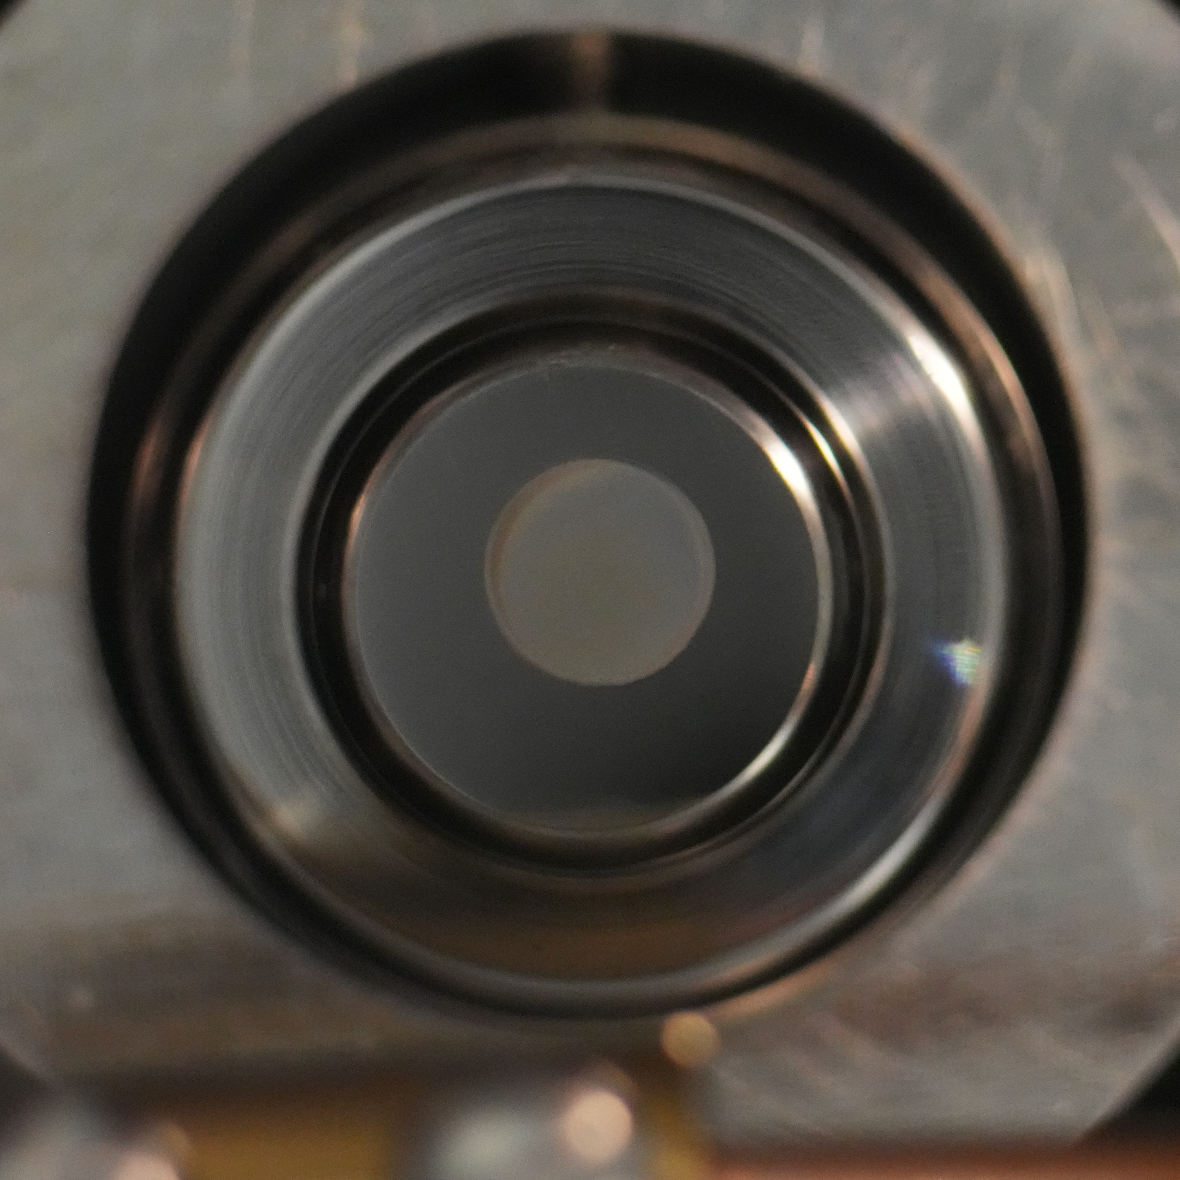
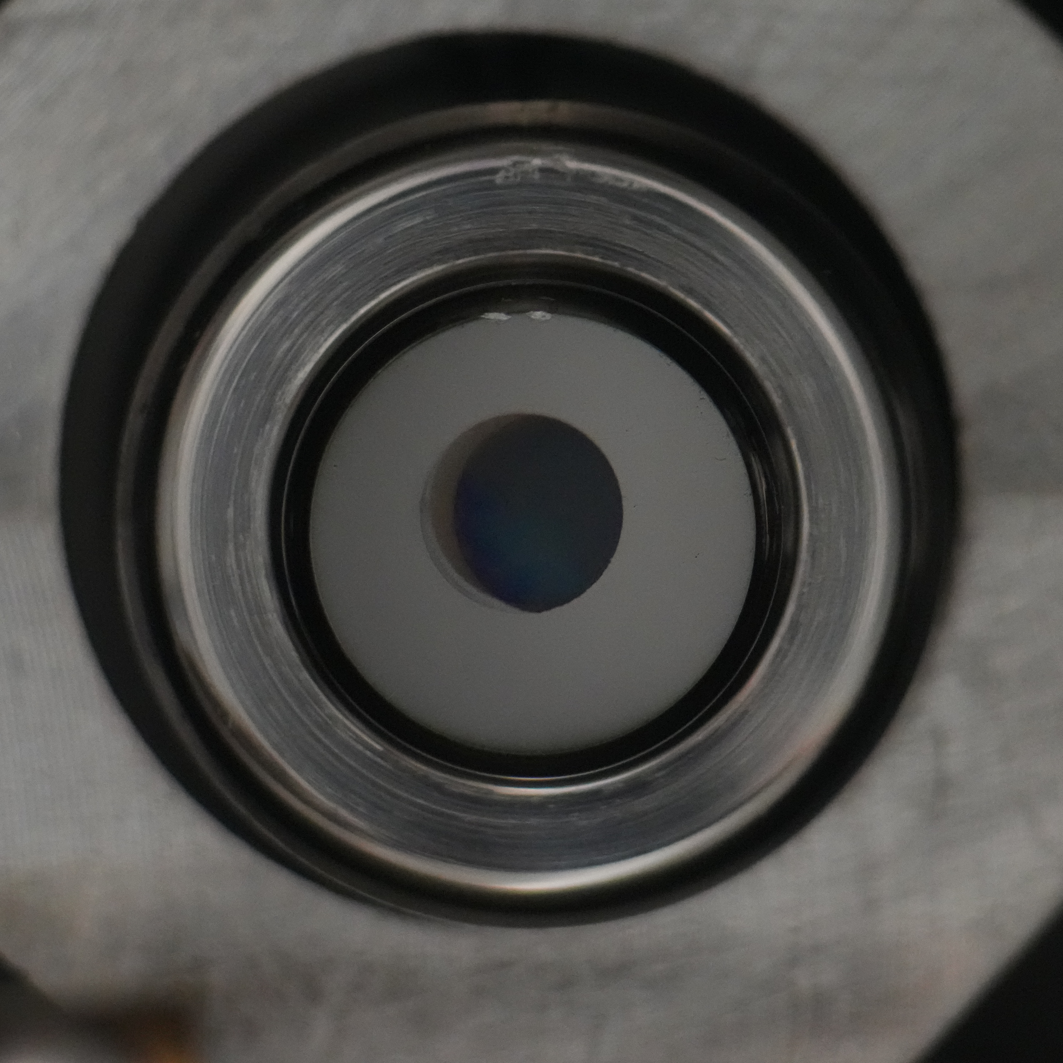
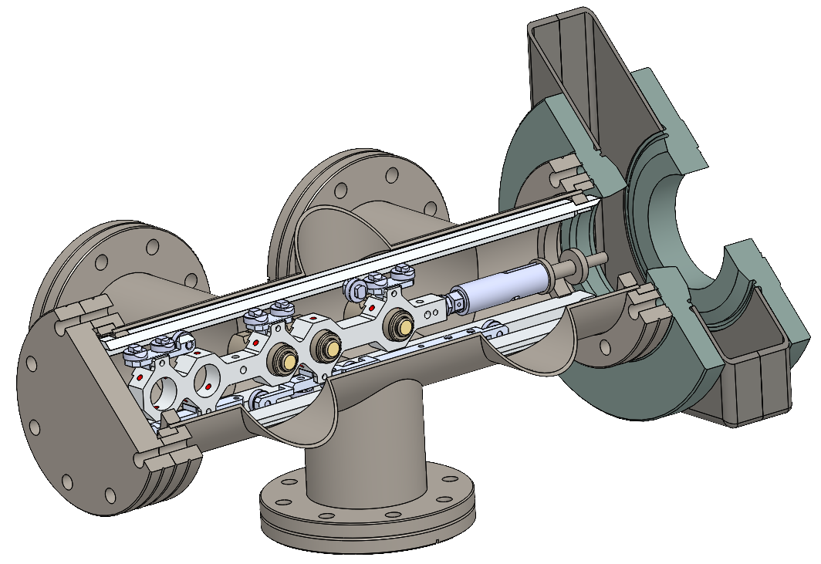
Semiconductor Photocathodes
Last year we presented results from Cs₃Sb but did not look at the Cs-Te cathode
UC04: Cs₃Sb
UC01: Cs-Te
UC03: Cs₃Sb
Notes:
Advanced semiconductor photocathodes such as Cs3Sb, K2CsSb or Cs2Te have displayed great perofrmnace, but require much more care compared to standard metals. They must be grown and transported to the gun under UHV conditions. In March 2025 we transported 3 cathodes grown at SLAC by Theo Vecchione & Gowri Adhikari to UCLA in a UHV suitcase. I presented results from the two Cs3Sb cathodes last annual meeting where you can see the quadratic and linear scalings of the QE and MTE
this presentation will be focused on the Cs-Te cathode that has been operational in our gun for more than a year.

Slide 6
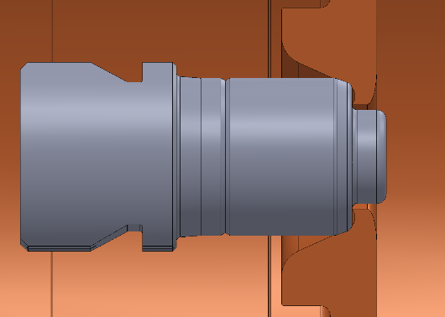
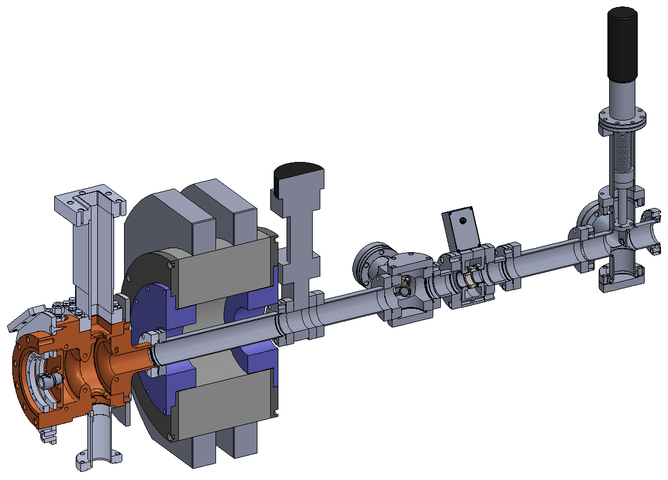
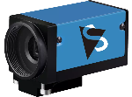
Pegasus S-band Gun
OPA produces a short pulse tunable through the visible and UV spectrum
Photoelectrons accelerated to 3MeV focused using solenoid
Charge, laser energy & transverse distribution at both the cathode & YAG screen are recorded
Notes:
Once the suitcase is attached to the load-lock system at UCLA, we transfer it into the RF gun and begin measurements. Photoelectrons are created using an optical parametric amplifier, providing us with a tunable wavelength drive laser from 300-700nm to vary the excess energy. The RF gun then accelerates the photoelectrons to 3MeV where a focusing solenoid transports them to downstream diagnostics.
The traverse distribution & energy of the laser on the cathode is measured with a virtual cathode camera & a YAG screen measurers the transverse distribution of the electron beam. An integrated current transformer nondestructively monitors the bunch charge and a dipole spectrometer measures the momentum of the beam. Taken together, these shot synchronized diagnostics proved data sets robust to shot to shot fluctuations in the laser energy.

Slide 7
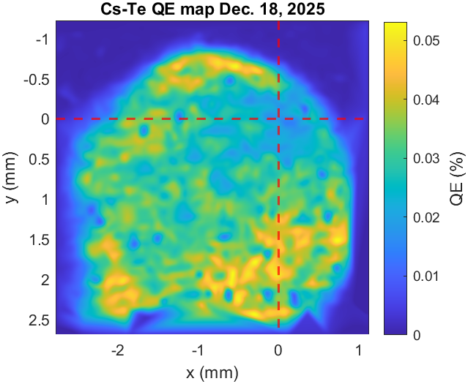
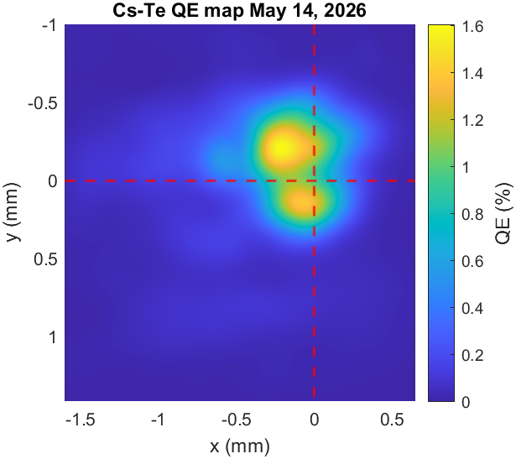
Lifetime & QE Maps
Cathode arrived to UCLA with a QE of 3% at 260nm, around 6 months later the QE decayed to < 0.1%
Cathode showed signs of rejuvenation through laser cleaning
Notes:
The Cs-Te cathode arrived to UCLA with a QE of 3% at 260nm. Around 6 months later a QE map of the cathode in the RF gun shows the spatial variation of the QE across the surface decayed to <0.1% and remained stable here for many months even after two exposures 1e-3 Torr.
A recent Compton scattering experiment extracted 200pC bunches for a 2 weeks from the cathode resulting in a rejuvenation of the QE around the center to ~1%. The interaction of the laser with the cathode is a complex process. Heating from the laser is hypothesized to induce roughness on the surface, diffusion of Cs across the surface & ablation of Cs off of the surface if the laser power is excessive. Somewhere between all of this, the laser can break the bonds of the surface contaminants and rejuvenate the QE.

Slide 8
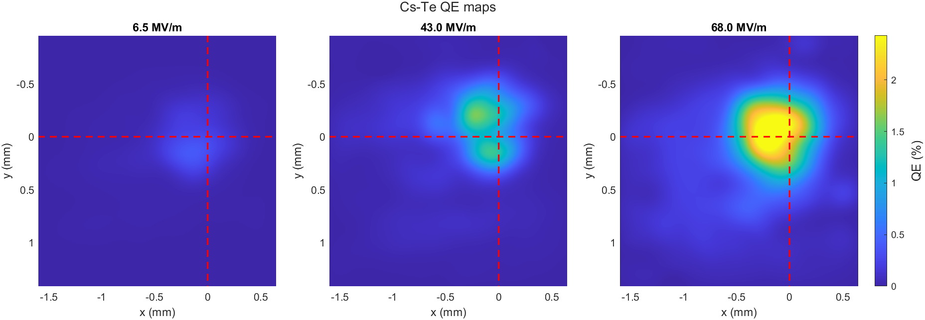
Lifetime & QE Maps
Mapping the rejuvenated cathode at increasing launch field shows regions of increased enhancement, attributed to physical roughness
Notes:
QE maps of this hotspot taken at increasing launch fields show spatially varying field enhancement. This could help resolve chemical vs physical roughness.
At low fields the QE is proportional to the work function. As the field increases, the only way for lower work function areas to have more QE than higher work function areas is if the local field enhancement is larger. Look into if this is true…
All of the measurements presented are taken on this hot spot

Slide 9
Charge Scans & QE
Short pulse laser shows nonlinear emission at 350nm, which becomes linear when the laser pulse is stretched and the launch field is increased
Notes:
QE maps are done with a constant laser energy, but to fully characterize the QE you need to vary the laser energy to take a charge scan. These scans show you if the emission is linear or nonlinear and allow you to extract the linear QE from nonlinear emission. Scans taken at multiple wavelengths show linear emission down to 300nm but nonlinear emission at 350nm.
Nonlinear photoemission is an intensity dependet effect and is also sensitive to the exces energy. We added a stretcher to increase the pulse length from 40fs to 1ps and increased the launch field from 20MV/m to 68MV/m this both lowered the intensity and increased the excess energy by ~150meV and resulted in linear emission at 350nm.
Its important to remember that this cathode is over a year old and has had many surface modifications due to contaminates and rejuvenation. A fresh cathode will likely emit linearly at 350nm with a short pulse at low fields

Slide 10
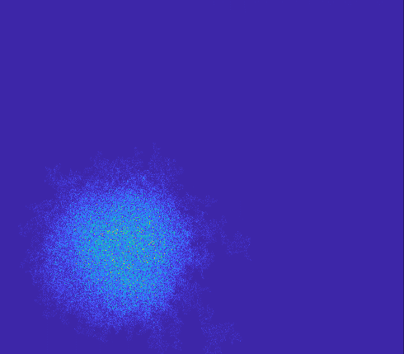
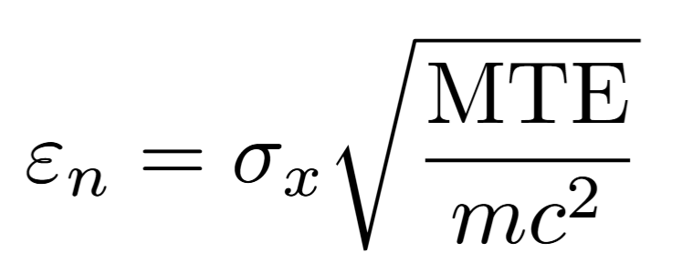
Transverse Emittance & MTE
95% emittance extracted from solenoid scan using linear transport formalism
  Low charge and short pulse reduce emittance growth from Coulomb force and RF field
Notes:
We use the solenoid scan technique with linear transport formalism to fit the beam covariance matrix and retrieve the transverse emittance. Multiple scans taken at varying spot sizes allows us to fit the MTE at a given wavelength. At 300nm we see a 2x reduction of MTE, proving an easy path towards improved performance in the photoinjectors at user facilities by tuning the drive laser wavelength. Wavelengths longer than 300nm display an increased MTE due to nonlinear emission
These scans are taken with a short pulse laser at a launch field of 20MV/m. A longer laser pulse and higher launch field would likely result in a lower MTE

Slide 11
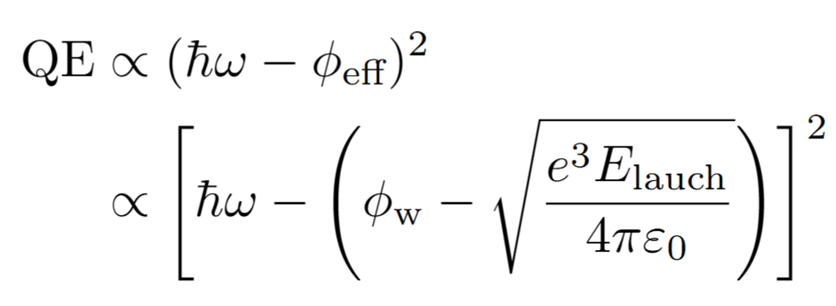
Phase Scans
Fit the Schottky enhancement of the QE to extract work function of Cs-Te using simple expression
Notes:
What you have heard in this talk until now is likely familiar to some of yall, but these next measurements are unique to the RF photoinjector. The Schottky scan or phase scan sweeps the phase of the RF field which increases the launch field and measures the charge extracted. This measurement is rich with information as it convolutes photoemission physics with beam dynamics. The phase scan has quickly become my favorite measurement to take in the gun for this reason.
There are two regions of these scans we will analyze, the first is the data after 0 phase. Here the Schottky effect lowers the effective work function and the excess energy will increase accordingly. When the drive laser wavelength is close to threshold the Schottky effect can increase the excess energy by >70%, resulting in a large gain in QE across the scan, while when the wavelength is far from threshold the Schottky effect will only increase the QE by <15% (check numbers)
Using the simple expression for the QE enhancement, we fit the work function of Cs-Te to be around 4eV which does not agree with the accepted value of 3.5eV, lielky due to many reasons. Our sample has many surface modifications from the decay and rejuvenation after over a year of use. Also, note the I have been writing Cs-Te and not Cs2Te, this is because Cs & Te form many different phases such as cs2Te & Cs5Te3 or simply pure cs that all have slightly different work functions. This has been shown to happen for overcesiated samples and we know that our cathode was overcesiated. Lastly, the model used to extract the work function is over simplified, it neglects local field enhancement, assumes the cathode has the same permittivity as a PEC & the nuances at the semiconductor vacuum interface are not accounted for.
The next region of this scan we will analyze is the charge extracted at negative phases. Looking closely you can see that the 260nm scan begins at a more negative phase and rises with a steeper slope. This region of negative phase has a decelerating field that pushes electrons born back into the cathode, so how can electrons escape?

Slide 12


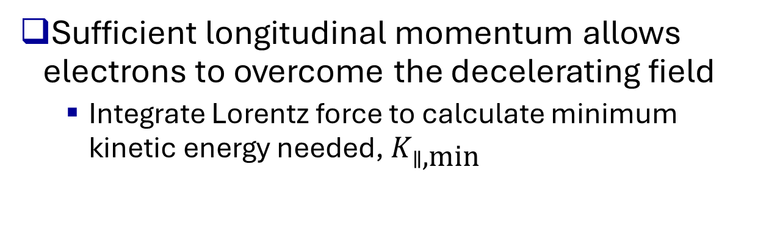
Negative Phase Dynamics
Sufficient longitudinal momentum allows electrons to overcome the decelerating field
  Integrate Lorentz force to calculate minimum kinetic energy needed, $K_{∥\text{,}\text{min}}$
$$\frac{dp_{∥}}{dt}=eE_{0}\sin{(ωt+φ_{0})}$$
$$K_{∥\text{,}\text{min}}=\frac{2}{9}mc^{2}α^{2}φ_{0}^{4}$$
$$α=\frac{eE_{0}}{2mcω}=1.22$$
Notes:
Analysis of the negative phase dynamics reveals electrons born with enough longitudinal kinetic energy can overcome the decelerating field. This is akin to ballistic motion, like rolling a ball up a hill that if you push hard enough will roll over the hill into the next valley, expect here we have a time varying potential.
By integrating the Lorentz force we can determine the minimum initial longitudinal kinetic energy needed to overcome the RF decelerating field at a given phase.
This plot shows the 1D trajectories a particle born with a given kinetic energy will take at -3 degrees phase. More than 1.7eV of longitudna energy is needed or else the particle will crash back into the cathode.
General particle tracer simulations validate our expresion

Slide 13
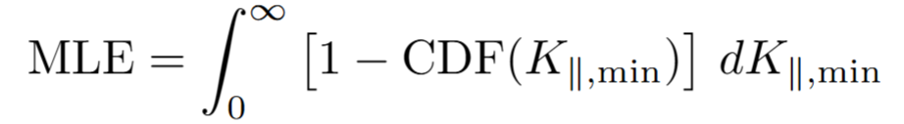
Mean Longitudinal Energy
Applying this mapping to the phase scan generates the cumulative distribution function (CDF) for the longitudinal energy of the electrons
The expected value integral gives the Mean Longitudinal Energy (MLE)
Notes:
Now that we have a monotonic mapping of initial longitudinal energy to phase, we can transform the phase scan for phases <0 into a Cumulative distribution function of the initial longitudinal energy
With this distrubion, we can define the MLE akin to the MTE, using the expected value of a CDF. But having the full distribution is more powerful than simply the first moment. Notice the high energy tails. These could be due to the finite pulse length of the laser, RF phase jitter or a small cross section of multiphoton emission, but whatever their source they heavily weigh the integral and increase the MLE. The shape of the distribution can also matter. Scattering processes can themalize the distribution leading to more lower energy electrons instead of an even distribution (check this…)
With this measurement we add a 5th dimension to our characterization, the temporal response of the cathode is the 6th dimension.

Slide 14
Indirect Measure of Pulse Length
The energy of the electron beam leaving the RF gun is correlated with the launch phase
  A longer pulse will sample many different energies, especially at high phase, resulting in a larger energy spread
Notes:
These cathodes are championed as low emittance sources to replace metals, but have drawbacks that temper our expectations.
Semiconductor cathodes are known to have a longer response time compared to metals, which are known to be prompt. What this means is that if the laser incident is 40fs long, the pulse coming out of the semiconductor cathode might be 400fs long. This stretching can happen because semiconductors have a longer optical depth compared to metals which have a very short skin depth as well as scattering events off of the semiconductor lattice. The amount a pulse is stretched by is characterized by its time response, which is time constant of an exponential decay convoluted with the laser pulse length to give the resulting electron bunch length.
Measuring this is very difficult, most measurement are made with a time varying field to streak the pulse downstream and measure the length. But the beam dynamics must be considered, coulomb forces for example will length the pulse as it travels to the detector. We instead opt for a measurement of the energy spread to indirectly measure the pulse length which is more robust to the coulomb forces.
A plot of the launch phase vs the energy gain form the gun shows the idea. At high phase a longer pulse will sample more phases and will have a larger energy spread. As a first test of this idea we used a 100fs UV pulse and stretched the pulse to different lengths to measure the change in energy spread. Here we see the incrae in energy spread we expect to see…

Slide 15
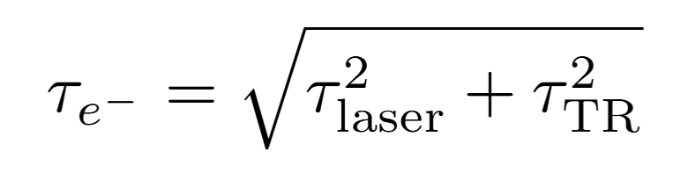

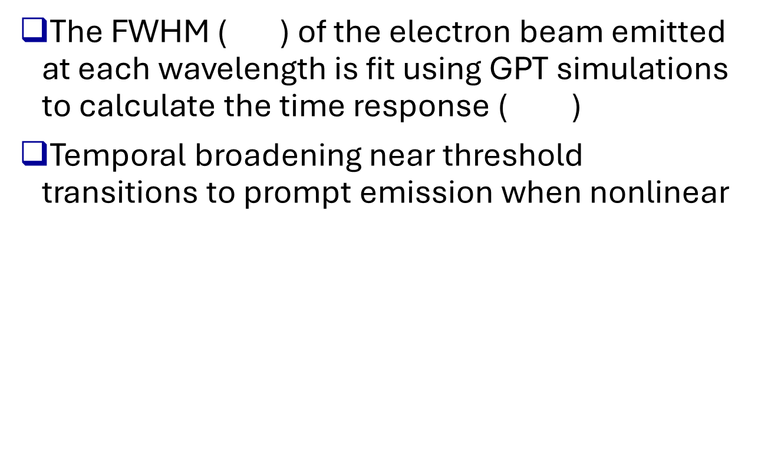
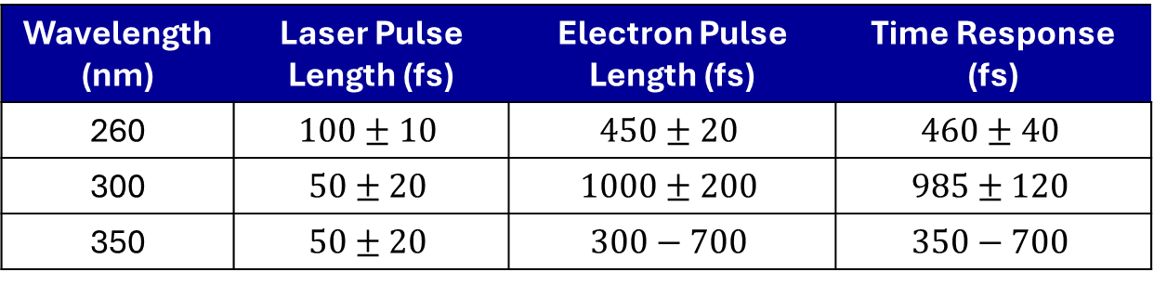
Time Response vs. Wavelength
The FWHM ( ) of the electron beam emitted at each wavelength is fit using GPT simulations to calculate the time response ( )
Temporal broadening near threshold transitions to prompt emission when nonlinear
Wavelength (nm) | Laser Pulse Length (fs) | Electron Pulse Length (fs) | Time Response (fs)
260 | $$100±10$$ | $$450±20$$ | $$460±40$$
300 | $$50±20$$ | $$1000±200$$ | $$985±120$$
350 | $$50±20$$ | $$300−700$$ | $$350−700$$
Notes:
The same measurements done with a short pulse laser but at different wavelengths reveals interesting trends. As the wavelength bcomes longer at 300nm the puse length also become longer. But once the emission becomes nonlinear the emission become prompter again. Note that at high fields the 350nm emission becomes more and more linear and the pulse length begins to rise above the 260nm pulse
This is becuase

Slide 16
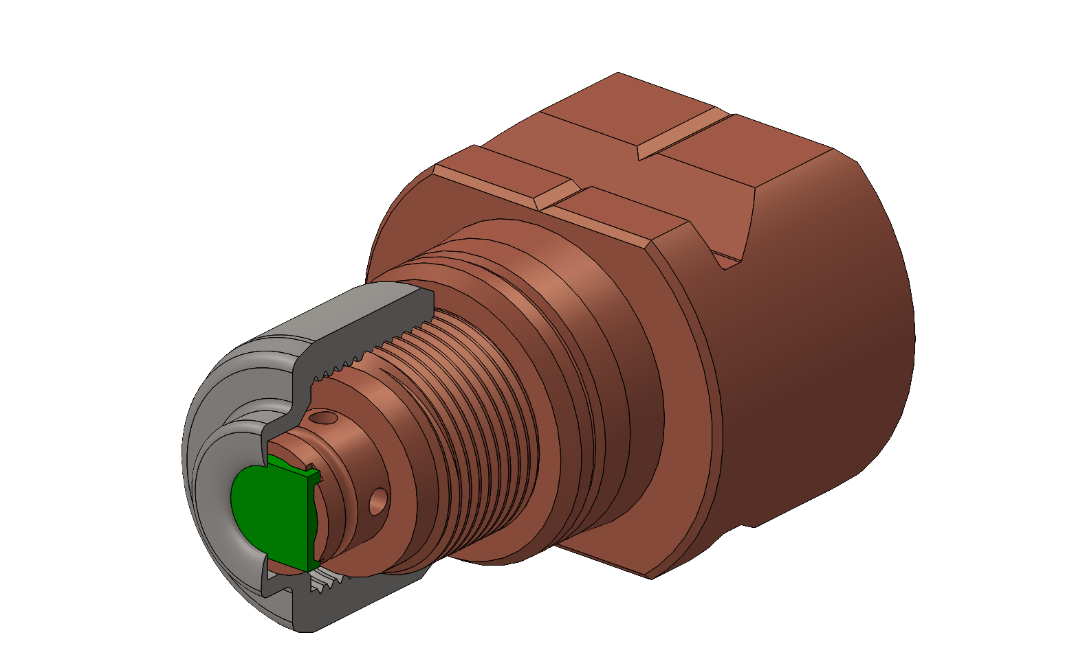
Conclusion & Outlook
We have demonstrated the capability to perform a 6D spectral characterization of the photocathode in high gradient gun
The relative trend of QE and MTE of Cs-Te measured show promise of improved performance at FEL user facilities
Future experiments will apply these techniques to fresh Cs₃Sb, K₂CsSb & Cs₂Te cathodes grown at ASU & SLAC
  Growth on a substate compatible INFN plug will allow for smoother cathodes

Slide 17







Acknowledgments
PBPL
  Advisor: Pietro Musumeci
  Support from post docs & students
Collaborators who have or will grow cathodes for testing at UCLA
  SLAC: T. Vecchione & G. Adhikari
  Cornell: Maxson Lab
  ASU: Karkare Lab
Funding
  CBB/NSF
  DOE

Slide 18
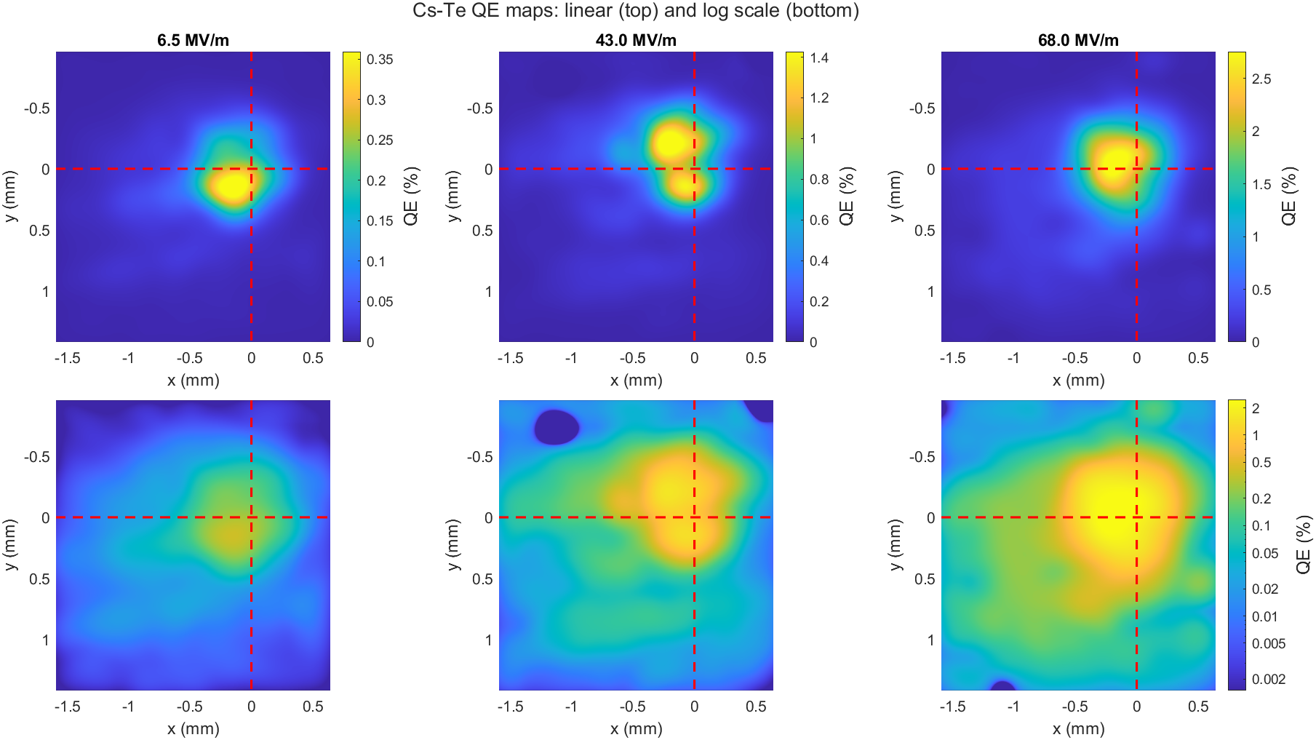
Lifetime & QE Maps
Mapping the rejuvenated cathode at increasing launch field shows regions of varying enhancement
  Shown in log space you can see the decayed region of the cathode
Notes:
The cathode arrived to UCLA with a QE of 3% at 260nm. Around 6 months later the QE had decayed to <0.1%, a QE map shows the spatial variation of the QE. The cathode remained stable for many months even after two exposures when the gun vas vented to a vacuum of 1e-3.
A recent Compton scattering experiment extracted 200pC bunches for a few weeks from the cathode resulting in a rejuvenation of the QE around the center of the cathode. The interaction of the laser with the cathode is a complex process. Heating from the laser is hypothesized to induce roughness on the surface, diffusion of Cs across the surface & ablation of Cs off of the surface if the laser power is excessive. Somewhere between all of this, the laser can break the bonds of the surface contaminants and rejuvenate the QE. A QE map shows this hotspot at the center of the cathode, and when taken at increasing launch fields spatially varying field enhancement are visible. This could help resolve chemical vs physical roughness.
At low fields the QE is proportional to the work function. As the field increases, the only way for lower work function areas to have more QE than higher work function areas is if the local field enhancement is larger. Look into if this is true…
All of the measurements presented are taken on this hot spot

Slide 19
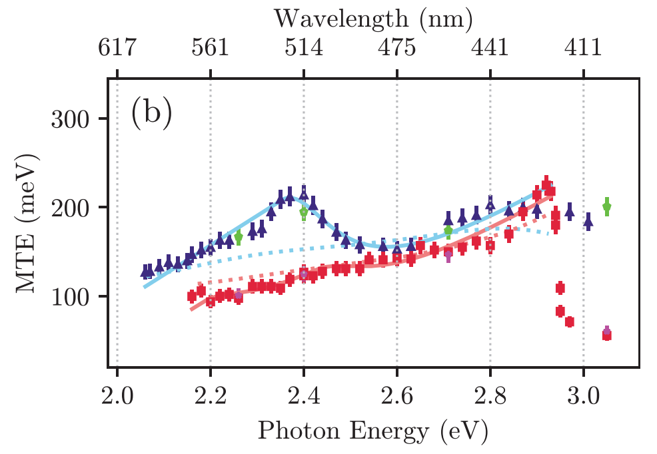

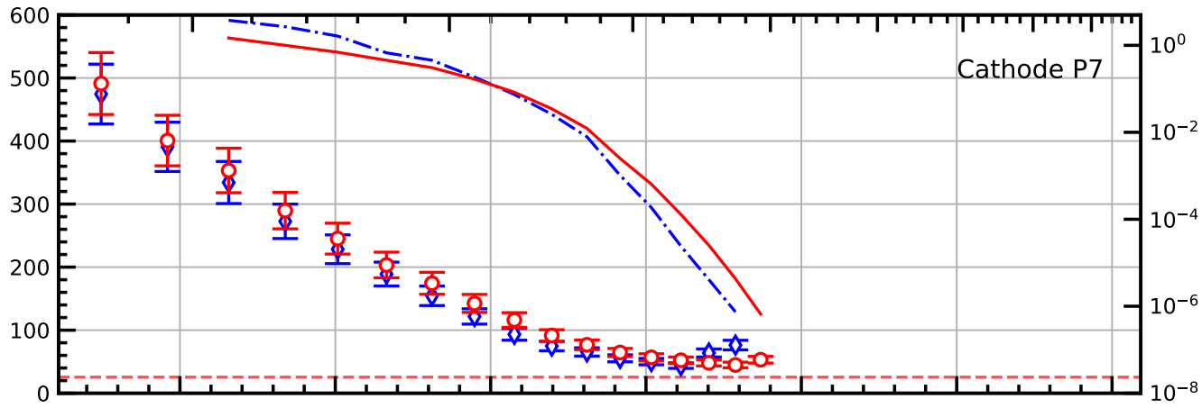

Comparison to Published Literature
Cs-Te has been measured to have low MTE in low field diagnostics
Other facilities have reported better emittance at 260nm even at high gradients
Facility | Launch Field (MV/m) | MTE (eV)
UCLA | 25 | 0.7-1.0
LBNL (APEX) | 20 | 0.29
DESY PITZ | 17-40 | 0.22
PSI | 50-76 | 0.13
Notes:
These Cs-Te cathodes are not new, they are widely adopted and their performance has been reported by many labs both at low and high gradients. Low field diagnostics have measured low emittance from the cathodes, while most of the user facilities with a high gradient gun have reported similar numbers. This difference can be attributed to a number of different effects, such as roughness and the Schottky lowering of the work function.
We see ~2x decrease in MTE while still keeping a higher QE than most metals by lowering the wavelength to 300nm for a heavily used cathode. This means that most of theses user facilities could see an improvement in brightness by switching the laser architecture while maintaining the robustness of the Cs2Te cathode.

Slide 20
Boersch Effect
Coulomb repulsion of the electron beam will increase the energy spread if too dense
  Correlation plots show this effect becomes negligible as the beam is stretched

Slide 21
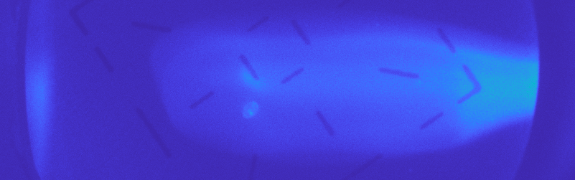
Dark Current & Thermal Current
Large accelerating gradient leads to field emission (dark current)
High laser pulse energy can heat the cathode and cause thermal emission
  ~0.3 µJ pulse of 350 nm light

