Slide 1

Development of C-band high gradient accelerator structures at LANL and potential applications
Evgenya Simakov, Yuri Batygin, Wonjin Choi, W. Brian Haynes, Dongsung Kim, Sergey Kurennoy, Haoran Xu, and MD Zuboraj
Los Alamos National Laboratory
2/25/2026
Managed by Triad National Security, LLC., for the U.S. Department of Energy’s NNSA.

Slide 2
Outline of this talk
Introduction and LANL C-band research overview
LANL C-band Engineering Research Facility CERF-NM
LANL C-band electron beam test facility CARIE
C-band accelerator research at LANL in response to 2026 Laboratory Agenda
Summary and near-term plans

Slide 3
LANL High Gradient C-band research
The goals for LANL’s high gradient project are evolving
To build a C-band (5.712 GHz) high gradient rf breakdown study facility (2019-2022).
To build a C-band cryo-cooled photoinjector study facility (2022-2025).
To conduct research relevant to LANL applications and Laboratory Agenda (2025 – forward).
Los Alamos National Laboratory internal funding comes from LANL Laboratory Directed Research and Development (LDRD) program, LANL Internal Infrastructure Investments, and Technology Evaluation and Development (TED) funds.

Slide 4
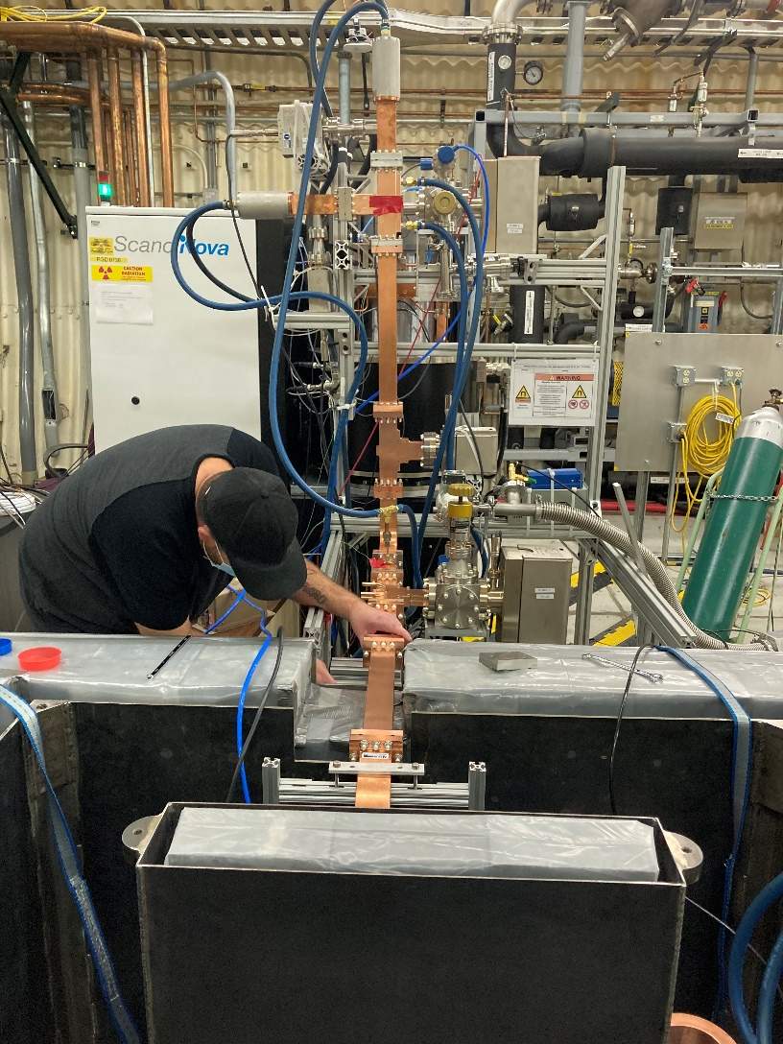
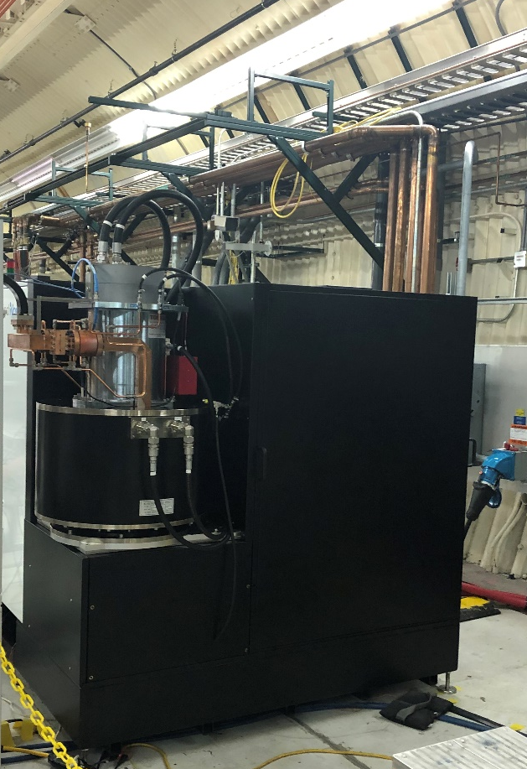
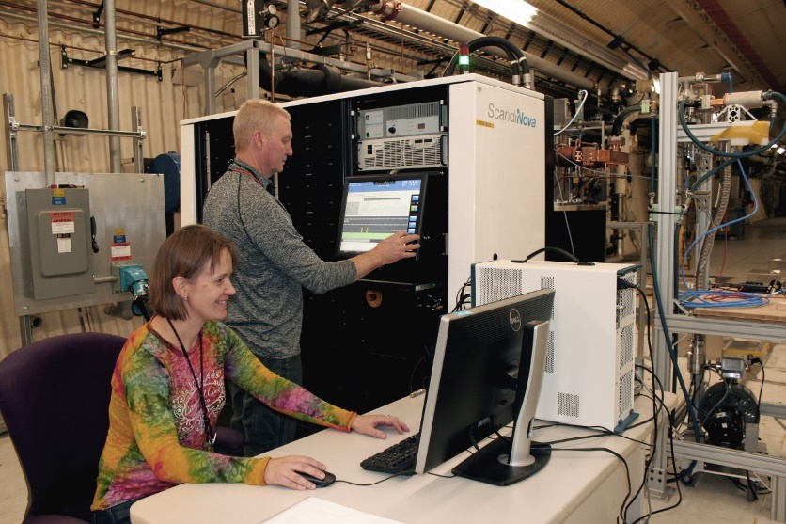
LANL C-band Engineering Research Facility (CERF-NM)
CERF-NM was built with $3M of LANL’s internal infrastructure investment.
Powered with a C-band Canon klystron
Conditioned to 50 MW
Frequency 5.712 GHz
300 ns – 1 µs pulse length
Rep rate up to 200 Hz (typical 100 Hz)
Nominal bandwidth 5.707-5.717 GHz

Slide 5
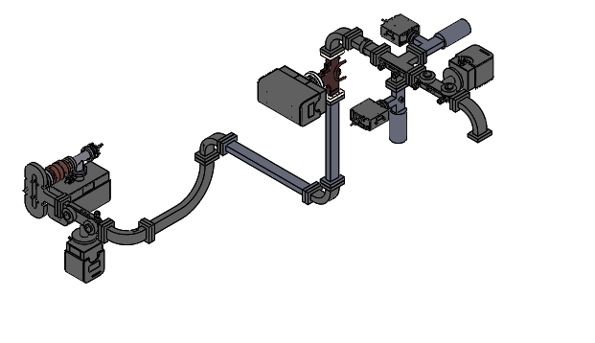
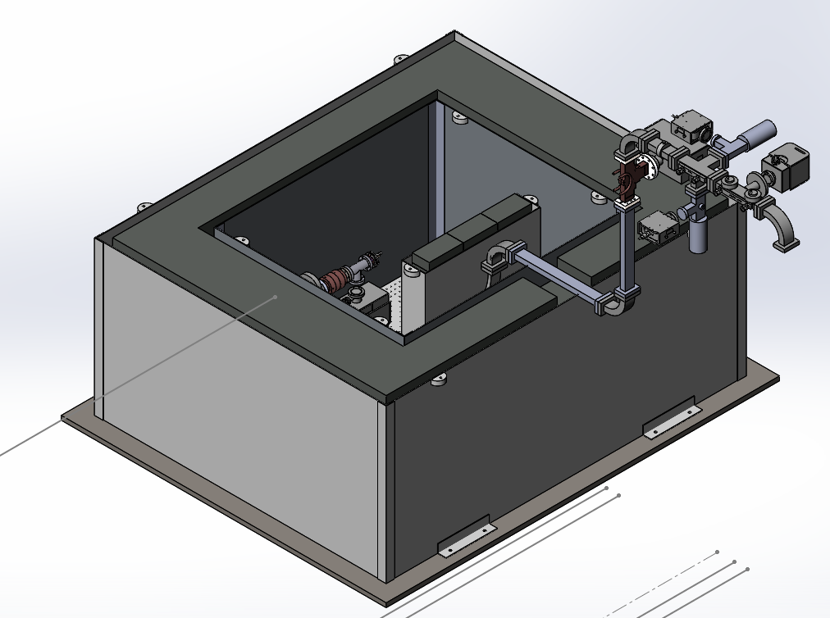
Schematic of CERF-NM test stand
Radiologically certified for dark currents up to 5 MeV and 10 μA.
Ion pump and ion gauge
Cavity
FC1
Mode launcher
FC2
Dir coupler (FWD, REV)

Slide 6
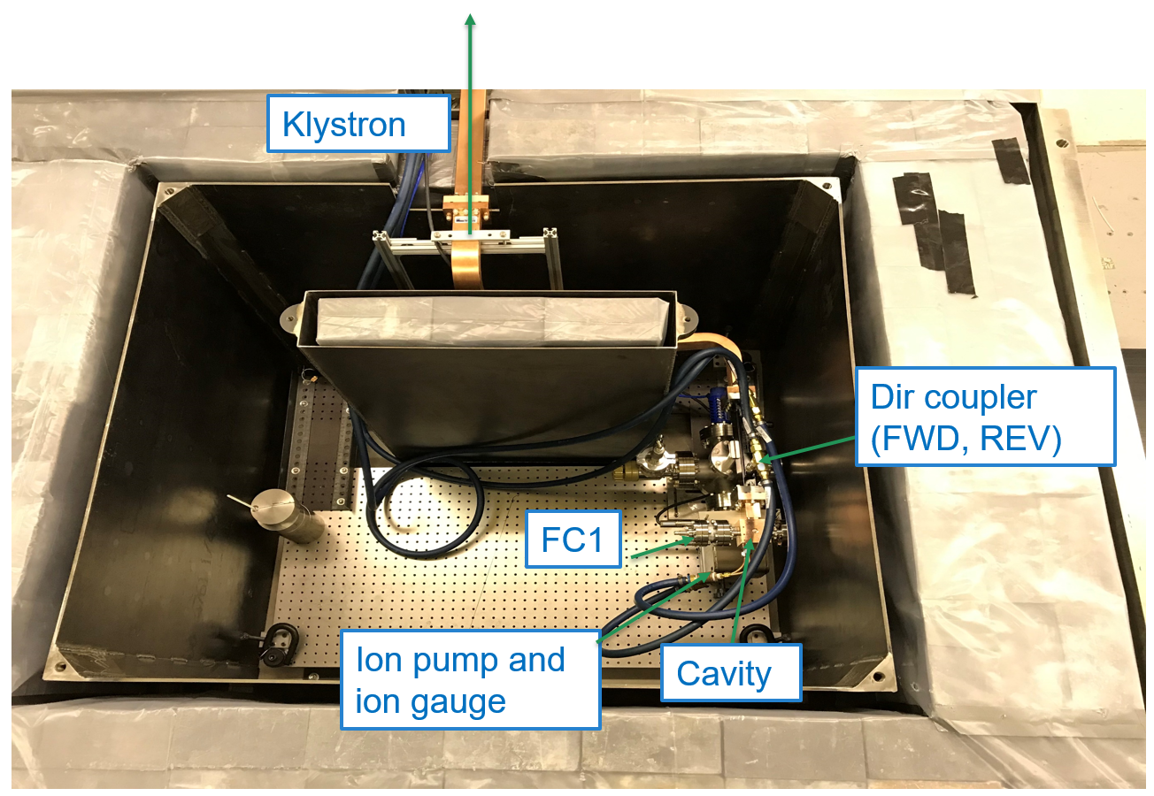
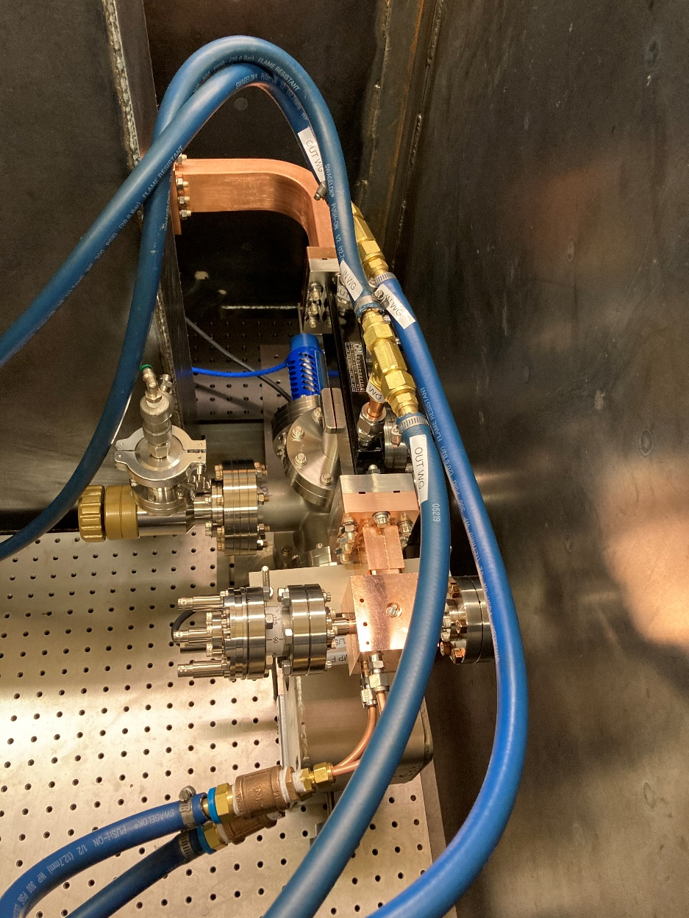
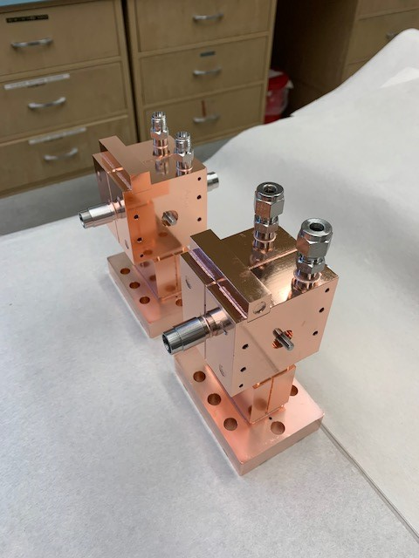
The first two high gradient cavities were tested at CERF-NM in FY21
This C-band high gradient test facility is nationally unique. The first cavities tested at CERF-NM were manufactured at SLAC.

Slide 7
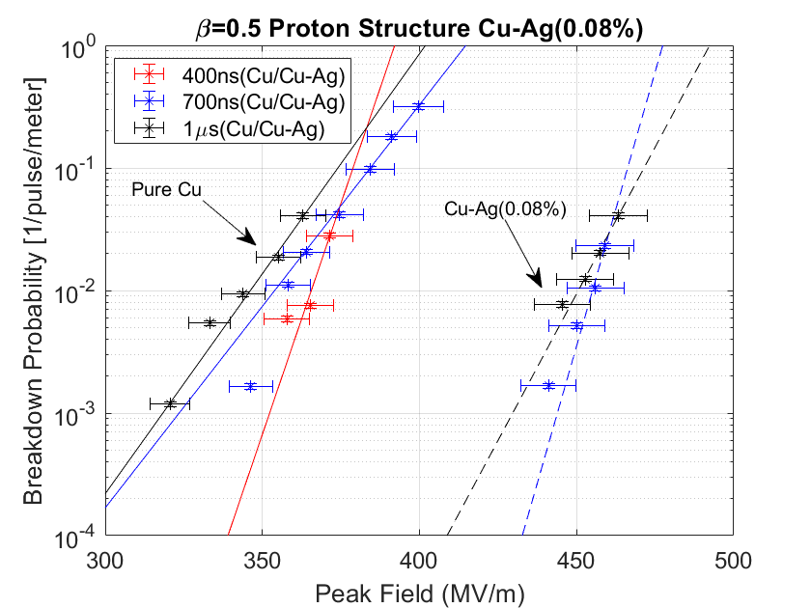
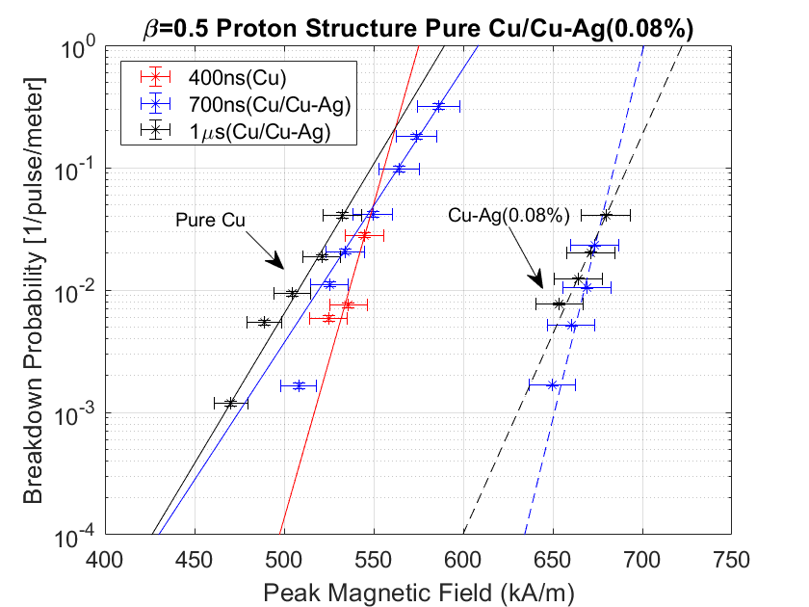
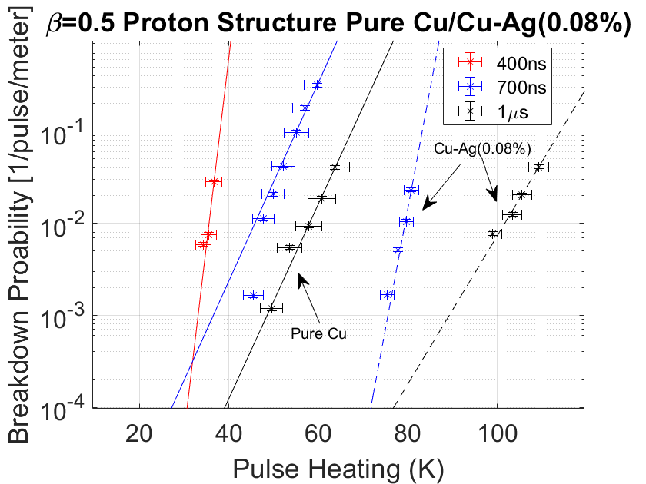
Peak surface electric fields in excess of 300 MV/m demonstrated in high gradient tests
Breakdown probabilities were recorded for three different pulse lengths for copper and copper-silver cavities.

Slide 8
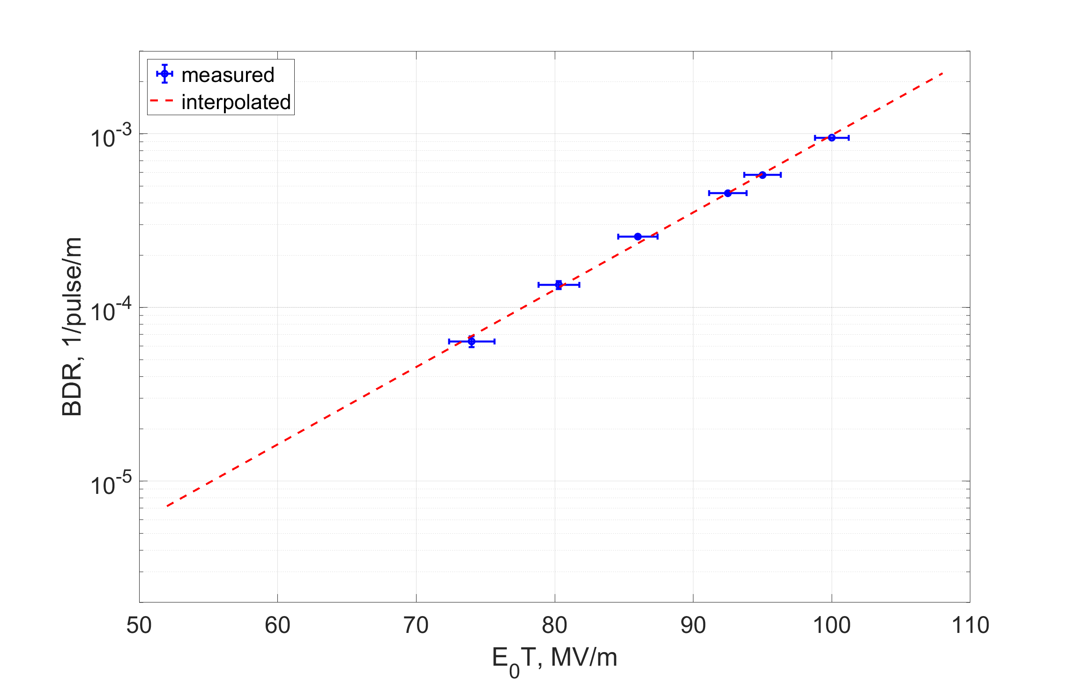
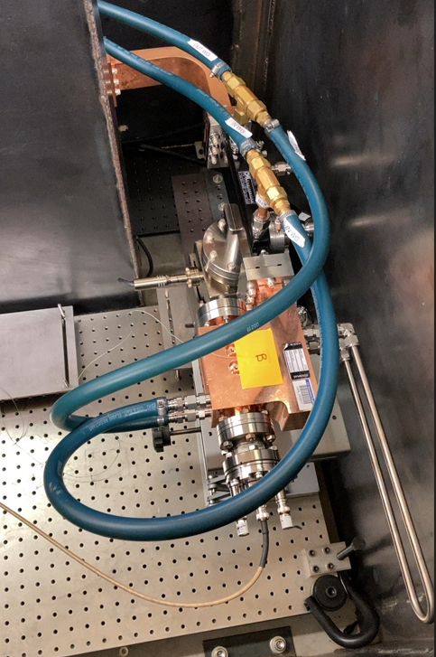
Prototype booster cell for LANSCE upgrade tested in FY23
The goal of this experiment was to measure the breakdown rates at accelerating gradients up to 100 MV/m.

Slide 9
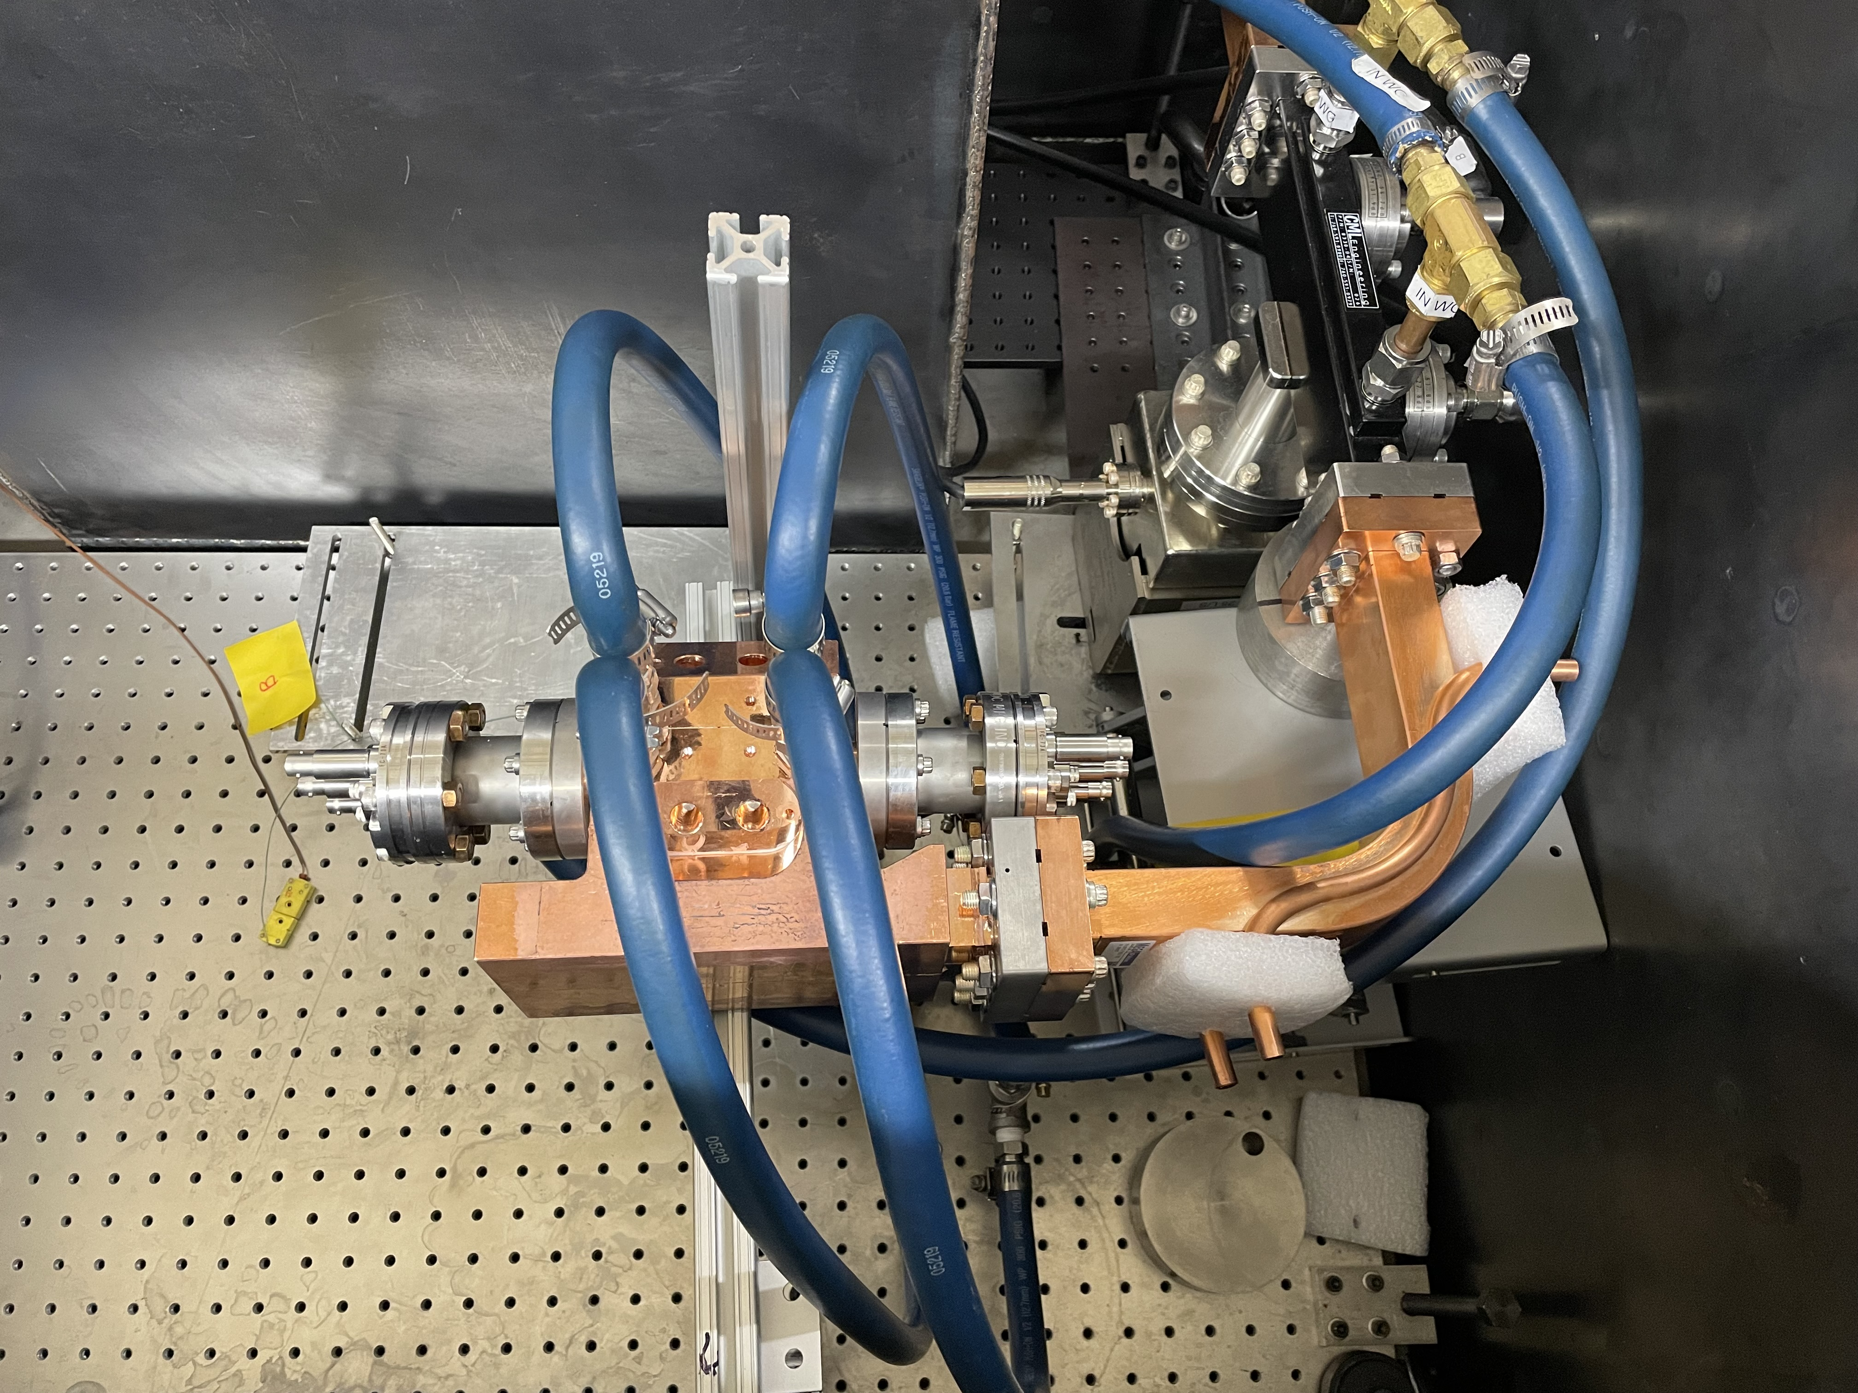
Current installation at CERF-NM
We are testing a two-cell structure with higher order mode absorbers made with NiCr.
Directional coupler
Faraday cups
Test structure

Slide 10
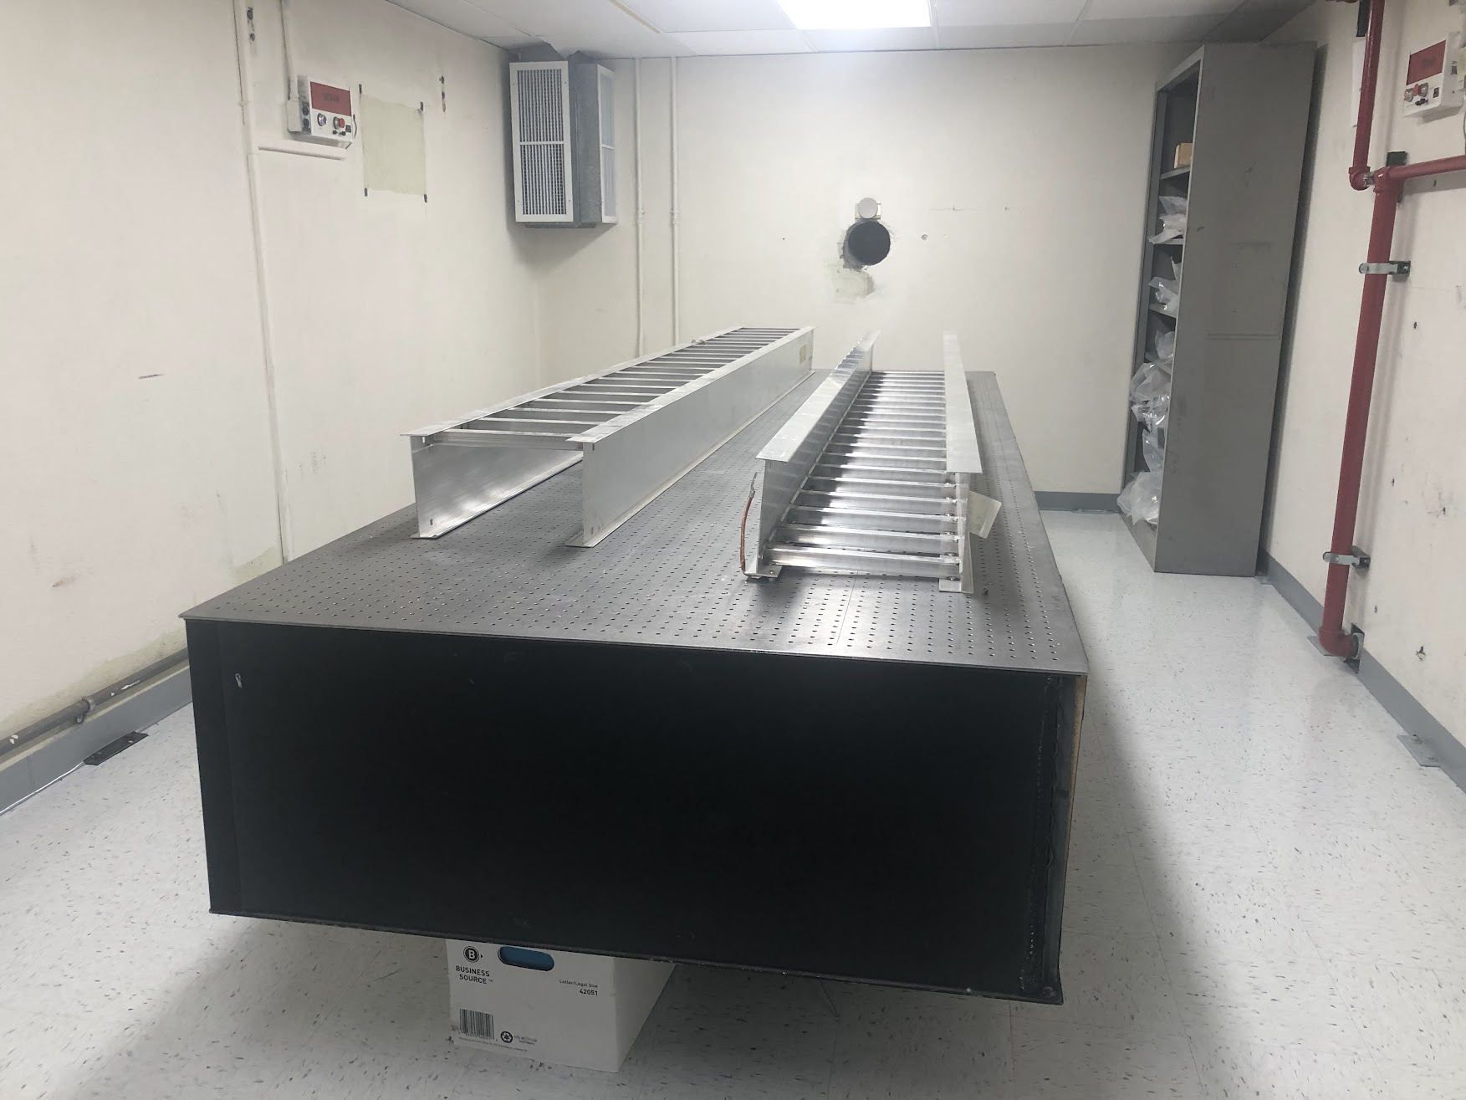
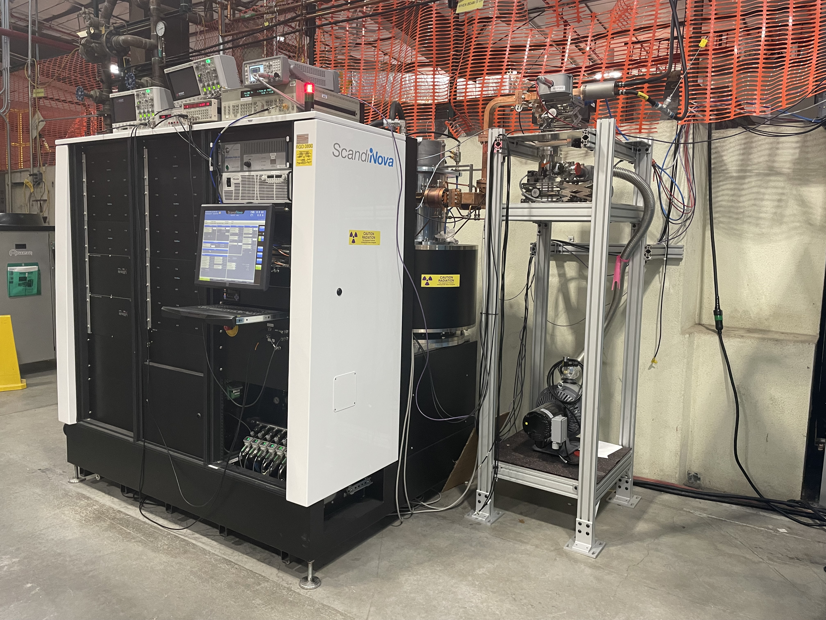
CARIE vault
The CARIE vault can accommodate a 20 kW electron beam.
The C-band Canon klystron with a Scandinova modulator is conditioned to 35 MW of the output power, 1.5 µs pulse width, 50 Hz rep rate (limited by the cooling system).

Slide 11
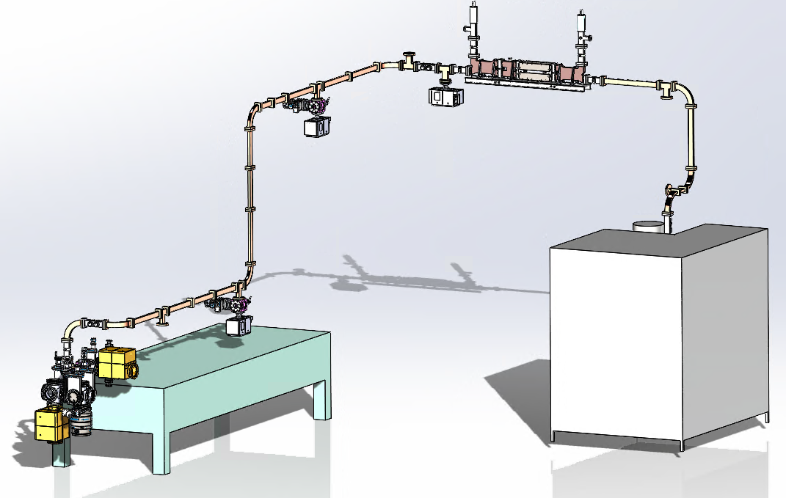
CARIE vault facility layout
High-power circulator
Modulator &
klystron
Concrete vault
Photoinjector

Slide 12
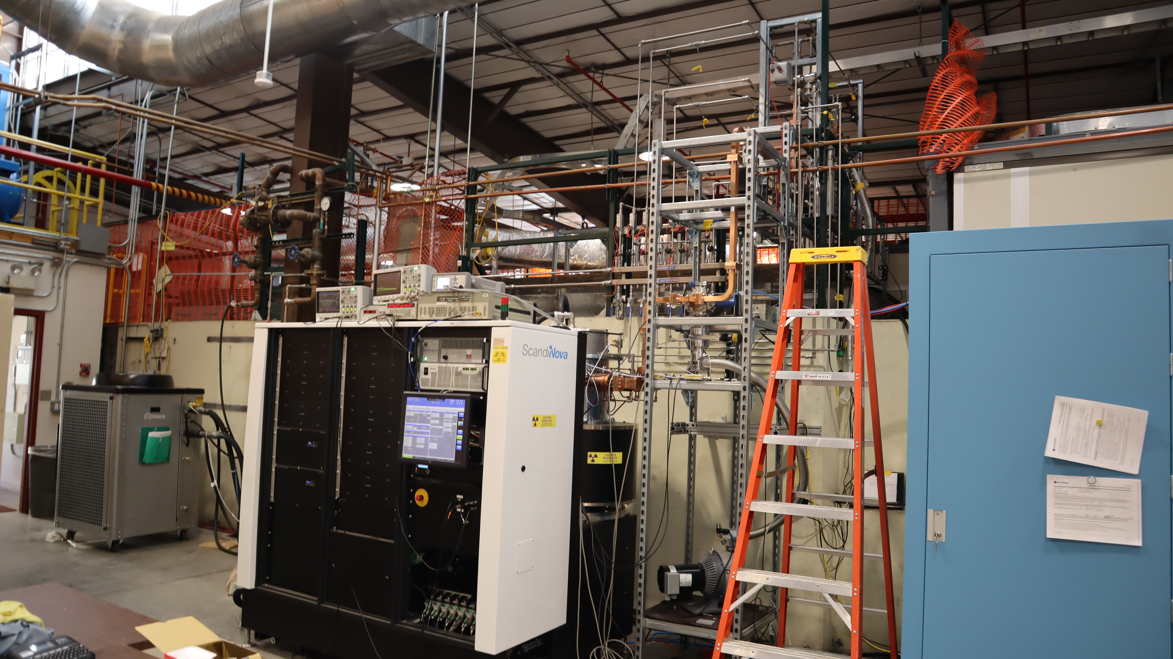
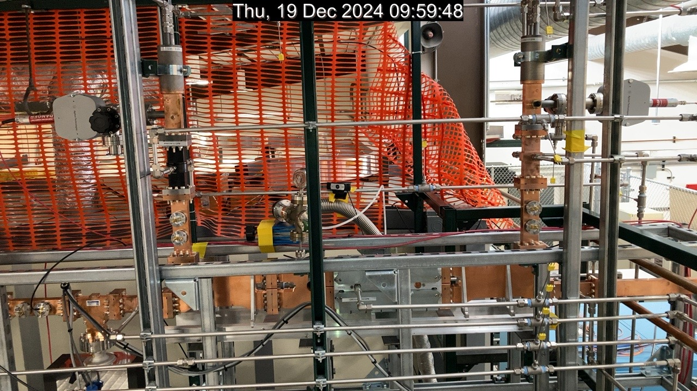
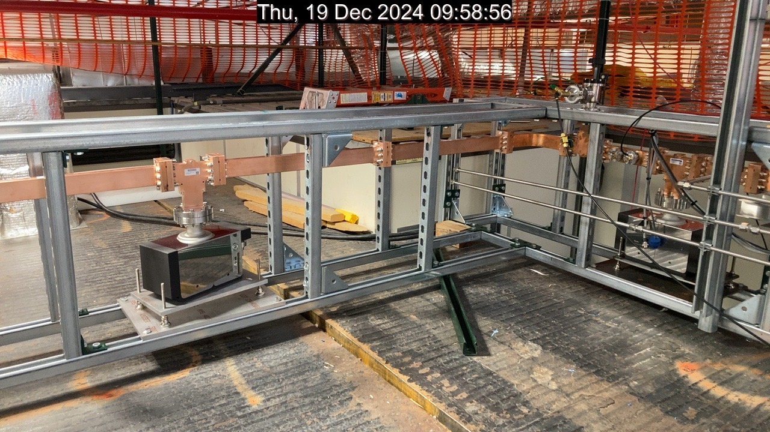
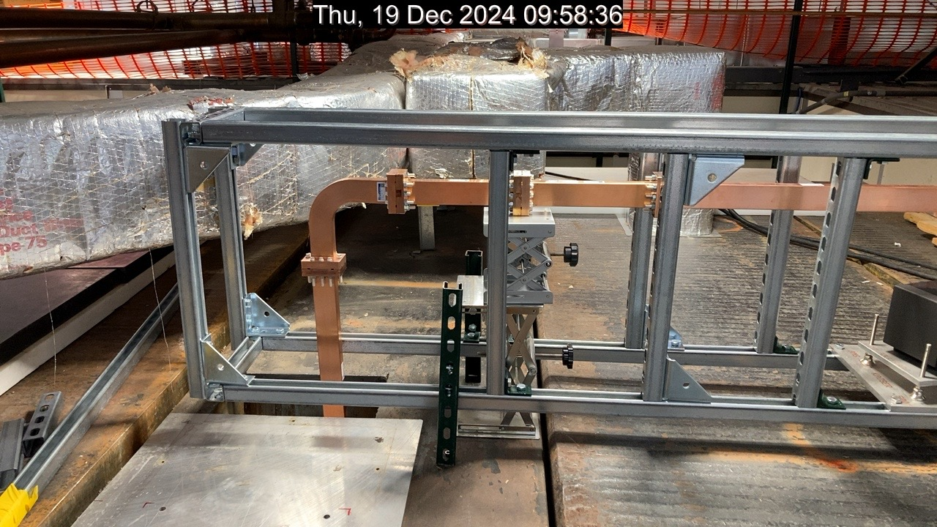
Photographs of the installation
Chiller
Modulator &
Klystron
Control rack
High-power circulator
Into the vault

Slide 13
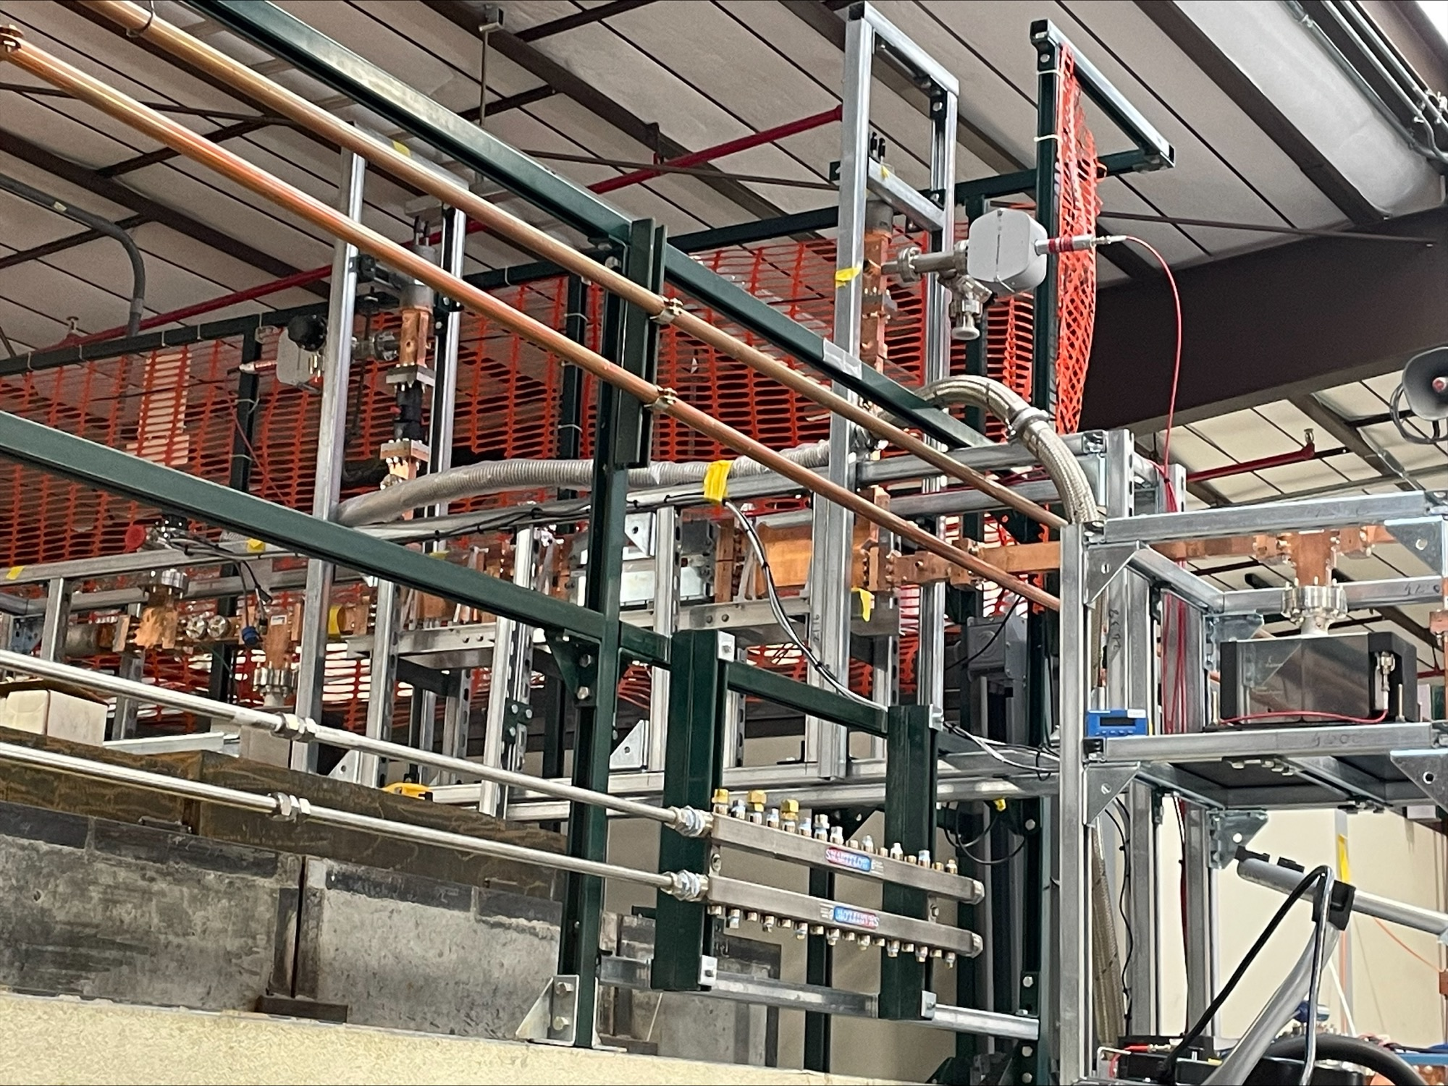
50 MW power circulator for CARIE
Fabricated by Microwave Techniques LLC.
Received at LANL in January, 2024.
Designed to operate at 50 MW of power, 1 µs pulse, 100 Hz repetition rate.
Must be filled with SF6 at 55 psi.
Problem: CML WR187 windows are designed for 40 psi, Microwave Techniques WR187 windows are designed for 35 psi.
Microwave Techniques states that if filled to 30 psi, should operate up to 10 MW of power.
High gradient conditioning of the circulator was done in November 2024.

Slide 14
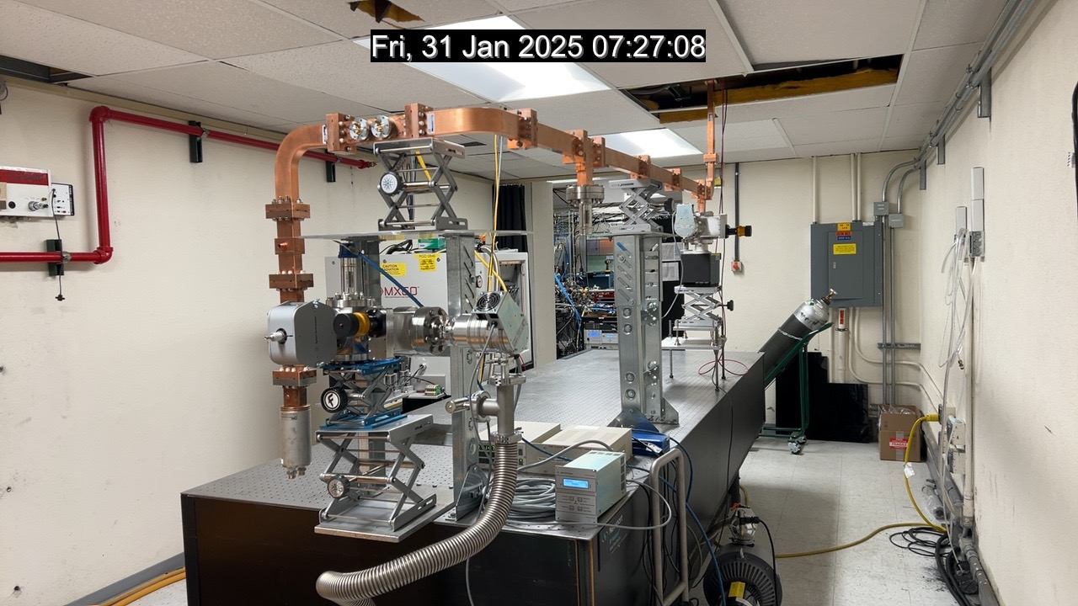
Photographs of the installation inside the vault (prior to injector installation)
From the klystron
RF load

Slide 15
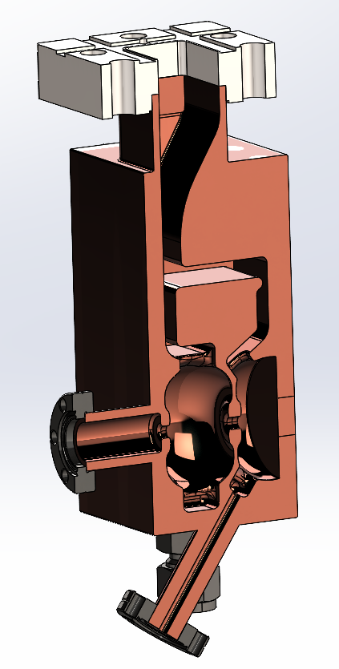
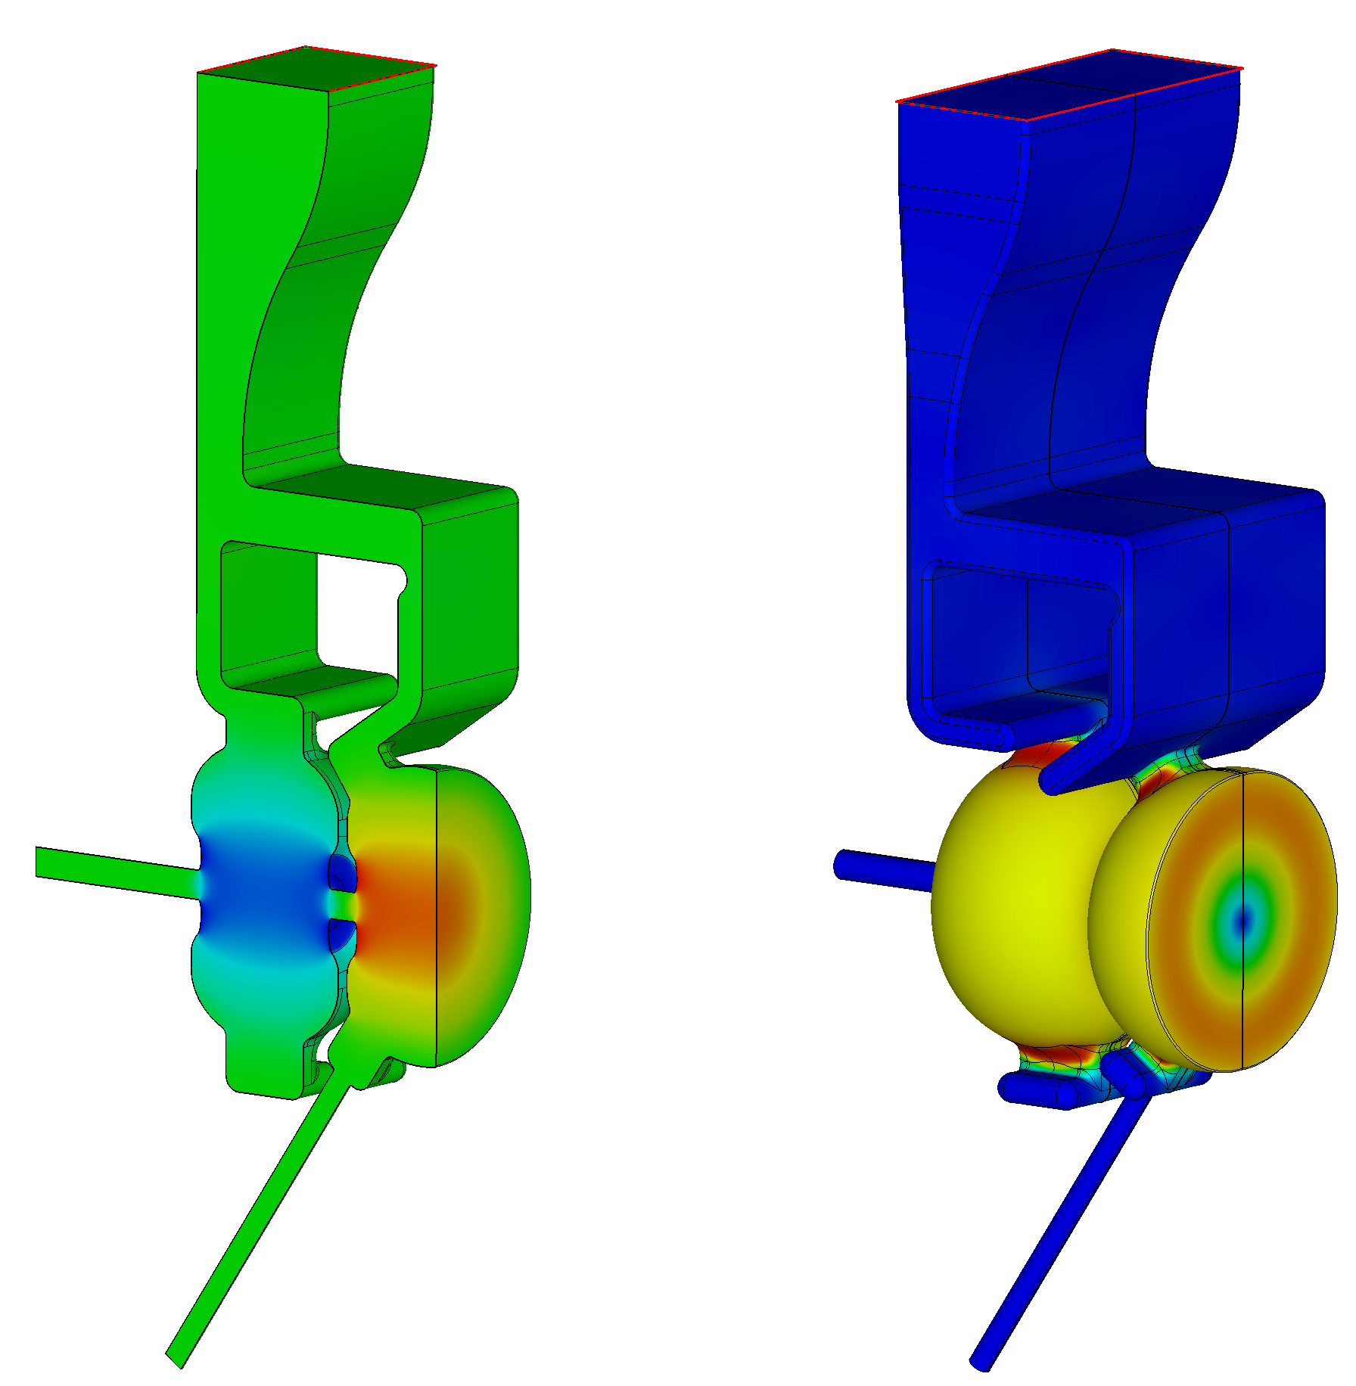
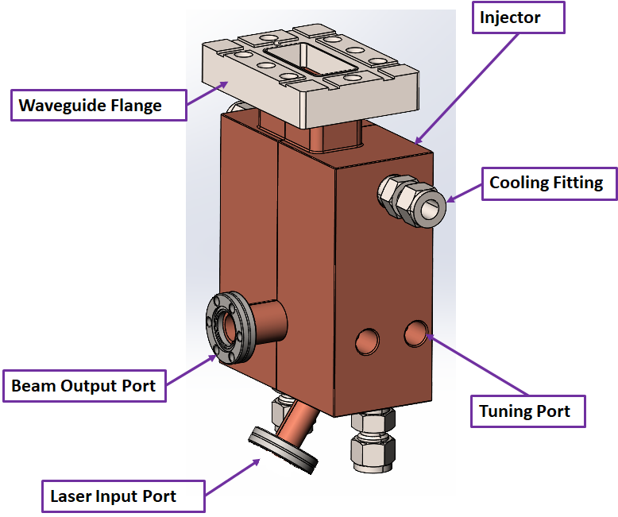


All-copper RF photoinjector design
We start with an all-copper injector with no cathode plug.
1.6 cell photoinjector. Two waveguides couple the half-cell and the full cell with 180⁰ phase advance.
Power for E_{cath}= 240 MV/m is about 8 MW.

Slide 16
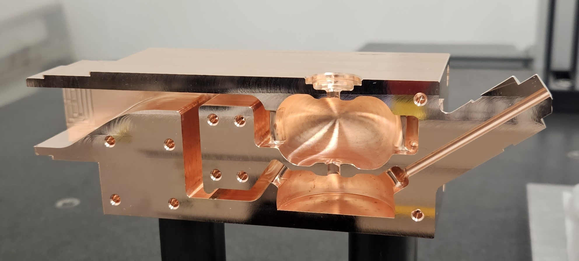
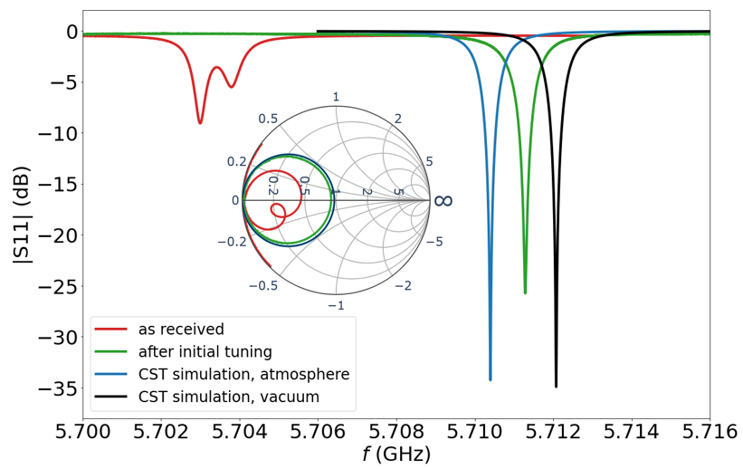
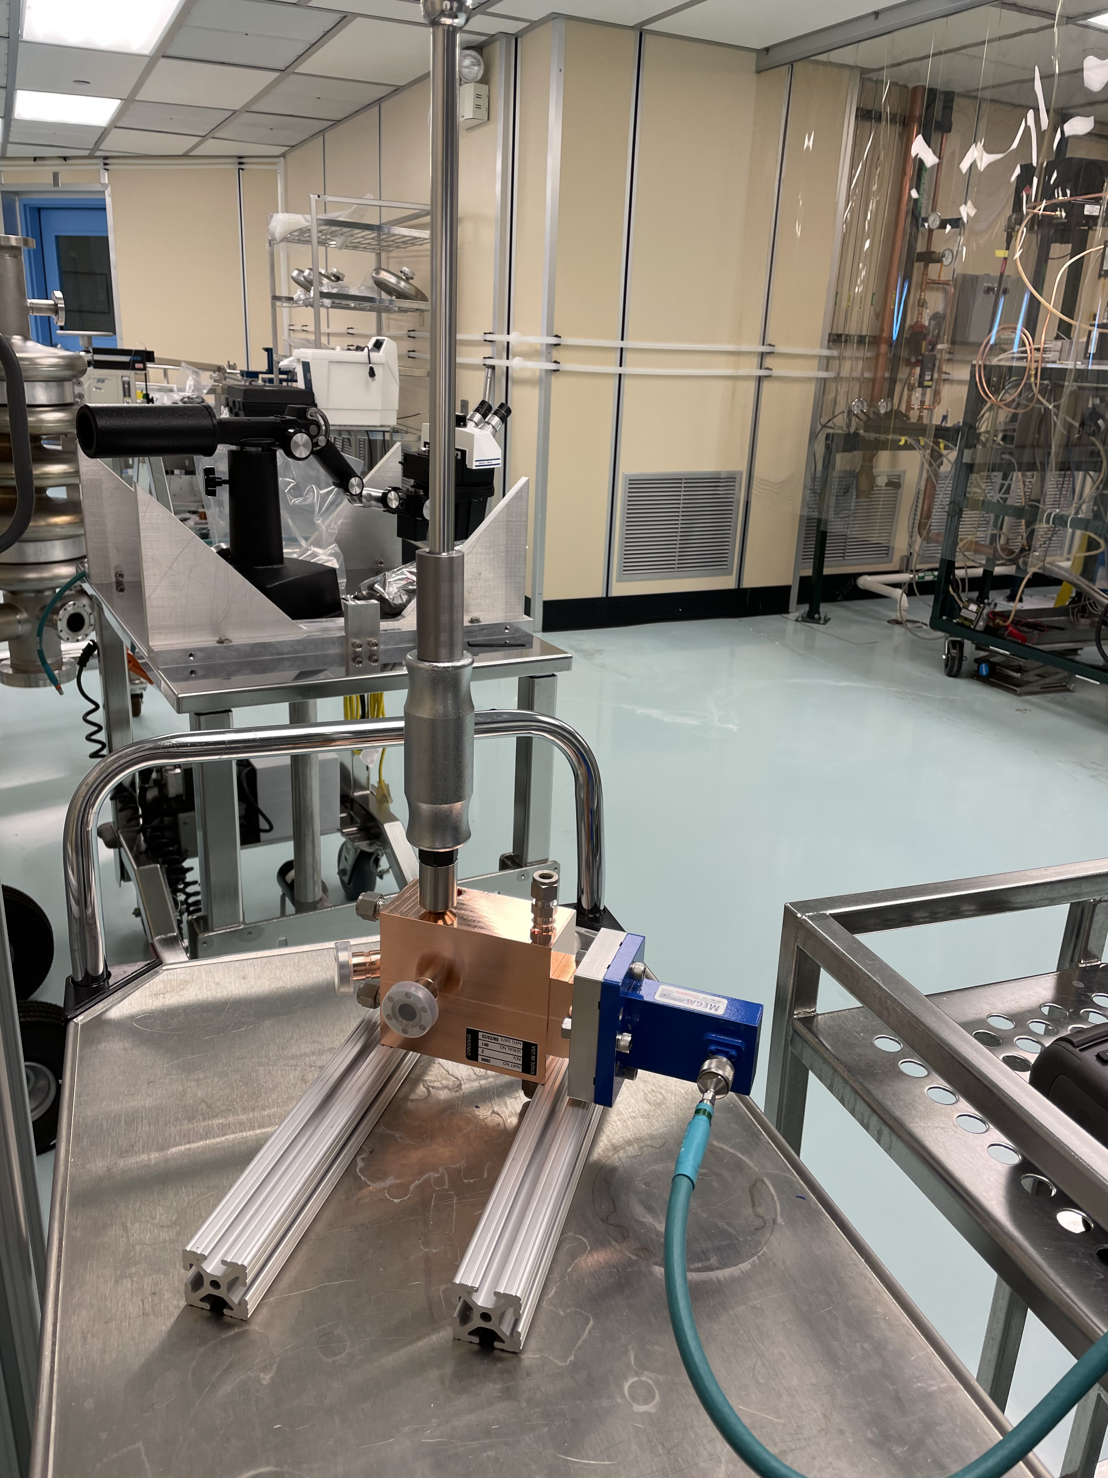
RF photoinjector cold testing
Tuning of the photoinjector was successful.
Tuned frequency 5710.53 MHz in air (5712.15 MHz in vacuum).
Measured Q-factor 11869 (computed Q-factor 11934).

Slide 17
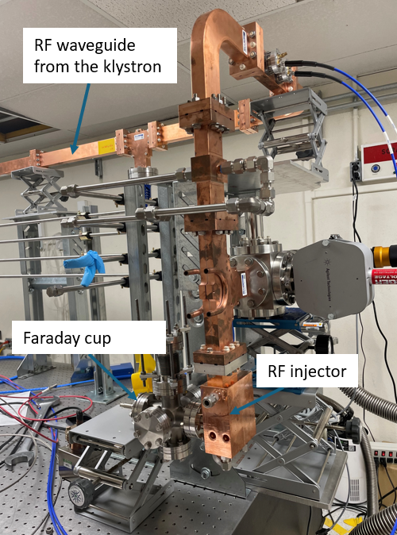
RF photoinjector installation on the waveguide line
RF injector with a copper cathode was installed at the end of the waveguide line in September of 2025.
We are working to resolve shielding issues.
High power testing is expected to start soon.

Slide 18
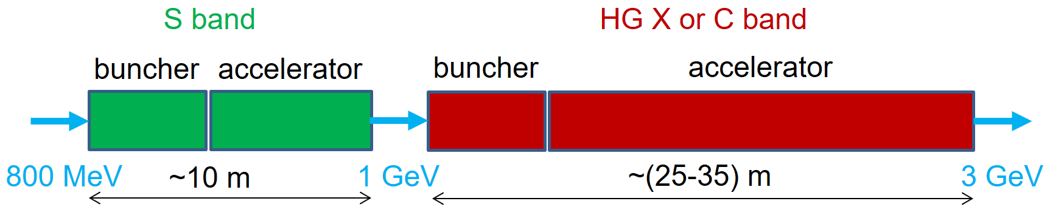
High gradient technology application: compact high-gradient booster for Enhanced Proton Radiography
What: High-gradient (HG) linear accelerator (linac) after the existing LANSCE linac to increase the proton beam energy from 800 MeV to 3 GeV.
Why: This increases proton radiography (pRad) resolution 10 times.
How: Compact 3-GeV high-gradient pRad booster:
Will be based on S- & C-band HG structures adapted for protons (v/c = 0.84 – 0.97). Prototype high-gradient proton C-band cavities will be tested at LANL.
Will have an optimal beam-physics design based on front-to-end modeling.
Fits the site and can be used in parallel with the existing 800-MeV pRad.
Can be the first-ever high-gradient normal-conducting proton linear accelerator.

Slide 19
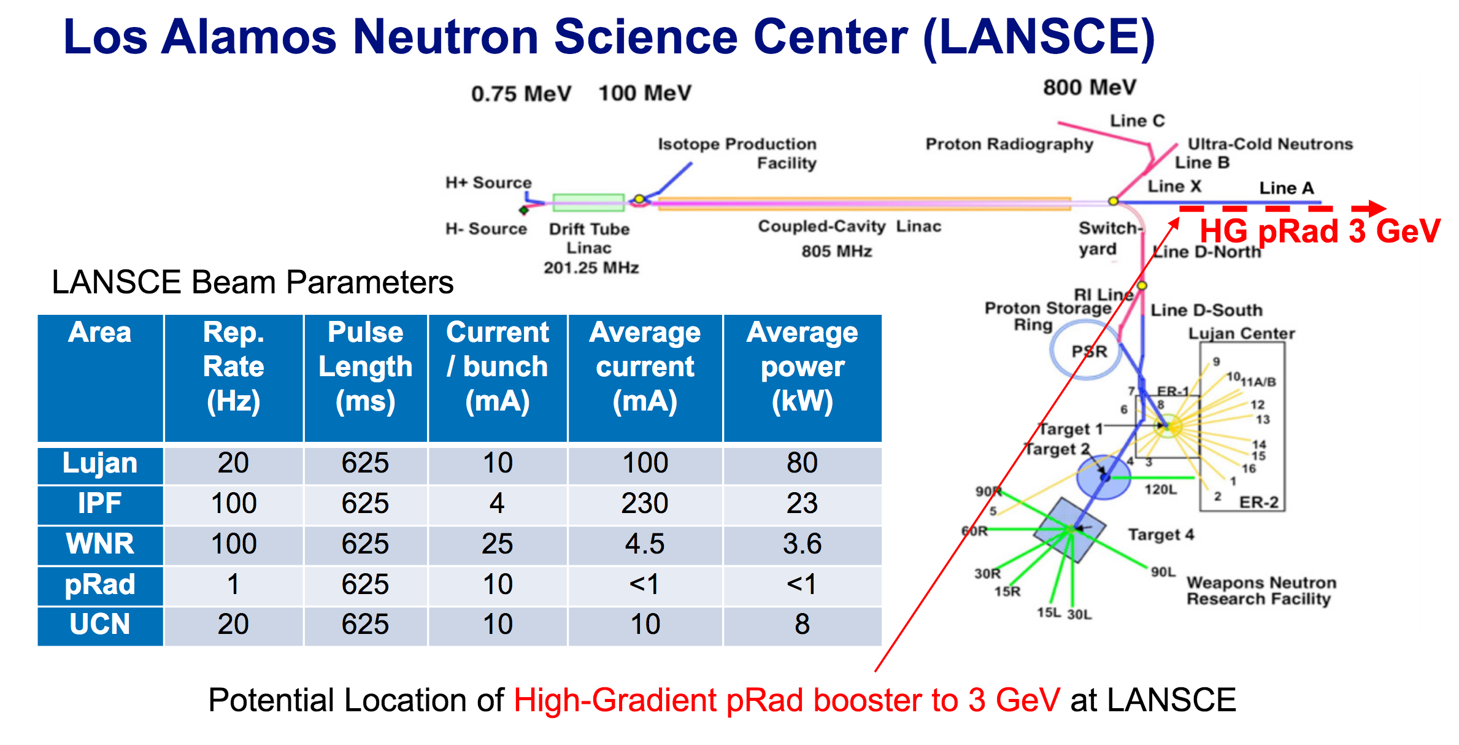
Area | Rep. Rate (Hz) | Pulse Length (μs) | Current / bunch (mA) | Average current (μA) | Average power (kW)
Lujan | 20 | 625 | 10 | 100 | 80
IPF | 100 | 625 | 4 | 230 | 23
WNR | 100 | 625 | 25 | 4.5 | 3.6
pRad | 1 | 625 | 10 | <1 | <1
UCN | 20 | 625 | 10 | 10 | 8
Beam’s relative energy spread scales with beam’s momentum as ~1/p, the higher energy results in better resolution of pRad:
Δp/p = 10⁻³ at 800 MeV → 3.3∙10⁻⁴ at 3 GeV.

Slide 20
R&D needs for the pRad booster
Beam physics requirements:
1 to 20 short beam pulses (<80 ns) separated by variable intervals of 0.2-2 µs. Each short beam pulse contains proton bunches following at 5 ns (f_{b} = 201.25 MHz bunch repetition frequency) and produces one radiograph.
very low duty: one pulse train per event; a few events per day.
Accelerator structure requirements:
HG structures have only been developed for electrons -> adapt for protons.
Gradients > 40 MV/m to fit in available footprint
beam magnetic focusing scheme defines minimal allowable cavity apertures.
standing-wave accelerator structures with distributed coupling are chosen.
RF sources requirements:
High peak power (~10s MW) RF sources (klystrons).
Variable single RF pulse up to 50 µs.
80 ns
RF pulse up to 50 µs
0.2-2 µs intervals
1-20 beam pulses

Slide 21
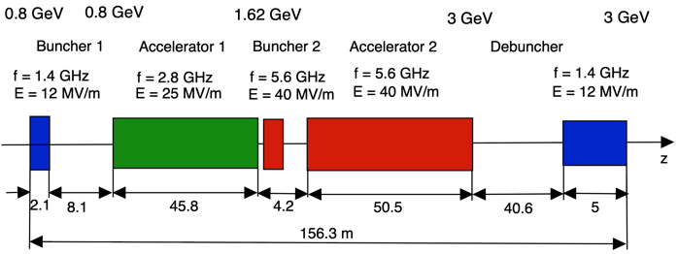
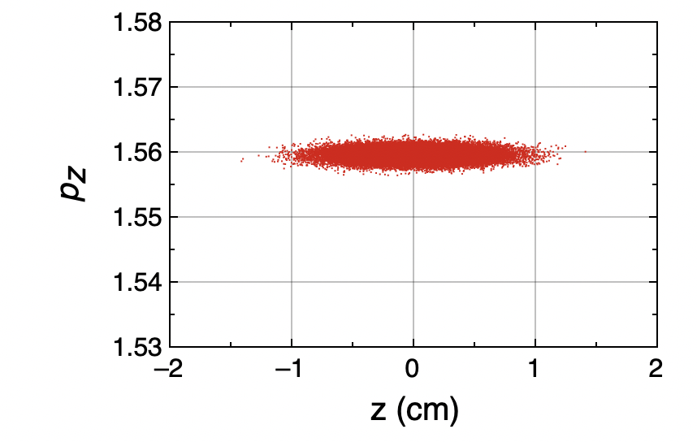
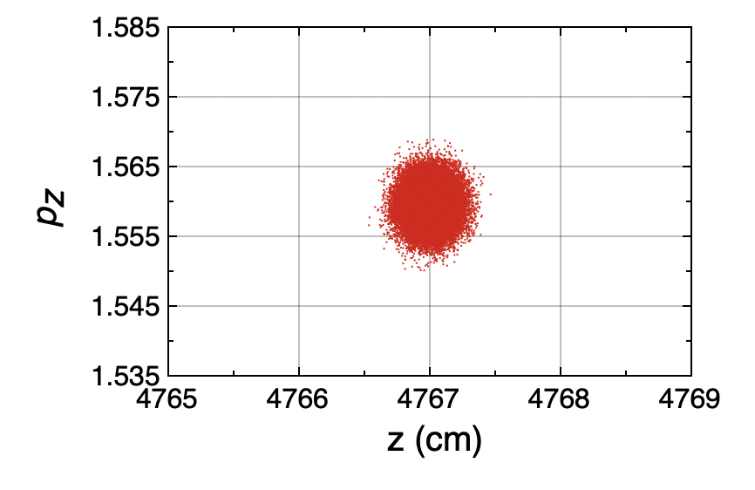
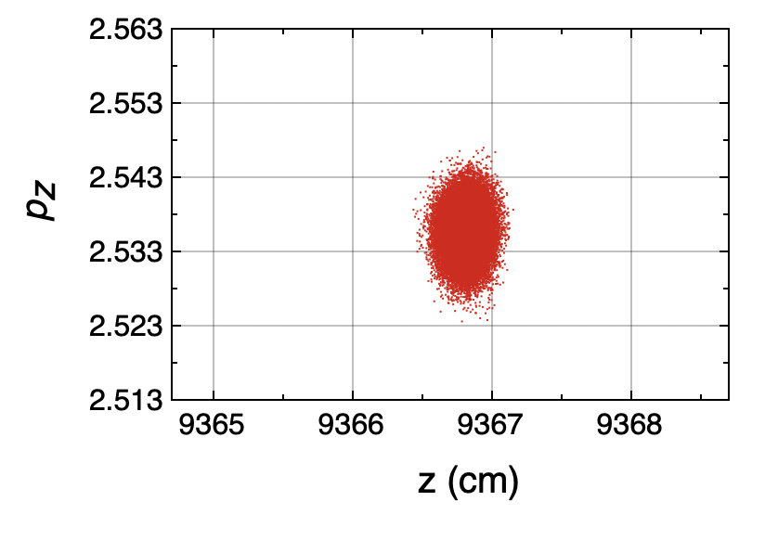
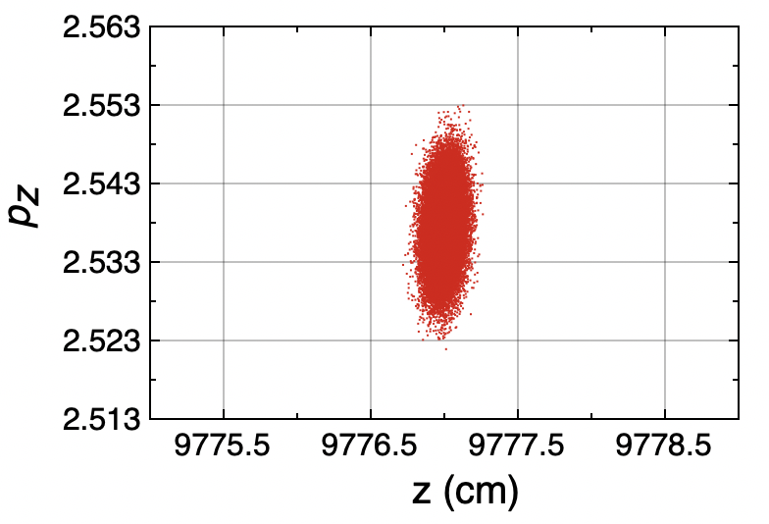
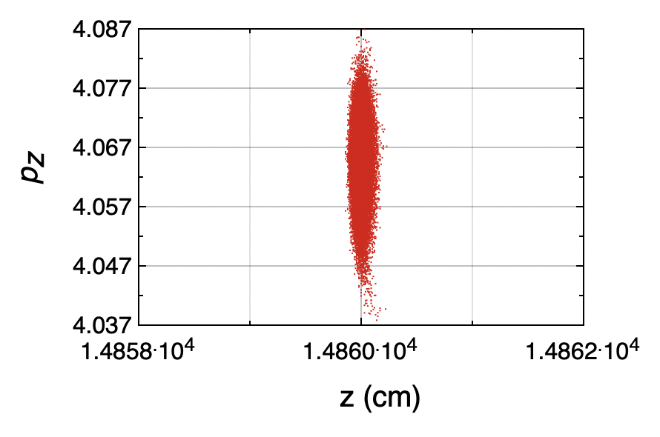
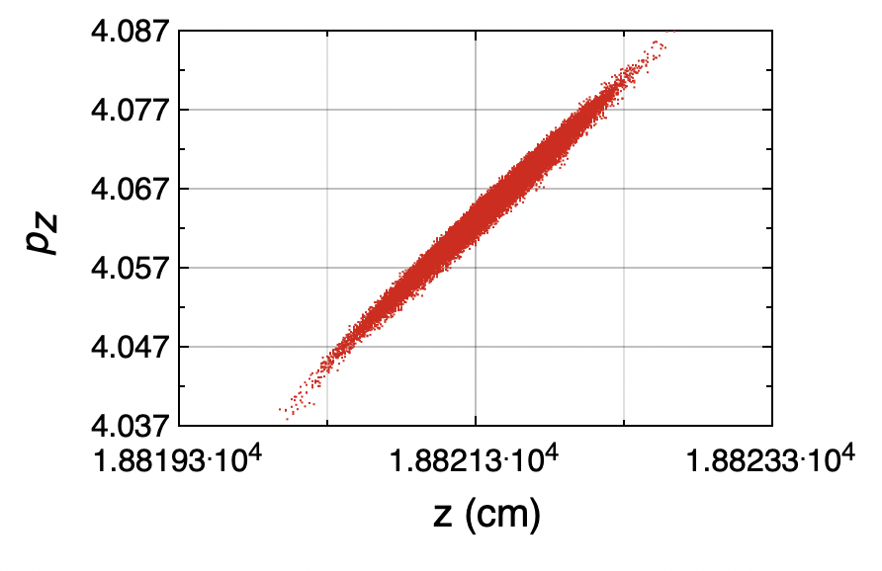
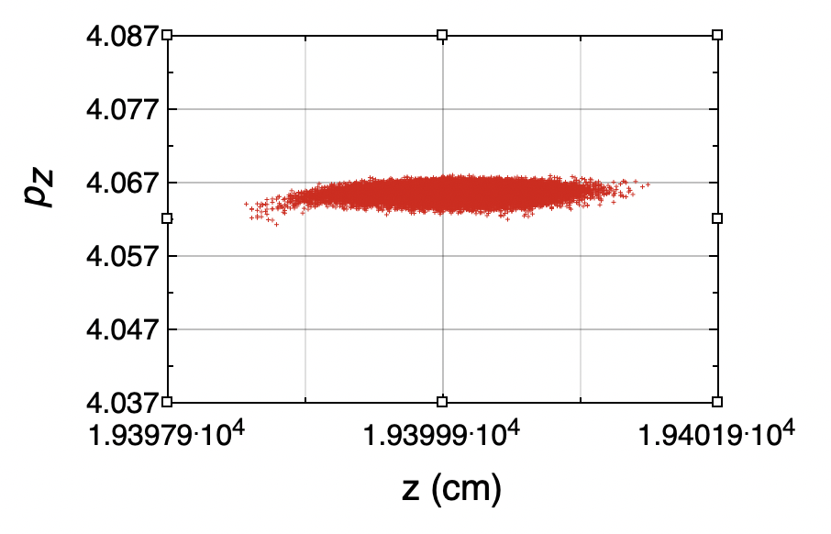
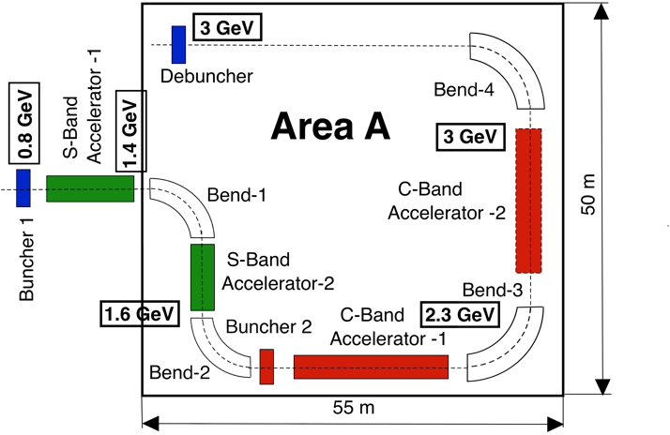
Layout of 3-GeV Booster
Evolution of Longitudinal Phase Space
The booster with reduced gradients can fit into existing buildings!

Slide 22
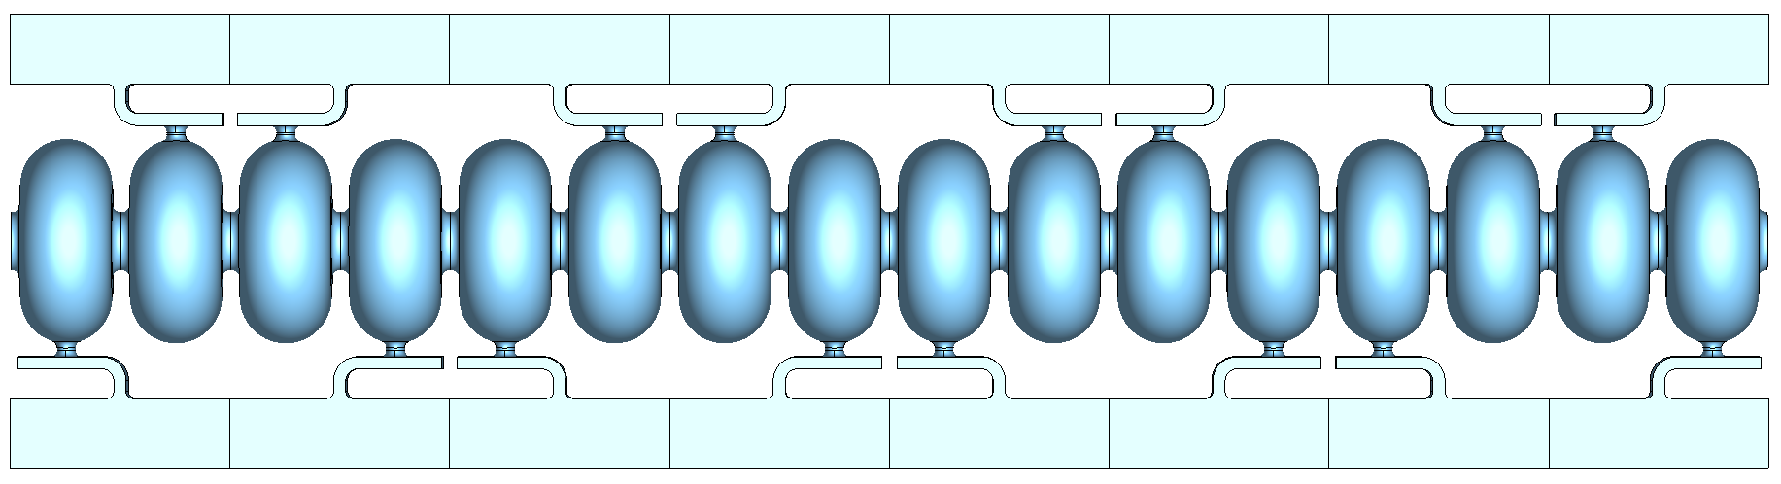
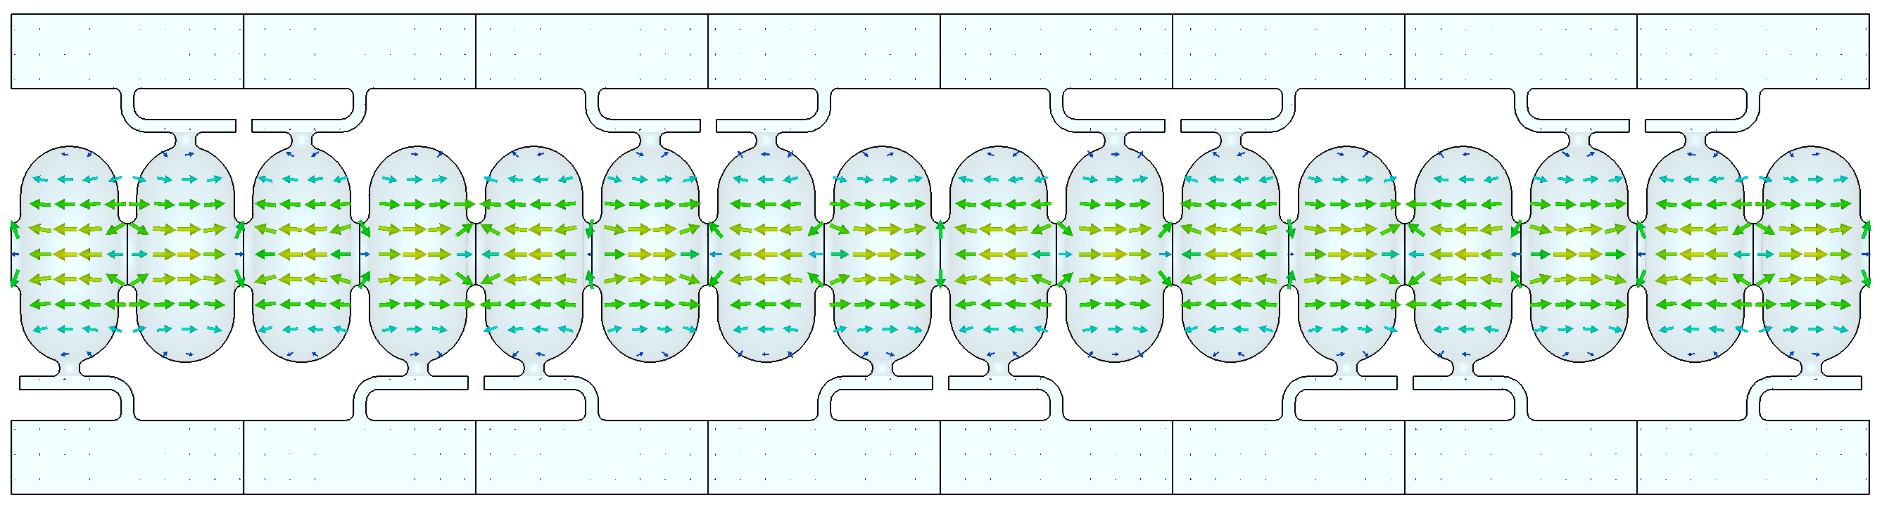
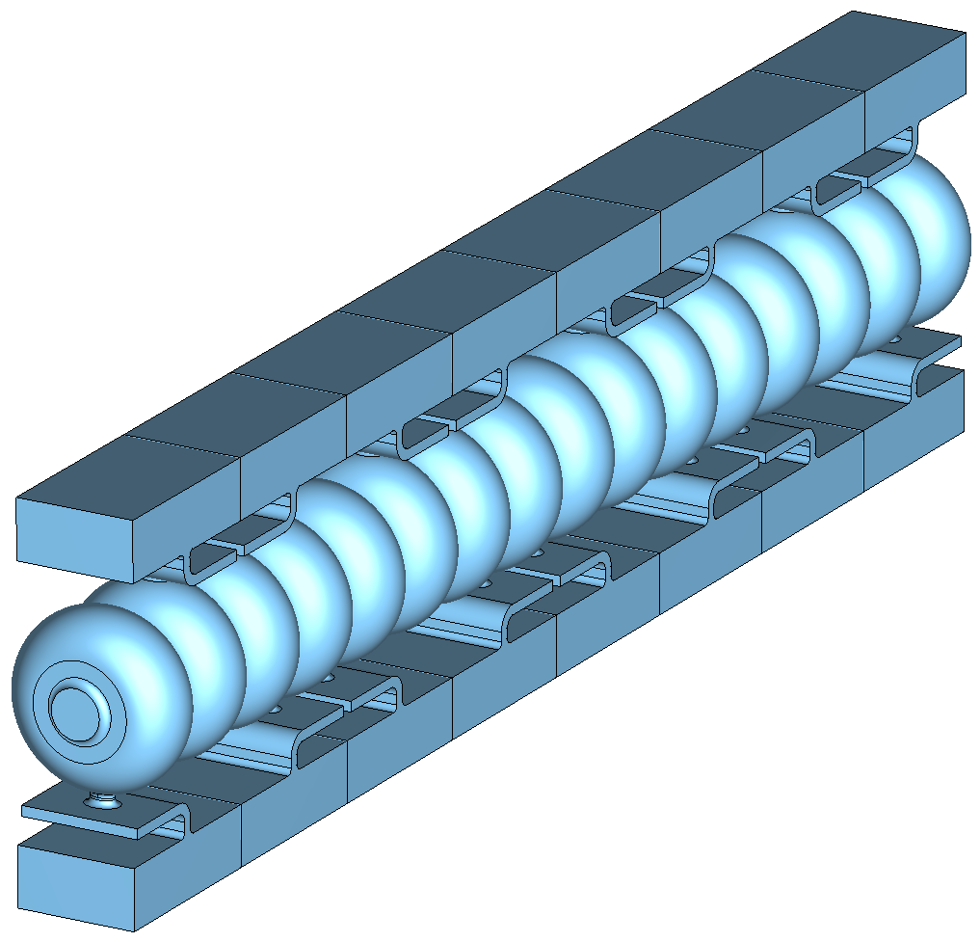
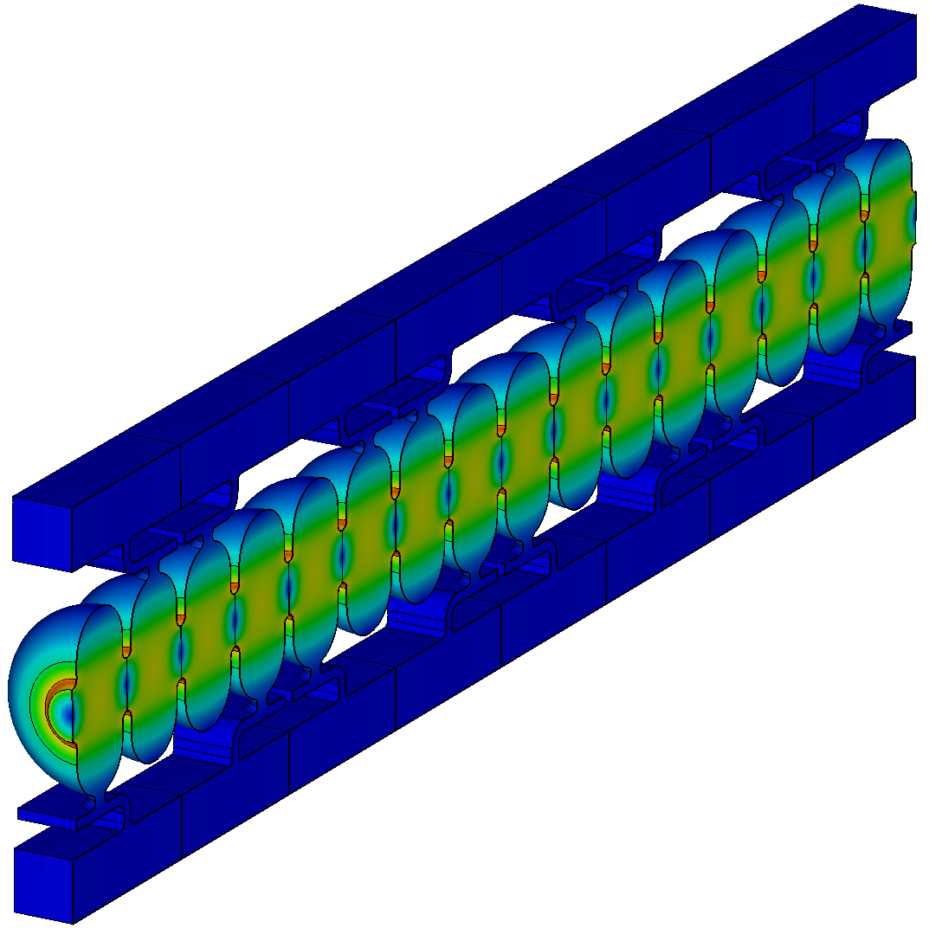
Multi-cell accelerating structure design
C-band multi-cell structure modeling (β = 0.93, 1.6 GeV protons)
Electric field in the π-mode at 5.635 GHz

Slide 23
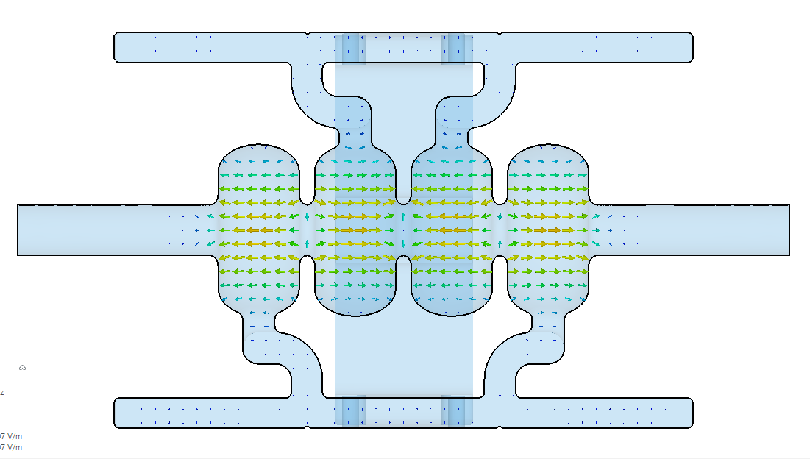
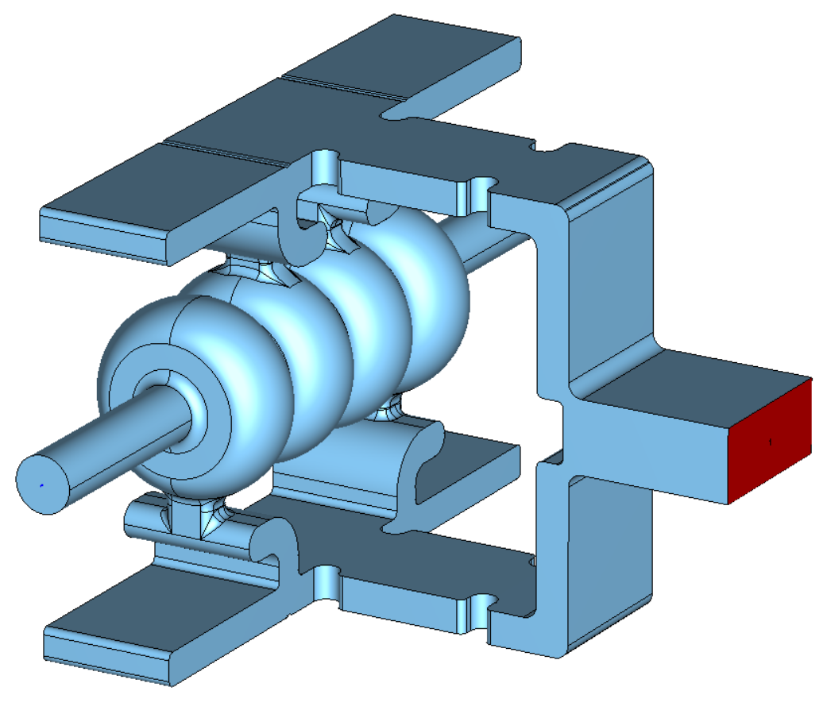
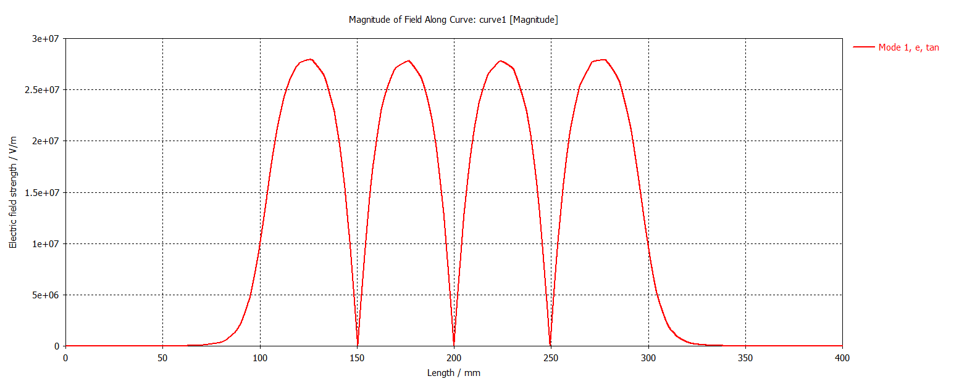
High gradient test structure: limited to 4 cells
Two 4-cell test structures will be fabricated and tested at liquid nitrogen temperatures:
2.856 GHz structure will be tested at RadiaBeam.
5.712 GHz structure will be tested at LANL.

Slide 24
Conclusions and future plans
LANL plans to perform high gradient testing of the two-cell structure with NiCr absorbers in 2026.
Conditioning of the waveguide line at CARIE is complete.
All-copper RF injector is installed on the waveguide line.
All-copper RF injector high-power testing will happen in 2026.
Starting in 2026, LANL C-band high gradient research is focused on proton structures for the pRad booster.
Test structure is limited to 4 cells due to available power and is currently under design.
4-cell proton C-band structure will be tested at CARIE.

