Slide 1
Rapid Density-Modulated Electron Beam Sources for Next-Generation X-ray Communications
Brandon E.J. Cortez, Halil Topözlü, Melisa Bozdemir, John Lambrecht, John H. Booske, Nader Behdad
Department of Electrical & Computer Engineering
University of Wisconsin-Madison
2026 AFOSR + NSF Scientific Opportunities with Compact, High Intensity Accelerators
This material is based upon work supported by the Air Force Office of Scientific Research under AFOSR awards FA9550-21-1-0367 and FA9550-18-1-0062 and by the National Science Foundation Graduate Research Fellowship for Brandon Cortez.

Slide 2

Motivation for X-ray Communications
Hypersonic vehicles develop plasma sheaths
Plasma sheaths repel RF/microwave → comms blackout
X-rays can penetrate plasma sheaths
X-ray Communications (XCOM)
Potential benefits
  Penetrative
  Security
  Ultra fast data rate
Notes:
Problem, Solution, More Benefits

Slide 3
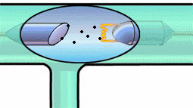
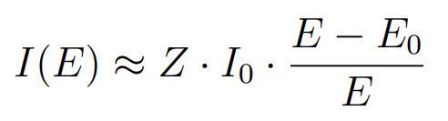
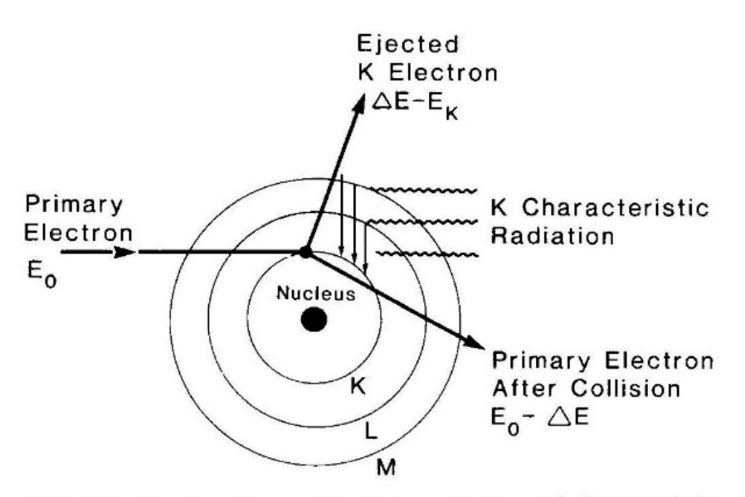
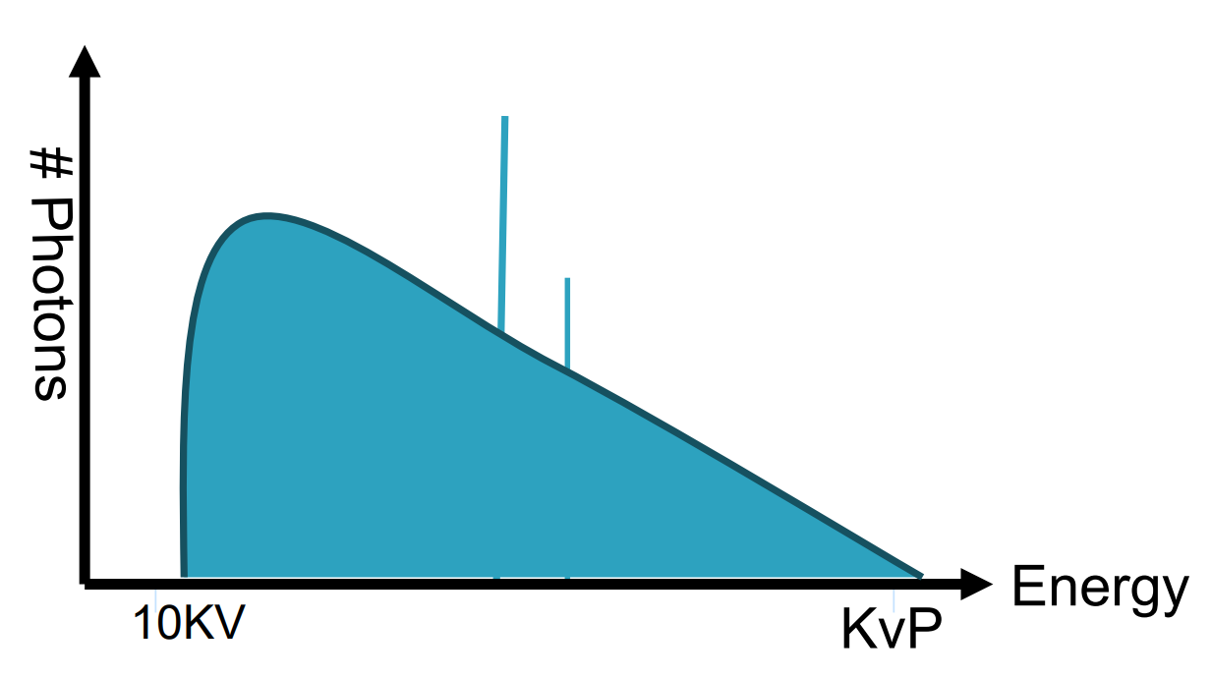
X-ray Production
Kramer’s Law for Bremsstrahlung
  X-ray intensity at energy E, I(E)
  Atomic number (Z)
  Beam current (I₀)
  Electron energy (E₀)
  X-ray energy (E)
Characteristic X-rays
X-ray spectra
Notes:
X-ray Production Basics

Slide 4
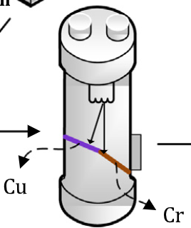
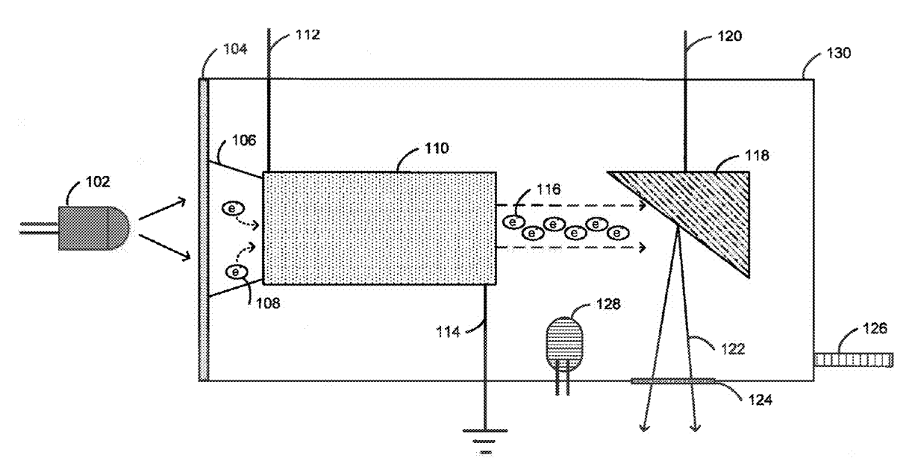
State of the Art
XCOM proposed in 2007 by Gendreau, et al
2015 Gendreau, et al awarded patent for miniaturized high-speed modulated x-ray source
Grid voltage modulation [Chen, et al 2021]
Photocathodes [Li, et al 2025]
Magnetic deflection to leverage characteristic x-rays [Jin, et al 2021]
Demonstrated only up to ~10 MHz modulation rates
Notes:
SOTA Gap

Slide 5
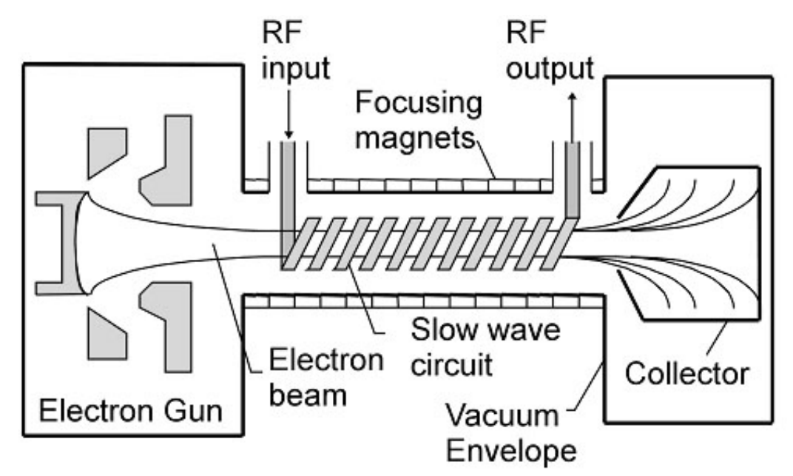
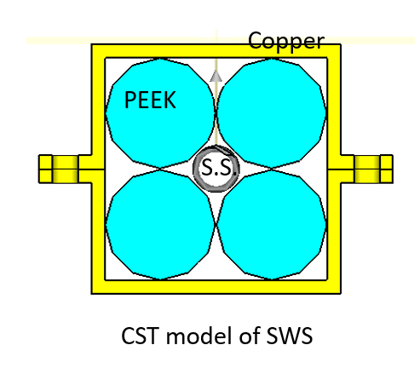
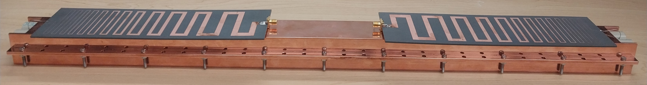
TWT Beam Modulation
Slow-wave circuits → wave-particle energy exchange
Wideband helix Traveling Wave Tube (TWT)
  0.2 – 1 GHz frequency range
Modulated RF signal into TWT → output density-modulated electron beam (spent beam)
Notes:
Our Solution: Use a TWT as the transmitter

Slide 6
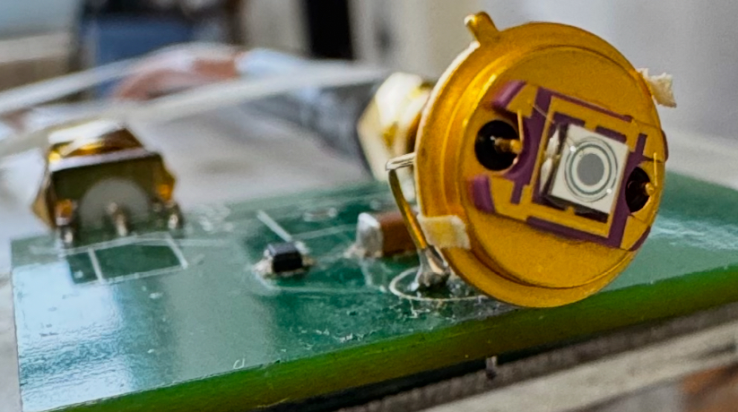
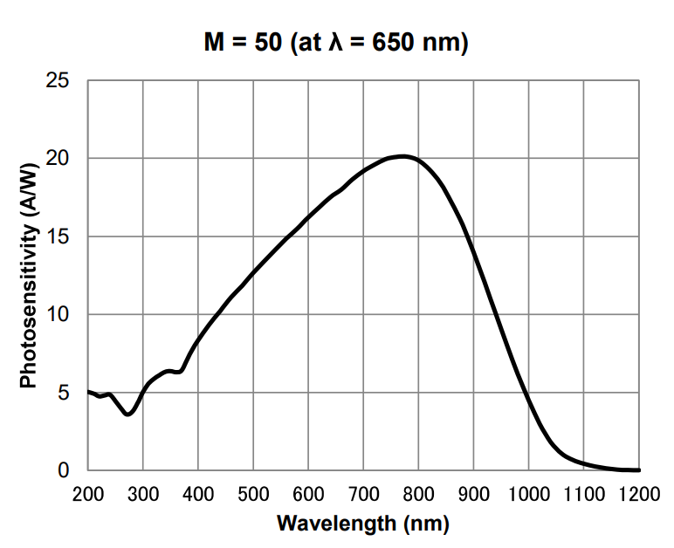
Fast X-ray Detector:
Avalanche Photodiode (APD)
APD used to detect soft X-ray intensity
Avalanche effect → high gain → highly sensitive
X-rays ionize to create even more electron-hole pairs
APD’s can be very fast
Notes:
Need a fast X-ray detector: use an APD

Slide 7
Experimental Configuration
Notes:
Put components together to get full system configuration

Slide 8
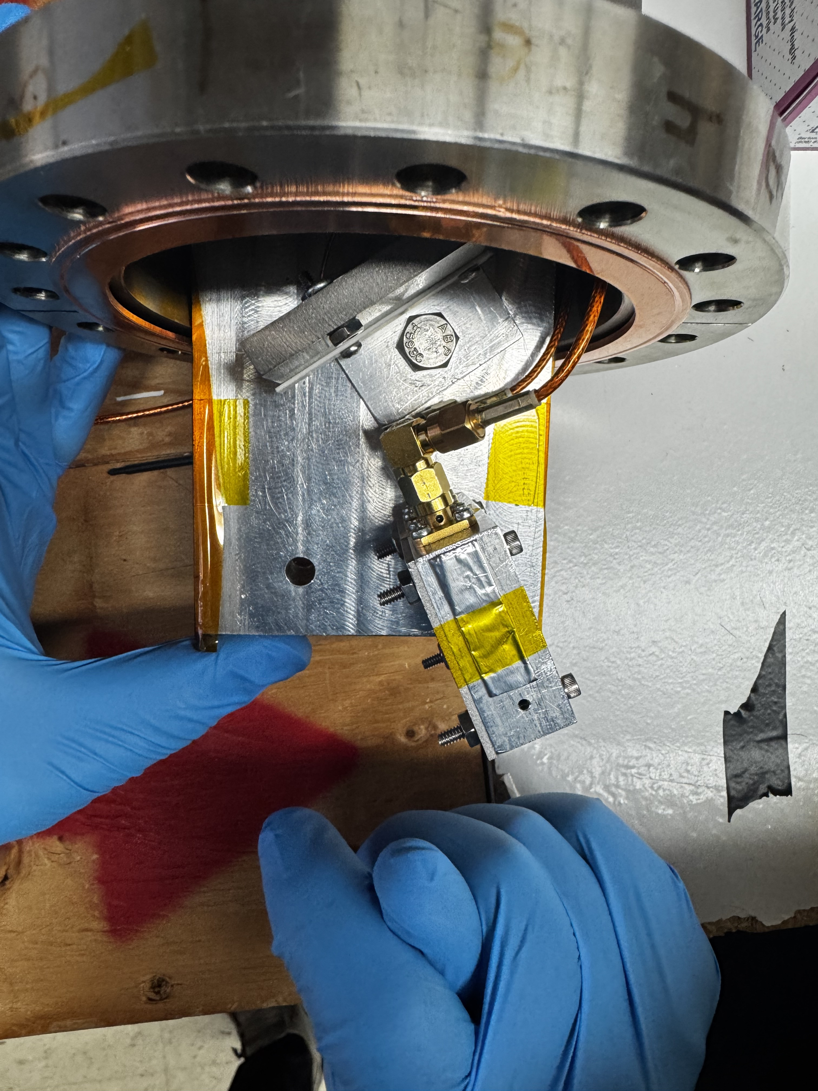
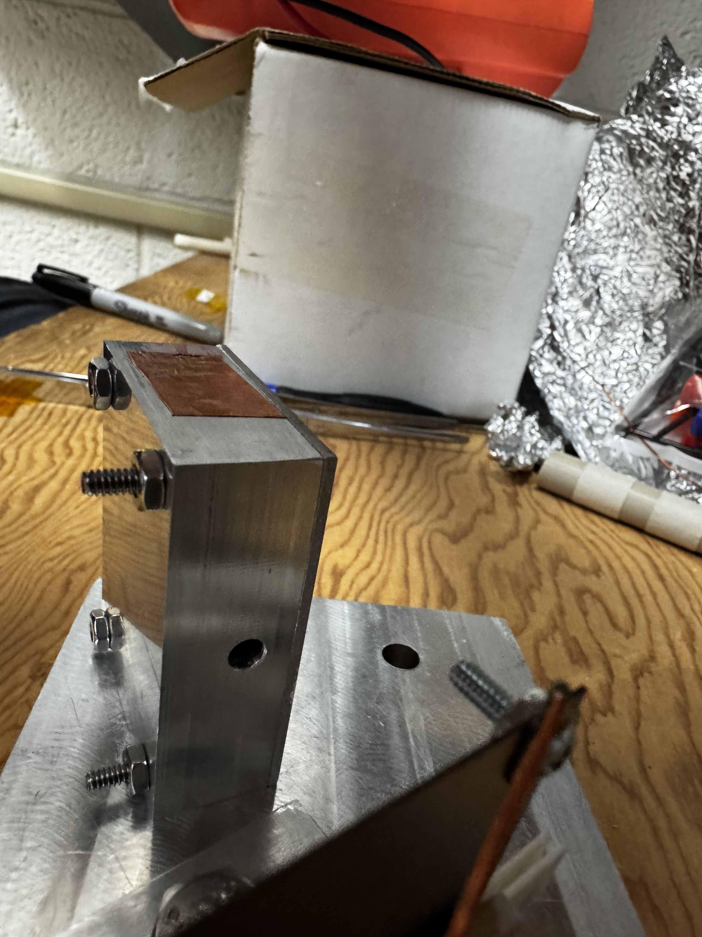
Internal Set-up
Target
Shielded APD
X-rays
Shielded APD
E-beam
Target
Notes:
Follow system figure up with real internals

Slide 9
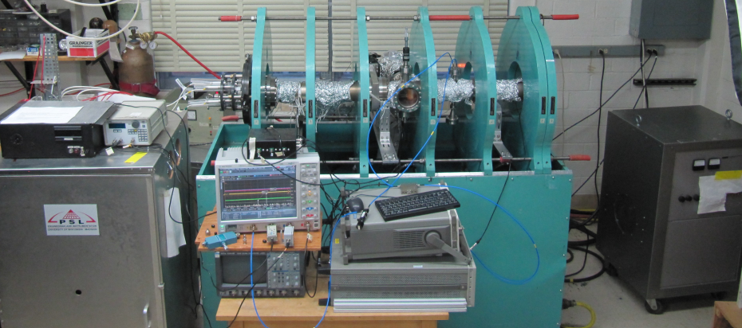
External Set-up
LaB₆ thermionic cathode on externally adjustable track
20 kV/650 mA power supply; pulse generator and HV switch pulses cathode negative; chamber, anode are grounded
500 Gauss axial magnetic field confines beam
Magnets
Electron Gun
TWT
XCOM Components
Magnet Power Supply
O’scope
High Voltage Power Supply
Notes:
Zoom out to see the externals

Slide 10
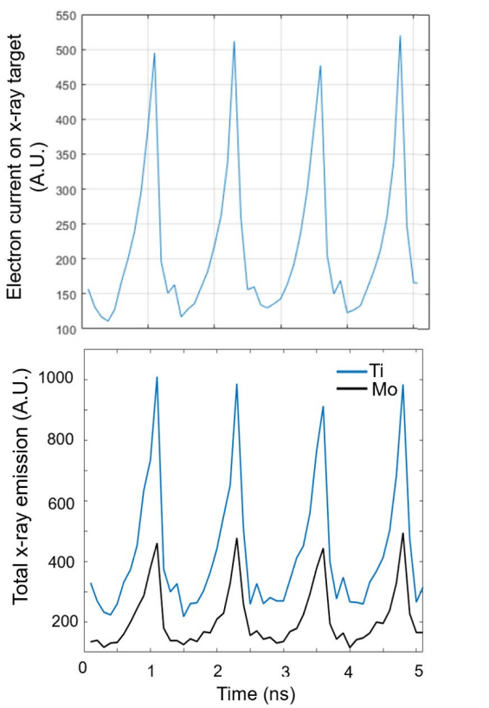
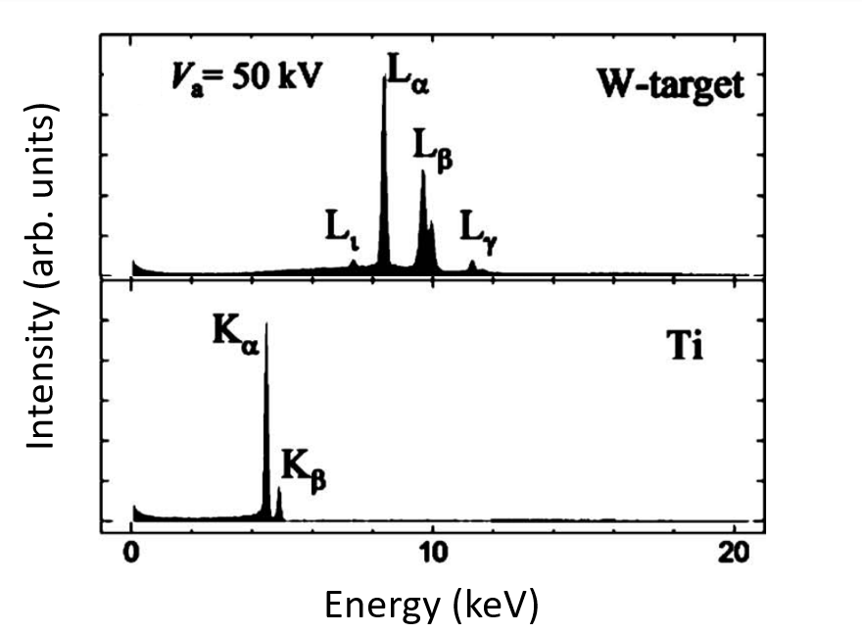
Leveraging Titanium Characteristic X-rays
Simulation of Ti/Mo target X-ray production
Ti/Tungsten Target Spectra
Notes:
X-ray efficiency is awful, so for accessibility we leverage Ti

Slide 11
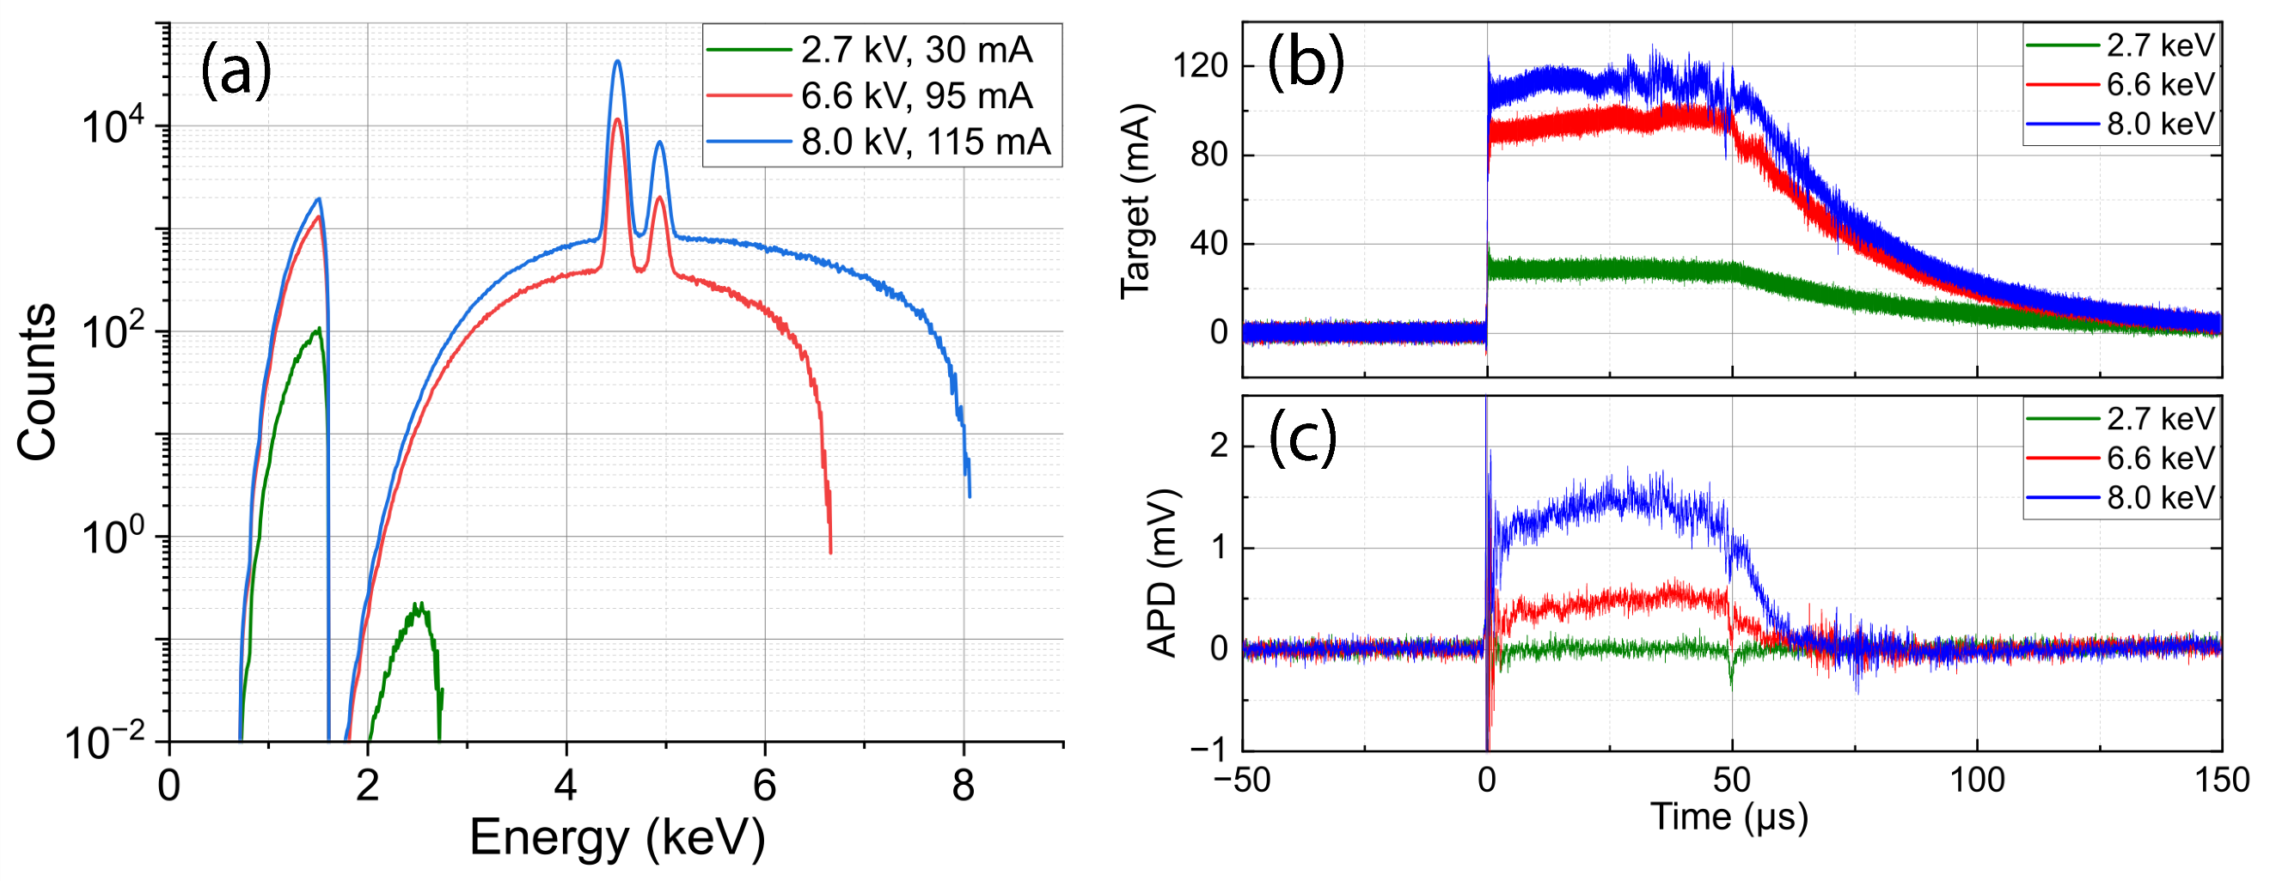
Performed Test: 50 us Pulse Measurement
Simulation:
Al-Filtered X-ray Spectra
Measurement:
50 us X-ray Pulse
Notes:
Test: Confirmed slow X-ray signal measurement, no amplifier

Slide 12
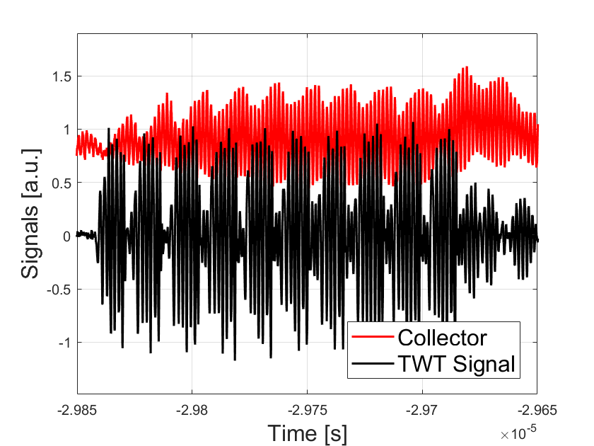
Measured Electron Beam Modulation:
575 MHz Carrier, 125 MHz On-Off Keying
Notes:
Test: How well does our TWT output preserve input signal

Slide 13
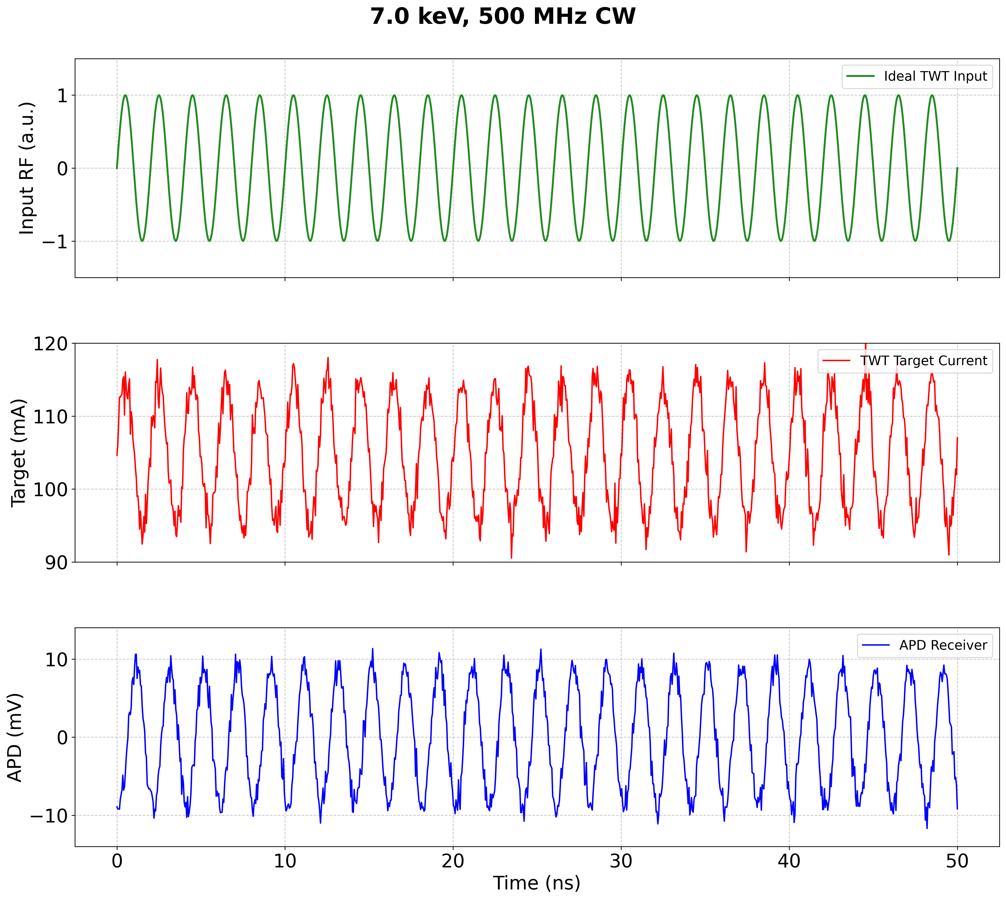
Proposed Test: Sinusoidally Modulated X-rays
Notes:
Proposed Test (not measured/simmed): Can APD resolve sinusoidally varying X-ray intensity from our modulated beam?

Slide 14
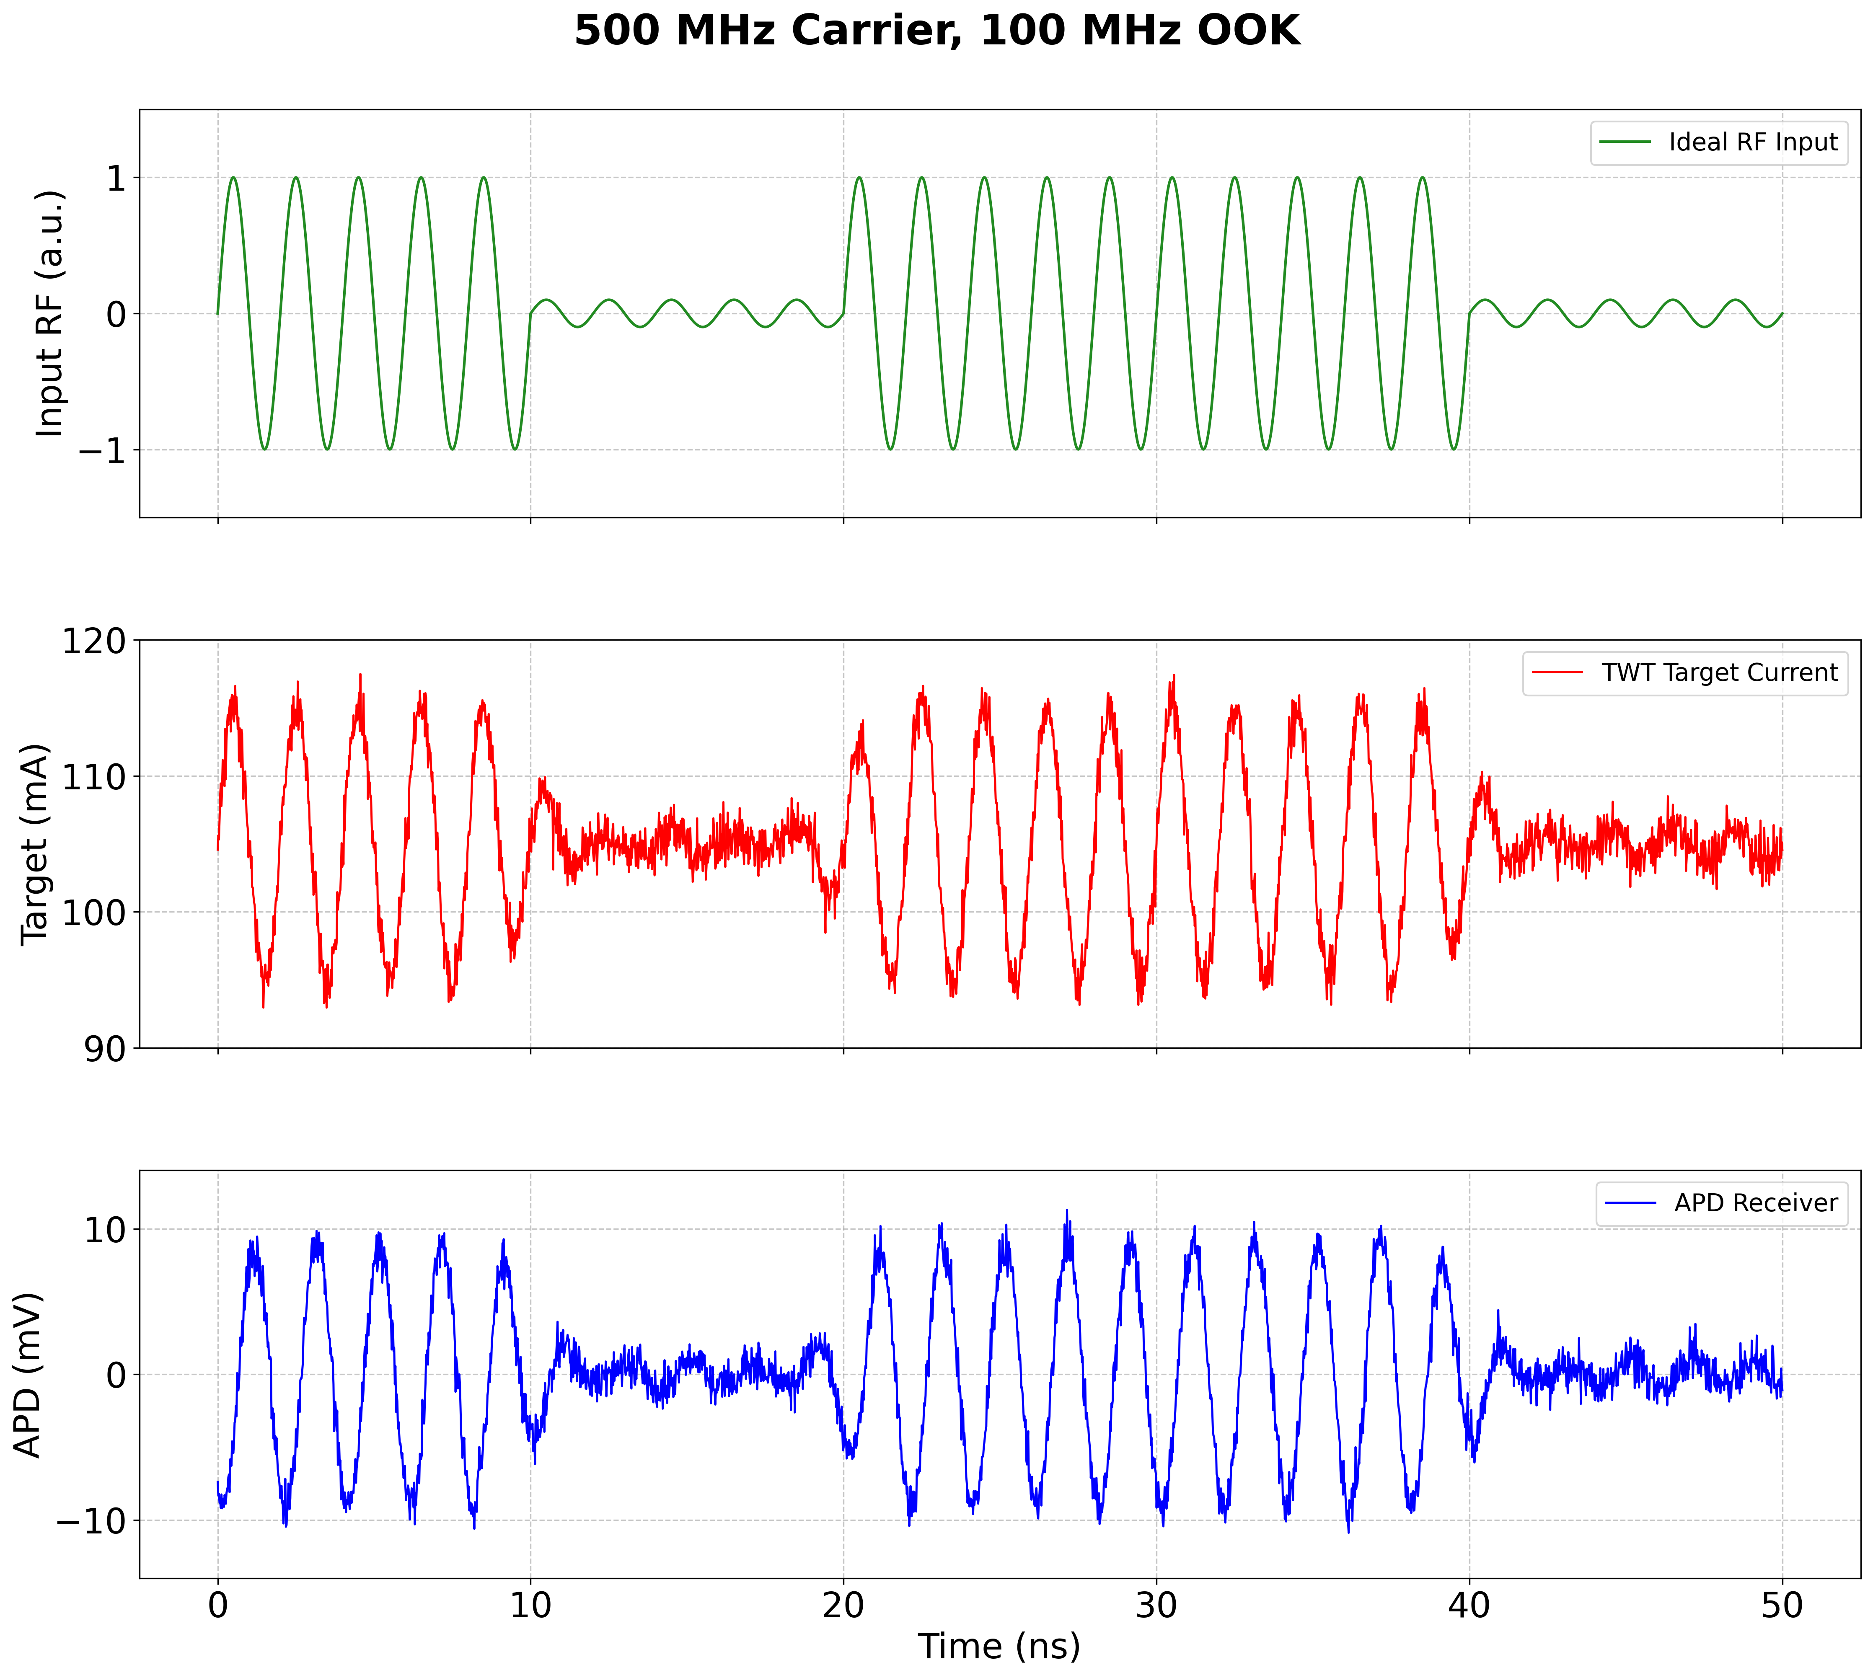
Proposed Test: Amplitude Modulation
Notes:
Proposed Test (not measured/simmed): Use OOK with our set-up, determine limitations.

Slide 15
The Direct Approach
The Hot Electron Light Assisted Cathode (HELAC)
Notes:
The Direct Appraoch: modulate beam at the source

Slide 16
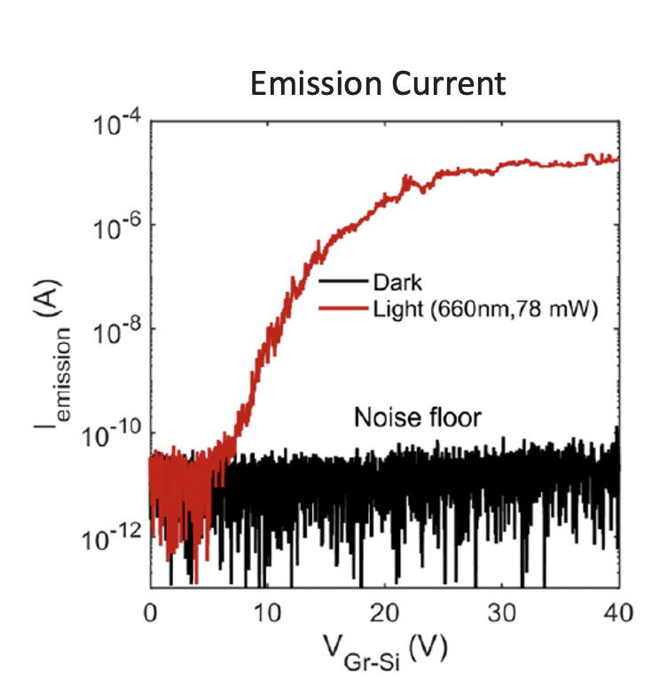
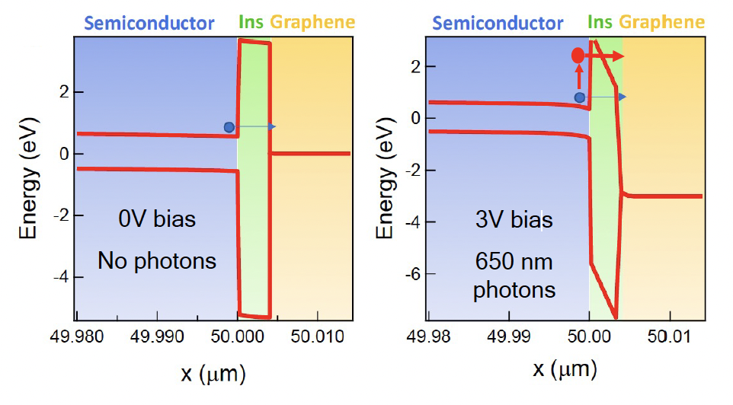
Hot Electron Light Assisted Cathode
A. Priyoti, et al, https://doi.org/10.1021/acsphotonics.3c01383
Notes:
HELAC basic principles

Slide 17
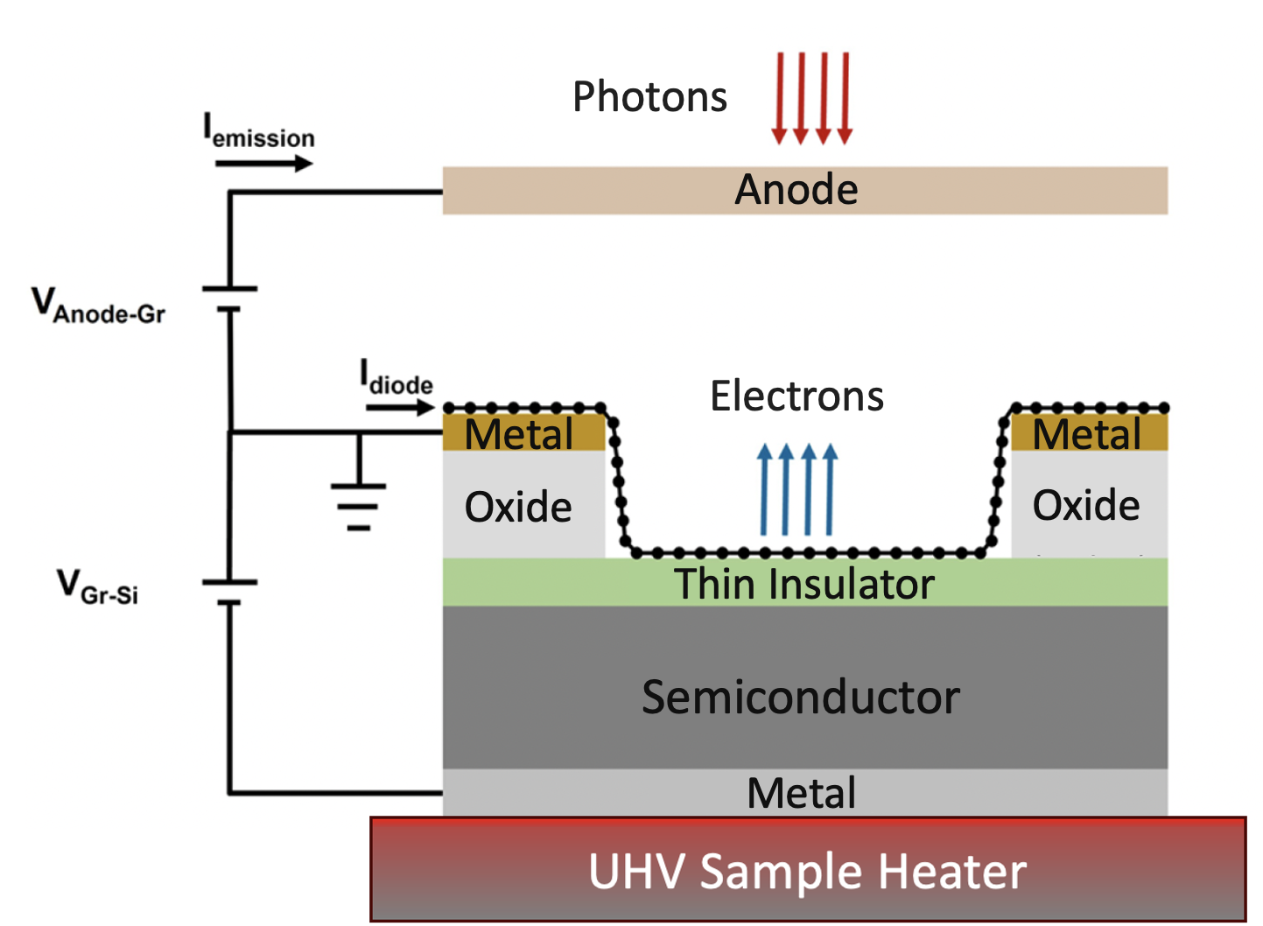
Hot Electron Light Assisted Cathode
A. Priyoti, et al, https://doi.org/10.1021/acsphotonics.3c01383
Notes:
HELAC basic principles

Slide 18
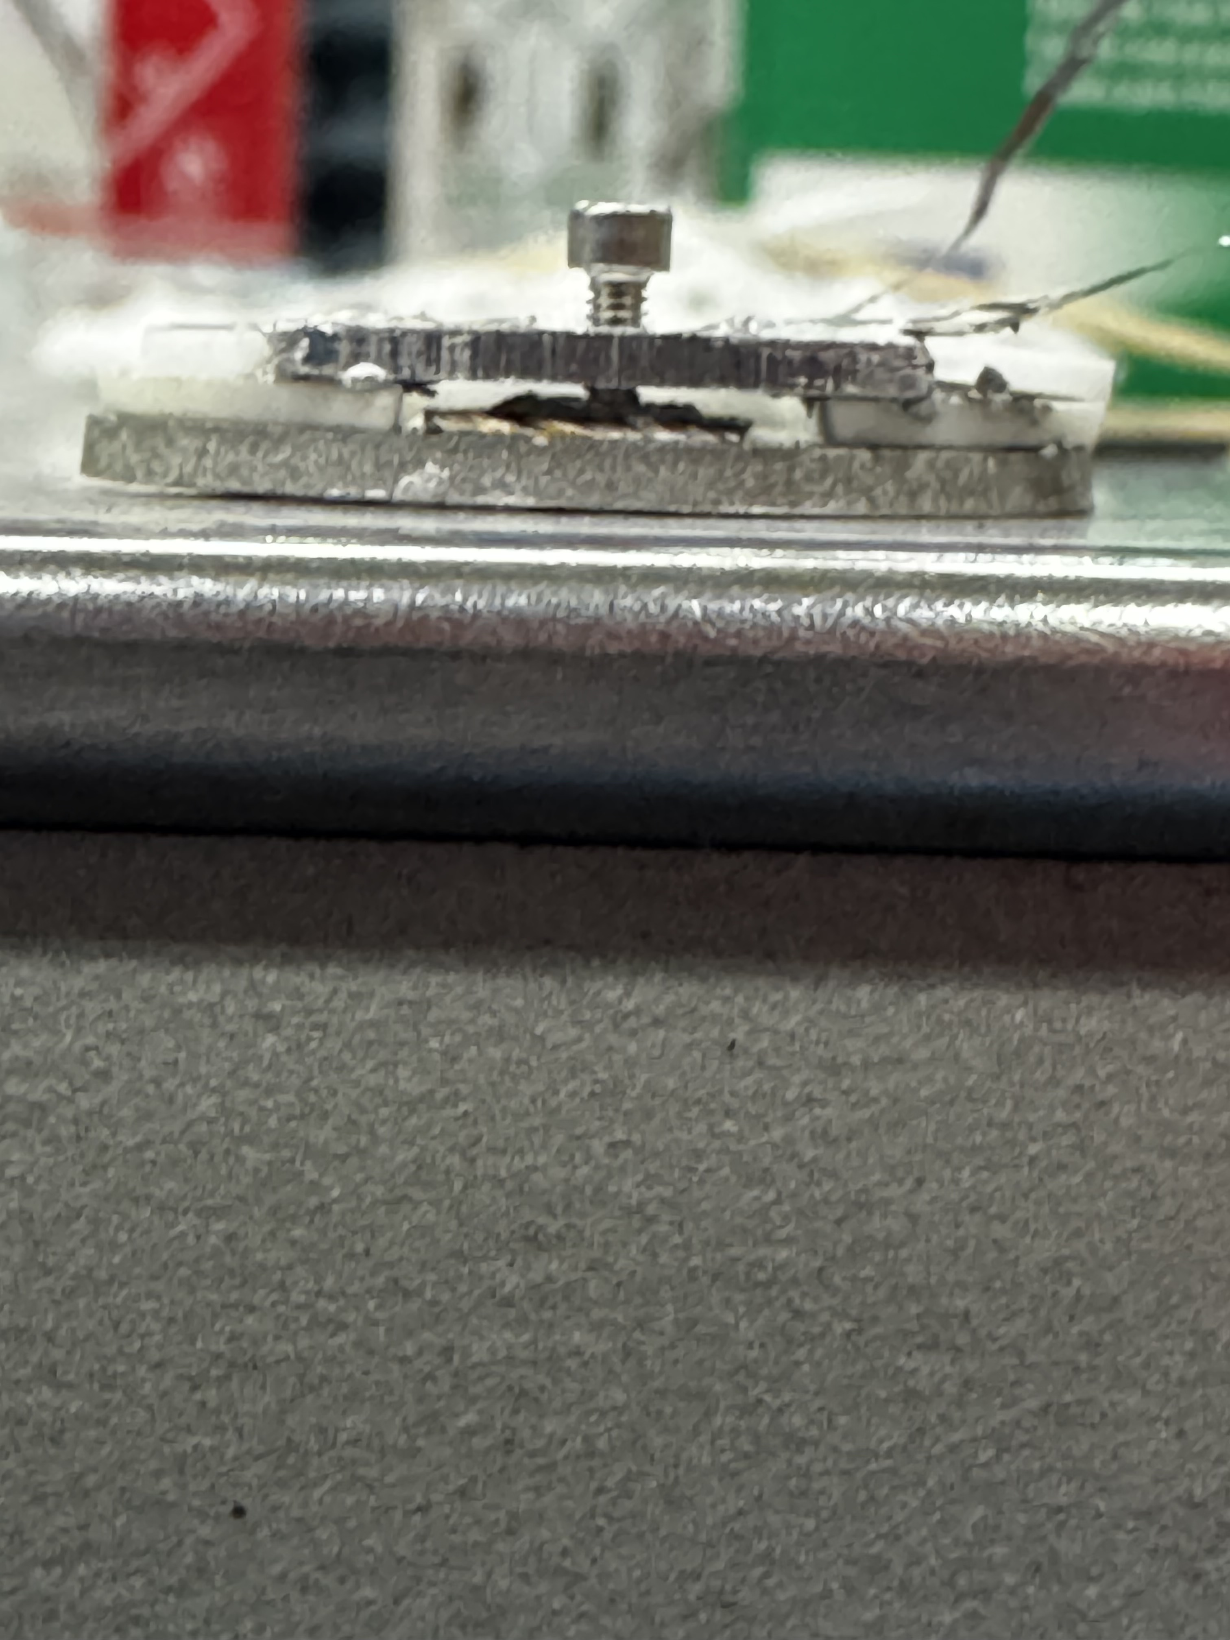
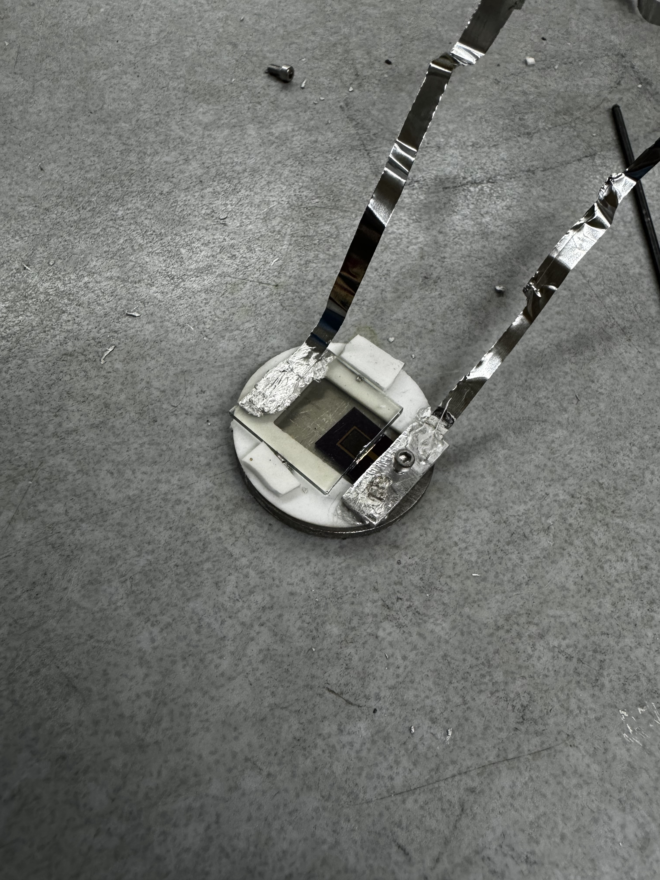
HELAC Testing Fixture

Slide 19
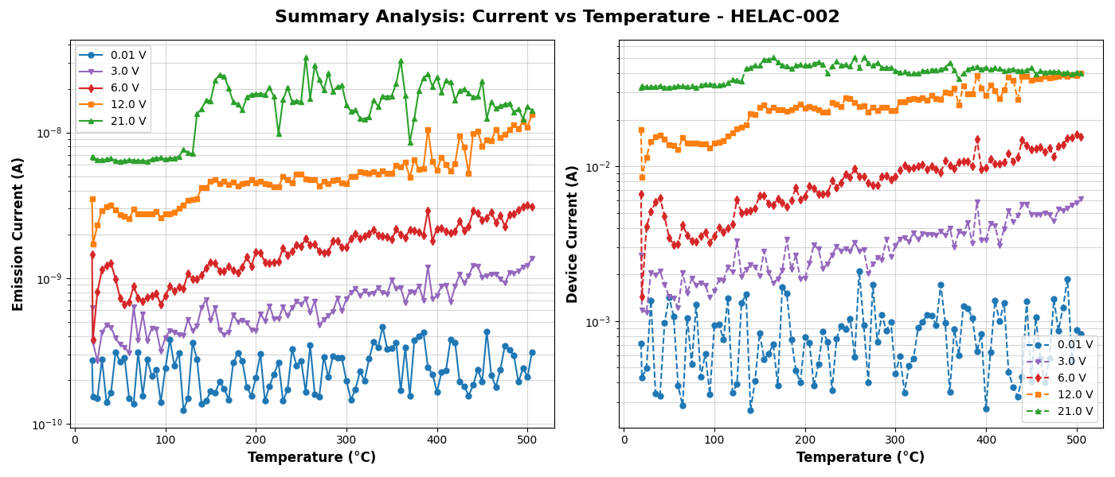
Thermally Enhanced Quantum Efficiency
Emission/Device Currents v. Temperature (With Varied Device Bias)

Slide 20
Conclusions
Takeaways:
  XCOM-TWT: Proof-of-concept for much higher modulation rates
  HELAC: Novel thermally-enhanced photo-gated cathode
Our next steps:
  XCOM-TWT: Reduce EMI beam coupling; Explore modulation schemes
  HELAC: Develop NIR-sensitive HELAC-based e-gun for XCOM

