Slide 1
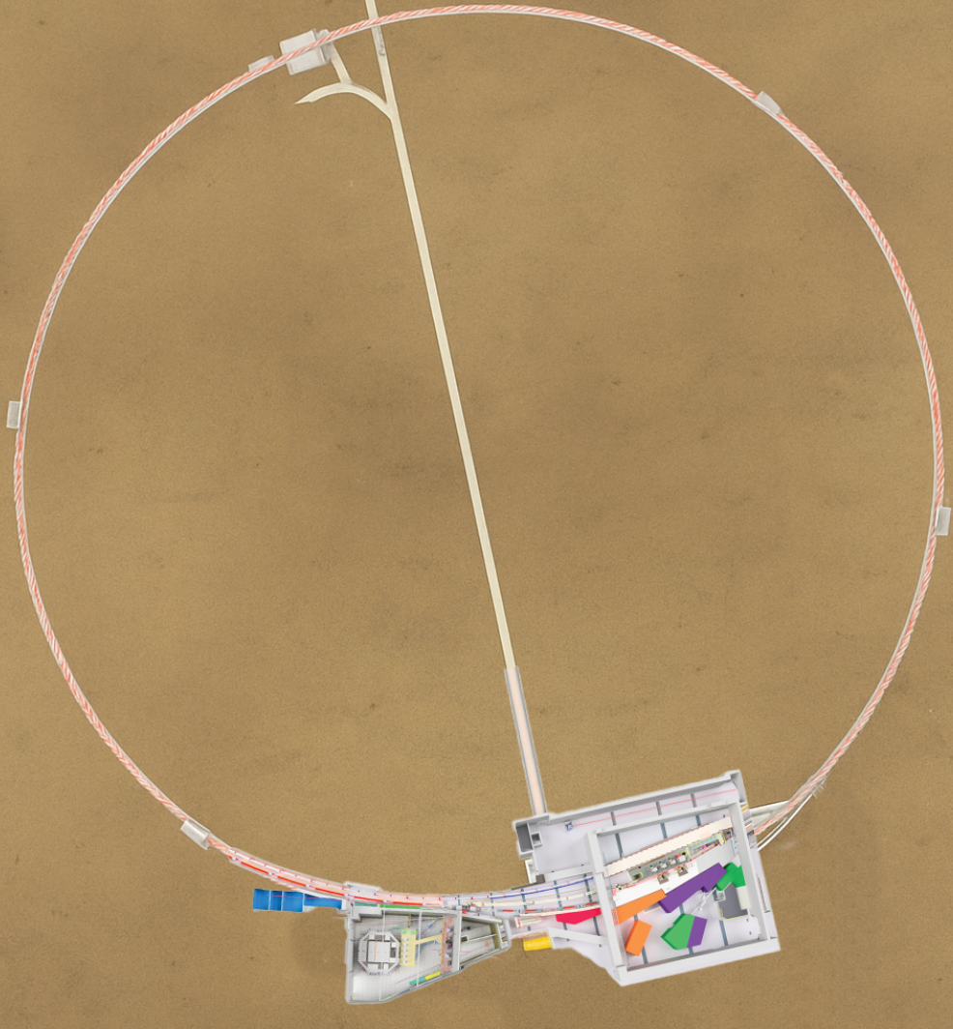
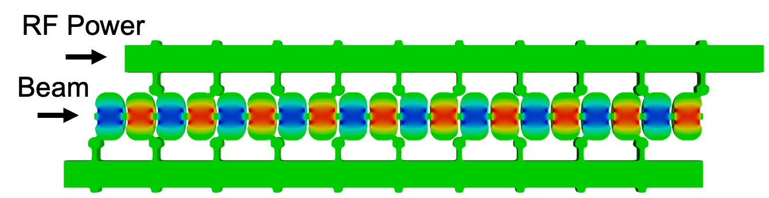
High gradient linacs for Cornell accelerator upgrades
Jared Maxson CHESS and CLASSE, Cornell University
Distributed coupling
structure
CHESS

Slide 2
Outline
Cornell’s 6 GeV light source, CHESS, is growing.
We have been interested in high gradient linac technology as an upgrade path and an R+D platform for some time.
We are partnering with AFOSR to develop a high peak intensity system to study the limits of performance of high frequency (6-100 GHz) acceleration systems.
Lots of opportunities for user science in DE, NSF materials, cancer therapy, and more from this facility.

Slide 3
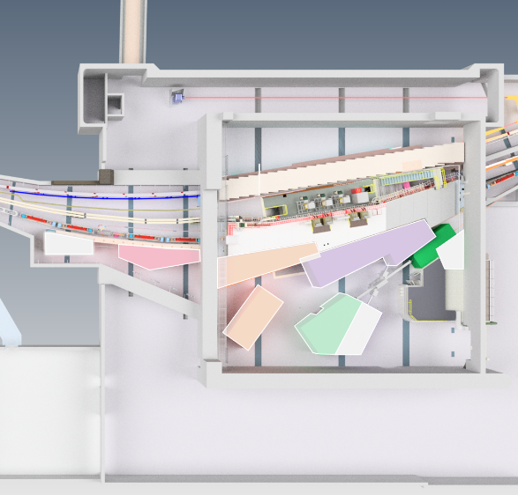
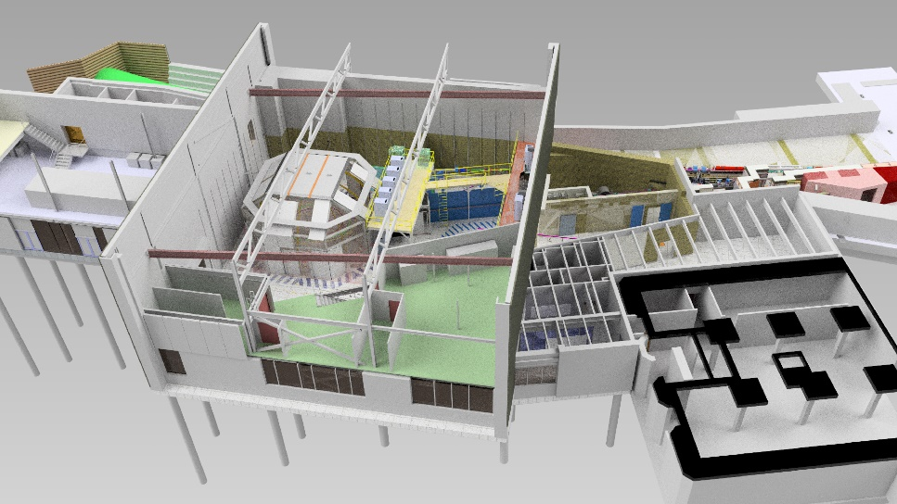
Our light source, CHESS, is growing
We’re presently in a period of growth at CHESS.
CHESS-U Upgrade (2018): Multi-bend achromat lattice in South
Partner Model: NSF, AFOSR, NIH, Cornell: broad engagement of federal funding agencies.
New facilities: High Magnetic Field Beamline, XLEAP Plan sciences beamline, and more.

Slide 4
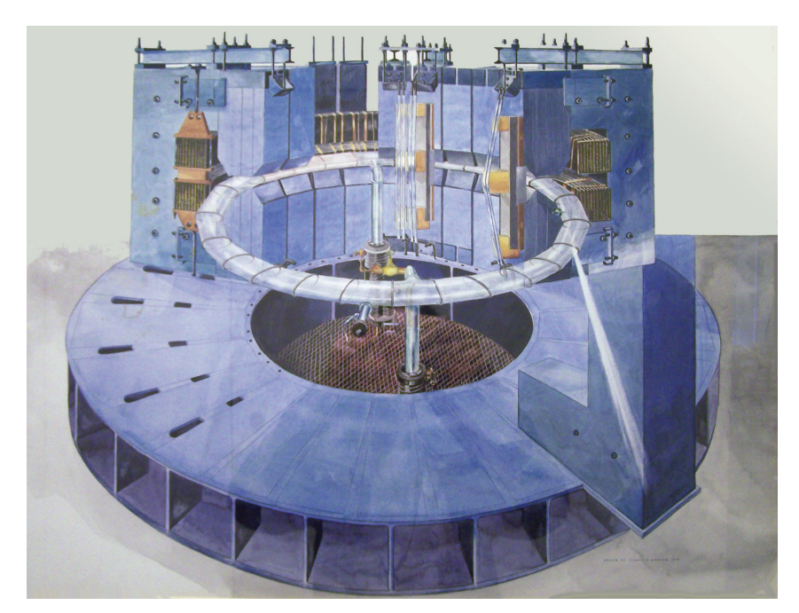
A quick Cornell accelerator overview
History:
300 MeV Synchrotron,
1949

Slide 5
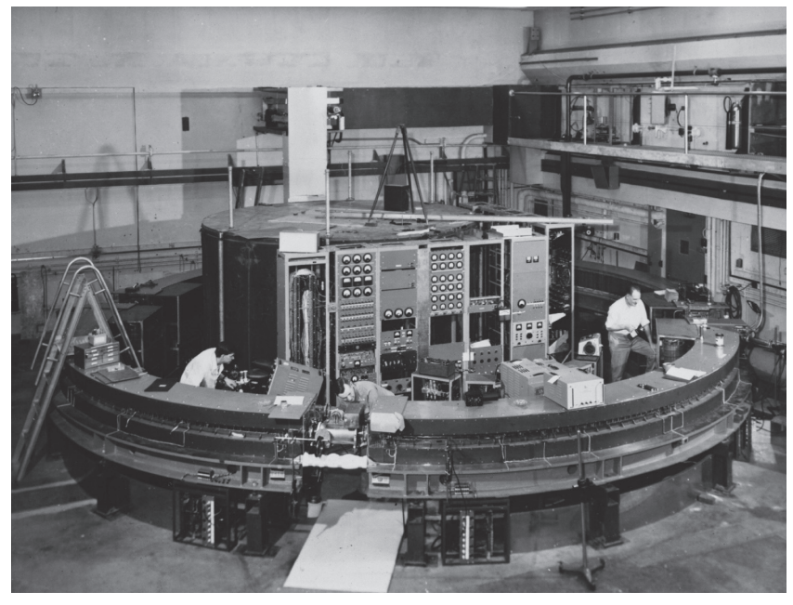
A quick Cornell accelerator overview
History:
1952:
1.3 GeV, strong focusing synchrotron

Slide 6
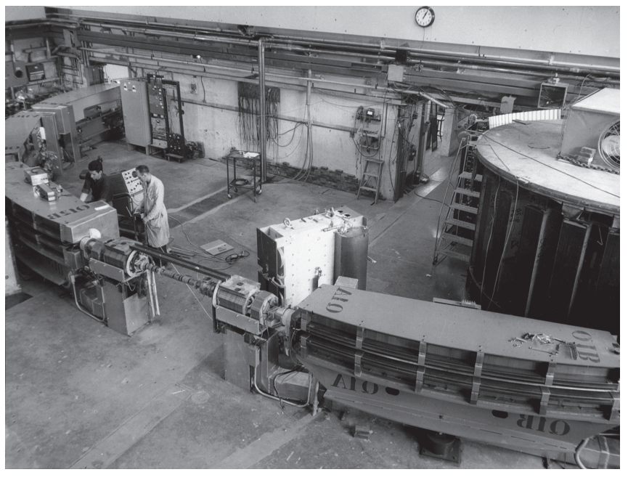
A quick Cornell accelerator overview
History:
Expanding to fill the space…
1963: 2.2 GeV

Slide 7
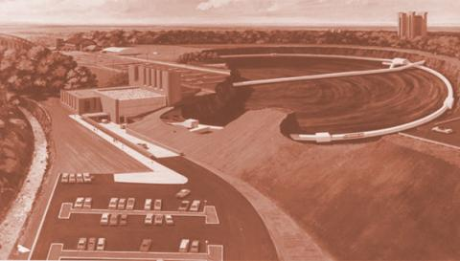
A quick Cornell accelerator overview
History:
Outgrowing the Newman Laboratory:
1967: 12 GeV Synchrotron

Slide 8
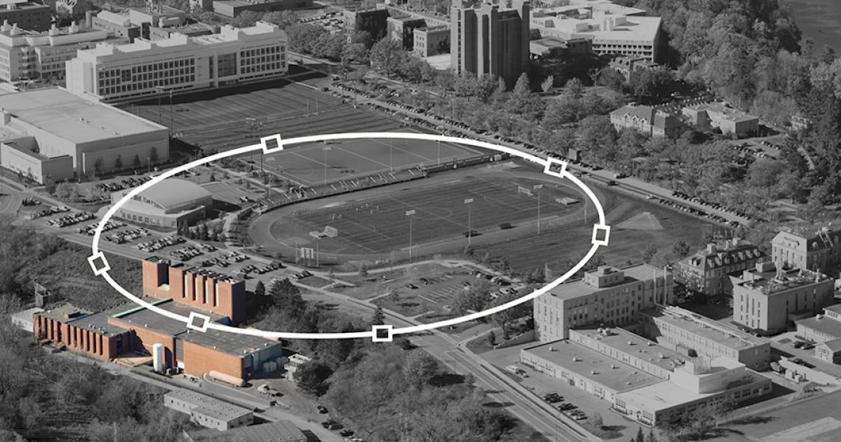
A quick Cornell accelerator overview
History:
Outgrowing the Newman Laboratory:
1967: 12 GeV Synchrotron

Slide 9
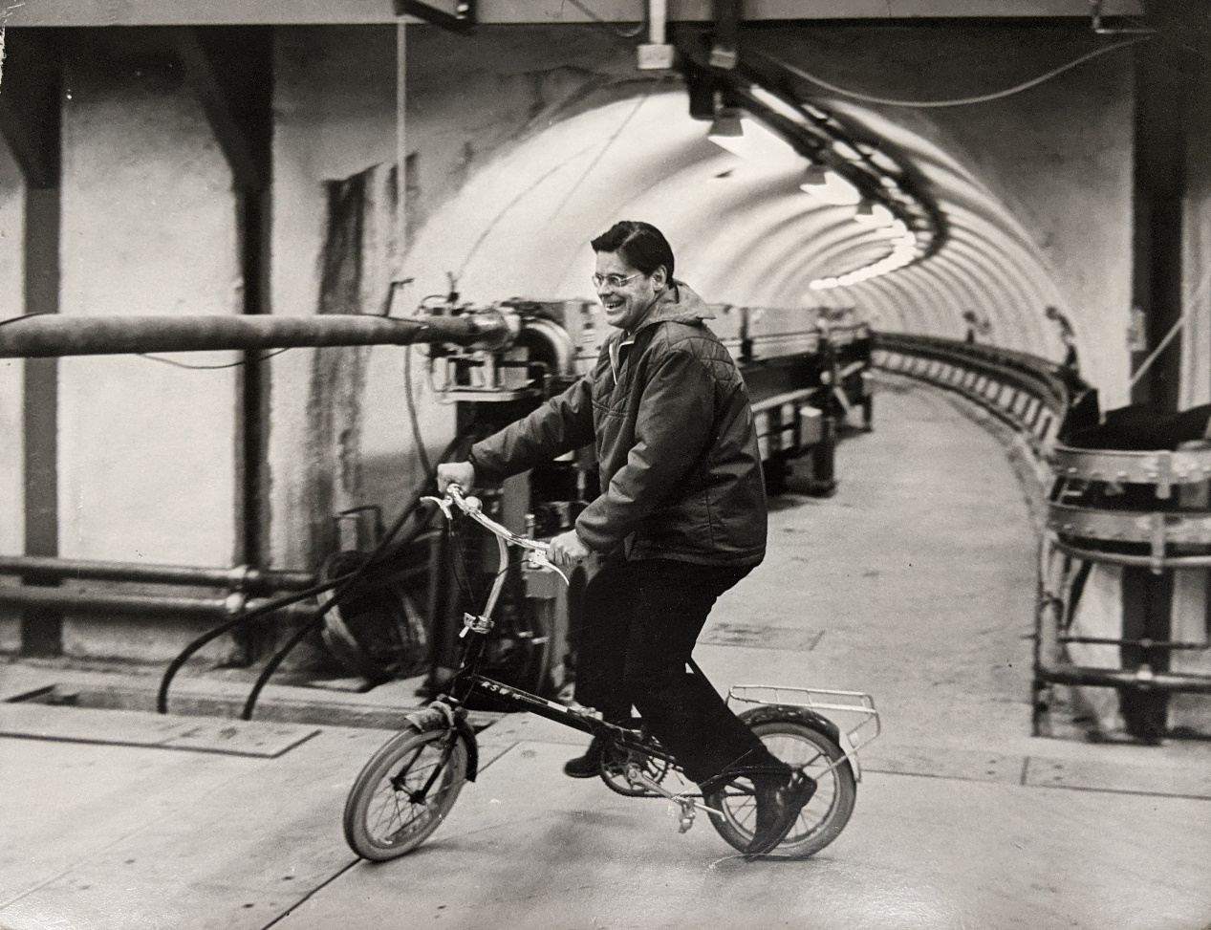
A quick Cornell accelerator overview
History:
Outgrowing the Newman Laboratory:
1967: 12 GeV Synchrotron
Wilsonian synchrotron:
In-vacuum magnets
(60 Hz 150 MeV-
>10 GeV)
Robert Wilson in the tunnel, 1968

Slide 10
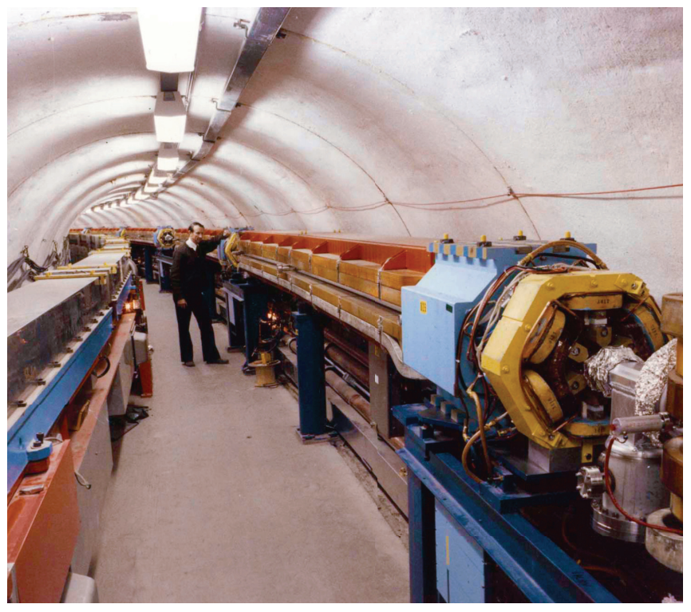
A quick Cornell accelerator overview
History:
1979: Cornell Electron Storage ring, CESR
Electron-positron collisions,
And more than 2 decades of elementary particle physics.
Since inception, CESR has also driven CHESS, running concurrently with the particle physics program.
CHESS is now the single use of CESR.
Remains the booster
for CESR to this day.
Boyce McDaniel with CESR

Slide 11
Future-proofing CESR + CHESS
We plan to run the facility for decades to come.
The linac and booster synchrotron (inner ring) are natural first places to look to consider accelerator upgrades for future-proofing.
This is not to say that CESR upgrades aren’t appropriate or necessary.
These can be more adiabatic, as CESR is much more modular (as demonstrated by CHESS-U).
High gradient linacs offer one path for an upgrade, certainly not the only. Currently this is our “target” option.

Slide 12
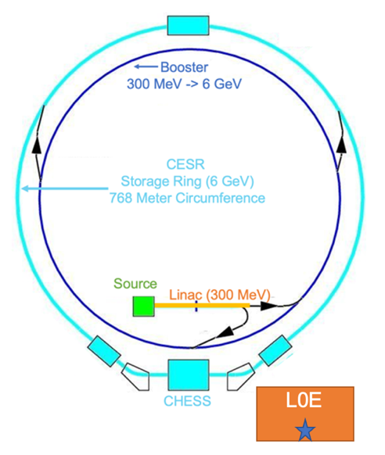
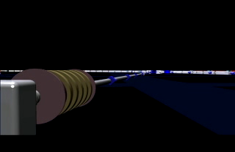
RF Cavity Technology
The linac and synch booster accelerate with conventional normal conducting RF cavities.
Average
Accelerating Fields
In CESR Linac:
~10 MeV/m
Beam completes
>3,000 revolutions in synch before reaching 6 GeV

Slide 13
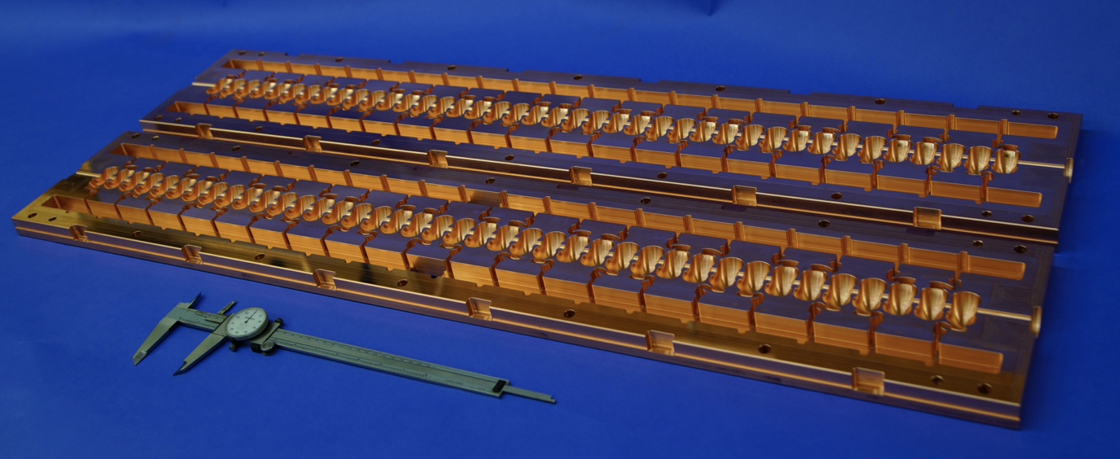
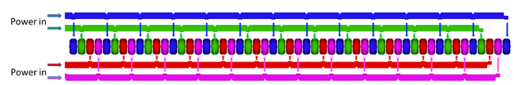
Target upgrade tech: distributed coupling cavities
Leverage a lovely new cavity geometry developed by SLAC, and now also ASU:
Examples: two manifolds, or even more:
“Bus” Waveguide feed
“Bus” Waveguide feed
Can even optimize the cell-to-cell phase!
See Sami and Emilio’s talk for even more advanced designs

Slide 14
What would it take to develop a 6 GeV linac for CHESS?
Strong synergy with ESRF COLD project; delighted to be collaborating with them.
Full energy injection at 6 GeV would
Require ~50 meters of active linac.
Order 100 m of floorplan

Slide 15
What could full energy injection offer?
We envision that CESR operation would look quite similar with a new injector, but with several new benefits (assuming e- in CESR)
The linac could provide enough charge to fill up CESR in seconds. Much higher brightness than existing synch.
Very rapid top-off
Opportunities for x-ray generation from the linac itself—including free electron laser operating parasitically. (cf SACLA, CXFEL, UCXFEL—see later today).

Slide 16
Linac Development Space
Linac Tunnel
Test Area
Testing area is 40 meters across, our existing linac tunnel is >50 m long.

Slide 17
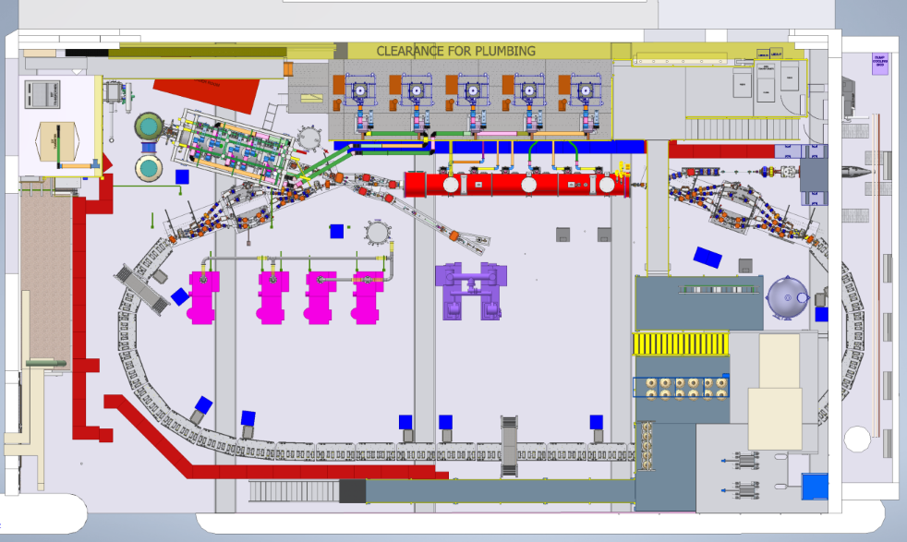
Test area: upgrades and plans (subject to evolution!)
40 m x 20 m bunker adjacent to CHESS
Upper section will remain dedicated to ERL/SRF research.
Decommissioning the CBETA loop now.
Proposed DURIP to fund high power 6 GHz (50 MW) klystron for high gradient, high frequency development
Selected for funding
Common Laser Room
High Gradient, High Power Test Beamline

Slide 18
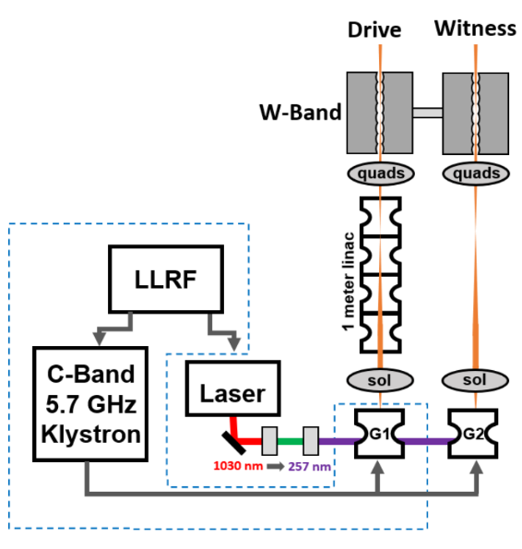
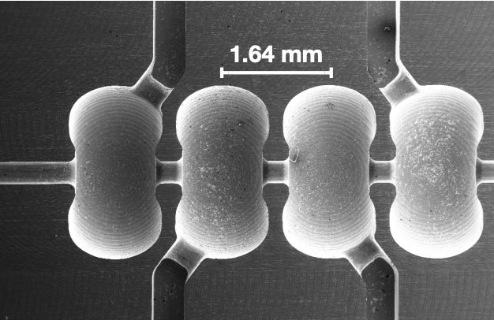
High Frequency Accelerator Testing
AFRL has interest in compact accelerators, RF sources from ~10 GHz – ~100 GHz.
Our proposed platform would allow tests of prototypes at C-band (6 GHz), with beam tests
High gradient gun desired—can begin with existing Cornell DC guns
Distributed coupling structures to be provided by SLAC (thank you!)
Excitation studies of high frequency structures using beam.
Pulse compression, RF source development
Example:
W-band Power Extraction Structure
F. Toufexis et al., IPAC2019, Melbourne, Australia
Wish to work with all of you to build this out!

Slide 19
Other opportunities/Upgrades
With this platform, one can imagine upgrading to a user facility providing:
Cryogenic accelerator testing (cold copper) for higher performance
X-ray generation with inverse Compton scattering
MeV Ultrafast electron diffraction (beyond-state of the art!)
VHEE and FLASH cancer therapy studies (Cornell Vet School)
Upgrades fit within portfolio of NSF MRI
Synergies with ASU, LANL, SLAC, UCLA, Rochester LLE, more…
Offer proving ground for upgrade strategies
All the while, we’d like this facility will be open to AFRL researchers for beam and RF tests.

Slide 20
Conclusion
Cornell’s accelerator laboratory is gearing up to test high gradient RF structures in a new laboratory.
Significant potential upside for CHESS—full energy injection.
Strongly synergistic with other efforts, especially ESRF COLD project.
Opportunities for compact x-ray generation—UCXFEL, for example.
The beamline we develop will prioritize AFOSR HERMES topics including high frequency, high intensity accelerator tests.
Potential for significant scientific expansion, both for AFRL and NSF topics, and more (X-rays, UED, cancer therapy).
Seeking your partnership!

Slide 21
Thank you
Thanks to our CLASSE and CHESS leadership, Nigel Lockyer and Joel Brock, for support.
Thanks to Matthew Andorf for continuous technical leadership
Thanks to our close collaborators and their teams: Emilio Nanni, James Rosenzweig, Sami Tantawi, Evgenya Simakov, Pietro Musumeci, Joel England
Thanks to our DOE BES+HEP, and NSF CBB for funding studies leading up to these developments.
Thanks to AFRL and AFOSR folks for new partnerships: Joel Bixler, John Luginsland, Daniel Enderich, and their teams.

