Slide 1


The Materials Solutions Network at CHESS:
an AFRL-sponsored sub-facility of the
Cornell High Energy Synchrotron Source
Arthur Woll, Director, MSN-C

Slide 2
The Materials Solutions Network at CHESS
Key Points
MSN-C enables DoD scientists and its industry partners to leverage synchrotron radiation for both fundamental research and practical challenges related to manufacture and processing.
This value is built on its access model, key capabilities, and sustained support for R&D.
MSN-C’s future relies on thriving R&D across the facility to maintain existing capability and ensure future relevance.

Slide 3
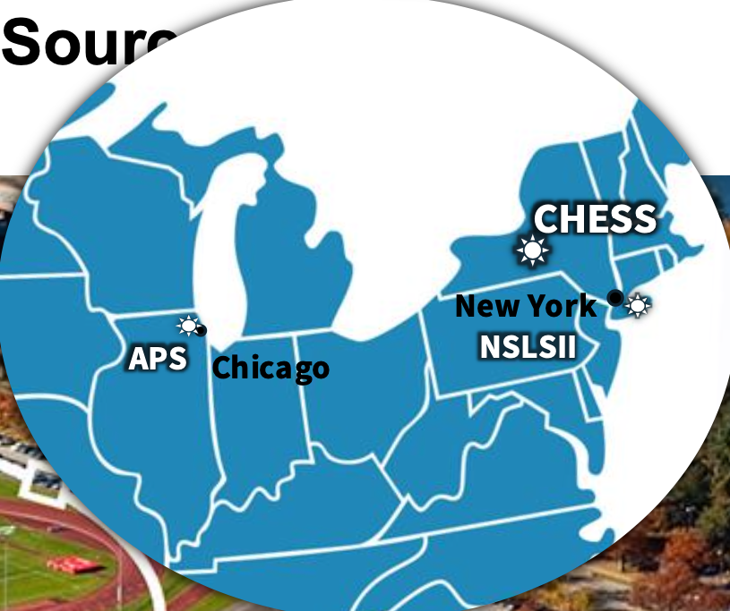
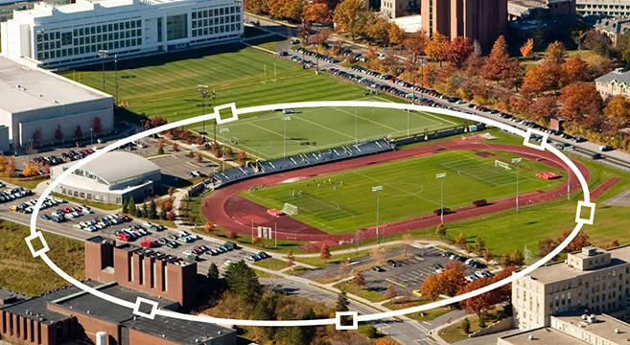
CHESS: Cornell High Energy Synchrotron Source
Located on Cornell University Campus
CHESS:
7 beamlines in routine operation
1 beamline in commissioning (HMF)
1 beamline in construction (XLEAP)
Annual Operating Budget: $45M
AFRL to-date investment: $48M
CHESS is based on CESR: the Cornell Electron Storage Ring:
6 GeV – one of only 6 worldwide
Legacy of innovation and flexibility
768 m circumference
145 mA operating current
3
Notes:
In case you’re not familiar with CHESS we are located in NY state, right on the Cornell campus, the synchrotron ring is 5 stories underground, below the track
We are a 6 GeV ring which gives us access to high energies- hence our name

Slide 4
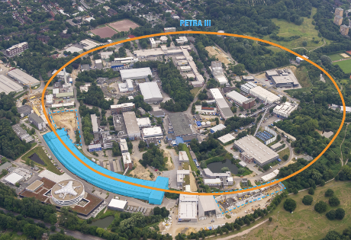
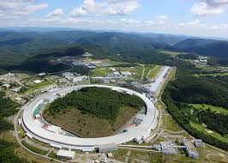
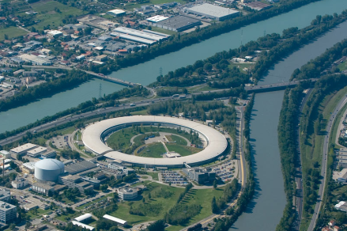
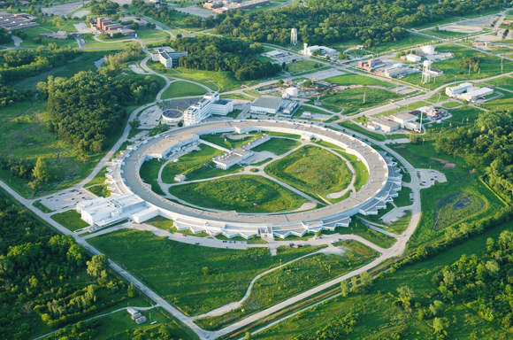
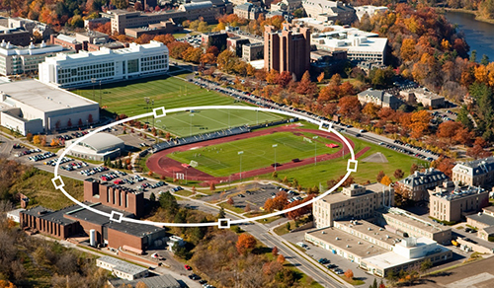
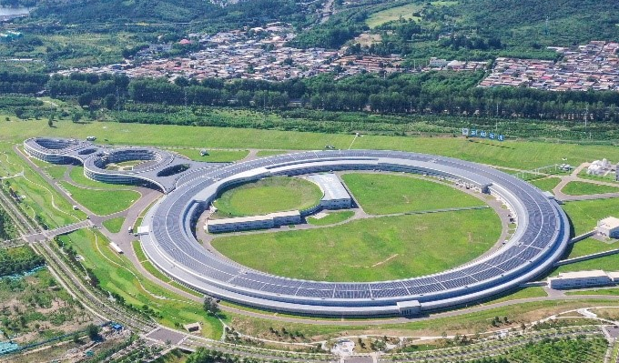
CHESS is 1 of only 6 High Energy X-ray Sources worldwide (>3 GeV)
Petra-III: Germany
SPring-8: Japan
ESRF: France
http://http://photon-science.desy.de
http://www.riken.jp
http://www.esrf.eu
APS: Illinois
CHESS: New York
HEPS: China (2025)
http://www.anl.gov
https://www.chess.cornell.edu
https://english.ihep.cas.cn/heps/nae/

Slide 5
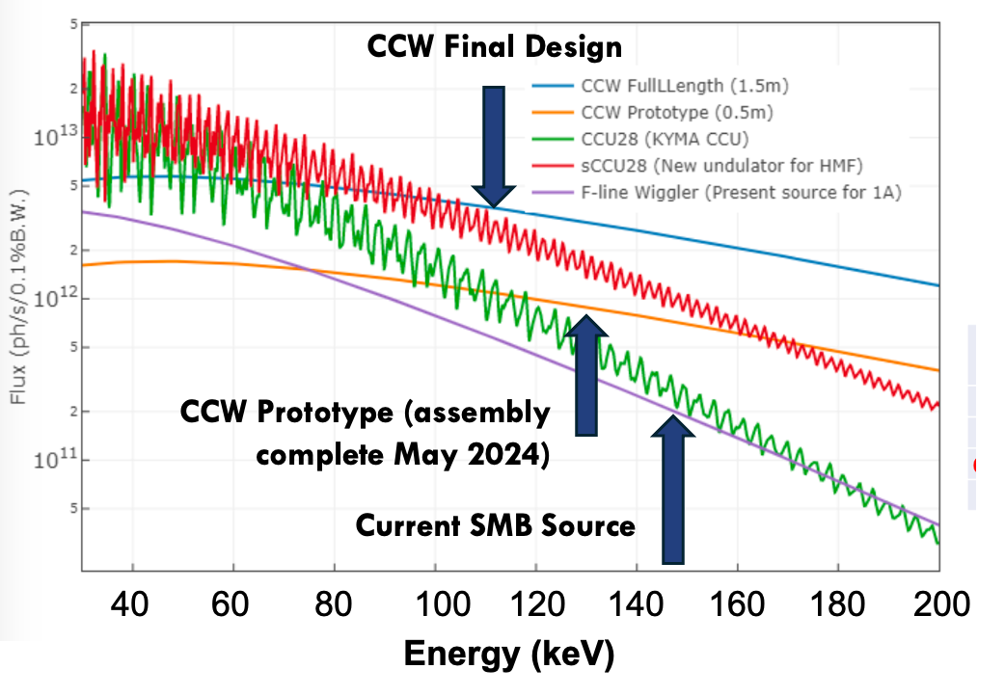
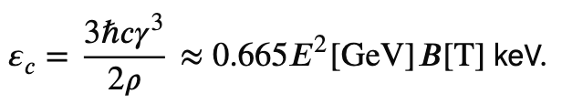
CHESS is 1 of only 6 High Energy X-ray Sources worldwide (>3 GeV)
High Particle Energy enables high flux at high X-ray energy

Slide 6
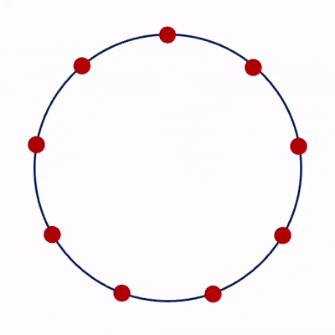
Thanks to CESR, CHESS has near-unique flexibility
At “normal” times:
CHESS looks continuous
At VERY short times:
CHESS is a strobe-light:

Slide 7
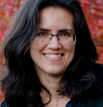
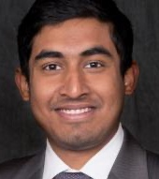
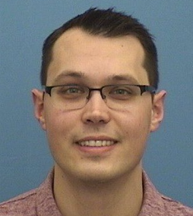

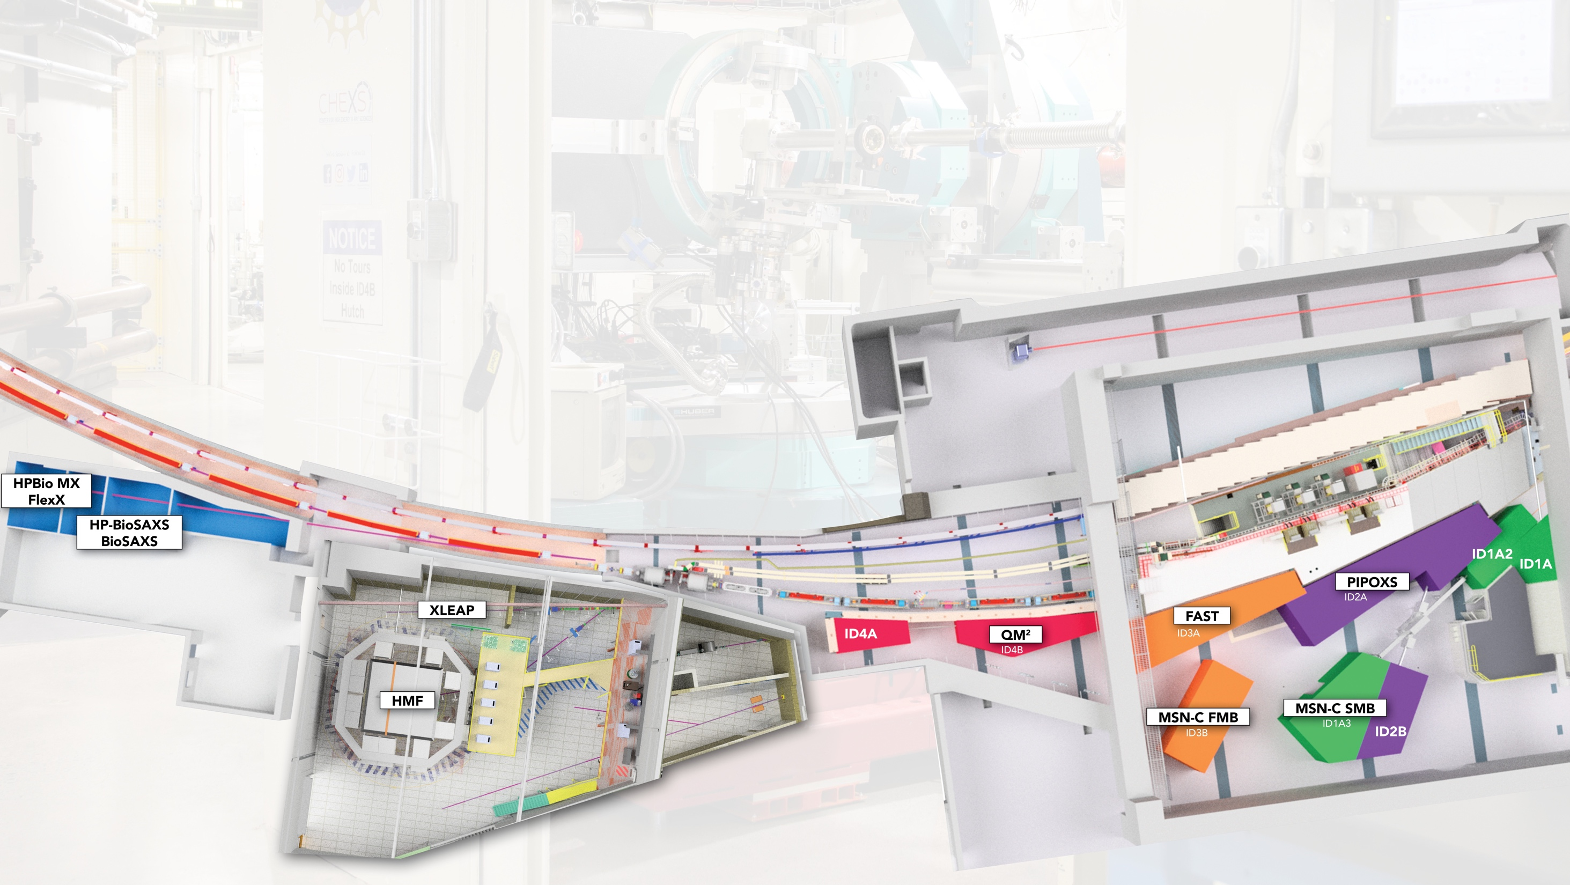
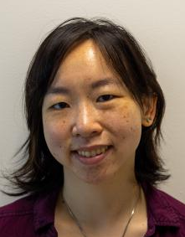
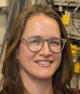
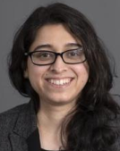
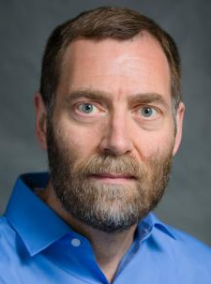
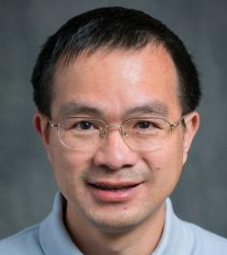


9 Beamlines
~1500 users/year
Estella Yee
Kate Shanks
Amlan Das
Sven Gustafson
Kelly
Nygren
Chris Pollock
Louisa
Smieska
Suchi Sarkar
Dave
Schuller
Qingqiu
Huang
Louise Debefve
Peter Ko
Notes:
Idea: put some scientists’ faces next to each hutch for extra context.
ALSO: can we say anything about Nozomi & Steve’s Astera work??
How about Lila?
Well over 100,000 square feed of laboratory space

Slide 8




The CHESS Partnership Model
NSF: Center for High Energy X-ray Science (CHEXS) at CHESS
  Four Beamlines
  Topics: Chemistry, quantum materials, additive manufacturing, biology at extreme pressure & the origins of life.
AFRL: Materials Solutions Network at CHESS (MSN-C)
  Two Beamlines
  Topics: Metal Alloy Structure, Residual Stress, Dynamics under Load, Failure, Additive Manufacturing, etc.
NIH: MacCHESS:
  One Beamline
  Atomic structure and function of proteins, viruses, drug molecules, etc.
NYSTAR: Matching award for MacCHESS

Slide 9
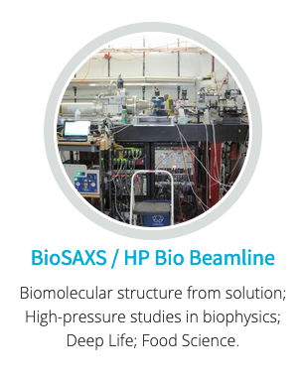
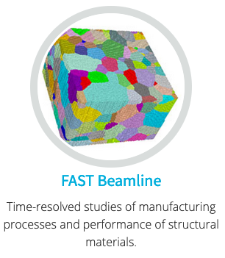
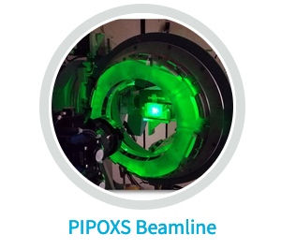
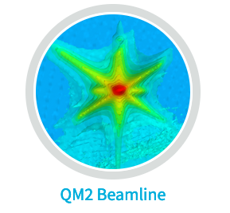
see Suchi Sarkar’s talk! tomorrow at 1:15 PM
XBIO Beamline
Structural Biology in Extreme Environments
Catalysis and
Functional Materials
Biomolecules in extremes (Pressure, Temperature, pH, anoxic, etc.)
Manufacturing Processes & Materials Performance
Novel Quantum Materials
Science Drivers @ CHEXS

Slide 10

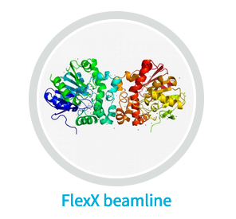
Biology in Extreme Conditions (XBIO)
MX Beamline
BioSAXS Beamline
Macromolecular Crystallography (MX), Serial Crystallography, High Pressure MX
Biomolecular structure from solution, High Pressure biophysics
Science Drivers at XBIO

Slide 11
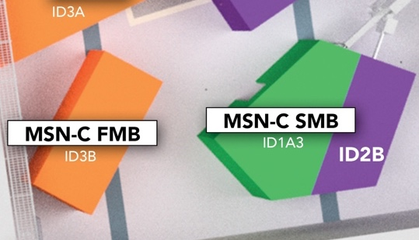
MSN-C Mission & Key Features
What is MSN-C?
In contrast to CHEXS, XBIO, and most other synchrotron facilities:
1. Beamtime allocation is controlled by AFRL, permitting balance between applied materials problems and fundamental research.
2. MSN-C serves non-X-ray specialists by providing interpretable information, not x-ray data.
3. MSN-C has established protocols to handle ITAR components and data.

Slide 12
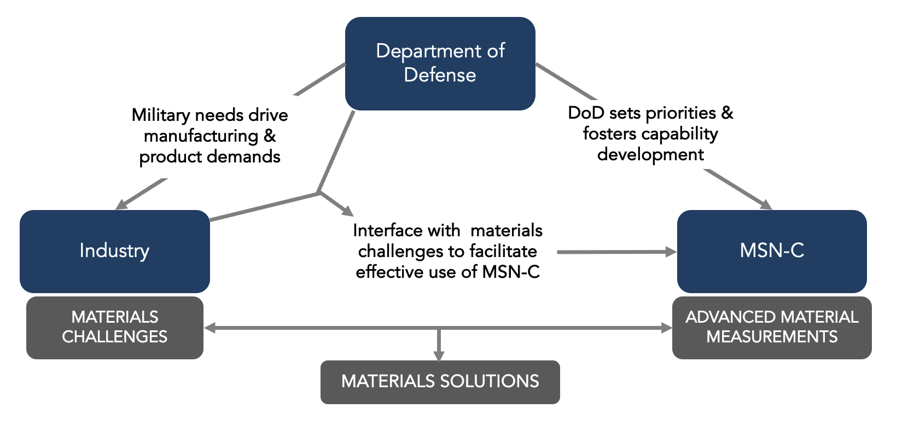
MSN-C, DoD, and Industry
MSN-C Mission: To advance critical materials solutions for DoD researchers and industry partners through dedicated access to world-leading non-destructive measurements and analysis
Notes:
DoD maximizes the application of techniques to a broad range of problems, facilitating industry access on a per-measurement basis
Strategy increases impact of materials problems addressed across defense services and industries

Slide 13


MSN-C Access
MSN-C Access
External Review
Submission
Allocation, Scheduling
Safety
Paul Shade, AFRL
Program Manager
Hilmar Koerner,
AFRL, FMB Lead
Review,
DoD (AFRL)
Submission
Allocation, Scheduling
Safety
Notes:
Clarify

Slide 14
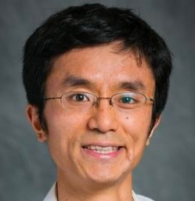


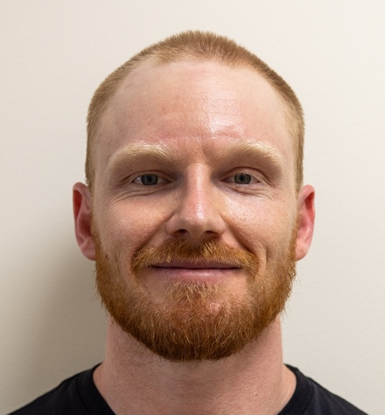
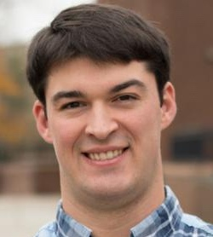


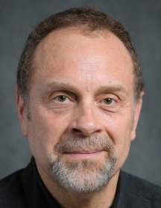
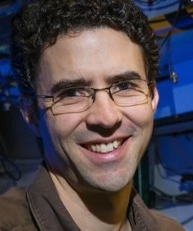
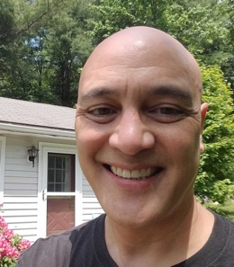
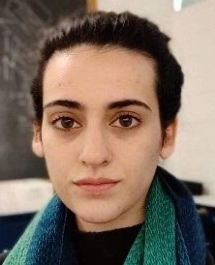
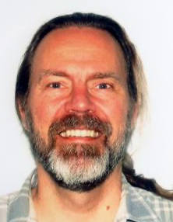
Acknowledgemetns - MSN-C Personnel
Staff Scientists
PostDoc
Grad
Visiting Scientists
Kelly Nygren
Metals, HEDM, Diffraction
(SMB)
Peter Ko
Instrumentation,
Electrochemistry (FMB)
Amlan Das
Metals
(SMB / FAST)
Louisa Smieska
Scan-probe, XRF, (XLEAP, FMB)
Zhongwu Wang
High Pressure (FMB)
Sven Gustafson
Metals (SMB)
Wiley Kirks
Metals (SMB)
Chris Budrow
Metals (Budrow
Consulting)
Kirt Page
Soft Matter
(UES, AFRL)
Diwakar Naragani
Metals
Matt Miller
PI
Arthur Woll
Director
Paul Shade, AFRL
Program Manager
Hilmar Koerner,
AFRL, FMB Lead
Mark Obstalecki (AFRL)
Joe Crum
Mech. Eng.
Keara Soloway
Programmer
Rolf Verberg
Programmer
Notes:
Adjust Louisa’s affiliation somehow? Think about organization? MSN-C, FMB, SMB.

Slide 15
MSN-C Beamlines
Structural Materials Beamline (SMB / ID1A3)
  Monochromatic mode: 40-90 keV
  White Beam: (50-200 keV)
  Methods: Diffraction Microscopy, Powder Diffraction, Tomography, Energy-Dispersive Diffraction
  Applications: In-situ and Ex situ characterization of processing and performance or metals and alloys.
thinner / lower density
thicker / higher density
FMB
SMB, white-beam mode
Functional Materials Beamline (FMB / ID3B)
SMB, mono-chromatic
  Energies: 9-30 keV
  Methods: Bulk & microbeam SAXS/WAXS, GISAXS/GIWAXS, Radiographic and Phase-Contrast Imaging.
  Applications: In-situ & ex situ characterization of polymers, composites, thin film structure and processing;
10
50
100
150
200
X-ray Energy (keV)

Slide 16
What needs does MSN-C serve? Example Projects
Current Materials and Processing
Used in Existing Manufacturing
Future Materials and Processing For
Next-Generation Manufacturing
Project | Institution
Validation of Welding Model for Thick Steel | Navy
Residual Stress due to Cold Hole Expansion | Air Force, Industry
Residual Strain in damaged Ti Fan Blade | Air Force
Residual Stress in Damaged Armor Components | Army, Navy
Residual Stress in Pt Films for UV Gratings | Penn State, NASA
SAXS/WAXS Mapping of Polymer-Matrix Composites | Air Force, Industry
Project | Institution
Covalent Organic Framework Materials Development using GISAXS | Air Force
Zwitterionic Block Polymer Phase Behavior | ASU, Army
Autonomous, AI-based Inorganic Materials Discovery | Cornell, AFOSR
Residual Stresses from Laser Shock Peening (LSP) treatment on Ti and Al | Air Force
In situ studies of polymer 3D printing | AFRL, Industry
Liquid Formulation Phase Diagrams using AI- Driven Automated Experimentation | NIST
Notes:
Aluminum fatigue crack growth.

Slide 17


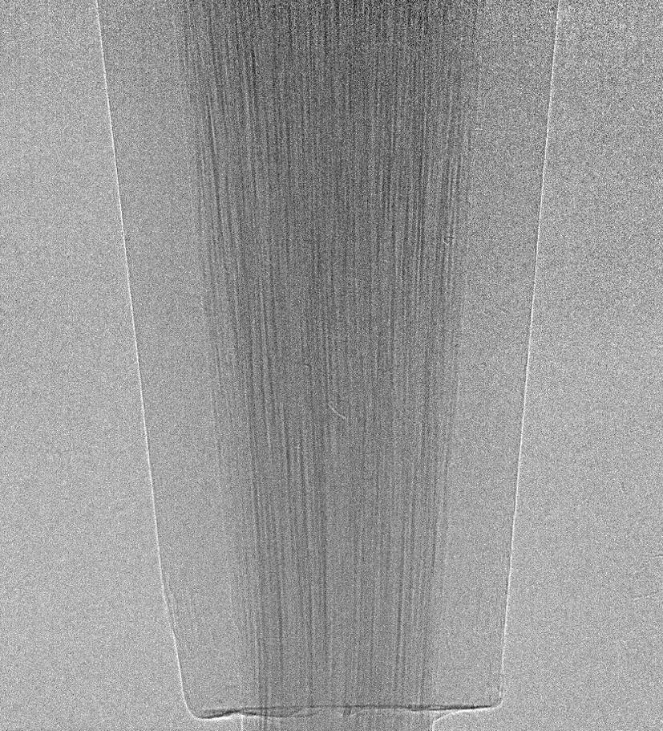
FMB Core Capabilities
FMB Core Capabilities
SAXS/WAXS microbeam Mapping
Full field Imaging
Length & Time scales
image rate: hours / image
field of view: unlimted resolution:
2 µm (absorption)
image rate: 50 Hz
field of view: ~2x2 mm²
resolution:
2 µm (absorption)
5-6 µm (phase contrast)
SAXS/WAXS mapping
(hours/
image)
Full-Field Imaging
(50 Hz)
Typical SAXS/WAXS beamsize
SAXS
WAXS

Slide 18
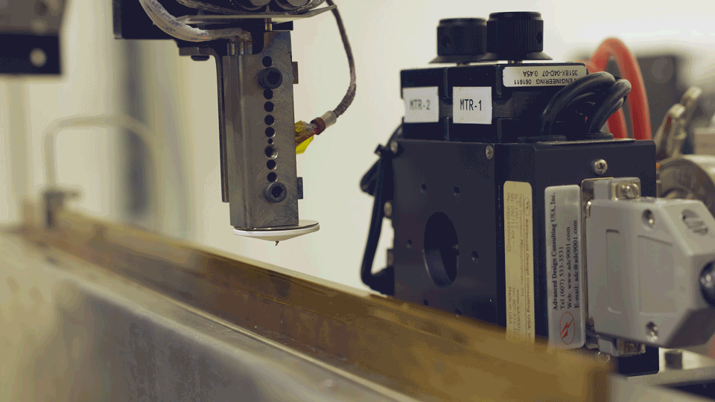
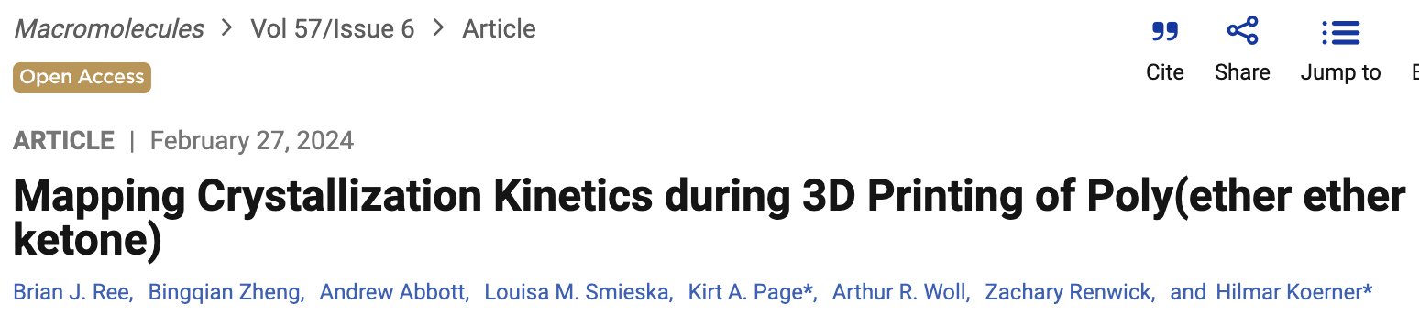
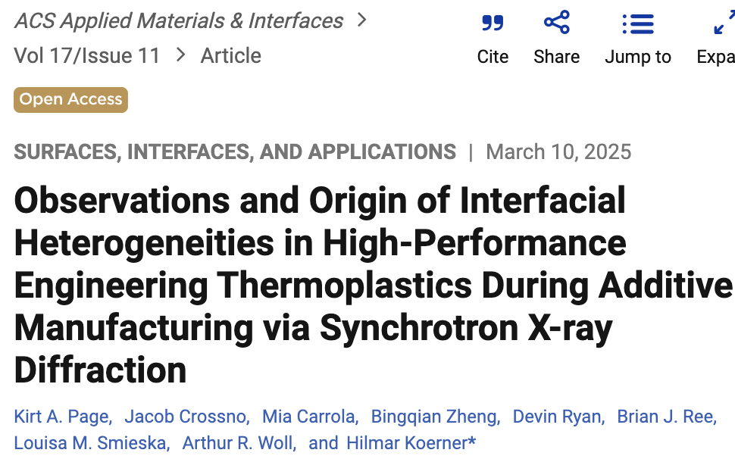
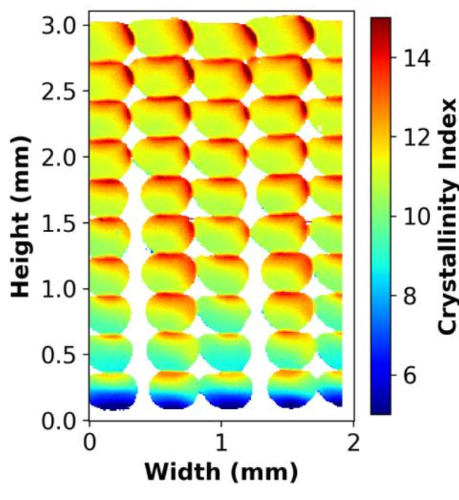
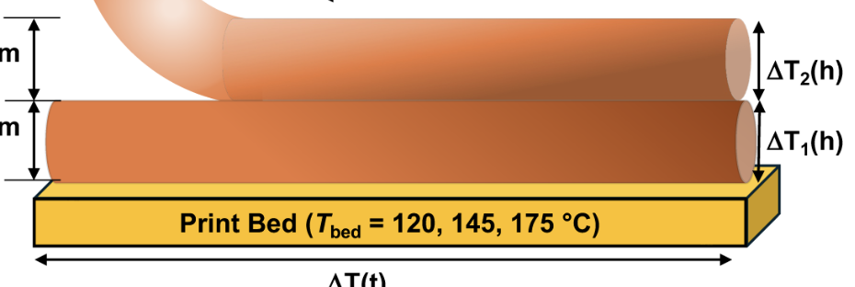
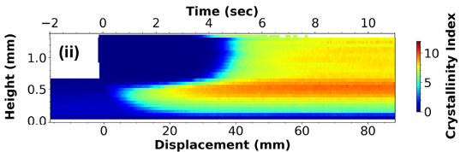
FMB Program – 3D printing of high strength polymers & composites
February 2024
March 2025

Slide 19
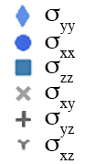
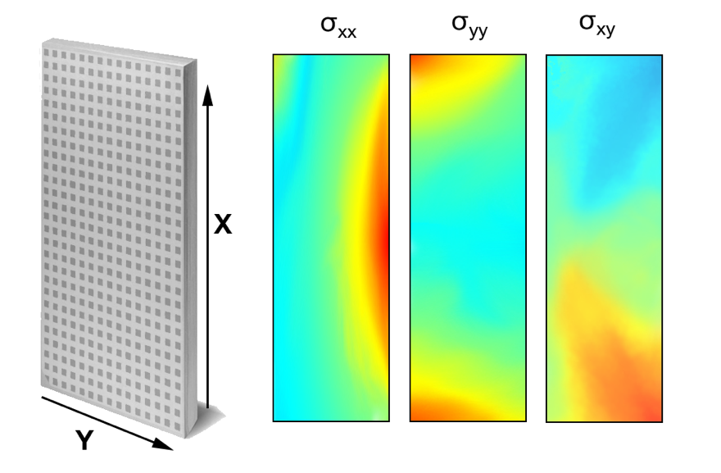
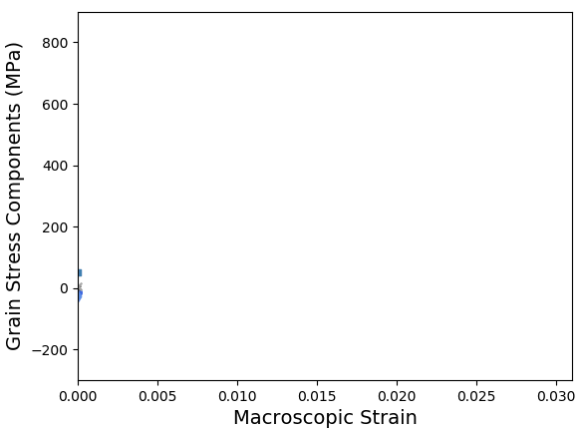
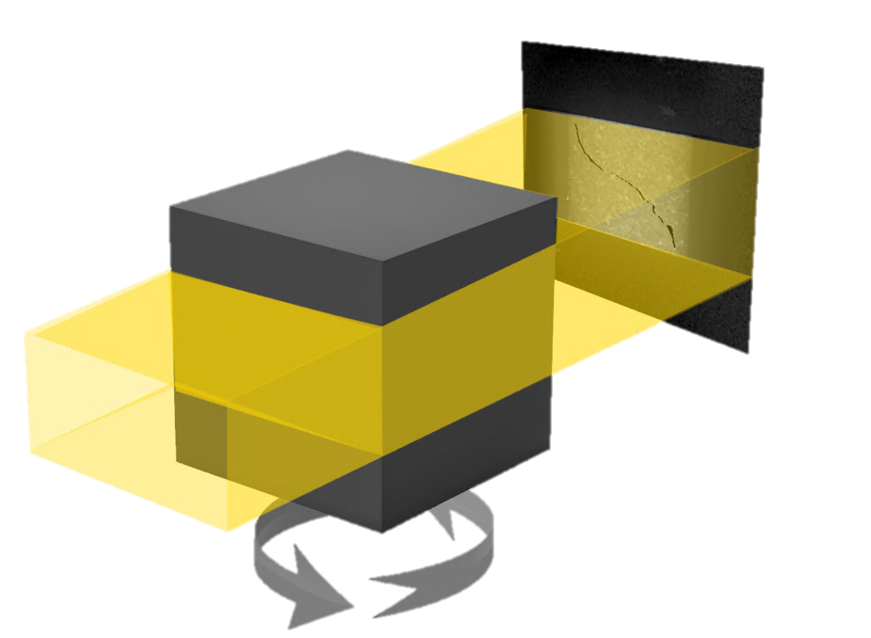
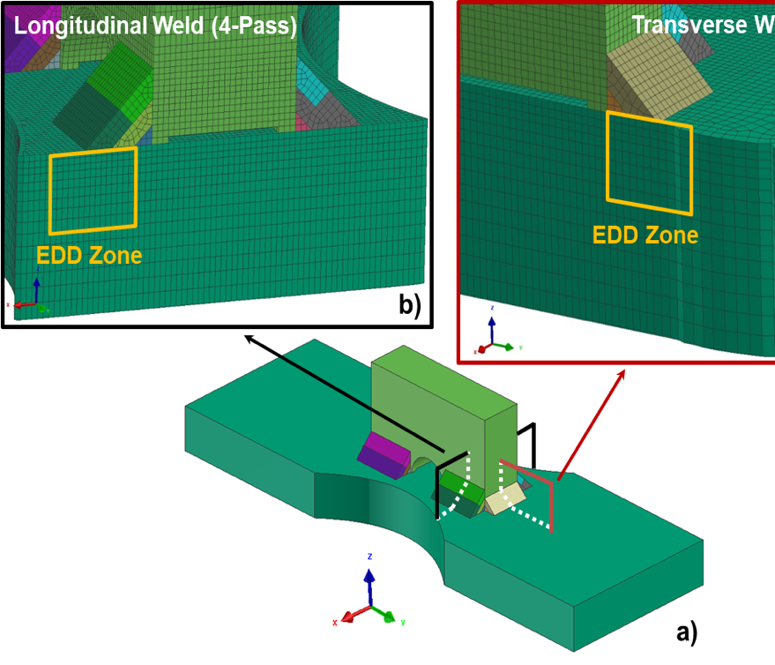
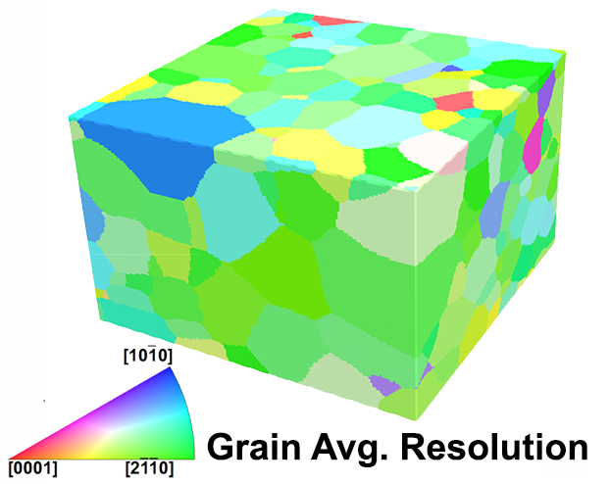
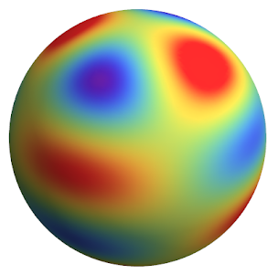
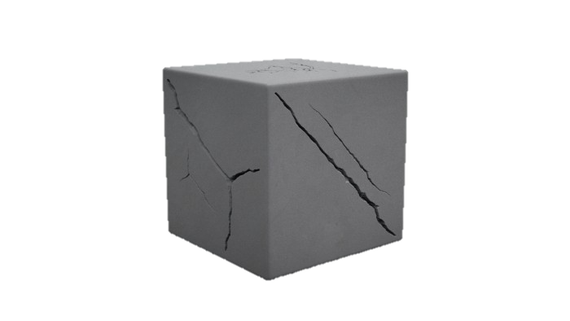

SMB Core Capabilities
Monochromatic Mode
White-Beam Mode
High Energy X-ray Diffraction Microscopy
Transmission Powder Diffraction
Absorption Tomography
Energy Dispersive Diffraction
PROVIDES: Grain centroid,
Grain strain tensor, Grain orientations
PROVIDES: 1D, 2D stress/strain distributions
PROVIDES: Density Variatios due to porosity or cracks; Phase Contrast
PROVIDES: High-throughput, spatially-resolved distributions of strain / texture in large volumes (cm)
Far-Field
PROVIDES: Spatial orientation maps of grains; Grain morphology
PROVIDES: Texture pole figures;
Strain pole figures
Near-Field
Sample is rotated 180° and a series of projection images are obtained
Notes:
Workhorse & Core Capabilities - not really such a thing as a “standard” measurement

Slide 20



Slide 21


Notes:
From woll-msnc-update-UM-2021-FINAL.pptx in MSN-C SharePoint:Documents/Presentations/
Saturday Feb 20th, United Airlines Flight 328, Denver to Honolulu:
Boeing 777-200 N772UA (26 years old), 231 passengers 10 crew)
https://www.youtube.com/watch?v=q5Wler87pwY

Slide 22


Sustained Investment in Equipment and Capability Development
Dectris CdTe Eiger2 X 16M
Custom toroidal slit 23-element energy dispersive detector system
Higher Dynamic Range –see microstructure in real materials
Smaller pixel size - more sensitive to strains
Faster data collection times
23-strain components simultaneously (vs. 1 strain component) More readily produce tensors
Faster data collection times
Notes:
SMB was a little ambitious (or delivery dates were unkind to the scientists) but both polychromatic and monochromatic experiments received a serious upgrade with new world-class detector systems. Along with the commissioning, the team converted to their new fully automated workflows for strain/texture mapping in both systems – enabling a major milestone for the program: Being able to return refined analysis data within 1 week of data collection to an industrial collaborator. As always – it takes an extraordinary team to pull this off and here are the faces of the major contributors who made it happen.

Slide 23
Critical Moments in CHESS’s History
1969: Original Construction of Wilson Laboratory for fixed-target particle physics
1980: Construction of the Cornell Electron Storage Ring (CESR): Counter-circulating electrons & positrons, foundation of the CHESS national user facility.
1990, 2000: Major Expansions of CHESS to 10 beamlines
2000: Energy Recovery Linac Project – Critical Rejuvenation of Accelerator R&D Faculty and technical staff
2003, 2008: Nobel Prizes awarded to Rod McKinnon, Ada Yonath for the structures of potassium ion channels, ribozomes, respectively, performed partly at CHESS.
2019: $15M CHESS-U project (NYSTAR): Conversion to positron-only operation: Re-build of 1/6th of CESR; tear-down / rebuild of most beamlines; BEGIN partner sponsor program
????: Future Upgrades Required, including replacement of original (ca 1970) synchrotron, which functions as the CESR booster ring

Slide 24
END

Slide 25







shortest x-ray pulses ever made
protein motion
1 hour
100 years
1 year
10⁻¹⁵ s
10⁻¹² s
10⁻⁹ s
10⁻⁶ s
10⁻³ s
1 s
10³ s
10⁶ s
10⁹ s
10¹² s
10¹⁵ s
10¹⁸ s
1 fs
1 ps
1 ns
1 μs
1 ms
1 s
Notes:
This way of visualizing time forms a map – a conceptual tool for thinking and reasoning about how the world works, and where to look for new phenomena. It is a scaffolding for thinking and reasoning about these time scales.

